Slide 1
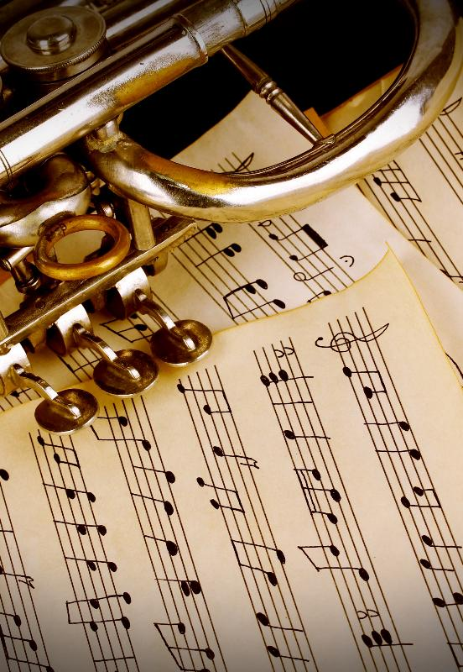
Jazz Music
Lesson 7
What a Wonderful World
Unit 1 Version 3

Slide 2
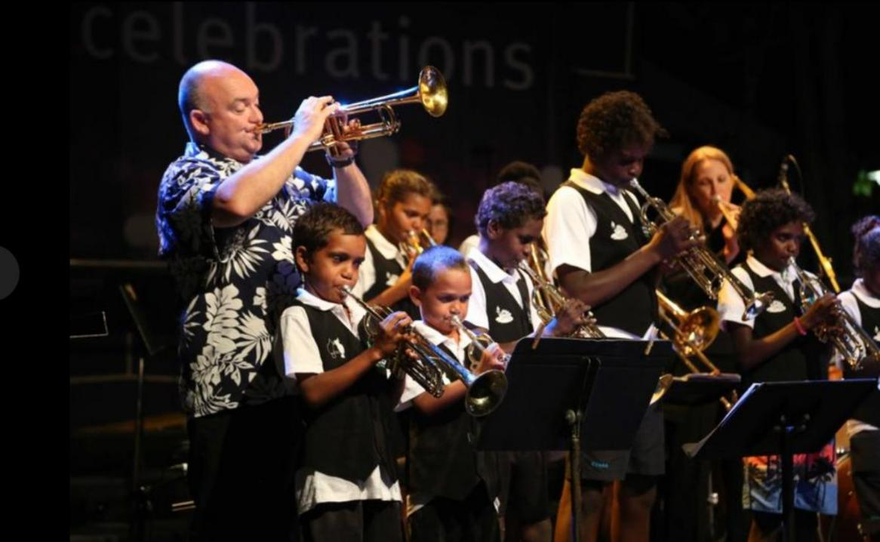
We can rehearse to prepare for a jazz music performance.

Slide 3
1. The steps to performing jazz music are:
A: finding the notes on the keyboard and playing them
B: singing the song
C: learning how to clap the rhythm
D: learning the rhythms, identifying the note names, finding the notes on the keyboard, rehearsing and performing.
3. The phrase to remember the line notes is:
E ___ good boy deserves fruit.
very

Slide 4
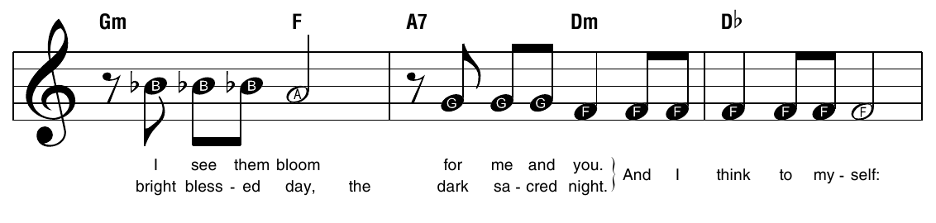
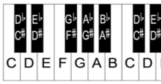

Slide 5
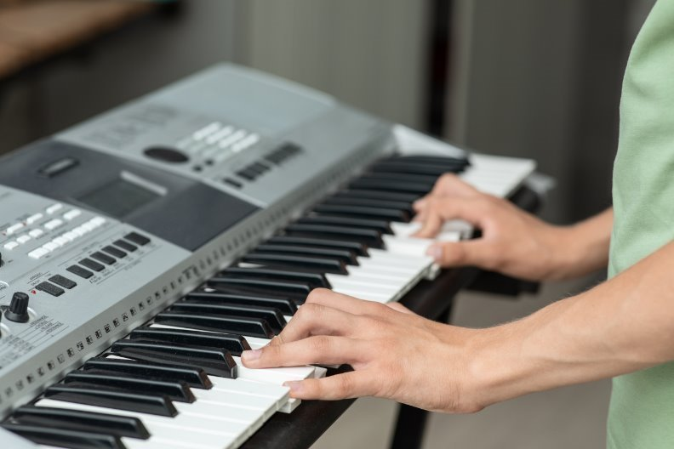
In this lesson, we will learn how to play the third line of What a Wonderful World by Louis Armstrong.

Slide 6
You will be successful when you can: ​
perform the third line of What a Wonderful World using the keyboard.

Slide 7
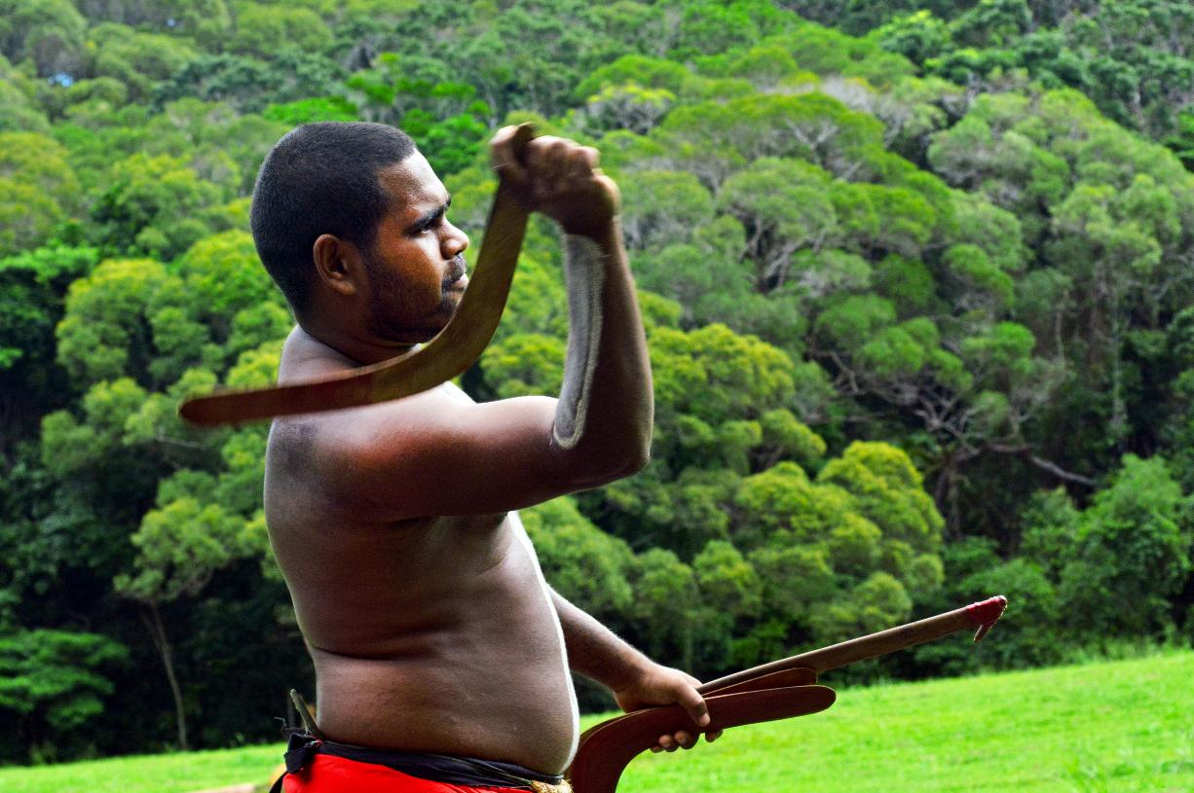

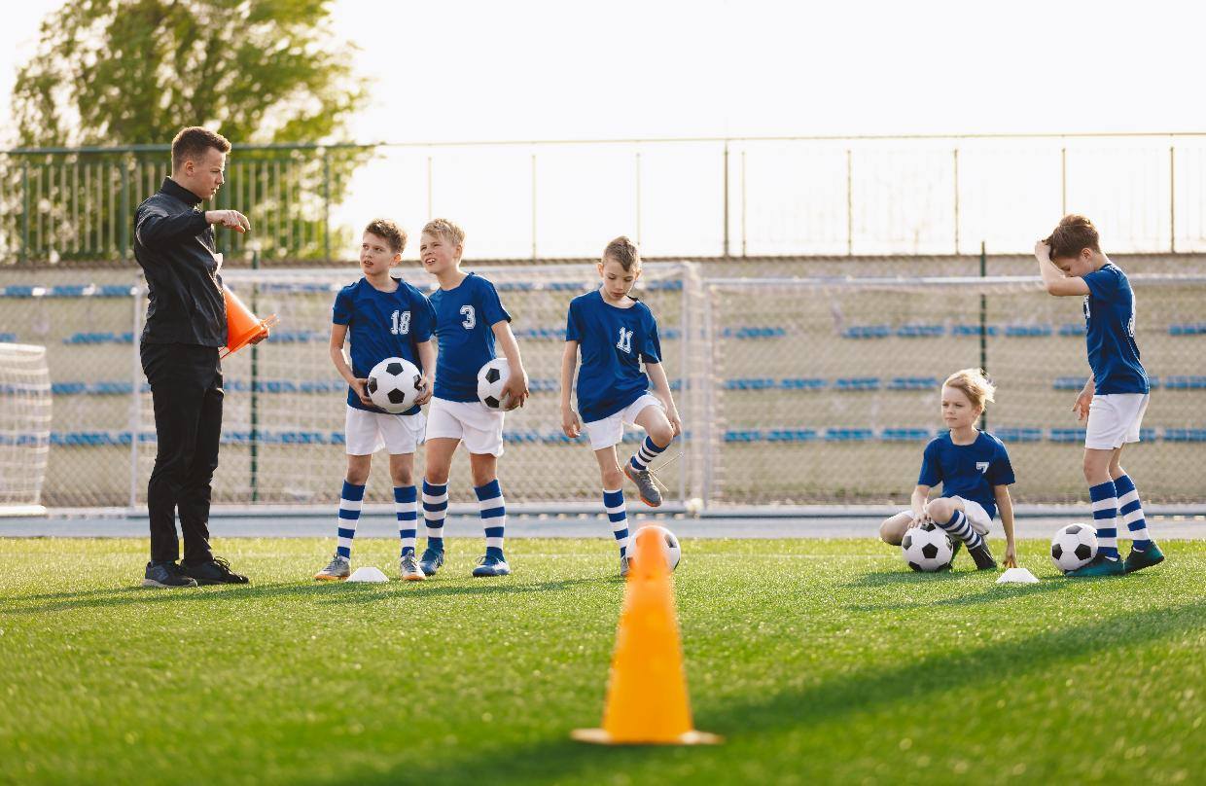

Slide 8

What a Wonderful World

Slide 9
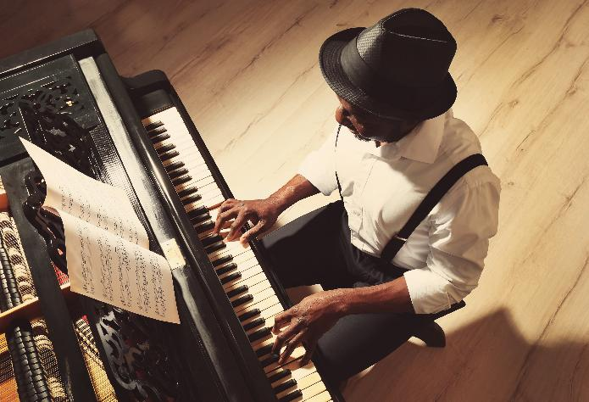
Steps to Success
1. Learn the rhythms.
2. Identify note names.
Find notes on the keyboard.
4. Rehearse in pairs.
5. Perform as a class.

Slide 10
Rhythms
1. Learn the rhythms.

Slide 11

Singing Rhythms

Slide 12
Rhythms
What a wonderful world

Slide 13
Note Names
1. Learn the rhythms.
2. Identify note names.

Slide 14
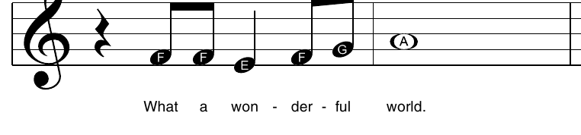
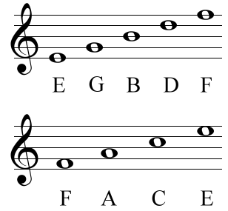
Note Names
Notes:
​

Slide 15
Note Names
Notes:
​

Slide 16
Notes on the Keyboard
1. Learn the rhythms.
2. Identify note names.
Find notes on the keyboard.

Slide 17
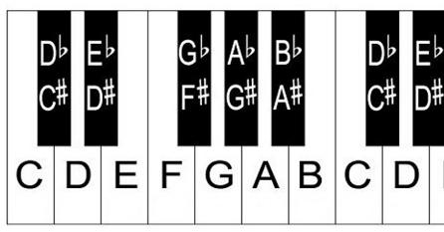
Notes on the Keyboard
keyboard chart

Slide 18
Notes on the Keyboard
keyboard chart

Slide 19
Rehearse
1. Learn the rhythms.
2. Identify note names.
Find notes on the keyboard.
4. Rehearse in pairs.

Slide 20

Rehearsing

Slide 21
Rehearsal

Slide 22
Perform
1. Learn the rhythms.
2. Identify note names.
Find notes on the keyboard.
4. Rehearse in pairs.
5. Perform as a class.

Slide 23

Performance

Slide 24
Singing the melody helps us to learn the rhythms.
We can remember the note names by using our note naming space word and line phrase.
We can find notes on the keyboard using the keyboard chart.
We can rehearse and perform music after working through the steps to success.

Slide 25
Exit Ticket
keyboard
1. I can rehearse and perform jazz music using the _________.
2. The steps to success are:
A: finding the notes on the keyboard and playing them
B: singing the song
C: learning how to clap the rhythm
D: learning the rhythms, identifying the note names, finding the notes on the keyboard, rehearsing and performing.
3. I can find the notes on the keyboard using the keyboard c____.
sport
violin
keyboard
hart

Slide 26
In the next lesson, we will rehearse all three lines of What a Wonderful World using the keyboard.

