Slide 1
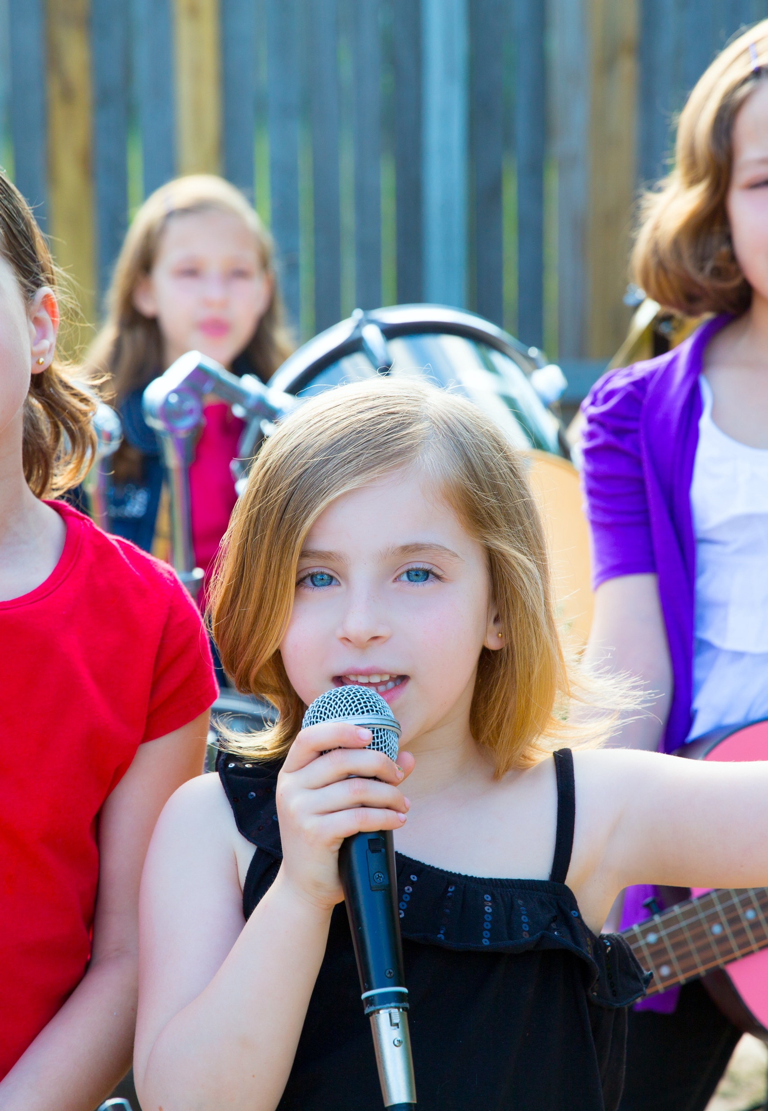
Tell Me a Story
Lesson 1
Sing Me a Story
Unit 1 Version 3

Slide 2
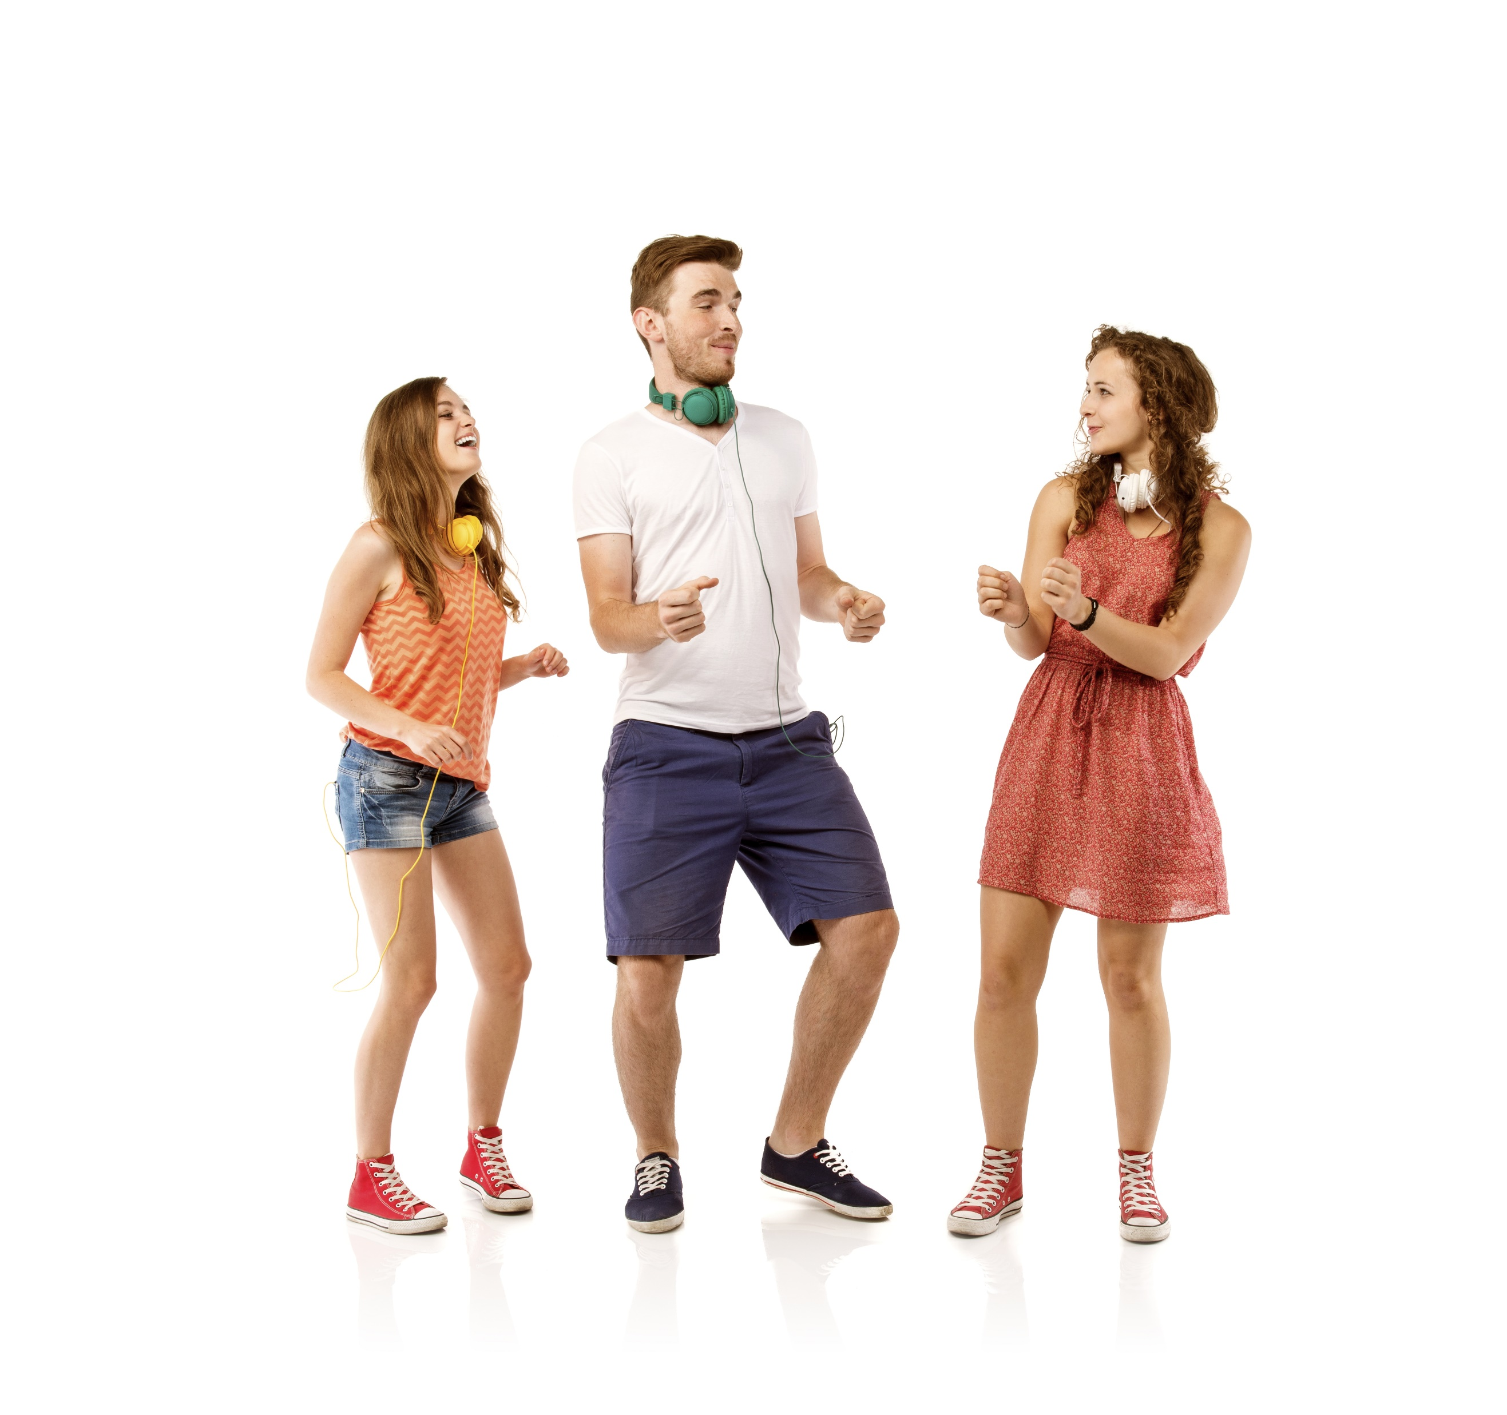
In this lesson, we will sing and move to music.

Slide 3
You will be able to: ​
say what happens in the songs
sing Toot Toot Chugga Chugga Big Red Car and Incy Wincy Spider
​ move in time with the music.

Slide 4
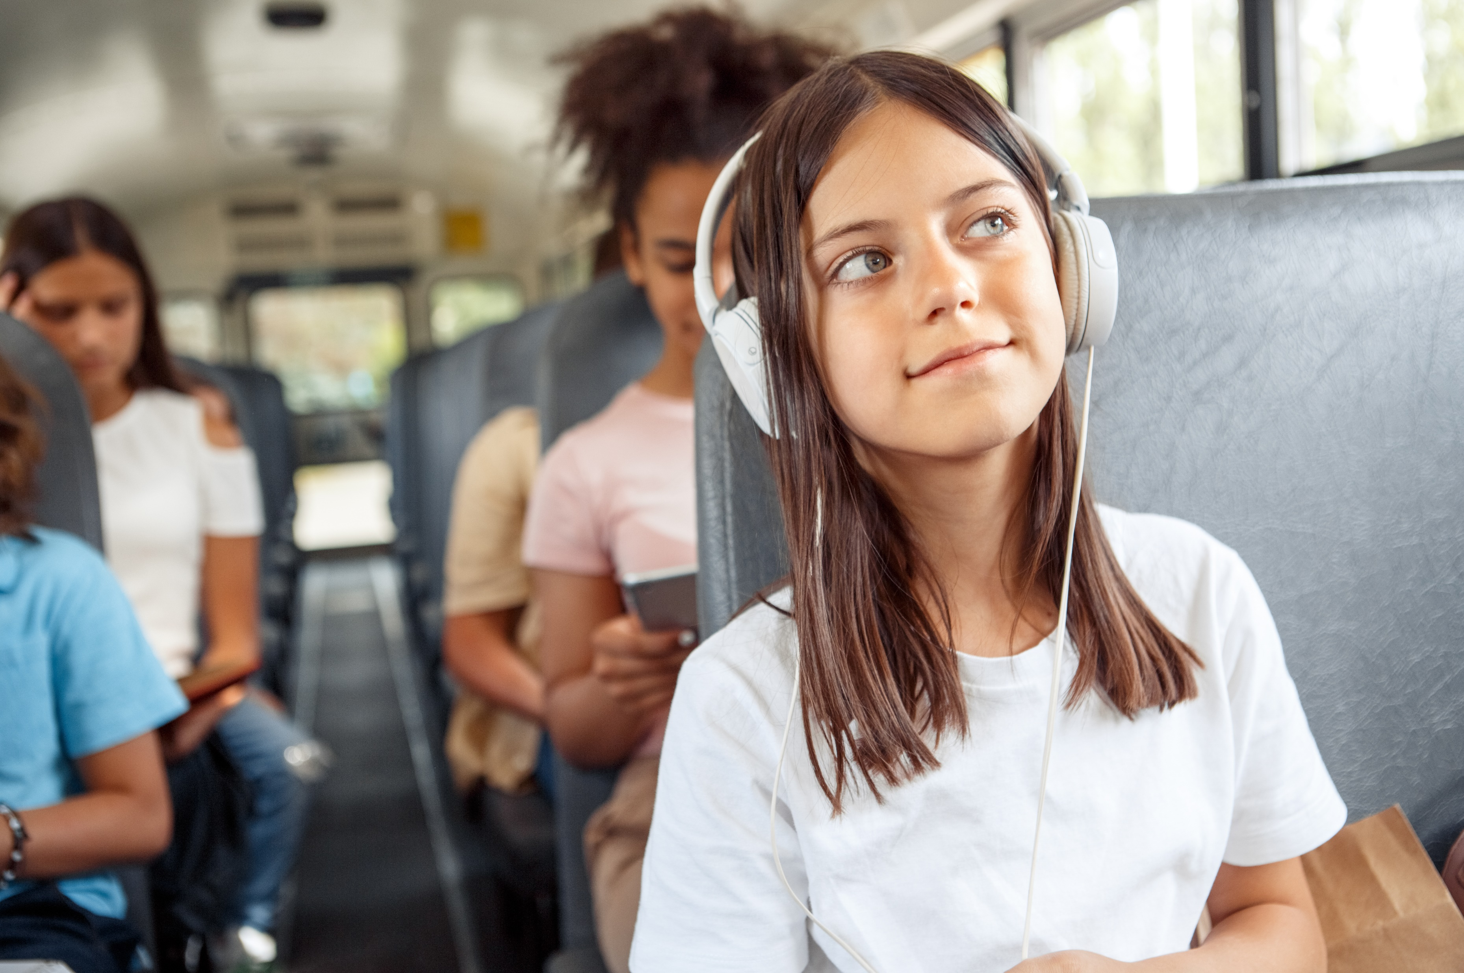
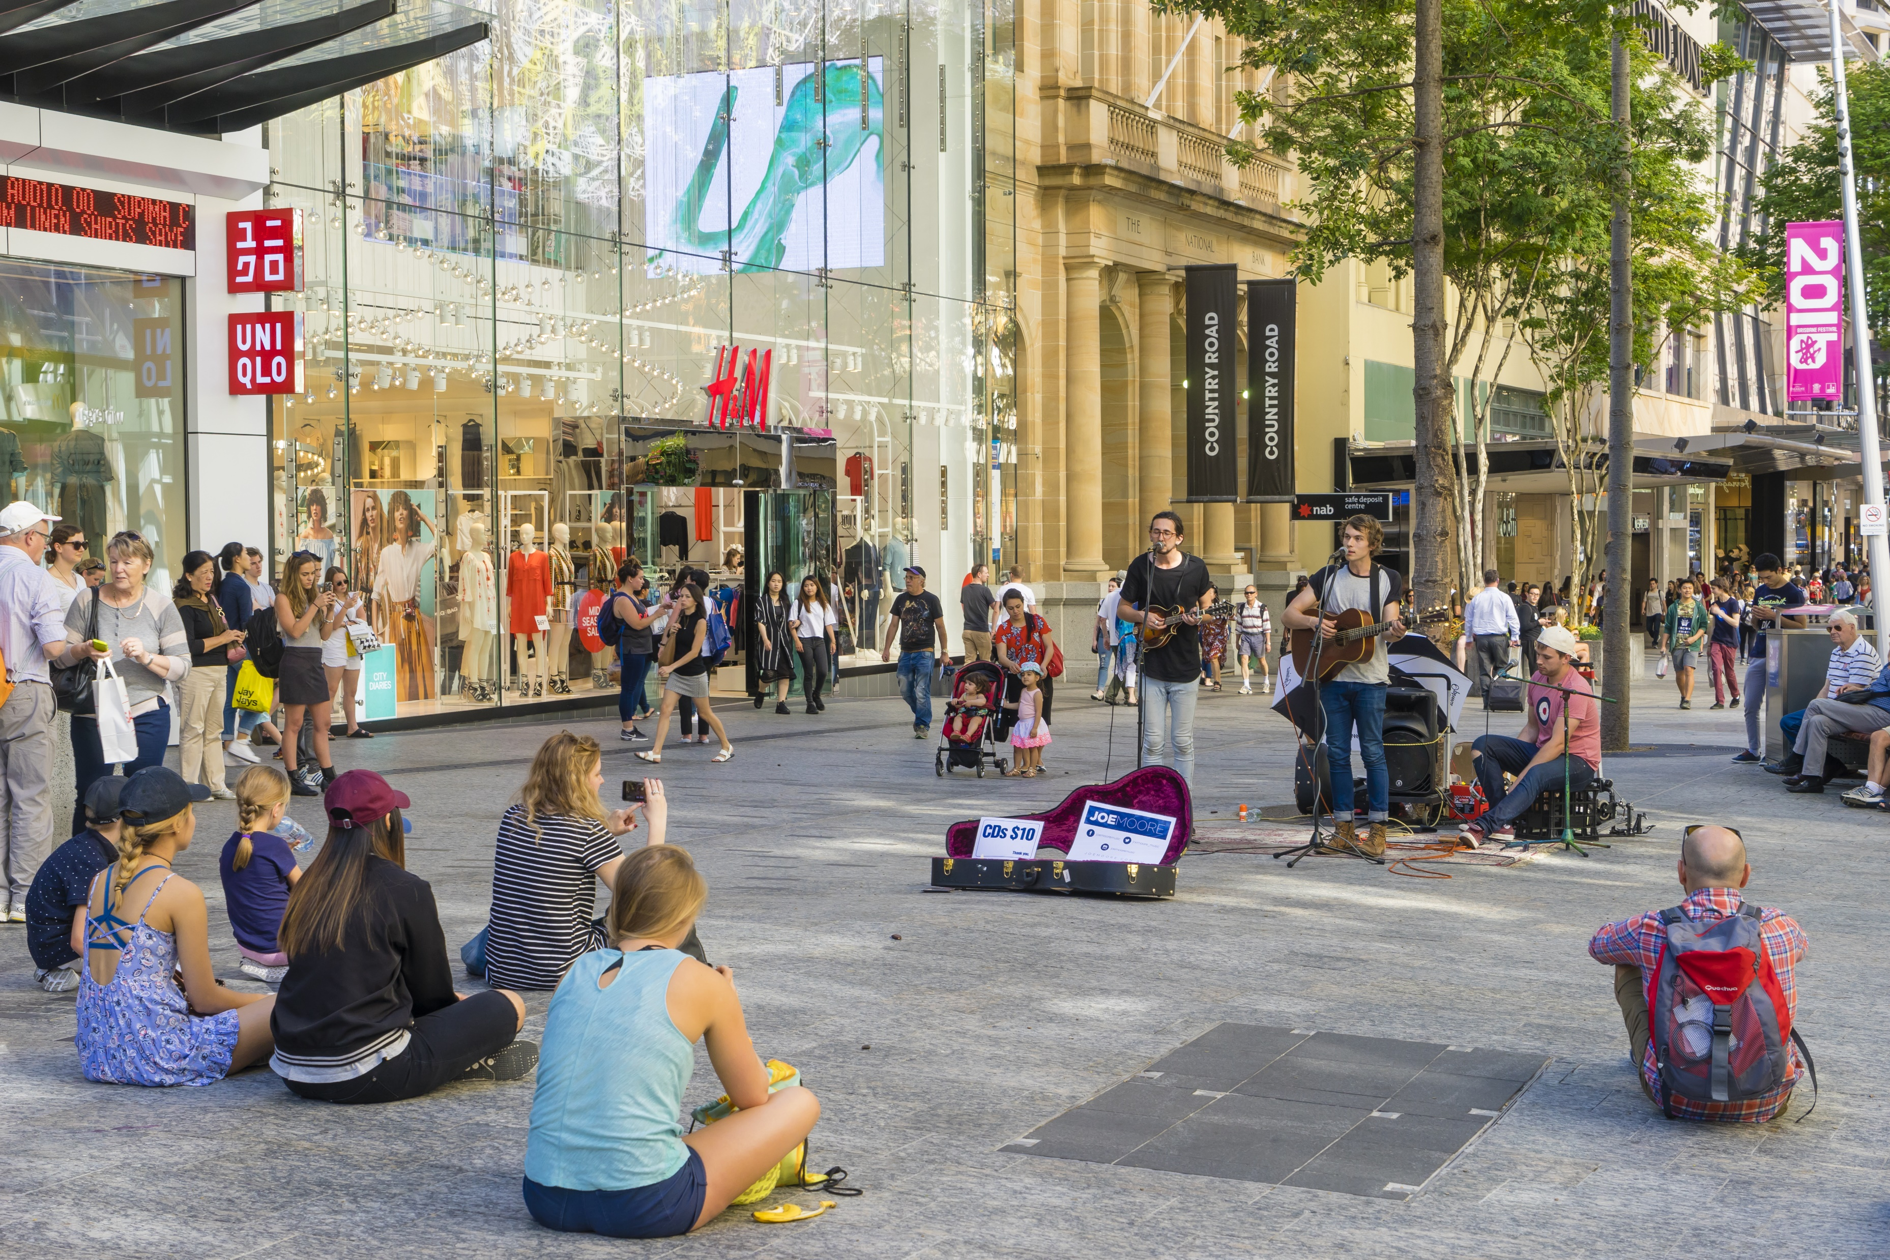
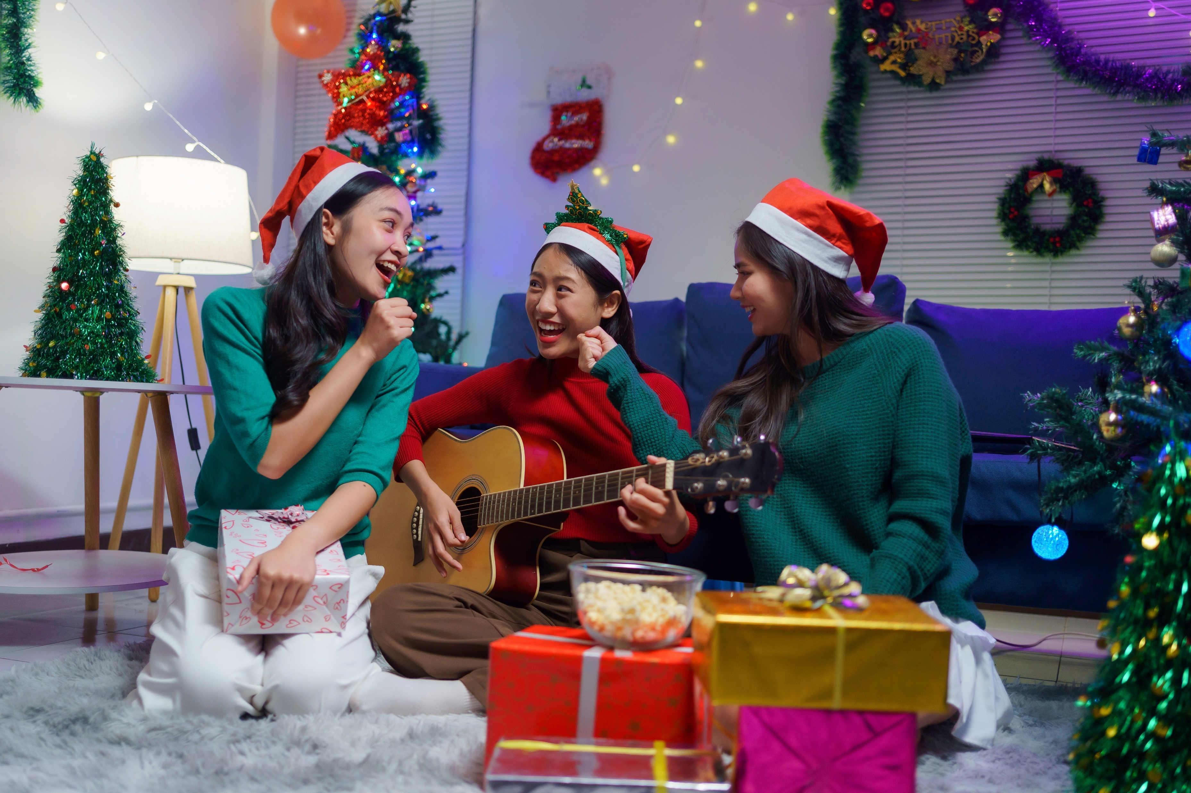

Slide 5






Stories

Slide 6

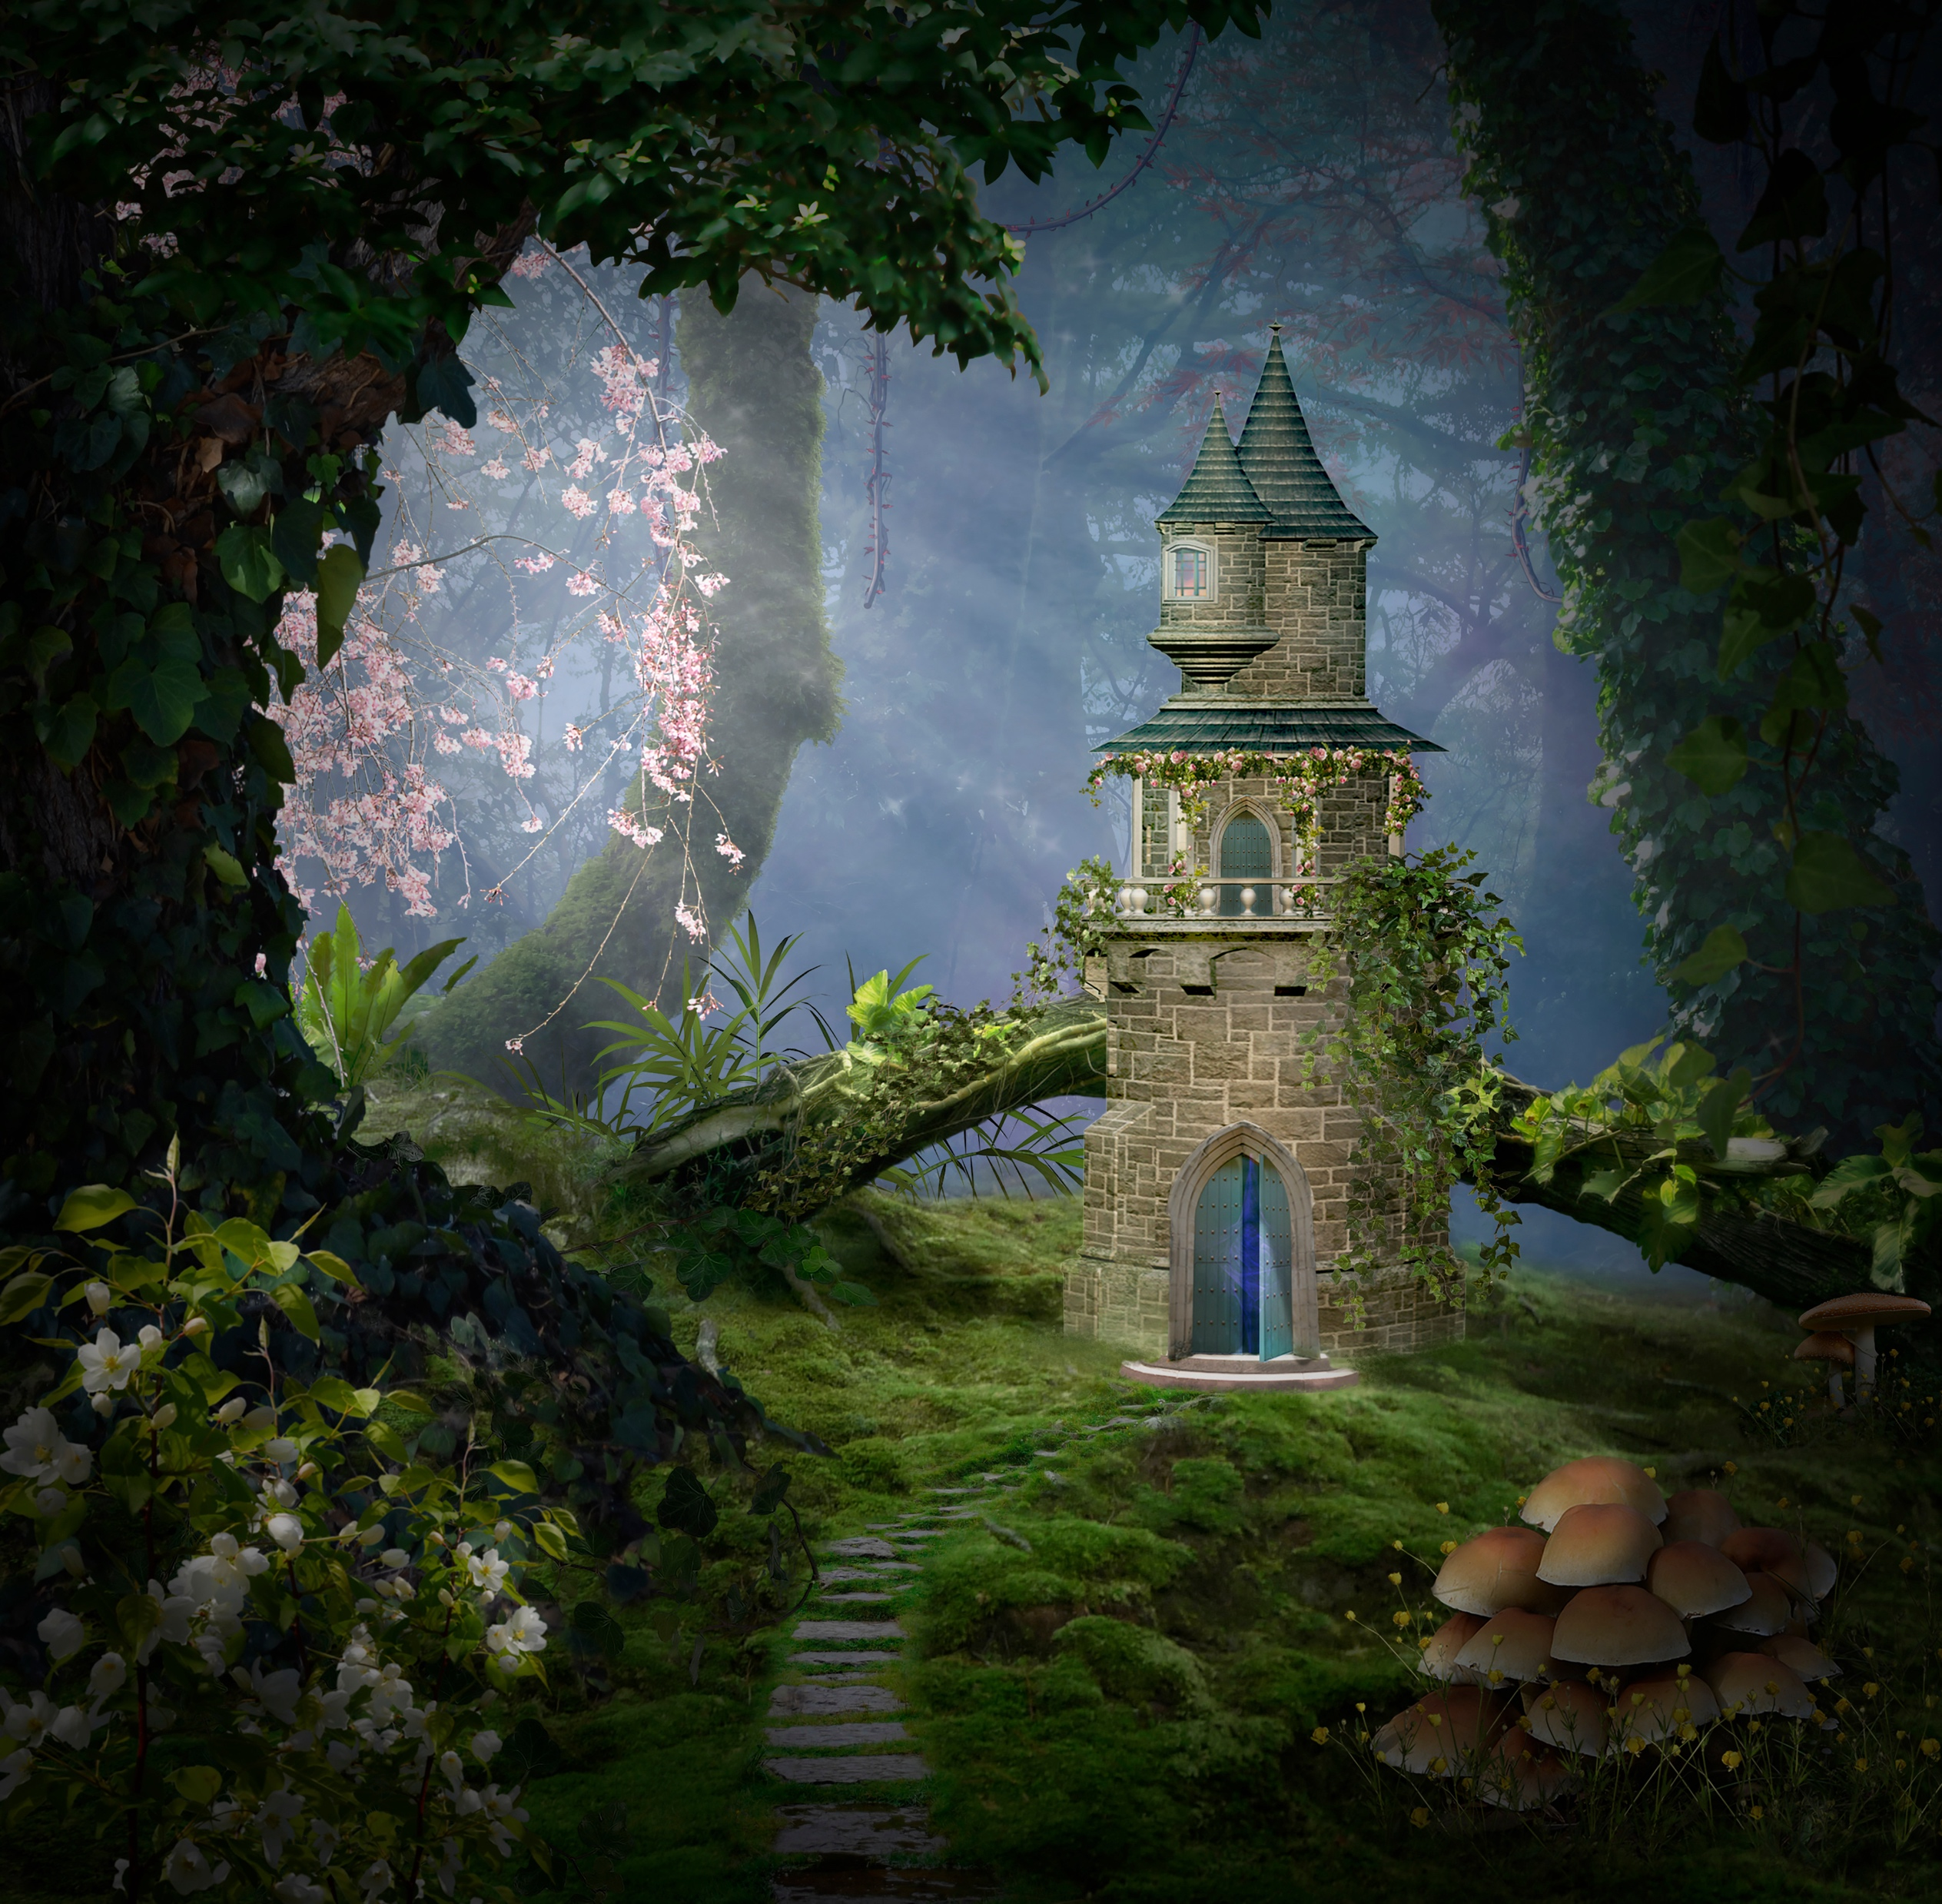

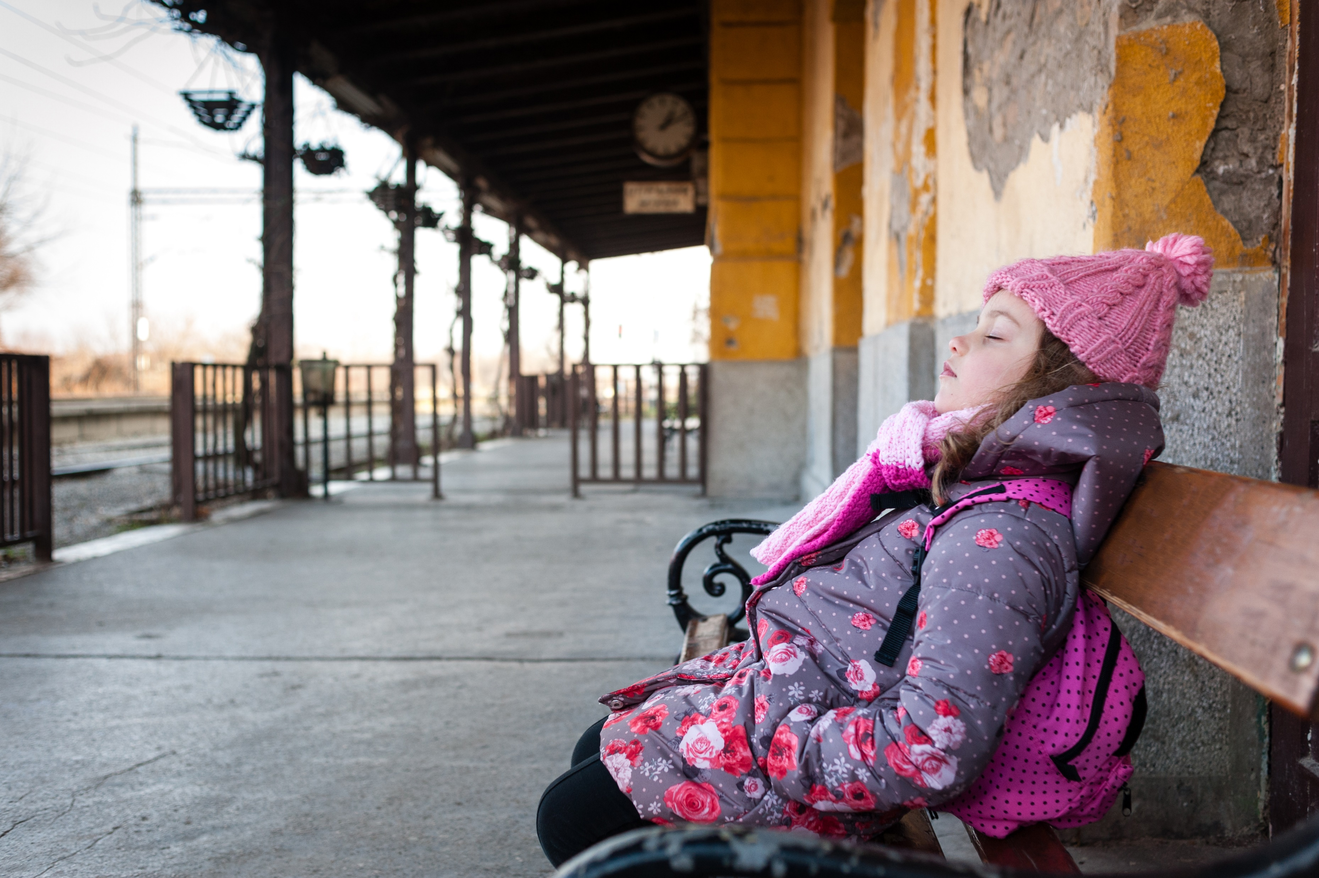
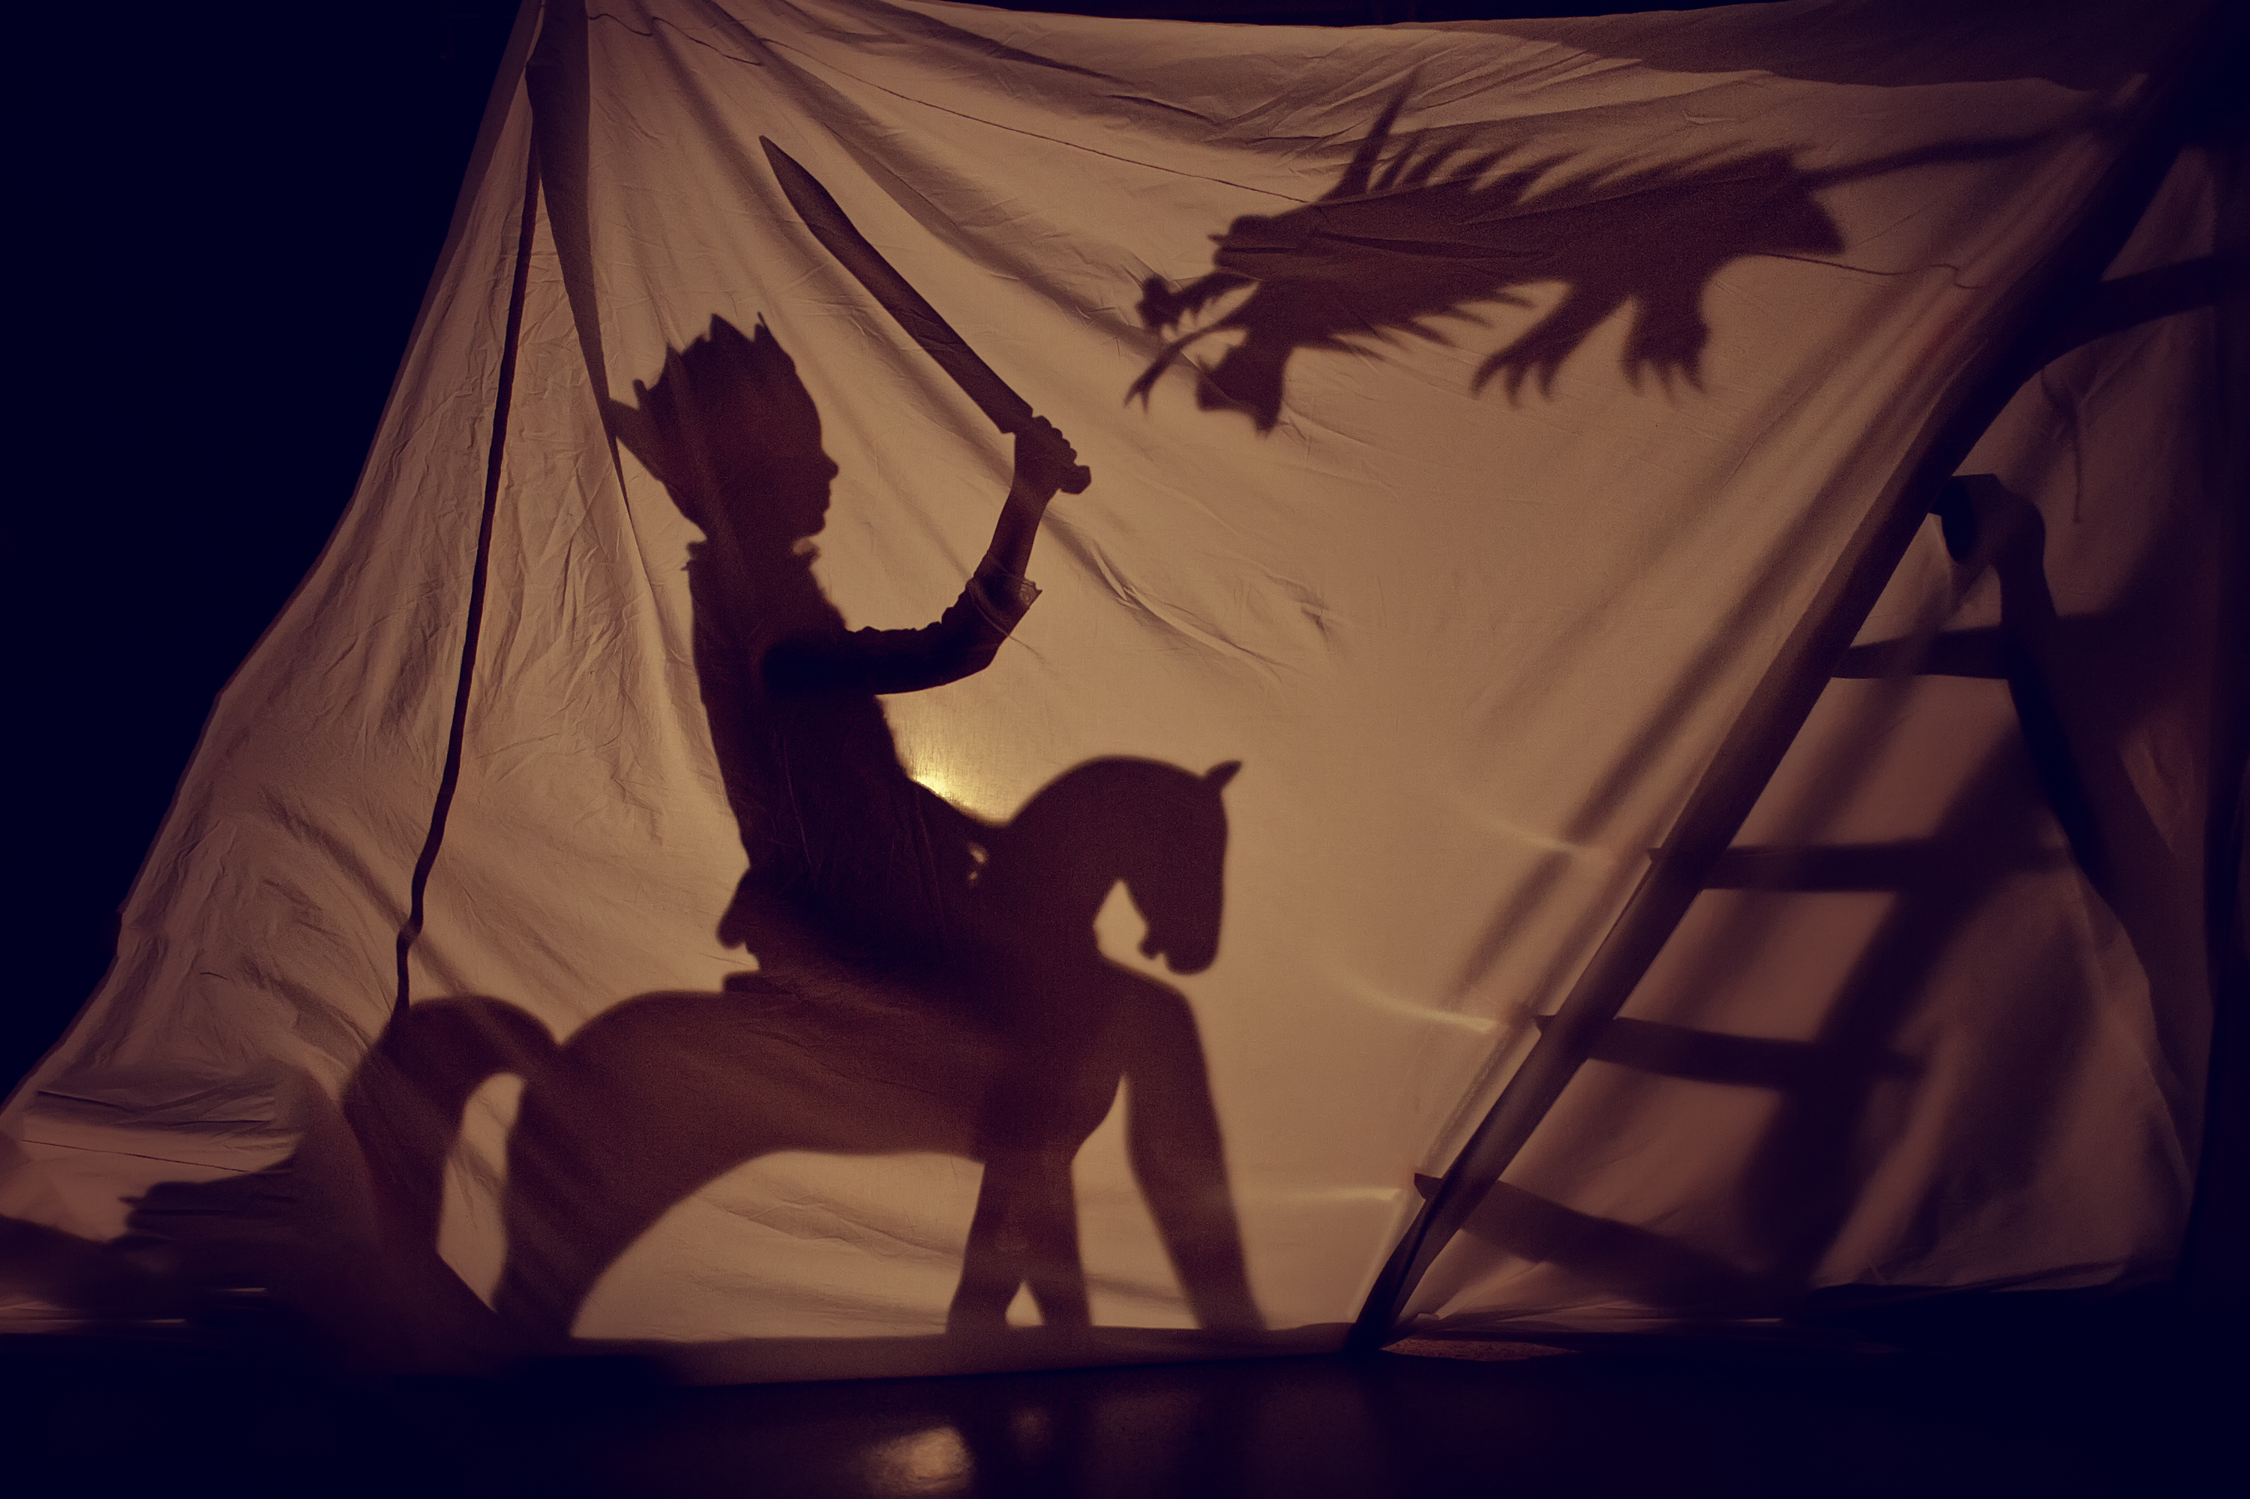

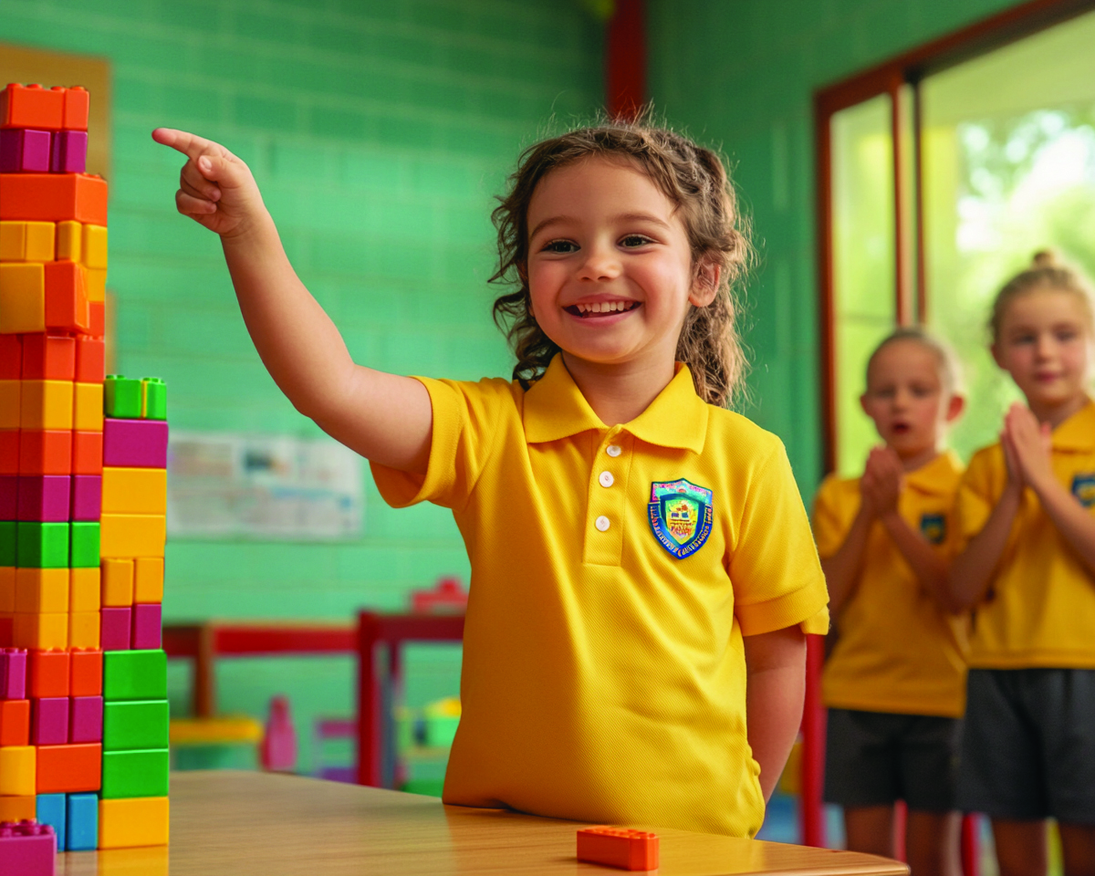
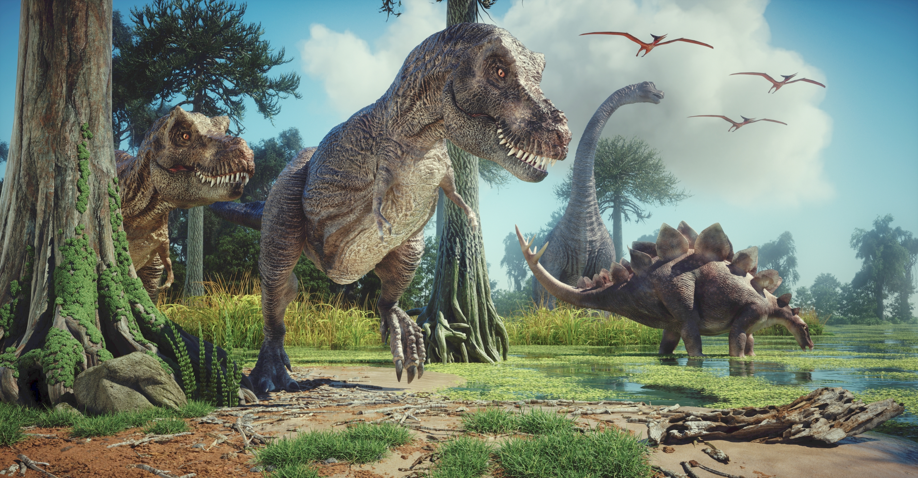
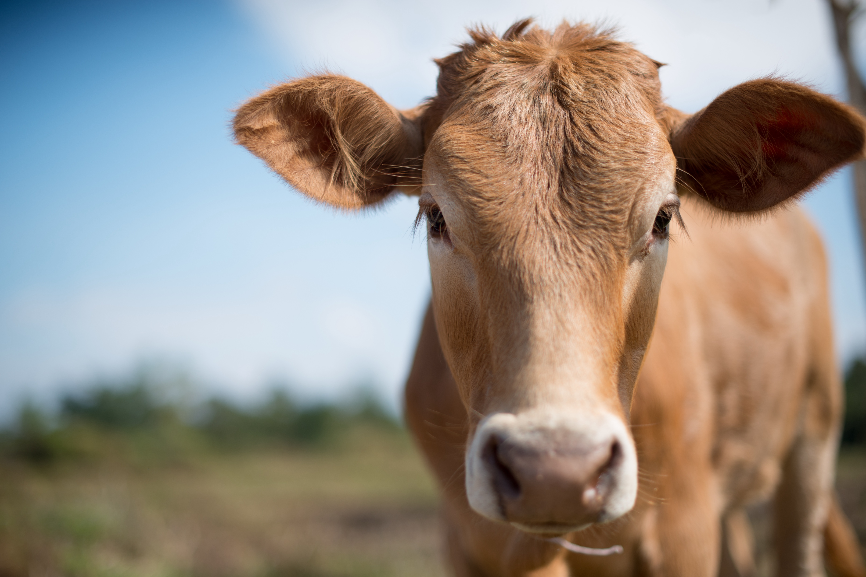

Stories in Music

Slide 7
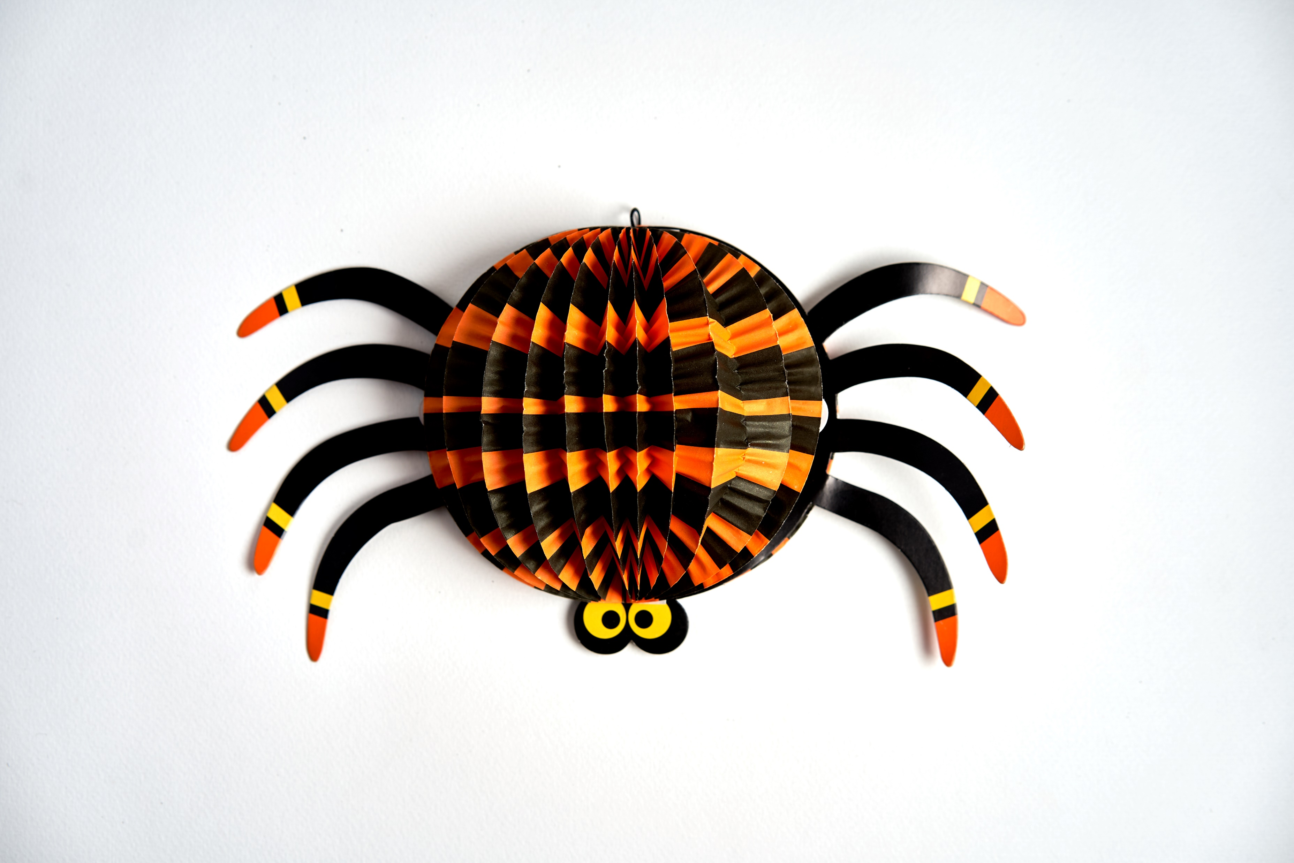

Songs that Tell Stories

Slide 8

Toot Toot Chugga Chugga

Slide 9
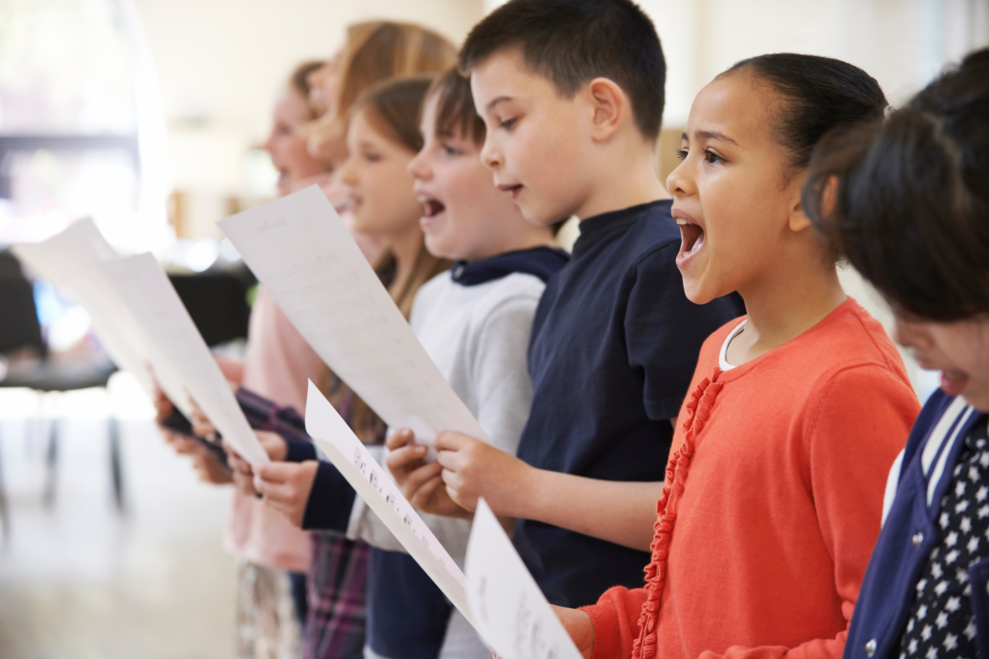
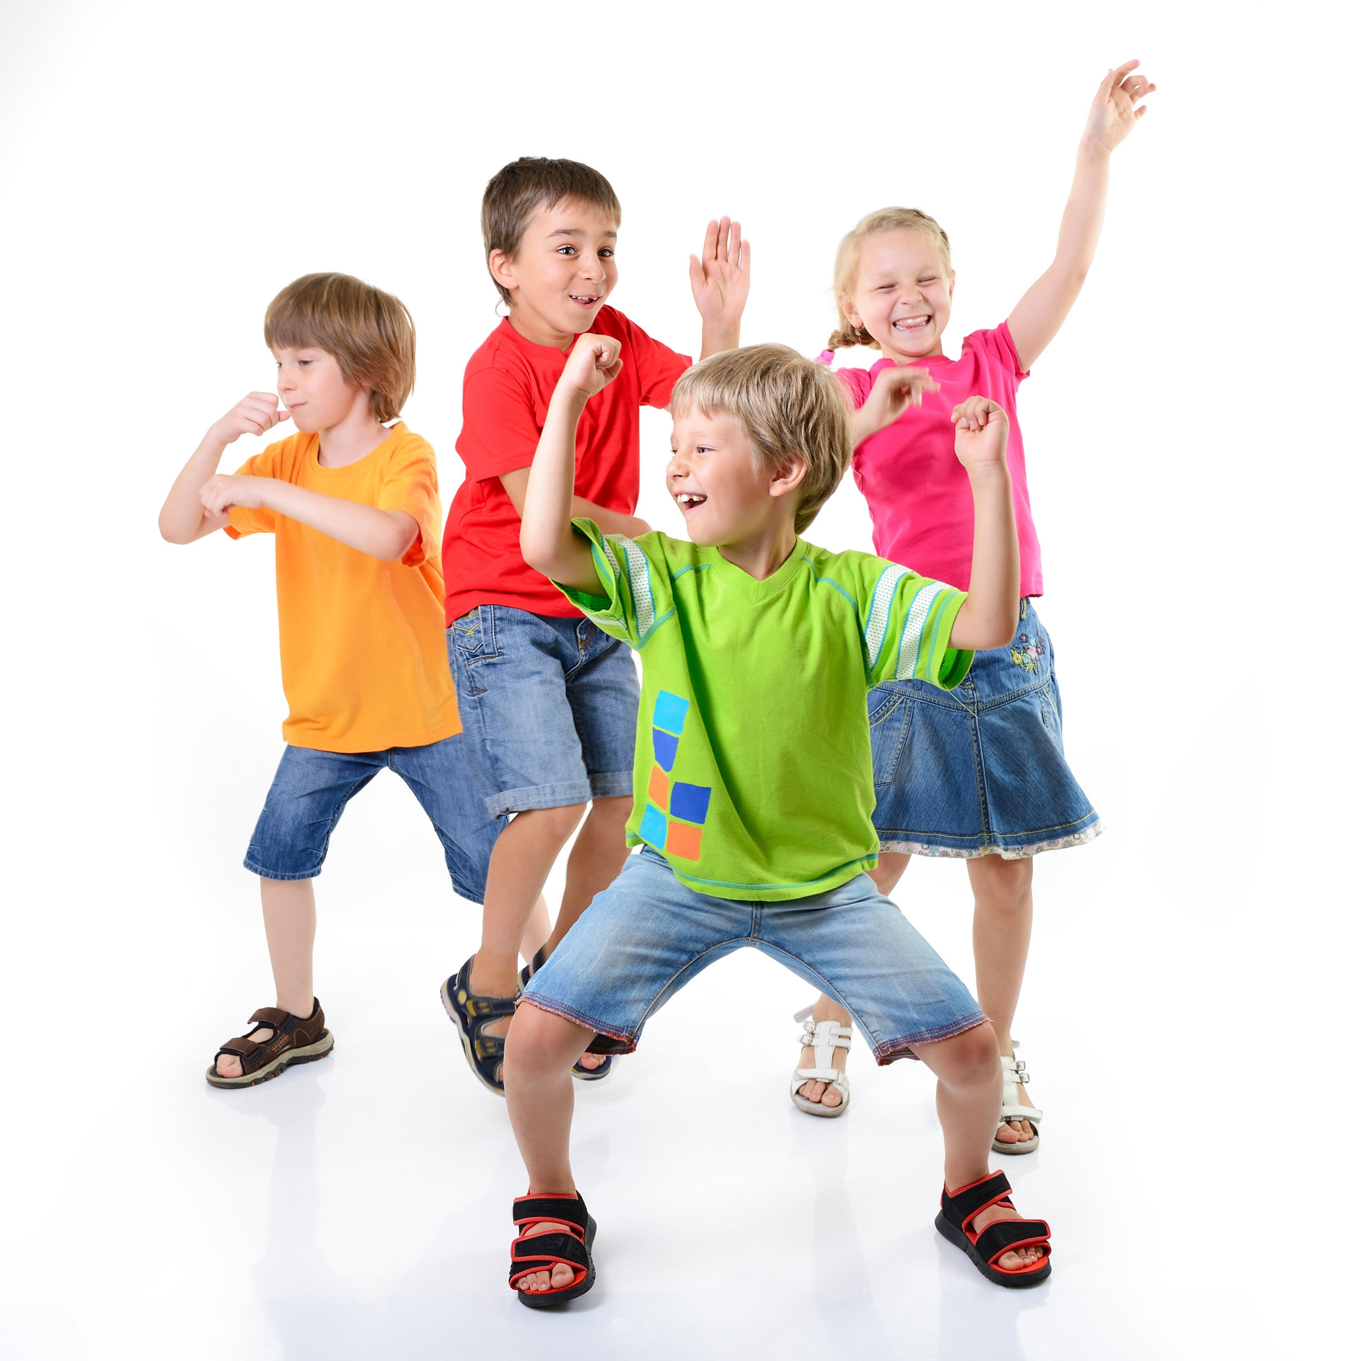

People Sing Songs Together

Slide 10
Saying Toot Toot Chugga Chugga

Slide 11
Singing Toot Toot Chugga Chugga

Slide 12
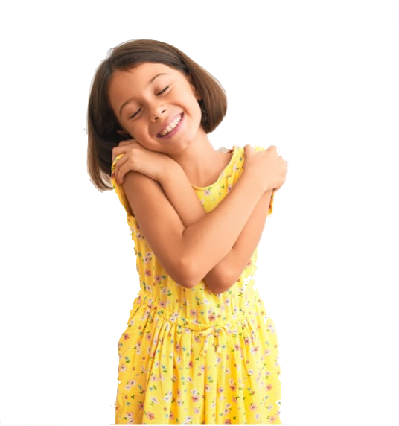




Singing with Body Actions
Chugga Chugga Big Red Car
Chugga Chugga Big Red Car
Toot Toot
Toot Toot
We’re gonna ride the whole day long!
We’ll travel near
And we’ll travel far

Slide 13
Singing with Body Actions
Chugga Chugga Big Red Car
Chugga Chugga Big Red Car
Toot Toot
Toot Toot
We’re gonna ride the whole day long!
We’ll travel near
And we’ll travel far

Slide 14
Singing with Body Actions
Chugga Chugga Big Red Car
Chugga Chugga Big Red Car
Toot Toot
Toot Toot
We’re gonna ride the whole day long!
We’ll travel near
And we’ll travel far

Slide 15
Toot Toot Chugga Chugga

Slide 16
Songs Can Tell Us Stories

Slide 17

Incy Wincy Spider

Slide 18
Incy Wincy Spider

Slide 19
Singing Incy Wincy Spider

Slide 20

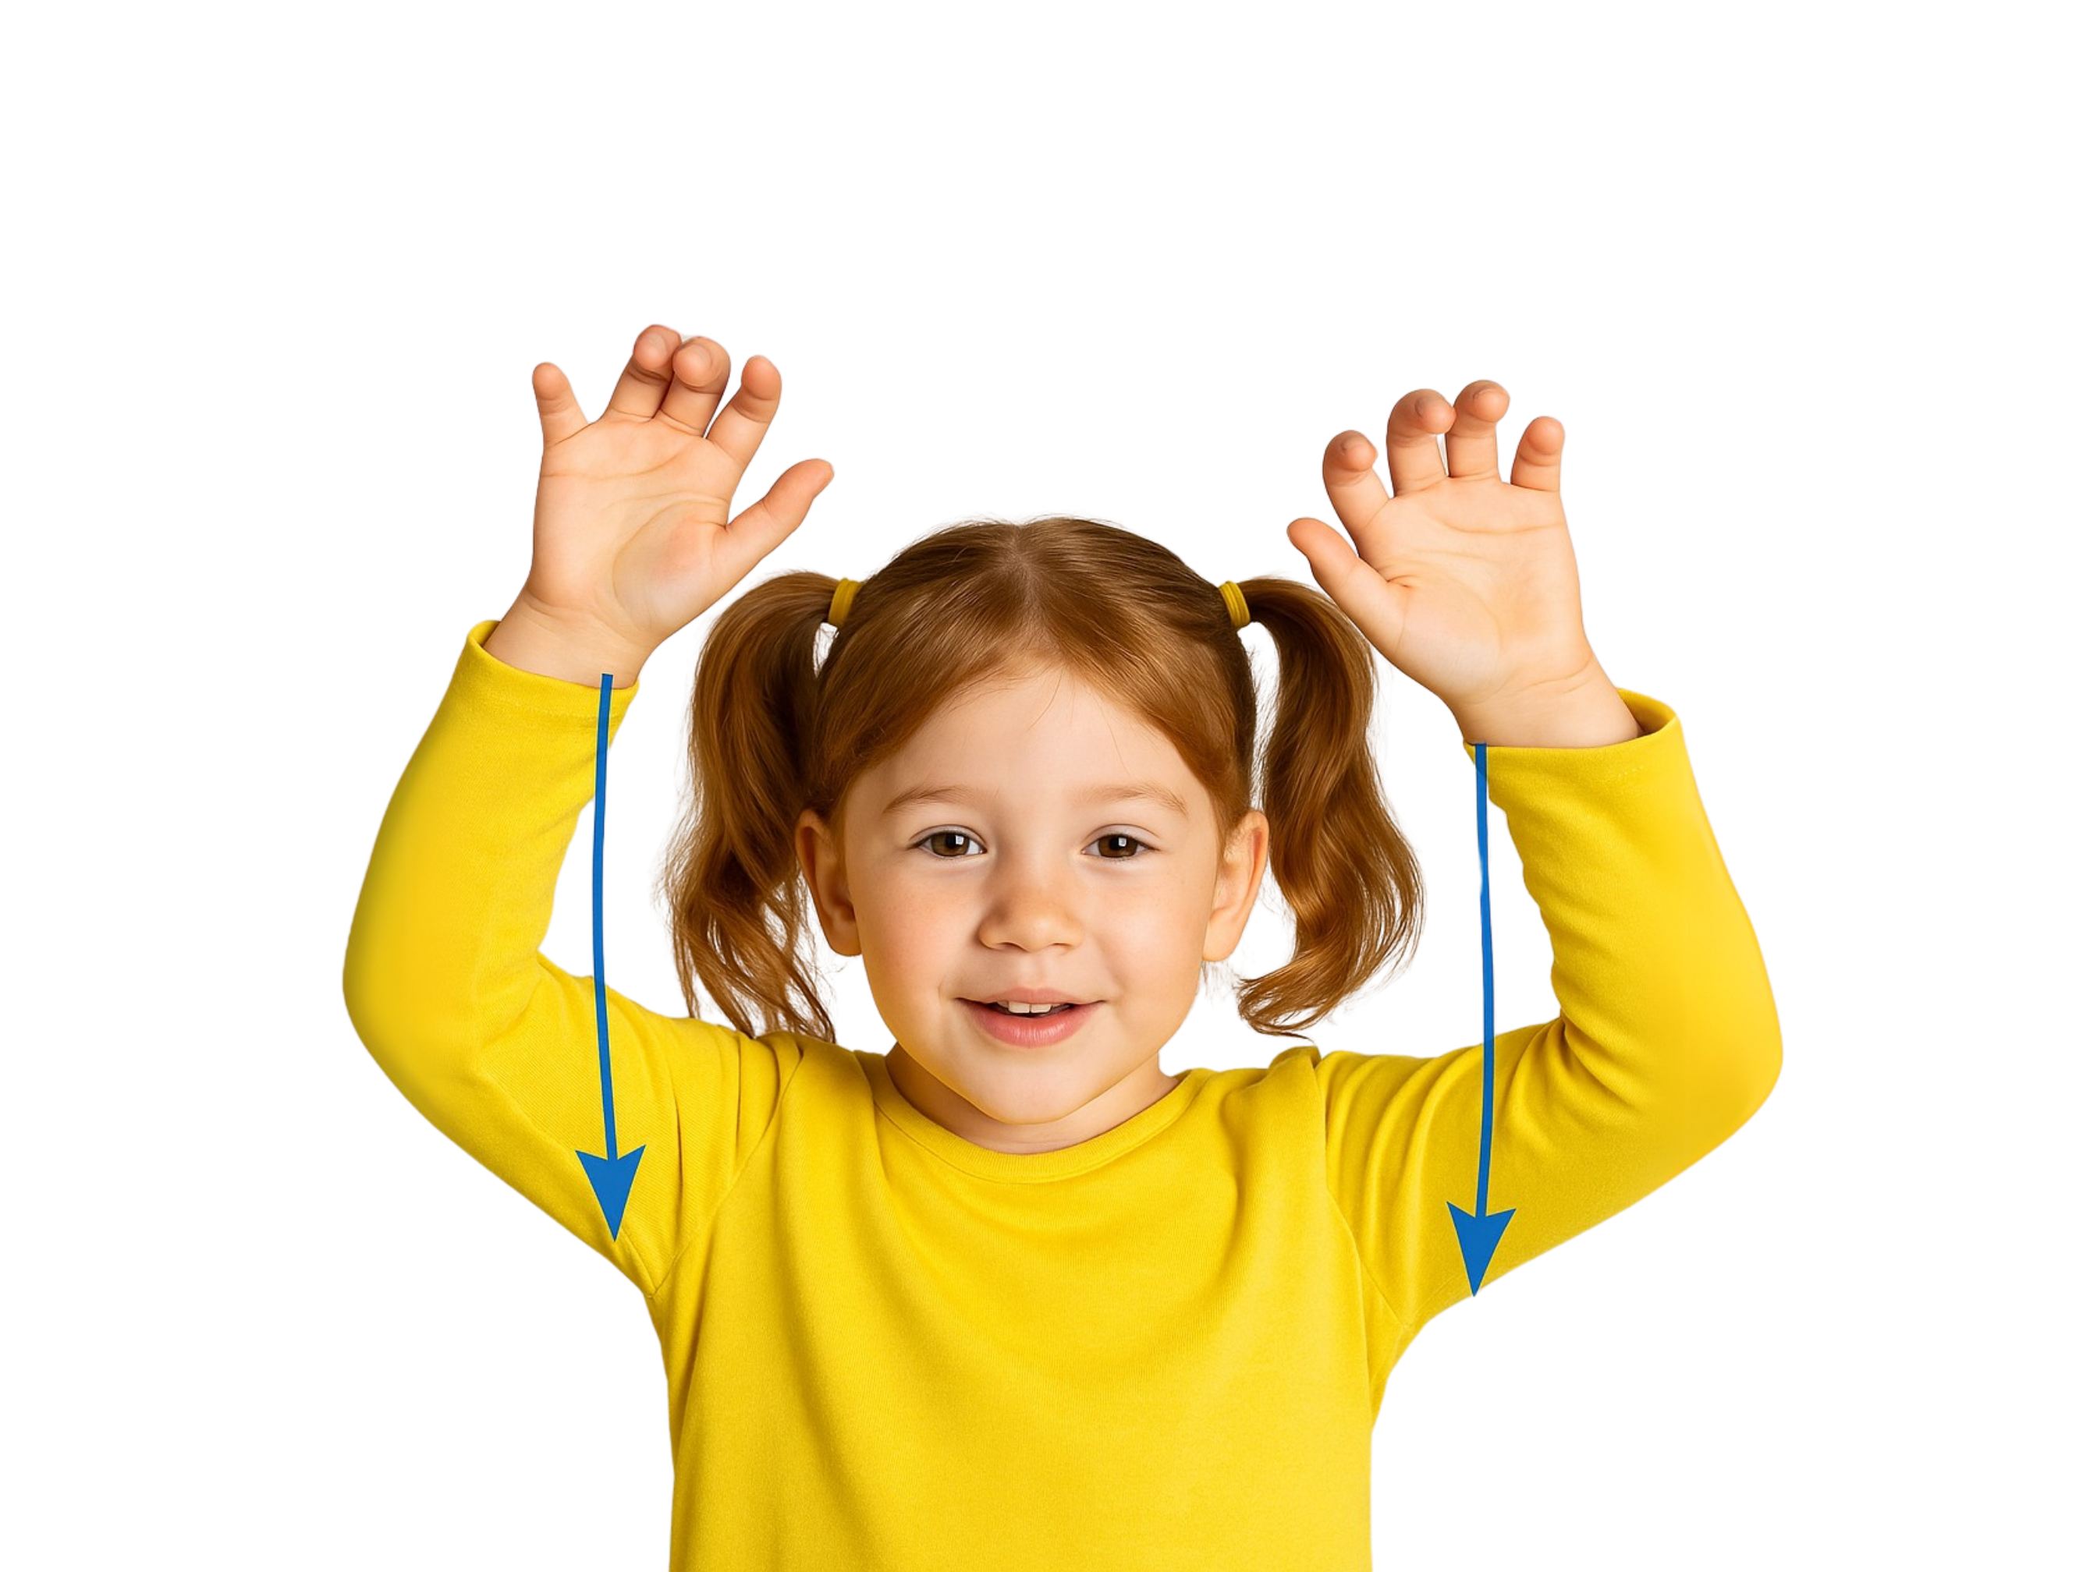
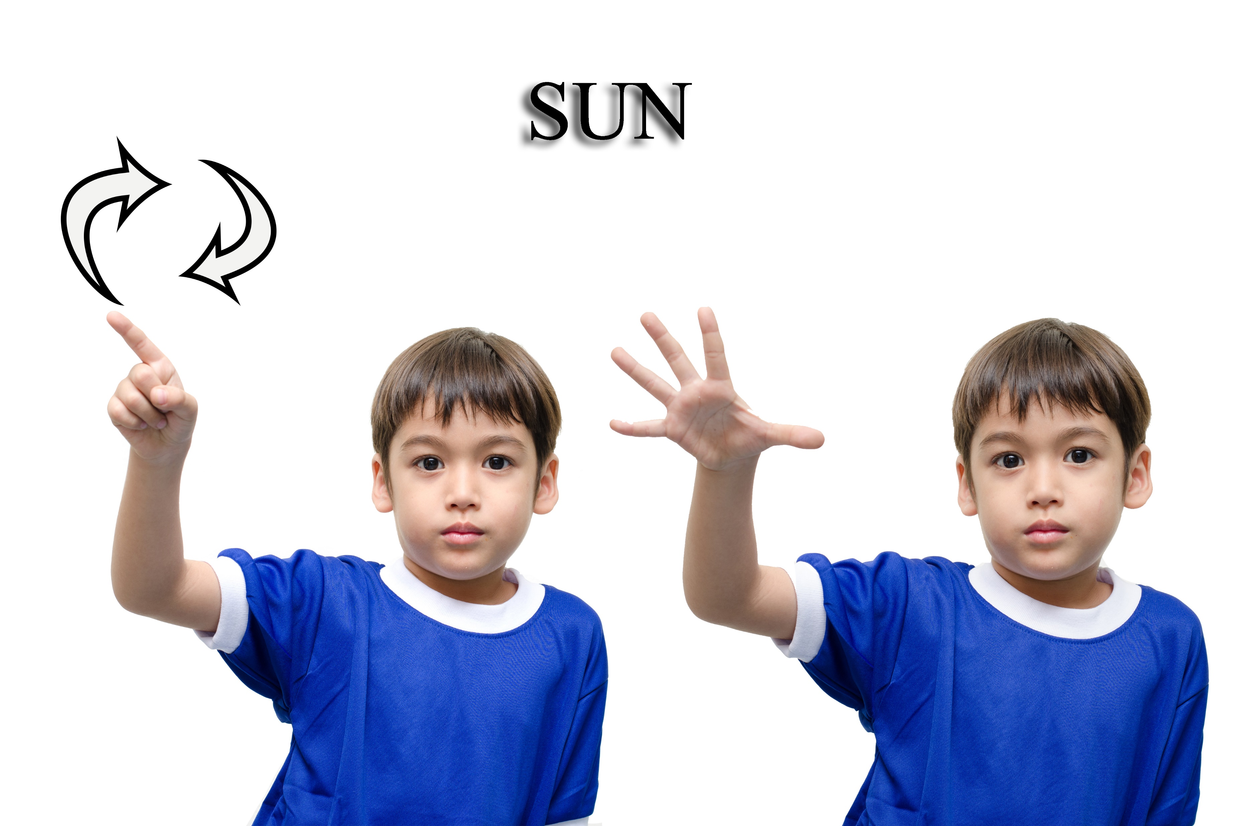

Incy Wincy Spider with Body Actions
Down came the rain and washed poor Incy out
Incy Wincy Spider
climbed up the watersprout
Incy Wincy Spider
climbed up the watersprout
Down came the rain and washed poor Incy out
Out came the sunshine and dried up all the rain.
Out came the sunshine and dried up all the rain.
And Incy Wincy spider Climbed up the waterspout again
And Incy Wincy spider Climbed up the waterspout again

Slide 21
Incy Wincy Spider with Body Actions

Slide 22
Songs Can Tell Us Stories

Slide 23
People sing and move to music together.
Songs tell stories about characters and places.

Slide 24
Exit Ticket
sing and move
People ____________ to music together.
2. Songs can tell stories about:
A: Characters
B: Places
C: Characters and places
3. We can sing and use body a_____ to tell a story in a song.
walk and run
sing and move
stand and sit
ctions

Slide 25

In the next lesson, we will use sounds and actions to tell a story about a bear hunt.

