Slide 1

Writing
Unit 3: Informational/ History
Lesson 2: Introduction to Informative Writing
Version 1

Slide 2
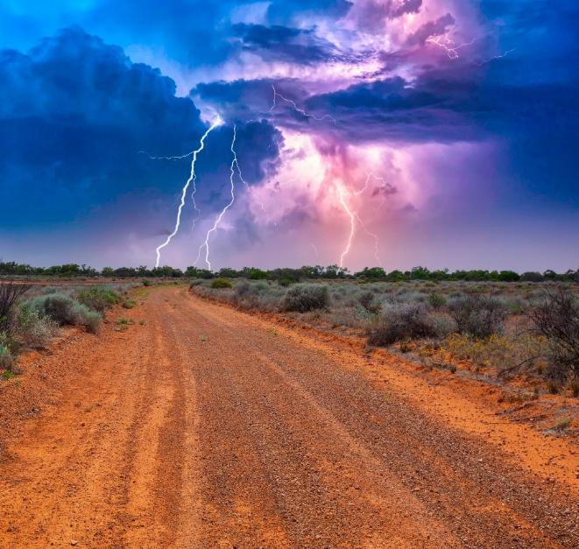
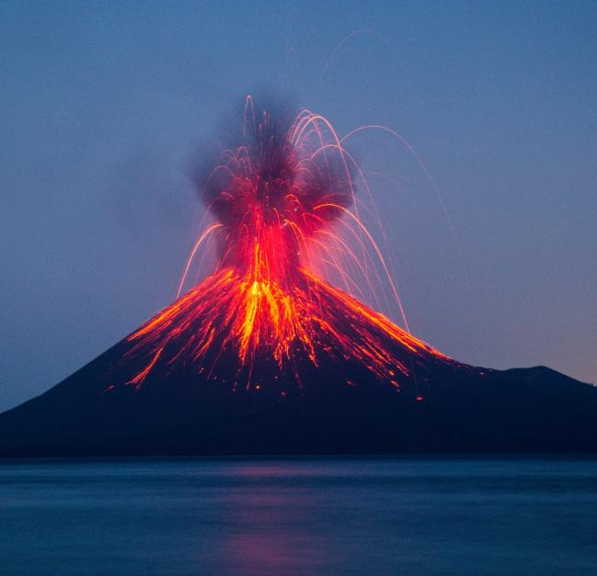
In nature, fire can start from volcanoes or lightning.

Slide 3
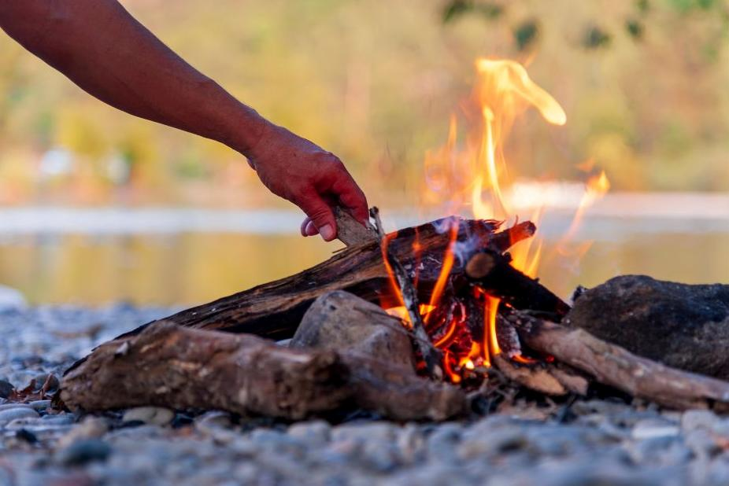
Early humans used fire for heat, to cook and to keep animals away.

Slide 4
Think: What is one thing humans have created to control fire?
Pair/Share.

Slide 5



In this lesson, we will learn about what informative writing is.

Slide 6
You will be able to: ​
understand the purpose of informative writing
understand that informative writing has an organised structure
identify information written in a text.

Slide 7

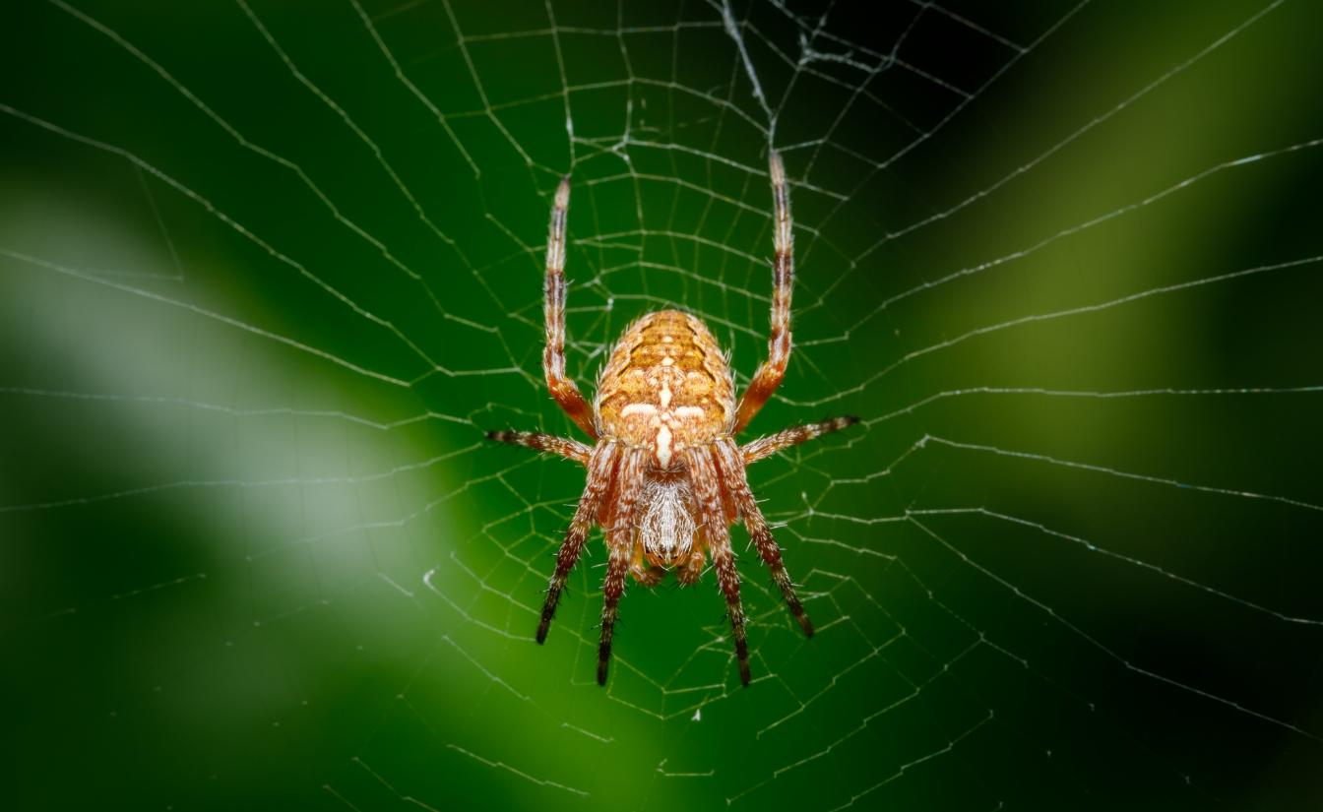


Slide 8
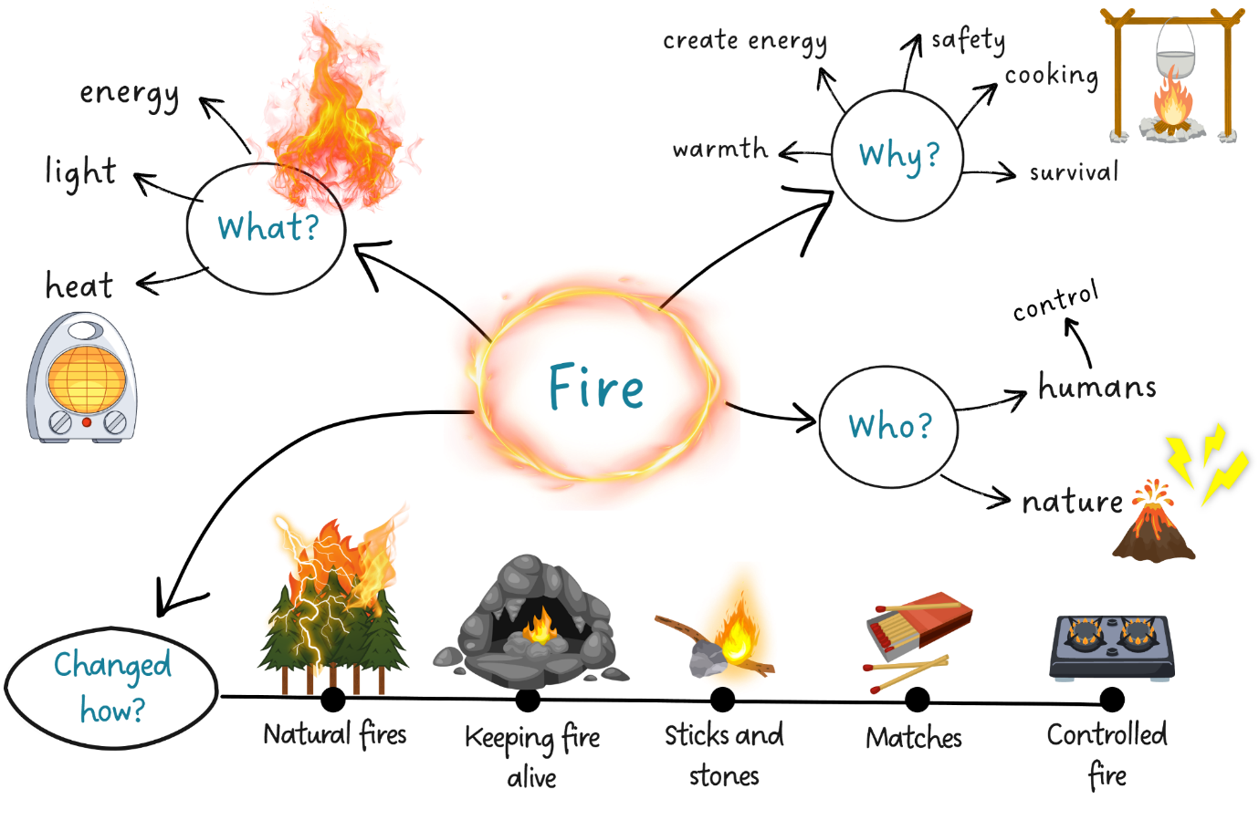
Discovery of Fire

Slide 9
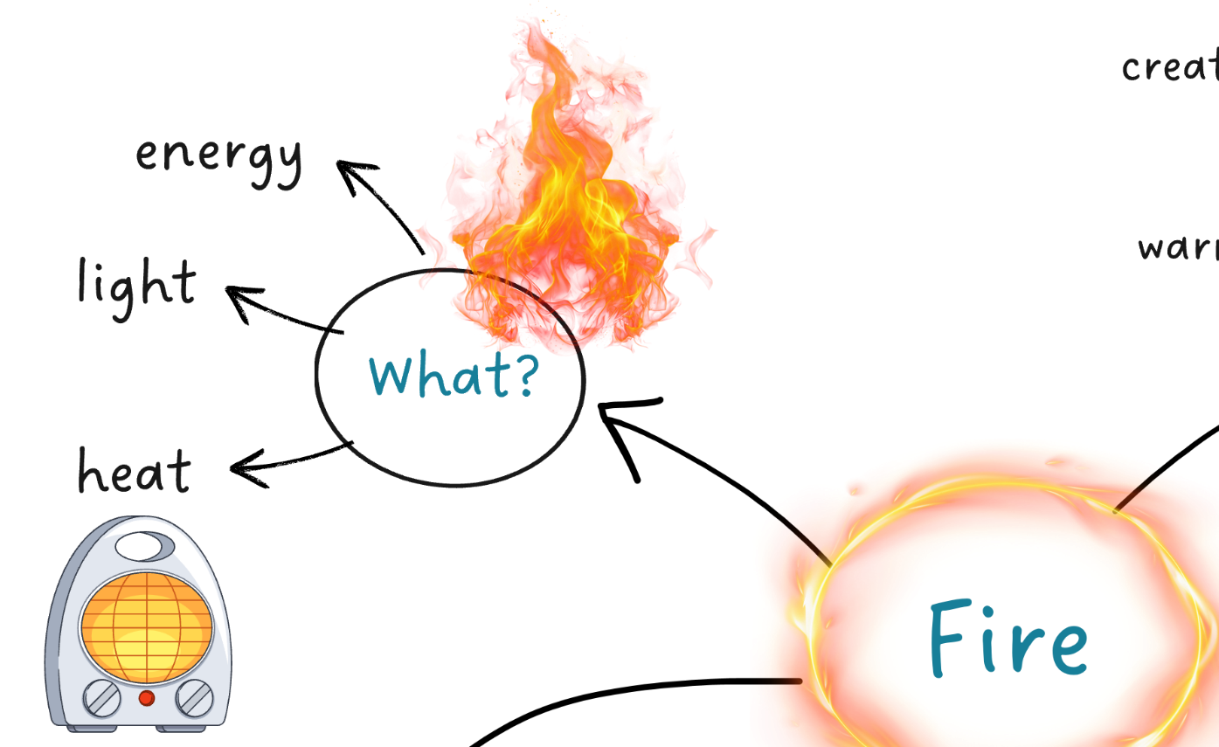
What Is Fire?

Slide 10
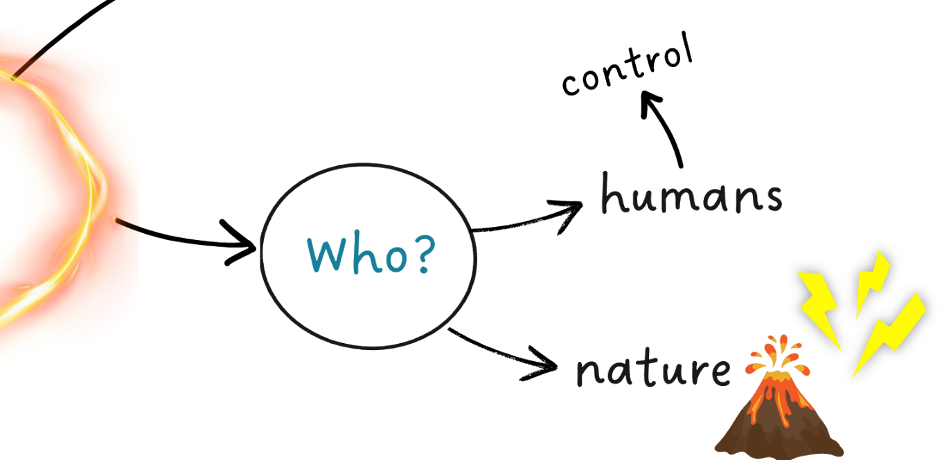
Who Discovered Fire?

Slide 11
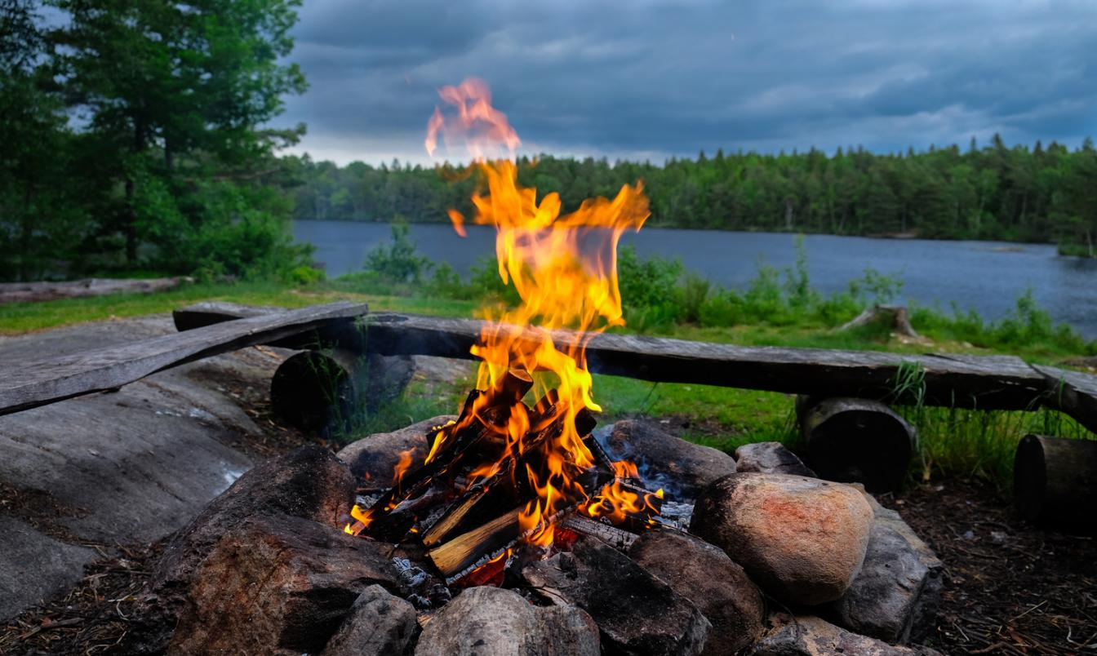
Discovery of Fire

Slide 12


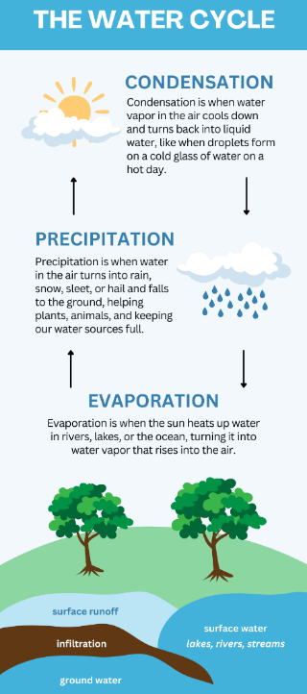
What Is Informative Writing?
The purpose of informative writing is to share information, teach others and add to knowledge.

Slide 13
What Is an Informative Text?
Informative texts teach about real things like animals, weather, space or people. Informative texts tell us what something is, how it works and why it happens.

Slide 14


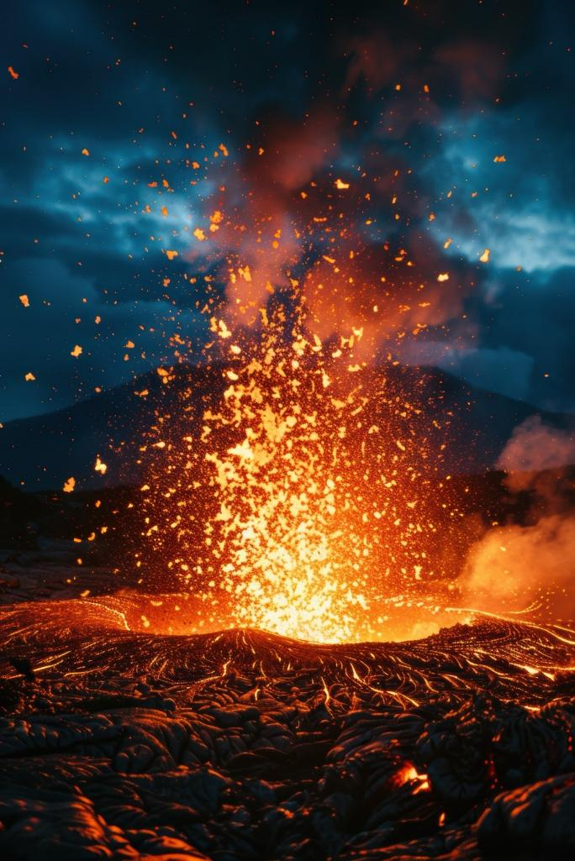


Slide 15
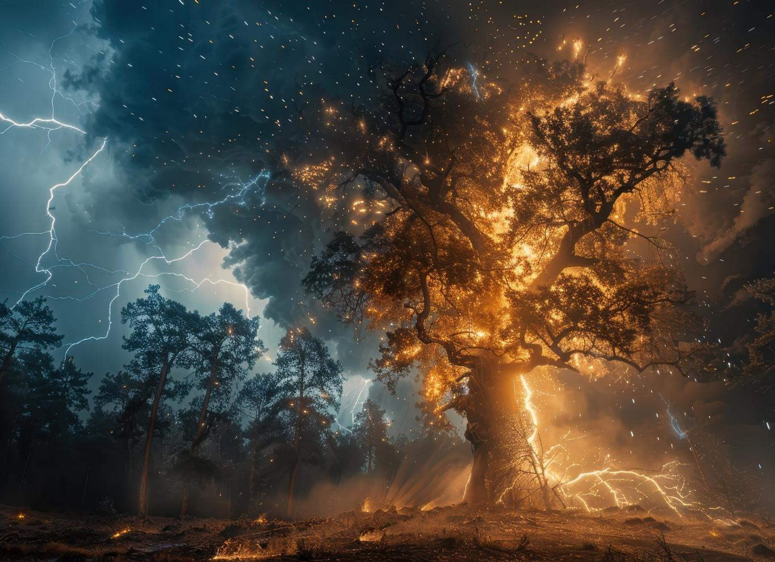
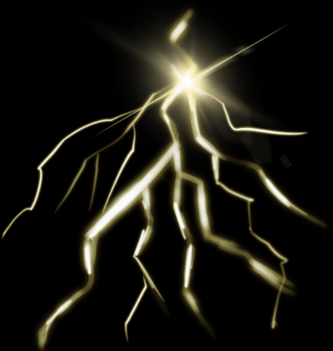

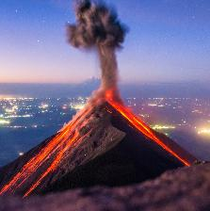
A very long time ago, before people even existed, fire happened in nature. Lightning would strike trees and cause fires in forests.
Lava from volcanos is one way fires start in nature.

Slide 16

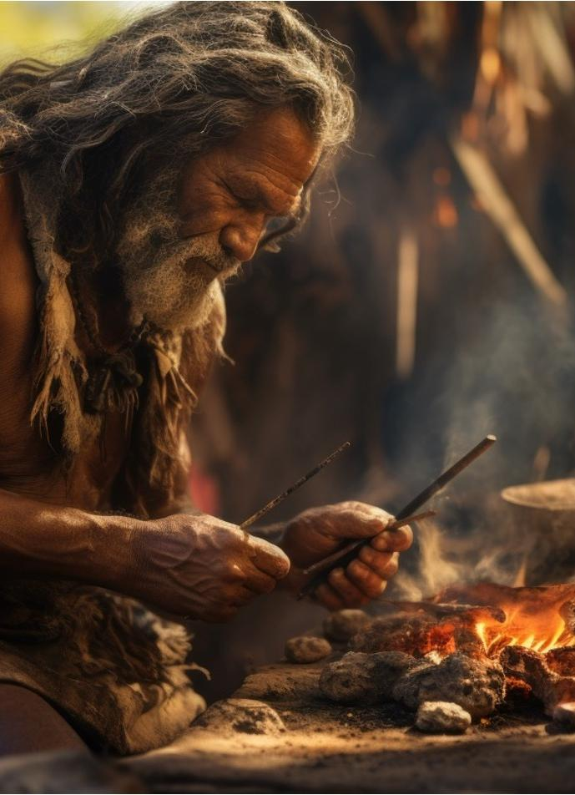
Later, early humans learned how to use fire. They saw natural fires and figured out how to keep the flames going. After some time, they even discovered how to make fire using sticks and stones. Humans learned to use it to cook food, stay warm, and keep safe.

Slide 17
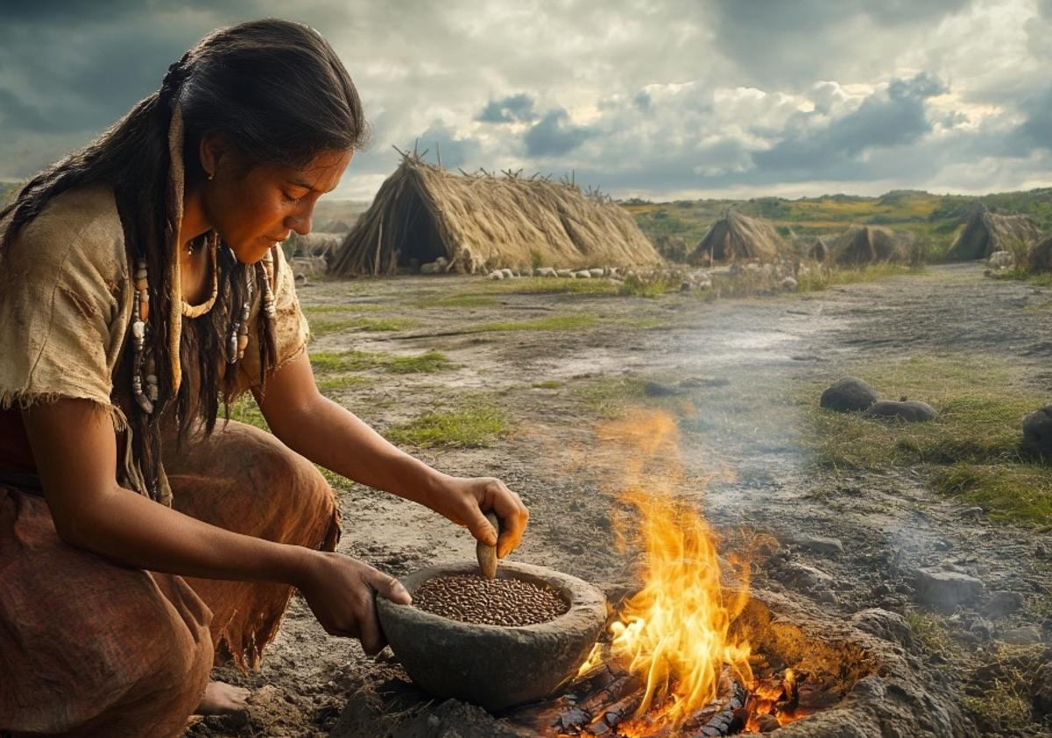

Fire made life easier for people. It gave them warmth in cold weather and light at night. It helped them cook food. Fire also kept wild animals away, which made people feel safer.

Slide 18
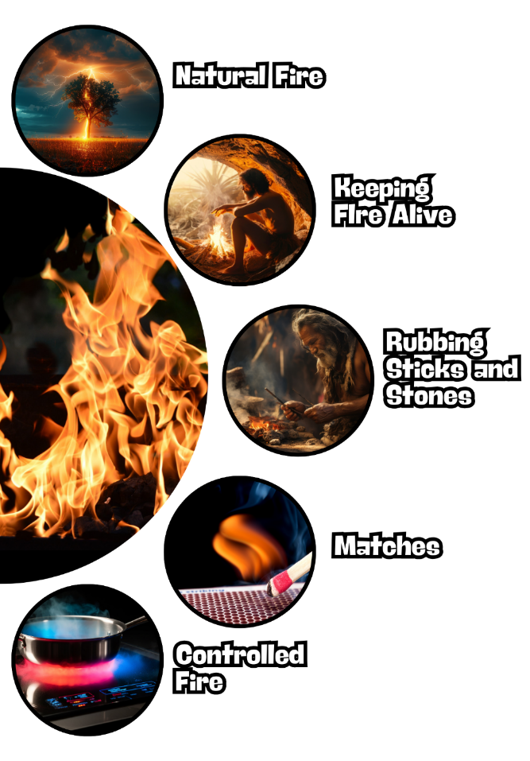

People found fire in nature and learned to keep it alive by carrying it and keeping it burning in their caves. Later, they rubbed sticks or stones together to make fire. Then, they made matches and lighters, so fire was easier to start. Now, we use fire in safe ways with stoves, heaters, and even electricity.

Slide 19

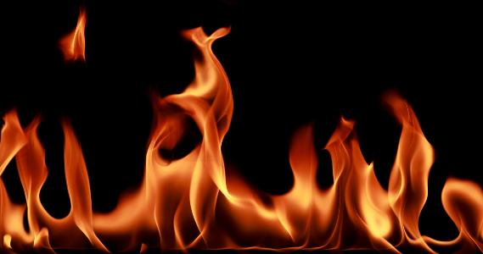
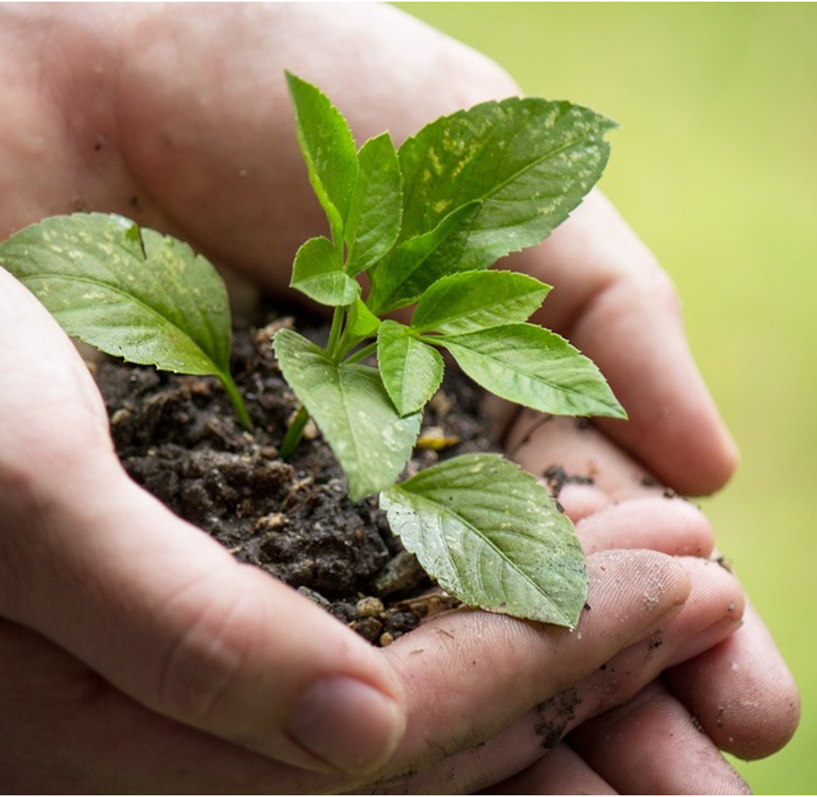
discovery – Finding or learning something new that you didn’t know before.
natural – Something that comes from nature and is not made by people.
flames – The bright, hot part of a fire that you can see.

Slide 20



Show of Fingers
What did early humans use to start a fire?
Sticks and stones
Matches
Steam
Hold one finger up if you agree the answer is number 1.
Hold two fingers up if you agree the answer is number 2.
Hold three fingers up if you agree the answer is number 3.

Slide 21
What Is an Informative Text?
An informative text is a type of writing that gives us information, rather than telling a story. It helps us learn about real things like animals, weather, space or people.

Slide 22


Informative Text Structure
Informative writing has an organised structure.
Paragraph
facts
subtopic
Information
Title
Paragraph
facts
subtopic
diagram

Slide 23
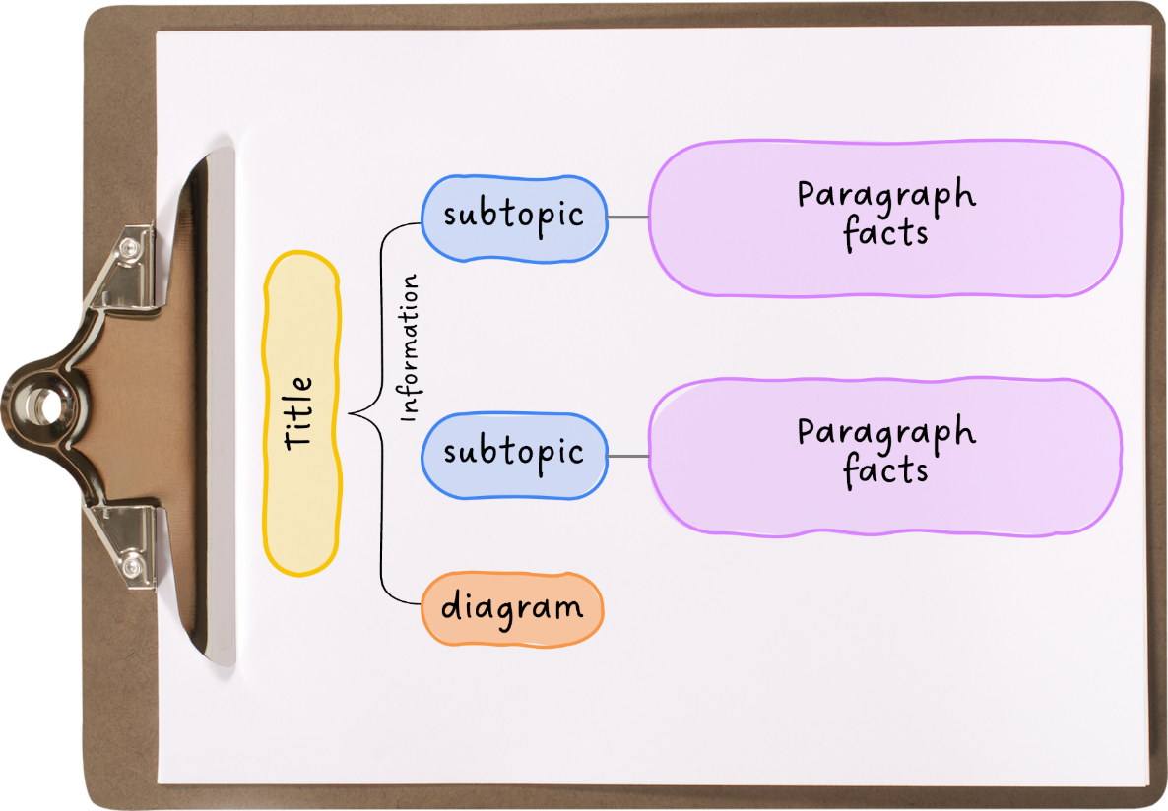







Informative Text Structure
Title

Slide 24
The purpose of informative writing is to share information, teach others and add to knowledge.
It helps us learn about real things.
Informative texts tell us what something is, how it works and why it happens.
Informative writing follows an organised structure.

Slide 25
give information
1. The purpose of informative writing is to _________________.
2. Informative texts are about ________.
A. real things
B. stories
C. talking animals
3. A s_______ tells what the paragraph will be about.
invent
entertain
give information
ubtopic

Slide 26



In the next lesson, we will learn how to identify informative texts.
A
pinch
of magic
Mark Sutherland

