Slide 1

Writing
Unit 3: Informational/
History
Lesson 1: The Story of Federation
Version 1

Slide 2

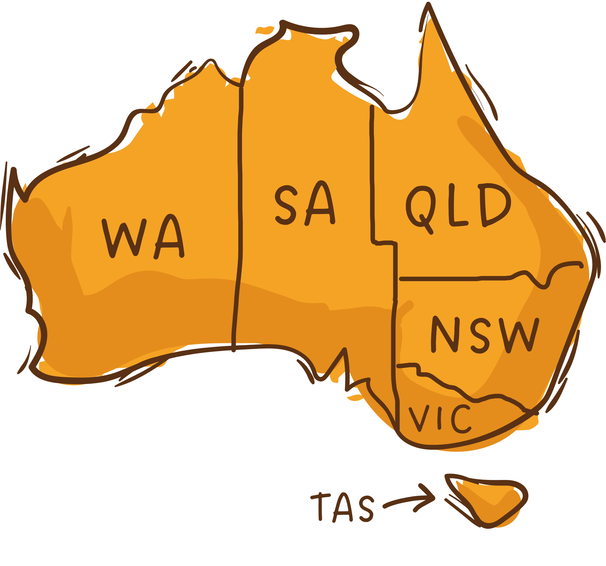
In this lesson, we will learn about The Story of Federation.

Slide 3
You will be able to: ​
understand The Story of Federation
understand how the colonies united to form the Federation
understand that the Australian Constitution is a rulebook for the nation.

Slide 4




Slide 5





















Mapping My Mind
remember what we’ve learned
Helps put information IN
organise ideas
Purpose
Show thinking
visualise thoughts
Mind Maps
Helps take information OUT
You can see:
Last levels: descriptive details and factual evidence
Read information
Radiate outwards
pictures
Centre circle: main topic
words
Next level: subtopics

Slide 6

6
Constitution
Each colony had its own
Colonial Australia
Stamps
Trainlines
Governor
The Story of Federation
States
Colonies planned to unite
Australian Constitution 1901
Father of
Federation
Drafted rules
for nation
Commonwealth
Adopted by Queen
Victoria
Sir Henry Parkes
One national government

Slide 7



The Six Colonies
Colonial Australia had six separate colonies.
Western Australia
South Australia
Queensland
New South Wales
Victoria
Tasmania

Slide 8
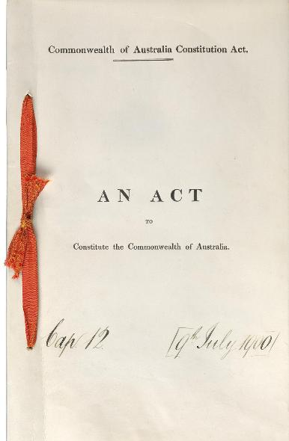

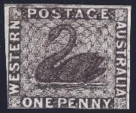
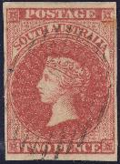
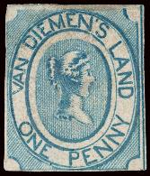
The Six Colonies
Each colony was like its own country.

Slide 9


The Six Colonies
Having six separate colonies caused confusion and problems.
Unite means to come together and work as one group.

Slide 10
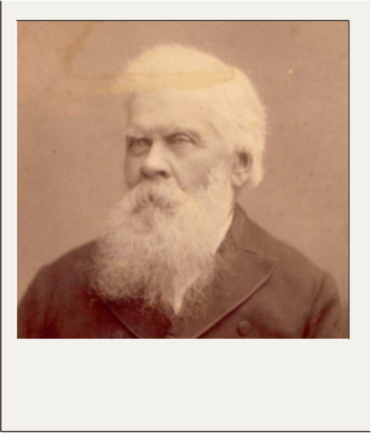

Sir Henry Parkes
Sir Henry Parkes is The Father of Federation.
Sir Henry Parkes

Slide 11


Thumbs Up or Thumbs Down
Sir Henry Parkes did not want the colonies to unite to form one nation.
No
Yes
Thumbs up for yes.
Thumbs down for no.

Slide 12

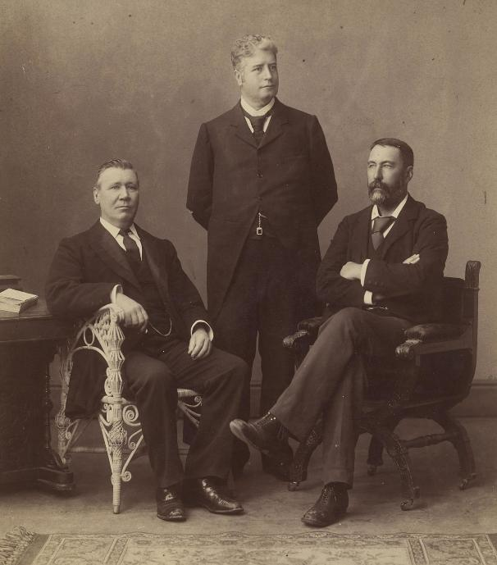
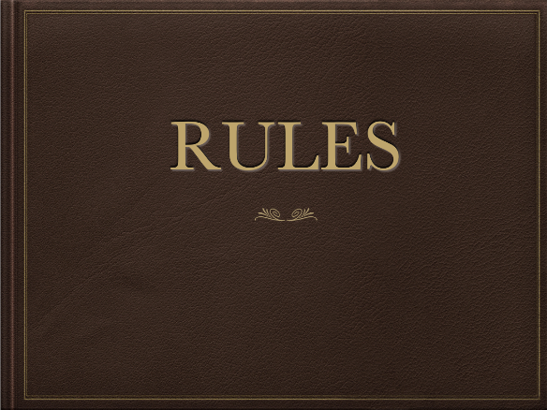


The Australian Constitution
The Australian Constitution was written as the rulebook for the nation.
A delegate is a person who is chosen to speak or act for others
De
gate
le

Slide 13

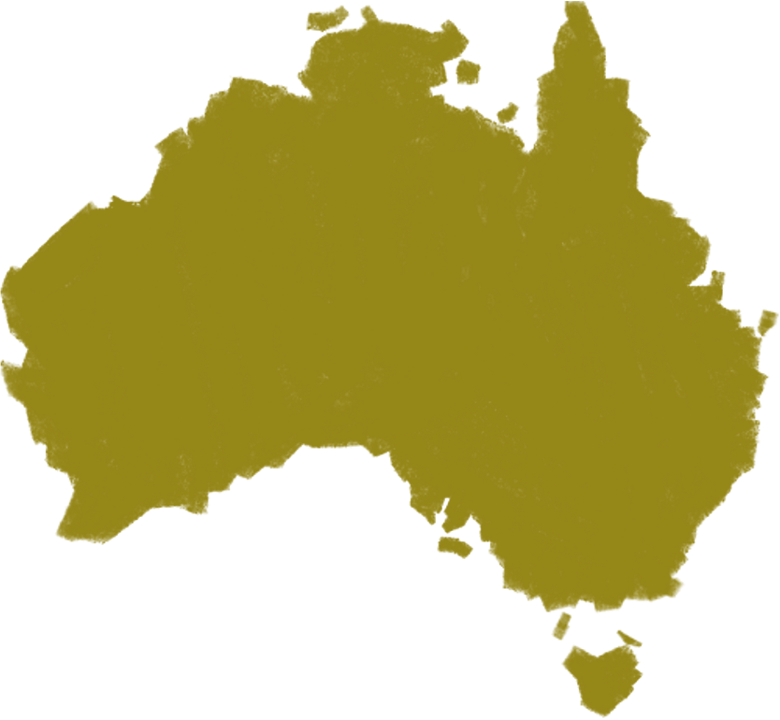
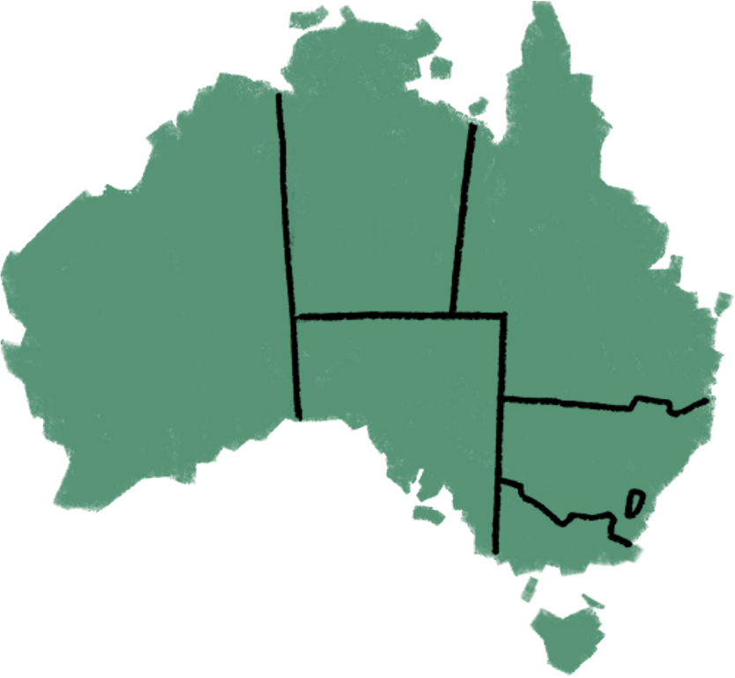

The Australian Constitution
In the Constitution, each state had its own government, while the national government would take care of things that affected the entire country.
Federal parliament
State parliaments

Slide 14
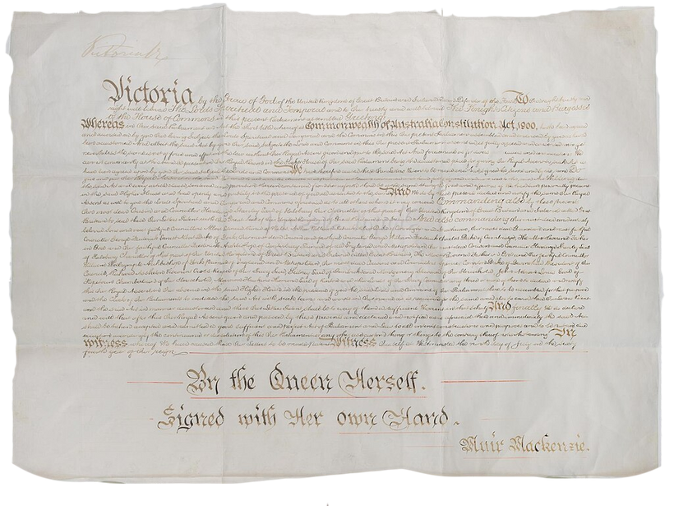
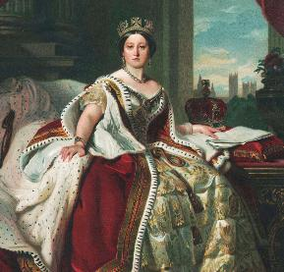
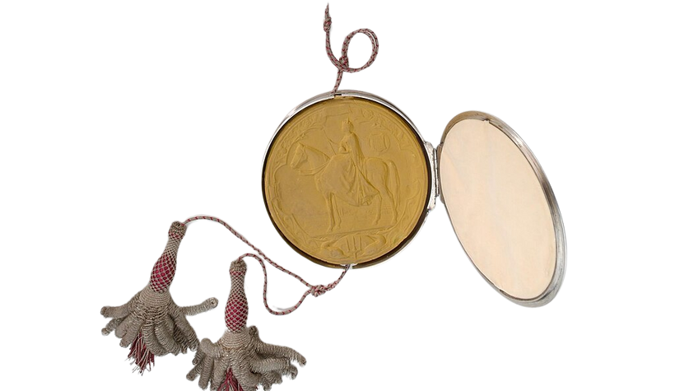
The Australian Constitution
The Constitution was approved by Queen Victoria.

Slide 15


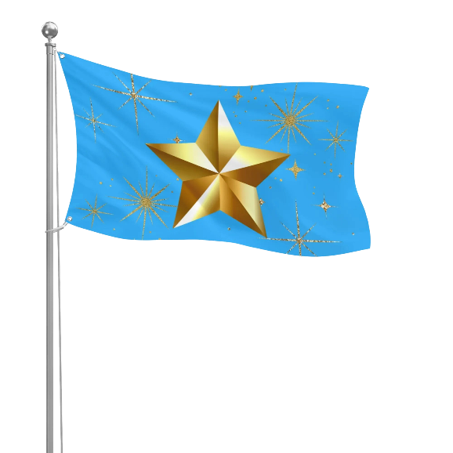
Form a Federation Activity
To form my own country, I made:
A name for my country
A constitution
A flag.
Be Kind and Respectful
Learn and Grow
Help the Community
Fairness for All
Fun is Required

Slide 16



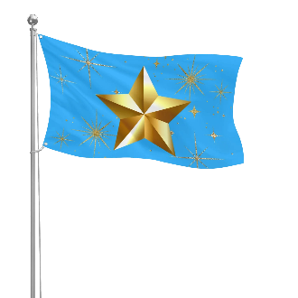
Form a Federation Activity
Form Your Country
1. Write Constitution
Write five rules for your country.
2. Create a Flag

Slide 17
Thumbs Up or Thumbs Down
The colonies did not need Queen Victoria’s approval before the Constitution became official.
No
Yes
Thumbs up for yes.
Thumbs down for no.

Slide 18

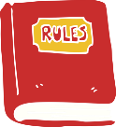

The Story Of Federation Mind Map
6
Constitution
Each colony had its own
Colonial Australia
Stamps
Trainlines
Governor
The Story of Federation
States
Colonies planned to unite
Australian Constitution 1901
Father of
Federation
Drafted rules
for nation
Commonwealth
Adopted by Queen
Victoria
Sir Henry Parkes
One national government

Slide 19
The Story of Federation Mind Map
6
Constitution
Each colony had its own
Colonial Australia
Stamps
Trainlines
Governor
The Story of Federation
States
Colonies planned to unite
Australian Constitution 1901
Father of
Federation
Drafted rules
for nation
Commonwealth
Adopted by Queen
Victoria
Sir Henry Parkes
One national government

Slide 20
The Story of Federation Mind Map
6
Constitution
Each colony had its own
Colonial Australia
Stamps
Trainlines
Governor
The Story of Federation
States
Colonies planned to unite
Australian Constitution 1901
Father of
Federation
Drafted rules
for nation
Commonwealth
Adopted by Queen
Victoria
Sir Henry Parkes
One national government

Slide 21
Colonial Australia had six separate colonies.
Each colony was like its own country. This caused problems.
Sir Henry Parkes is The Father of Federation.
The Australian Constitution was written as the rulebook for the nation.
In the Constitution, each state had its own government, while the national government would take care of things that affected the entire country.
The Constitution was approved by Queen Victoria.

Slide 22
Having six different colonies caused confusion so Australia needed to ___________.
2. Sir Henry Parkes:
A. Was known as The Father of Federation
B. Gave a famous speech called The Tenterfield Oration
C. Pushed the colonies to unite
D. All of the above.
The Australian Constitution was written as the r_____________ for the nation.
unite
fight
unite
separate
ulebook

Slide 23
In the next lesson, we will learn the purpose and structure of informative writing.

