Slide 1

Writing
Unit 3: Informational/ History
Lesson 2: Informative Writing
Version 1

Slide 2





Having six different colonies caused confusion, so Australia needed to unite.
Unite means to come together and work as one group.

Slide 3
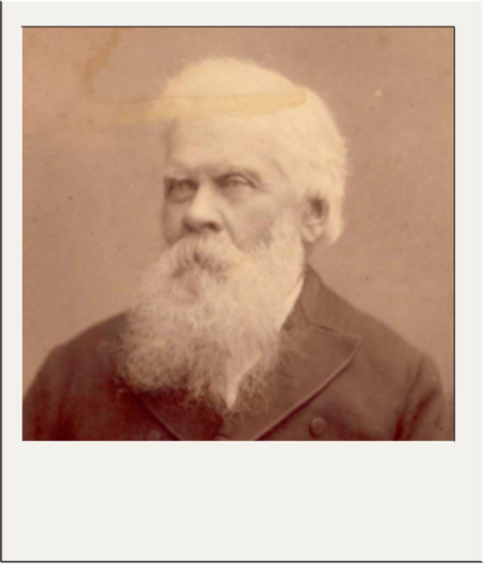
Sir Henry Parkes was known as The Father of Federation. He gave a famous speech called The Tenterfield Oration and pushed the colonies to unite.

Slide 4


The constitution includes:
how the rules will be created in parliament
the rule for driving at night.
Hold one finger up if you agree the answer is number 1.
Hold two fingers up if you agree the answer is number 2.

Slide 5
In this lesson, we will learn the purpose and structure of informative writing.

Slide 6
You will be able to: ​
understand the purpose of informative writing
understand the structure of informative writing.

Slide 7




Slide 8

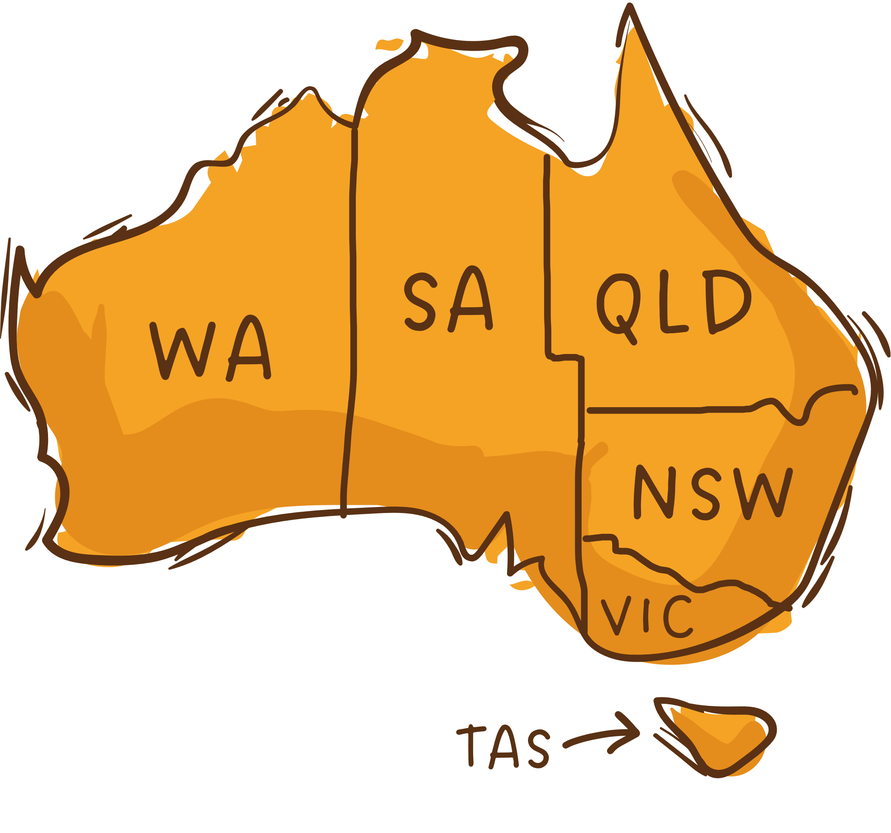

6
Constitution
Each colony had its own
Colonial Australia
Stamps
Trainlines
Governor
The Story of Federation
States
Colonies planned to unite
Australian Constitution 1901
Father of
Federation
Drafted rules
for nation
Commonwealth
Adopted by Queen
Victoria
Sir Henry Parkes
One national government

Slide 9
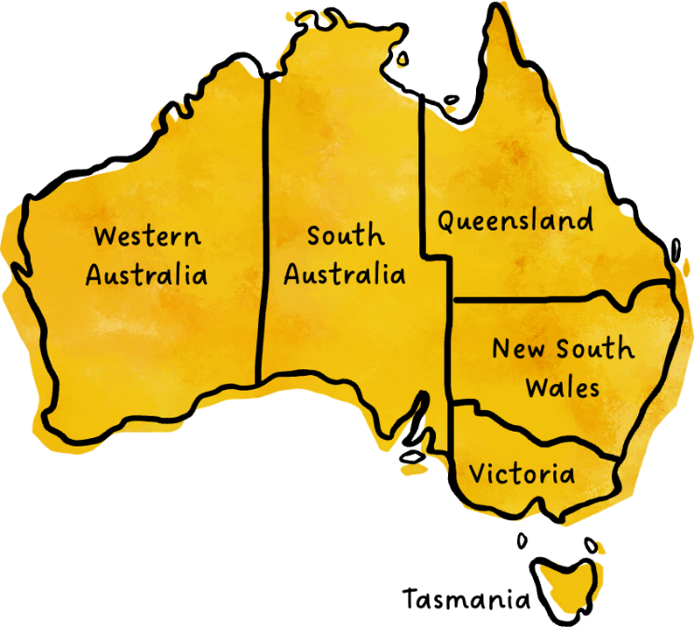
The Story of Federation
Colonial Australia had six separate colonies. Each colony was like its own country.

Slide 10
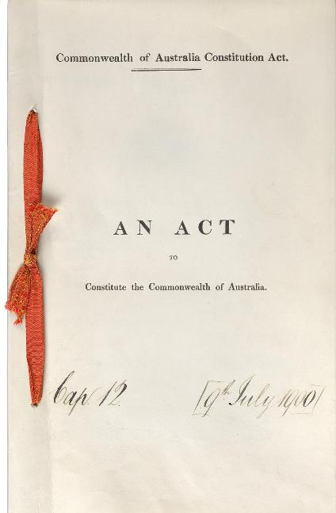
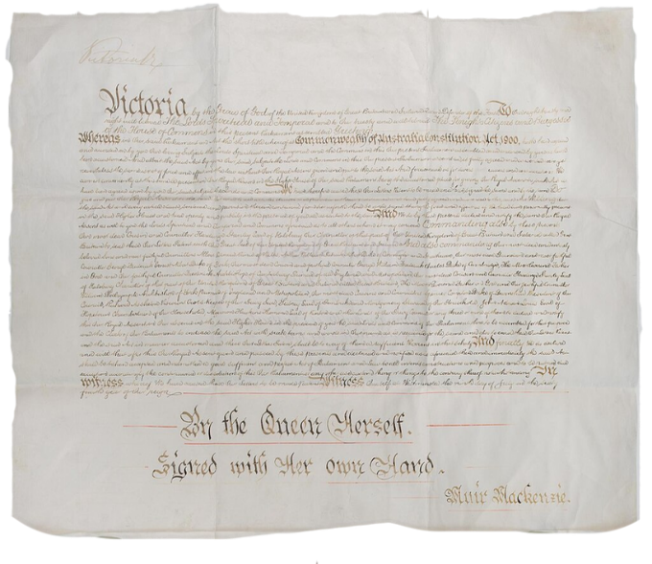
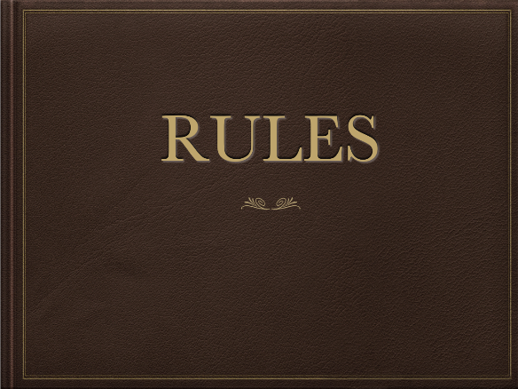
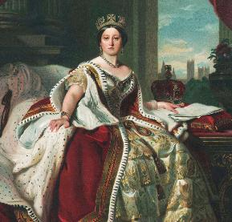
The Australian Constitution
The Australian Constitution was written as the rulebook for the nation. The Constitution was approved by Queen Victoria.

Slide 11


Informative Text Structure
Informative writing has an organised structure.
Introduction
Focus sentence, descriptive details and factual evidence.
Subtopic
Topic
Focus sentence, descriptive details and factual evidence.
Title
Subtopic
Focus sentence, descriptive details and factual evidence.
Subtopic
Conclusion

Slide 12




Informative Text Purpose
The purpose of informative text is to provide:
facts
explanations
details about a topic.

Slide 13


Thumbs Up or Thumbs Down
The purpose of an informative text is to share information.
No
Yes
Thumbs up for yes.
Thumbs down for no.

Slide 14




The Story of Federation

Slide 15

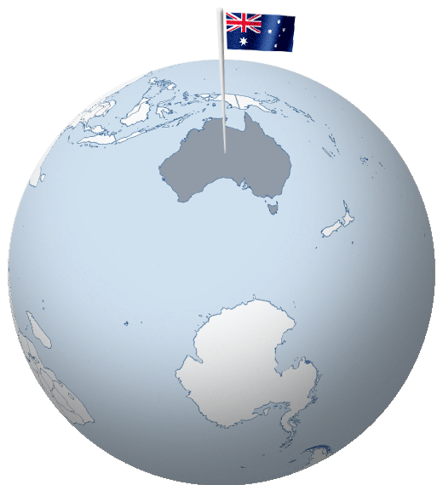
The Birth of Australia as One Nation
Australia became a united country through a process called Federation. Before 1901, Australia was made up of separate colonies that were controlled by Britain. The journey to becoming one nation was long and took many years of discussion and planning.

Slide 16
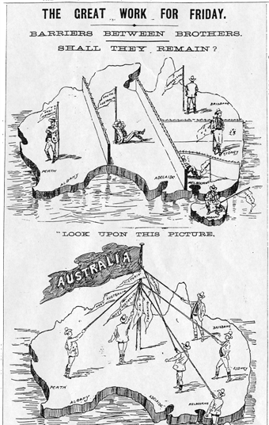
Colonial Australia
In the 1800s, Australia was divided into six colonies: New South Wales, Victoria, Queensland, South Australia, Western Australia and Tasmania. Each colony had its own government, laws and way of doing things. People could not travel easily between the colonies because they had different railway systems and trade rules. Even though they were all part of the British Empire, they operated separately, which caused many problems.

Slide 17
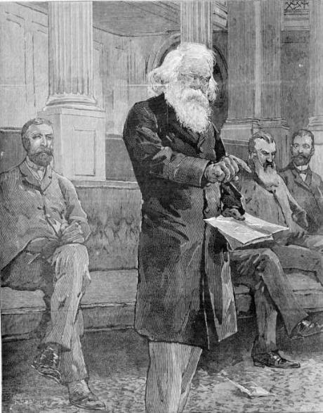
Colonies Unite
By the late 1800s, people started to see the benefits of joining together. One of the biggest supporters of the Federation was Sir Henry Parkes, the Premier of New South Wales. He gave a famous speech in 1889, encouraging the colonies to unite. His leadership helped start discussions about forming a single nation. After many meetings and votes, the people of Australia agreed to unite. On January 1, 1901, Australia officially became a nation with six states.
_{Sir Henry Parkes 1889}

Slide 18

Australian Constitution
To create a strong and fair government, Australia needed a set of rules. These rules were written in a document called the Constitution or the Commonwealth of Australia. It explained how the government would work and what powers each state would have. The Constitution was sent to Britain for approval, and Queen Victoria signed it in 1900. After this, Australia became a federation under its own laws.

Slide 19
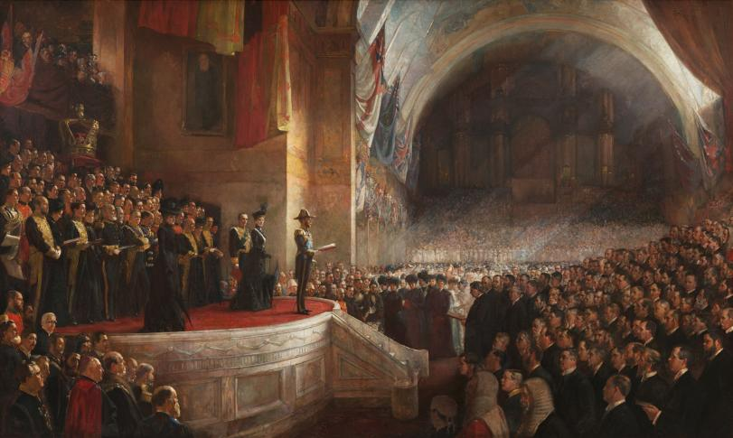
The Federation was an important moment in Australia’s history. It helped create a united country with a strong government while still allowing states to have their own control. Today, Australians celebrate this moment as the birth of their nation.
This painting shows the official ceremony where Australia became one nation in January 1901.

Slide 20
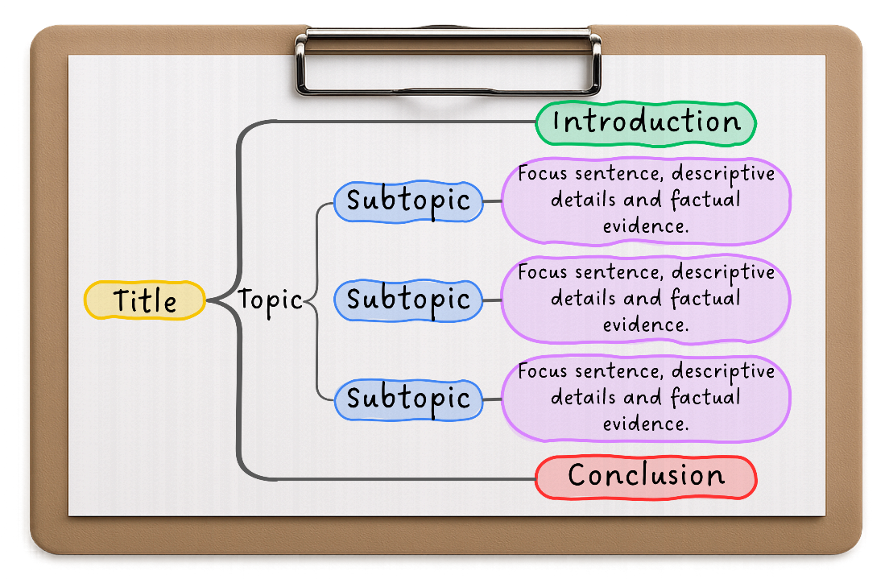
The Birth of Australia as One Nation
Australia became a united country through a process called Federation. Before 1901, Australia was made up of separate colonies that were controlled by Britain. The journey to becoming one nation was long and took many years of discussion and planning.
Colonial Australia
In the 1800s, Australia was divided into six colonies: New South Wales, Victoria, Queensland, South Australia, Western Australia and Tasmania. Each colony had its own government, laws, and way of doing things. People could not travel easily between the colonies because they had different railway systems and trade rules. Even though they were all part of the British Empire, they operated separately, which caused many problems.
Colonies Unite
By the late 1800s, people started to see the benefits of joining together. One of the biggest supporters of the Federation was Sir Henry Parkes, the Premier of New South Wales. He gave a famous speech in 1889, encouraging the colonies to unite. His leadership helped start discussions about forming a single nation. After many meetings and votes, the people of Australia agreed to unite. On January 1, 1901, Australia officially became a nation with six states.
Australian Constitution
To create a strong and fair government, Australia needed a set of rules. These rules were written in a document called the Constitution or the Commonwealth of Australia. It explained how the government would work and what powers each state would have. The Constitution was sent to Britain for approval, and Queen Victoria signed it in 1900. After this, Australia became a federation under its own laws.
The Federation was an important moment in Australia’s history. It helped create a united country with a strong government while still allowing states to have their own control. Today, Australians celebrate this moment as the birth of their nation.
The Birth of Australia as One Nation
Australia became a united country through a process called Federation. Before 1901, Australia was made up of separate colonies that were controlled by Britain. The journey to becoming one nation was long and took many years of discussion and planning.
Colonial Australia
In the 1800s, Australia was divided into six colonies: New South Wales, Victoria, Queensland, South Australia, Western Australia, and Tasmania. Each colony had its own government, laws, and way of doing things. People could not travel easily between the colonies because they had different railway systems and trade rules. Even though they were all part of the British Empire, they operated separately, which caused many problems.
Colonies Unite
By the late 1800s, people started to see the benefits of joining together. One of the biggest supporters of Federation was Sir Henry Parkes, the Premier of New South Wales. He gave a famous speech in 1889 encouraging the colonies to unite. His leadership helped start discussions about forming a single nation. After many meetings and votes, the people of Australia agreed to unite. On January 1, 1901, Australia officially became a nation with six states.
Australian Constitution
To create a strong and fair government, Australia needed a set of rules. These rules were written in a document called the Constitution or the Commonwealth of Australia. It explained how the government would work and what powers each state would have. The Constitution was sent to Britain for approval, and Queen Victoria signed it in 1900. After this, Australia became a federation under its own laws.
The Federation was an important moment in Australia’s history. It helped create a united country with a strong government while still allowing states to have their own control. Today, Australians celebrate this moment as the birth of their nation.

Slide 21
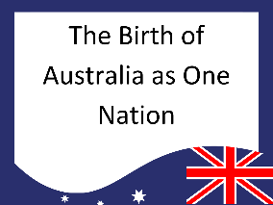
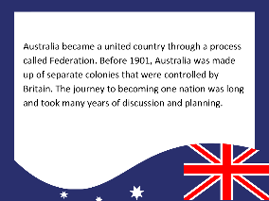

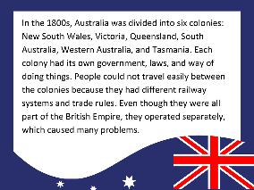

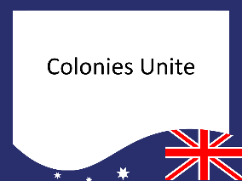


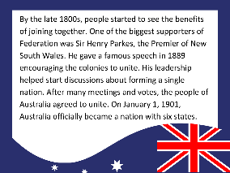
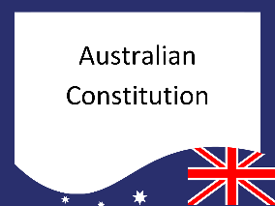


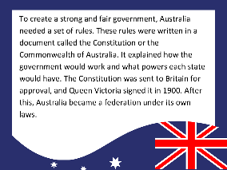

Card Activity – Text Structure

Slide 22
The purpose of informative text is to provide facts, explanations and details about a topic.
Informative writing has an organised structure.

Slide 23
organised
Informative writing has a(n) ___________ structure.
2. The first part of the informative writing structure is:
A. Paragraph
B. Orientation
C. Conclusion
D. Title
The purpose of informative text is to share i_____________.
creative
no
organised
nformation

Slide 24
In the next lesson, we will learn about topics and titles.

