Slide 1
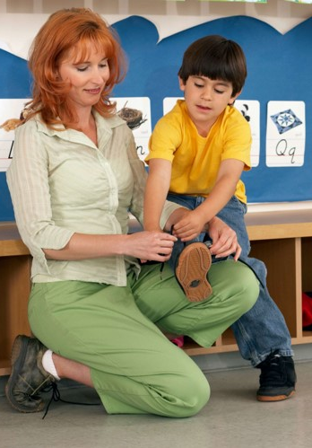
English
Top-Ups
Lesson 1
Exercise 1: Language Used at Home and at School
Version 2

Slide 2
Lesson Objective
We will learn about how we speak to different people.

Slide 3
Success Criteria
You will be successful when you know how we speak to different people.

Slide 4

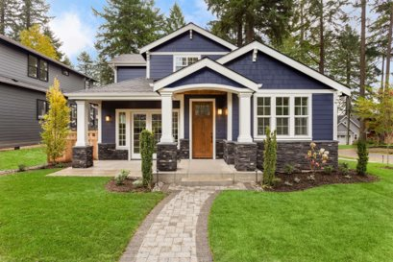

Activate Prior Knowledge

Slide 5
I Do: Read with Me
We speak to people at home.
We speak to people at school.
The words that we use at school are different to the words we use at home.

Slide 6
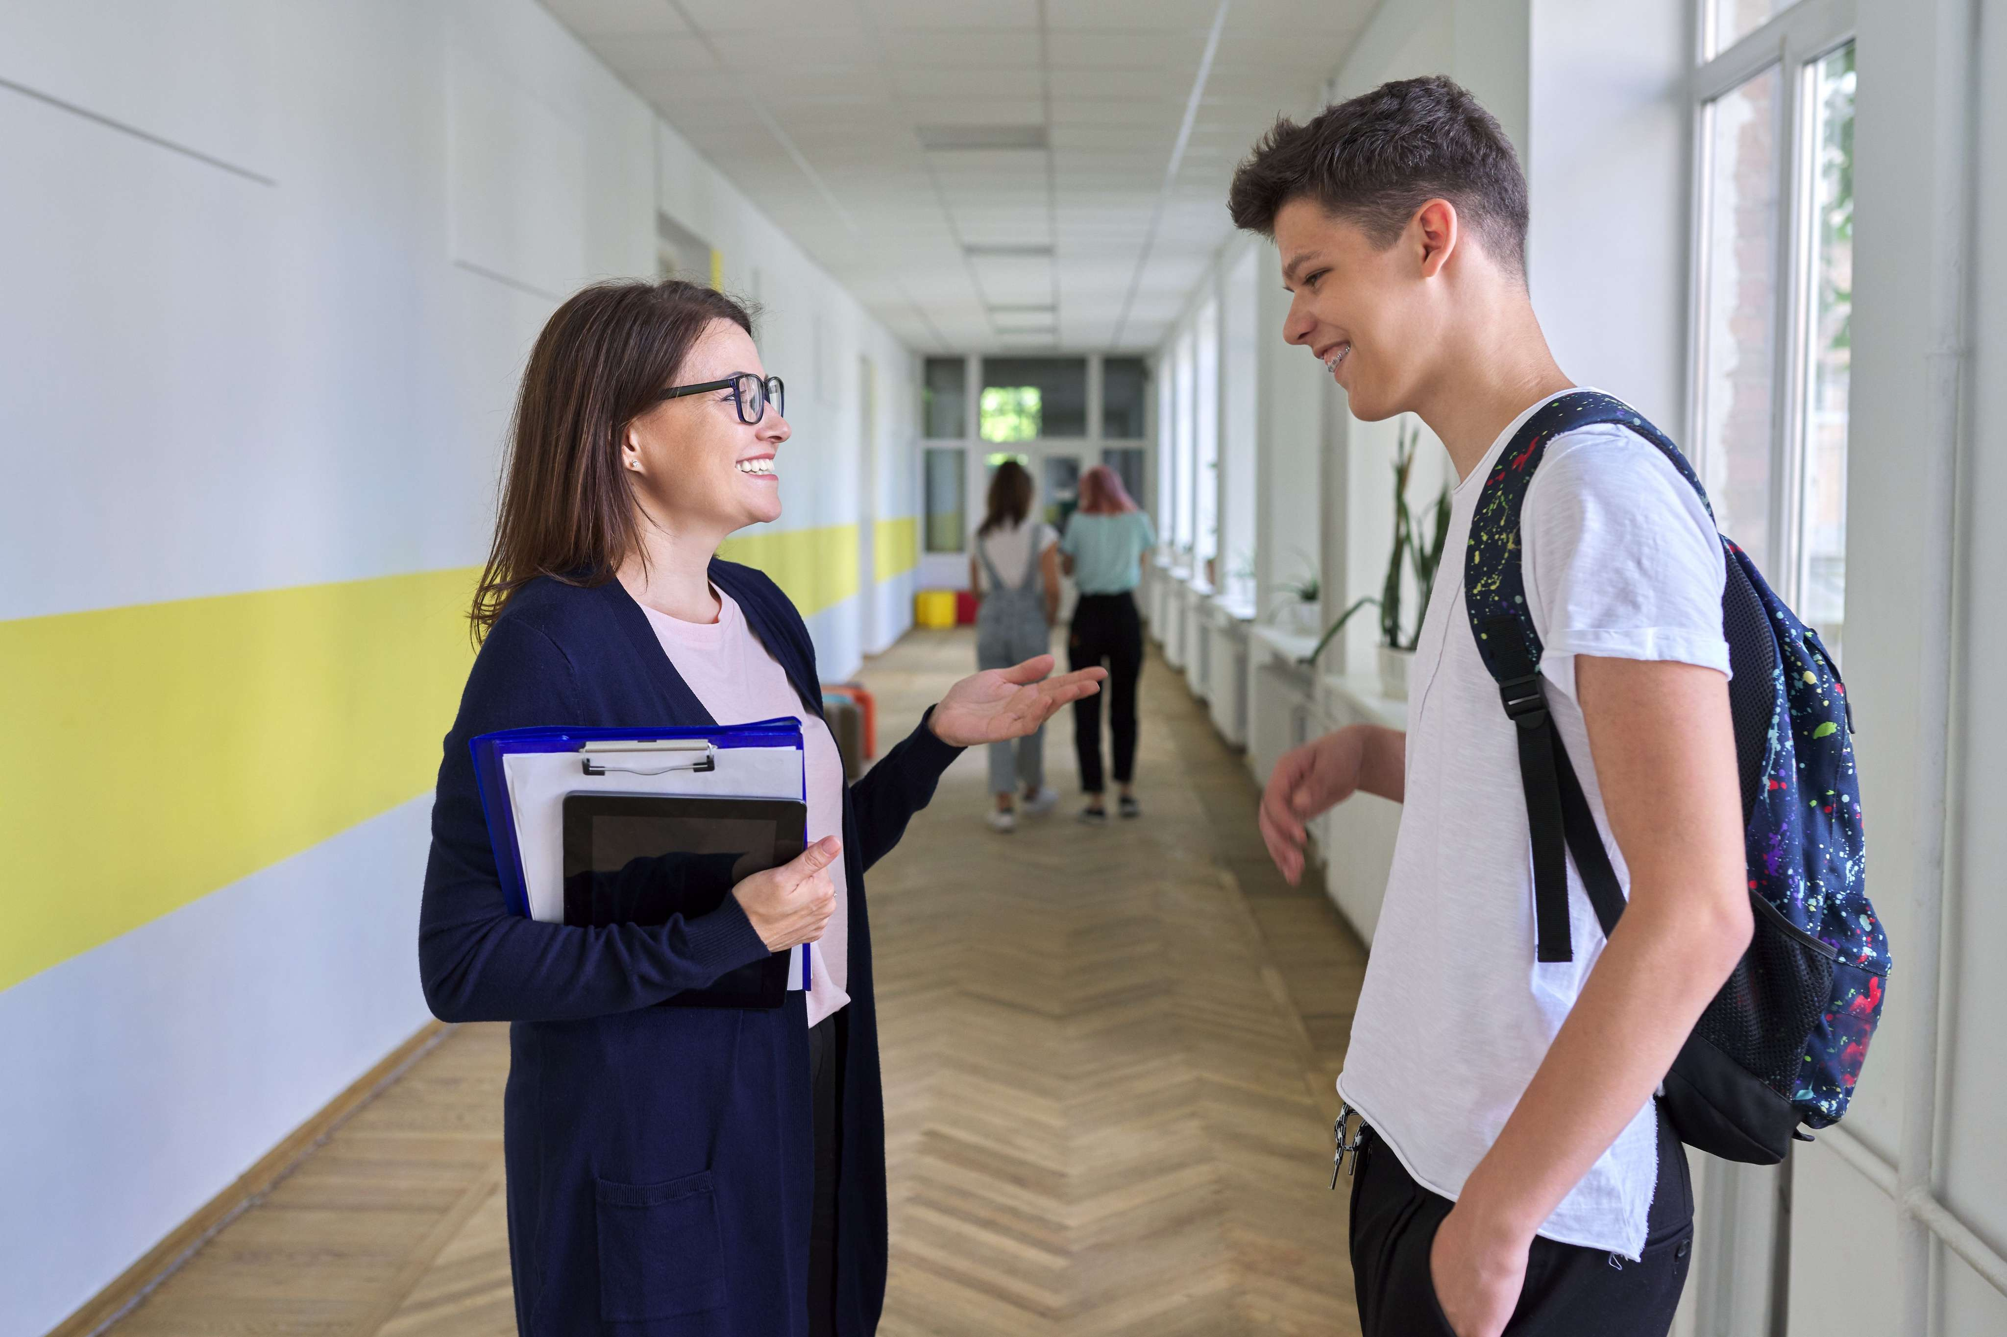
I Do: Speaking at School

Slide 7

I Do: Speaking at Home

Slide 8
I Do: Differences

Slide 9
We Do: Activity – At School or At Home?

Slide 10







APPLE Question
How do you say hello to your teacher in the morning?

Slide 11

You Do: Role-play – Teacher and Student

Slide 12

You Do: Role-play – Mother and Child

Slide 13
Revise
We know that we speak differently at school and at home.

