Slide 1
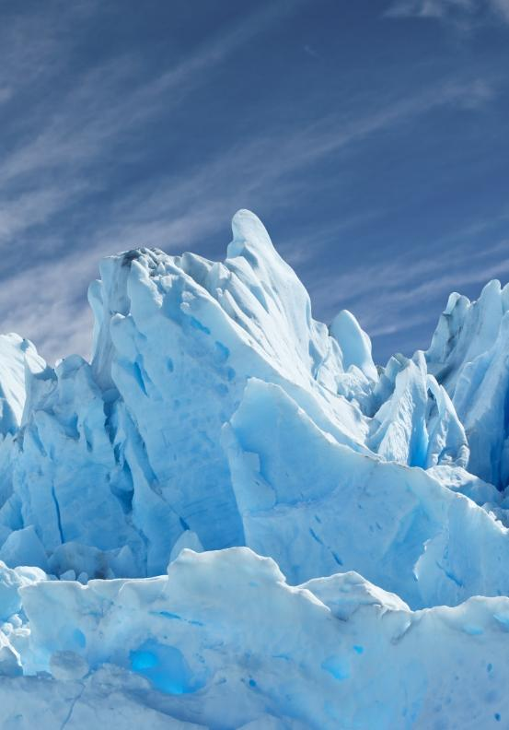
Writing
Unit 3: Informational/ History
Lesson 1: Frozen in Time: The Ice Age
Version 1

Slide 2
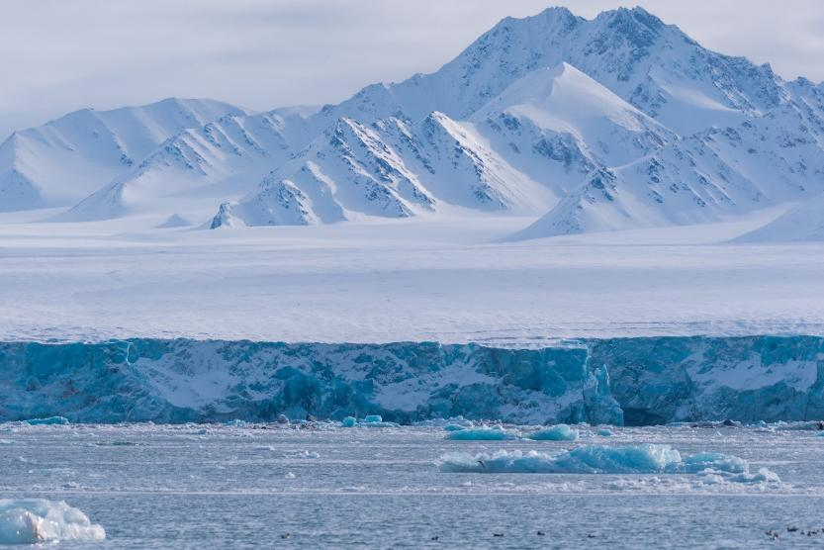
In this lesson, we will learn about the Ice Age.

Slide 3
You will be able to: ​
understand that the Ice Age happened a long time ago
share a word or picture to show what you know about the Ice Age.

Slide 4
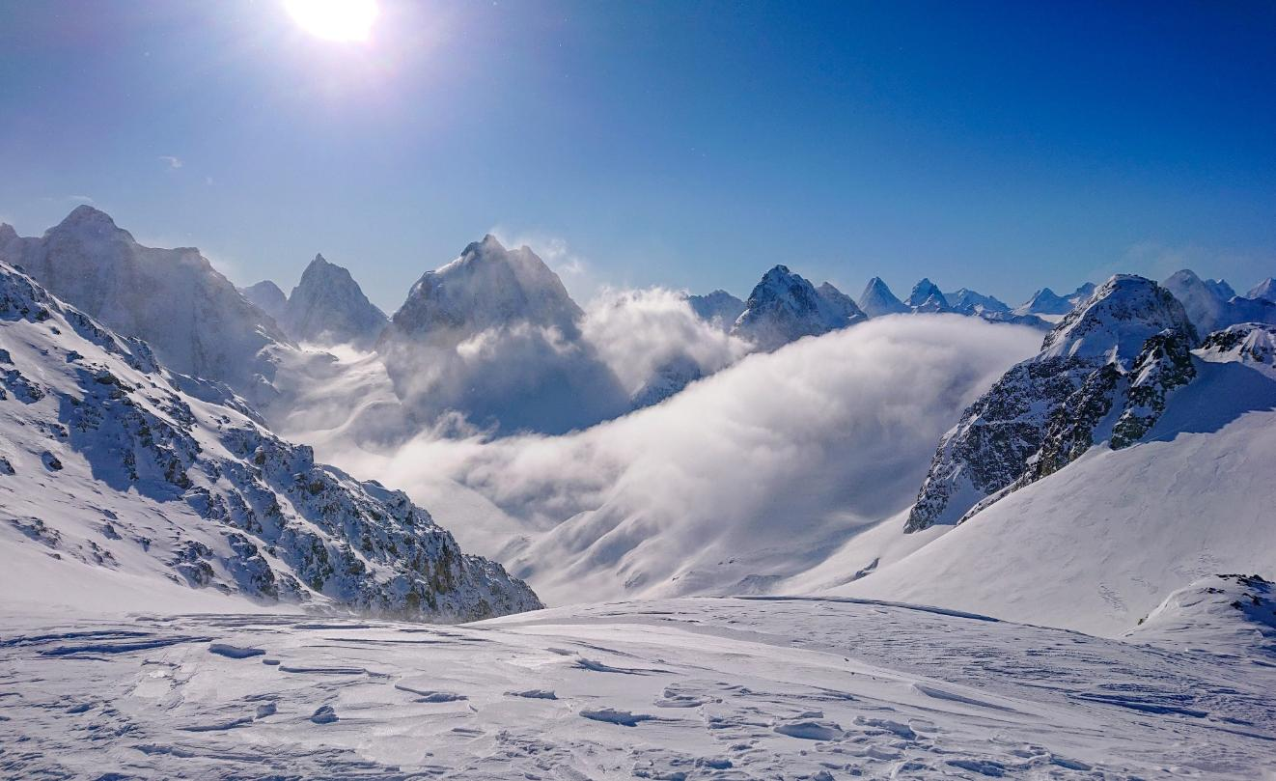

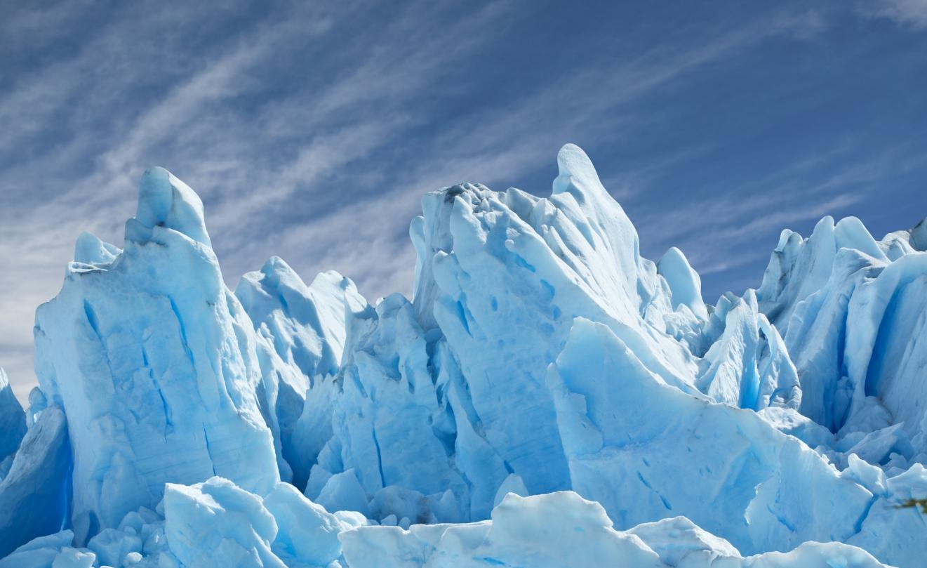
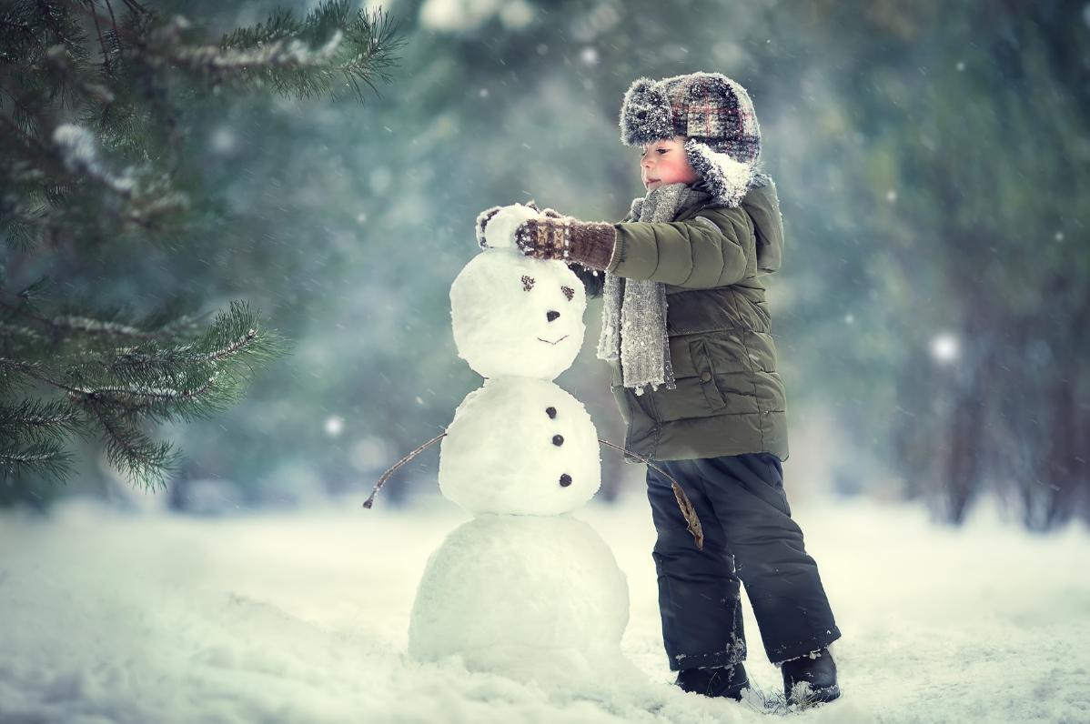

Slide 5



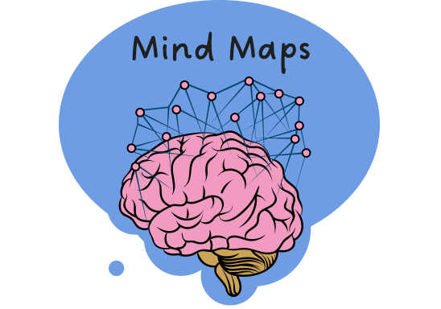














I Do: What Are Mind Maps?
remember what we’ve learned
Helps put information IN
organise ideas
Purpose
Show thinking
visualise thoughts
Mind Maps
Helps take information OUT
You can see:
Last levels: descriptive details and factual evidence
Read information
Radiate outwards
pictures
Centre circle: main topic
words
Next level: subtopics

Slide 6









Mind Map: The Ice Age
6th birthday = 6 Years
Earth
Many different ice ages
Where?
When?
Last Ice Age ended
One-third covered
The Ice Age
years ago
Long winter
Sheets of ice formed
What?
How?
Very cold temperatures
Warm to cold

Slide 7
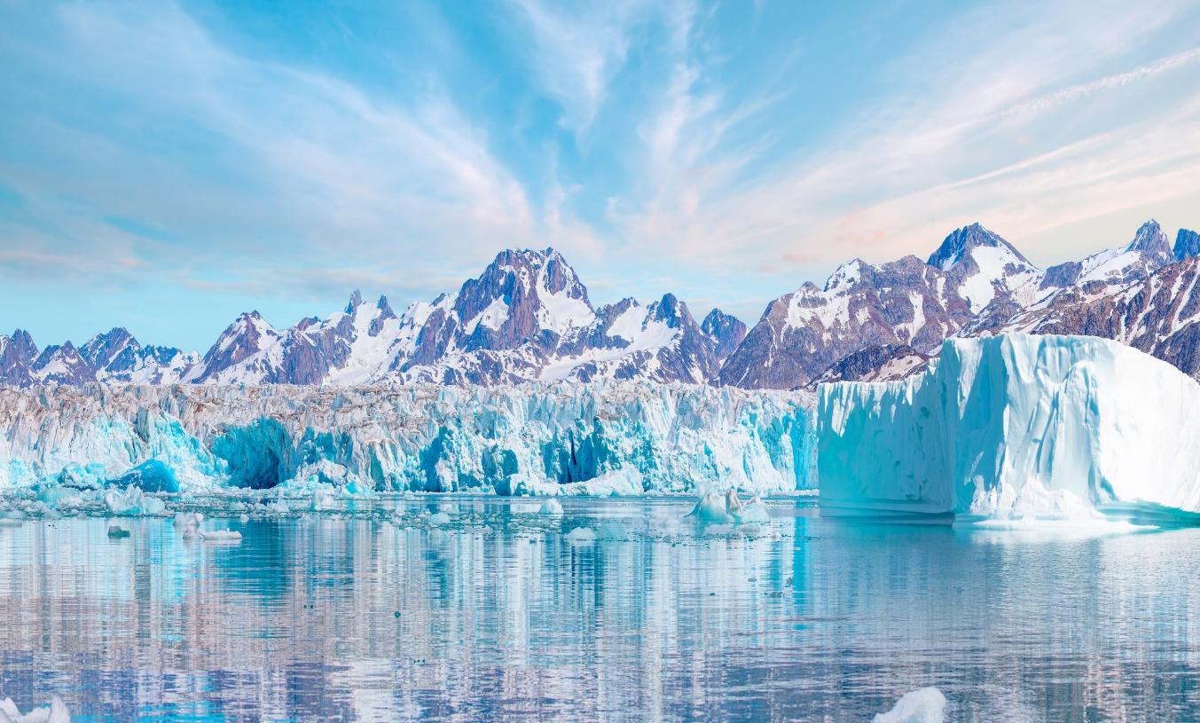
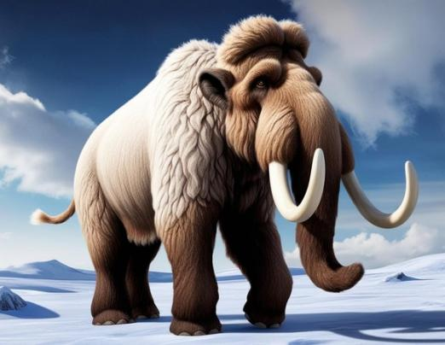
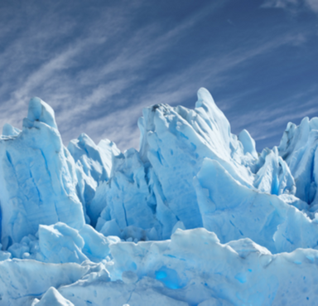
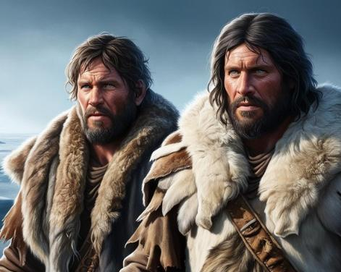

What Is the Ice Age?

Slide 8
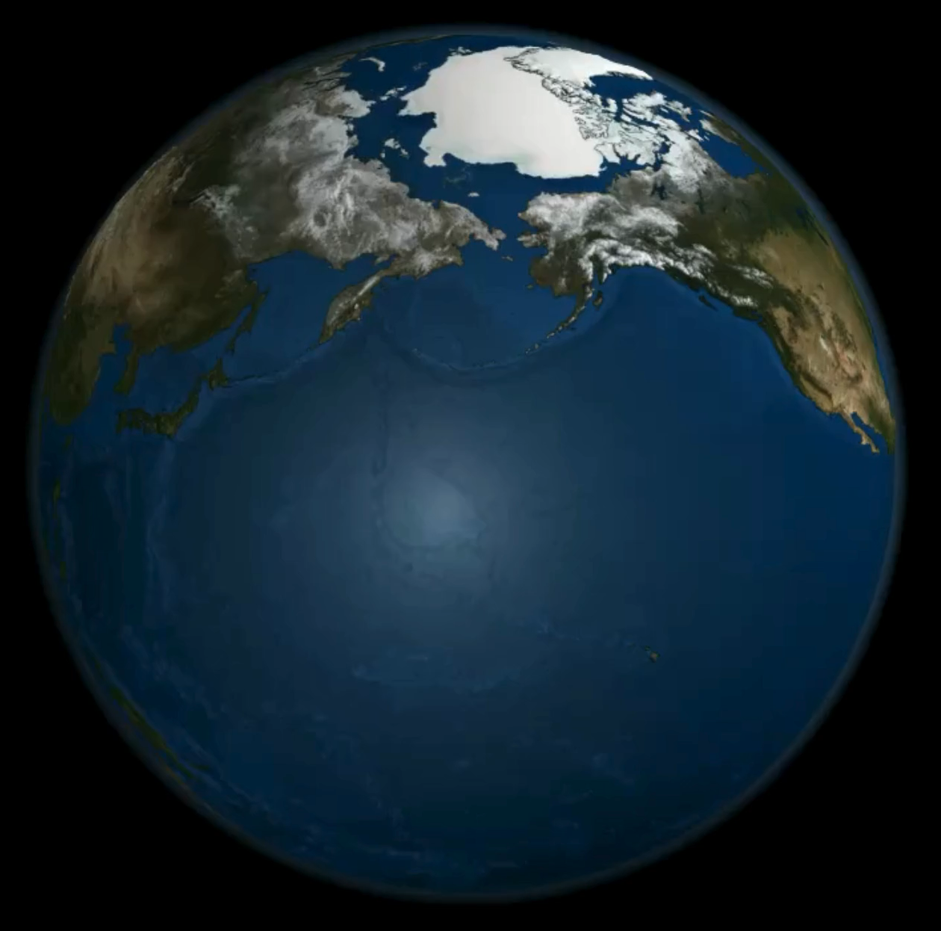

How Did the Ice Age Happen?

Slide 9

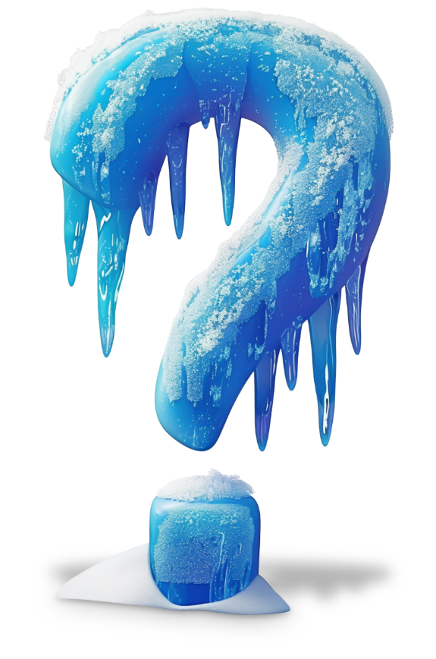
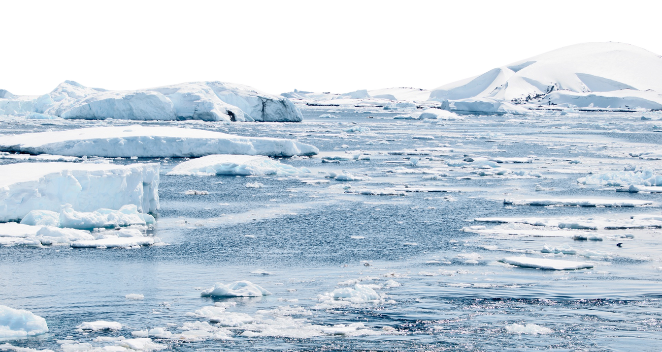
When Was the Last Ice Age?

Slide 10

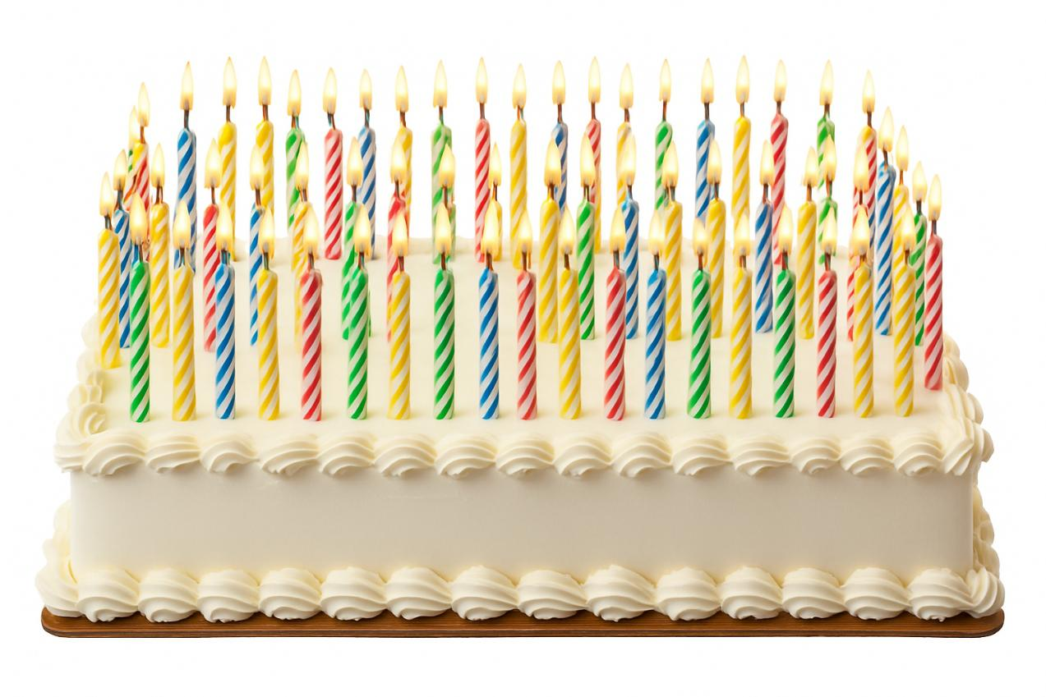
When Was the Last Ice Age?

Slide 11
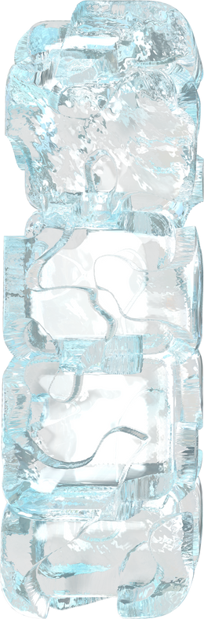
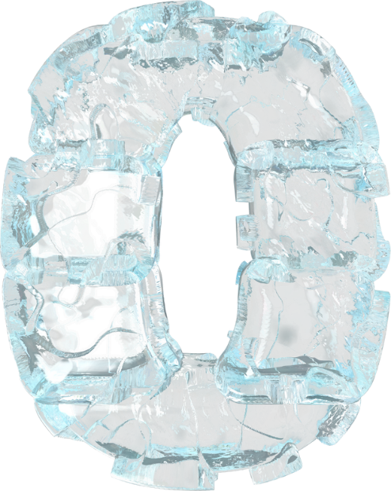
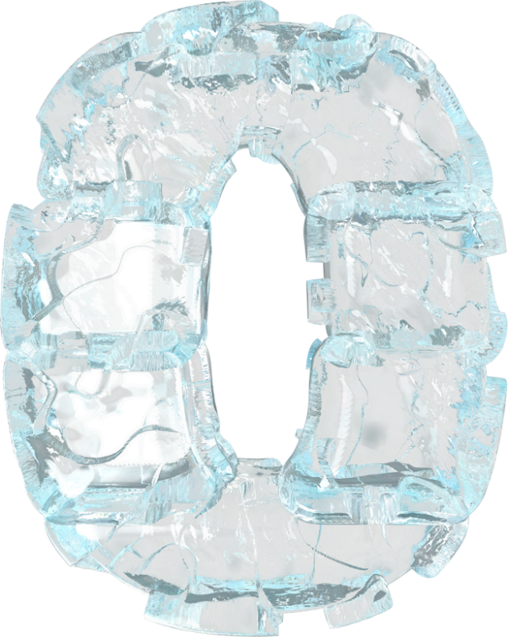














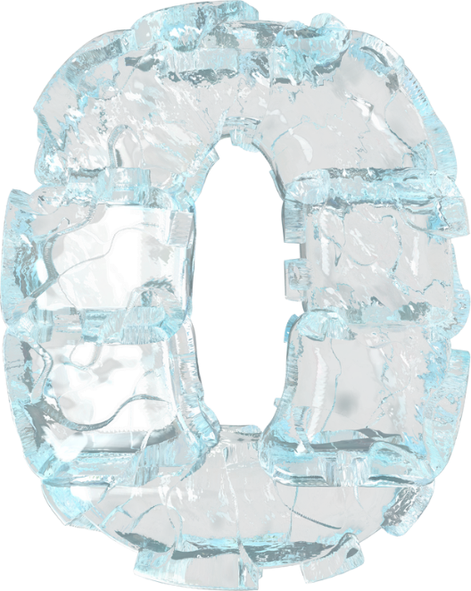
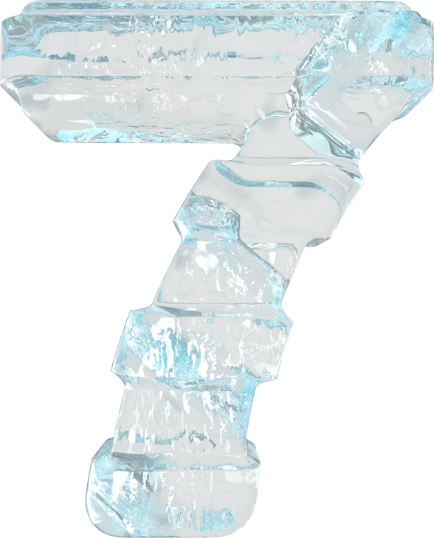
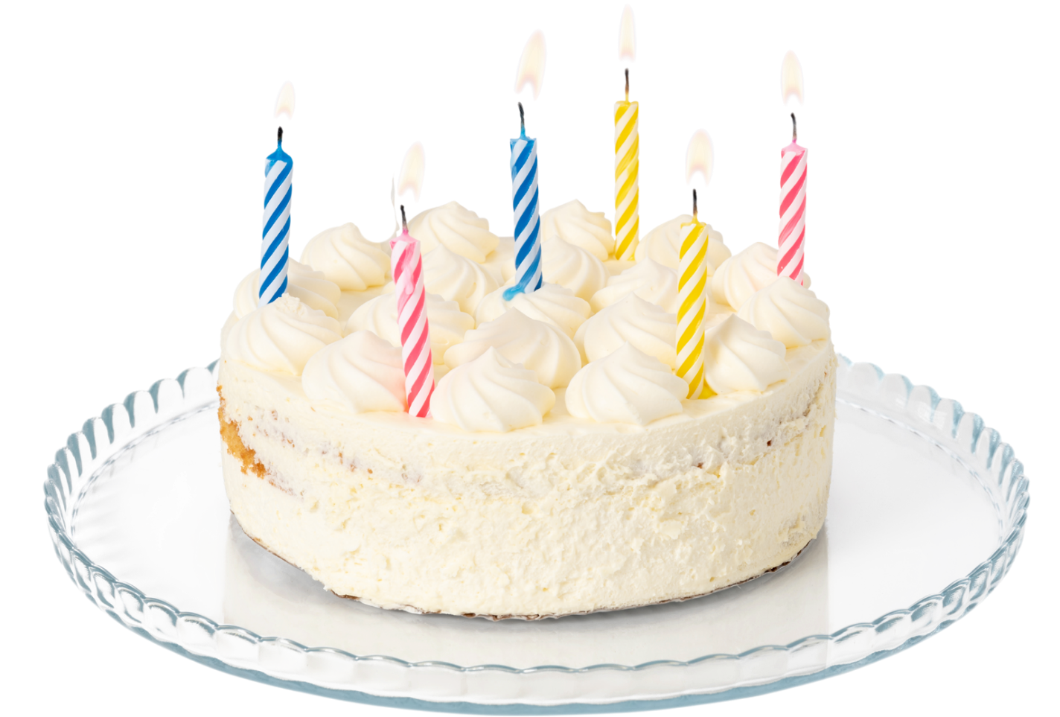
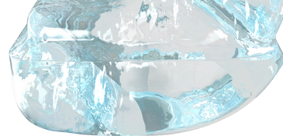
17,000 Years Ago
Notes:
This is what 100 candles looks like.
Click.
The Ice Age we’re learning about happened 17,000 years ago. If I wanted to show you 17,000 candles I would need to show you this many candles 170 times.

Slide 12

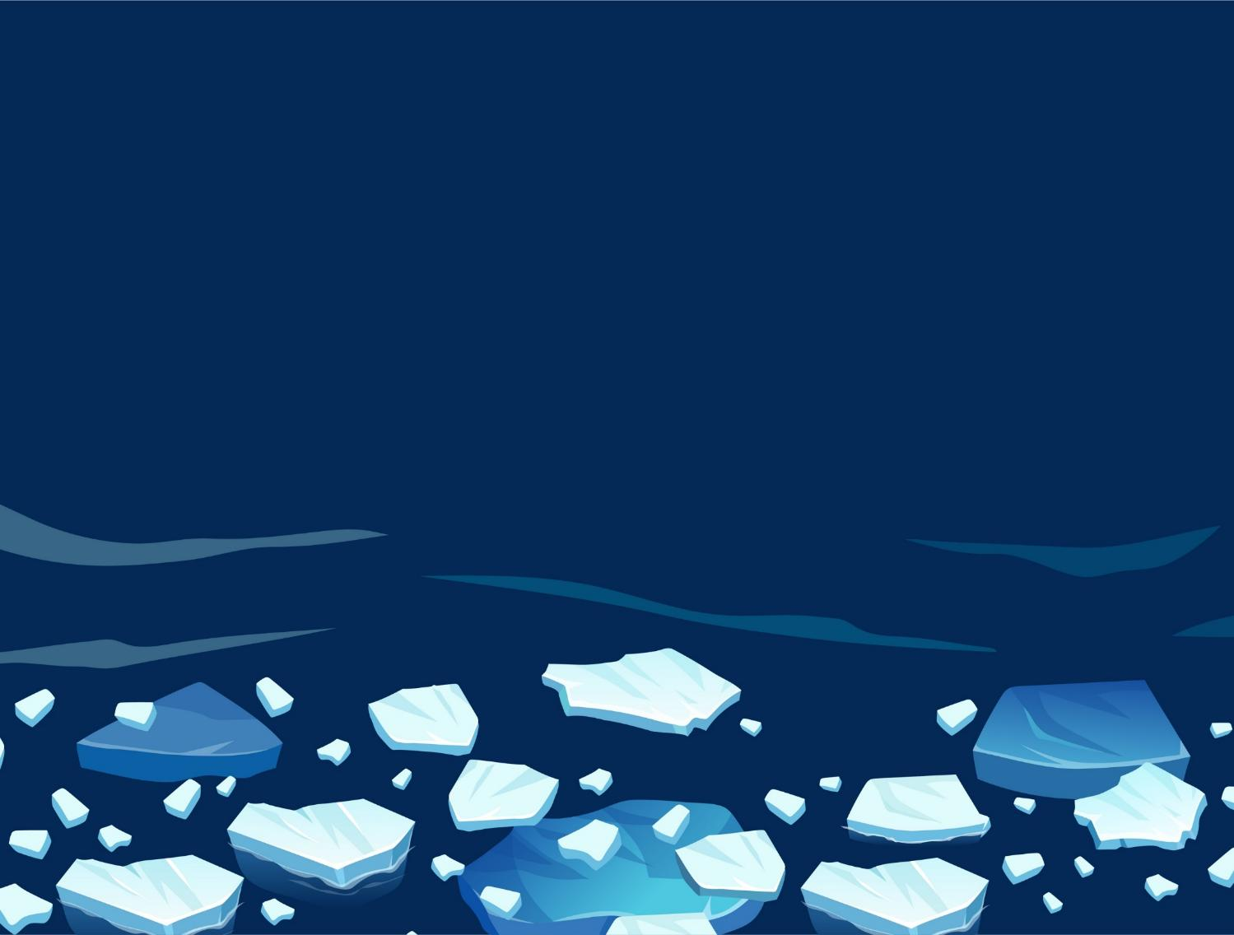
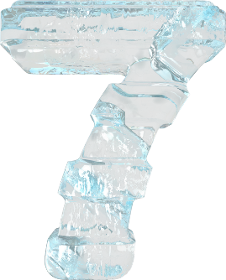

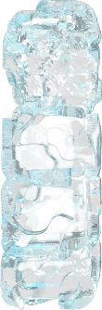

years ago

Slide 13


Show of Fingers
How long ago was the last Ice Age?
60 years ago.
17,000 years ago.

Slide 14




What 1/3 Looks Like
Earth
Where?
One-third covered
The Ice Age

Slide 15
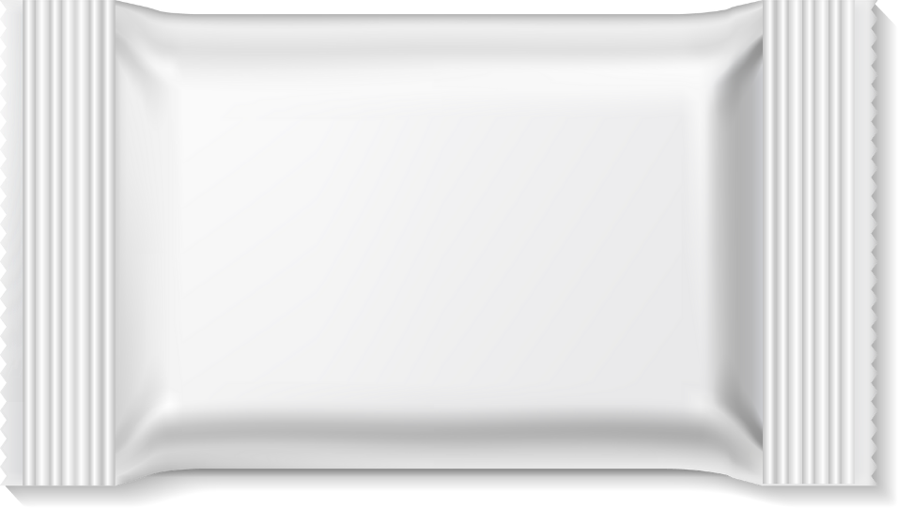



What 1/3 Looks Like
1/3

Slide 16
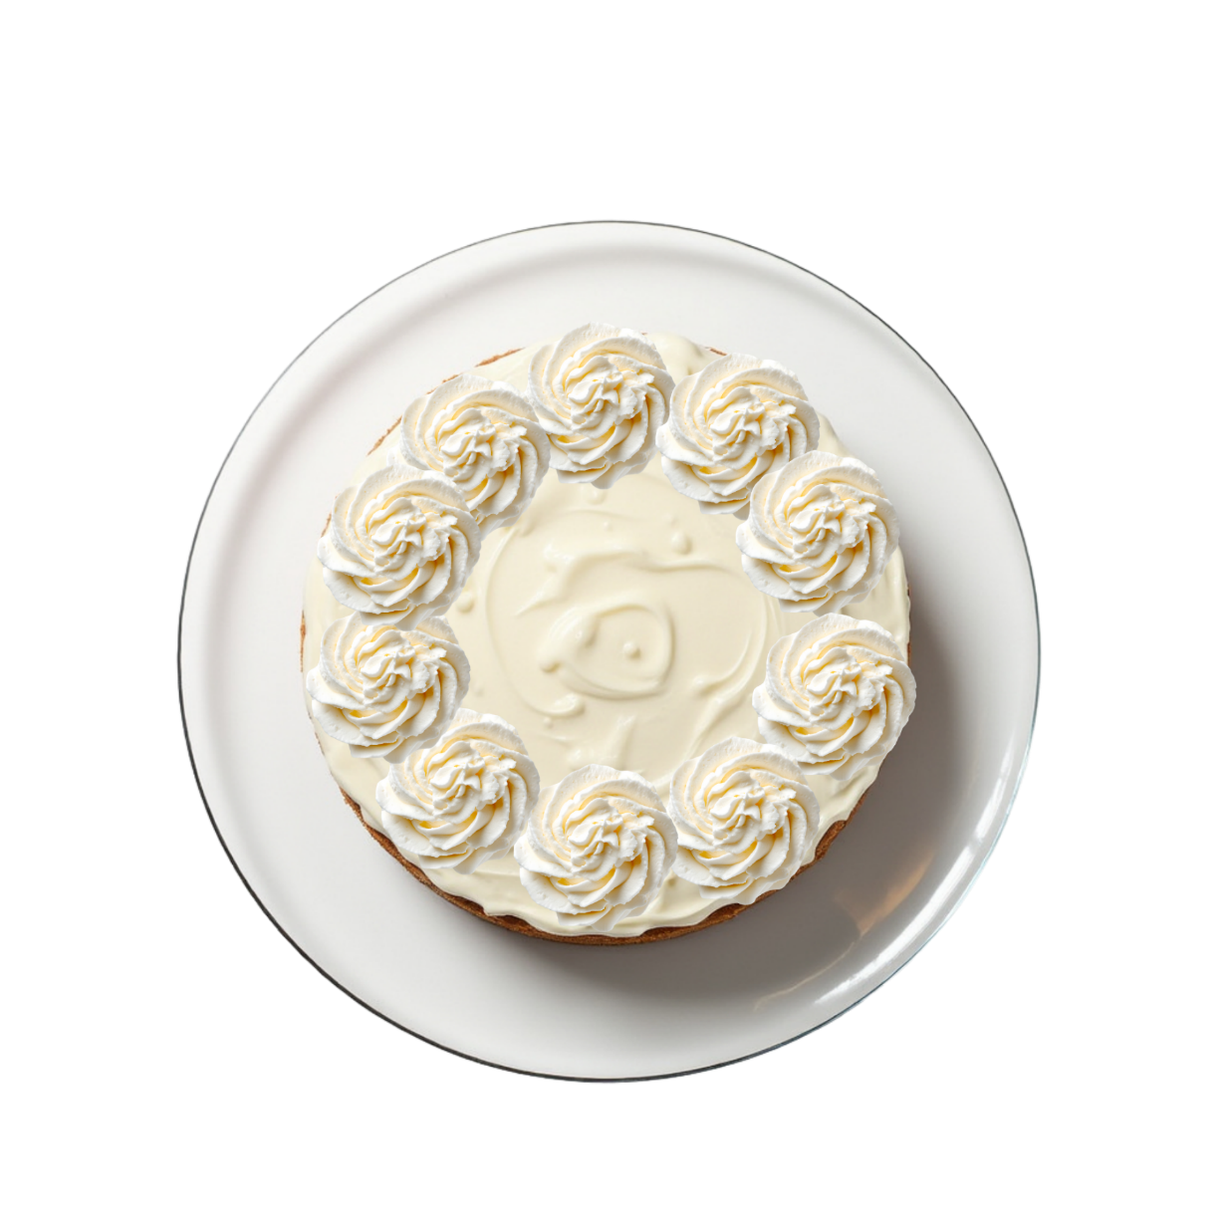
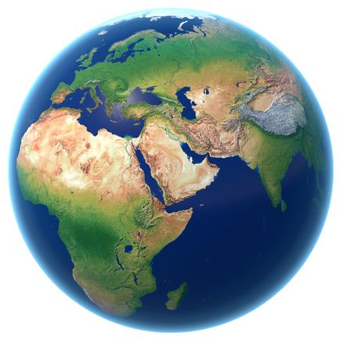
What 1/3 Looks Like

Slide 17
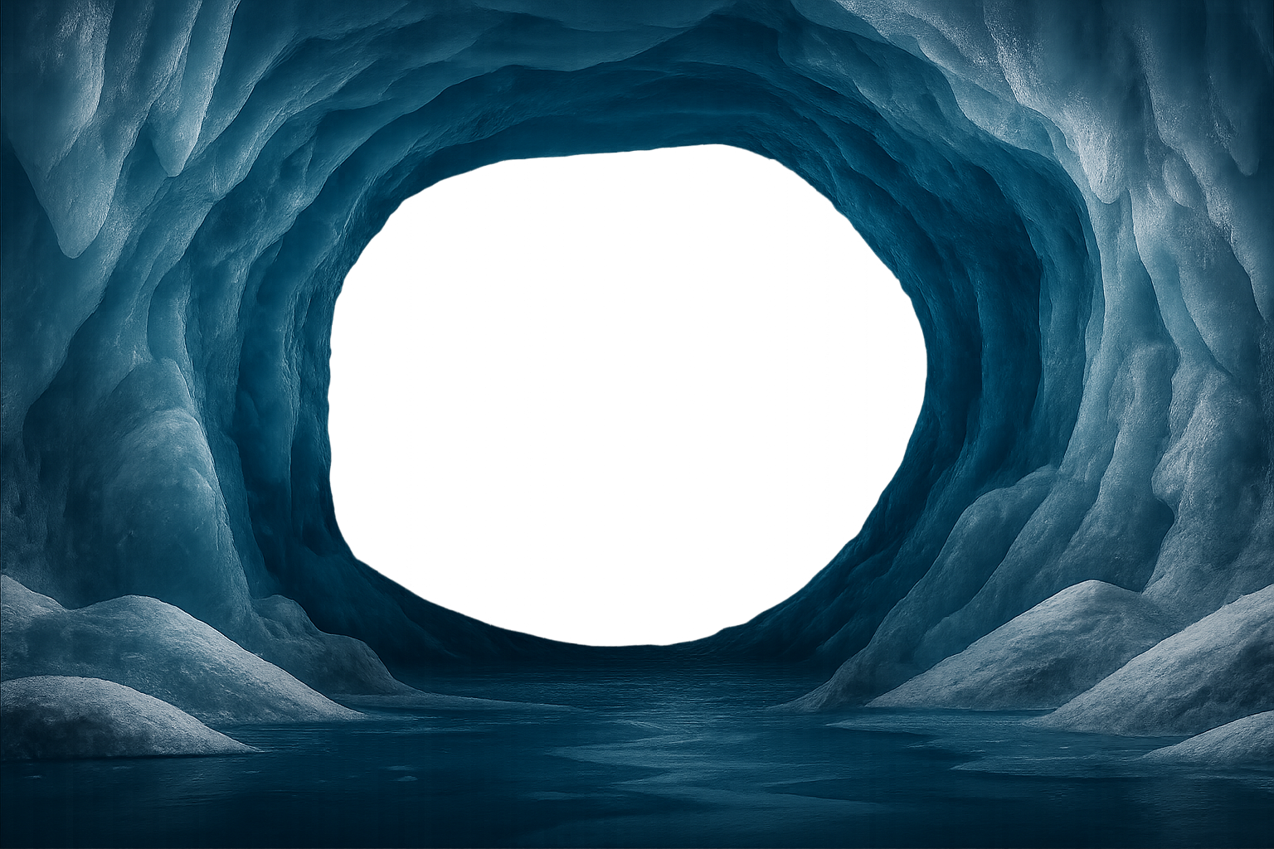
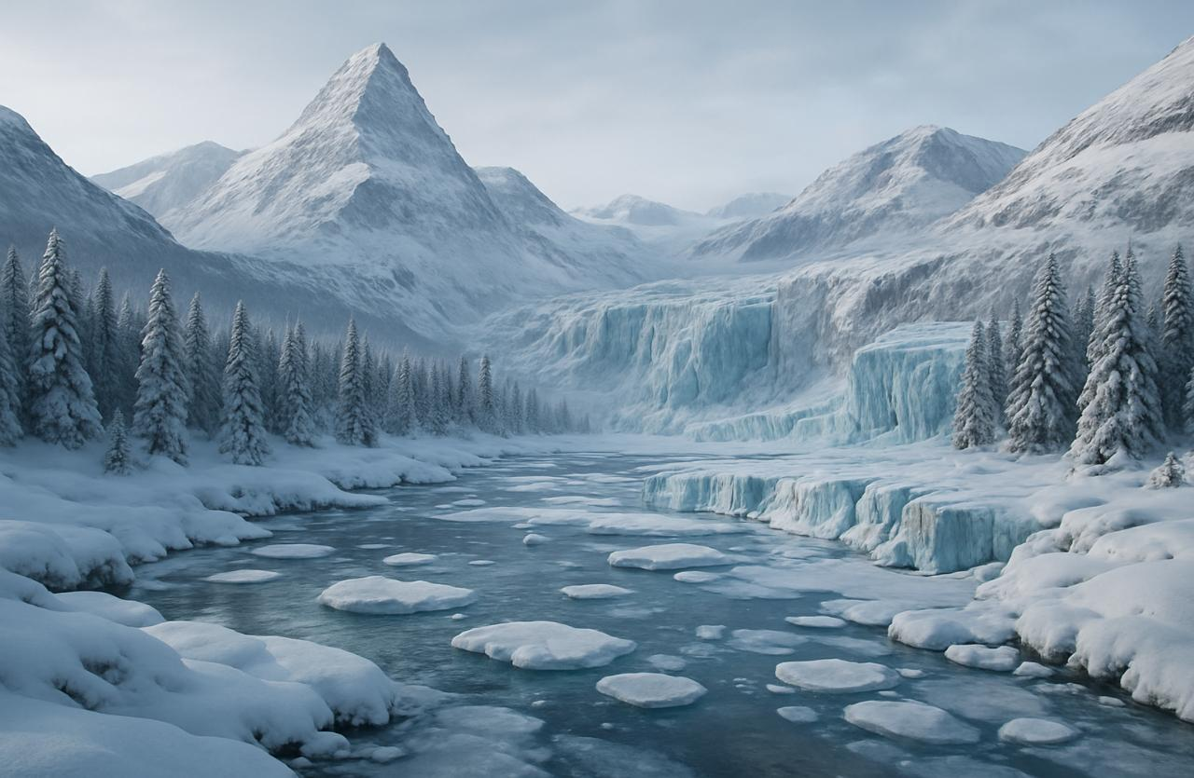
What Did the Ice Age Look Like?
Mountains
Glaciers
Forests
Thick Ice

Slide 18

360° view from inside a glacier
Notes:
https://artsandculture.google.com/story/explore-inside-a-glacier-in-360%CB%9A/GQXBQm8iQxjMiA?hl=en

Slide 19
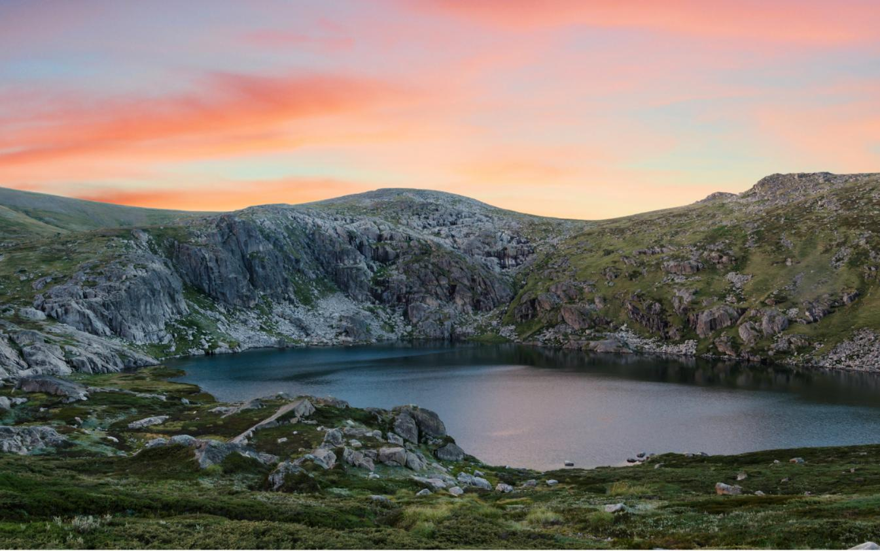
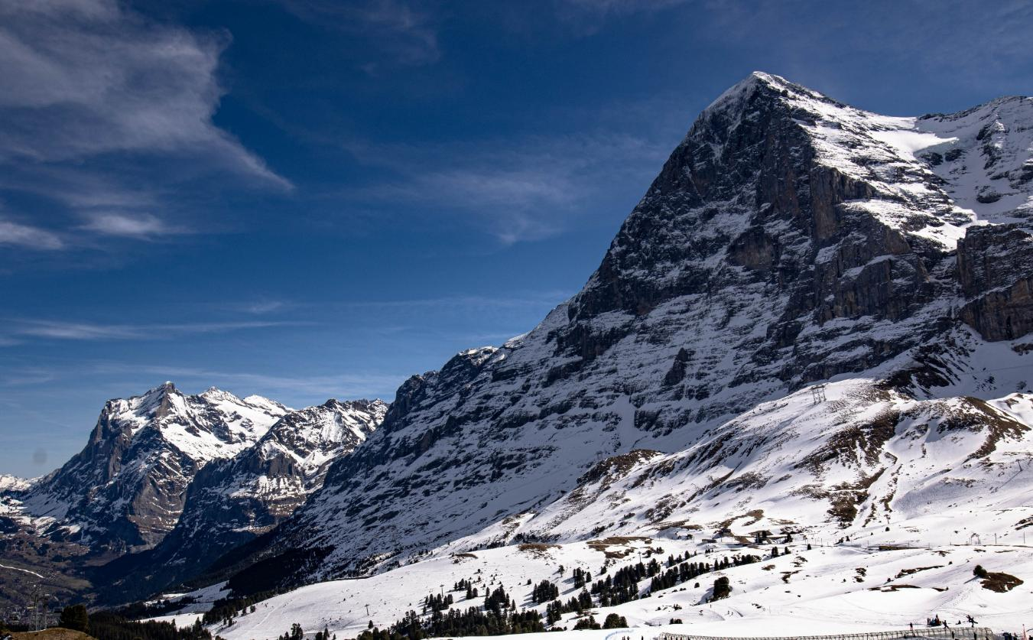







A Long Time Ago

Slide 20
Show of Fingers
A _______ is a huge, slow-moving sheet of ice that can shape the land.
glacier
mountain

Slide 21
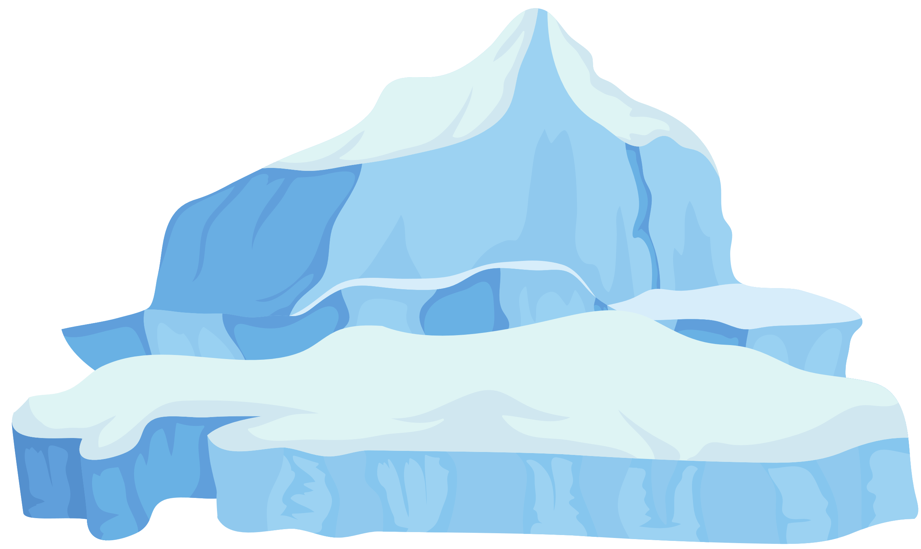


I Do: Show What I Know
6th birthday = 6 Years
Earth
Many different ice ages
Where?
When?
Last Ice Age ended
One-third covered
The Ice Age
years ago
glacier
Long winter
Sheets of ice formed
What?
How?
Very cold temperatures
Warm to cold

Slide 22
The Ice Age Mind Map
6th birthday = 6 Years
Earth
Many different ice ages
Where?
When?
Last Ice Age ended
One-third covered
The Ice Age
years ago
glacier
Long winter
Sheets of ice formed
What?
How?
Very cold temperatures
Warm to cold

Slide 23
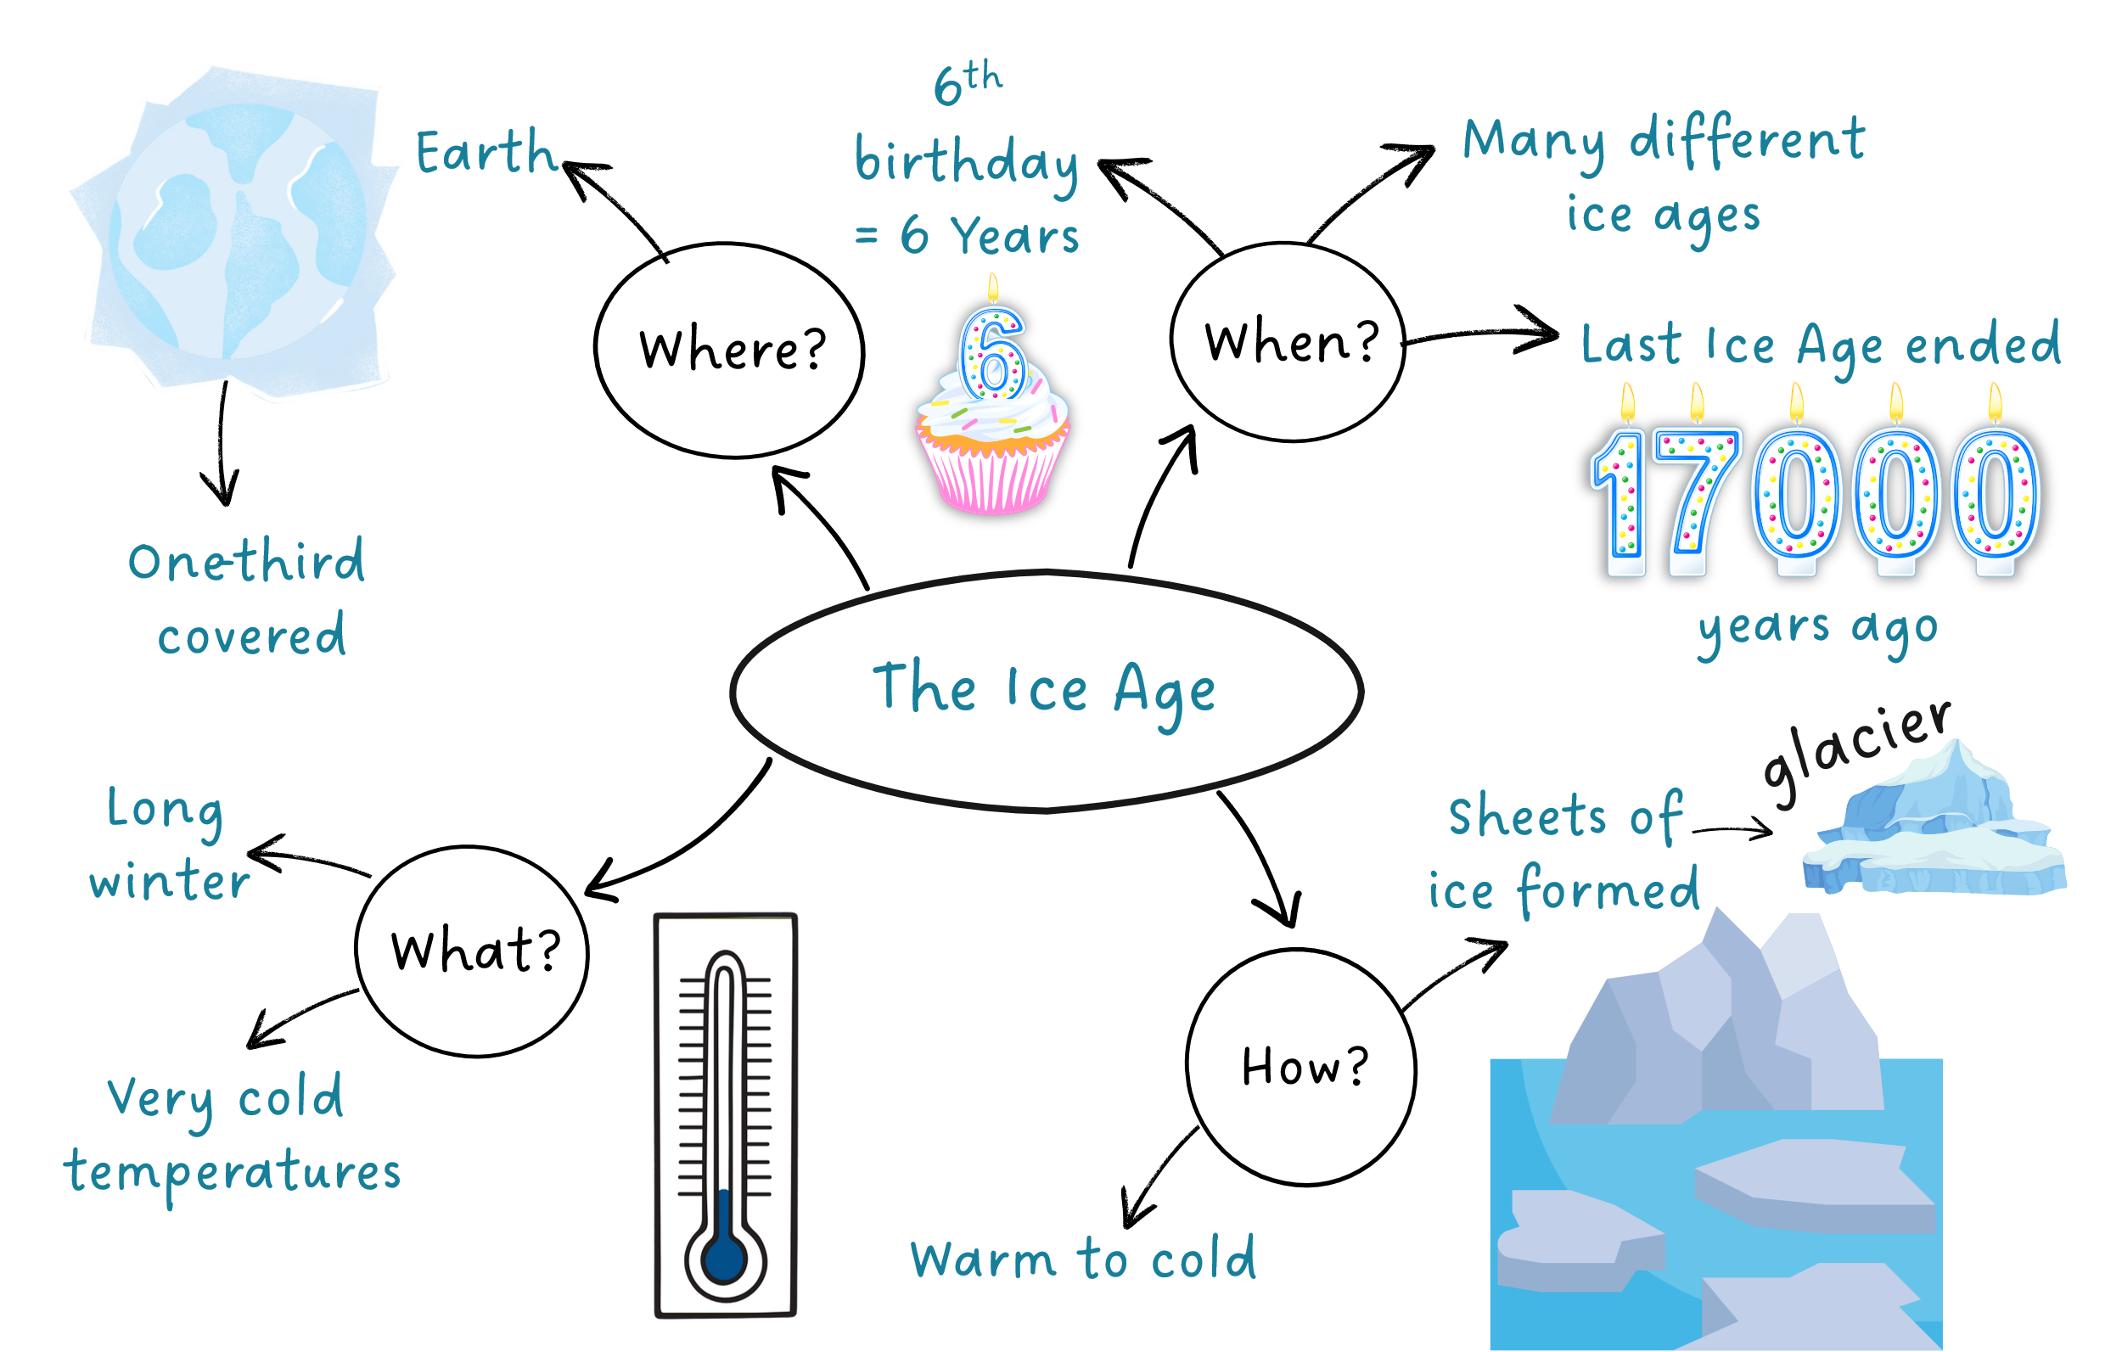
Show What You Know

Slide 24
The Ice Age ended 17,000 years ago.
During the Ice Age, 1/3 of the Earth was covered in glaciers.

Slide 25
winter
The Ice Age was like a long ______.
2. The Ice Age happened a ____ time ago.
A: short
B: long
C: tall
3. A moving sheet of ice is a g_____.
summer
winter
spring
long
lacier

Slide 26

In the next lesson, we will learn the purpose of informative writing.

Slide 27
Attributions
Slide 12 Video: Earth's Ice Ages by NASA/Goddard Space Flight Center Scientific Visualization Studio, from NASA SVS, is in the Public Domain.
Slide 16 Image: Blue Lake, Kosciuszko National Park by jaywoo, from Flickr, is licensed under CC BY-NC-ND 2.0.

