Slide 1
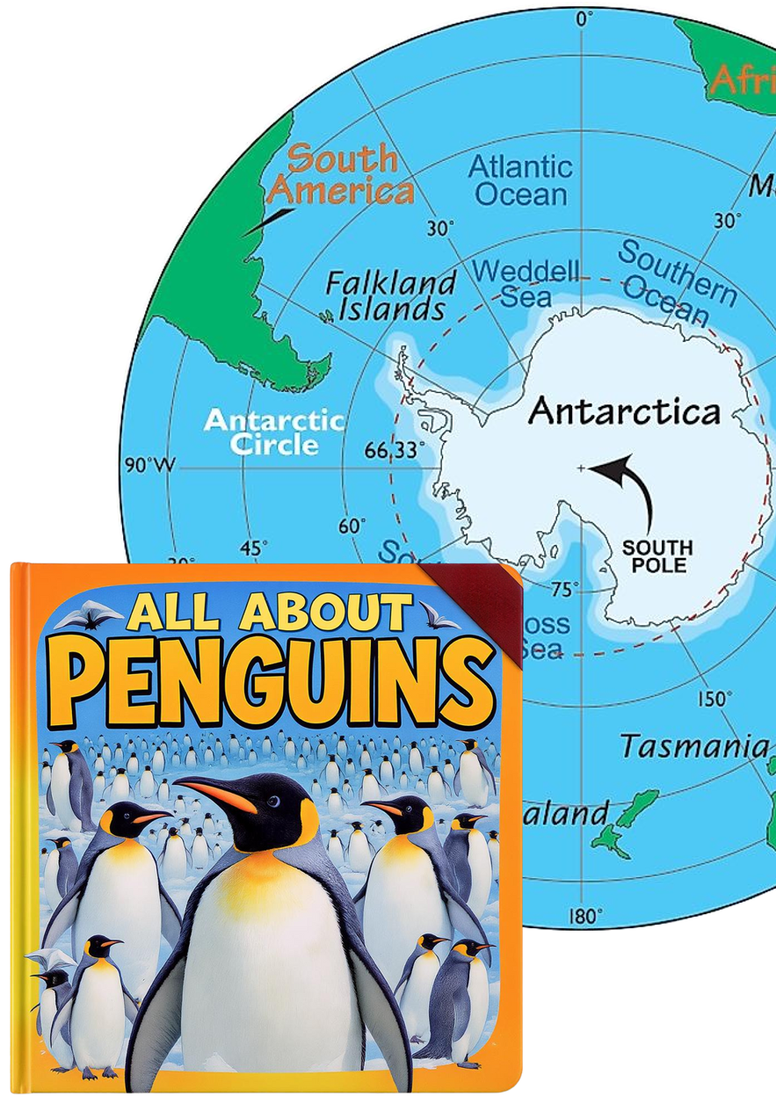
Writing
Unit 3: Informational/
History
Lesson 2: Informative Texts
Version 1

Slide 2
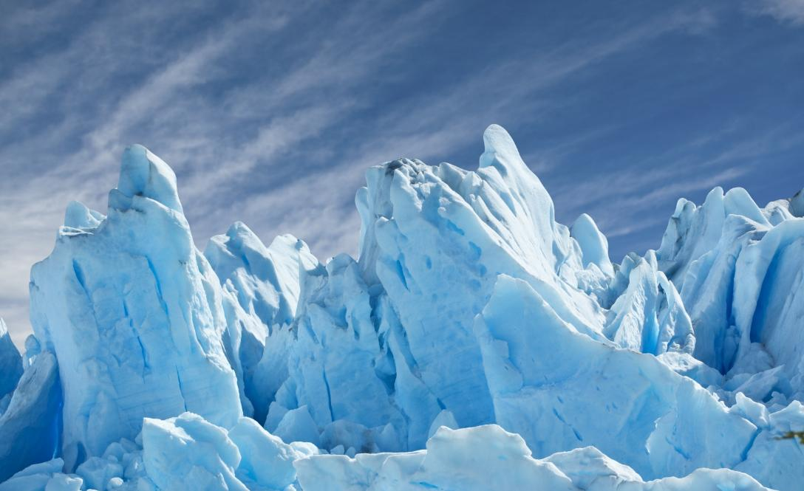
The Ice Age was like a long winter.

Slide 3
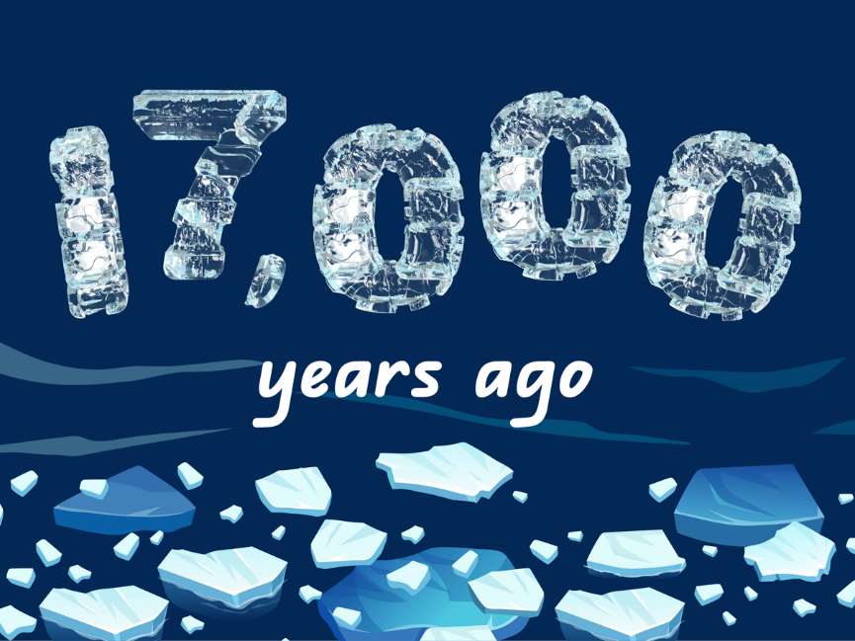
The Ice Age happened a long time ago.

Slide 4
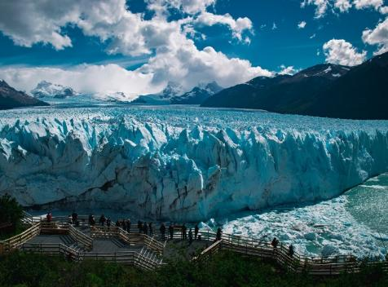
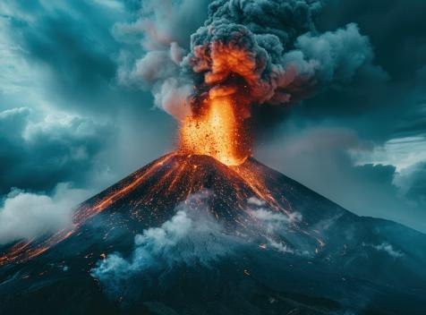


Which shows a glacier?

Slide 5

In this lesson, we will learn the purpose of informative writing.

Slide 6
You will be able to: ​
identify the purpose of informative writing.

Slide 7
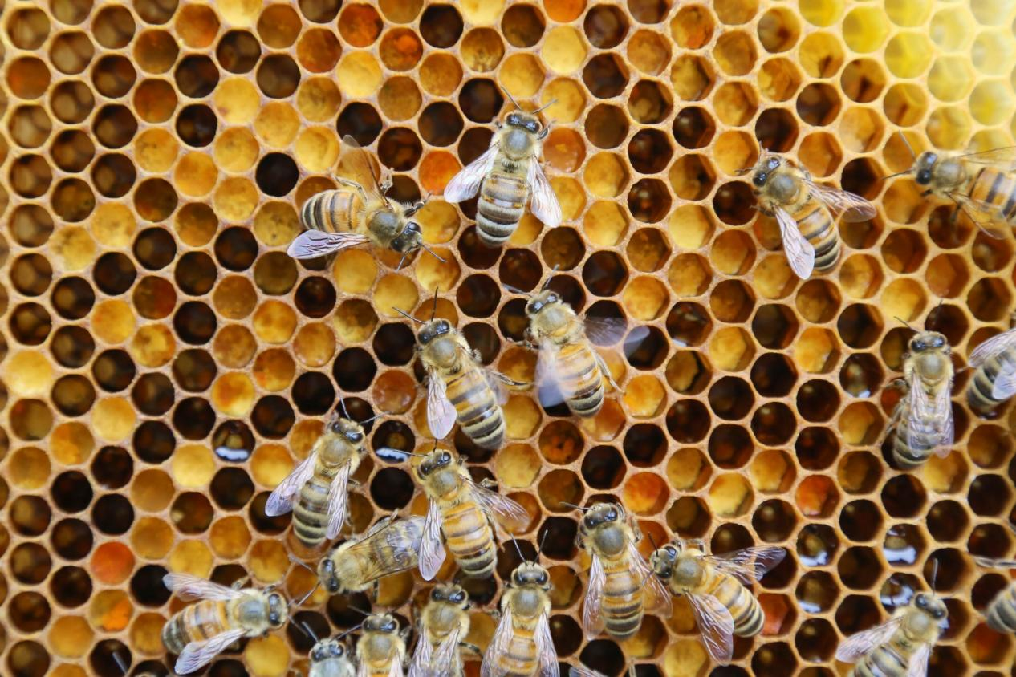
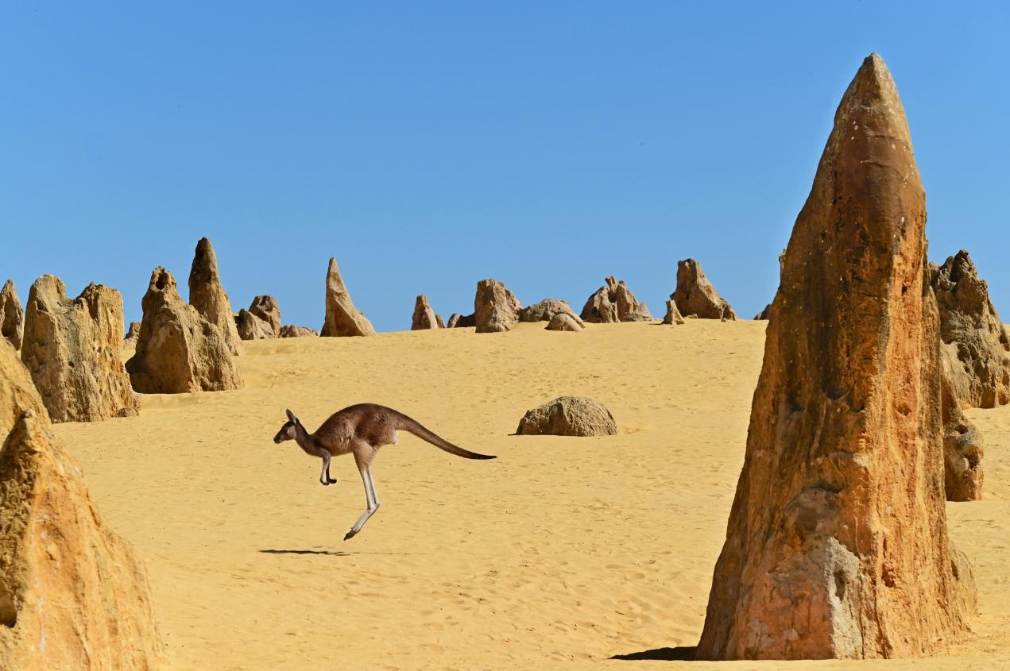
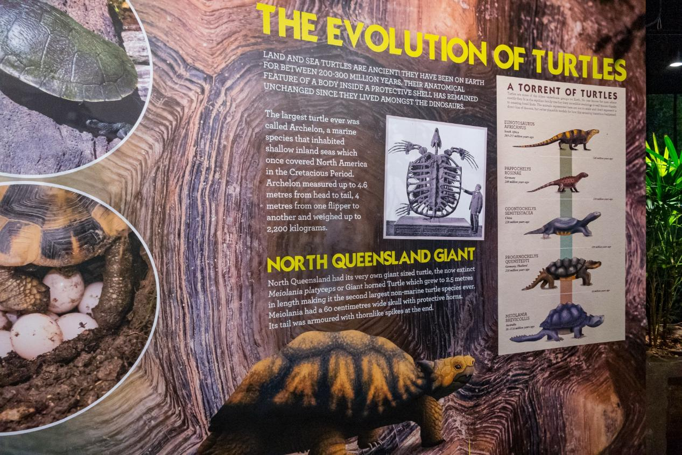

Slide 8
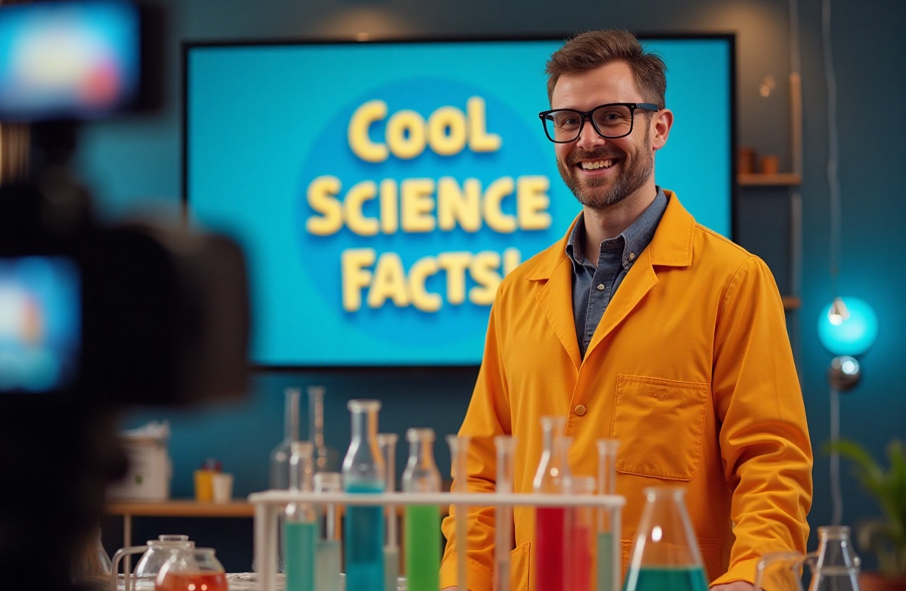
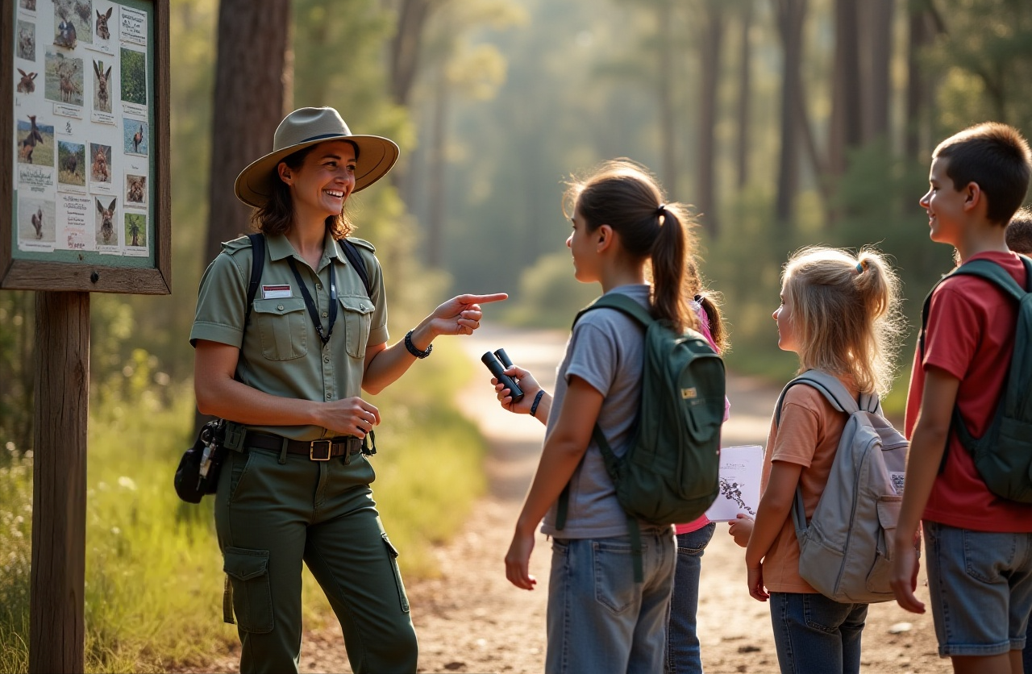

What’s Informative?

Slide 9



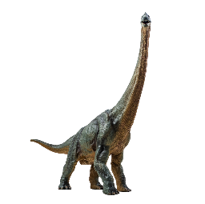


Being Informative

Slide 10
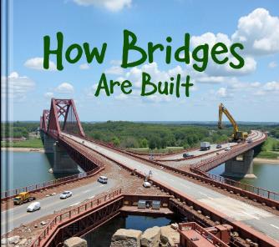


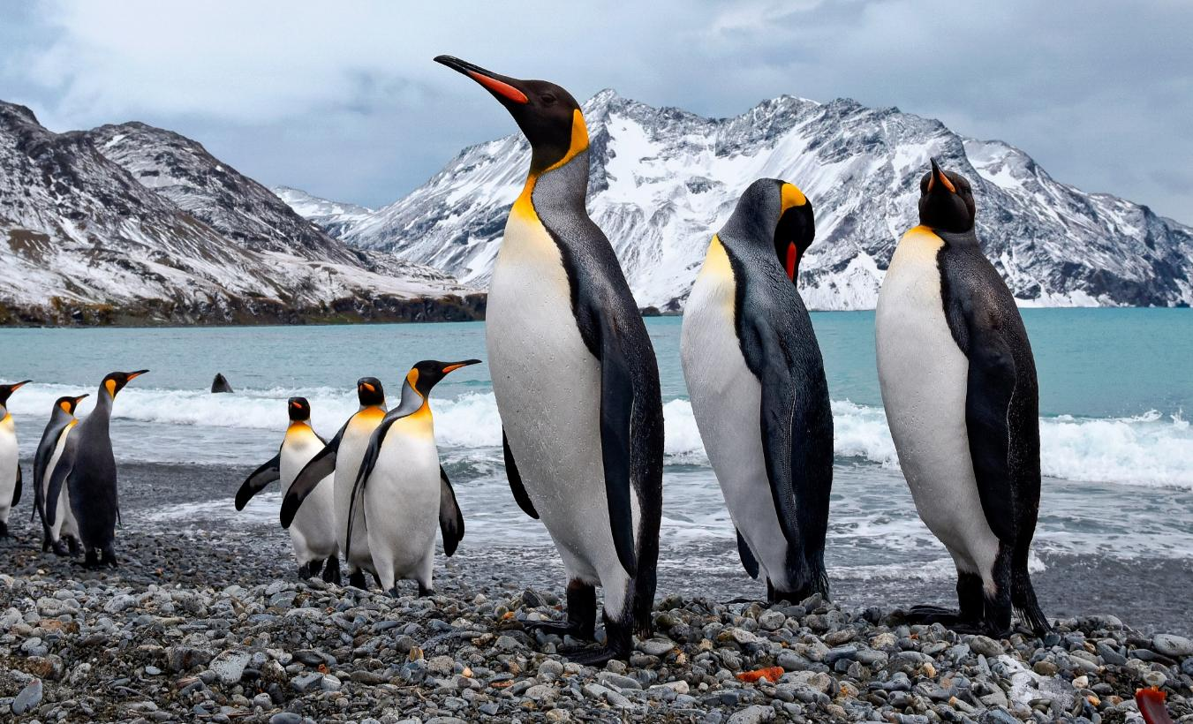

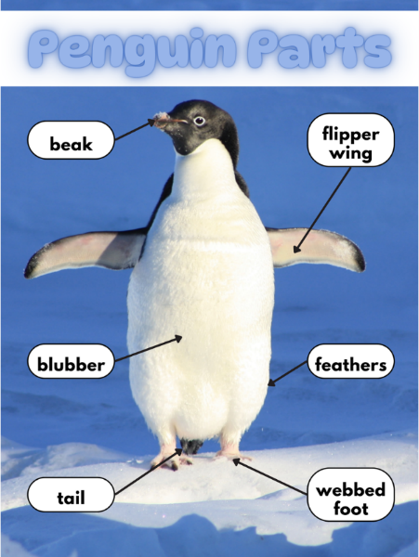
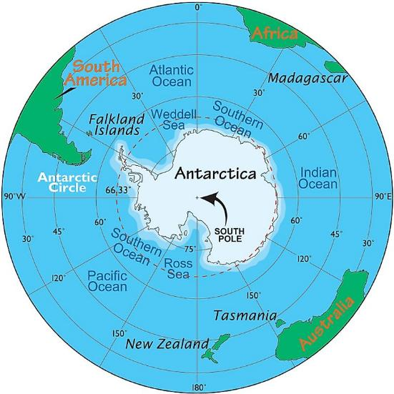



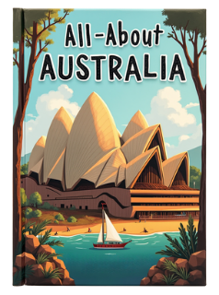
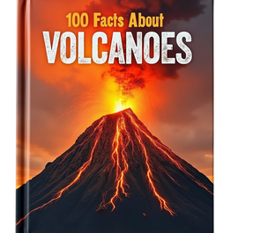
What’s Informative Text?

Slide 11



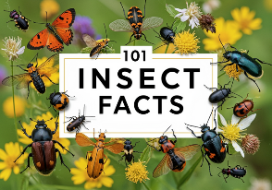



What’s the Purpose?

Slide 12
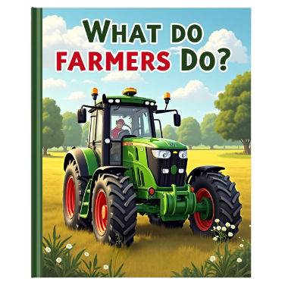



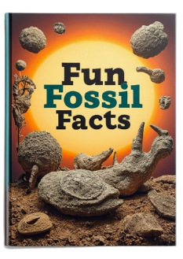
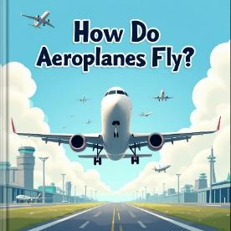

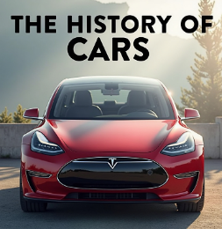
What’s the Purpose?

Slide 13



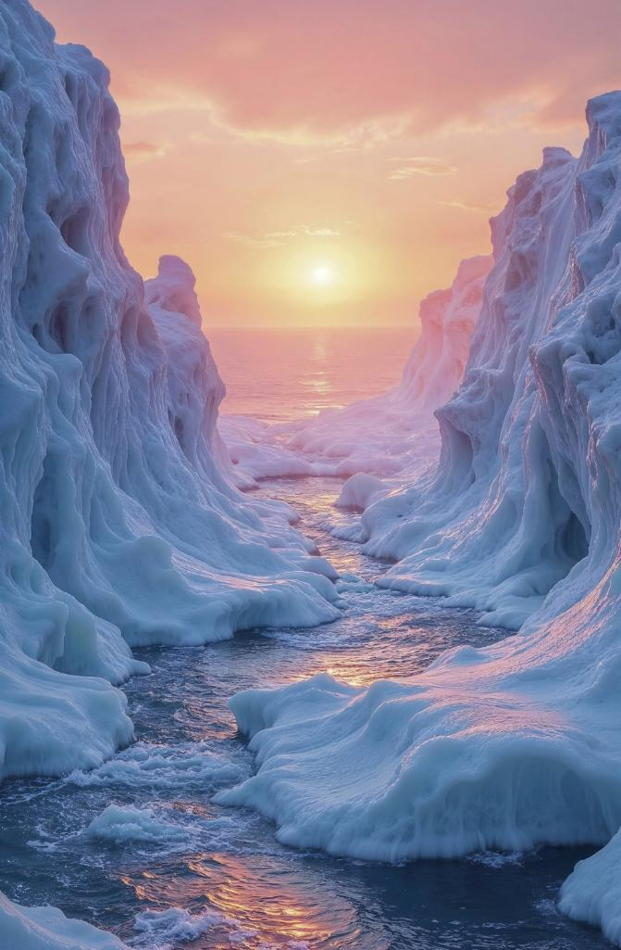


Slide 14

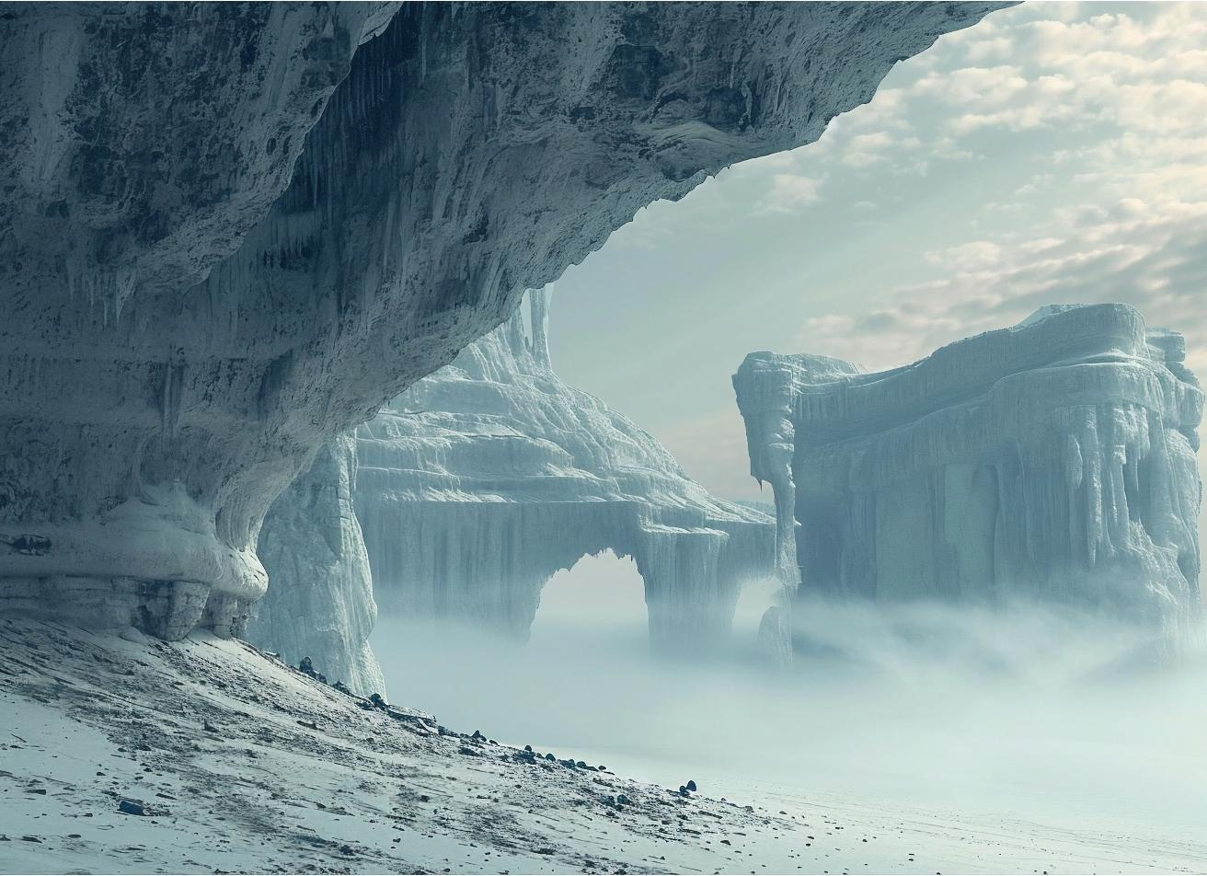
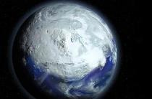

The largest Ice Age happened on one third of the Earth’s surface.
The Ice Age was a time when much of the Earth was covered in ice and snow.
The last Ice Age ended 17,000 years ago.

Slide 15
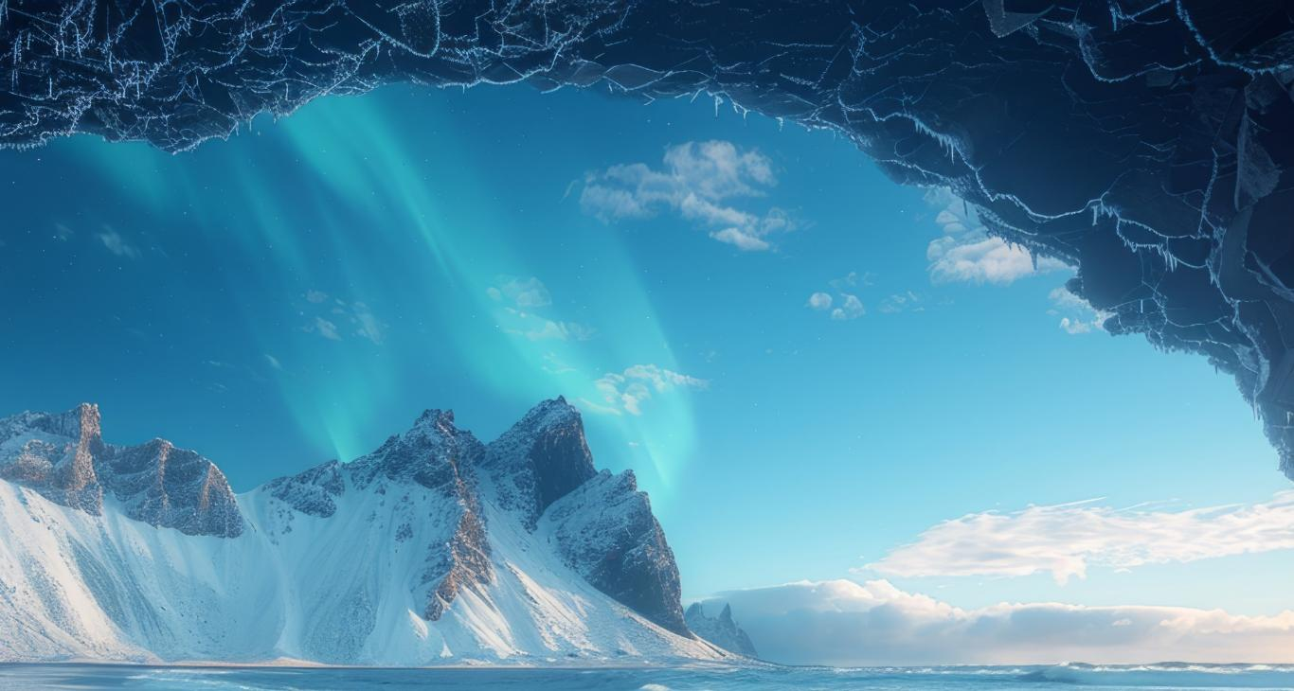
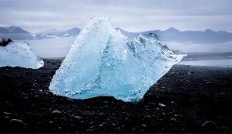
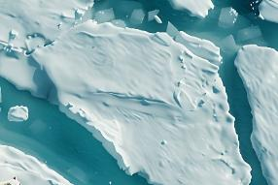
The weather during the Ice Age was very cold. It felt like a very, very long winter.
In the last Ice Age, the temperature was 7 degrees.

Slide 16
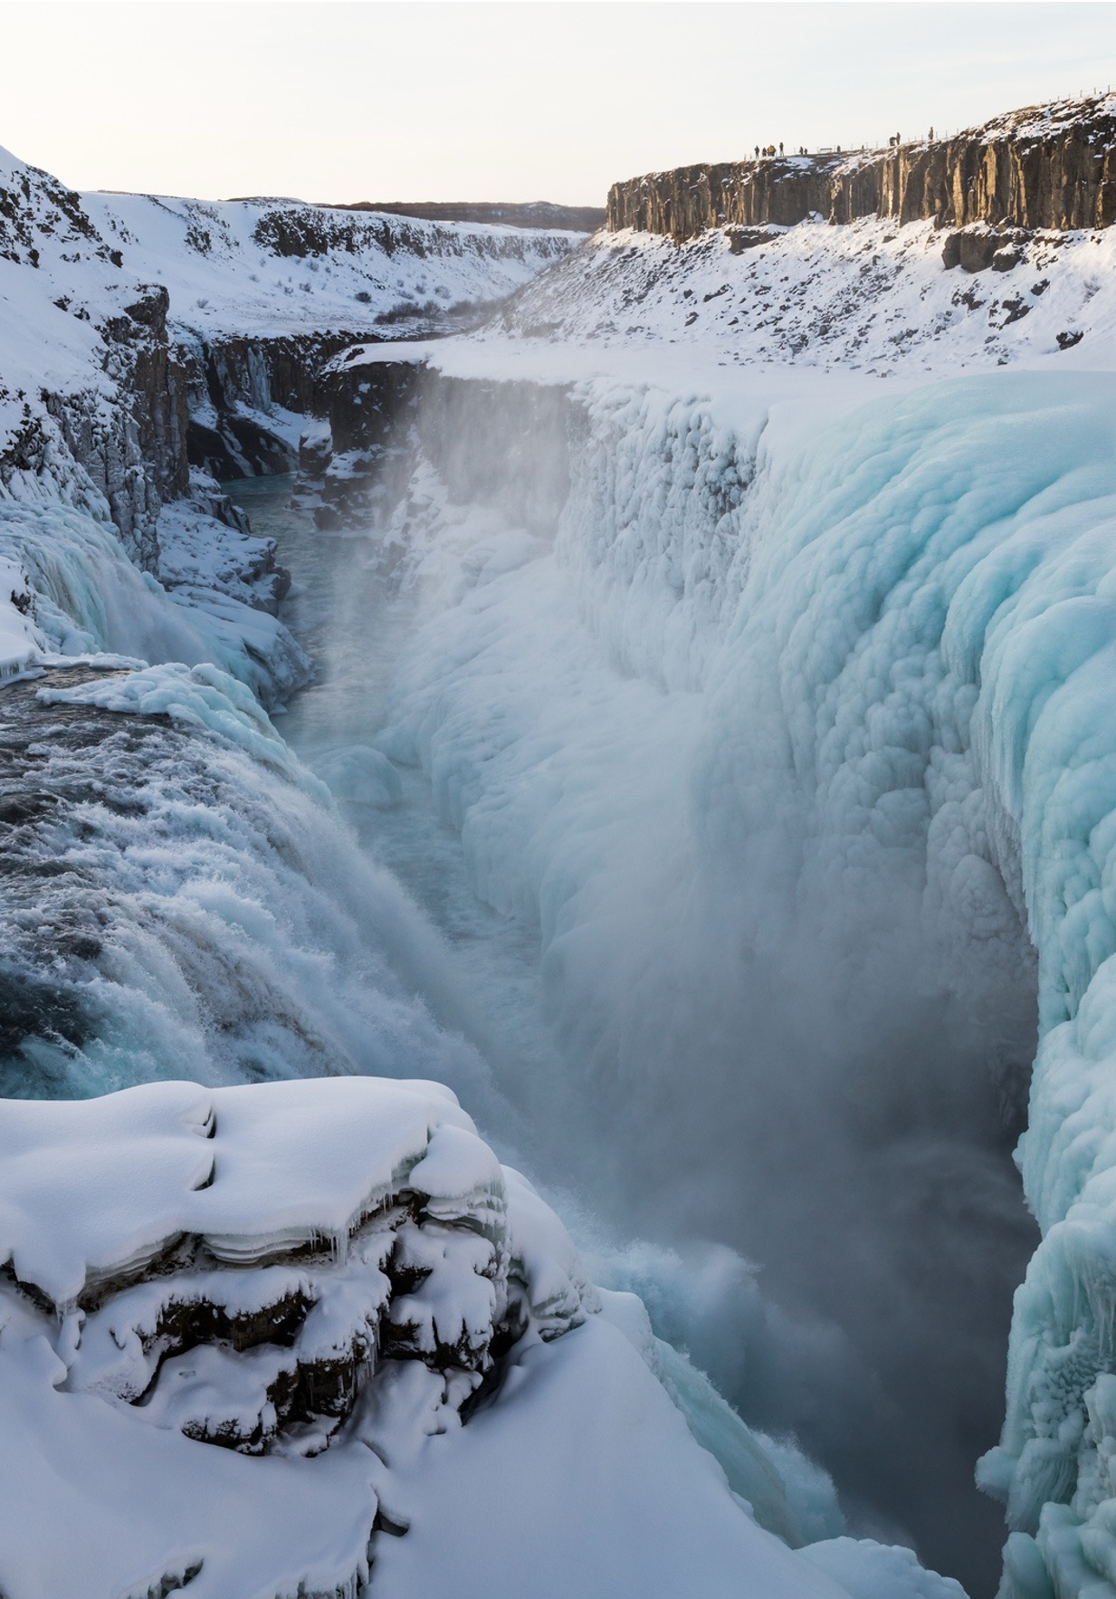
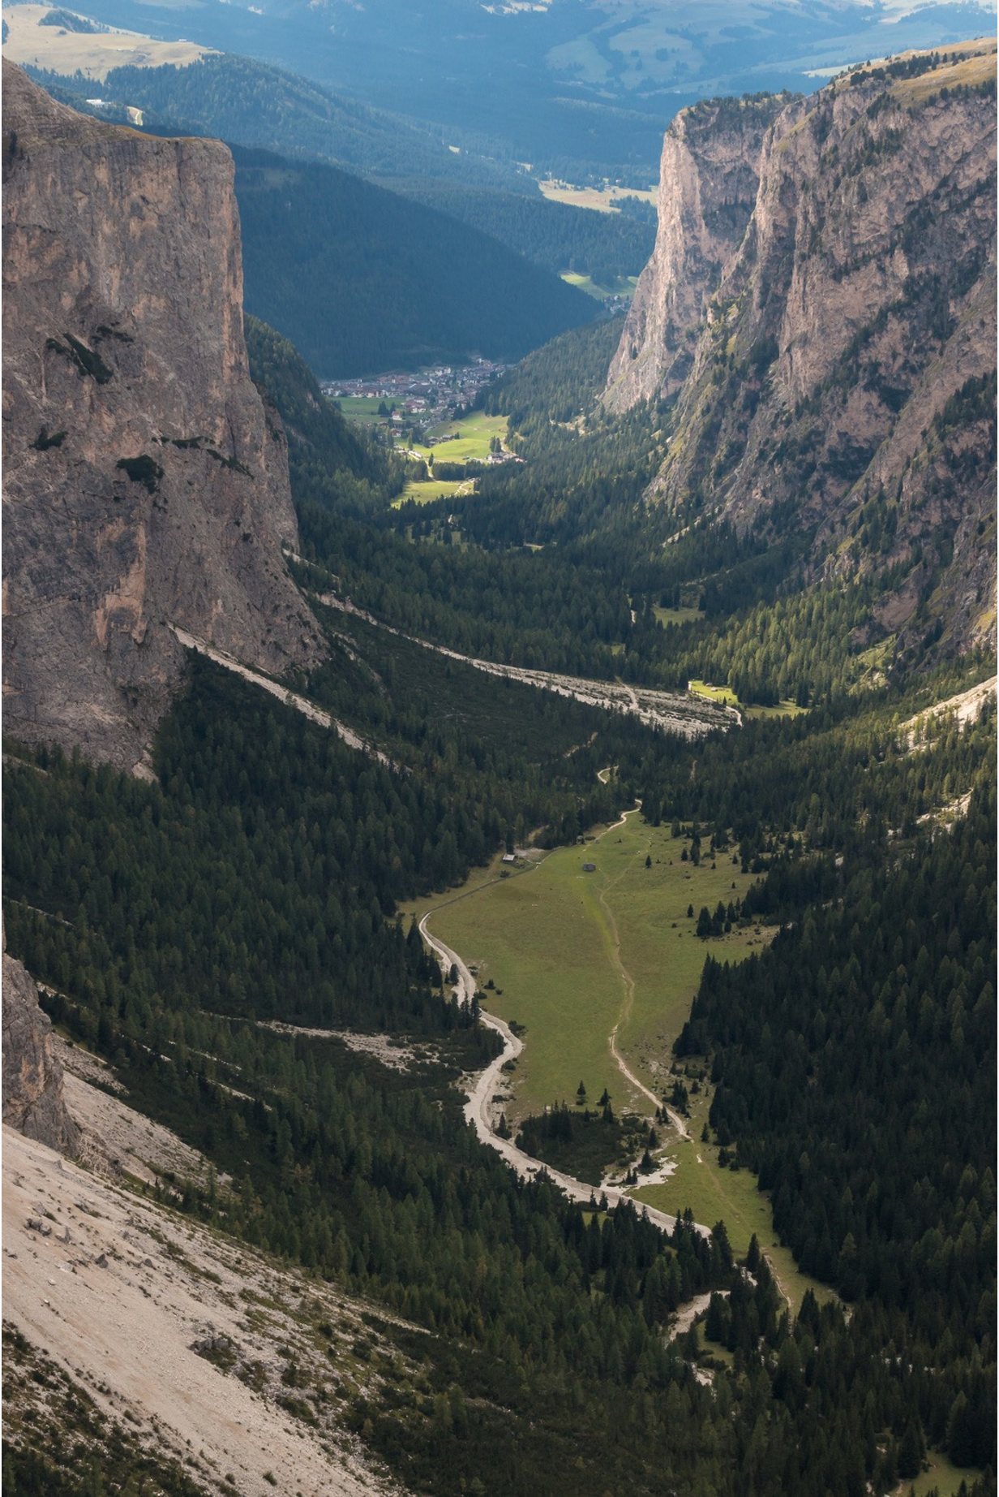
There were many different Ice Ages when the climate changed from warm to cold. Big sheets of ice, called glaciers, covered much of the Earth. As they moved, glaciers pushed soil and rocks, made valleys and left behind big rocks and lakes.

Slide 17

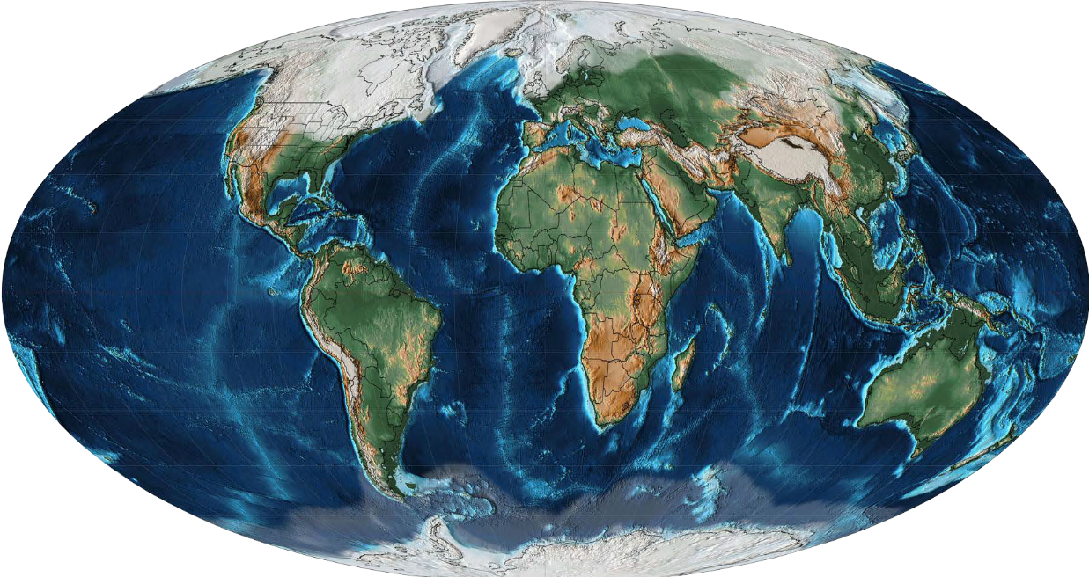
North America
Europe
Asia
The Earth looked very different during the Ice Age.
Big ice sheets covered parts of North America, Europe and Asia.

Slide 18
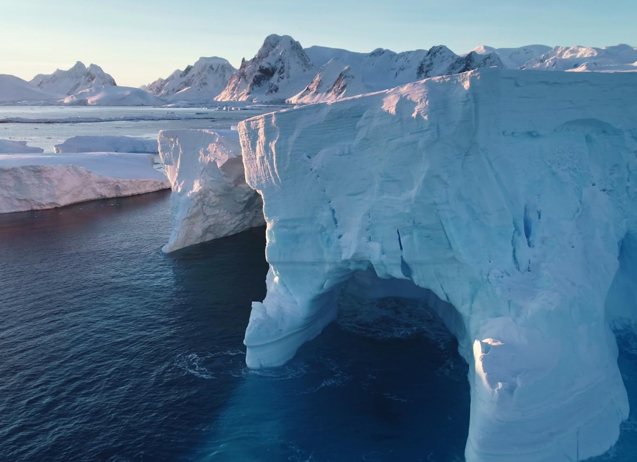
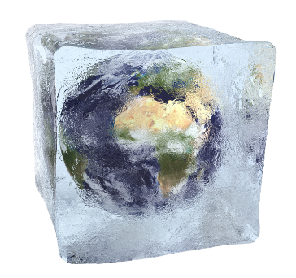
The Bibbulmun people of Australia tell stories from the past when the climate was much colder than it is today. These stories start with the phrase ‘In the nyitting times …,’ which means ‘In the icy cold times of long, long ago…’

Slide 19
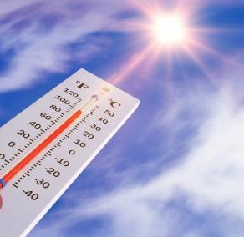
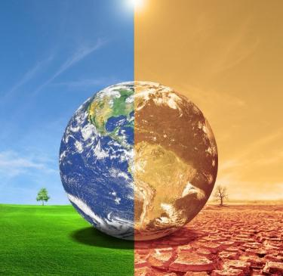

temperature – How hot or cold it is in a place.
climate – The kind of weather a place usually has.
glacier – A huge, slow-moving sheet of ice that can shape the land.

Slide 20
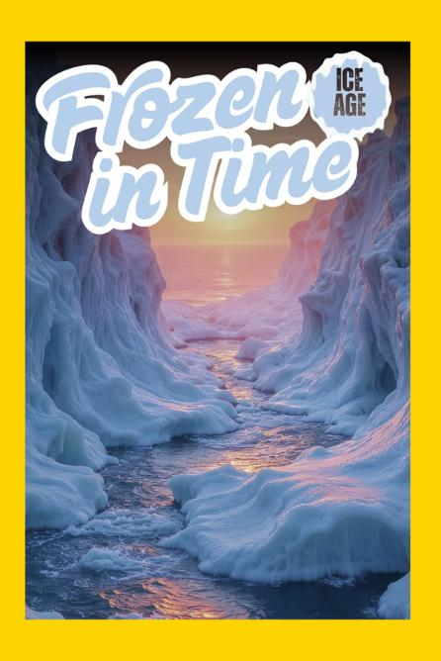


Purpose of Informative Text
Where?
When?
What?
How?

Slide 21
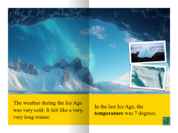



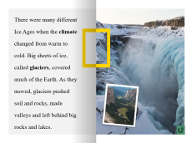

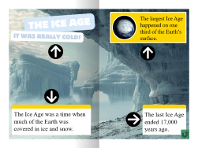
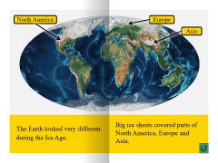
Purpose of Informative Text

Slide 22
The purpose of an informative text is to share information.
Informative texts have words and visuals called diagrams to share information.

Slide 23
learn
Informative texts help the reader _____.
2. The ___________________ can tell the purpose of an informative text.
A: title
B: cover images
C: title and cover images
3. Informative texts teach about r___ things.
forget
share
learn
title and cover images
eal

Slide 24
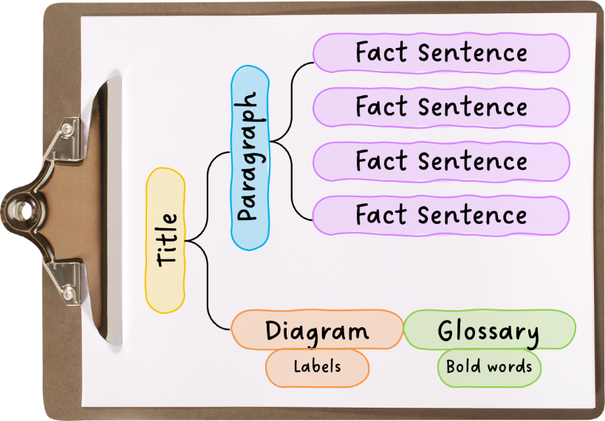
In the next lesson, we will learn the structure of informative texts.

Slide 25
Attributions
Slide 7 Photo: Australian Brush-turkey (Alectura lathami) by Steve Shattuck, via Flickr, licensed under CC BY 2.0.
Slide 17 Photo: ‘Mollweide Paleographic Map of Earth, 21 Ka (Late Pleistocene Age)’ by Fama Clamosa, available at Wikimedia Commons, is licensed under CC BY-SA 4.0.

