Slide 1
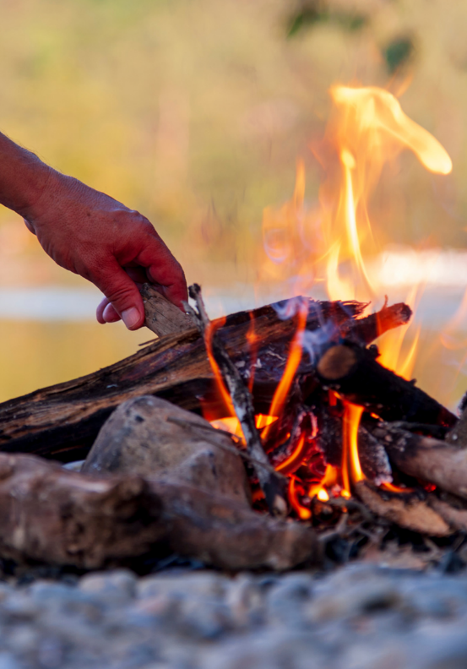
Writing
Unit 3: Informational/ History
Lesson 1: Discovery of Fire
Version 1

Slide 2
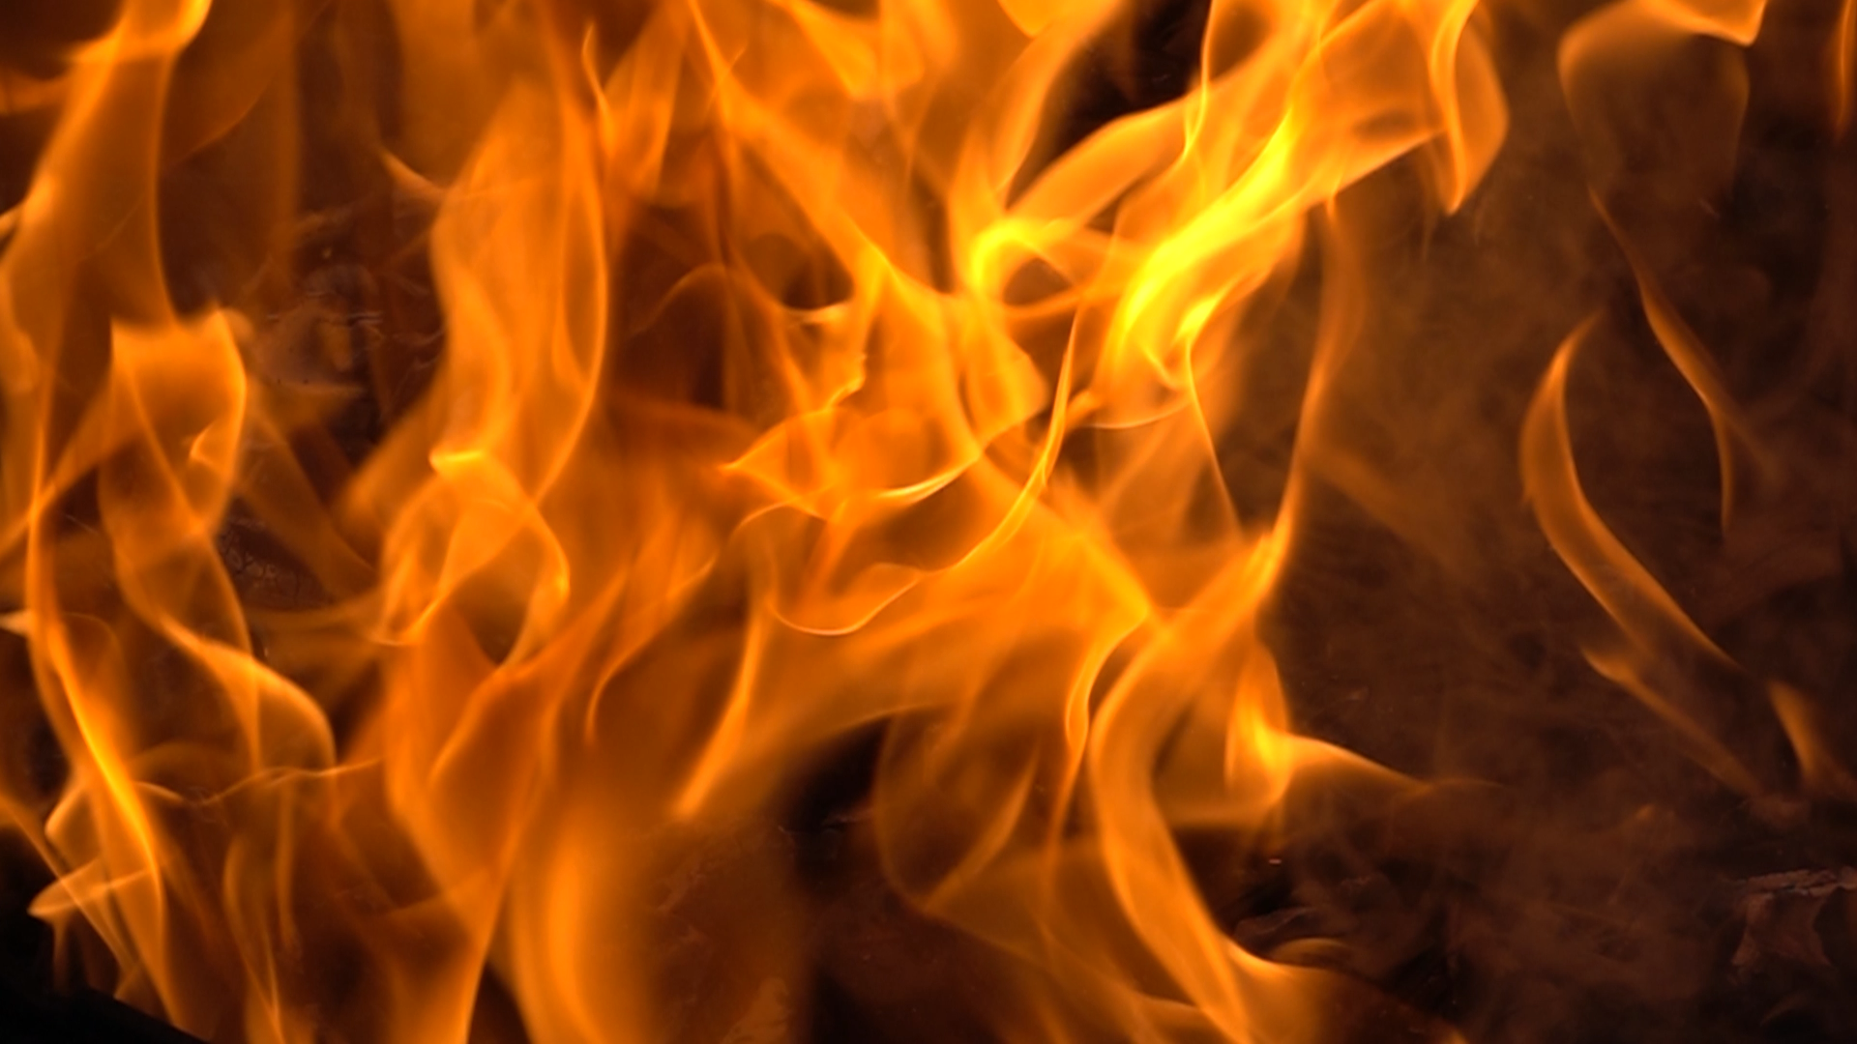




In this lesson, we will learn about the discovery of fire.

Slide 3
You will be able to: ​
understand why fire was an important discovery
understand how fire has changed
identify who discovered fire.

Slide 4
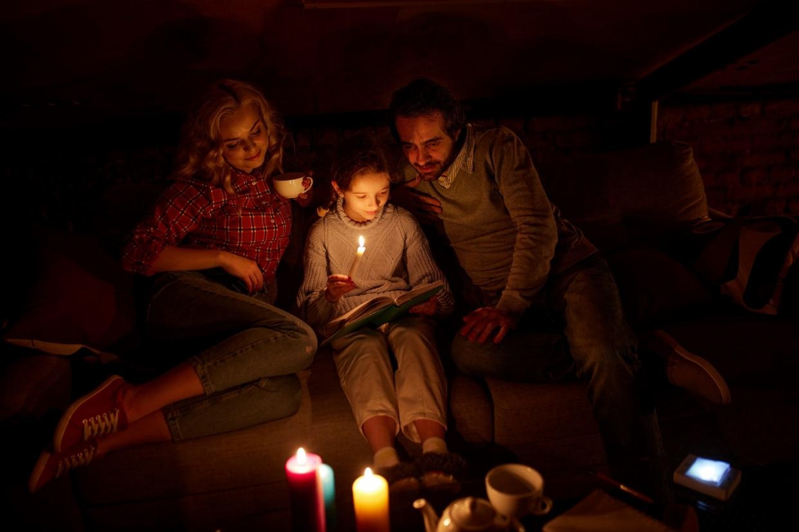
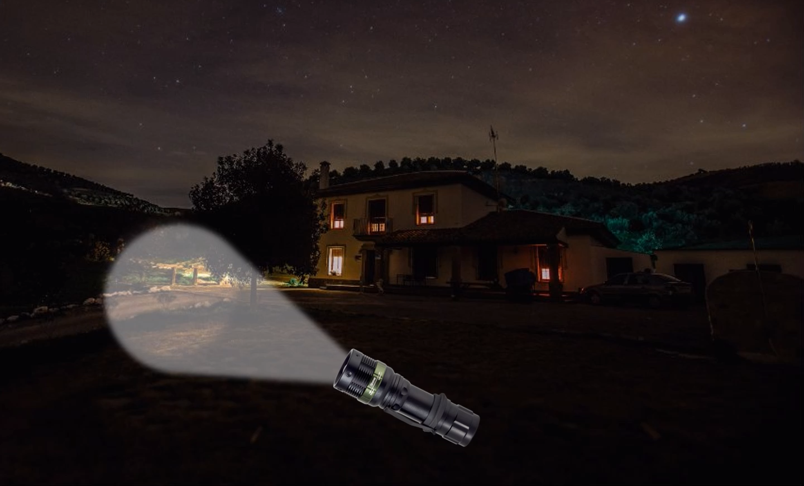

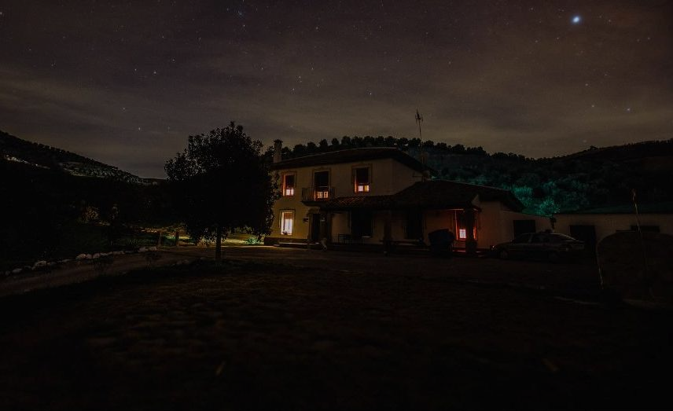

Slide 5



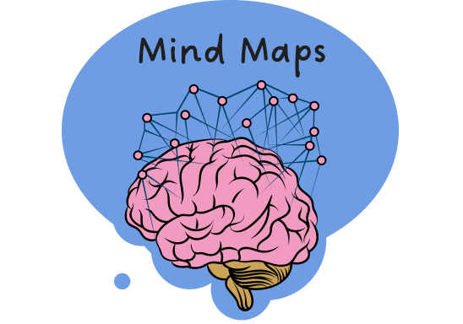
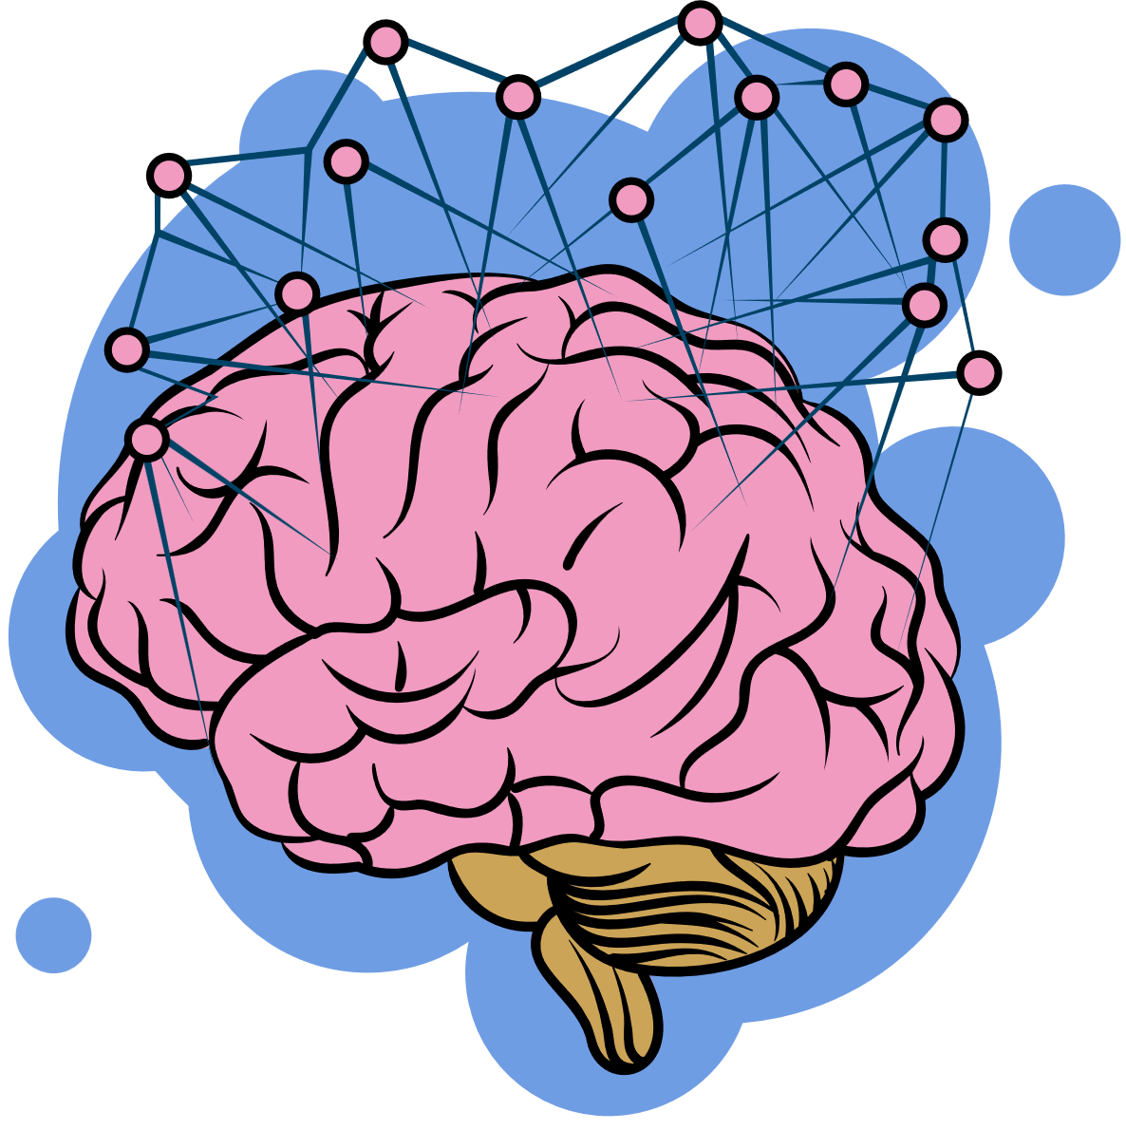
















I Do: What Are Mind Maps?
remember what we’ve learned
Helps put information IN
organise ideas
Purpose
Show thinking
visualise thoughts
Mind Maps
Helps take information OUT
You can see:
Last levels: descriptive details and factual evidence
Read information
Radiate outwards
pictures
Centre circle: main topic
words
Next level: subtopics

Slide 6
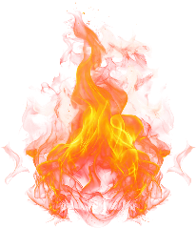
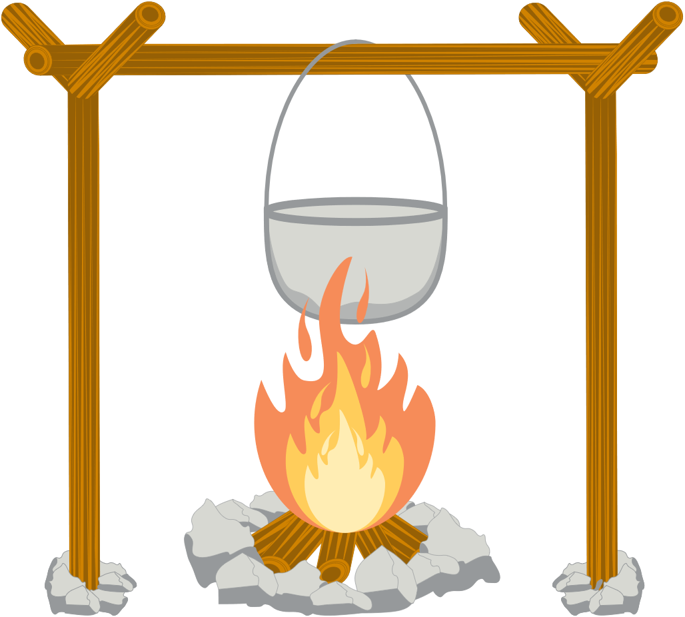





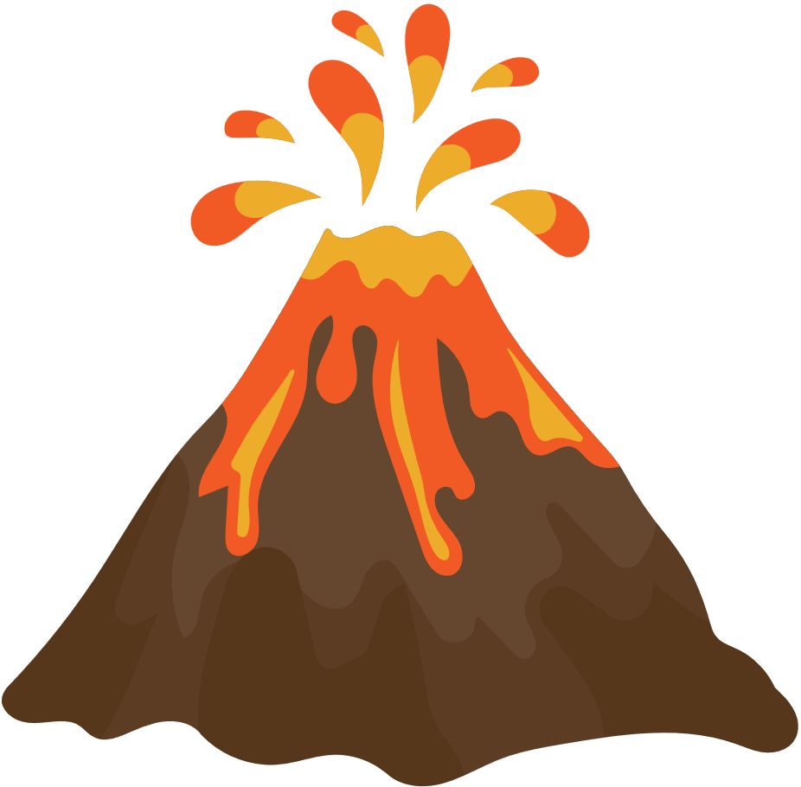
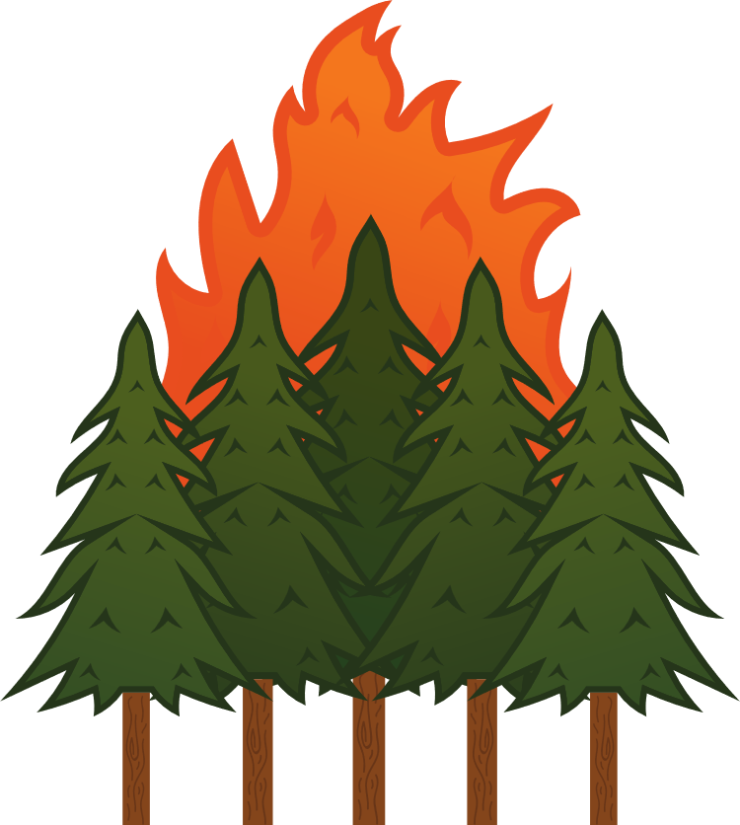
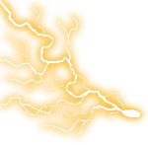




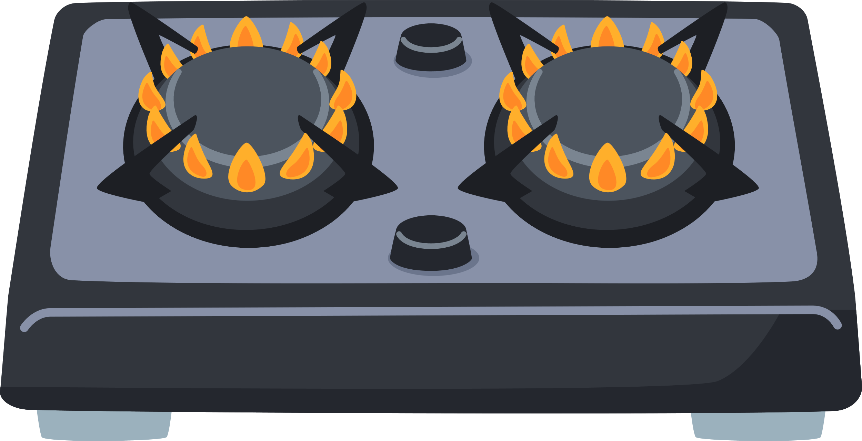





Mind Map: Discovery of Fire
safety
create energy
energy
cooking
Why?
light
warmth
What?
survival
heat
control
Fire
Who?
humans
nature
Changed how?
Natural fires
Keeping fire alive
Sticks and stones
Matches
Controlled fire

Slide 7
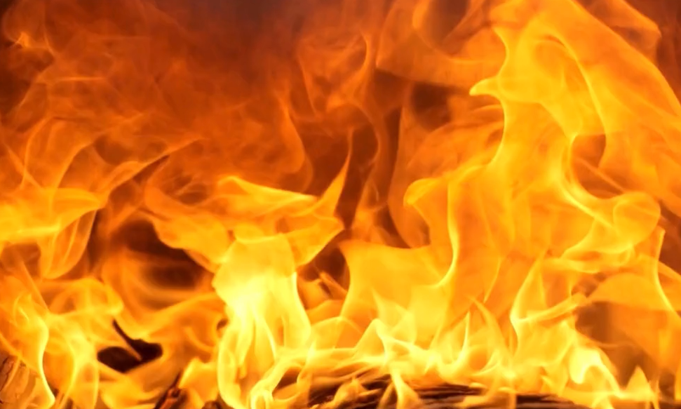
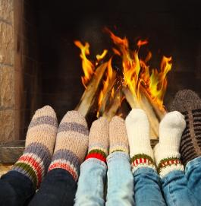
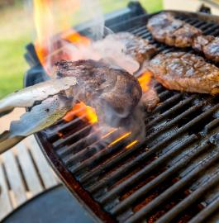
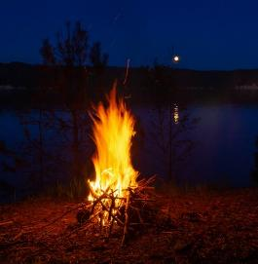
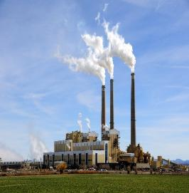
What Is Fire?
heat
cooking
Fire
light
energy

Slide 8
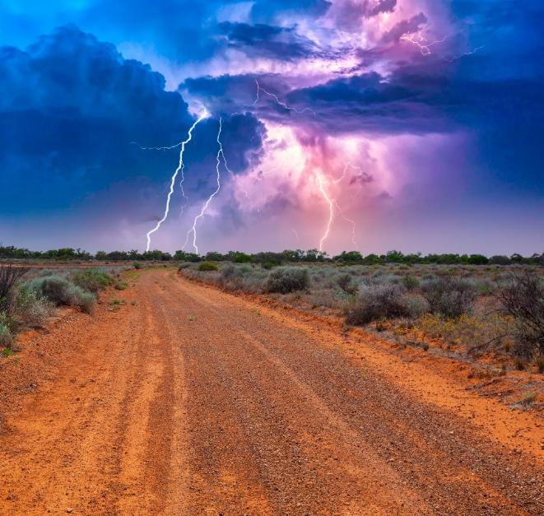
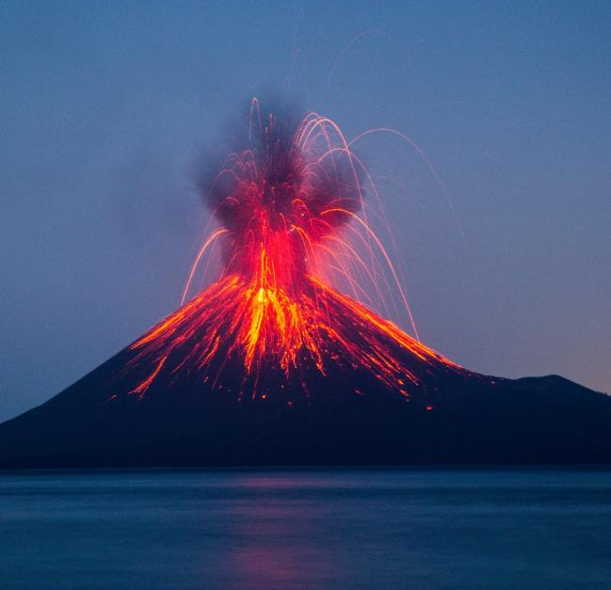
Who Discovered Fire?
Fire has always existed in nature, such as from lightning and volcanoes.

Slide 9


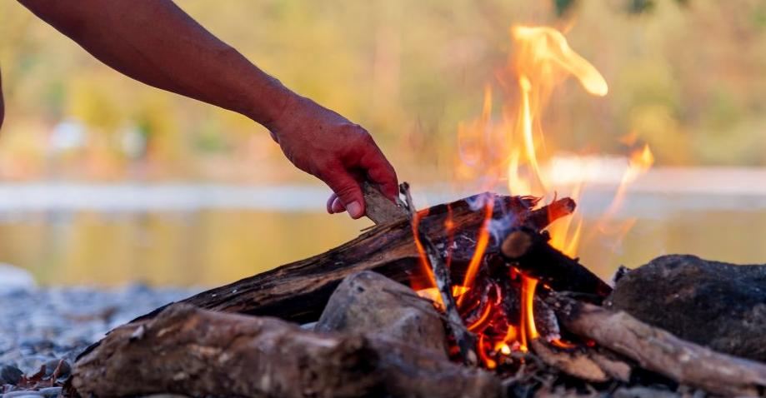
Who Discovered Fire?
Humans did not invent fire, but they learned ways to start and control it.

Slide 10
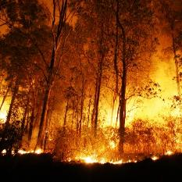
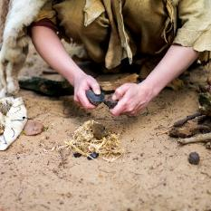

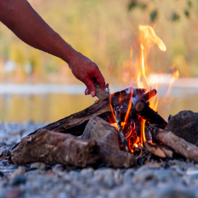
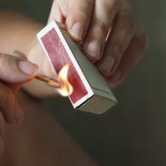
How Has Fire Changed?
The way we start fire has changed throughout history.
Keeping fire alive
Matches
Natural fires
Rubbing sticks and stones
Controlled fire

Slide 11
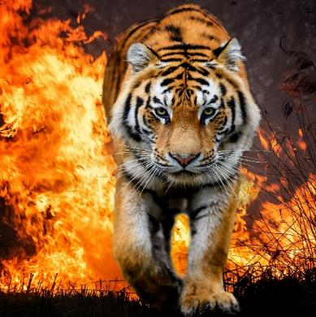
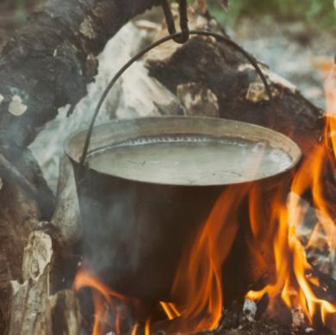
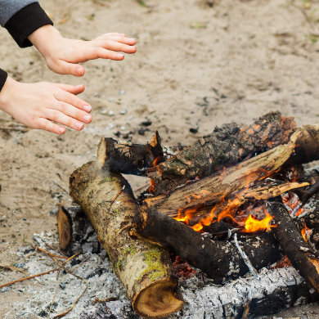
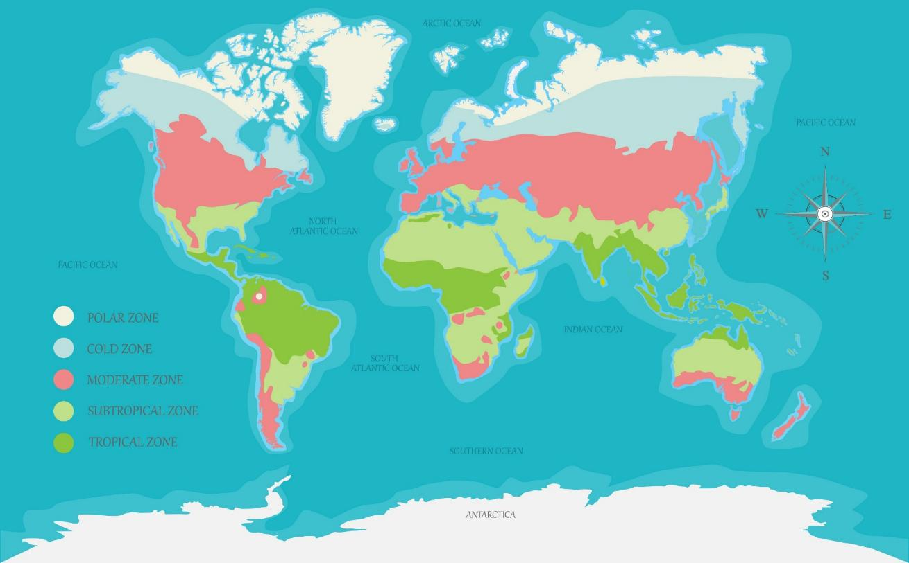
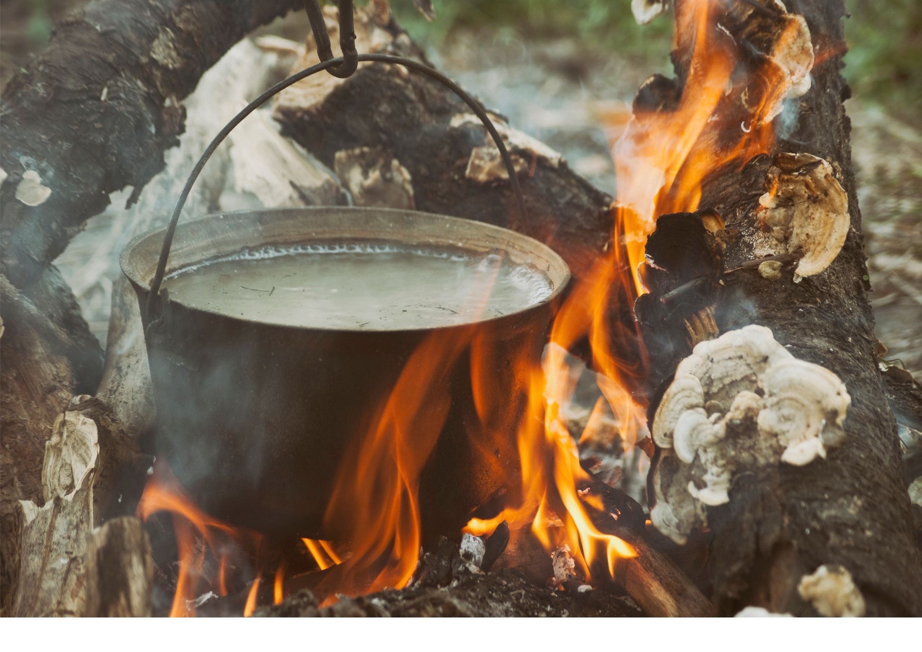



I Do: Importance of Fire
Fire helps humans cook their food.
Fire provides warmth.
Fire keeps away dangerous animals.
Fire Helped Humans Survive

Slide 12
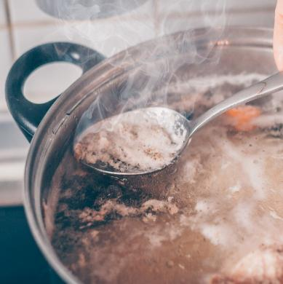
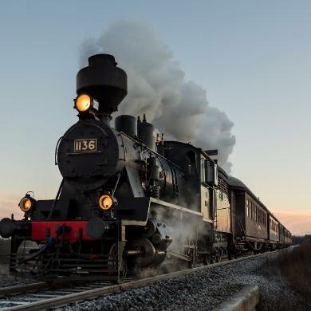
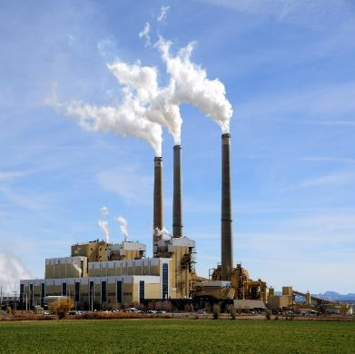

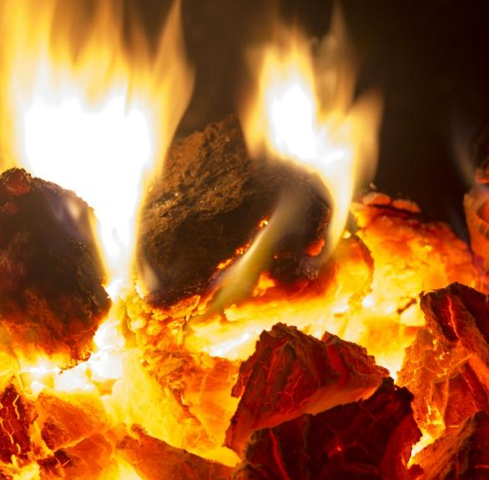

I Do: Importance of Fire
Energy is what makes things move, grow or work.
Fire helps people do work faster and easier.
Fire heats water to create steam.
Steam can power machines.
Fire Allows Humans to Create Energy

Slide 13


Thumbs Up or Thumbs Down
Humans did not invent fire but learned to control it.
No
Yes
Thumbs up for yes.
Thumbs down for no.

Slide 14





I Do: Mind Map Discovery of Fire
warmth
create energy
energy
cooking
Why?
light
safety
What?
survival
start/ stop
heat
control
Fire
Fire
Who?
humans
nature
Changed how?
Natural fires
Keeping fire alive
Sticks and stones
Matches
Controlled fire

Slide 15
We Do: Mind Map Discovery of Fire
warmth
create energy
energy
cooking
Why?
light
safety
What?
survival
start/ stop
heat
control
Fire
Fire
Who?
humans
nature
Changed how?
Natural fires
Keeping fire alive
Sticks and stones
Matches
Controlled fire

Slide 16

Mind Map Discovery of Fire

Slide 17
Fire has always existed in nature, such as from lightning and volcanoes.
Humans did not invent fire, but they learned ways to start and control it.
The way we start fire has changed throughout history.
Fire helped humans survive and allows us to create energy.

Slide 18
lightning
In nature, fire can start from volcanoes or ___________.
How did early humans use fire?
A. To stay warm
B. To cook food
C. To keep animals away
D. All of the above
Early humans learned to c______ fire.
matches
the Sun
lightning
ontrol

Slide 19



In the next lesson, we will learn about what informative writing is.

