Slide 1
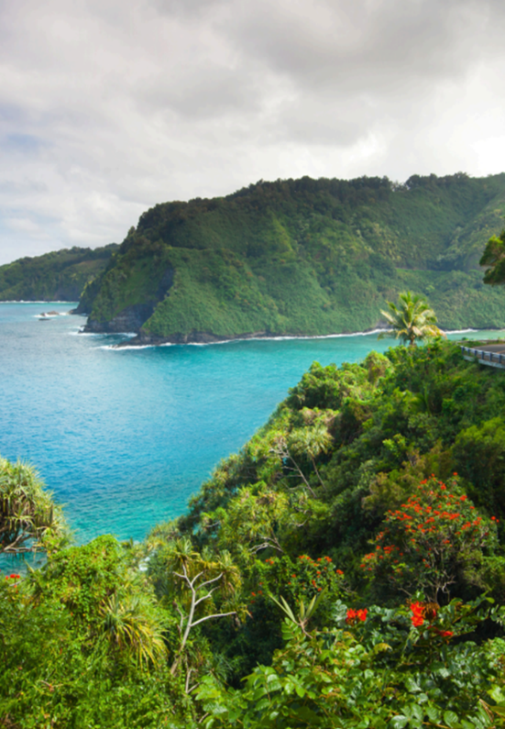
Writing
Unit 3: Informational/ History
Lesson 2: Informative Text Purpose and Structure
Version 1

Slide 2
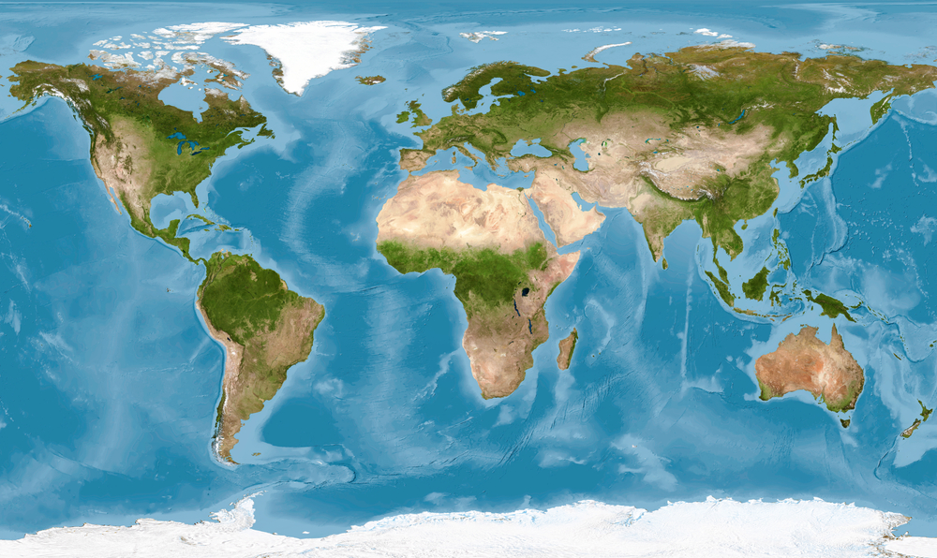
The Pacific Ocean is home to 30,000 islands.

Slide 3
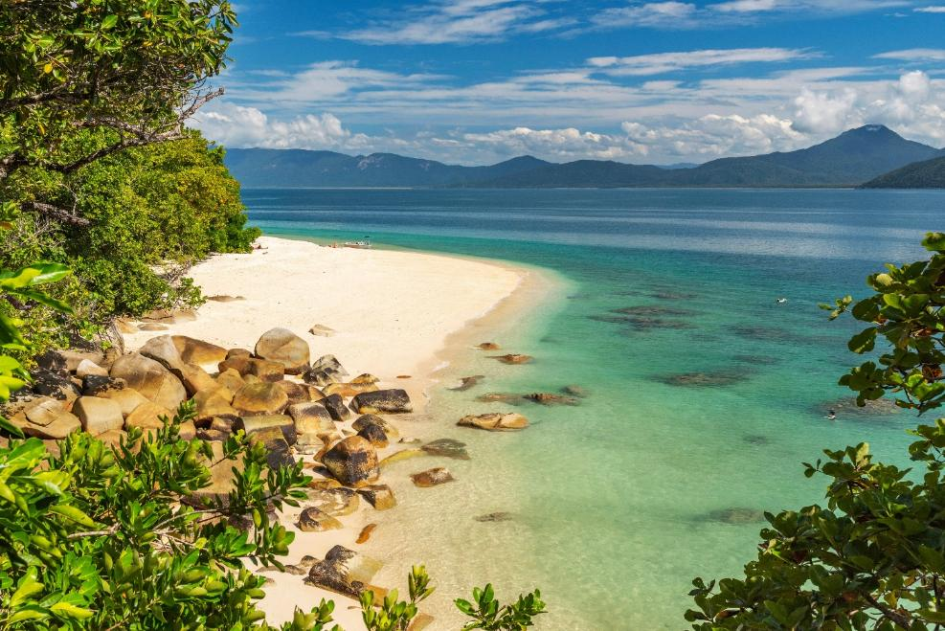
The Pacific Islands were settled because people were looking for new places to live where they could find food, shelter and safety.

Slide 4

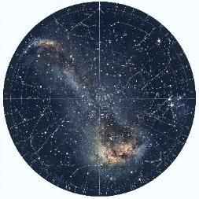


The islands in the Pacific were settled by people who travelled long distances using ________ to find their way.
the stars
a compass
the stars
Hold 1 finger up if you agree the answer is number 1.
Hold 2 fingers up if you agree the answer is number 2.

Slide 5
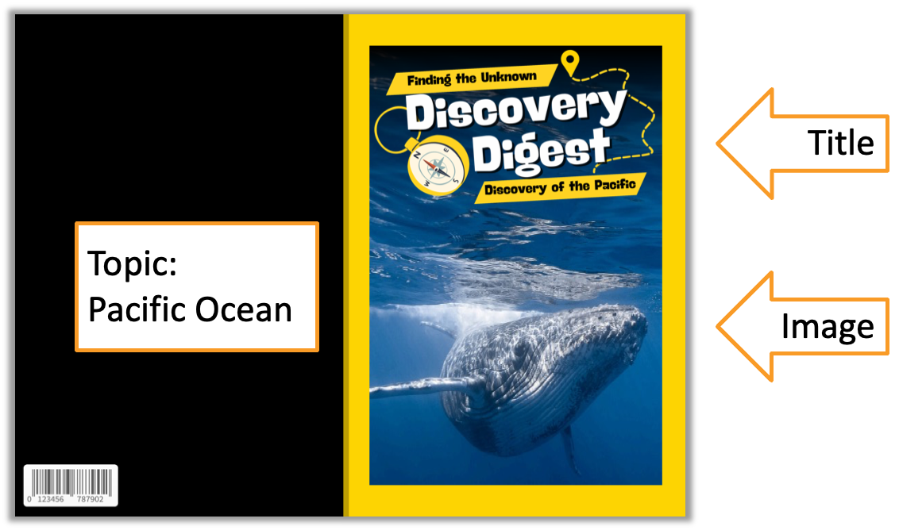
In this lesson, we will learn the purpose and structure of informative writing.

Slide 6
You will be able to: ​
understand the purpose of informative writing
understand the structure of informative writing.

Slide 7
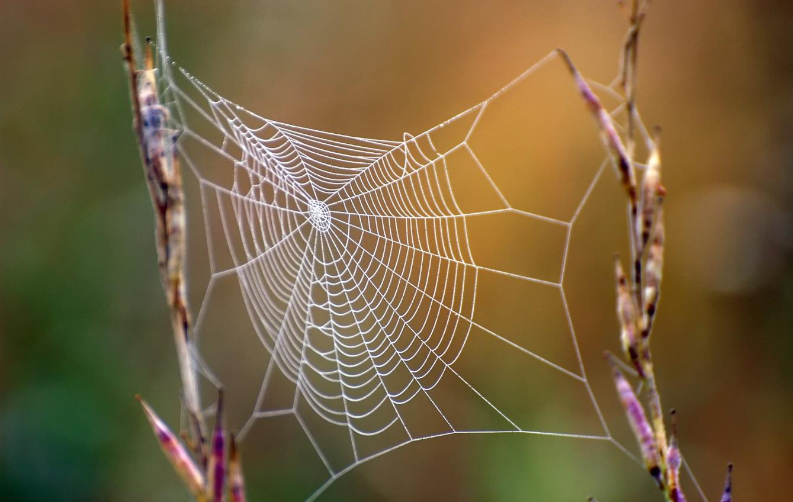

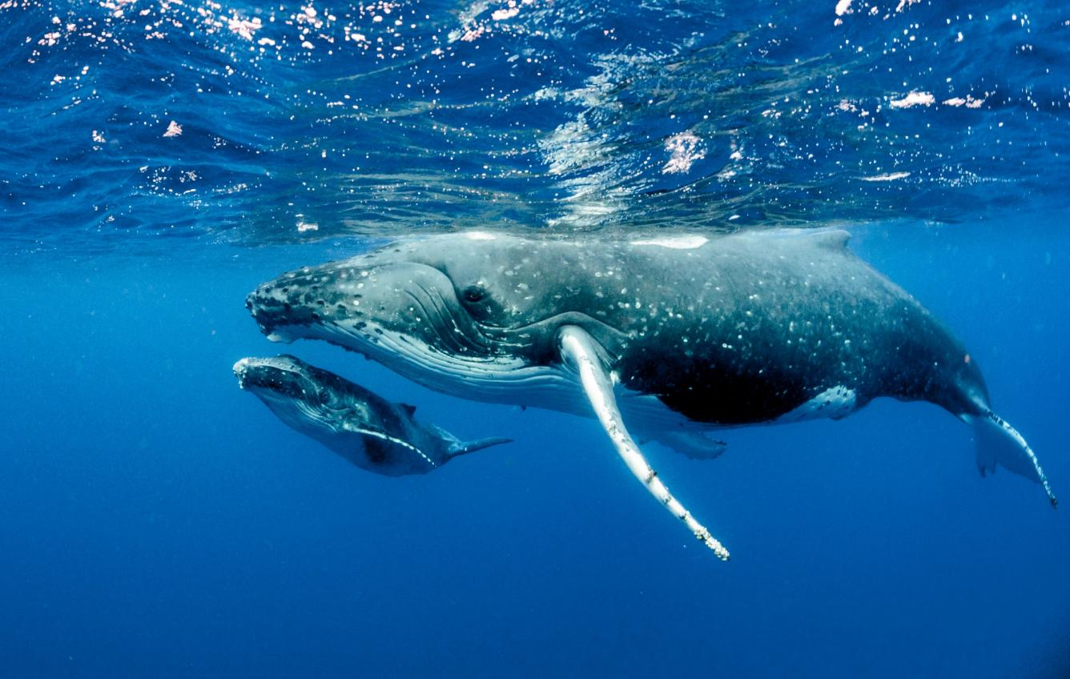


Slide 8

The Pacific Ocean
The Pacific Ocean is located between Asia and Australia on the west, and North and South America on the east.

Slide 9
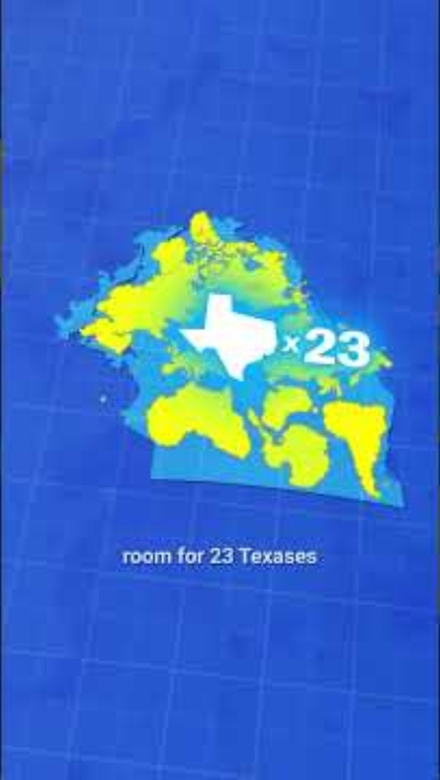
The Pacific Ocean
The Pacific Ocean covers one-third of Earth’s surface.

Slide 10

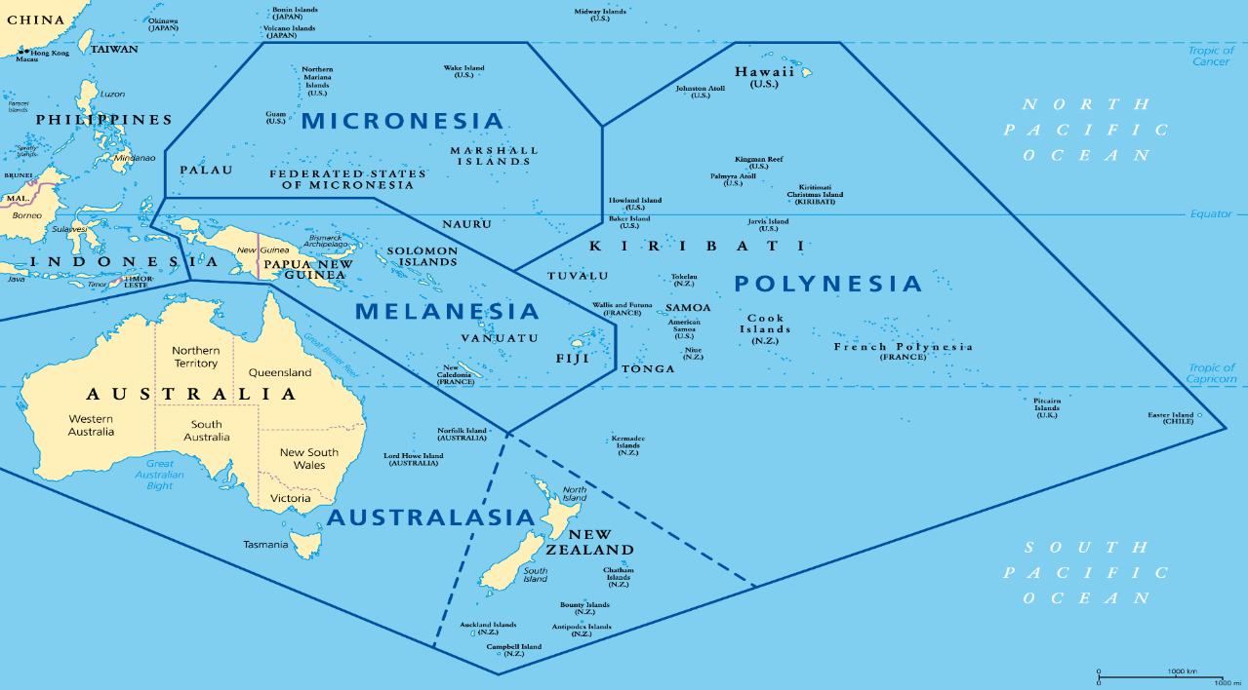




The Pacific Ocean Map
The Pacific Ocean is home to roughly 30,000 islands. This includes Tahiti, Hawaii, Easter Island and New Zealand.

Slide 11
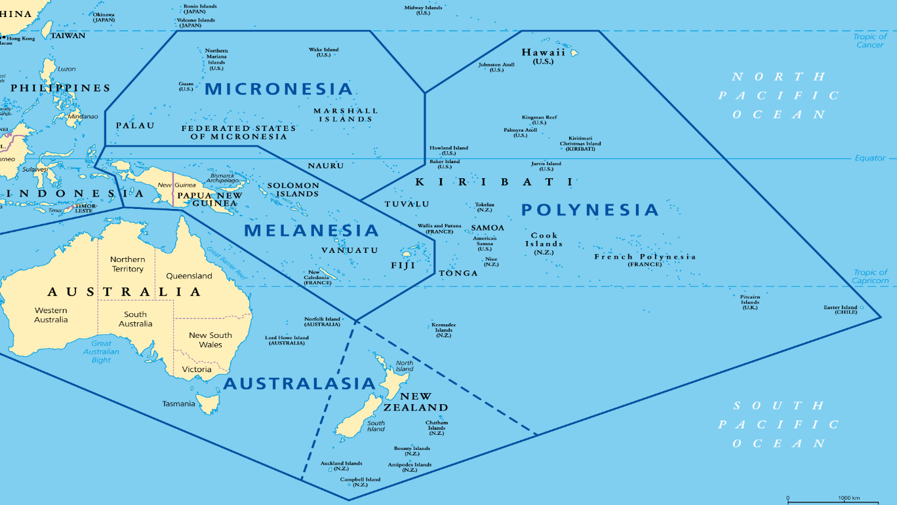
The Pacific Ocean Map

Slide 12



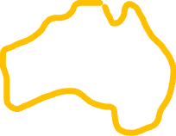
The Pacific Ocean Map

Slide 13
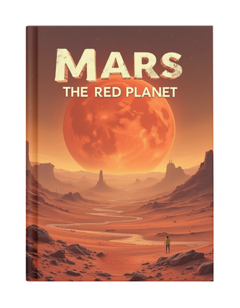
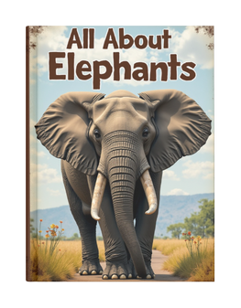
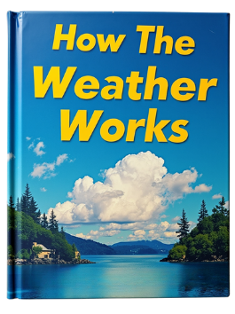


What Is Informative Text?
An informative text gives true facts to teach the reader about a topic.

Slide 14
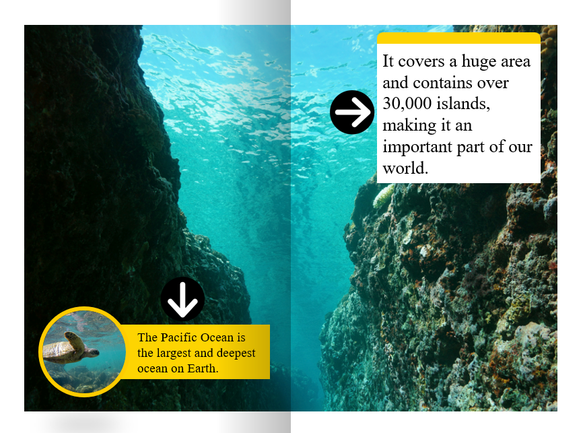
Informative Text Purpose
The purpose of informative text is to share information.
Detail
Title
Topic:
Pacific Ocean
Image
Fact

Slide 15


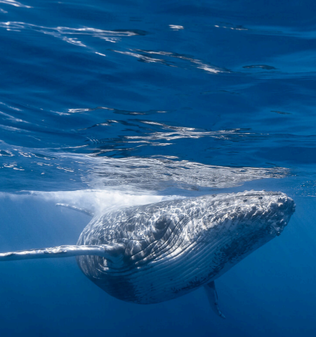
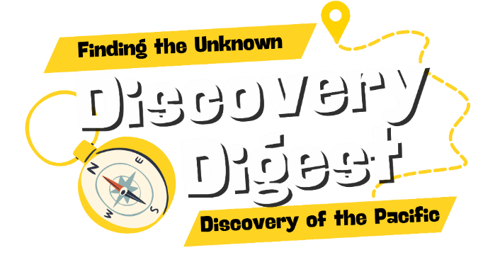

Slide 16
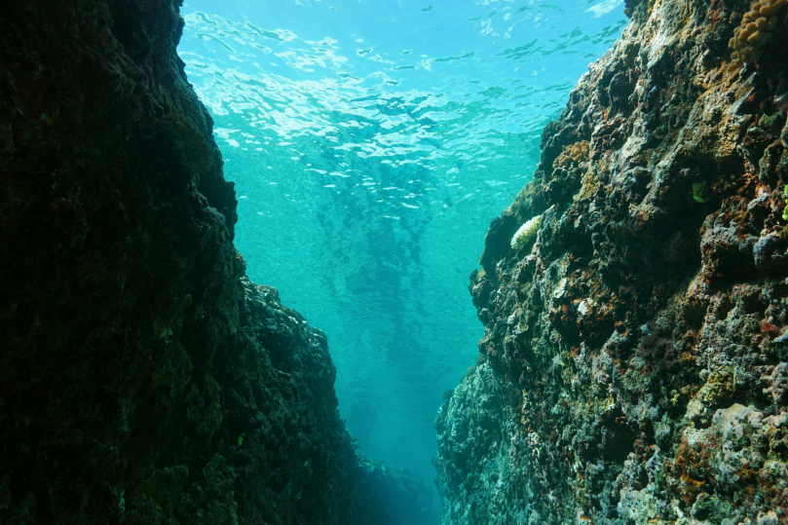

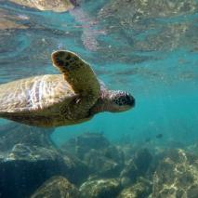
It covers a huge area and contains over 30,000 islands, making it an important part of our world.
The Pacific Ocean is the largest and deepest ocean on Earth.

Slide 17

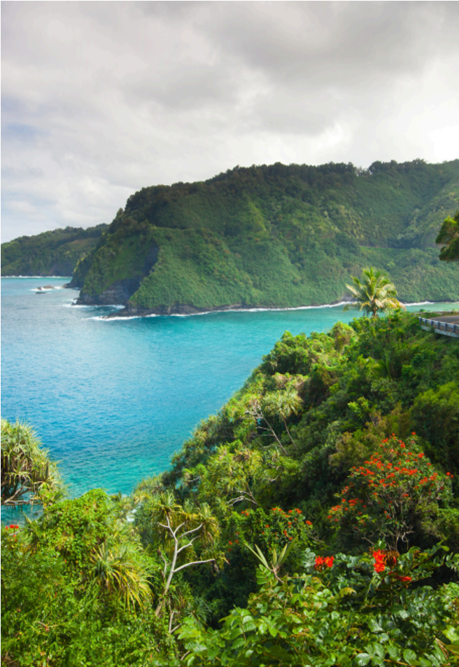
The Pacific Ocean covers one-third of the Earth’s surface. A fact about its location is that it lies between Asia and Australia on the west, and North and South America on the east. For example, it stretches from the Arctic Ocean in the north to Antarctica in the south. This makes it the largest ocean, connecting many continents and countries.

Slide 18
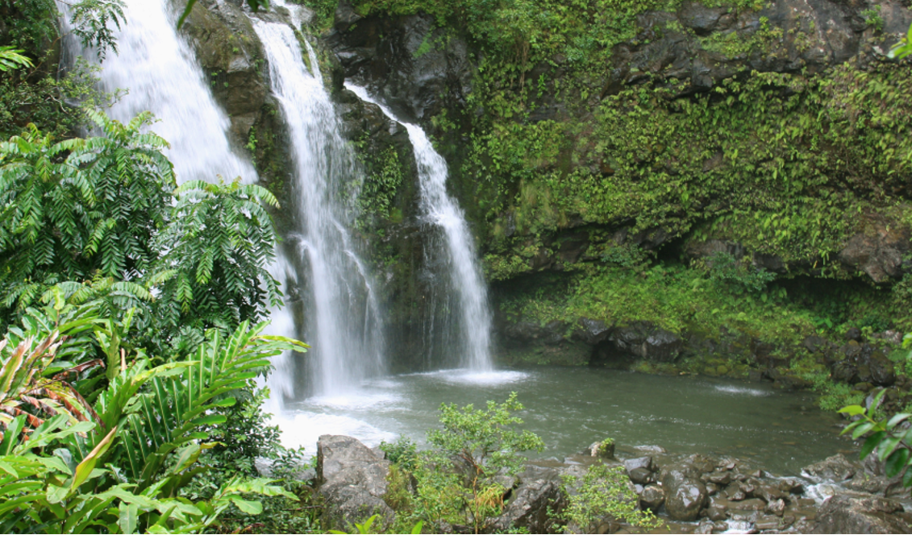

The Pacific Ocean is home to thousands of islands. A fact about these islands is that some of the most famous ones include Tahiti, Hawaii, Easter Island and New Zealand.
For example, these islands are known for their beautiful landscapes and unique cultures. The many islands make the Pacific Ocean a special and diverse part of our planet.

Slide 19
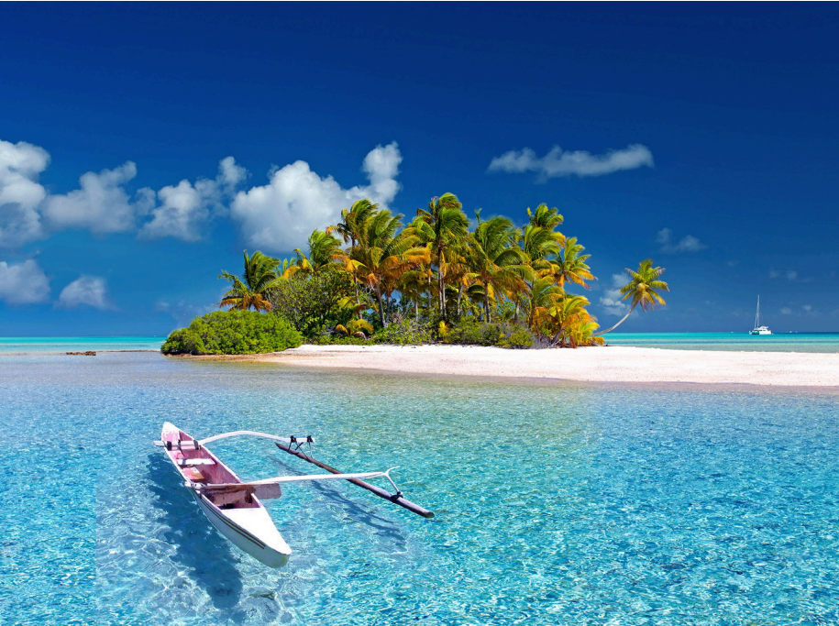
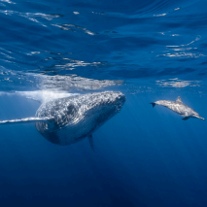
The Pacific Ocean is located between Asia, Australia and the Americas.
It is the biggest ocean on Earth, with thousands of islands. This makes it a very special and interesting part of our world.

Slide 20

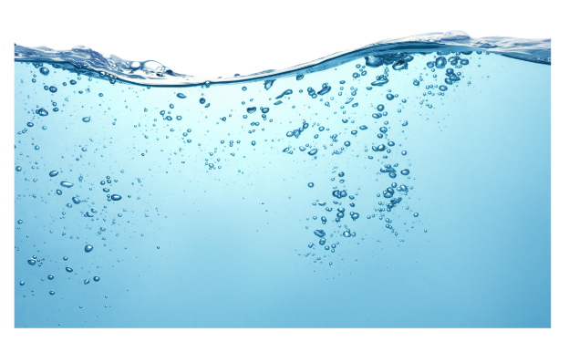
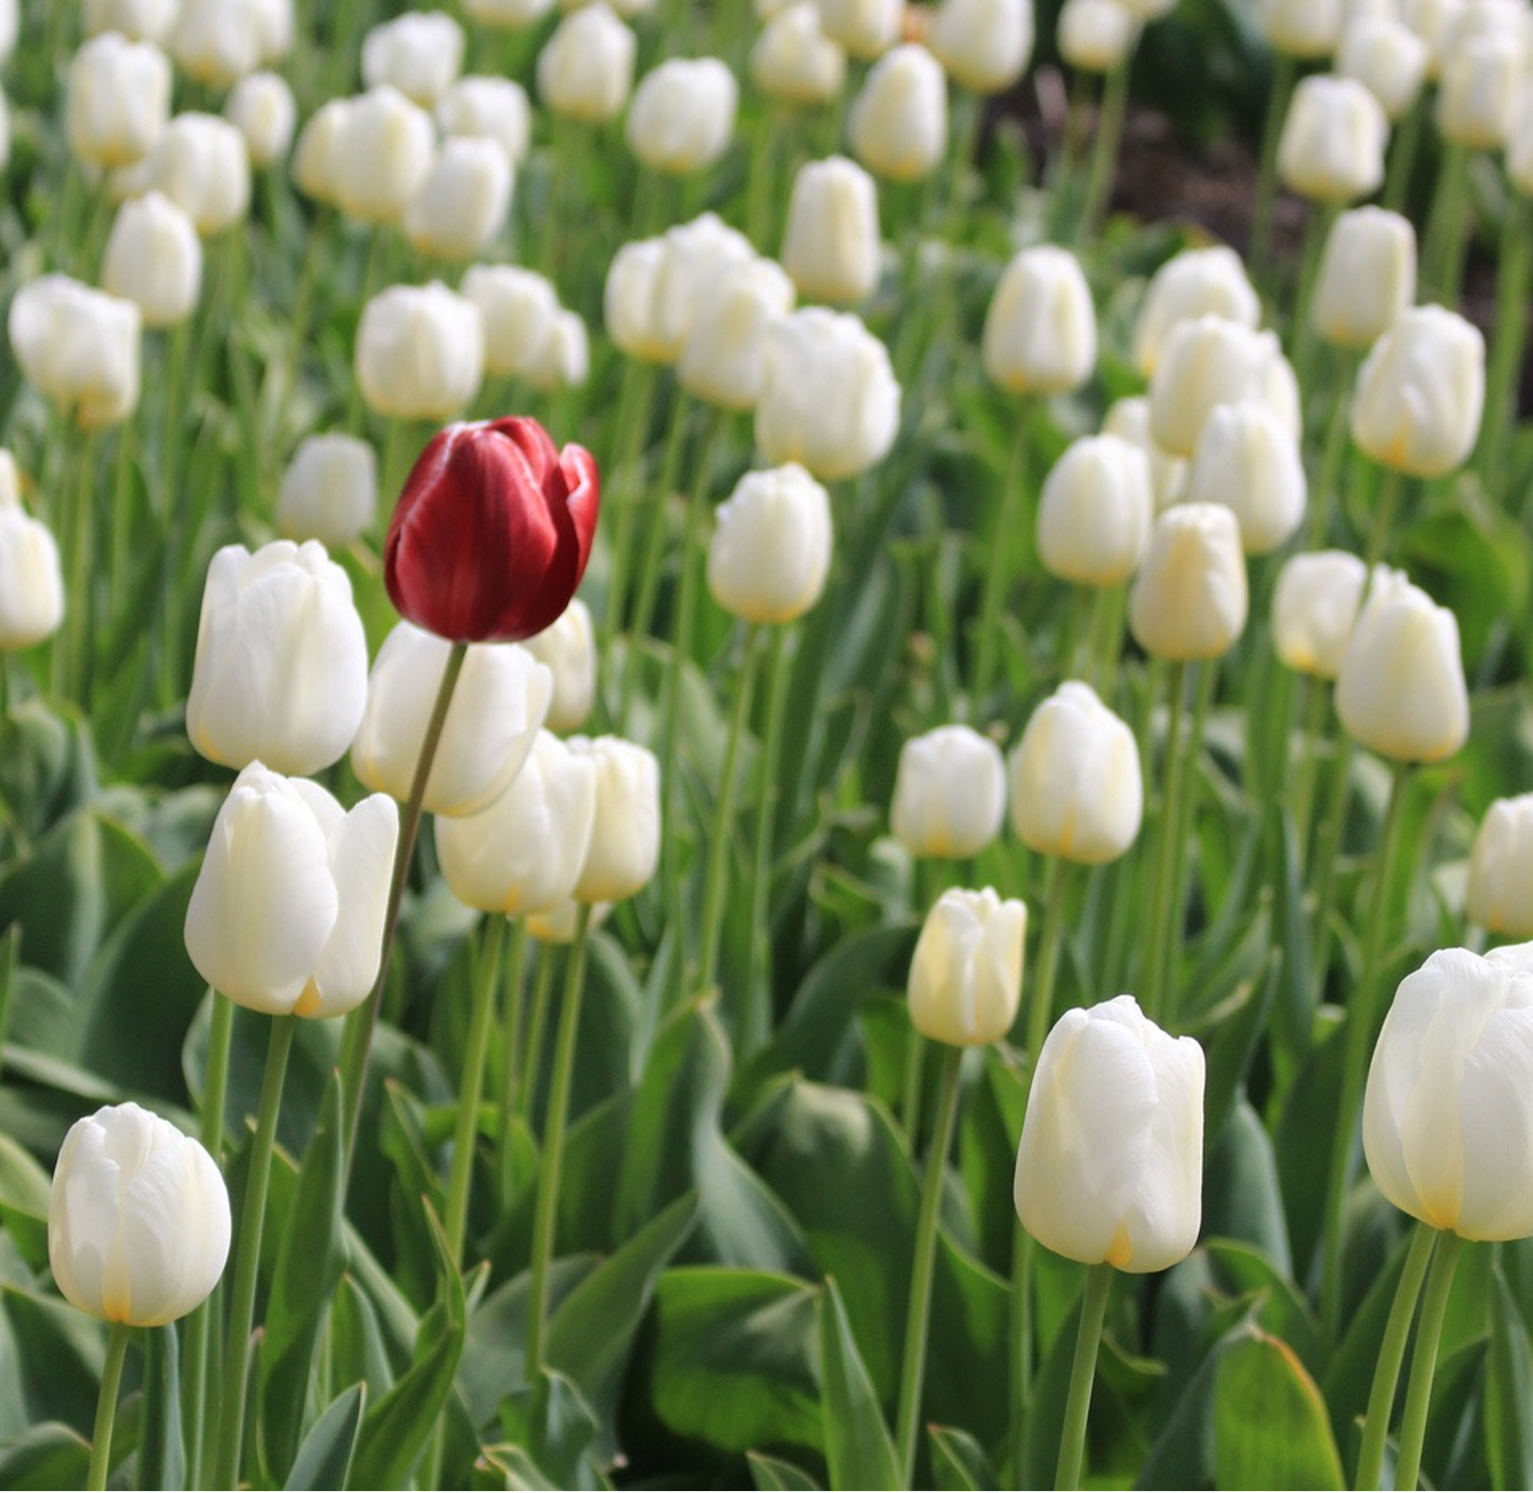
stretches – Goes a long way in one direction.
diverse – Different from each other; made up of many kinds.
surface – The top part of water.
unique – One of a kind; not like anything else.

Slide 21


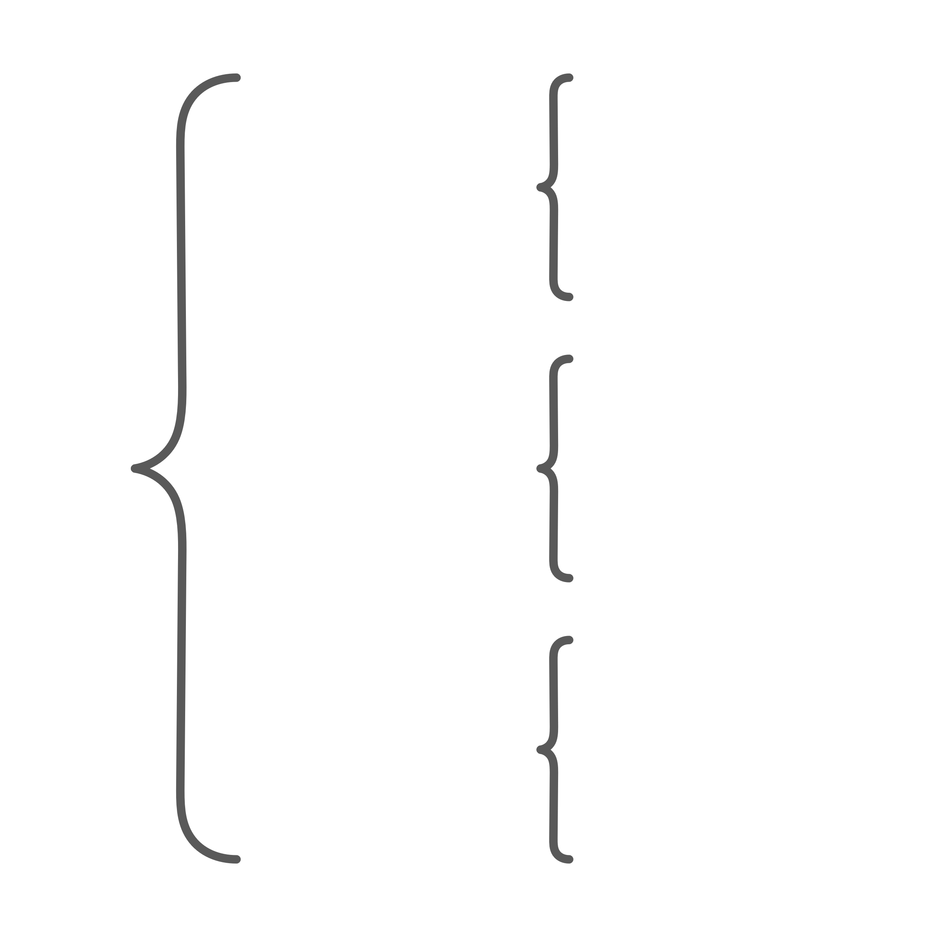
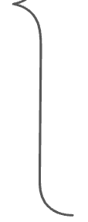
Informative Text Structure
Informative writing has an organised structure.
Introduction
subtopic
Topic sentence. Facts/Details. Closing sentence.
Information
Title
subtopic
Topic sentence. Facts/Details. Closing sentence.
Conclusion

Slide 22


The Pacific Ocean is the largest and deepest ocean on Earth.
It covers a huge area and contains over 30,000 islands, making it an important part of our world.
The Pacific Ocean covers one-third of the Earth’s surface. A fact about its location is that it lies between Asia and Australia on the west, and North and South America on the east. For example, it stretches from the Arctic Ocean in the north to Antarctica in the south. This makes it the largest ocean, connecting many continents and countries.
Size
Information
Discovery of the Pacific
The Pacific Ocean is home to thousands of islands. A fact about these islands is that some of the most famous ones include Tahiti, Hawaii, Easter Island and New Zealand. For instance, these islands are known for their beautiful landscapes and unique cultures. The many islands make the Pacific Ocean a special and diverse part of our planet.
Islands
It is the biggest ocean on Earth, with thousands of islands. This makes it a very special and interesting part of our world.

Slide 23

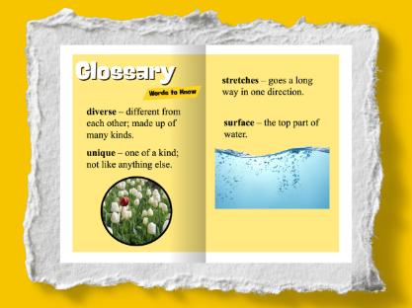
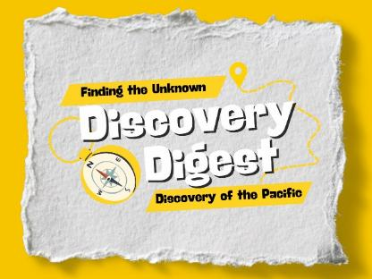
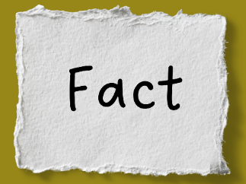
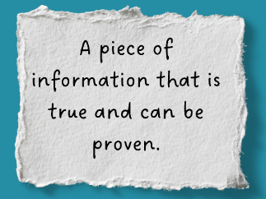
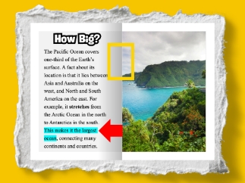
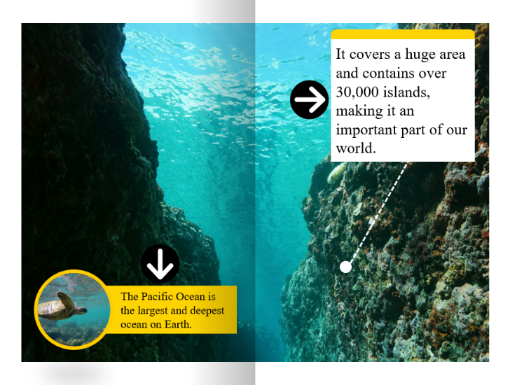

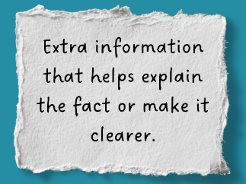
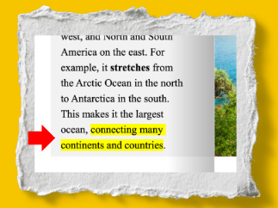

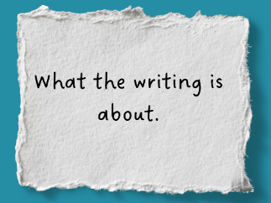
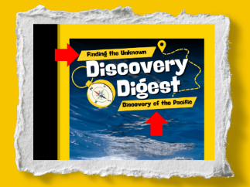
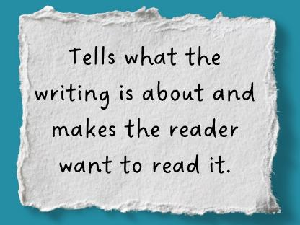
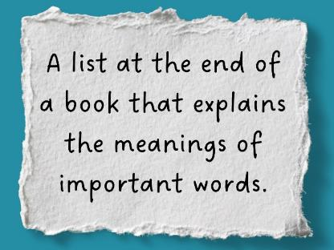
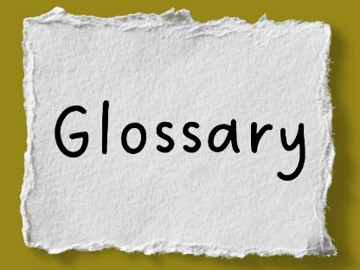
Informative Text Element Matching
An informative text is a type of writing that gives us information, rather than telling a story. It helps us learn about real things like animals, weather, space or people. Informative texts tell us what something is, how it works and why it happens. ​

Slide 24
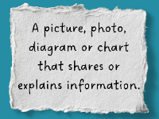


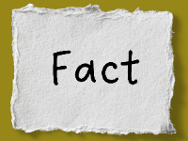
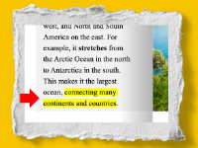
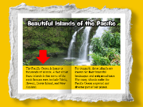
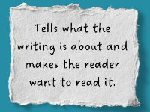

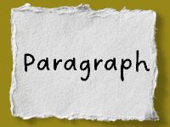
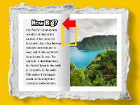

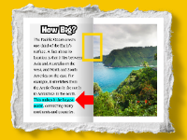

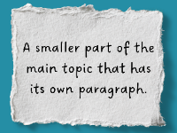



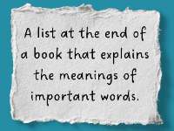






Informative Text Sorting Activity
Informative Text Element
Definition
Example

Slide 25
Answers
Informative Text Element | Definition | Example
Informative Text Element | Definition | Example

Slide 26
The Pacific Ocean is located between Asia and Australia on the west, and North and South America on the east.
The Pacific Ocean is home to roughly 30,000 islands. This includes Tahiti, Hawaii, Easter Island and New Zealand.
An informative text gives us facts and details to help us learn about a topic.
Informative writing has an organised structure.
Informative texts tell us what something is, how it works and why it happens. ​

Slide 27
details
An informative text gives us facts and _______.
An informative text is about real things such as:
A. Animals
B. Space
C. People
D. All of the above
I__________ texts tell us what something is, how it works and why it happens.
details
stories
characters
nformative

Slide 28


In the next lesson, we will learn about topics and titles.

