Slide 1
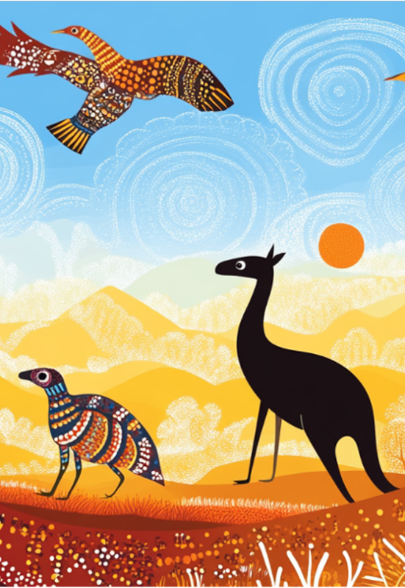
Writing
Unit 3: Informational/ History
Lesson 1: The History of the Dreaming
Version 1

Slide 2
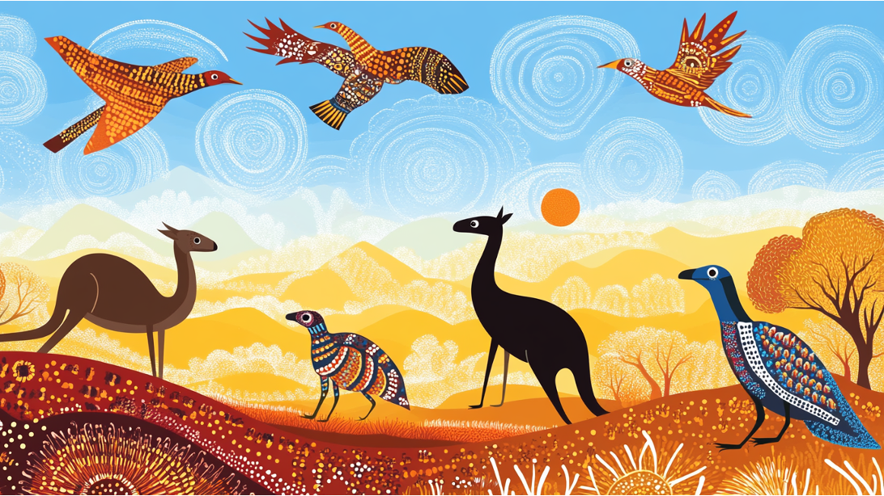
In this lesson, we will learn about The Dreaming in Indigenous Australian culture.

Slide 3
You will be successful when you can: ​
understand The Dreaming is part of Indigenous Australian culture
understand how stories of the Dreaming are passed on. ​

Slide 4

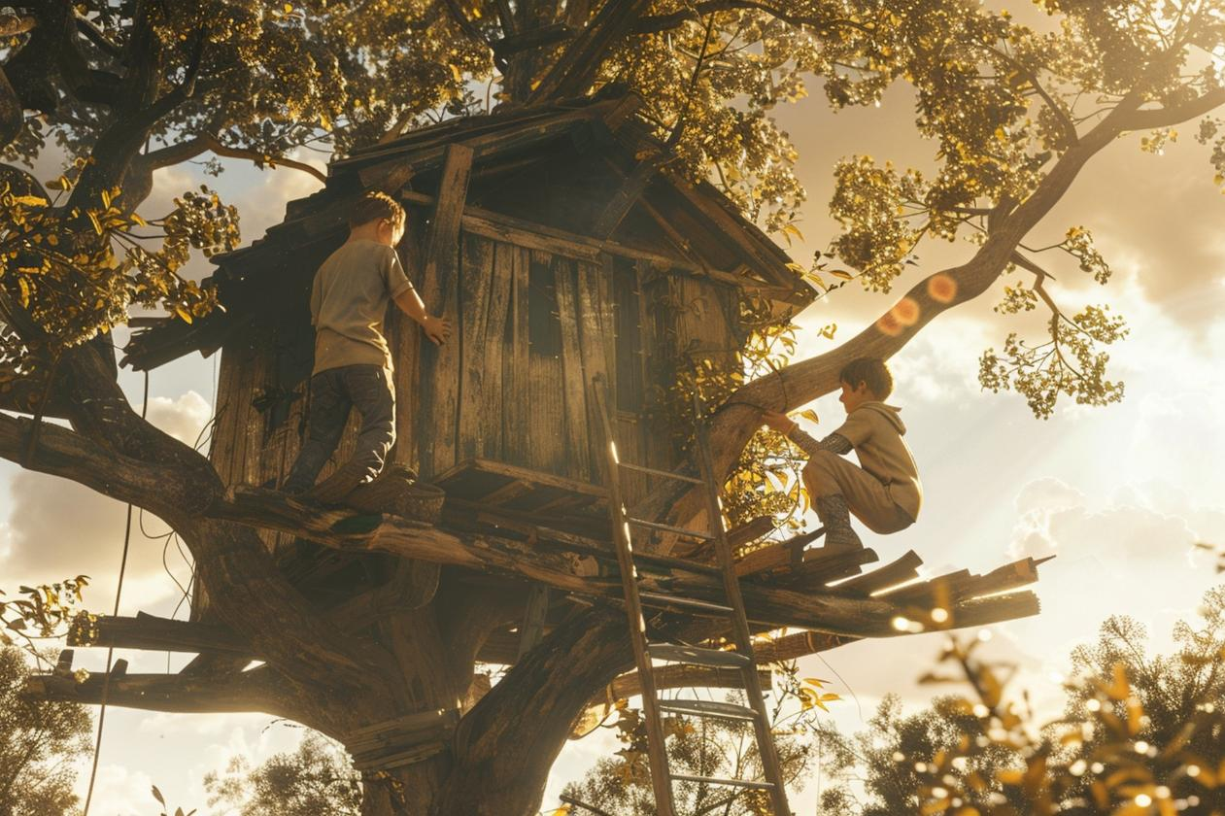
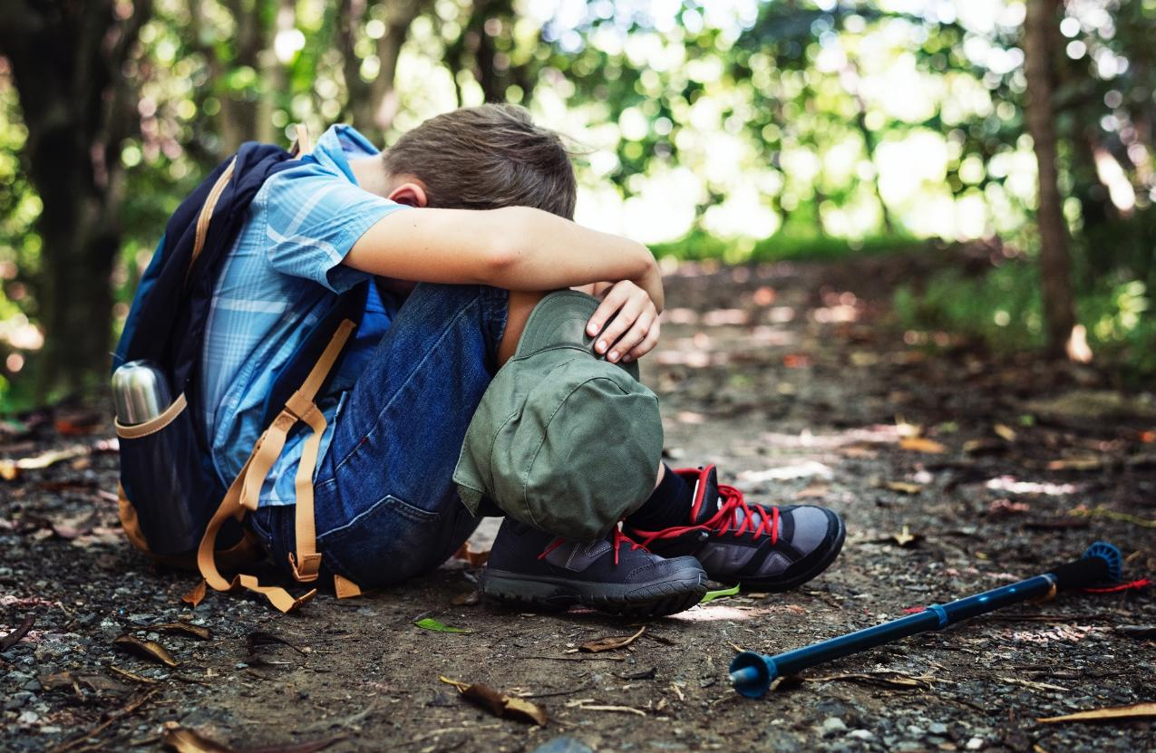

Slide 5



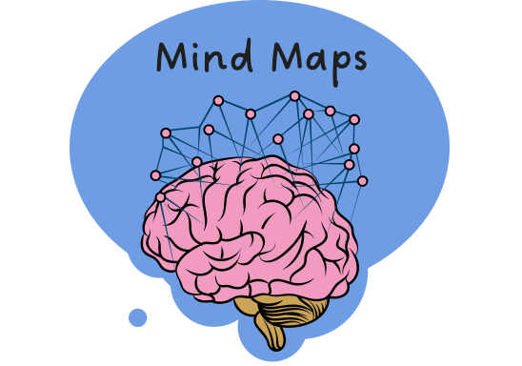
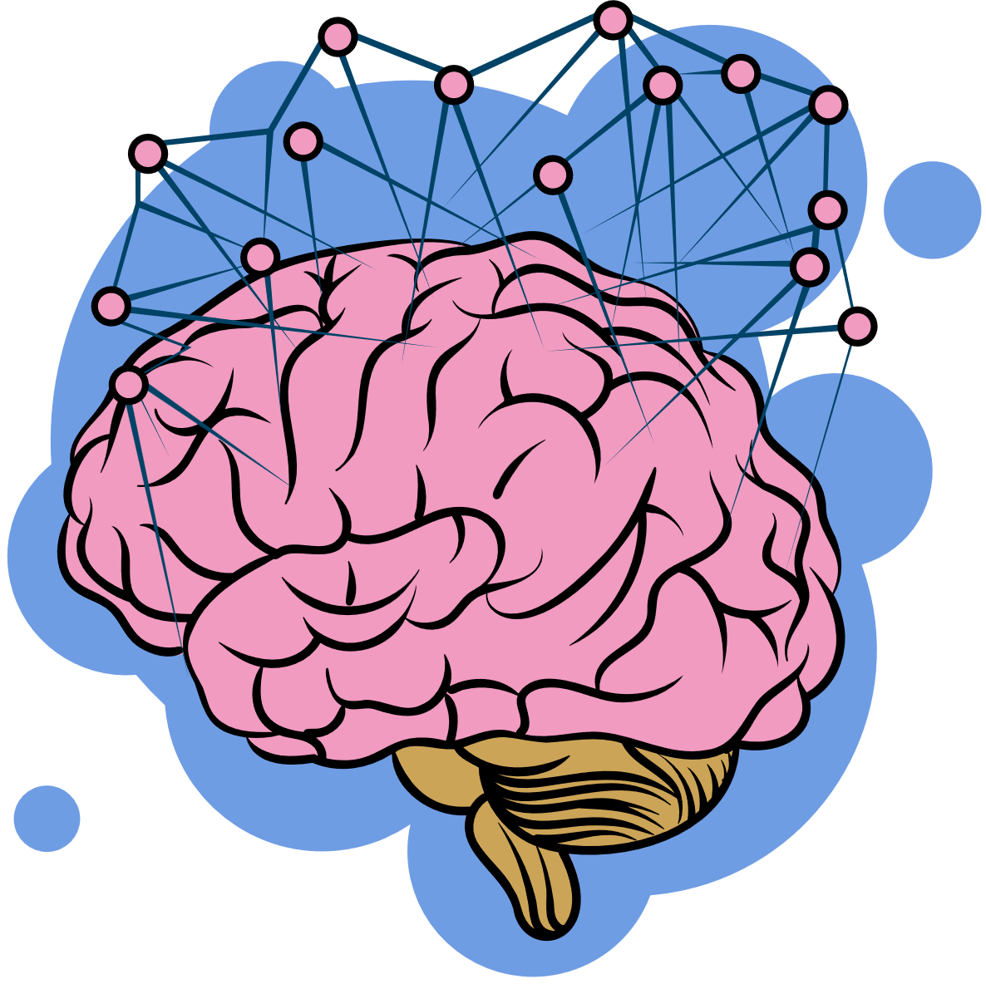
















Mapping My Mind
Remember what we’ve learned
Helps put information IN
Organise ideas
Purpose
Show thinking
Visualise thoughts
Mind Maps
Helps take information OUT
You can see:
Last levels: descriptive details and factual evidence
Read information
radiate outwards
pictures
Centre circle: main topic
words
Next level: subtopics

Slide 6



nature
spirit world
people
passed down from generation to generation
Creation of the World
oral stories
The Dreaming
how to treat others
land
The Law
Cultural Memory
water
how to live in harmony with nature
animals
responsibilities
sky

Slide 7


Slide 8
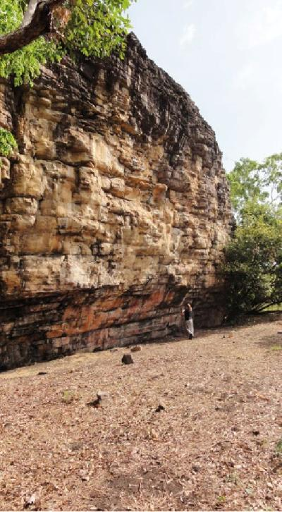
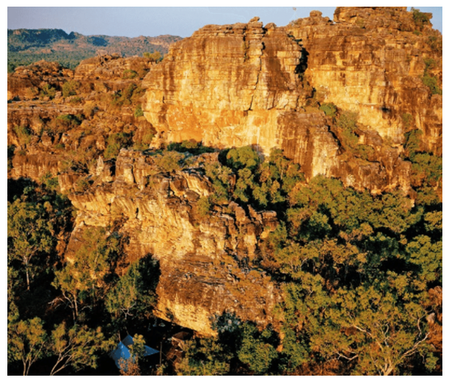
Madjedbebe Rock Shelter
May, S.K., Taçon, P.S., Wright, D.W., Marshall, M., Goldhahn, J., & Sanz, I.D. (2017). The rock art of Madjedbebe (Malakunanja II).

Slide 9
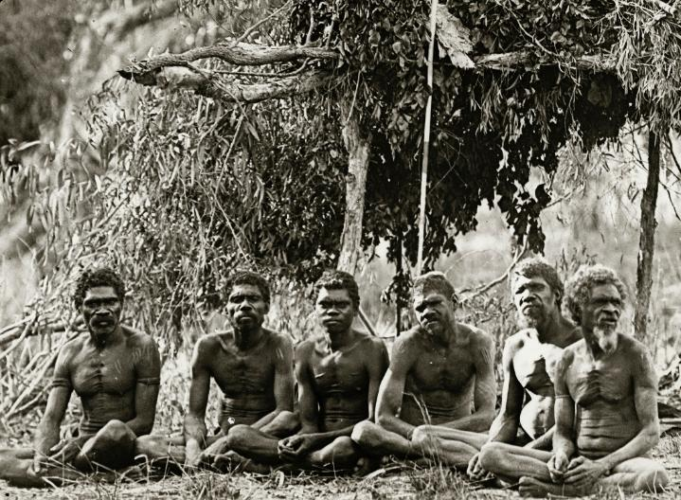
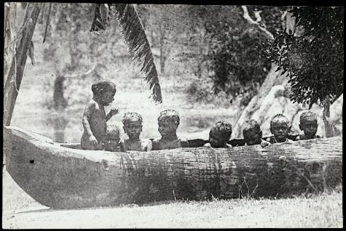
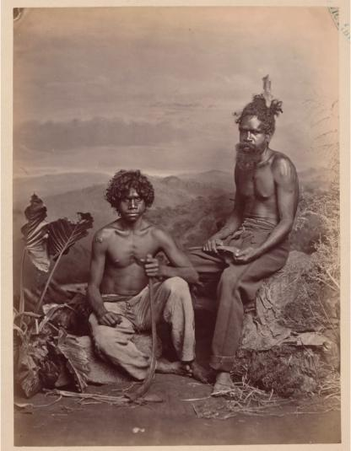
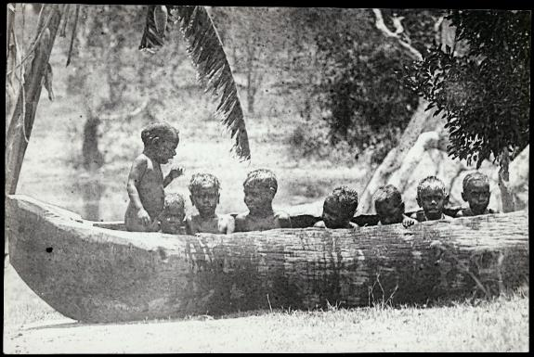

Slide 10
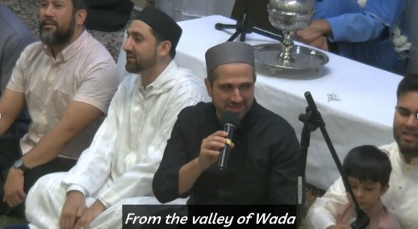
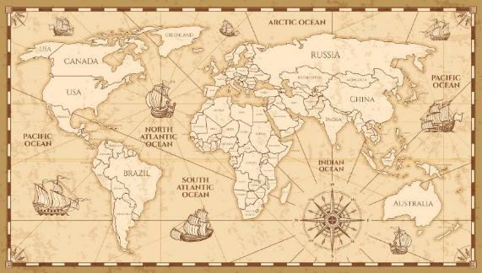


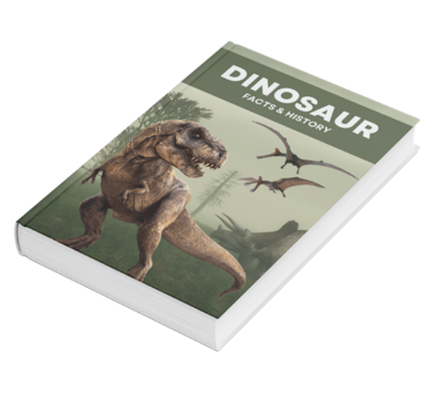
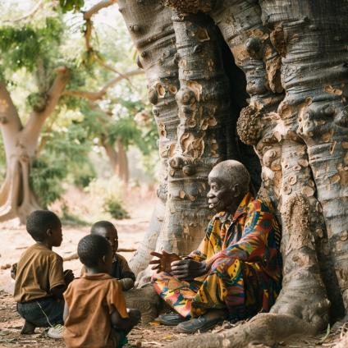
History is...
Written History
Spoken History

Slide 11


Thumbs Up or Thumbs Down
History can only be passed down when it is written.
No
Yes
Thumbs up for yes.
Thumbs down for no.

Slide 12
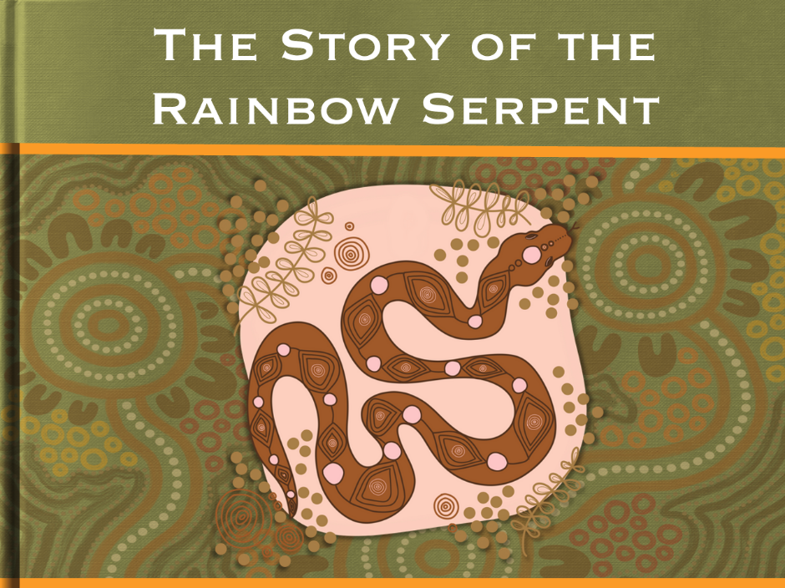
The Dreaming
The Dreaming is Indigenous Australians’ understanding of the world and how the world was made.

Slide 13
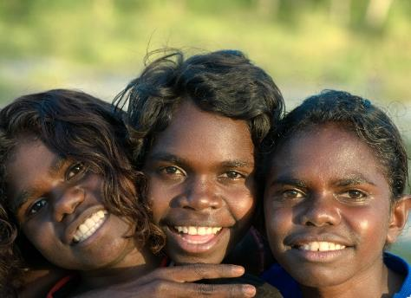


The Dreaming
The Dreaming is Indigenous Australians’ understanding of the world and how the world was made.
Indigenous people refers to the first people inhabiting or existing in a land.
In
dig
e
nous

Slide 14
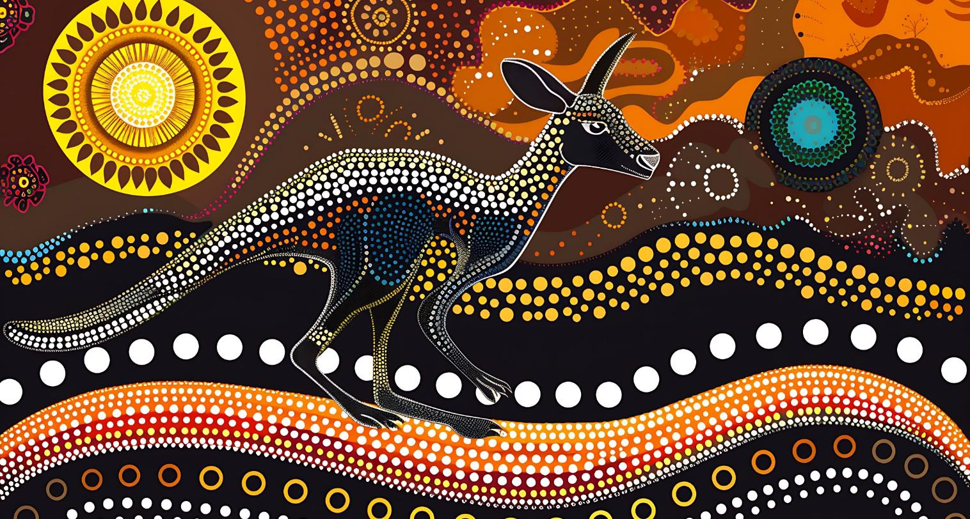
The Story of the Rainbow Serpent

Slide 15

A long time ago, the world was flat and empty. There were no trees, no rivers and no animals. Everything was still and quiet.

Slide 16
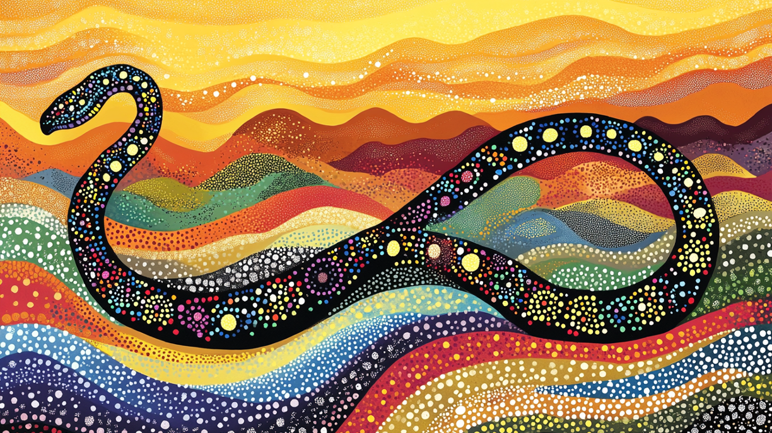
Deep beneath the ground, the great Rainbow Serpent slept. One day, she woke up and stretched her long, colourful body, creating hills and valleys as she moved.

Slide 17
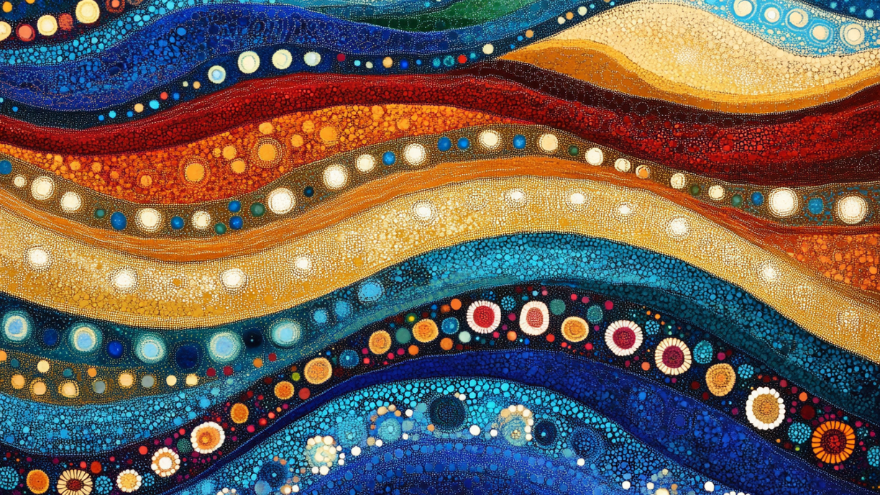
The Rainbow Serpent slithered across the land, carving deep tracks into the ground. As she moved, these tracks filled with water and became rivers and lakes.

Slide 18
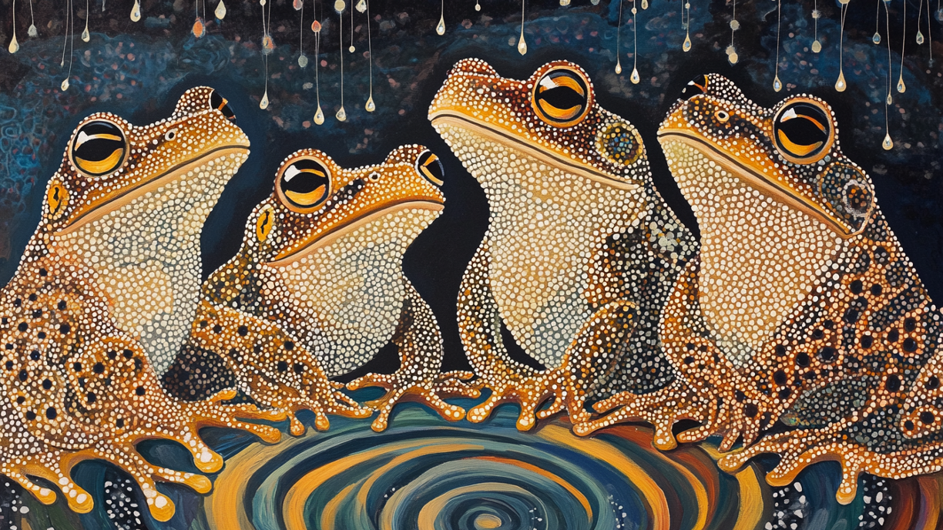
She called out to the frogs hiding underground. They heard her voice and came out, their bellies full of water. When the Rainbow Serpent tickled them, they laughed and released the water, creating the rain.

Slide 19
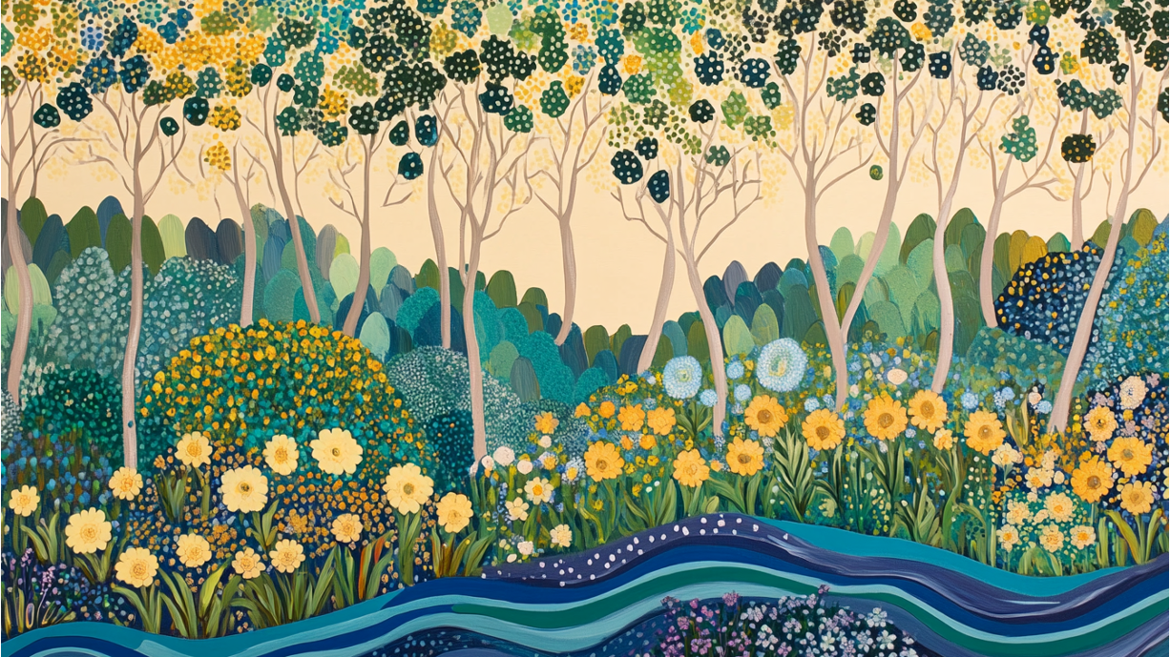
With water now flowing across the land, plants and trees began to grow. Flowers bloomed, and the land became colourful and full of life.

Slide 20
Then, the animals woke up and came out to explore their new home. Kangaroos, emus and lizards roamed the land, and birds filled the sky with song.

Slide 21
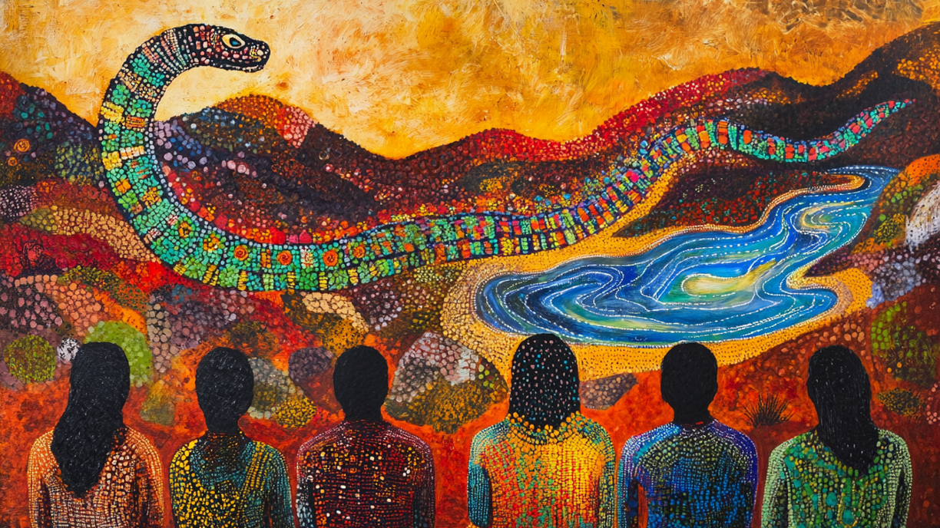
She told them, ‘If you take care of the land, it will take care of you. But if you do not, you will be punished.’ The First People listened and promised to respect the land forever.

Slide 22

The Rainbow Serpent slithered into the sky, watching over the land she created. When the rain falls and a rainbow appears, people remember her story and the promise to care for the world.

Slide 23
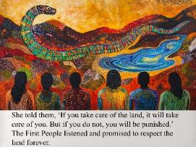

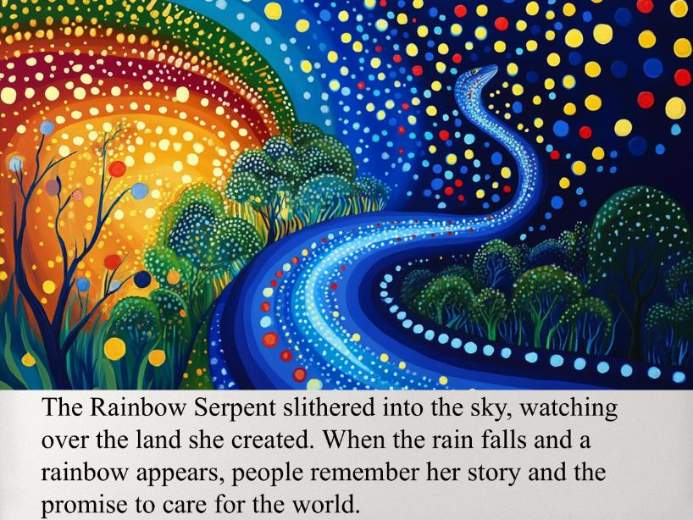
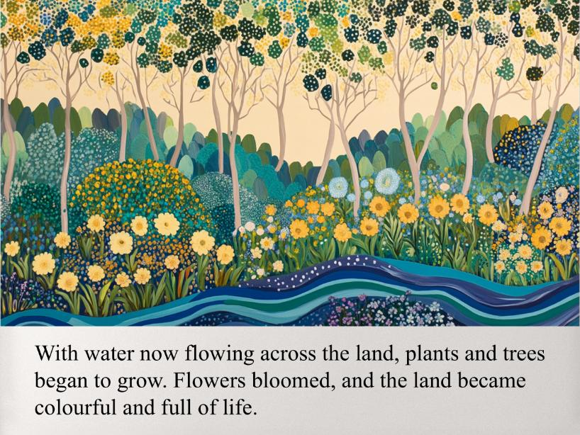
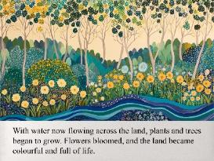

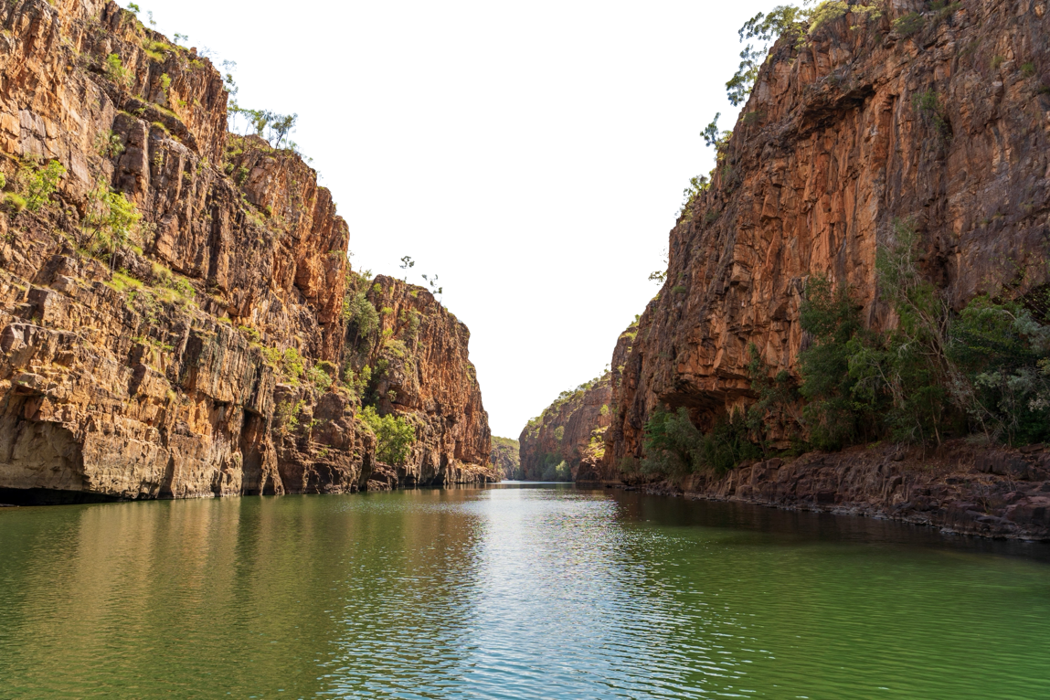
The Dreaming Connections
The Dreaming explains the connection between people, nature and the spirit world.
people
nature
spirit world

Slide 24

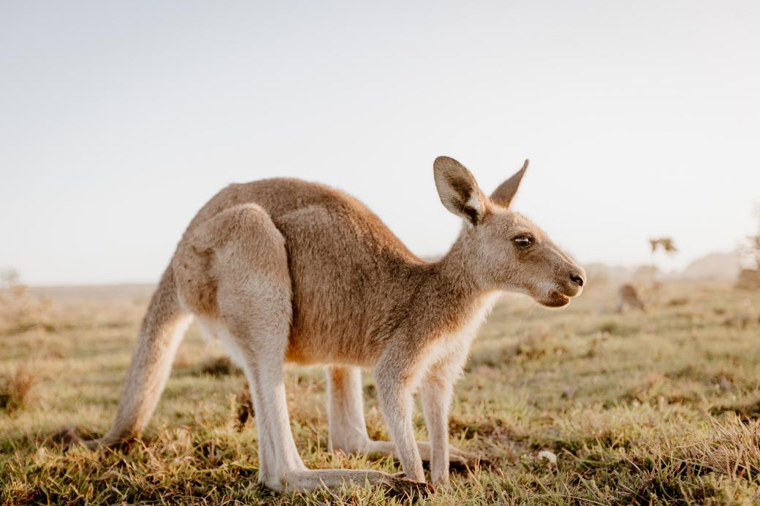
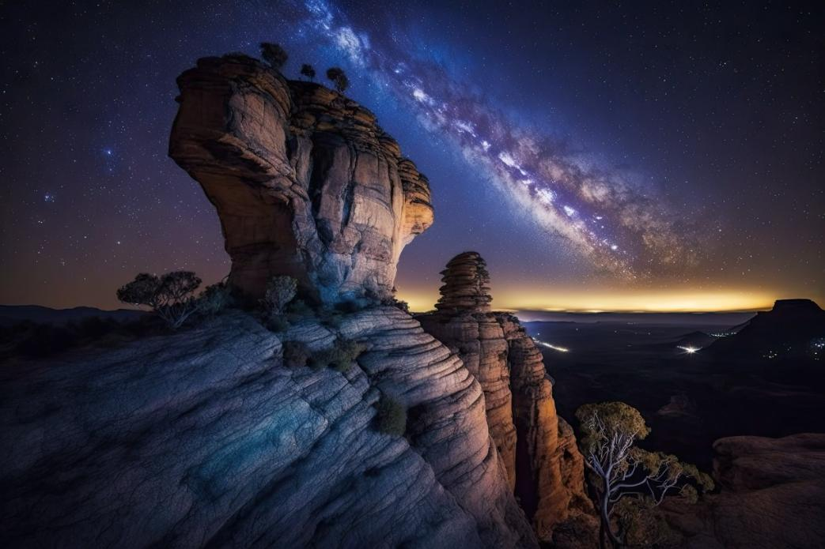
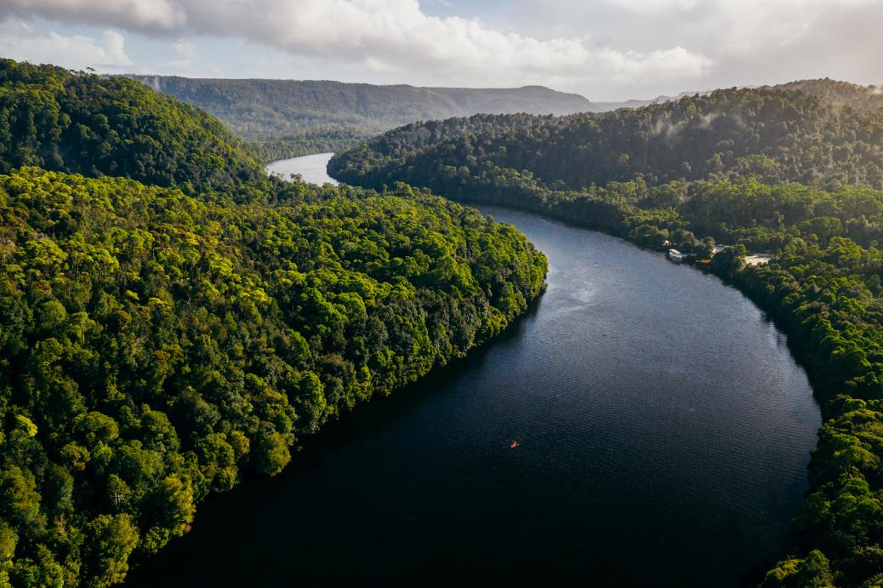
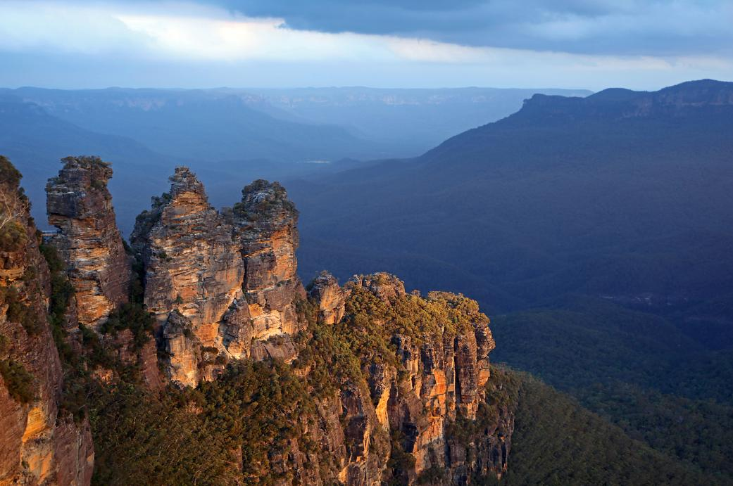
Cultural Memory
The Dreaming preserves cultural memory by linking physical places to stories about the land, water, sky and animals.

Slide 26
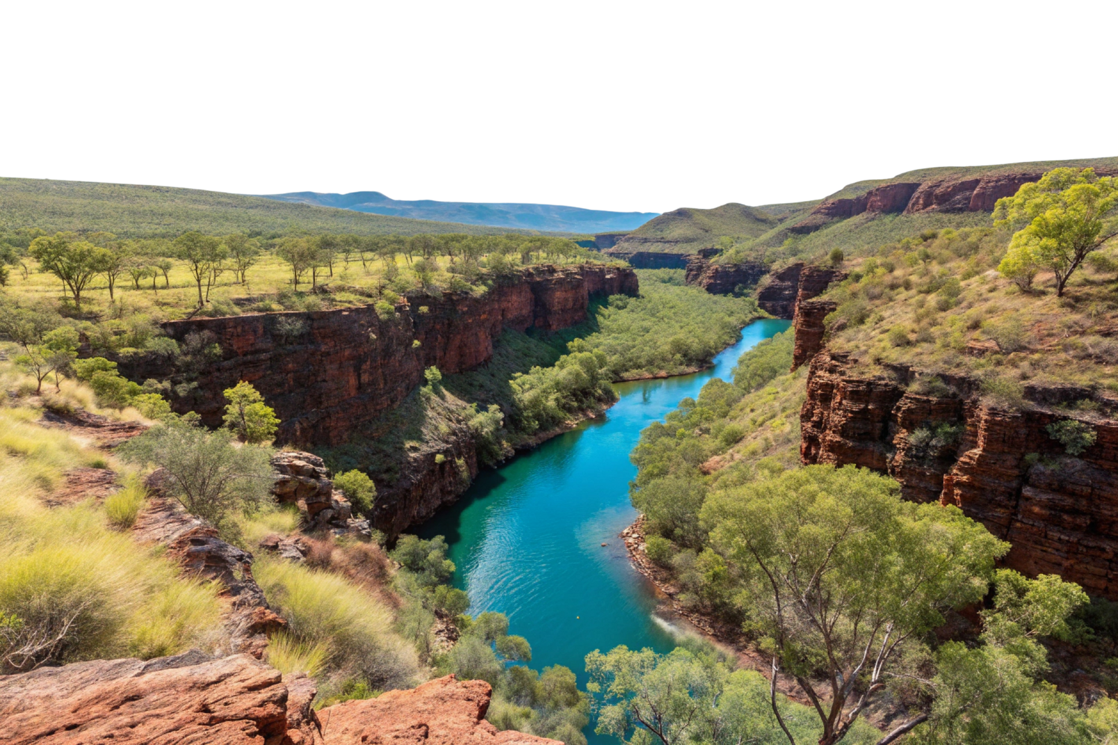

Slide 27
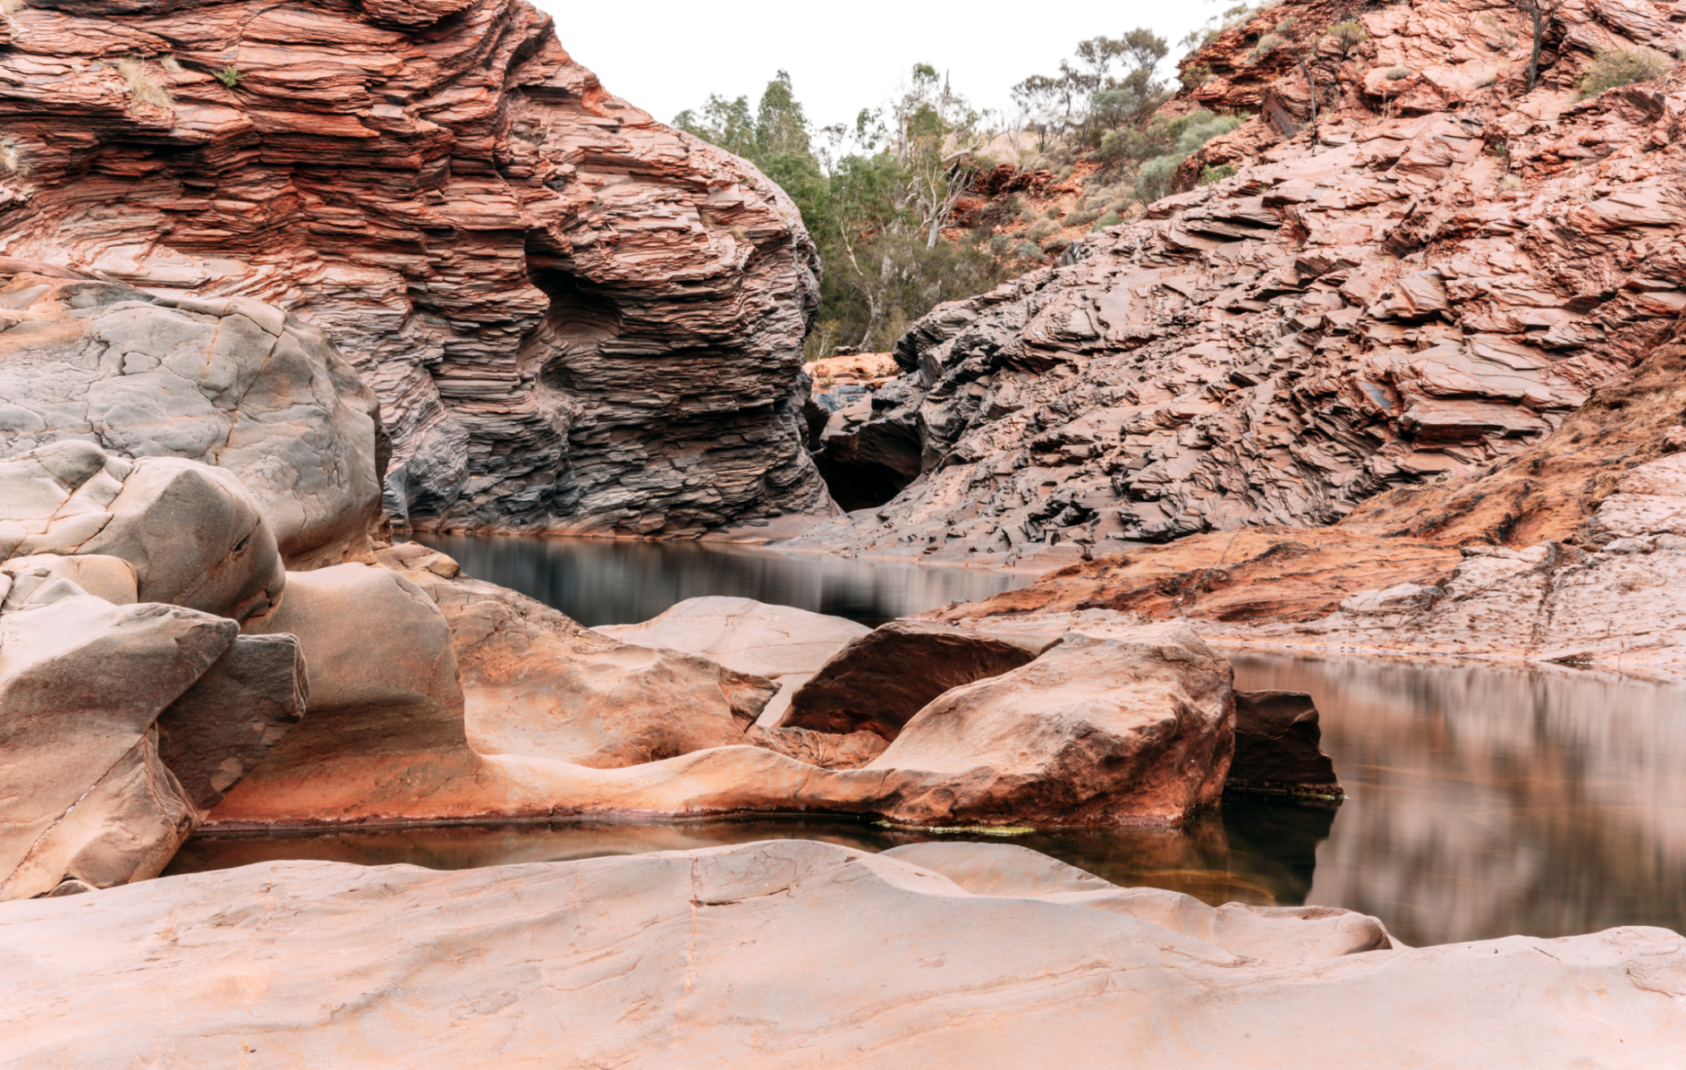

Slide 28
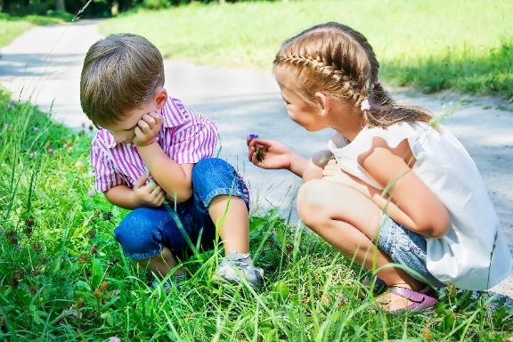

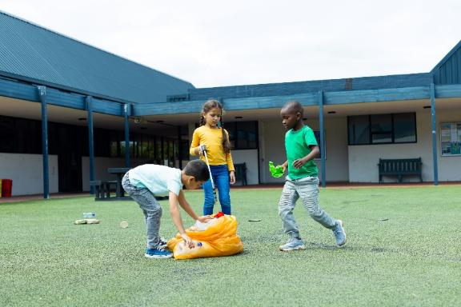
The Law
The Dreaming teaches:
responsibilities
harmony with nature
how to treat others.
Notes:
.

Slide 29



The Dreaming Mind Map
nature
spirit world
people
passed down from generation to generation
Creation of the World
oral stories
The Dreaming
how to treat others
land
The Law
Cultural Memory
water
how to live in harmony with nature
animals
responsibilities
sky

Slide 30
The Dreaming Mind Map
nature
spirit world
people
passed down from generation to generation
Creation of the World
oral stories
The Dreaming
how to treat others
land
The Law
Cultural Memory
water
how to live in harmony with nature
animals
responsibilities
sky

Slide 31
The Dreaming Mind Map
nature
spirit world
people
passed down from generation to generation
Creation of the World
oral stories
The Dreaming
how to treat others
land
The Law
Cultural Memory
water
how to live in harmony with nature
animals
responsibilities
sky

Slide 32
First Nations People lived here for over 60,000 years.
History is passed down through different ways, either written or spoken, so we can learn about the past.
The Dreaming is Indigenous Australians understanding of the world and how the world was made.
The Dreaming explains the connection between people, nature and the spirit world.
The Dreaming preserves cultural memory by linking physical places to stories about the land, water, sky and animals.
The Dreaming teaches responsibility, harmony with nature and how to treat others.

Slide 33
65,000
First Nations People have lived here for over ___________ years.
History can be passed down through:
A. Storytelling
B. Diaries
C. Songs
D. All of the above
The Dreaming explains the connection between people, nature and the s____ ______.
65,000
85,000
95,000
pirit world

Slide 34




In the next lesson, we will learn the purpose and structure of informative writing.
Introduction
subtopic
Focus sentence, descriptive details and factual evidence
Information
subtopic
Focus sentence, descriptive details and factual evidence
Title
subtopic
Focus sentence, descriptive details and factual evidence
Conclusion

