Slide 1

Writing
Unit 3: Informational/ History
Lesson 2: Informative Structure
Version 1

Slide 2
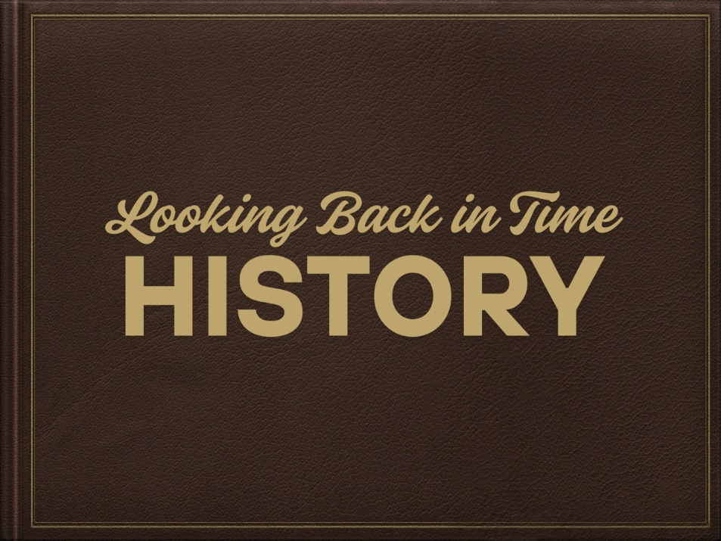
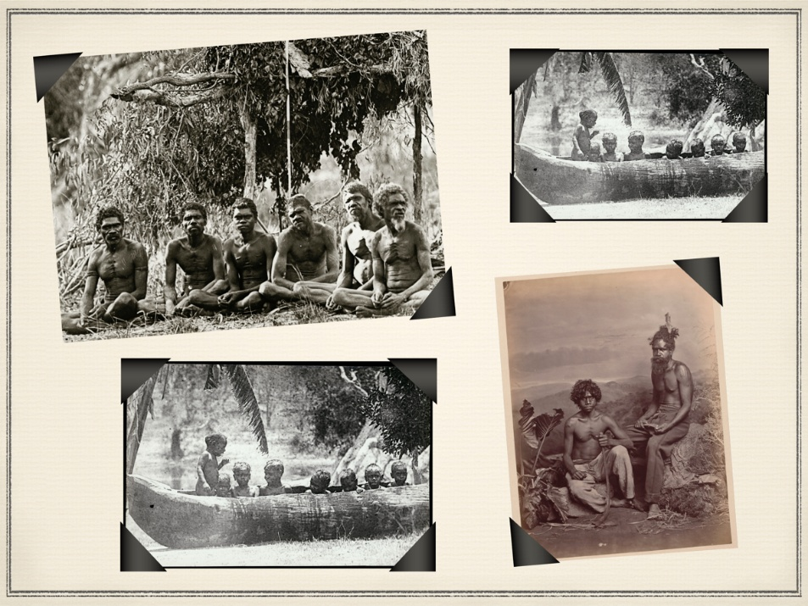
First Nations People have lived here for over 65,000 years.

Slide 3
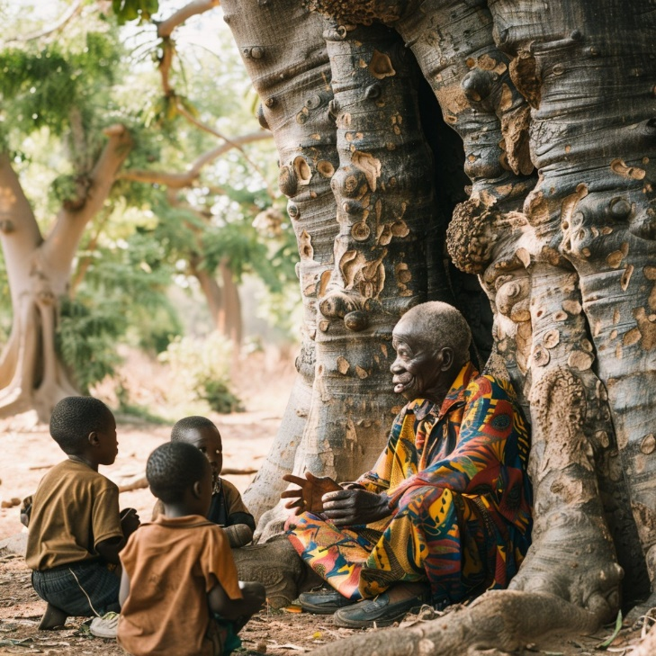

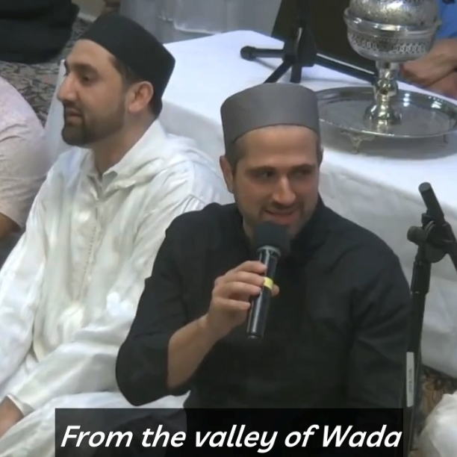
History can be passed down through storytelling, diaries and songs.

Slide 4


The Dreaming explains the connection between people, nature and…
the spirit world.
the arrival of Captain Cook.
Hold one finger up if you agree the answer is number 1.
Hold two fingers up if you agree the answer is number 2.

Slide 5




In this lesson, we will learn the purpose and structure of informative writing.
Introduction
subtopic
Focus sentence, descriptive details and factual evidence
Information
subtopic
Focus sentence, descriptive details and factual evidence
Title
subtopic
Focus sentence, descriptive details and factual evidence
Conclusion

Slide 6
You will be successful when you can: ​
understand the purpose of informative writing
understand the structure of informative writing.​

Slide 7
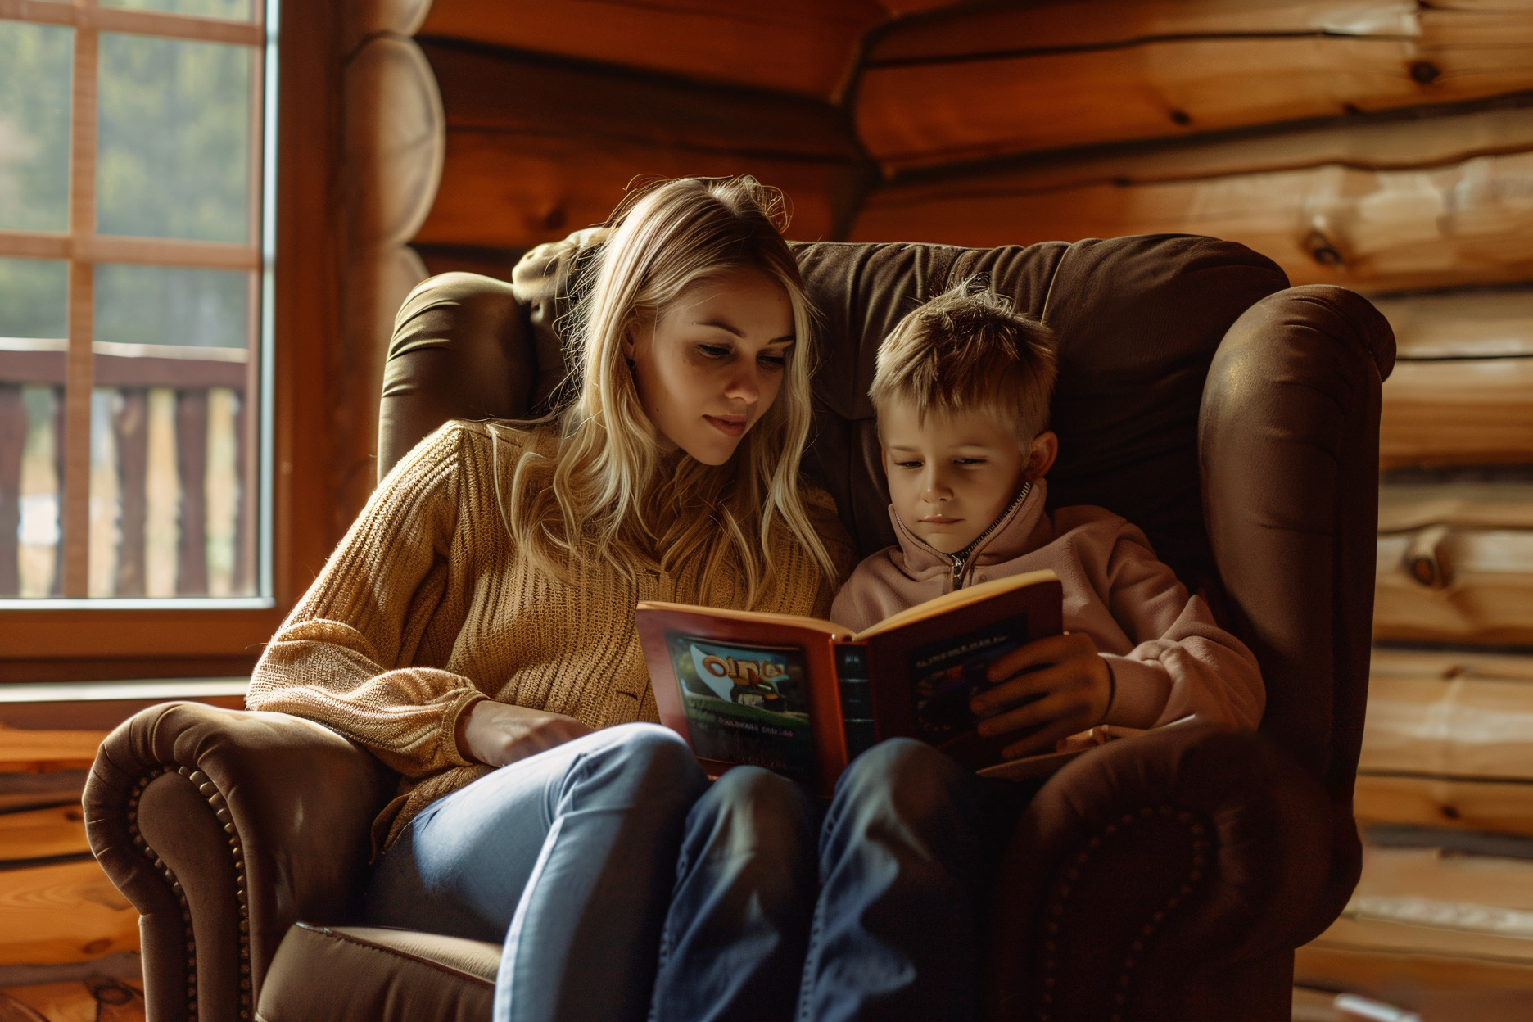
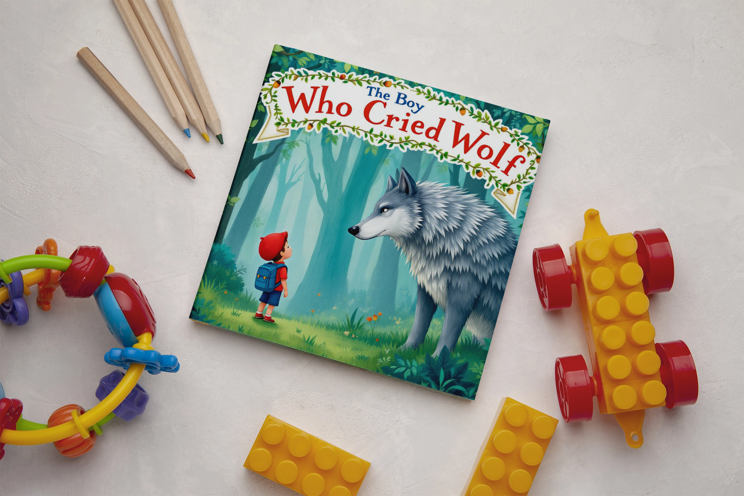
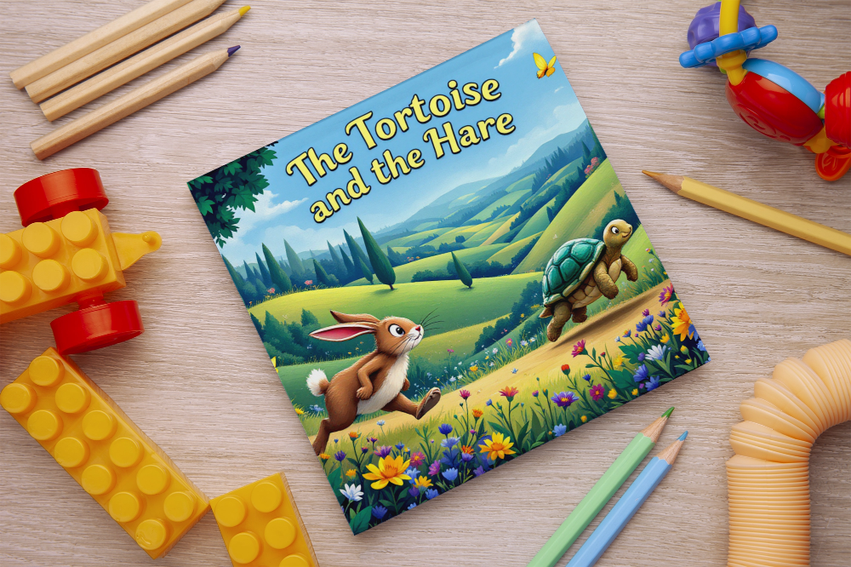
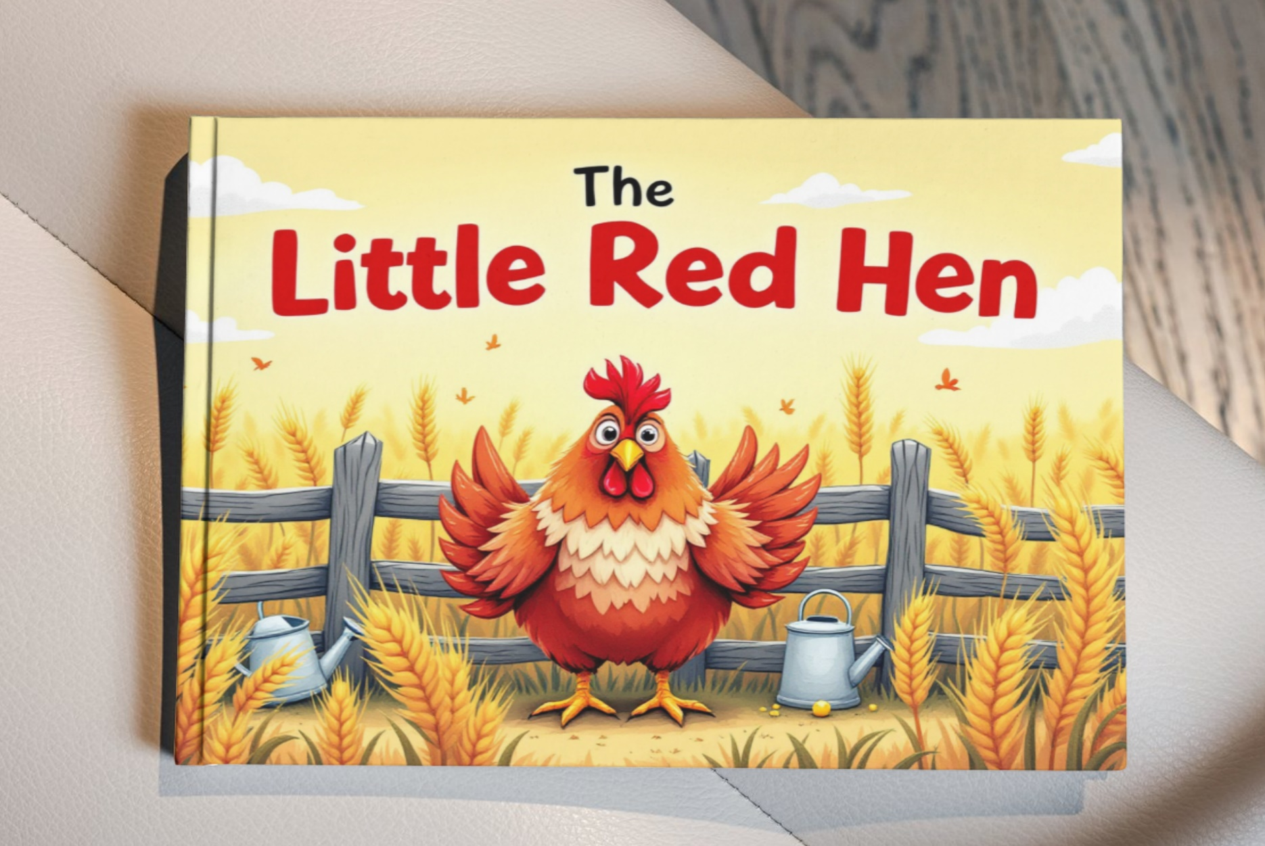

Slide 8
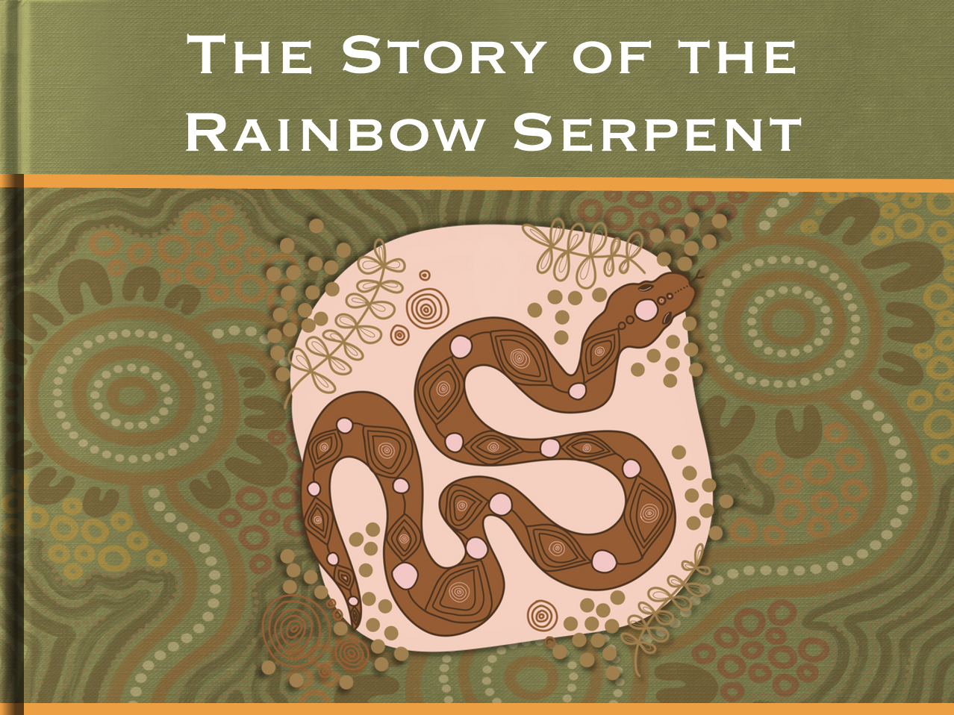
The Dreaming
The Dreaming is Indigenous Australians’ understanding of the world and how the world was made.

Slide 9
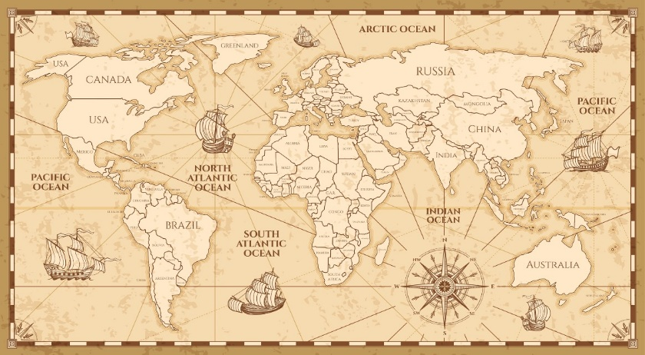
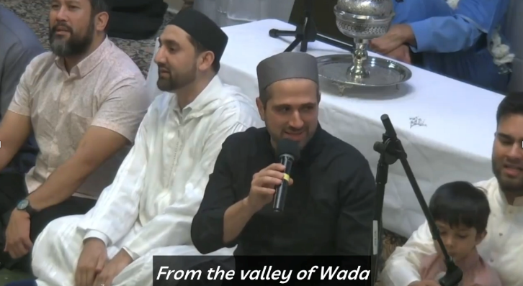
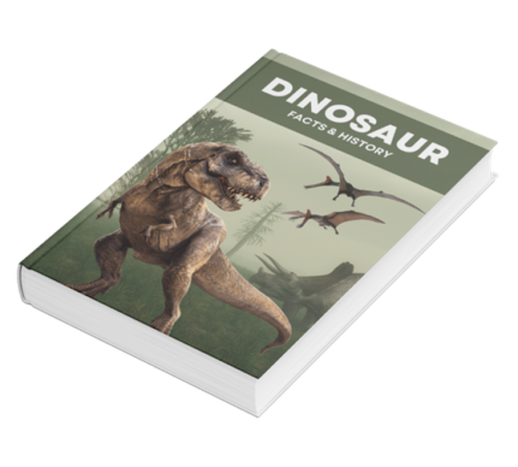

History is...
Written History
Spoken History

Slide 10
Informative Text Structure
Informative writing has an organised structure.
Introduction
subtopic
Focus sentence, descriptive details and factual evidence
Information
subtopic
Focus sentence, descriptive details and factual evidence
Title
subtopic
Focus sentence, descriptive details and factual evidence
Conclusion

Slide 11
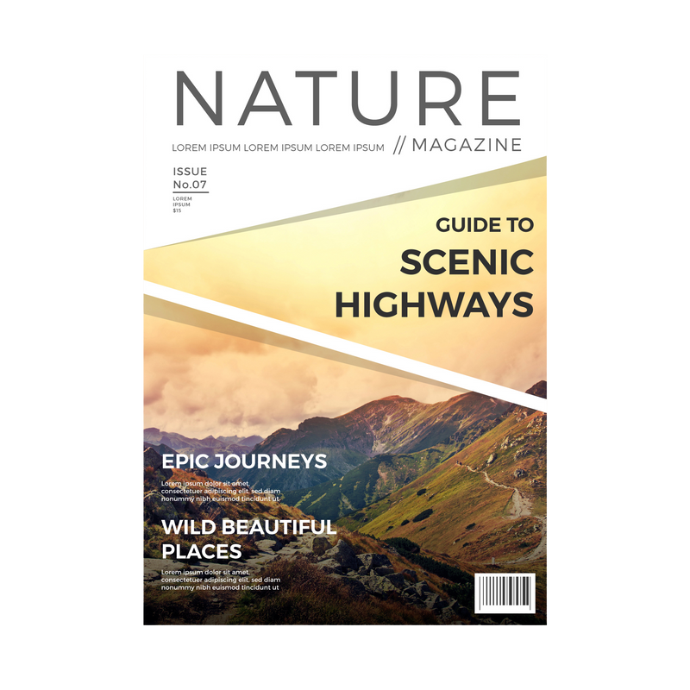
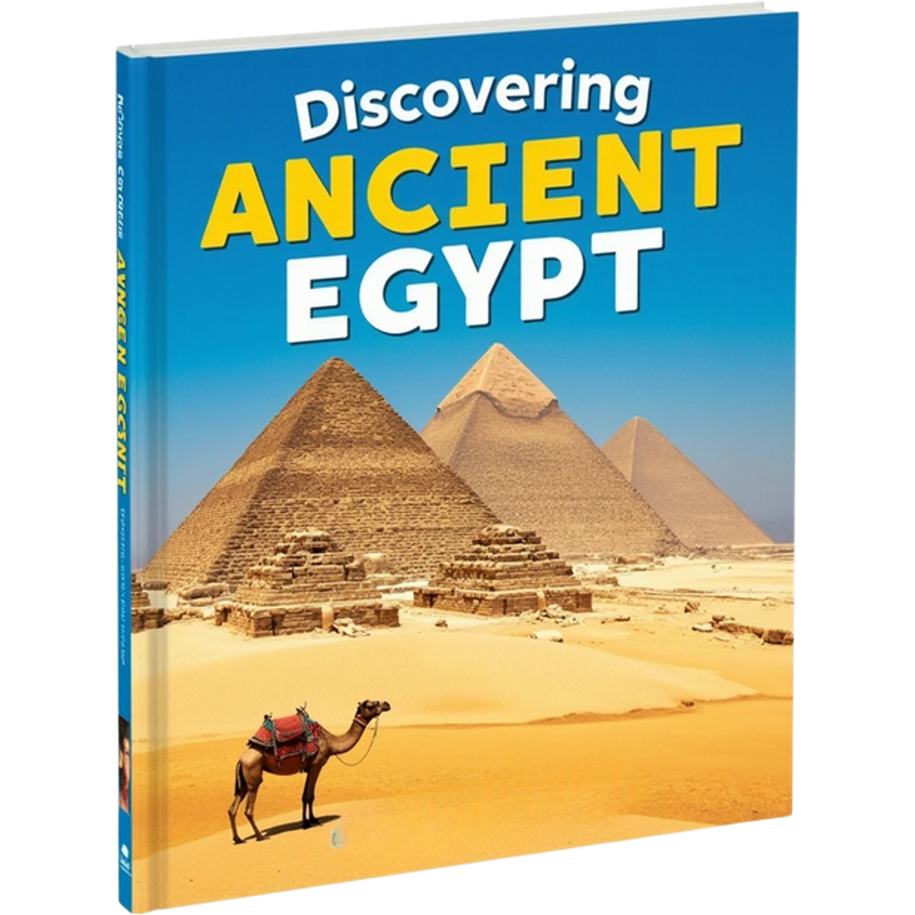

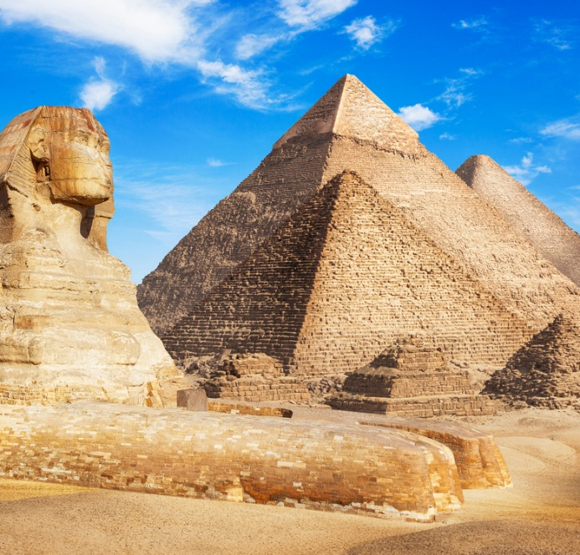




Purpose of Informative Text
The purpose of an informative text is to share information.

Slide 12

Reading Informative Text
Reading an informative text is like watching or listening to the news – you are learning new information.

Slide 13


Thumbs Up or Thumbs Down
The purpose of an informative text is to share information.
No
Yes
Thumbs up for yes.
Thumbs down for no.

Slide 14




The Dreaming

Slide 15
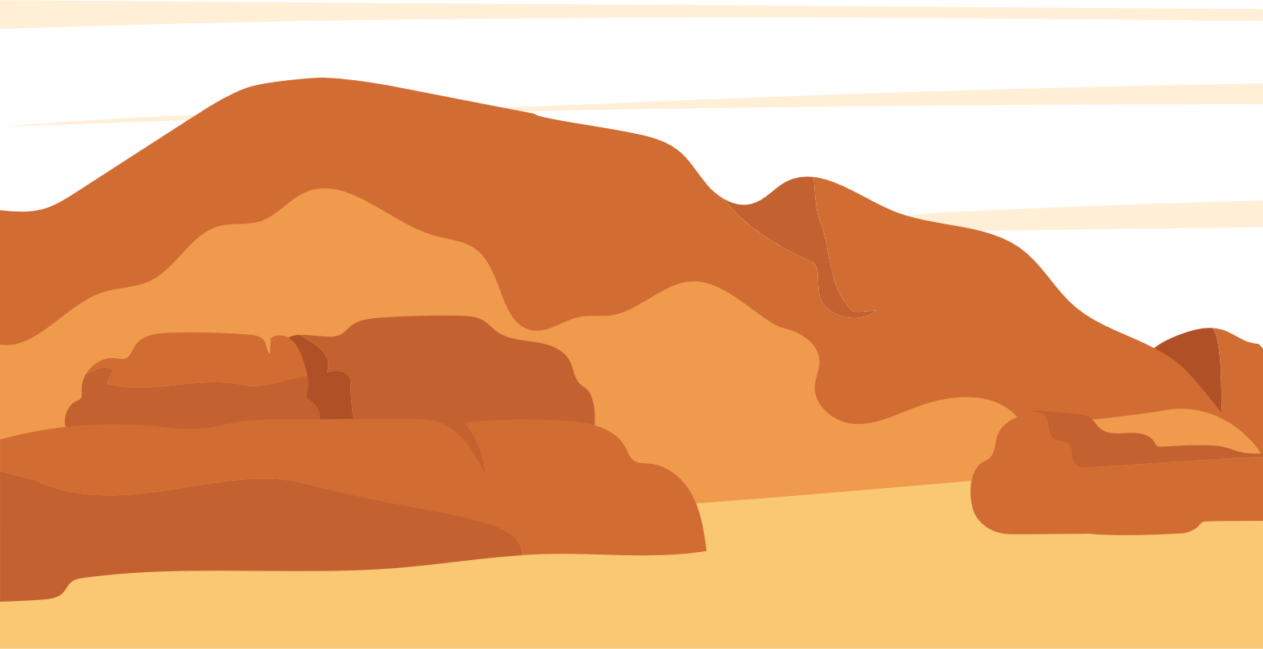
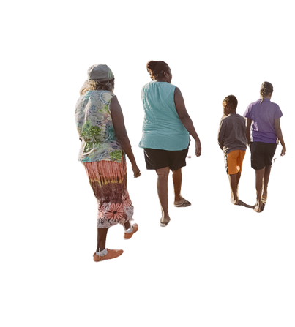
How the Dreaming Stories Shape Land and Law
The Dreaming is the name for stories that explain how the world and all living things began. These stories are very important because they teach First Nations people their role in the world and how to care for it.

Slide 16

A Way to Understand the World
The Dreaming stories help explain how the world was created. They often feature Creation Ancestors like kangaroos or snakes. The Rainbow Serpent is said to have created mountains and rivers before going to live in the sky. This shows how deeply connected Indigenous Australians are to their land.
Rules to Live By
The Dreaming stories teach important lessons about how to live. These stories show the importance of sharing and not being greedy.

Slide 17
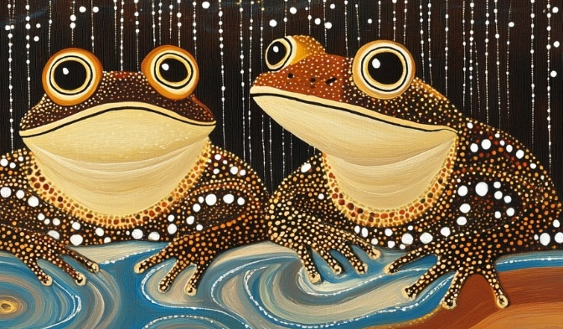
The story of Tiddalik the Frog explains how sharing is important because he leaves no water for the other animals to drink. This story teaches the importance of respecting each other and the environment.
Telling Tales of Creation
The Dreaming is shared through storytelling, which is an important part of Indigenous culture. Elders pass down these stories to younger generations. They tell those stories to help young people learn who they are and their connection to the land. This tradition helps keep the culture strong and connected to the past.

Slide 18
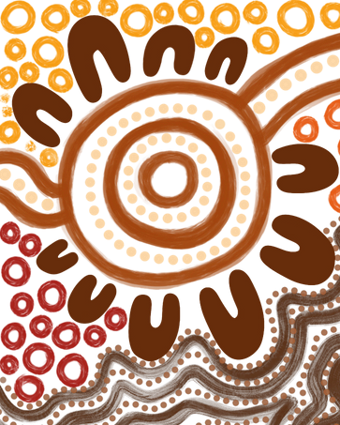
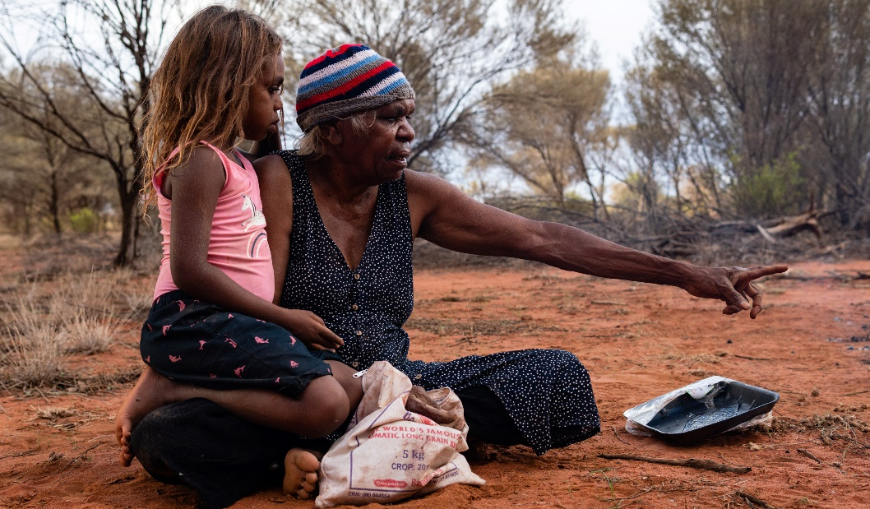
The Dreaming stories and beliefs are an important part of Indigenous Australian culture. They help preserve traditional culture and encourage us to live in harmony with the environment.

Slide 19
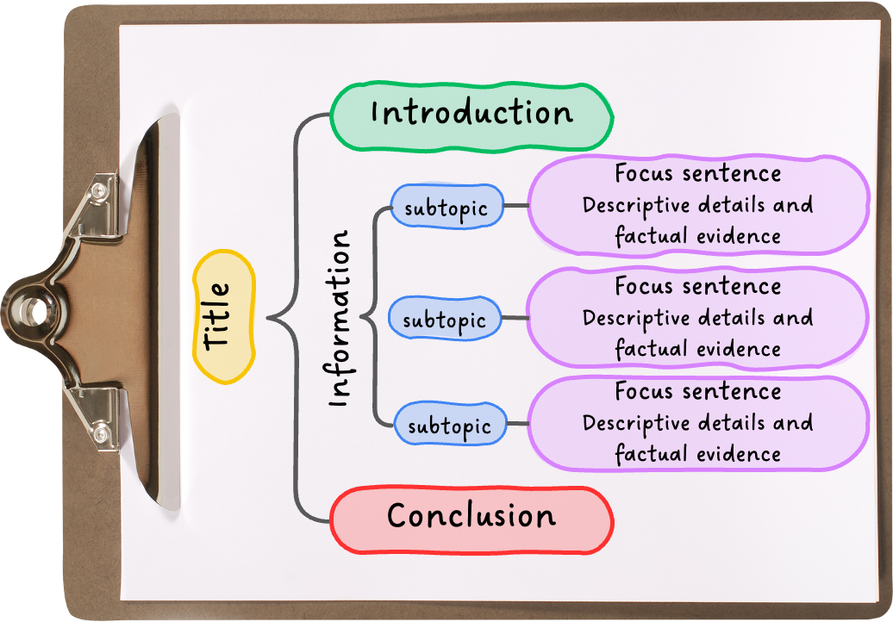
How the Dreaming Stories Shape Land and Law
The Dreaming is the name for stories that explain how the world and all living things began. These stories are very important because they teach First Nations people their role in the world and how to care for it.
A Way to Understand the World
The Dreaming stories help explain how the world was created. They often feature Creation Ancestors like Kangaroos or snakes. The Rainbow Serpent is said to have created mountains and rivers before going to live in the sky. This shows how deeply connected Indigenous Australians are to their land.
Rules to Live By
The Dreaming stories teach important lessons about how to live. These stories show the importance of sharing and not being greedy. The story of Tiddalik the Frog explains how sharing is important because sharing is important because he leaves no water for the other animals to drink. This teaches us that respecting each other and the environment is important.
Telling Tales of Creation
The Dreaming is shared through storytelling, which is an important part of Indigenous culture. Elders pass down these stories to younger generations. They tell those stories to help young people learn who they are, and their connection to the land. This tradition helps keep the culture strong and connected to the past.
The Dreaming stories and beliefs are an important part of Indigenous Australian culture. They help preserve traditional culture and encourage us to live in harmony with the environment.
How the Dreaming Stories Shape Land and Law
The Dreaming is the name for stories that explain how the world and all living things began. These stories are very important because they teach First Nations people their role in the world and how to care for it.
A Way to Understand the World
The Dreaming stories help explain how the world was created. They often feature Creation Ancestors like kangaroos or snakes. The Rainbow Serpent is said to have created mountains and rivers before going to live in the sky. This shows how deeply connected Indigenous Australians are to their land.
Rules to Live By
The Dreaming stories teach important lessons about how to live. These stories show the importance of sharing and not being greedy. The story of Tiddalik the Frog explains how sharing is important because he leaves no water for the other animals to drink. This teaches us that respecting each other and the environment is important.
Telling Tales of Creation
The Dreaming is shared through storytelling, which is an important part of Indigenous culture. Elders pass down these stories to younger generations. They tell those stories to help young people learn who they are and their connection to the land. This tradition helps keep the culture strong and connected to the past.
The Dreaming stories and beliefs are an important part of Indigenous Australian culture. They help preserve traditional culture and encourage us to live in harmony with the environment.

Slide 20


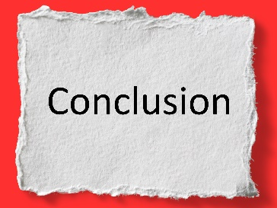
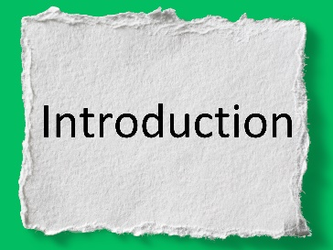

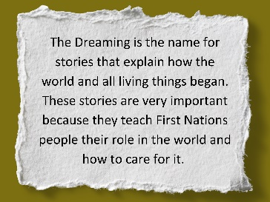
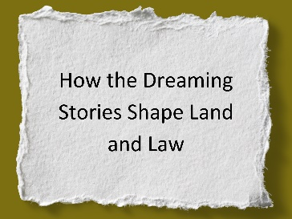
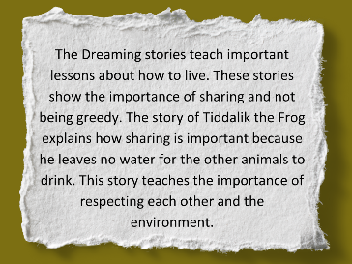
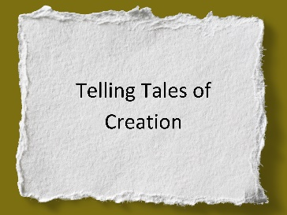
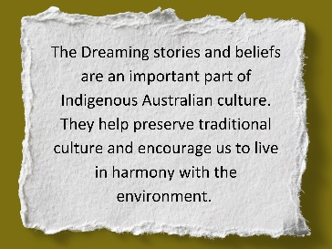
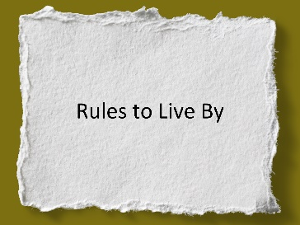
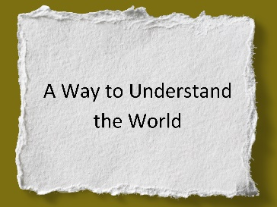
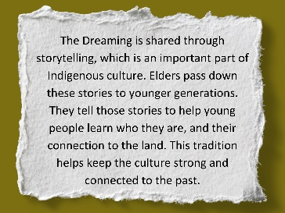
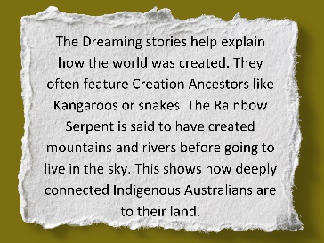
I Do: I Have; Do You Have?

Slide 21
I Do: I Have; Do You Have?

Slide 22
I Have; Do You Have?

Slide 23
I Do: I Have; Do You Have?

Slide 24
Informative writing has an organised structure.
The purpose of an informative text is to share information.
Reading an informative text is like watching or listening to the news – you are learning new information.

Slide 25
organised
Informative writing has an ___________ structure.
The purpose of an informative text is to share:
A. Stories
B. Memories
C. Jokes
D. Information
Reading an informative text is like watching the n____.
random
creative
organised
ews

Slide 26
In the next lesson, we will learn about topics and titles.

