Slide 1
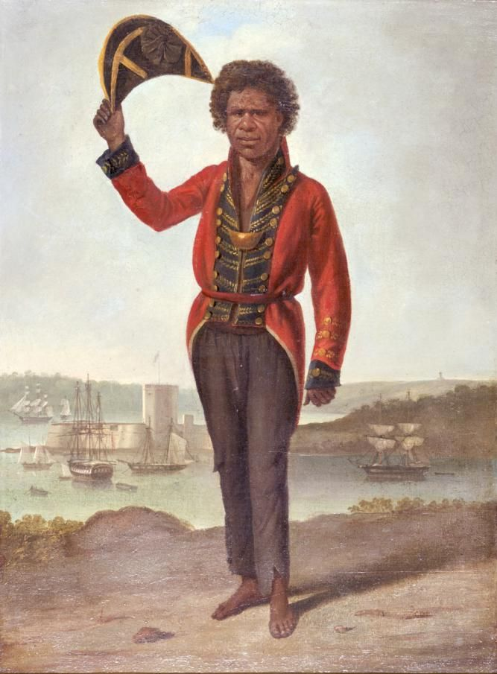
Writing
Unit 3: Informational/
History
Lesson 1: Bungaree and the Circumnavigation of Australia
Version 1

Slide 2
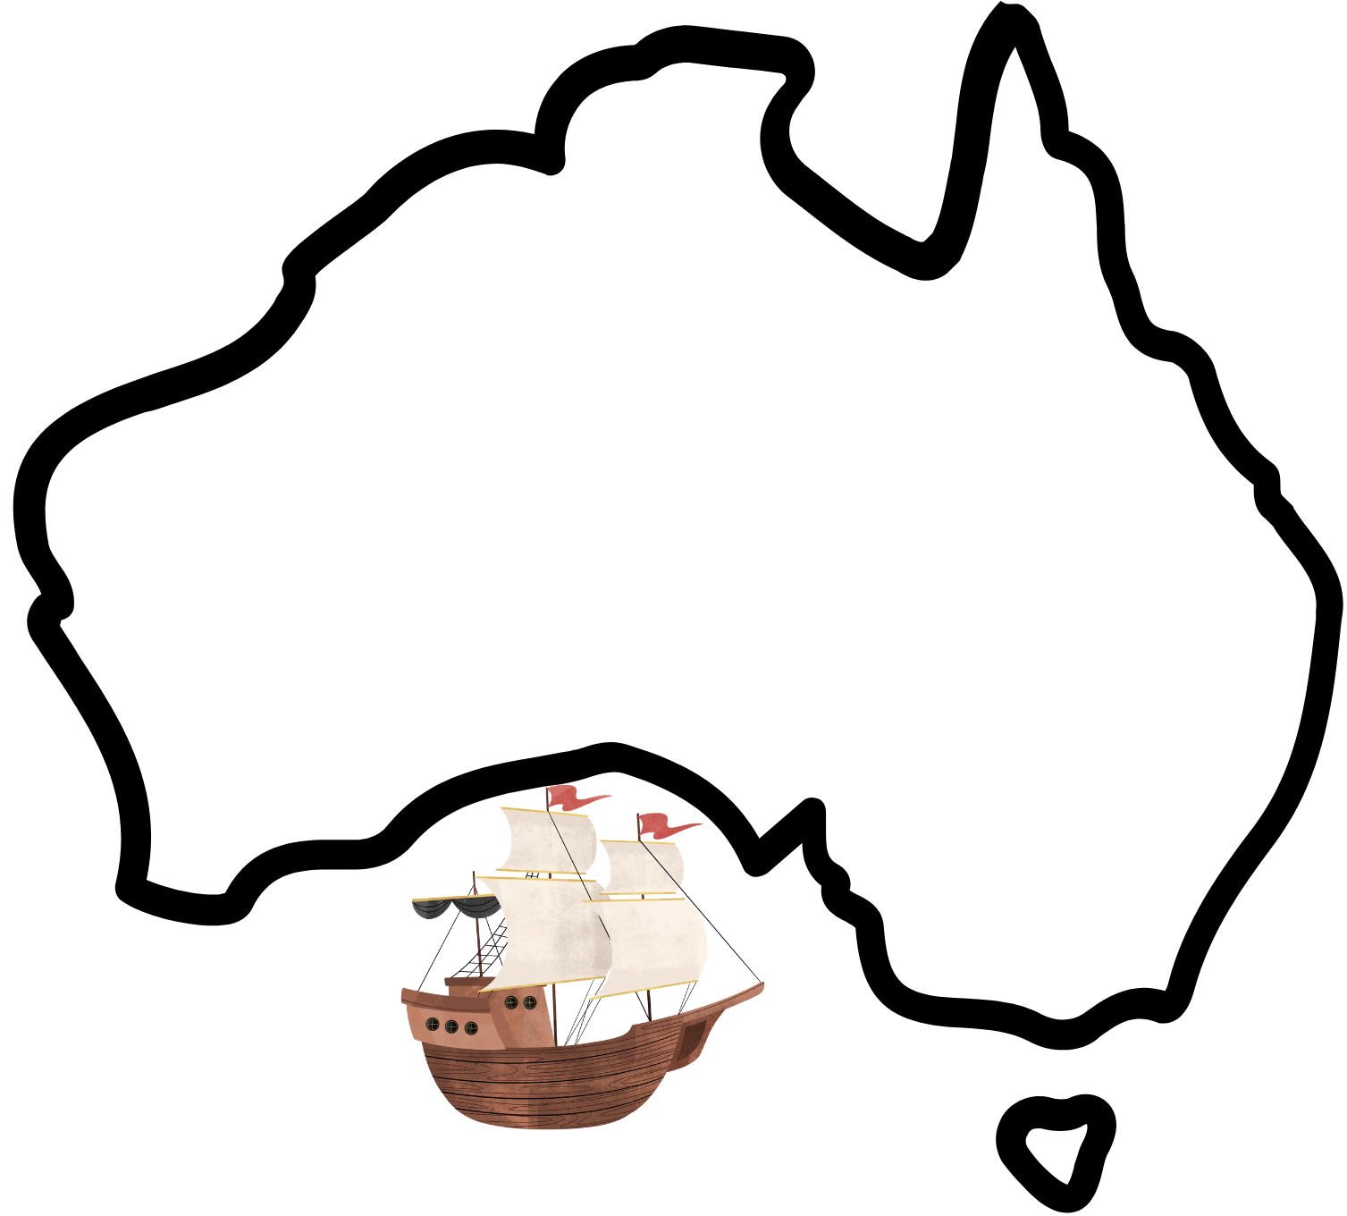
In this lesson, we will learn how Bungaree helped Matthew Flinders circumnavigate Australia.

Slide 3
You will be successful when you can: ​
understand who Bungaree and Matthew Flinders were
understand how Bungaree helped Matthew Flinders circumnavigate Australia.

Slide 4
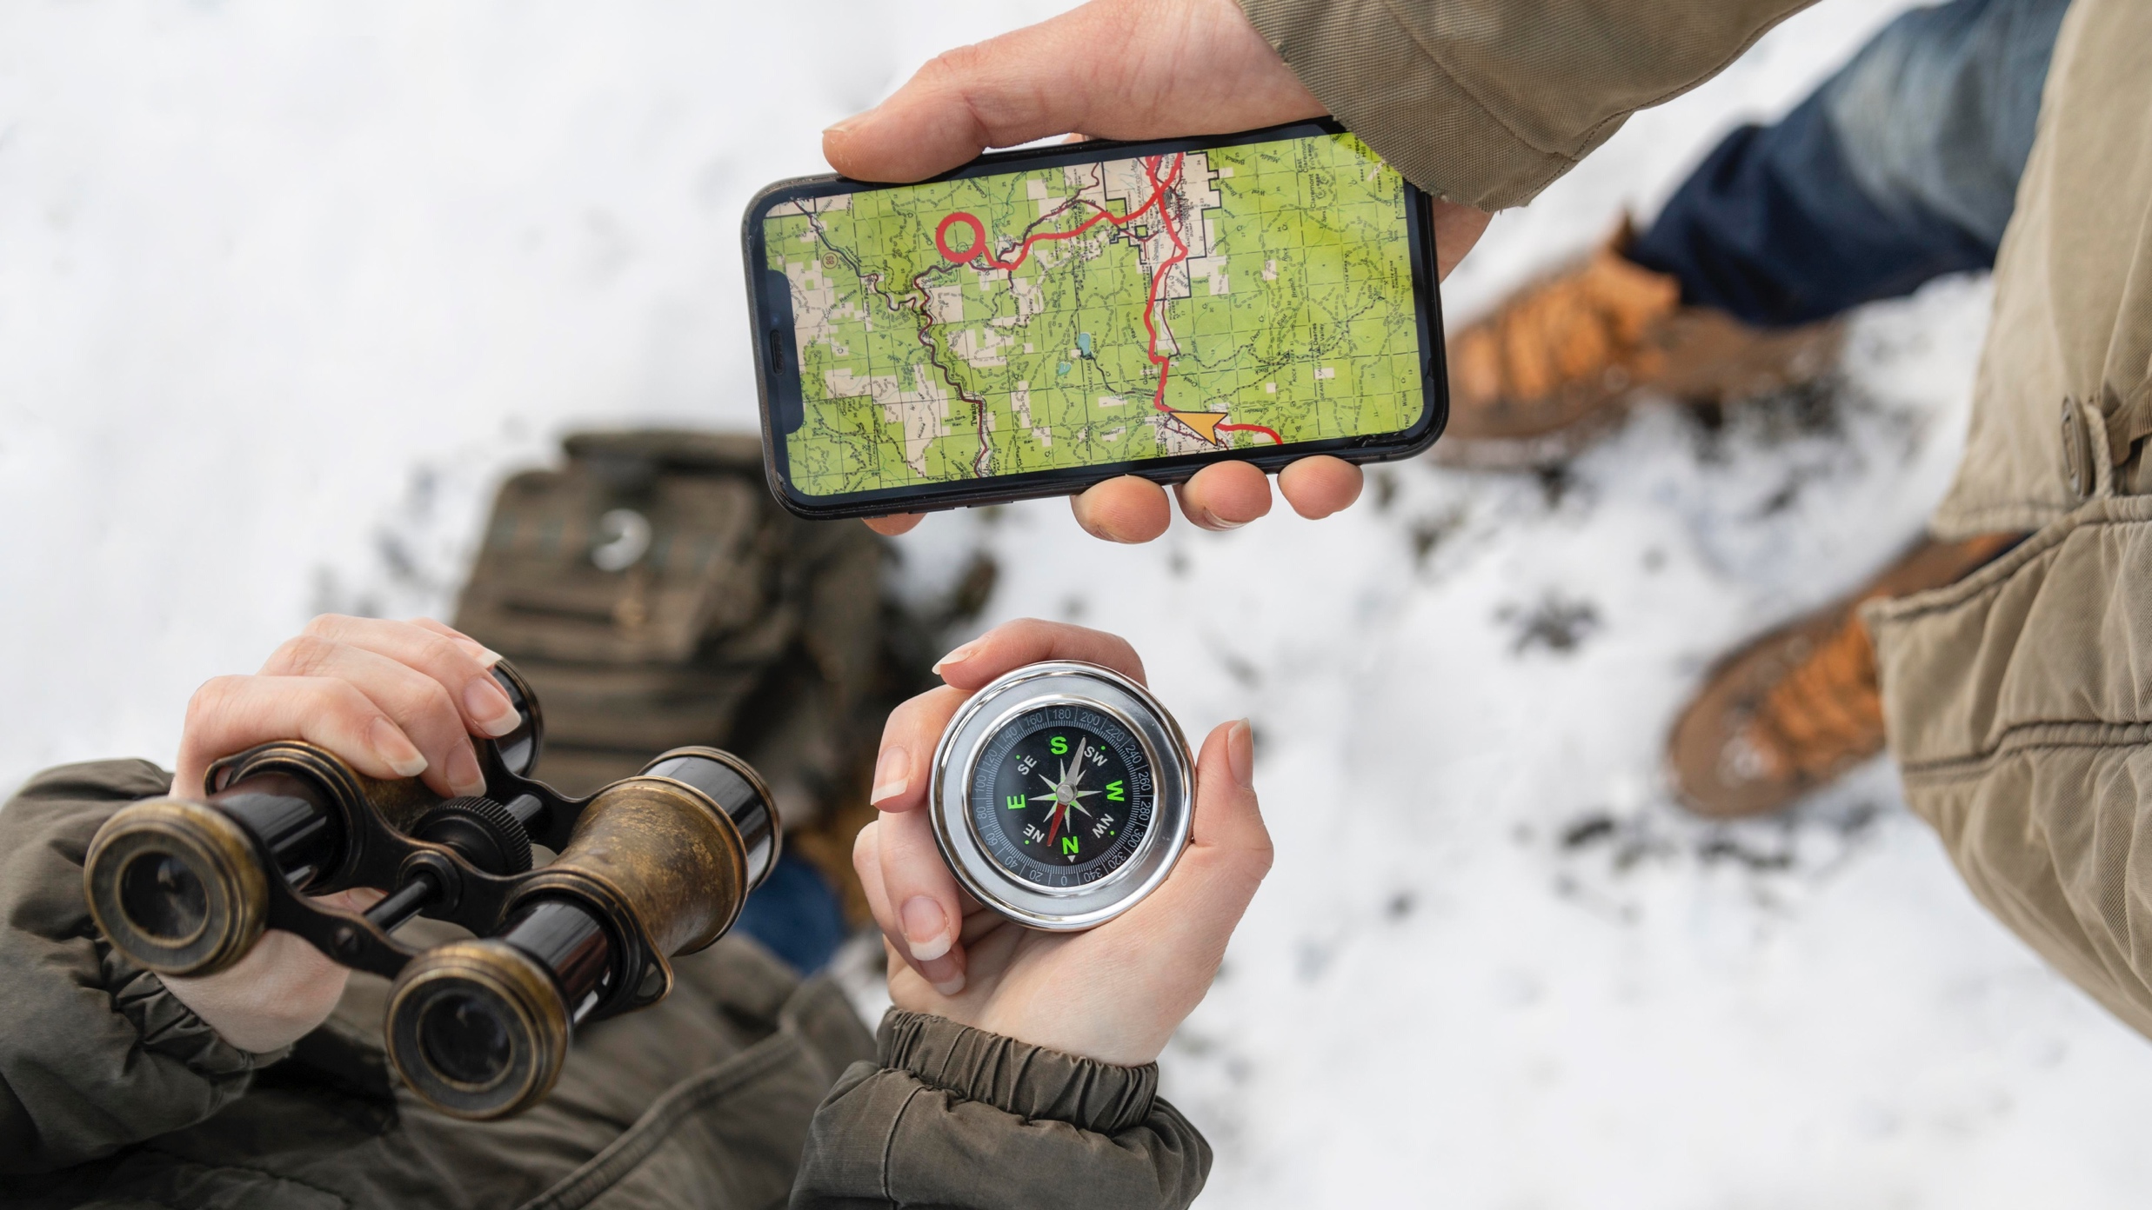
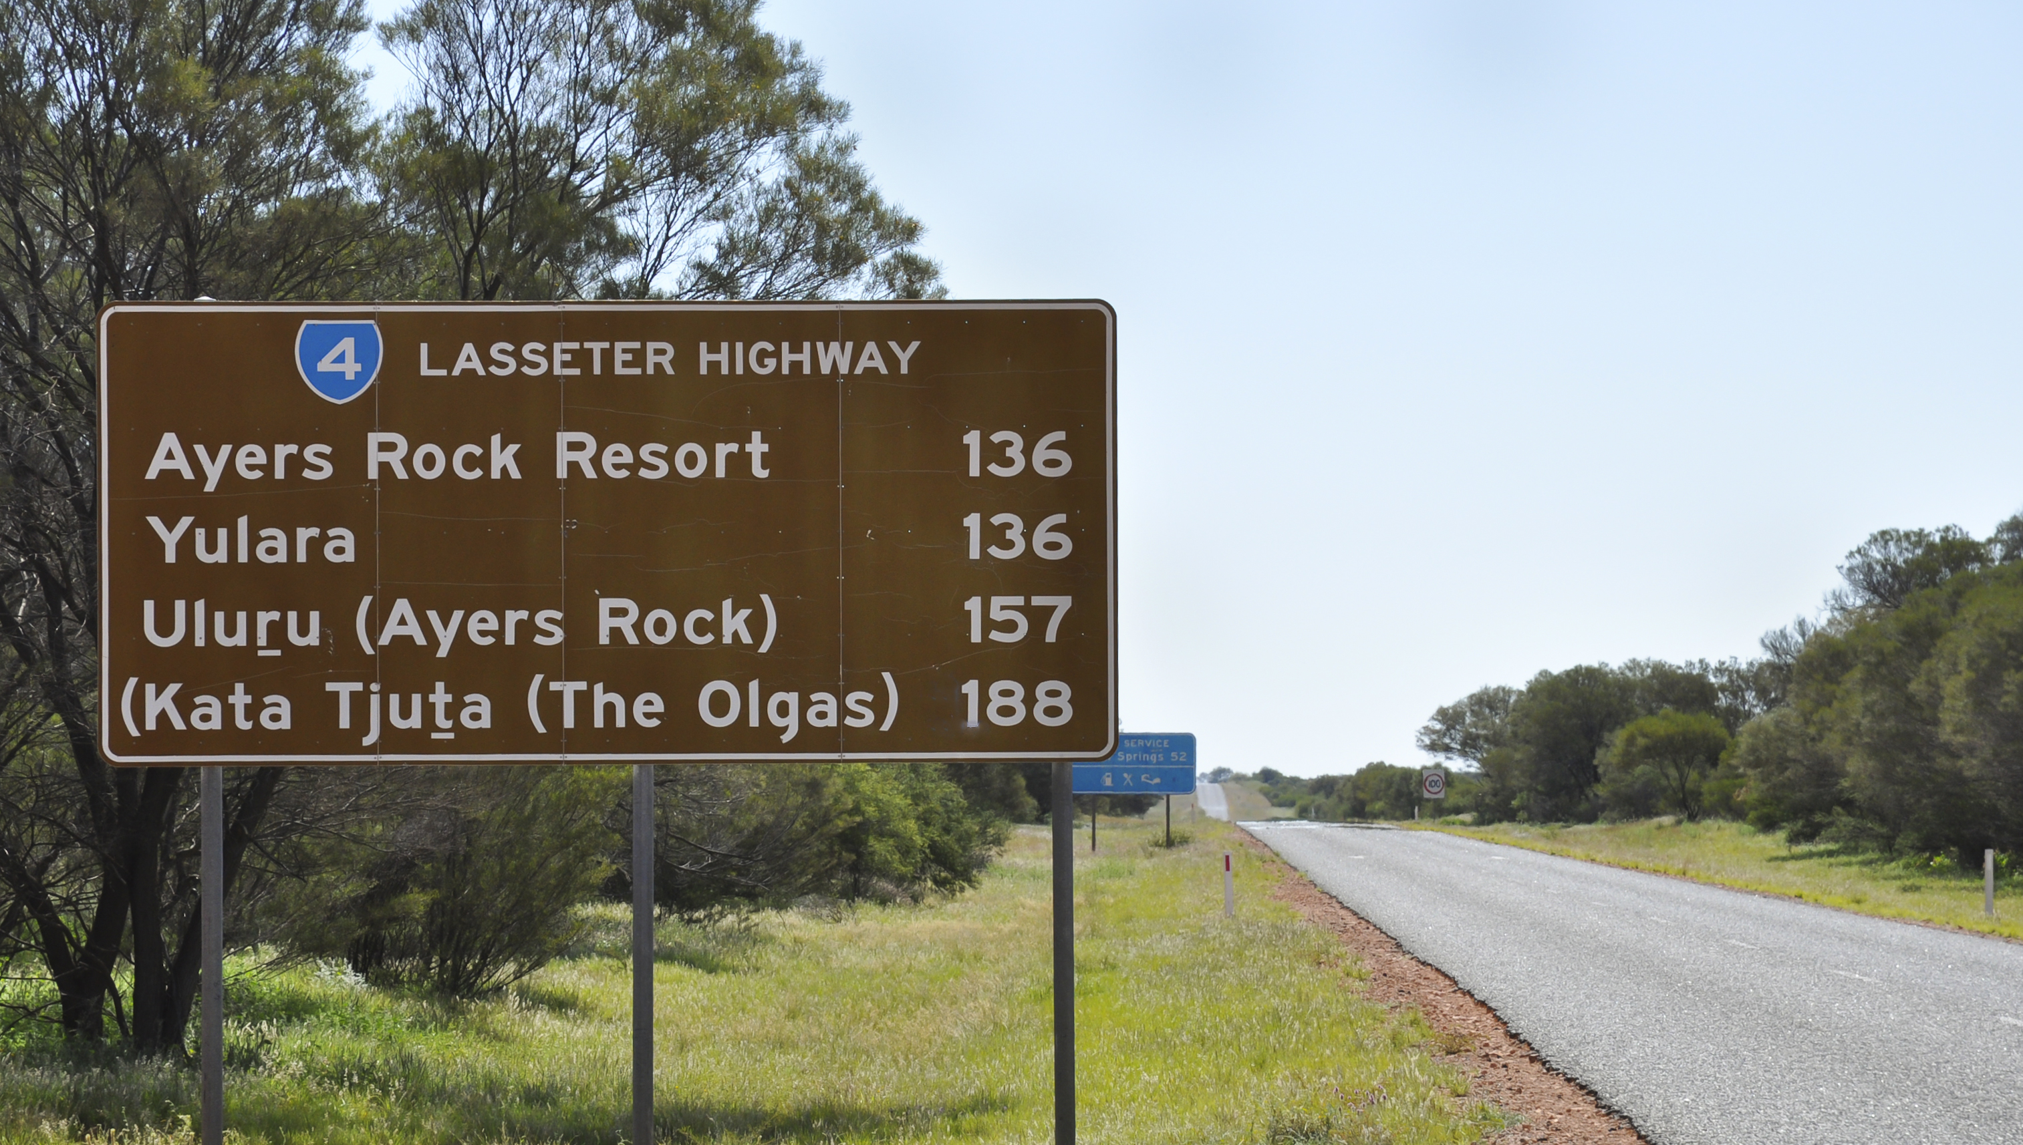

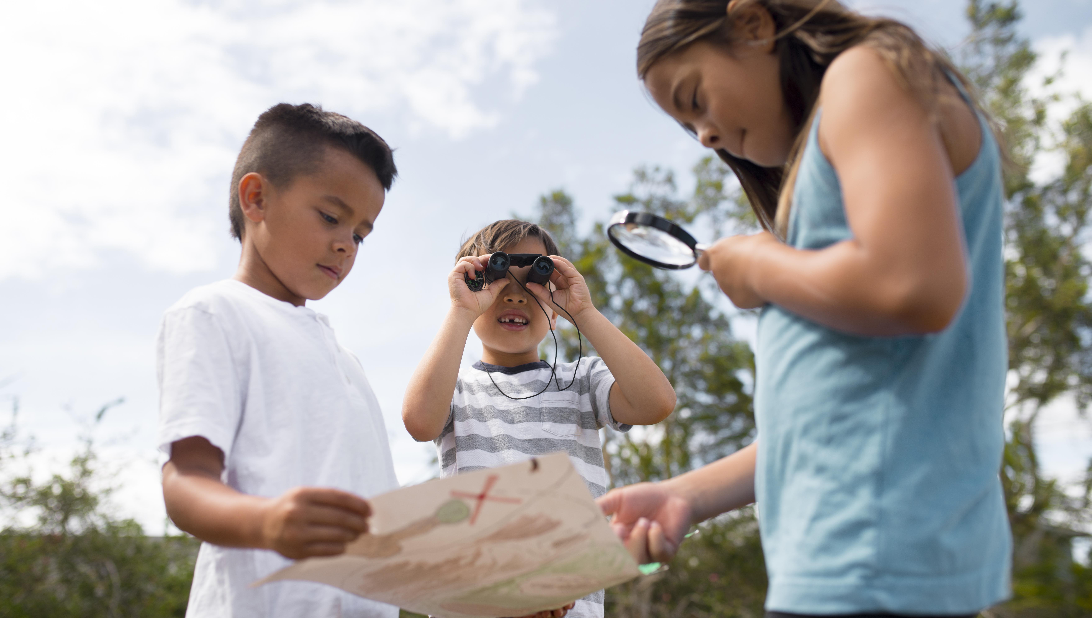

Slide 5



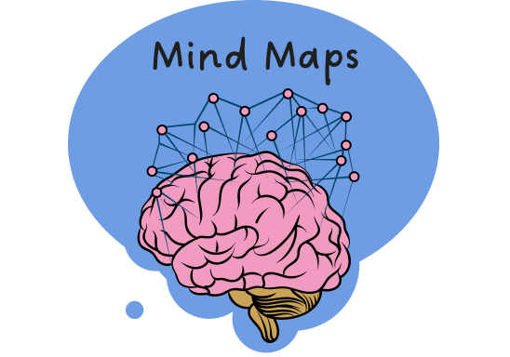












Mapping My Mind
Remember what we’ve learned
Helps put information IN
Organise ideas
Purpose
Show thinking
Visualise thoughts
Mind Maps
Helps take information OUT
You can see:
Last levels: descriptive details and factual evidence
Read information
Radiate outwards
Pictures
Centre circle: main topic
Words
Next level: subtopics

Slide 6
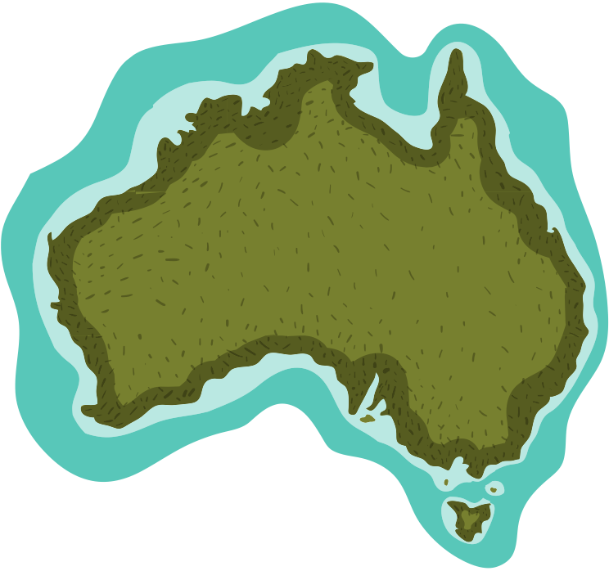
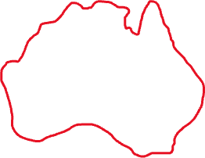
Diplomat
Australian coastlines unknown
Mapped coastline
Interpreter
Bungaree = connection to Indigenous communities
Exploration, led by Matthew Flinders
Circumnavigation
Of Australia
Faced difficulties
Local Customs
Port Jackson
NOW: Growing
appreciation for...
Indigenous perspectives
Bungaree’s contribution
Indigenous role in exploration
Indigenous knowledge

Slide 7
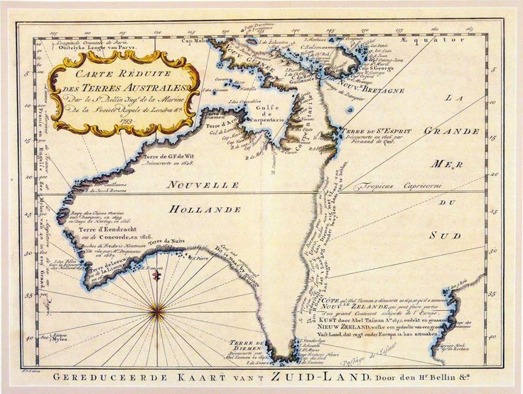
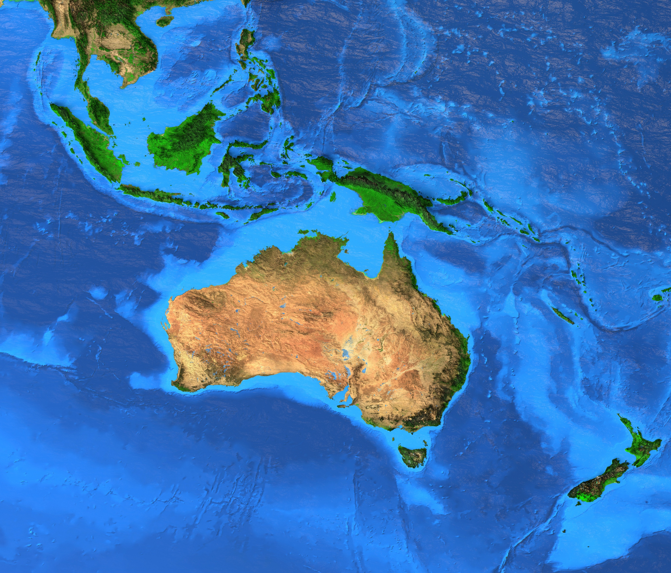
The Early Days
Before 1803, not much was known about Australia.

Slide 8
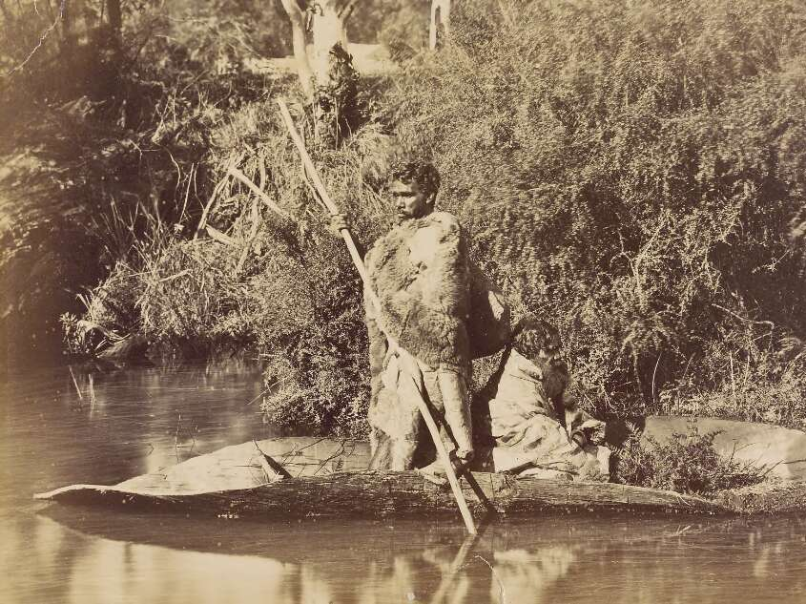
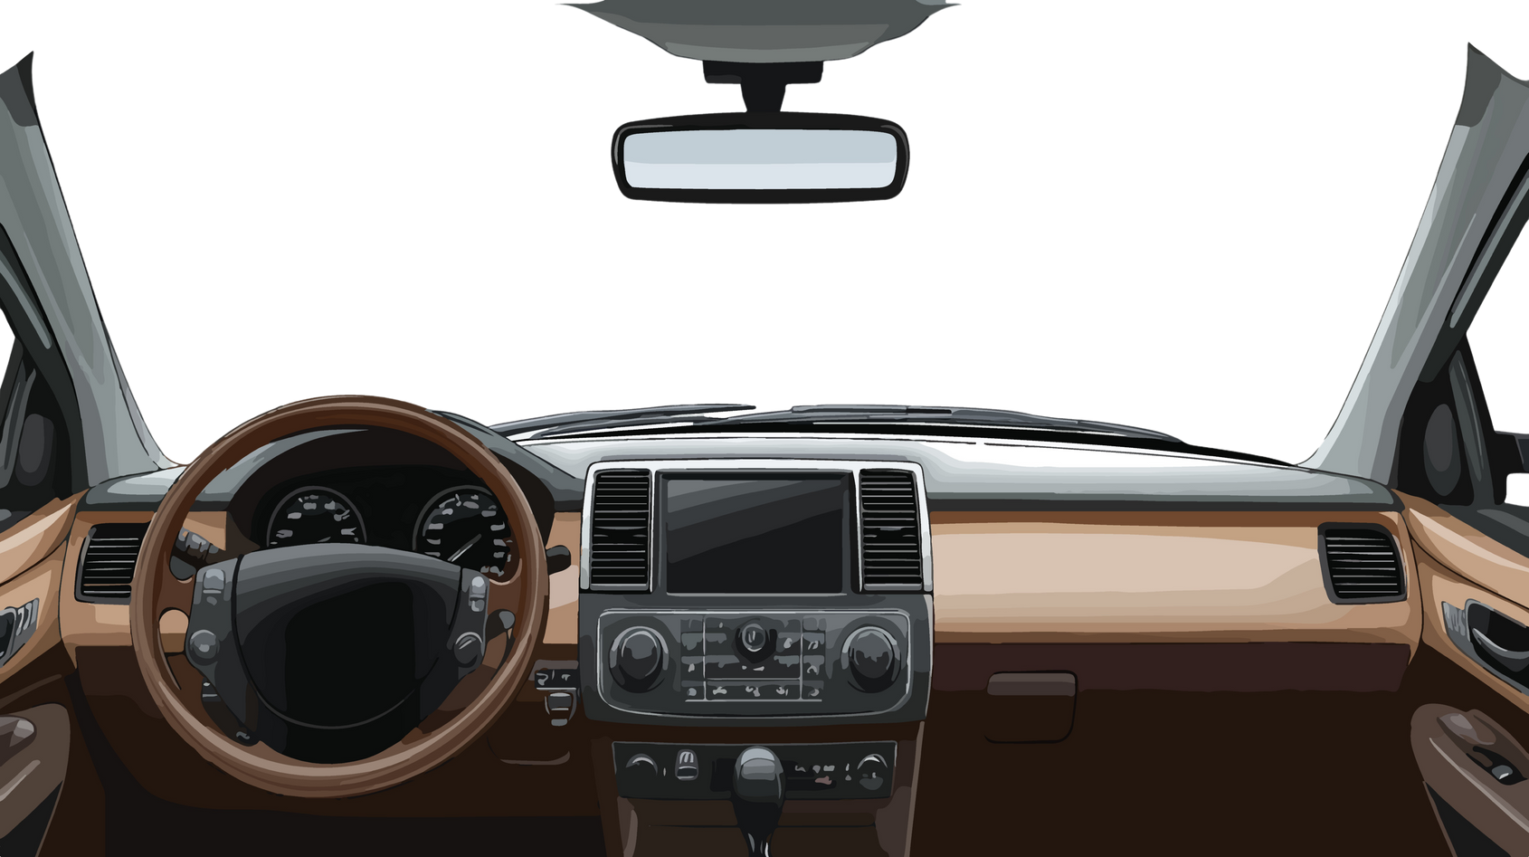



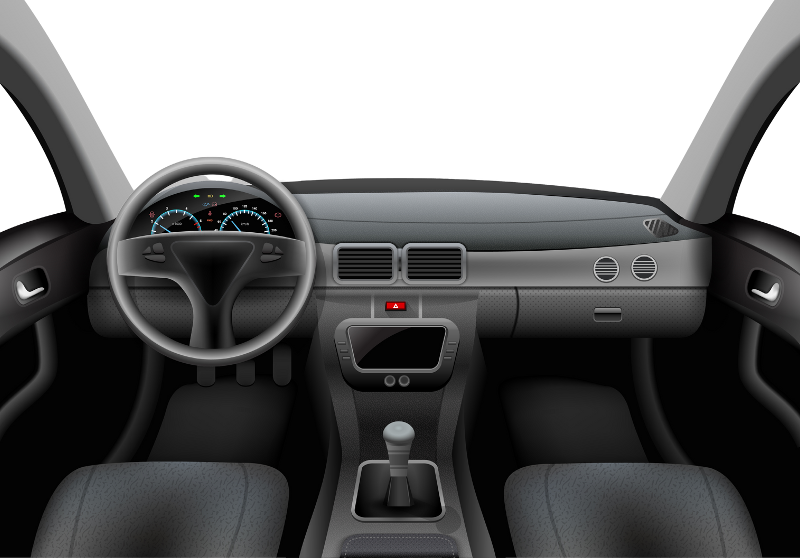


Slide 9
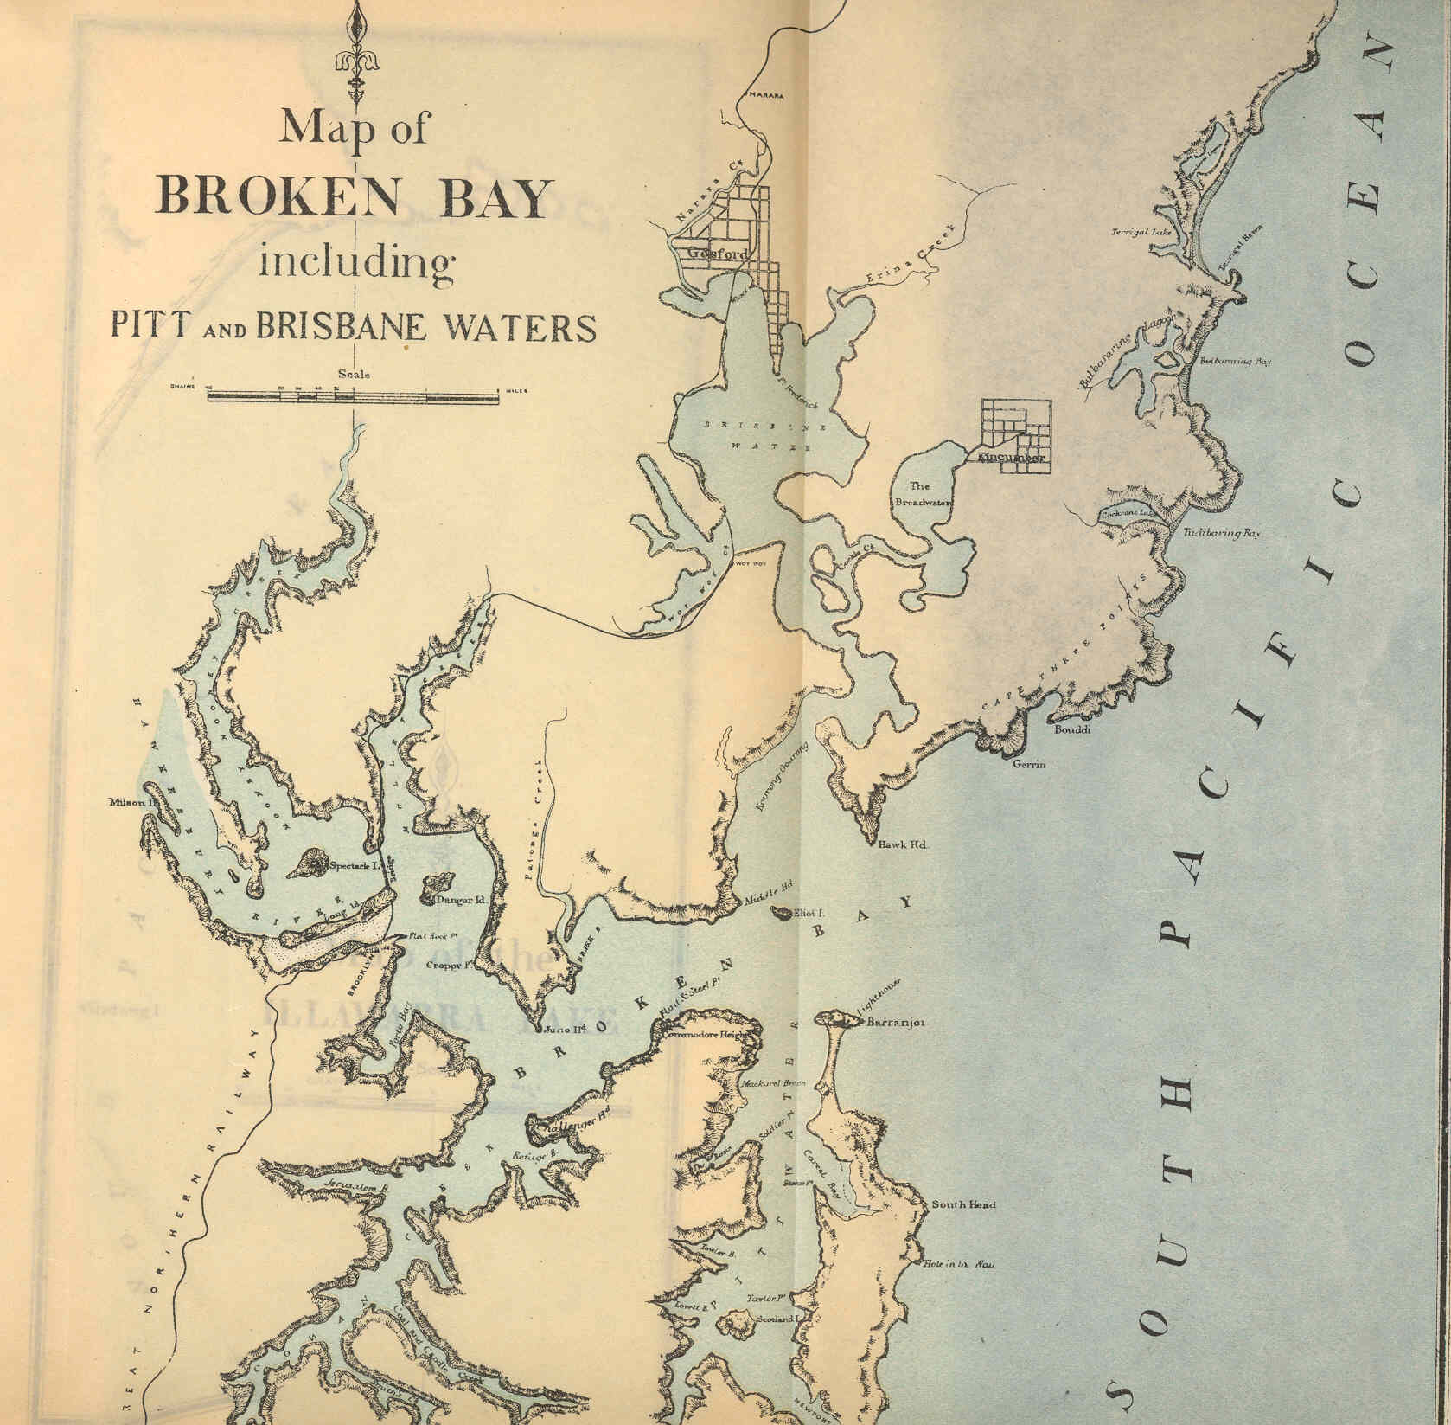
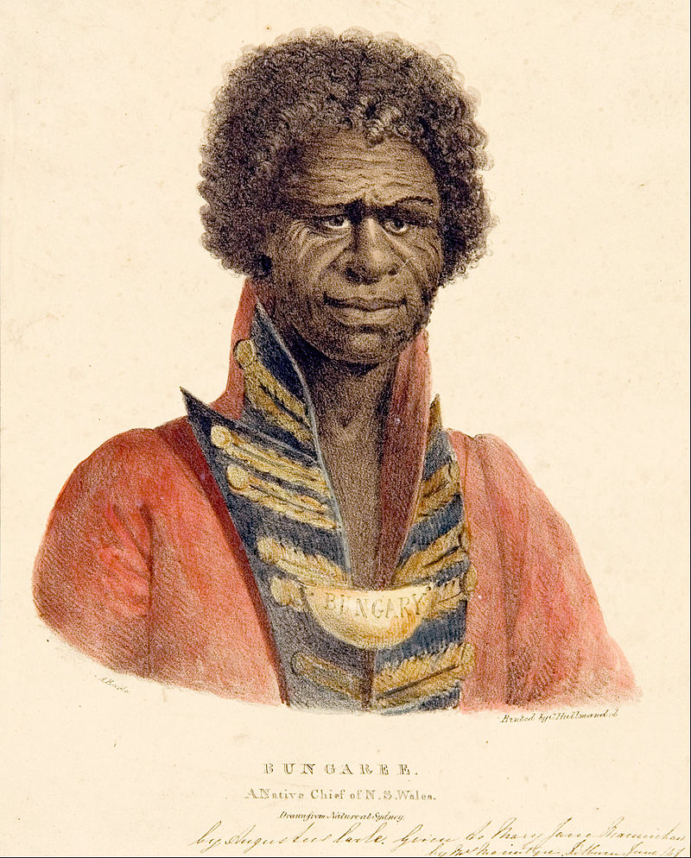
Who Was Bungaree?
Bungaree was an Indigenous Australian man who played a key role in the circumnavigation of Australia.
Bungaree was from the Broken Bay area, near Sydney.
Bungaree spoke Garigal and learned English.

Slide 10

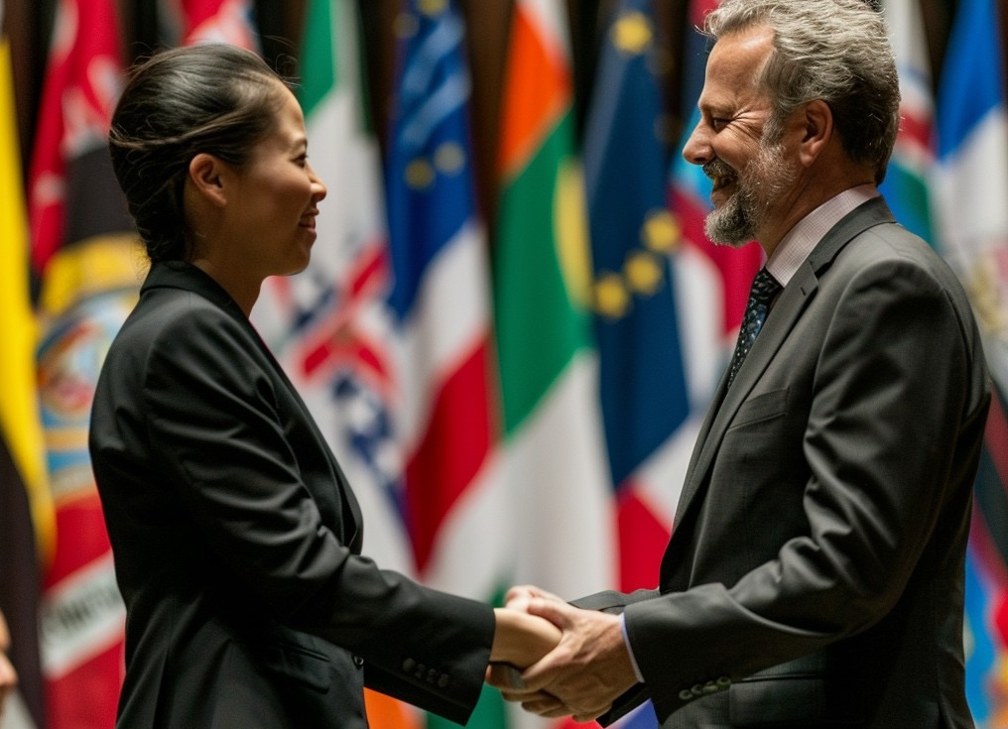



Who Was Bungaree?
Bungaree was a diplomat and an interpreter.
A diplomat is someone who helps people with different points of view find common ground.
Dip
lo
mat
An interpreter is someone who translates words from one language into another.

Slide 11



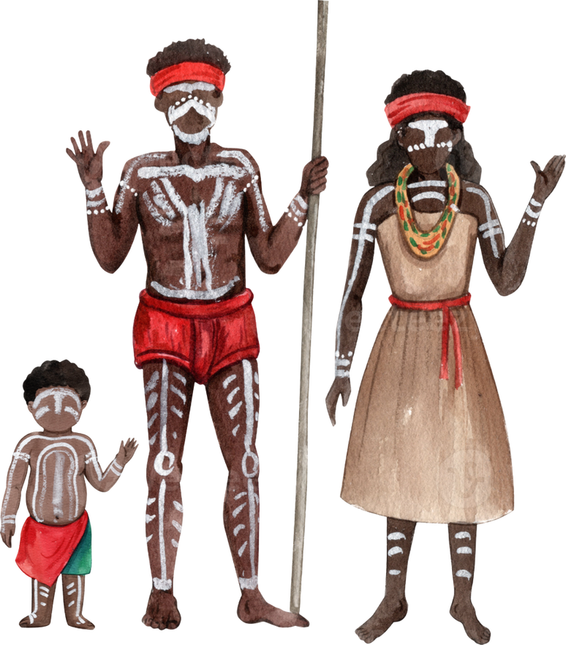
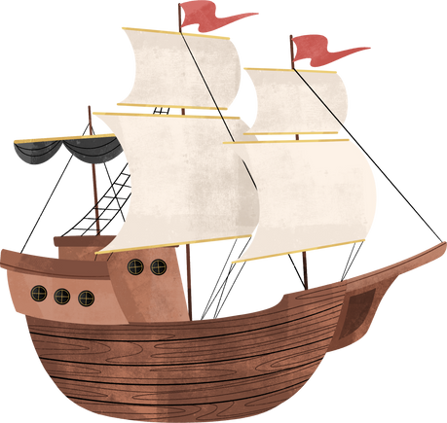
Who Was Bungaree?
Bungaree helped Matthew Flinders connect with Indigenous communities.

Slide 12
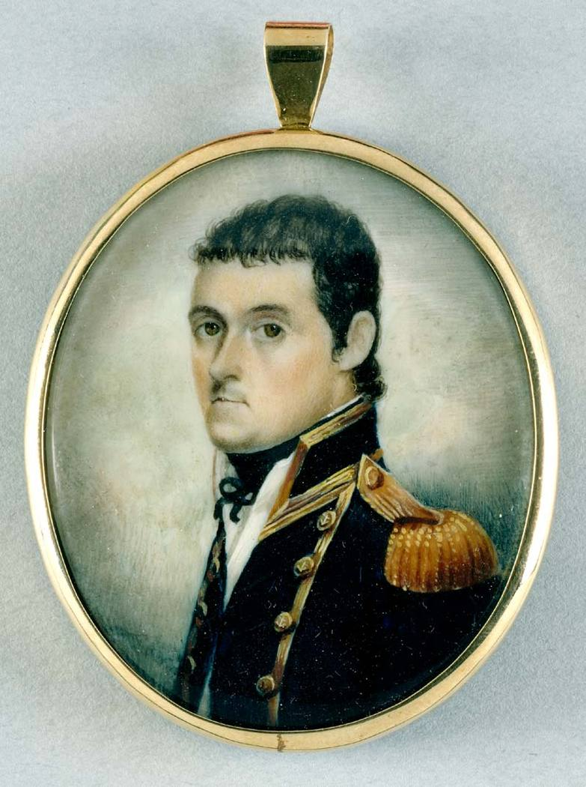

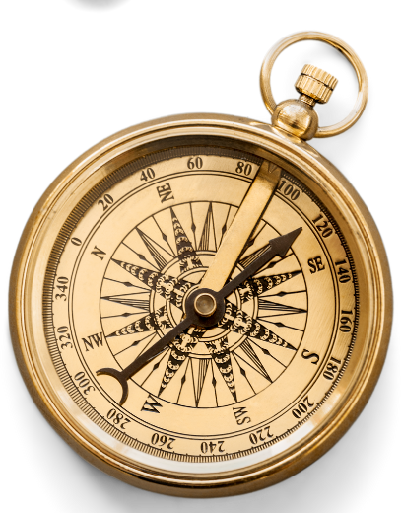

Who Was Matthew Flinders?
The exploration was led by Matthew Flinders.
Matthew Flinders was a British explorer.
His mission was to chart the unknown coastline of Australia.
Circumnavigate Australia.

Slide 13





The Exploration
Matthew Flinders explored and mapped the coastline of Australia.
Circumnavigation
Of Australia

Slide 14
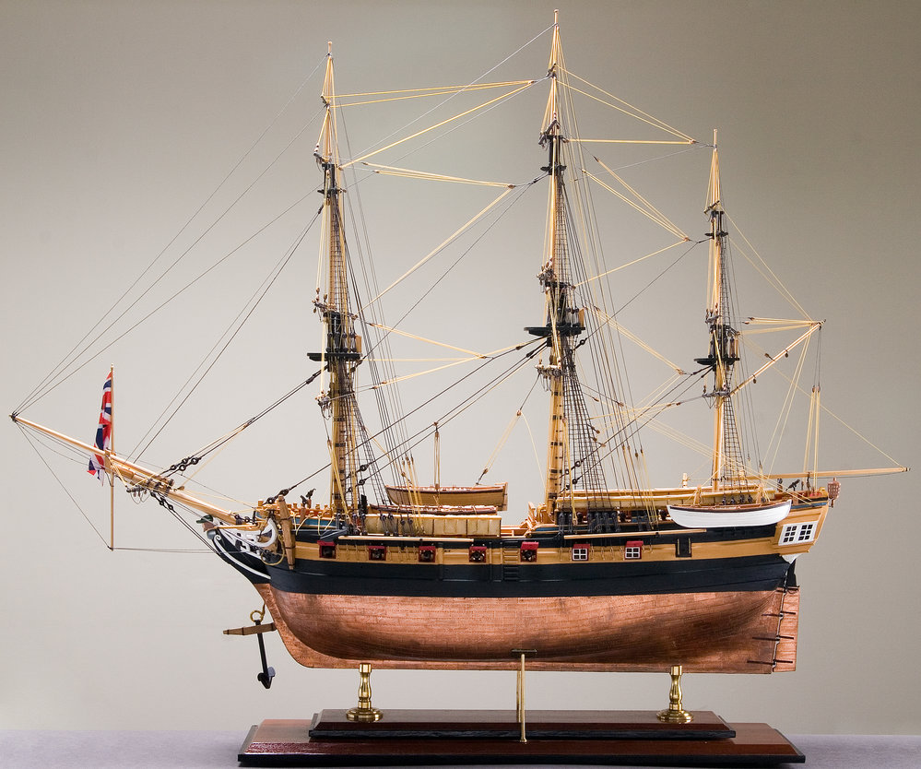
How Did They Explore?
The crew sailed aboard HMS Investigator.
The crew was sick and exhausted.
HMS Investigator was leaking.
HMS stands for His (or Her) Majesty's Ship.

Slide 15
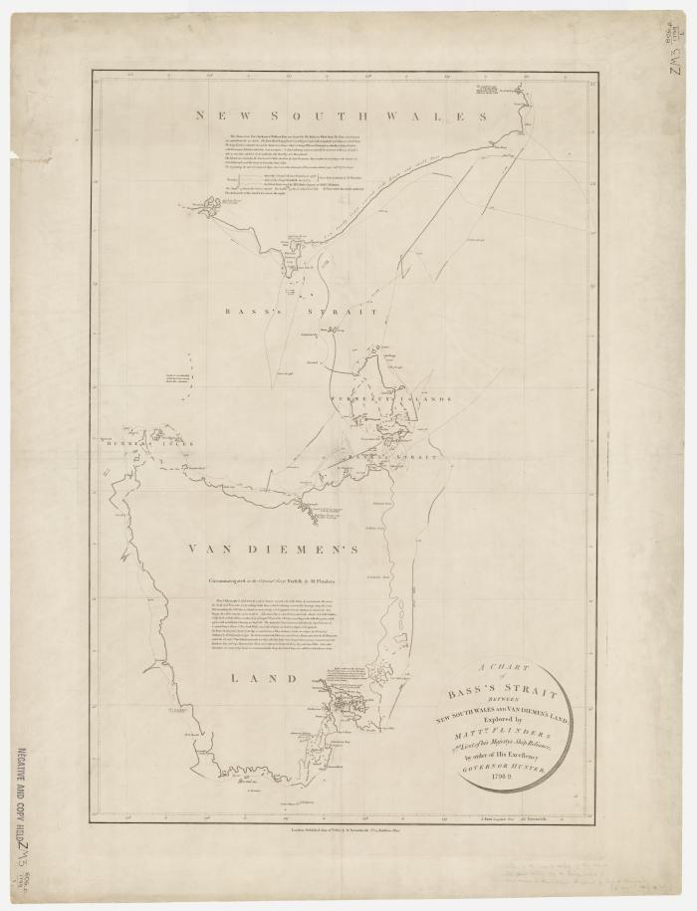

What Was the Outcome?
The exploration taught people more about Australia.
Matthew Flinders found:
the southern coast
how big the continent was
that Australia was an island.

Slide 16


Thumbs Up or Thumbs Down
Bungaree helped Matthew Flinders with the mapping of the Australian coastline.
No
Yes
Thumbs up for yes.
Thumbs down for no.

Slide 17


Who Was Bungaree?
Bungaree’s contribution is now being recognised.
A contribution is something you give or do to help others.
To recognise means to be celebrated, acknowledged or appreciated.

Slide 18
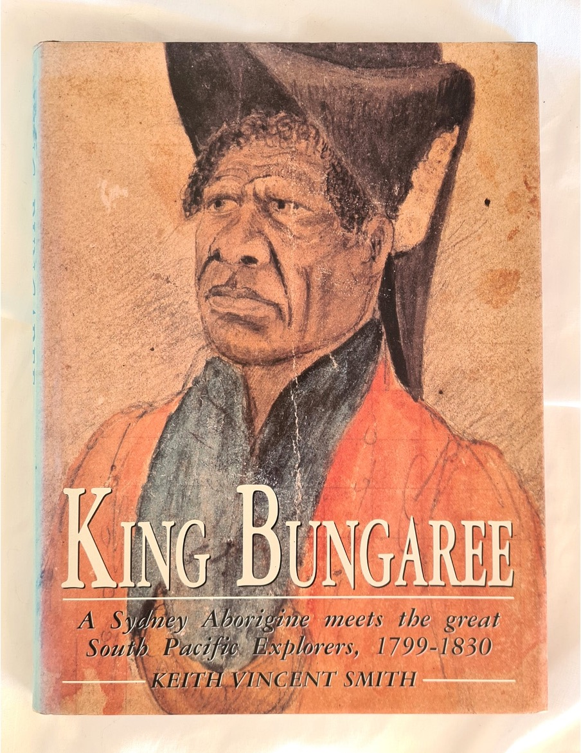
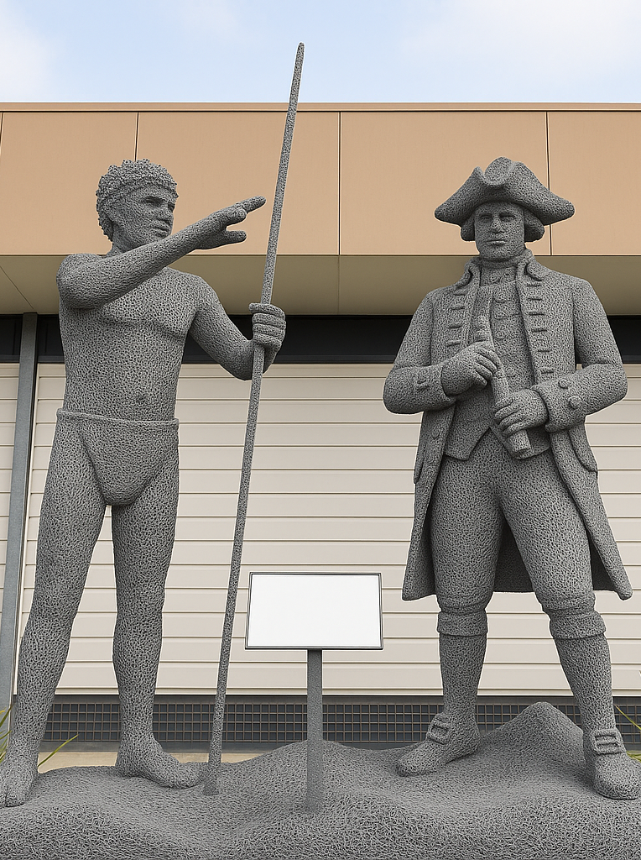


Bungaree’s Contribution
Today, when people retell this part of history, Bungaree is being recognised, but not equally.

Slide 19
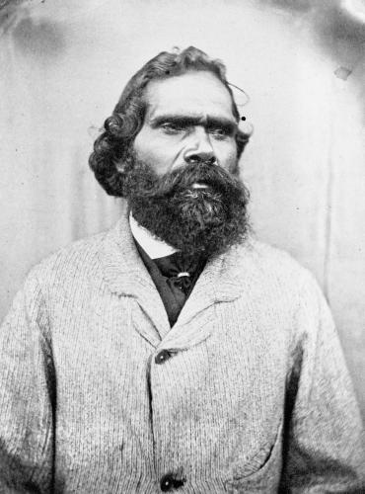
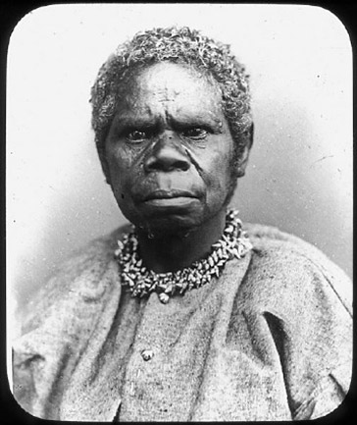
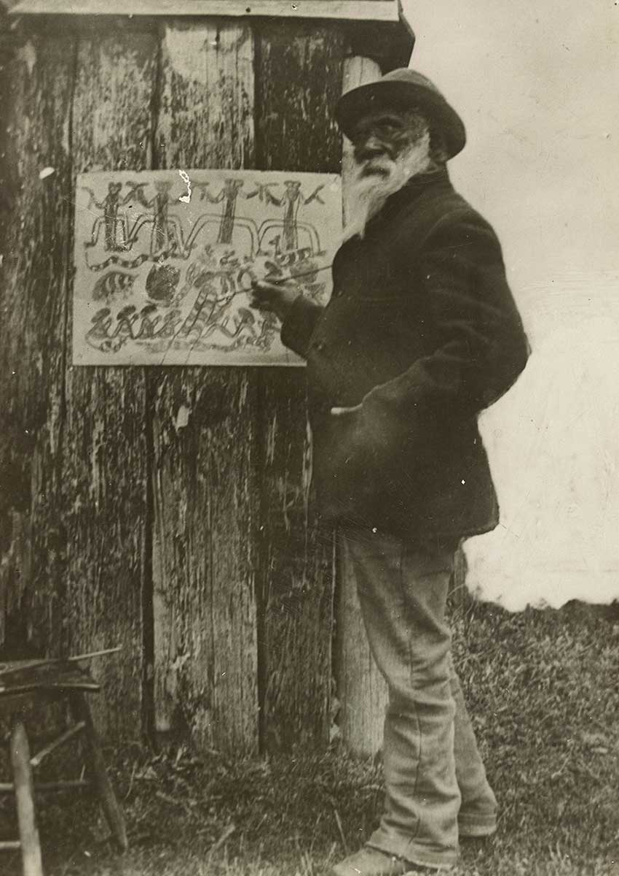

Bungaree’s Contribution
People are interested in Indigenous Australians’ experiences.
Simon Wonga
Truganini
William Barak

Slide 20



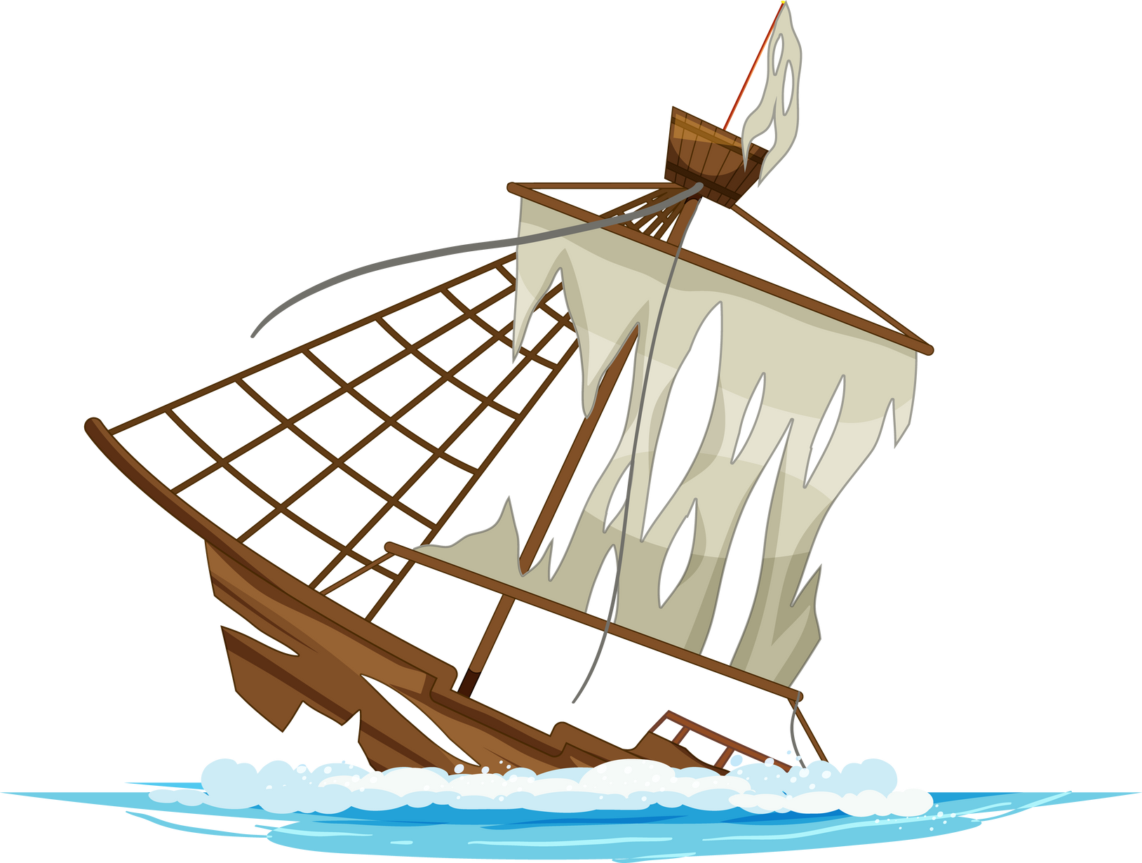
Circumnavigation of Australia
Diplomat
Australian coastlines unknown
Mapped coastline
Interpreter
Bungaree = connection to Indigenous communities
Exploration, led by Matthew Flinders
Circumnavigation
Of Australia
Faced difficulties
Local Customs
Port Jackson
NOW: Growing
appreciation for...
Indigenous perspectives
Bungaree’s contribution
Indigenous role in exploration
Indigenous knowledge

Slide 21
Circumnavigation of Australia
Diplomat
Australian coastlines unknown
Mapped coastline
Interpreter
Bungaree = connection to Indigenous communities
Exploration, led by Matthew Flinders
Circumnavigation
Of Australia
Faced difficulties
Local Customs
Port Jackson
NOW: Growing
appreciation for...
Indigenous perspectives
Bungaree’s contribution
Indigenous role in exploration
Indigenous knowledge

Slide 22
Add to Mind Map
Diplomat
Australian coastlines unknown
Mapped coastline
Interpreter
Bungaree = connection to Indigenous communities
Exploration, led by Matthew Flinders
Circumnavigation
Of Australia
Faced difficulties
Local Customs
Port Jackson
NOW: Growing
appreciation for...
Indigenous perspectives
Bungaree’s contribution
Indigenous role in exploration
Indigenous knowledge

Slide 23
Before 1803, not much was known about Australia.
Bungaree was an Indigenous Australian diplomat and an interpreter who played a key role in the circumnavigation of Australia.
Bungaree helped Matthew Flinders connect with Indigenous communities. His contribution is now being recognised.
Matthew Flinders led the exploration to map the Australian coastline.
The crew sailed aboard the HMS Investigator.
The exploration taught people more about Australia.

Slide 24
diplomat
Bungaree was a ________ and an interpreter.
Matthew Flinders found:
A. that Australia was an island
B. the southern coast of Australia
C. how big the continent of Australia was
D. all of the above.
The coastline of Australia was able to be mapped because the crew c_____________ Australia.
teacher
diplomat
author
ircumnavigated

Slide 25
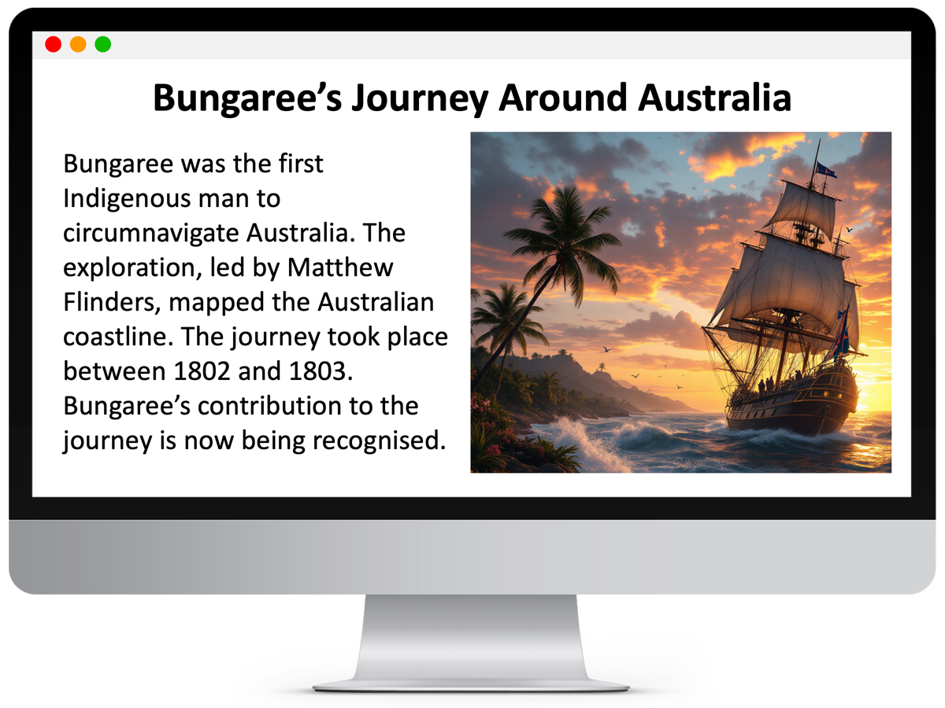
In the next lesson, we will learn the purpose and structure of informative writing.

Slide 26
Attributions
Slide 14 Photo: Model of HMS Investigator, State Library of South Australia, D 7835(Misc)
Slide 15 Photo: Arrowsmith, A., Bass, G. and Hunter, J. (1800) A chart of Bass Strait between New South Wales and Van Diemen's Land [cartographic material] : explored by Matt W. Flinders and Lieut. of his Majesty's ship Reliance by order of His Excellency Governor Hunter, 1798-9 / Aaron Arrowsmith. London: A. Arrowsmith. Accessed from State Library of NSW
Slide 18 Photo: Cover artwork features the sketch 'Bungaree King of Port Jackson Tribe Sydney' attributed to John Carmichael, held in a private collection accessed from State Library New South Wales

