Slide 1

Writing
Unit 3: Informational/ History
Lesson 2: What Is Informative Writing?
Version 1

Slide 2
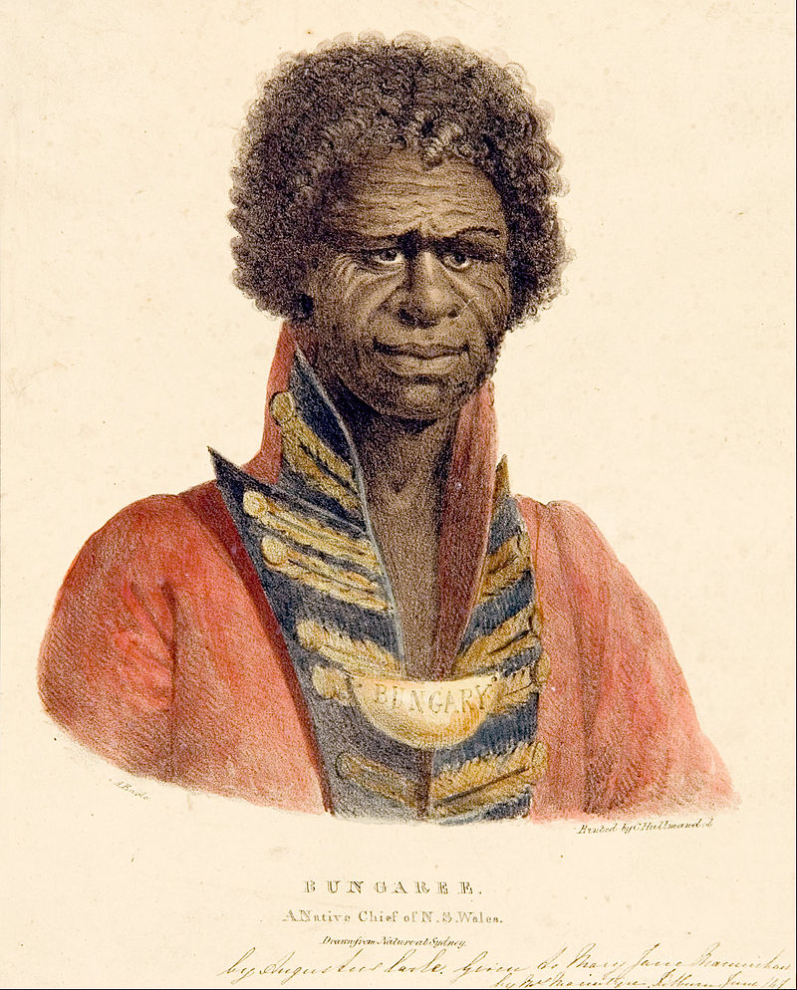
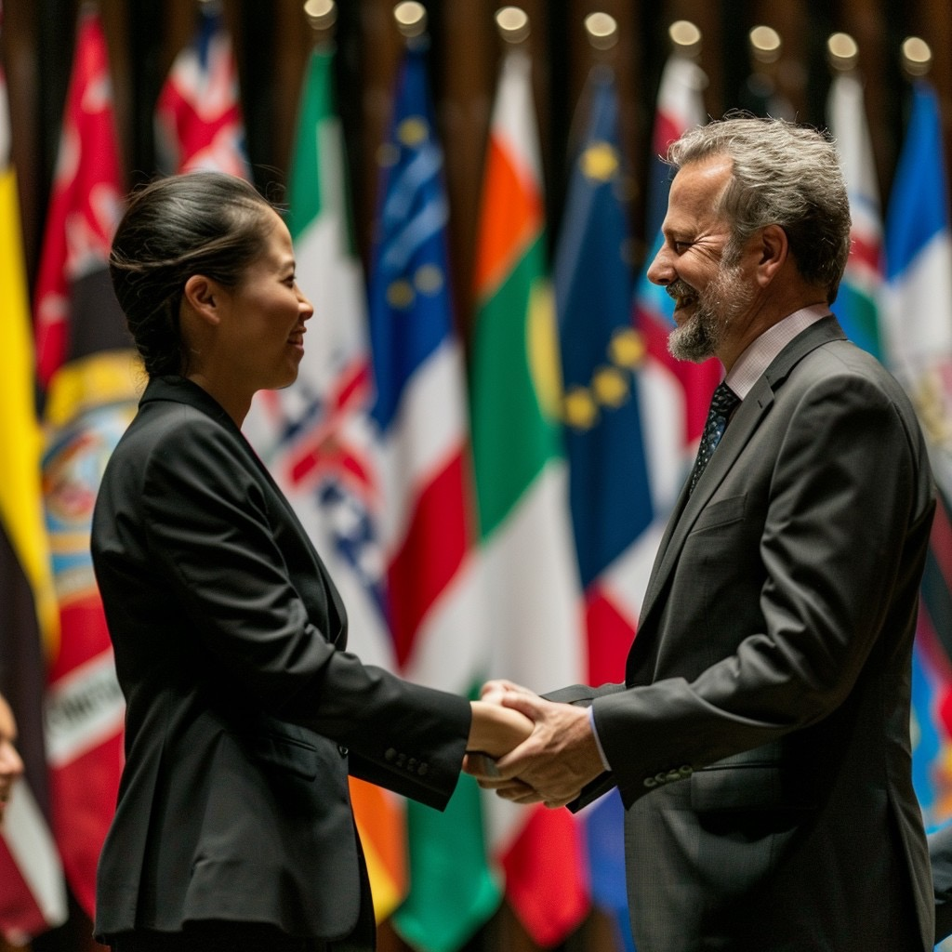

Bungaree was a diplomat and an interpreter.

Slide 3
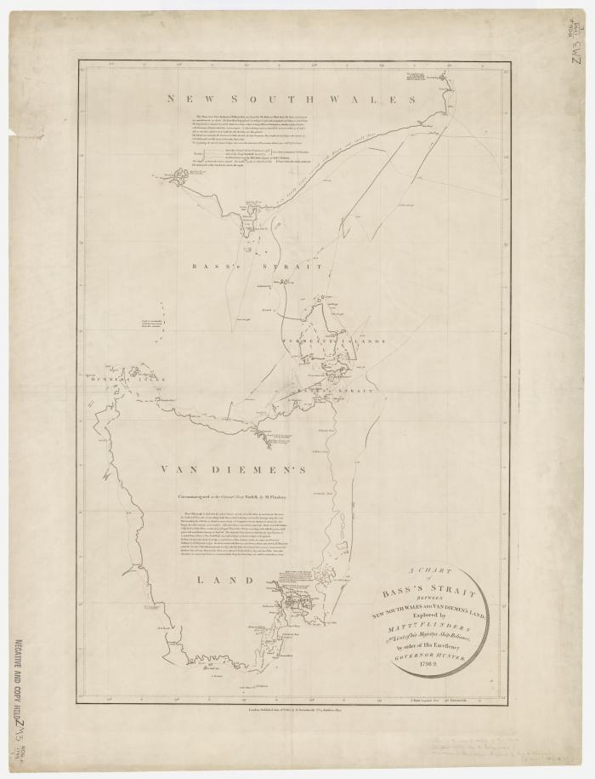


Matthew Flinders found:
that Australia was an island
the southern coast of Australia
how big the continent of Australia was.

Slide 4


Circumnavigate your desk.

Slide 5
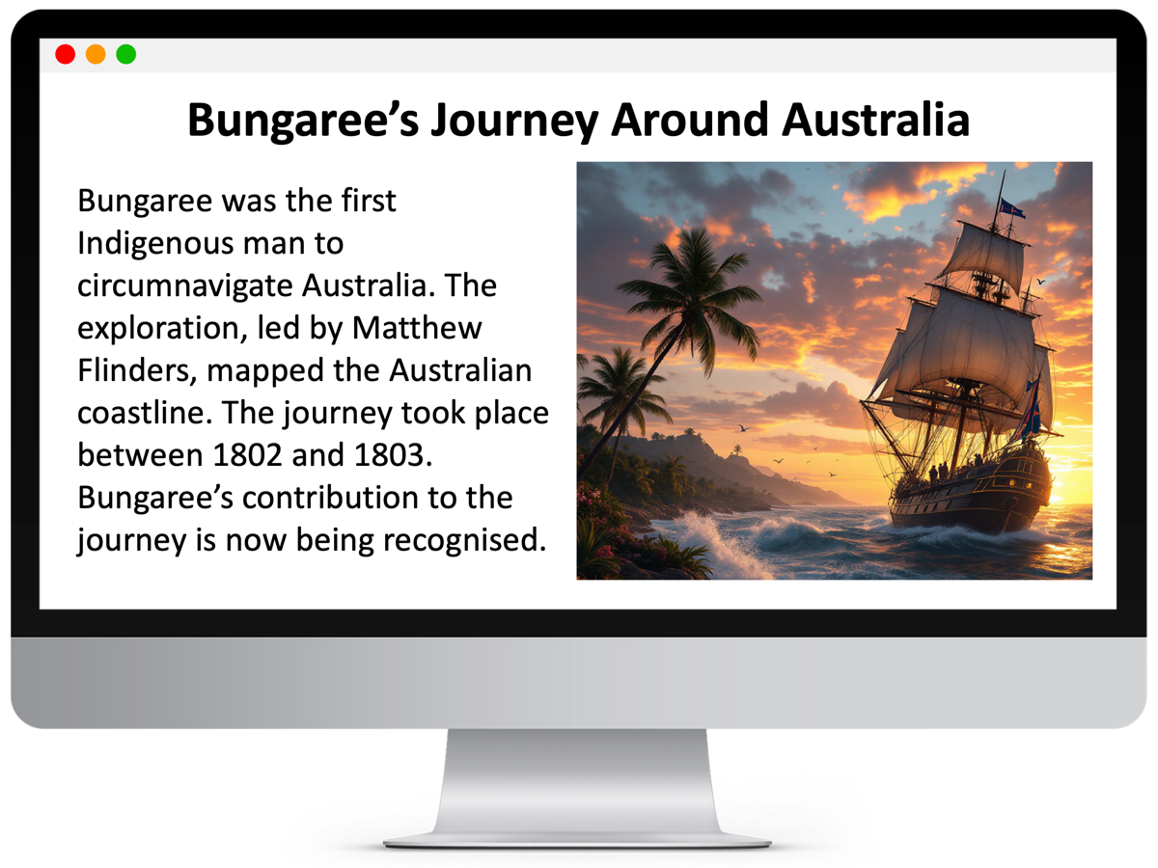
In this lesson, we will learn the purpose and structure of informative writing.

Slide 6
You will be successful when you can: ​
understand the purpose of informative writing
understand the structure of informative writing.​

Slide 7
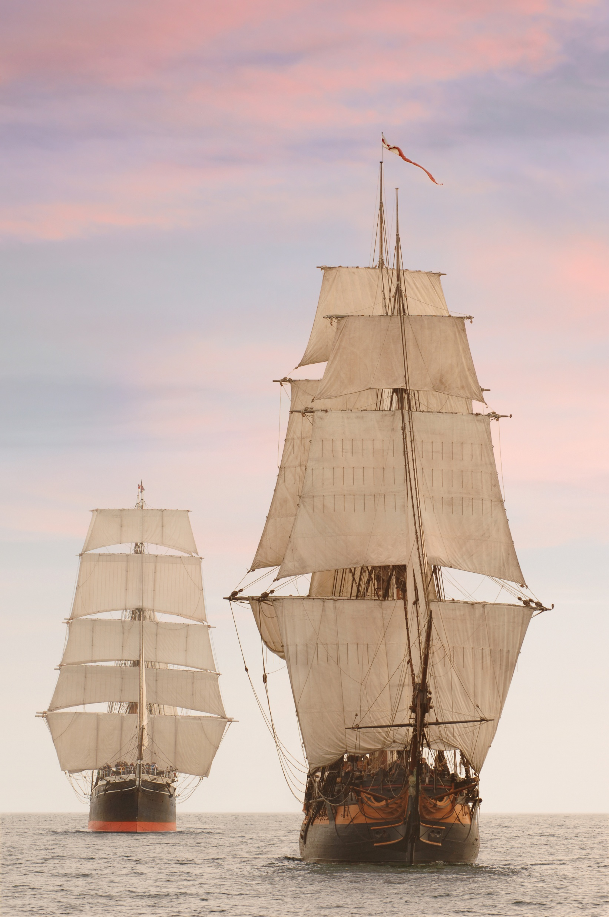
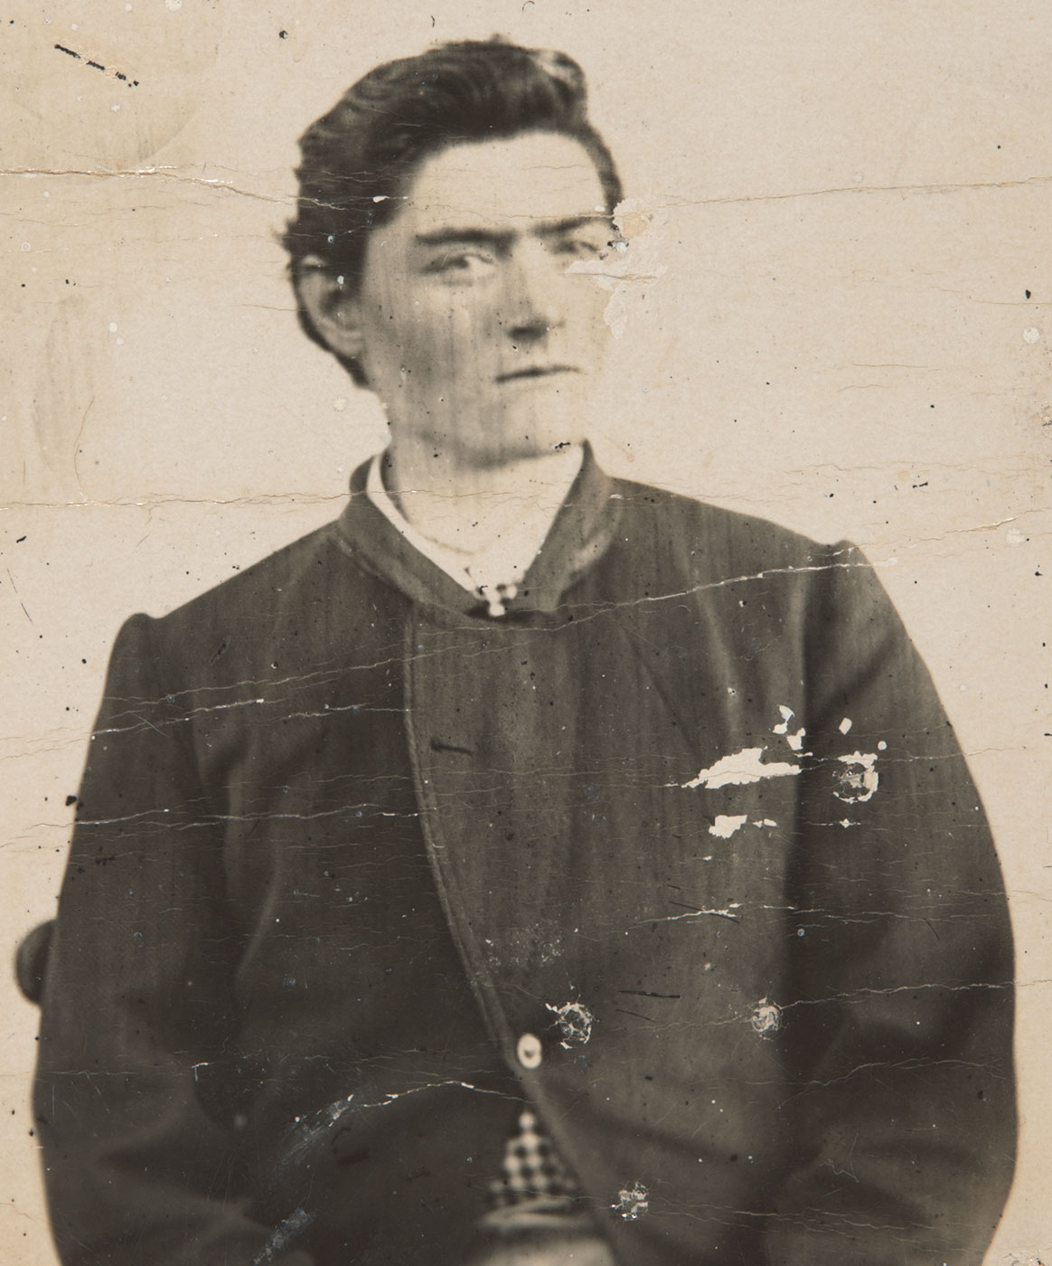
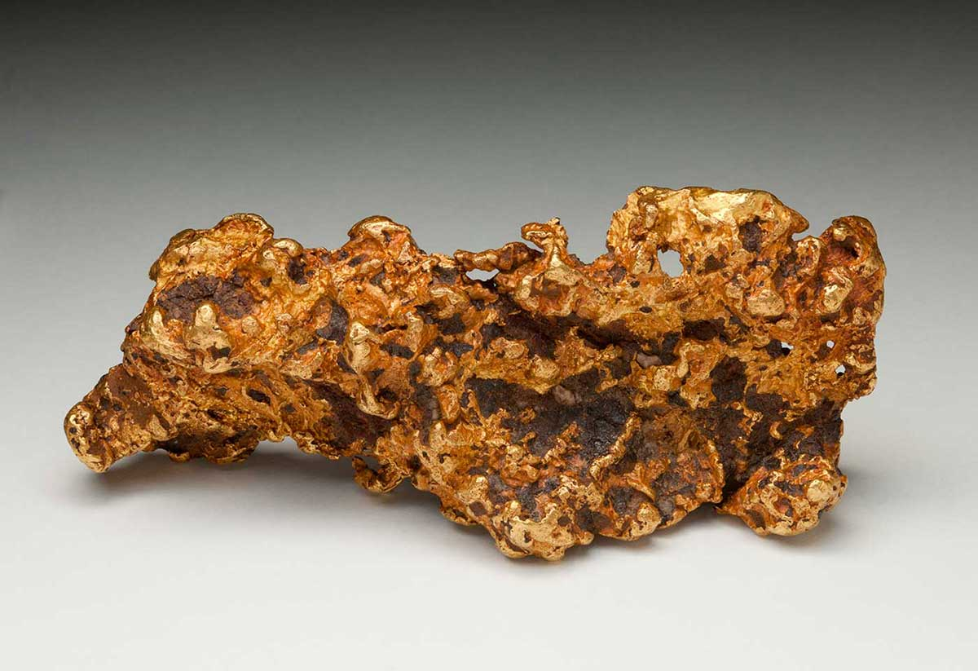

Slide 8

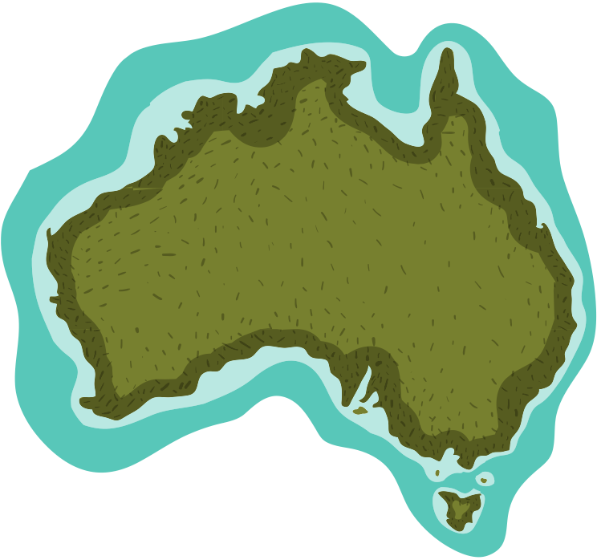

Diplomat
Australian coastlines unknown
Mapped coastline
Interpreter
Bungaree = connection to Indigenous communities
Exploration, led by Matthew Flinders
Circumnavigation
Of Australia
Faced difficulties
Local Customs
Port Jackson
NOW: Growing
appreciation for...
Indigenous perspectives
Bungaree’s contribution
Indigenous role in exploration
Indigenous knowledge

Slide 9
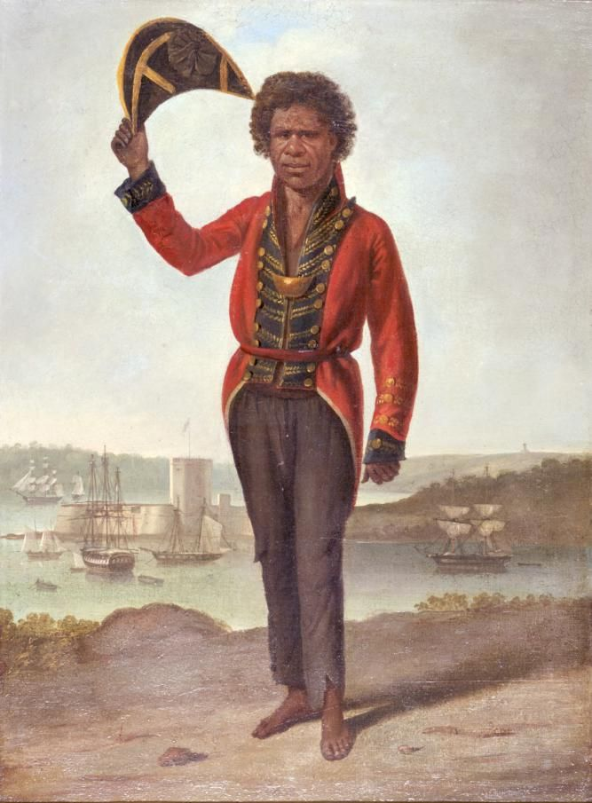
Who Was Bungaree?
Bungaree was an Indigenous Australian man who played a key role in the circumnavigation of Australia.

Slide 10


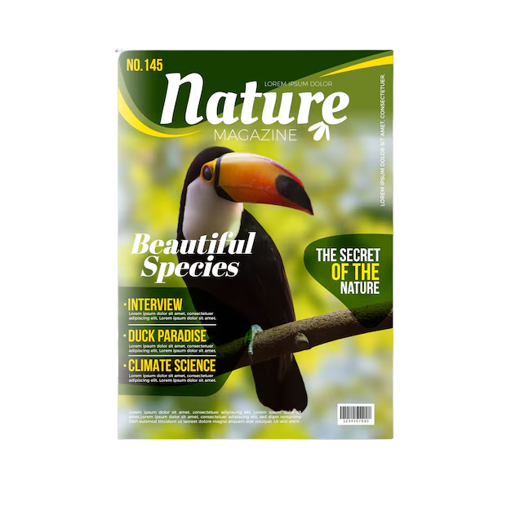




Informative Texts
People write informative texts to explain a topic. People read informative texts to learn about a topic.

Slide 11
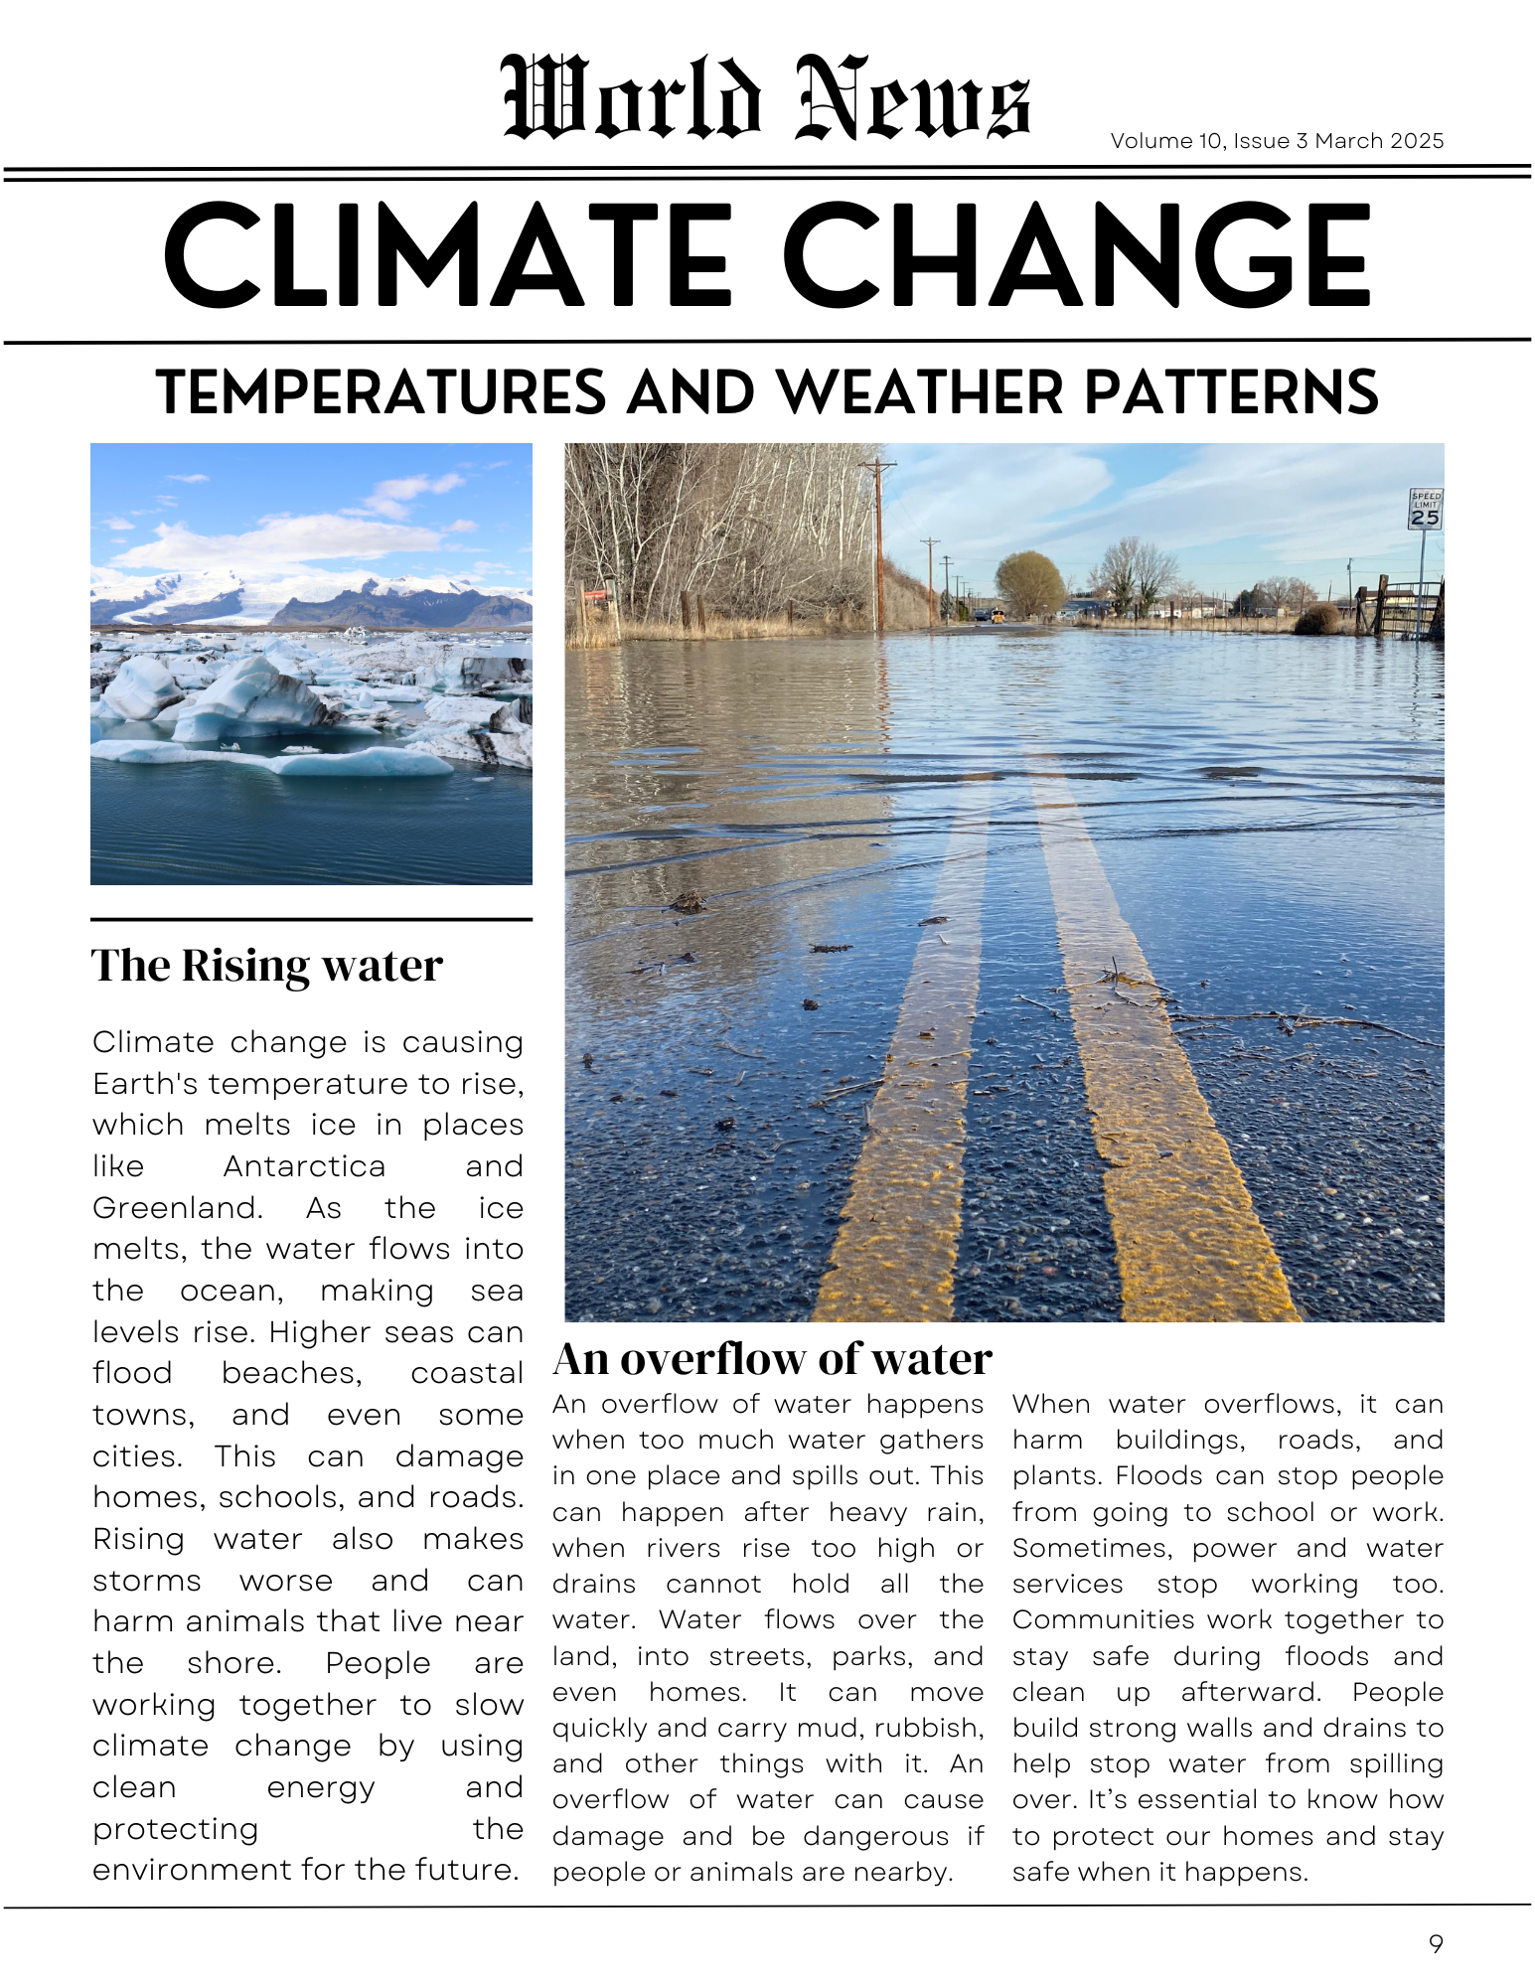


Purpose of Informative Texts
Authors write informative texts to teach about a topic.

Slide 12



Informative Text Structure
Informative writing has an organised structure.
Introduction
Focus sentence, descriptive details and factual evidence.
Subtopic
Focus sentence, descriptive details and factual evidence.
Title
Topic
Subtopic
Focus sentence, descriptive details and factual evidence.
Subtopic
Conclusion

Slide 13




Technical Vocabulary
Informative writing uses technical vocabulary to explain ideas clearly.
coastline
Where the land meets the sea.
contribution
Something you give or do to help others.

Slide 14


Technical Vocabulary
Informative writing uses technical vocabulary to explain ideas clearly.
instrumental
Something or someone that plays an important part in making something happen.
legacy
Something a person leaves behind that continues to have an impact, even after they’ve gone.
Notes:
The next word is (click) instrumental. Instrumental is something or someone that plays an important part in making something happen. Bungaree was instrumental to the mapping of Australia. Without him, the journey probably would not have been successful, he was the key to their success.
Click. Legacy. A legacy is something a person leaves behind that continues to have an impact, even after they’ve gone. A family tradition started by your grandmother, a piece of art your father gave you, an idea or story passed through your family – these are all legacies.

Slide 15




The Circumnavigation of Australia
Notes:
Just like you can read informative text in books, you can also read it online. I will now search for our topic of the week (click) The Circumnavigation of Australia.

Slide 16



Bungaree’s Journey Around Australia
Bungaree was the first Indigenous man to circumnavigate Australia. The exploration, led by Matthew Flinders, mapped the Australian coastline. The journey took place between 1802 and 1803. Bungaree’s contribution to the journey is now being recognised.
Notes:
The title of this informative digital text is Bungaree’s Journey Around Australia.
Track with me as I read.
Bungaree was the first Indigenous man to circumnavigate Australia. The exploration, led by Matthew Flinders, mapped the Australian coastline. The journey took place between 1802 and 1803. Bungaree’s contribution to the journey is now being recognised.

Slide 17
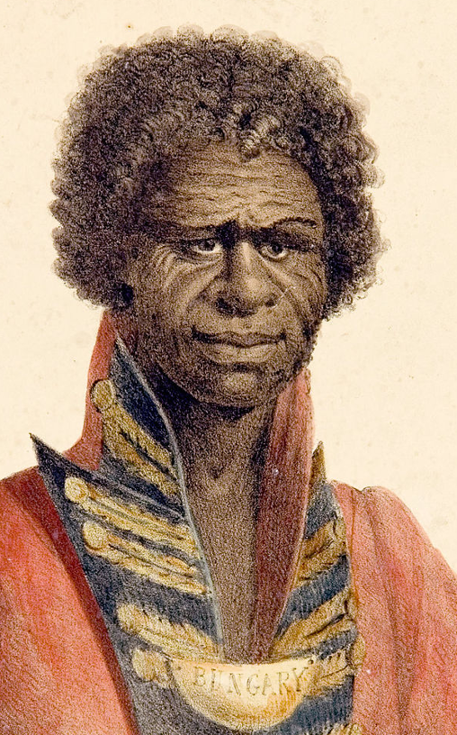
Bungaree’s Role
Bungaree was instrumental in helping Matthew Flinders connect with Indigenous groups around Australia. Bungaree could not speak the languages of all the Aboriginal lands, but he used his knowledge of Indigenous customs to keep the peace. Bungaree’s understanding of local customs helped lead to successful exploration.
The Expedition
Bungaree travelled with Matthew Flinders around the coast of Australia for one year, joining
Notes:
Bungaree’s Role
Bungaree was instrumental in helping Matthew Flinders connect with Indigenous groups around Australia. Bungaree could not speak the languages of all the Aboriginal lands, but he used his knowledge of Indigenous customs to keep the peace. Bungaree’s understanding of local customs helped lead to successful exploration.
The Expedition
Bungaree travelled with Matthew Flinders around the coast of Australia for 1 year, joining

Slide 18
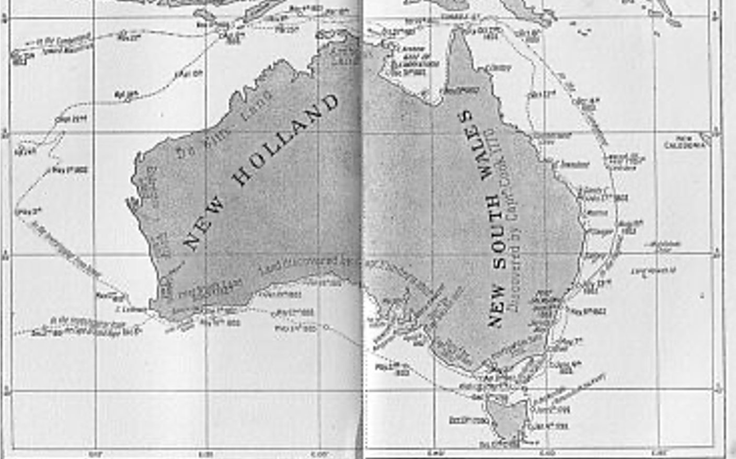
the crew of HMS Investigator on 22 July 1802. With Bungaree’s help, Matthew Flinders was able to map the Queensland coast, pass through the Great Barrier Reef, the Torres Strait and into the Gulf of Carpentaria.
By 1803, the crew was sick and tired, and their ship was in bad shape. They managed to complete the journey despite many challenges.
Notes:
The crew of HMS Investigator on 22 July 1802. With Bungaree’s help, Matthew Flinders was able to map the Queensland coast, pass through the Great Barrier Reef, the Torres Strait and into the Gulf of Carpentaria. By 1803, the crew was sick and tired, and their ship was in bad shape. They managed to complete the journey despite many challenges.

Slide 19
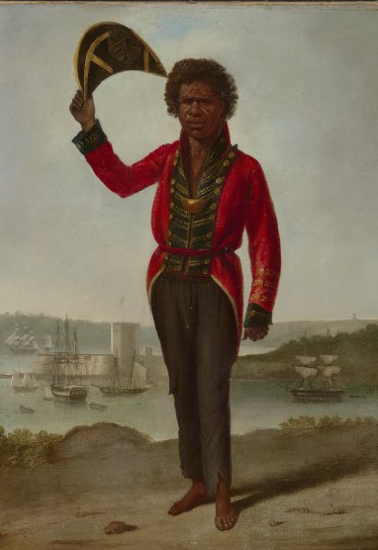
Bungaree’s Legacy
For many years, Bungaree’s contribution to the journey was not recognised. Twelve years after the expedition, Bungaree was made Chief of the Broken Bay Tribe in the Garigal district, NSW. However, many Australians did not know how Bungaree helped until recently. Now, Bungaree’s story can be read in history books and seen on display in museums around the country.
Notes:
Bungaree’s Legacy
For many years, Bungaree’s contribution to the journey was not recognised. Twelve years after the expedition, Bungaree was made Chief of the Broken Bay Tribe in the Garigal district, NSW. However, many Australians did not know how Bungaree helped until recently. Now, Bungaree’s story can be read in history books and seen on display in museums around the country.

Slide 20
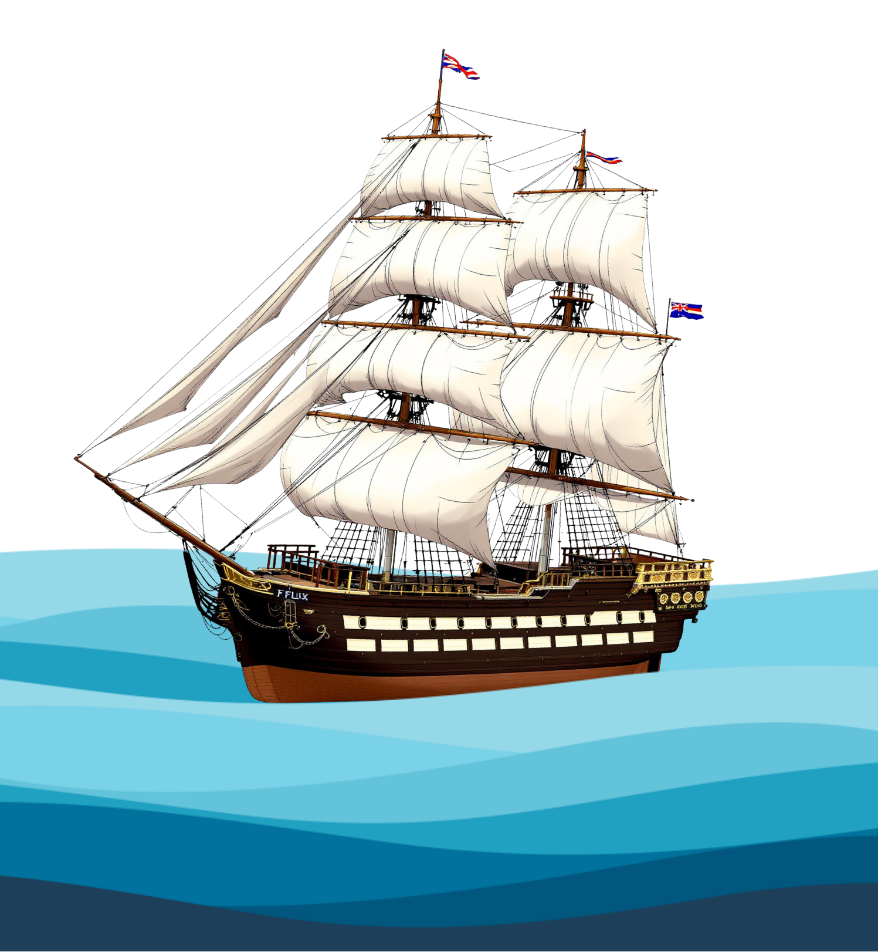
The circumnavigation of Australia by Matthew Flinders and Bungaree was an important journey in Australian history. Bungaree helped Matthew Flinders connect with Indigenous people, which led to the success of a difficult journey. Unfortunately, like so many Aboriginal people from that time, Bungaree’s legacy was not fully recognised until recently.
Notes:
The circumnavigation of Australia by Matthew Flinders and Bungaree was an important journey in Australian history. Bungaree helped Matthew Flinders connect with Indigenous people, which led to the success of a difficult journey. Unfortunately, like so many Aboriginal people from that time, Bungaree’s legacy was not fully recognised until recently.

Slide 21



CFU: Show of Fingers
In Bungaree’s Journey Around Australia, the text teaches:
Bungaree wasn’t important in helping Matthew Flinders connect with Indigenous Australians.
Bungaree was instrumental in helping Matthew Flinders connect with Indigenous Australians.
Bungaree could not help Matthew Flinders connect with Indigenous Australians.
Hold one finger up if you agree the answer is number 1.
Hold two fingers up if you agree the answer is number 2.
Hold three fingers up if you agree the answer is number 3.
Notes:
In Bungaree’s Journey Around Australia, the text teaches:
1. Bungaree wasn’t important in helping Matthew Flinders connect with Indigenous Australians.
2. Bungaree was instrumental in helping Matthew Flinders connect with Indigenous Australians.
3. Bungaree could not help Matthew Flinders connect with Indigenous Australians.
Hold one finger up if you agree the answer is number 1.
Hold two fingers up if you agree the answer is number 2.
Hold three fingers up if you agree the answer is number 3.
Pause. Give the students time to respond.
Click to reveal the correct answer.
The correct answer is number 2. Bungaree’s Journey Around Australia, the text teaches: Bungaree was instrumental in helping Matthew Flinders connect with Indigenous Australians.

Slide 22
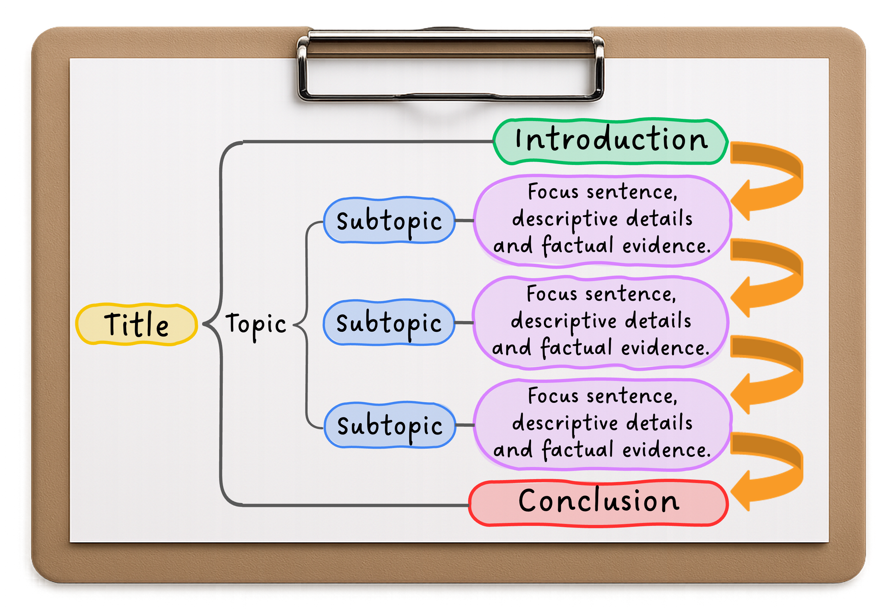
Bungaree’s Journey Around Australia
Bungaree was the first Indigenous man to circumnavigate Australia. The exploration, led by Matthew Flinders, mapped the Australian coastline. The journey took place between 1802 and 1803. Bungaree’s contribution to the journey is now being recognised.
Bungaree’s Role
Bungaree was instrumental in helping Matthew Flinders connect with Indigenous groups around Australia. Bungaree could not speak the languages of all the Aboriginal lands, but he used his knowledge of Indigenous customs to keep the peace. Bungaree’s understanding of local customs helped lead to successful exploration.
The Expedition
Bungaree travelled with Matthew Flinders around the coast of Australia for 1 year, joining the crew of HMS Investigator on 22 July 1802. With Bungaree’s help, Matthew Flinders was able to map the Queensland coast, pass through the Great Barrier Reef, the Torres Strait and into the Gulf of Carpentaria. By 1803, the crew was sick and tired, and their ship was in bad shape. They managed to complete the journey despite many challenges.
Bungaree’s Legacy
For many years, Bungaree’s contribution to the journey was not recognised. 12 years after the expedition, Bungaree was made Chief of the Broken Bay Tribe in the Garigal district, NSW. However, many Australians did not know how Bungaree helped until recently. Now, Bungaree’s story can be read in history books and seen on display in museums around the country.
The circumnavigation of Australia by Matthew Flinders and Bungaree was an important journey in Australian history. Bungaree helped Matthew Flinders connect with Indigenous people, which led to the success of a difficult journey. Unfortunately, like so many Aboriginal people from that time, Bungaree’s legacy was not fully recognised until recently.
Bungaree’s Journey Around Australia
Bungaree was the first Indigenous man to circumnavigate Australia. The exploration, led by Matthew Flinders, mapped the Australian coastline. The journey took place between 1802 and 1803. Bungaree’s contribution to the journey is now being recognised.
Bungaree’s Role
Bungaree was instrumental in helping Matthew Flinders connect with Indigenous groups around Australia. Bungaree could not speak the languages of all the Aboriginal lands, but he used his knowledge of Indigenous customs to keep the peace. Bungaree’s understanding of local customs helped lead to successful exploration.
The Expedition
Bungaree travelled with Matthew Flinders around the coast of Australia for one year, joining the crew of HMS Investigator on 22 July 1802. With Bungaree’s help, Matthew Flinders was able to map the Queensland coast, pass through the Great Barrier Reef, the Torres Strait and into the Gulf of Carpentaria. By 1803, the crew was sick and tired, and their ship was in bad shape. They managed to complete the journey despite many challenges.
Bungaree’s Legacy
For many years, Bungaree’s contribution to the journey was not recognised. Twelve years after the expedition, Bungaree was made Chief of the Broken Bay Tribe in the Garigal district, NSW. However, many Australians did not know how Bungaree helped until recently. Now, Bungaree’s story can be read in history books and seen on display in museums around the country.
The circumnavigation of Australia by Matthew Flinders and Bungaree was an important journey in Australian history. Bungaree helped Matthew Flinders connect with Indigenous people, which led to the success of a difficult journey. Unfortunately, like so many Aboriginal people from that time, Bungaree’s legacy was not fully recognised until recently.
Notes:
I will use the informative text structure to identify the parts of the text I just read. First, I will use yellow to highlight the title and green to highlight the introduction.
Click.
The title is (click) Bungaree’s Journey Around Australia.
The introduction comes after the title. Click. I know this is the introduction because it says what topic the text is about and why this topic is important. I have highlighted the introduction green.
Click.
I am checking the informative text structure to see what comes next. The next parts of the text are the subtopics and the paragraphs. The subtopics divide the topic into parts. Each of these parts are their own paragraph. Click.
I have highlighted each subtopic (click) blue.
Click.
I have highlighted each paragraph purple.
Click.
The last part is called the conclusion. I will highlight this part red.
Click.
I have highlighted the conclusion red.

Slide 23

Informative Text Structure
title
introduction
subtopic
Topic
paragraph
conclusion
Notes:
We will identify the order of the parts within an informative text.
The part that tells what the topic is and why it is important, I highlighted green. This part is called (click) the introduction.
The parts that are smaller parts within the topic, I highlighted blue. These parts are called (click) subtopics.
The parts that explain each subtopic, I highlighted purple. These parts are called (click) paragraphs.
What is the part that tells what can be figured out from the facts and evidence in the paragraphs? I highlighted this part red.
Pair/share.
Give students time to discuss.
Click.
The part that tells what can be figured out from the facts and evidence in the paragraphs and is highlighted red is (click) the conclusion.
What is the part that states the topic and gets the reader interested to read the writing? I highlighted this part yellow.
Pair/share.
Give students time to discuss.
Click.
the part that states the topic and gets the reader interested to read the writing and is highlighted yellow is (click) the title.

Slide 24
Find Informative Text Structure
introduction
paragraph
subtopic
Topic
title
conclusion
Notes:
Open your workbook to Lesson 2.
In your workbook, you will identify the title with yellow highlight, the introduction with green highlight, the subtopics with blue highlight, the paragraphs with purple highlight and the conclusion with red highlight.
Allow students time to complete the activity.

Slide 25
Informative writing tells us about a topic.
Informative writing has an organised structure.
Informative writing uses special words related to the topic.
The purpose of informative texts is to share information.
Authors write informative texts to teach about a topic.
Notes:
Informative writing tells us about a topic.
Informative writing has an organised structure.
Informative writing uses special words related to the topic.
The purpose of informative text is to share information.
Authors write informative text to teach about a topic.

Slide 26
The area where the land meets the ocean or sea is the _________.
Why was Bungaree important to Matthew Flinders' exploration?
A. He built ships for the journey.
B. He helped connect with Indigenous groups by understanding their customs.
C. He mapped the coastline by himself.
Authors write informative text to t____ about a topic.
coastline
contribution
coastline
map
each
Notes:
Open your workbook to Exit Ticket, lesson 2.
1. The area where the land meets the ocean or sea is the
Contribution, coastline, map
Choose the correct word.
Give students time to respond.
Click. The correct answer is- coastline.
2. Why was Bungaree important to Matthew Flinders' exploration?
A. He built ships for the journey.
B. He helped connect with Indigenous groups by understanding their customs.
C. He mapped the coastline by himself.
Circle the correct answer.
Give students time to respond.
Click. The correct answer is- B. He helped connect with Indigenous groups by understanding their customs.
Authors write informative text to t_______ about a topic.
Fill in the missing word.
Give students time to respond.
Click. The correct answer is- teach.

Slide 27


In the next lesson, we will learn what makes a strong title.
Notes:
In the next lesson, we will learn what makes a strong title.

