Slide 1
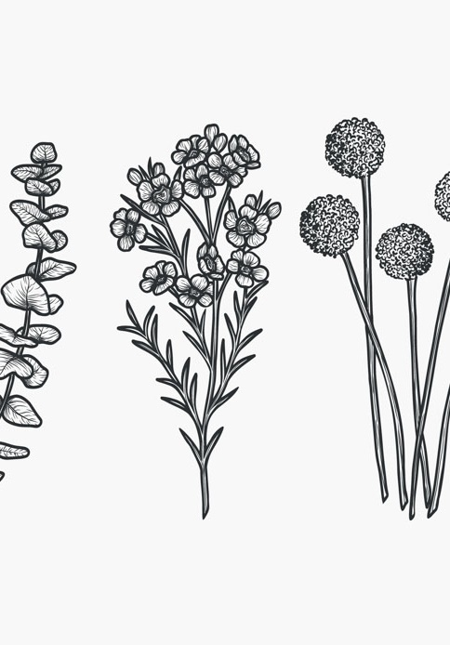
Art and Nature
Lesson 2
Nature's Symbols
Unit 1B Version 1

Slide 2
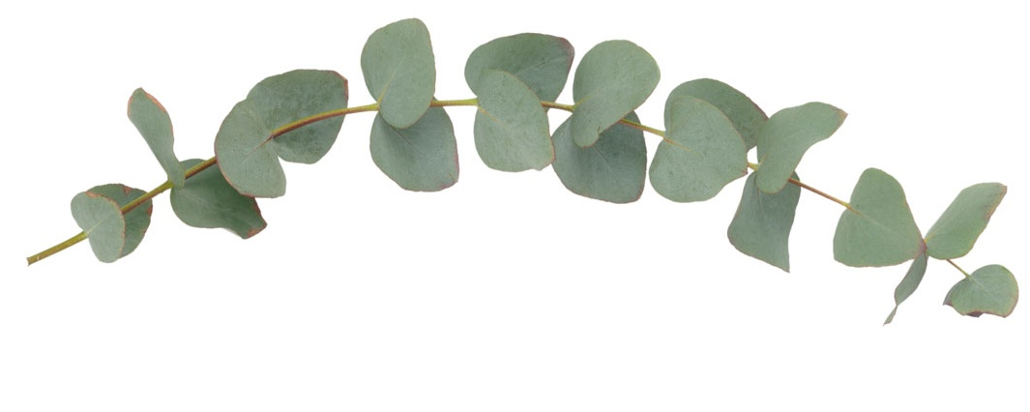
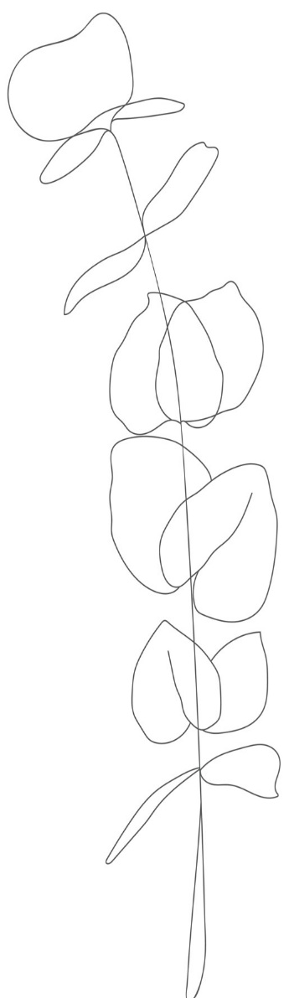
An observational sketch can capture what you saw.

Slide 3

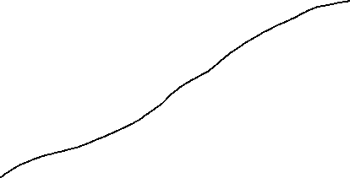
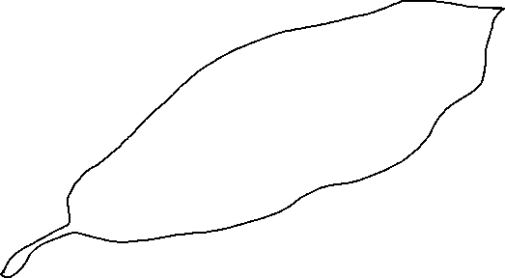
Labels can be attached to drawings or diagrams to identify the parts.
blade
vein
petiole

Slide 4
Labels on a drawing can:
make the picture colourful
identify the parts
replace a sketch

Slide 5
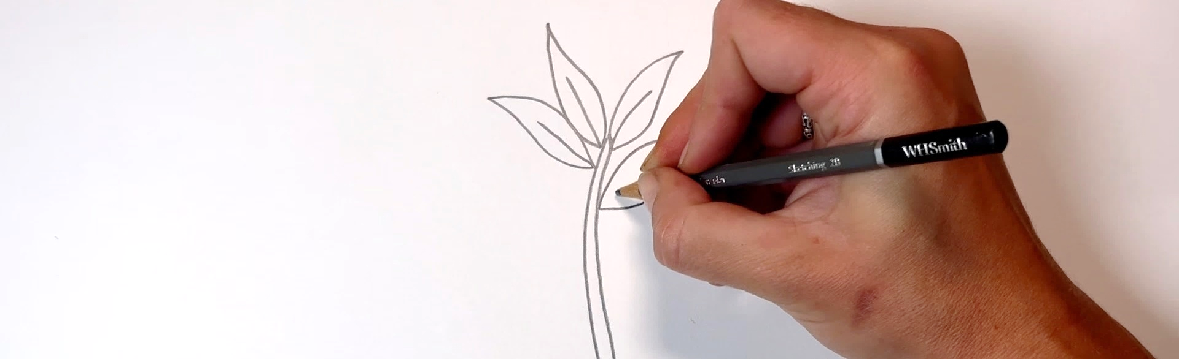
In this lesson, we will turn our drawing of a plant into a simple symbol and label it.

Slide 6
You will be successful when you can:
simplify shapes to the recognisable features
add a word or phrase next to the symbol.

Slide 7


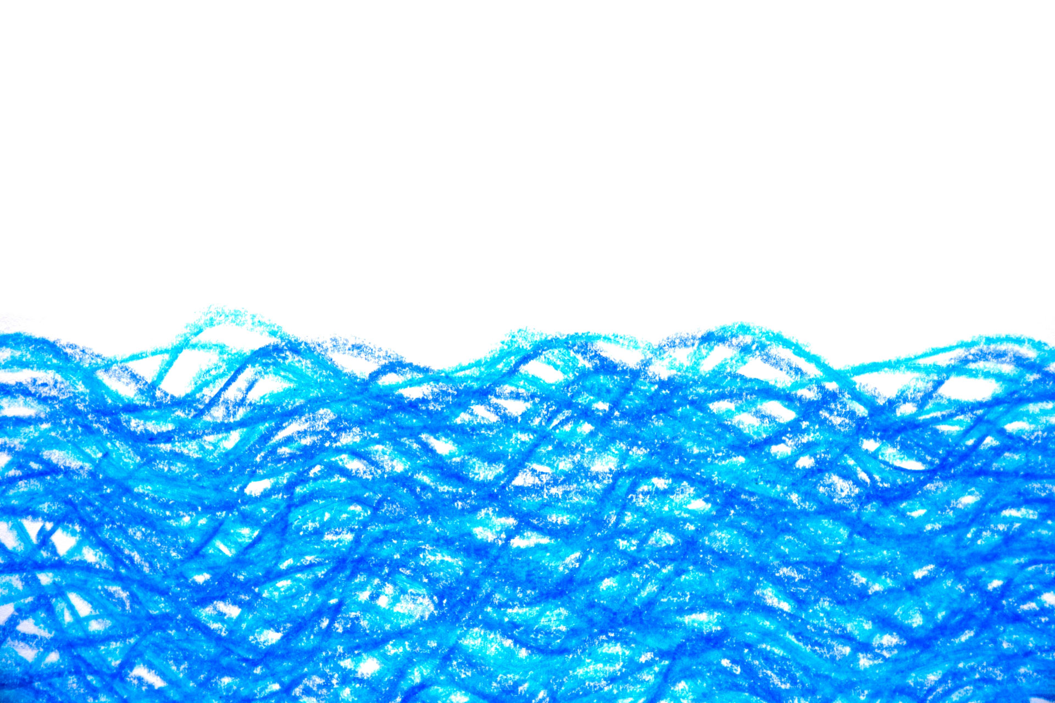


Slide 8

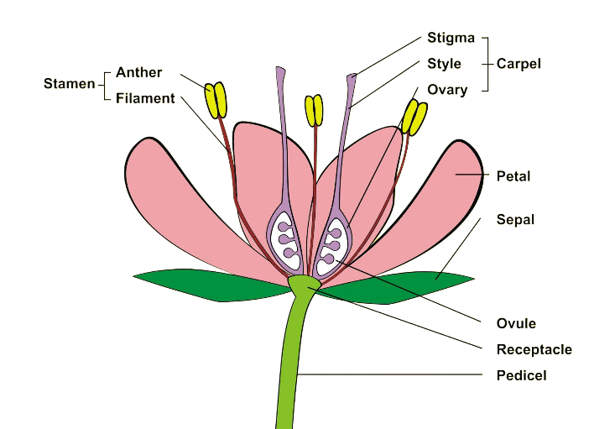
symbol
A simplified drawing that represents something.
label
A word or phrase that gives information.

Slide 9

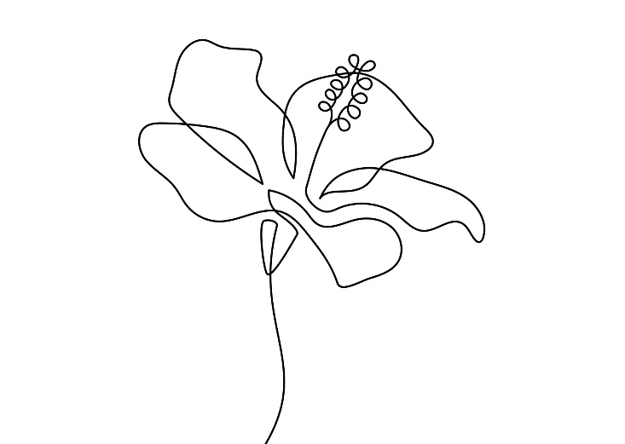
identify
To recognise and name something.
contour lines
Lines that show the outline and internal shapes of an object.

Slide 10
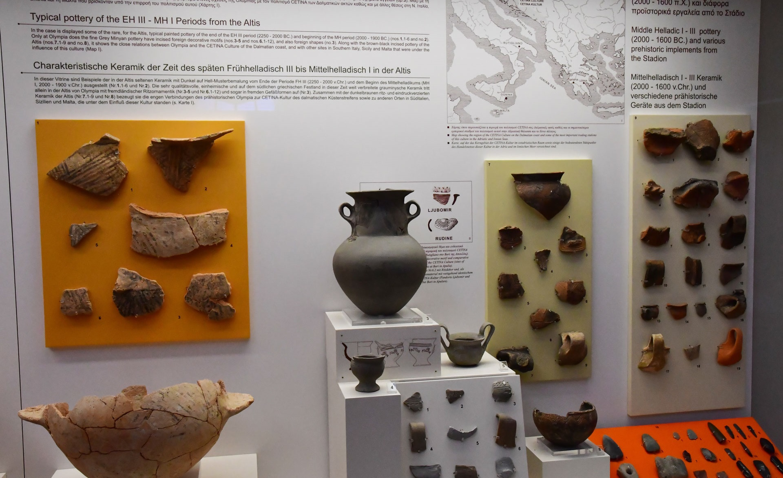
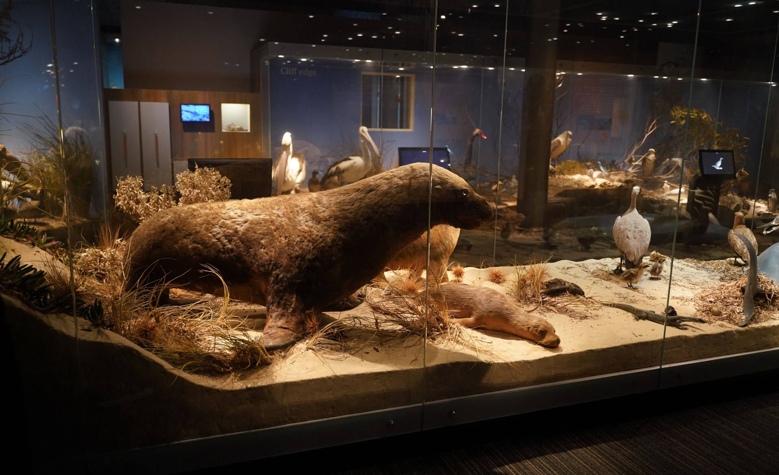

Museums

Slide 11


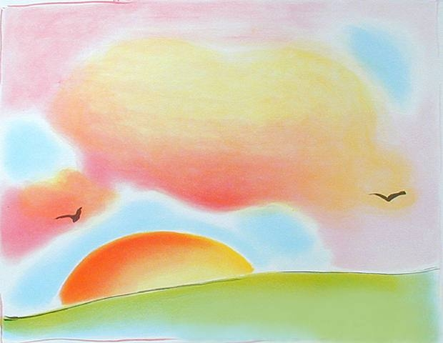
Diagrams and Labels

Slide 12
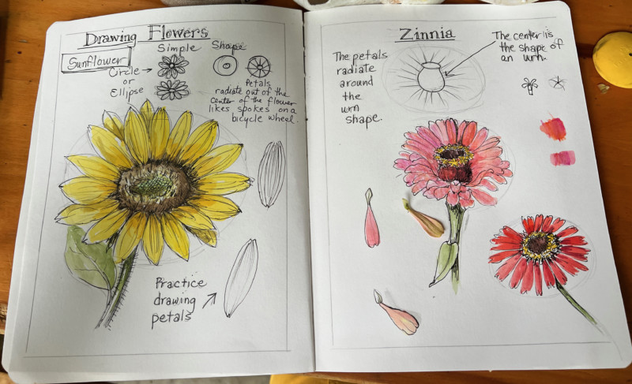
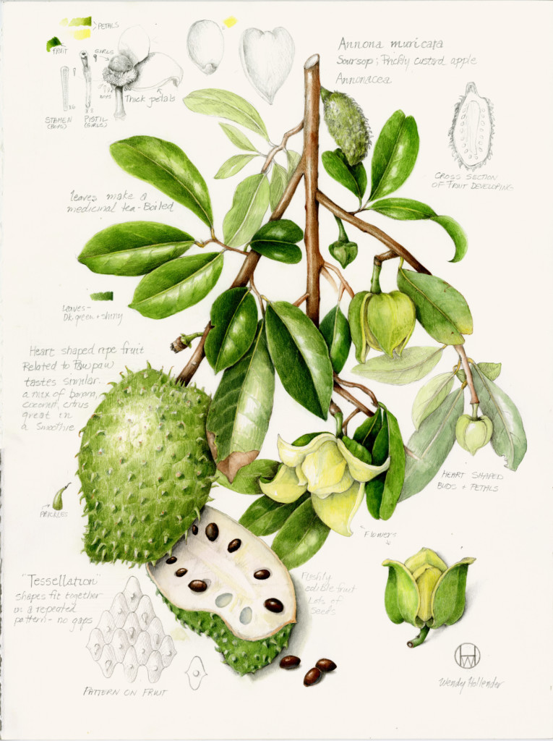

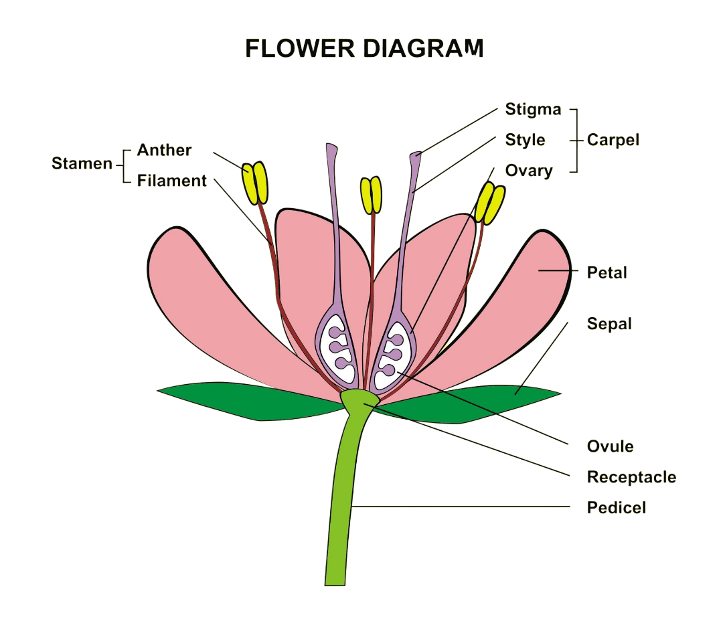
Diagrams and Labels

Slide 13
Diagrams and Labels

Slide 14
Museums
The purpose of a diagram is to:
explain and show information clearly
decorate a page
replace writing completely

Slide 15

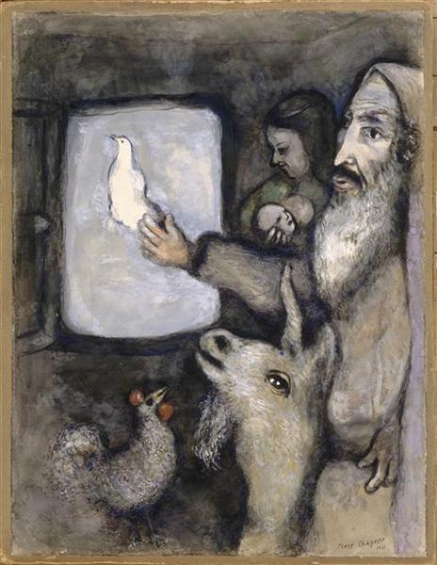



Symbols

Slide 16

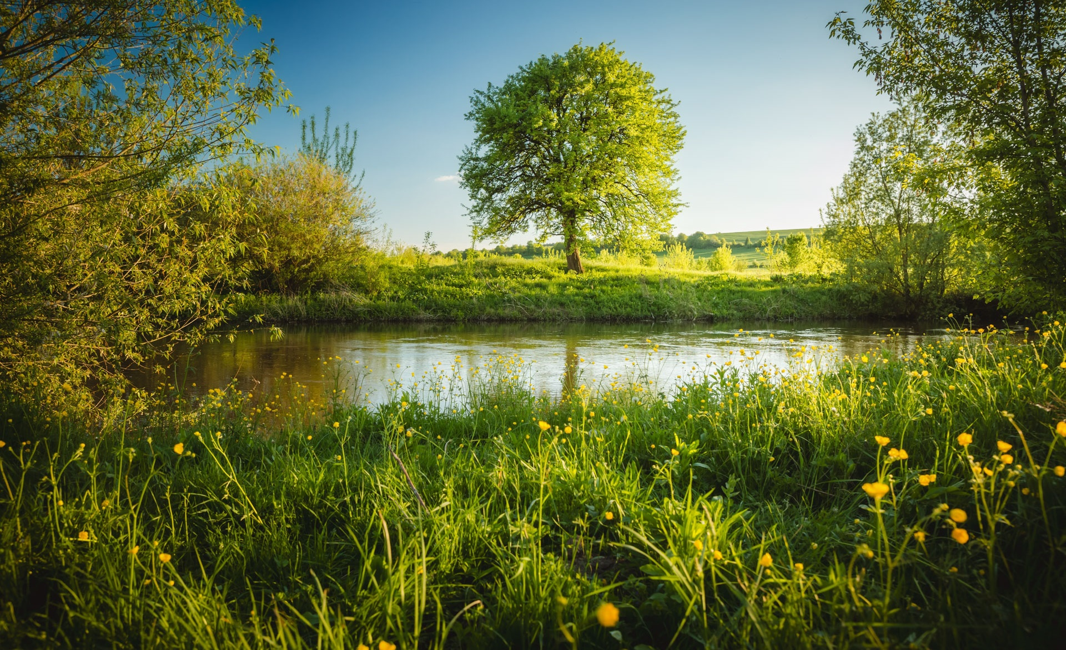


Symbols

Slide 17
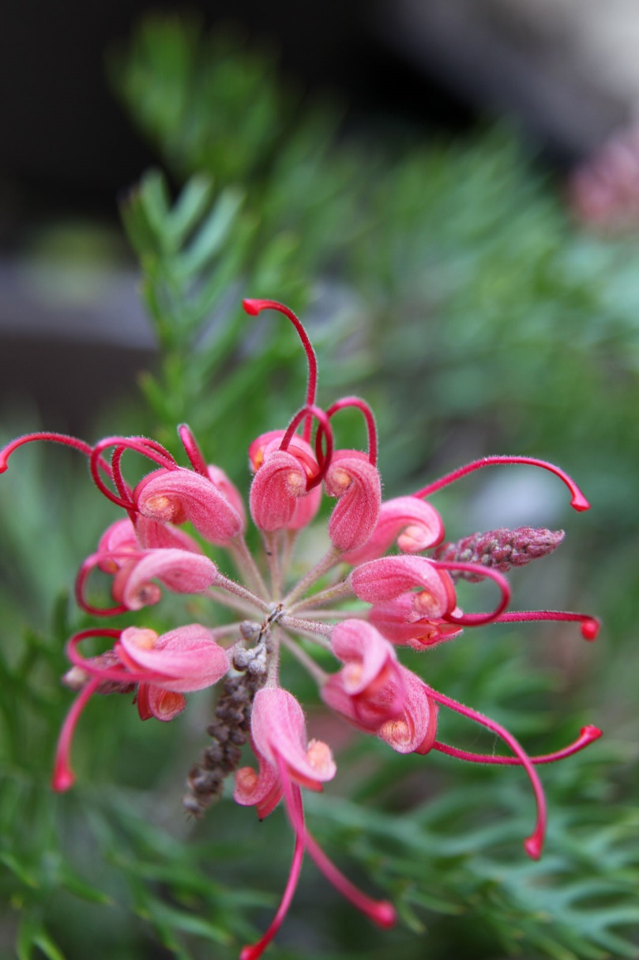
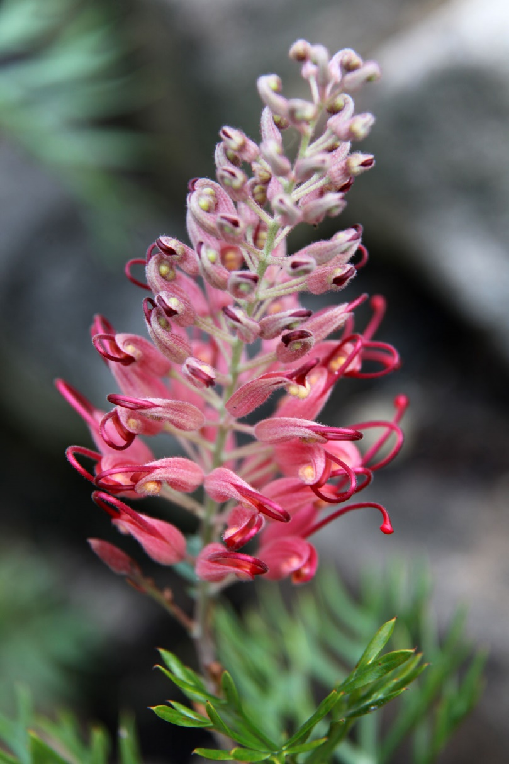
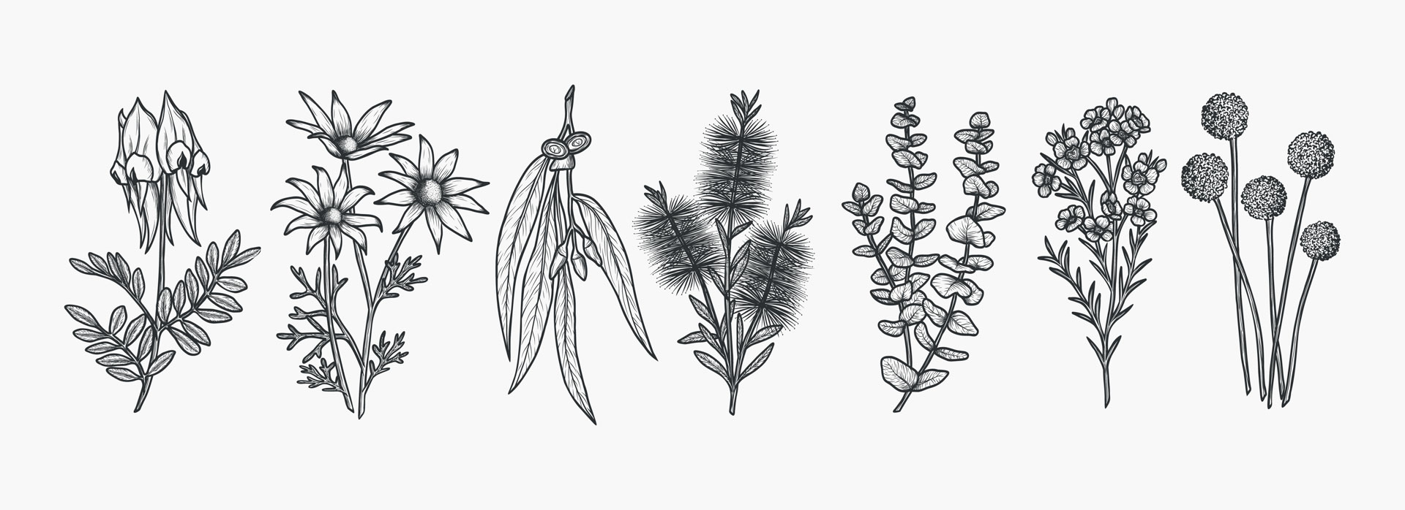
























Symbols

Slide 18
Documenting Nature
In your symbol, you will use:
straight, jagged lines
short broken lines
soft, smooth, curving lines

Slide 19
Symbols

Slide 20
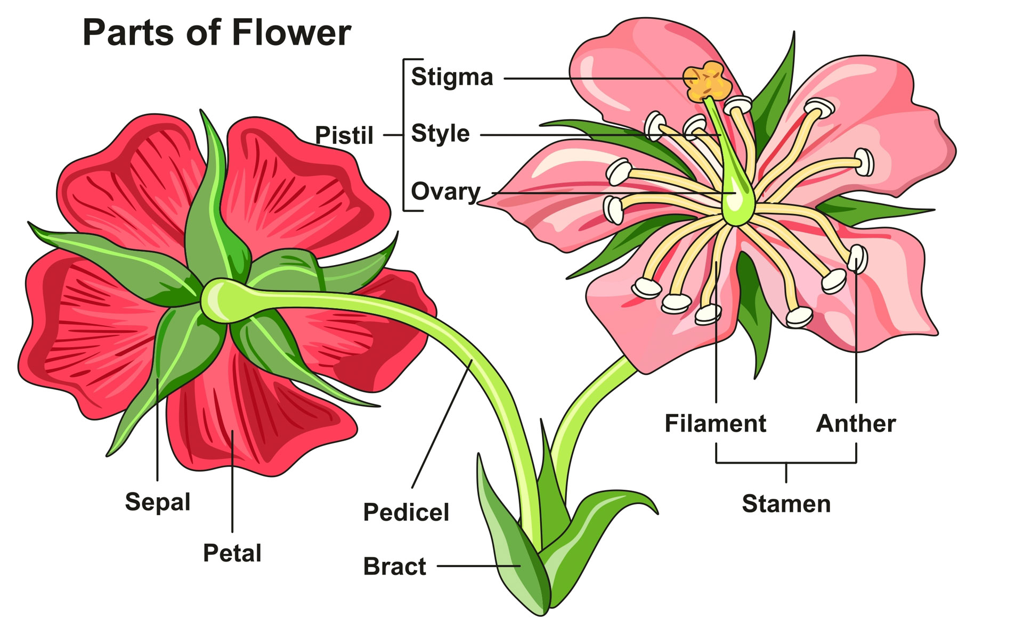
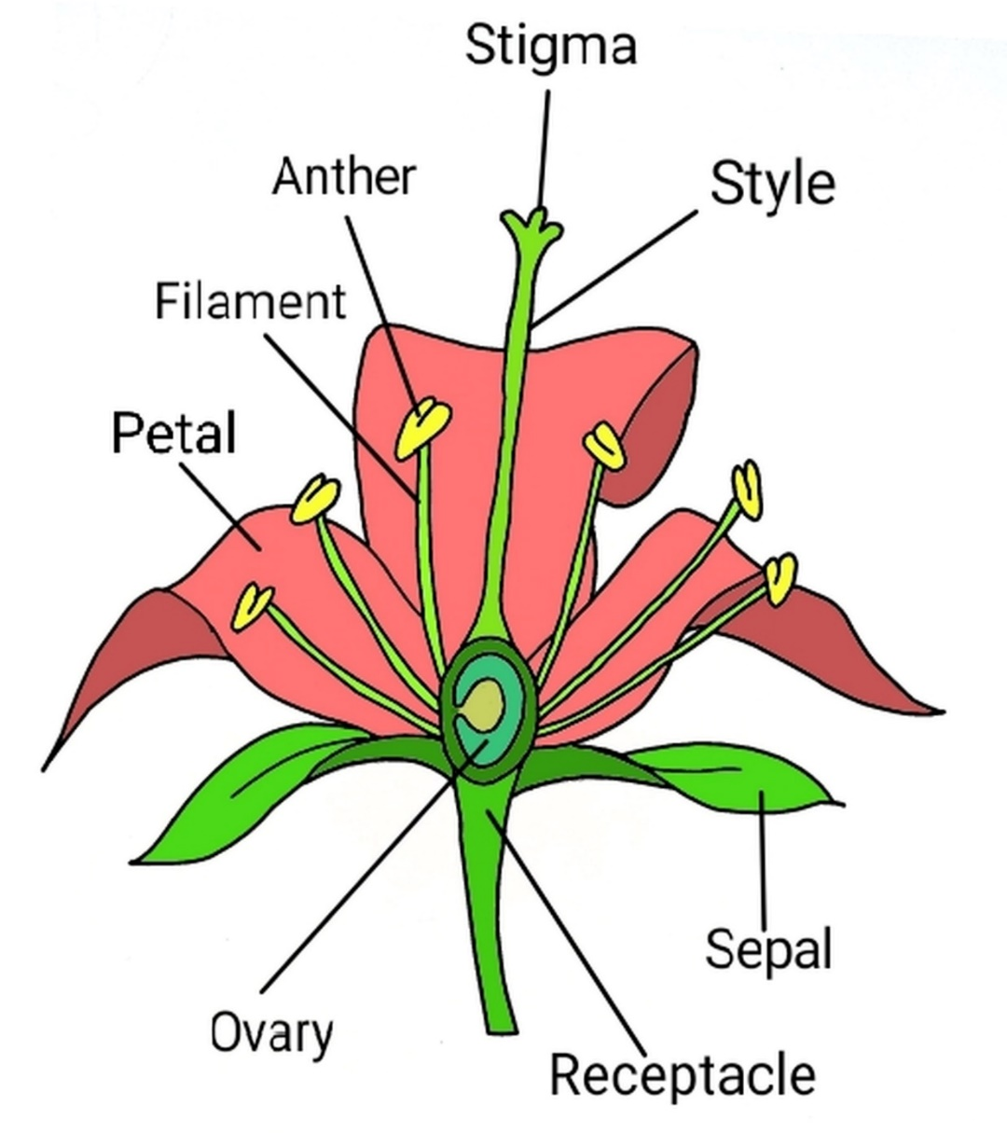
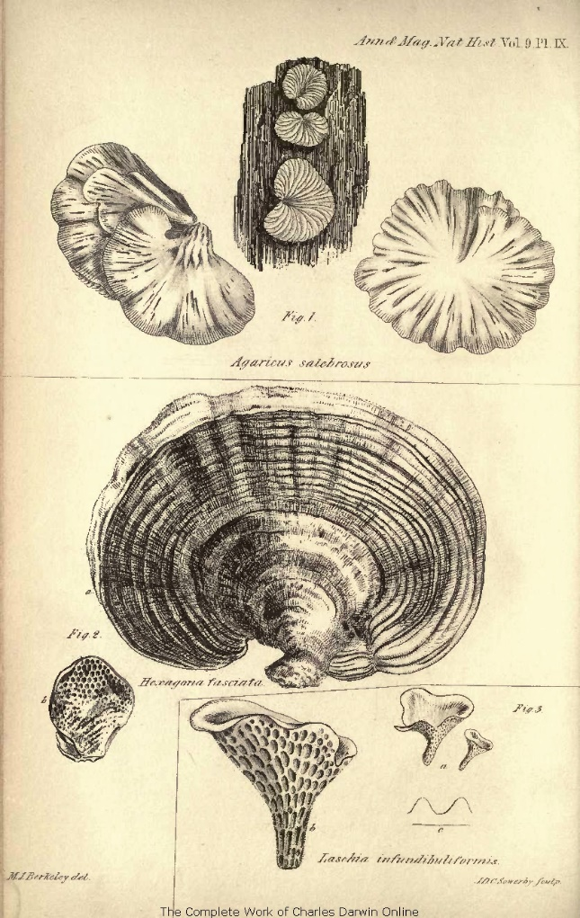
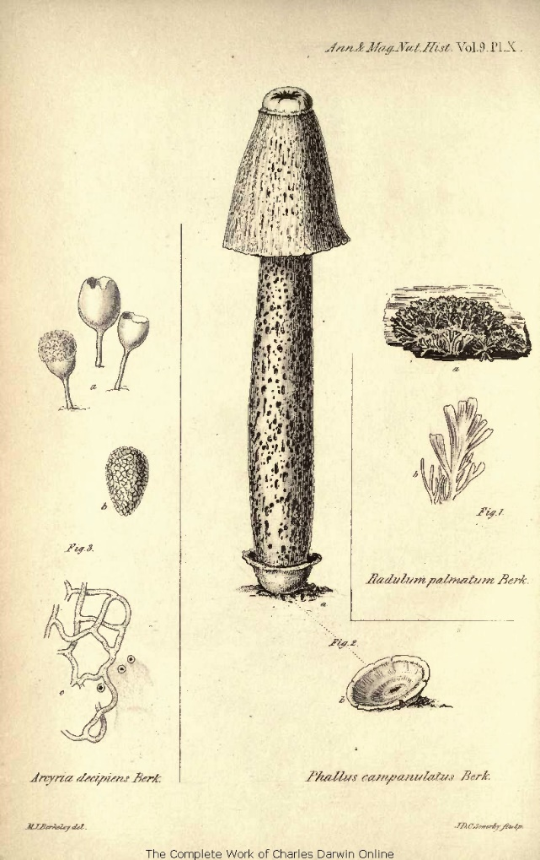
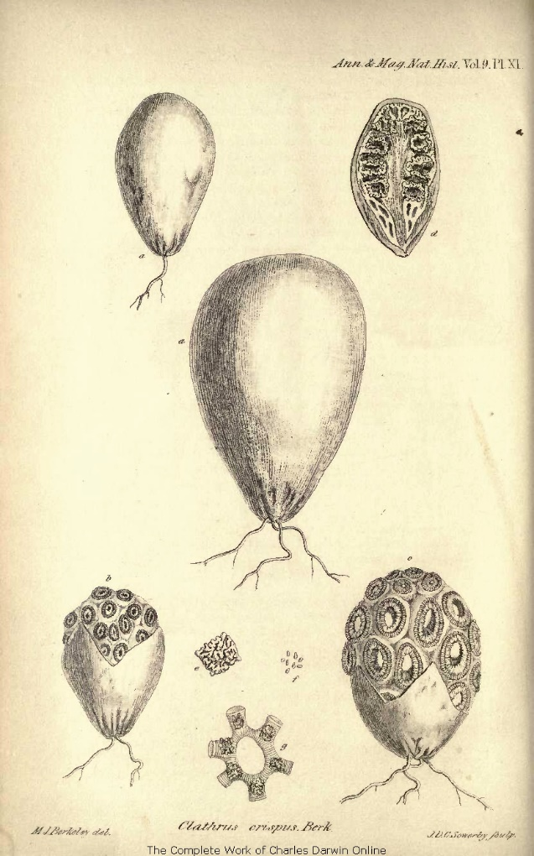
Adding Labels

Slide 21

Adding Labels
leaf
branch
trunk

Slide 22
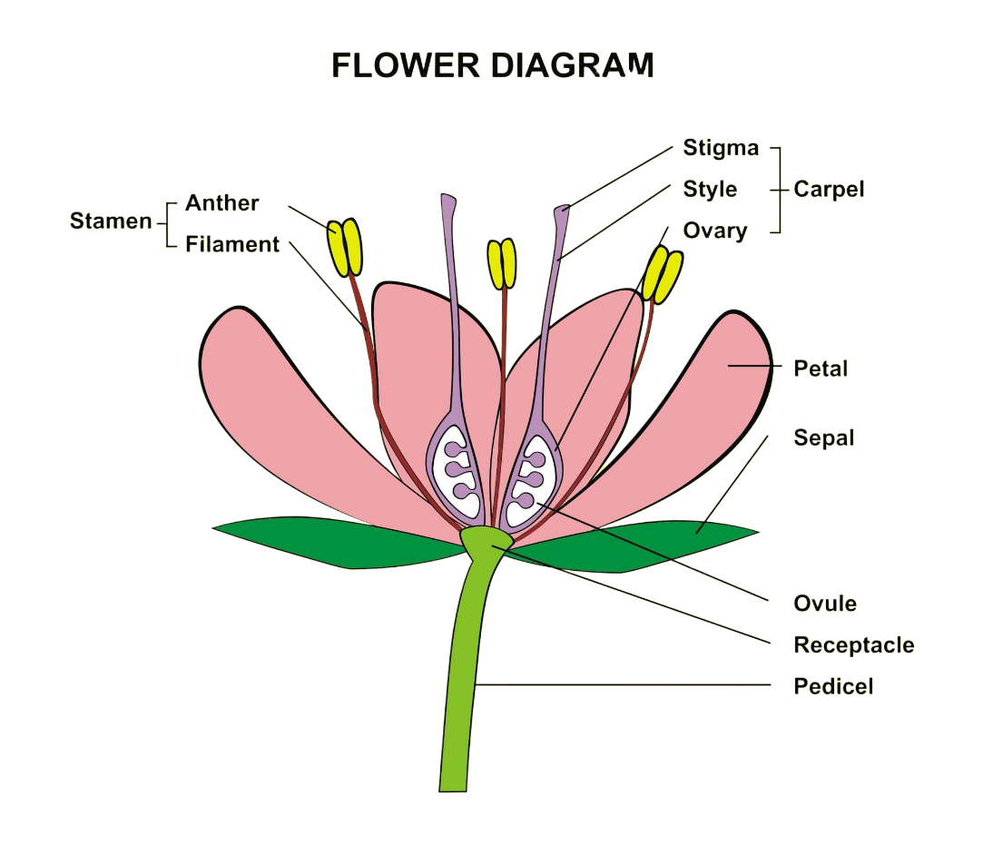



















Adding Labels
petal
carpel
pedicel

Slide 23
Adding Labels
The purpose of a label is to:
make the picture colourful
name the parts clearly
decorate the page

Slide 24

Creating Symbols
Notes:
We will watch a video to learn how to create a symbol of our plant and add labels to give extra information.
Play Demo Video.

Slide 25
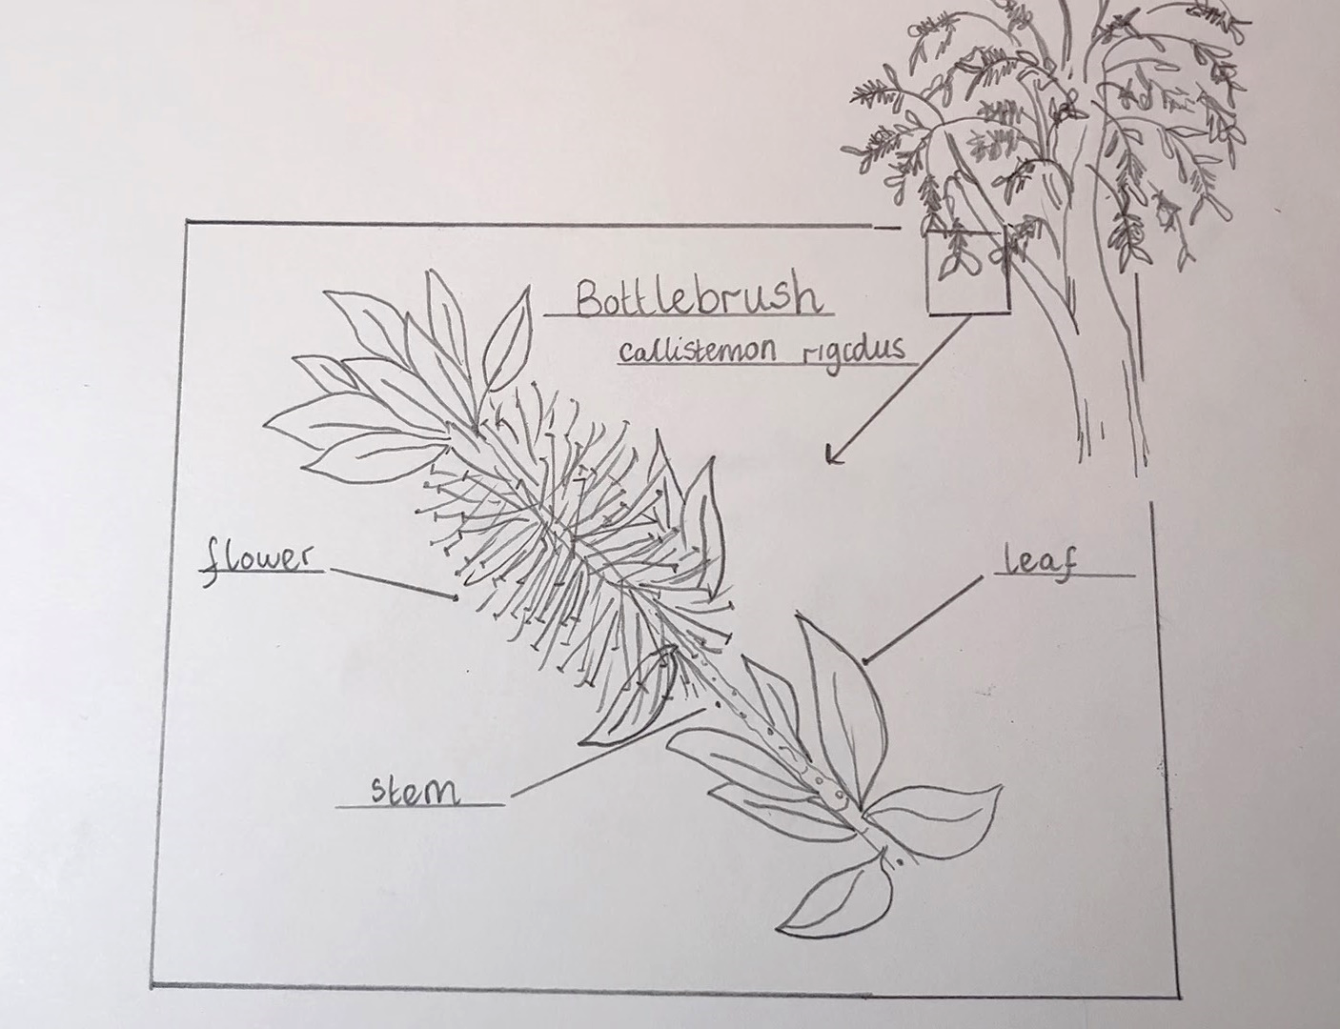
Plant Study

Slide 26
Plant Study
Looking carefully helps us:
notice the important parts
use our imagination
add colour

Slide 27
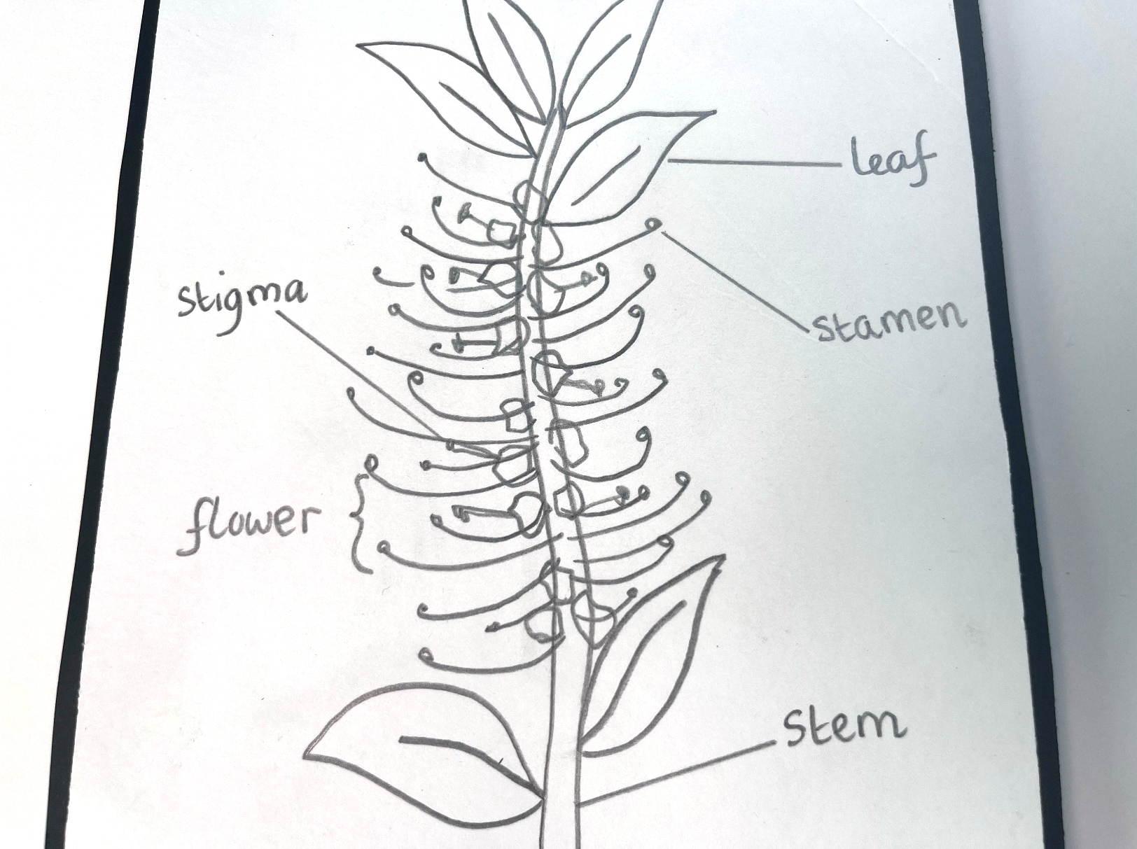
Plant Study

Slide 28


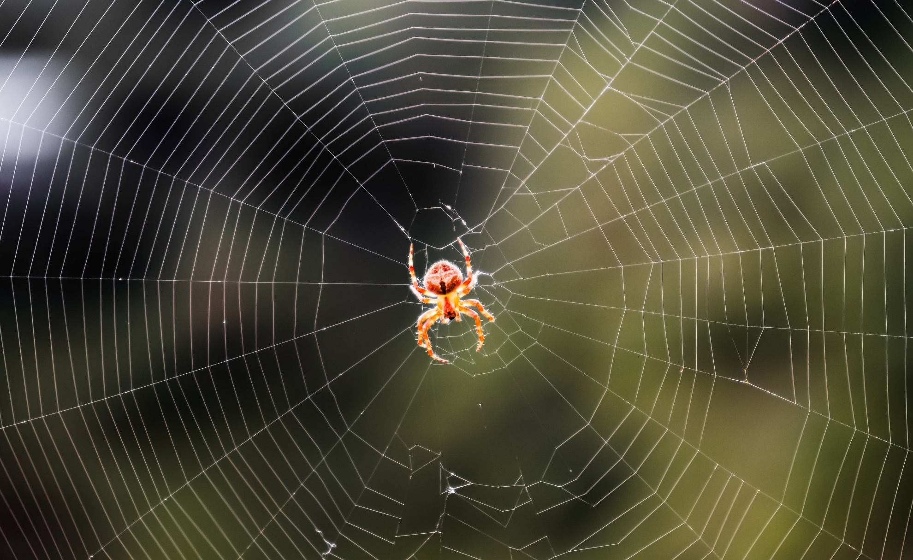

Find the Most Interesting Part

Slide 29

Find the Most Interesting Part

Slide 31

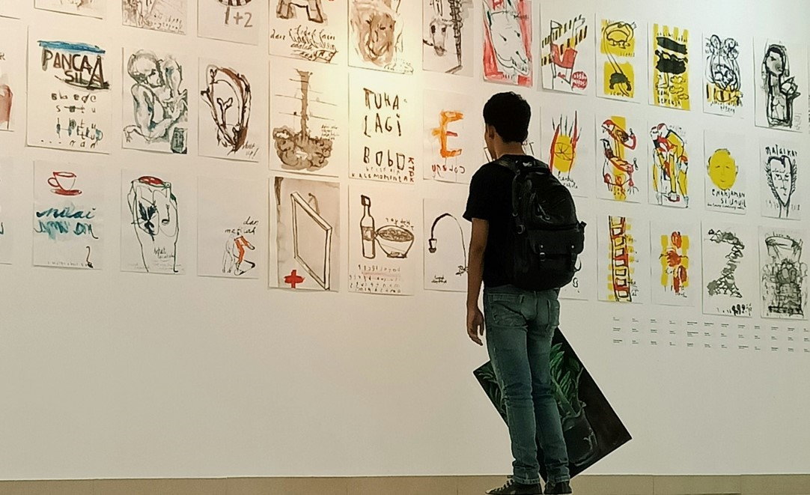


Slide 32


Slide 33








Symbols and labels help us share tricky information in an easy way.
A symbol shows something real using just the most important parts.
petal
carpel
pedicel

Slide 35
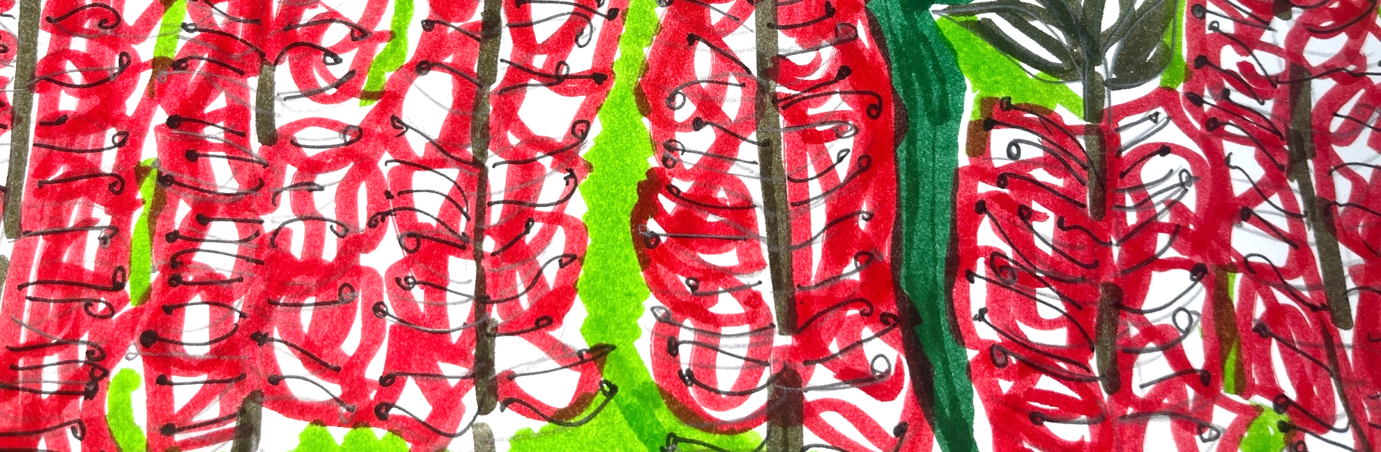
In the next lesson, we will create a colourful pattern inspired by our plant.

Slide 36
Slide 11 (2nd) Photo: Freedom by Peter Max (1980), from WikiArt, Used under Fair Use, https://www.wikiart.org/en/peter-max/freedom-1980
Slide 12 (2nd) Photo: Soursop page by Wendy Hollender, from Draw Botanical, LLC, Used with Permission, https://drawbotanical.com/wp-content/uploads/soursop-765x1024.jpg​
Slide 12 (3rd) Photo: IMG_5491 by Wendy Hollender, from Draw Botanical, LLC, Used with Permission, https://miro.com/app/board/uXjVJK5peKQ=/?moveToWidget=3458764640302987705&cot=14
Slide 15 (2nd) Photo: Noah lets go the dove through the window of the Ark (Genesis VIII, 6 9) by Marc Chagall (1931), from WikiArt, Used under Fair Use, https://www.wikiart.org/en/marc-chagall/noah-lets-go-the-dove-through-the-window-of-the-ark-genesis-viii-6-9-1931

