Slide 1
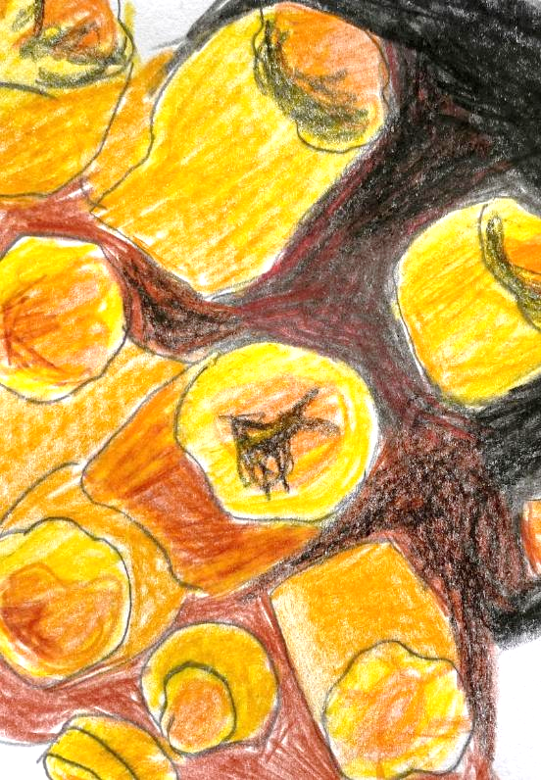
Unit 1A
Art and Action
Lesson 2
Coral Drawings
Unit 1A Version 1

Slide 2
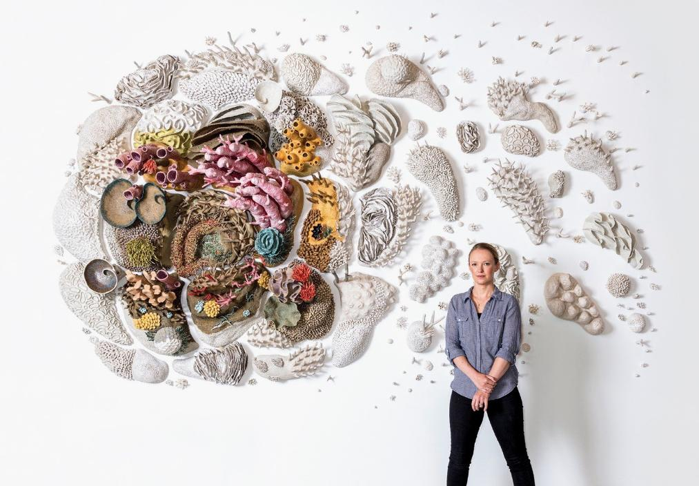
Artists like Nikolina Kovalenko, Rogan Brown and Courtney Mattison use their artwork to raise awareness of coral bleaching.
© Jeff Minton

Slide 3
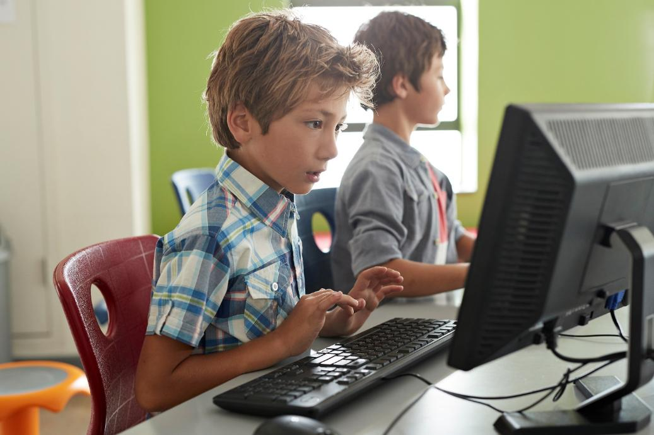
We research facts about coral bleaching to help us learn important information about it that we can share in our own artwork.

Slide 4
Artists like Courtney Mattison create artwork about coral bleaching to:
give away their art
help people
understand coral bleaching
make people laugh

Slide 5
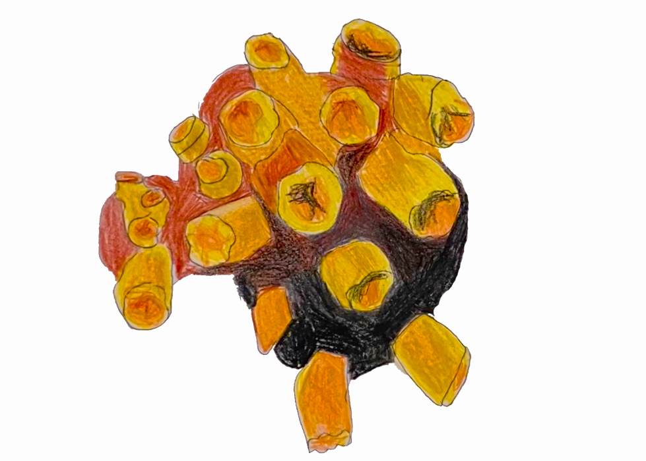
In this lesson we will draw our coral carefully, showing all the important details we learned about.

Slide 6
You will be successful when you can:
look closely at coral features
draw what you see accurately
include important details about your coral.

Slide 7
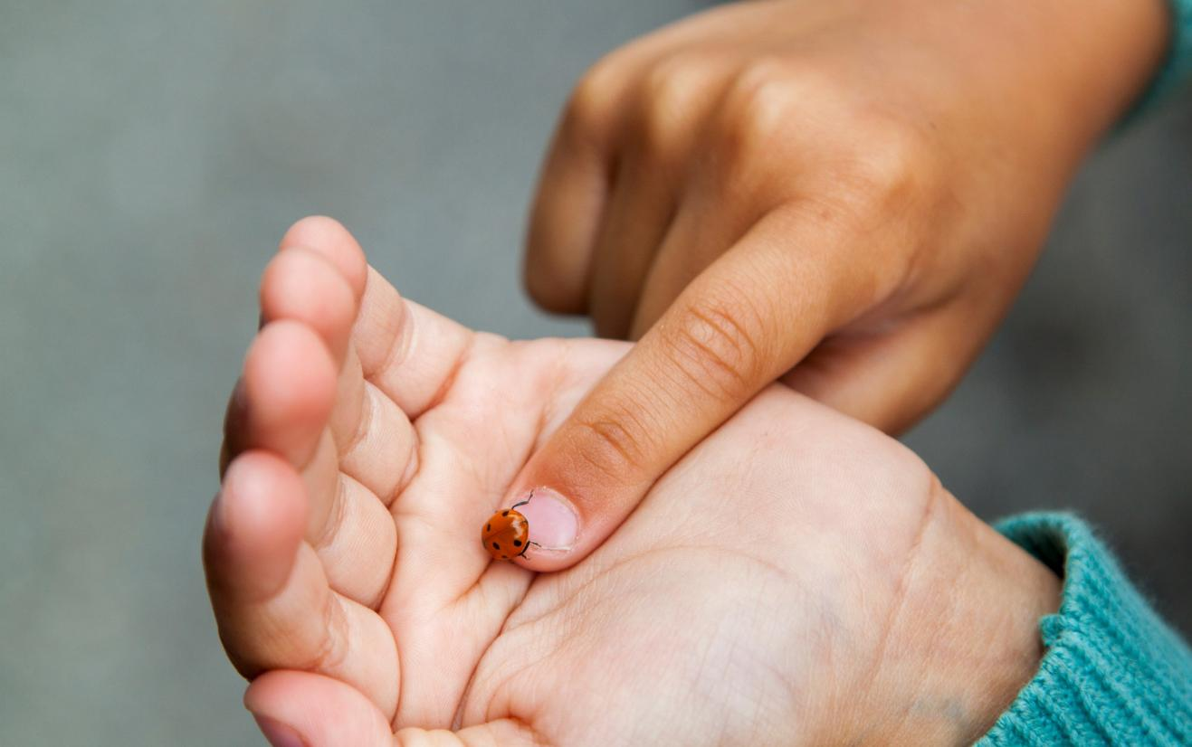
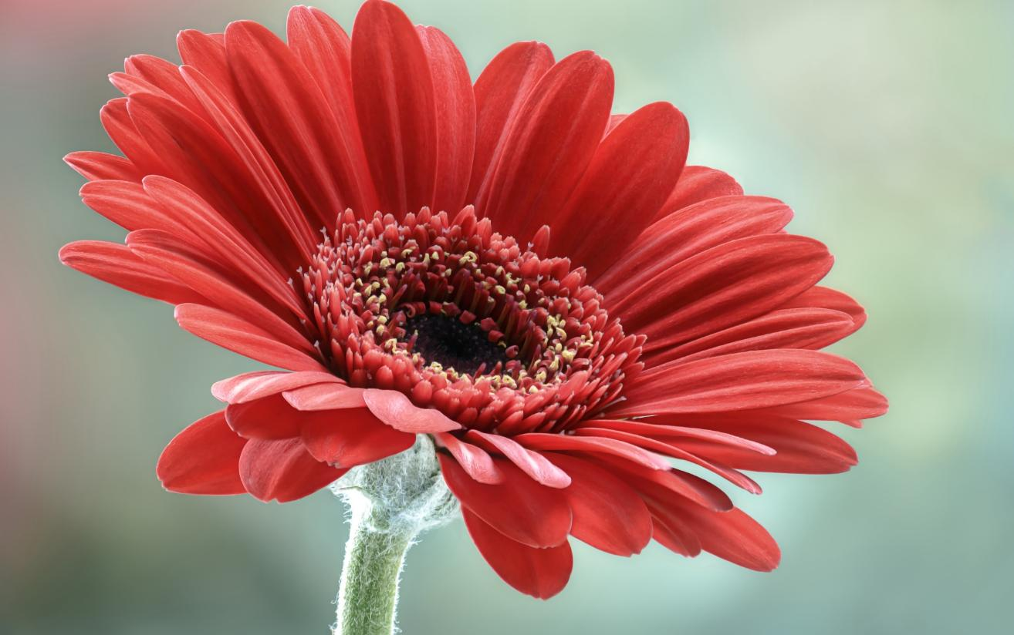
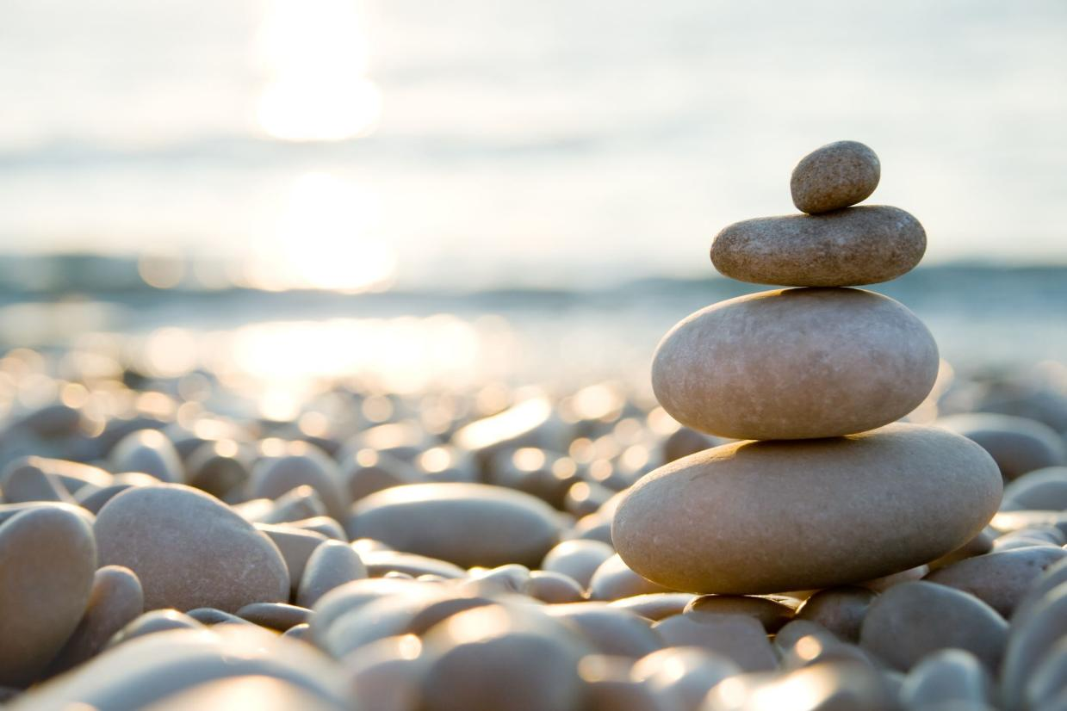

Slide 8
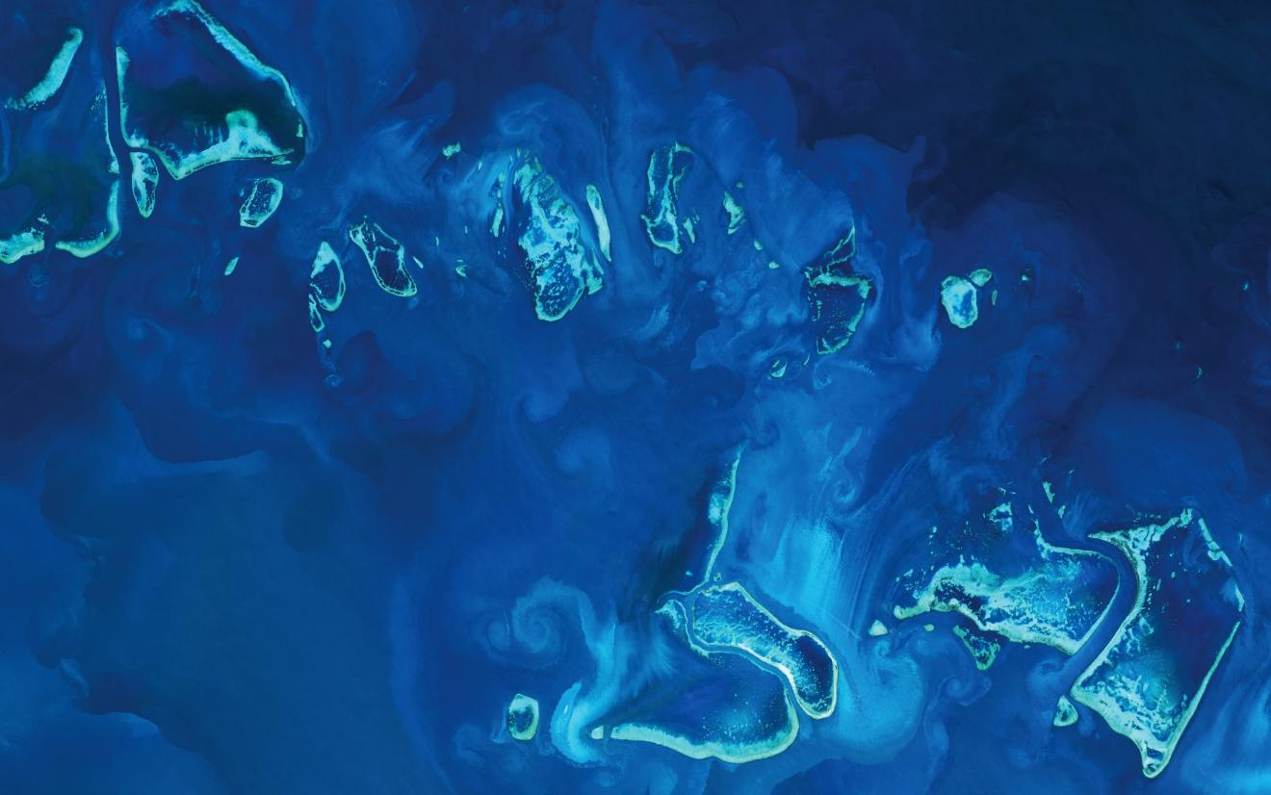
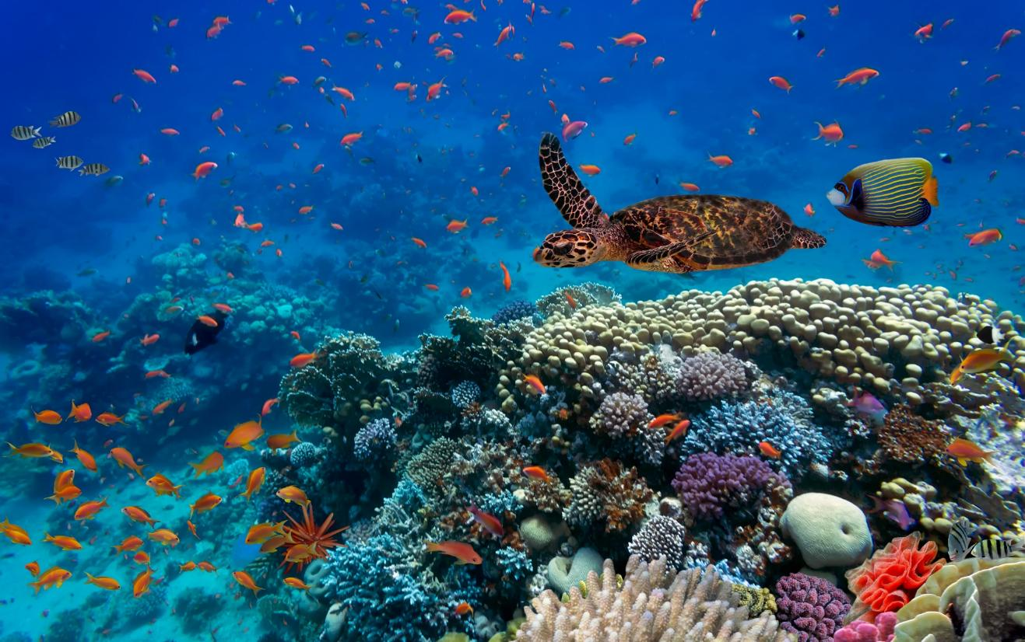
Review

Slide 9
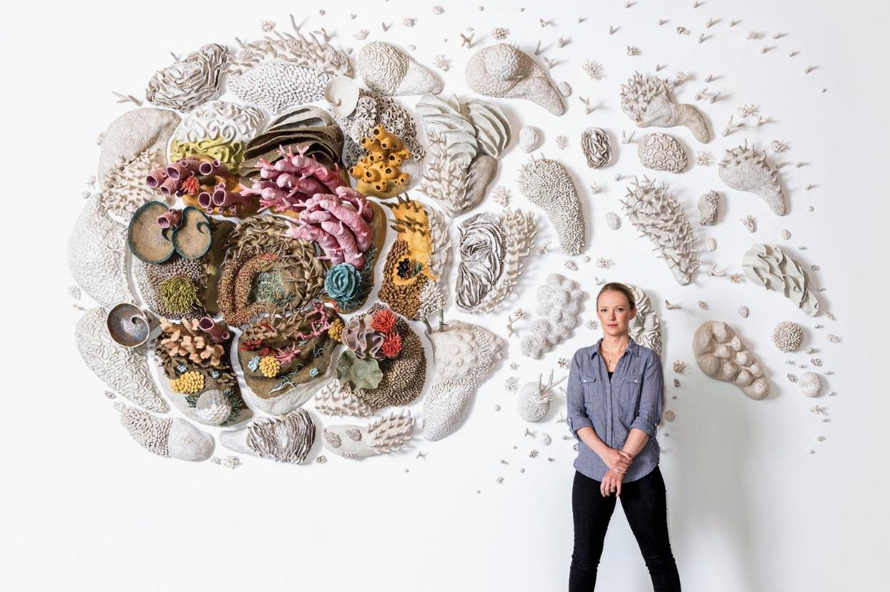
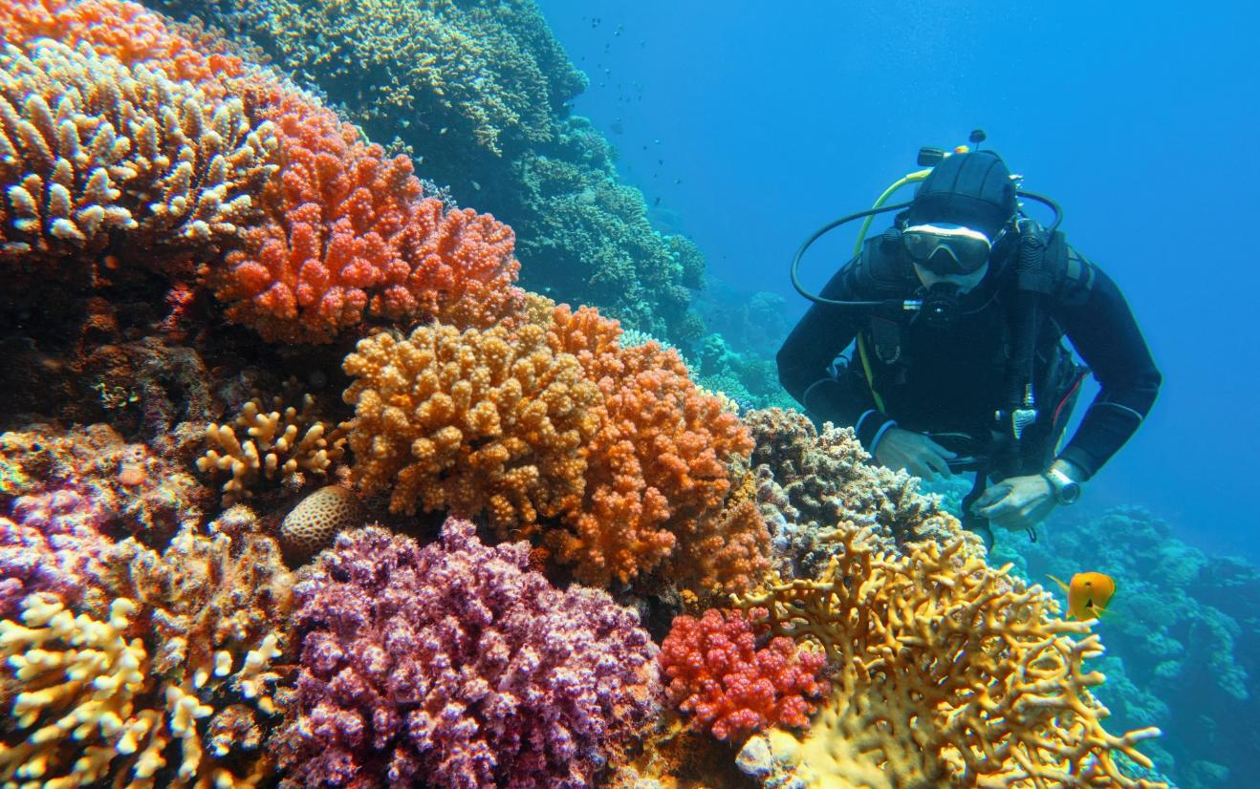
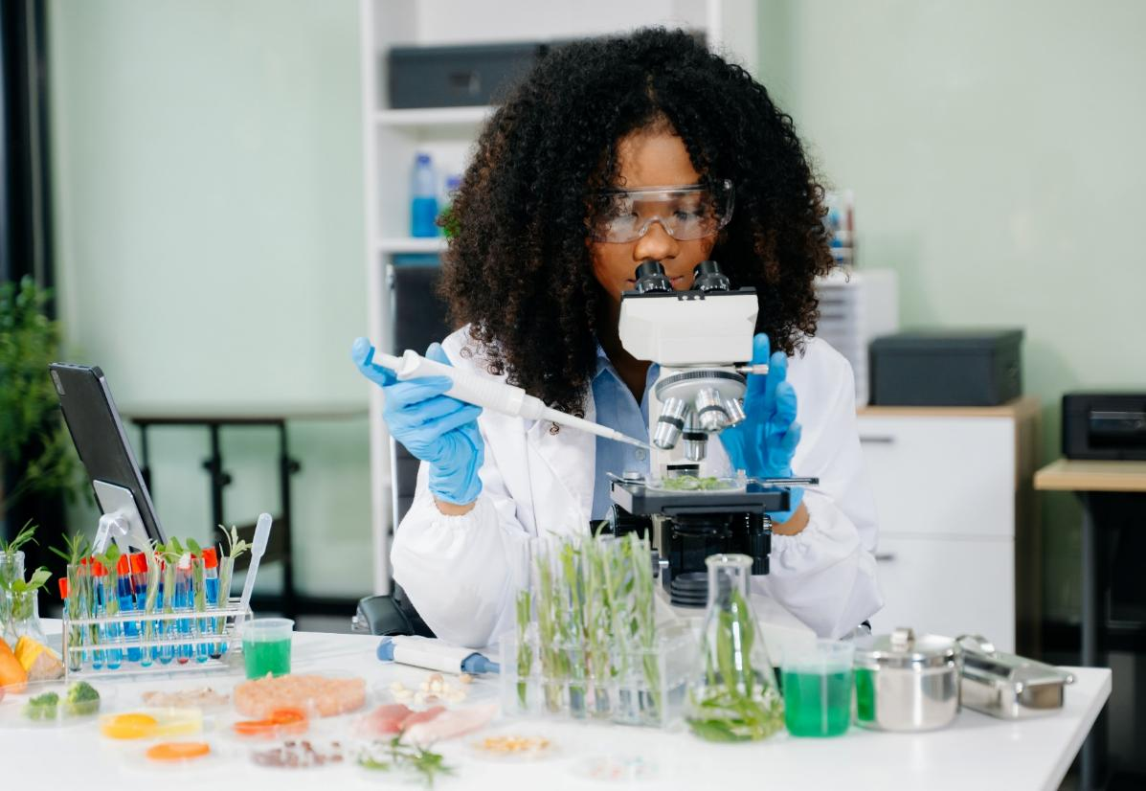
Looking Closely

Slide 10

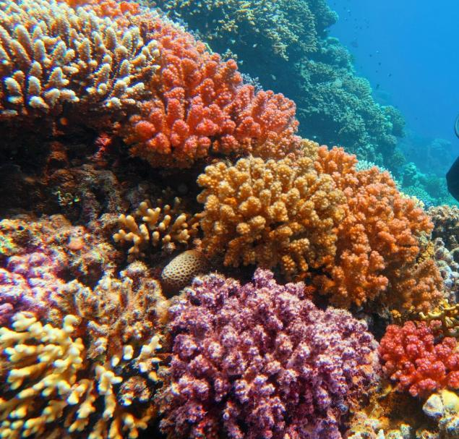
Looking Closely

Slide 11
Looking Closely

Slide 12
It is important to look closely at something before we draw it because it:
helps us notice things we might miss
helps us make our drawings really big
helps us
draw faster

Slide 13
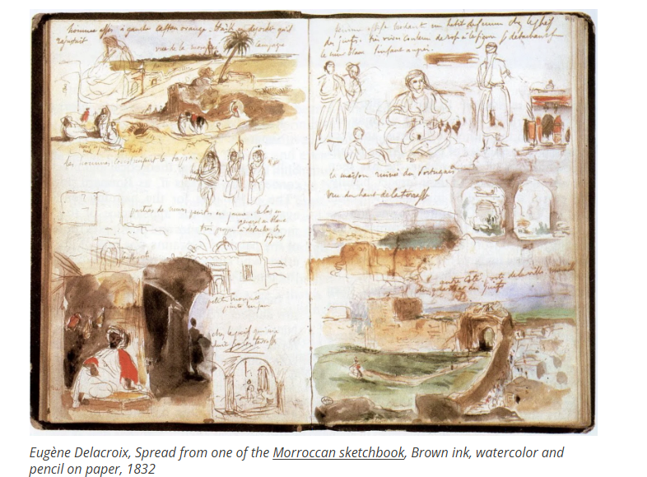
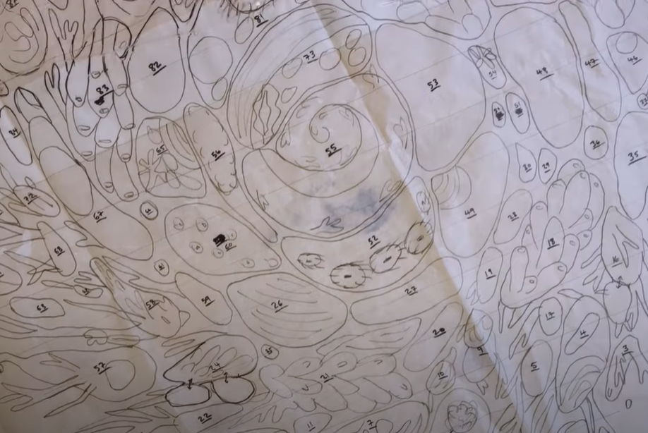
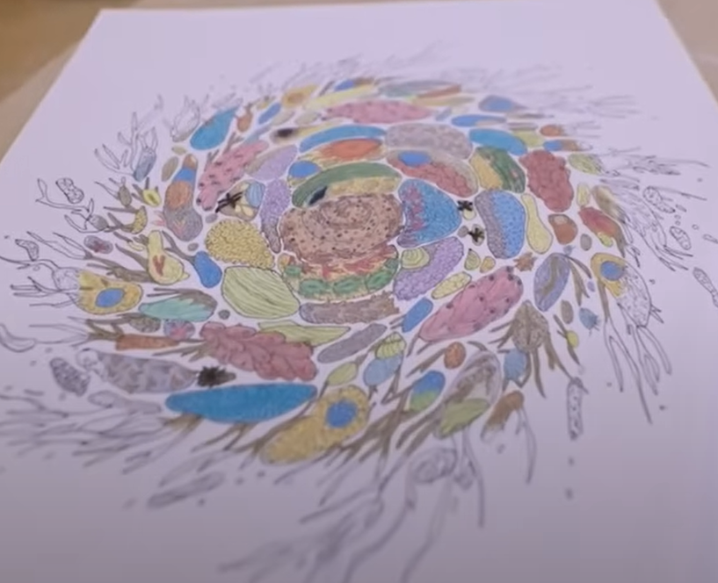
Coral Drawings

Slide 14
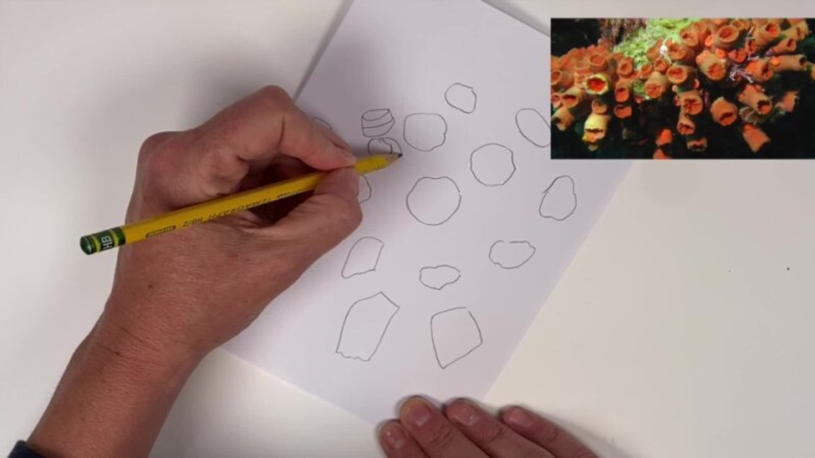
Coral Drawings

Slide 15
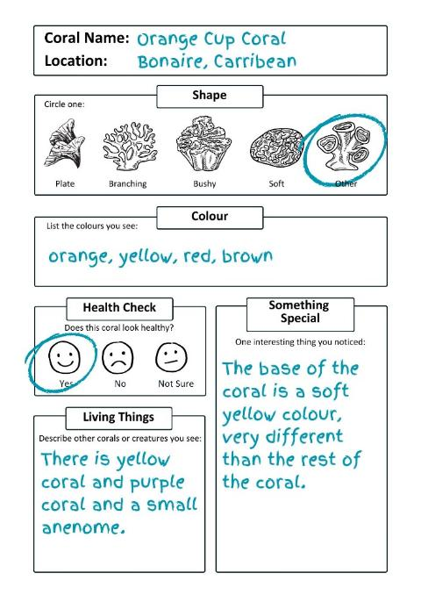
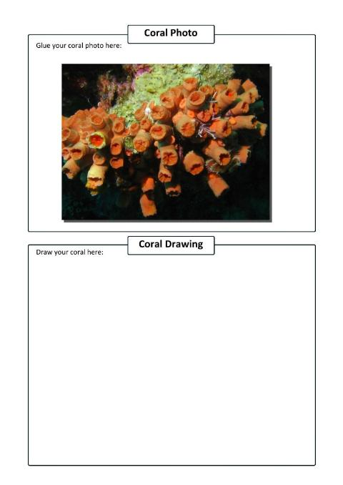
1. Refer closely to your research in your Student Workbook.

Slide 16
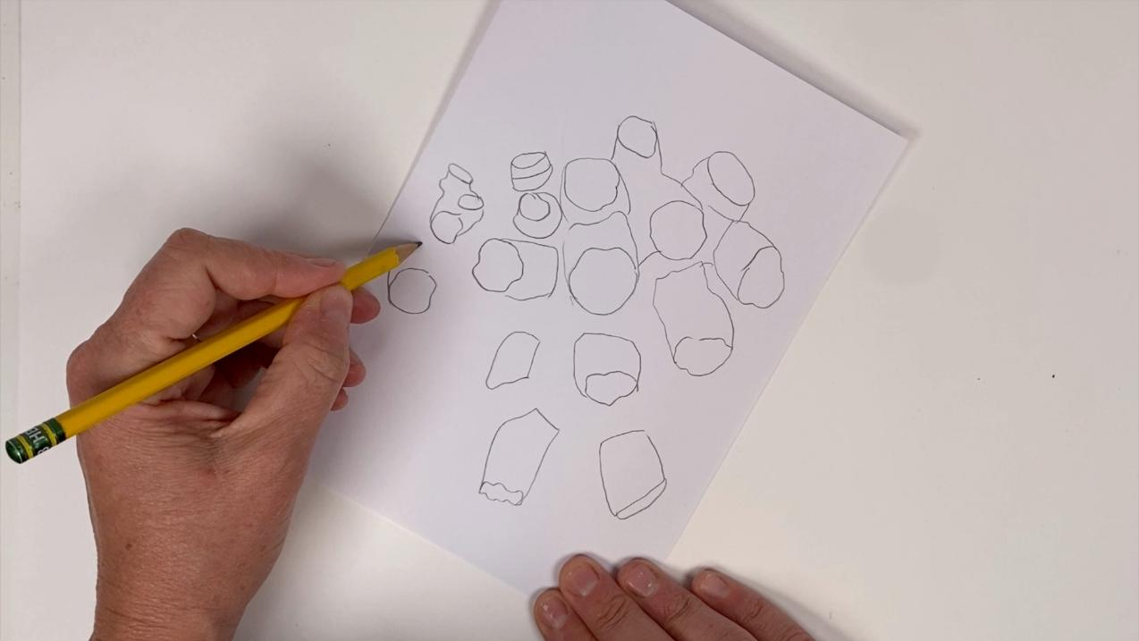
2. Draw the exact shape and all the textures of the coral.

Slide 17
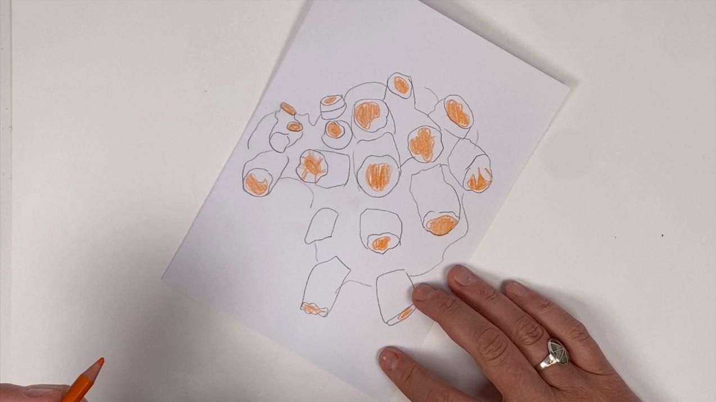
3. Look at the coral colours and begin colouring in.

Slide 18
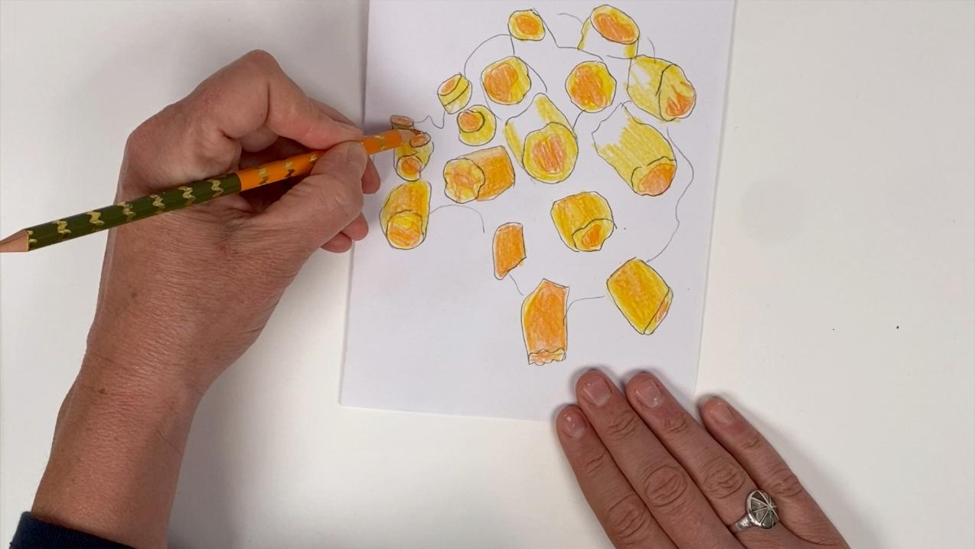
4. Add other colours as needed.

Slide 19
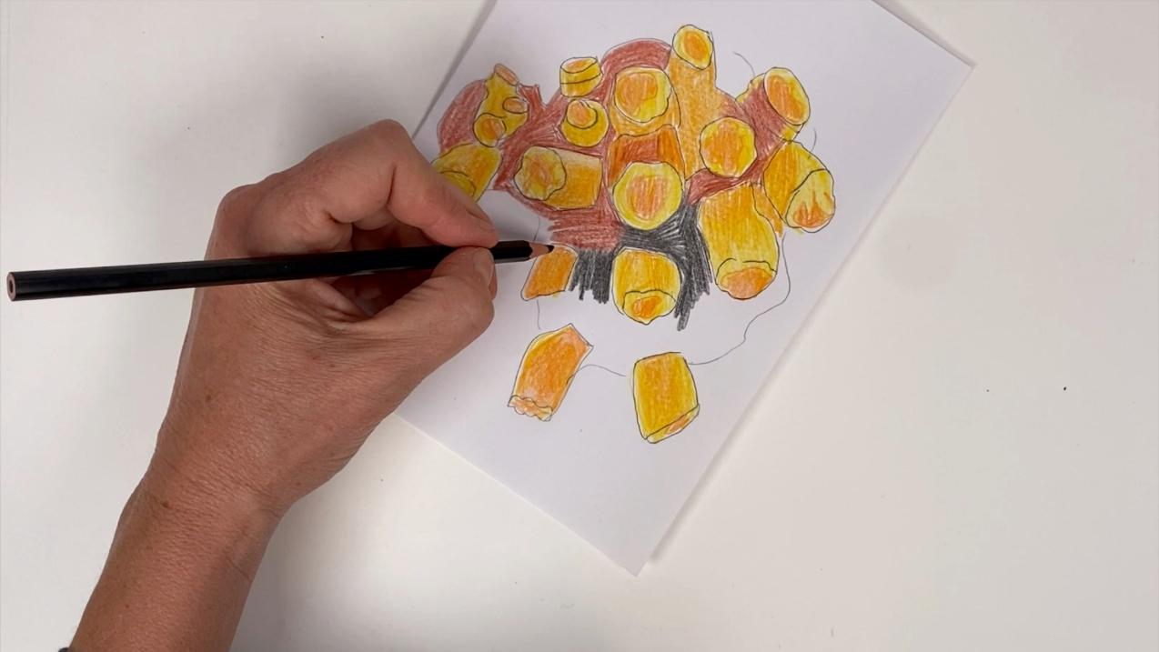
5. Colour in the base of the coral, if you can see it.

Slide 20
Artists create detailed drawings before making their final artwork because:
they want
to draw
quickly
they want to skip important details
drawings help them plan their final artwork

Slide 21

Coral Drawings

Slide 22
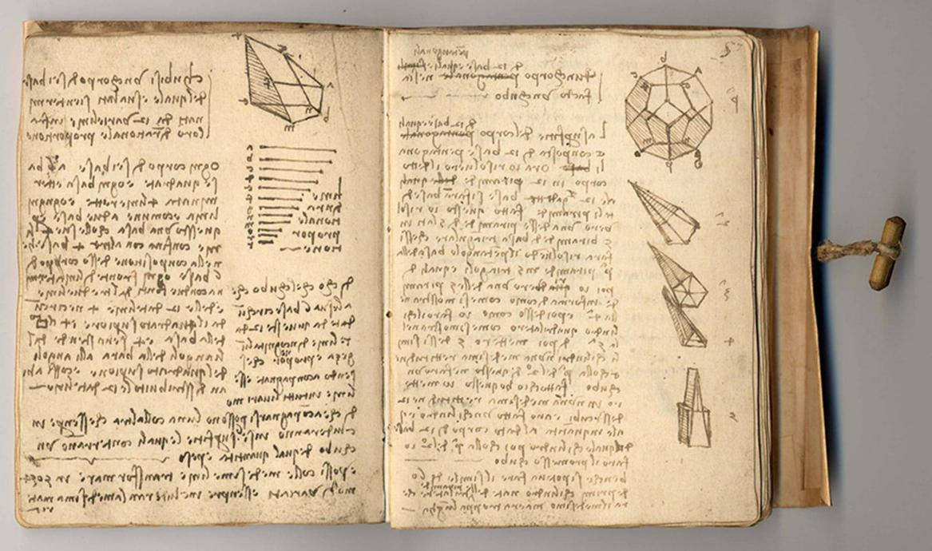
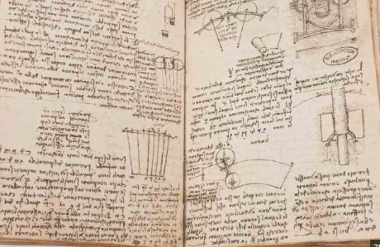
Reflect
Artists write and record what they learn and how they did in creating their work.

Slide 23

I included important details in my drawing like…
the bumps and textures found on the surface of the coral.

Slide 24
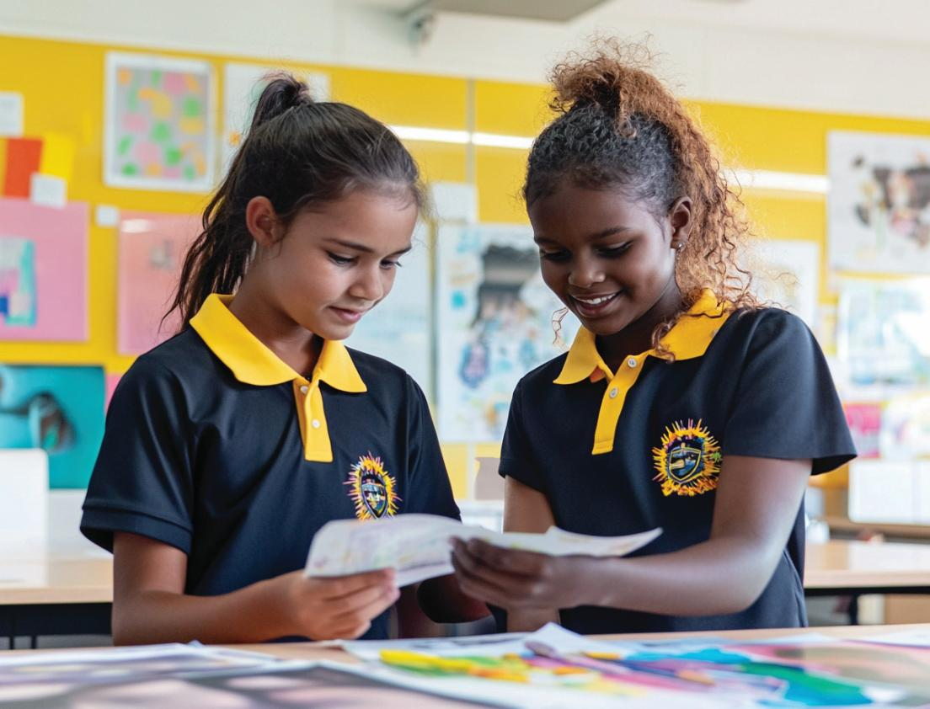

Slide 25
These details I included are important to show because:

Slide 26
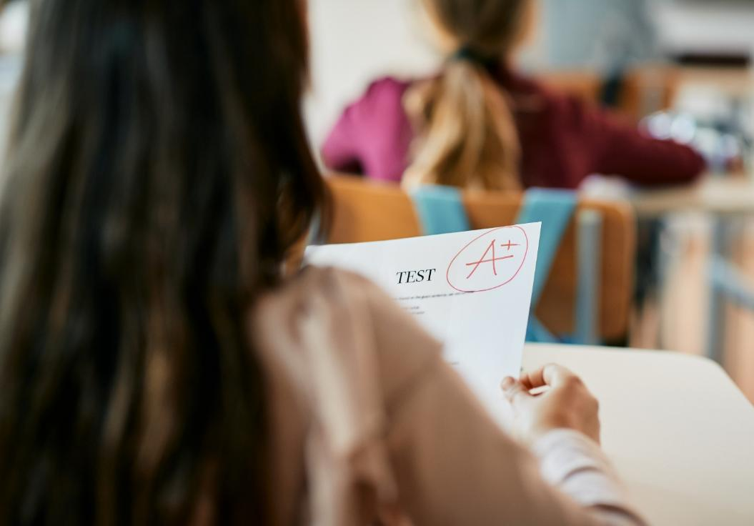
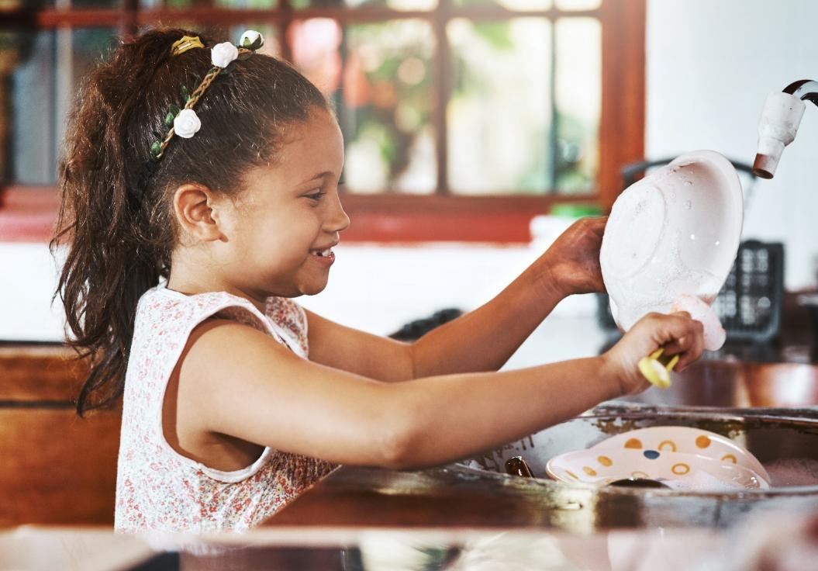
Share
I feel pride when my work shows my very best effort.

Slide 27
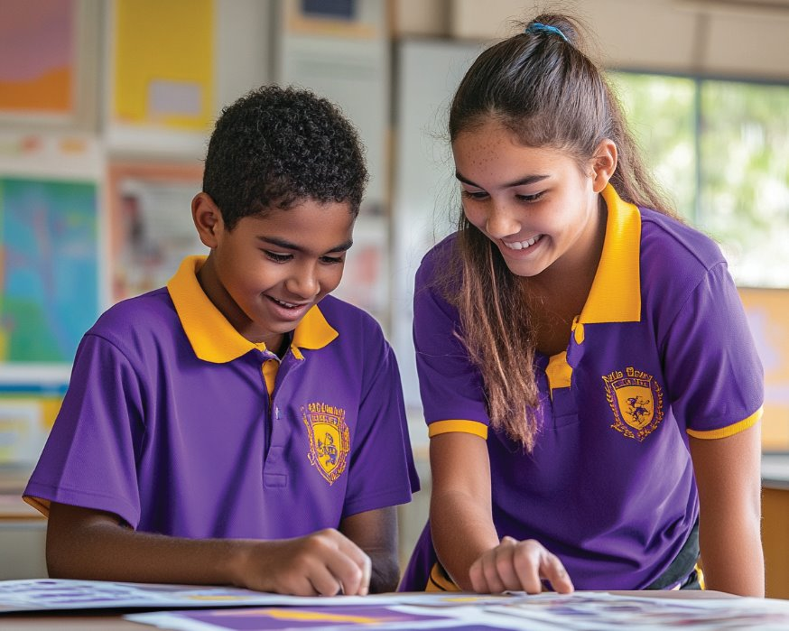
Share
We will think about a part of our work today where we put in the effort and feel proud of the results.

Slide 28

Looking closely helps us to notice important details in our coral.
Drawing our coral carefully helps us show these important details of the coral.

Slide 30
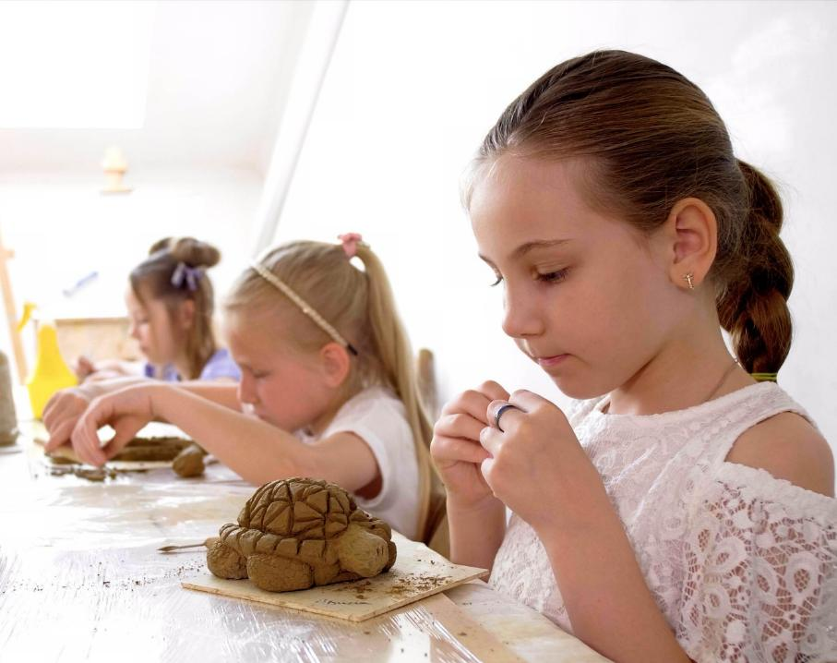
In the next lesson, we will learn clay techniques to make a patterned sea turtle.

Slide 31
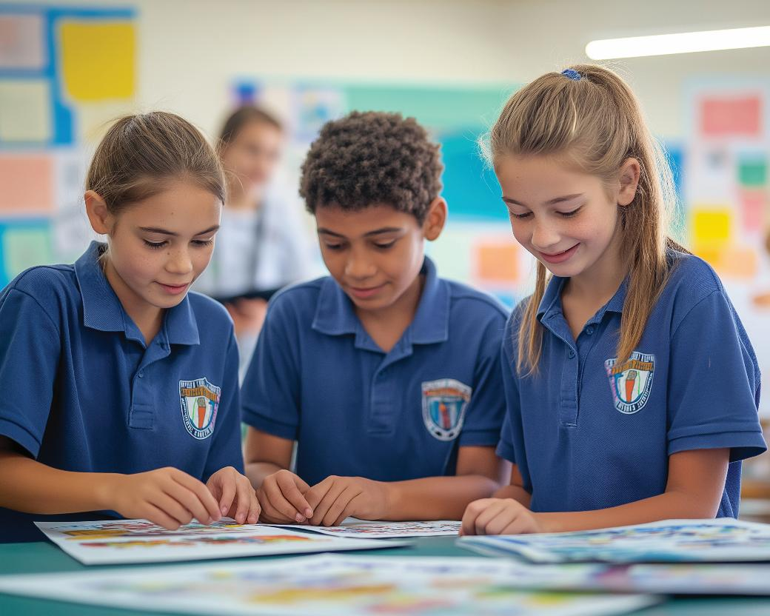
help people understand coral bleaching

