Slide 1
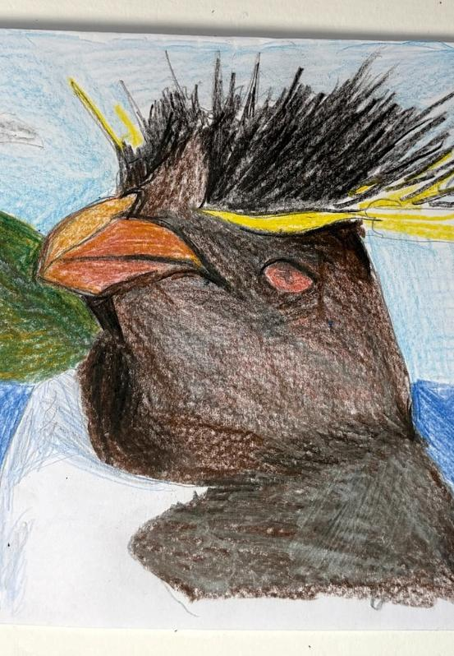
Unit 1B
Art and Action
Lesson 2
Animal Drawings
Unit 1B Version 1

Slide 2
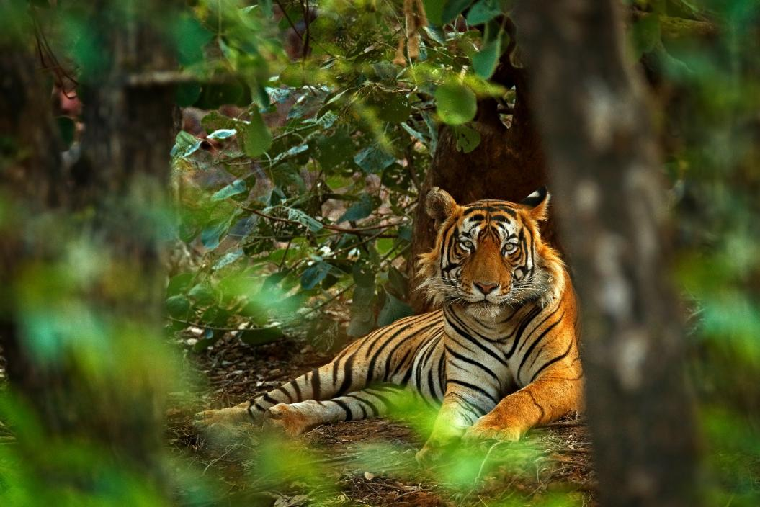
Endangered animals are animals that might disappear from our world.

Slide 3
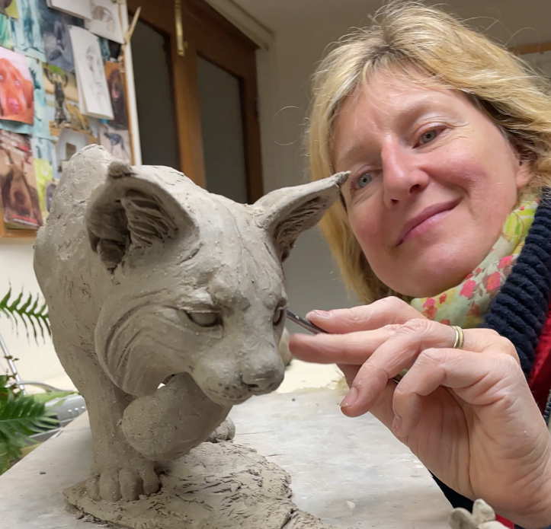
Artists like Nick Mackman use their artwork to raise awareness about endangered animals.

Slide 4
Artists like Nick Mackman create artwork about endangered animals to:
have a job
help people want to protect them
have people not care

Slide 5
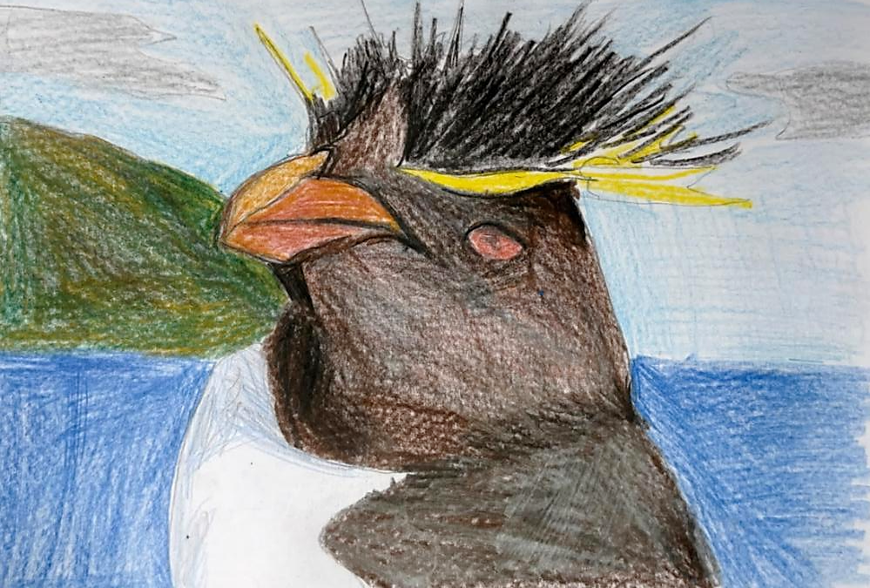
In this lesson we will draw our animals carefully, showing all the important details we learned about.

Slide 6
You will be successful when you can:
look closely at animal features
draw what you see accurately
include important details about your animal.

Slide 7
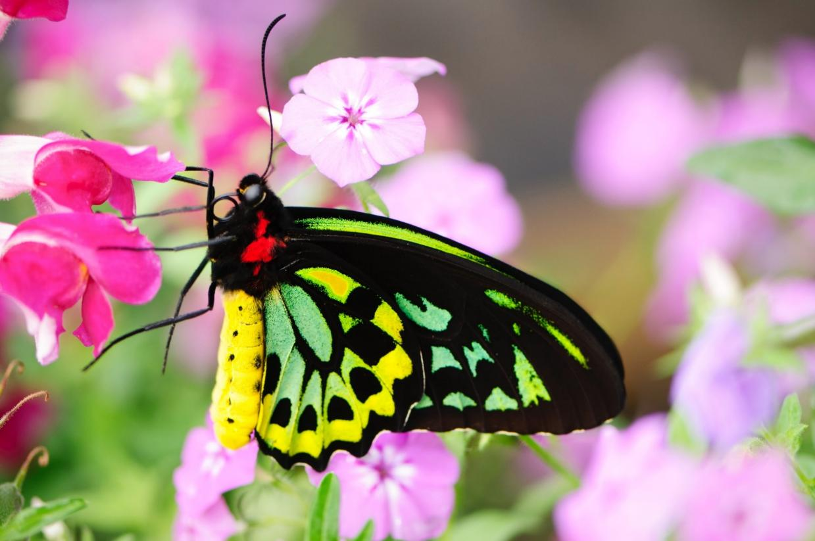
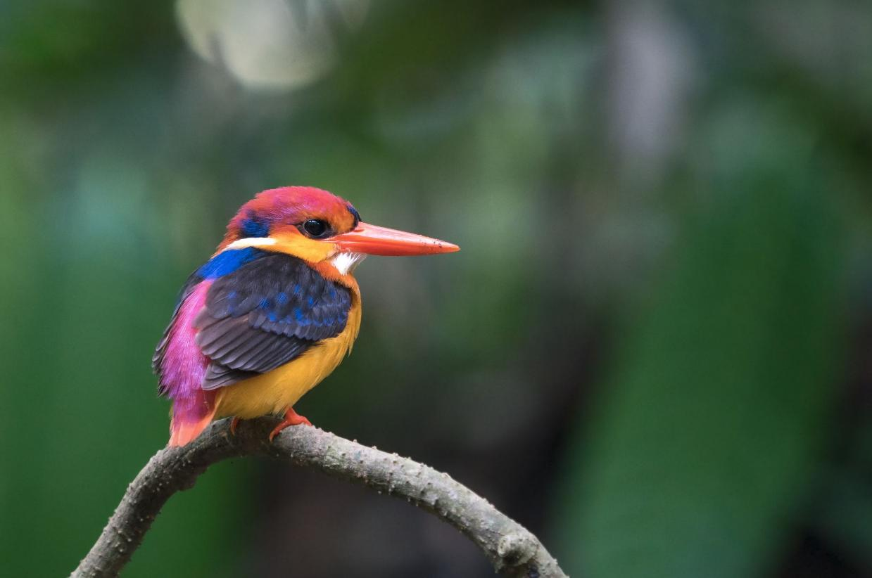


Slide 8
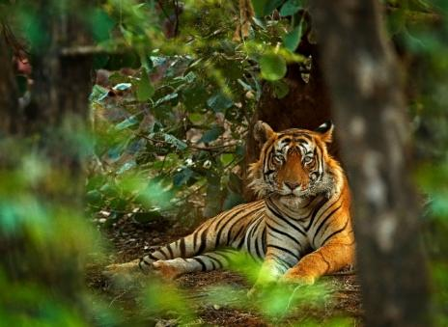
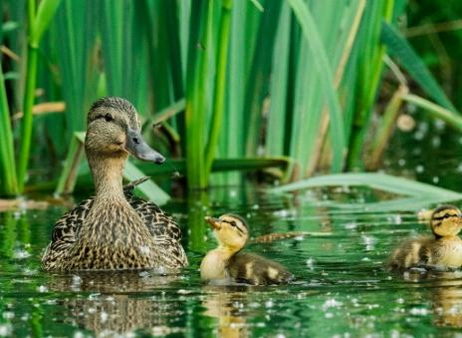
endangered
An animal or plant that might disappear forever because there are very few left.
habitat
A place where an animal makes its home.

Slide 9

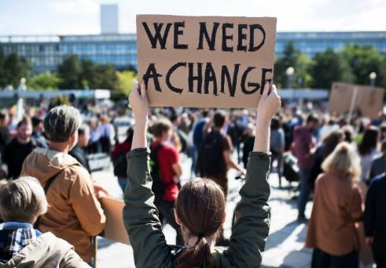
research
Finding out information about a topic by looking closely, asking questions and discovering new things.
awareness
When people notice and understand important problems they might not know about.

Slide 10
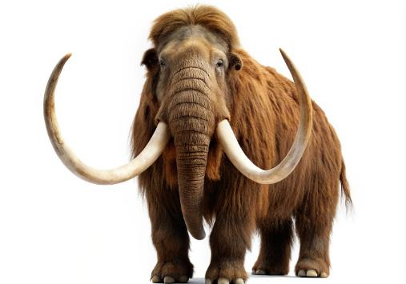
extinction
When all of a type of animal or plant is gone and there are none left anywhere in the world.

Slide 11
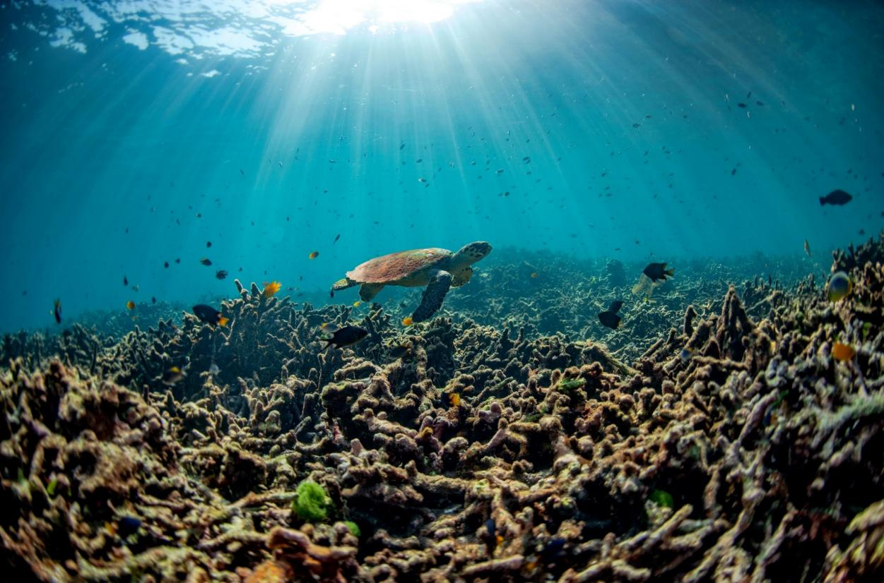
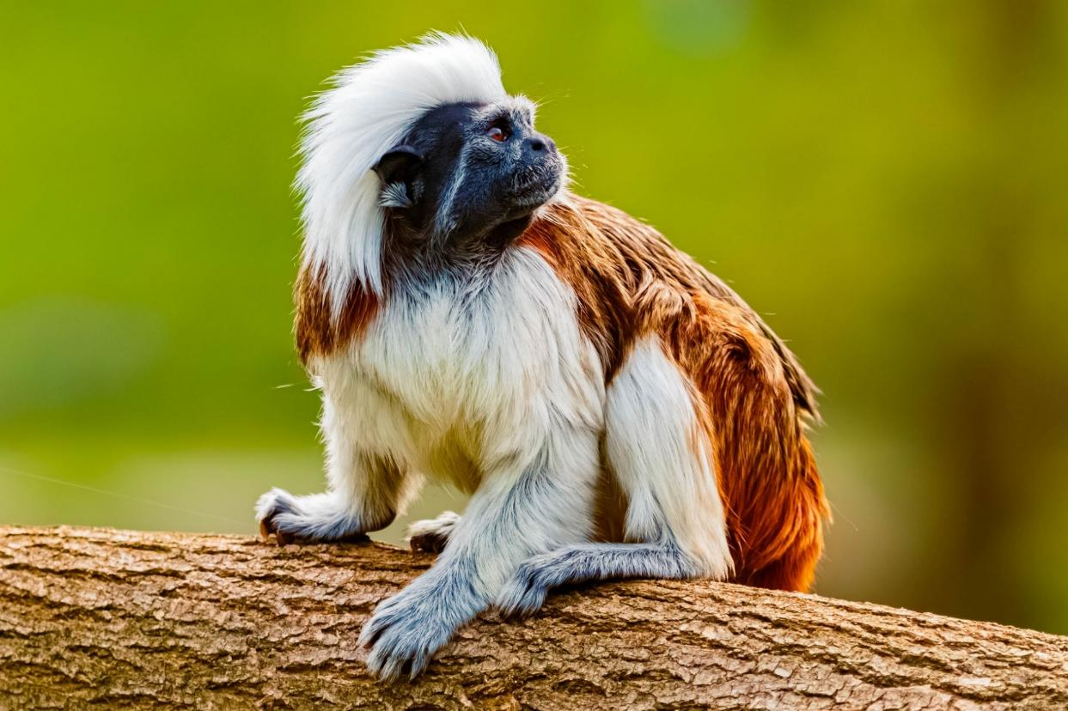
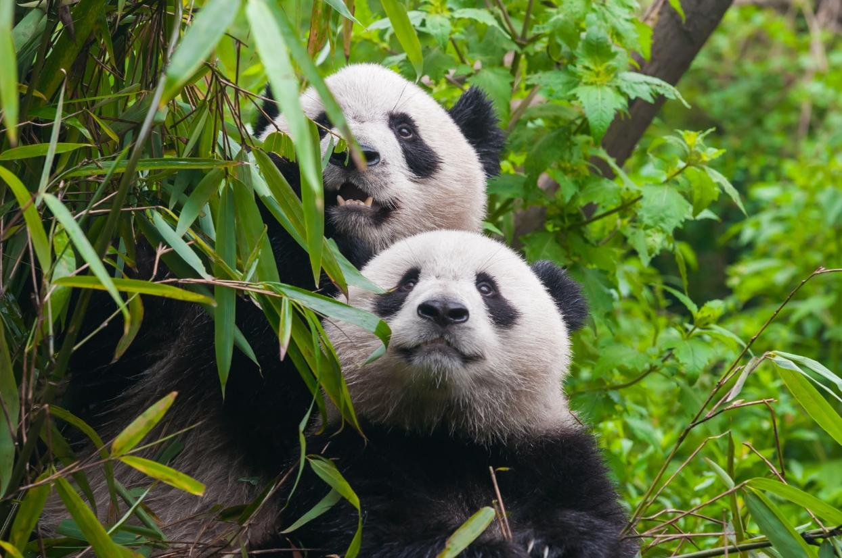
Review

Slide 12
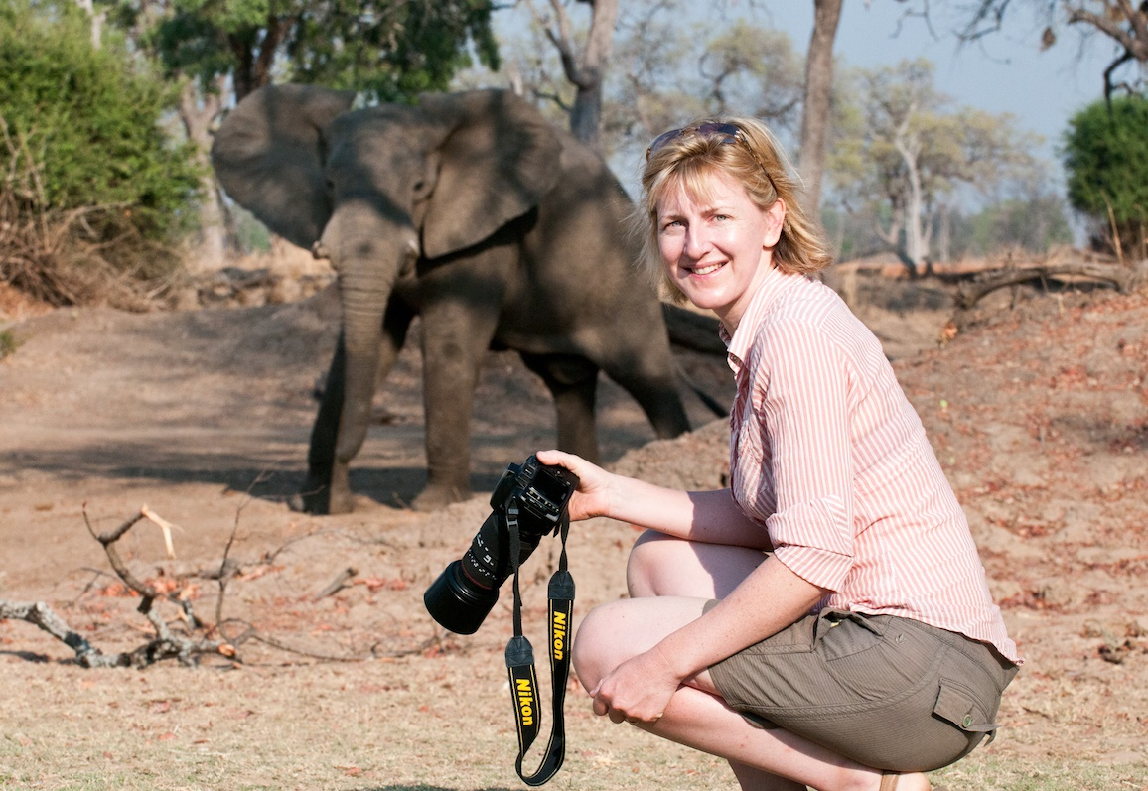
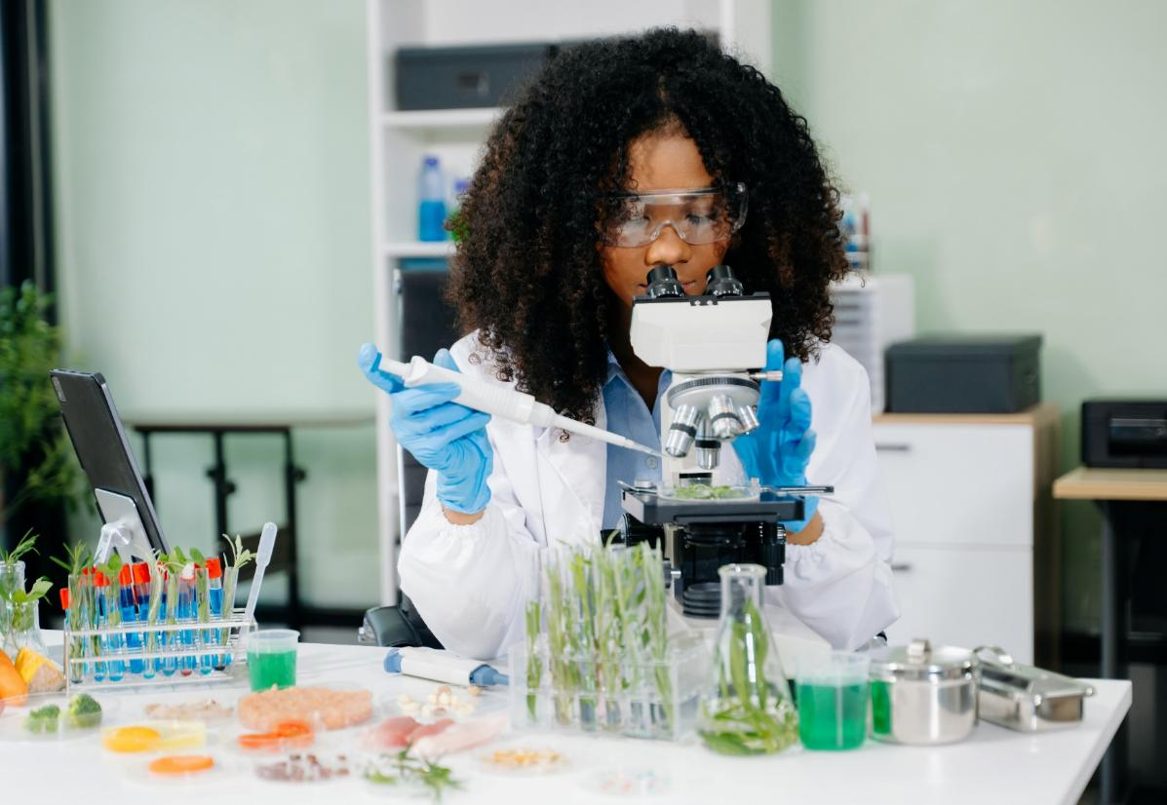
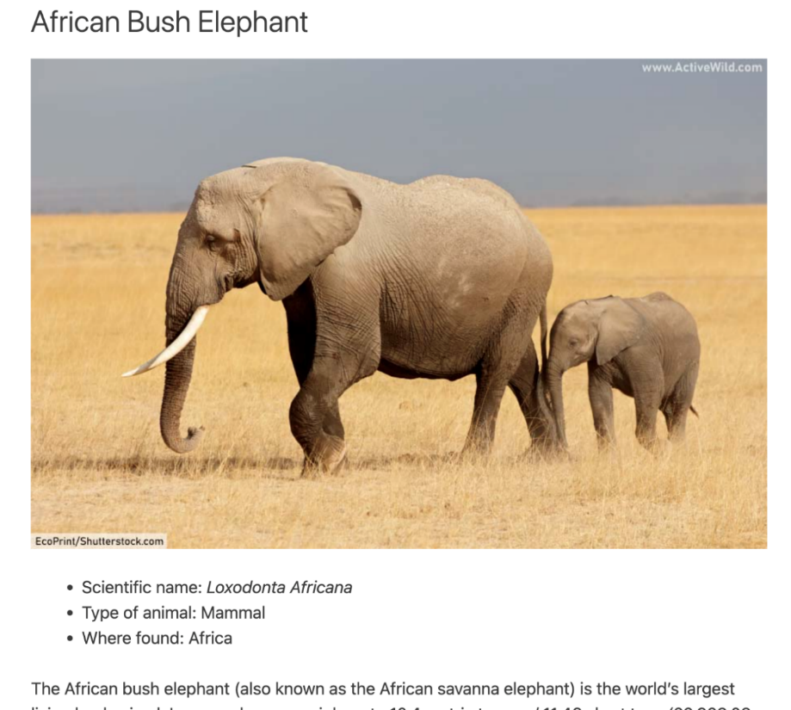
Looking Closely

Slide 13

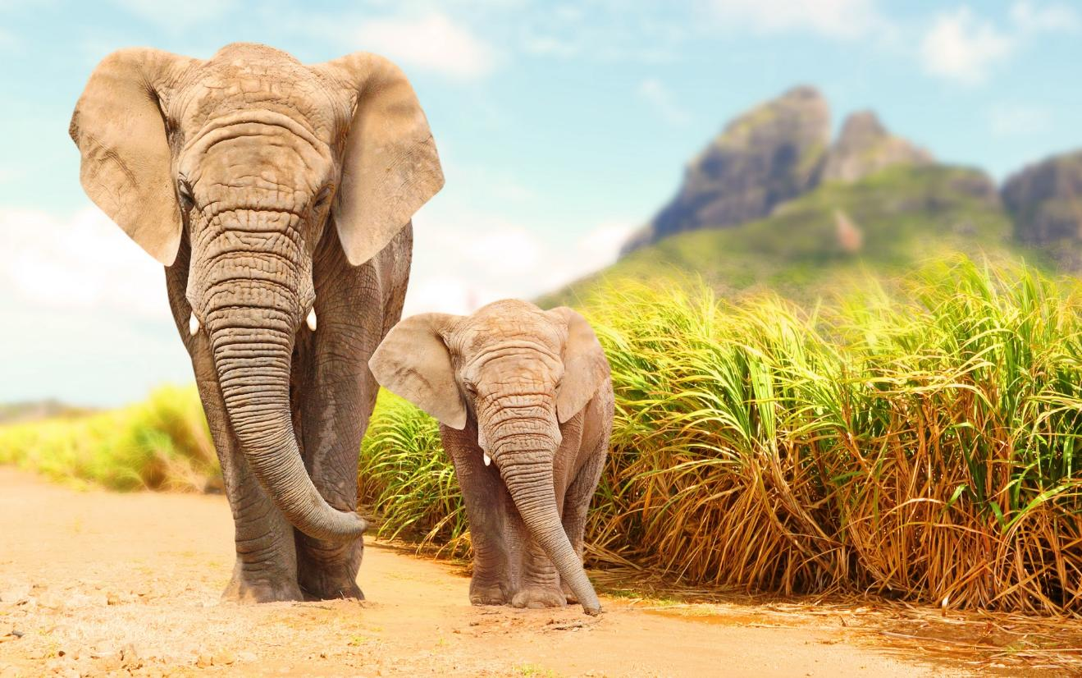
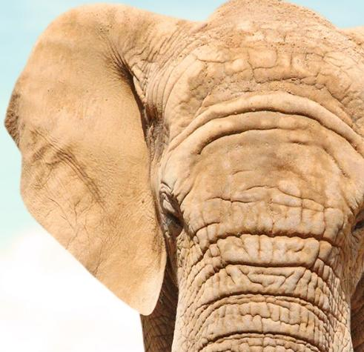
Looking Closely

Slide 14
It is important to look closely at something before we draw it because it:
helps us notice things we might miss
helps us make our drawings really big
helps us
draw faster

Slide 15
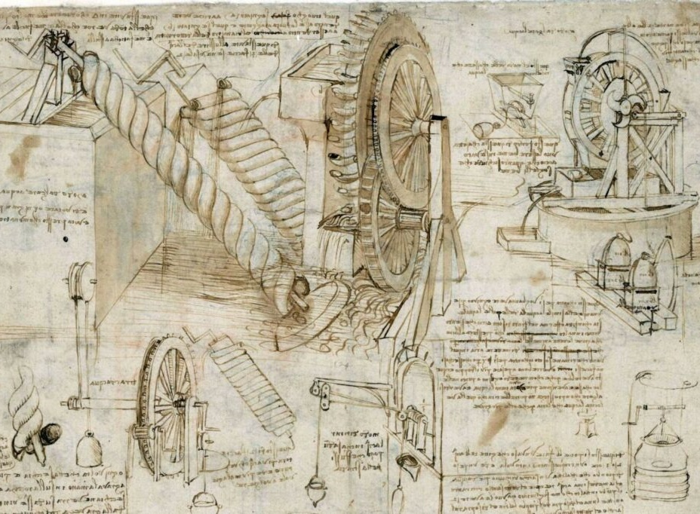
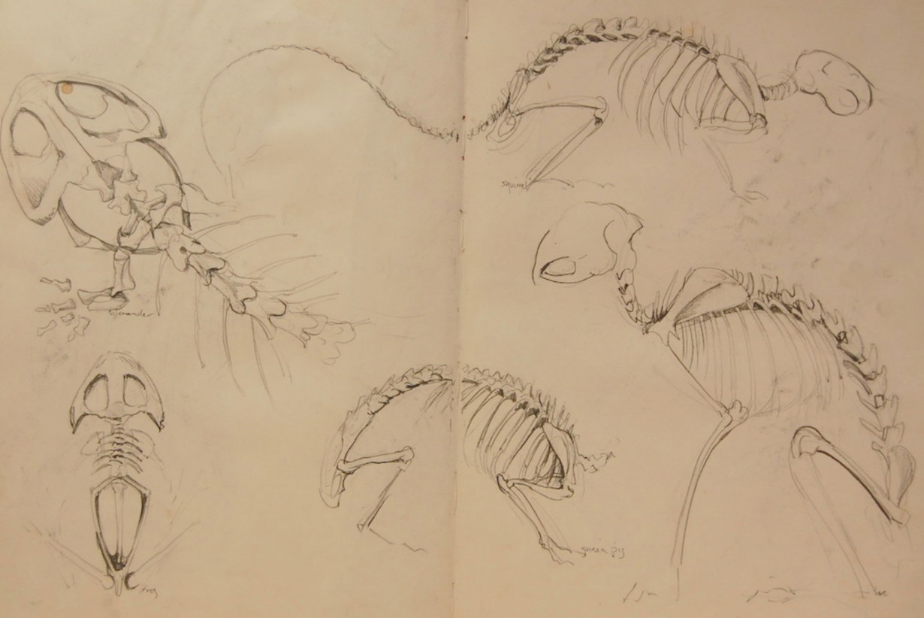
Animal Drawings

Slide 16

Animal Drawings

Slide 17
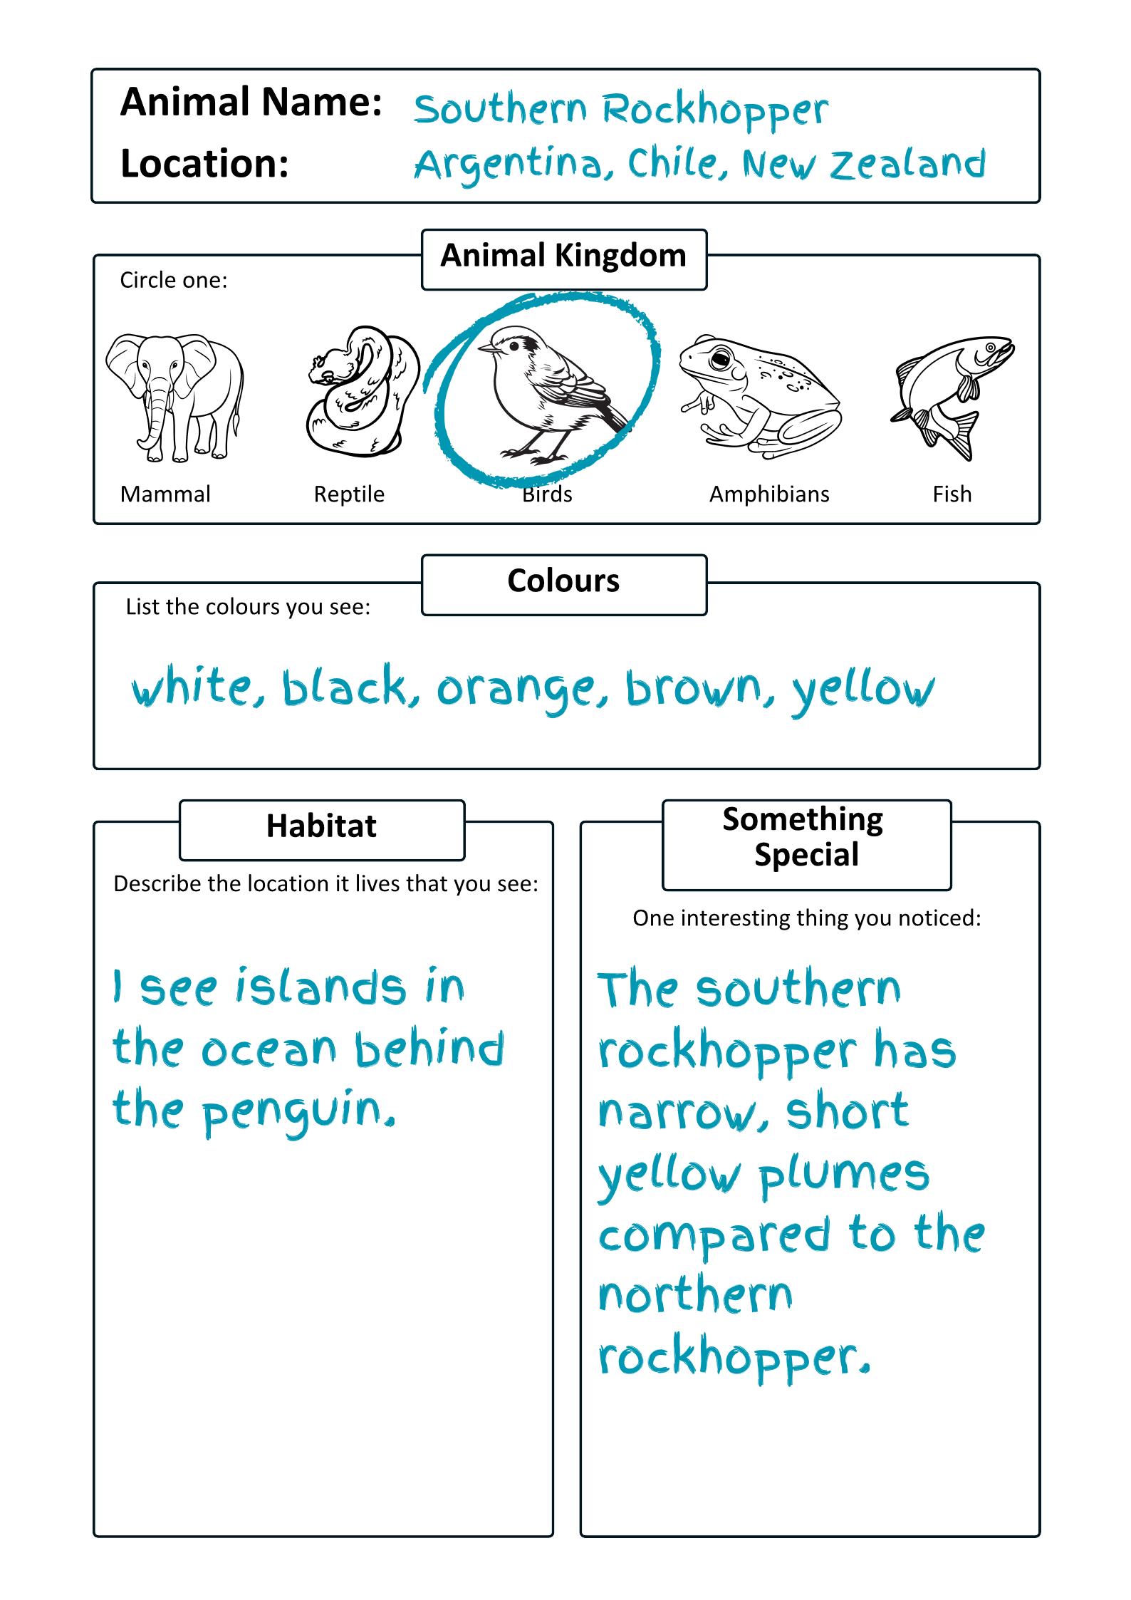
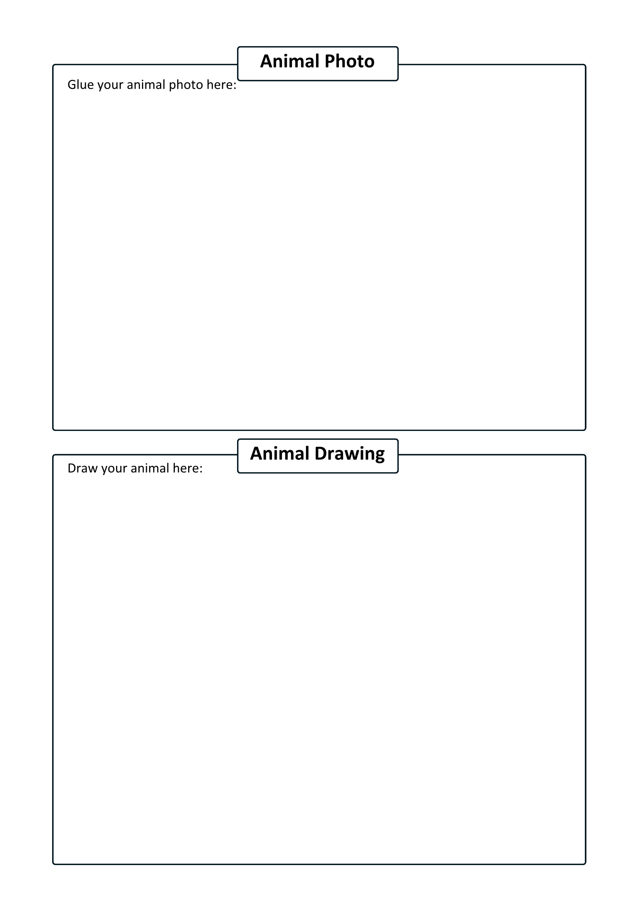
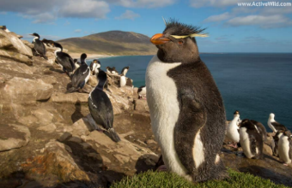
1. Refer closely to your research in your Student Workbook.

Slide 18
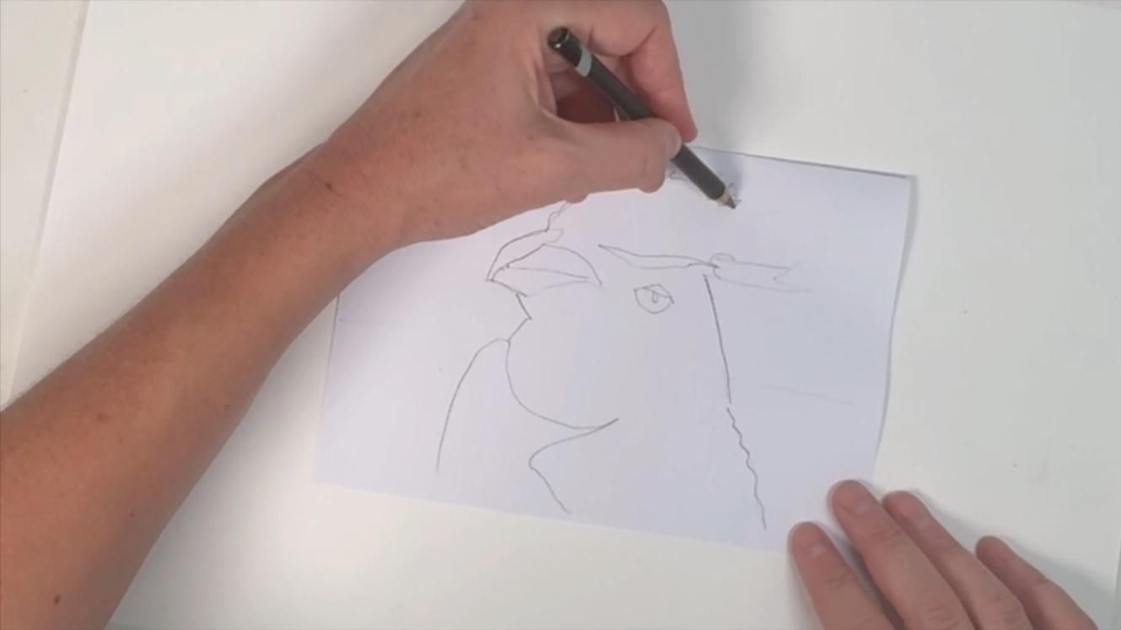
2. Draw the exact shape and all the features of your animal.

Slide 19
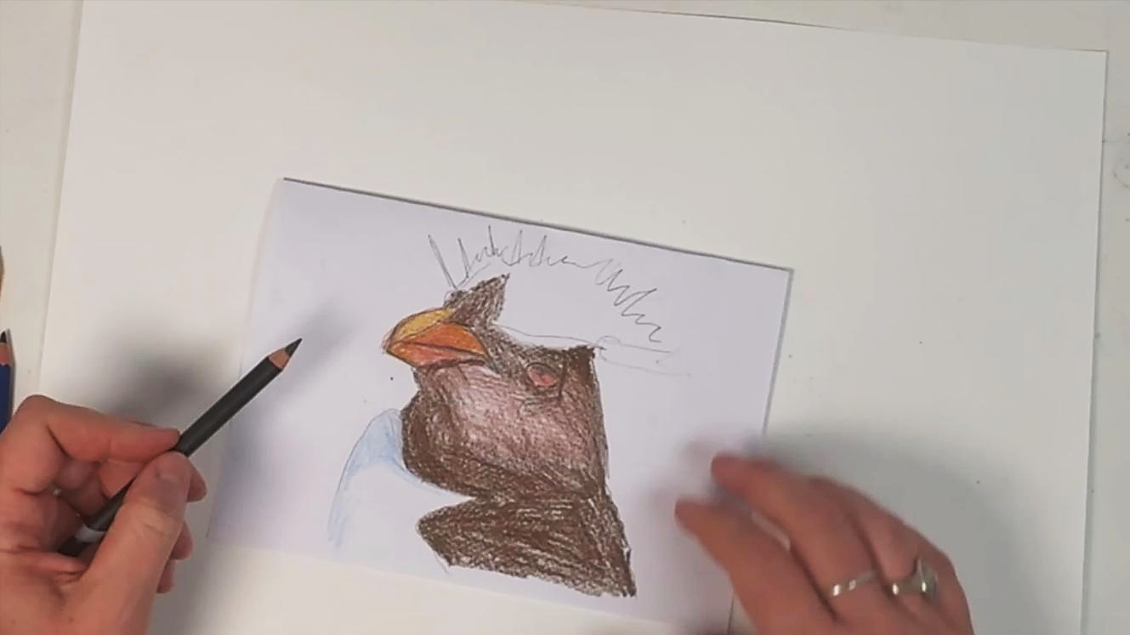
3. Work from the darkest to lightest parts of your animal.

Slide 20
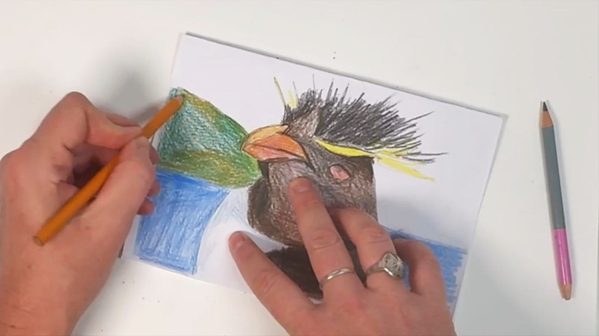
4. Complete the background by layering colours.

Slide 21
Artists create detailed drawings before making their final artwork because:
they want
to draw
quickly
they want to skip important details
drawings help them plan their final artwork

Slide 22
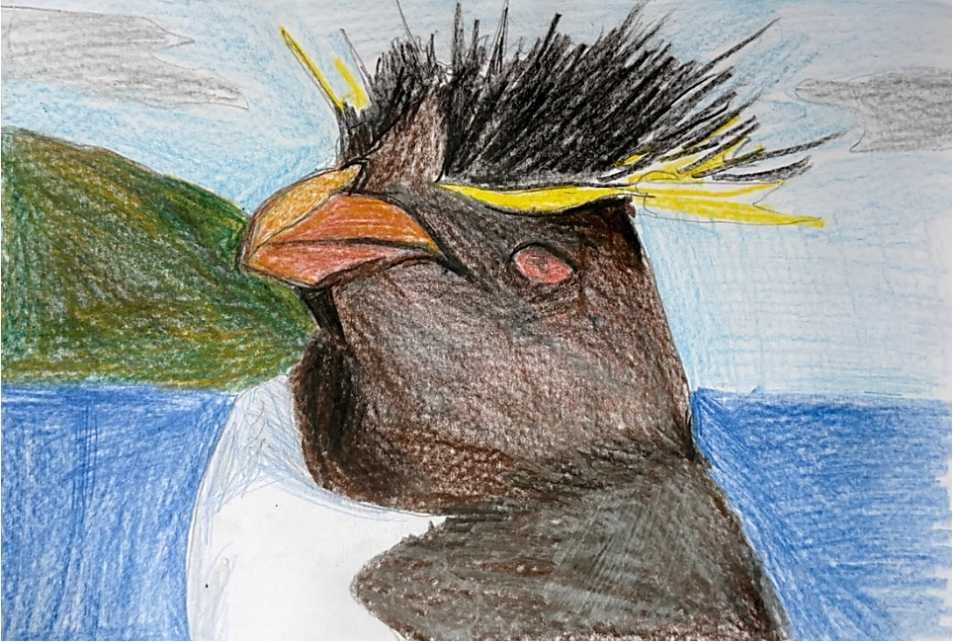
Animal Drawings

Slide 23
Endangered: an animal or plant that might disappear forever because there are very few left.
Habitat: a place where an animal makes its home.
Research: finding out information about a topic by looking closely, asking questions and discovering new things.

Slide 24
Awareness: when people notice and understand important problems they might not know about.
Extinction: when all of a type of animal or plant is gone and there are none left anywhere in the world.

Slide 25
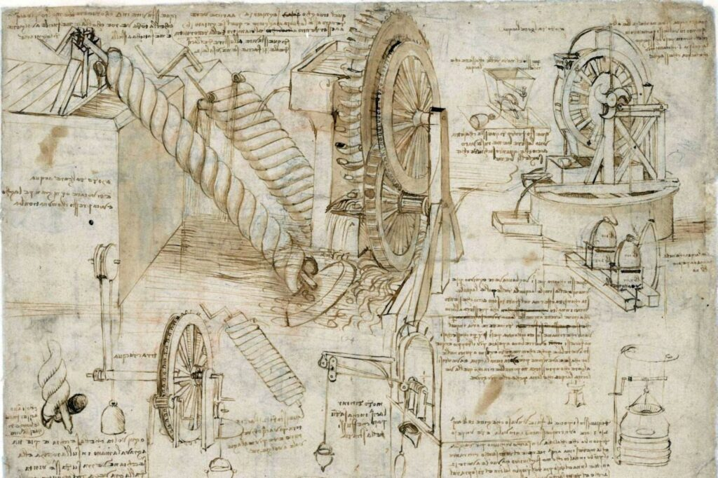
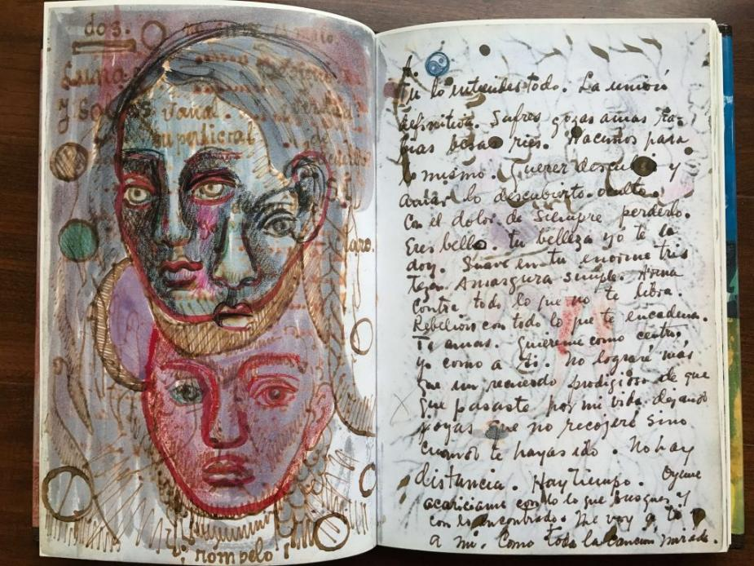
Reflect
Artists write and record what they learn and how they did in creating their work.

Slide 26

I included important details in my drawing like…
the penguin’s spikey head feathers and the red-orange of its beak and eyes.

Slide 27


Slide 28
These details I included are important to show because:

Slide 29


Share
I feel pride when my work shows my very best effort.

Slide 30
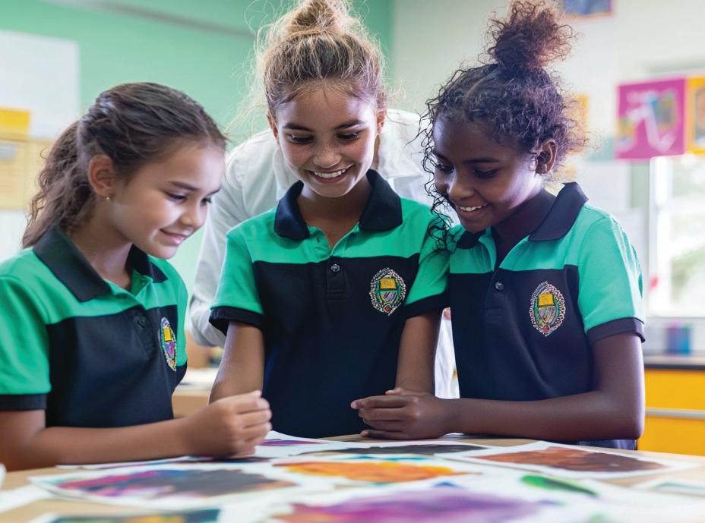
Share
We will think about a part of our work today where we put in the effort and feel proud of the results.

Slide 31
Looking closely helps us to notice important details in our animals.
Drawing our animals carefully helps us show these important details.

Slide 33
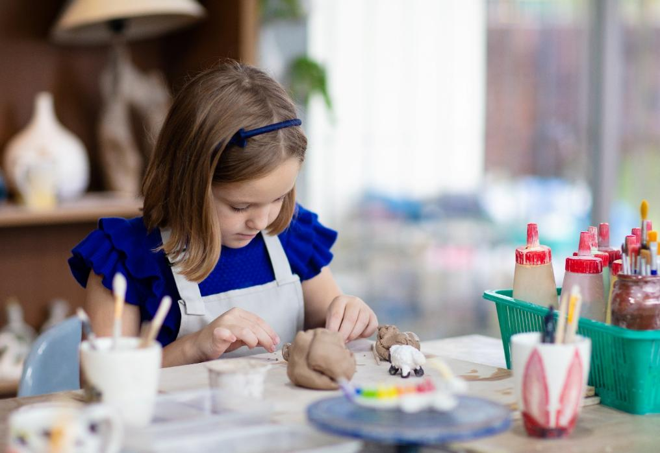
In the next lesson, we will learn clay techniques to make a hairy wombat.

Slide 34

help people understand coral bleaching

Slide 35
Slide 3 Photo: Mackman, N. (n.d.) Baby elephant sculpting. [Image] Available at: https://nickmackmansculpture.co.uk/wp-content/uploads/baby-elephant-sculpting-700x700@2x.jpg (Accessed: 22 September 2025).
Slide 12 (second photo) Photo: Mackman, N. (n.d.) 'Giant of the Plains', Nick Mackman Animal Sculpture [Image]. Available at: https://nickmackmansculpture.co.uk/blog/giant-of-the-plains (Accessed: 22 September 2025).
Slide 12 (third photo) Photo: Active Wild (2024) African Bush Elephant [Image]. In: Endangered Animals List With Pictures & Interesting Facts – Updated 2024. Available at: https://www.activewild.com/list-of-endangered-animals/#african-bush-elephant (Accessed: 22 September 2025).

