Slide 1
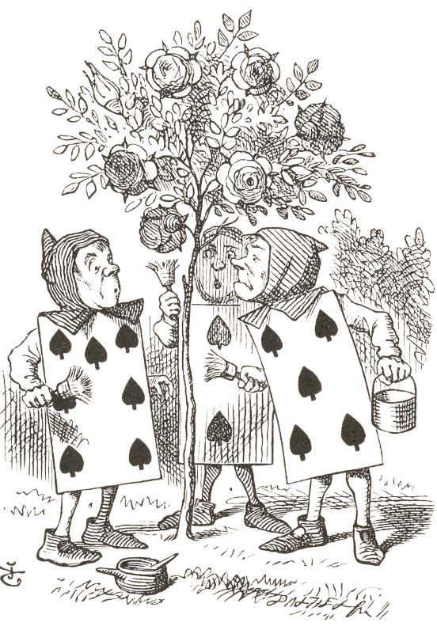
Unit 1A
Art and Story
Lesson 2
Narrative Art
Unit 1A Version 1

Slide 2

Narrative art tells stories through pictures.

Slide 3
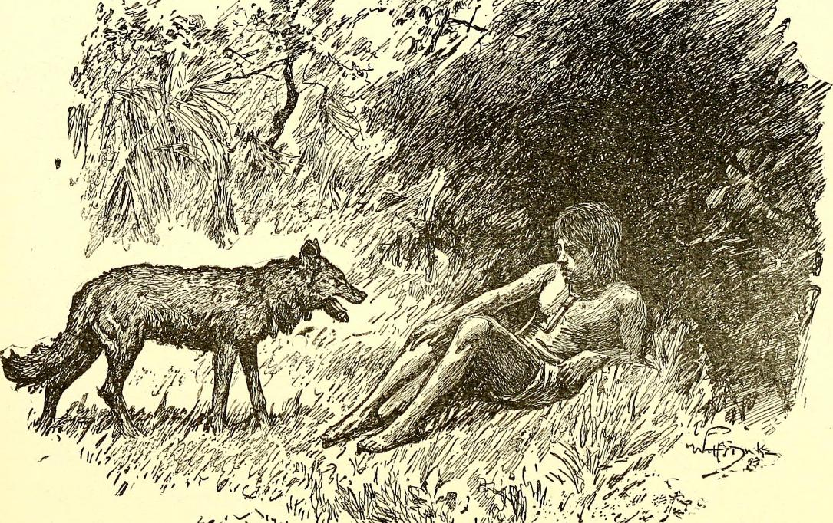
Different kinds of marks create light and dark areas that help to tell the story by making the characters and action look real.

Slide 4

To make characters in narrative art look three-dimensional and real, artists use:
light and dark
areas made
with different
marks
bright colours
big
paintbrushes

Slide 5
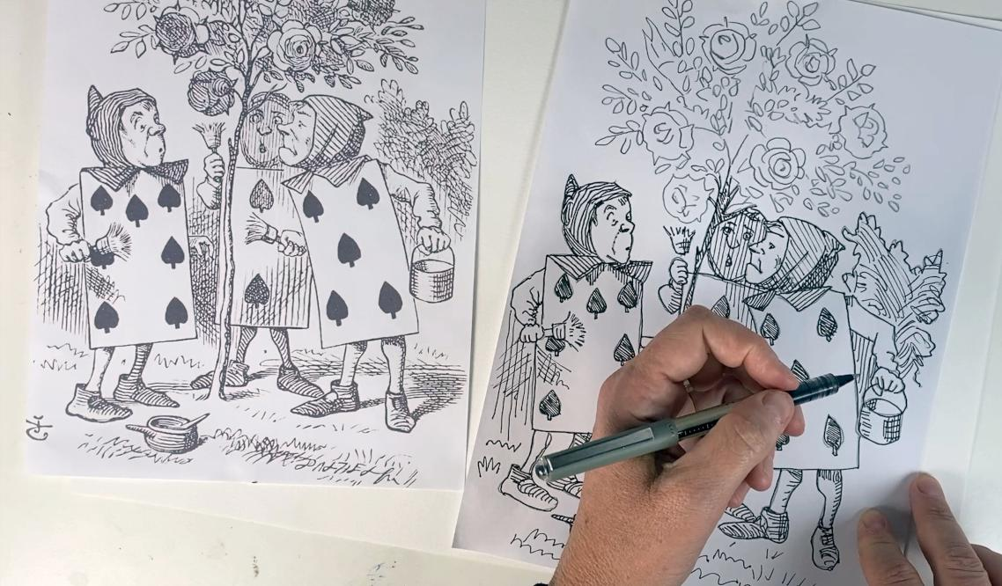
In this lesson, we will create a copy of a narrative artwork using different kinds of marks and lines.

Slide 6
You will be successful when you can:
create a copy of a narrative artwork
use different kinds of marks to make a narrative artwork.

Slide 7
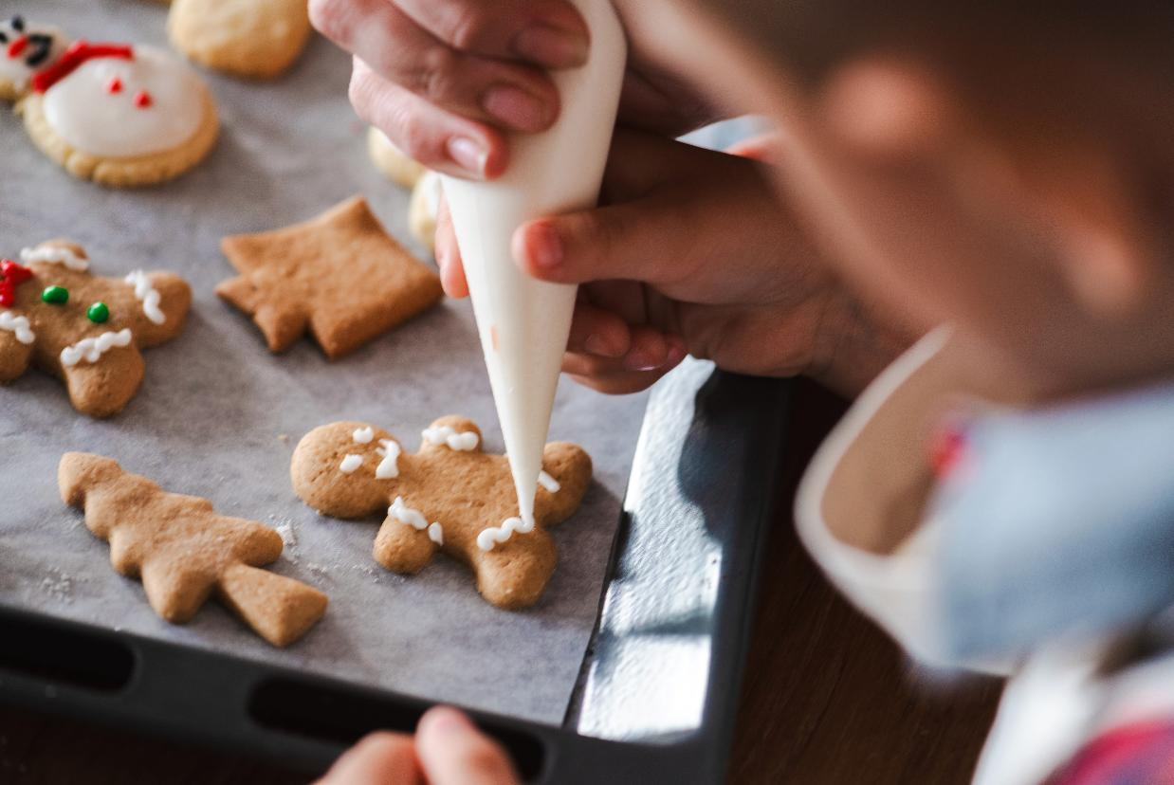
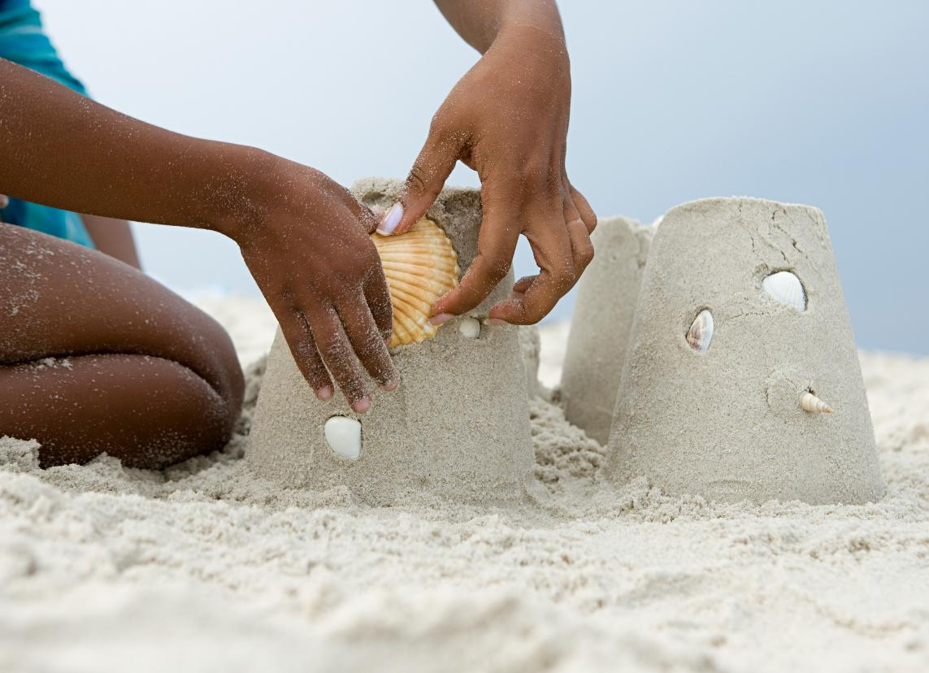


Slide 8

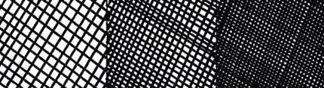
hatching
Drawing lines close together and in the same direction to create shading – closer lines make darker areas.
cross-hatching
Drawing lines that cross over each other like a grid to make even darker shading.

Slide 9
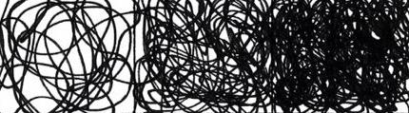
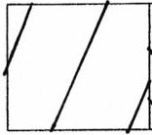
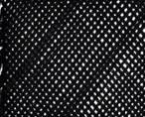
scumbling
Swirling lines used to create texture and shading.
density
How close or far apart the marks or lines are in an artwork.

Slide 10

narrative art
Artwork that tells a story.

Slide 11
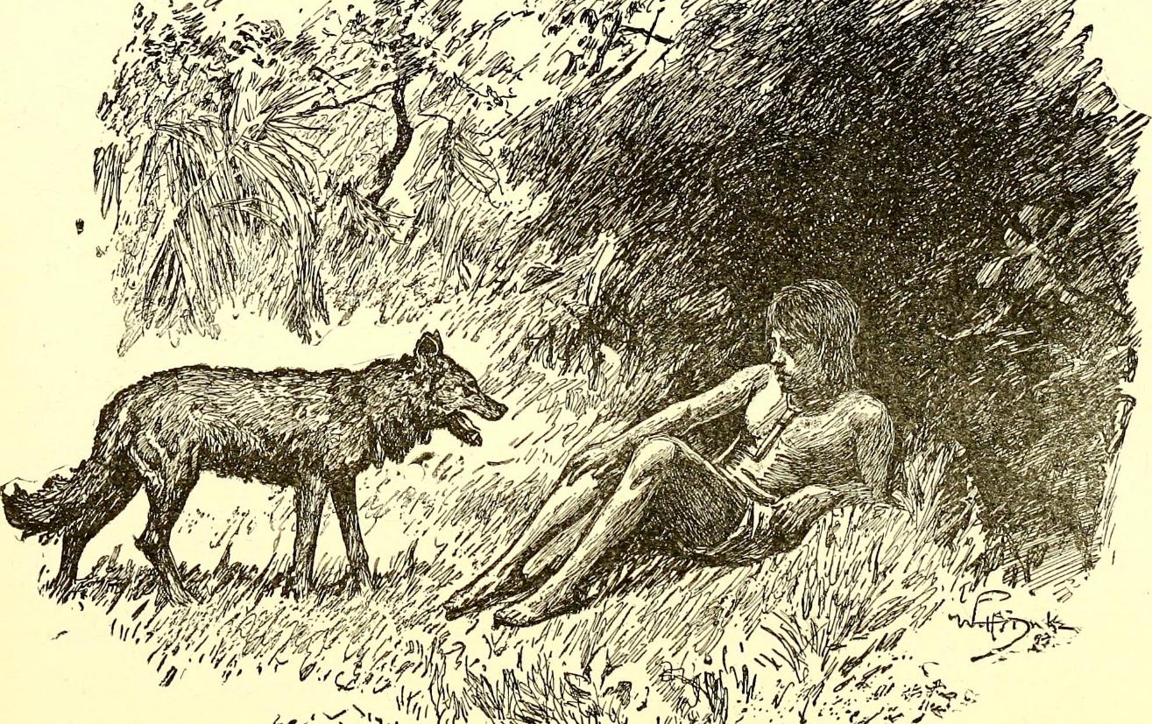
Review

Slide 12
Artists create dark areas in their artworks by:
colouring everything black
placing marks closer together
turning off the lights

Slide 13
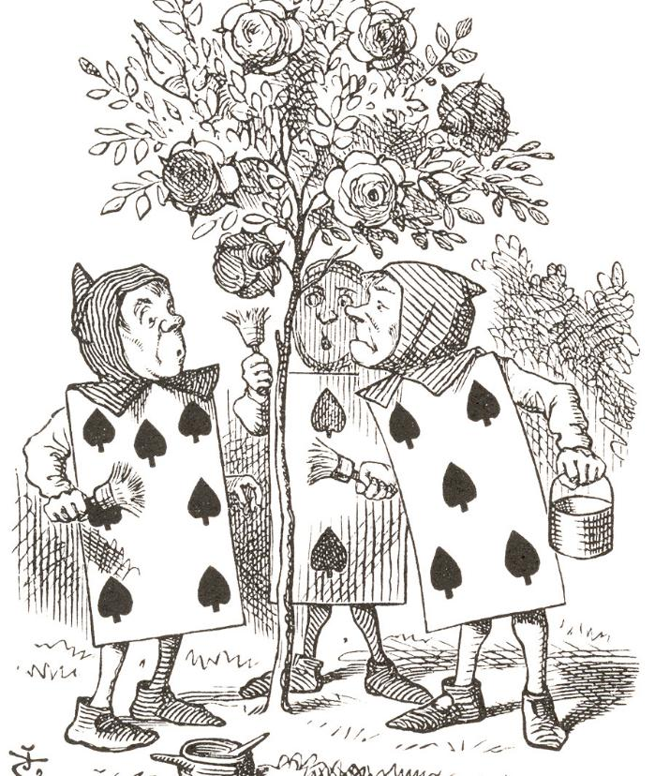
Marks and Lines

Slide 14
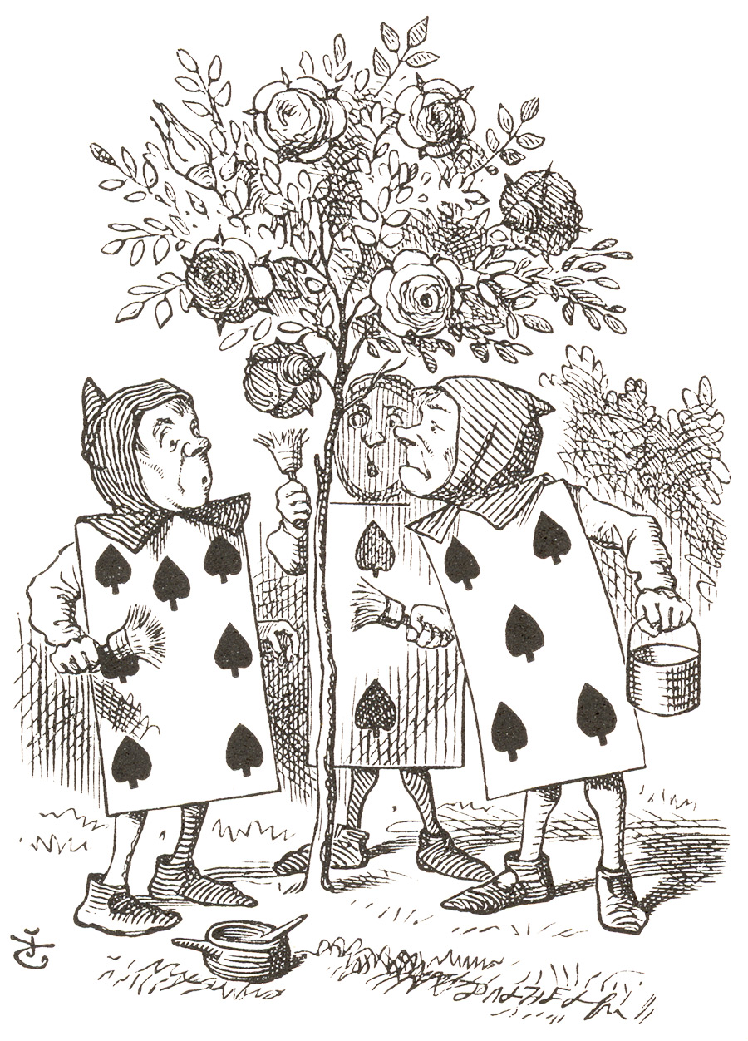

Slide 16

Narrative Artwork

Slide 17
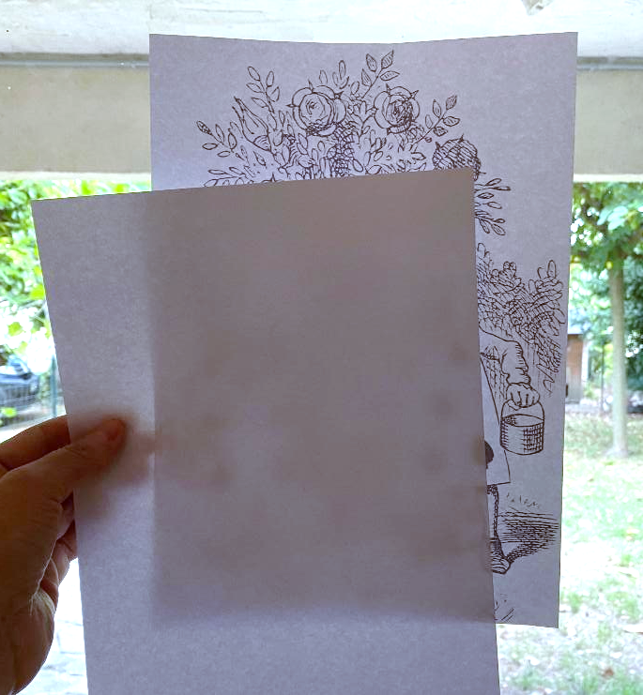
Tape the image and your paper on a window.

Slide 18
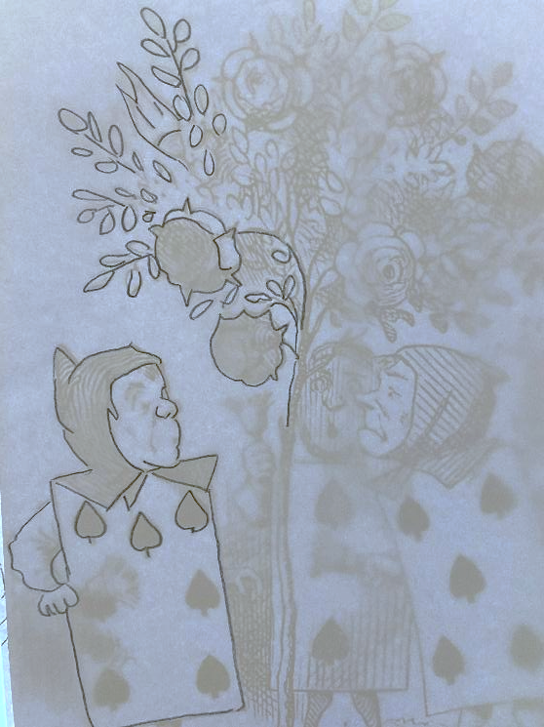
Trace only the outline of the objects you see.

Slide 19
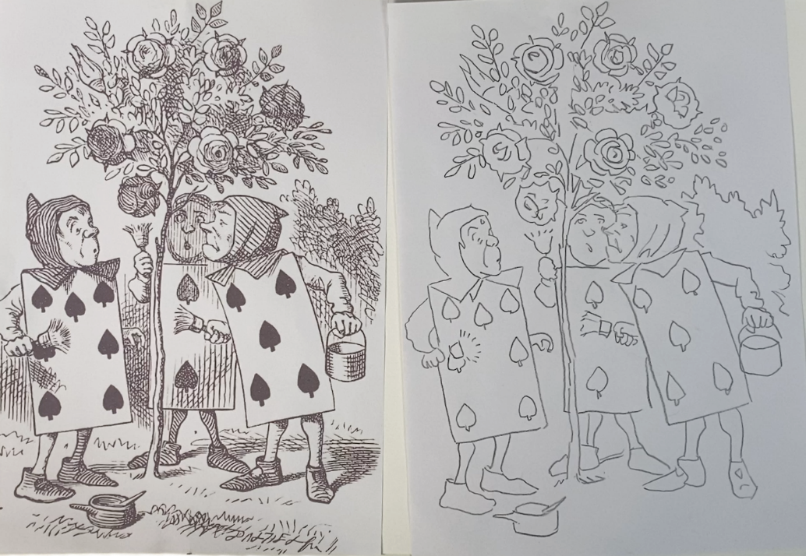
Compare your tracing and add any missing lines.

Slide 20
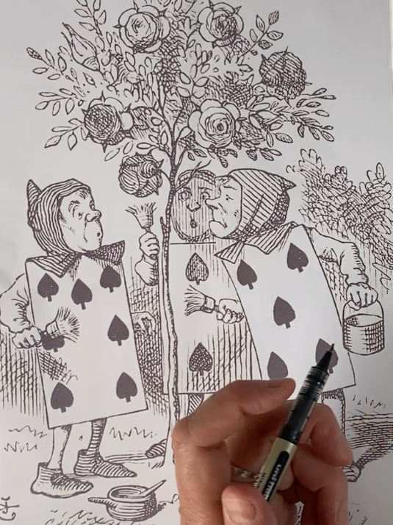
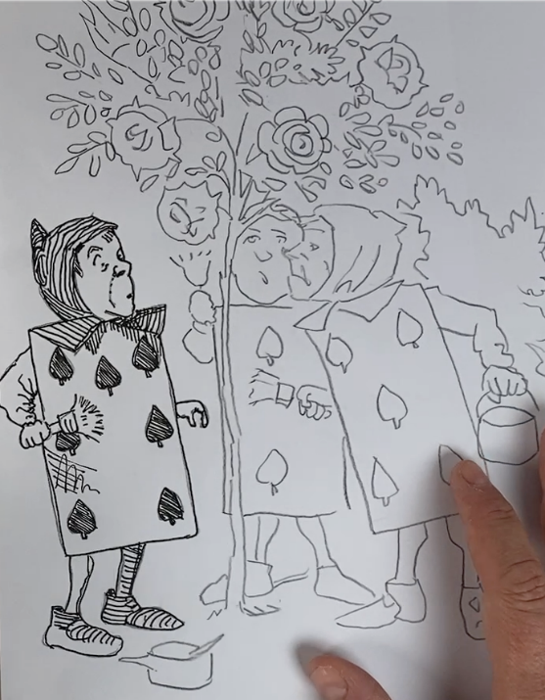
Begin using mark-making to copy and draw what you see.

Slide 21

Continue working slowly on each section.

Slide 22
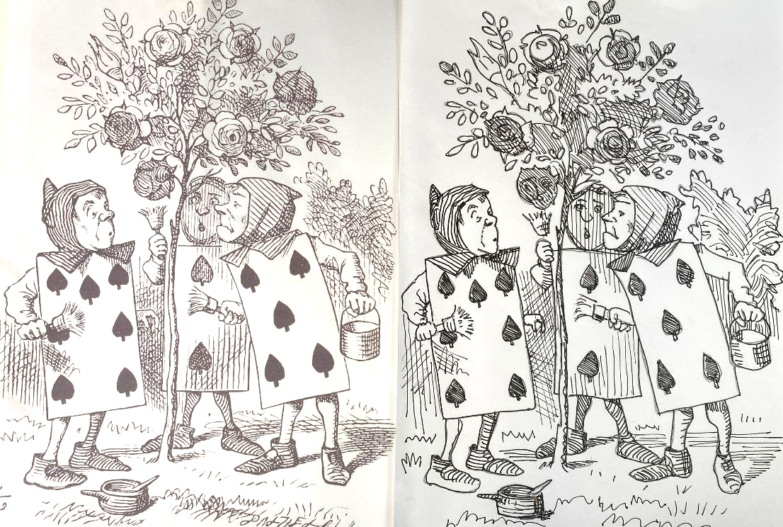
Carefully compare and add to areas as needed.

Slide 23
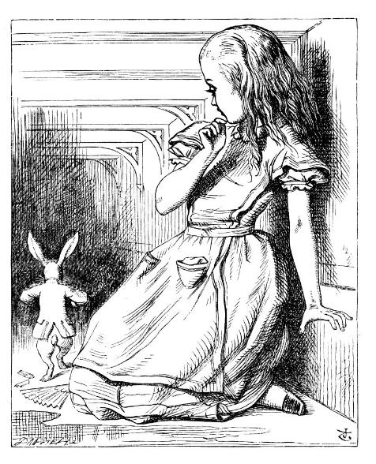
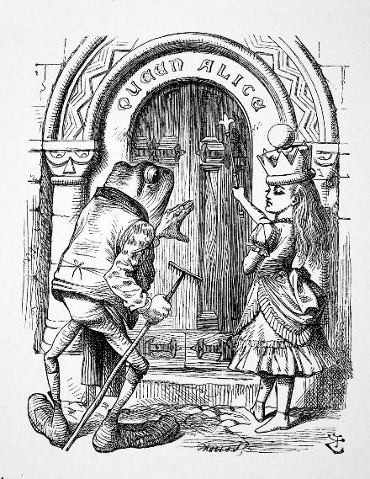
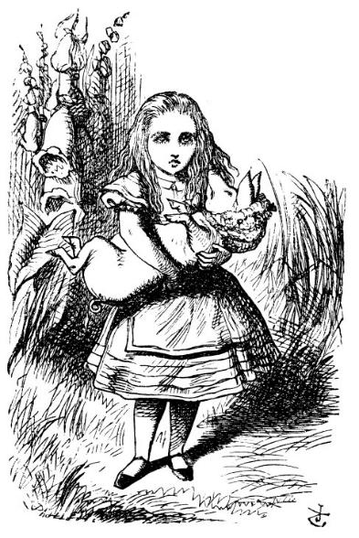
Narrative Artwork

Slide 24
The first thing you will do to make your narrative artwork is:
fill in the darkest areas
fill in the background
trace the outline

Slide 25

Narrative Artwork

Slide 26
Hatching: drawing lines close together and in the same direction to create shading – closer lines make darker areas.
Cross-hatching: drawing lines that cross over each other like a grid to make even darker shading.
Scumbling: swirling lines used to create texture and shading.

Slide 27
Density: how close or far apart the marks or lines are in an artwork.
Narrative Art: artwork that tells a story.

Slide 28
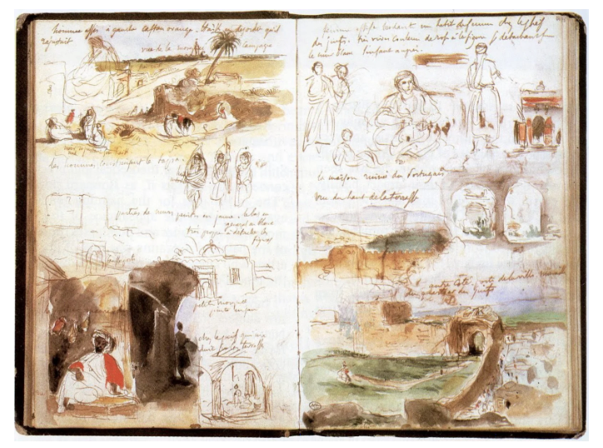
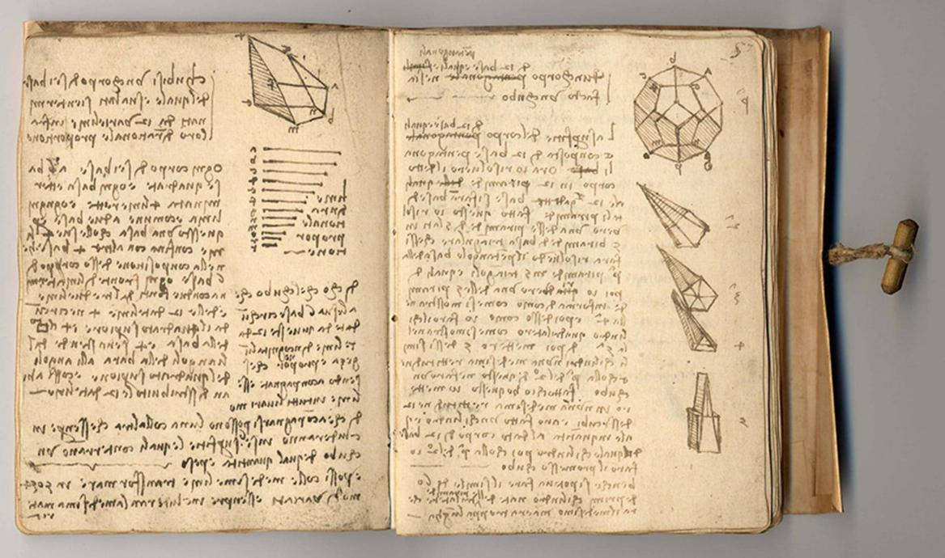
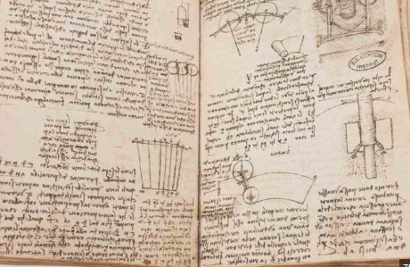
Reflect
Artists write and record what they learn and how they did in creating their work.

Slide 29

One thing I noticed about drawing and using marks is…
cross-hatching makes really good shadows.

Slide 30


Slide 31
One area of my work that was challenging today was…

Slide 32

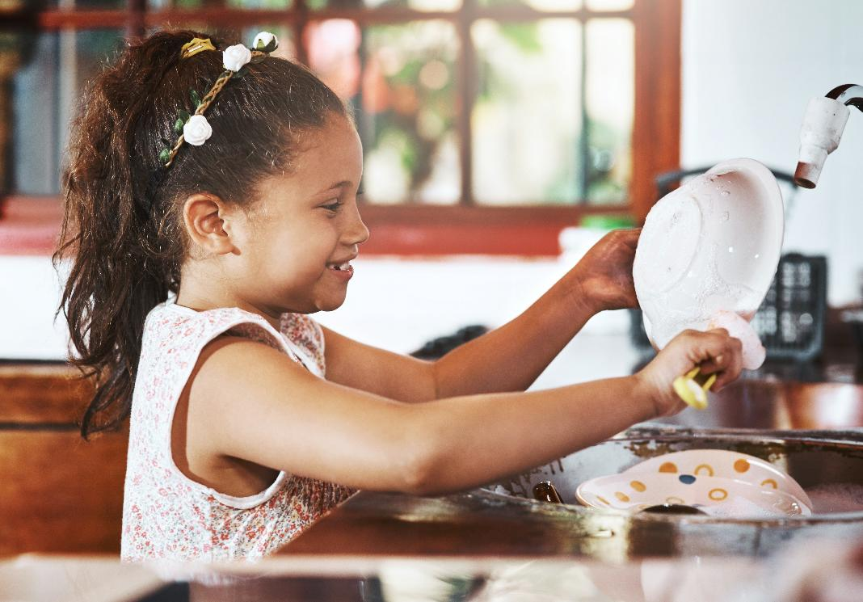
Share
I feel pride when my work shows my very best effort.

Slide 33

Share
We will think about a part of our work today where we put in the effort and feel proud of the results.

Slide 34
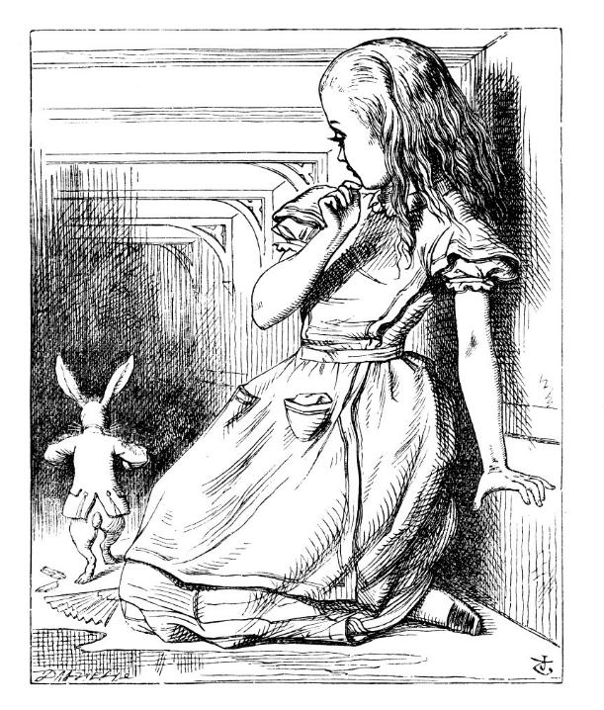
Artists use different mark-making techniques like hatching, cross-hatching and scumbling to create light and dark areas that bring stories to life.
We can learn these techniques by making copies of narrative artworks like Sendak’s drawings.

Slide 36
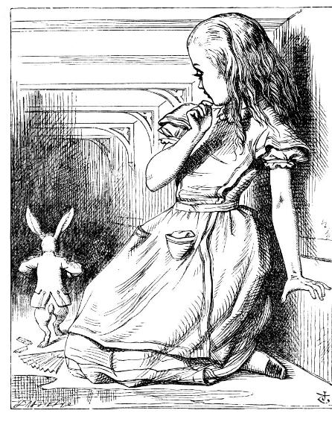
In the next lesson, we will create story sentences about our narrative artwork.

Slide 37
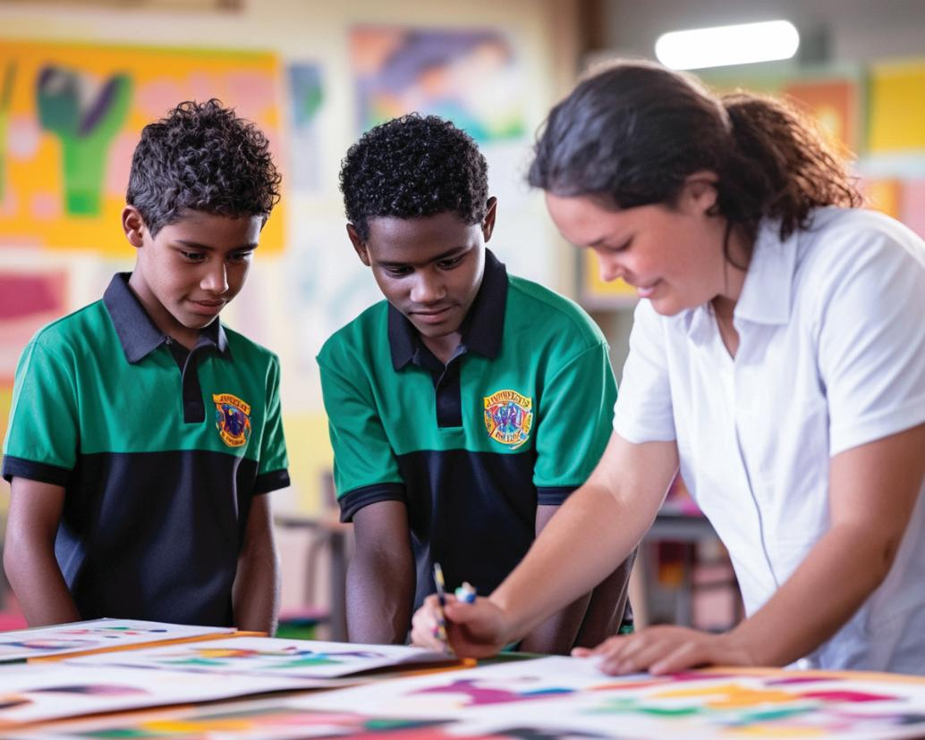

Slide 38
Slides 1, 13-15, 23, 34 and 36 Photos: Tenniel, J. (1865) Alice's Adventures in Wonderland [Illustrations]. Available at: Alice-in-Wonderland.net, https://www.alice-in-wonderland.net/resources/pictures/alices-adventures-in-wonderland/ (Accessed: 8 September 2025)
Slides 3 and 11 Photo: Kipling, J.L. (1894) The Jungle Book [Illustration]. Available at: Wikimedia Commons, https://commons.wikimedia.org/wiki/File:The_jungle_book_%281894%29_%2814598262110%29.jpg (Accessed: 8 September 2025)

