Slide 1
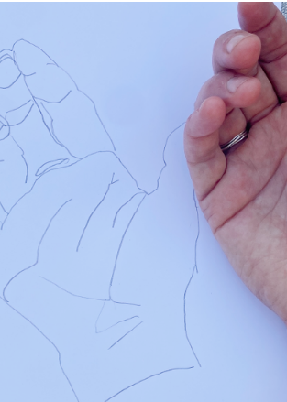
Unit 1A
Art and Seeing
Lesson 2
Foreshortening and Contours
Unit 1A Version 2

Slide 2

Observation in art helps artists to create artwork from what they see.

Slide 3
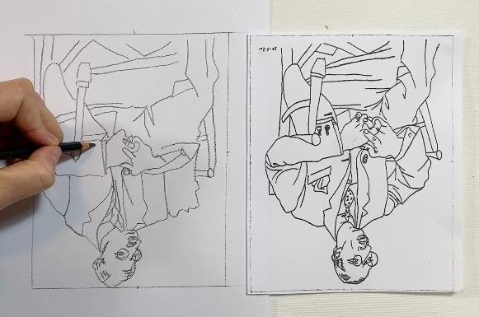
An outline uses shapes and lines to show an object.

Slide 4
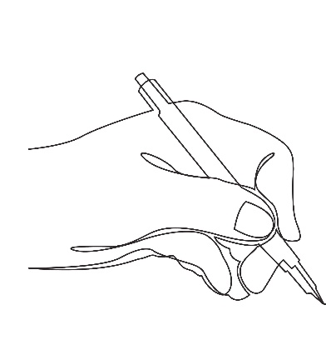
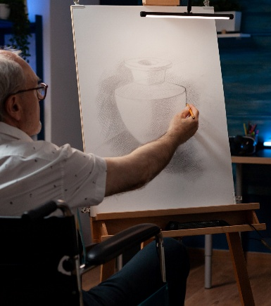

An example of an outline is:

Slide 5
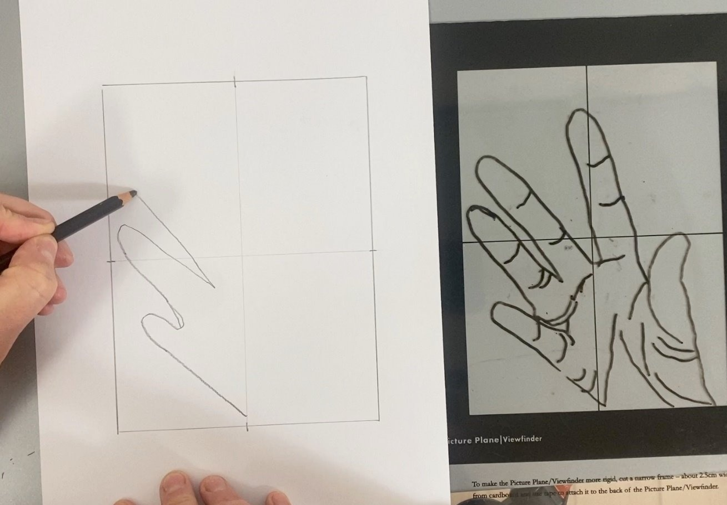
In this lesson, we will learn how to use foreshortening and contour lines.

Slide 6
You will be successful when you can:
use a picture plane as a tool to support your drawing
draw contour lines
use foreshortening.

Slide 7

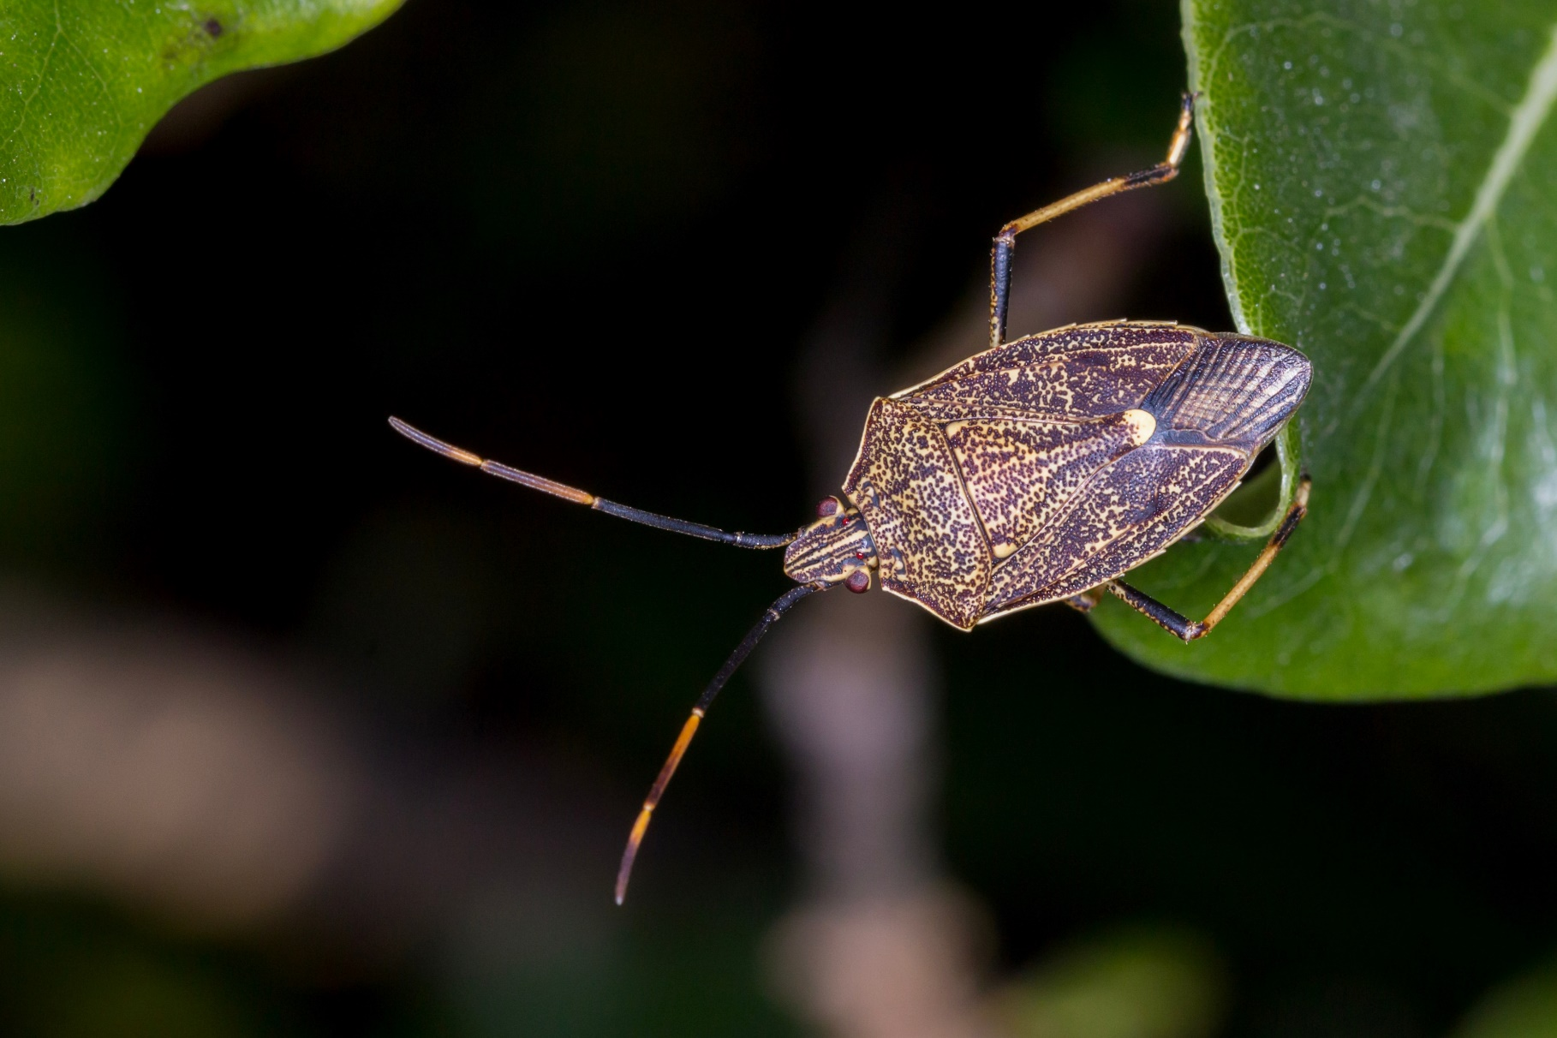



Slide 8
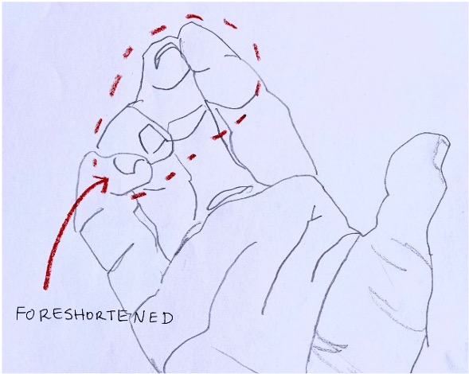
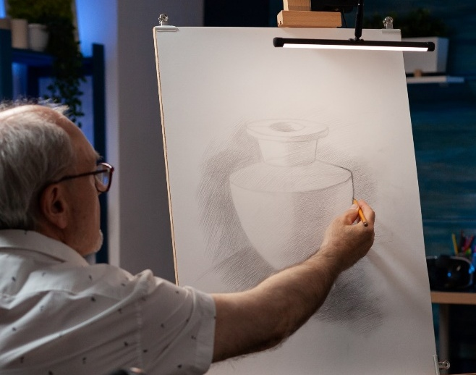
foreshorten
To shorten a detail in a drawing or painting so that it looks like it is closer.
form
How something looks in 3D. It has height, width and depth. It is different from a shape that only has height and width.

Slide 9
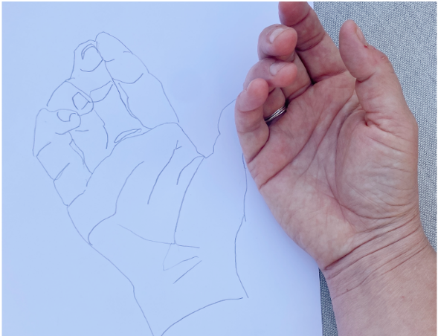
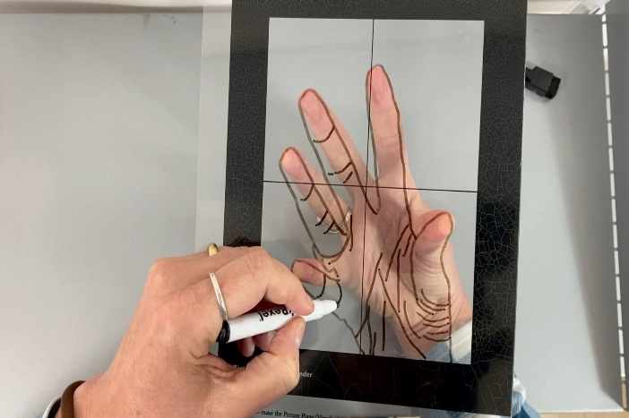
contour line
The outline of a form, including interior structure, without shading.
picture plane
Similar to a window, an artist uses this to focus on what they are studying.

Slide 10

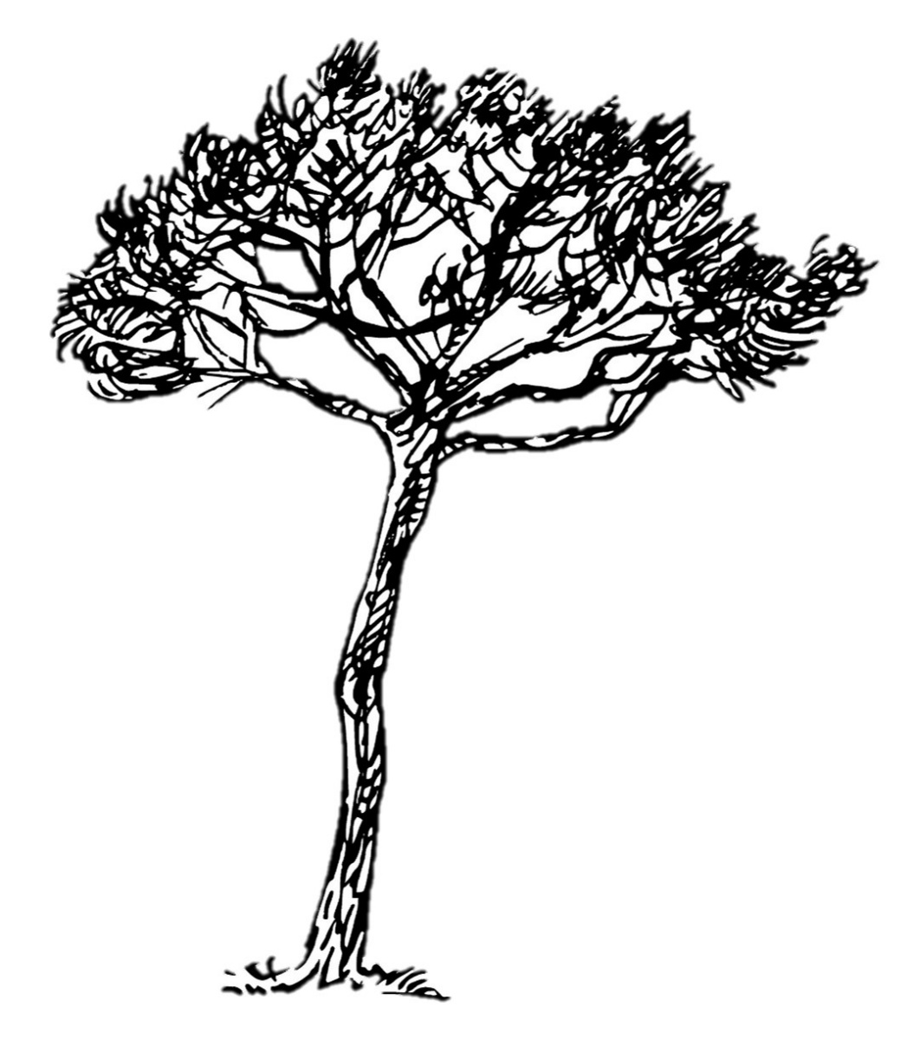



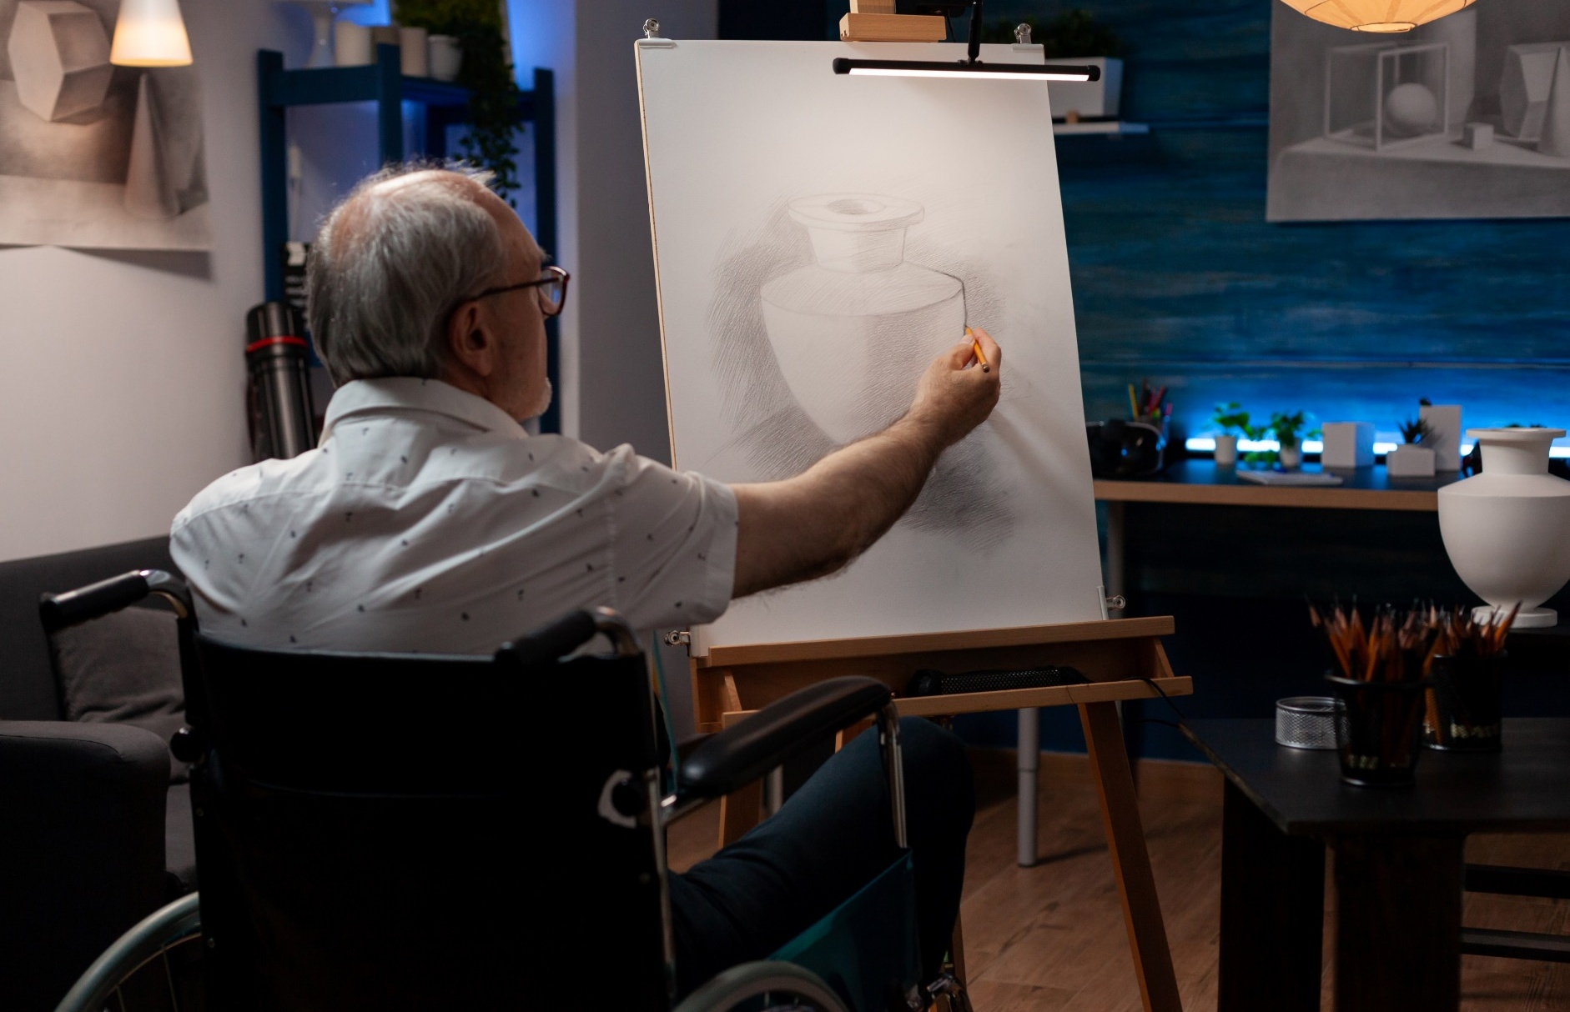
Drawing from Observation

Slide 11
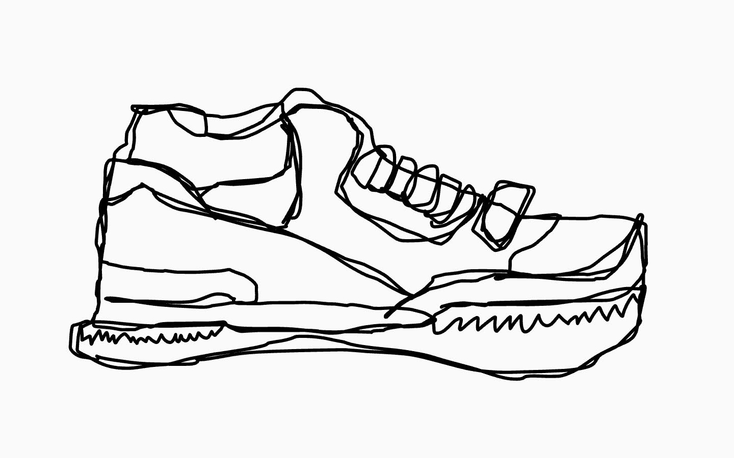


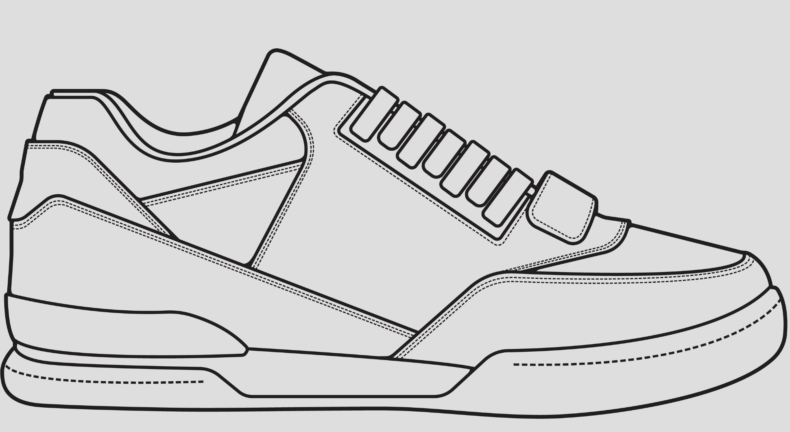
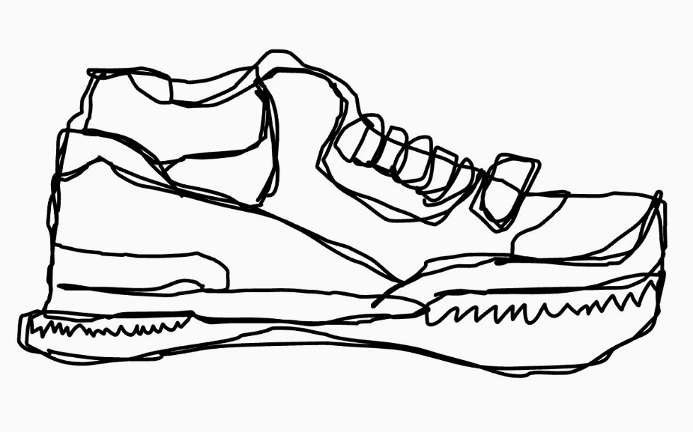







Drawing from Observation

Slide 12

Drawing from Observation

Slide 13

A blind contour drawing is where you:
only look at the object
close your eyes
only look at the page

Slide 14
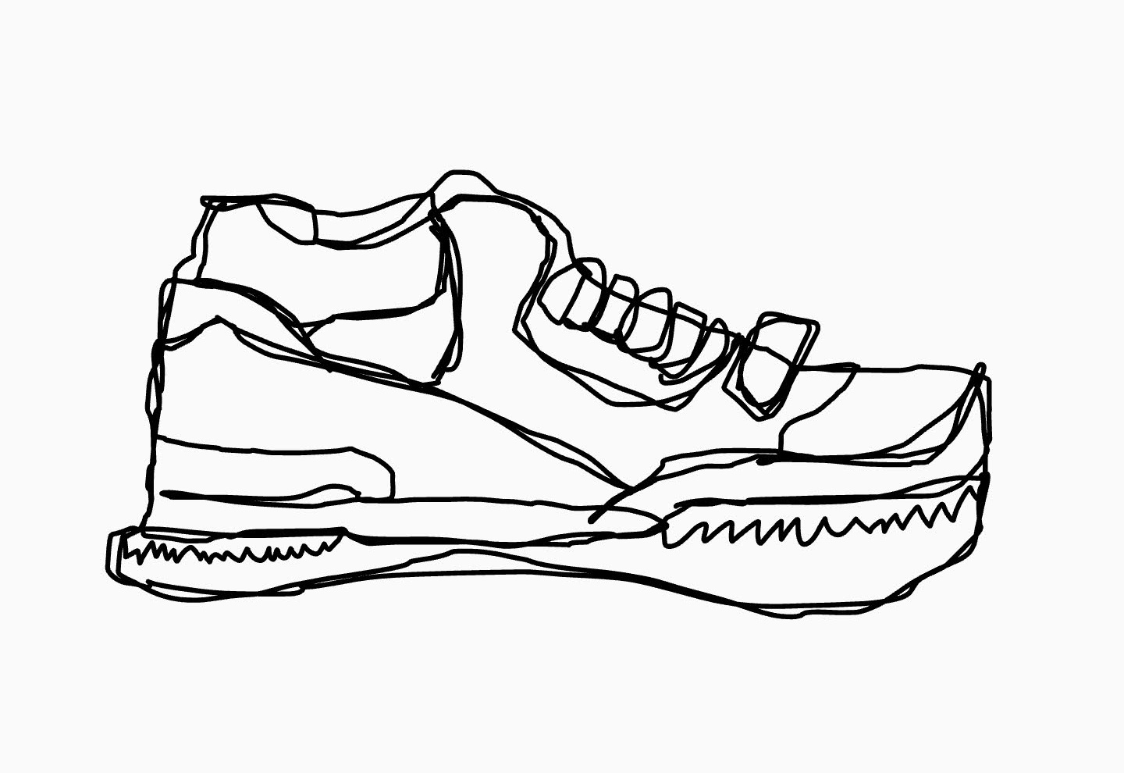
Drawing from Observation

Slide 15

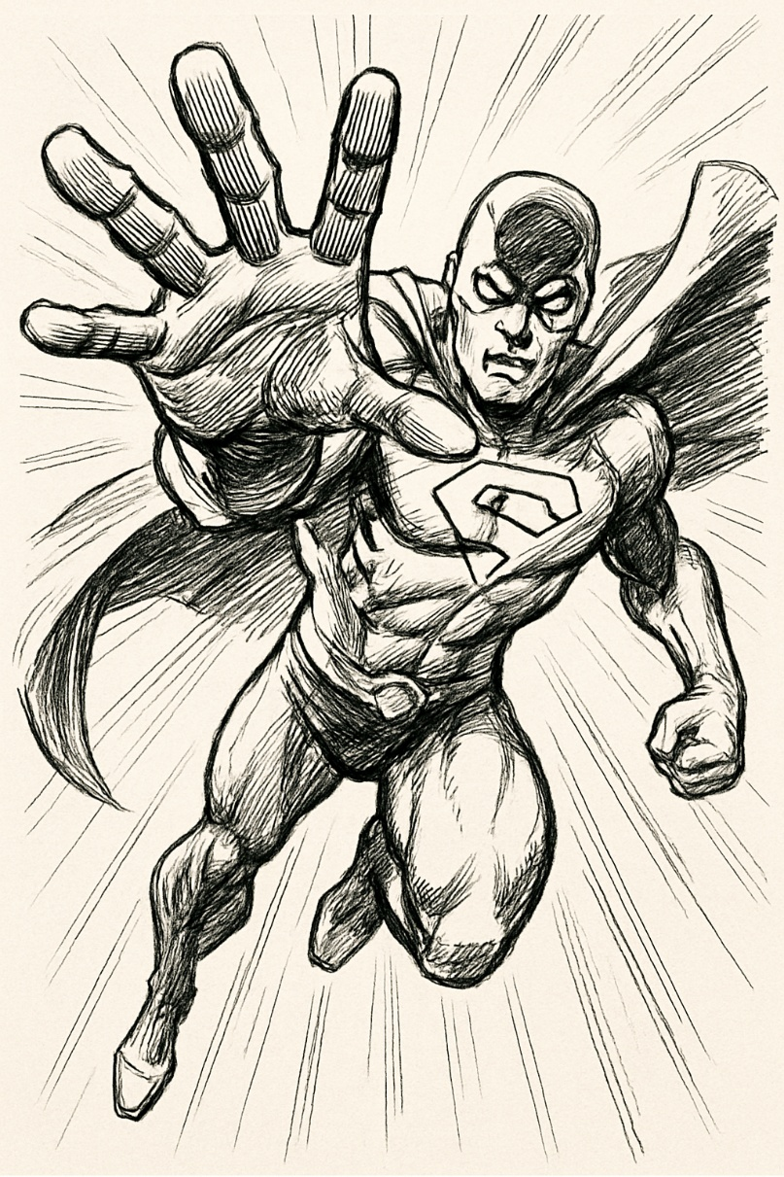
Foreshortening

Slide 16
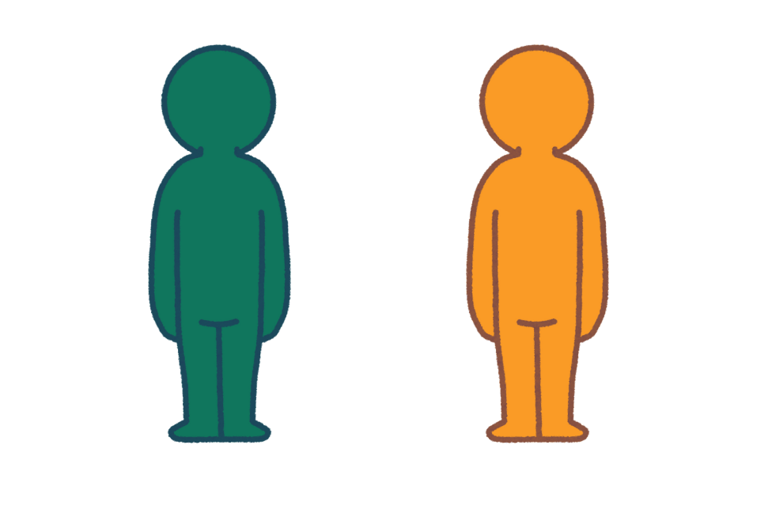
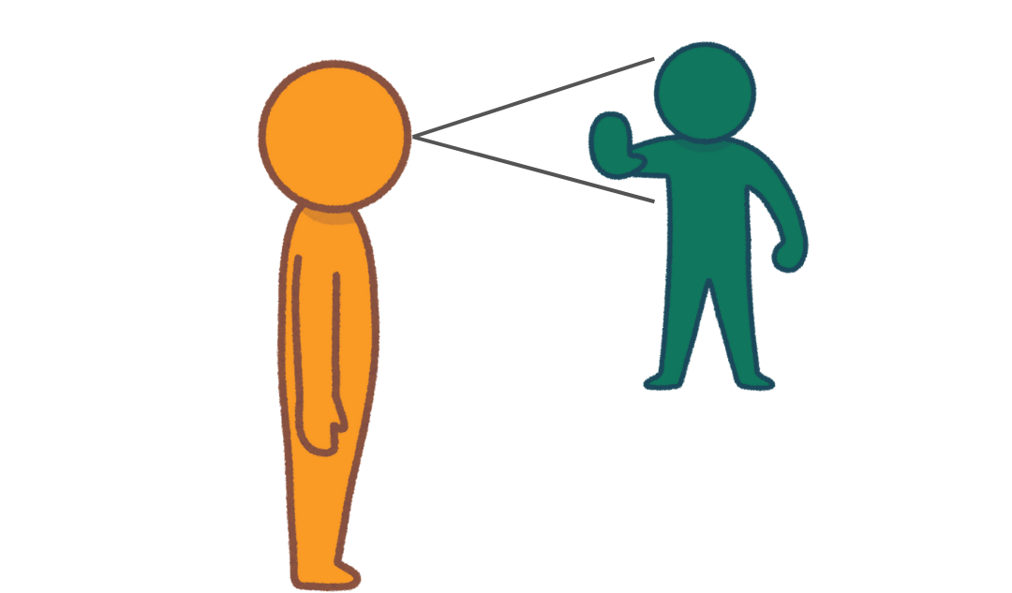
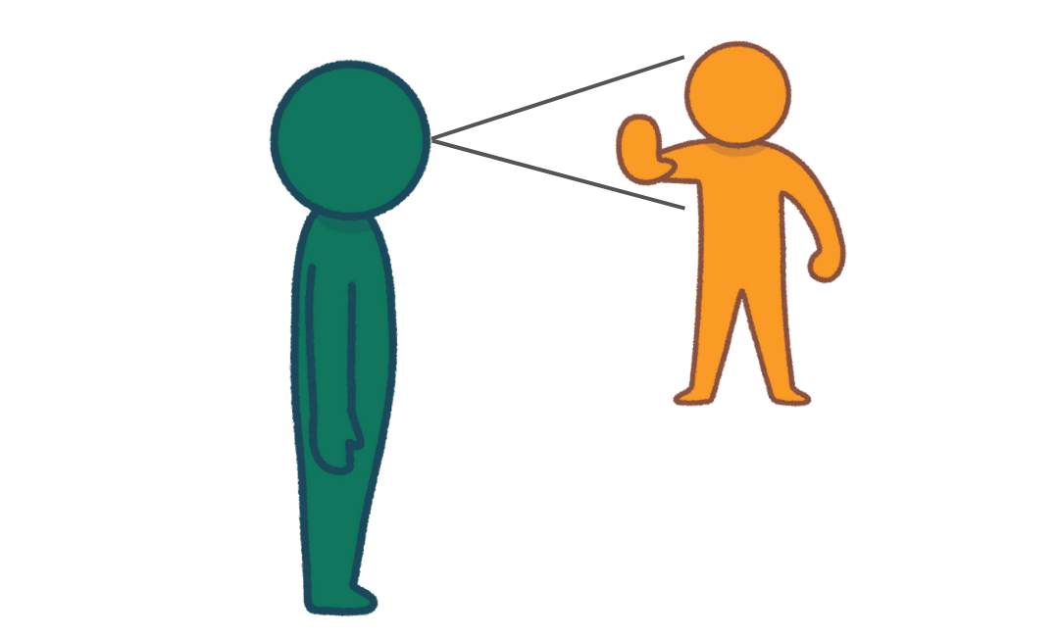
Foreshortening
Partner A
Partner B

Slide 17
Foreshortening is:
To shorten shapes and lines so they look like they are closer.
to draw things bigger than they are
to draw things shorter than they are

Slide 18
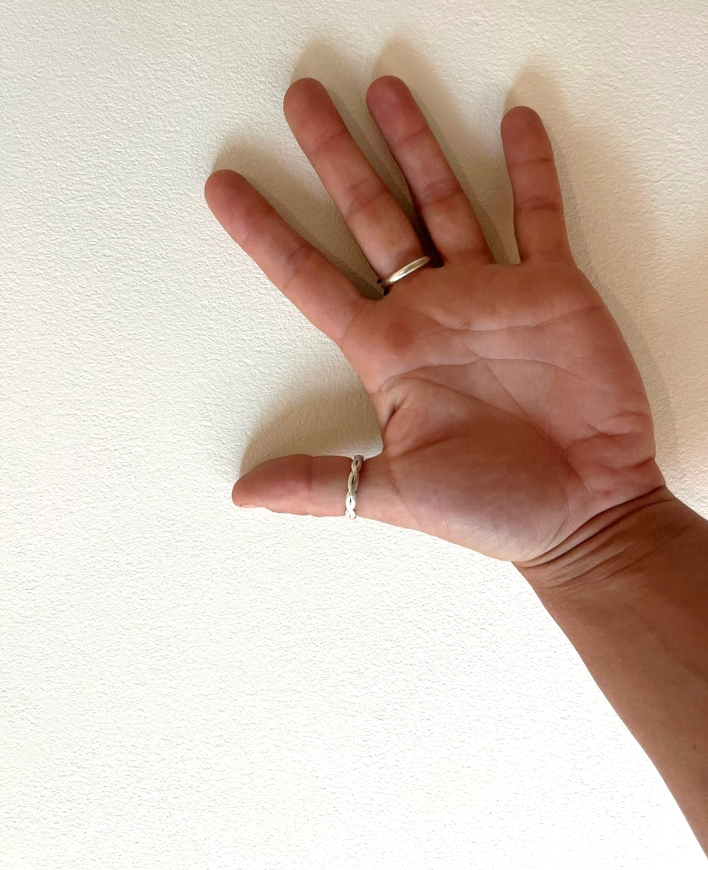
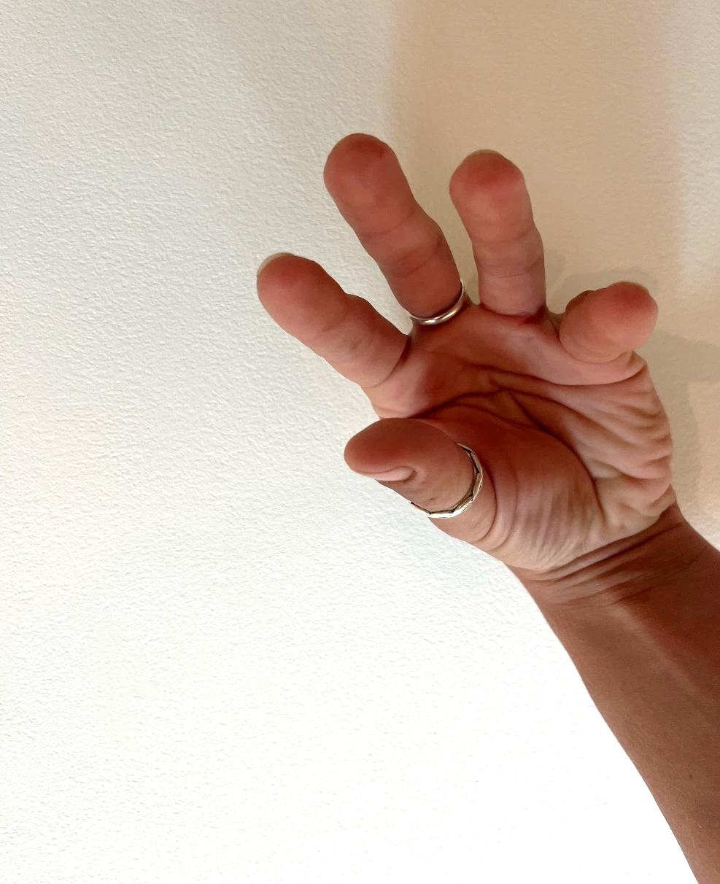
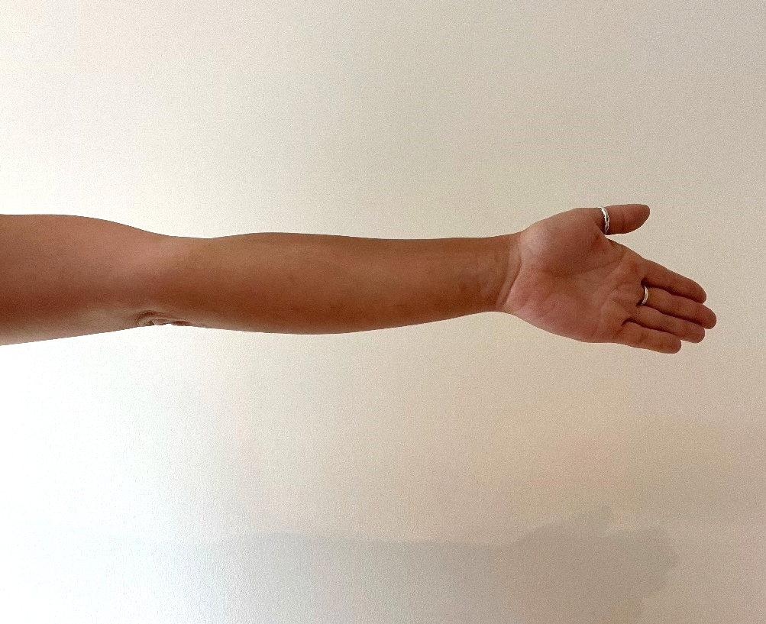
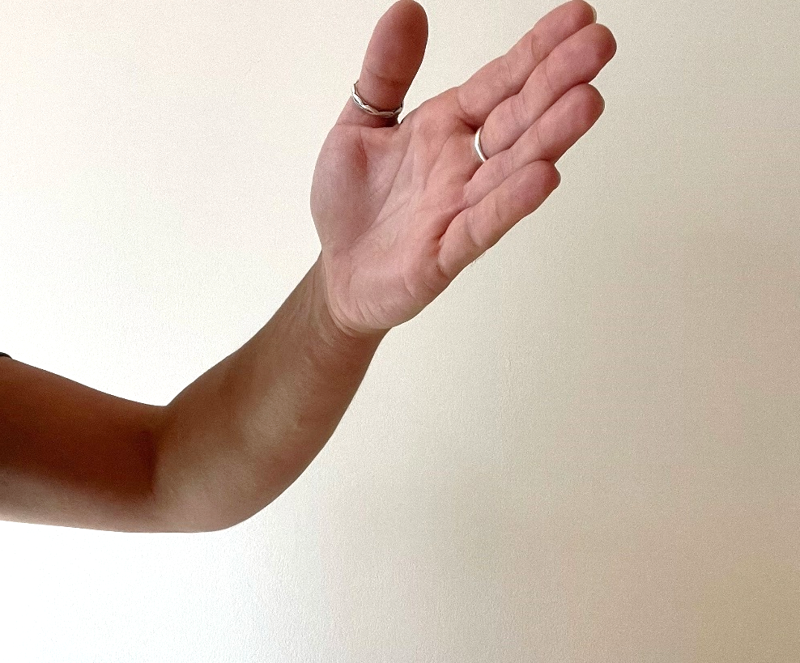























Foreshortening – Using Contour lines

Slide 19

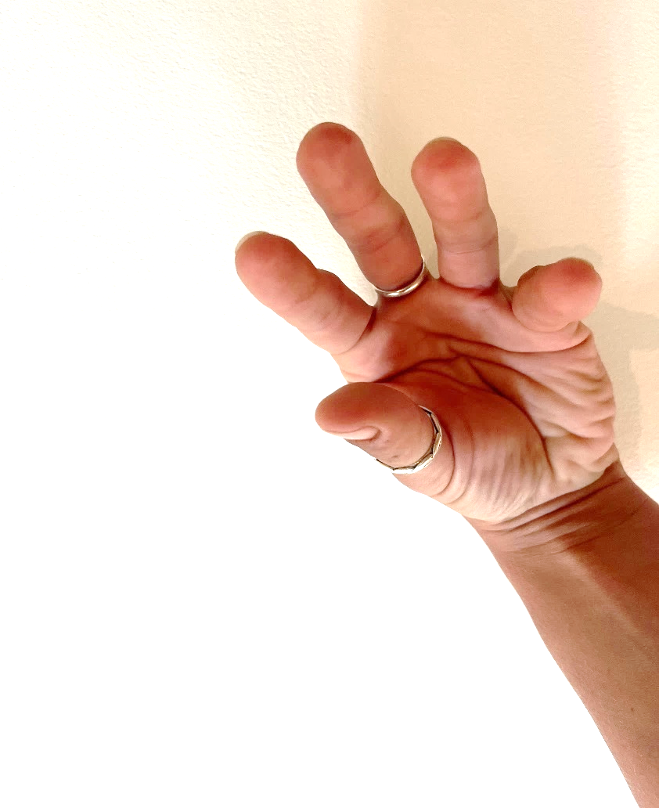













Drawing Using Foreshortening
Compare the lines and shapes by drawing the contour lines.

Slide 20

Drawing Using Foreshortening

Slide 21
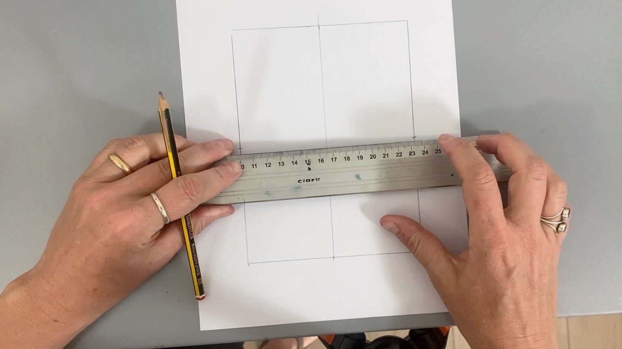
Draw crosshairs using a ruler, dividing your paper into four sections.

Slide 22
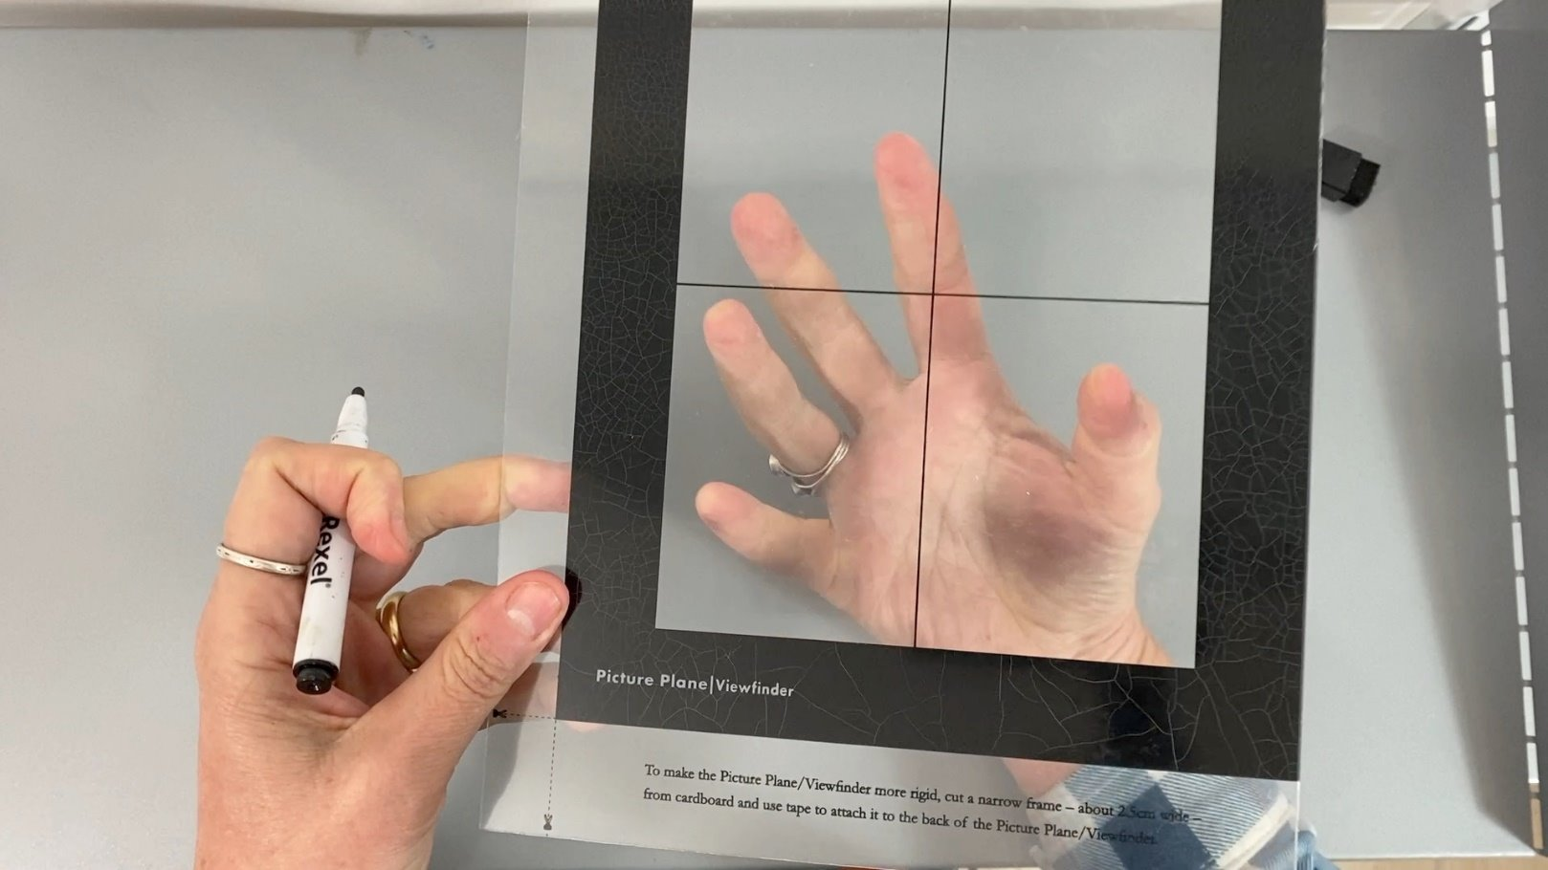
Rest your non-drawing hand on the table, behind the picture plane, with fingers pushing toward the back.

Slide 23
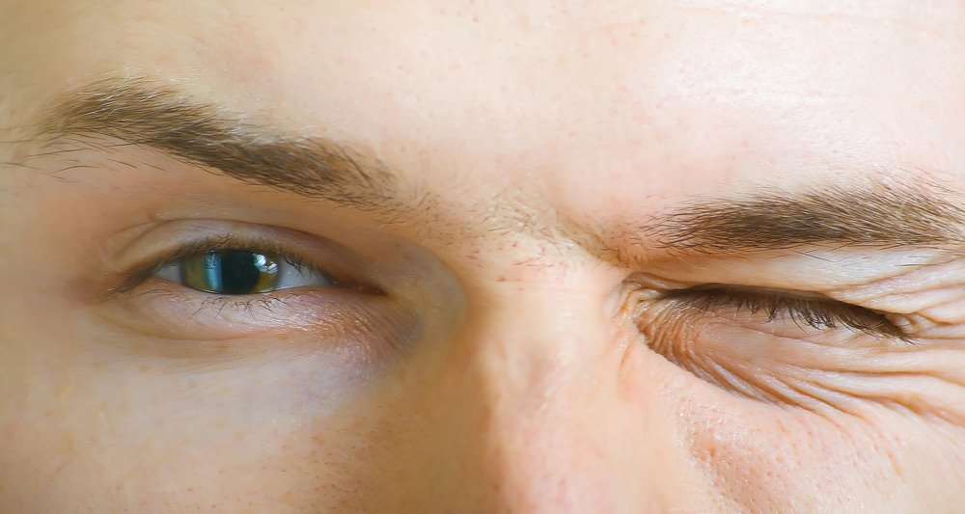
Close one eye to see. This is called monocular vision; you are only seeing one image.

Slide 24

Use the marker to trace the contour lines of your hand onto the plastic. Add lots of detail.

Slide 25
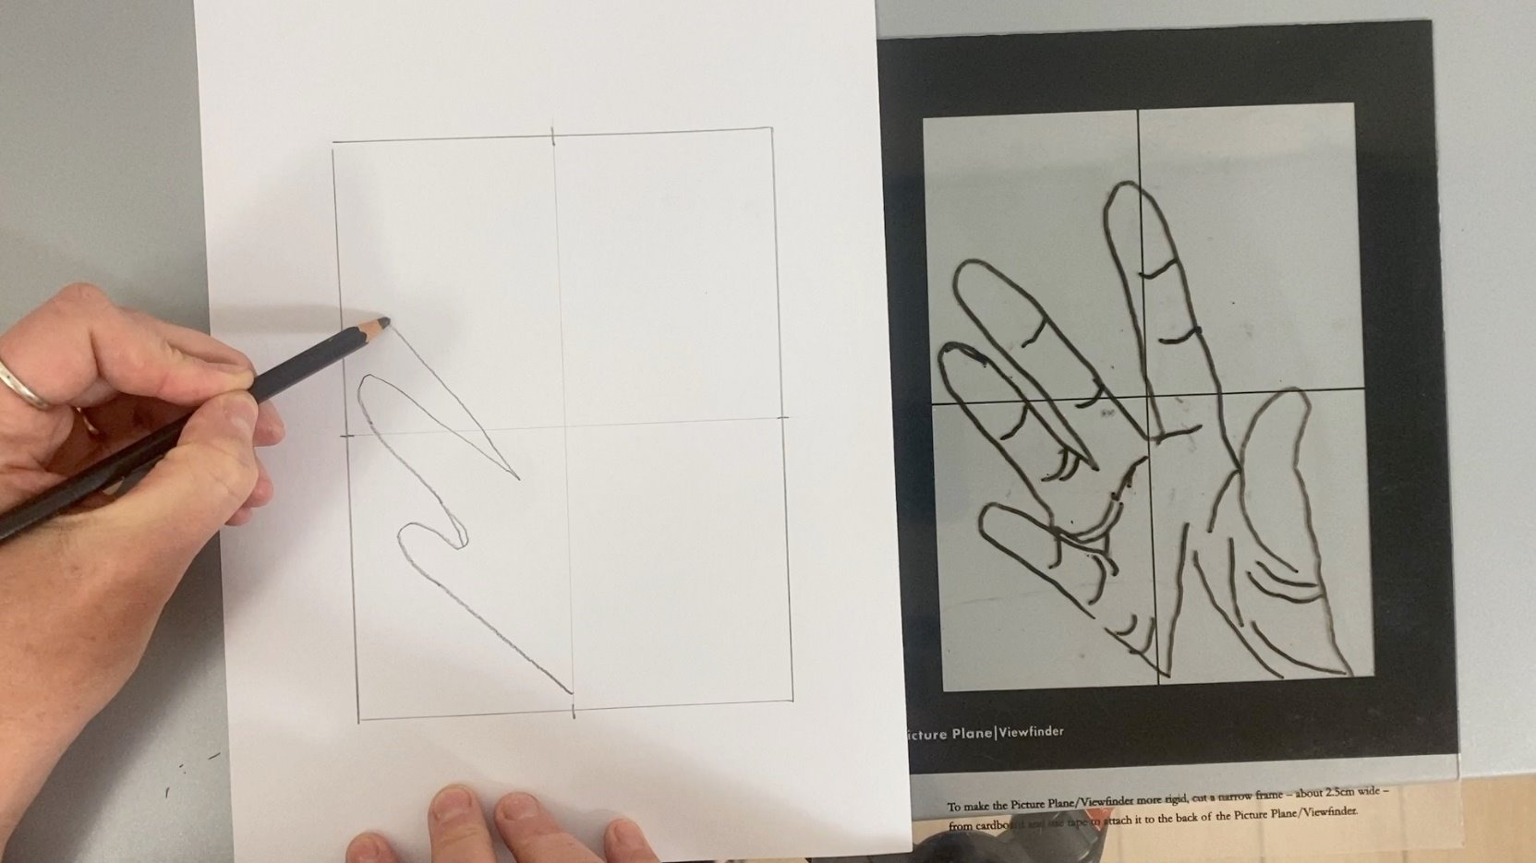
Transfer the contour line drawing onto the paper, using cross hairs to help you place each line and shape.

Slide 26
A contour line is:
the outline of a form, including interior structure
the lines around the outside of a form
the shading within a form showing light and dark

Slide 27
Drawing Using Foreshortening

Slide 28
Foreshorten: to shorten a detail in a drawing or painting so that it looks like it is closer.
Form: how something looks in 3D. It has height, width and depth. It’s different from a shape, which is flat and only has height and width.

Slide 29
Contour line: the outline of a form, including interior structure, without shading.
Picture Plane: similar to a window, an artist uses this to focus on what they are studying.

Slide 30



Reflect

Slide 31

This area of the drawing was difficult. I had to observe very closely because …
I was using foreshortening.

Slide 32
Here is a part of my drawing where my foreshortening is strongest because …
The contour lines change size, and make it look like the fingers are reaching off the paper.

Slide 33


Slide 34


Slide 35

















Contour lines show the form and include interior outlines. Foreshortening makes parts of form appear closer by changing the size.

Slide 36
In what part of your work today did you discover something new about yourself or your skills?

Slide 37
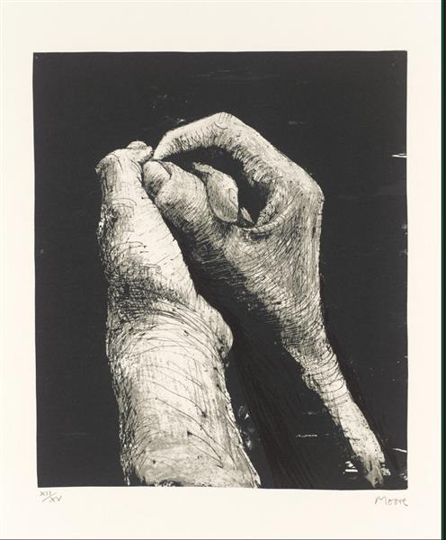
In the next lesson, we will learn how artists use space and observation to capture form.

Slide 38
Lesson 2 Slide 37 Photo: Hands II (1973) by Henry Moore, via WikiArt, © The Henry Moore Foundation. Used under Fair Use for educational and non-commercial purposes. https://www.wikiart.org/en/henry-moore/hands-ii-1973

