Slide 1
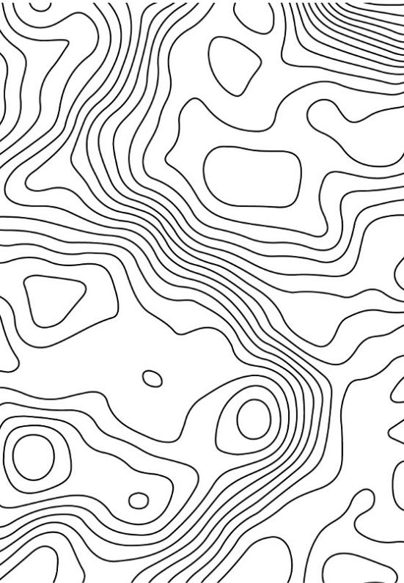
Unit 1B
Art and Seeing
Lesson 1
Clever Contours
Unit 1B Version 2

Slide 2
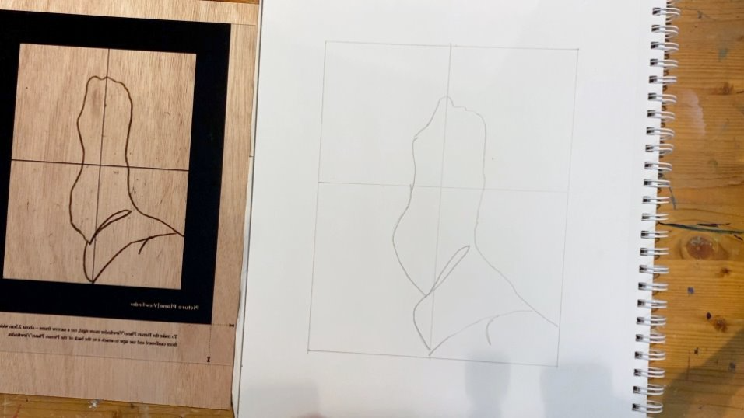
In this lesson, we will learn how to draw the form of an object.

Slide 3
You will be successful when you can:
see the outline of an object
draw contour lines
create form.

Slide 4
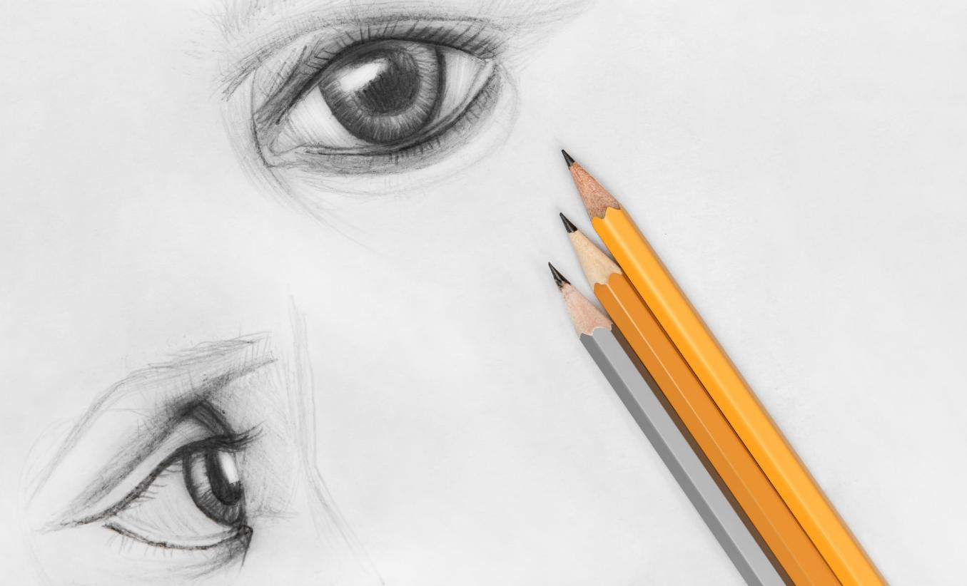

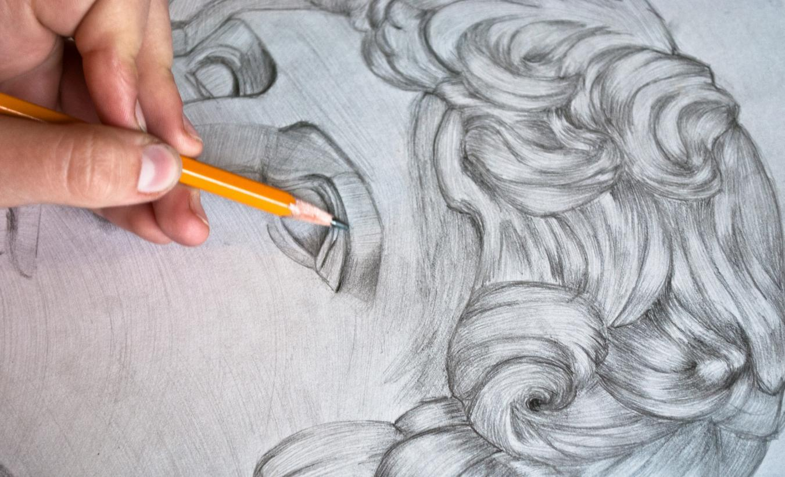

Slide 5
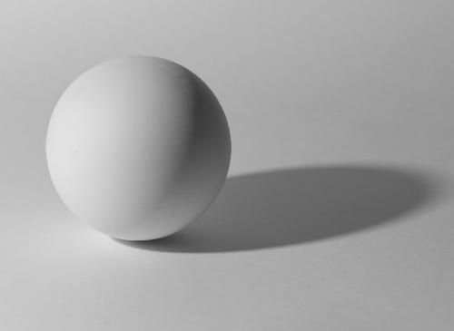
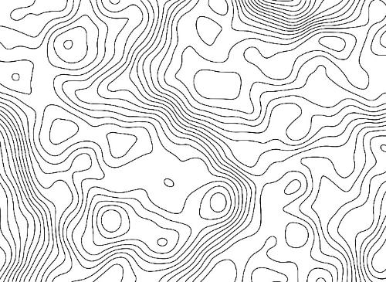
form
Form is how something looks in three-dimensions (3D). Form has height, width and depth.
contour lines
Contour lines are the outline and edges you draw to show the shape of something.

Slide 6
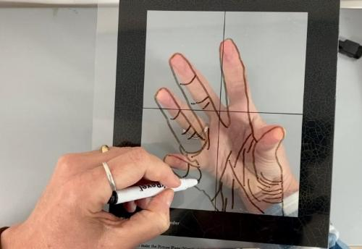
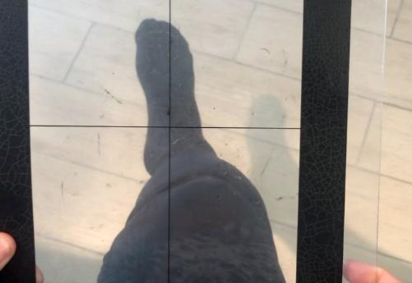
picture plane
A picture plane is like a window you look through to see your picture.
crosshairs
Crosshairs are two lines, one up and one down, that cross in the middle.

Slide 7


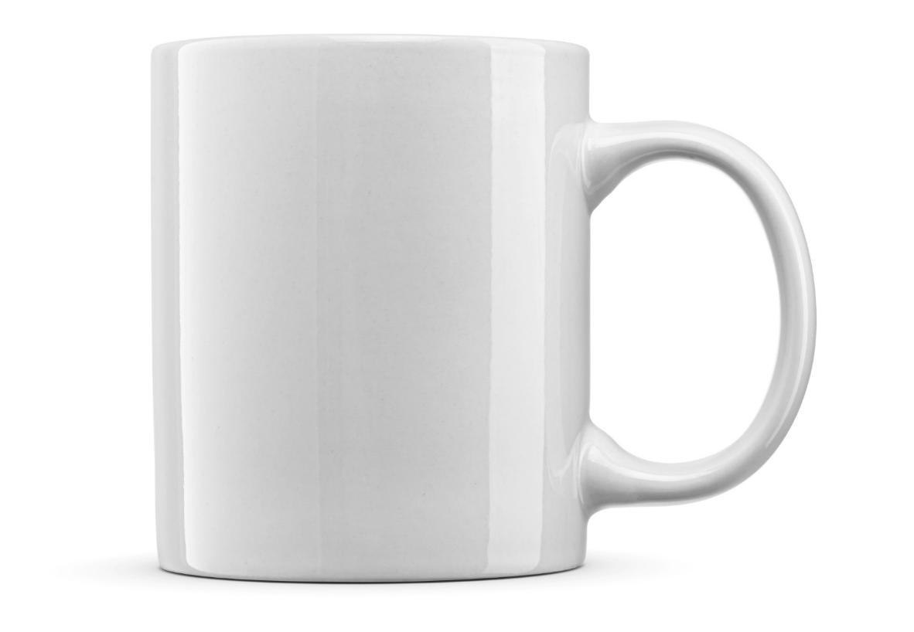

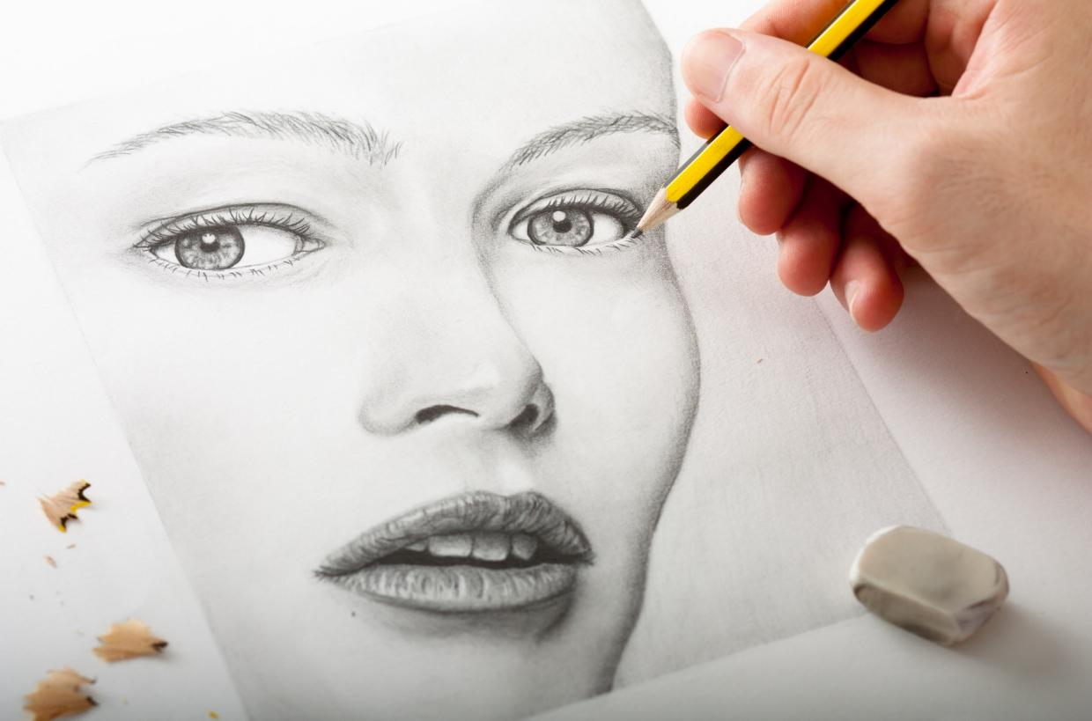

3D Form

Slide 8
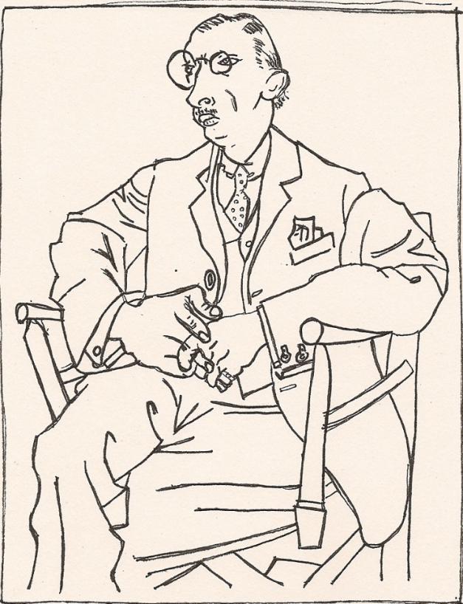

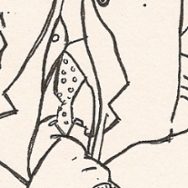
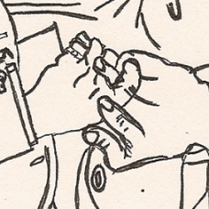
3D Form

Slide 9
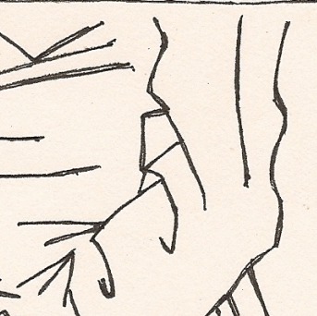
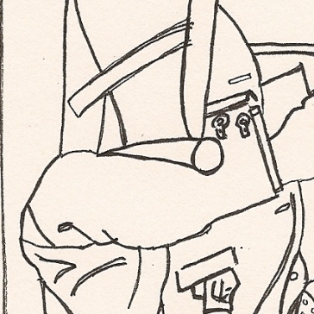
3D Form

Slide 10

A 3D object has:
height, width and length
height, width and depth
height and width

Slide 11


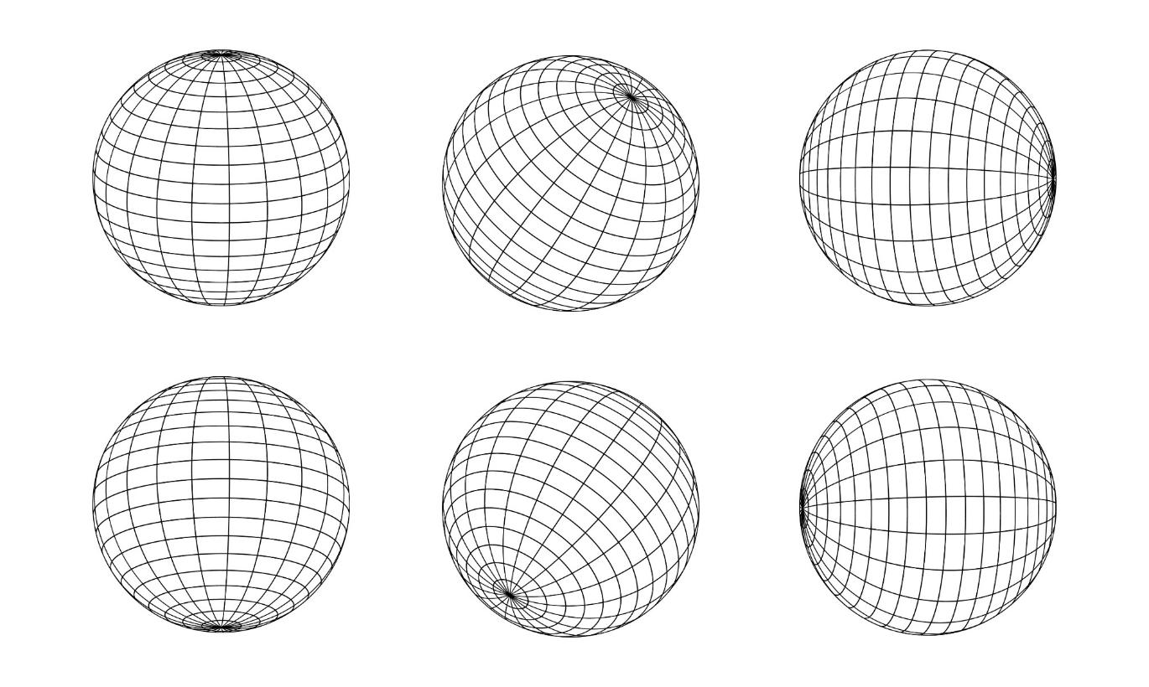
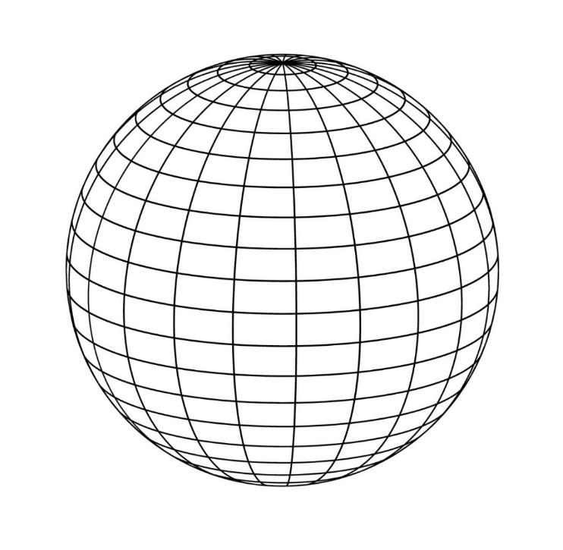
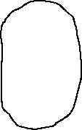

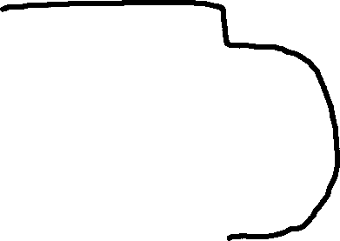
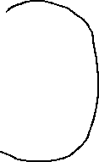
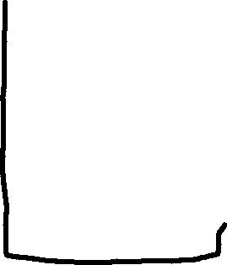
Contour Lines

Slide 12
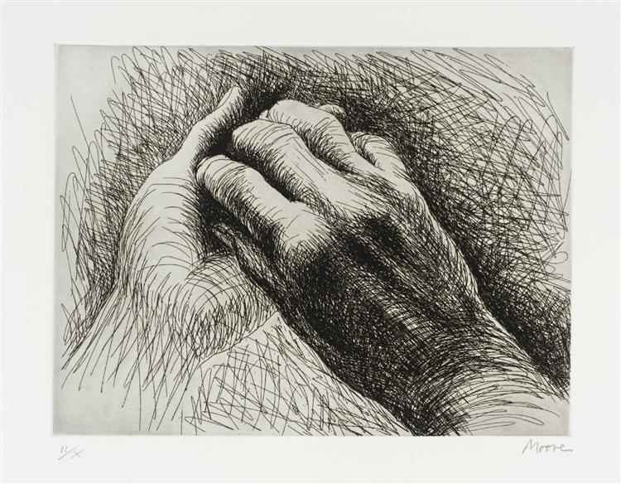




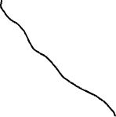










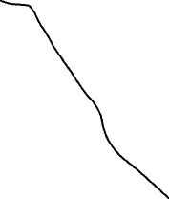

Contour Lines

Slide 13
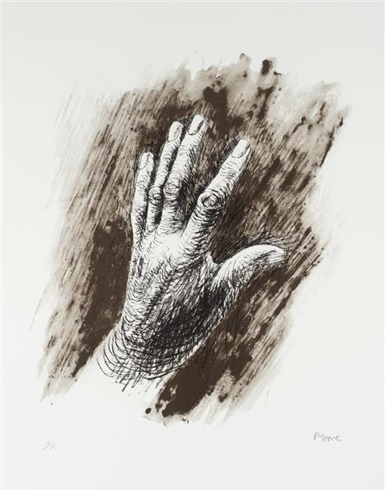
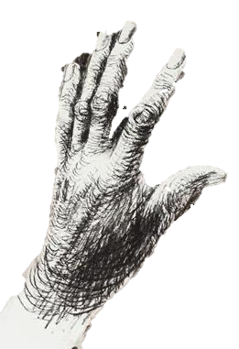
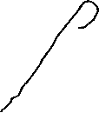

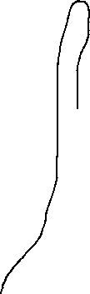





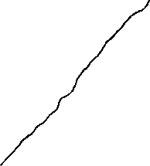

Contour Lines

Slide 14

An example of a contour line is:

Slide 15

Contour Line Drawing

Slide 16
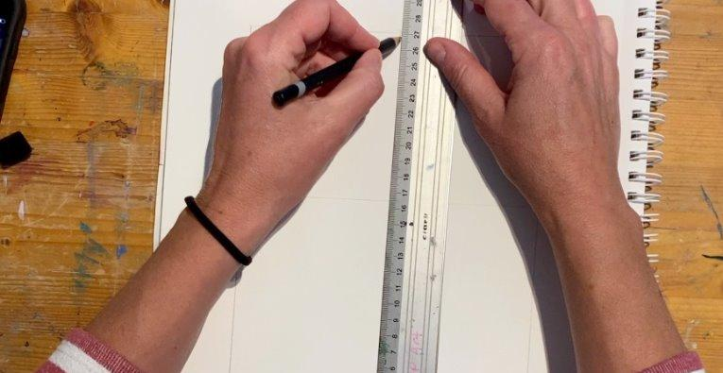
Divide your paper into four sections by drawing crosshairs with a ruler.

Slide 17
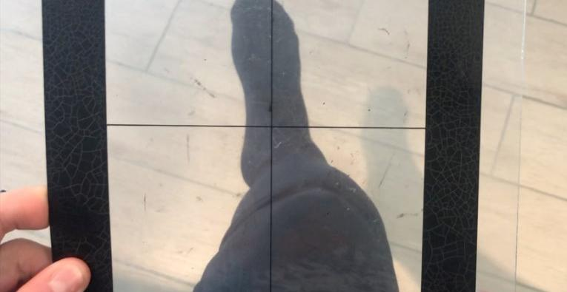
Look through a picture plane to choose a view of your knee and foot.

Slide 18
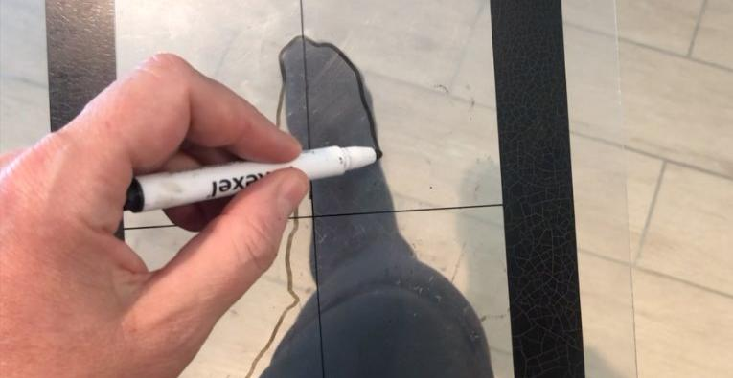
Draw the contour lines with a whiteboard pen.

Slide 19
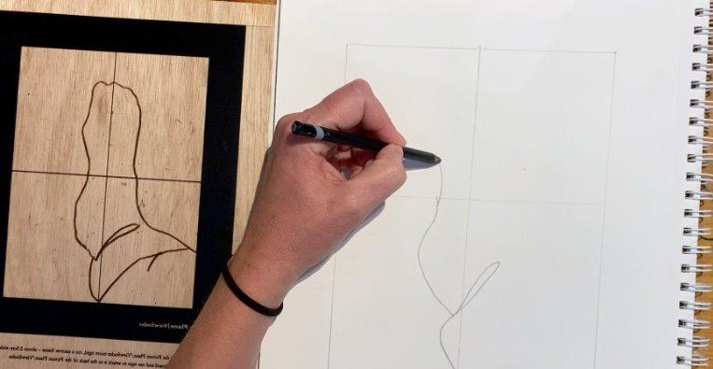
Transfer the lines you drew on your picture plane to your Process Journal.

Slide 20
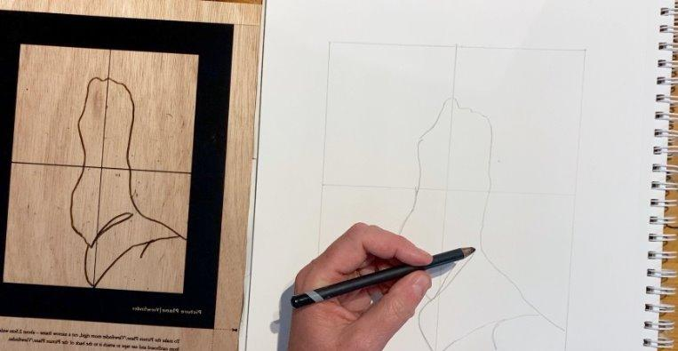
Complete your drawing, paying special attention to the contour lines that show changes in form.

Slide 21
Crosshairs are:
whiskers
a guide
a target

Slide 22
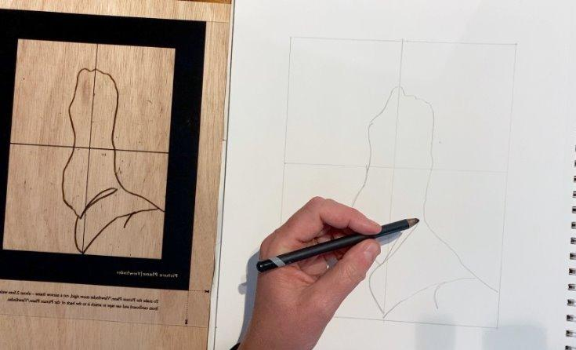
Contour Line Drawing

Slide 23
Form: Form is how something looks in three-dimensions (3D). 3D objects have height, width and depth.
Contour lines: Contour lines are the outline and edges you draw to show the shape of something.

Slide 24
Picture plane: A picture plane is like a window you look through to see your picture.
Crosshairs: Crosshairs are two lines: one up, one down, that cross in the middle.

Slide 25



Reflect

Slide 26

This area of the drawing was difficult. I had to observe very closely because…
the shapes of my leg and foot looked different from what I had imagined.

Slide 27
Here is my best example of form because…
I have shown the contour lines across the foot, not just around the outside.

Slide 28


Slide 29


Slide 30
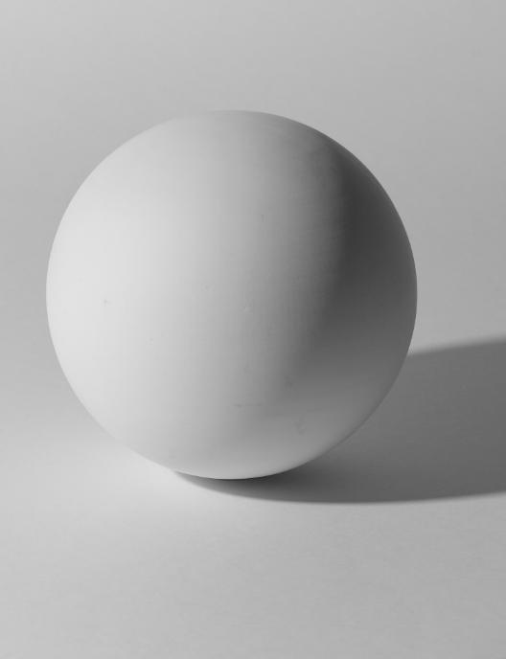
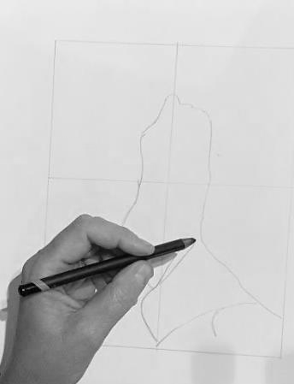
Objects have form. Contour lines show changes in the form of an object.

Slide 31
In what part of your work today did you discover something new about yourself or your skills?

Slide 32
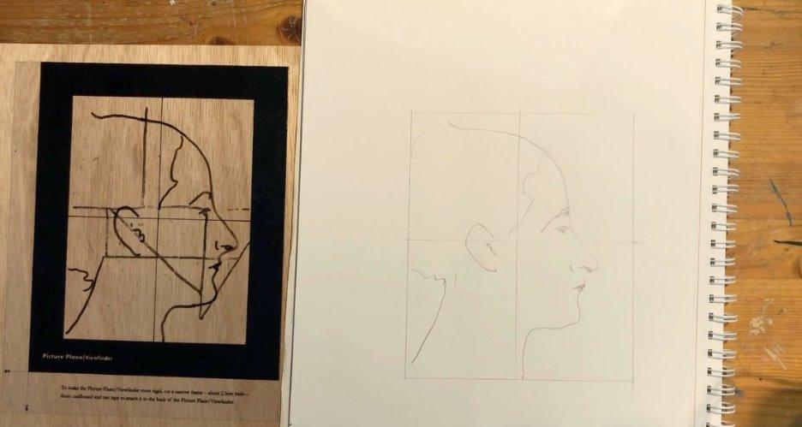
In the next lesson, we will learn how to use proportion.

Slide 33
Slide 8, Slide 9 Photo: Portrait of Igor Stravinsky by Pablo Picasso (1920), from WikiArt, Public Domain, https://www.wikiart.org/en/pablo-picasso/portrait-of-igor-stravinsky-1920
Slide 12 Photo, Slide 13 Photo: The Artist's Hand II by Henry Moore (1979), from WikiArt, © Henry Moore - Fair Use, https://www.wikiart.org/en/henry-moore/the-artists-hand-ii-1979
Slide 12 Photo, Slide 13 Photo: The Artist's Hand III by Henry Moore (1979), from WikiArt, © Henry Moore - Fair Use, https://www.wikiart.org/en/henry-moore/the-artists-hand-iii-1979

