Slide 1
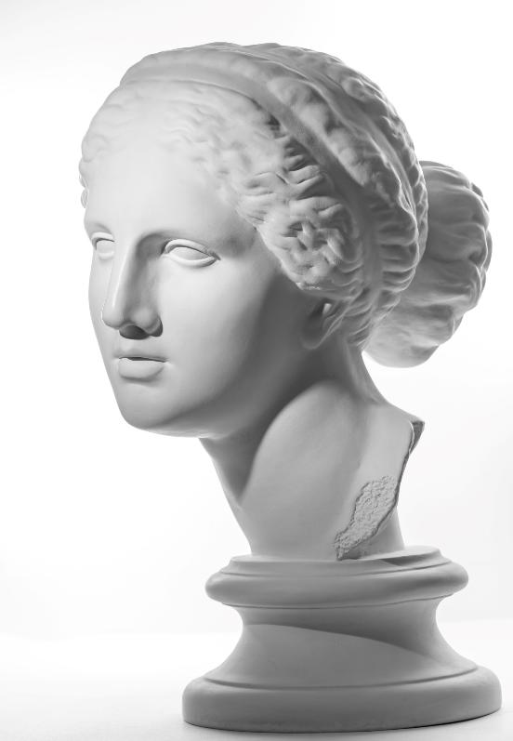
Unit 1B
Art and Seeing
Lesson 2
Perfect Proportions
Unit 1B Version 2

Slide 2
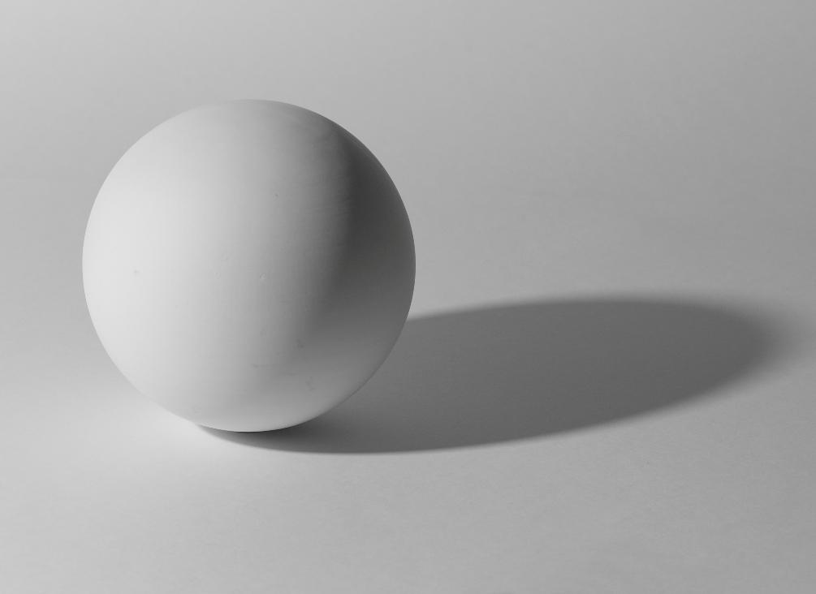
Objects have form.

Slide 3
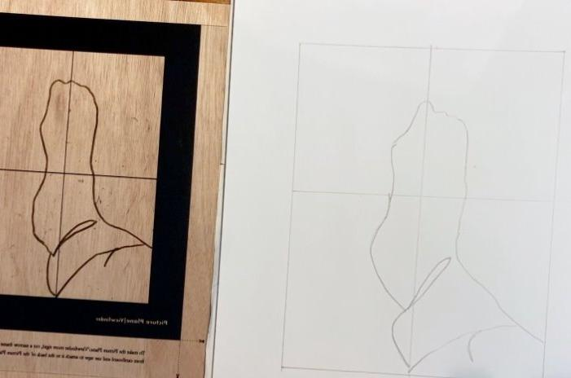
Contour lines show changes in the form of an object.

Slide 4
Contour lines show:
the form
the inside
the outside

Slide 5
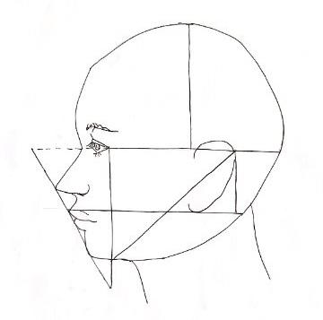
In this lesson, we will learn how to use proportion.

Slide 6
You will be successful when you can:
observe the proportions of a face
use a proportions map
copy a master drawing.

Slide 7
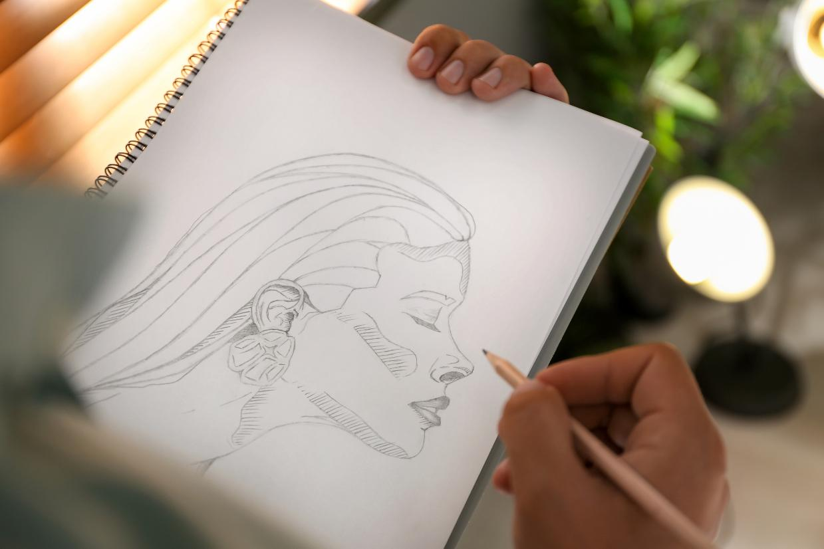
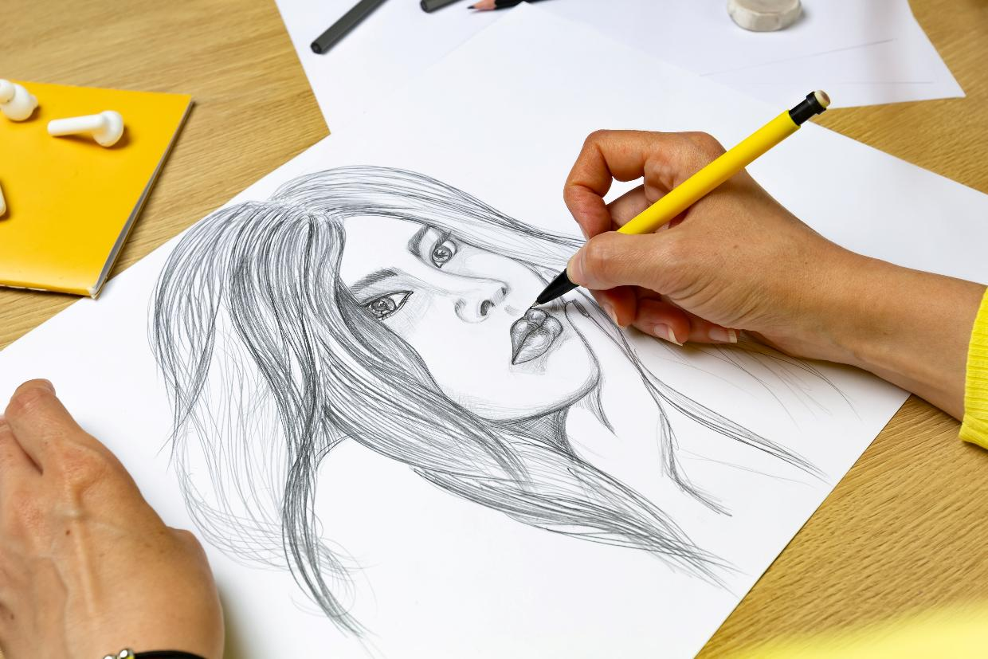
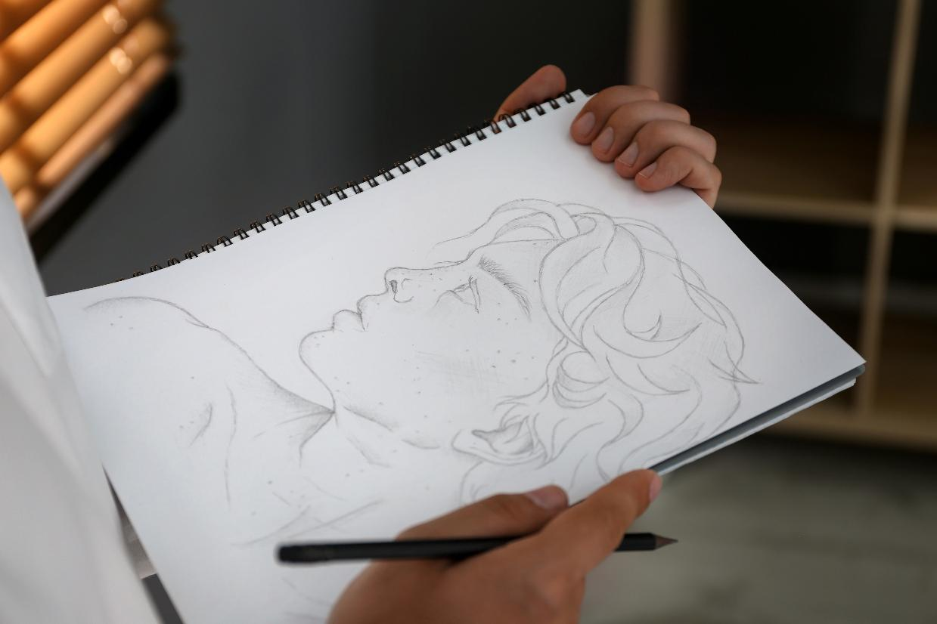

Slide 8
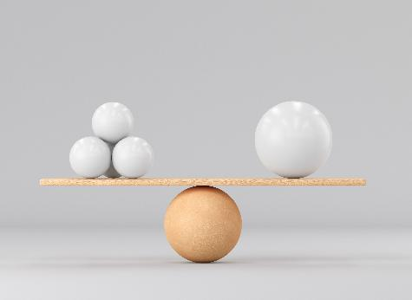
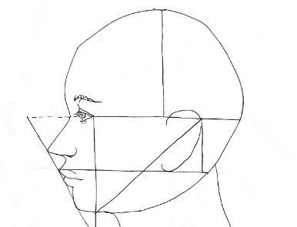
proportion
Proportion means the size of one part compared to another. When things are in proportion, they look balanced.
proportion map
A proportion map is a guide that shows where the parts of something should go, and how big or small each part should be.

Slide 9
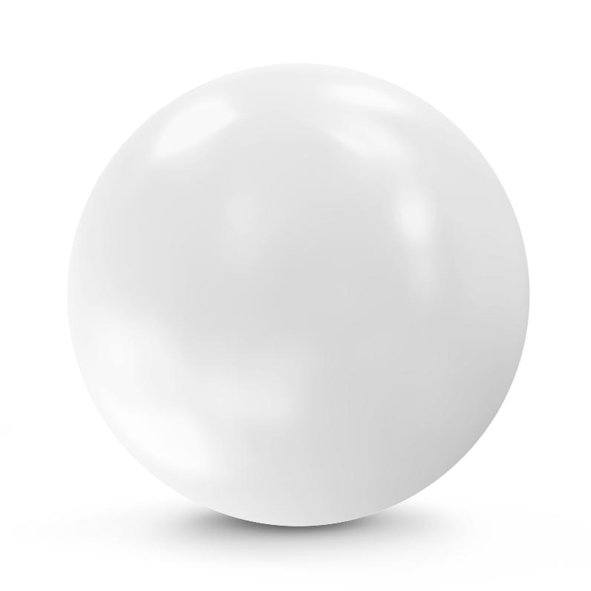
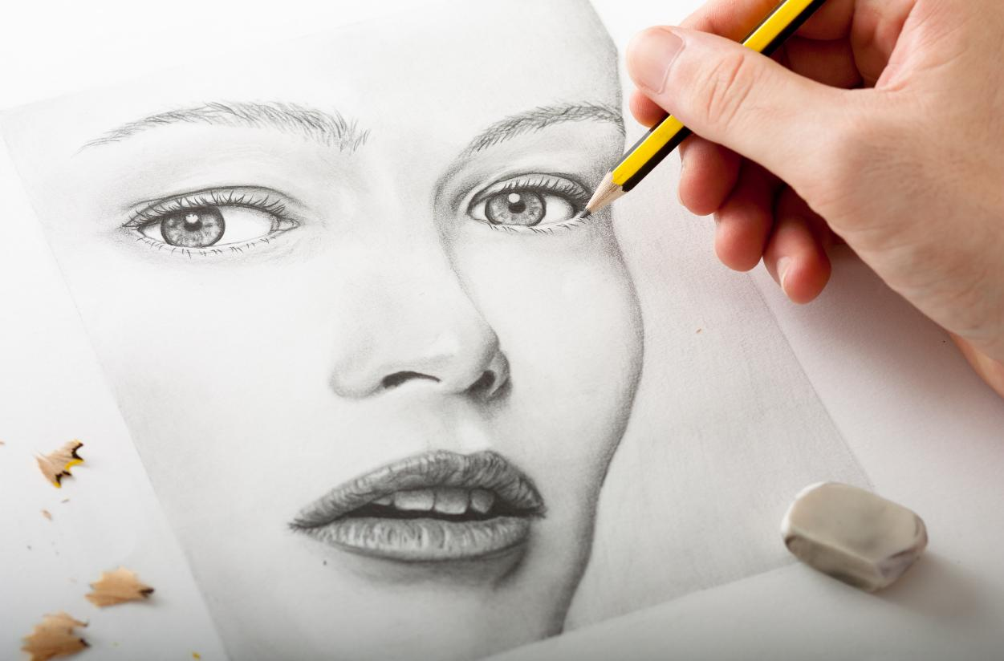

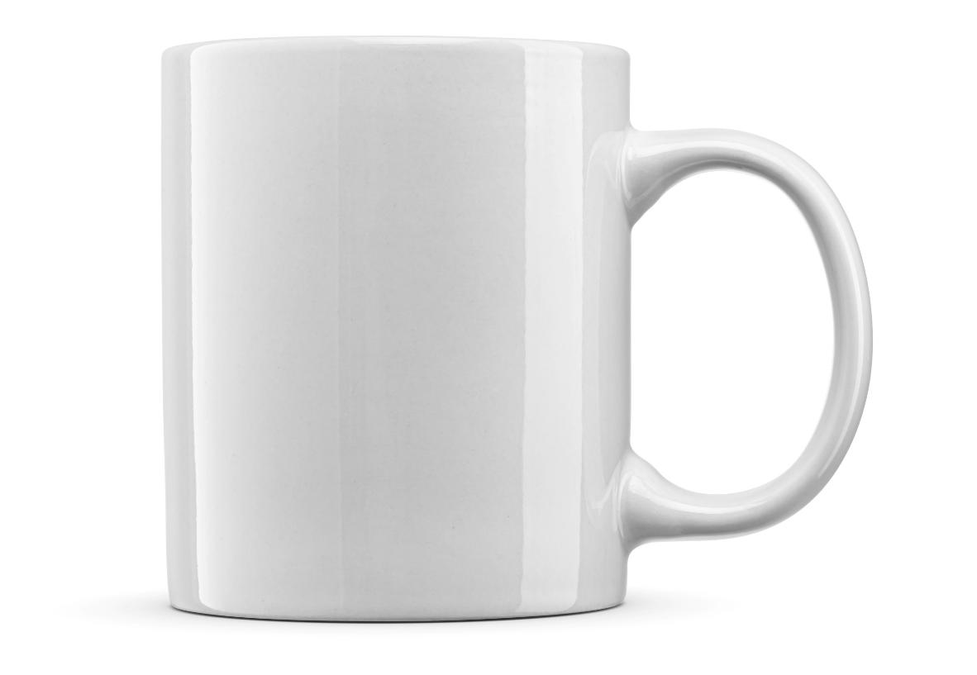

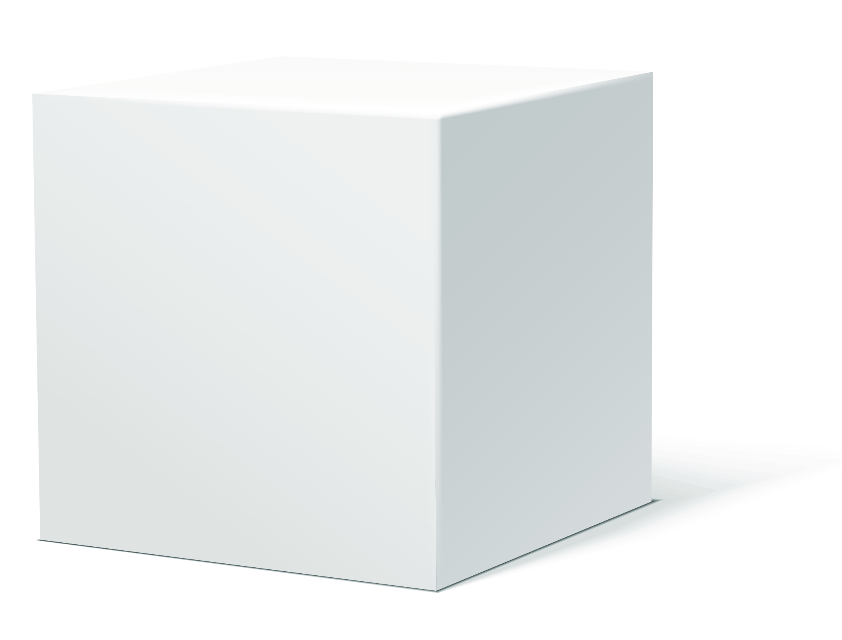
3D Form

Slide 10
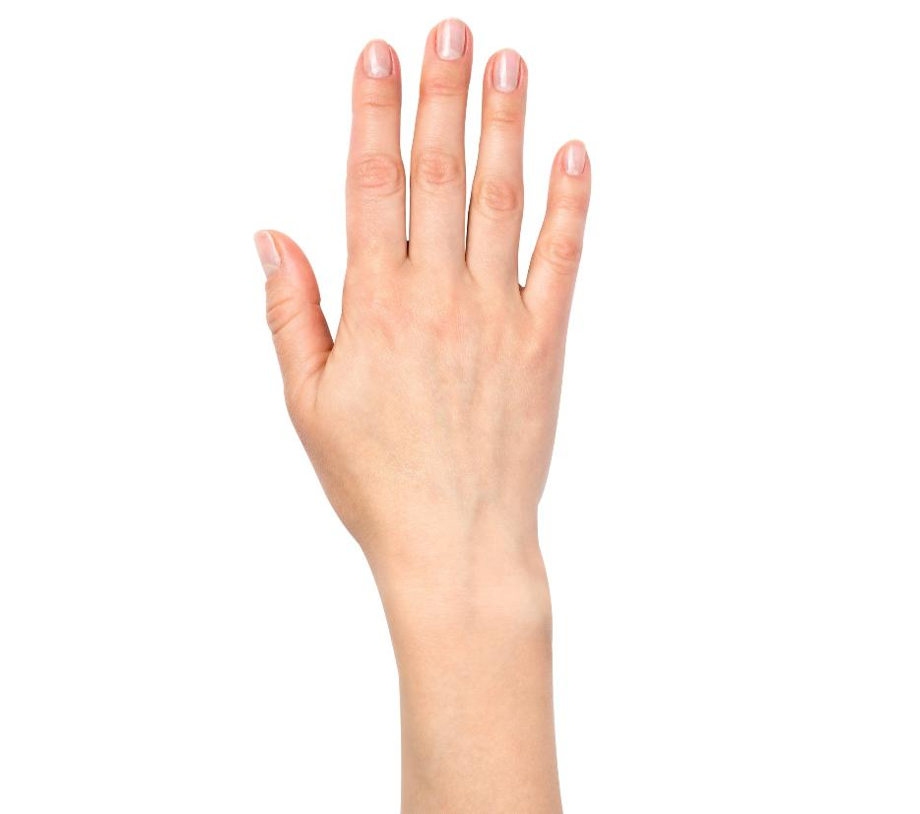
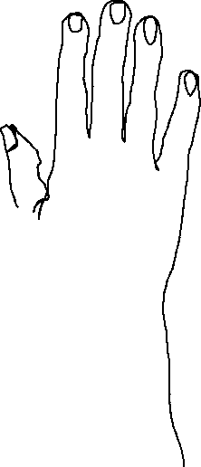


3D Form

Slide 11
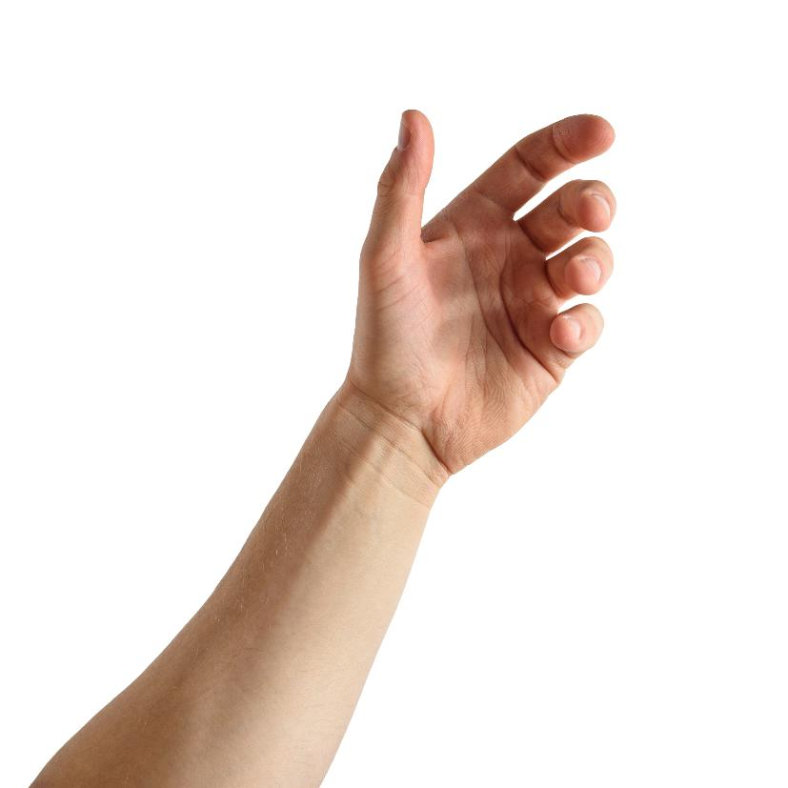
3D Form

Slide 12

3D objects have:
one shape
form
one line

Slide 13

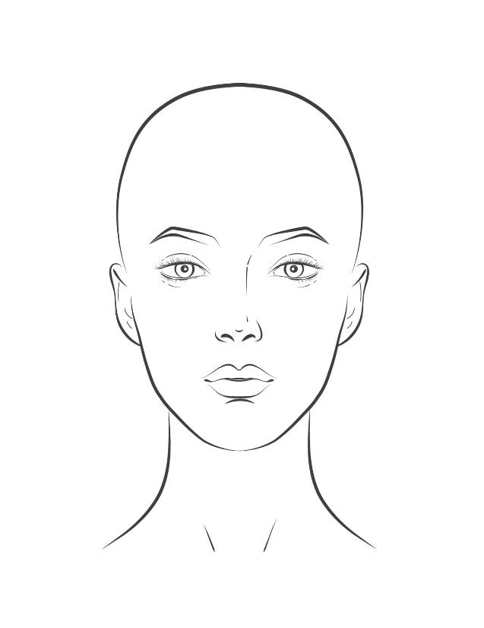
Mapping Proportions

Slide 14
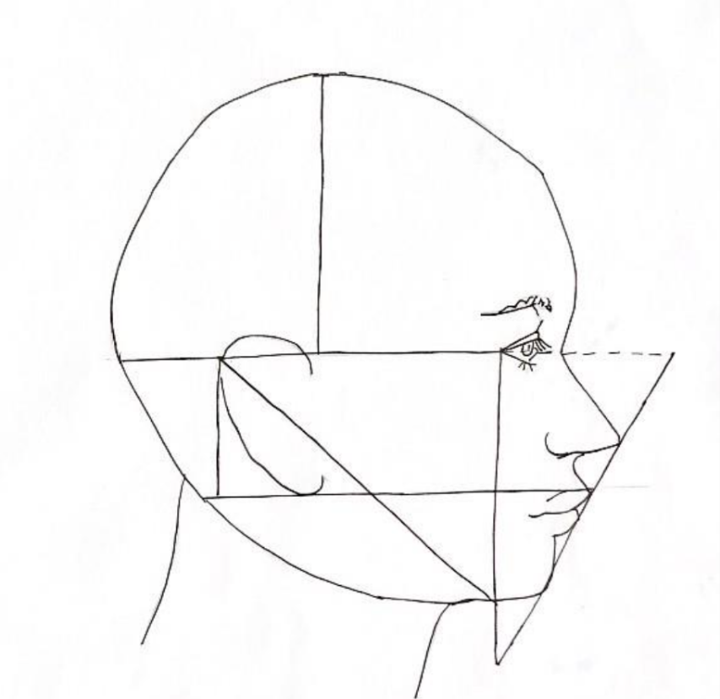
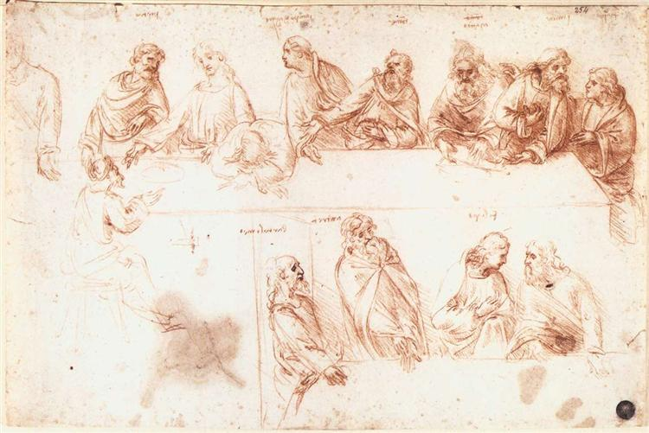
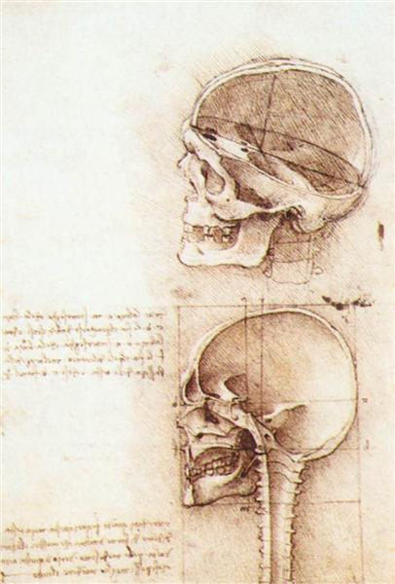
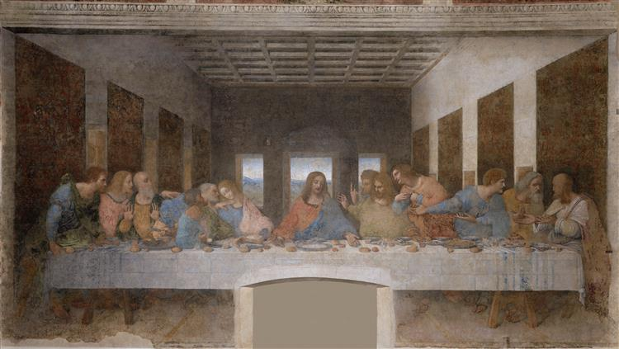
Mapping Proportions

Slide 15
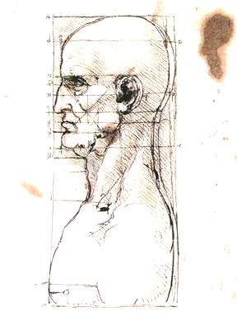
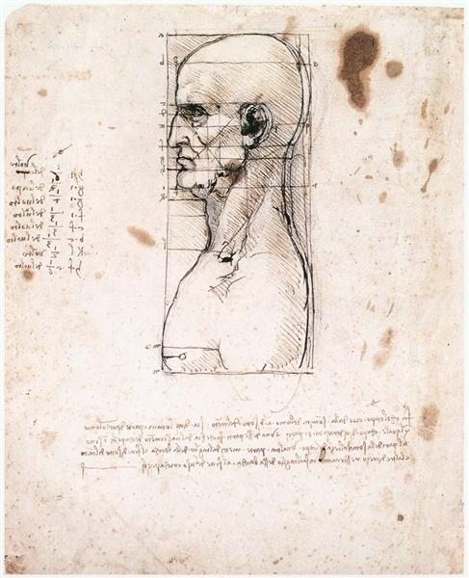
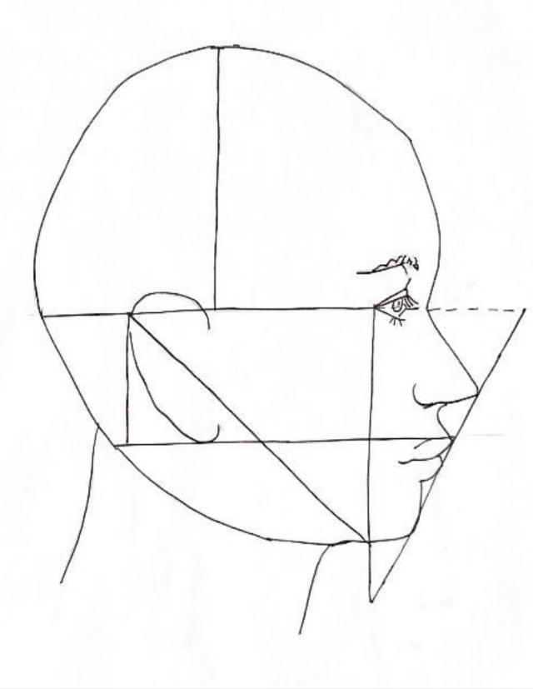
Mapping Proportions

Slide 16
Mapping the proportion helps artists to:
draw all the parts together in the right place
make colourful artwork
draw what they imagine

Slide 17
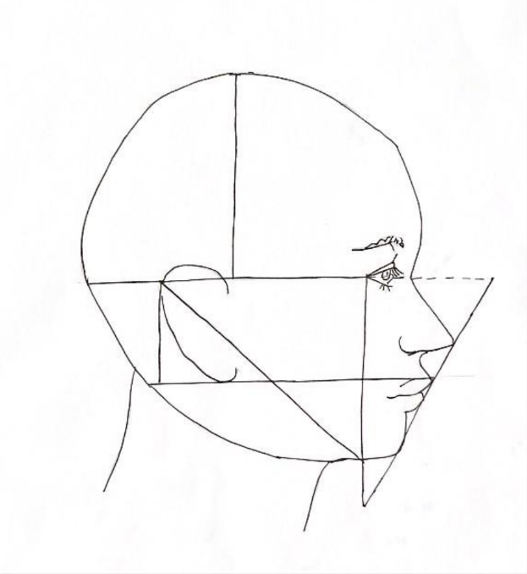
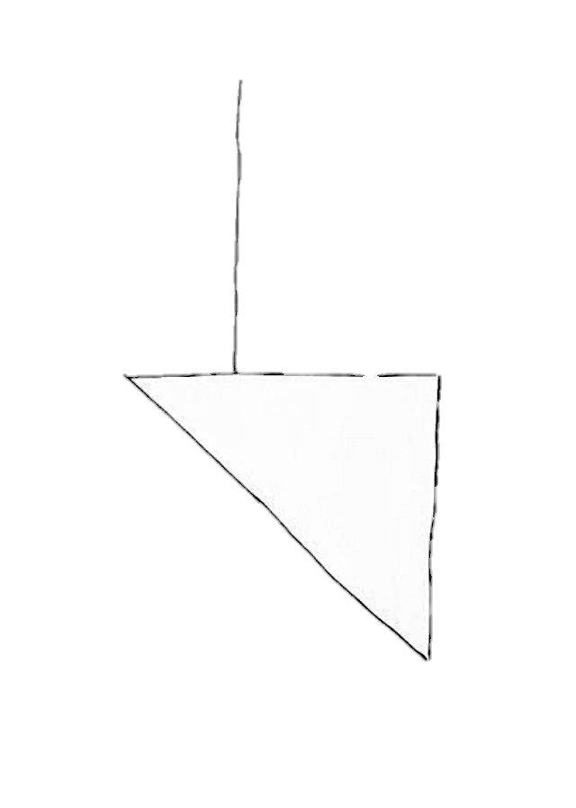
Mapping Proportions

Slide 18

Copy a Master Drawing

Slide 19
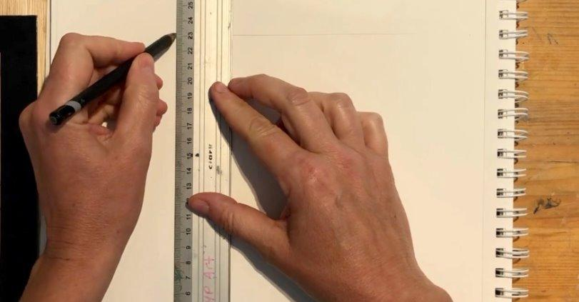
Divide your paper into four sections using a ruler.

Slide 20
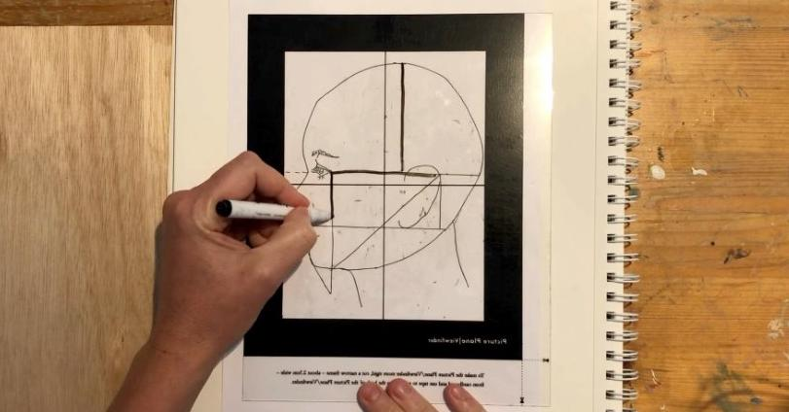
Trace the proportions map onto your picture plane.

Slide 21
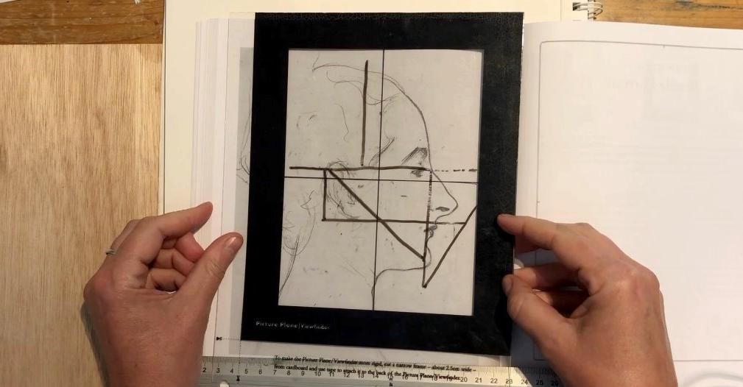
Line the picture plane on top of the drawing.

Slide 22
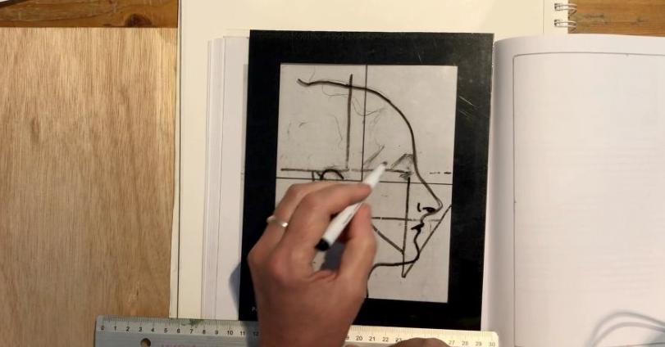
Trace the contour lines of the face onto your picture plane.

Slide 23
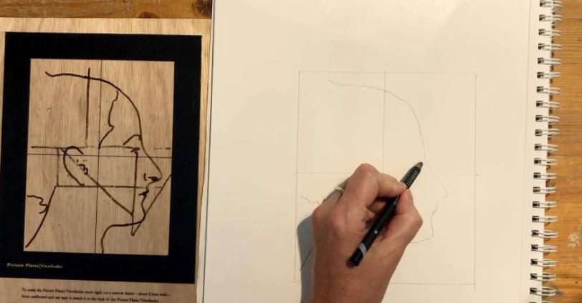
Draw the outline of the head and face, using the crosshairs.

Slide 24
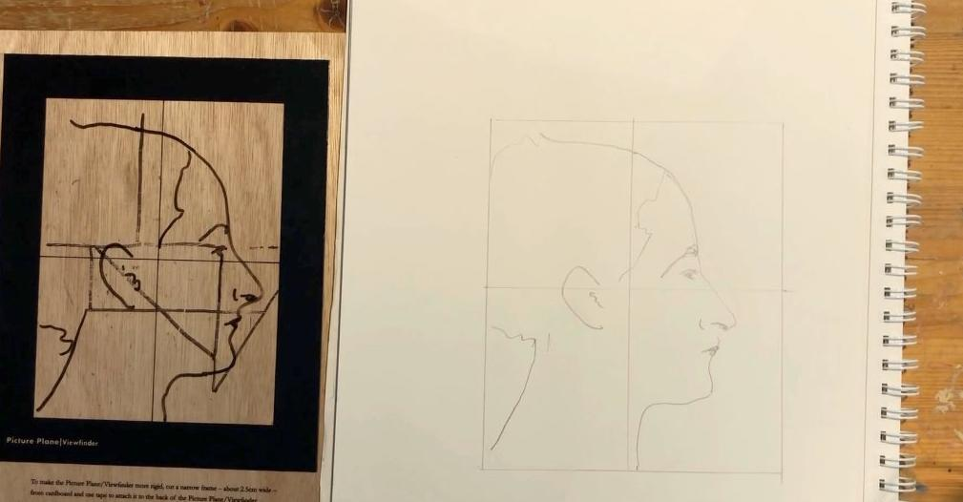
Draw the rest of the features, using the proportion map.

Slide 25
Show of Fingers
The proportion map is part of the final drawing.

Slide 26
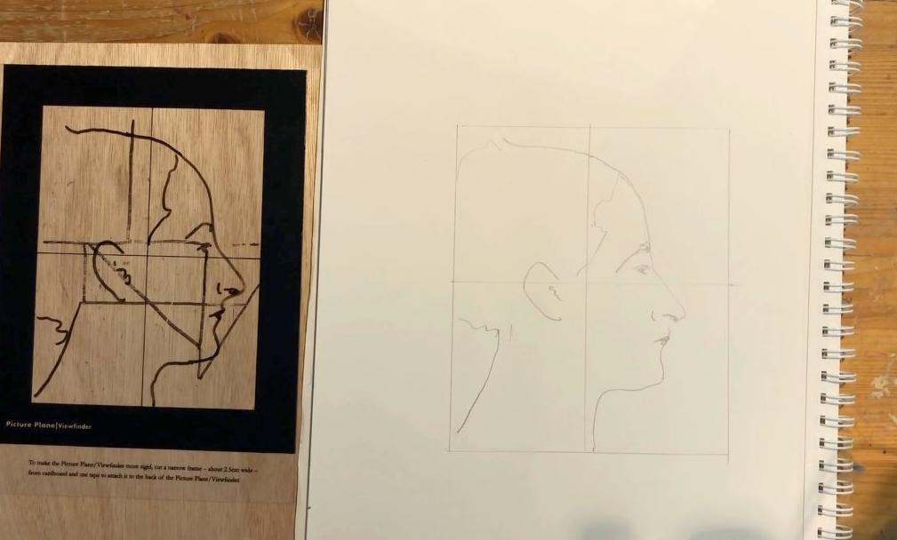
Copy a Master Drawing

Slide 27
Proportion: Proportion means the size of one part compared to another. When things are in proportion, they look balanced.
Proportion map: A proportion map is a guide that shows where the parts of something should go, and how big or small each part should be.

Slide 28

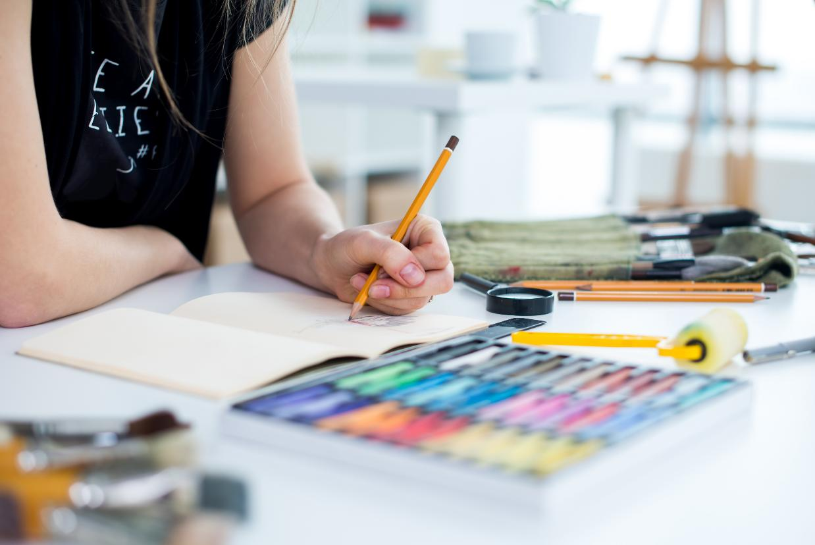

Reflect

Slide 29

This area of the drawing was the most difficult to show proportion because…
the contour lines were very detailed as this part of the face has many surface shapes.

Slide 30
This area of my work shows the most interesting proportion because...
the lines of proportion were not as I expected; they were much closer together than what I imagined they would be on a face.

Slide 31


Slide 32


Slide 33
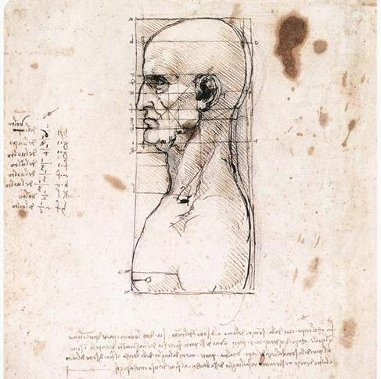

Artists use proportion to make drawings realistic. A proportion map shows the proportions.

Slide 34
In what part of your work today did you discover something new about yourself or your skills?

Slide 35
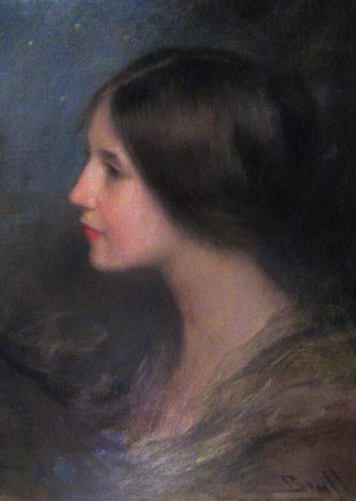
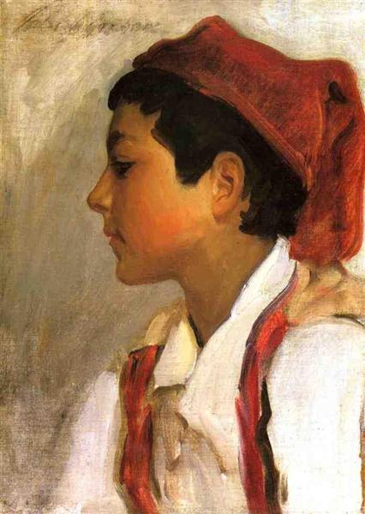
In the next lesson, we will learn how artists use proportion and positive and negative space in an artwork.

Slide 36
Slide 14 First Photo: The Last Supper by Leonardo da Vinci, from WikiArt, Public Domain, https://www.wikiart.org/en/leonardo-da-vinci/the-last-supper-1495
Slie 14 Second Photo: Study for the Last Supper by Leonardo da Vinci, from WikiArt, Public Domain, https://www.wikiart.org/en/leonardo-da-vinci/study-for-the-last-supper-1
Slide 14 Third Photo: Studies of human skull by Leonardo da Vinci, from WikiArt, Public Domain, https://www.wikiart.org/en/leonardo-da-vinci/studies-of-human-skull-1489
Slide 15 Photo: Bust of a man in profile with measurements and notes by Leonardo da Vinci, from WikiArt, Public Domain, https://www.wikiart.org/en/leonardo-da-vinci/bust-of-a-man-in-profile-with-measurements-and-notes

