Slide 1
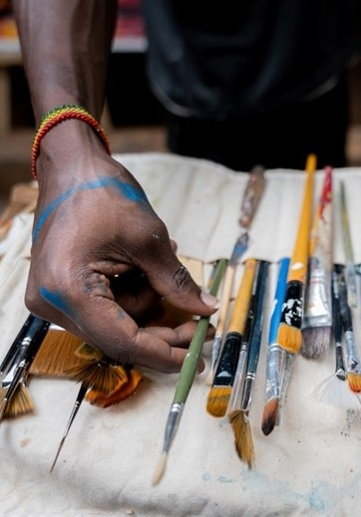
Unit 1A
Art and Identity
Lesson 2
Brushwork
Unit 1A Version 2

Slide 2

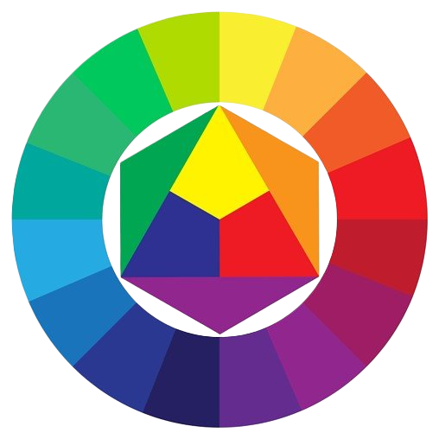
The primary colours are red, blue and yellow.

Slide 3
Secondary colours are made by mixing two primaries together, and are green, violet and orange.

Slide 4

A tertiary colour is made by mixing:
two
primaries together
one primary and one secondary together
two secondaries together

Slide 5
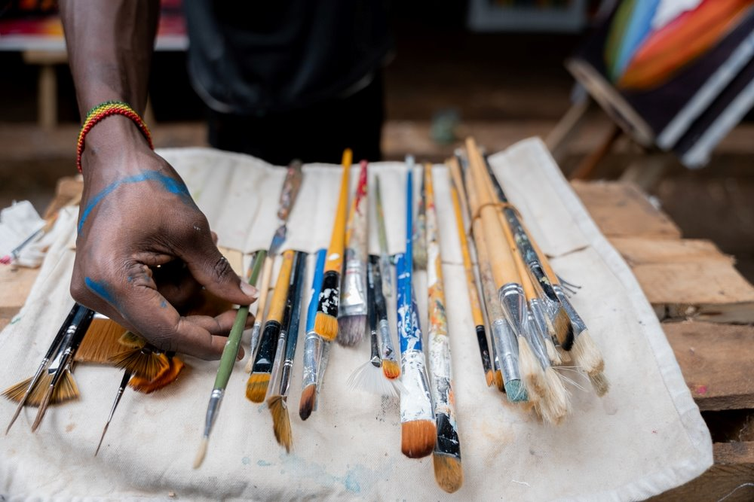
In this lesson, we will practice using our paint brushes carefully and with control.

Slide 6
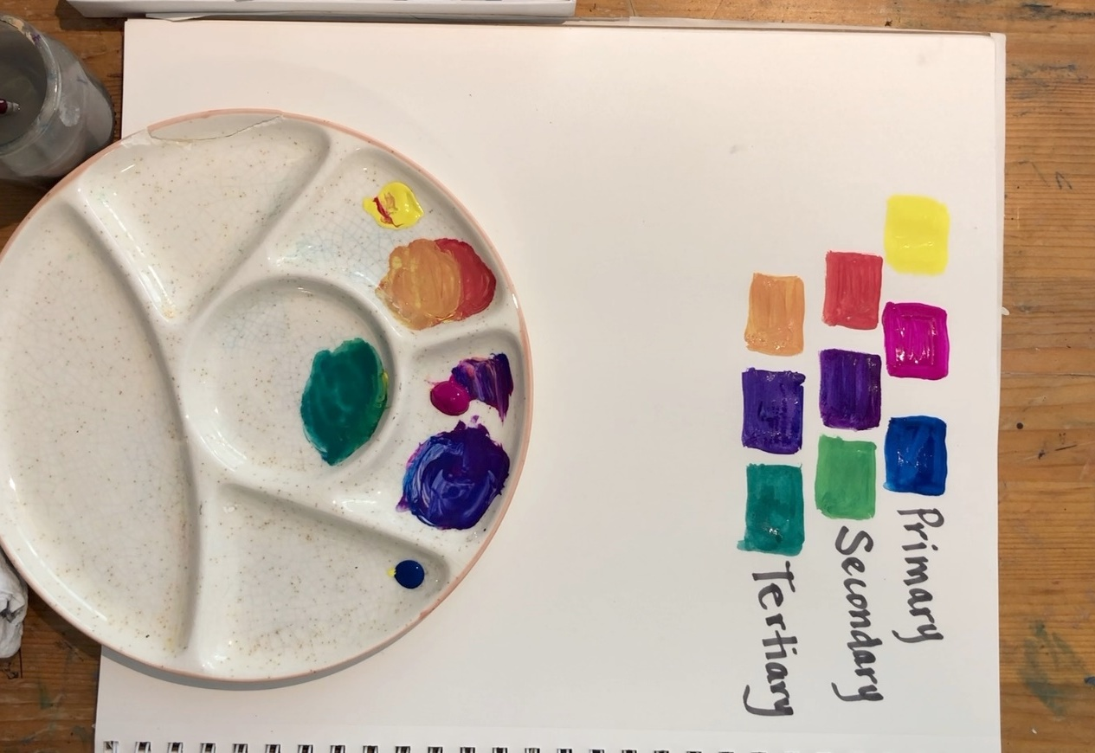
You will be successful when you can:
paint neatly by pulling the brush towards yourself
use your brush in different ways to make the effects you want.

Slide 7
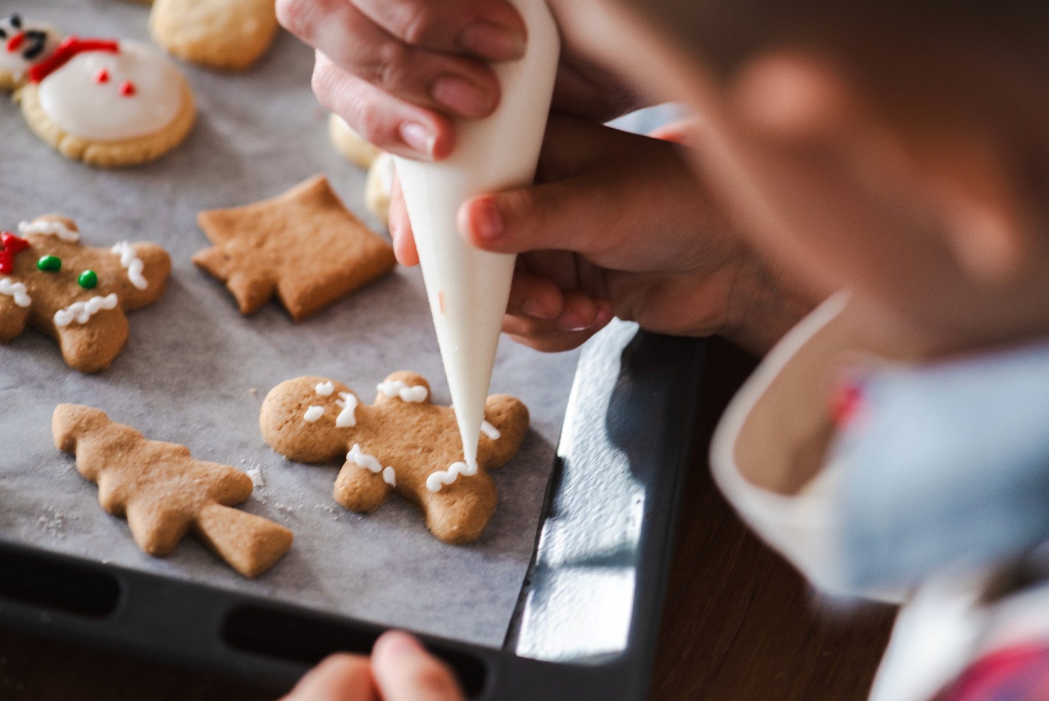
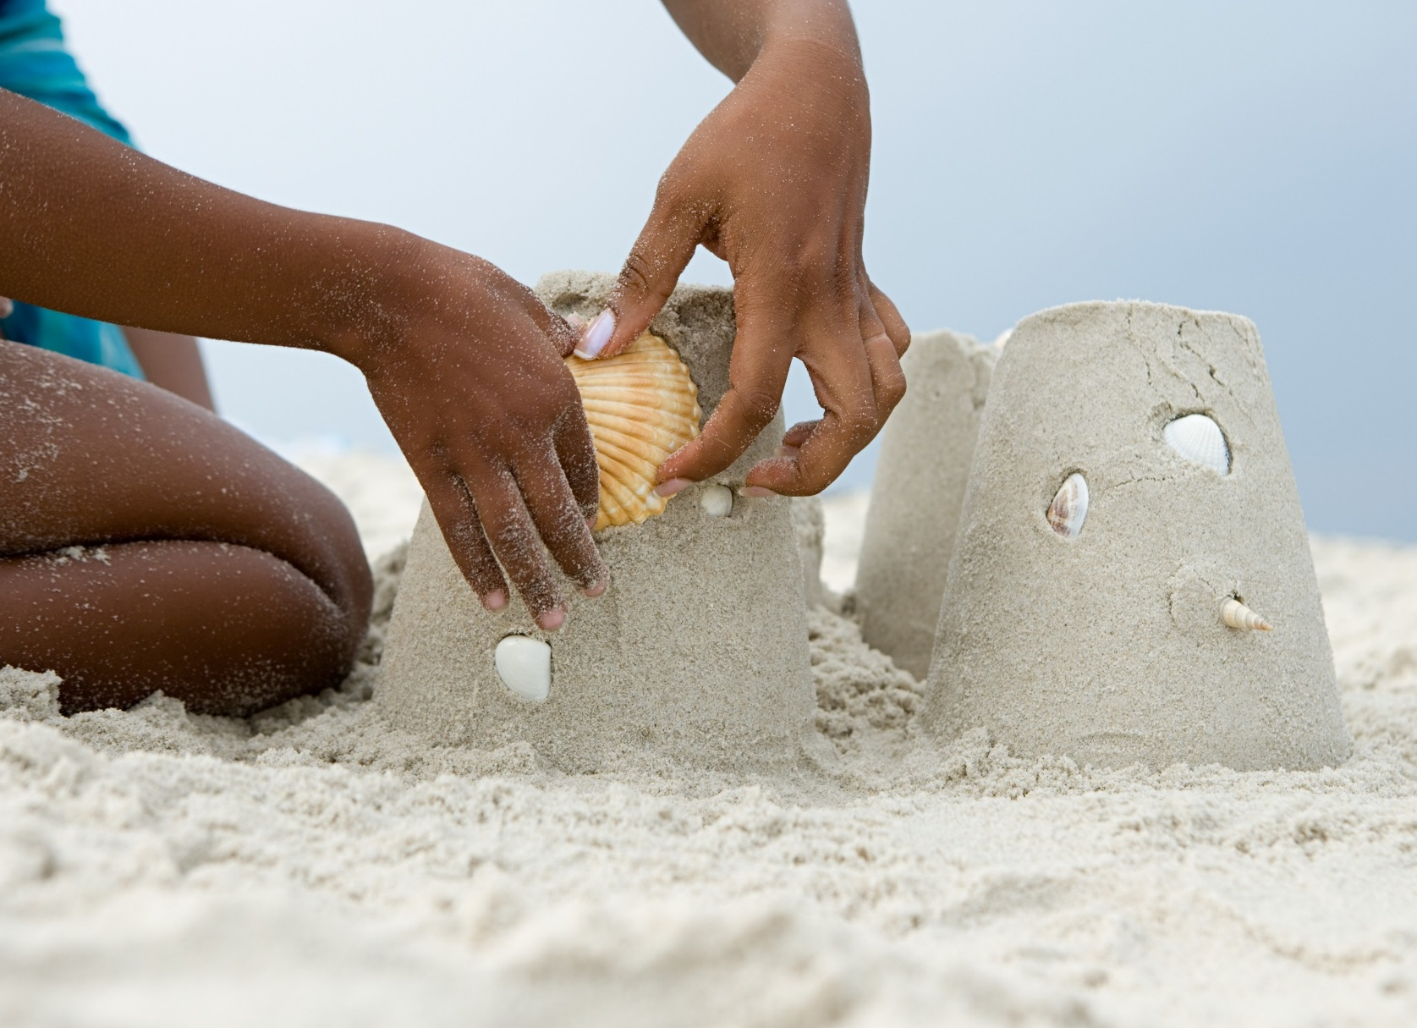
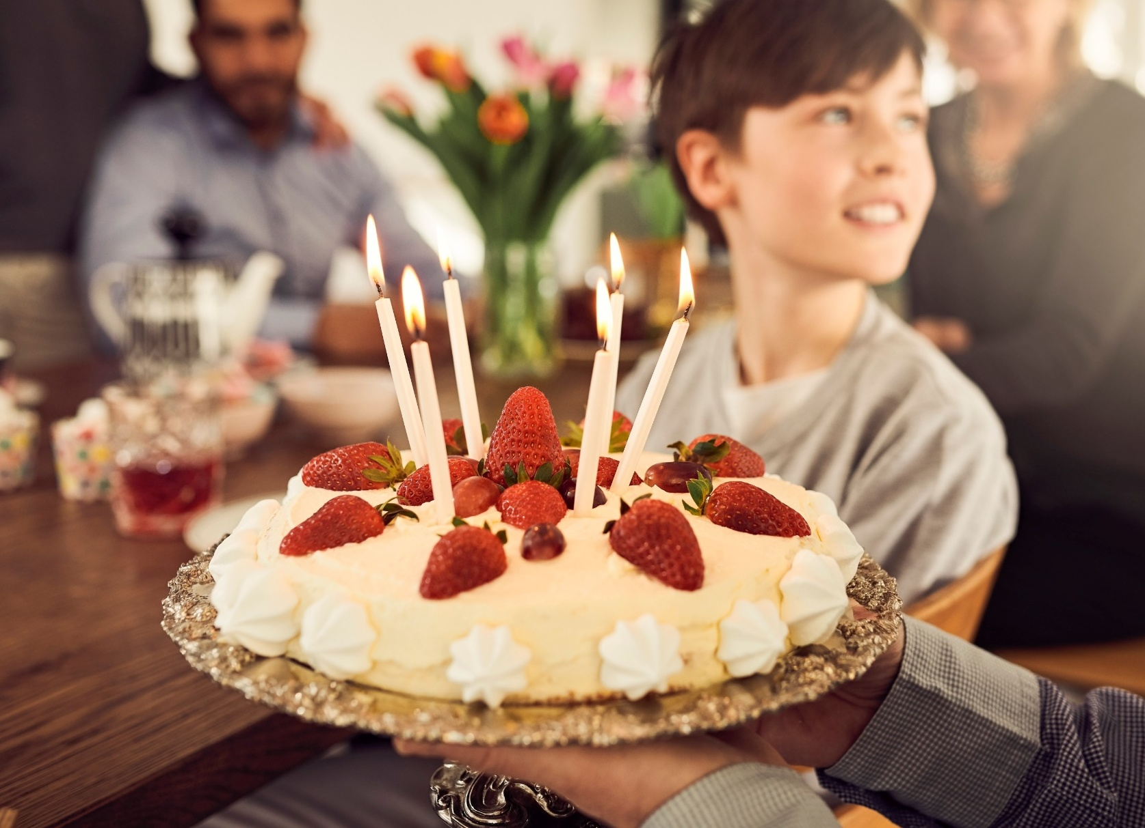

Slide 8
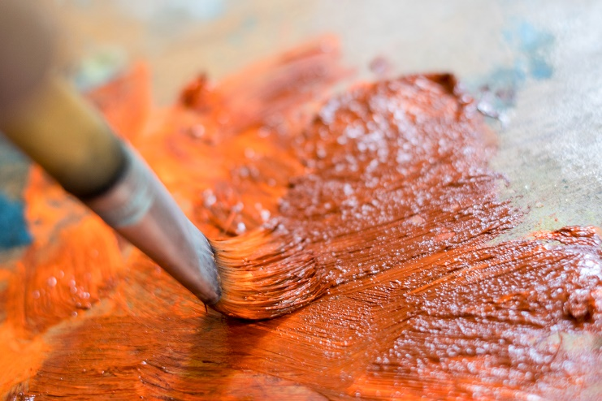
brushstrokes
The marks made by a paintbrush on a surface. They can show movement, texture and direction in a painting.

Slide 9
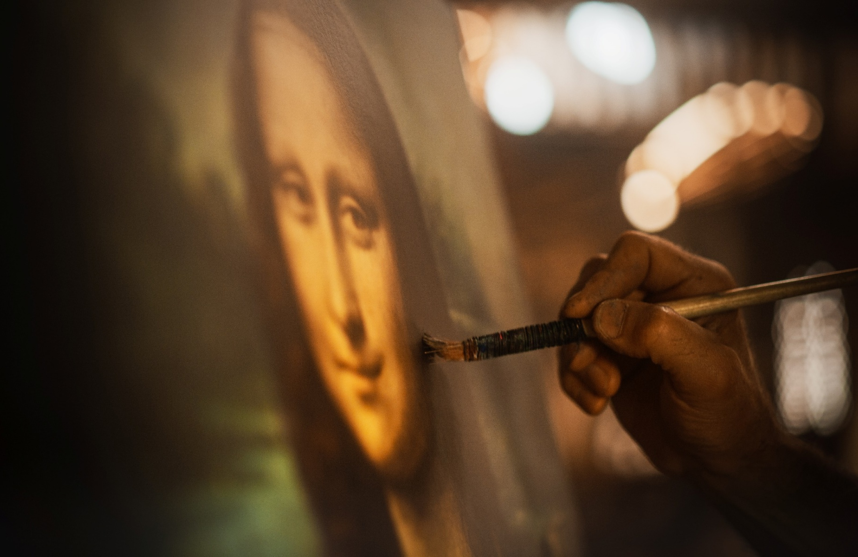
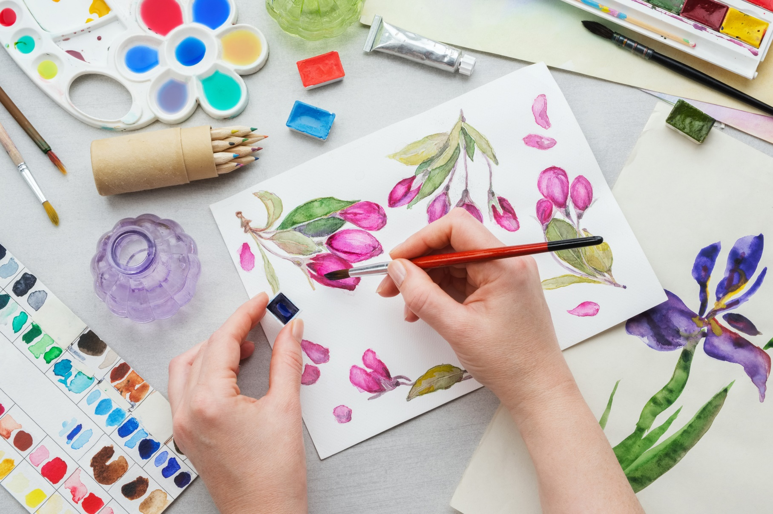
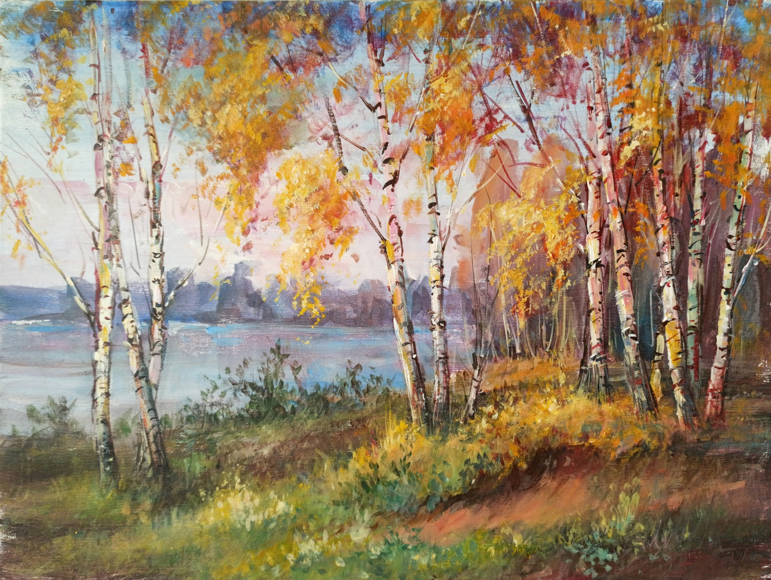
Brushwork

Slide 10
Brush control means that:
artists use only one type of brush stroke for their entire painting
artists paint as quickly as possible
the brush is used with care to create the desired effect

Slide 11
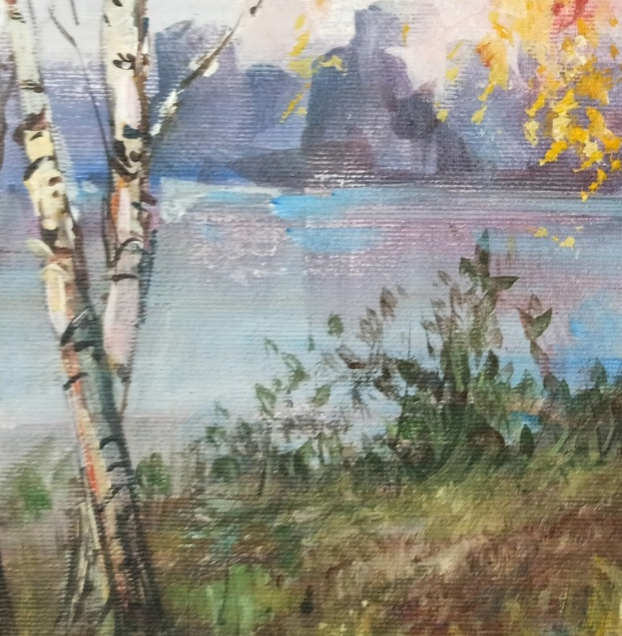
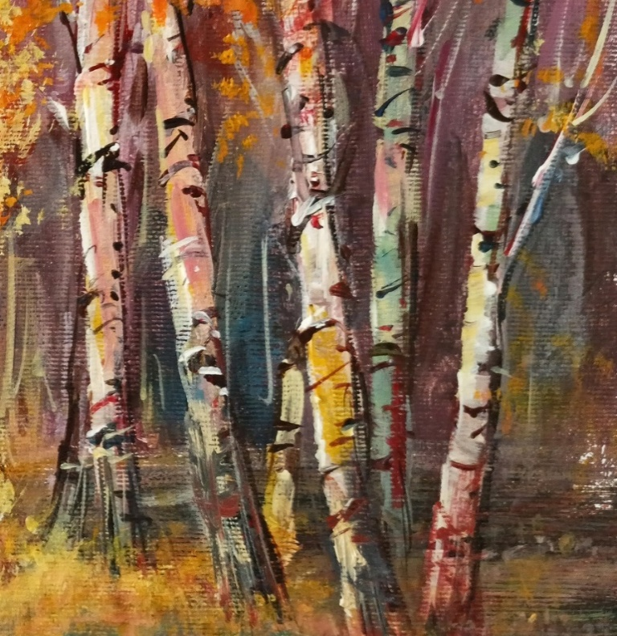
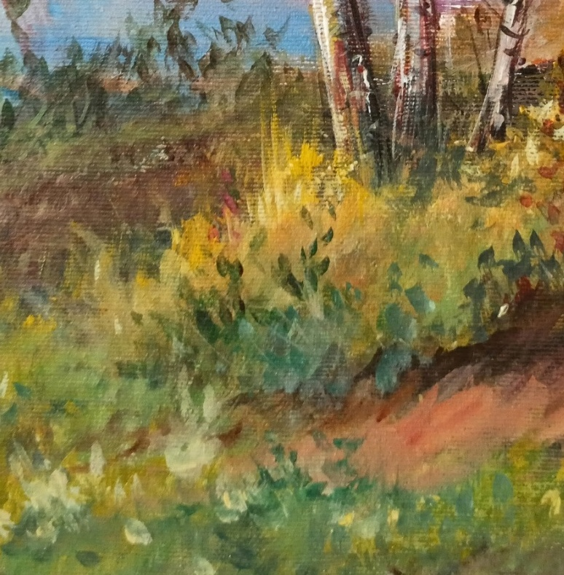
Brushwork

Slide 12

Brushwork

Slide 13
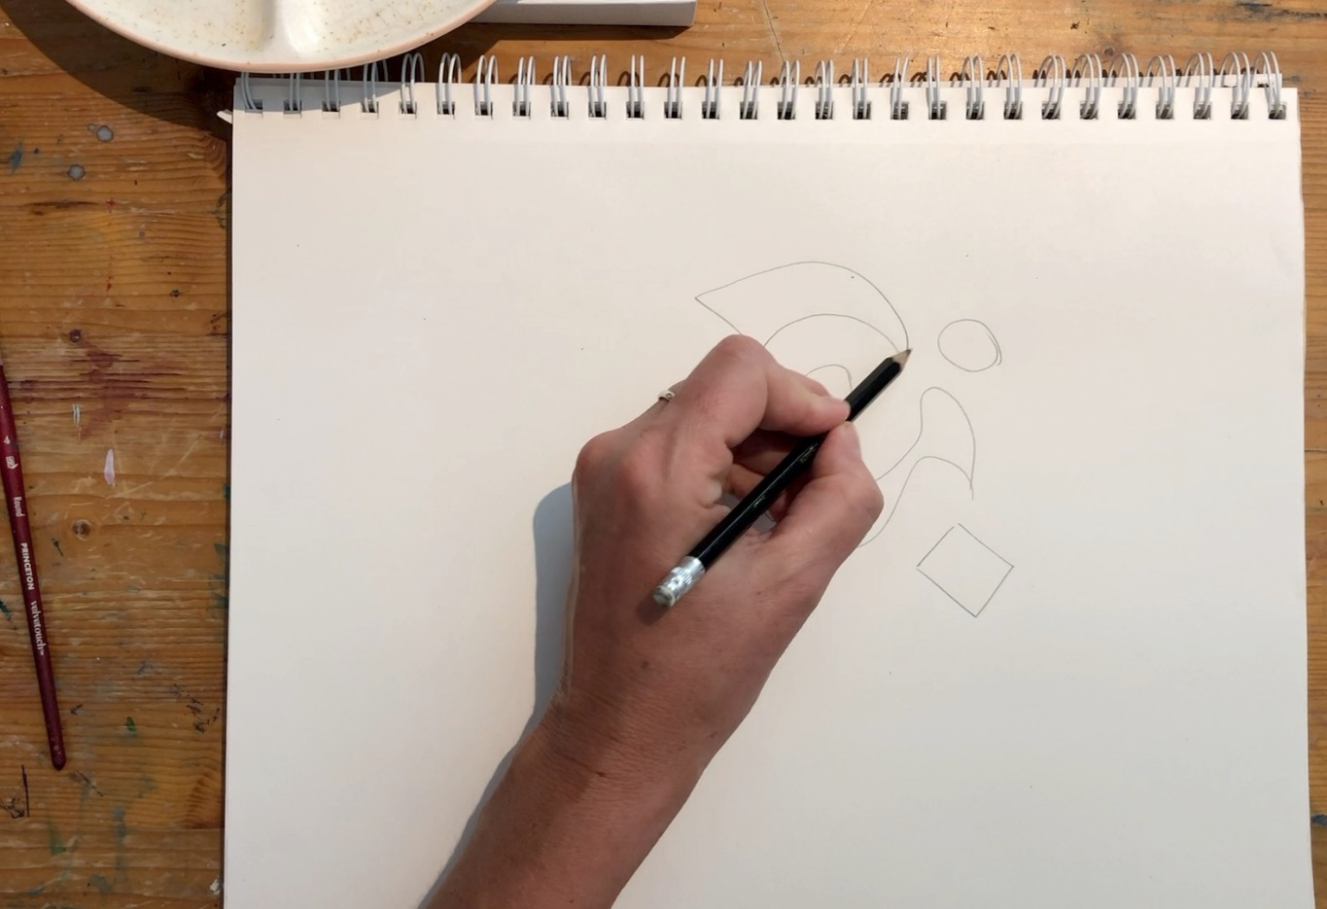
On a new page in your Process Journal, begin to draw interesting shapes on your page. These can be overlapping or stand-alone.

Slide 14
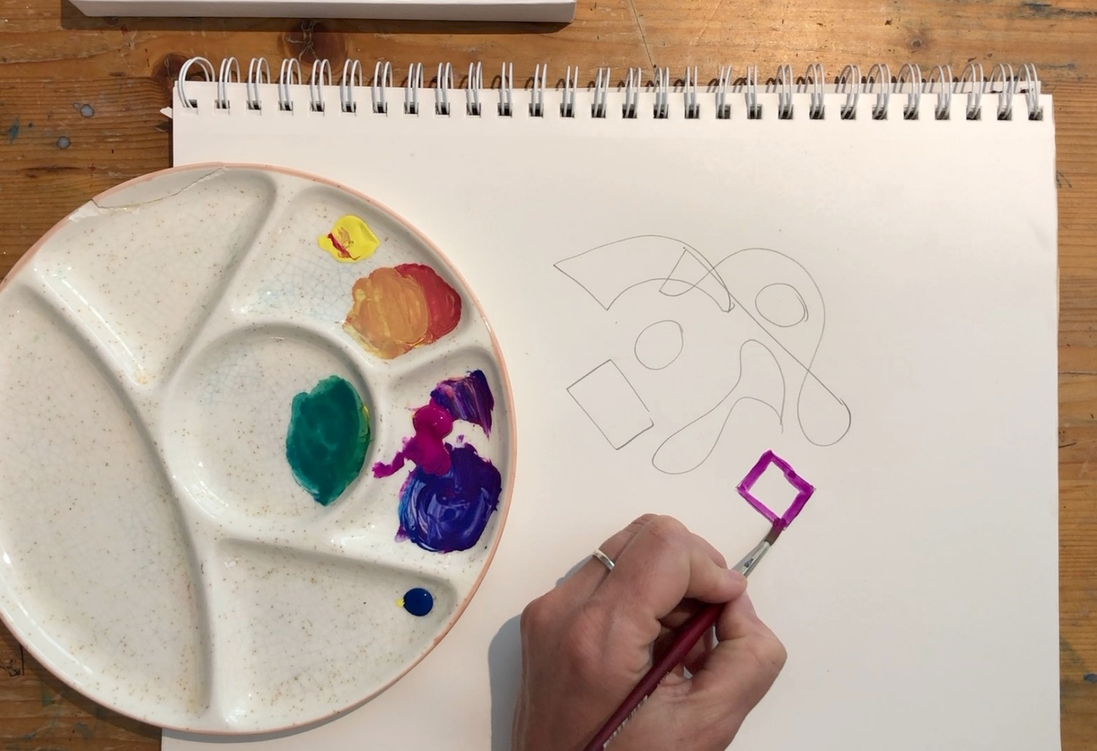
Mix 2–3 colours on your palette. Always begin painting the outline of each shape first.

Slide 15
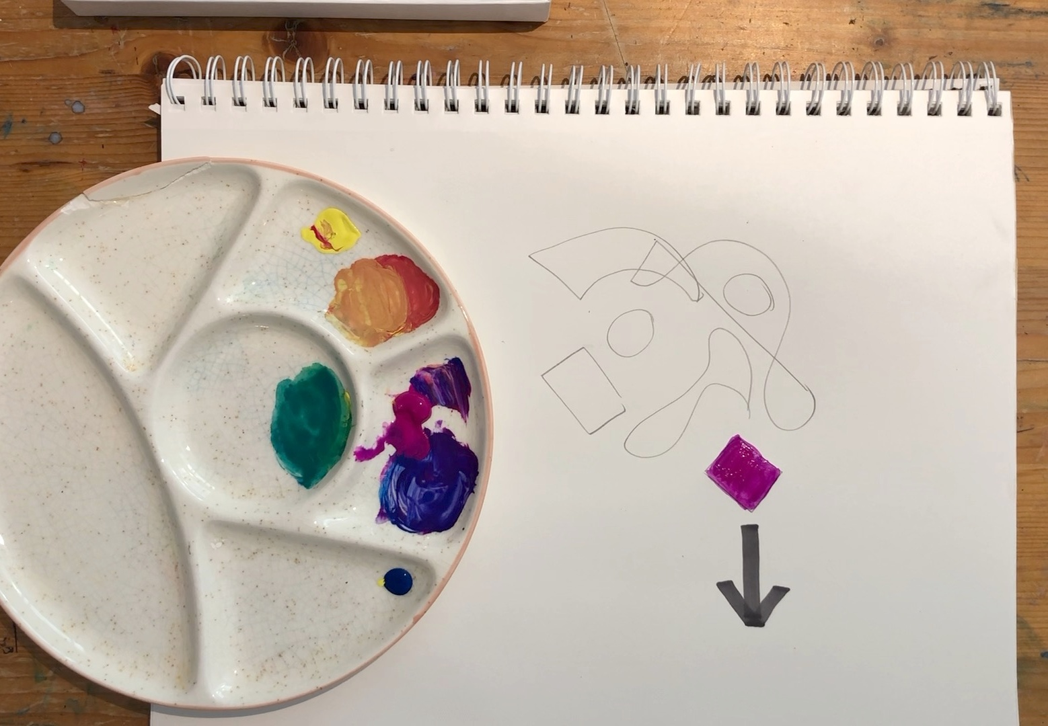
Turn your page so you are always painting towards yourself.

Slide 16
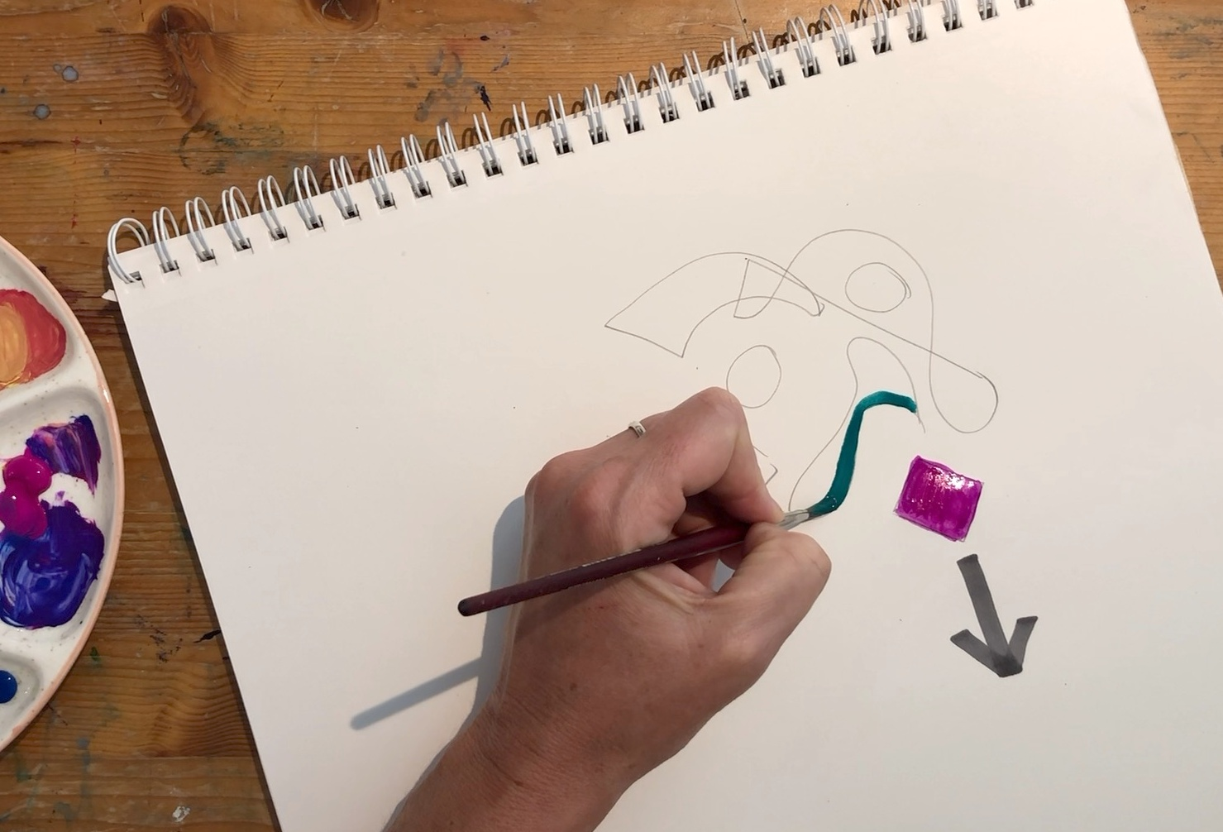
Remember to start with the outside edges of the next shape.

Slide 17
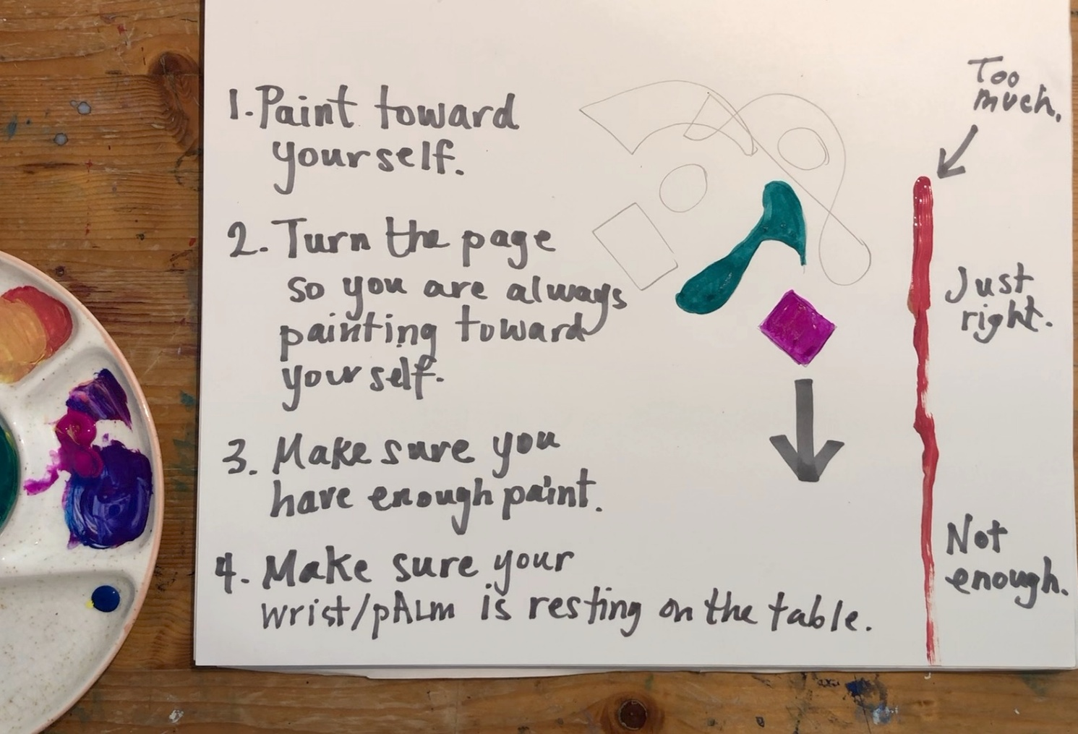
Push and roll your brush until it is loaded with enough paint. Not too much, not too little.

Slide 18
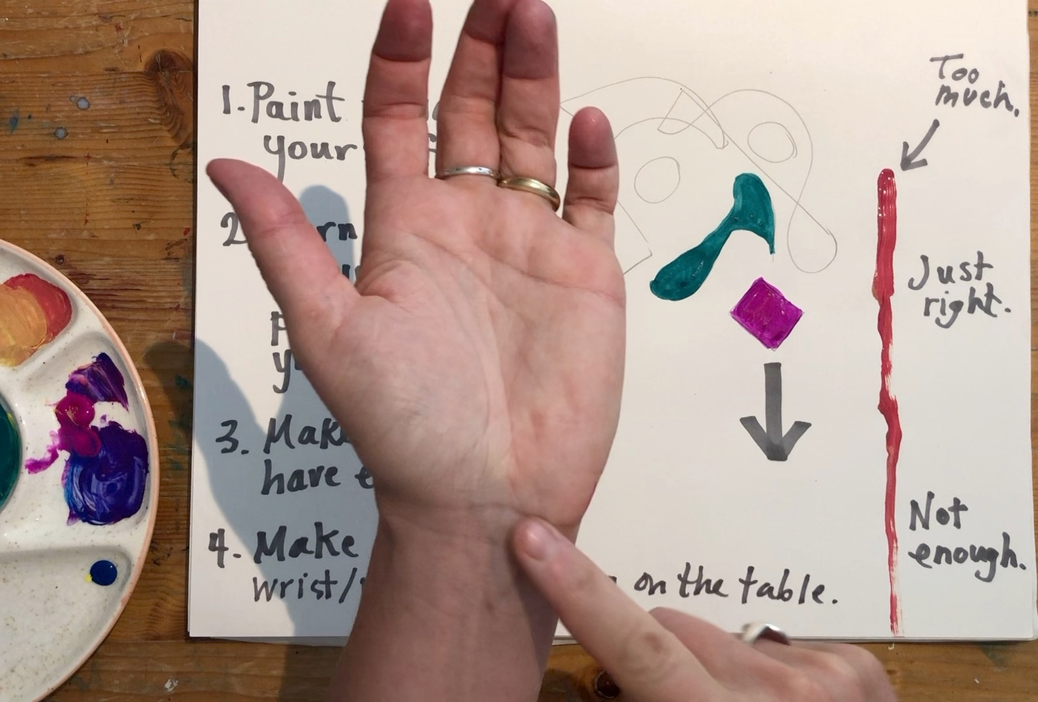
Make sure your wrist is always resting on the table.

Slide 19
I am able to use my brush well when I am:
painting towards myself
painting as fast as I can
painting the inside of shapes before the edges

Slide 20
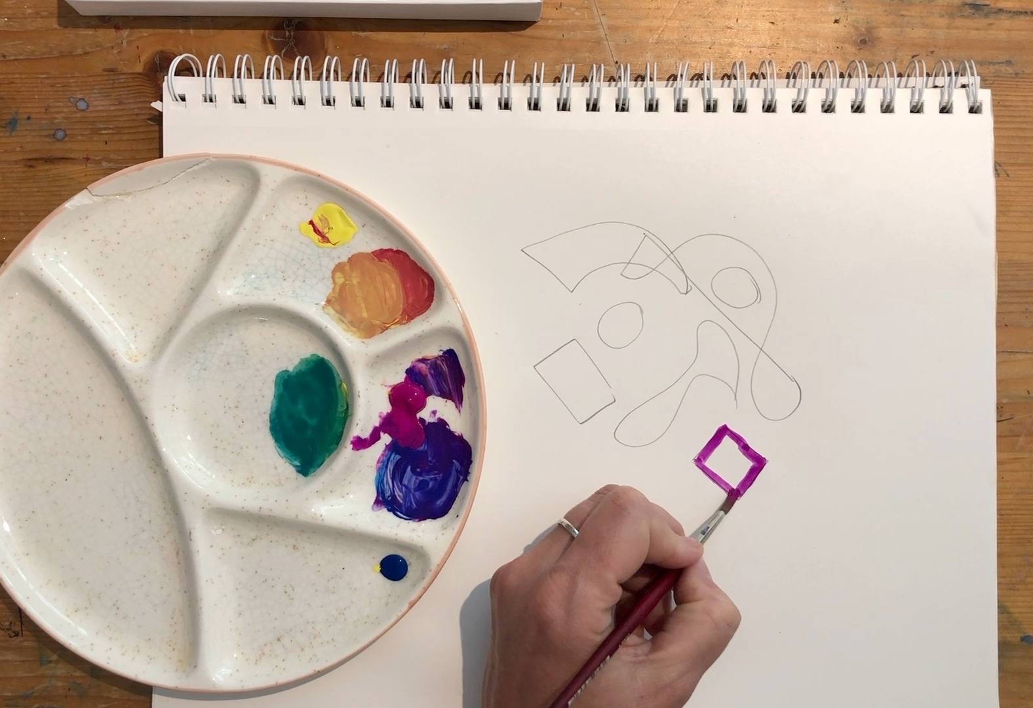
Brushwork

Slide 21
Brushstrokes: the marks made by a paintbrush on a surface. They can show movement, texture and direction in a painting.

Slide 22

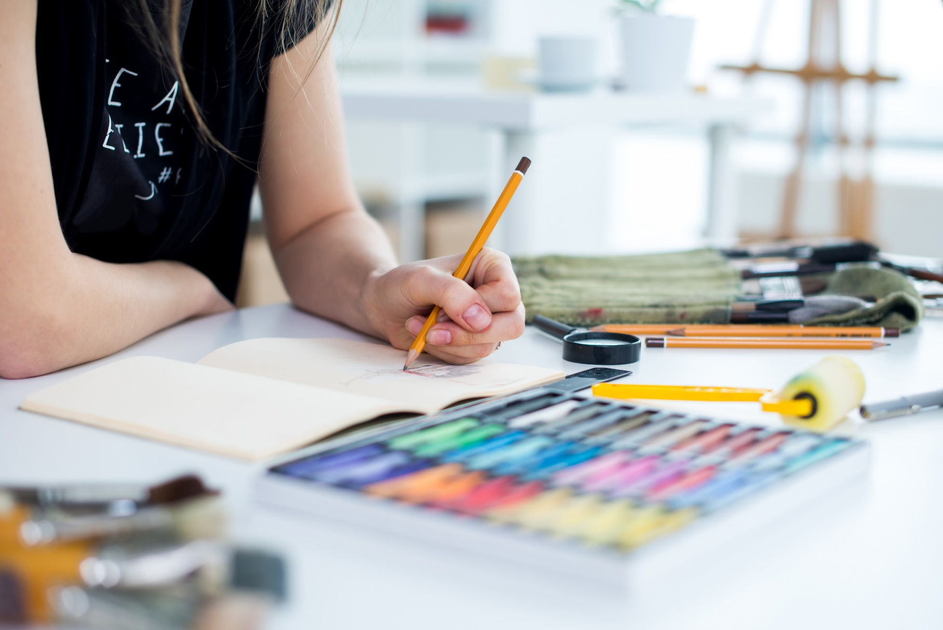

Reflect

Slide 23

This part of my work shows my neatest painting towards myself because…
I remembered to paint towards my body instead of pushing the brush away, which gave me much better control.

Slide 24
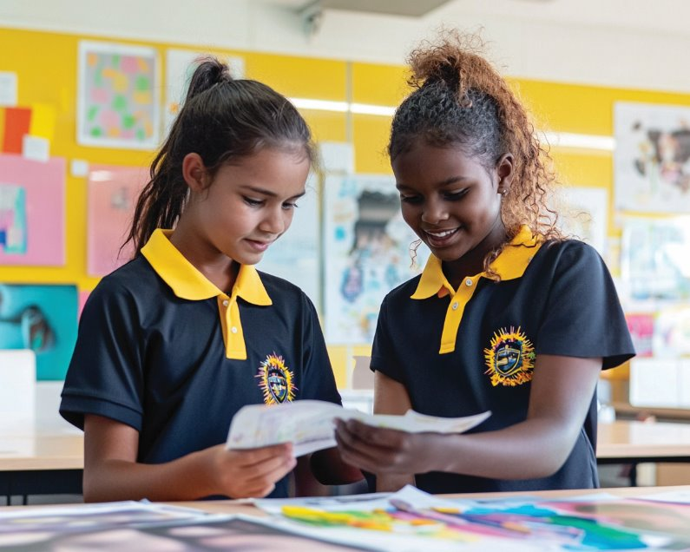

Slide 25


Slide 26
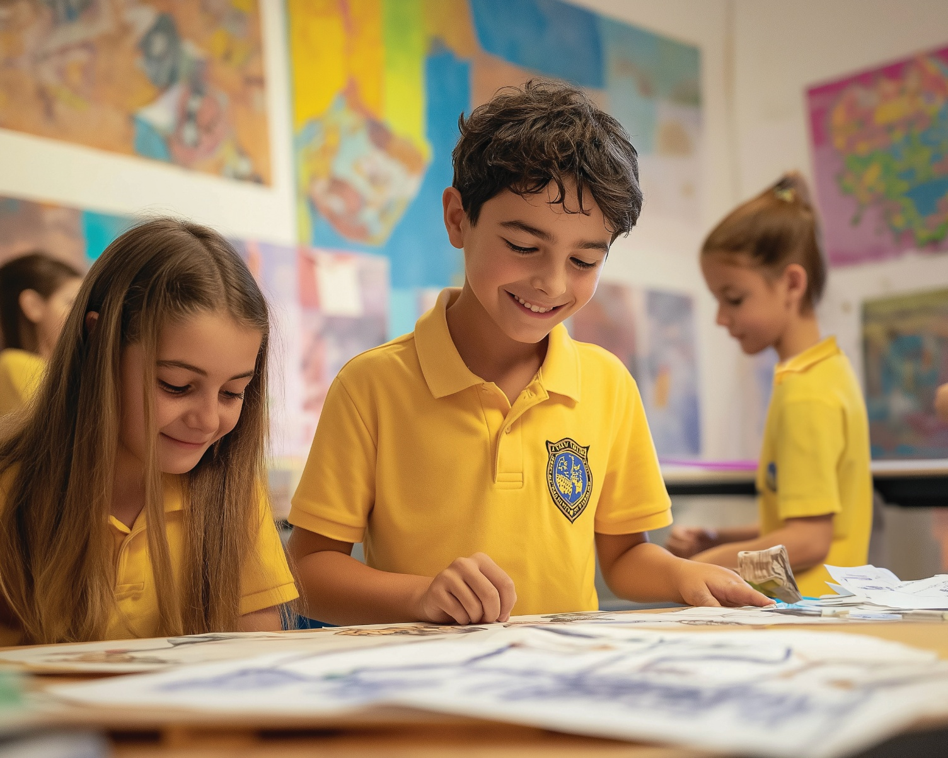

Slide 27
Artists control their brush by pulling the brush towards themselves, using the right amount of paint and painting outside edges first.

Slide 28
In what part of your work today did you discover something new about yourself or your skills?

Slide 29
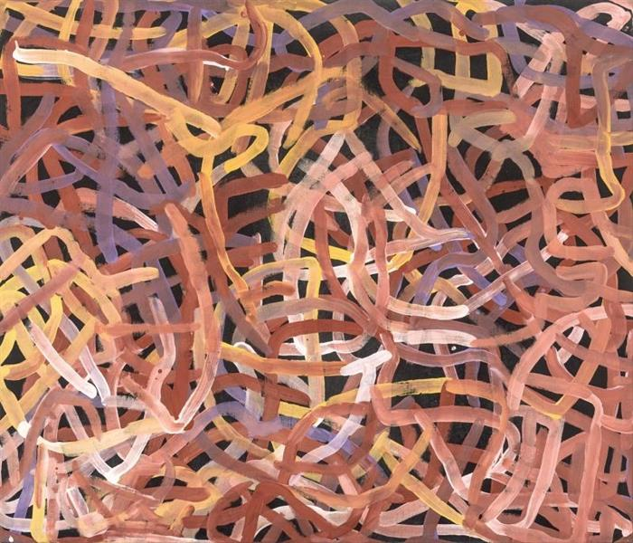
In the next lesson, we will learn at artwork and understand the meaning behind it.

Slide 30
Slide 29: Kngwarreye, E K, 1995, Yam Dreaming, synthetic polymer paint on canvas, Queensland Art Gallery | Gallery of Modern Art, viewed 14 July 2025, https://collection.qagoma.qld.gov.au/index.php/objects/4782

