Slide 1
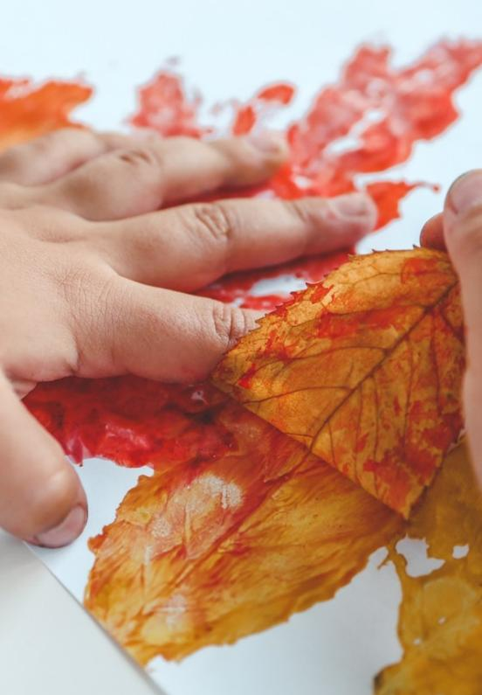
Unit 1A
Art and Nature
Lesson 2
Nature’s Lines and Textures
Unit 1A Version 1
Notes:
Teacher Preparation:
Read through the Teaching Guide.
Click through the PowerPoint slides.
Ensure students have their Student Workbook and Process Journal.
Additional materials needed for each student: collection of leaves, pencils, erasers, sharpeners, coloured pencils or crayons (red, orange, yellow, blue, green and purple)
Before the lesson, prepare the materials. Set up a resource station for distribution and place collected leaves in a tray or box at the station. Sort crayons into separate colours for students to easily access.

Slide 2
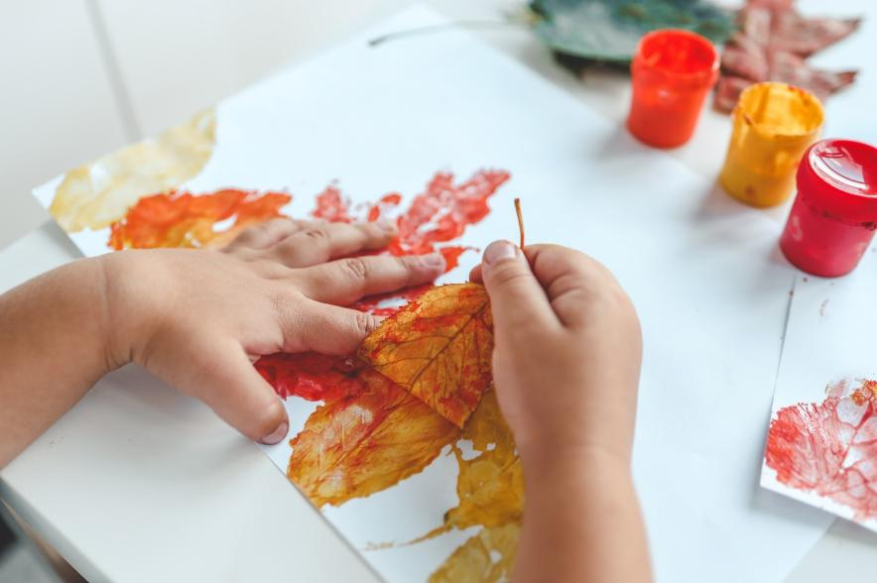
Natural objects can be used to make art.
Notes:
Natural objects can be used to make art.

Slide 3
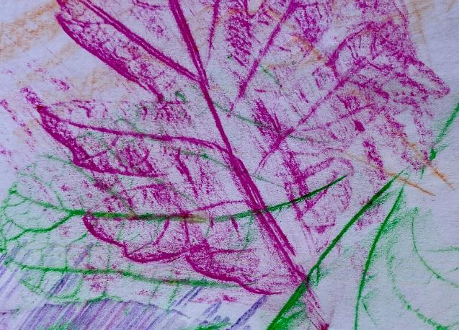
We can notice the different shapes and textures that transfer from the leaf in a leaf rubbing.
Notes:
We can notice the different shapes and textures that transfer from the leaf in a leaf rubbing.

Slide 4
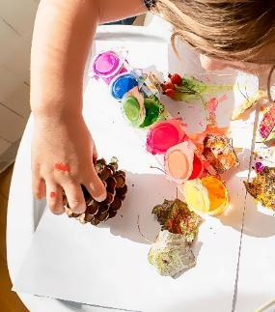
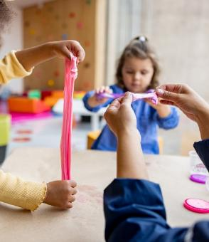
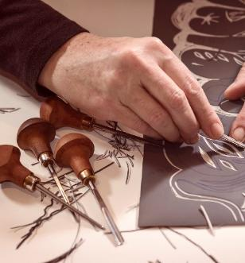
Which picture shows using things from nature to make art:
Notes:
Which picture shows using things from nature to make art:
Hold up one finger if you think the answer is number one.
Hold two fingers up if you think the answer is number two.
Hold up three fingers if you think the answer is number three.
Pause and give time for students to respond.
Click. The answer is number one: The child is using pinecones and leaves to make art.

Slide 5
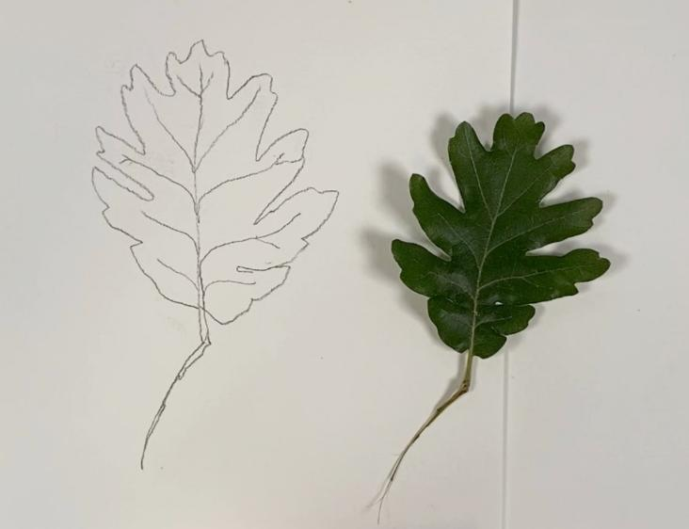
In this lesson, we will learn how to draw objects that we see in nature.
Notes:
In this lesson, we will learn how to draw objects that we see in nature.

Slide 6
You will be successful when you can:
look closely at natural objects
use shapes and lines to create textures.
Notes:
You will be successful when you can:
look closely at natural objects
use shapes and lines to create textures.

Slide 7
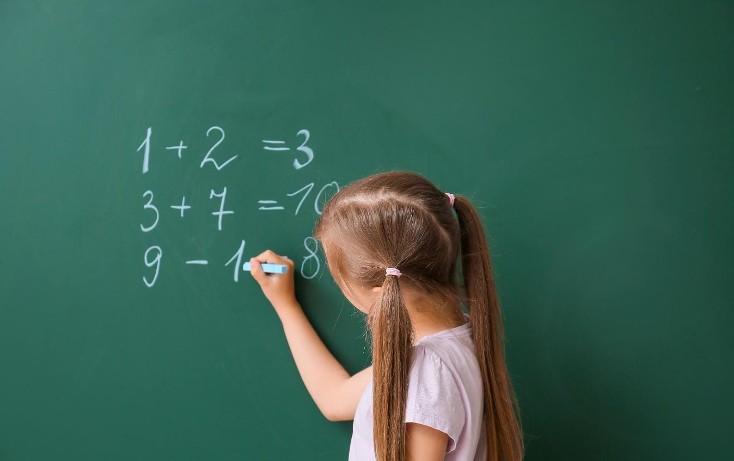
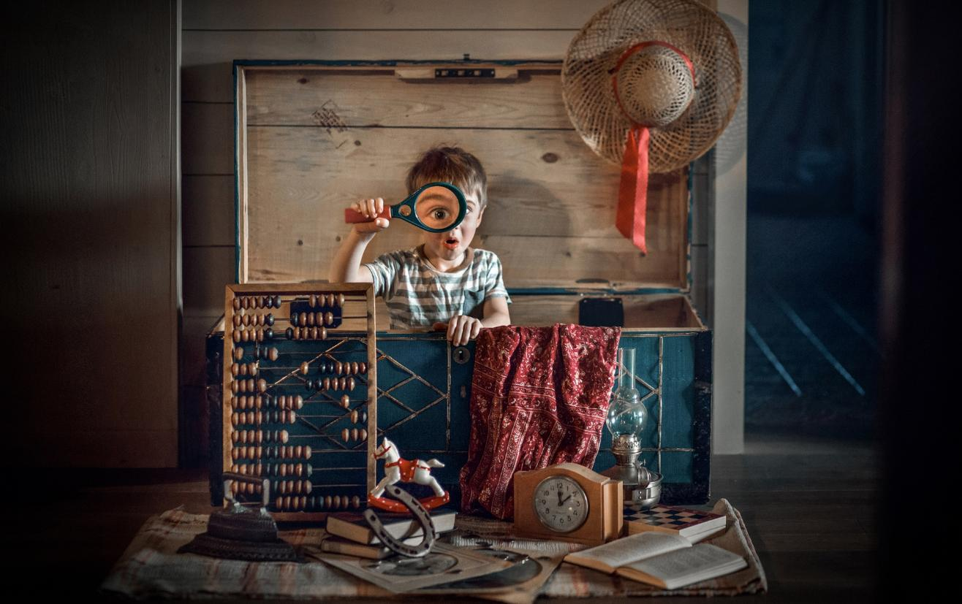
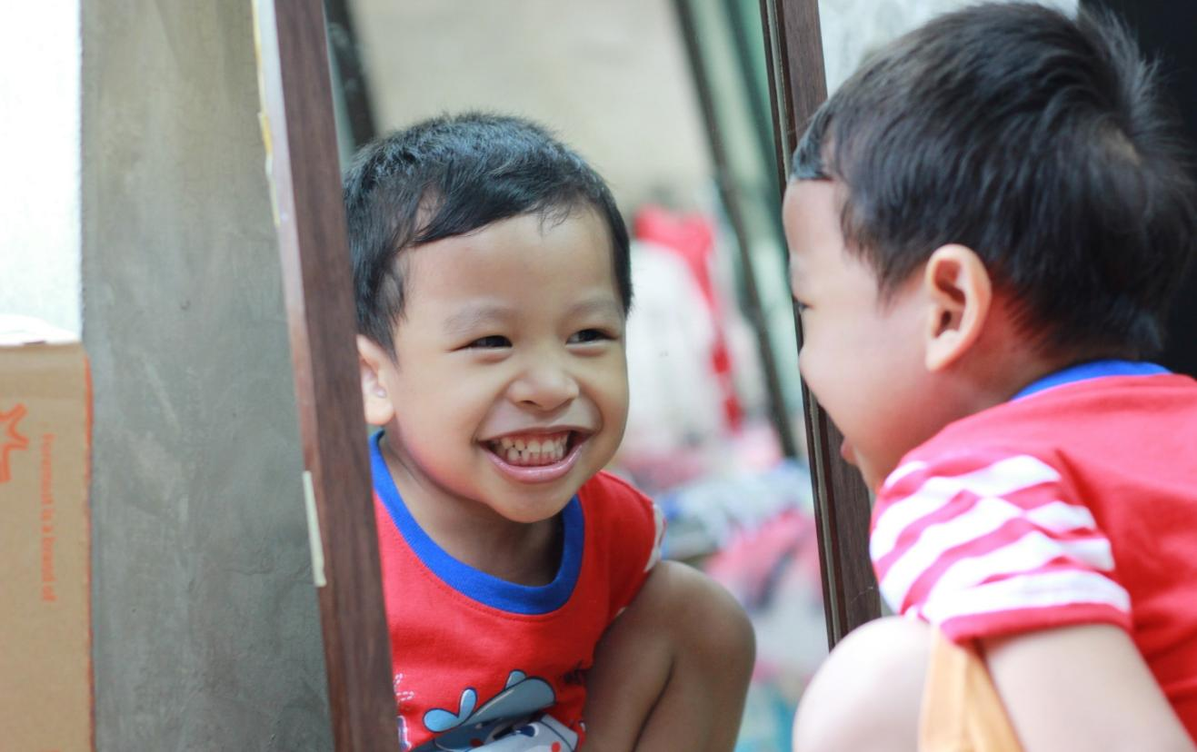
Notes:
Think about a time when you looked closely at something. You might have looked closely at your face in the mirror.
Click. You might have looked closely to find your favourite toy.
Click. You might have looked closely at a maths question. When you looked closely, you saw more detail or noticed something else.
In this lesson we will be learning to look closely to draw objects found in nature.

Slide 8
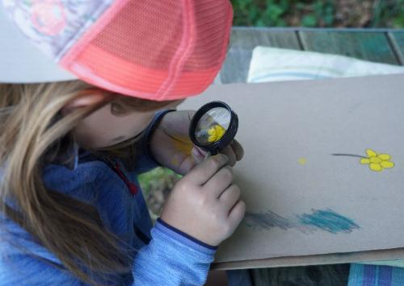
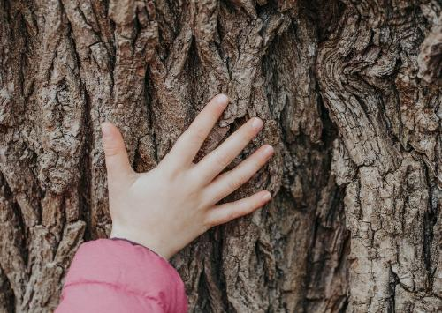
observational drawing
Looking at something carefully and drawing what you see.
texture
How something feels, like rough, bumpy or smooth.
Notes:
Learning words in art is important because it helps us to talk about our artwork and our artmaking. In this unit, you might see new words. We will learn these words together so that you can understand and use them yourself. This will help you become a better artist!
Turn to the Vocabulary List in the back of your workbook.
Find the word observational drawing. Repeat after me: observational drawing.
Click. Read the definition: looking at something carefully and drawing what you see.
Click. Point to the image on the slide. This child is looking closely at a flower to draw it as it looks. Repeat after me: observational drawings are when we look at something carefully and draw what we see.
Click. Find the word texture. Repeat after me: texture.
Click. Read the definition: how something feels, like rough, bumpy or smooth.
Click. Point to the image on the slide. This child is touching the bark of a tree. The texture is bumpy and rough. Repeat after me: texture is how something feels, like rough, bumpy or smooth.

Slide 9
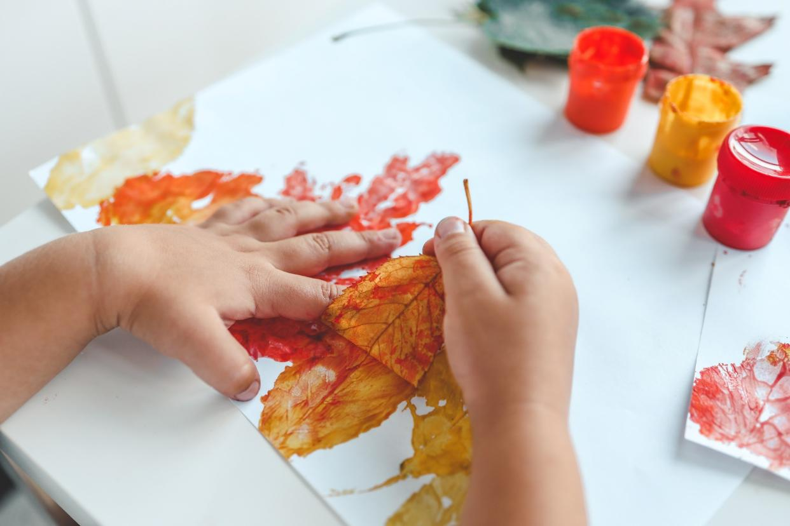
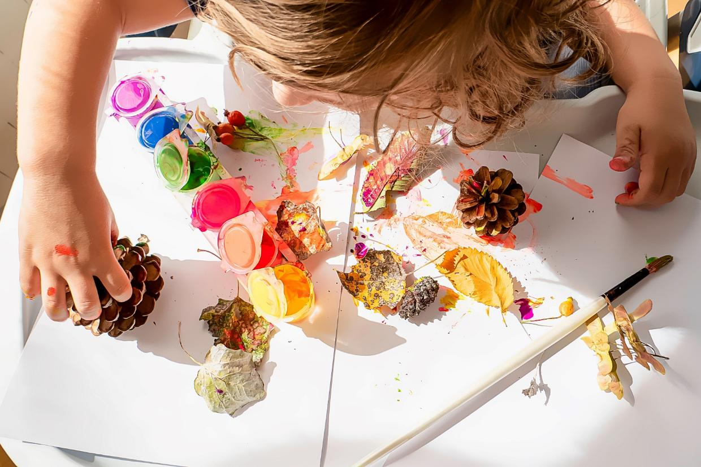
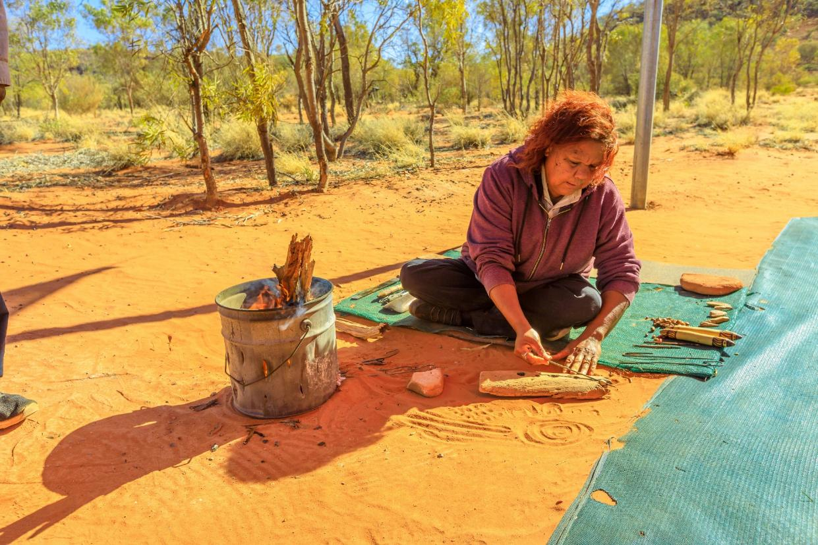
Review
Notes:
You will remember: Artists use natural objects like leaves, sticks and feathers to make beautiful artwork.
They use these natural objects to make different marks on the page with paint. Here the artist is painting with the pinecones to make interesting marks.
Click. They use natural materials to make the artwork, like this sandpainting where the artists have used different colours of sand to make beautiful designs.
Click. They use natural objects to make prints and transfer the textures, lines and shapes onto the page. Like this leaf being printed using ink.
Natural objects have different lines, shapes and textures and can be used in different ways to make artwork.

Slide 10
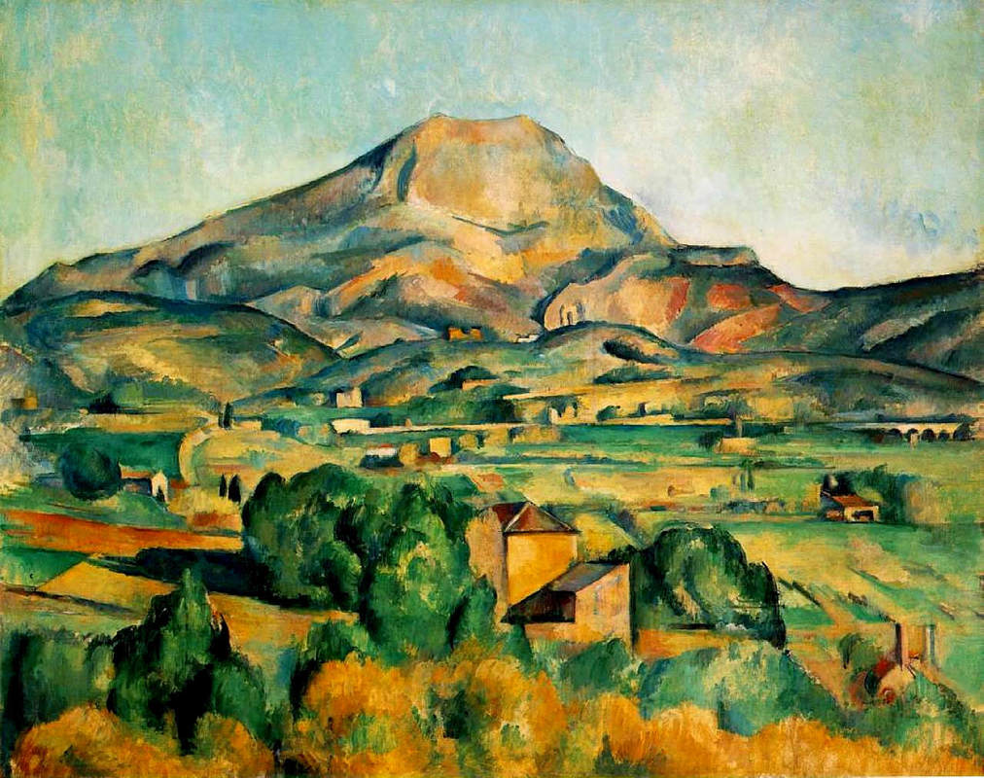
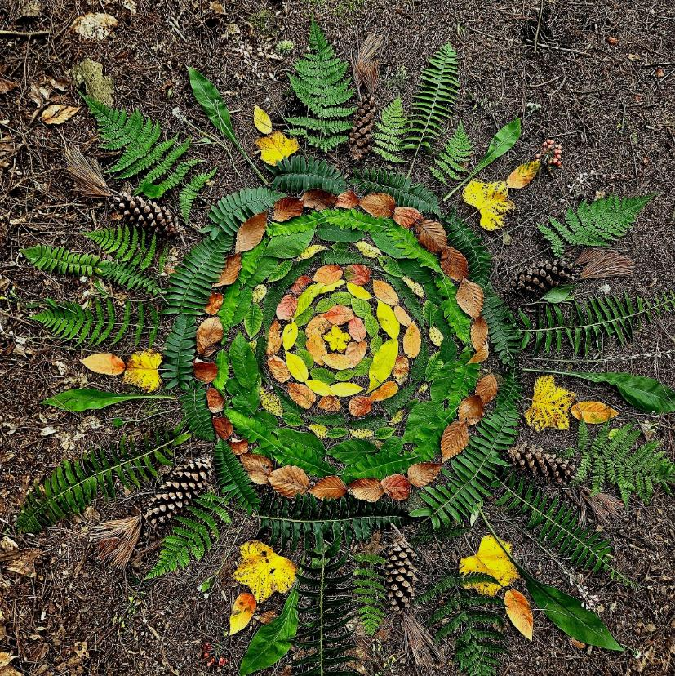
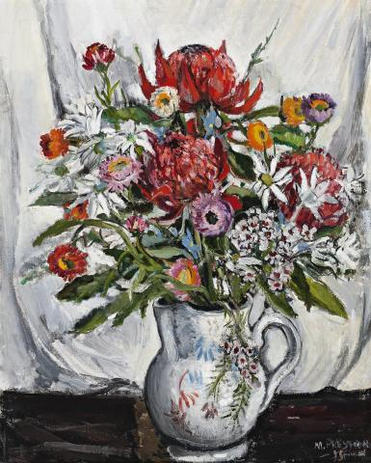
Artists Draw Things in Nature
Notes:
Artists like to draw different things that they see or know. Artists draw objects that they see in nature by looking closely.
Artists draw landscape pictures of nature, like this landscape painting by Albert Namatjira.
Click. Artists draw flowers, like this painting of a jug of flowers by Margaret Preston.
Click. Artists use natural objects in their artwork. Like this piece made with leaves by Andy Goldsworthy.

Slide 11
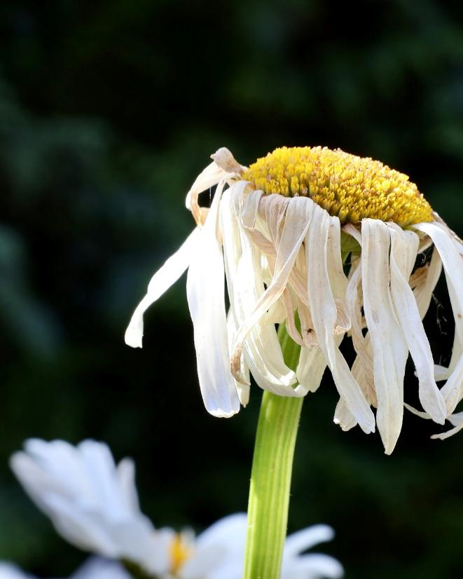
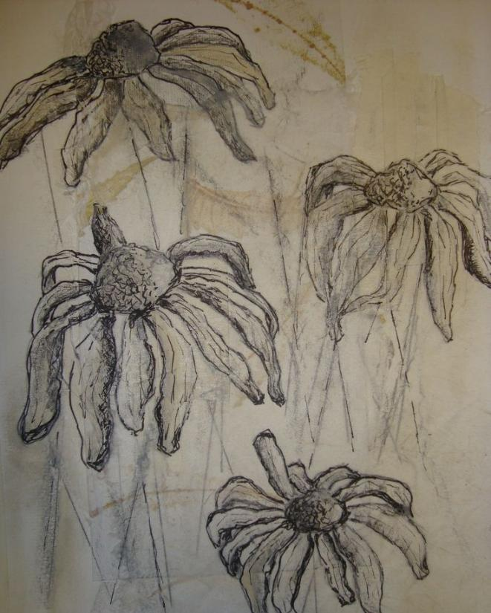
Artists Draw Things in Nature
Notes:
Observational drawings are made when the artist looks closely at what they are drawing to draw what they see. Observe is looking closely with our eyes to see the details. I can observe the details of this flower. I can create an observational drawing using what I can see.
Click. I will notice the shapes in the flower and the shapes in the drawing.
Click. I will notice the lines in the flower and the lines in the drawing.
Click. I will notice the lines that show the texture of the petals, and the lines that show texture in the drawing.

Slide 12
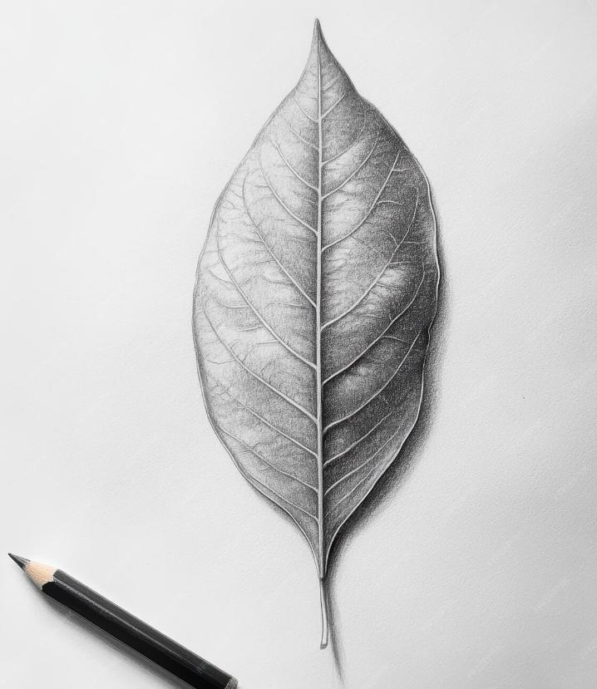
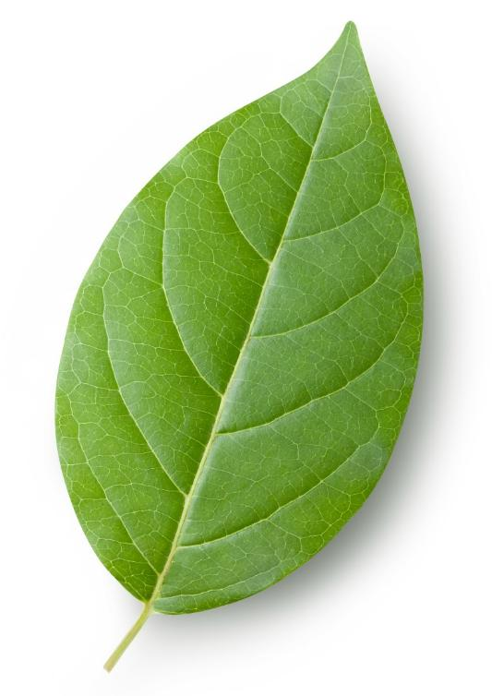
Artists Draw Things in Nature
Notes:
Open your Student Workbook to Lesson 2.
We can see the image of the green leaf, and the drawing of a leaf beside it. ​
We will notice the shapes in the leaf and the shapes in the drawing.
We will notice the lines in the leaf and the lines in the drawing.
We will notice the lines that show the texture of the leaf, and the lines that show texture in the drawing.
Think, what shapes and lines can we see that is the same in the image of the green leaf and the drawing? Circle these in your workbook.
Pair/Share.
Click. We notice the shape of the leaf. ​
Click. We notice the lines in the leaf and the lines in the drawing. ​
Click. We notice the lines that show the texture of the leaf, and the lines that show texture in the drawing.​

Slide 13



Show of Fingers
We make an observational drawing by…
looking closely
painting
guessing
Notes:
We make an observational drawing by...
1. looking closely
2. painting
3. guessing.
Hold up one finger if you think the answer is number one.
Hold two fingers up if you think the answer is number two.
Hold up three fingers if you think the answer is number three.
Pause and give time for students to respond.
Click. The answer is number one: We make an observational drawing by looking closely.

Slide 14
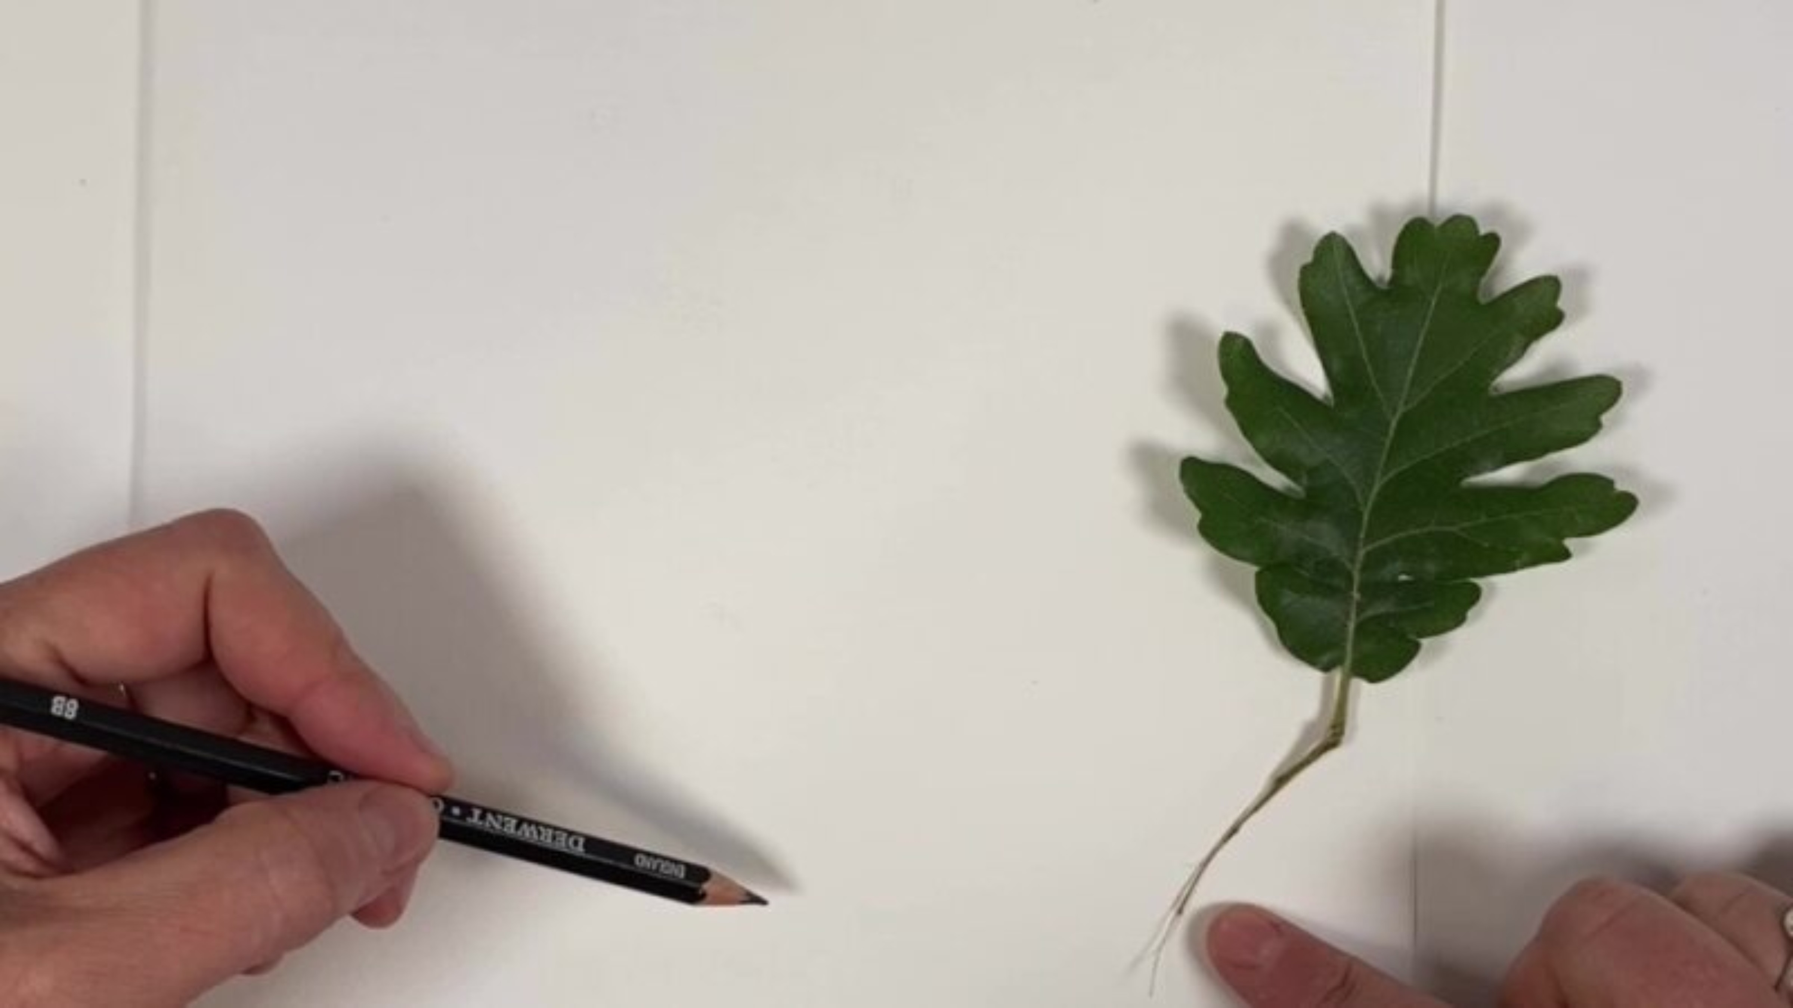
Nature Drawing
Notes:
I know that artists like to draw things they see in nature. I also know that I can choose the shapes and lines I use to show the natural object that I want to draw. I will play a video to show you how to look closely and draw a natural object. After the video, you will choose a natural object to draw.
Play video.

Slide 15
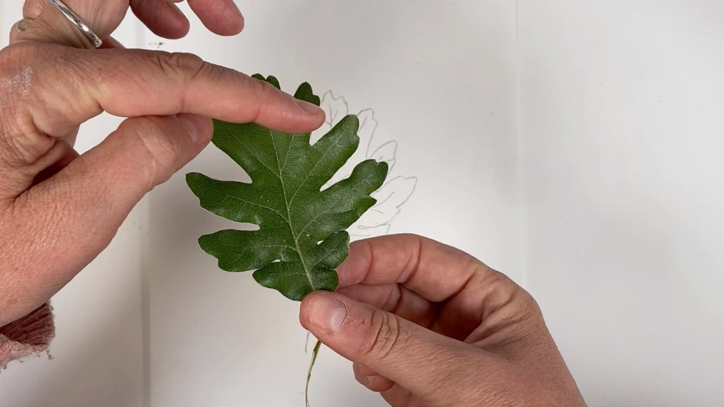
Nature Drawing
Notes:
Hold up a leaf.
I will look at my leaf. I will point to the stems and notice what they look like. I will point to the edges of our leaves and notice what they look like. I will think about the shapes and lines that I will use in my drawing.
We will look at our leaves with our partner. We will point to the stems and notice what they look like. We will point to the edges of our leaves and notice what they look like.

Slide 16
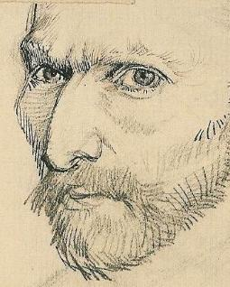
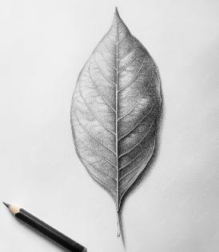
Nature Drawing
Which is an observational drawing of a leaf?
Notes:
Which is an observational drawing of a leaf?
Hold up one finger if you think the answer is number one.
Hold two fingers up if you think the answer is number two.
Pause and give time for students to respond.
Click. The answer is number two: it is a drawing of a leaf made by looking very closely at the leaf. The image in number one, you will remember, is called a self-portrait.

Slide 17

Nature Drawing
Notes:
You will open your Process Journal to the next blank page.
You will look at the shapes and lines that make up your leaf. You will begin drawing your leaf slowly, in your process journal.
Pause for students to complete the task. Once they have drawn their leaf, instruct them to glue their leaf next to the drawing.

Slide 18
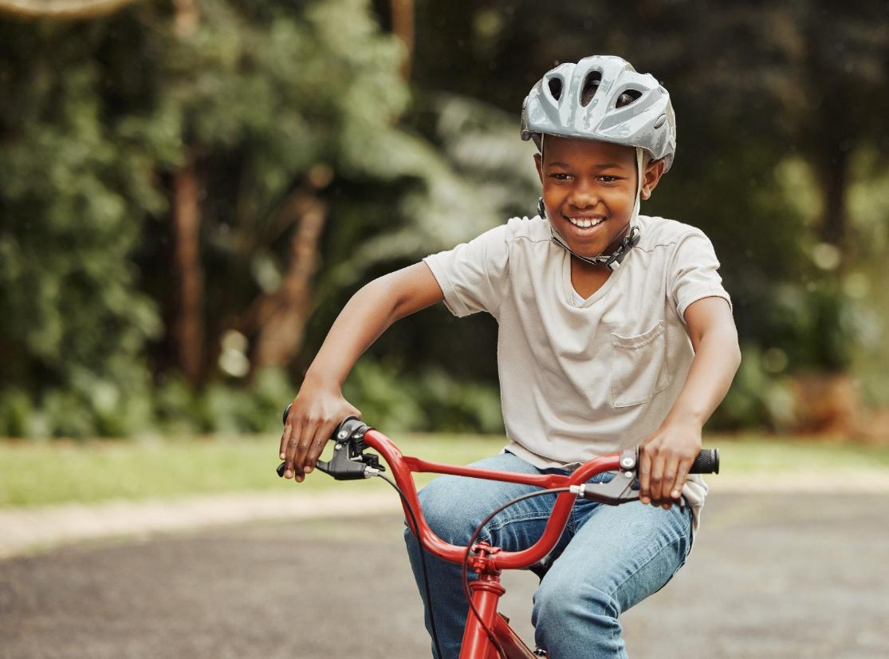
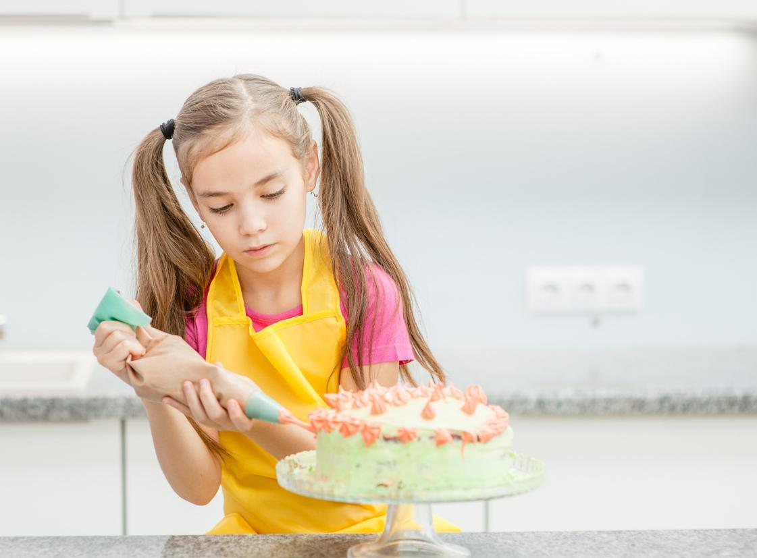
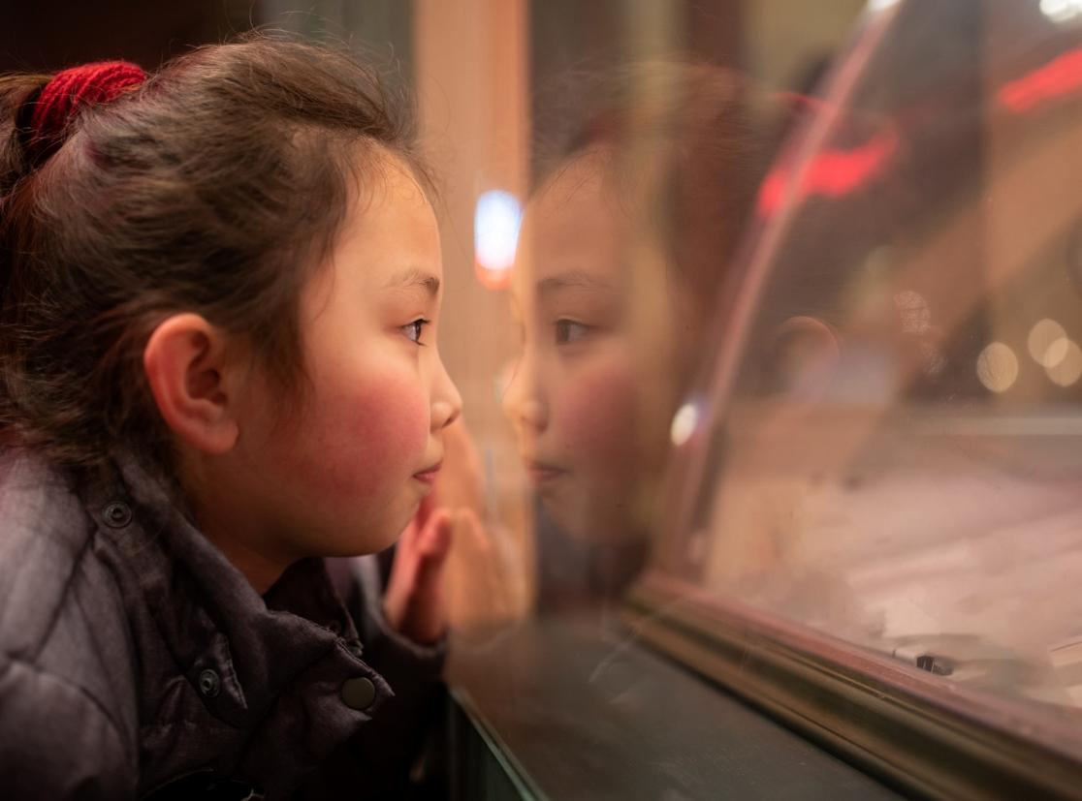
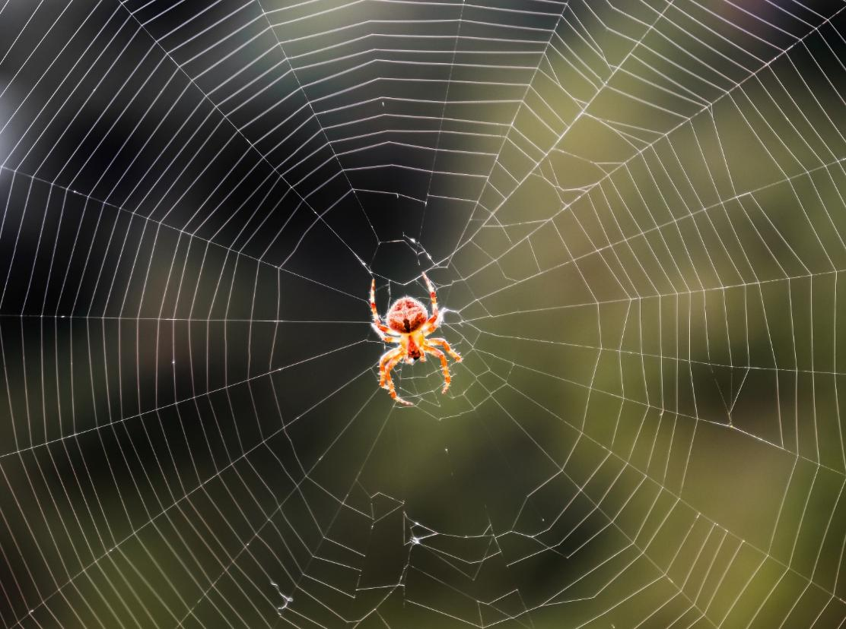
Find the Most Interesting Part
Notes:
Interesting is when something makes you stop and look, or stop and think. Just like when you walk past a shop window and stop to look inside because the display is interesting.
Click. Or when you see a spider weaving its web and you stop to watch.
When we learn something new, we can show our skills in an interesting way.
Click. When you learn to ride a bike, then you can do interesting tricks. Click. When you learn how to decorate a cake, you can make interesting designs.
Artists learn how to become a better so that it makes people stop and think when they see their work. They want to make artwork that is interesting and learn new skills so that they can improve.

Slide 19

Find the Most Interesting Part
Notes:
I will think about which part of my work today was the most interesting. I might choose where I drew really cool shapes and textures.
You will think about which part of your work today was the most interesting. Pause and give students time to think.
I will point to the most interesting part of my artwork. Point to an example from a student’s work where they have added interesting shapes and textures.
You will point to the most interesting part of your artwork. Pause and give students time to point.

Slide 20
Notes:
I will put a sticker where I am pointing. This will show others where my most interesting part is.
You will now put a sticker where you are pointing. This shows the most interesting part of your artwork!
Pause and give students time to place their sticker.
I will tell my partner why I chose this part. I might say it is because I worked really hard on this part.
You will now tell your partner why you chose the part you did. Pause and give students time to share.

Slide 21
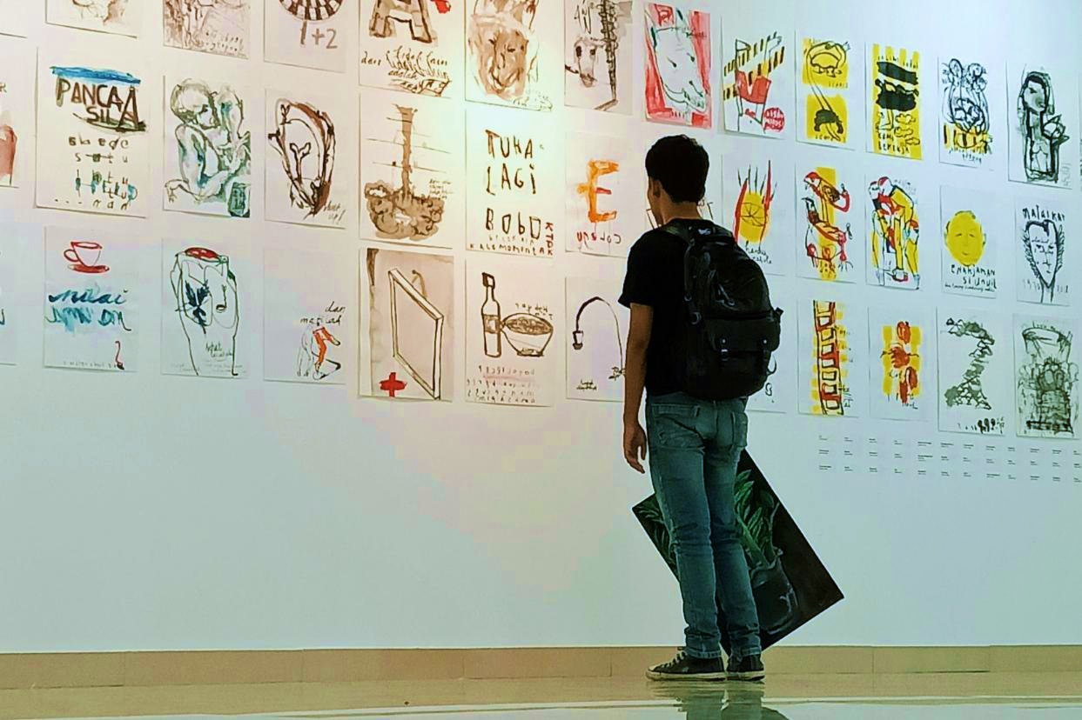
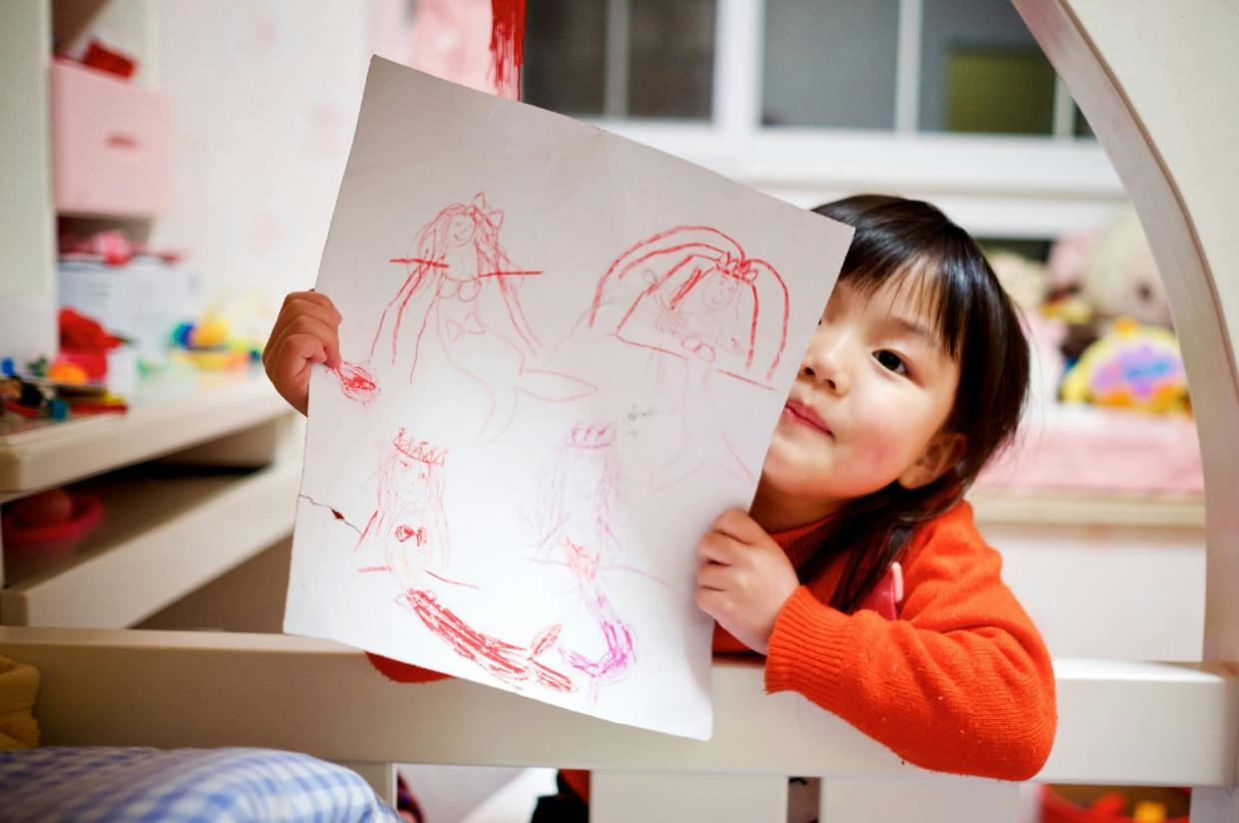
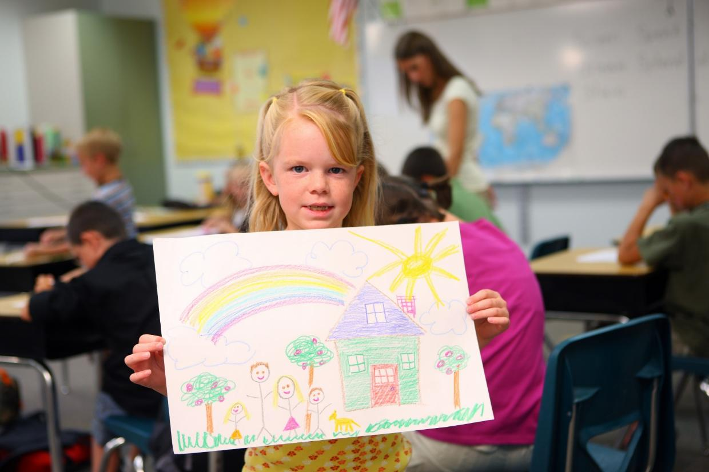
Notes:
I know that artists choose the most interesting parts of their artwork, and artists also share their artwork with others. The artwork people share is very special to them.
Artists share their artwork with their classmates.
Click. Artists share their artwork in art galleries.
Click. Artists share their artwork at home with their families.

Slide 22
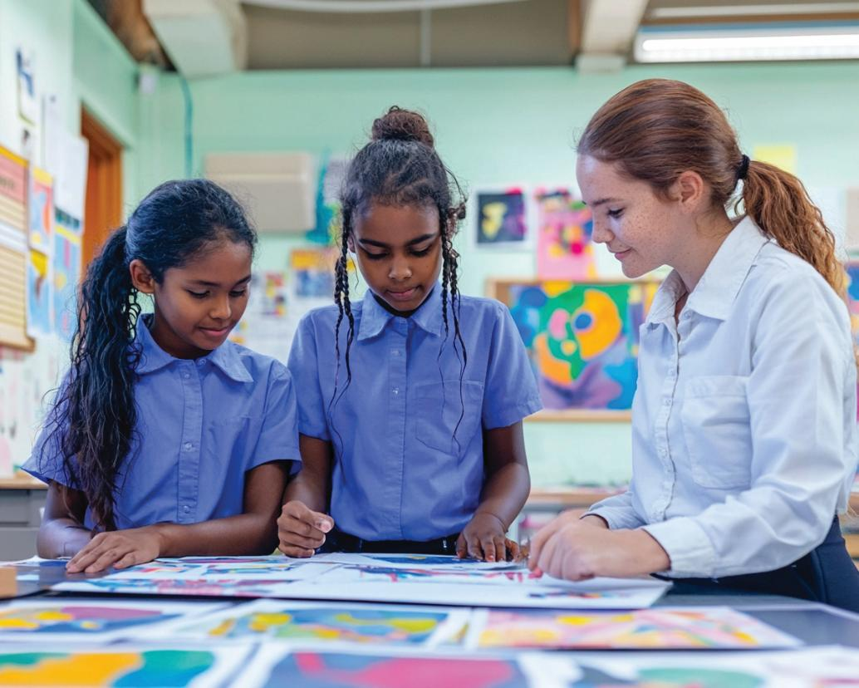
Notes:
At the end of every lesson, we will share our artwork in our classroom. This is called an Art Walk! Today we will share our art with our classmates.
First, we will tidy up our desks. It is important to look after the resources so that we can find them next lesson. We will put the pencils or crayons back in the pot and place nature items in the box so that we can put them back in nature. We will leave our artwork on the desk for the Art Walk. Pause and give time for students to tidy the desk and set up artwork.
When we are on an Art Walk, we are looking at the artwork of other people in our class. We are always being kind with the words we use and we never touch the artwork because it is special to the person who made it.
Now we will go on an Art Walk! We will slowly walk around the classroom looking at the artworks we all made today. Give students time to look at the artwork. When you see that students have had the chance to look at everyone’s art, bring the students back together.
Thank you for being kind. We have now had our first Art Walk. We will do this every lesson so that we can share our artwork as a class.

Slide 23
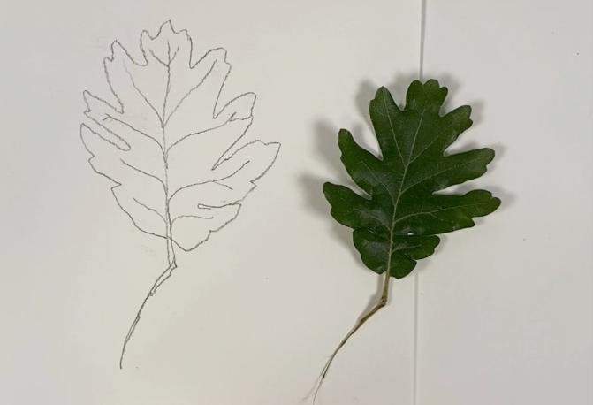
We used these shapes, lines and textures to make our own drawings.
Today we learned to draw objects we see in nature.
Notes:
Today we learned to draw objects we see in nature.
Click. We used shapes, lines and textures to make our own drawings.

Slide 24
Notes:
We will think about what we’ve learned while we watch the soft waves moving on the screen. Think about something new you did today or something you learned. What was your favorite part of your artwork? Take a little time to think. Pause and give students time to think.
As you keep watching the waves, you will think about the artwork you saw in our class Art Walk. We are an amazing class of artists, all learning new things together! Think about the art you saw today and what you noticed and liked. Take a little time to think. Pause and give students time to think.
Sometimes we will make a mistake or face a challenge, but we will always be kind to ourselves and each other so that we can become better artists.

Slide 25
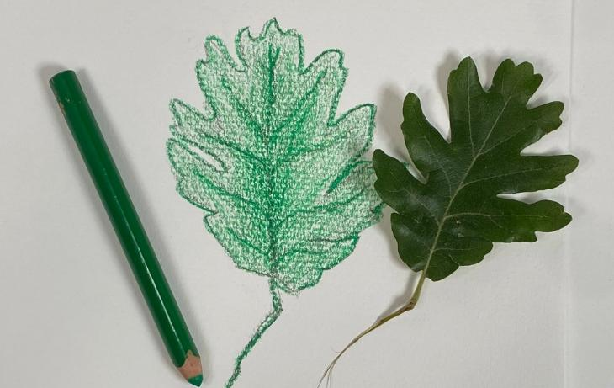
In the next lesson, we will learn how to blend colours from light to dark.
Notes:
In the next lesson, we will use dark and light colours to draw a natural object.

Slide 26
Lesson 2 Slide 10 First Photo: Landscape by Paul Cézanne, 1880, The Auction Collective, https://theauctioncollective.com/auctions/demo-auction/landscape-5/
Lesson 2 Slide 10 Second Photo: Flowers in a Jug by Margaret Preston, 1955, https://www.mutualart.com/Artwork/Flowers-in-a-Jug/ED9884230BDB9AB5

