Slide 1
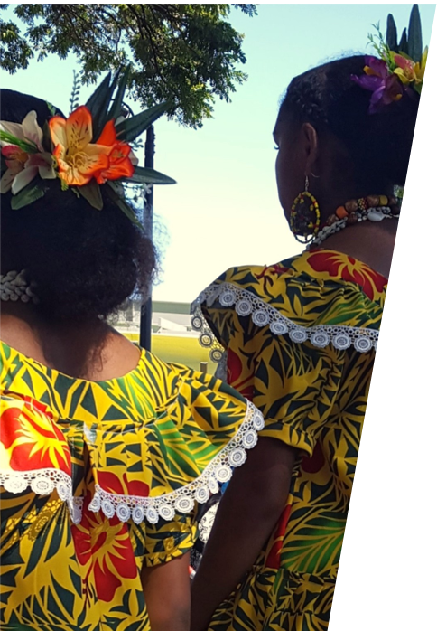
Unit 1A
Art and Culture
Lesson 2
Hands Full of Stories
Unit 1A Version 1

Slide 2
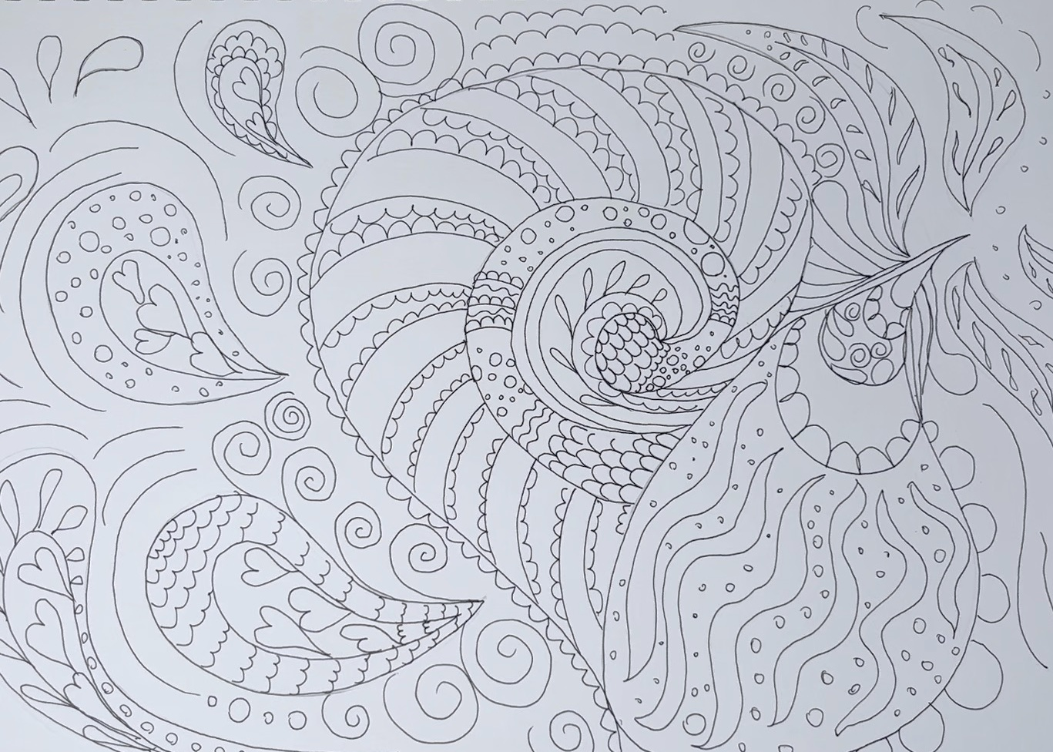
Organic shapes are soft and natural.

Slide 3
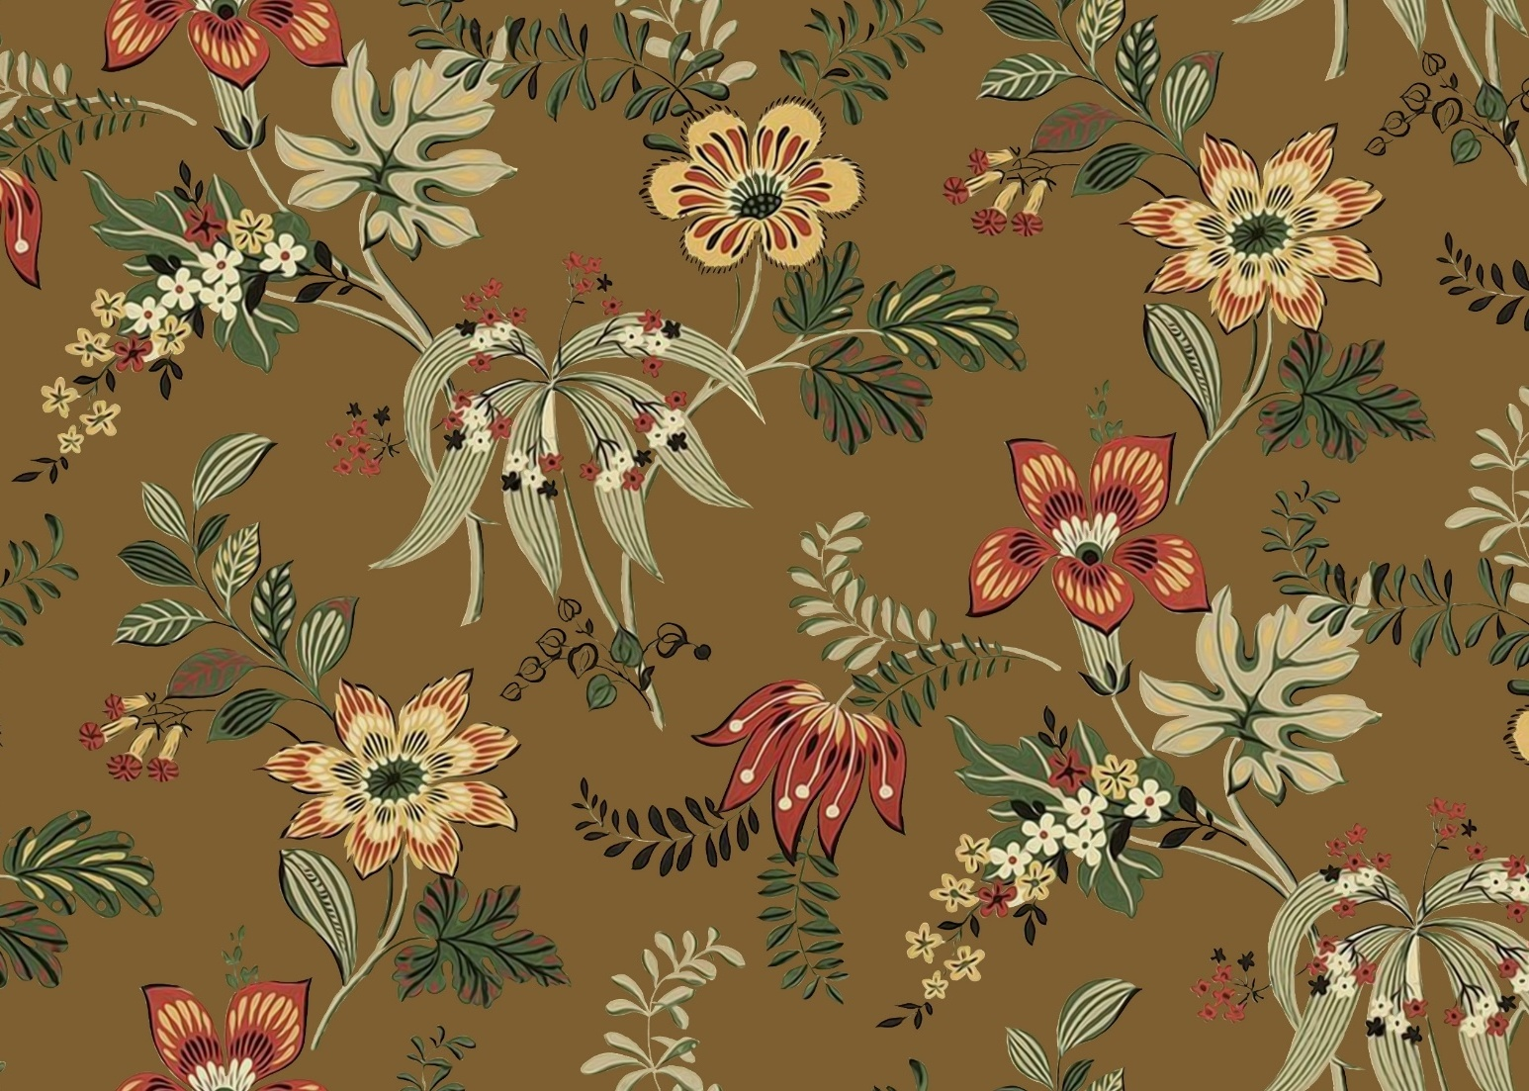
Patterns are made from repeated lines and shapes.

Slide 4
An example of an organic shape is:

Slide 5
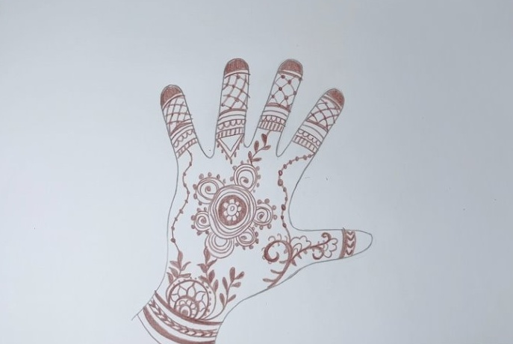
In this lesson, we will learn how to draw patterns inspired by mehndi design.

Slide 6
You will be successful when you can:
use organic shapes
draw patterns using shapes and lines
create a special design.

Slide 7


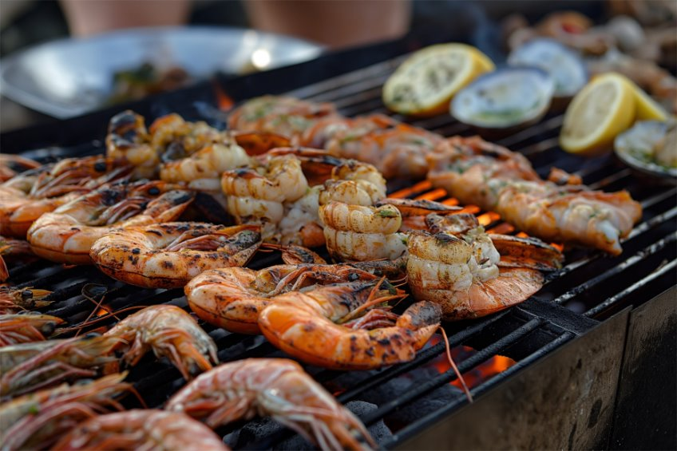
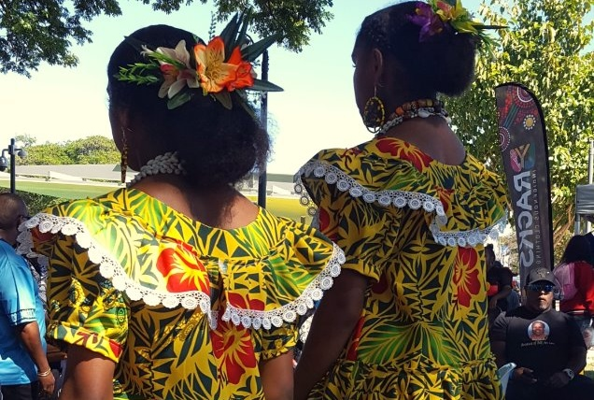

Slide 8
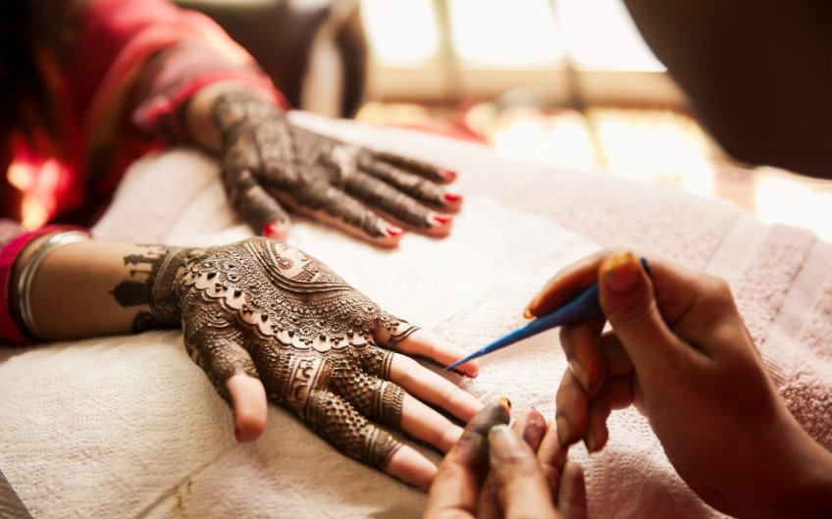

mehndi
A special drawing made on hands and feet using a brown paste. People use it for celebrations.
culture
The way a group of people live. It includes their language, food, celebrations and traditions.

Slide 9

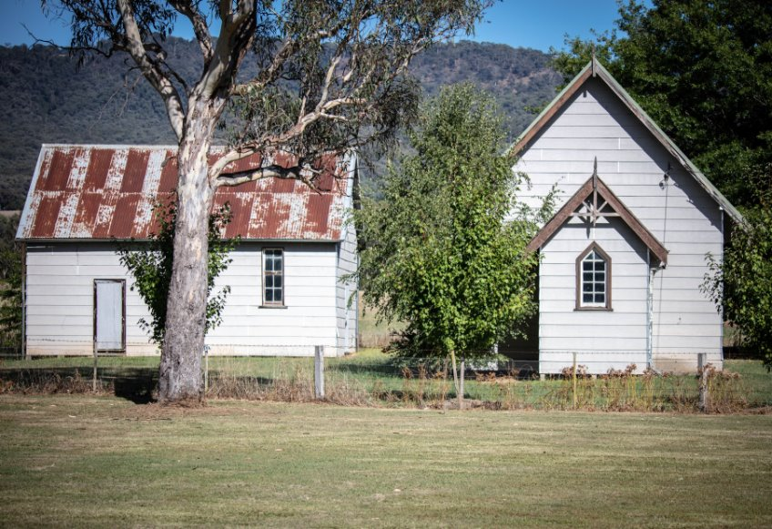
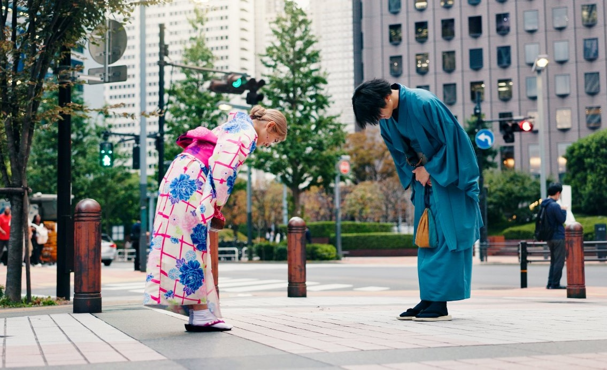


Culture

Slide 10



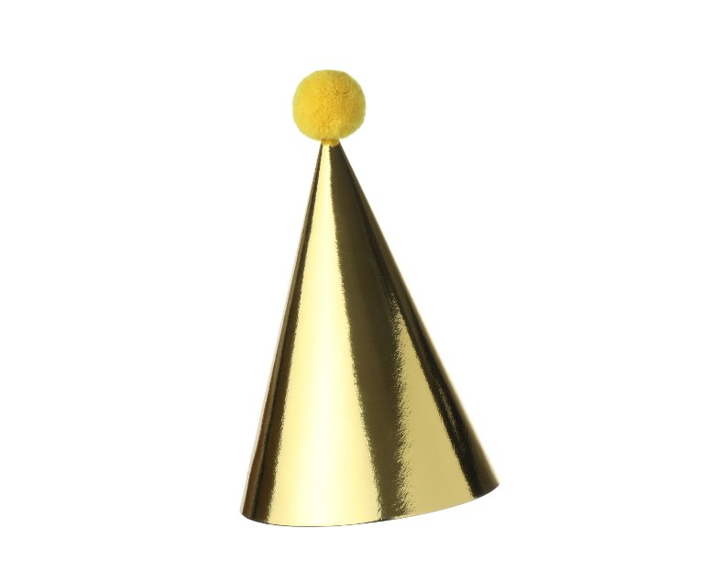
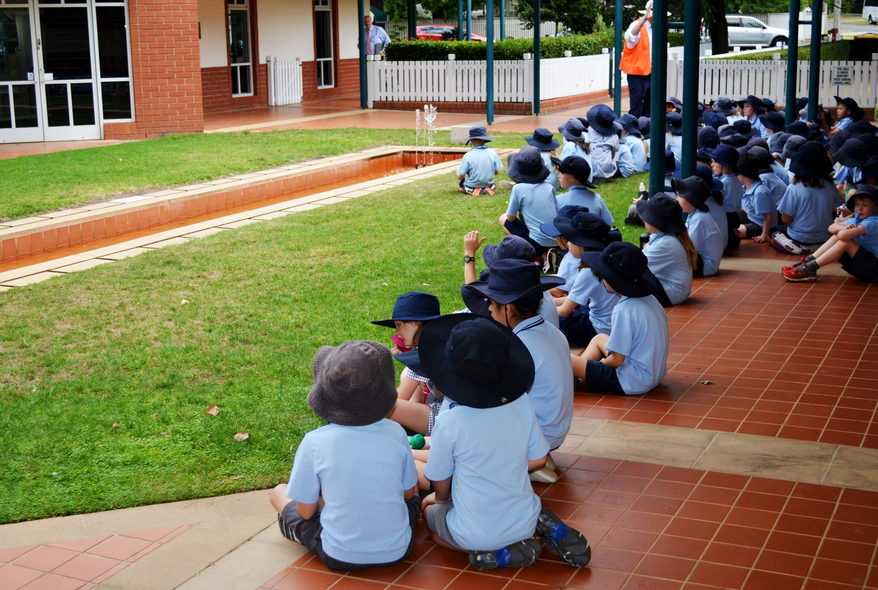
Culture

Slide 11
Culture

Slide 12


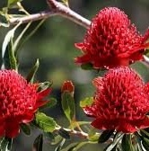
Culture
A part of your culture is:

Slide 13
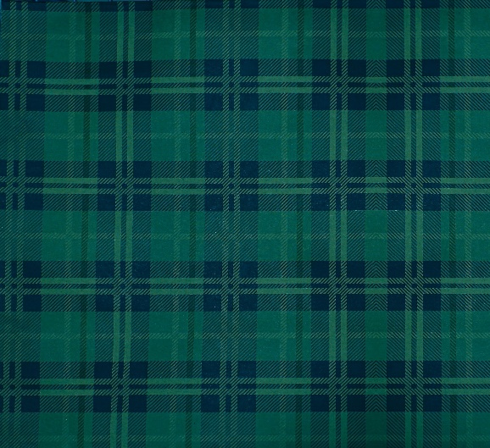
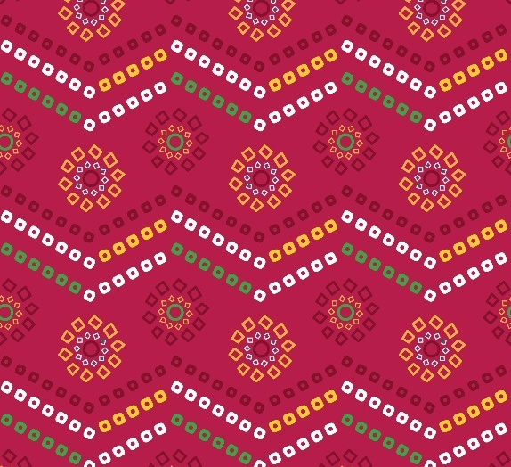


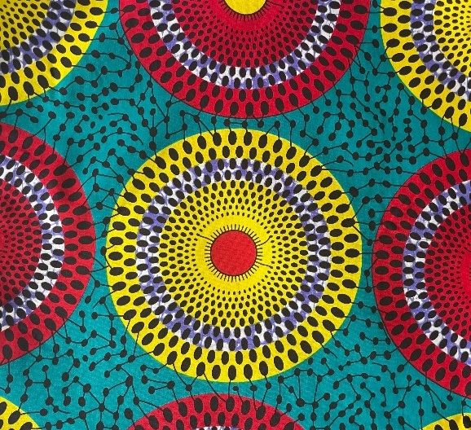
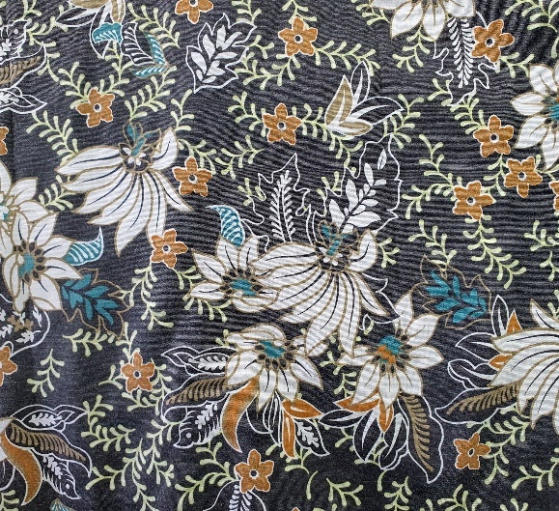


Pattern and Culture

Slide 14
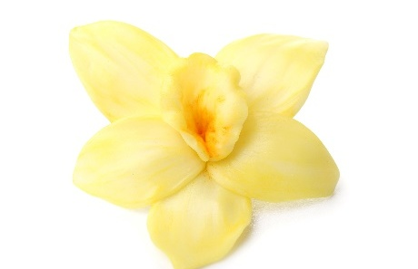

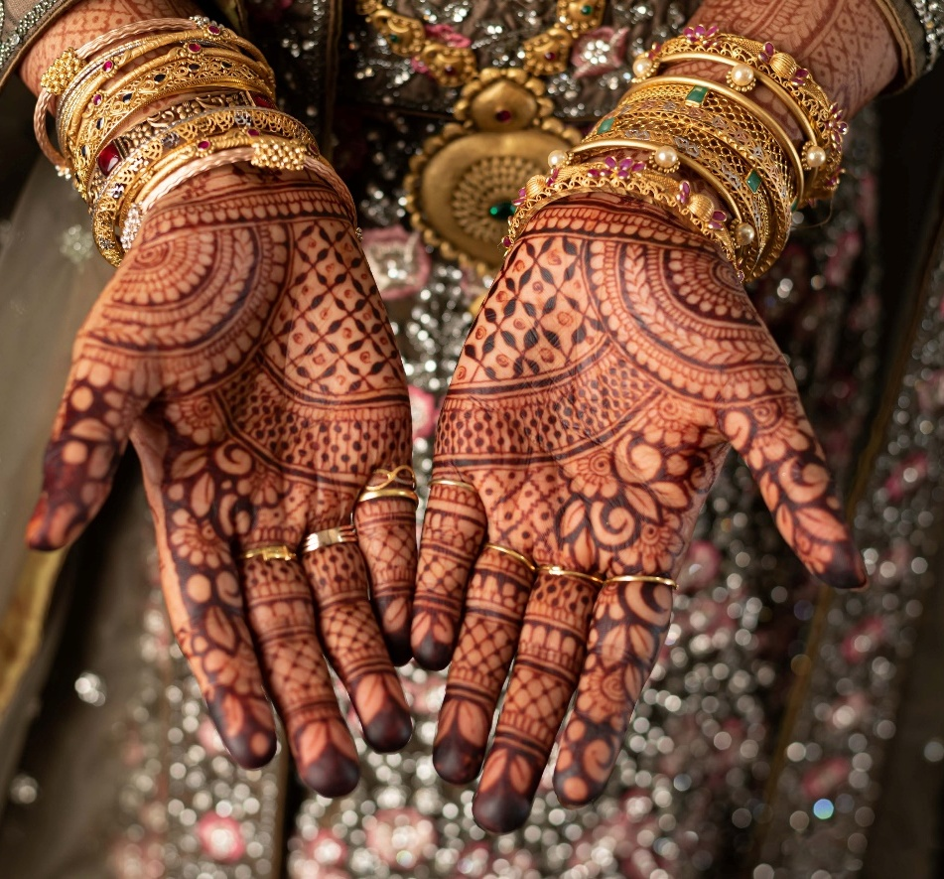
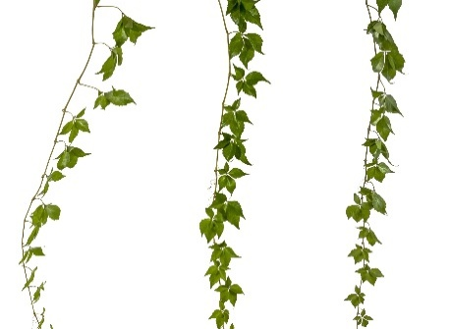

Patterns and Culture

Slide 15
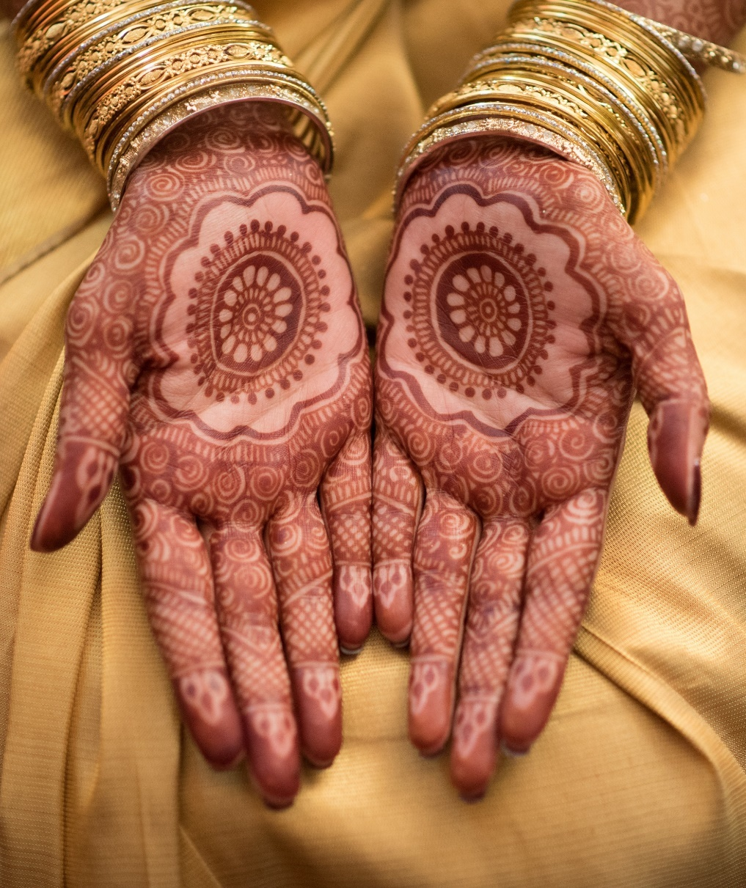
Patterns and Culture

Slide 16
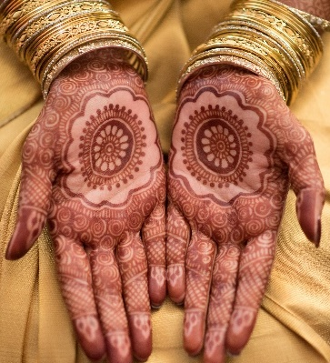
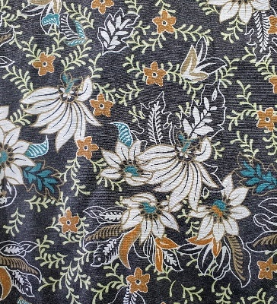
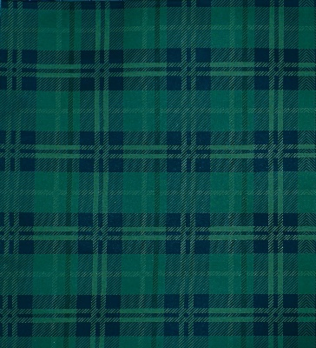
Patterns and Culture
An example of a mehndi pattern is:

Slide 17
Patterns and Culture

Slide 18
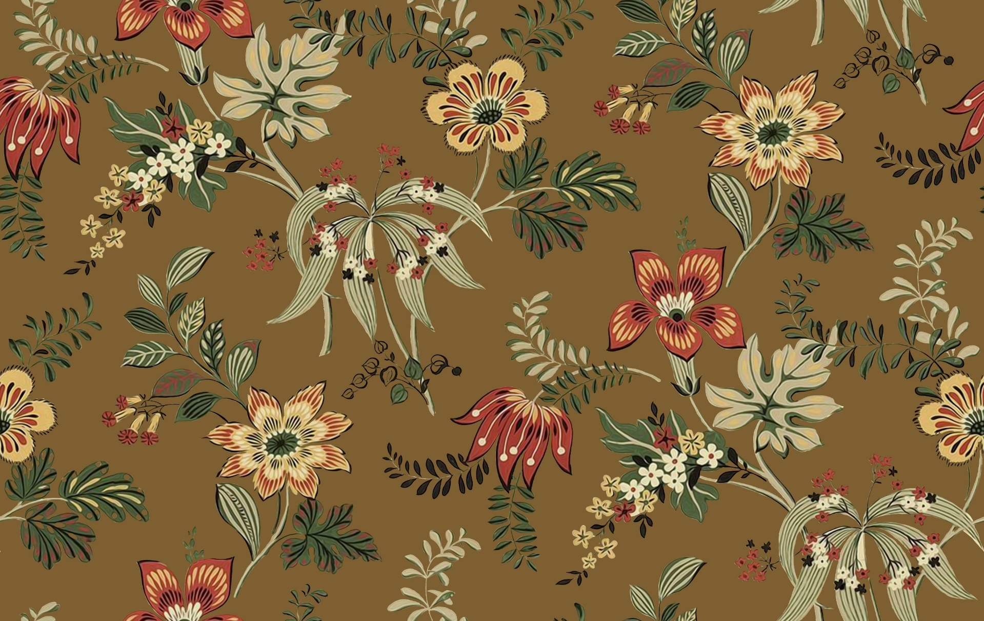
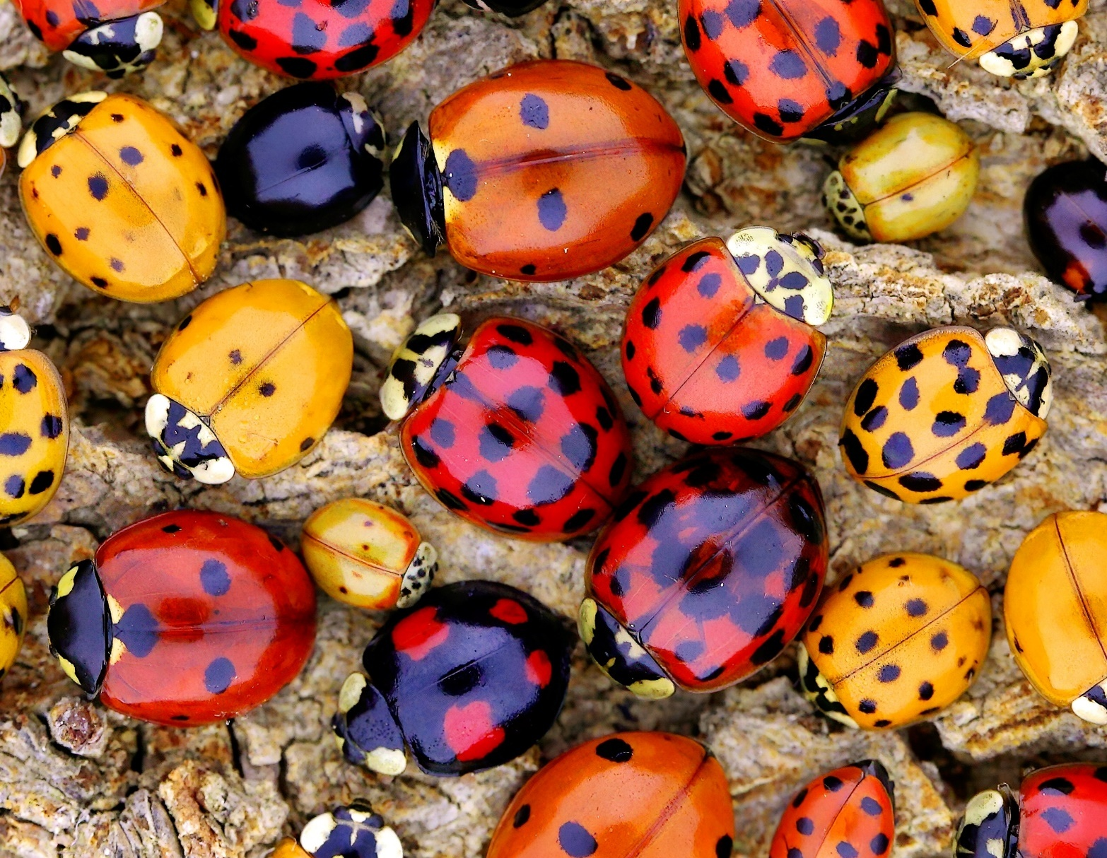
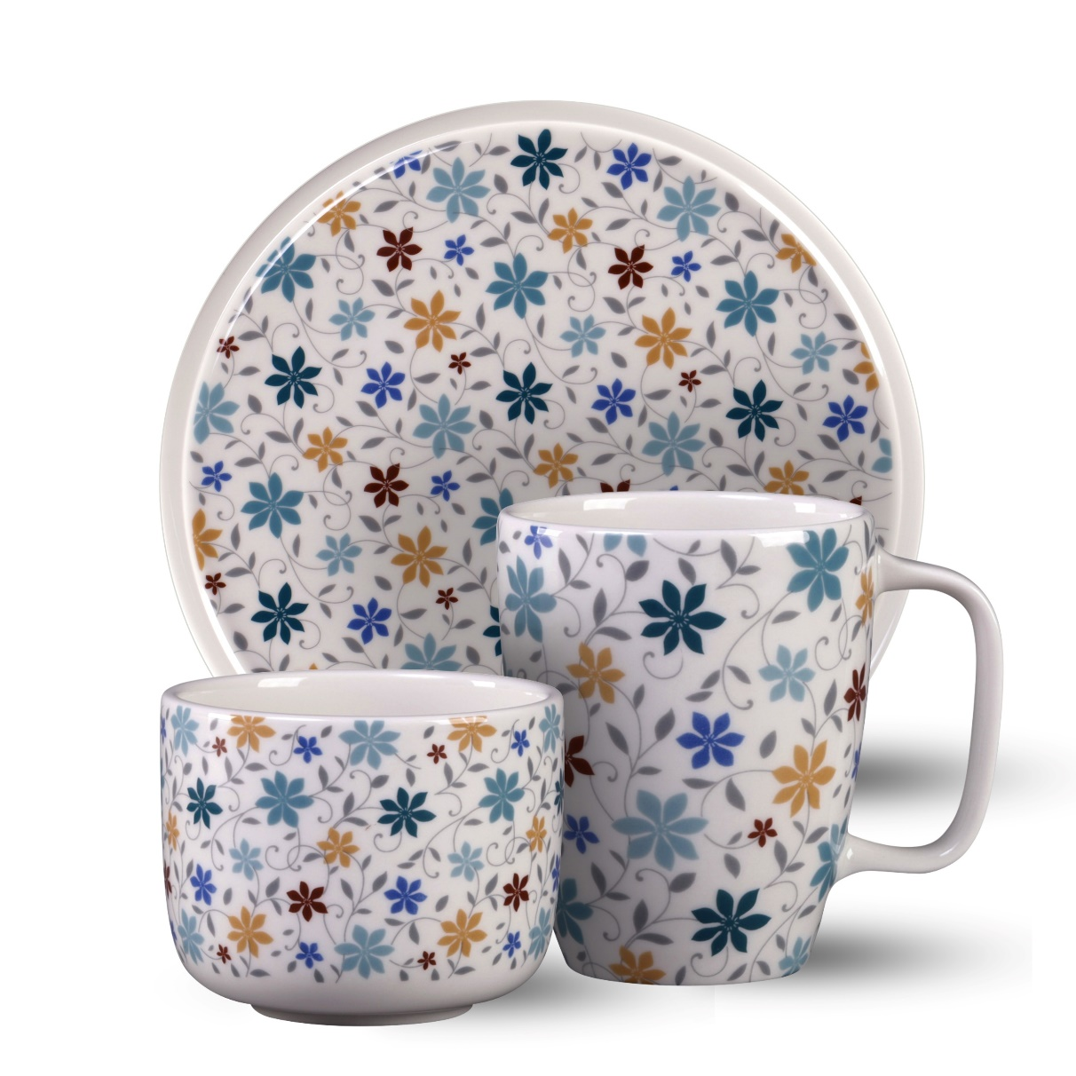
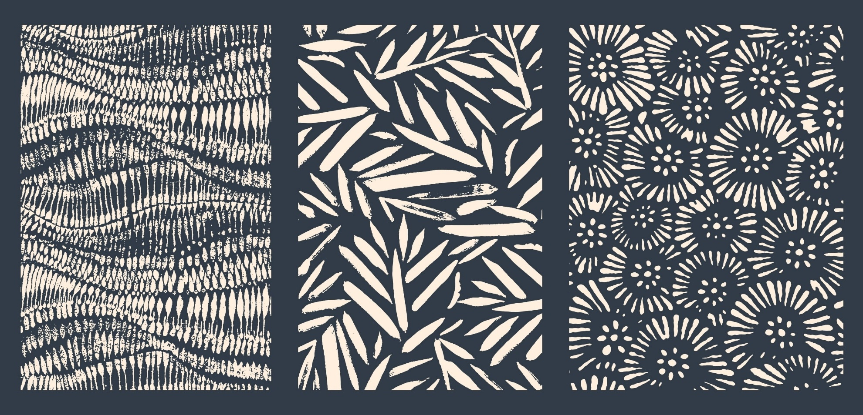
Patterns and Culture

Slide 19
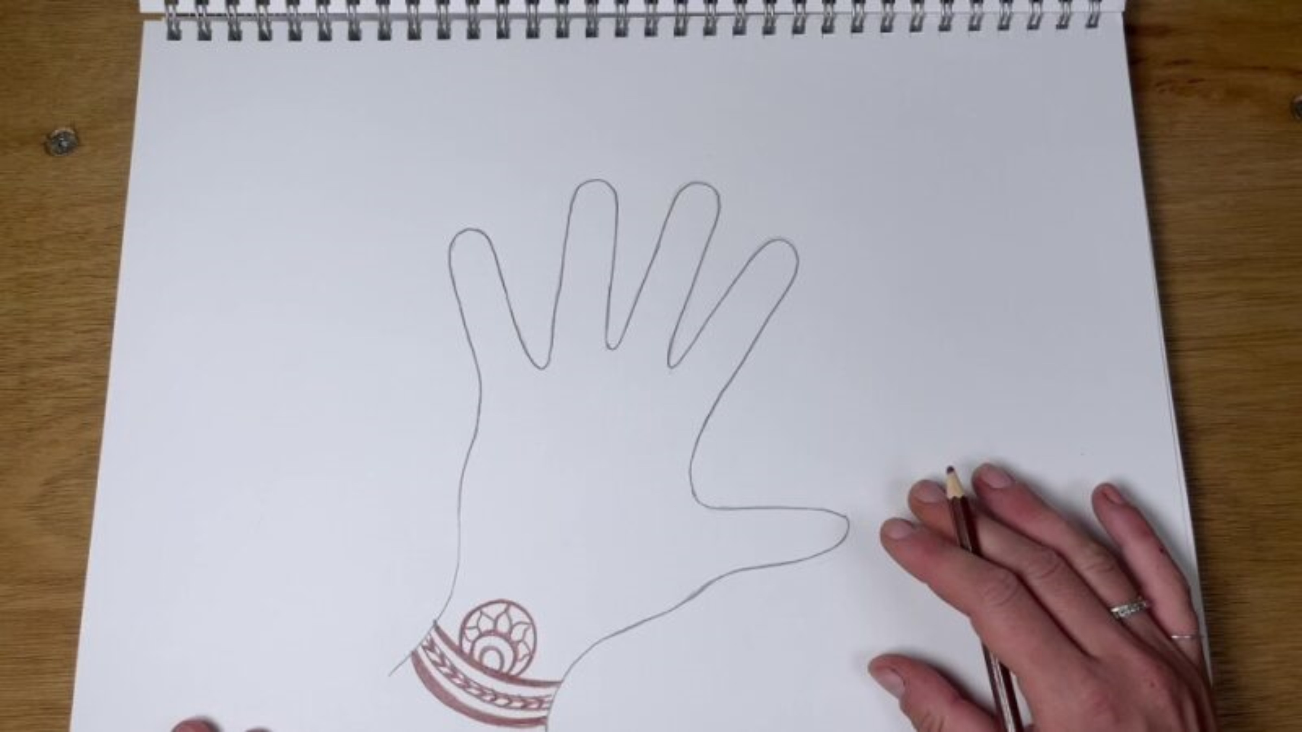
Mehndi Designs

Slide 20
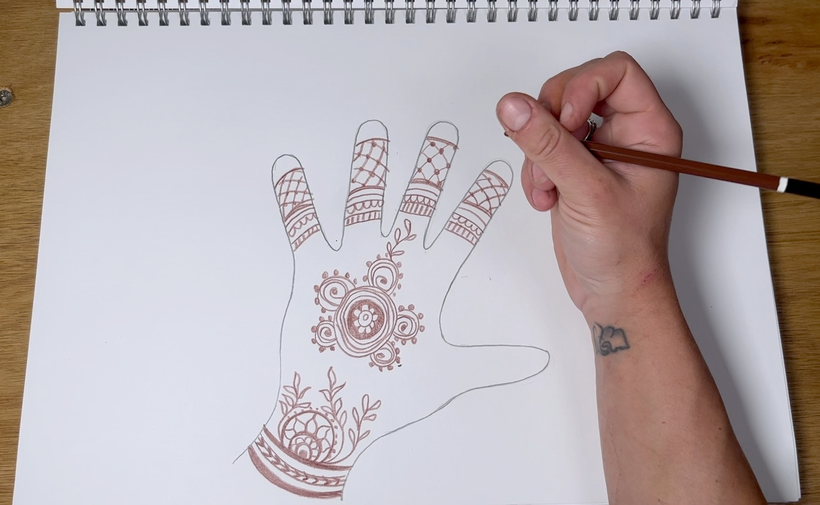
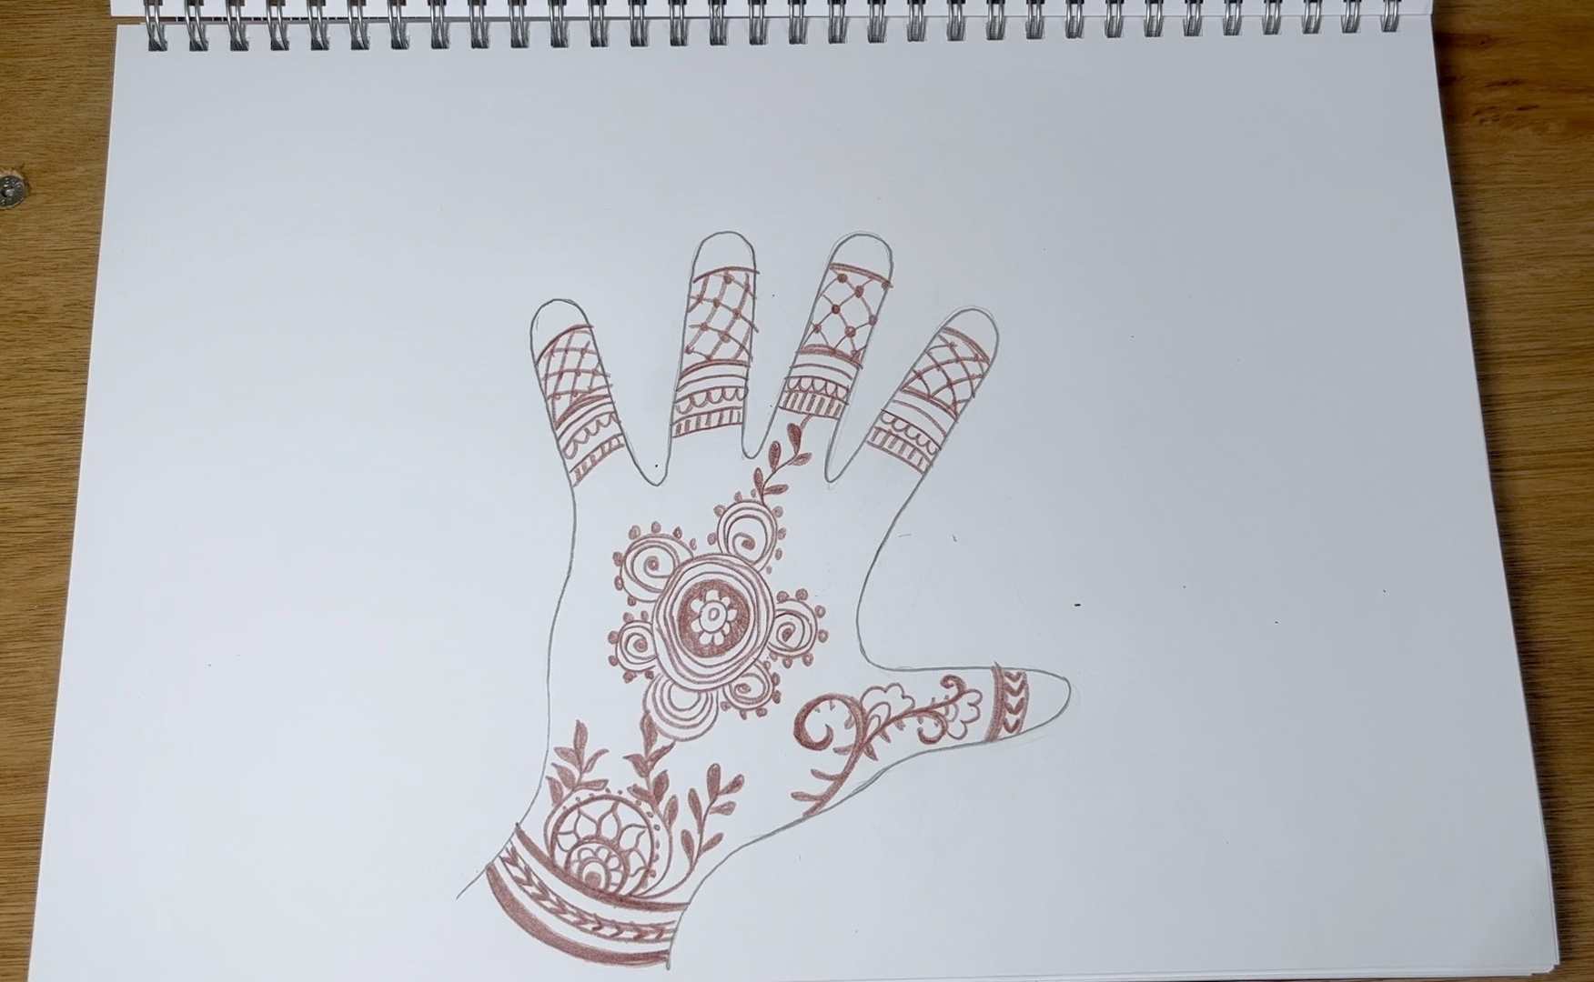
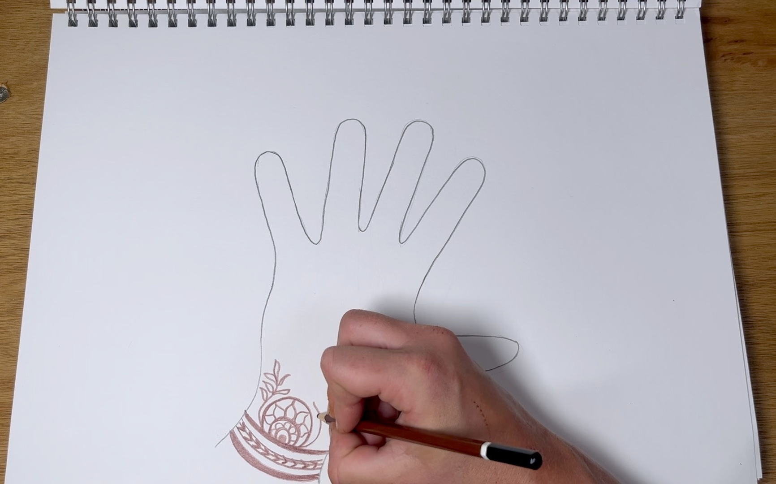
Mehndi Designs

Slide 21
Mehndi Designs
A mehndi design uses the same pattern.

Slide 22
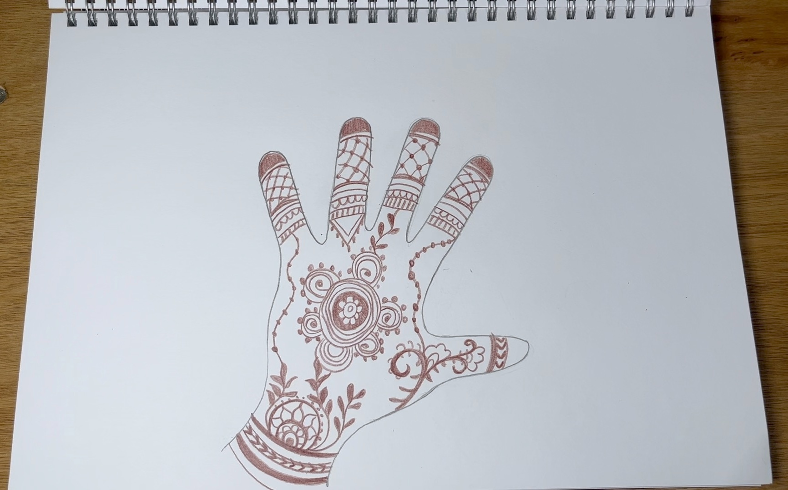
Mehndi Designs

Slide 23


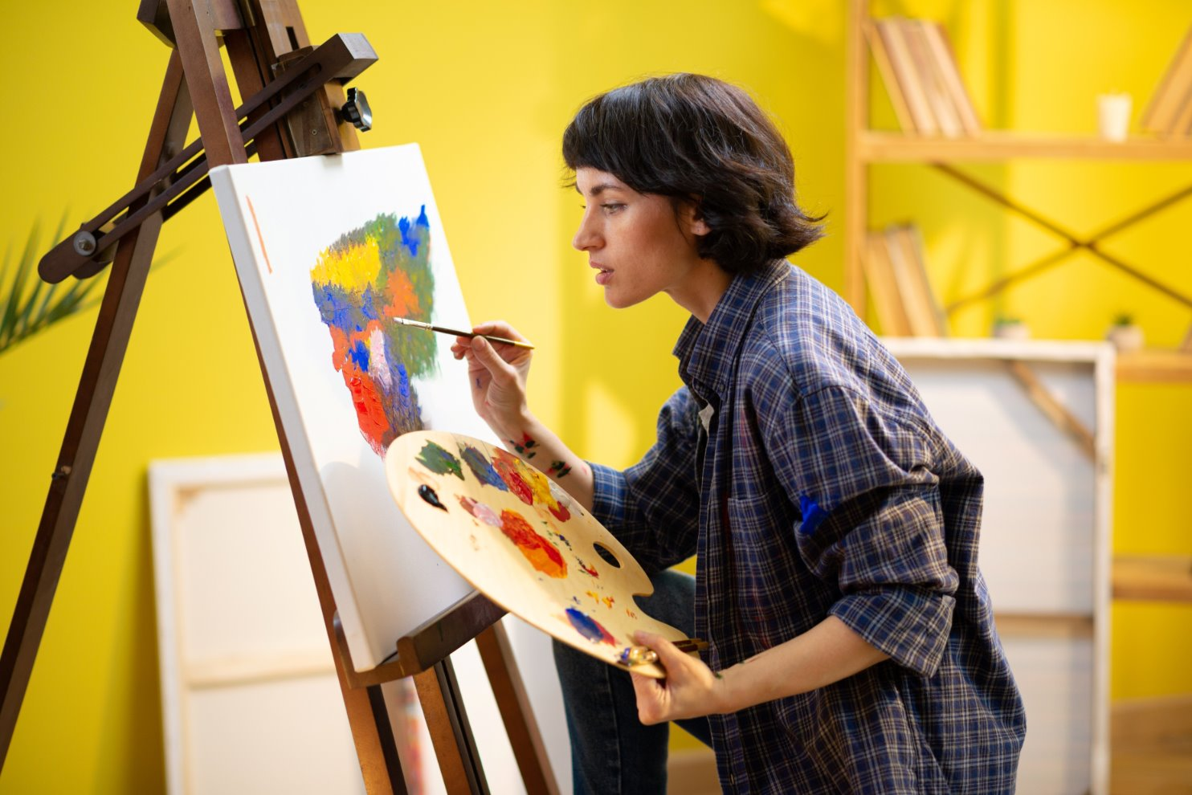
Find My Most Interesting Part

Slide 24
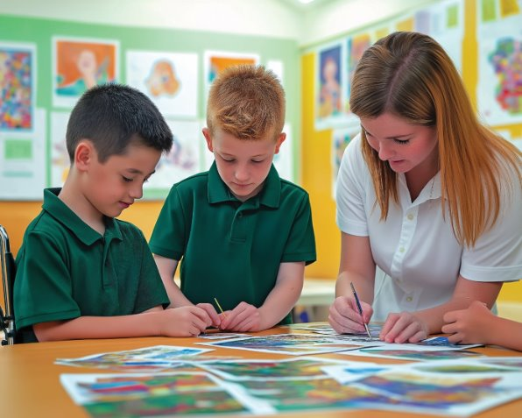
Find My Most Interesting Part

Slide 25
Find My Most Interesting Part

Slide 26

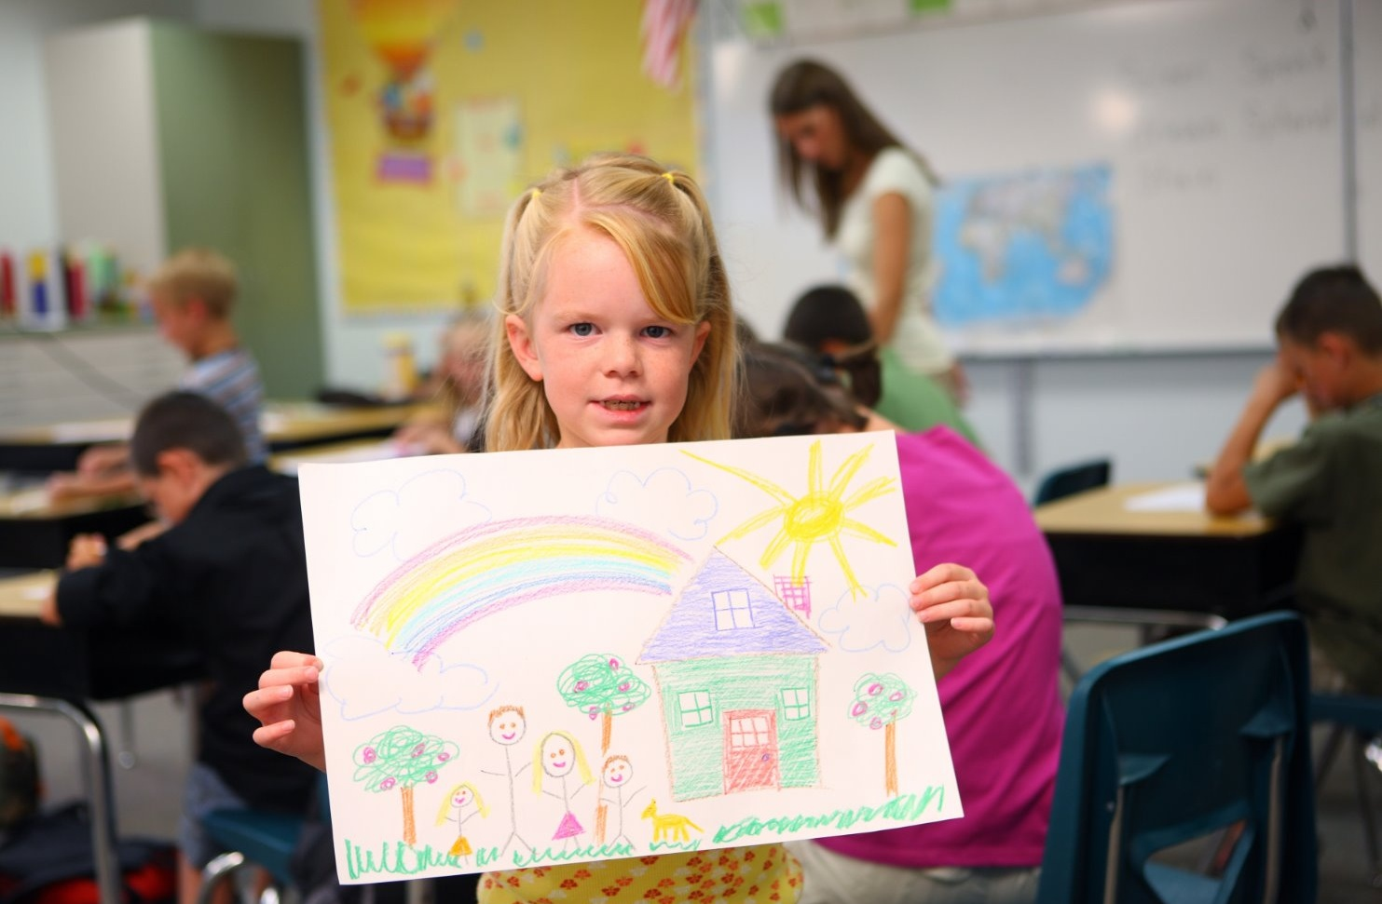
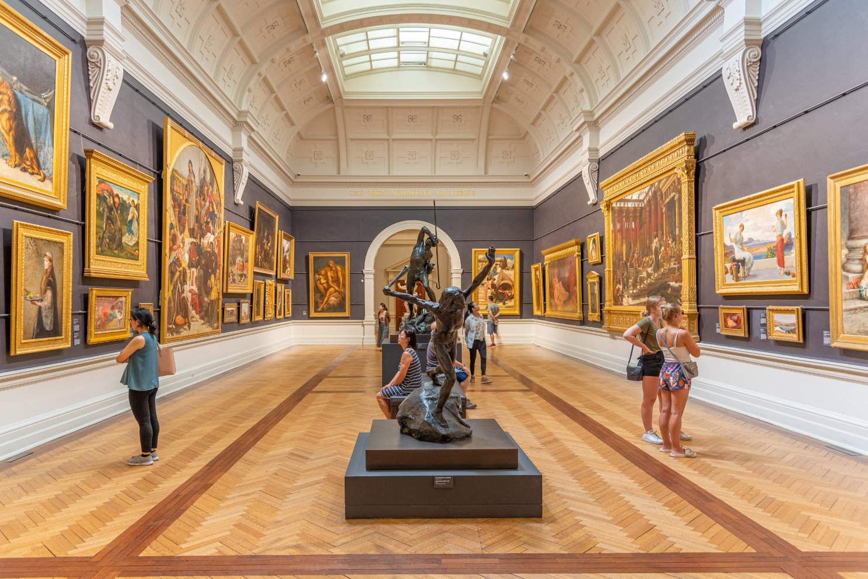

Slide 27


Slide 28

Mehndi is a special drawing on hands or feet using a brown paste.
Mehndi designs use organic shapes and patterns.

Slide 30
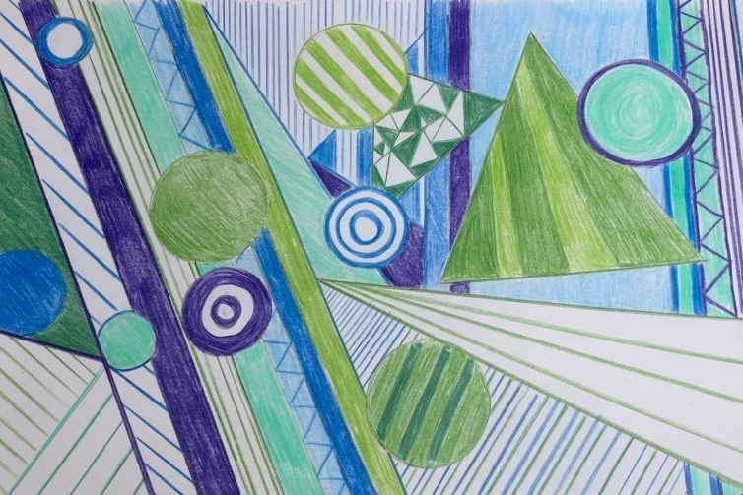
In the next lesson, we will learn how to draw colourful geometric patterns.

