Slide 1
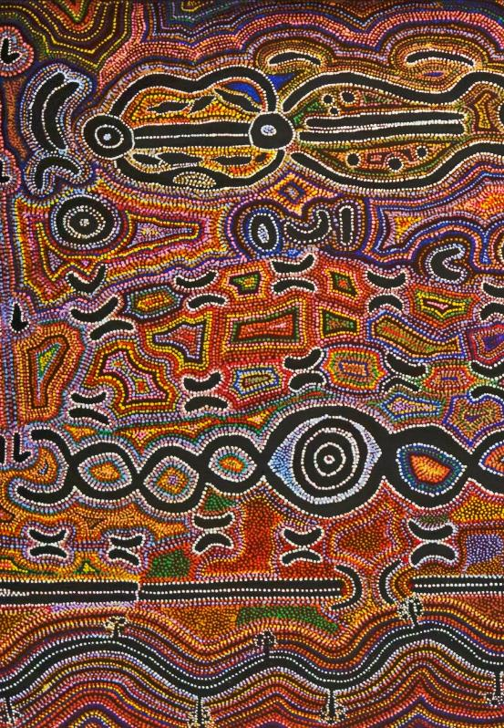
Unit 1B
Art and Culture
Lesson 1
Symbols as Culture
Unit 1B Version 1

Slide 2
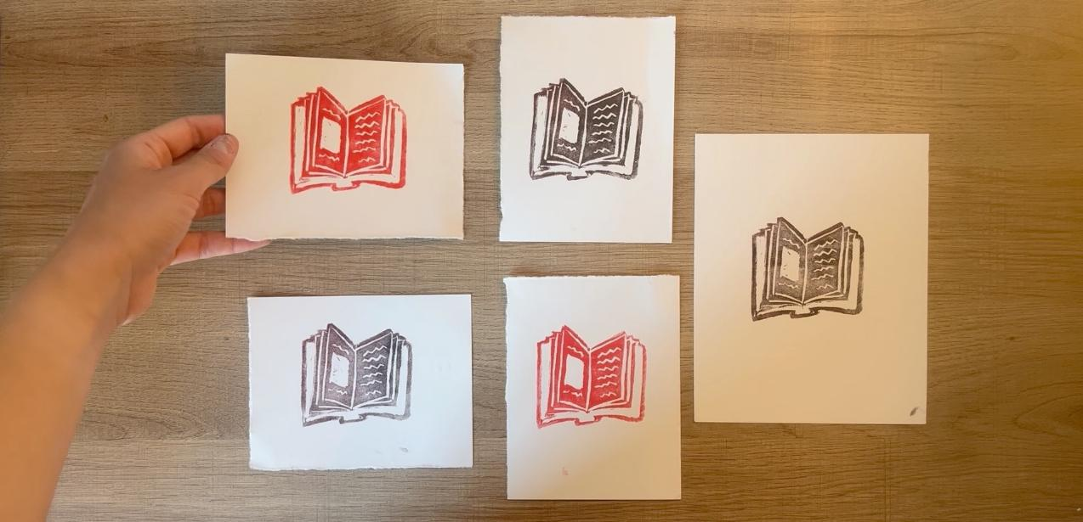
In this lesson, we will make a simple relief print of a symbol that represents something important.

Slide 3
You will be successful when you can:
brainstorm your own symbol
carve your design into the printing foam
print your design many times on different pieces of paper.

Slide 4




Slide 5






symbol
A simple picture that stands for something else.
represent
To stand for something else.
= peace

Slide 6
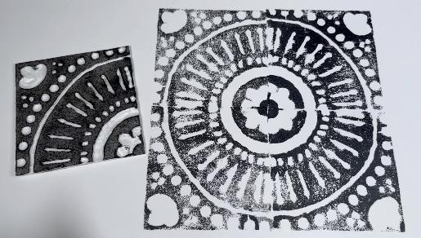
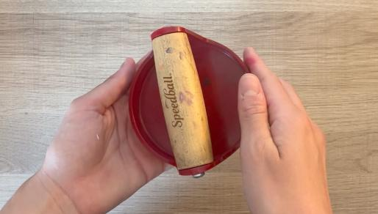
relief print
A stamp you can make by carving or pressing into material.
baren
A tool you can use to press a relief print onto paper.

Slide 7


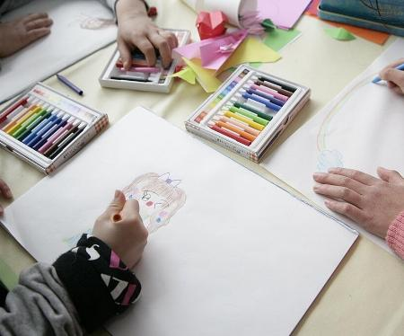





Symbols Represent Ideas

Slide 8
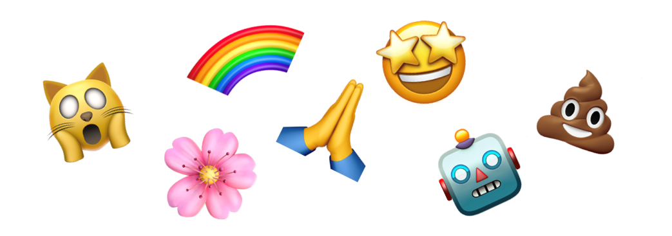

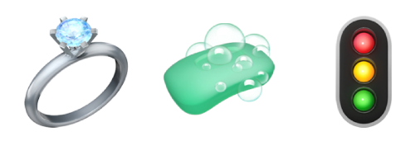
Symbols Represent Ideas
Symbol | Idea
Happiness, Excitement
Cleaning

Slide 9


Symbols Represent Ideas
Symbol | Idea
Love, Care
Hot Weather

Slide 10


Symbols Represent Ideas
A symbol you could use to represent water is:
🐒

Slide 11




Symbols in Different Cultures
女
男

Slide 12
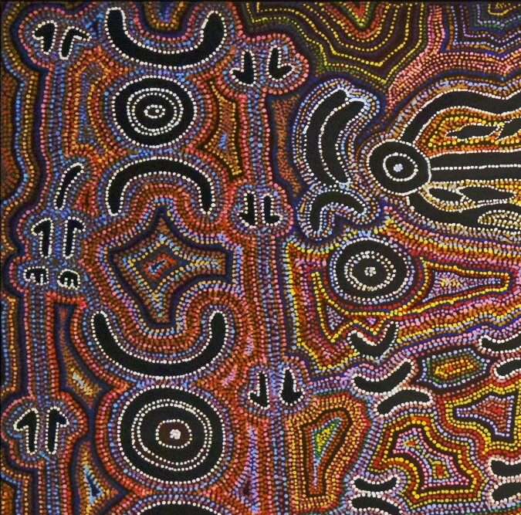
Symbols in Different Cultures
person
kangaroo
water
possum

Slide 13
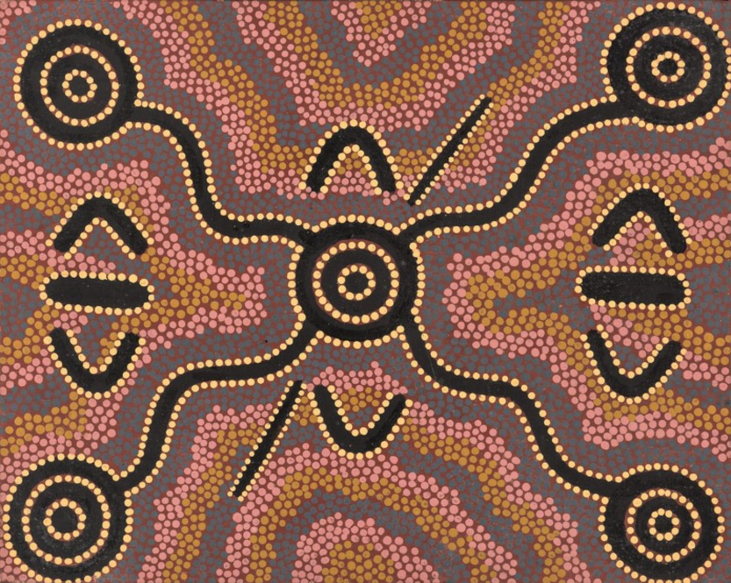
Symbols in Different Cultures
person
water

Slide 14


Symbols in Different Cultures
Different cultures use different symbols.

Slide 15
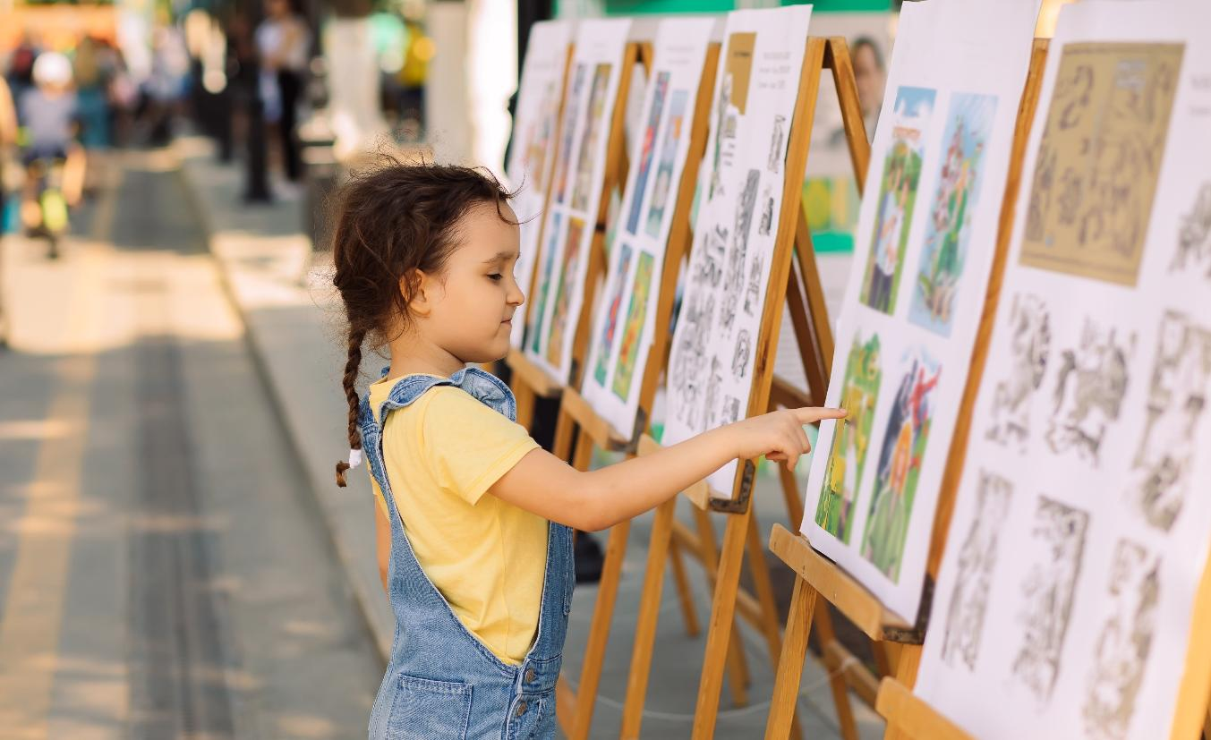
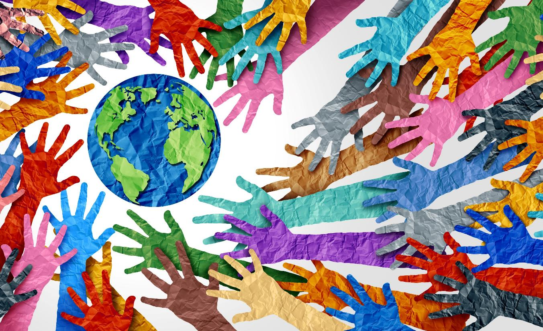
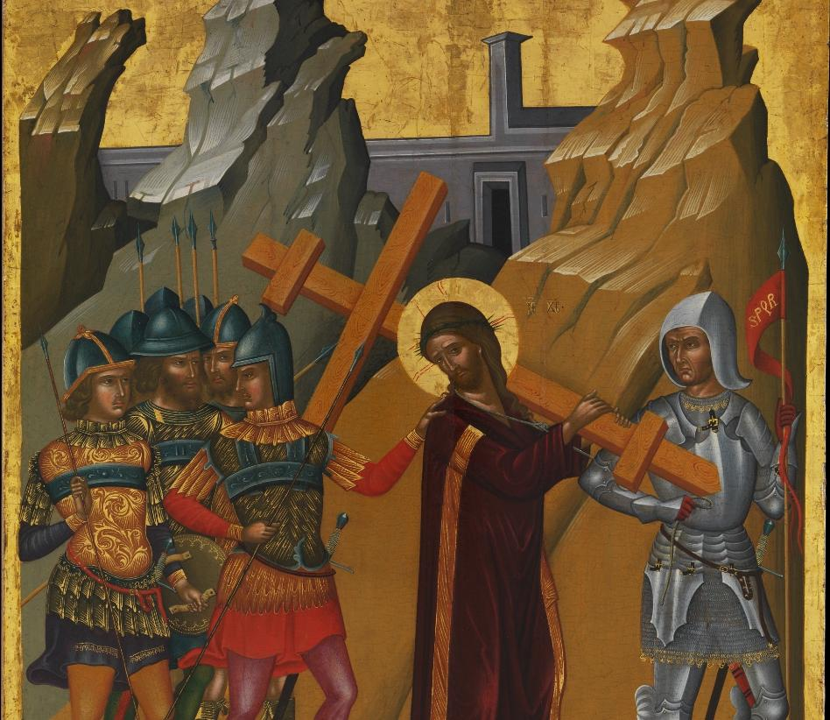
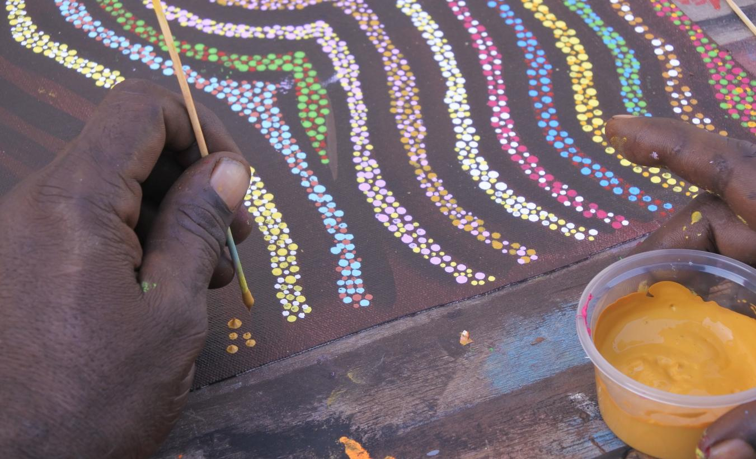
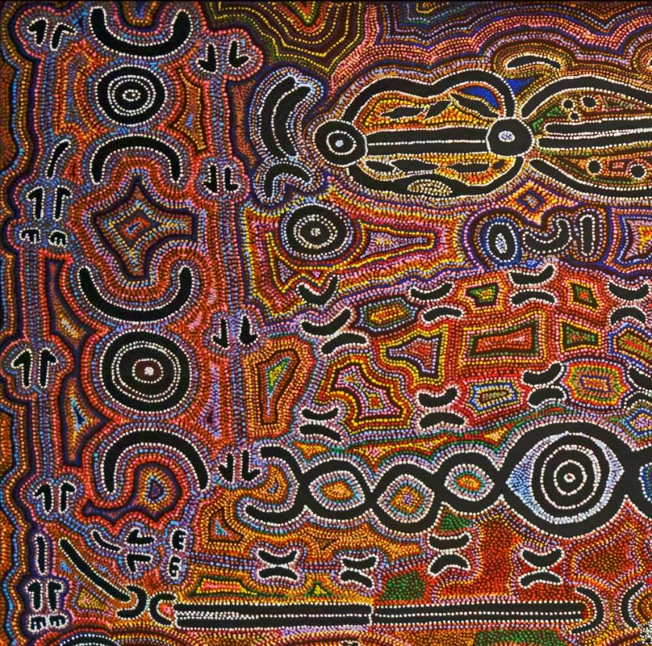
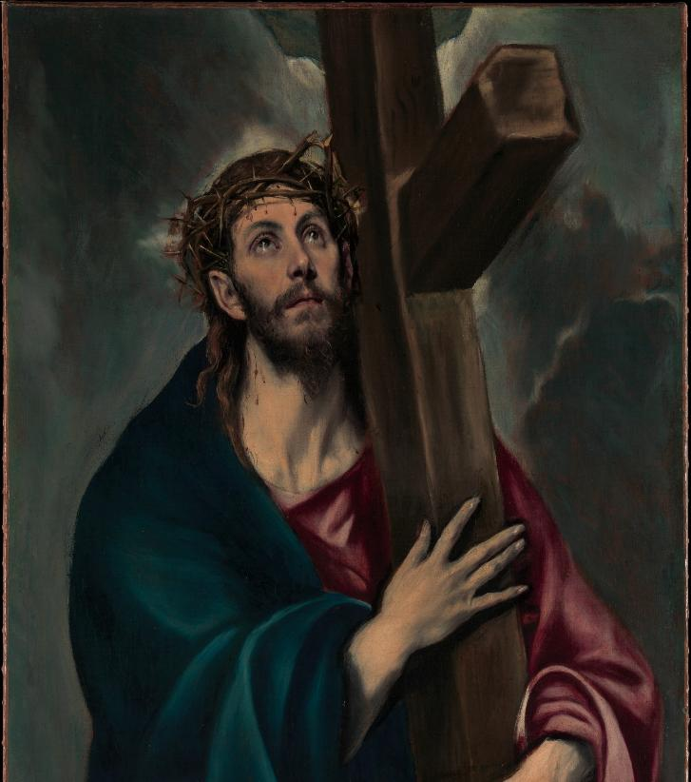
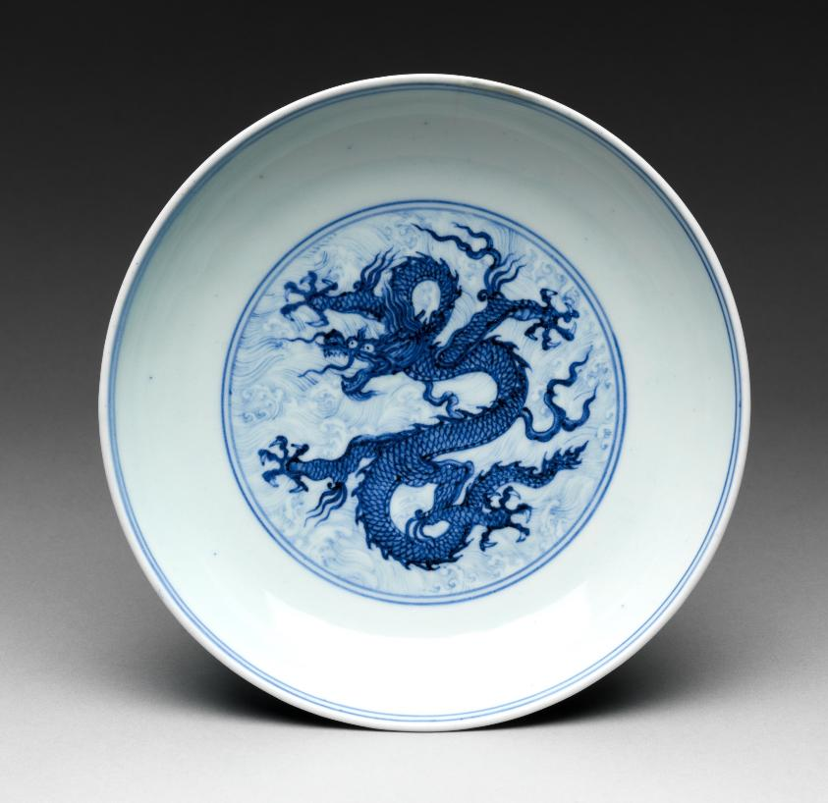
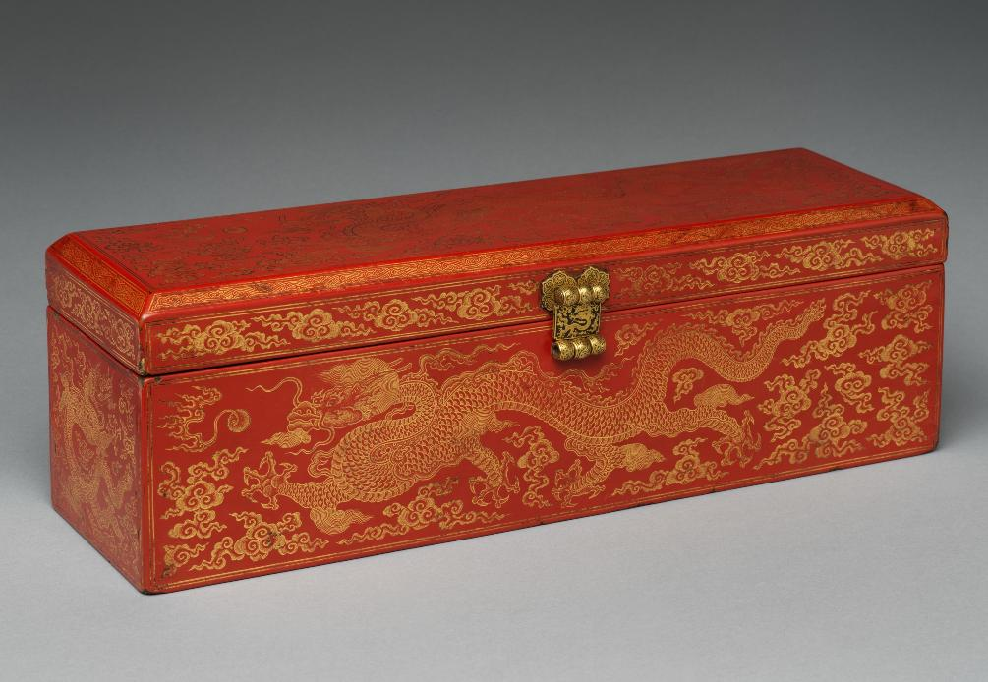

Art Shows the Artist’s Culture

Slide 16
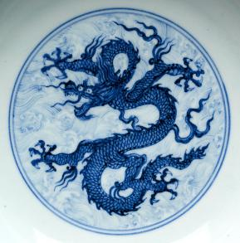
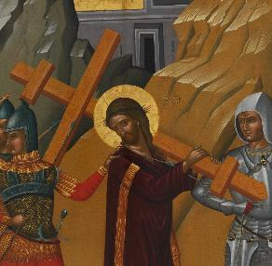
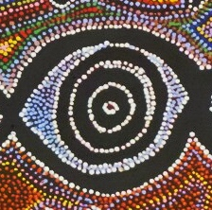










Art Shows the Artist’s Culture
Strength/Luck
Religion
???
Pets
Family
Friendship
Learning
Water
___________
?

Slide 17



























Art Shows the Artist’s Culture
???
Having fun
___________________
Something that is important to our culture
?
Symbol that represents this idea

Slide 18
Art Shows the Artist’s Culture
A symbol must look exactly like what it represents.

Slide 19
Art Shows the Artist’s Culture
???
___________________
Something that is important to my culture
?
Drawing of symbol that represents important thing

Slide 20

Making My Own Symbol

Slide 21
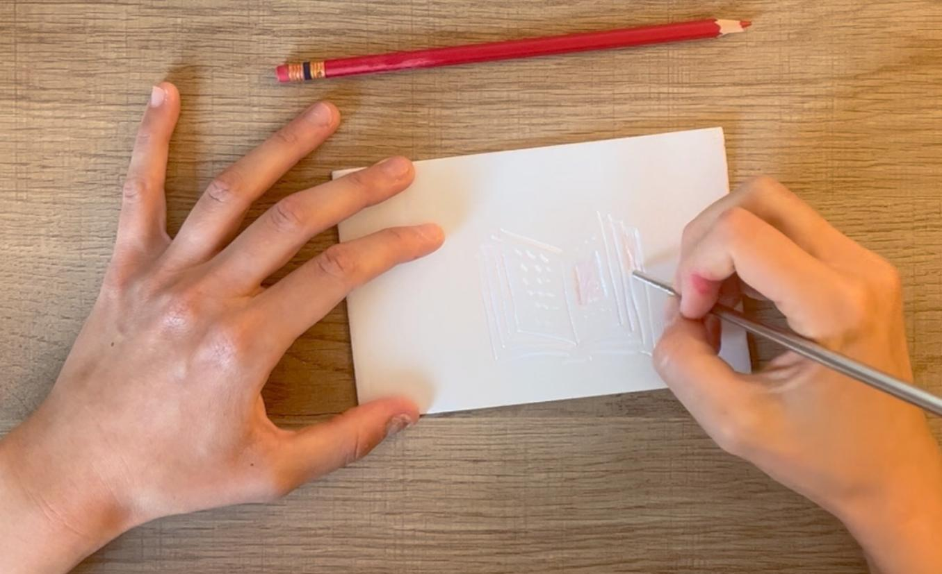
Carving Our Symbol

Slide 22
Art Shows the Artist’s Culture
The parts you carve with your pencil will get ink on them.

Slide 23
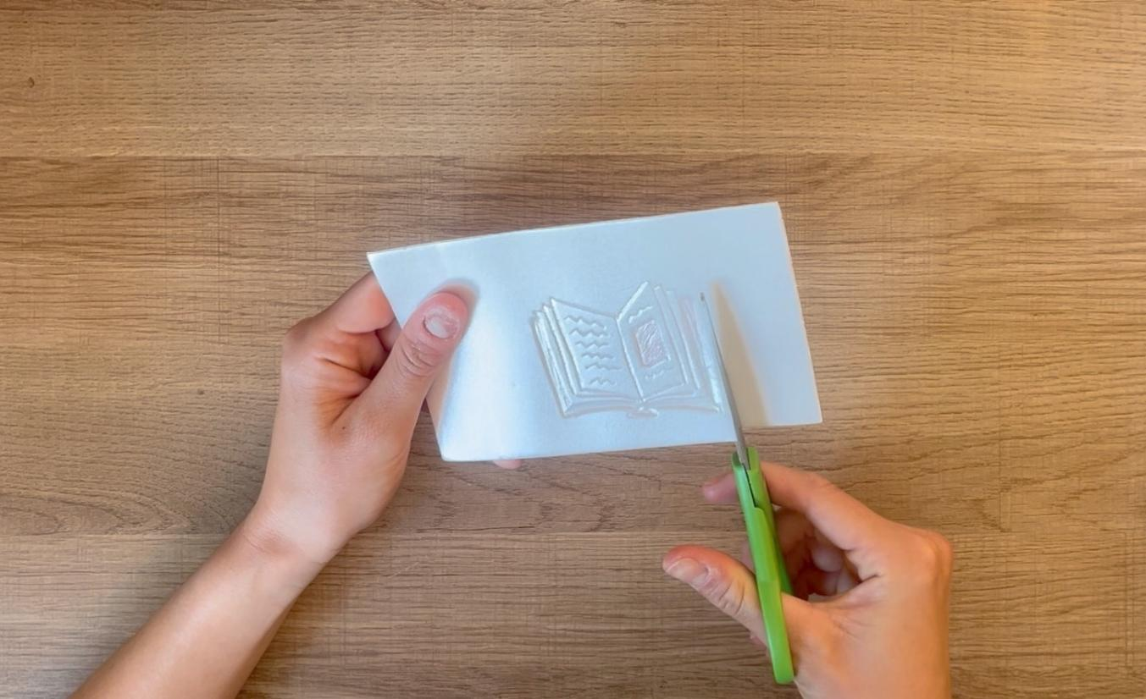
Cutting Out Your Symbol

Slide 24
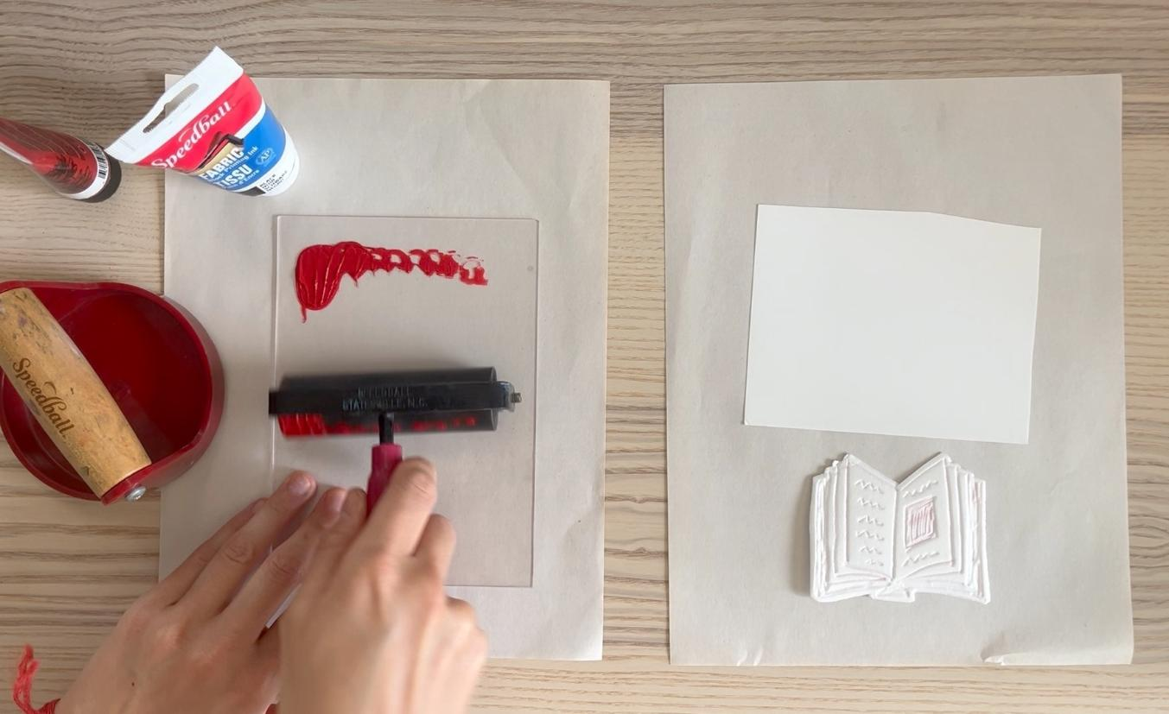
Rolling Out Your Ink

Slide 25
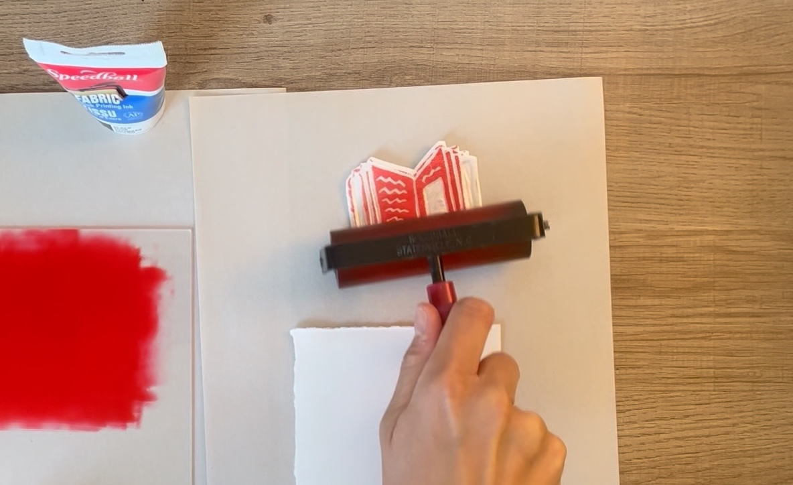
Rolling Ink Onto the Styrofoam

Slide 26
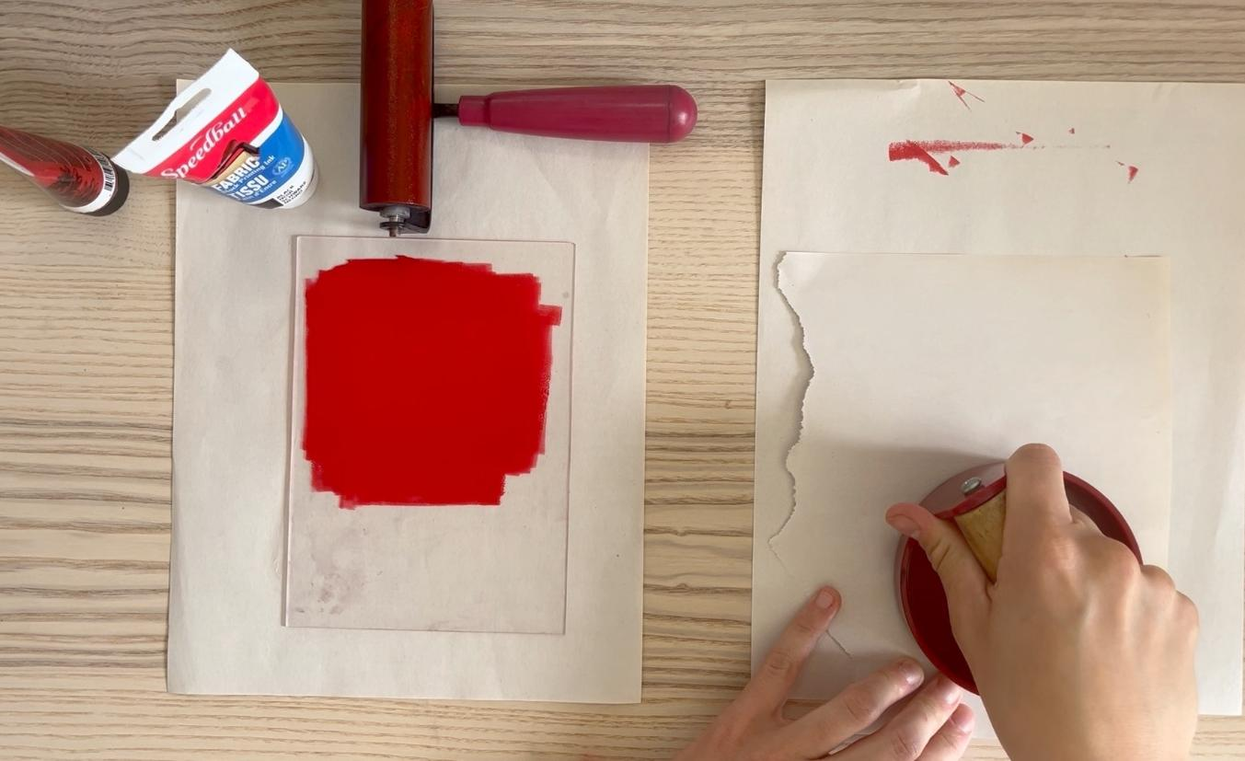
Printing Your Symbol

Slide 27
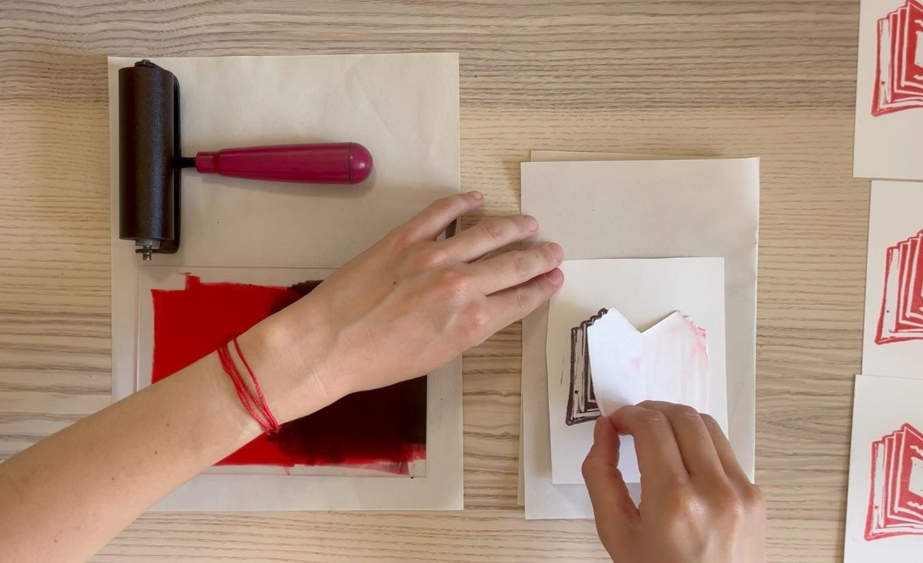
Seeing Your Results

Slide 28

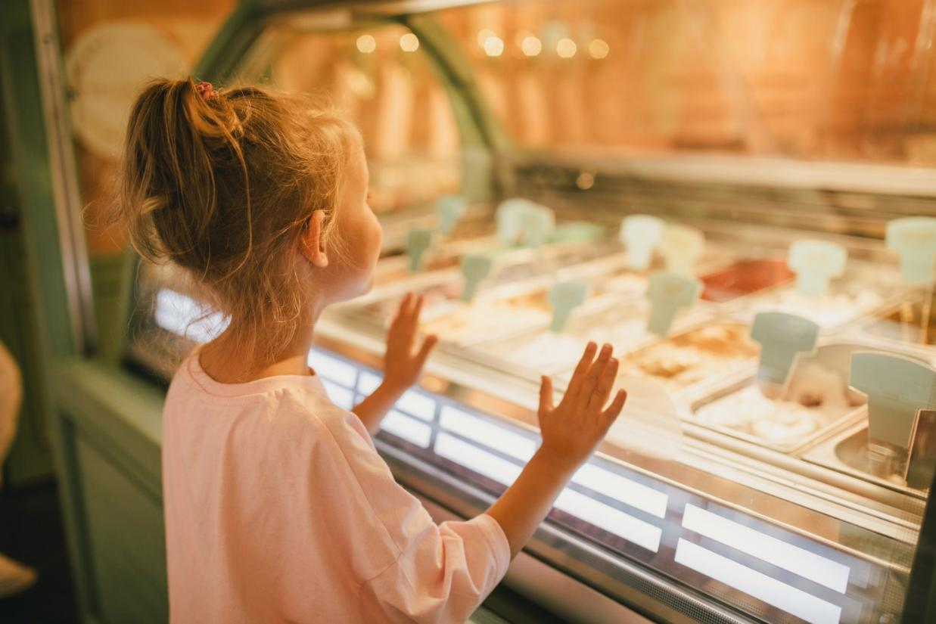
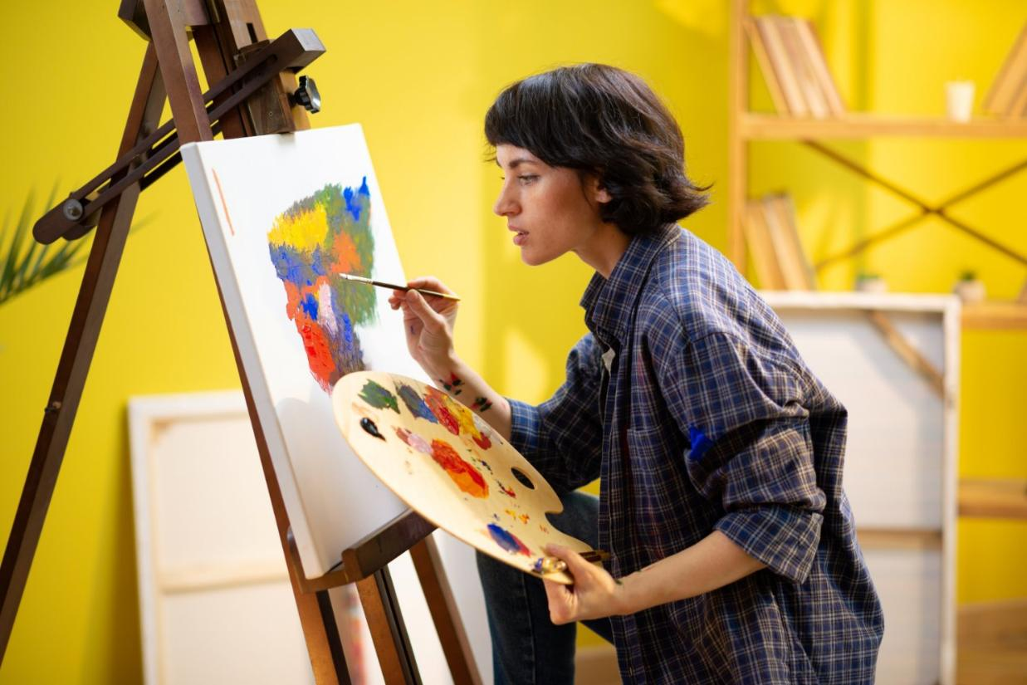
Find My Most Interesting Part

Slide 29
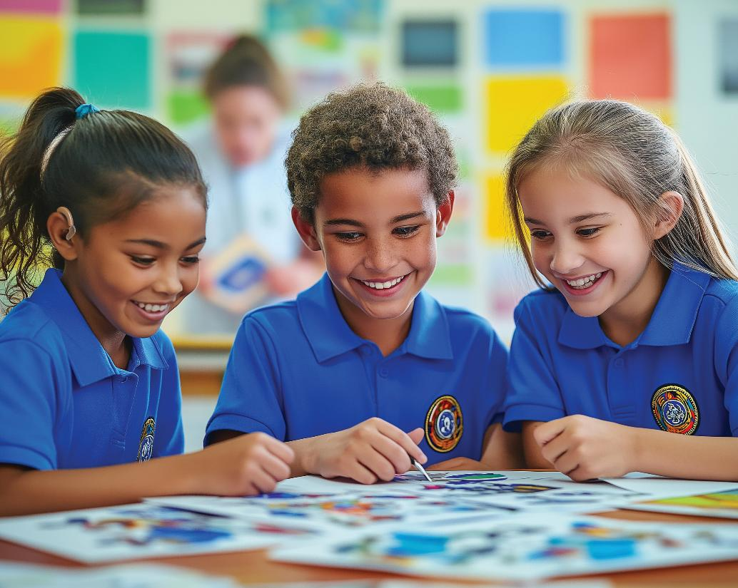
Find My Most Interesting Part

Slide 30
Find My Most Interesting Part

Slide 31

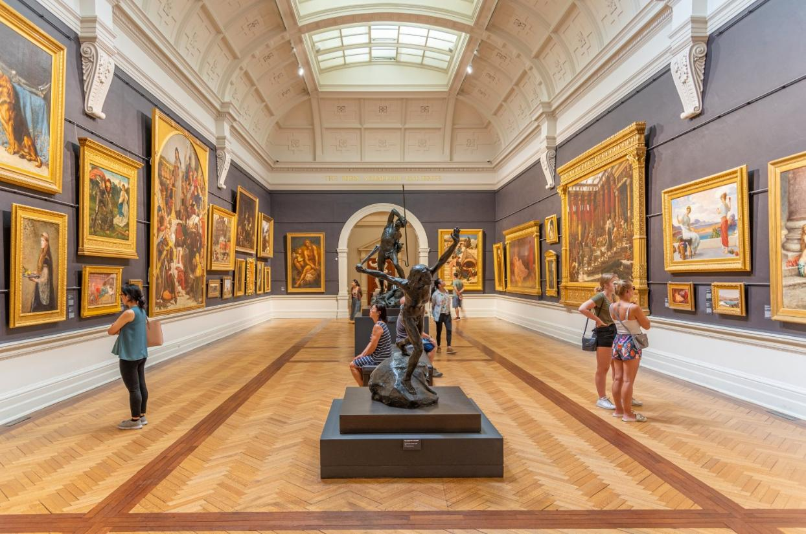
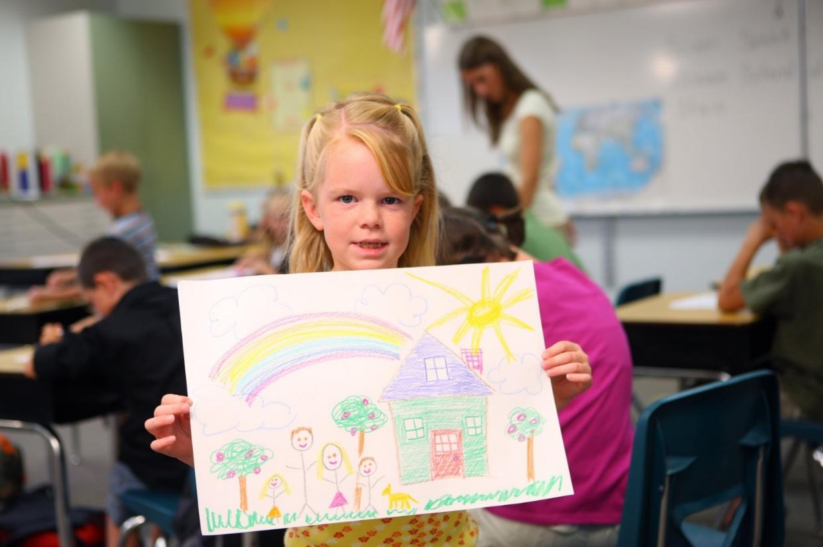

Slide 32
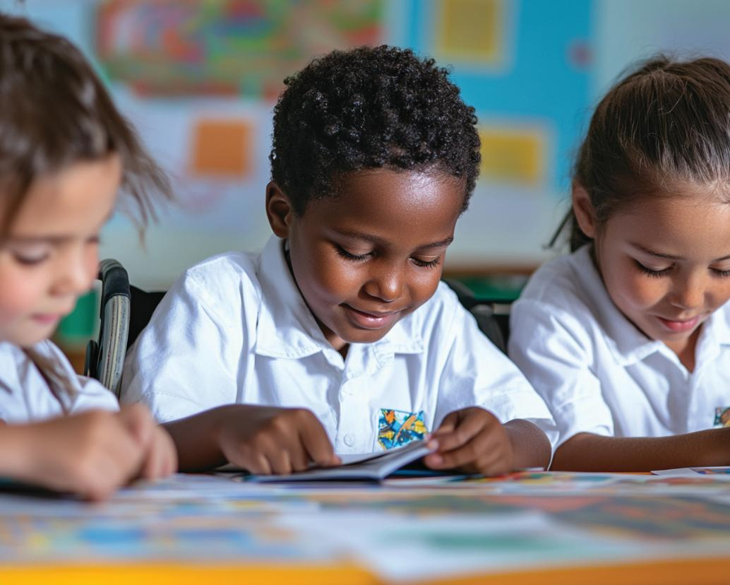

Slide 33
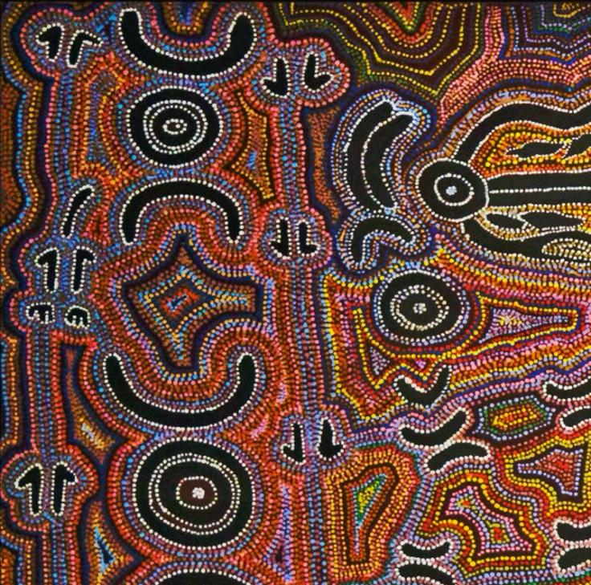
Symbols are simple pictures that represent ideas.
Different cultures use different symbols.
🌈
🤩
🙀
💩
🙏
🌸
🤖

Slide 35
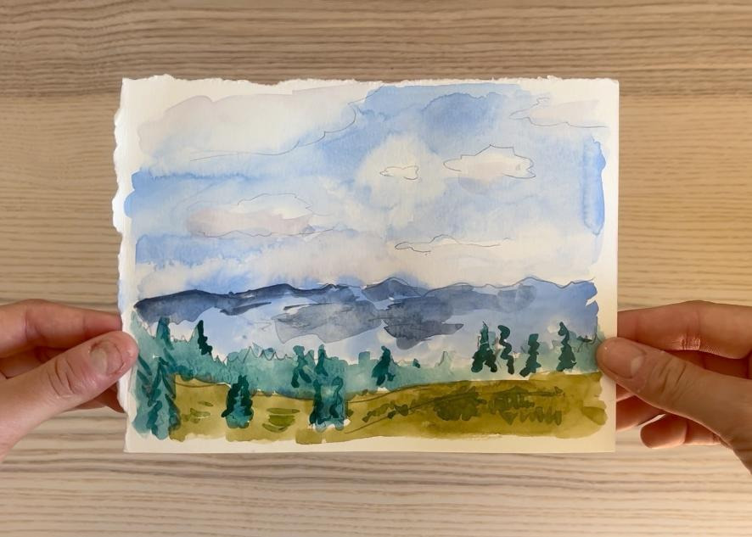
In the next lesson, we will learn how to paint a landscape that is important to our culture.

Slide 36
The Aboriginal and Torres Strait Islanders of Australia cultural materials featured in this resource are the Cultural and Intellectual Property of their respective Traditional Owners, representing over sixty thousand years of cultural knowledge and continuing connection to Australia.
Slide 1, Slide 12, Slide 15 (seventh), Slide 16 (Water), Slide 33 (2nd) Photo: Aboriginal Religious Art, painting by Bessie Nakamarra Sims & Paddy Japaljarri Sims, uploaded by dun_deagh, from Wikimedia Commons, CC BY-SA 2.0, https://commons.wikimedia.org/wiki/File:Aboriginal_Religious_Art_%286854184762%29.jpg
Slide 7 (third), Photo: Save the Children Canada, from Wikimedia Commons, CC BY 2.0, https://commons.wikimedia.org/wiki/File:Children_Art_Therapy.jpg
Slide 10 (first), Photo: apasciuto, from Wikimedia Commons, CC BY 2.0 , https://commons.wikimedia.org/wiki/File:Ocean_water.jpg
Slide 13, Slide 15 (eighth) Photo: Untitled by Clifford Possum Tjapaltjarri, from WikiArt, Used under Fair Use, https://www.wikiart.org/en/clifford-possum-tjapaltjarri/untitled-1980
Slide 15 (third) Photo: Sutra box with dragons amid clouds, Purchase, Sir Joseph Hotung and The Vincent Astor Foundation Gifts, 2001, from The Metropolitan Museum of Art, Public Domain, https://www.metmuseum.org/art/collection/search/60870
Slide 15 (fourth), Slide 16 (Strength/Luck) Photo: Dish with dragon amid waves, Gift of Mrs. Richard E. Linburn, in memory of Richard E. Linburn, 1975, from The Metropolitan Museum of Art, Public Domain, https://www.metmuseum.org/art/collection/search/42497
Slide 15 (fifth), Slide 16 (Religion) Photo: Christ Bearing the Cross by Nikolaos Tzafouris, Bashford Dean Memorial Collection, Funds from various donors, 1929, from https://www.metmuseum.org/art/collection/search/437855 via Wikimedia Commons, CC0, https://commons.wikimedia.org/wiki/File:Christ_Bearing_the_Cross_MET_DP215890.jpg
Slide 15 (sixth) Photo: Christ Carrying the Cross by El Greco (Domenikos Theotokopoulos), ca. 1577–87, Robert Lehman Collection, 1975, from The Metropolitan Museum of Art, Public Domain, https://www.metmuseum.org/art/collection/search/459087

Slide 37
Slide 20 Music: chimes by Snoozy Beats https://soundcloud.com/snoozybeats License: Creative Commons — Attribution 3.0 Unported — CC BY 3.0 Free Download / Stream: https://www.audiolibrary.com.co/snoozybeats/chimes Music promoted by Audio Library: https://youtu.be/9emPKhTjPVM

