Slide 1
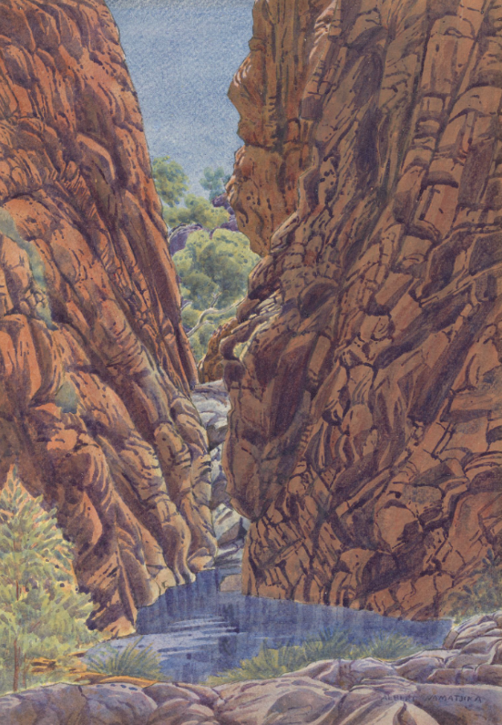
Unit 1B
Art and Culture
Lesson 2
Landscape as Culture
Unit 1B Version 1

Slide 2
Remember, symbols are simple pictures that represent ideas.
🌈
🤩
💩
🙀
🙏
🌸
🤖

Slide 3
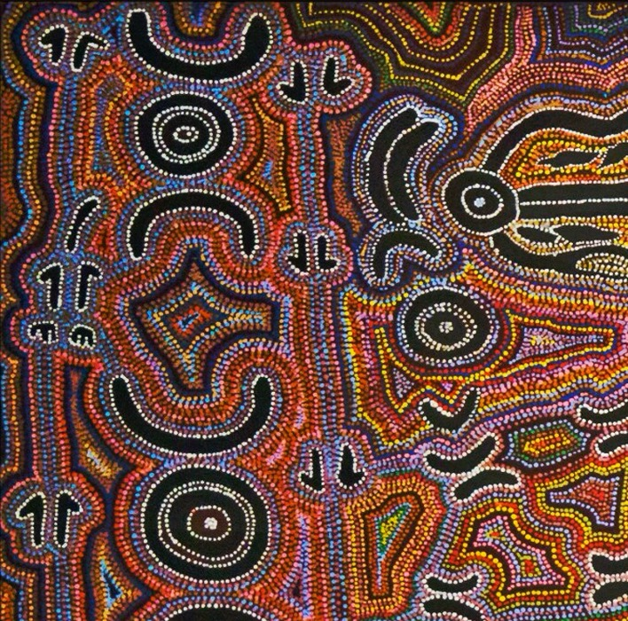
Different cultures use different symbols.

Slide 4
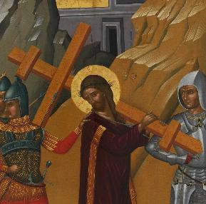
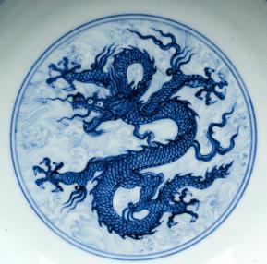
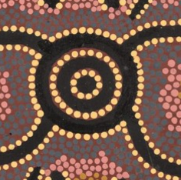
A symbol that represents water in First Australians culture is:

Slide 5
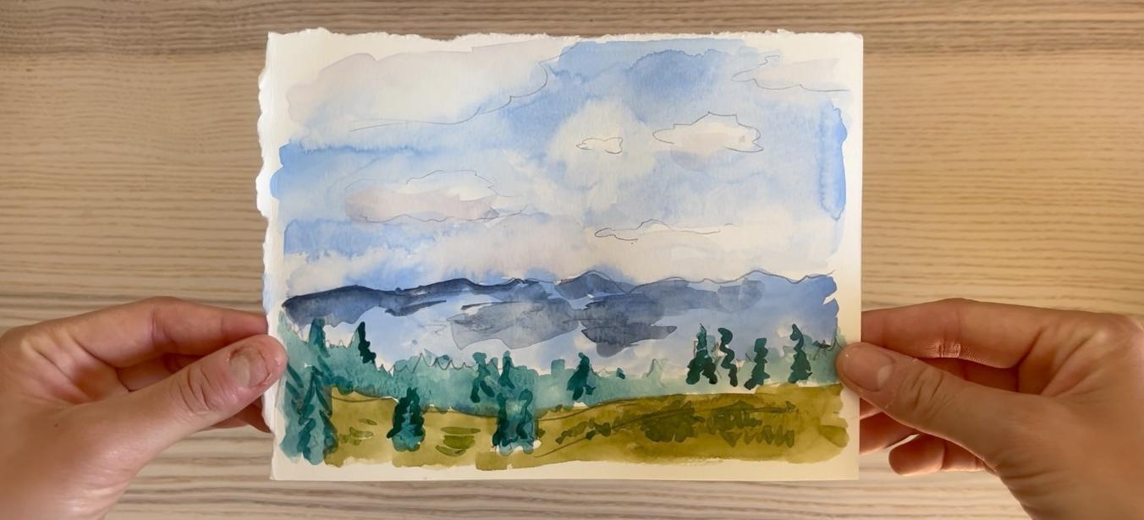
In this lesson, we will learn how to paint a landscape that is important to our culture.

Slide 6
You will be successful when you can:
identify different parts of the landscape from a photo
choose realistic colours to paint your landscape.

Slide 7
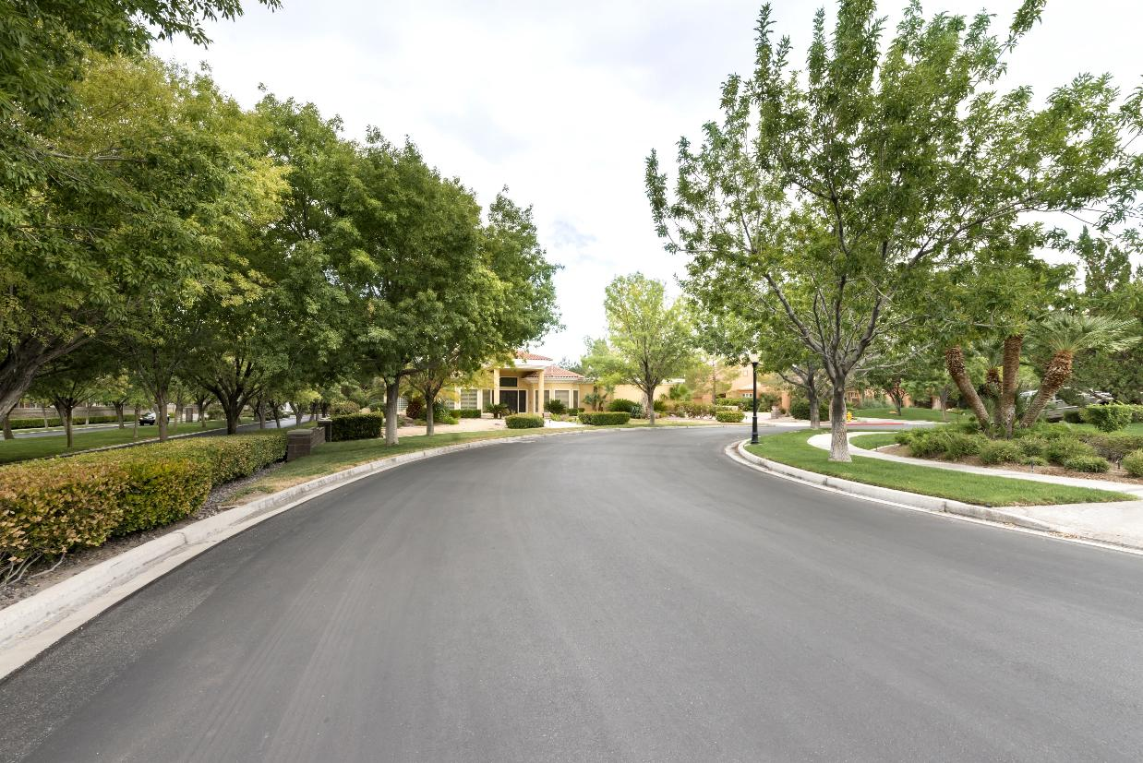
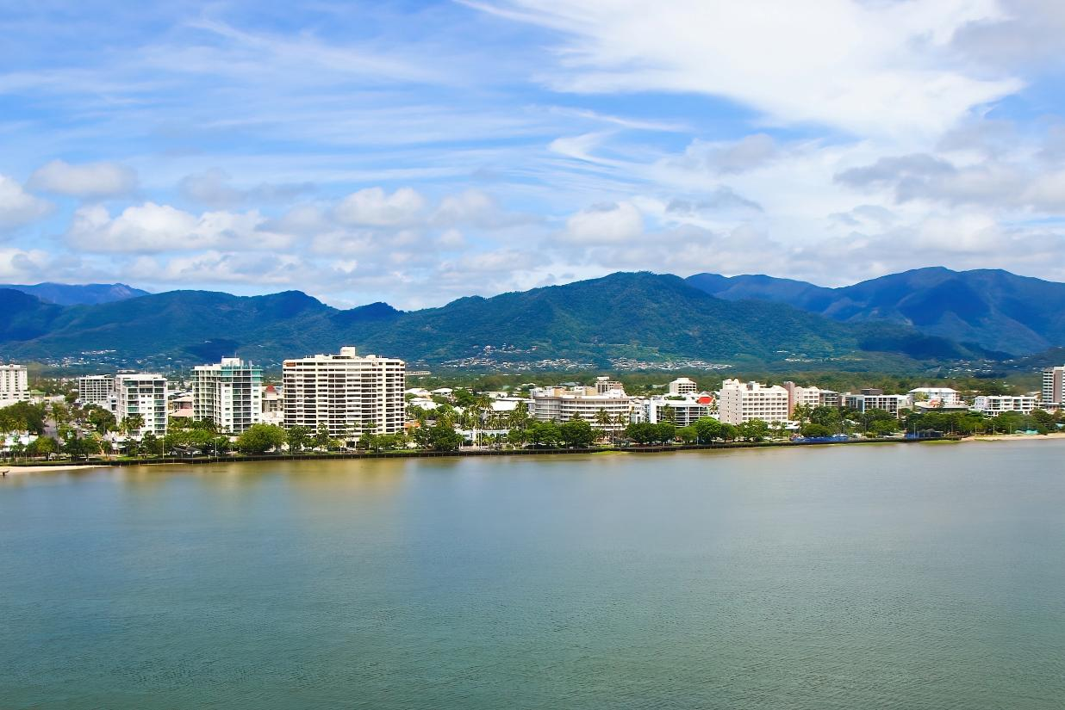
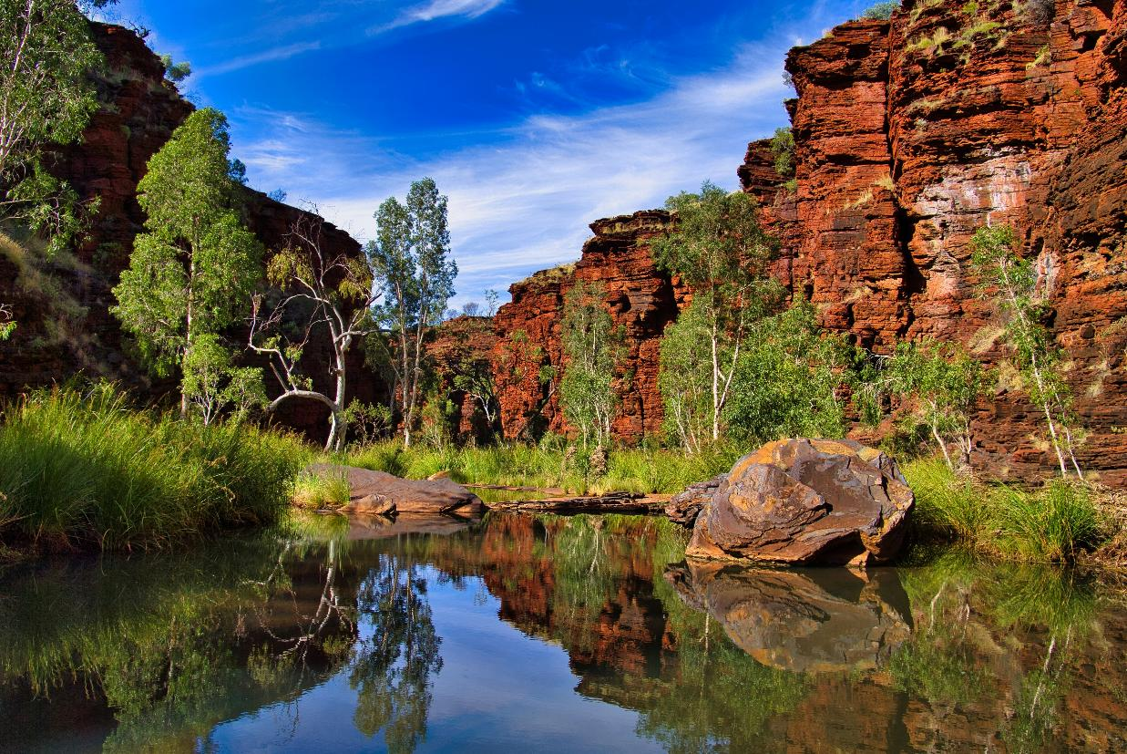

Slide 8
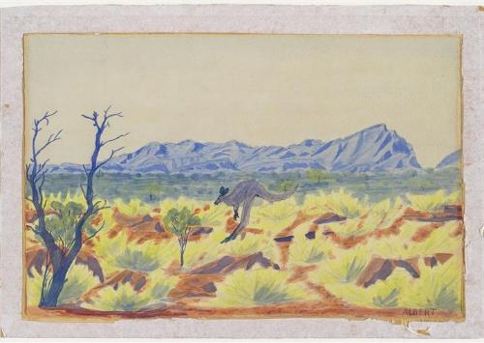
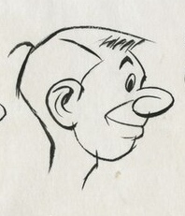
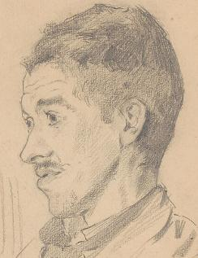


landscape
A picture of the outside world, full of things like hills, trees and lakes.
realistic
When a picture of something looks like it actually does in real life.

Slide 9
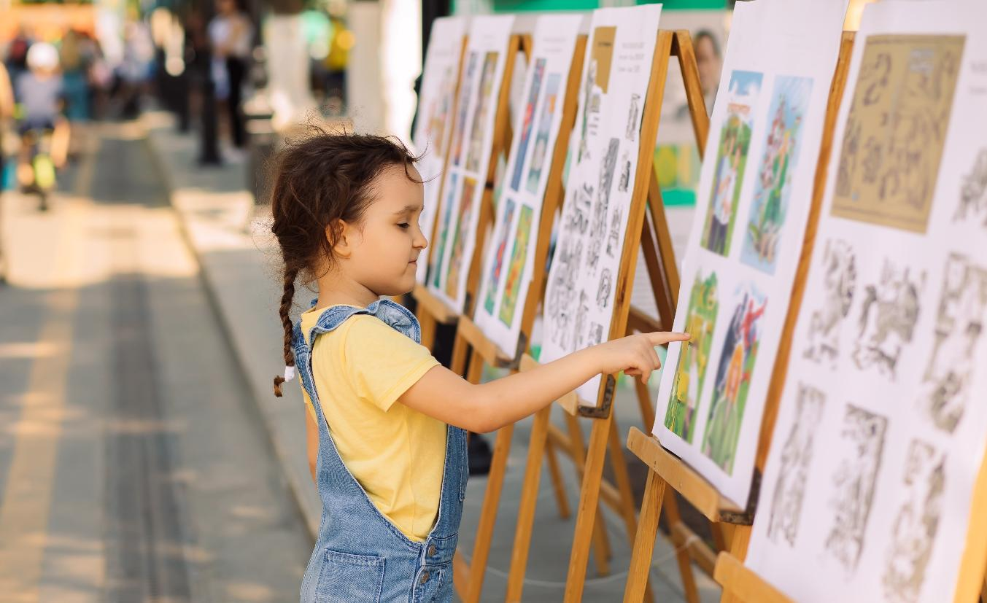
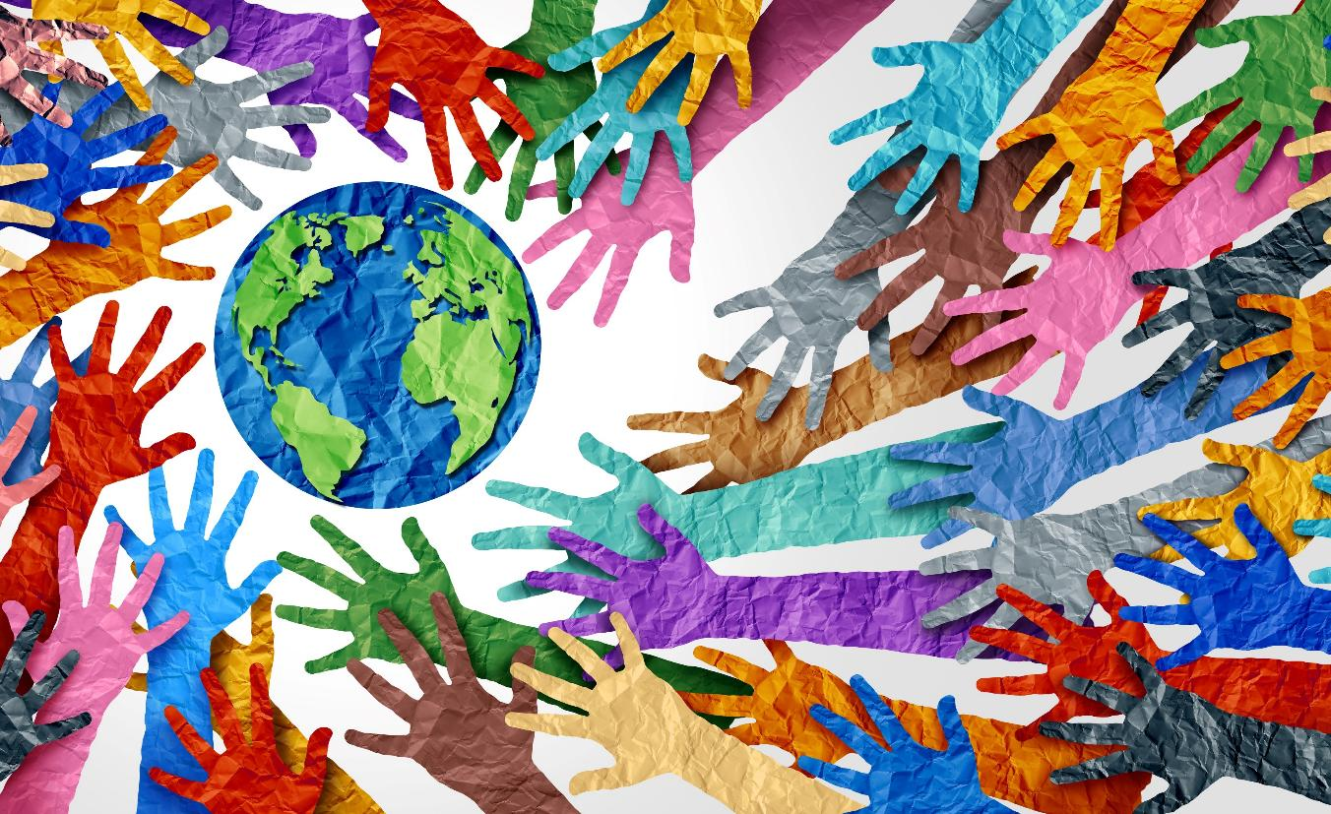
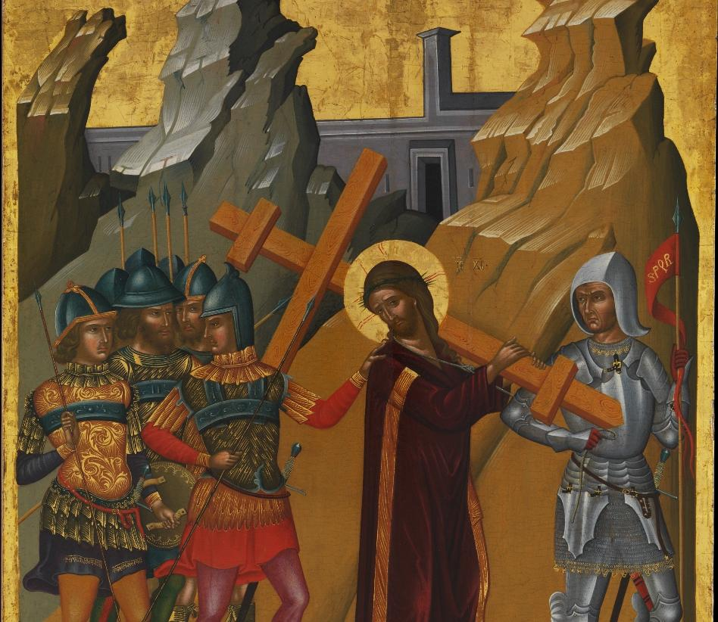
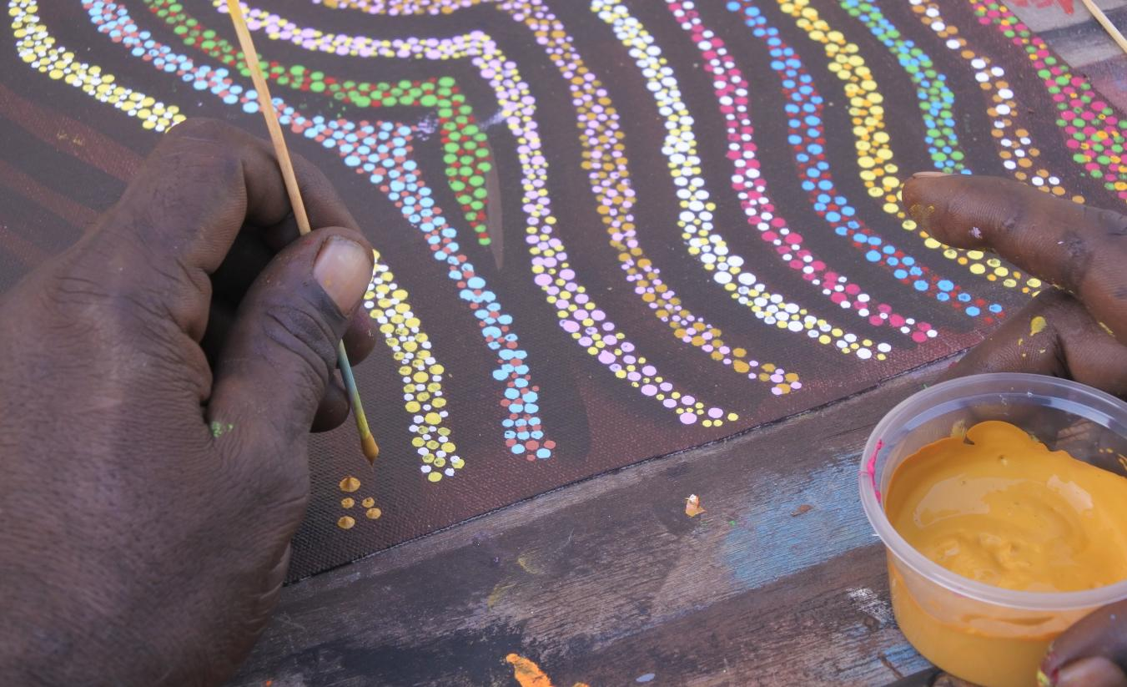
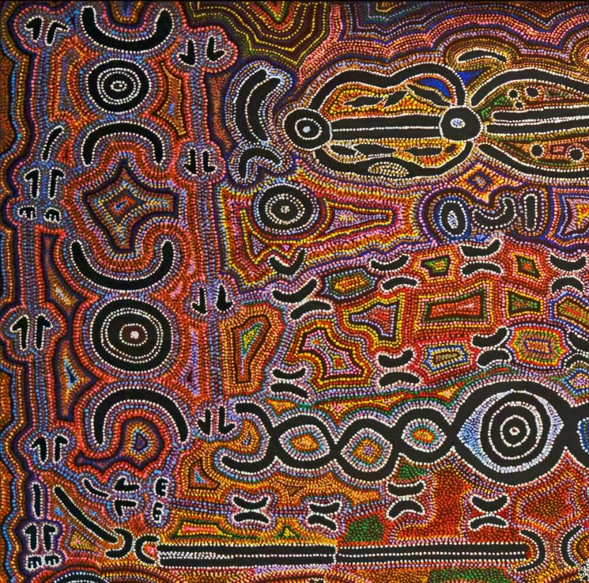
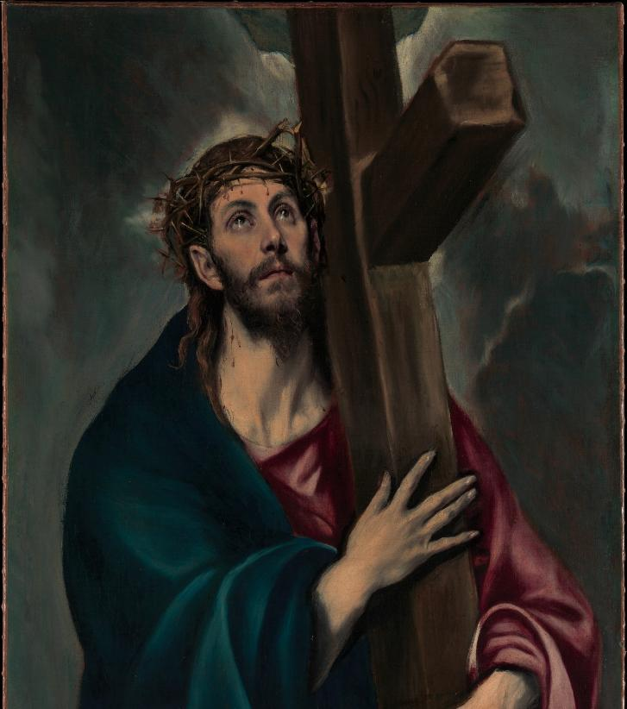
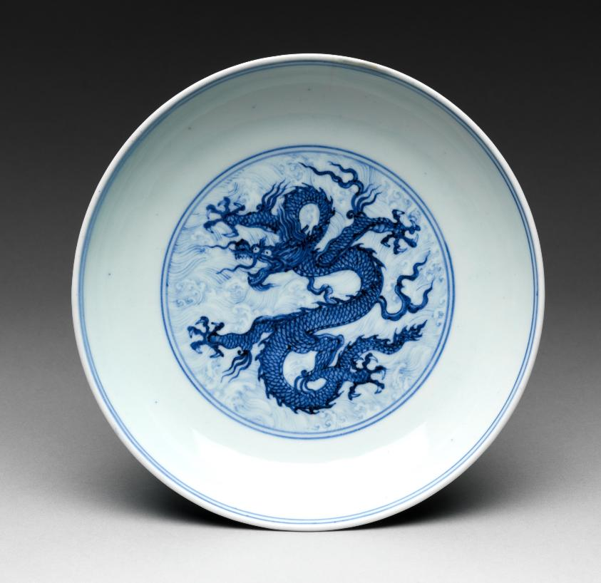
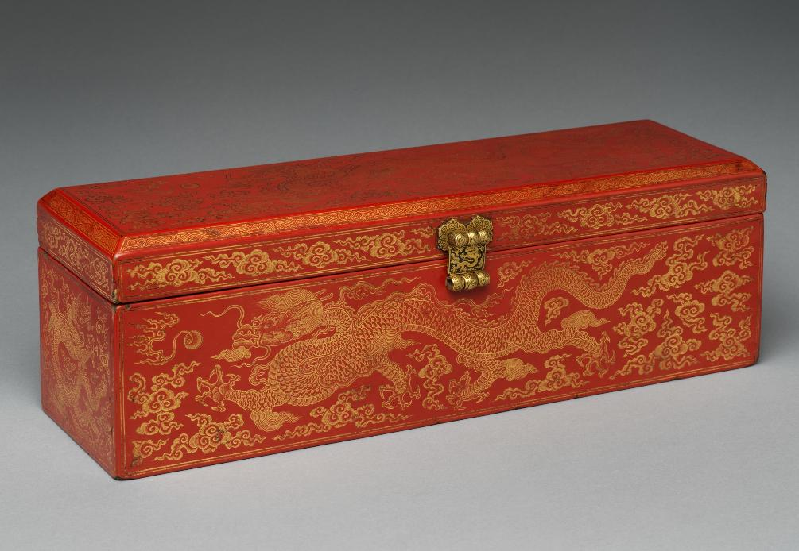

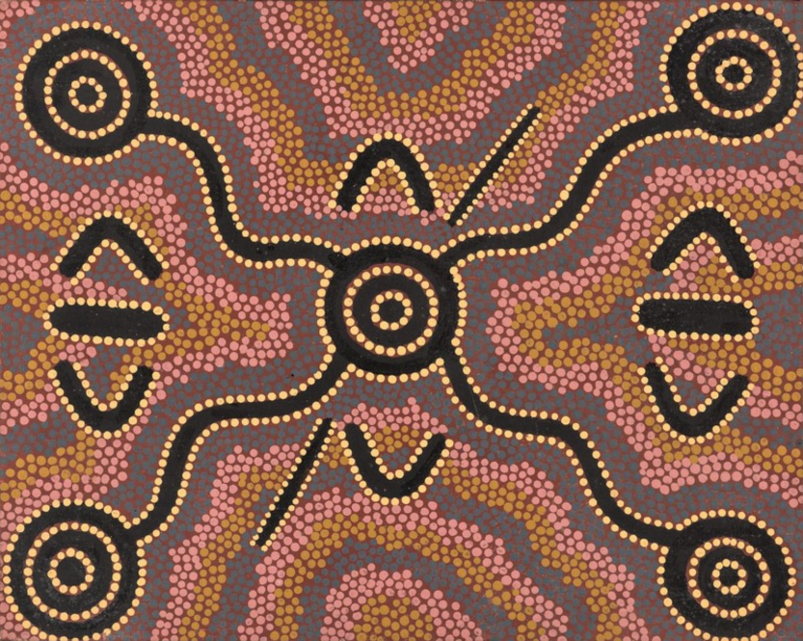
Art Shows the Artist’s Culture

Slide 10
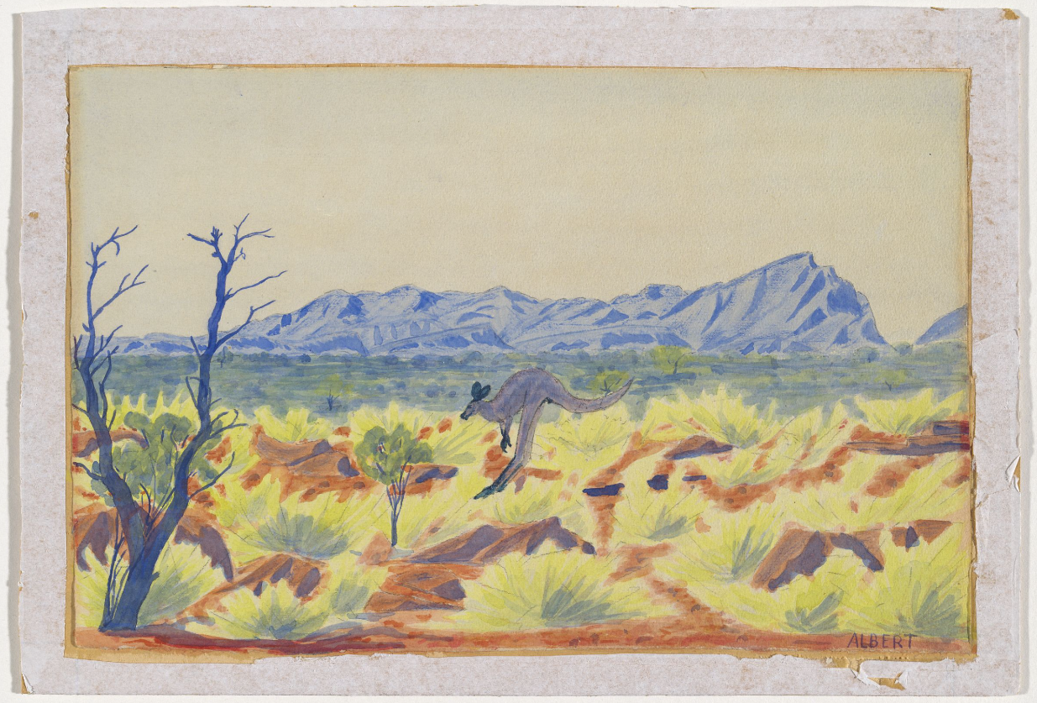
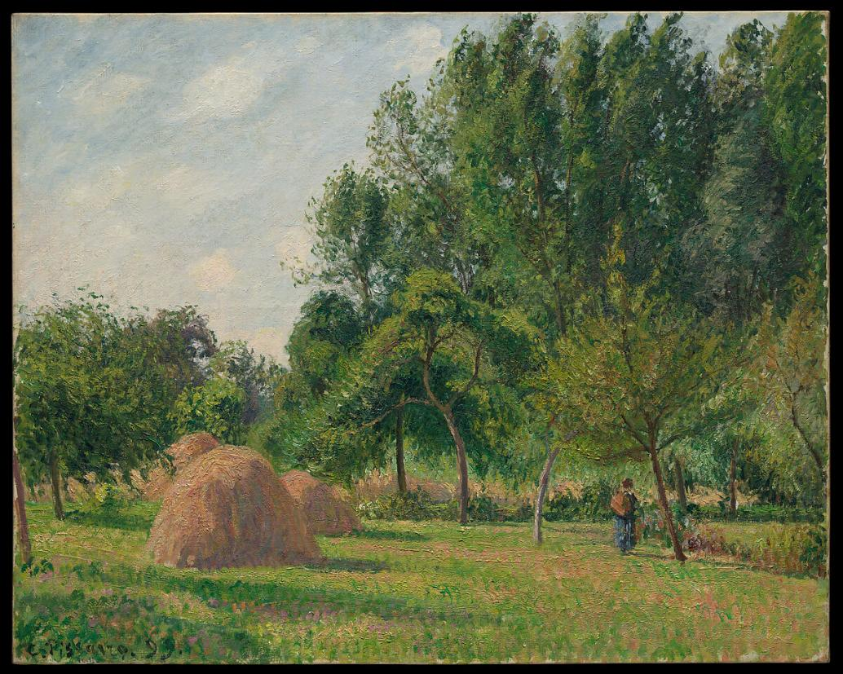
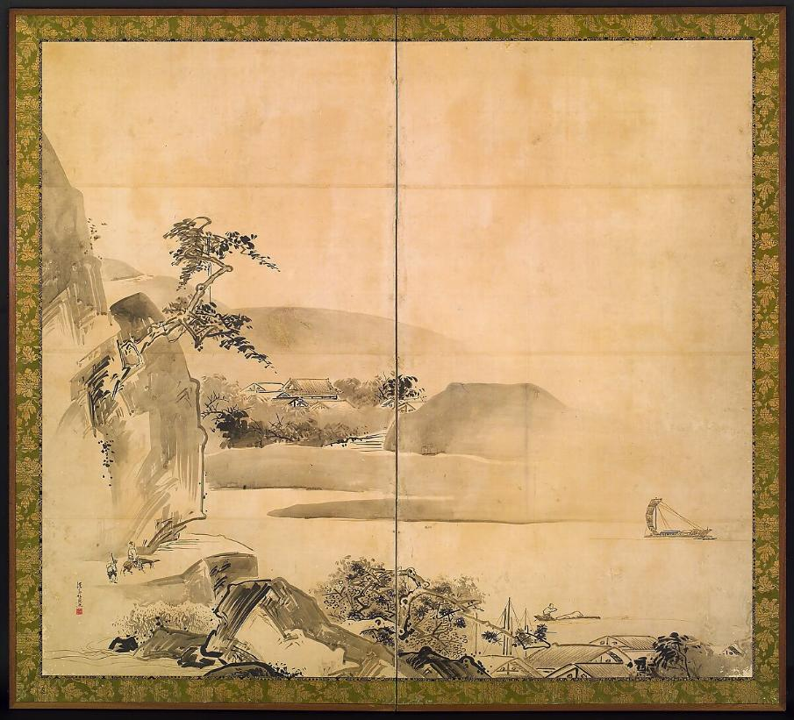
Parts of the Landscape

Slide 11
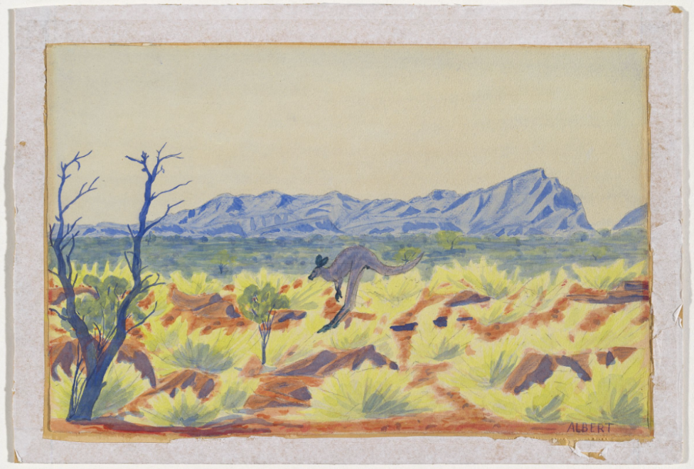





Parts of the Landscape
Word Bank
Bushes/Grass
Rocks
Mountains
Trees
Water
Mountains
Rocks
Trees
Bushes / Grass

Slide 12
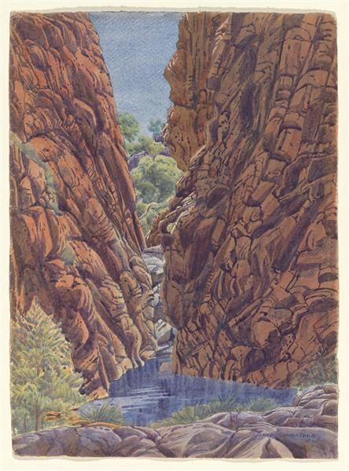










Parts of the Landscape
Rocks/
Mountains
Word Bank
Bushes/Grass
Rocks
Mountains
Trees
Water
Trees
Water
Grass
Rocks

Slide 13
Parts of the Landscape
One important part of Namatjira's landscapes is:
grass and bushes
the ocean
snow

Slide 14
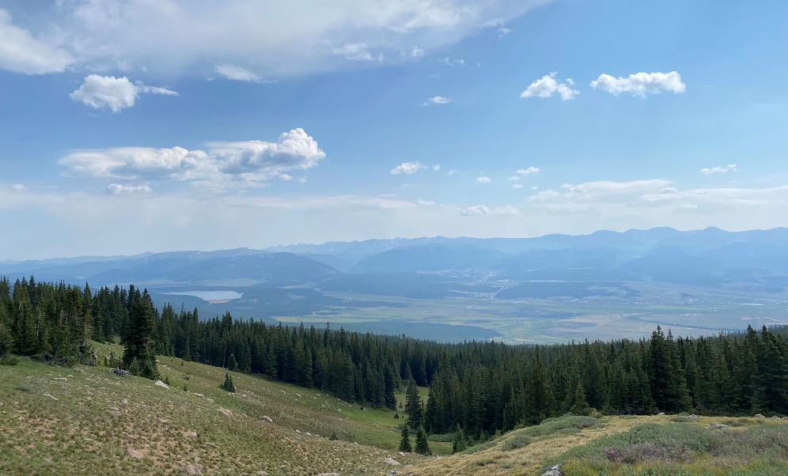




Parts of the Landscape
clouds
sky
trees
grass
mountains

Slide 15
Parts of the Landscape
Label all the parts of the landscape
Photo 1
Photo 2
?
Photo 3

Slide 16
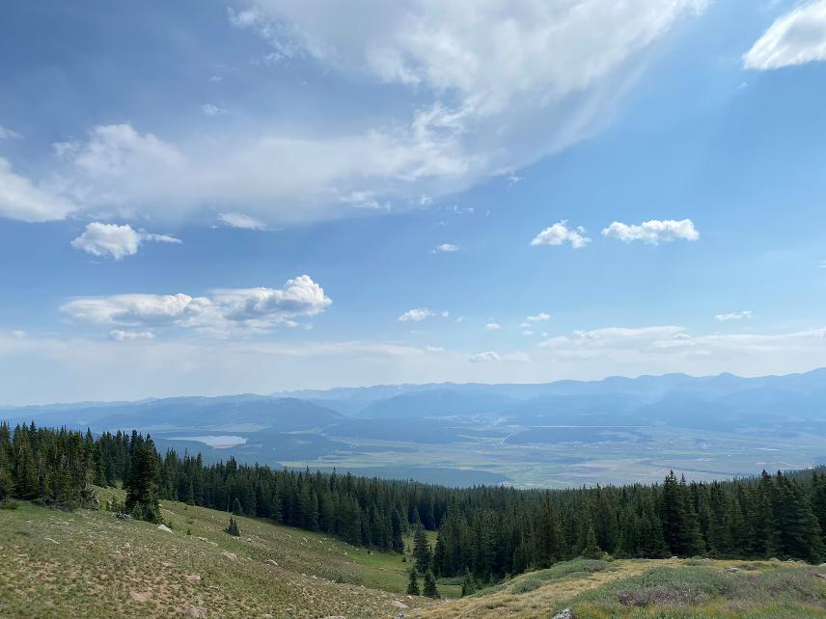
Realistic Colours

Slide 17
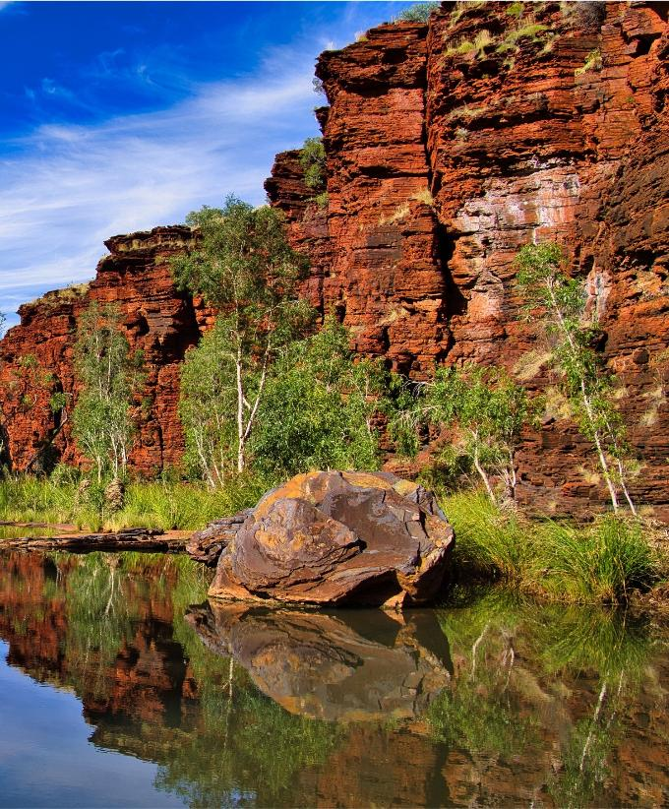
Realistic Colours
The colour of the rocks is __________________.
reddish-brown

Slide 18
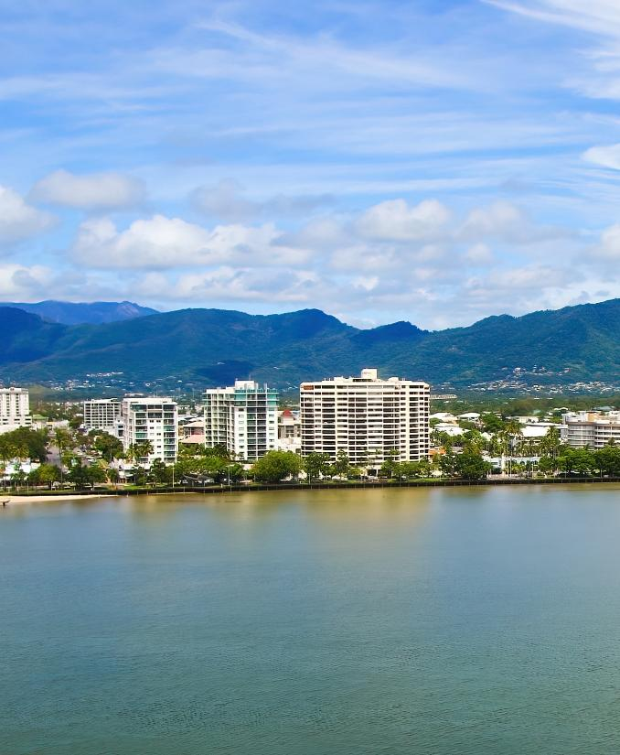
Realistic Colours
The colour of the ocean is ______________.
blue-green

Slide 19
Realistic Colours
A realistic colour for a grassy hill is:

Slide 20












Realistic Colours
light grey
light blue
clouds
sky
grass
dark green
trees
mountains
brownish-green
light blue

Slide 21
Parts of the Landscape
Label the colours for each part of the landscape
Photo 1
Photo 2
?
Photo 3

Slide 22

Landscapes in My Culture

Slide 23
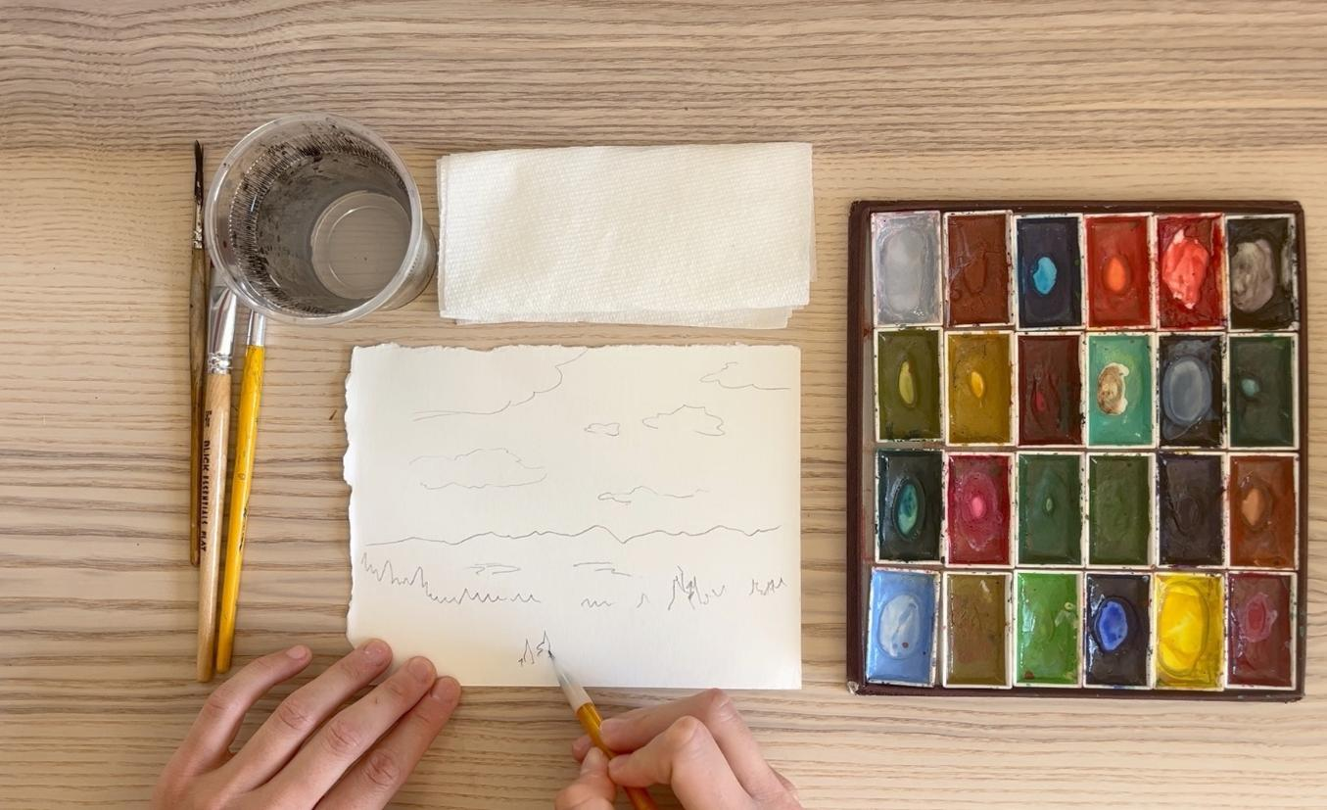
Landscapes in My Culture

Slide 24


Landscapes in My Culture
You use a bigger brush if you want to paint over a bigger space.

Slide 25
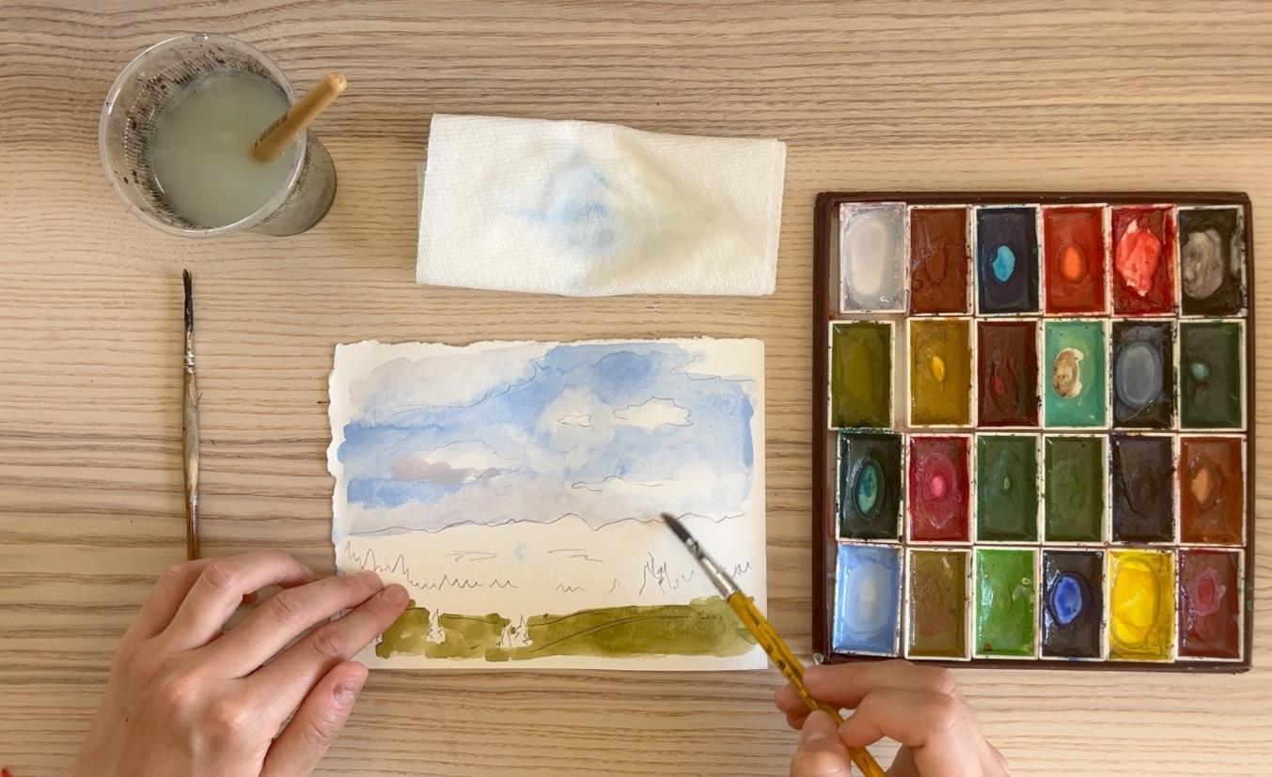
Landscapes in My Culture

Slide 26
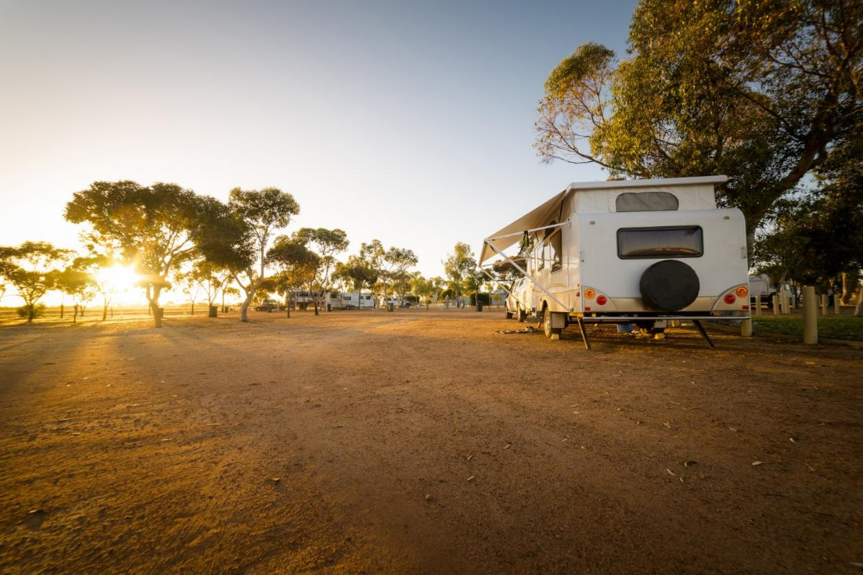
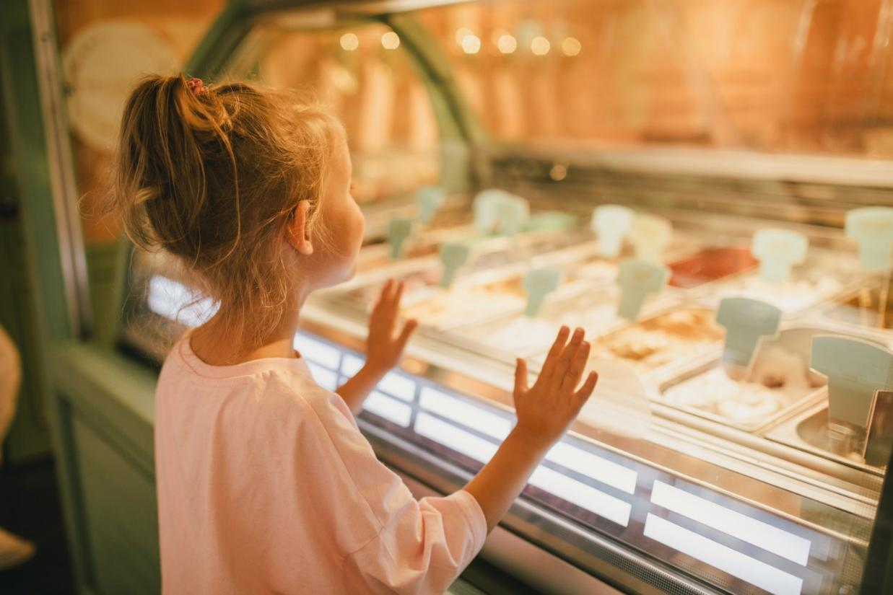
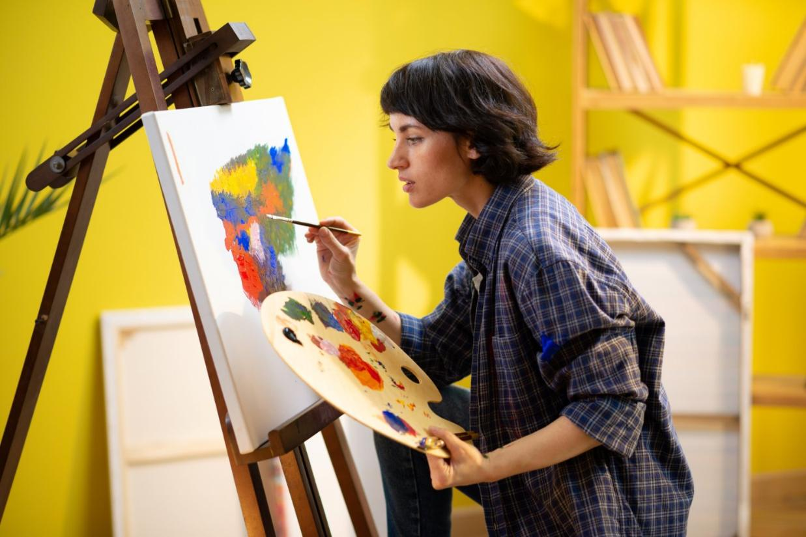
Find My Most Interesting Part

Slide 27
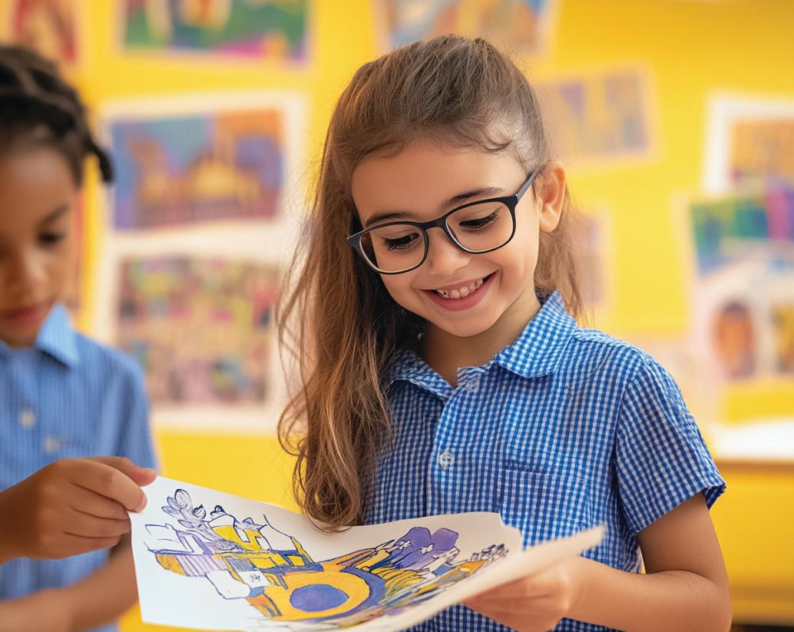
Find My Most Interesting Part

Slide 28
Find My Most Interesting Part

Slide 29
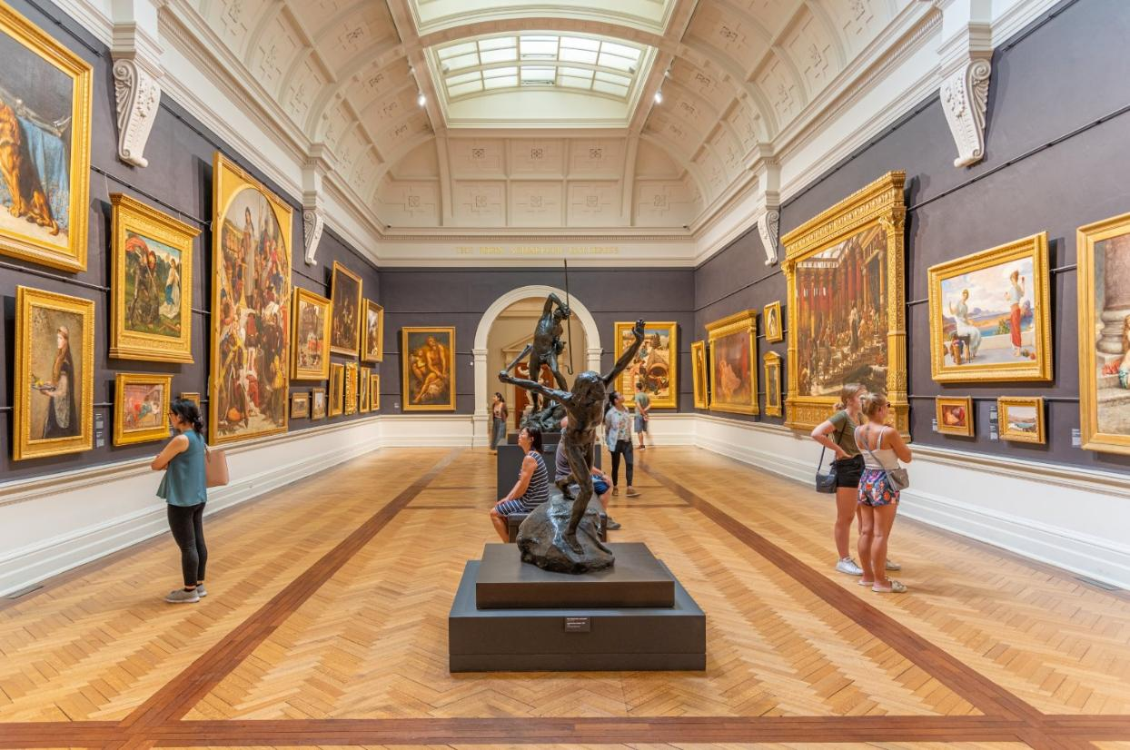
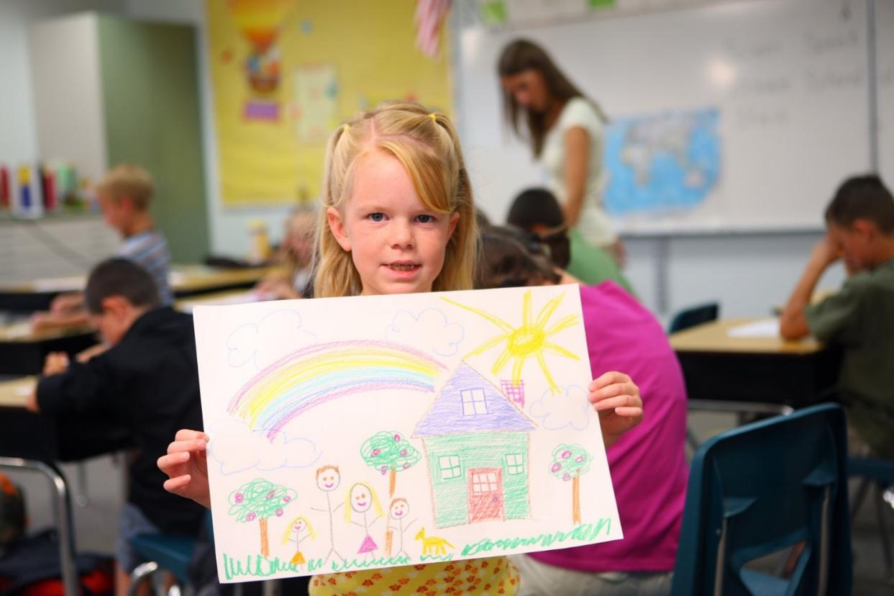


Slide 30


Slide 31
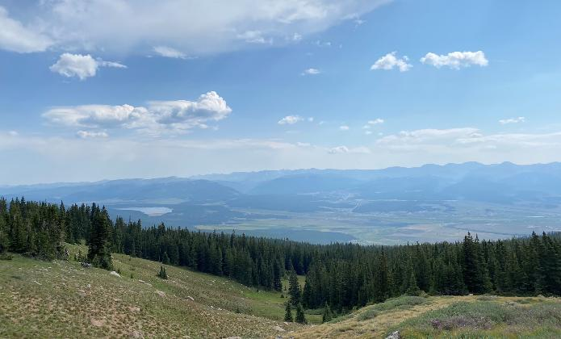

Landscapes are made of many parts.
Realistic colours are the colours we see in real life.
light grey
light blue
clouds
sky
trees
grass
dark green
mountains
brownish-green
light blue

Slide 33
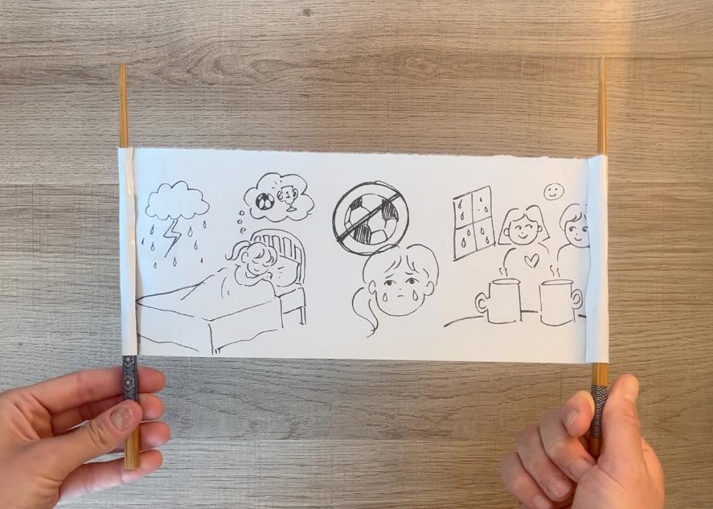
In the next lesson, we will learn how to tell a story about a very special day, using only symbols and images.

Slide 34
The Aboriginal and Torres Strait Islanders of Australia cultural materials featured in this resource are the Cultural and Intellectual Property of their respective Traditional Owners, representing over sixty thousand years of cultural knowledge and continuing connection to Australia.
Slide 1, Slide 12 Photo: Morning, Narrow Gap, Western James Range, Central Australia by Albert Namatjira (c.1944), from WikiArt, Used under Fair Use, https://www.wikiart.org/en/albert-namatjira/morning-narrow-gap-western-james-range-central-australia-1944
Slide 3, Slide 9 (7th) Photo: Aboriginal Religious Art, painting by Bessie Nakamarra Sims & Paddy Japaljarri Sims, uploaded by dun_deagh, from Wikimedia Commons, CC BY-SA 2.0,
Slide 4 (right), Slide 9 (8th) Photo: Untitled by Clifford Possum Tjapaltjarri, from WikiArt, Used under Fair Use, https://www.wikiart.org/en/clifford-possum-tjapaltjarri/untitled-1980
Slide 4 (left), Slide 9 (seventh) Photo: Christ Bearing the Cross by Nikolaos Tzafouris, Bashford Dean Memorial Collection, Funds from various donors, 1929, from https://www.metmuseum.org/art/collection/search/437855 via Wikimedia Commons, CC0, https://commons.wikimedia.org/wiki/File:Christ_Bearing_the_Cross_MET_DP215890.jpg
Slide 4 (middle), Slide 9 (fourth) Photo: Dish with dragon amid waves, Gift of Mrs. Richard E. Linburn, in memory of Richard E. Linburn, 1975, from The Metropolitan Museum of Art, Public Domain, https://www.metmuseum.org/art/collection/search/42497
Slide 8 (landscape), Slide 10 (third), Slide 11, Slide 16 (1st) Photo: Kangaroo in Landscape by Albert Namatjira (1937), from WikiArt, Used under Fair Use, https://www.wikiart.org/en/albert-namatjira/kangaroo-in-landscape-1937
Slide 8 (realistic, left) Photo: Wells Man's Face Turned into a Cartoon Man's Face by Beaudoin.gouin, from Wikimedia Commons, CC BY-SA 4.0, https://commons.wikimedia.org/wiki/File:Wells_Man%27s_Face_Turned_into_a_Cartoon_Man%27s_Face.jpg
Slide 8 (realistic, right) Photo: Theodore Robinson by Kenyon Cox (1878), from The Metropolitan Museum of Art, Public Domain, https://www.metmuseum.org/art/collection/search/19522
Slide 9 (third) Photo: Sutra box with dragons amid clouds, Purchase, Sir Joseph Hotung and The Vincent Astor Foundation Gifts, 2001, from The Metropolitan Museum of Art, Public Domain, https://www.metmuseum.org/art/collection/search/60870 ​

Slide 35
Slide 9 (third) Photo: Christ Bearing the Cross by Nikolaos Tzafouris, Bashford Dean Memorial Collection, Funds from various donors, 1929, from https://www.metmuseum.org/art/collection/search/437855 via Wikimedia Commons, CC0, https://commons.wikimedia.org/wiki/File:Christ_Bearing_the_Cross_MET_DP215890.jpg ​
Slide 9 (third) Photo: Christ Carrying the Cross by El Greco (Domenikos Theotokopoulos), ca. 1577–87, Robert Lehman Collection, 1975, from The Metropolitan Museum of Art, Public Domain, https://www.metmuseum.org/art/collection/search/459087 ​​
Slide 10 (first) Photo: Haystacks, Morning, Eragny by Camille Pissarro (1899), from The Metropolitan Museum of Art, Public Domain, https://www.metmuseum.org/art/collection/search/438738
Slide 10 (second) Photo: Landscape by Watanabe Shikō, from The Metropolitan Museum of Art, Public Domain, https://www.metmuseum.org/art/collection/search/72416
Slide 22 Music: jellyfish by Tokiwave https://soundcloud.com/tokiwave License: Creative Commons — Attribution 3.0 Unported — CC BY 3.0 Free Download / Stream: https://www.audiolibrary.com.co/tokiwave/jellyfish Music promoted by Audio Library: https://youtu.be/KOOJwbtvq8g

