Slide 1
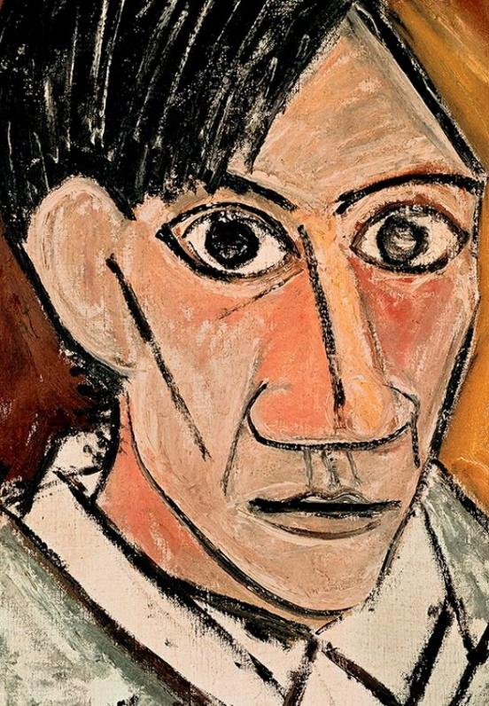
Unit 1A
Art and Me
Lesson 2
Shapes Make Faces
Unit 1A Version 1

Slide 2
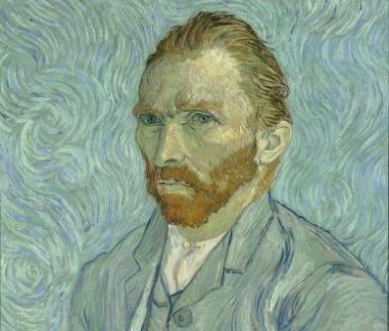
A self-portrait is a picture of the artist’s face.

Slide 3
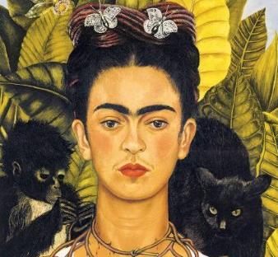
We can use different shapes and lines to draw parts of a face.

Slide 4



A self-portrait shows:
The artist’s face.
The artist’s house.
The artist’s dog.

Slide 5
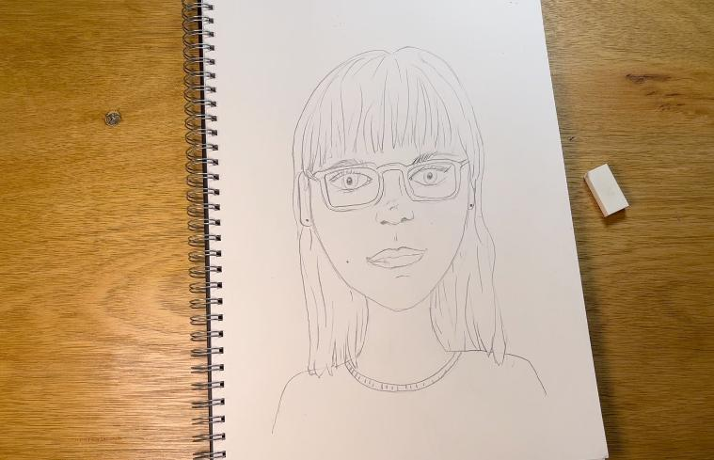
In this lesson, we will use shapes and lines to make a detailed self-portrait.

Slide 6
You will be successful when you can:
look at yourself to see the details of your face
use shapes and lines to add details to your self-portrait.

Slide 7
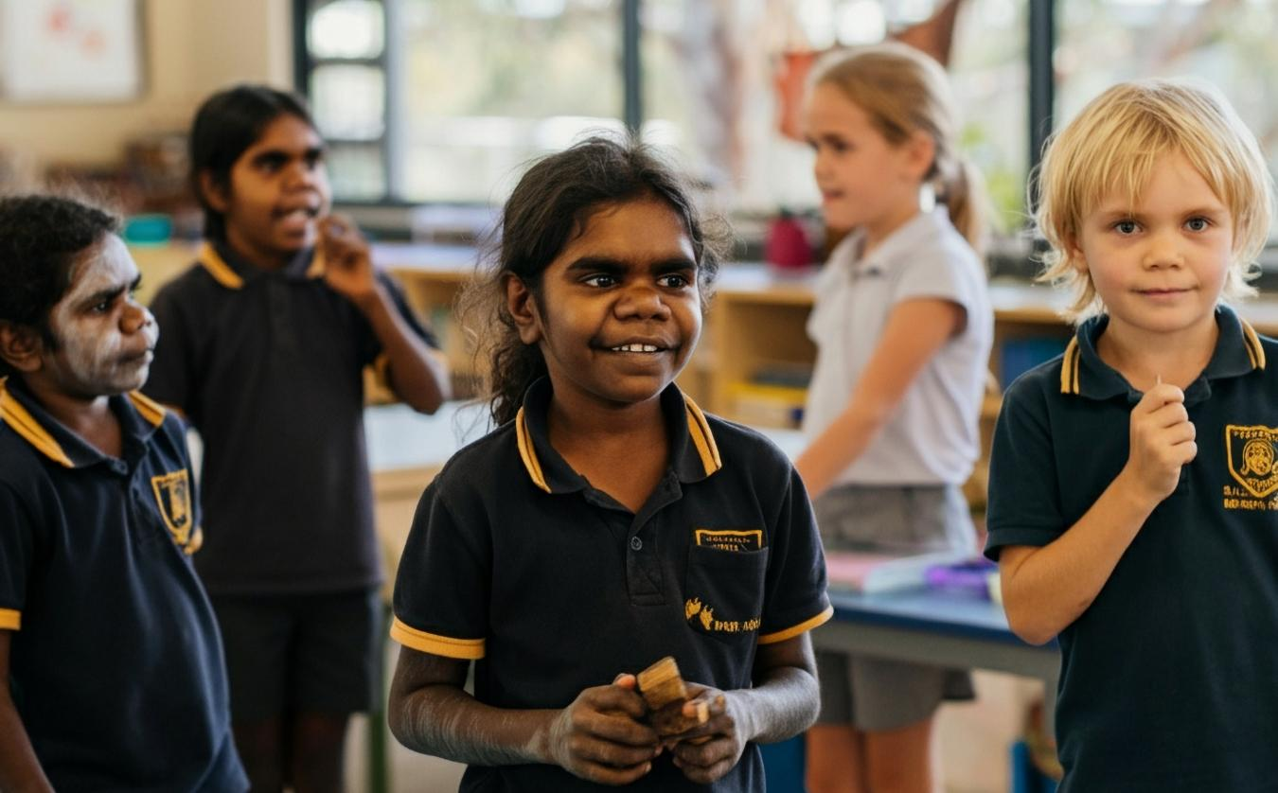

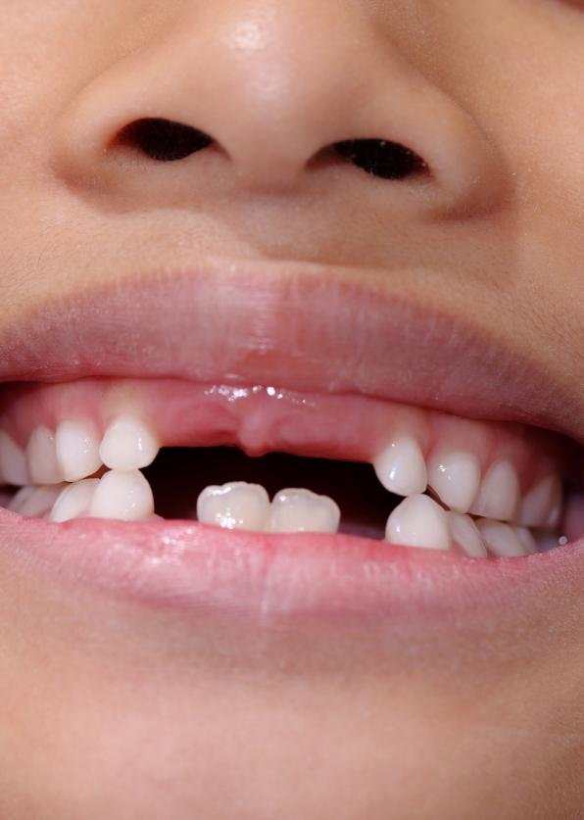
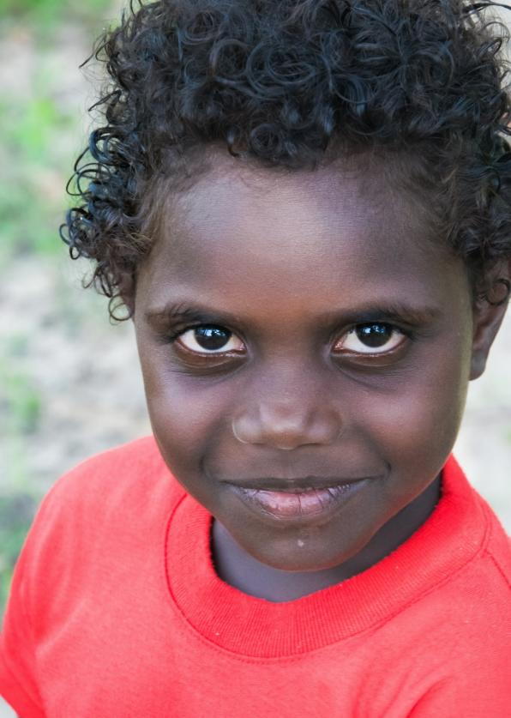
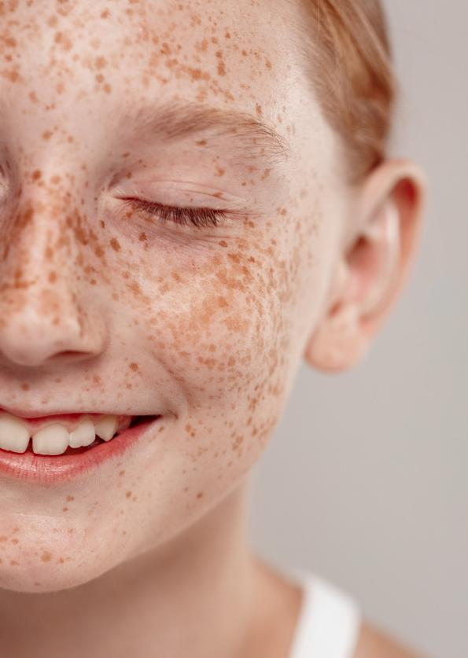
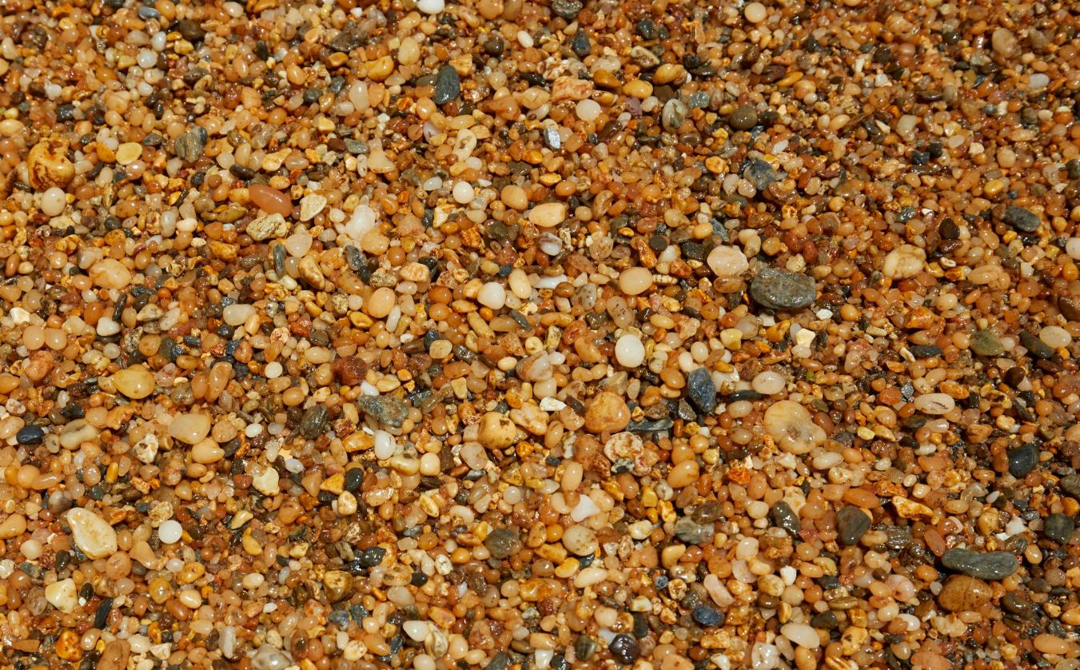

Slide 8
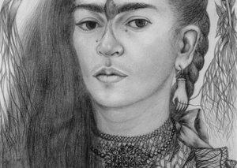
shape
A flat outline. Some shapes have straight edges; some have curvy edges.
detail
Small parts that make a picture more interesting.

Slide 9




Shapes and Lines

Slide 10
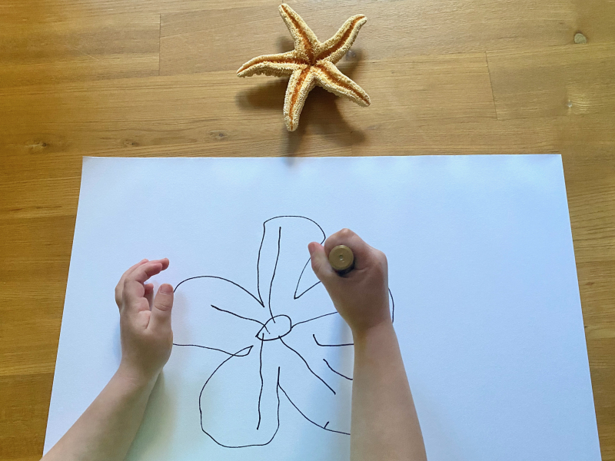
Shapes and Lines
© www.howwemontessori.com

Slide 11




Shapes and Lines

Slide 12


Shapes Can Turn into Pictures
Pictures use one shape.

Slide 13
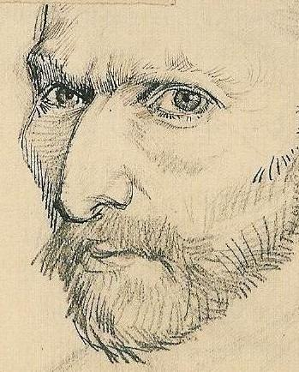
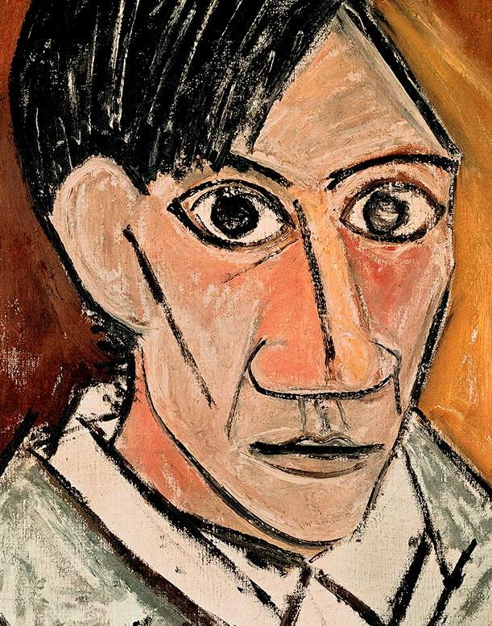
Shapes and Lines in Self-Portraits

Slide 14
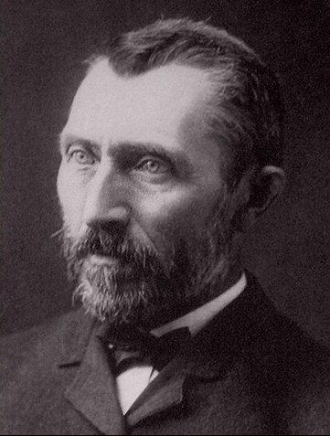
Shapes and Lines in Self-Portraits

Slide 15
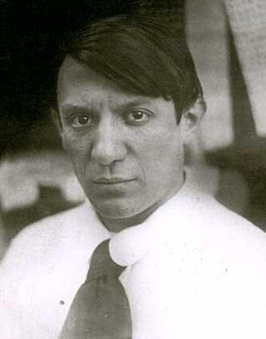
Shapes and Lines in Self-Portraits

Slide 16
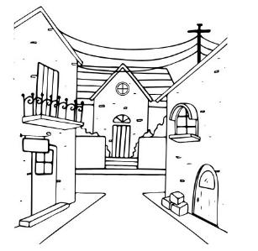
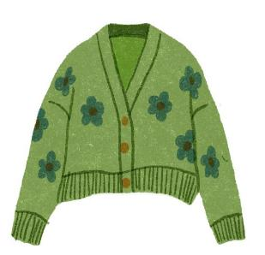
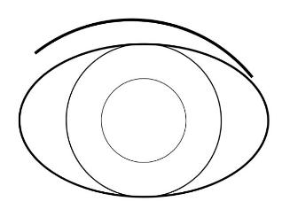
Shapes and Lines in Self-Portraits
Artists show their face by drawing:

Slide 17
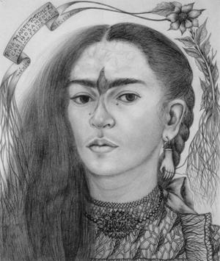
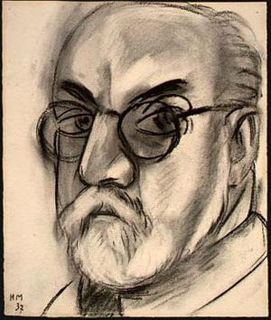
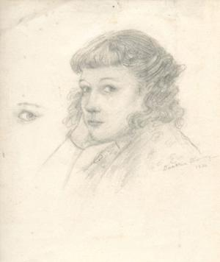
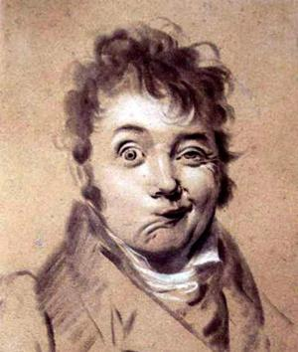
Unique Self-Portraits

Slide 18
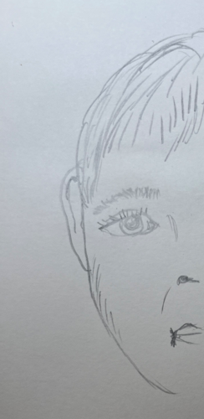
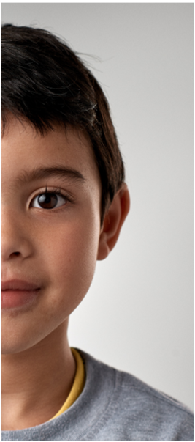
Special Self-Portraits

Slide 19
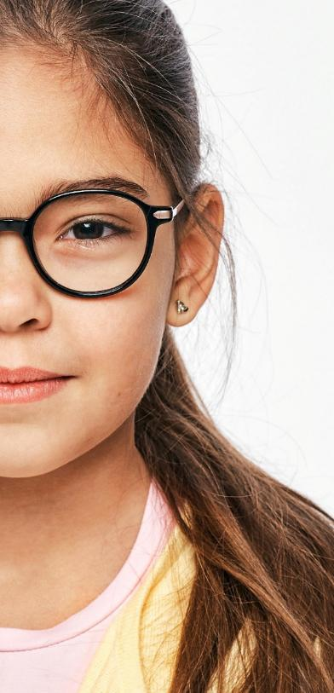
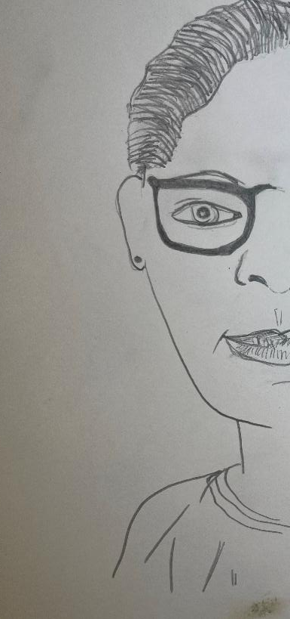
Special Self-Portraits

Slide 20


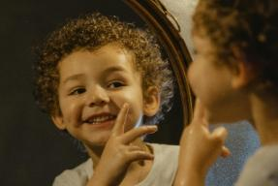
Special Self-Portraits
An artist’s self-portrait looks like…
someone else
someone famous
them

Slide 21
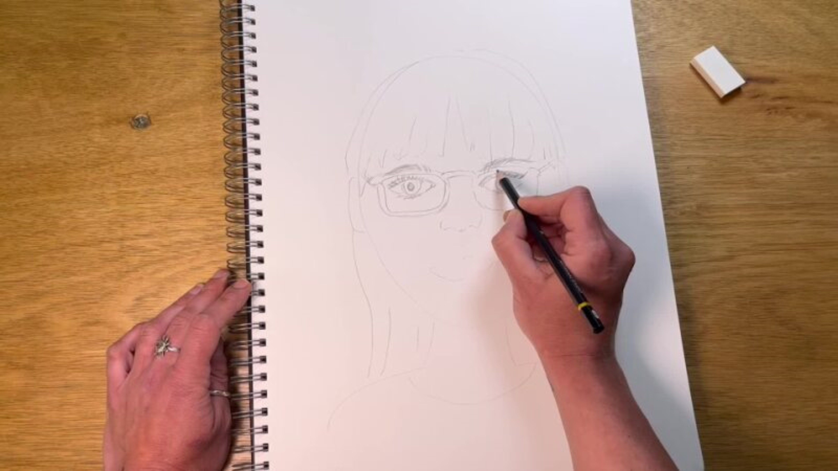
Draw a Self-Portrait

Slide 22
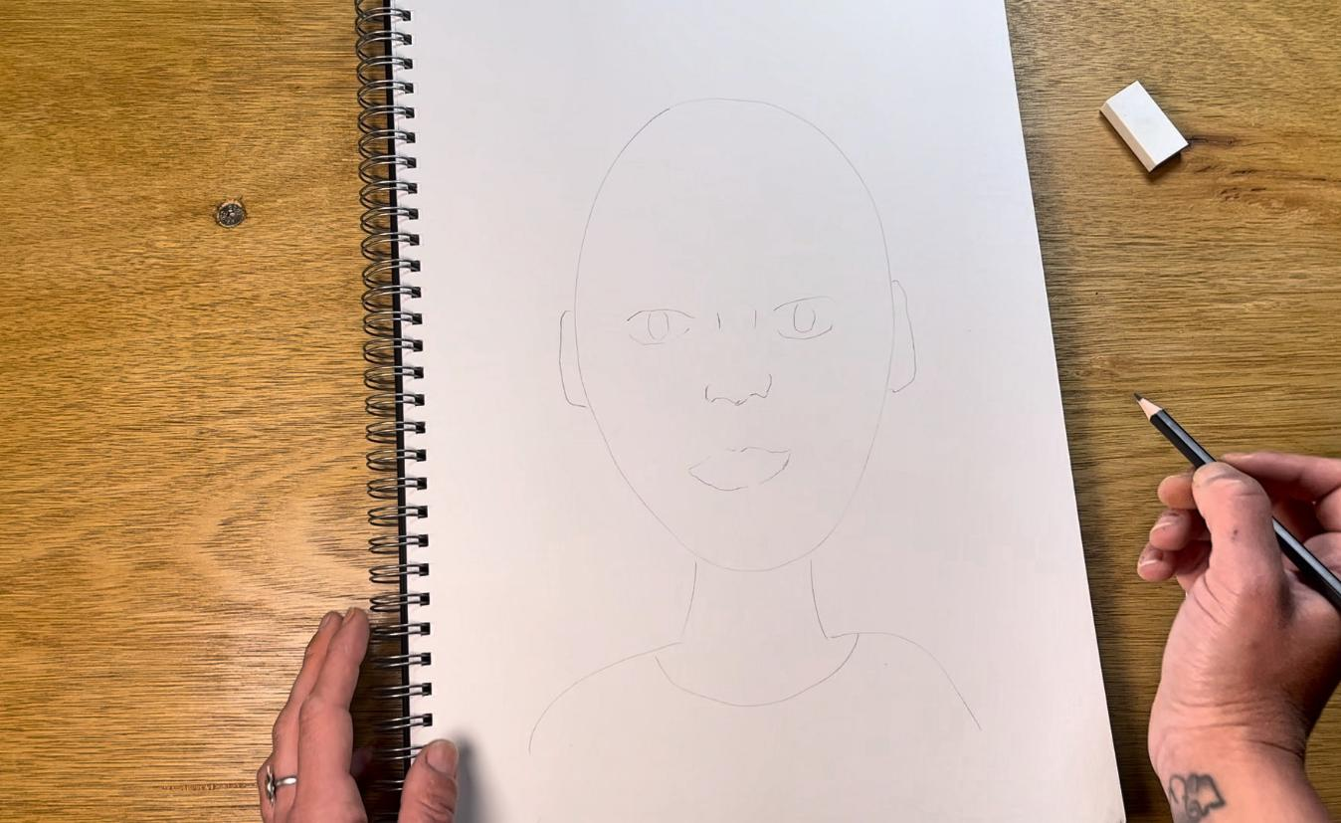
Draw Our Guidelines

Slide 23
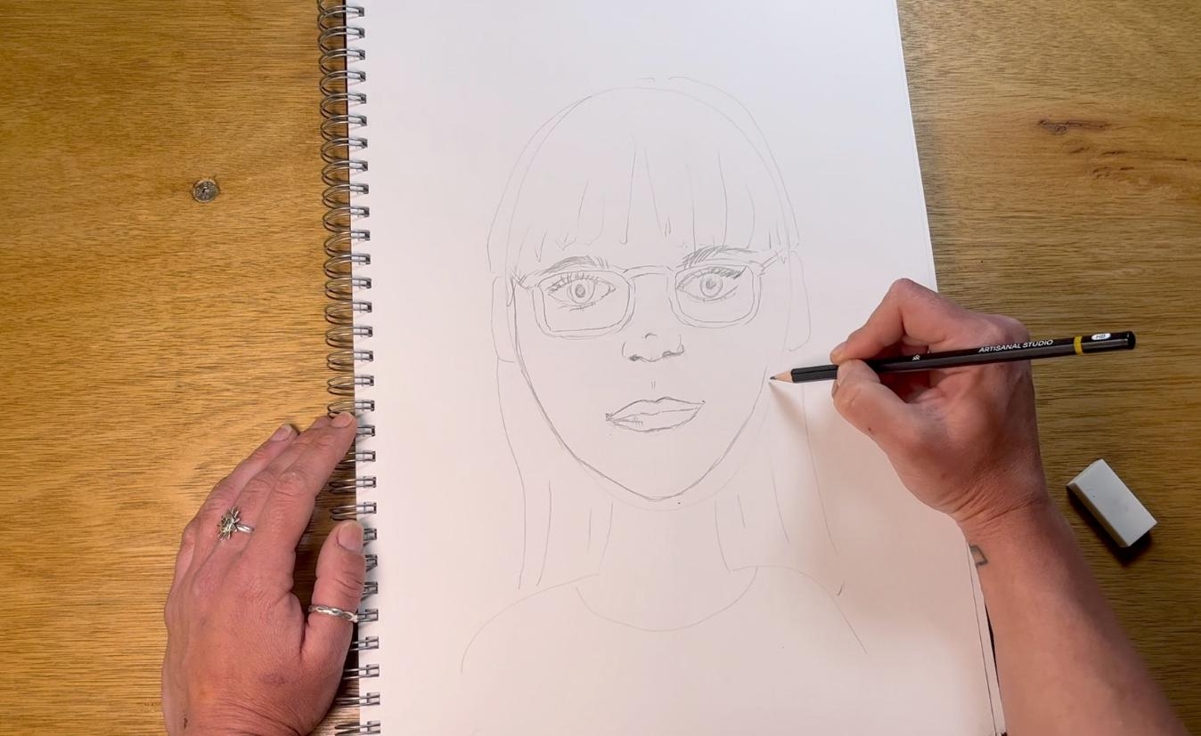
Draw Our Features

Slide 24


Draw a Self-Portrait
An example of a detail is:

Slide 25
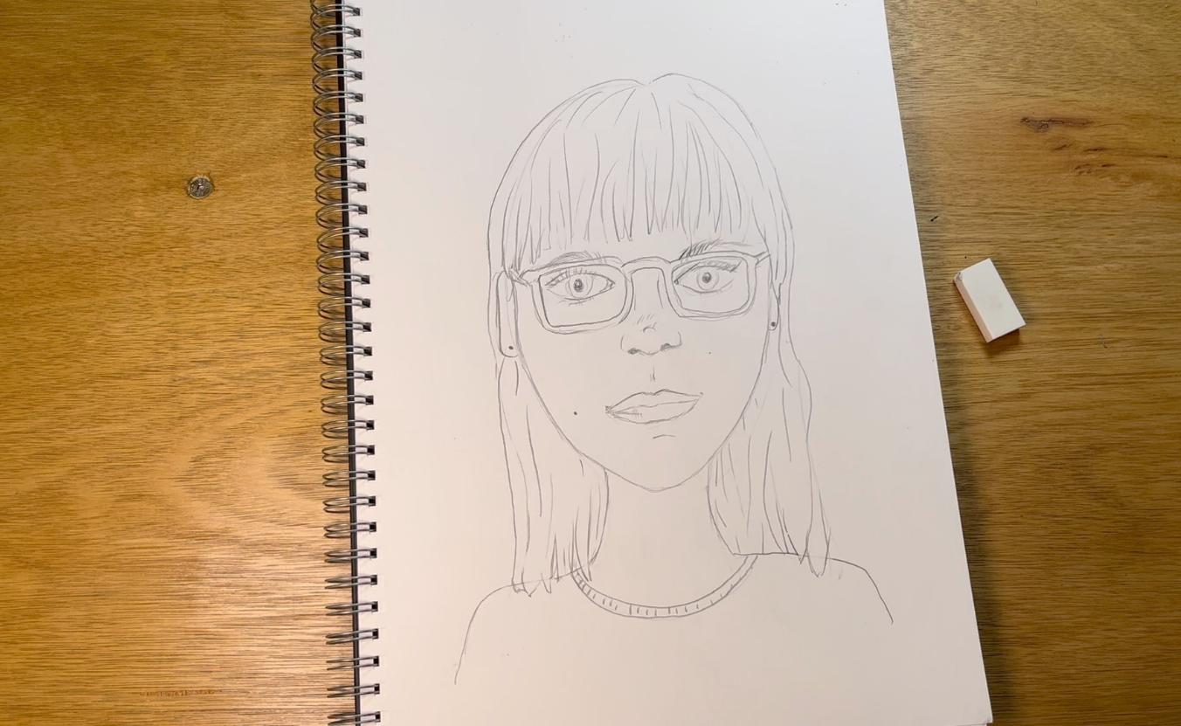
Draw the Details

Slide 26
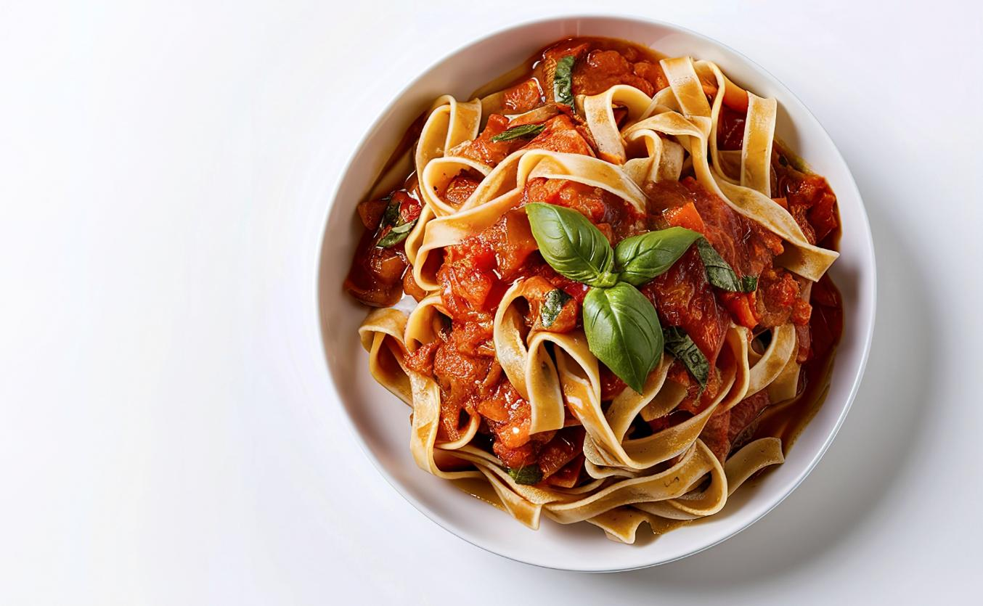
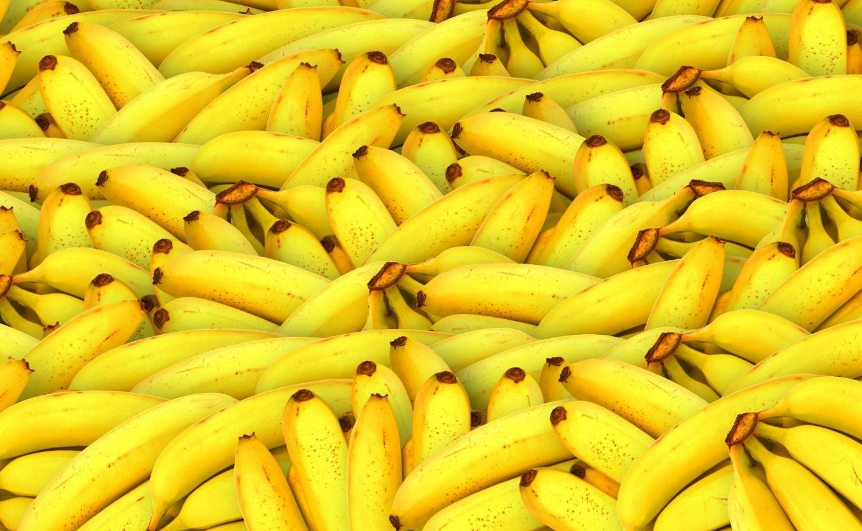
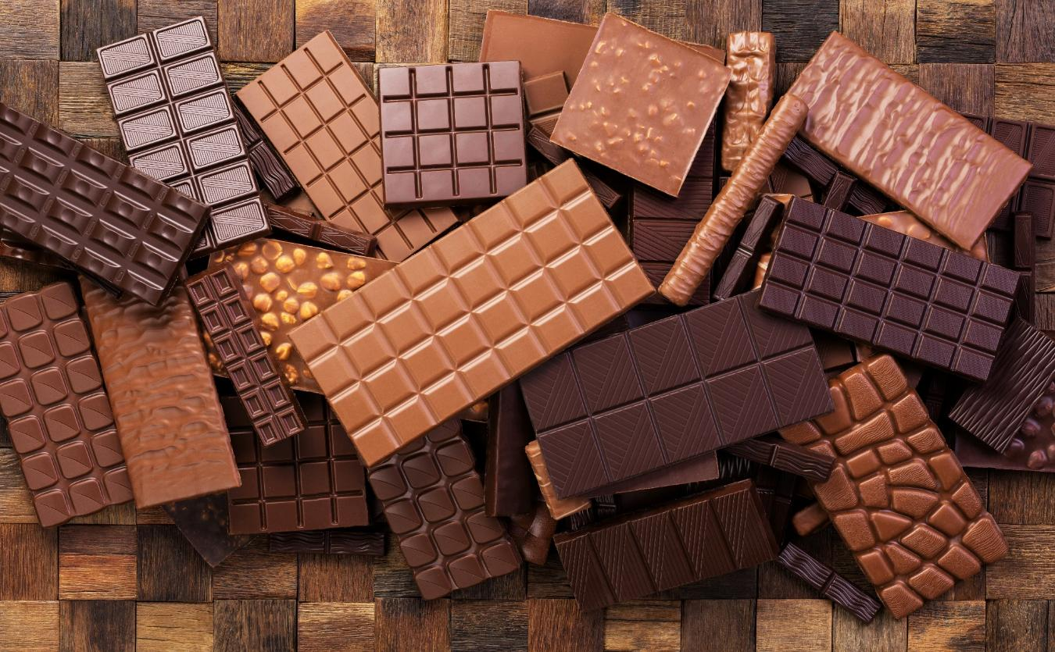


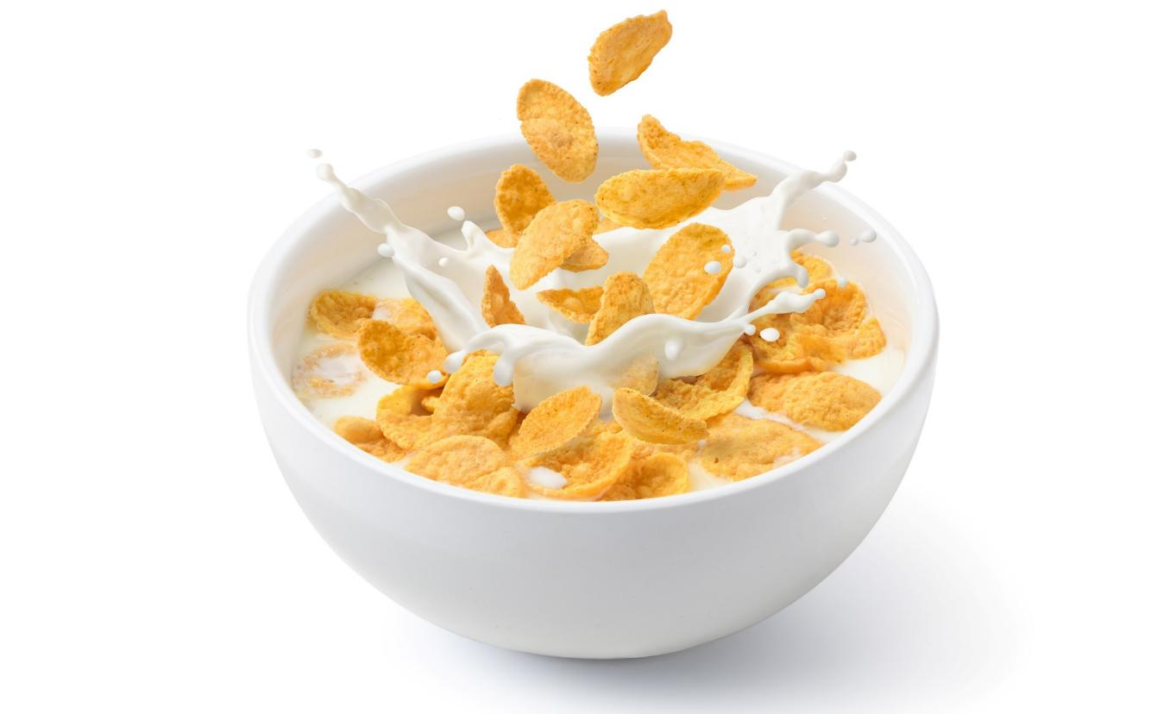
Favourite Part

Slide 27
Favourite Part

Slide 28
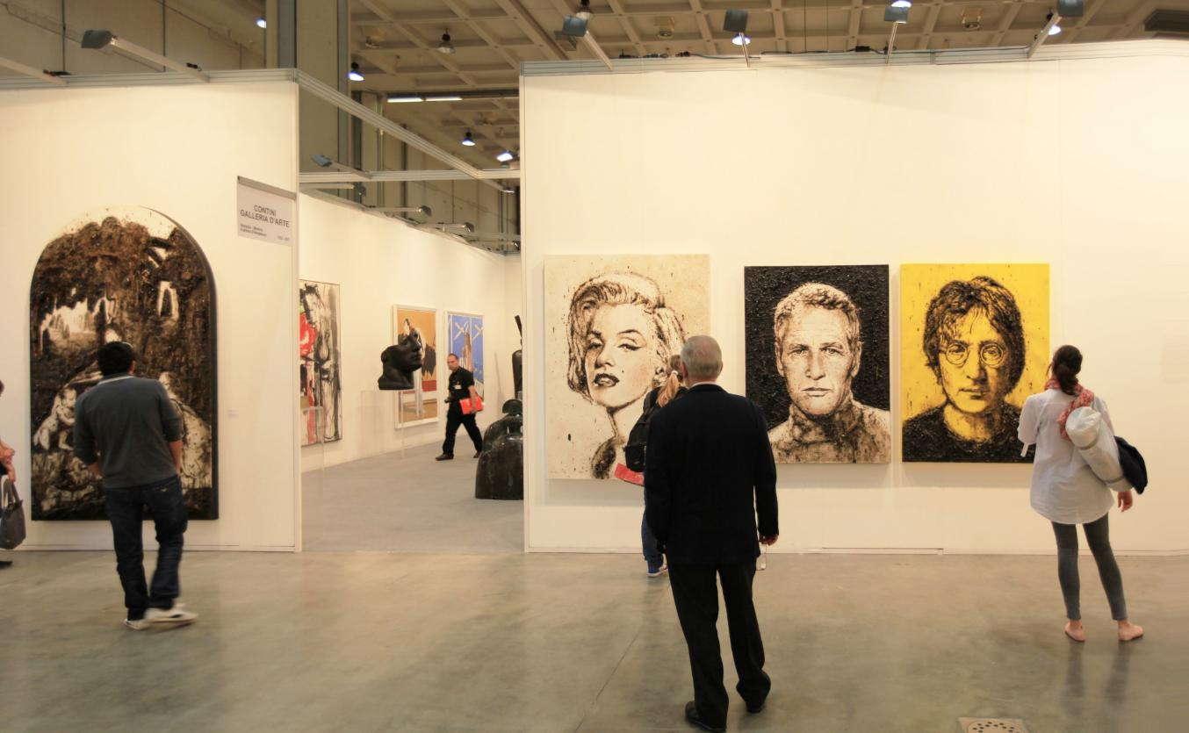

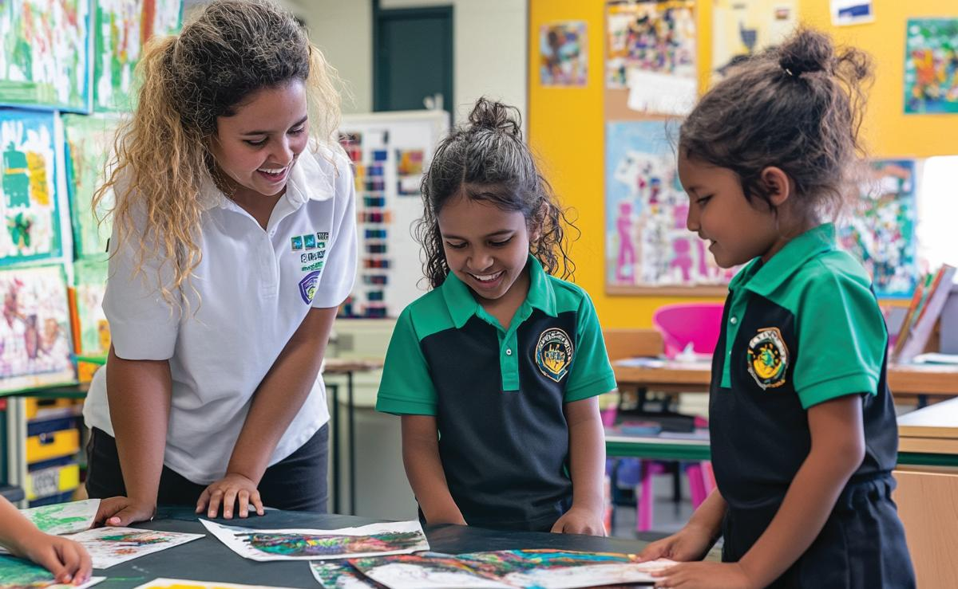

Slide 29

Artists Share Their Work

Slide 30
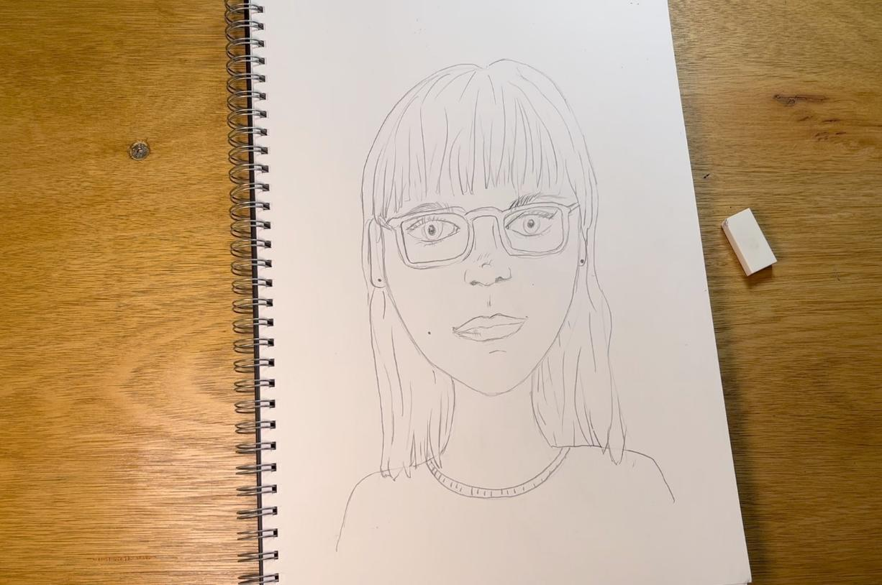
Details are the small parts of a picture that make it interesting.
We can use shapes and lines to add details.

Slide 32
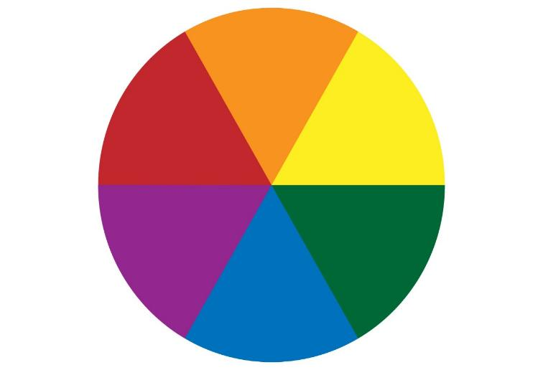
In the next lesson, we will mix colours and learn their names.

