Slide 1
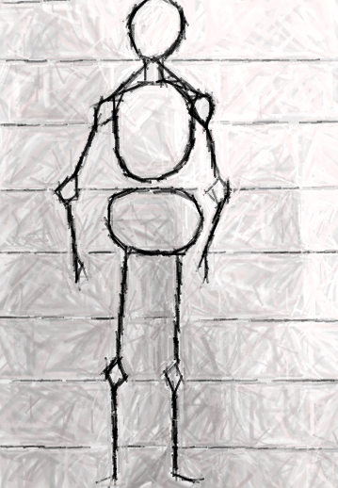
Unit 1B
Art and Me
Lesson 1
As Big as Me
Unit 1B Version 1

Slide 2
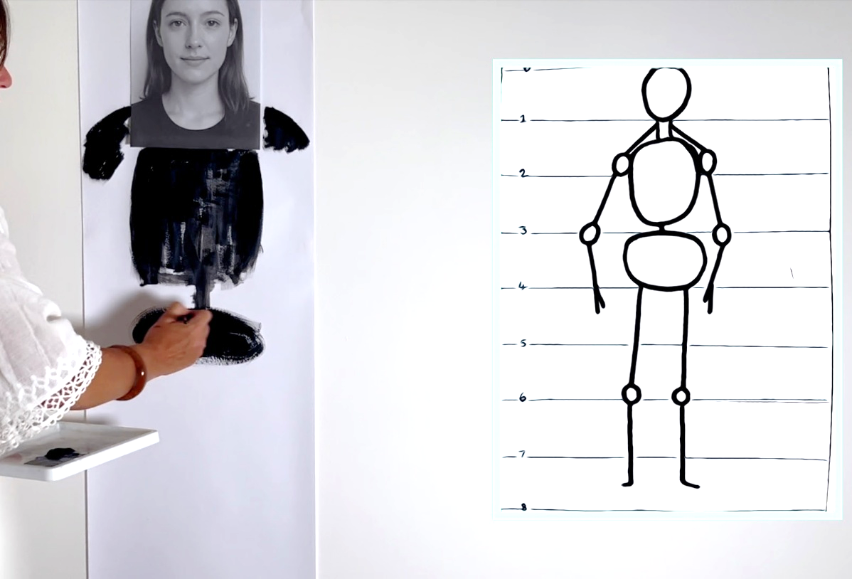
In this lesson, we will learn how to draw ourselves in proportion.

Slide 3
You will be successful when you can:
draw body parts in proportion to your head
create a picture of yourself using shapes and lines.

Slide 4
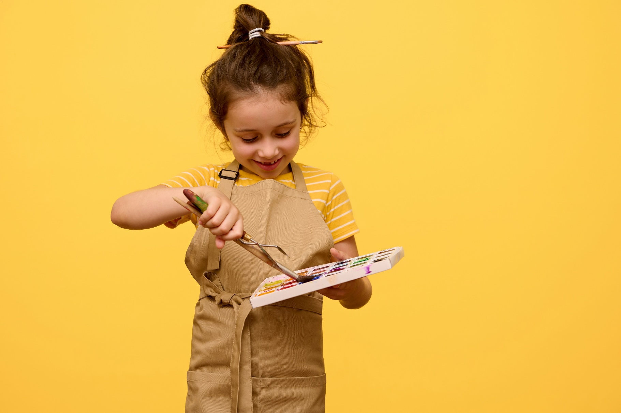
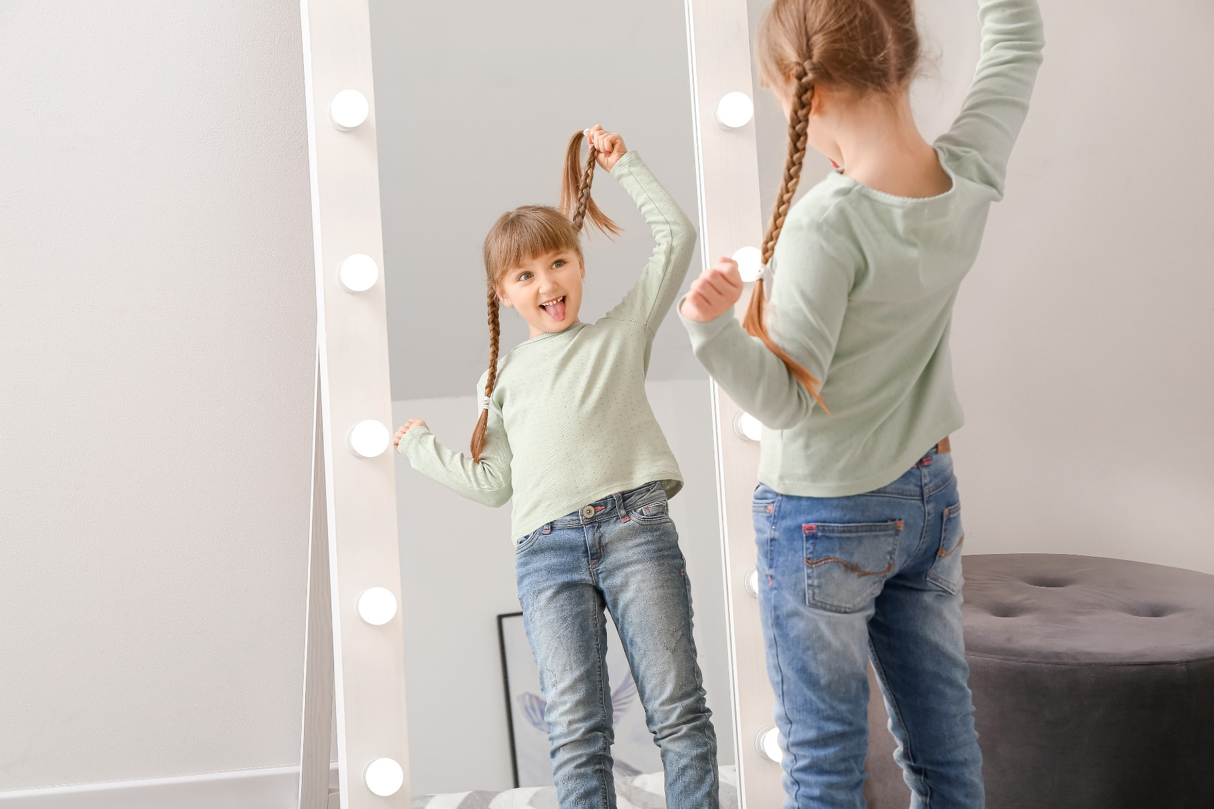
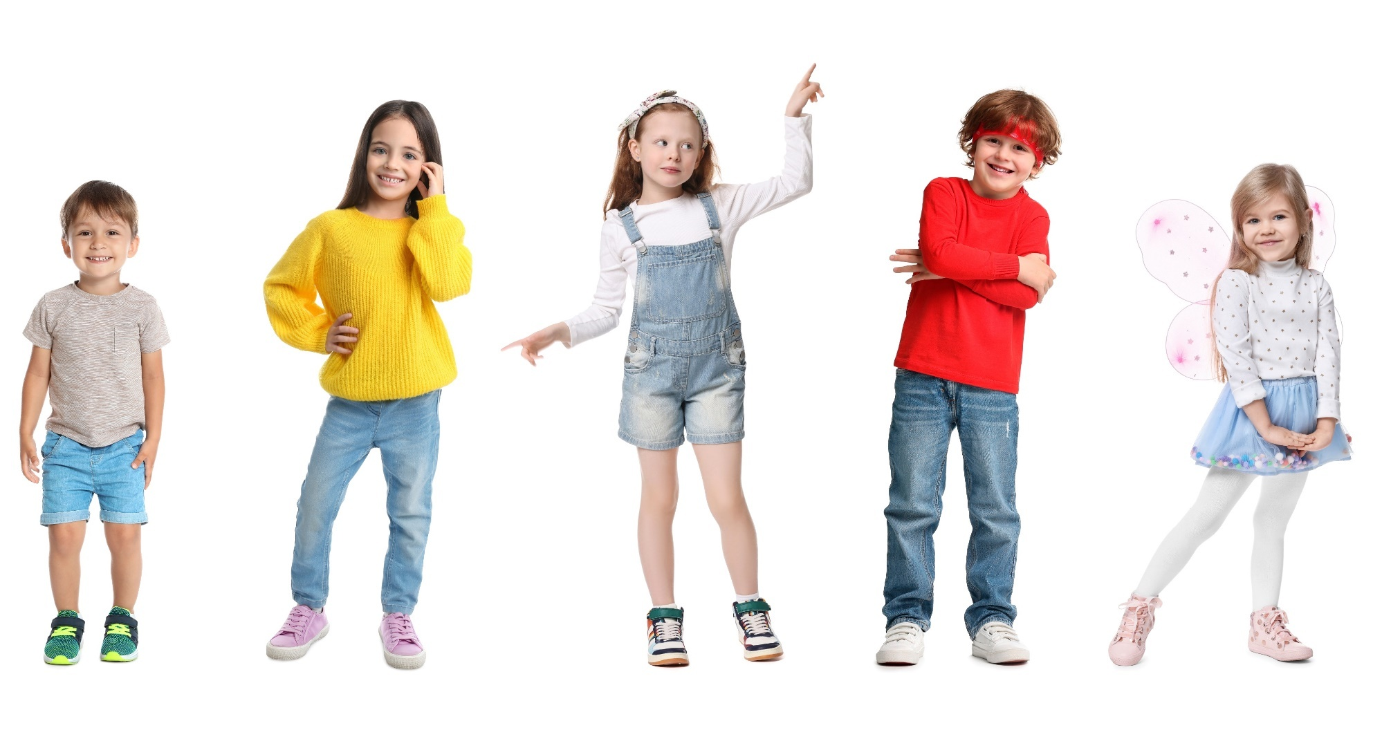

Slide 5
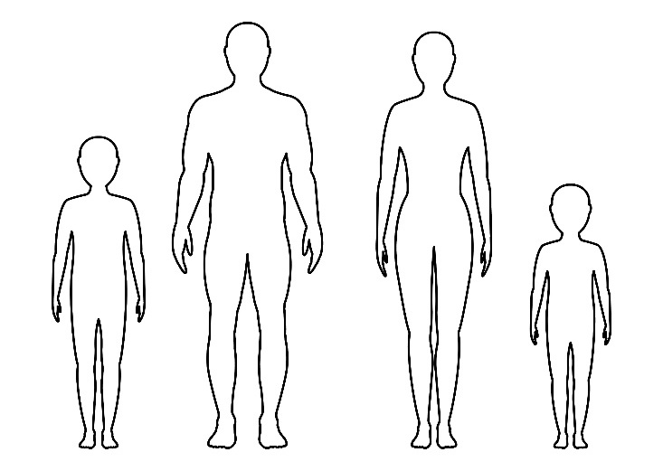
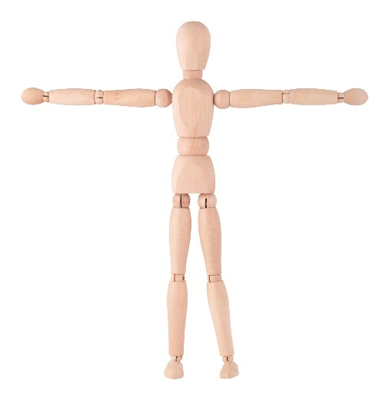
body structure
The way our body is built, like how our head sits on our neck and our arms and legs come out from our body.
proportion
How big or small things are compared to each other.

Slide 6
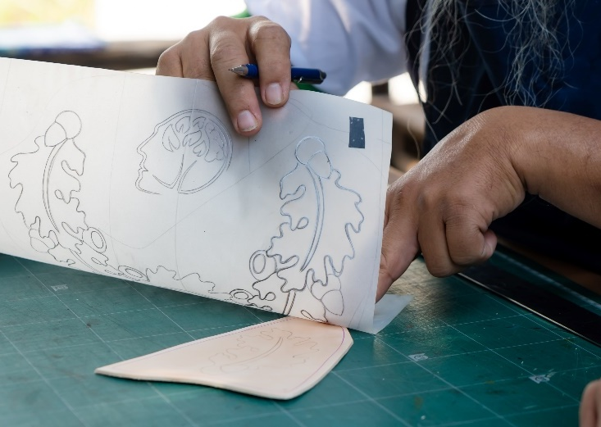
trace
To follow the lines and copy the shape.

Slide 7
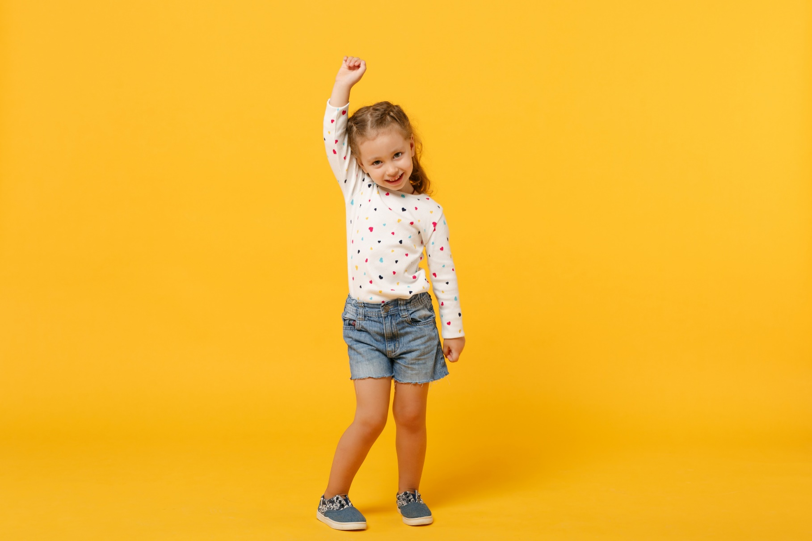
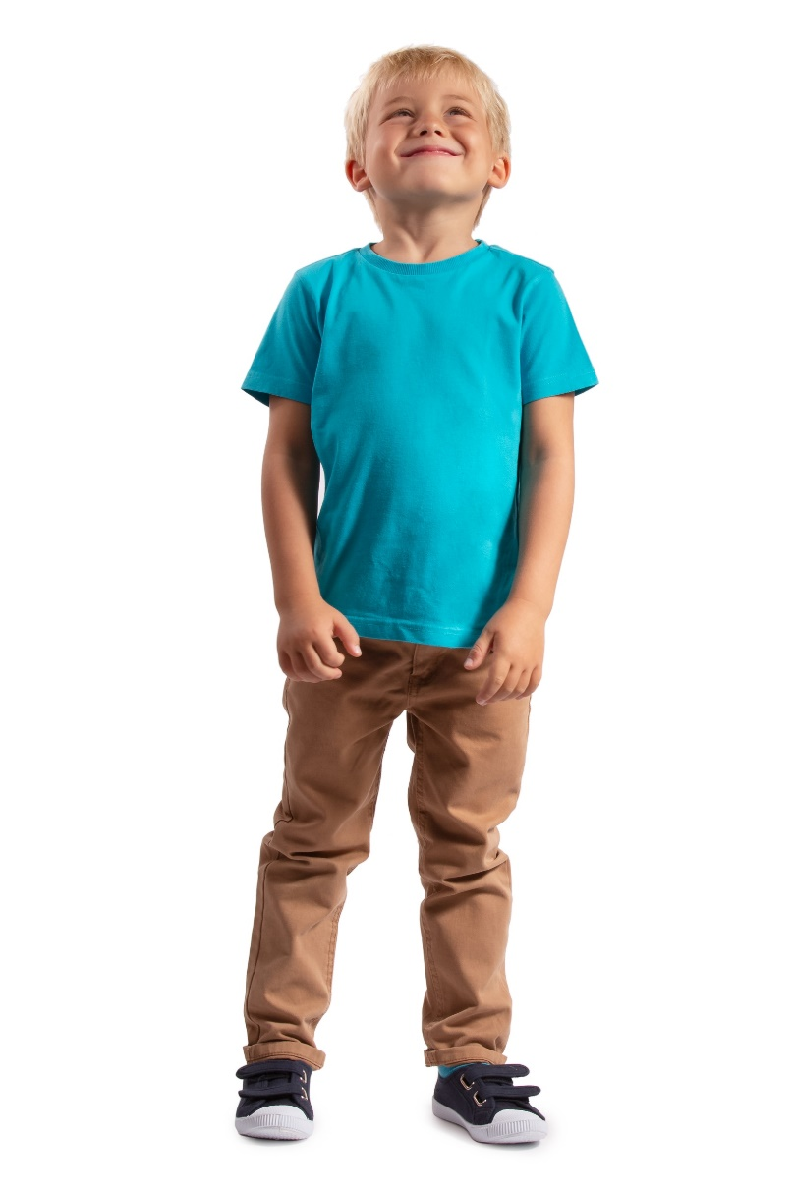





Drawing People

Slide 8
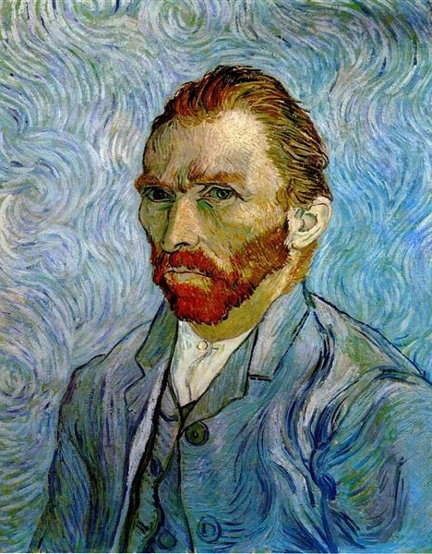
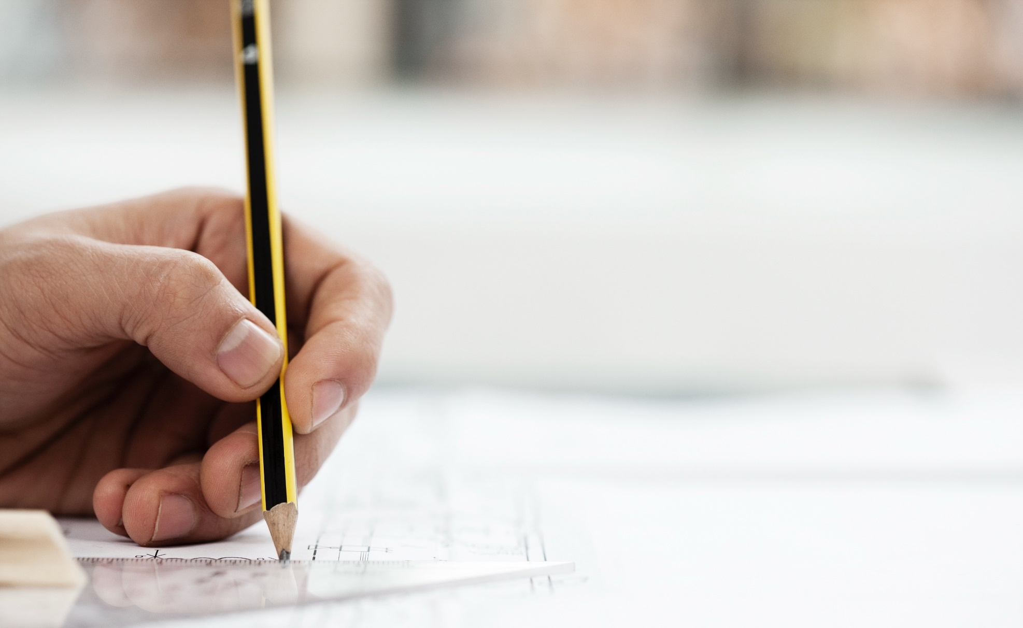
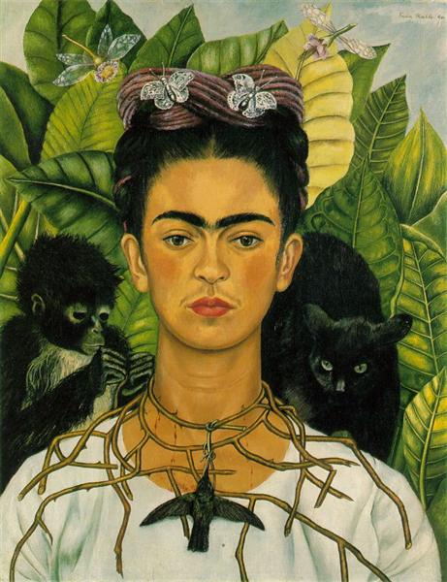
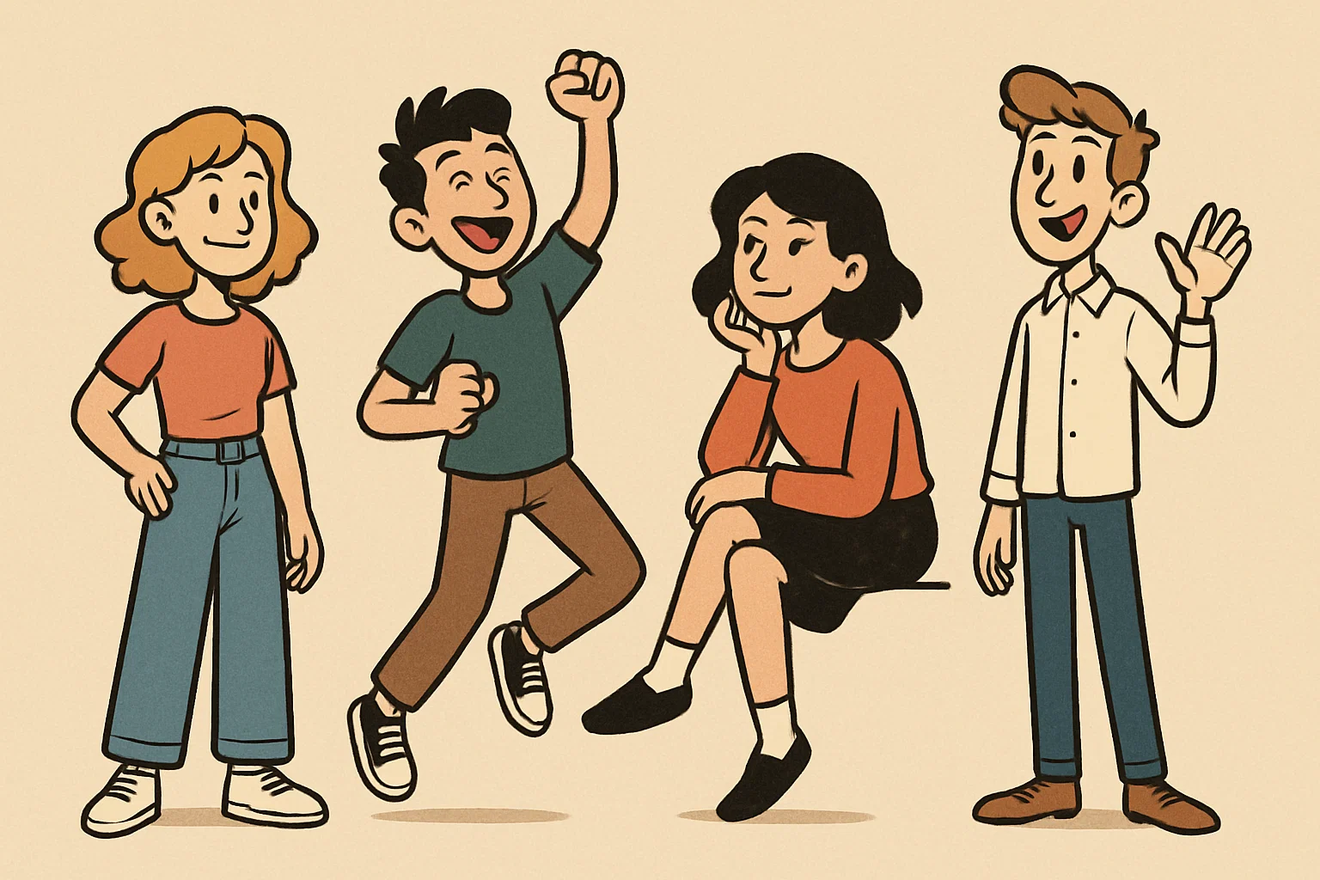
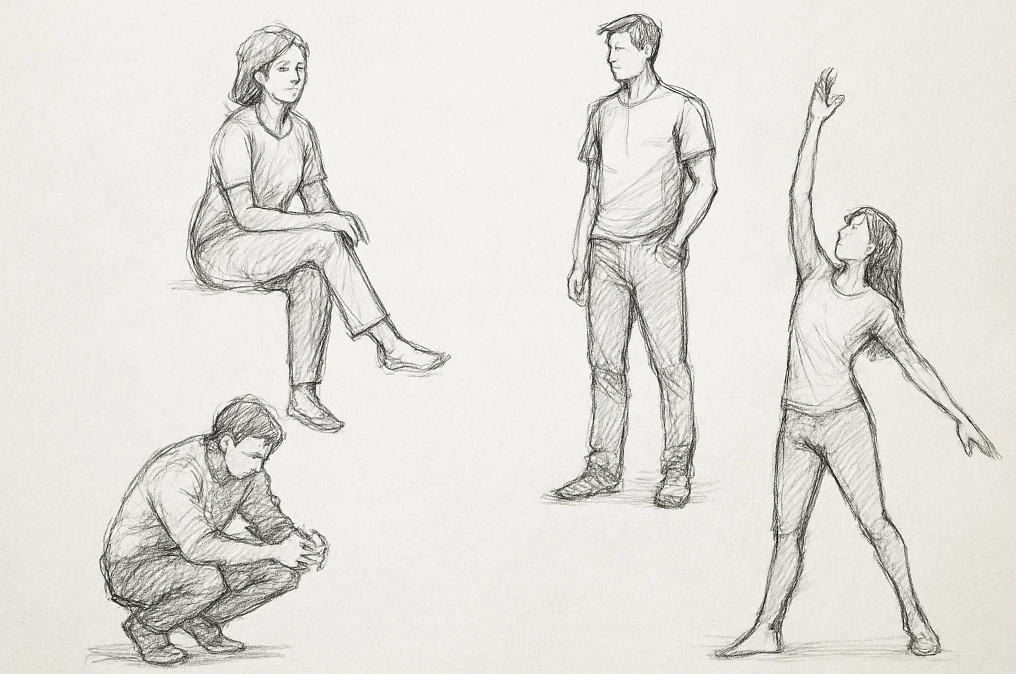
Drawing People

Slide 9
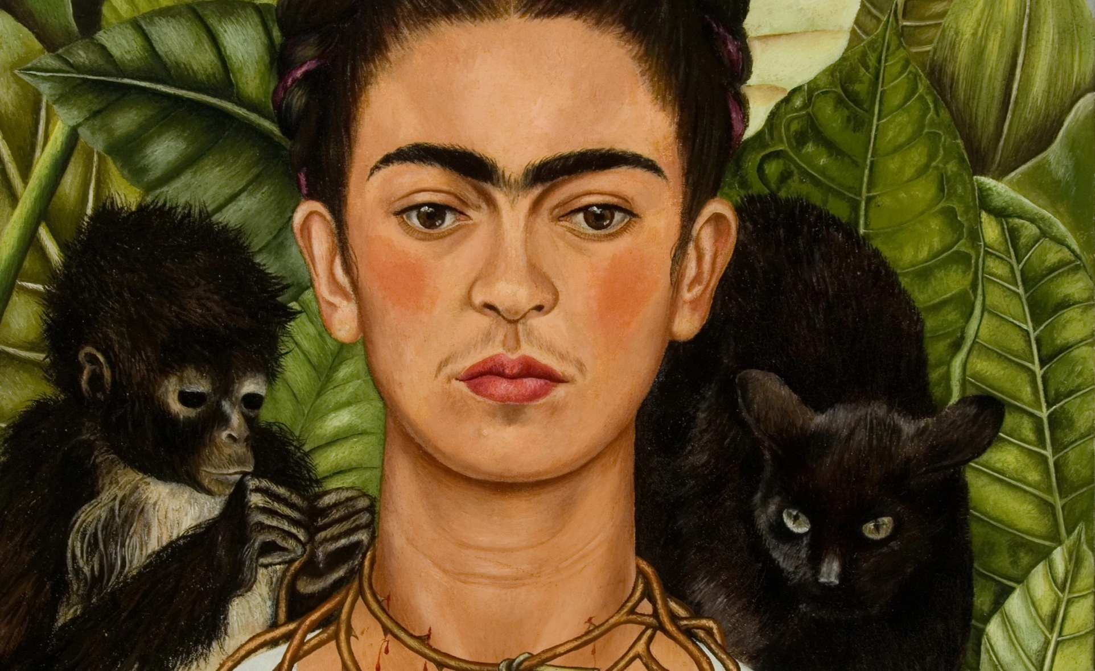
Drawing People

Slide 10
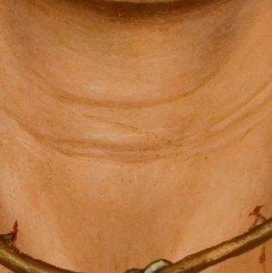
Drawing People

Slide 11
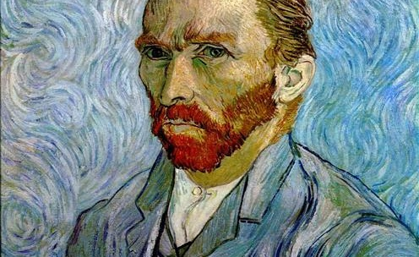
Drawing People

Slide 12
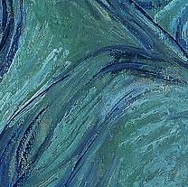
Drawing People

Slide 13
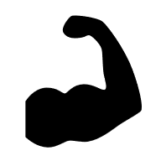


Drawing People
One part of your body structure is:
your arm
your hat
your house

Slide 14
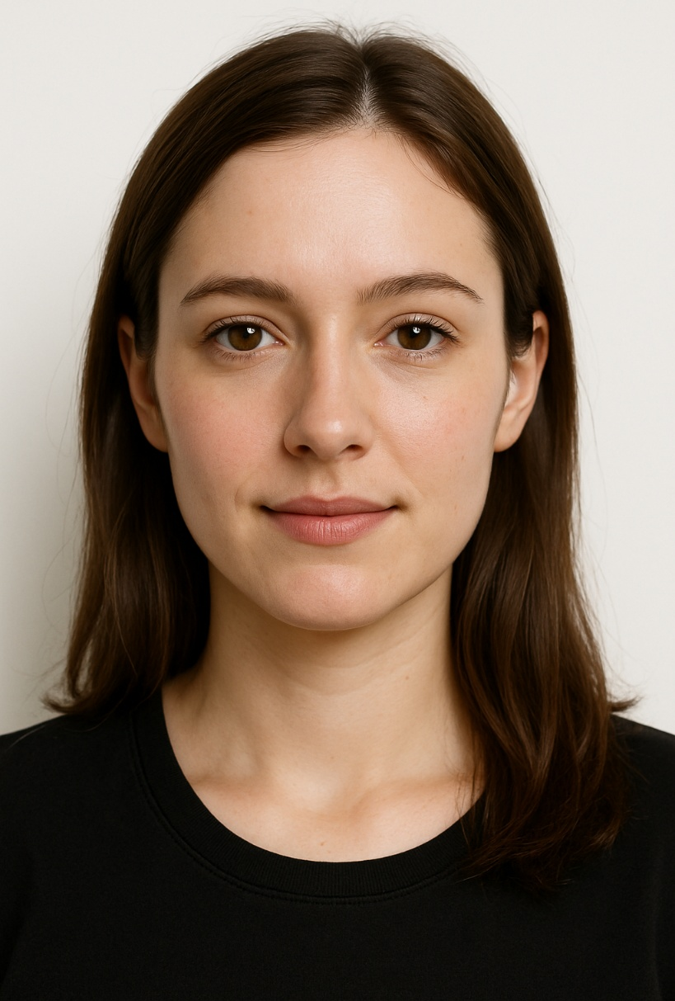

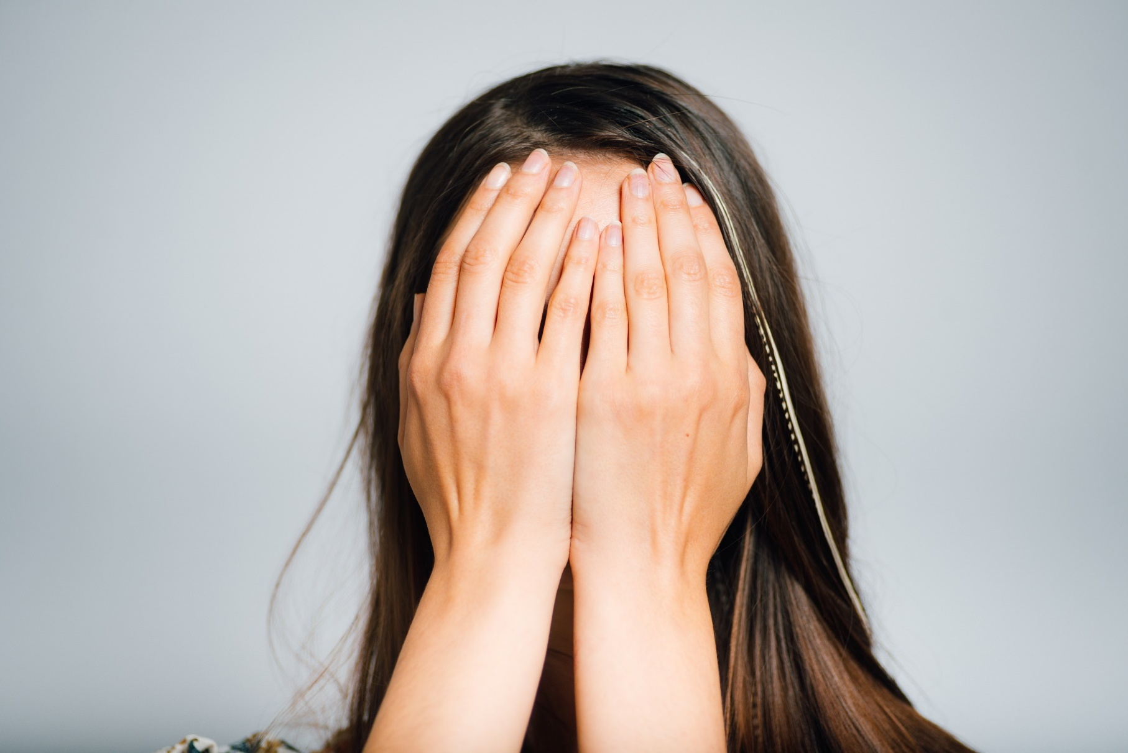
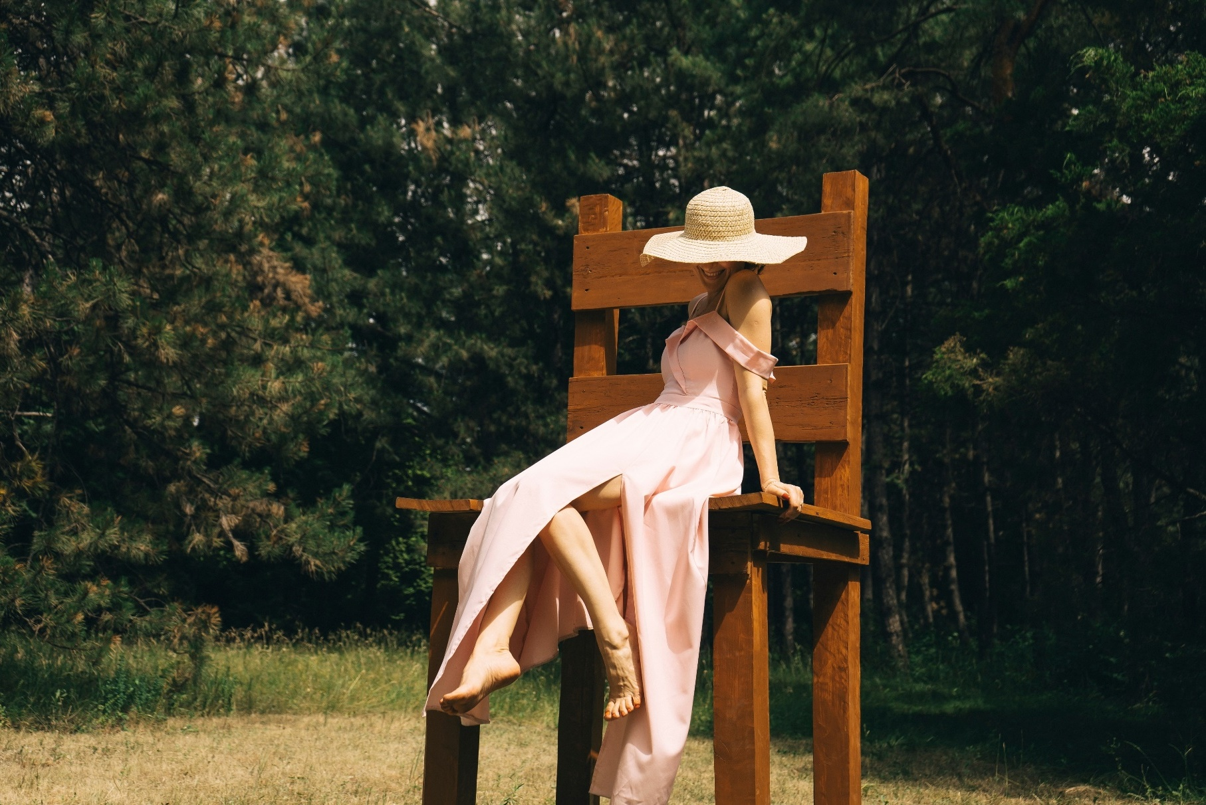
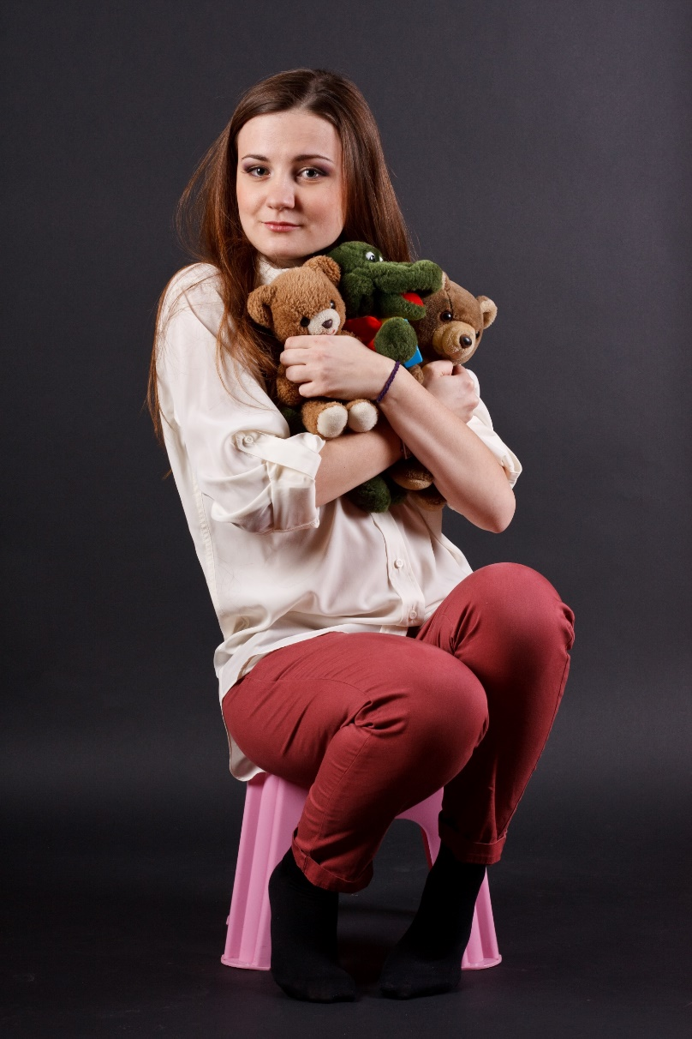
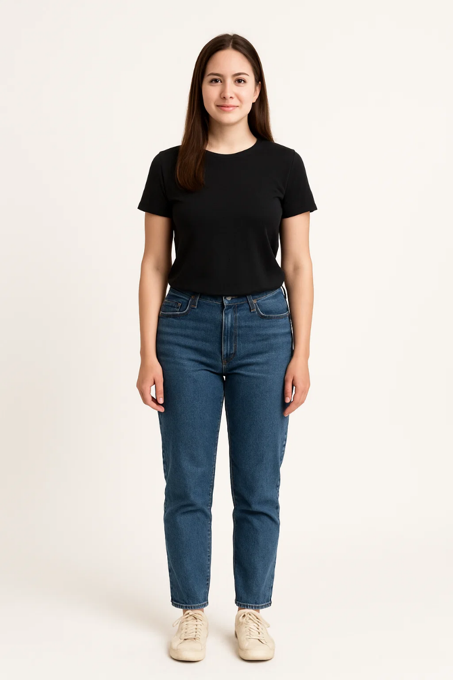




Proportion

Slide 15
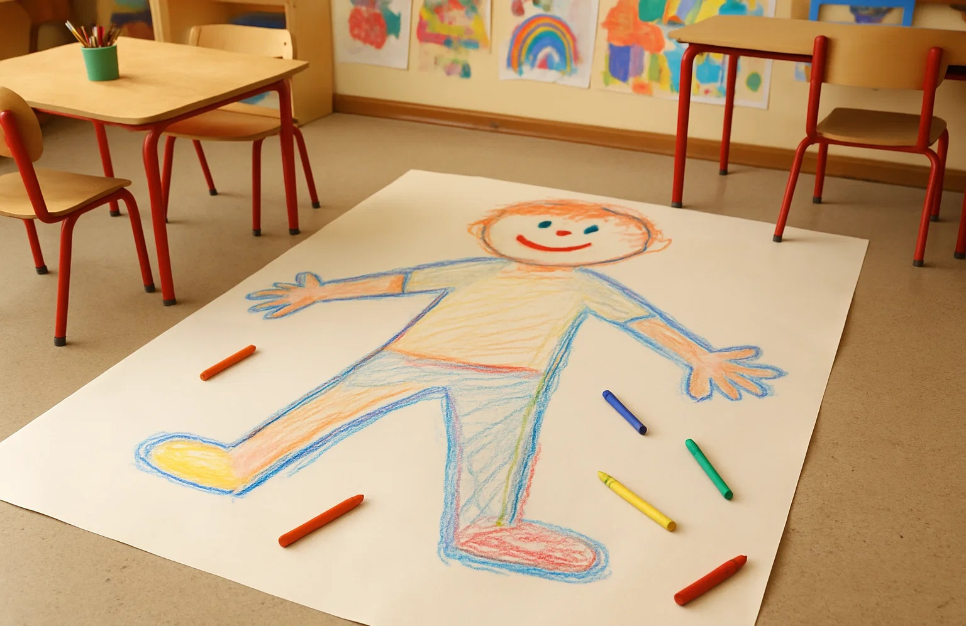
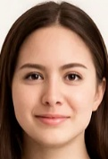
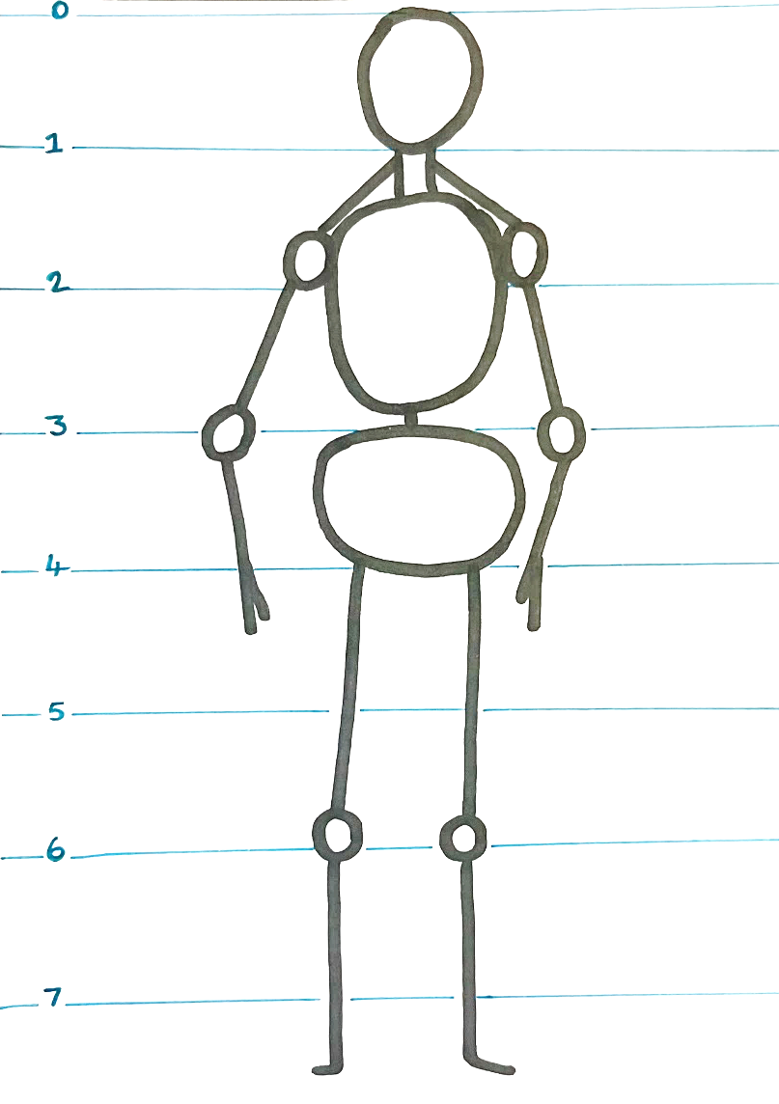






Proportion

Slide 16
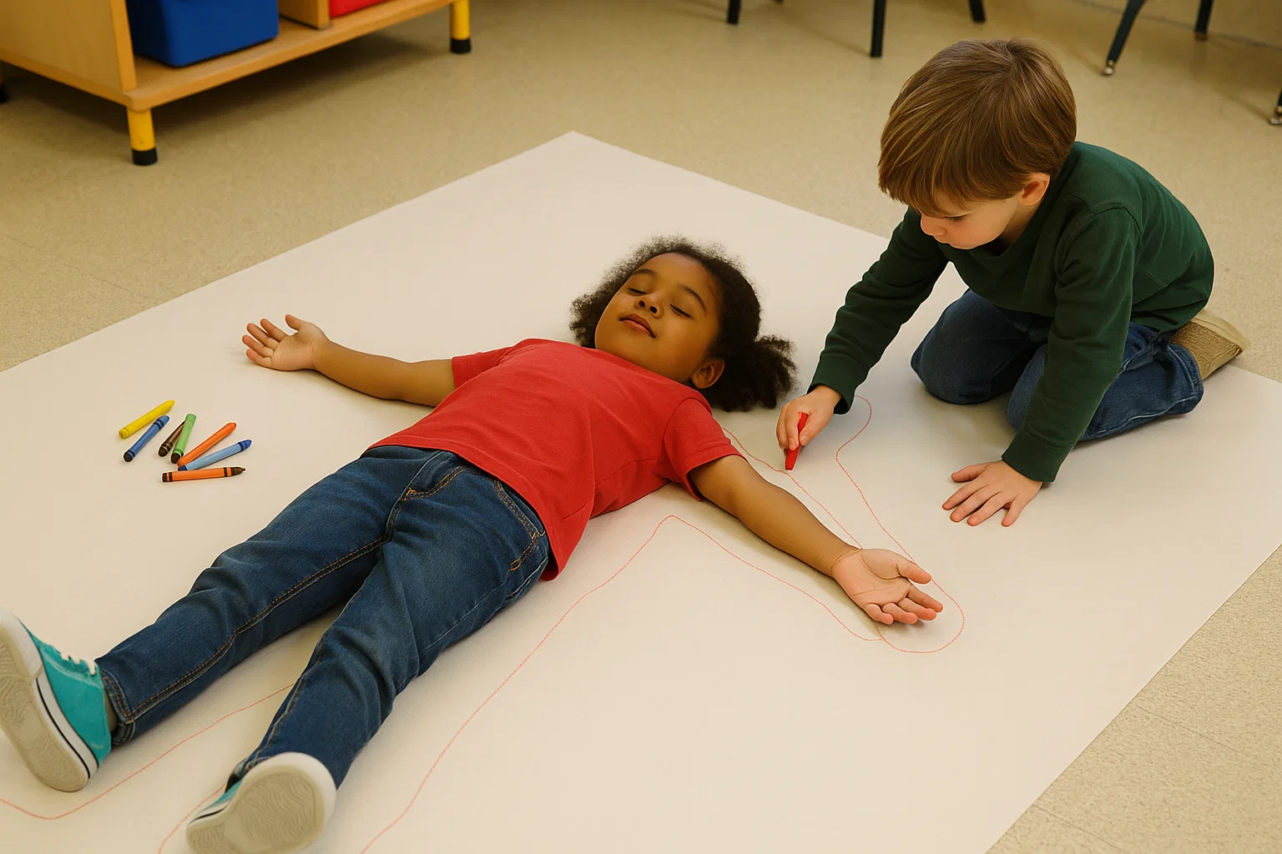
Proportion

Slide 17

Proportion
Proportion is comparing:
colours
size
lines

Slide 18

As Big As Me

Slide 19
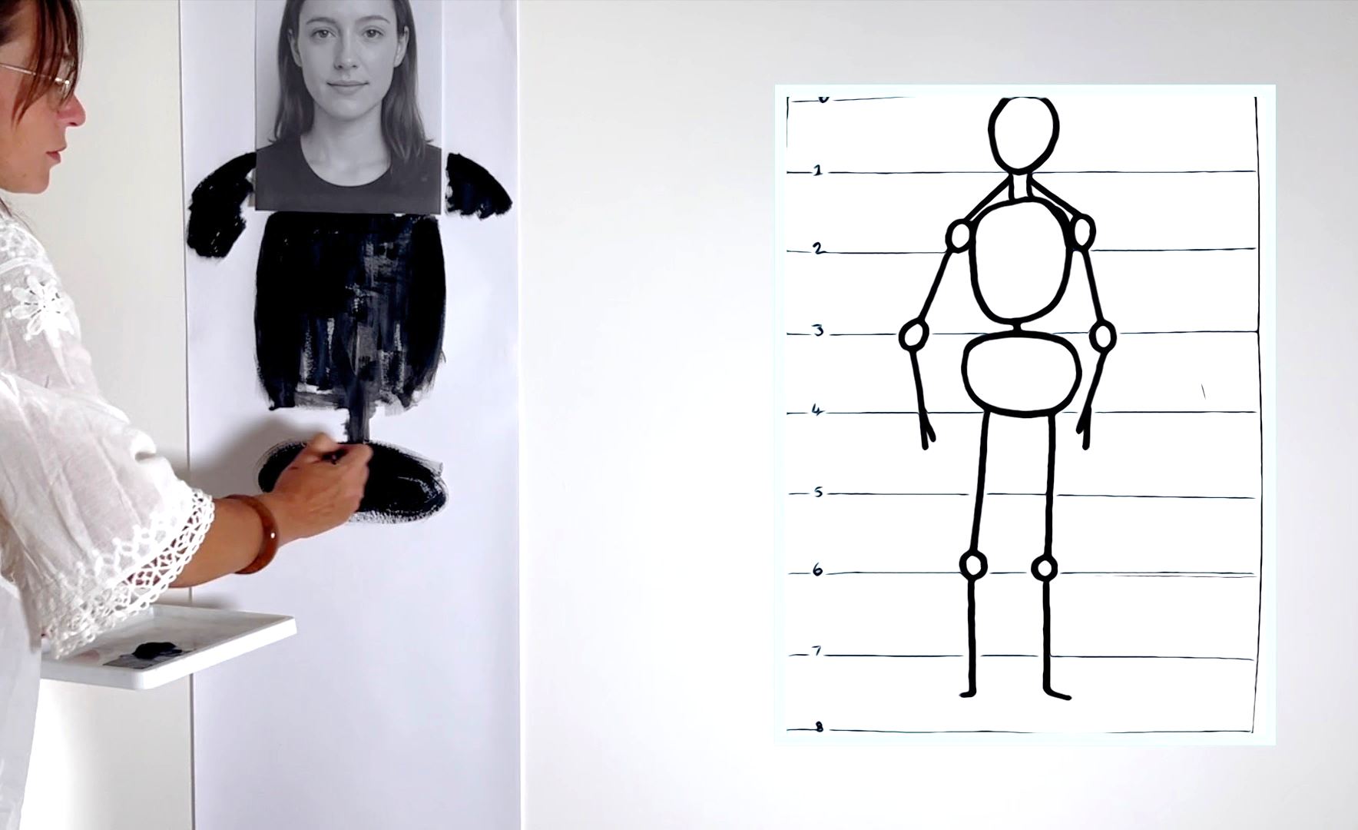
As Big As Me

Slide 20


As Big As Me
A head is smaller than a body.

Slide 21
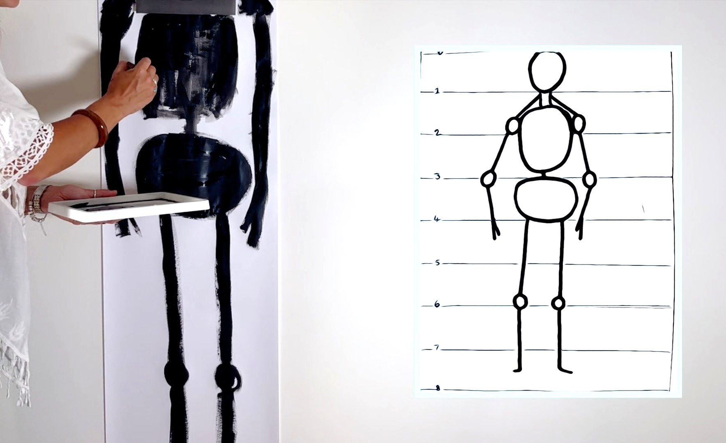
As Big As Me

Slide 22


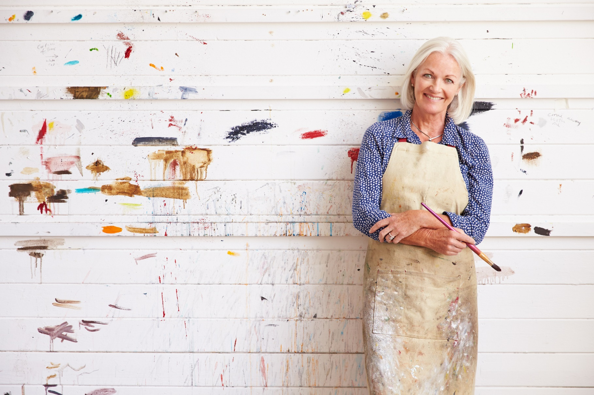
Favourite Part
What next?
What do I like?
What was fun?
What was tricky?

Slide 23
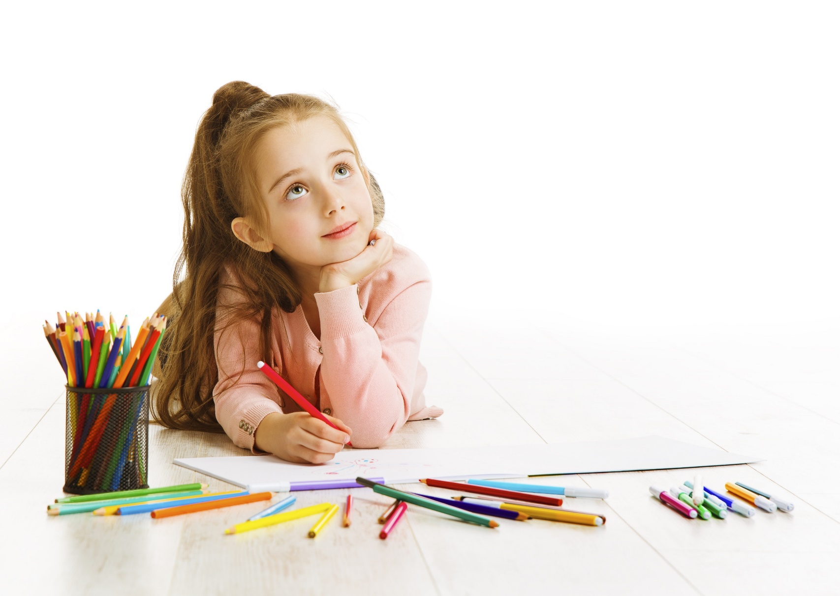

Favourite Part
This is my favourite part because...

Slide 24
Favourite Part

Slide 25
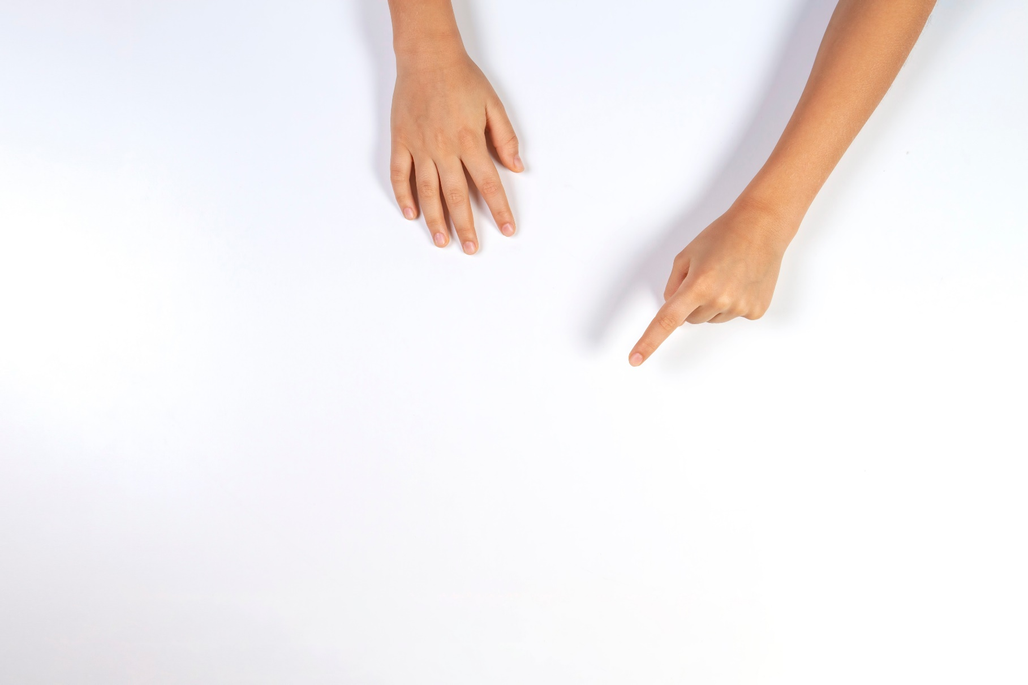
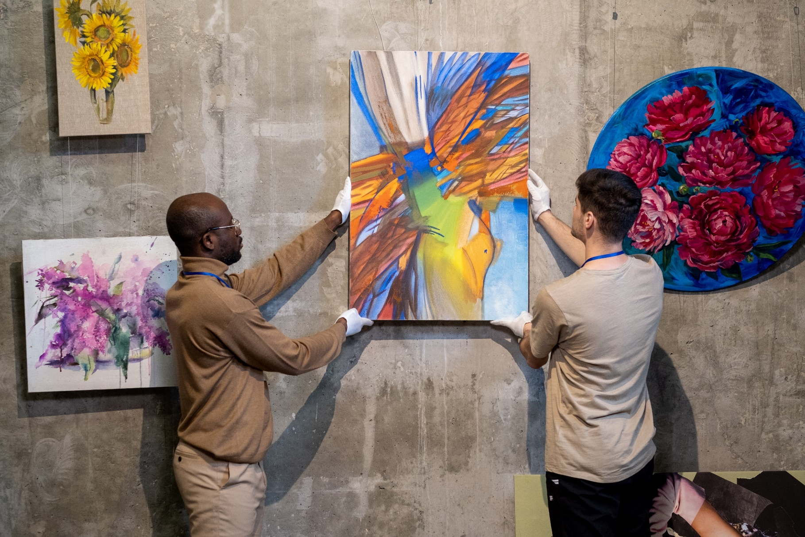
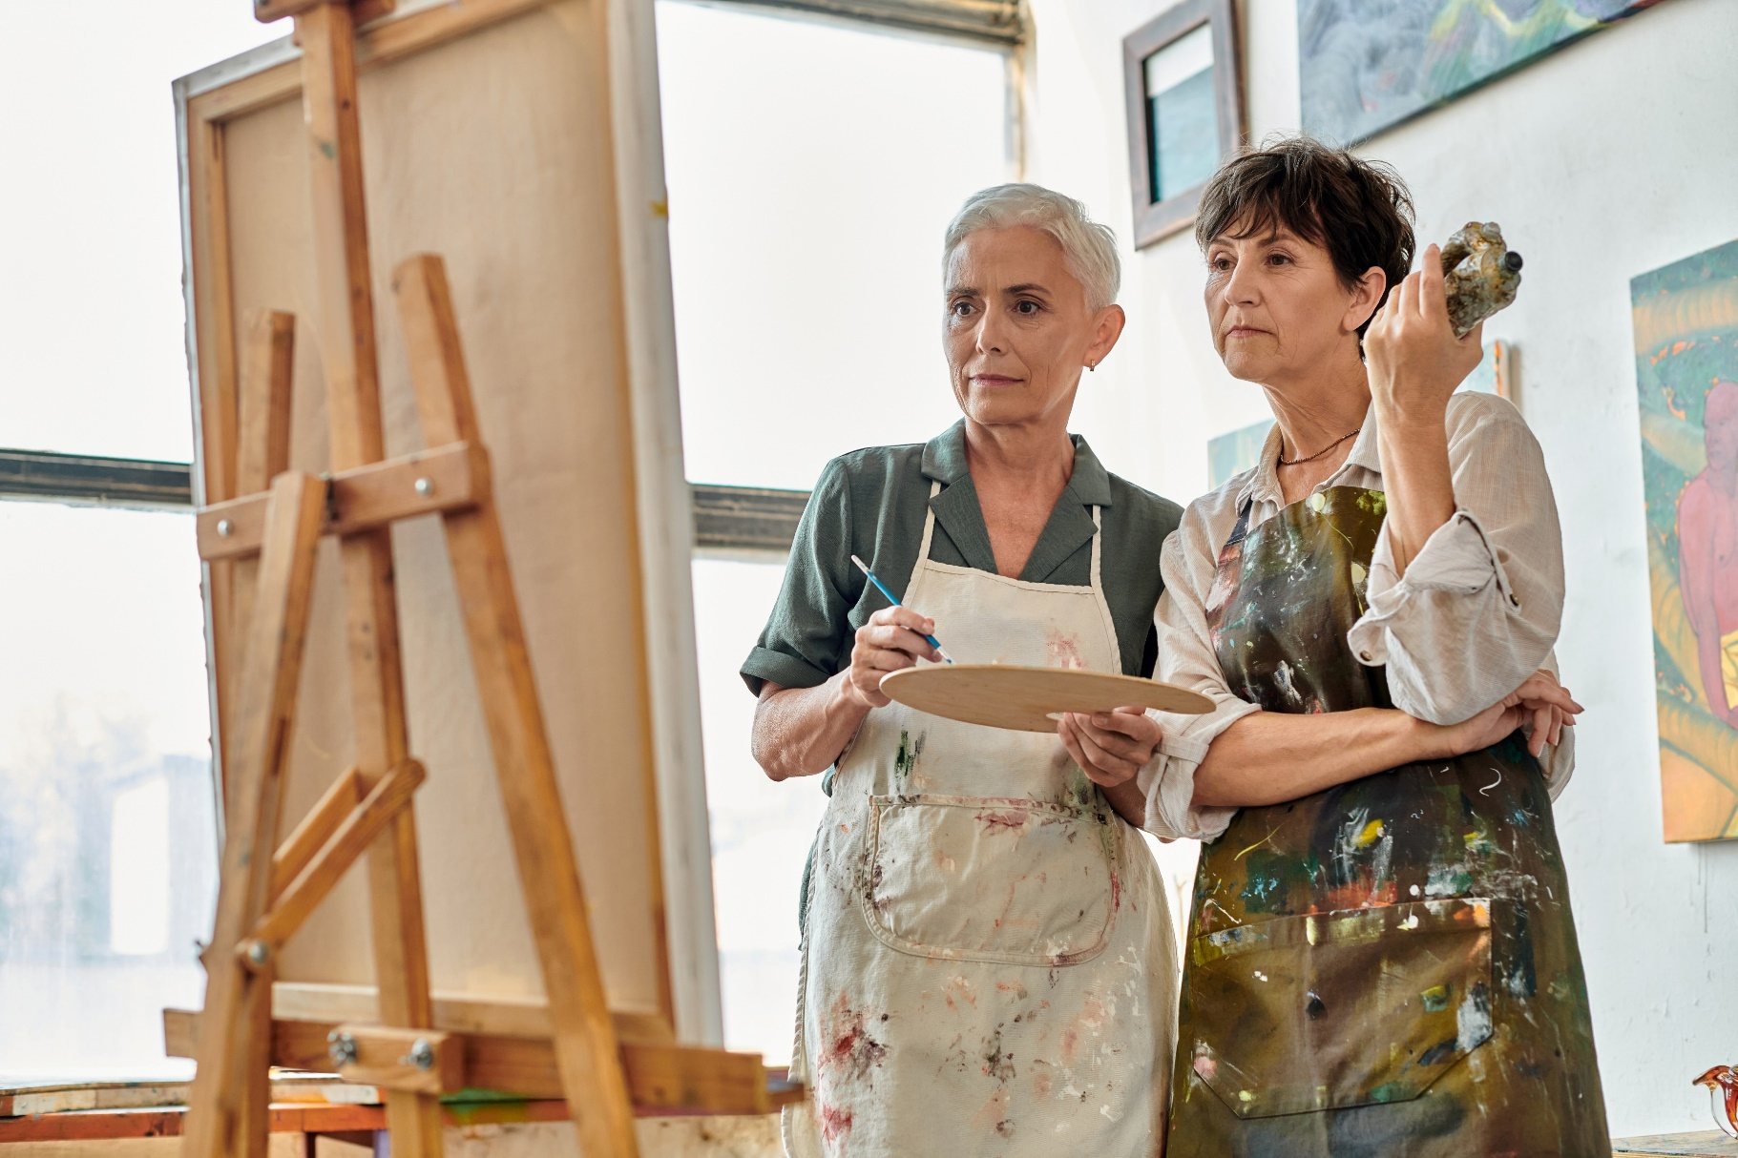
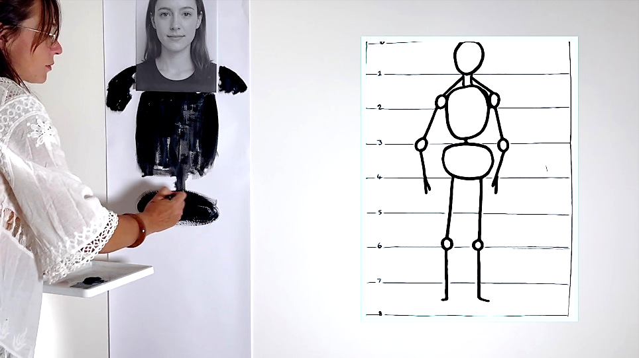

Slide 26
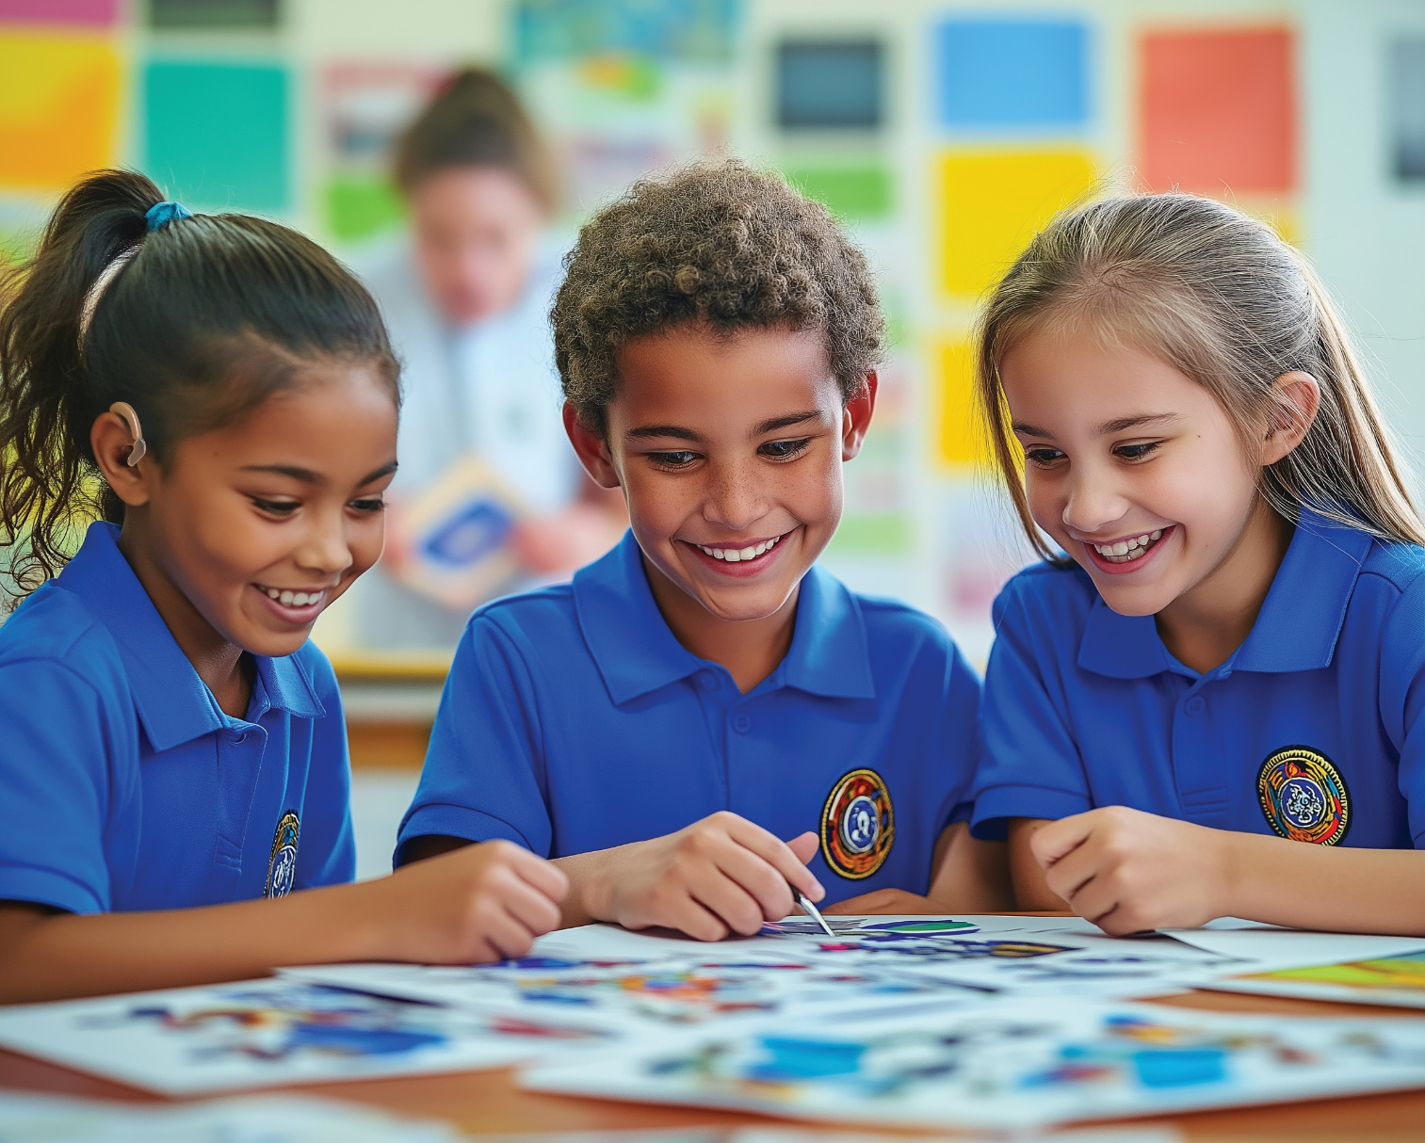
Artists Share Their Work

Slide 27


A body has a structure.
Proportion is the size in comparison.

Slide 29
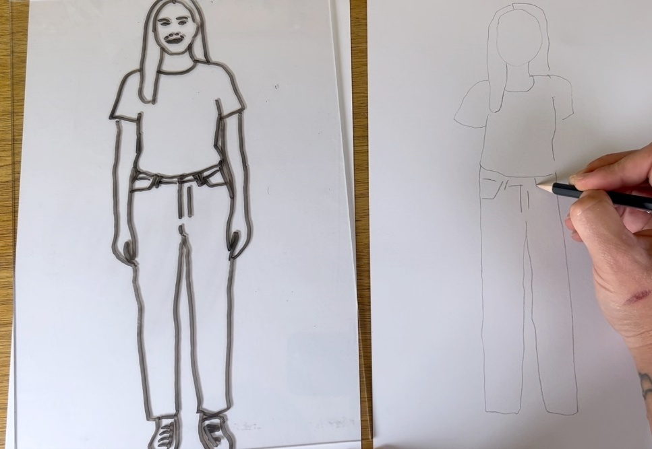
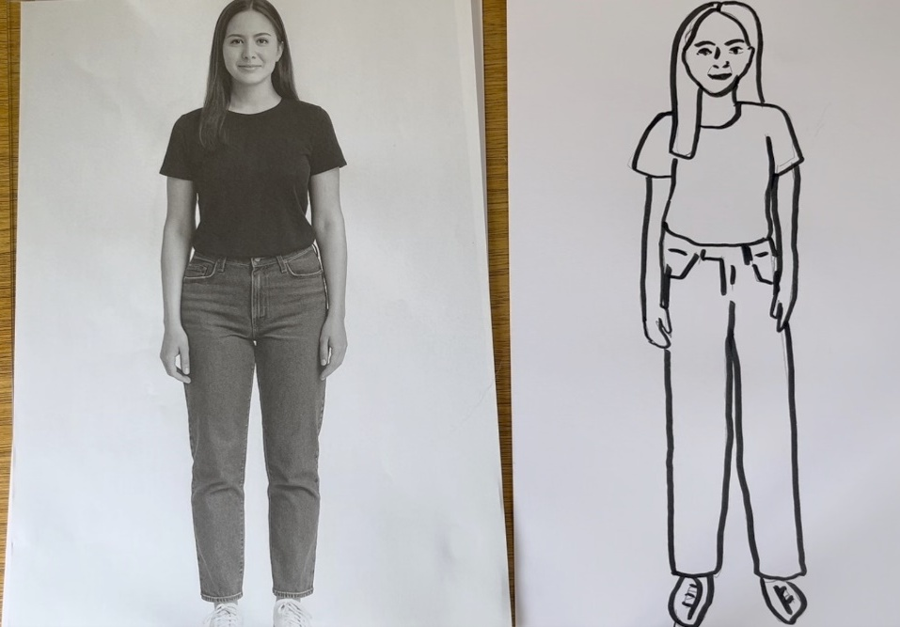
In the next lesson, we will learn how to draw an outline and add details about ourselves.

Slide 30
Slide 8 (left), Slide 9 and Slide 10 Photo: Self Portrait with Necklace of Thorns by Frida Kahlo, WikiArt, Public Domain, https://www.wikiart.org/en/frida-kahlo/self-portrait-with-necklace-of-thorns-1940
Slide 8 (right), Slide 11 and Slide 12 Photo: Self-Portrait by Vincent van Gogh, WikiArt, Public Domain, https://www.wikiart.org/en/vincent-van-gogh/self-portrait-1889-1

