Slide 1
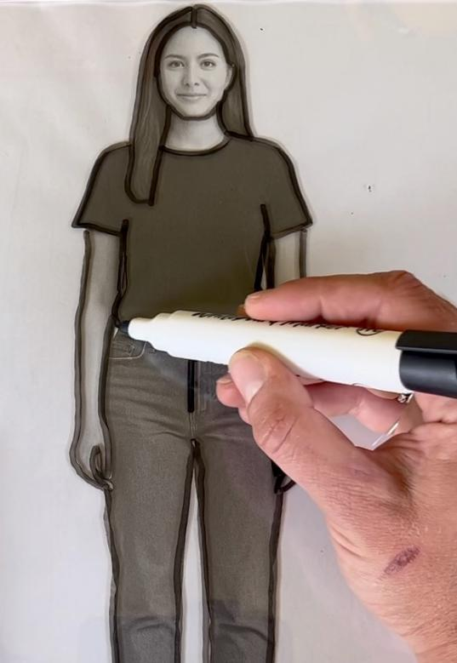
Unit 1B
Art and Me
Lesson 2
Outline of Me
Unit 1B Version 1

Slide 2
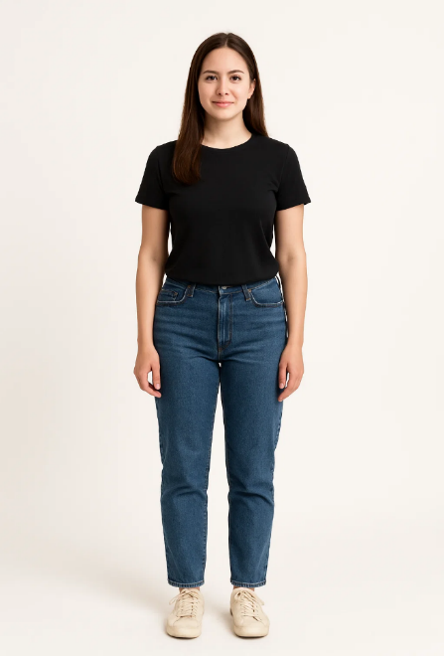
A body has structure.

Slide 3
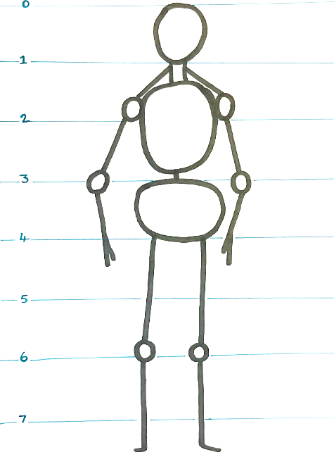
Proportion is the size in comparison.

Slide 4

The person in proportion is:

Slide 5
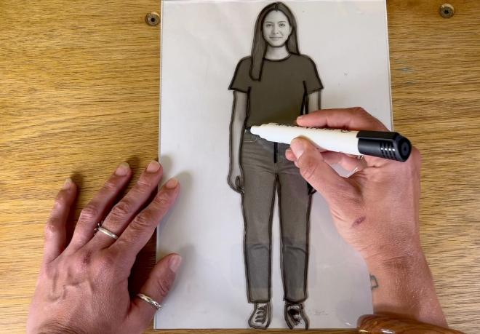
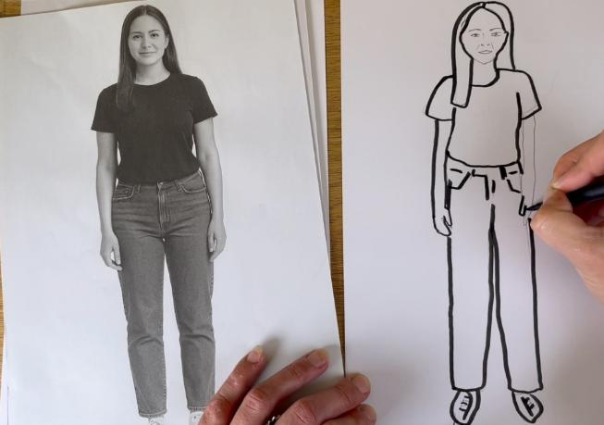
In this lesson, we will learn how to draw an outline and add details about ourselves.

Slide 6
You will be successful when you can:
draw yourself in proportion
use an outline
add details to make your picture look like you.

Slide 7
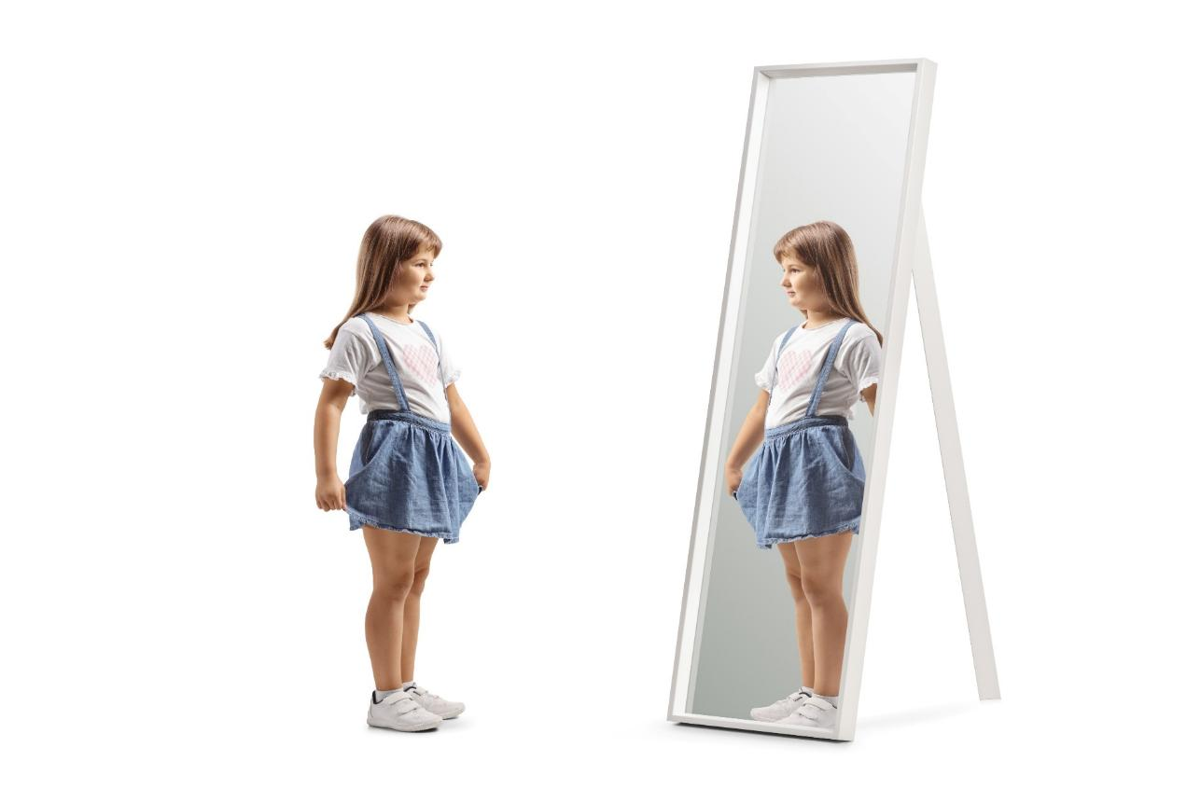
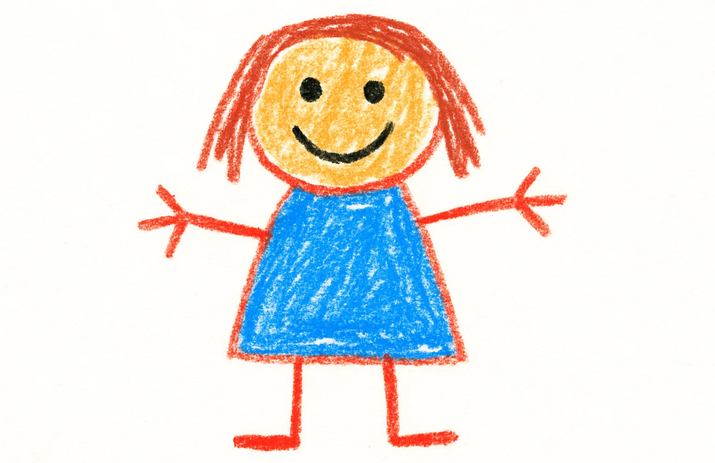
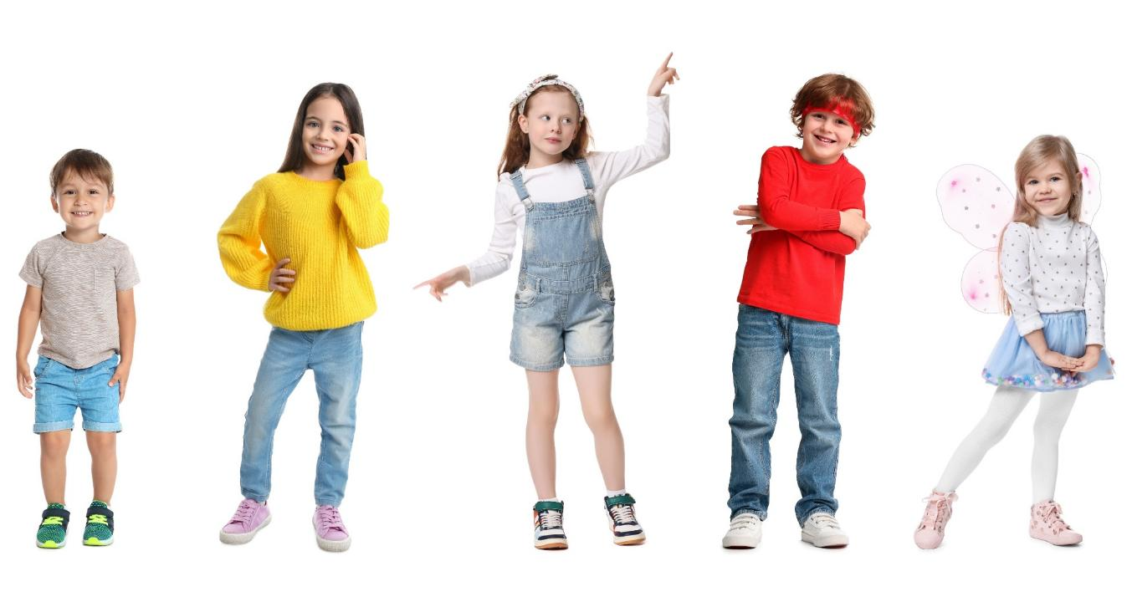

Slide 8
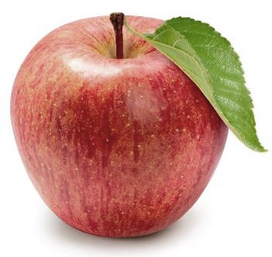
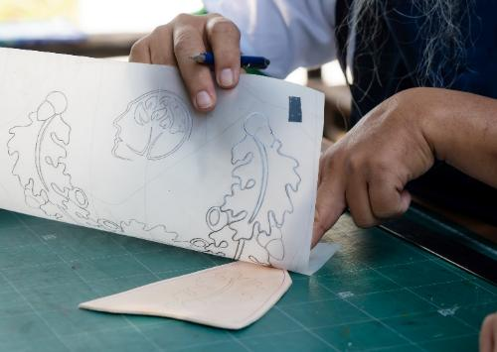


outline
The line around something that shows its shape.
trace
To follow the lines and copy the shape.

Slide 9
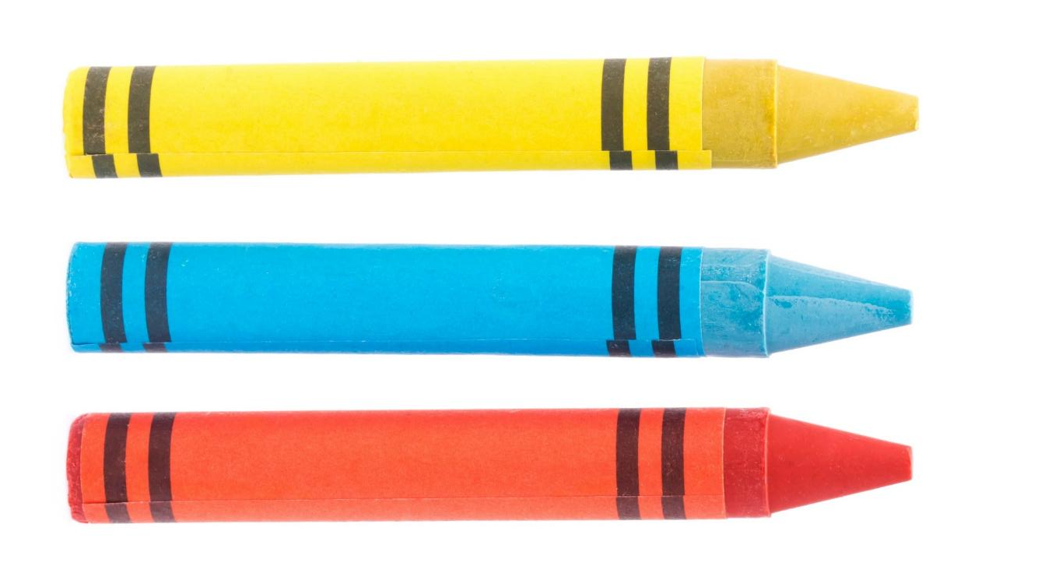
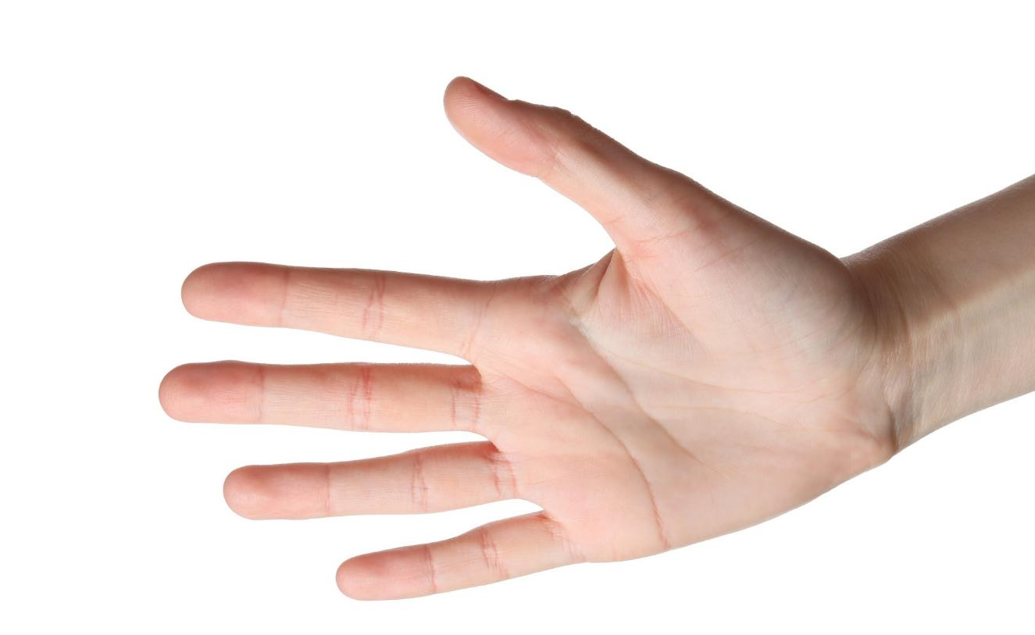

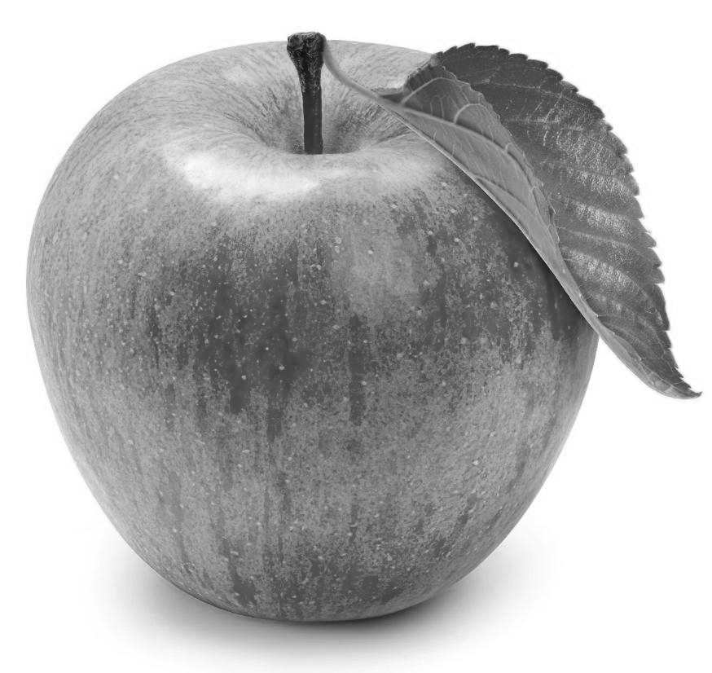
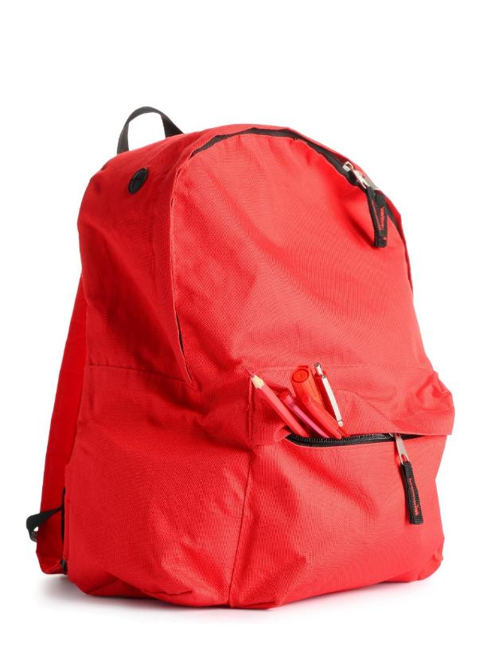
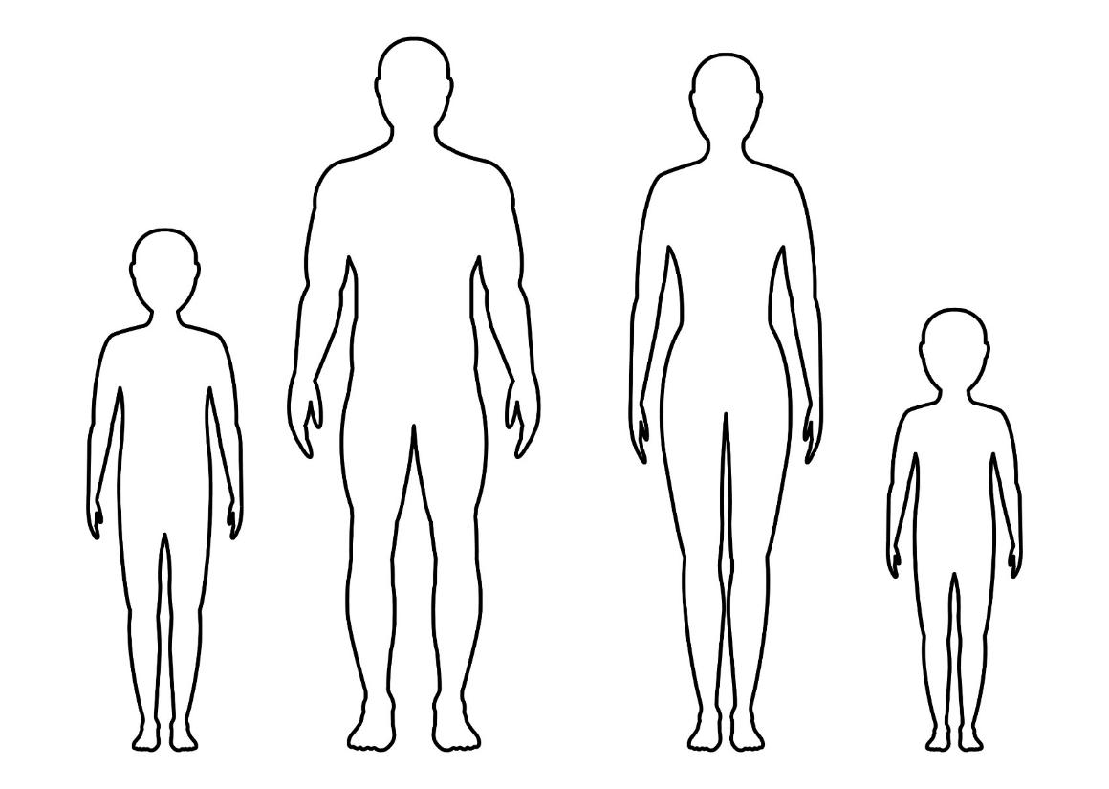







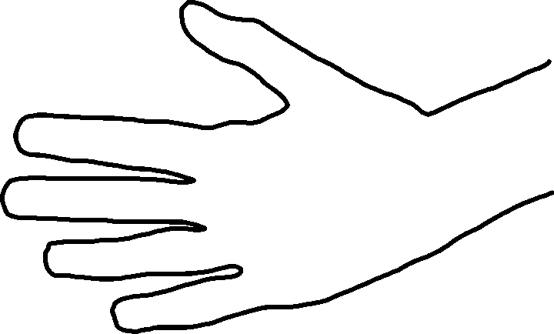
Outlines

Slide 10
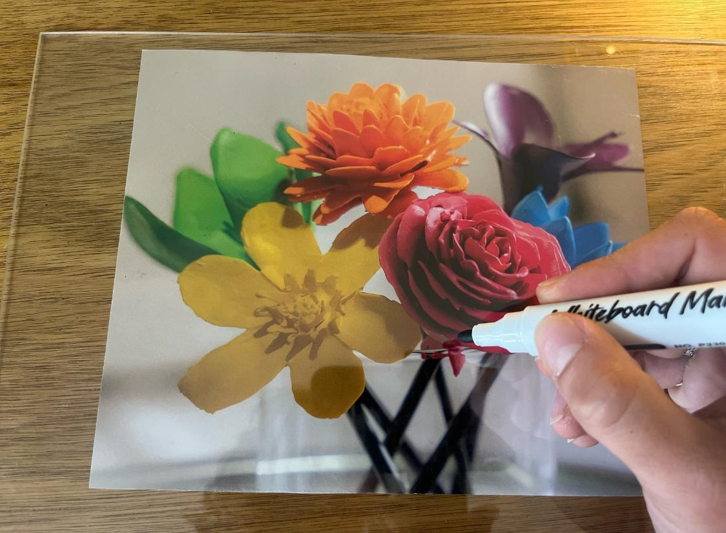
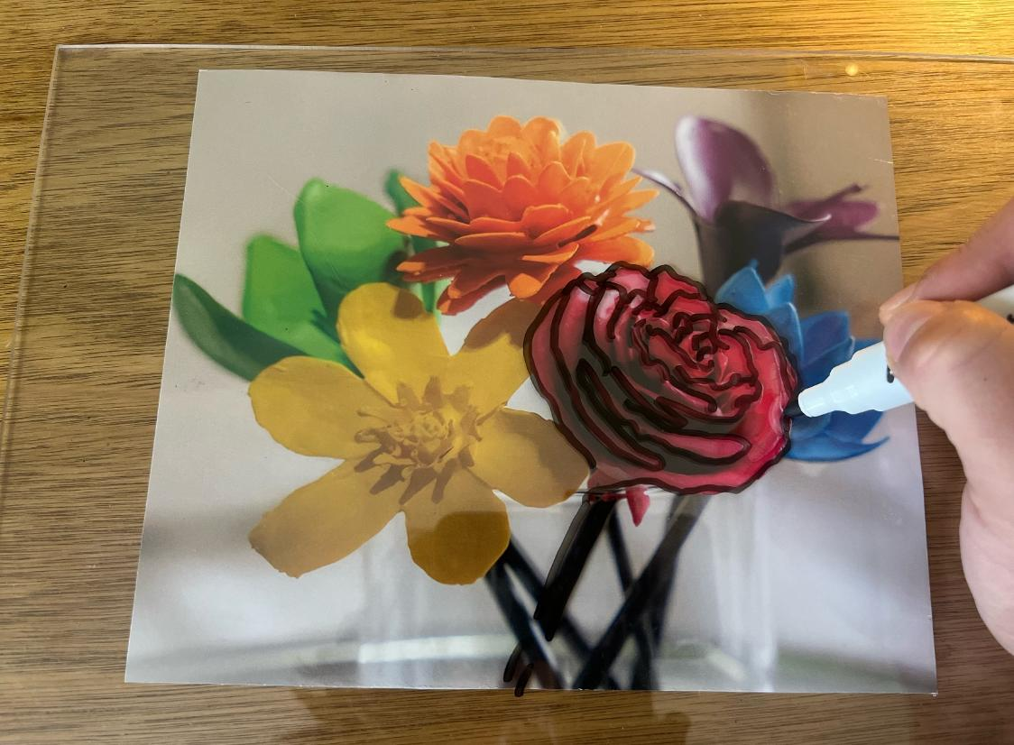
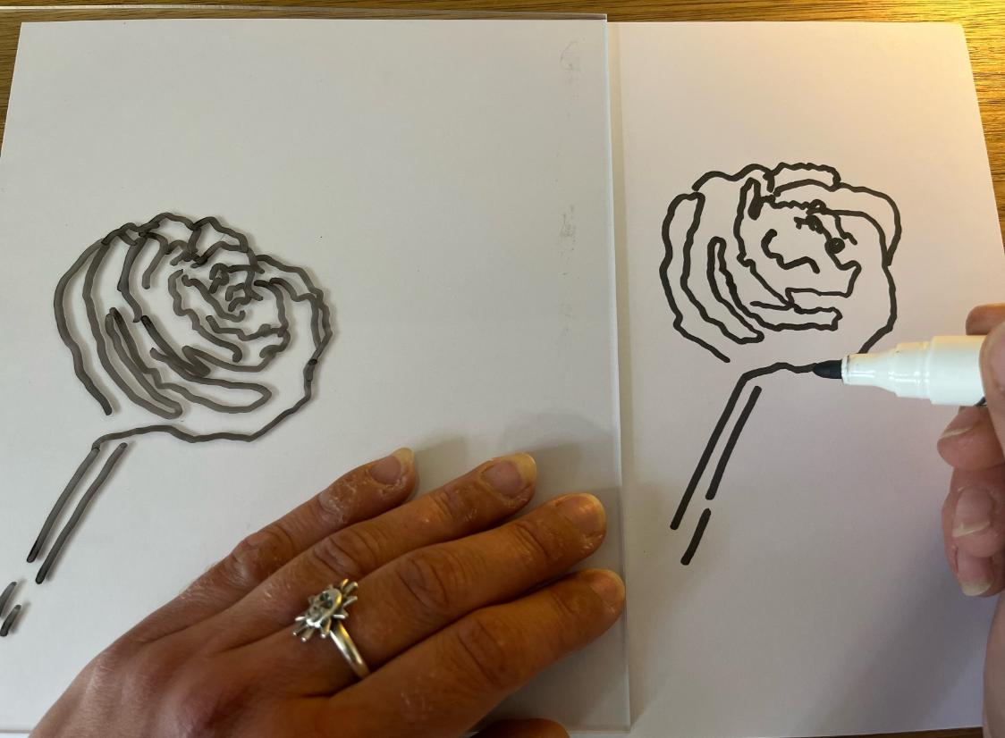
Outlines
Create exemplar

Slide 11




Outlines

Slide 12


Outlines
An outline goes around a shape.

Slide 13
Outlines

Slide 14
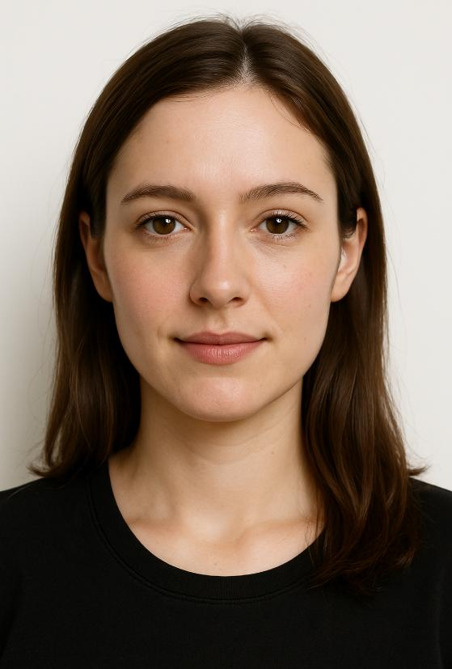

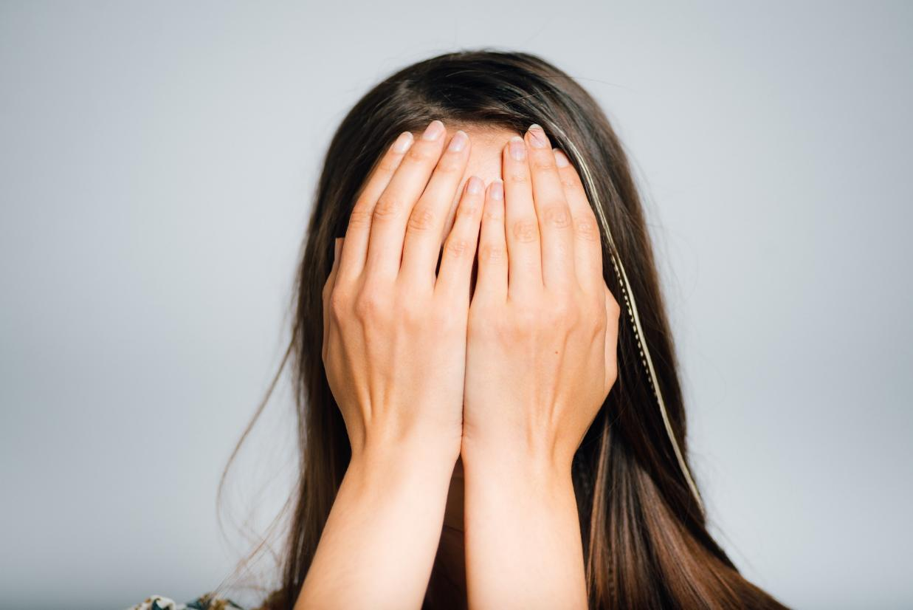
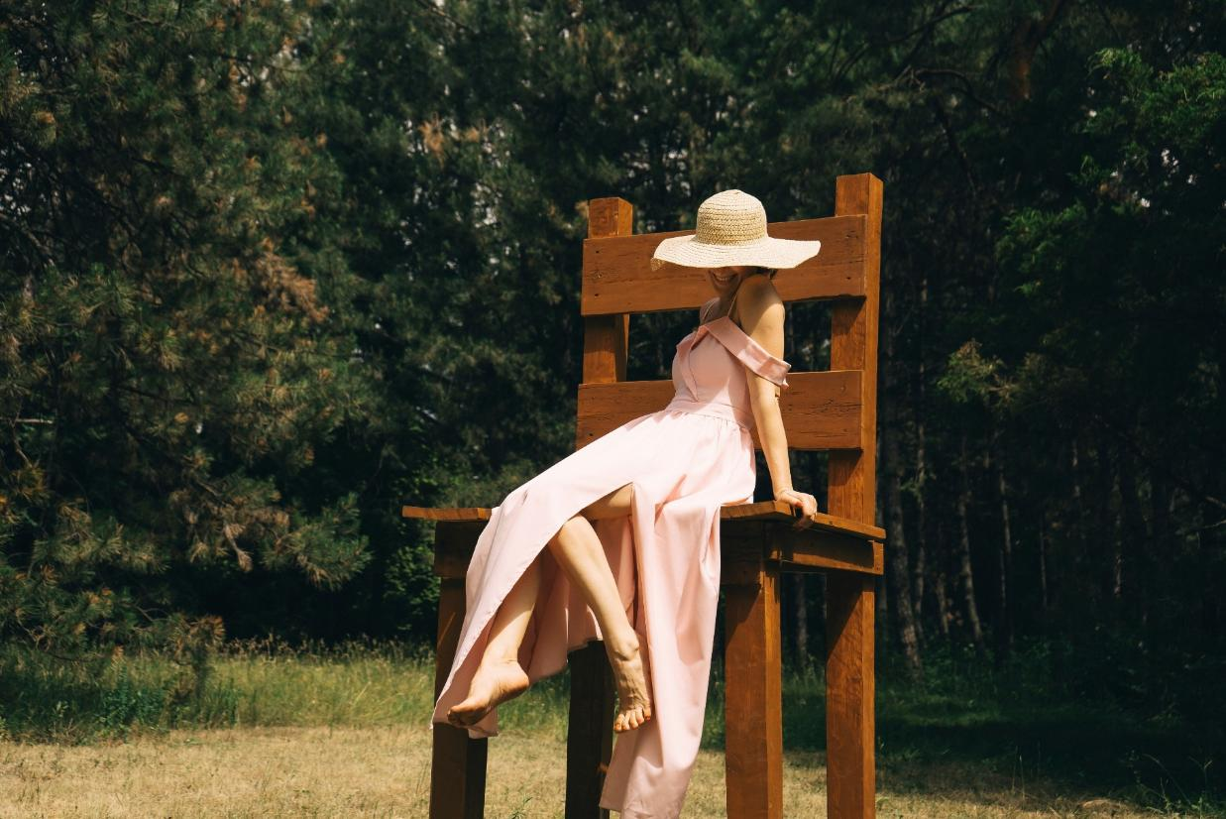
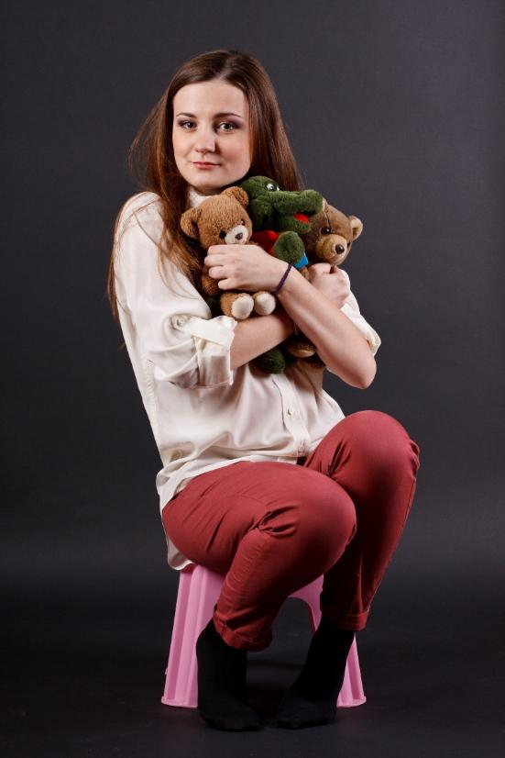





Proportion

Slide 15
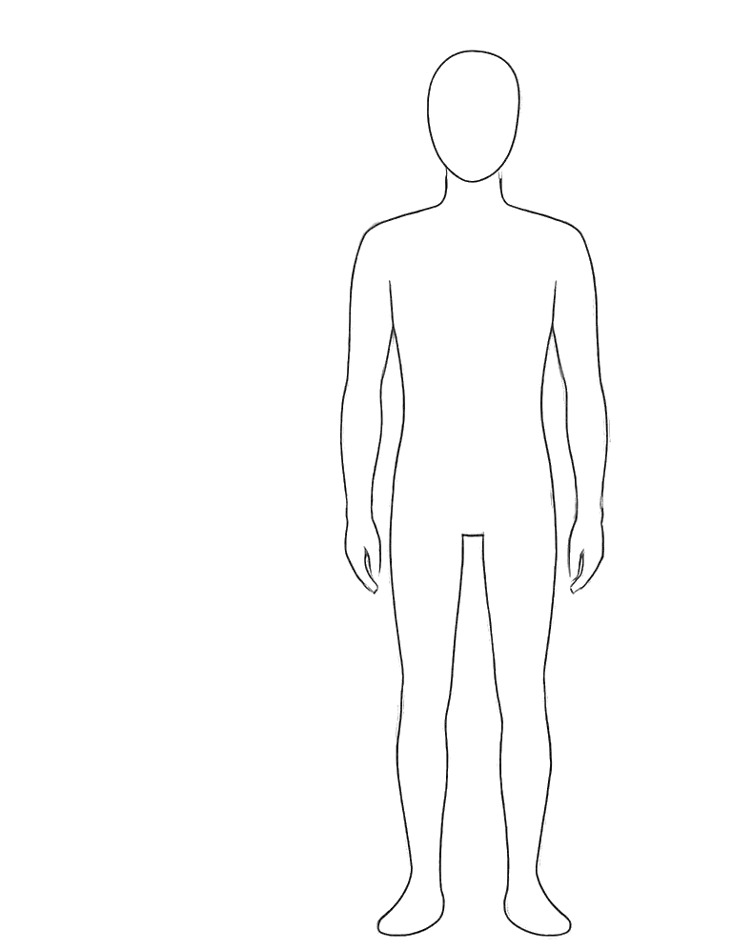
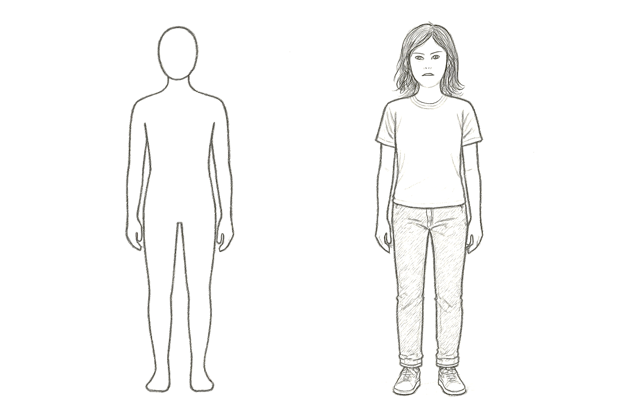
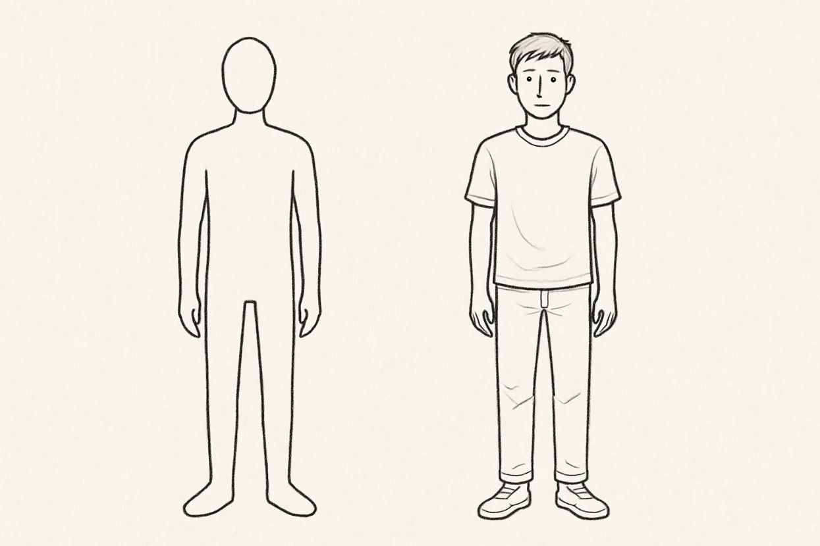
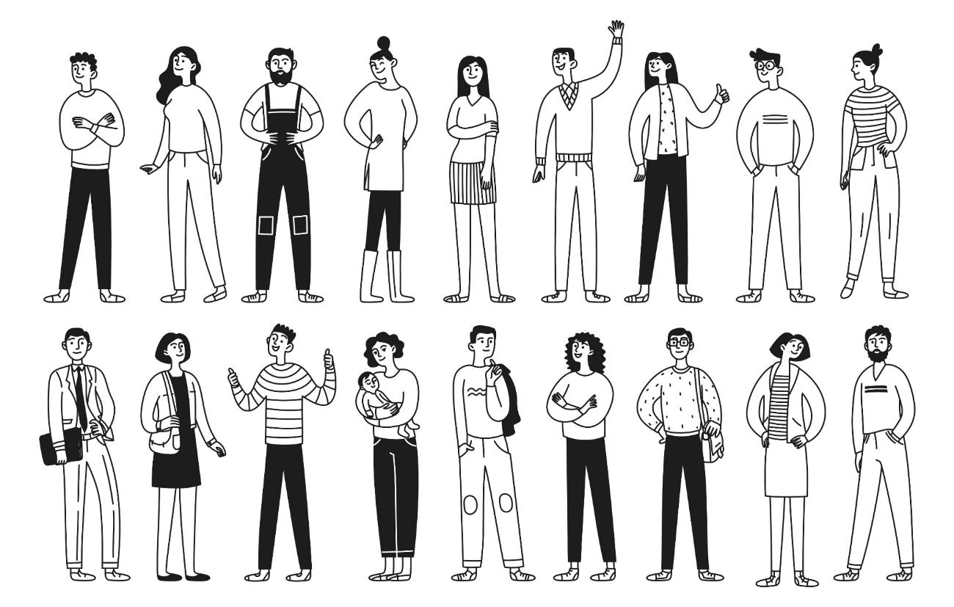
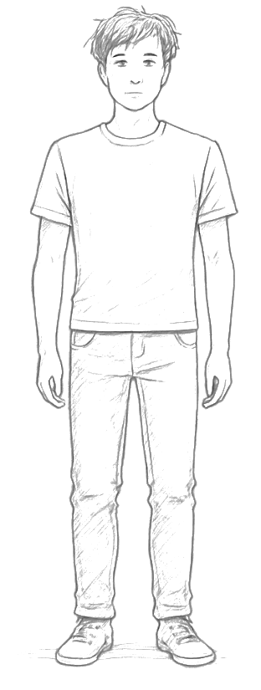
Add Details

Slide 16

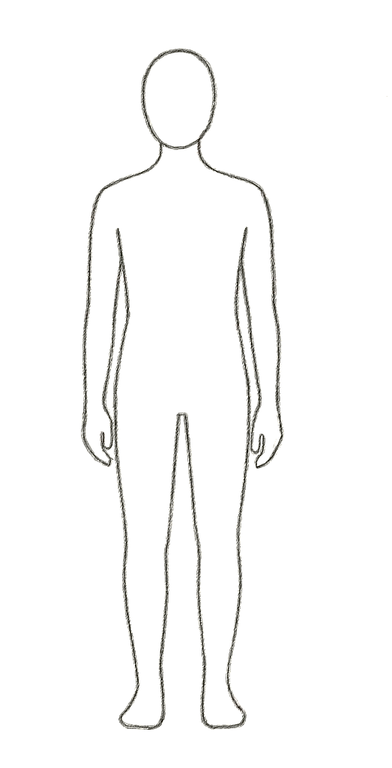







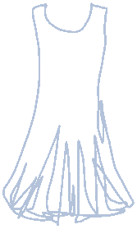

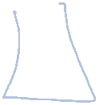
Add Details

Slide 17
Add Details

Slide 18



Outlines
An example of a detail is:
hair
arm
leg

Slide 19
Add Details

Slide 20

An Outline of Me

Slide 21
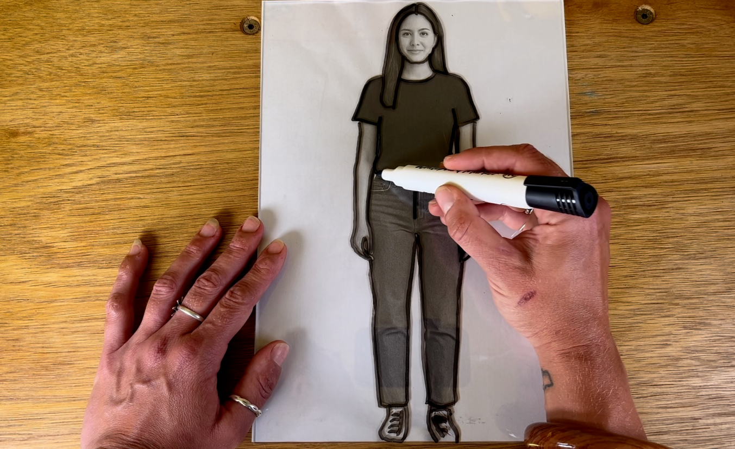
An Outline of Me

Slide 22
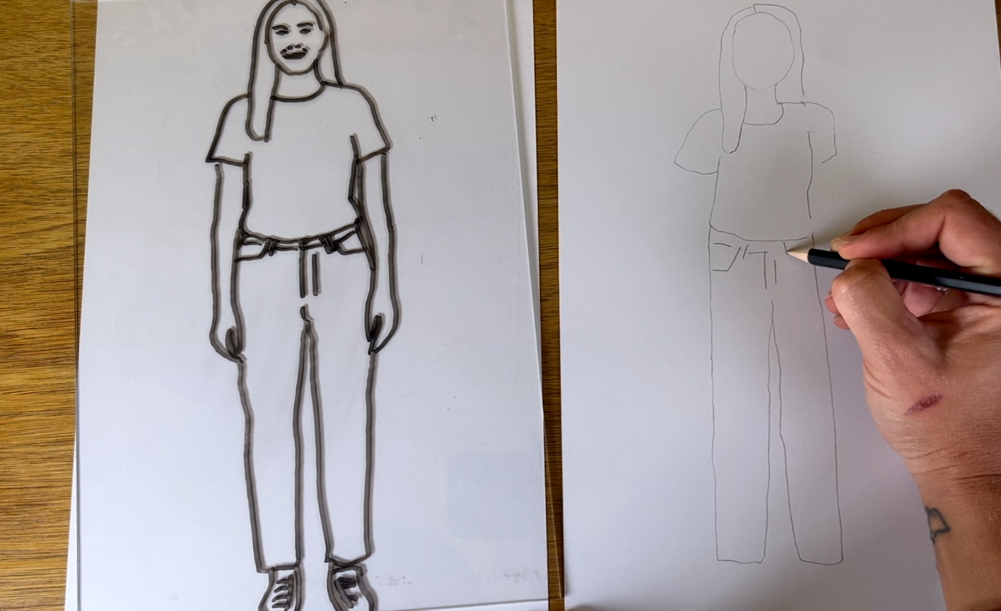
An Outline of Me

Slide 23
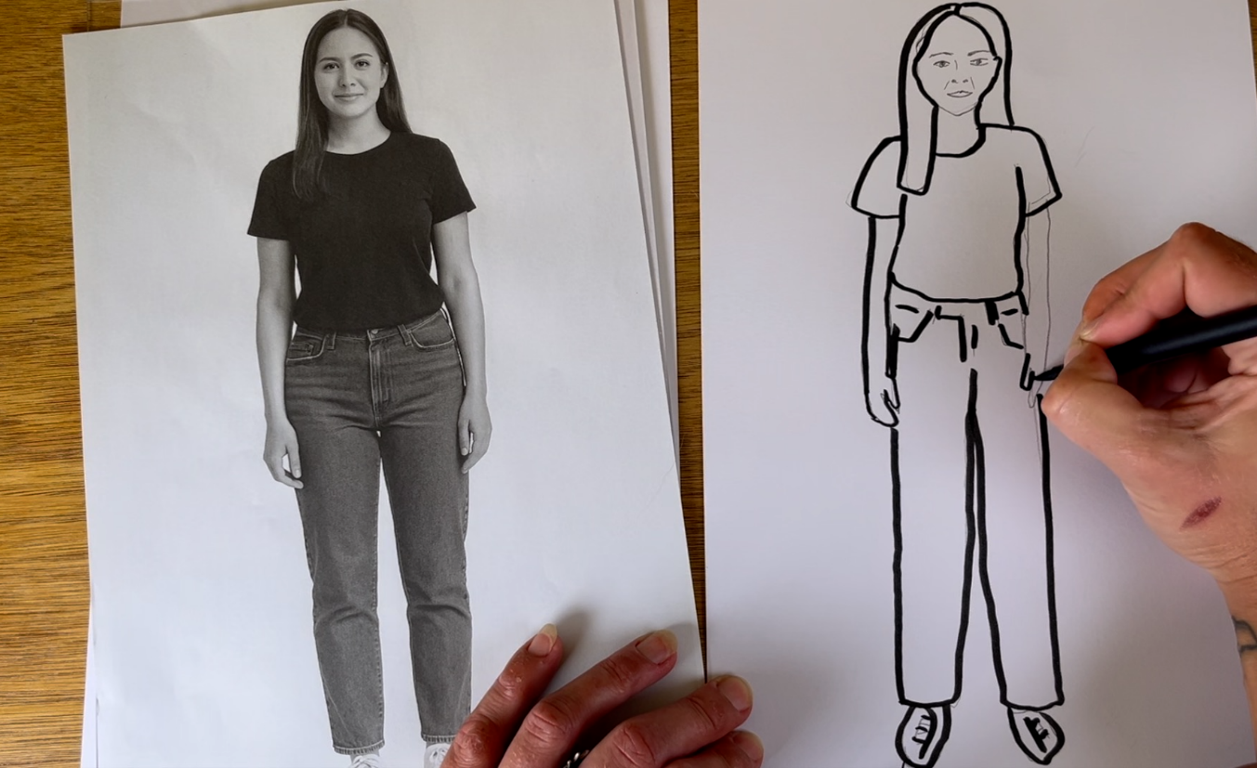
An Outline of Me

Slide 24
An Outline of Me
Details make your picture:
look like you
look
colourful
look
boring

Slide 25
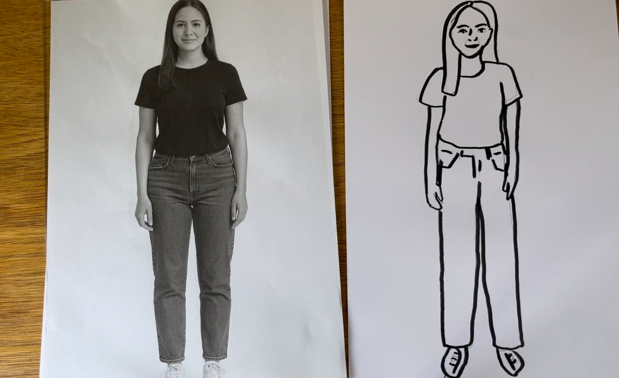
An Outline of Me

Slide 26

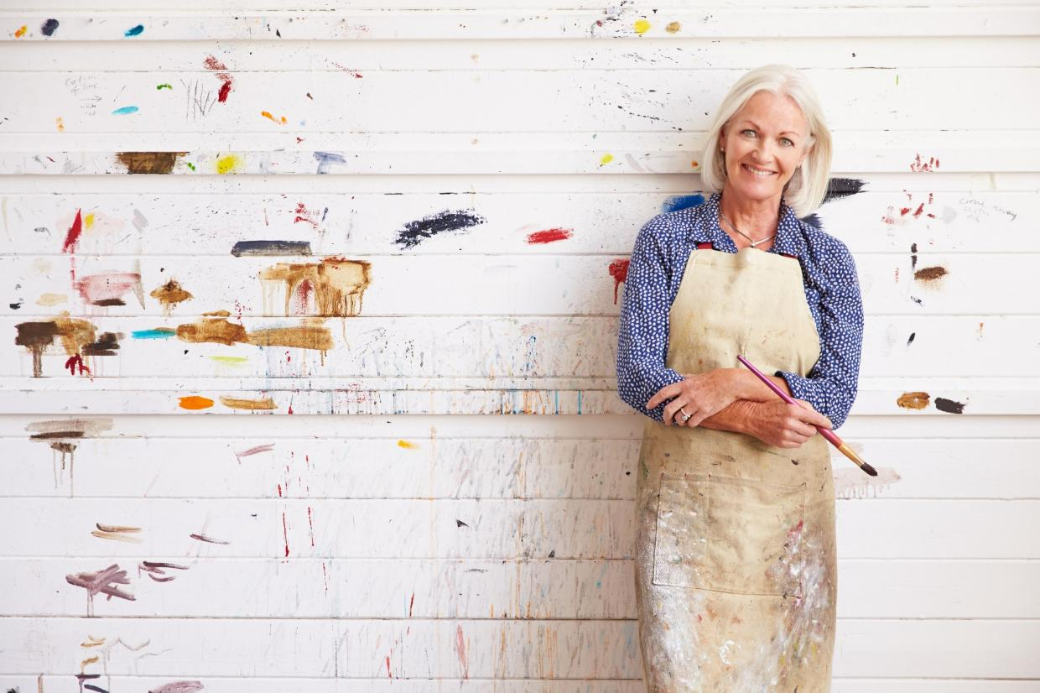
Favourite Part
What's next?
What do I like?
What was fun?
What was tricky?

Slide 27


Favourite Part
This is my favourite part because...

Slide 28
Favourite Part

Slide 29
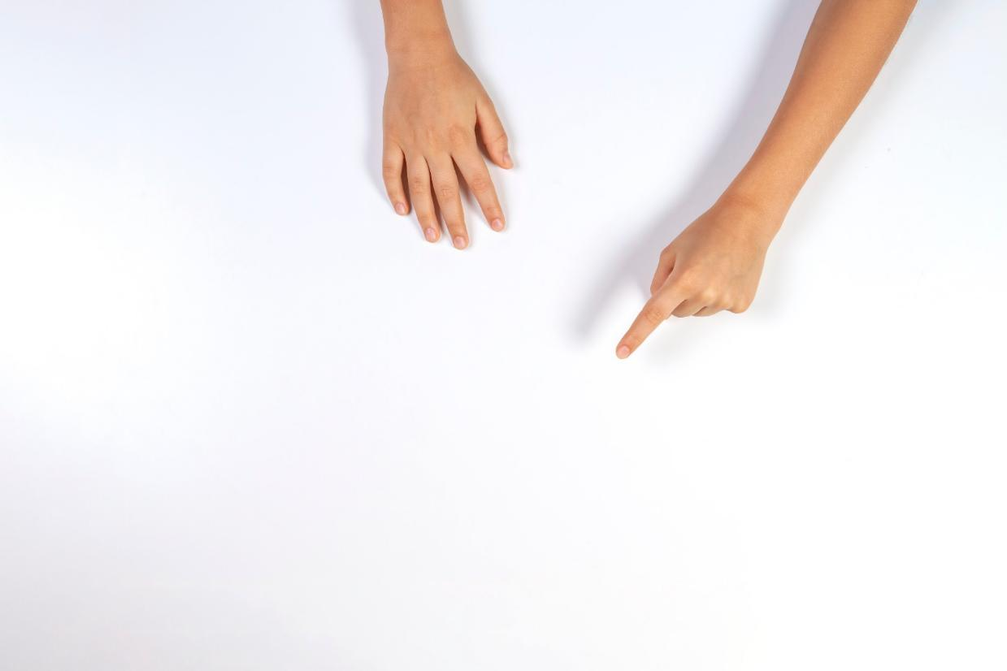
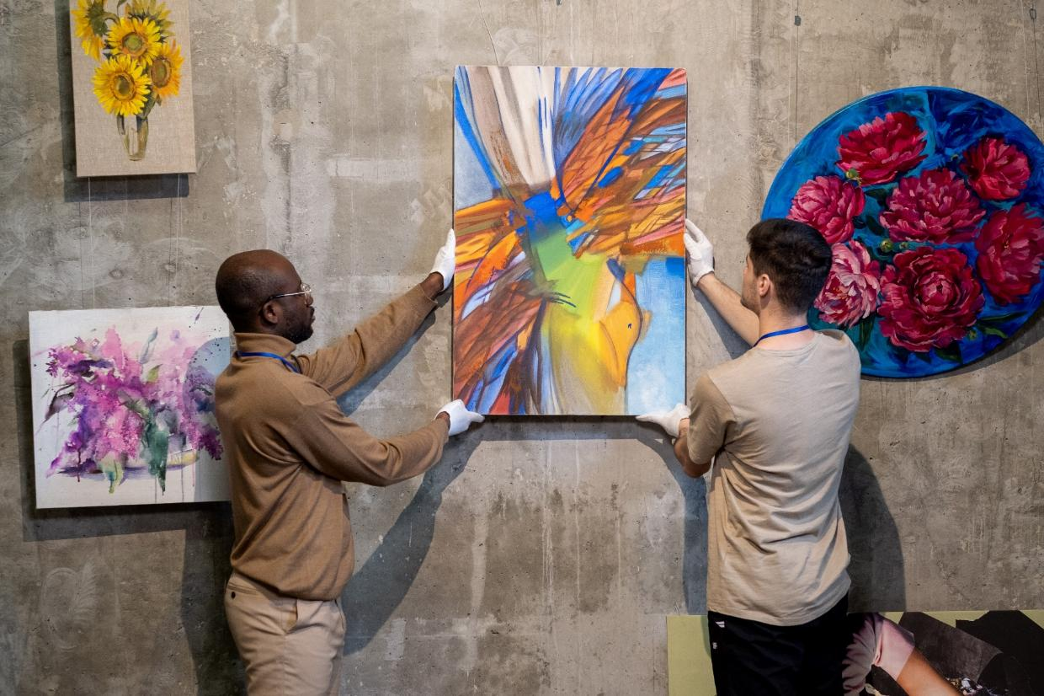
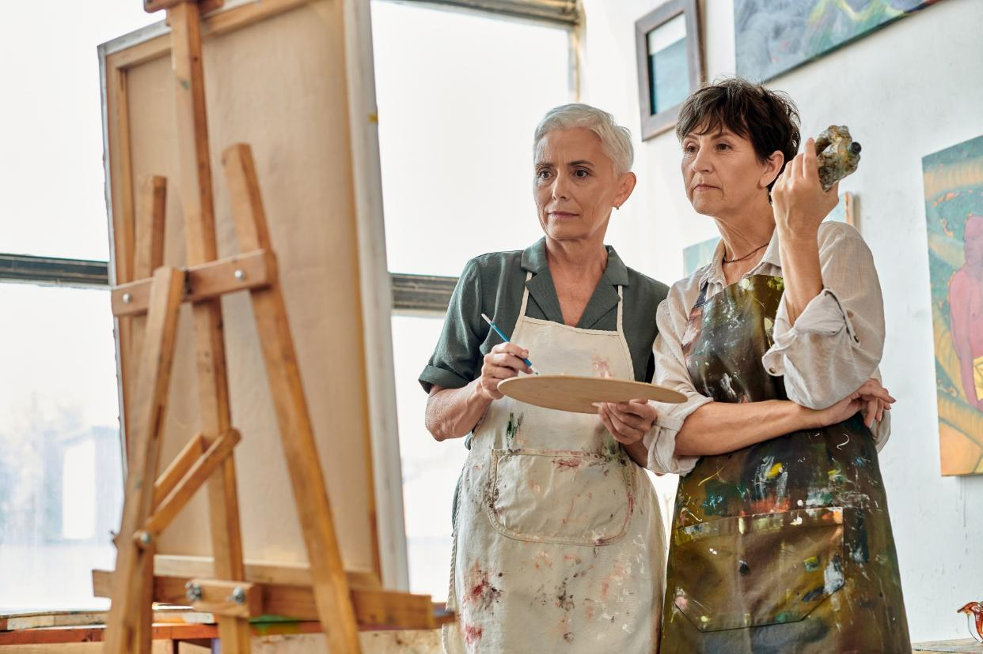
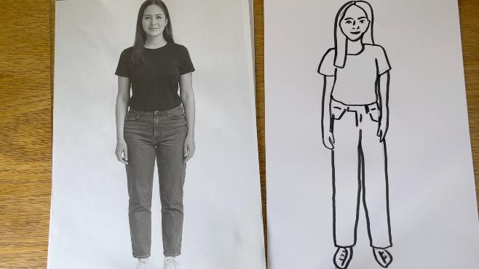

Slide 30

Artists Share Their Work

Slide 31
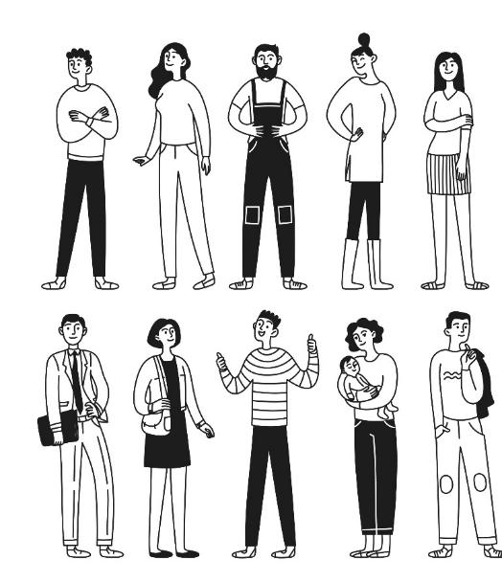



Details make drawings look different.
An outline shows the shape.

Slide 33

In the next lesson, we will blend and layer colours to make a radiating line background.

