Slide 1
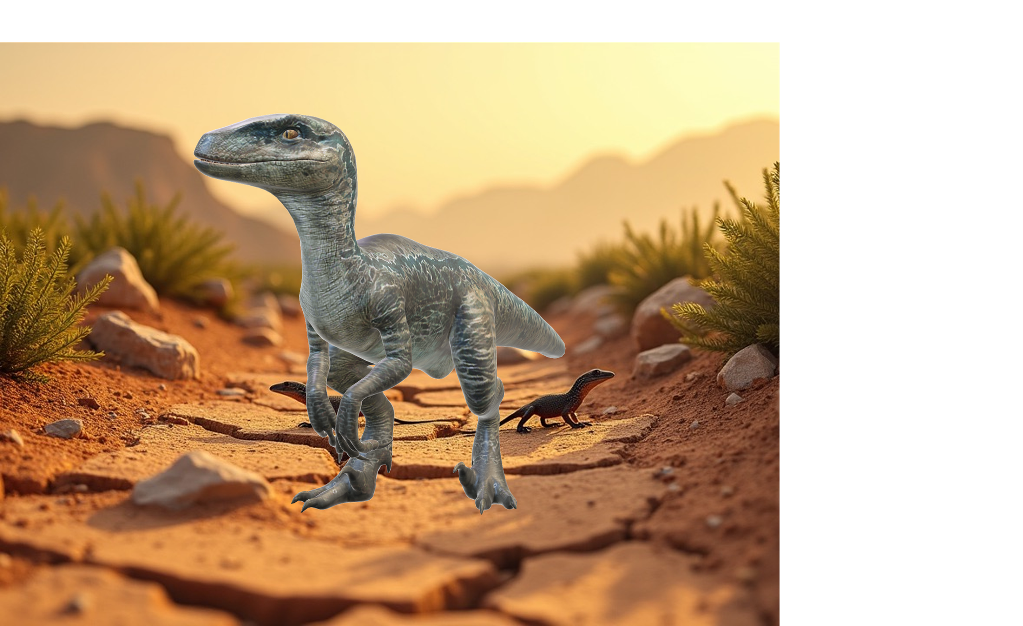
Writing
Unit 3: Informational/ History
Lesson 2: Reading About Eoraptor
Version 1

Slide 2
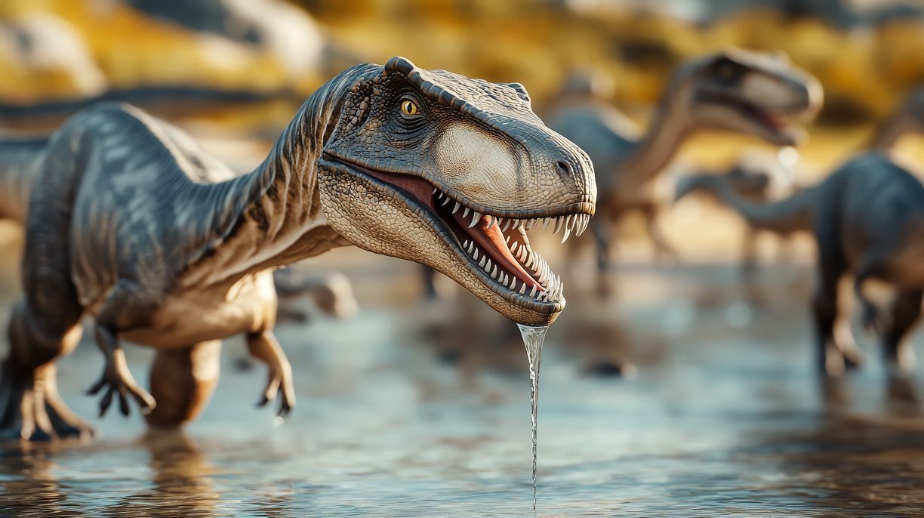
Eoraptor lived near rivers and lakes.

Slide 3

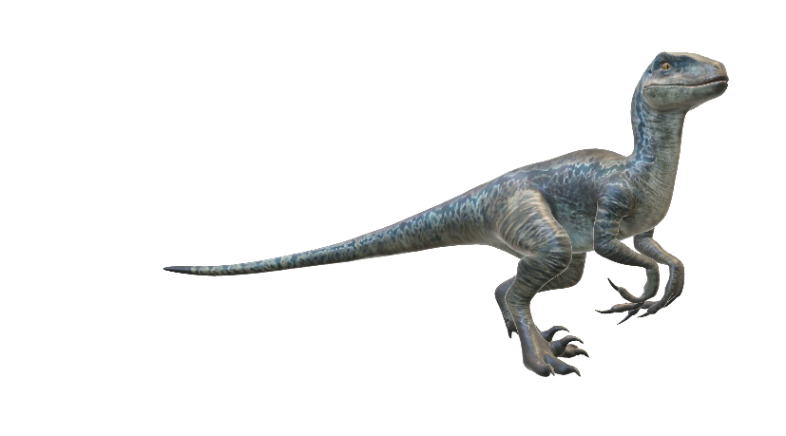

Eoraptor lived in the Triassic period.

Slide 4


What makes Eoraptor special?
Eoraptor was a really big dinosaur.
Eoraptor was one of the first dinosaurs.

Slide 5


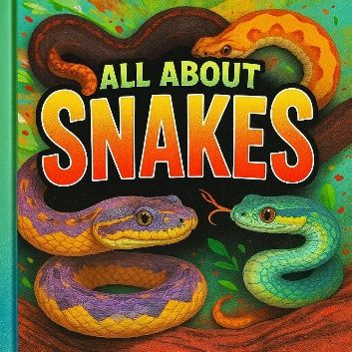

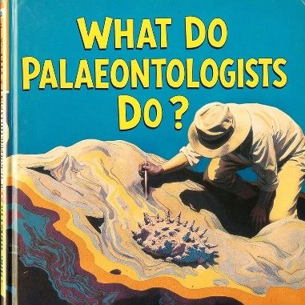
In this lesson, we will learn about informative writing and its purpose.

Slide 6
You will be able to: ​
understand the purpose of informative writing.

Slide 7
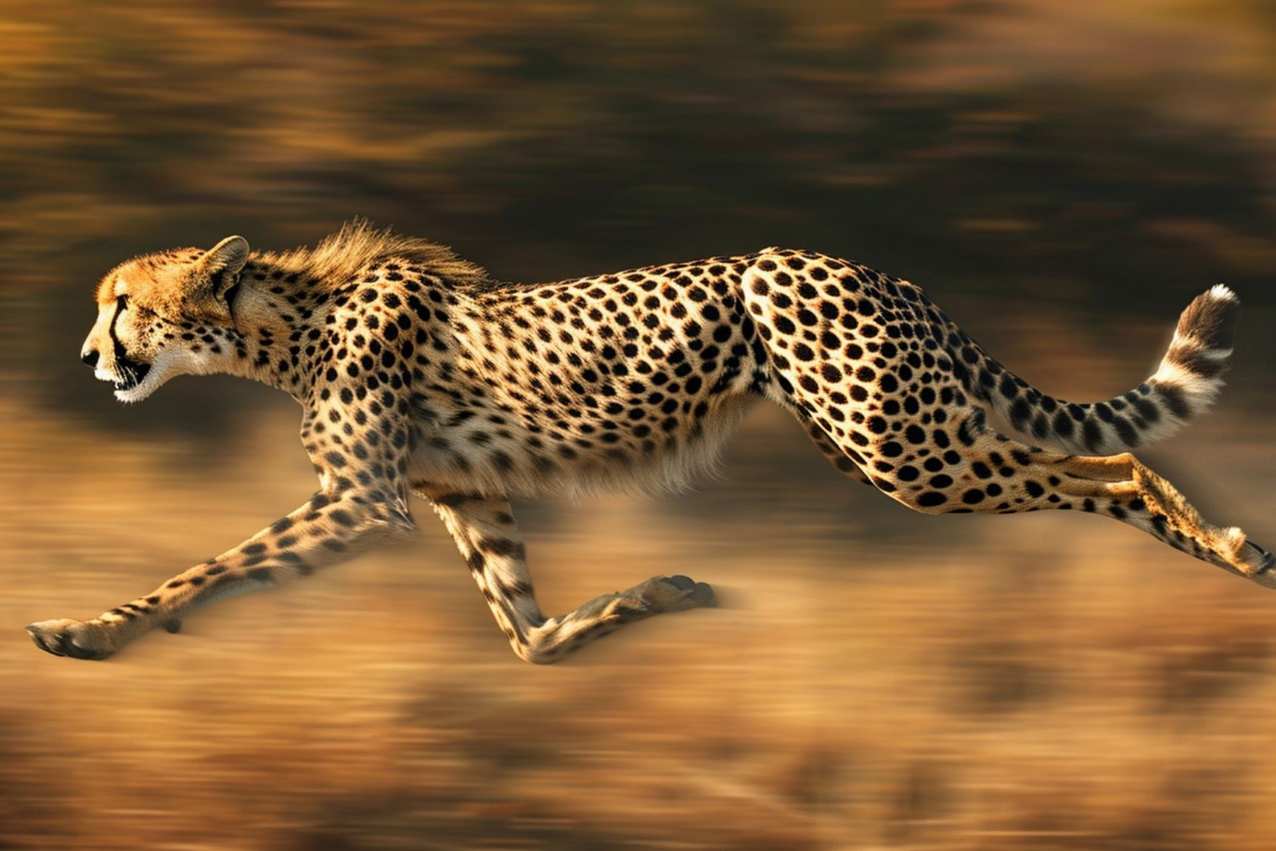



Slide 8
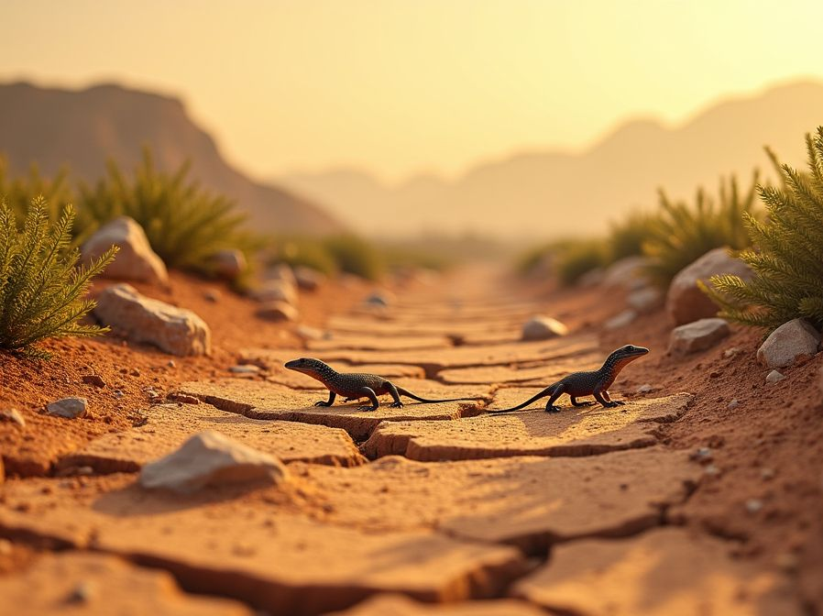


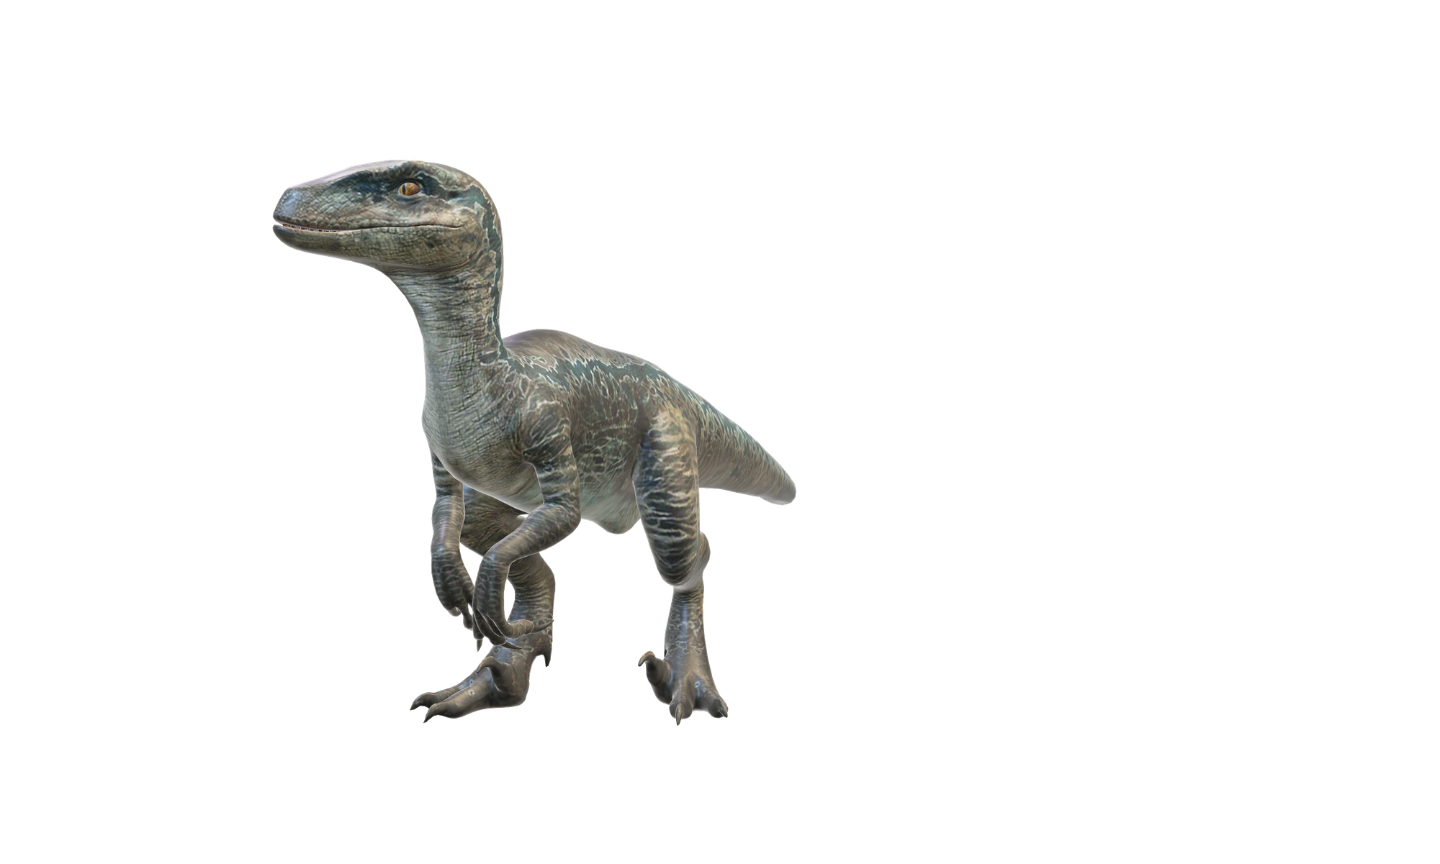

Slide 9
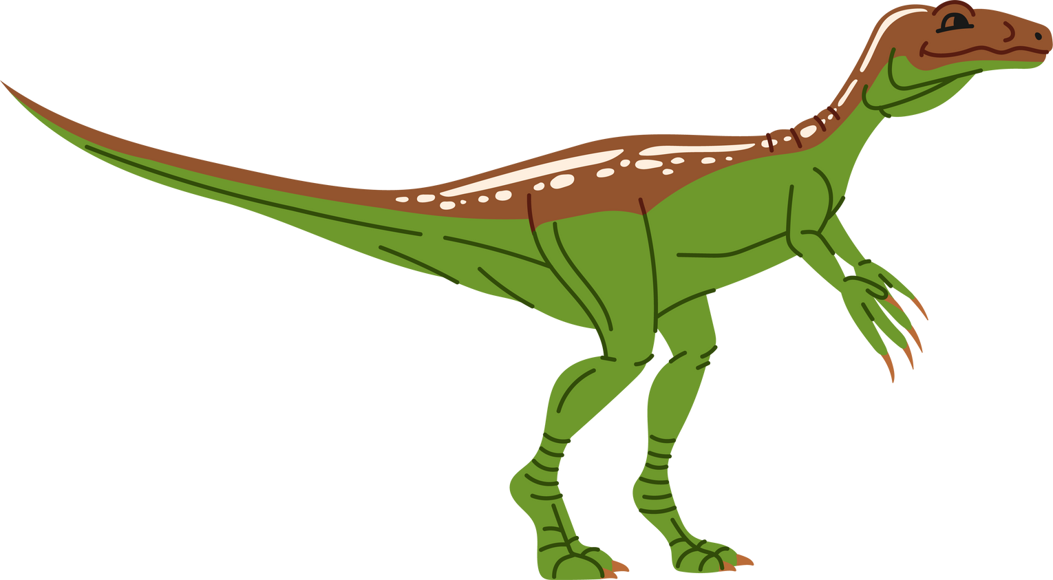
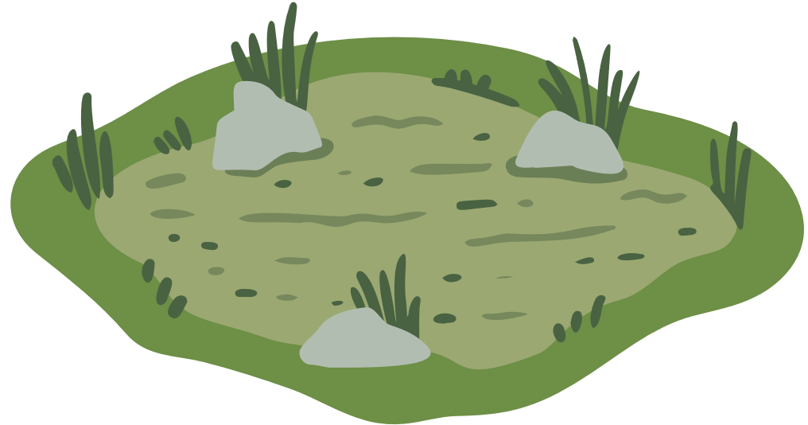




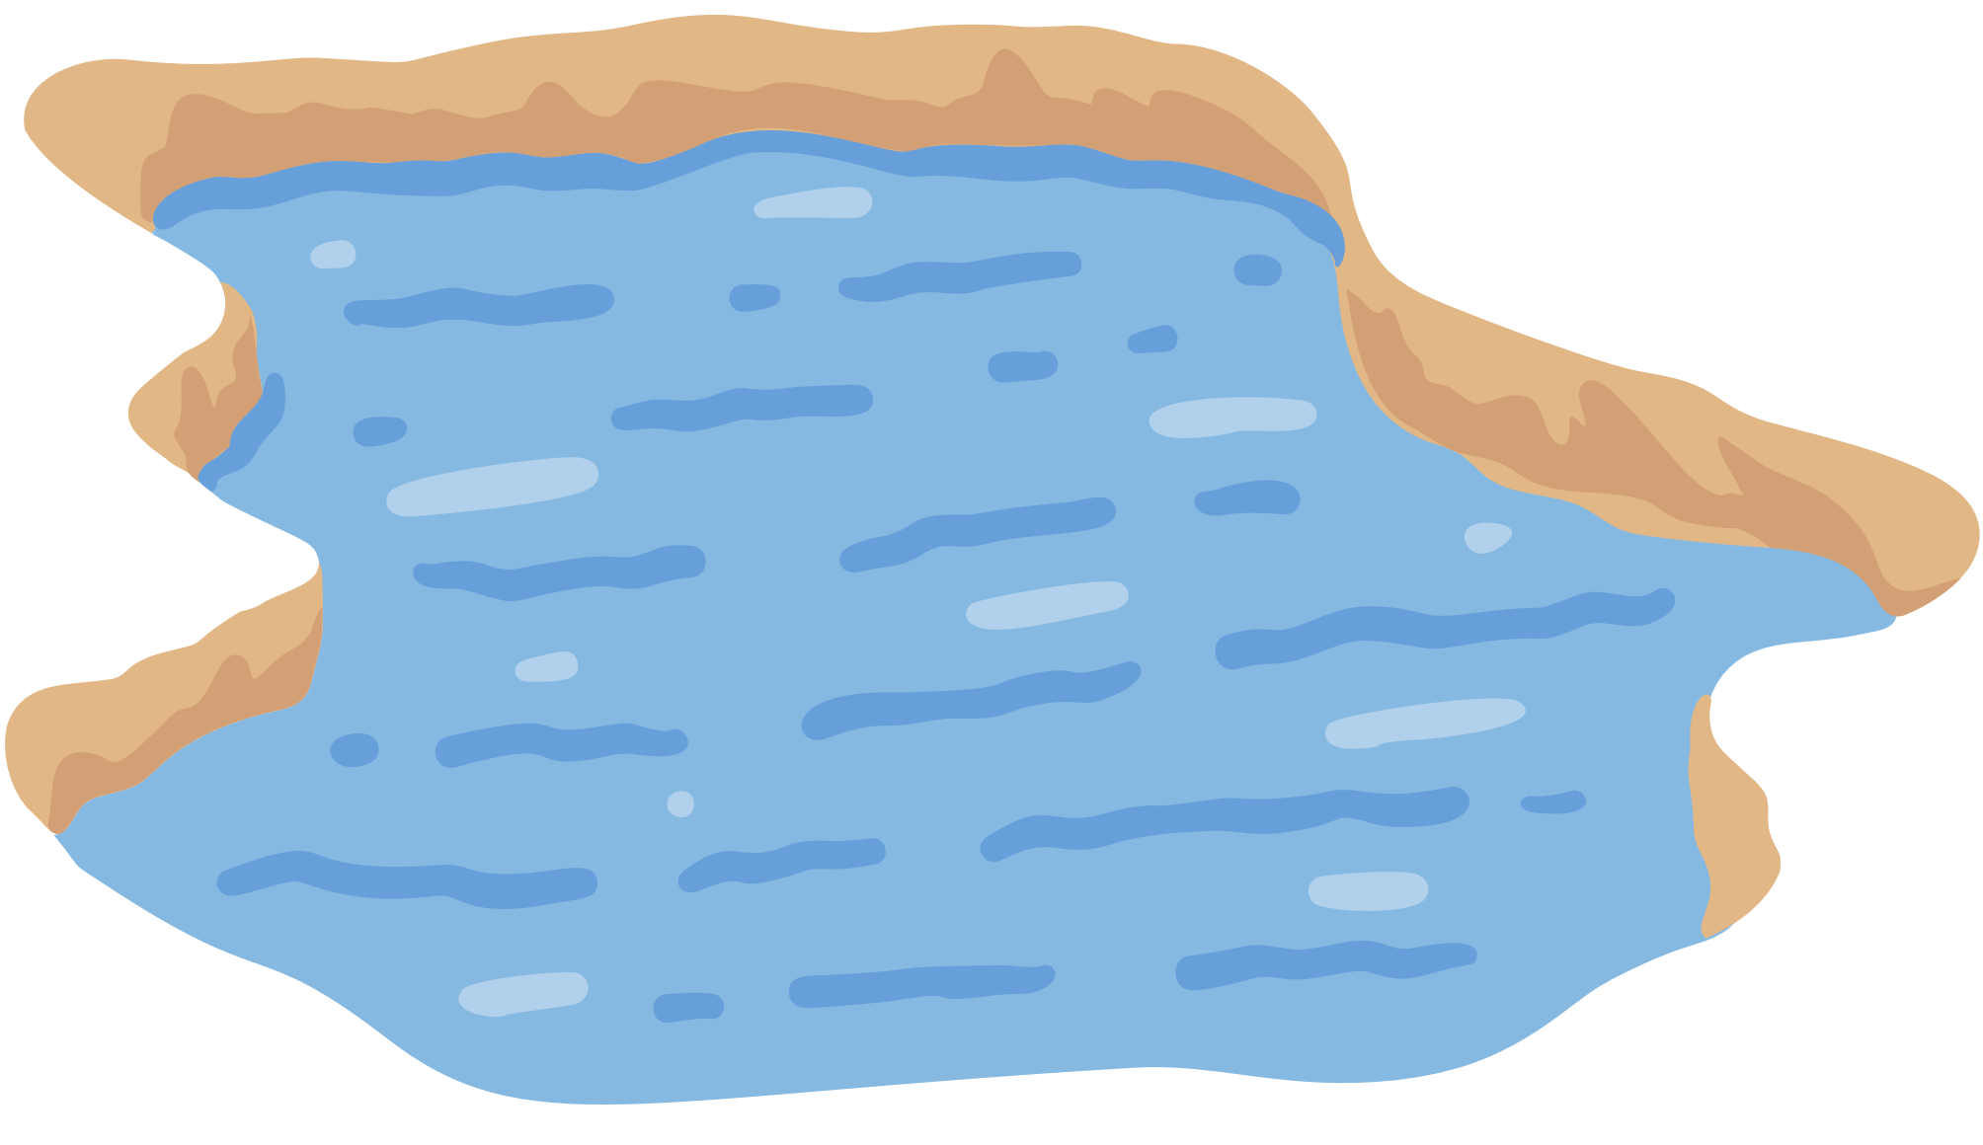



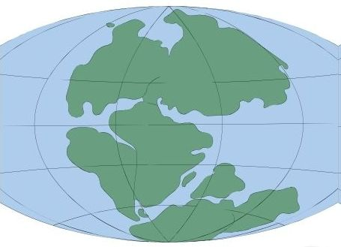



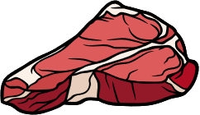

Eoraptor Mind Map
Grassy areas
Big eyes
Home
Appearance
Near water
Stood on two legs
Eoraptor
230 million years ago
Size of a chicken
When
Special
Carnivore
Food
Herbivore
Triassic period
One of the first dinosaurs

Slide 10


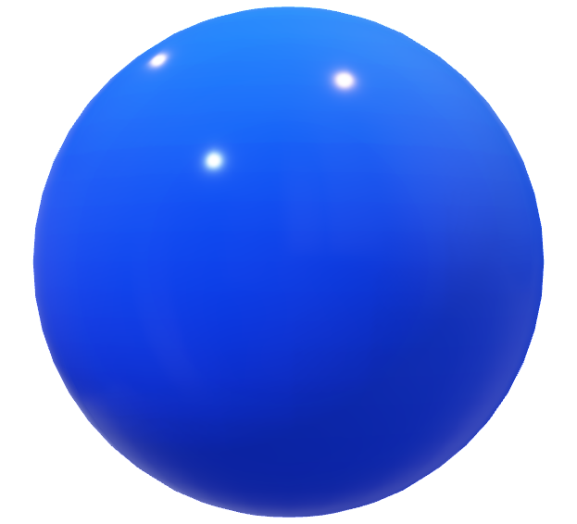
When the Eoraptor Lived
Triassic Period | Jurassic Period | Cretaceous Period
246–206 million years ago | 206–144 million years ago | 144–65 million years ago

Slide 11
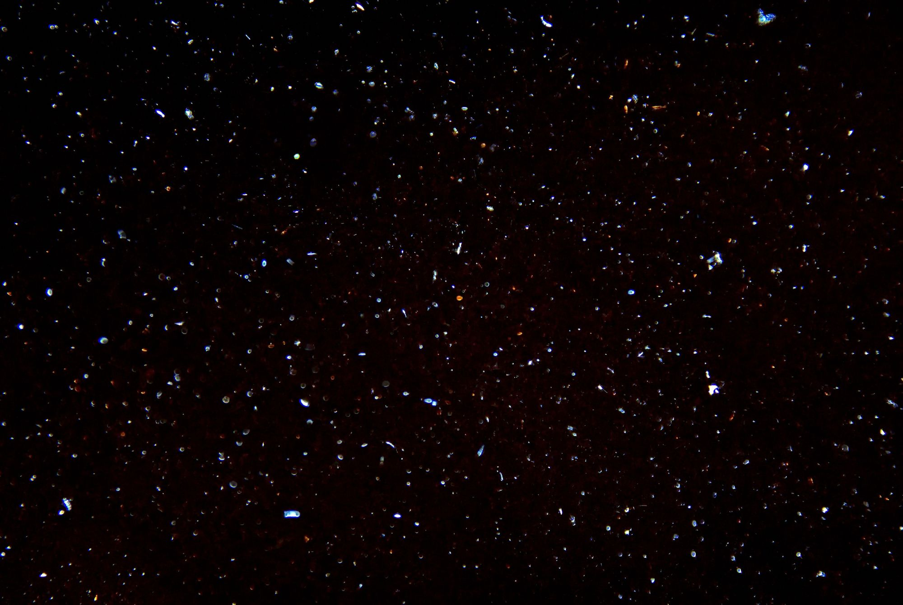


TRIASSIC
TRIASSIC
246–206 million years ago

Slide 12
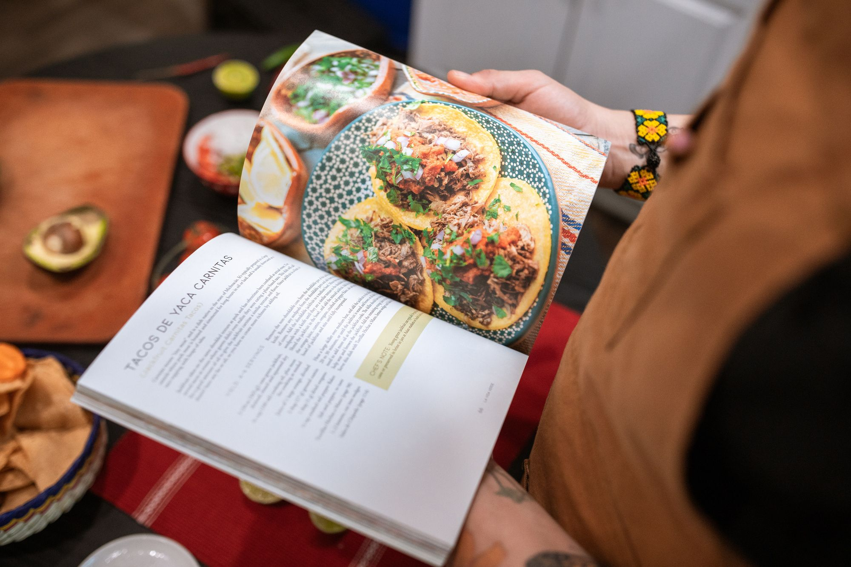
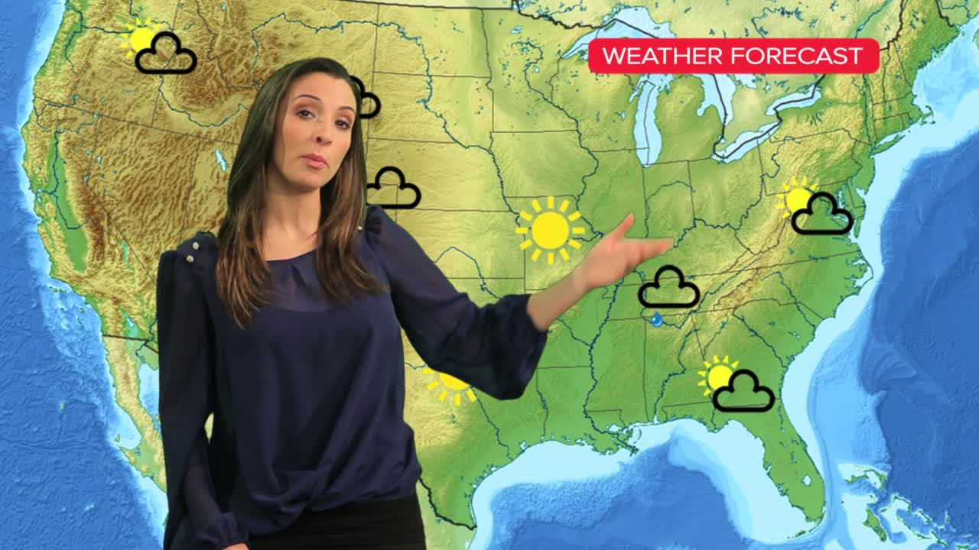
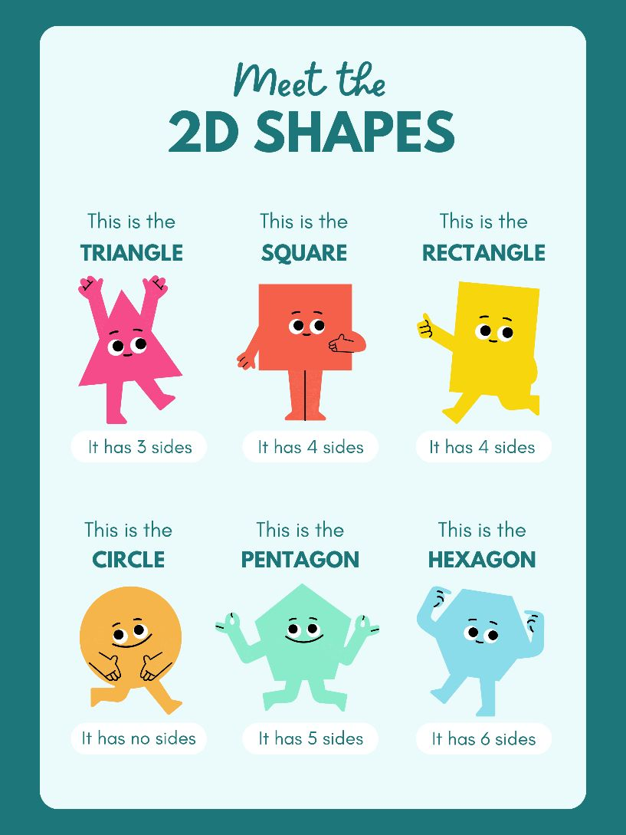

What’s Informative?

Slide 13





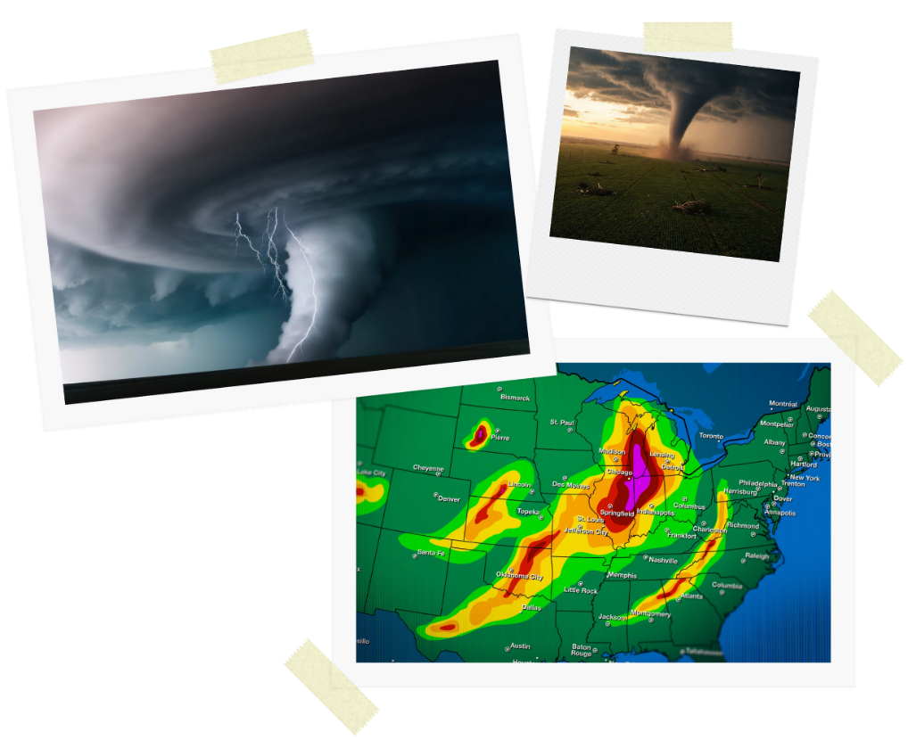

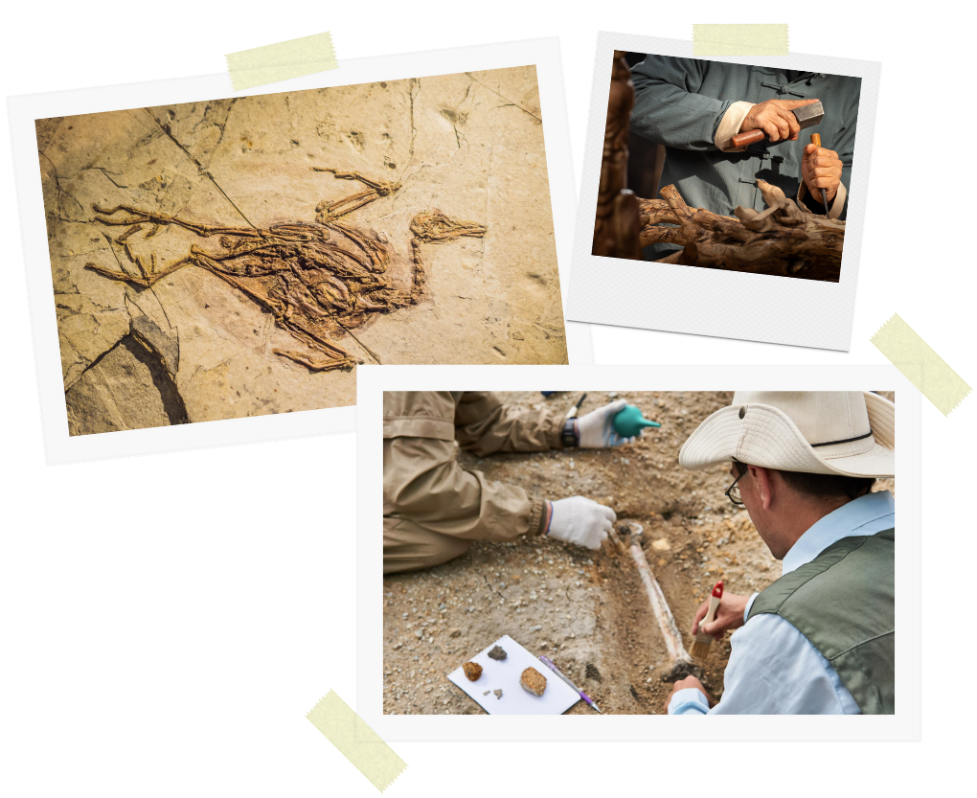

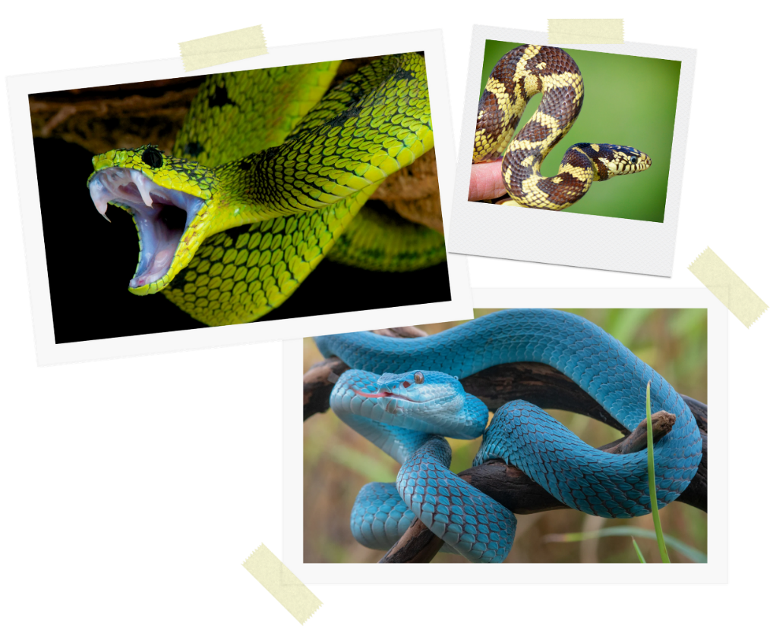


Why Informative?

Slide 14



Show of Fingers
People write informative texts to share what they know.

Slide 15

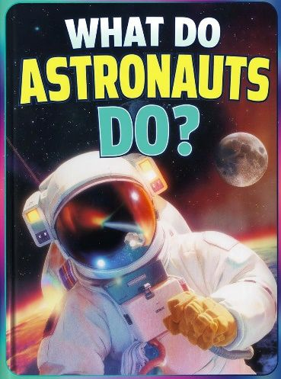

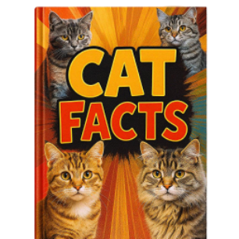



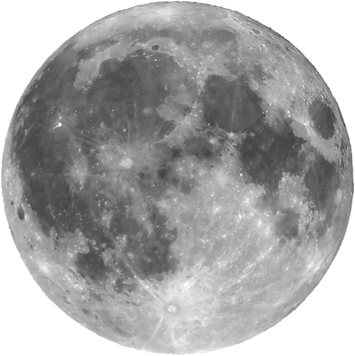

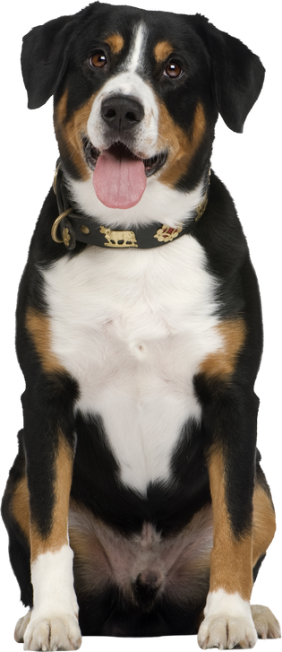
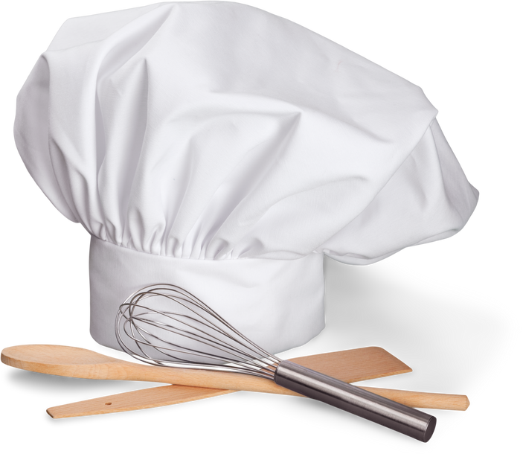
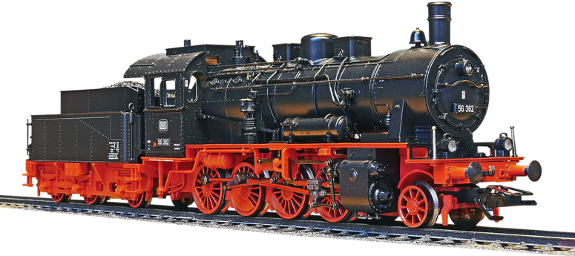
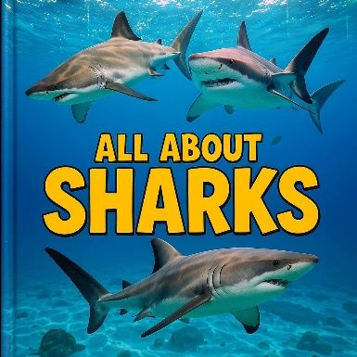



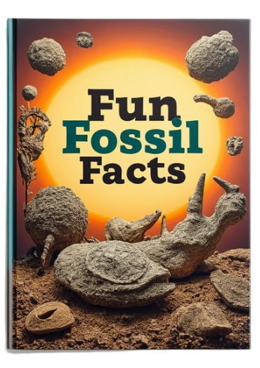
Being Informative

Slide 16






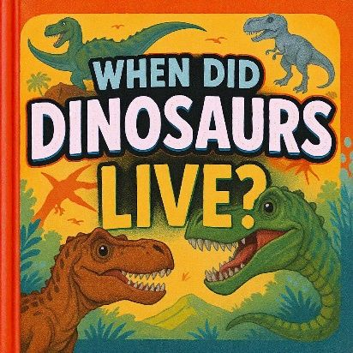
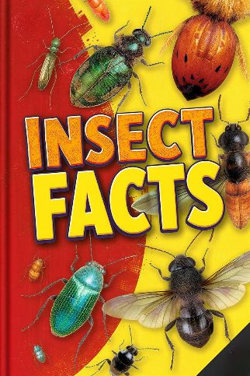
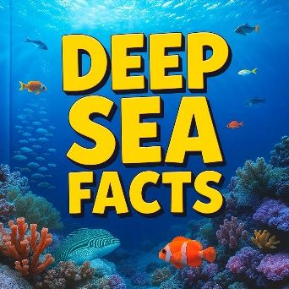
What’s the Purpose?

Slide 17





What’s the Purpose?

Slide 18

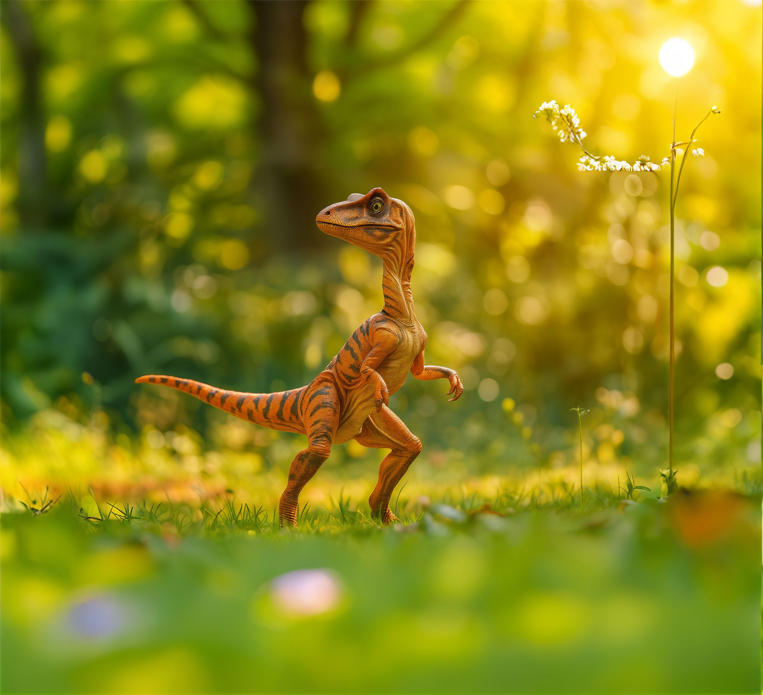




Slide 19
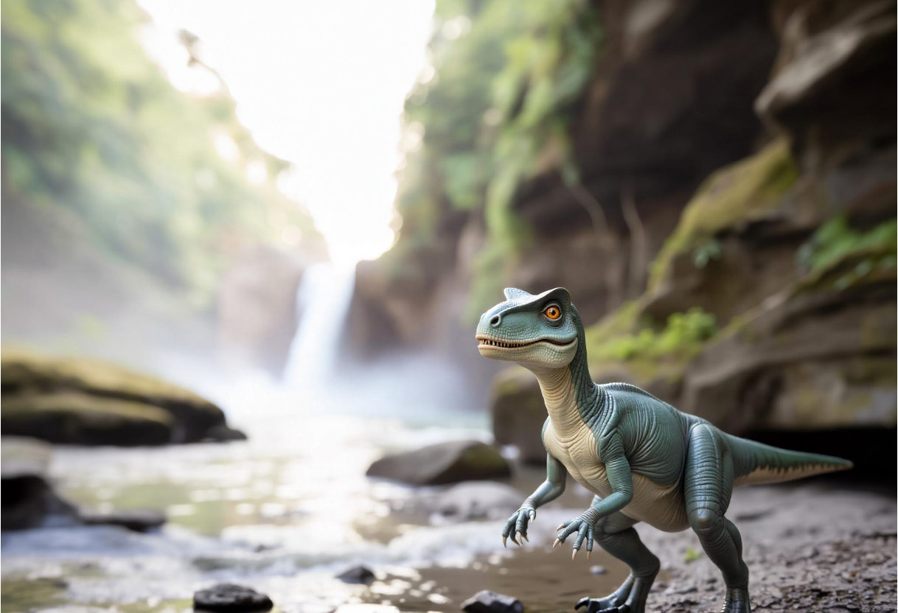



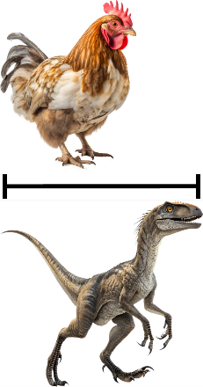
The Eoraptor was one of the first dinosaurs.
The Eoraptor stood on two legs, just like a bird.

Slide 20
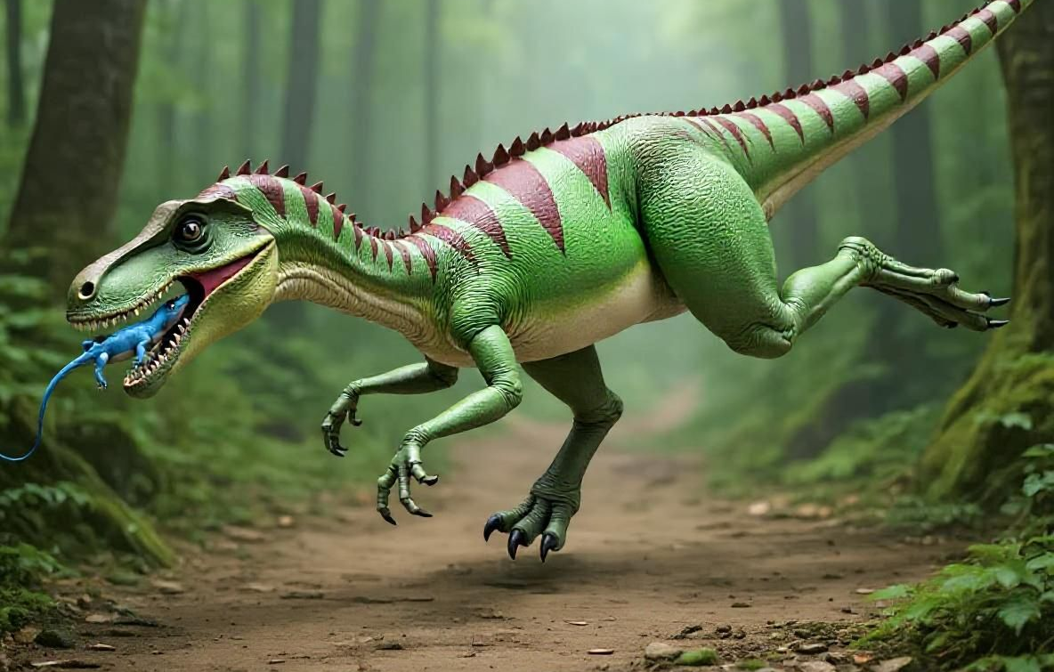
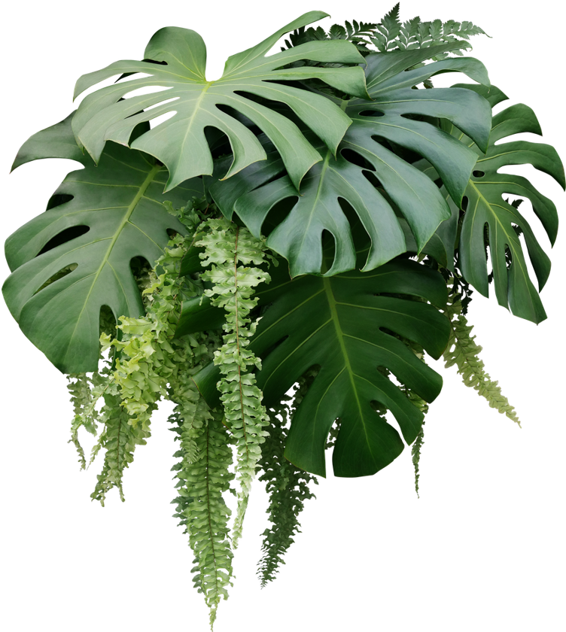
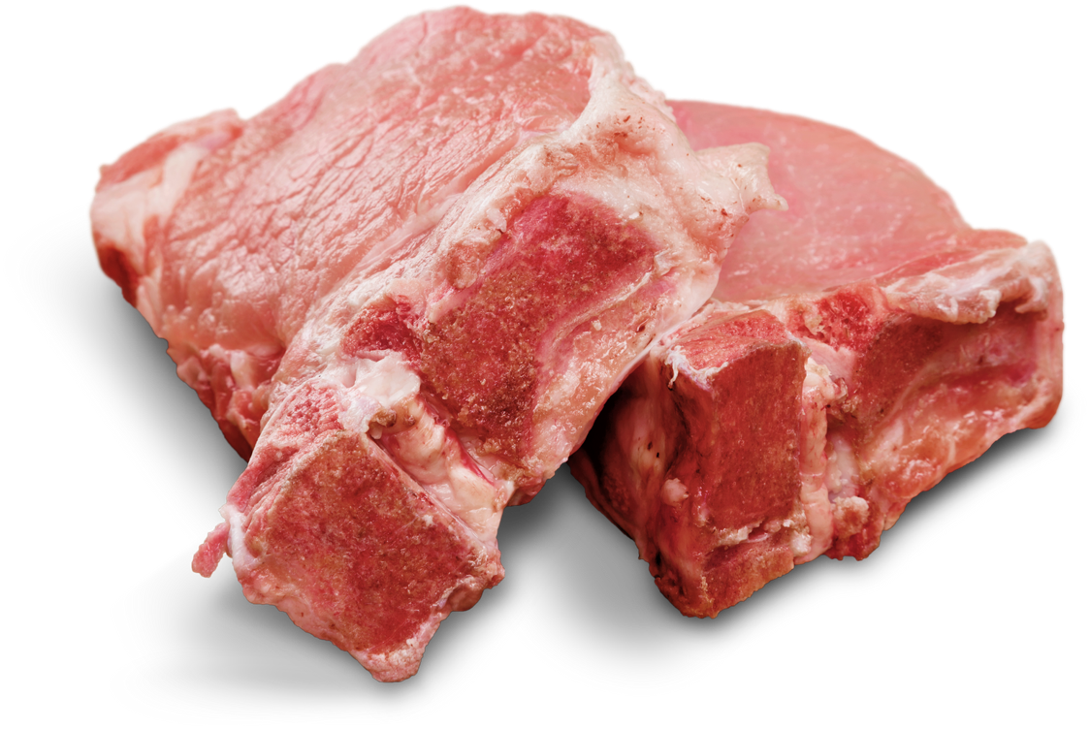
The Eoraptor had two types of teeth. It had sharp teeth to eat meat. It had flat teeth to eat plants.
This means it was an omnivore because it ate meat and plants.

Slide 21
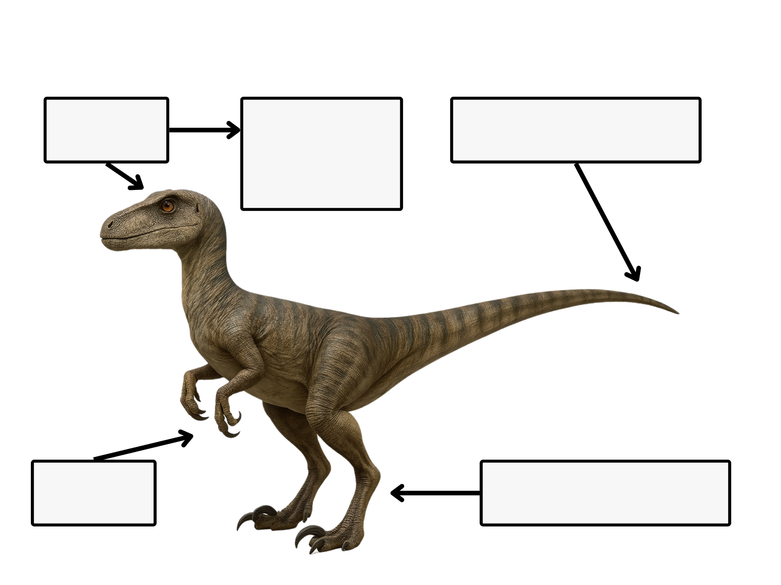
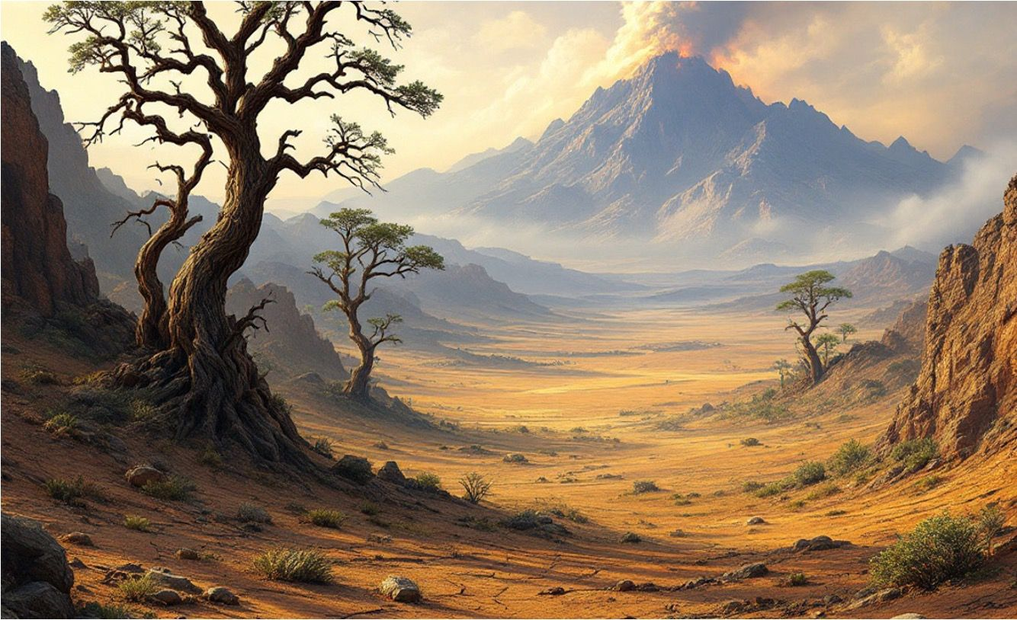
2 eyes
on side
tail to balance
of head
claws
skinny legs

Slide 22
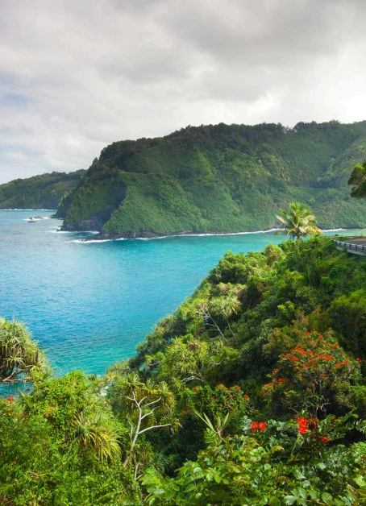
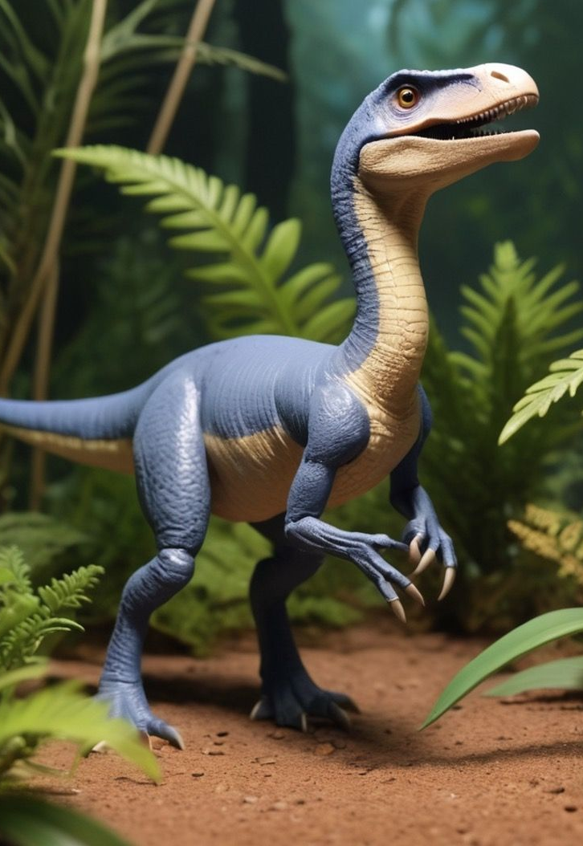
The Eoraptor was small and fast.
It had long legs and short arms.
It could see all around without turning its head.
It walked on two legs.

Slide 23

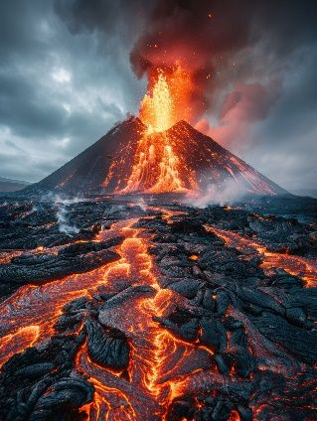

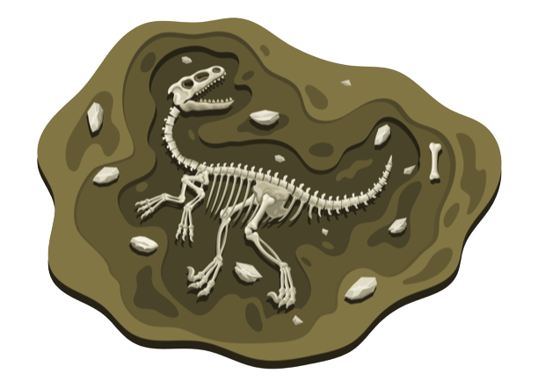

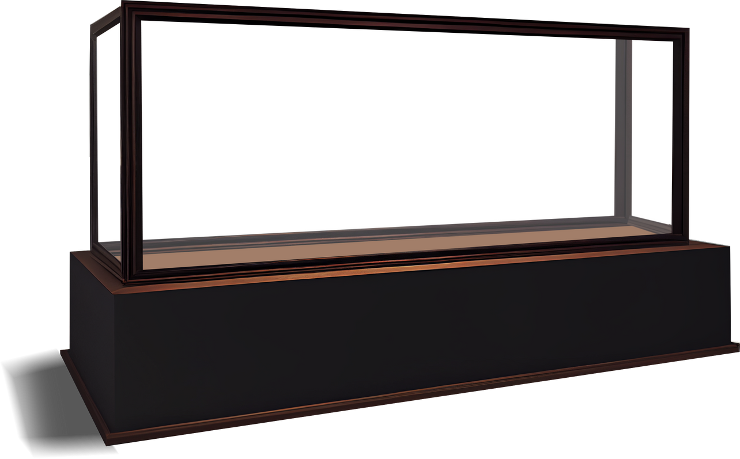
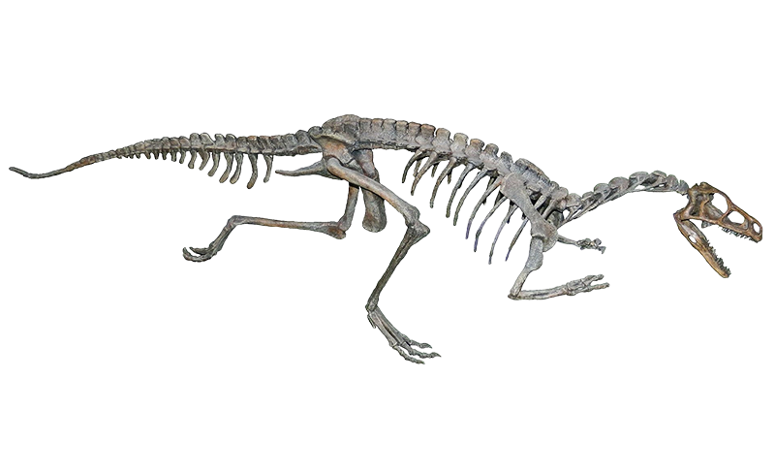
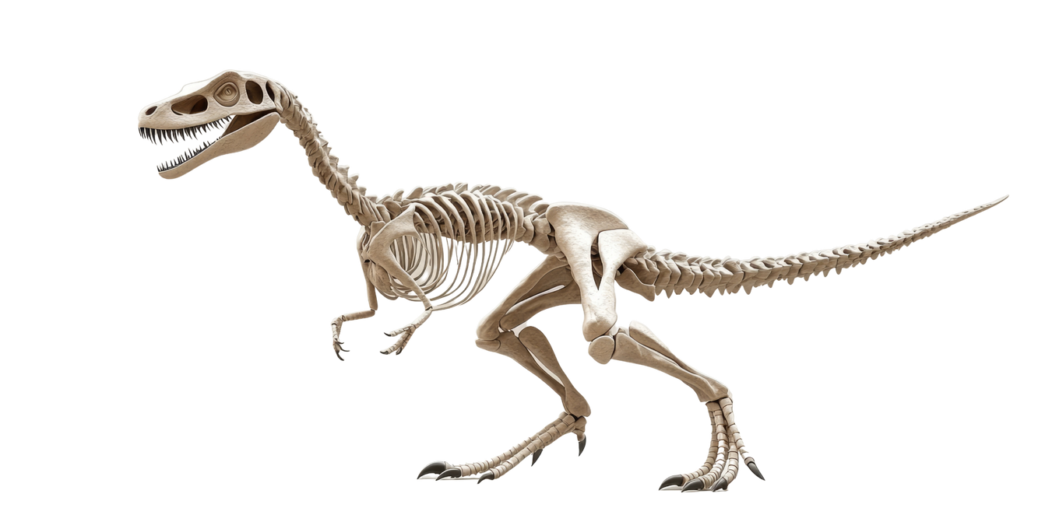

The Eoraptor lived in South America. Palaeontologists found Eoraptor bones in rocks.
The rocks were made of volcanic ash. This helped palaeontologists know how long ago the Eoraptor lived.

Slide 24

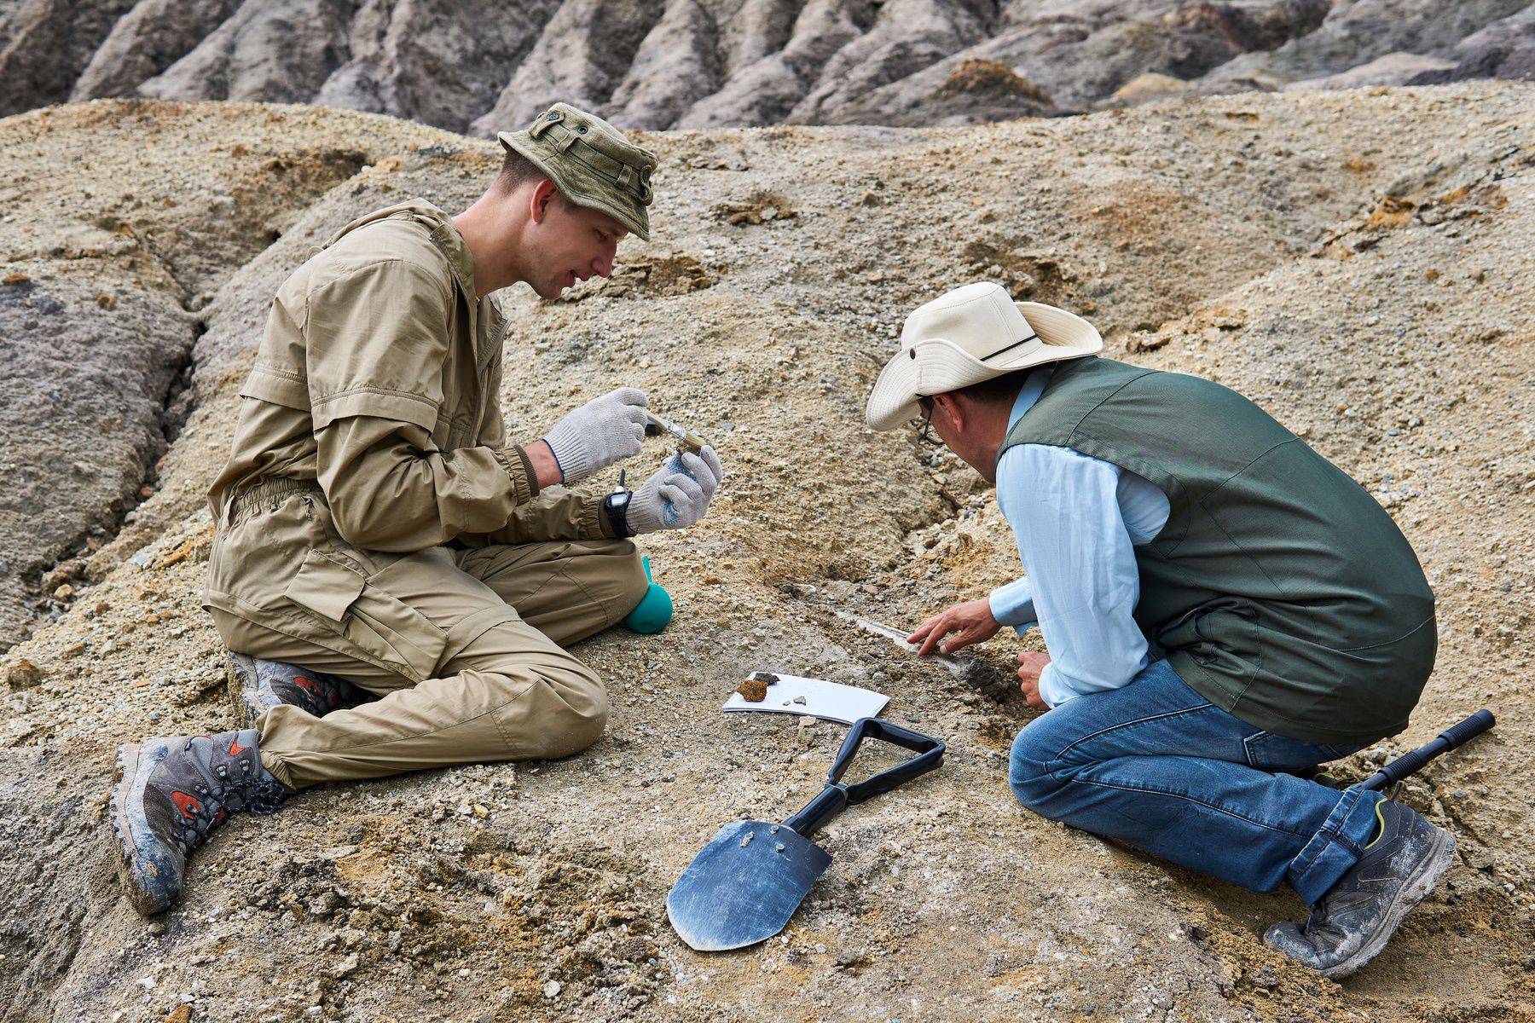
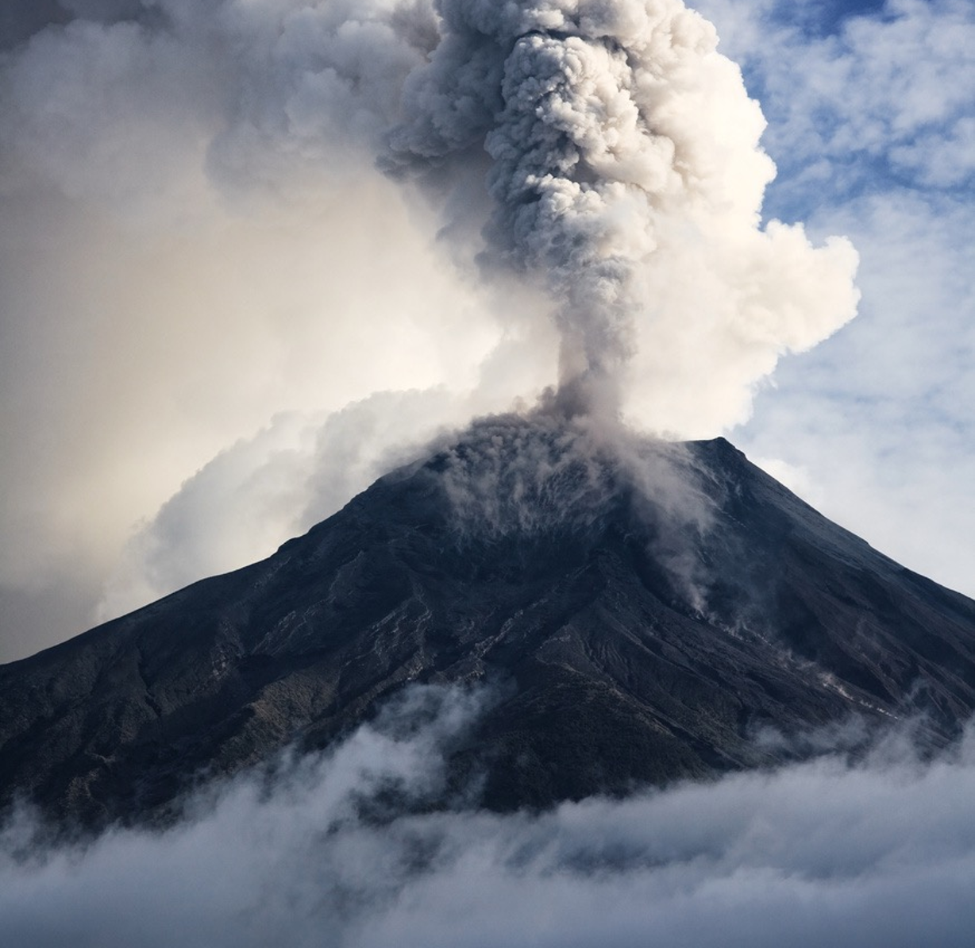
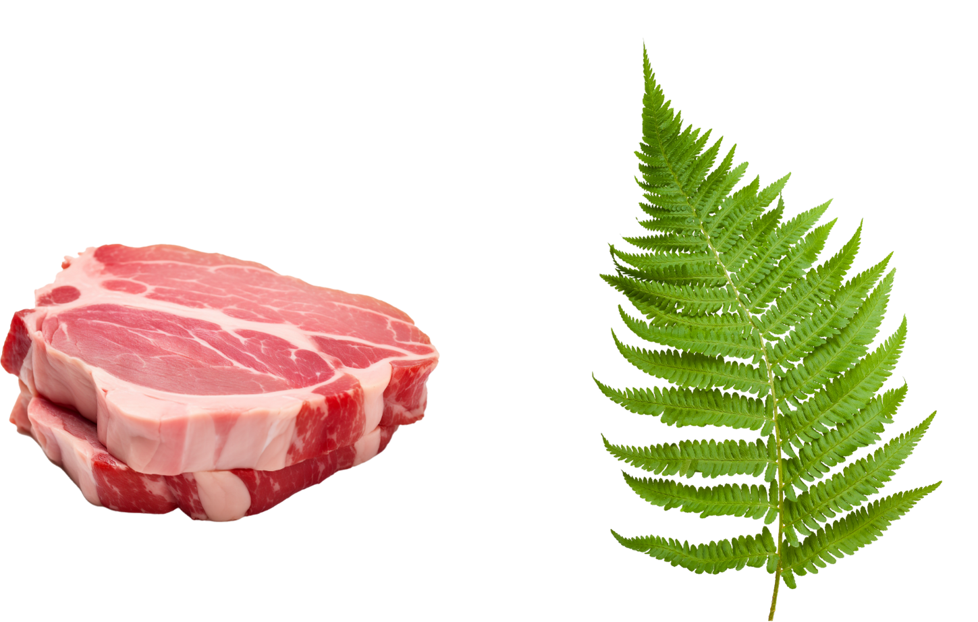
Palaeontologists – Scientists who study fossils to learn about animals and plants that lived a long time ago.
volcanic ash – Powdery dust that comes out of a volcano when it erupts.
omnivore – An animal that eats both plants and meat.

Slide 25













Vocabulary Words
volcanic ash
omnivore
palaeontologists

Slide 26

Diagram
The Eoraptor had 2 eyes on the side of its head.
The Eoraptor had skinny legs and used its tail to balance.
The Eoraptor had claws to catch food.

Slide 27
Show of Fingers
The purpose of a diagram is to share information visually.

Slide 28






Text Purpose
Home
Special
Appearance
Food
When

Slide 29
230
Eoraptor lived ____ million years ago.
2. What is the purpose of informative text?
A: To be silly.
B: To tell a pretend story.
C: To share information.
3. Eoraptor used its tail to b______.
230
5
100
alance

Slide 30



In the next lesson, we will learn about topics and titles.

