Slide 1
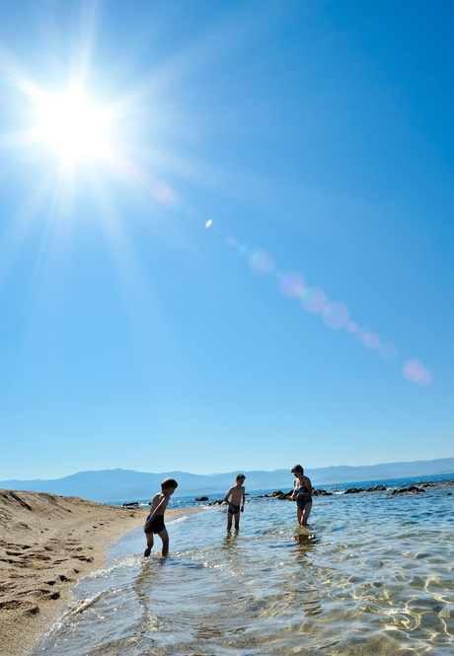
Music for Learning
Unit 2
The Weather
Week 1, Lesson 1
Version 2

Slide 2
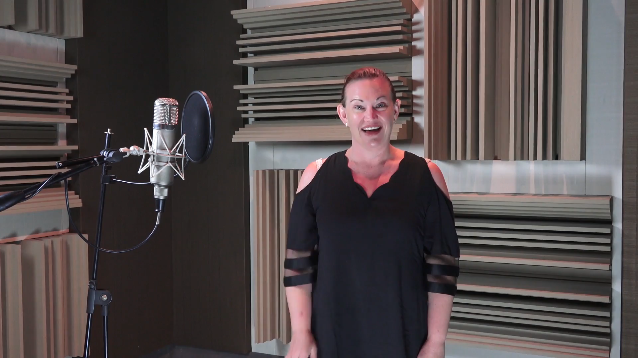
Hello Song

Slide 3


Warm-up:
Echo Rhythms

Slide 4

Recite
Music can have long sounds.
Music can have short sounds.
ta is a long sound:
ti ti has two short sounds:
ta
ti ti
Notes:
Insert your name.

Slide 5
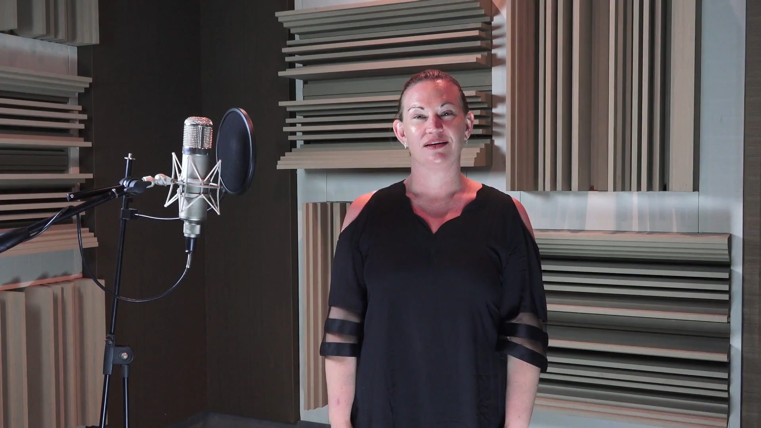

Recall:
Star Light, Star Bright
Star light, star bright,
First star I see tonight.
Wish I may, wish I might,
Have the wish I wish tonight.
Notes:
Insert your name.

Slide 6
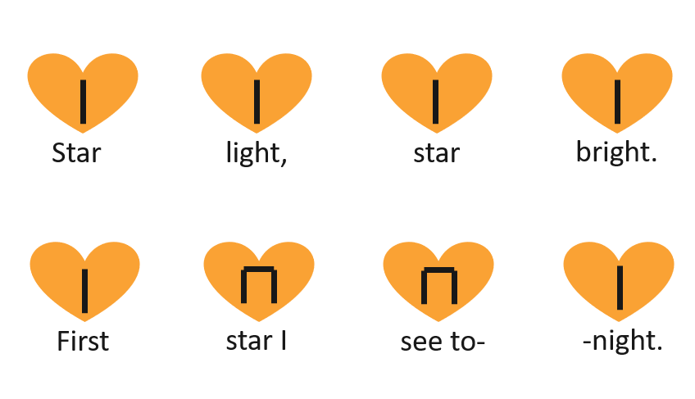
Apply
Notes:
Insert your name.

Slide 7
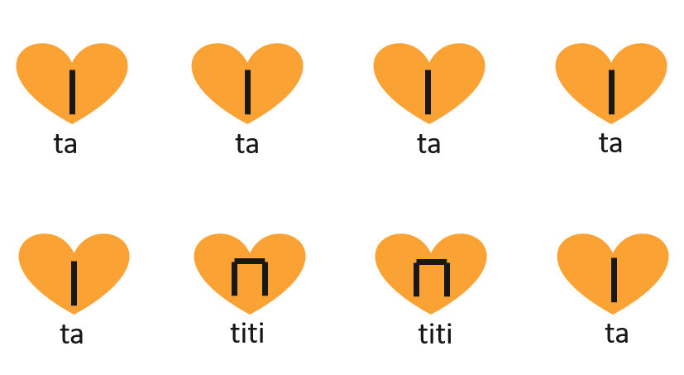
Apply
Notes:
Insert your name.

Slide 8
Today, you will learn:
to sing a new song about the weather
to show your body ladder for a new song.
You will be successful when you:
sing your new song about the weather in tune
show the correct body ladder positions for a new song.

Slide 9
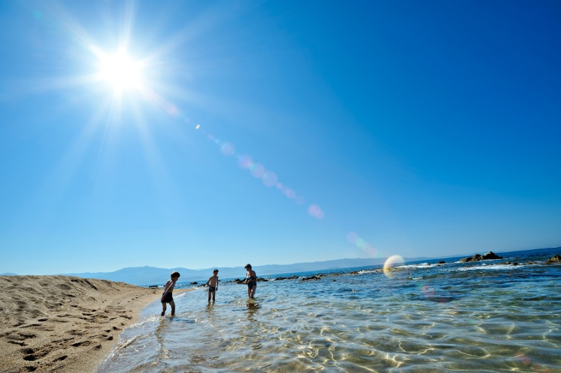
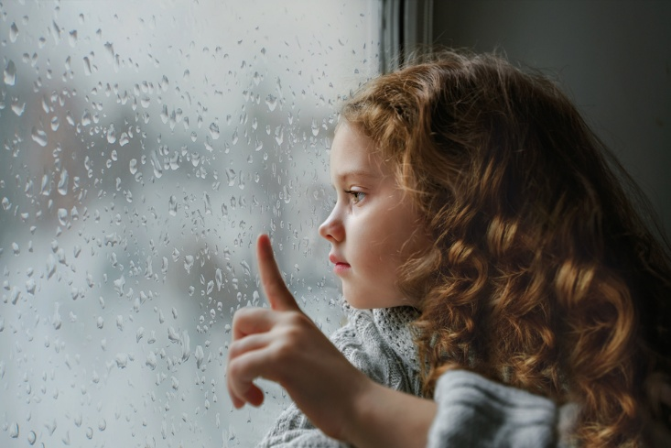
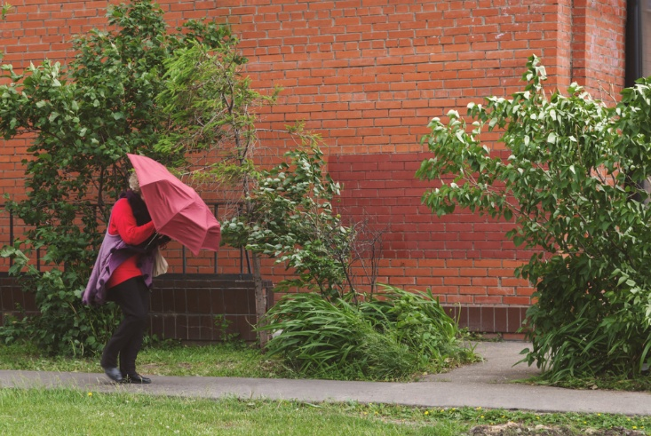

You may remember some different types of weather.

Slide 10
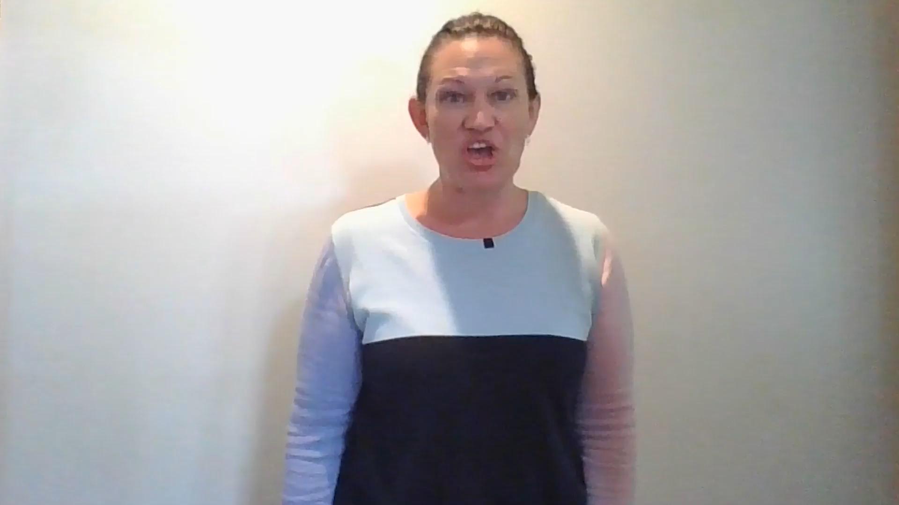
Listen to Me:
Rain, Rain
Notes:
Insert your name.

Slide 11
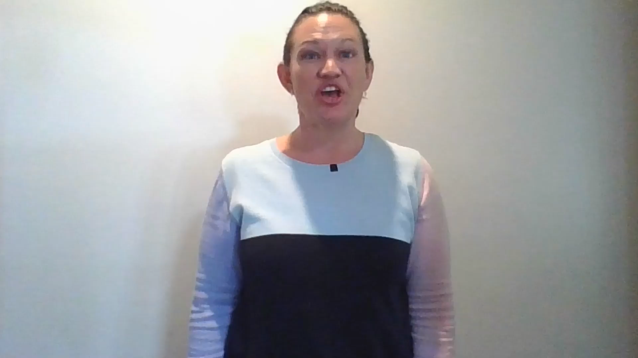
Follow Me:
Rain, Rain
Notes:
Insert your name.

Slide 12
Sing With Me:
Rain, Rain
Notes:
Insert your name.

Slide 13


Concept Development
High
Low
Rain rain go a- way

Slide 14
Rain, Rain
High
Low
Come a- gain a- no- ther day

Slide 15
We Do:
High-Low
Rain rain go a- way

Slide 16
We Do:
High-Low
Come a- gain a- no- ther day

Slide 17
You Do:
Rain, Rain

Slide 18
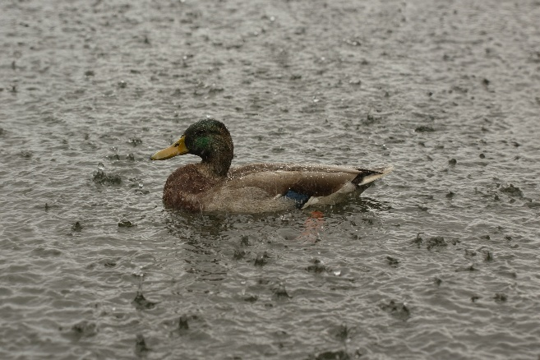
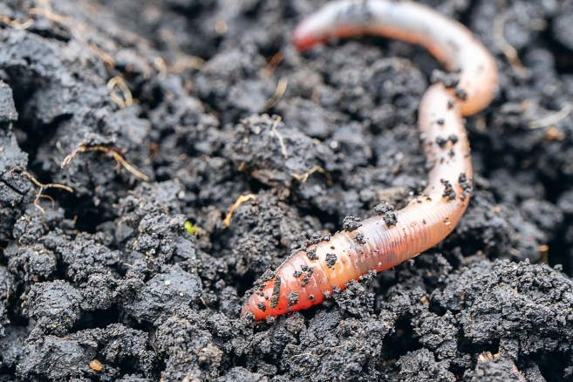
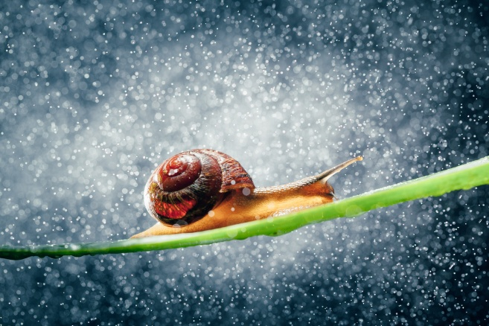
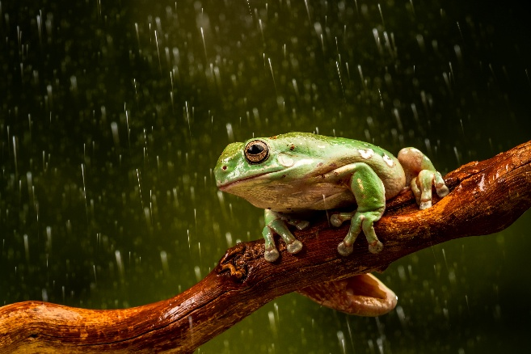
You may know about some types of insects and animals that like to come out in rainy weather.

Slide 19

Listen to Me:
Snail, Snail
Notes:
Insert your name.

Slide 20
Follow Me:
Snail, Snail
Notes:
Insert your name.

Slide 21

Sing With Me:
Snail, Snail
Notes:
Insert your name.

Slide 22
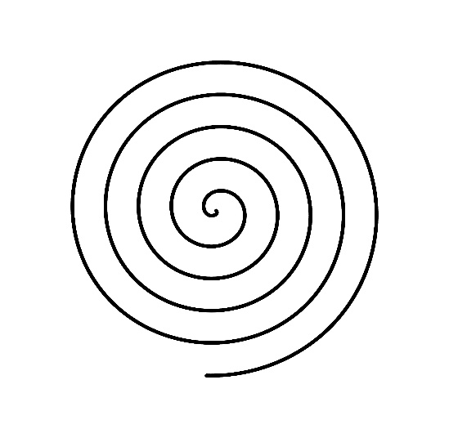


I Do/We Do:
Snail, Snail Game
Notes:
Insert your name.

Slide 23
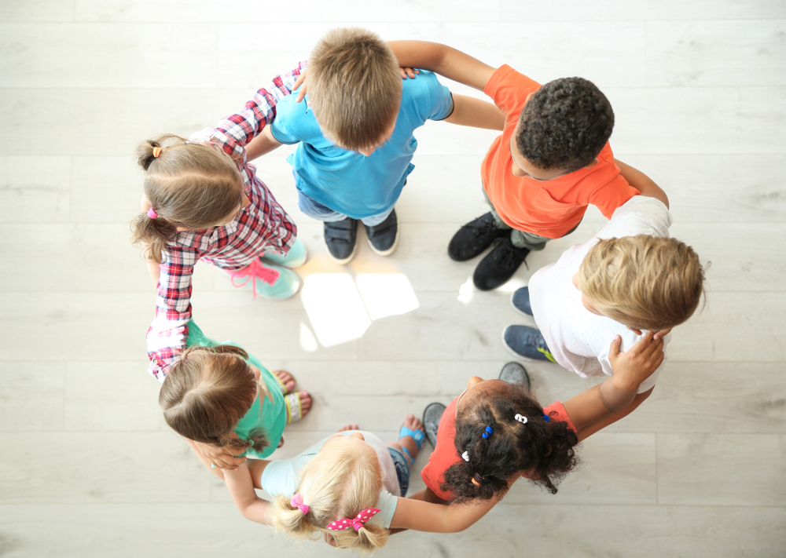

Transition:
Make a Circle
Notes:
Insert your name.

Slide 24

I Do/We Do:
Snail, Snail Game
Notes:
Insert your name.

Slide 25
Sounds can be high or low.
Sounds can be long or short.
Songs can be about animals, insects and the weather.

Slide 26
How well did you:
sing your new song about the weather in tune
show the correct body ladder positions for a new song?

Slide 27
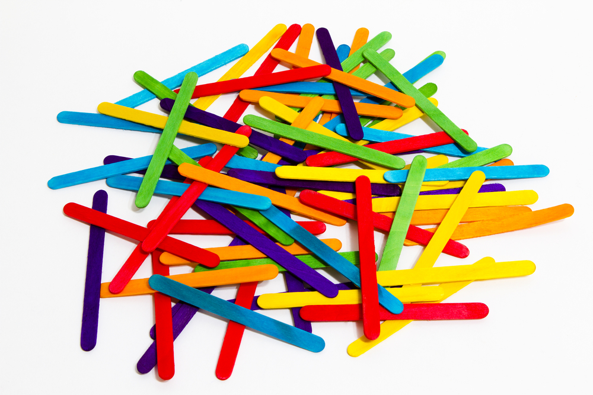
Next lesson, we will be learning to show the rhythm of Snail, Snail using popsicle sticks!

Slide 28
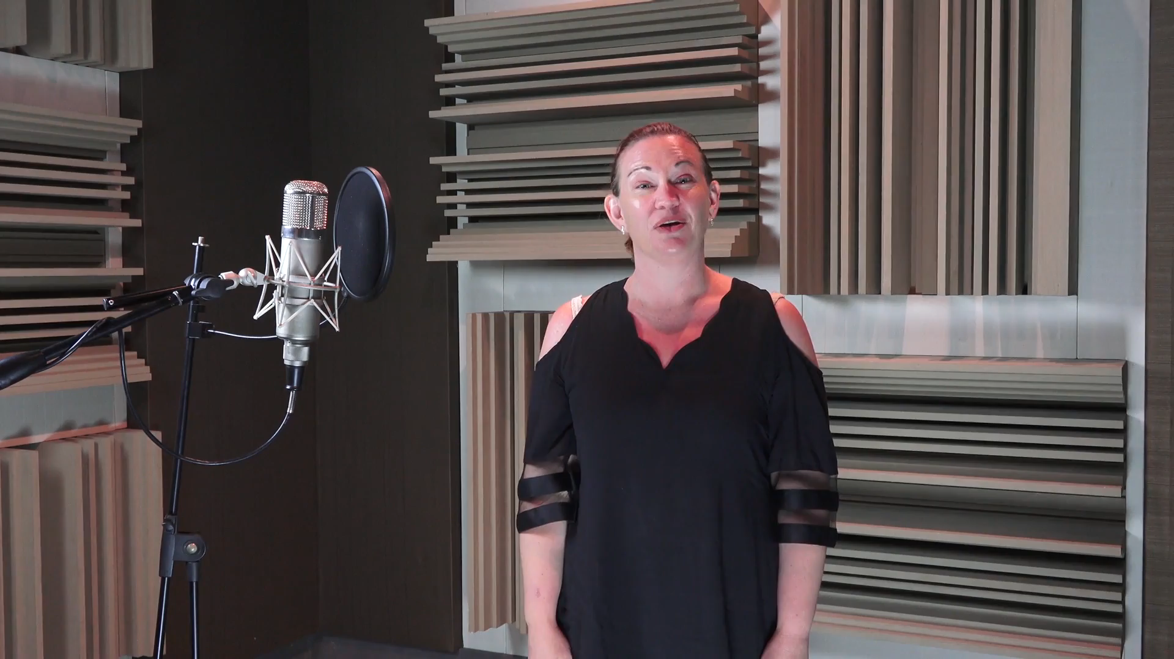
Goodbye Song

