Slide 1
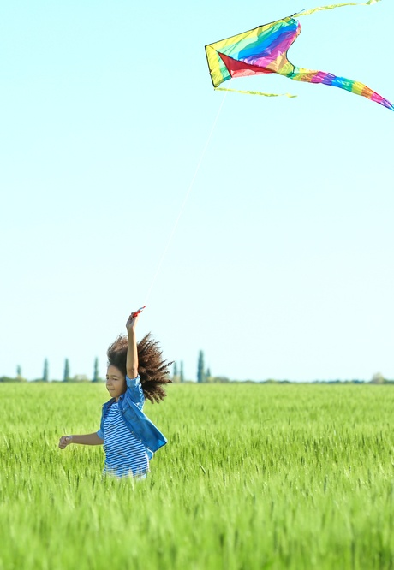
Music for Learning
Unit 2
The Weather
Week 1, Lesson 2
Version 2

Slide 2
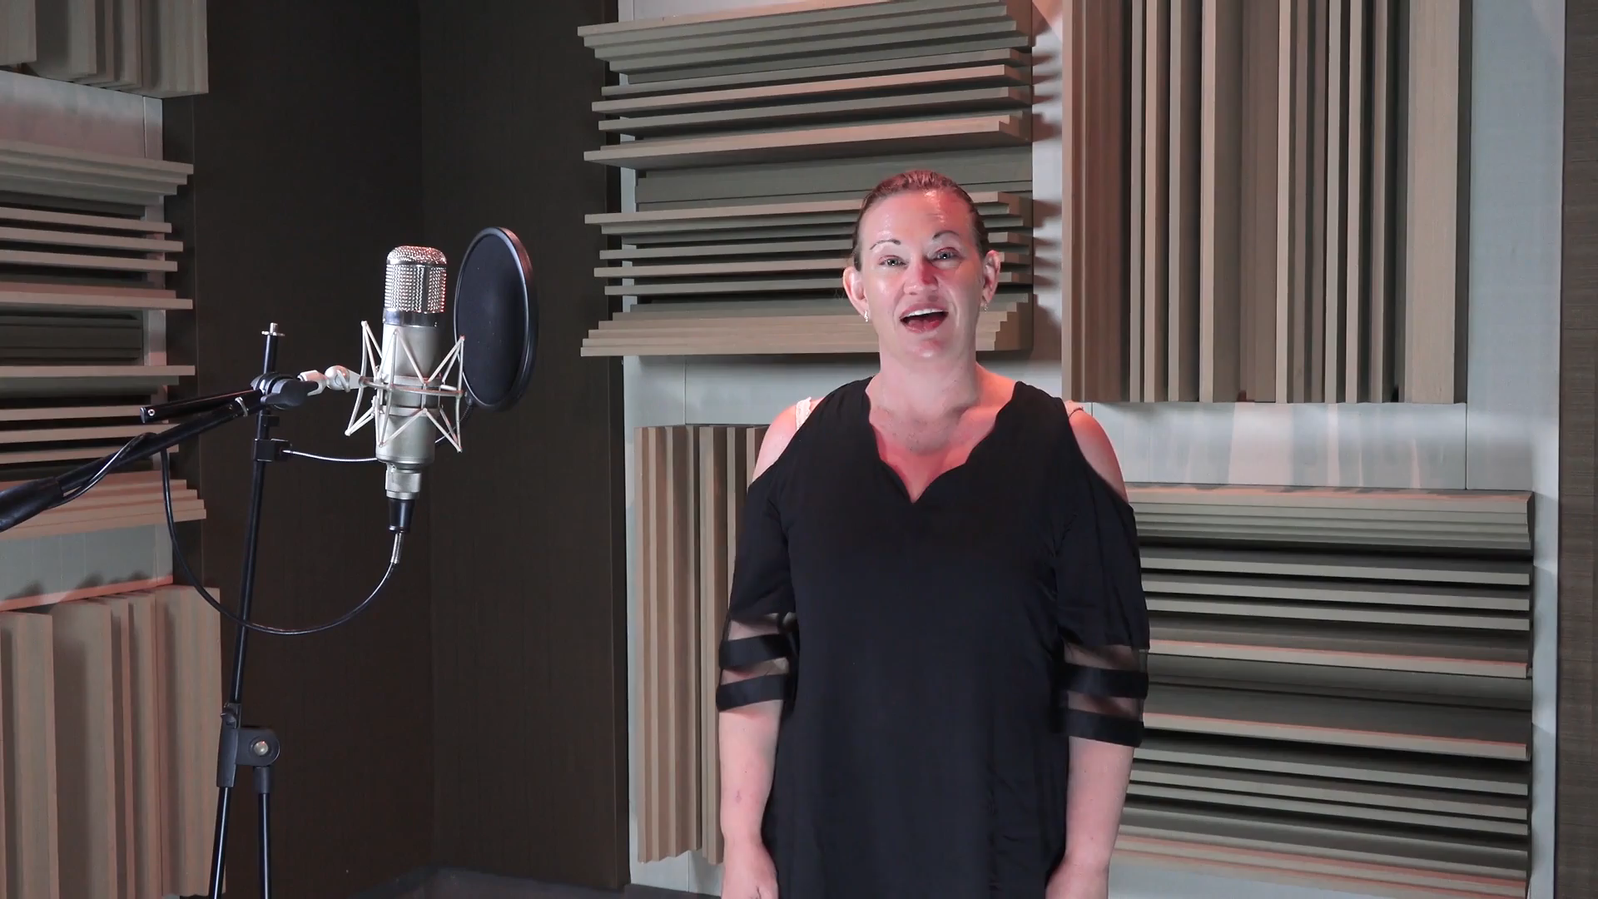
Hello Song: Follow Me

Slide 3
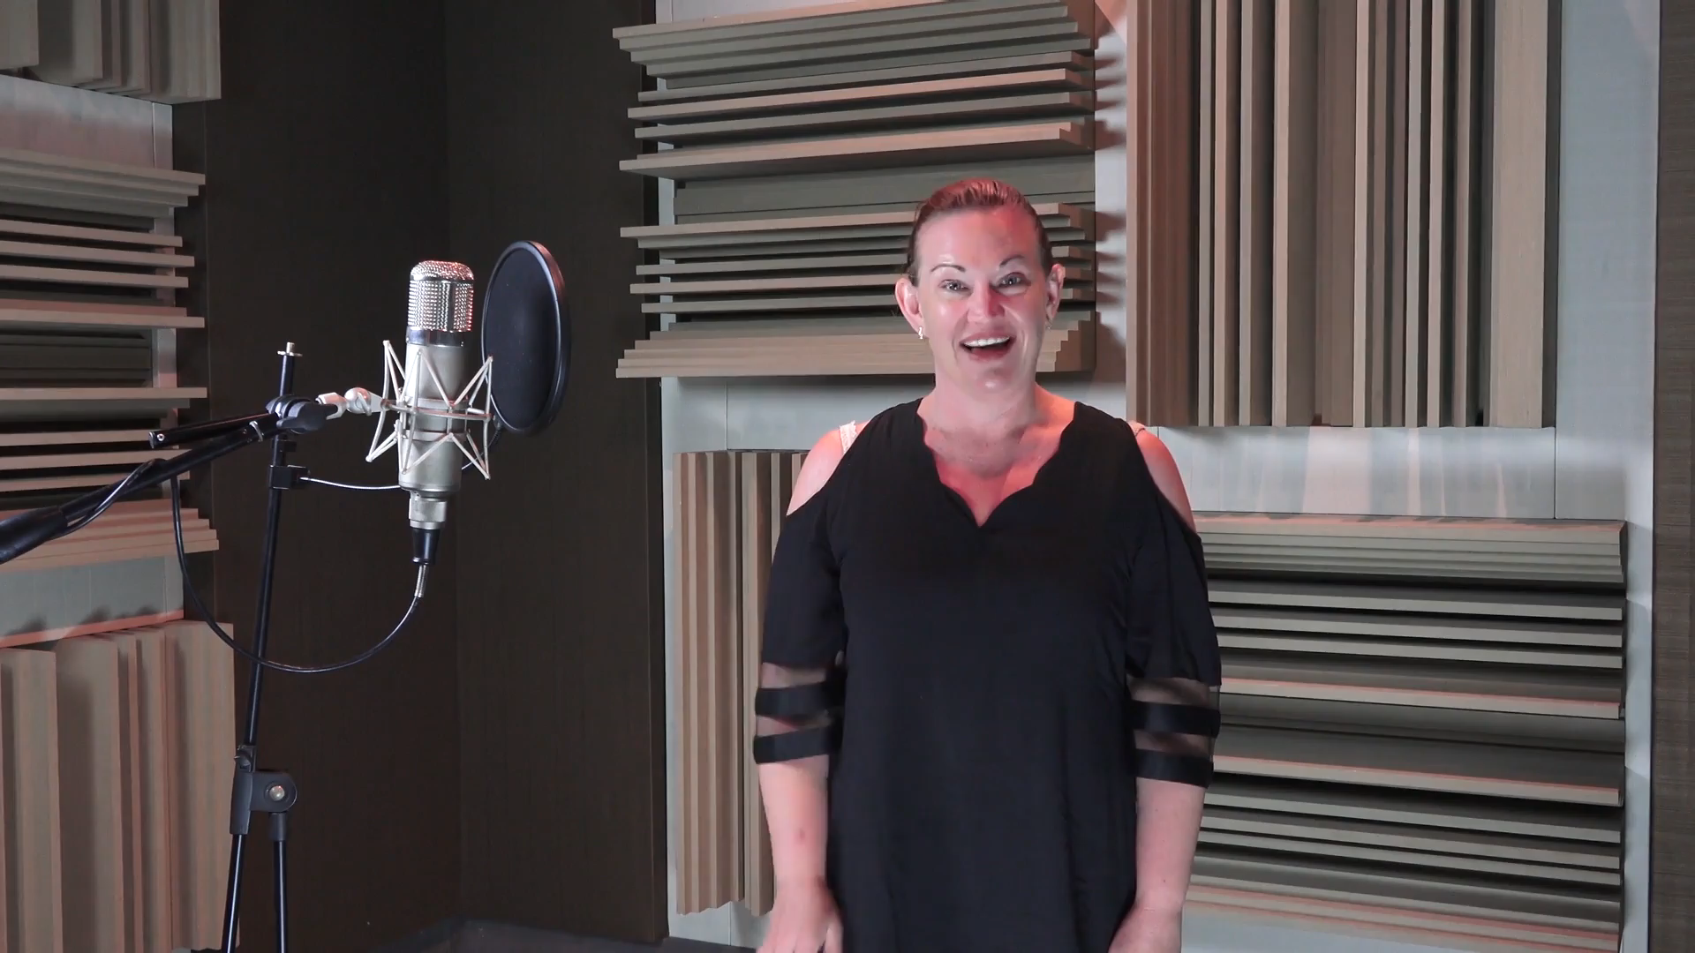
Hello Song: Sing With Me

Slide 4
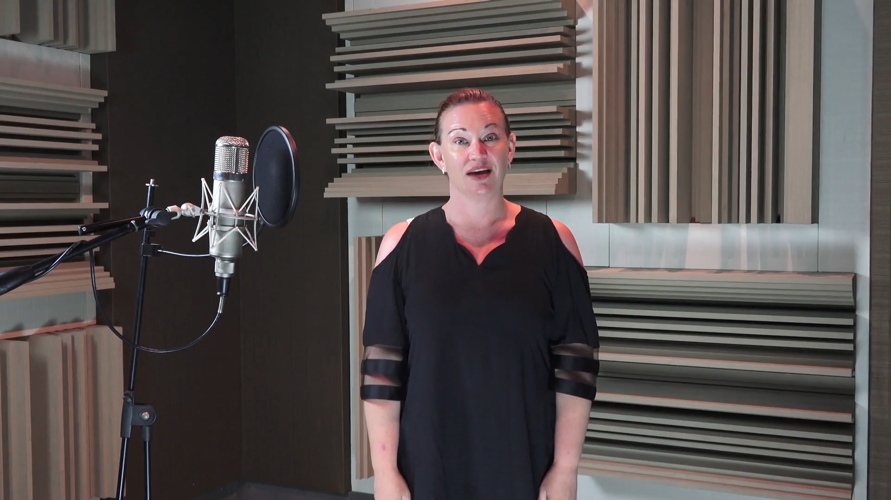
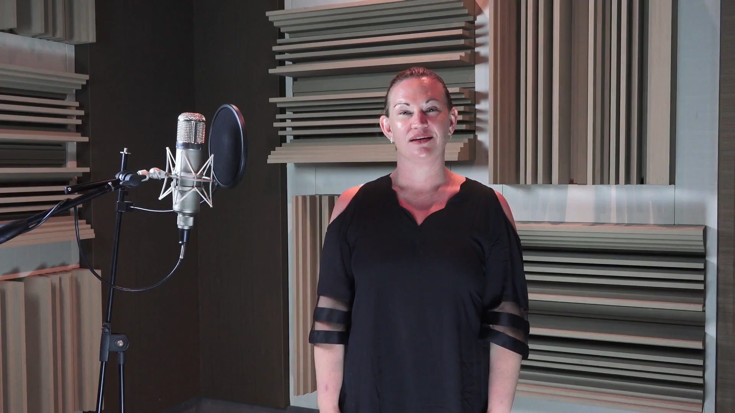
Warm-up:
Star Light, Star Bright
Follow me.
Sing with me.

Slide 5
Today, you will learn to:
sing and memorise new songs about the weather
show the shape of musical phrases in the air.
You will be successful when you can:
sing our new songs about the weather
draw the high and low sounds of a melody in the air.

Slide 6
You will remember the weather outside.
Today, it is…
Yesterday, it was…

Slide 7
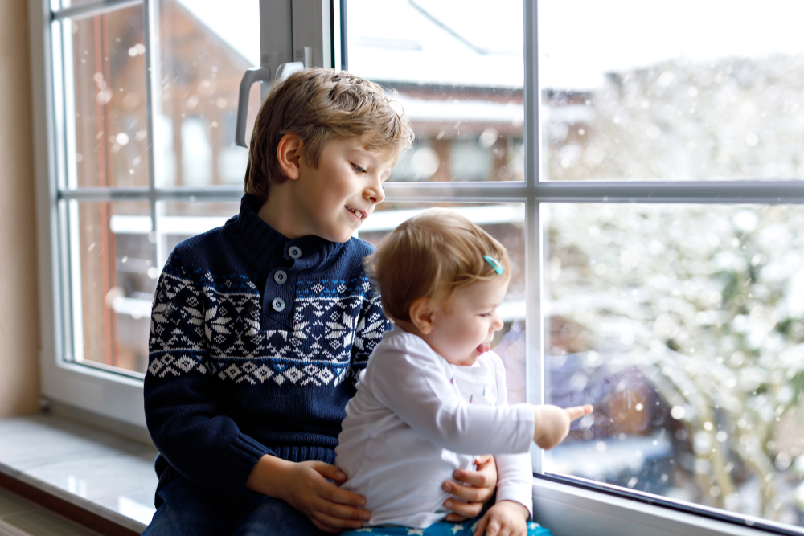

Skill Development

Slide 8



What’s the Weather?
I will show the shape of the melody.
What’s the wea-ther,
What’s the wea-ther like to-day?
What’s the wea-ther,

Slide 9
We Do:
What’s the Weather?
We will show the shape of the melody.

Slide 10
You Do:
What’s the Weather?
You will show the shape of the melody.

Slide 11
All Together
I will show the shape of the melody.
All to- ge- ther,
All to- ge- ther,
What’s the wea-ther like to- day?

Slide 12
We Do:
All Together
We will show the shape of the melody.

Slide 13
You Do:
All Together
You will show the shape of the melody.

Slide 14
We Do:
What’s the Weather? Verse 1

Slide 15
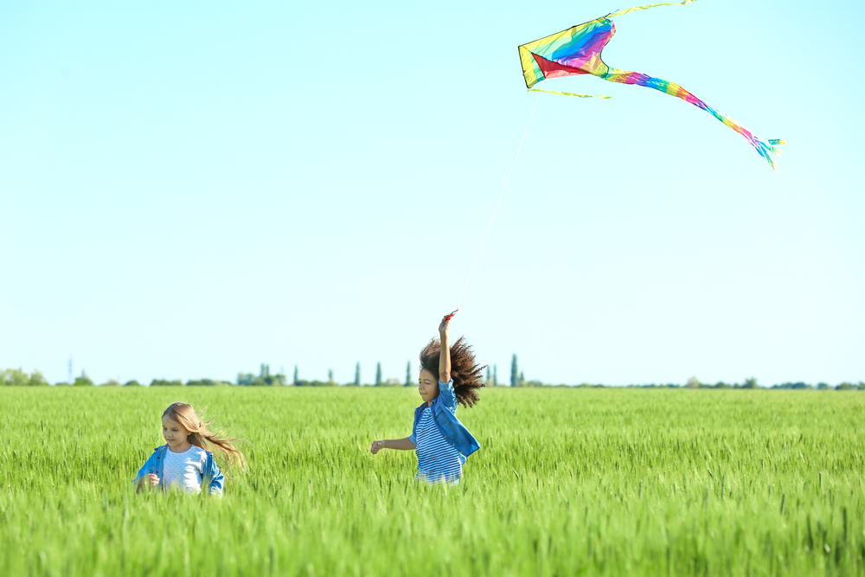
You may remember a windy day.

Slide 16



Look, it’s Windy
I will show the shape of the melody.
Look it’s win- dy,
Look it’s win- dy ev-’ry-one.
Look it’s win- dy,

Slide 17
We Do:
Look, it’s Windy
We will show the shape of the melody.

Slide 18
You Do:
Look, it’s Windy
You will show the shape of the melody.

Slide 19



Fly a Kite
I will show the shape of the melody.
Fly a kite,
Fly a kite,
Fly a ki----te ev-‘ry one.

Slide 20
We Do:
Fly a Kite
We will show the shape of the melody.

Slide 21
You Do:
Fly a Kite
You will show the shape of the melody.

Slide 22
We Do:
Look, it’s Windy – Verse 2

Slide 23
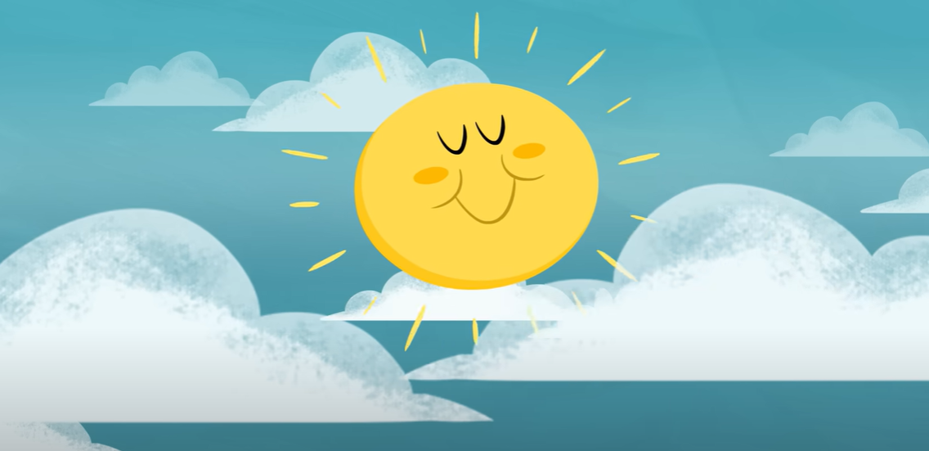
Listen to Me:
Mister Sun
Notes:
Insert your name.

Slide 24
Sing With Me:
Mister Sun
Notes:
Insert your name.

Slide 25
Melodies we sing can be in lots of different shapes.
Some melodies go down.
Some melodies go up.
Some melodies go up and then down.

Slide 26
How well did you:
sing our new songs about the weather
draw the high and low sounds of a melody in the air?

Slide 27
Next lesson, we will be learning actions to go with Mister Sun. We will also be singing about rainy weather.

Slide 28
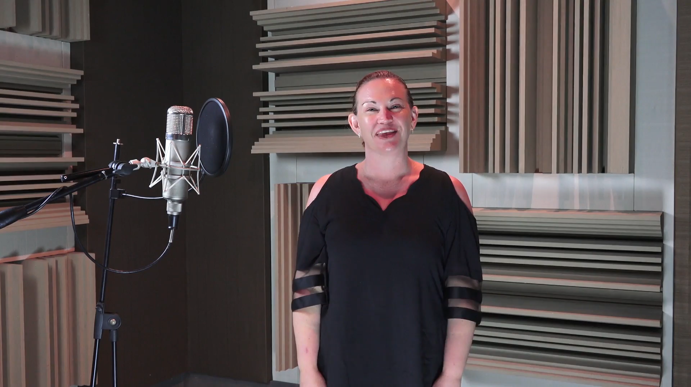
Goodbye Song: Follow Me

Slide 29

Goodbye Song: Sing With Me

