Slide 1
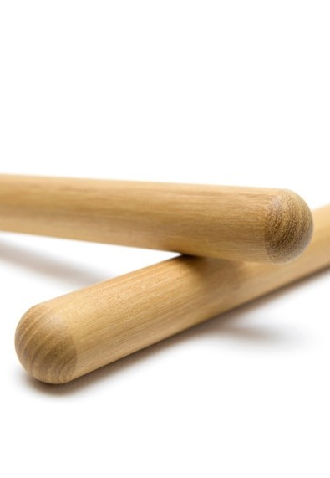
The Arts
Week 1: Lesson 2
Unit 3:
Music Around the World
Obwisana 1
Version 1

Slide 2
Good Listening Behaviours
Practical

Slide 3
Learning Objective
In this lesson, you will learn:
to sing a new hello song
to sing a new song called Obwisana
body positions for Obwisana.
Success Criteria
You will be successful when you can:
sing the new hello song with some confidence
sing the start of Obwisana with some confidence
show body positions for the first part of Obwisana
keep the beat while speaking Obwisana.
Practical

Slide 4



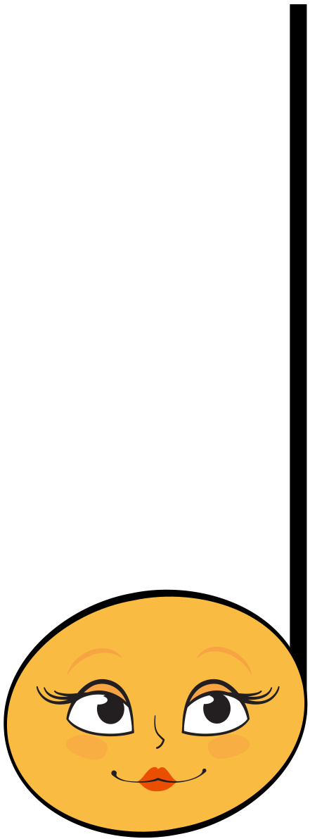
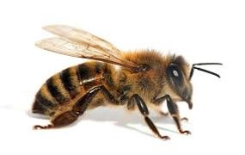
Recite: Bee Bee Bumble Bee
Bee bee bum- ble bee. Can you sing your name to me?
My name is [tea- cher]. Hel- lo [tea- cher].
Practical

Slide 5
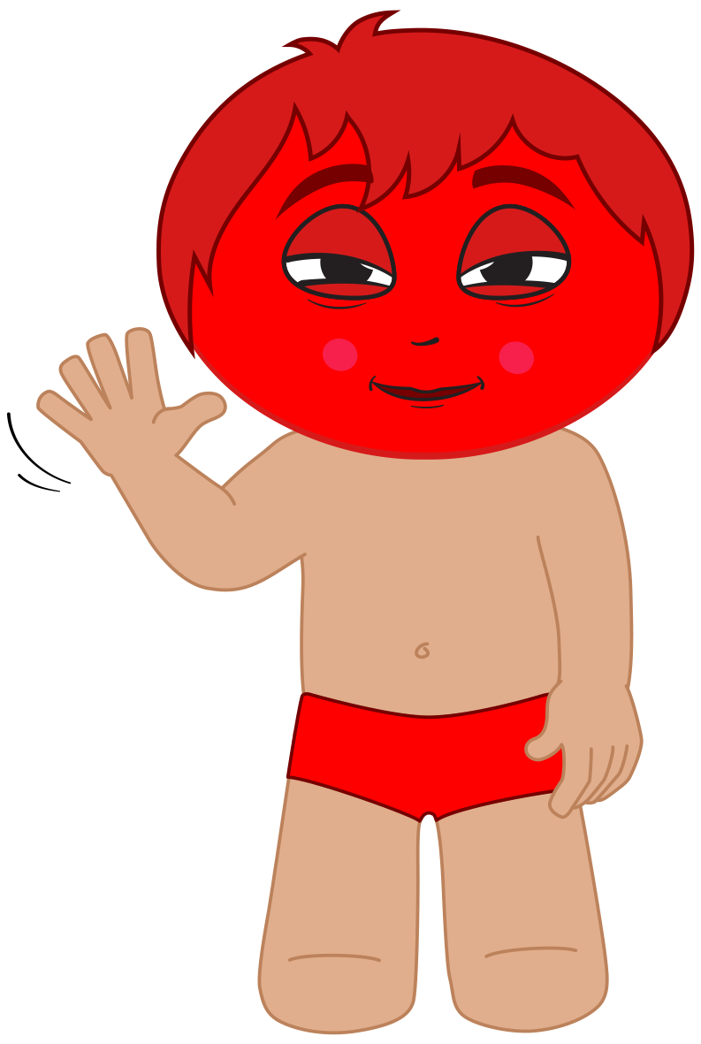
I Sing: Hello Song
Hello, hello. How do you do?
How do you do? How do you do?
Hello, hello. How do you do?
How do you do today?
If you're wearing blue, stand up!
If you're wearing blue, stand up!
Pat, pat, pat your knees.
Pat, pat, pat your knees.
Pat, pat, pat your knees.
Pat your knees today.
Practical

Slide 6
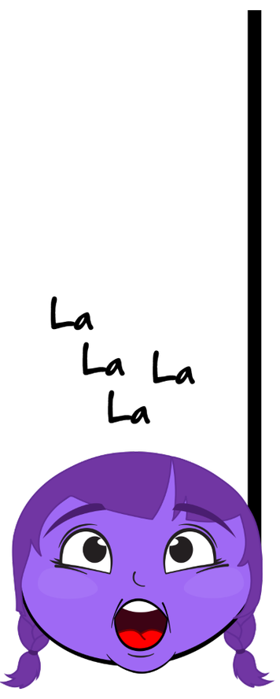
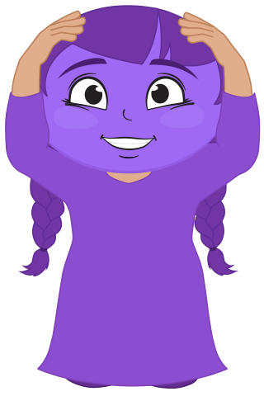
Learn: Hello Song First Note
Practical

Slide 7
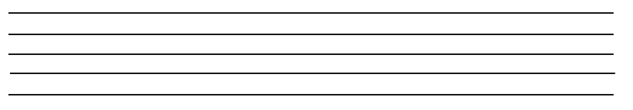


Learn: Hello Song Part 1
Hel- lo , hel- lo. How do you do?
How do you do? How do you do?
Practical

Slide 8
We Sing: Hello Song Part 1
Hel- lo , hel- lo. How do you do?
How do you do? How do you do?
Practical

Slide 9
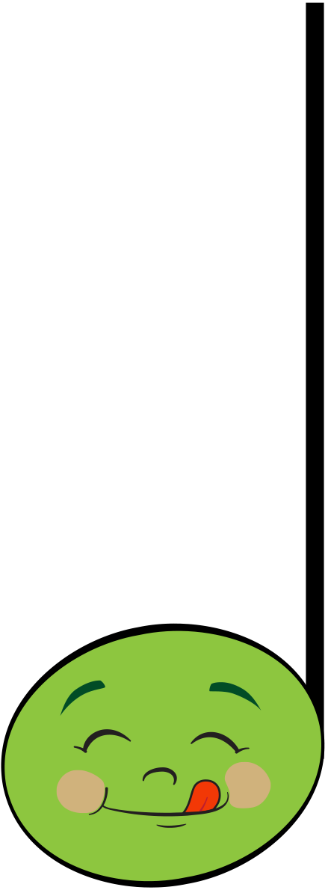
I Sing: Hello Song Part 2
Hel- lo , hel- lo. How do you do?
How do you do? How do you do to- day?
Practical

Slide 10
We Sing: Hello Song Part 2
Hel- lo , hel- lo. How do you do?
How do you do? How do you do to- day?
Practical

Slide 11
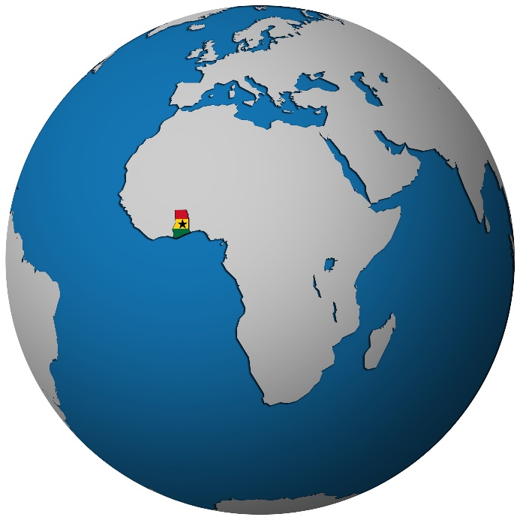
Learn: Obwisana Origin and Meaning
Obwisana is a children’s song from Ghana – a country in Africa.
Children sing the song while they each tap a rock on the ground.
Here are the words to the song:
The rock has crushed my hand, grandma.
The rock has crushed my hand.
The rock has crushed my hand, grandma.
The rock has crushed my hand.
Practical

Slide 12

I Say: Obwisana
Listen.
Obwisana sa na na Obwisana sa.
Obwisana sa na na Obwisana sa.
Practical

Slide 13
We Say: Obwisana
Listen.
Obwisana sa na na Obwisana sa.
Obwisana sa na na Obwisana sa.
Practical

Slide 14
I Sing: Obwisana
Listen.
Obwisana sa na na Obwisan na sa.
Obwisana sa na na Ob wi sa na sa.
Practical

Slide 15
We Sing: Obwisana
Listen.
Obwisana sa na na Obwisan na sa.
Obwisana sa na na Ob wi sa na sa.
Practical

Slide 16
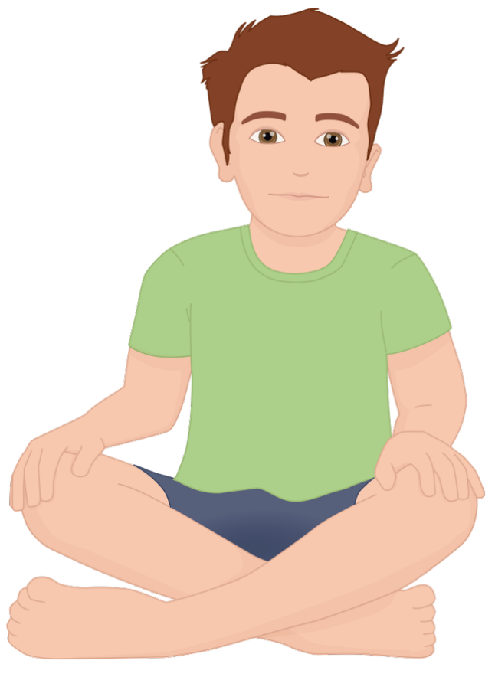
Beat: Obwisana
Listen.
Obwisana sa na na Obwisan na sa.
Obwisana sa na na Ob wi sa na sa.
Keep the beat on your knees as we listen.
Practical

Slide 17
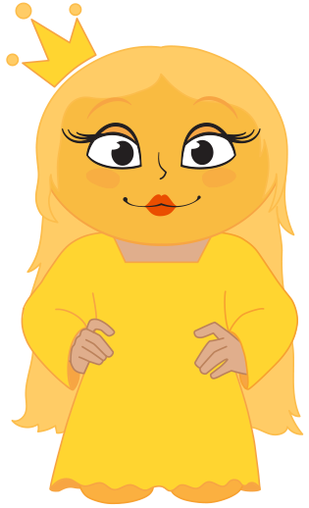
We Sing: First Note Body Position
Practical

Slide 18
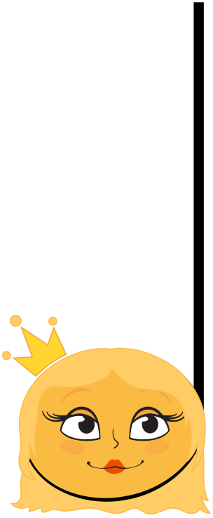
Revise: Low Note
Miss Mi is a low note.
Practical

Slide 19
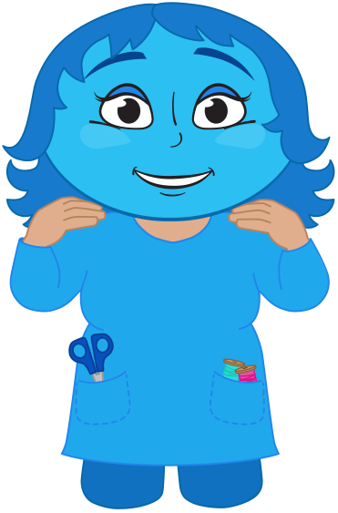

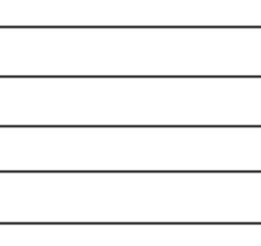
Revise: Middle Note
Missus So is a middle body position.
Practical

Slide 20
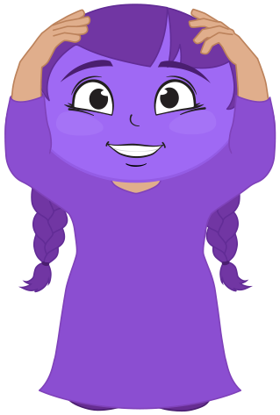
Apply: So Mi
Ob wi sa na sa na na
Practical

Slide 21
Apply: So Mi Mi So
Ob wi sa na sa na na
Practical

Slide 22
Revise: High Note
Missus La is a high body position.
Practical

Slide 23
Apply: La
Ob wi sa na sa na na
Practical

Slide 24
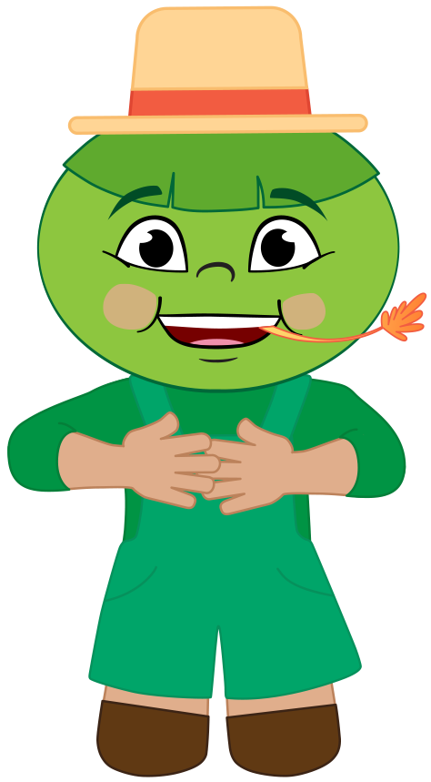
Revise: Middle Note
Mister Fa is a middle body position.
Practical

Slide 25
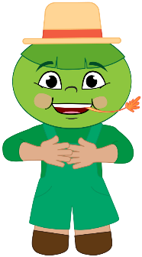
Apply: Fa
Ob wi sa na sa na na
Practical

Slide 26
Apply: First Part
Ob wi sa na sa na na
Practical

Slide 27


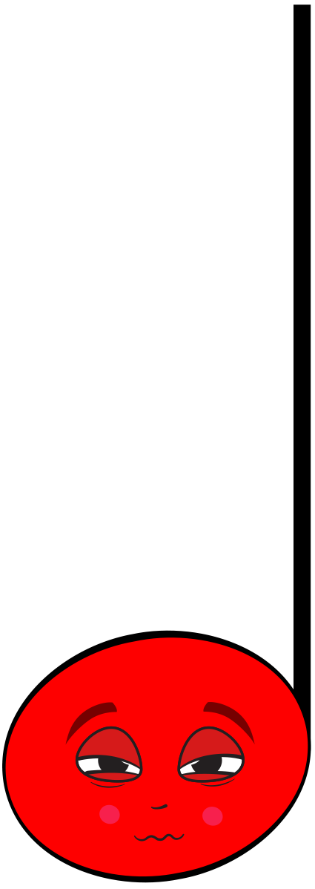
Listen: Obwisana Call and Response
Ob wi sa na sa na na. Ob wi sa na sa.
Ob wi sa na sa na na. Ob wi sa na sa.
Practical

Slide 28
I Sing: Obwisana Call
Ob wi sa na sa na na na.
Ob wi sa na sa.
Practical

Slide 29
We Sing: Obwisana Call
Ob wi sa na sa na na na.
Ob wi sa na sa.
Practical

Slide 30
I Sing: Obwisana Response
Ob wi sa na sa na na na.
Ob wi sa na sa.
Practical

Slide 31
We Sing: Obwisana Response
Ob wi sa na sa na na na.
Ob wi sa na sa.
Practical

Slide 32
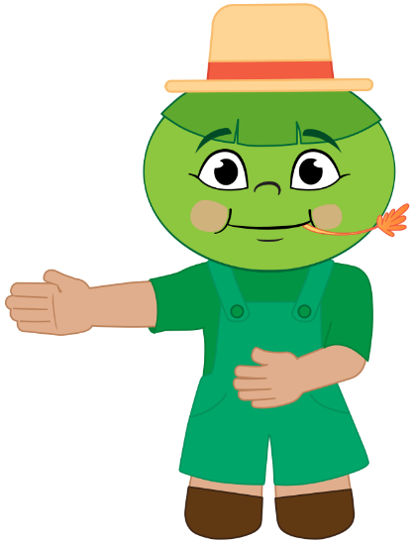
Reflect and Connect
In this lesson:
we sang a new hello song
we learnt body positions for Obwisana
we learnt the call and response for Obwisana.
How well are you able to:
sing our new hello song?
sing Obwisana with confidence?
show body positions for the first part of the song with confidence?
keep the beat while speaking Obwisana?
Practical

Slide 33

Reflect and Connect
In the next lesson, we will keep learning Obwisana.
Practical

Slide 34
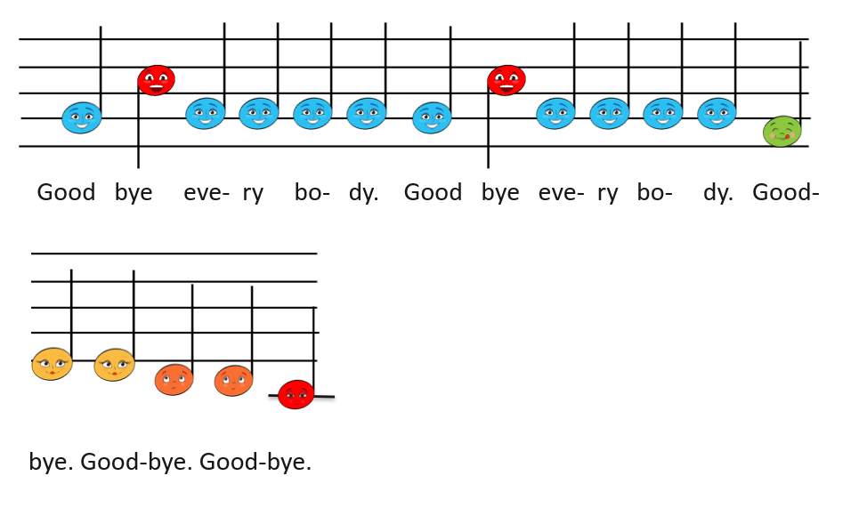

Goodbye Song
Goodbye song piano
Goodbye song vocal
Practical

