Slide 1
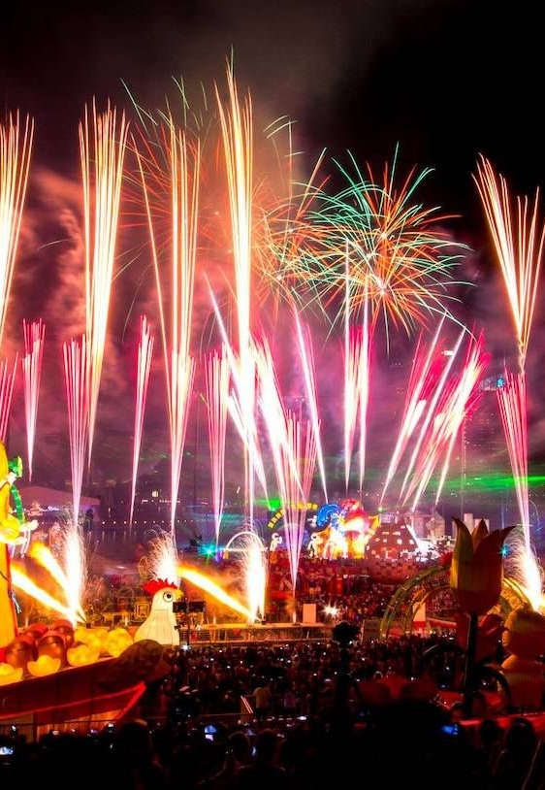
The Arts
Lesson 1: Week 1
Unit 3:
Music in the World - Music for Celebration
Version 1

Slide 2
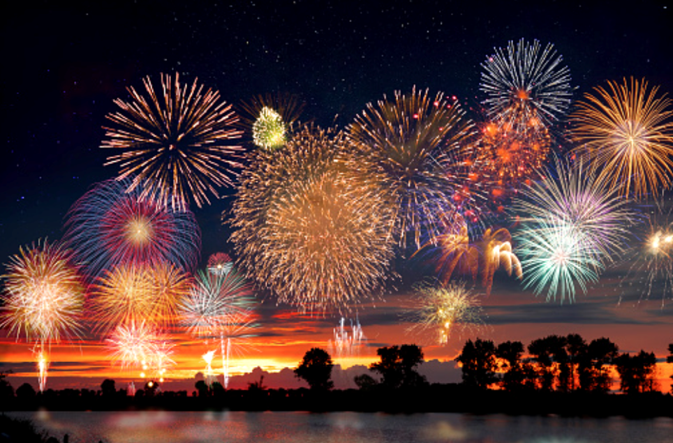
Introduction to a World of Celebration

Slide 3
Good Listening Behaviours
Theory

Slide 4

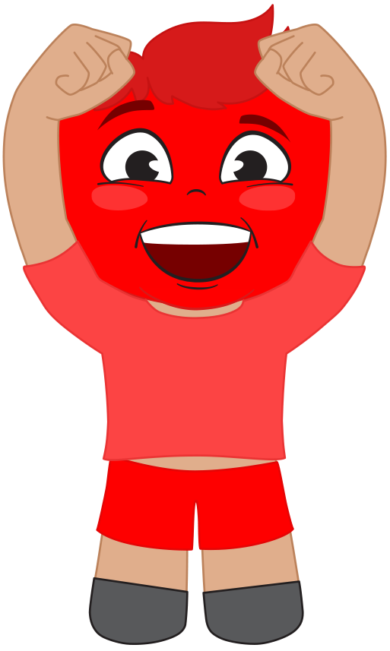
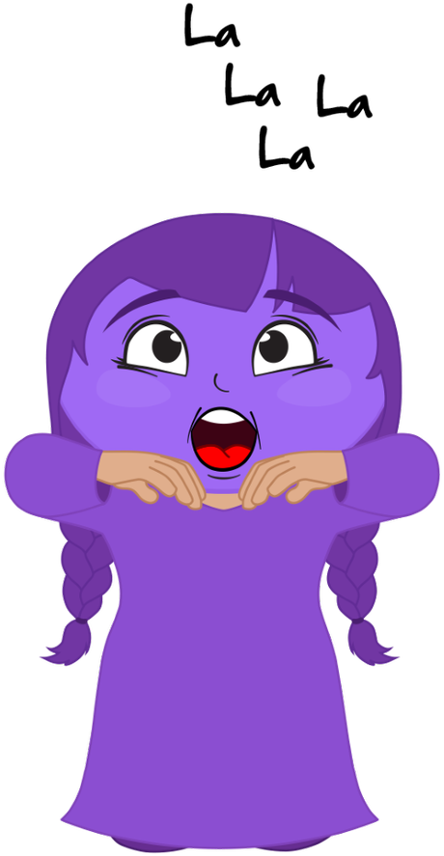
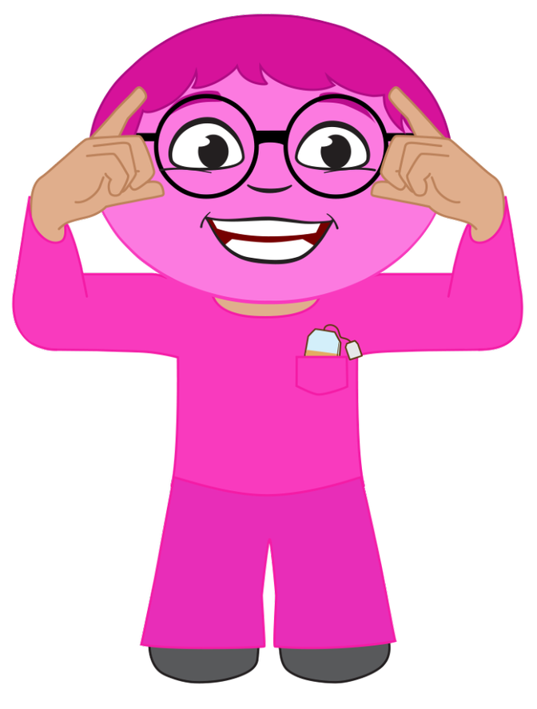

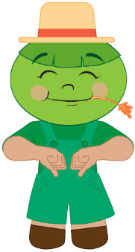
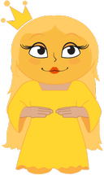
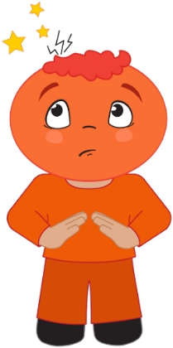
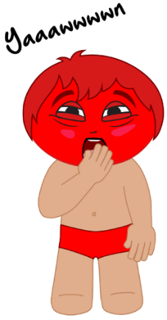
Recite: Do Re Mi Family Song
Mister Do is dozing in his bright red underwear.
Missus Re is radiant with spiky orange hair.
Miss Mi is a meanie in her shiny crown so yellow.
Mister Fa’s a farmer; he’s a jolly green-faced fellow.
Missus So loves sewing with her ball of string so blue.
Missus La sings opera dressed in purple hues.
Mister Ti’s a teacher and he likes to drink pink tea.
Little Do is way up high as red as red can be.
Now we’ve met the members of our music family,
Children join together and sing along with me.
Theory

Slide 5
Learning Objective
In this lesson, you will learn:
that every culture in the world has different celebrations and music traditions
some celebration songs from your own culture.
Success Criteria
You will be successful when you can:
explain what it means to celebrate
explain why we use music to celebrate special occasions
list some occasions where you use music to celebrate.
Theory

Slide 6

Activating Prior Knowledge
We know that:
there are many different cultures all around the world
Theory

Slide 7
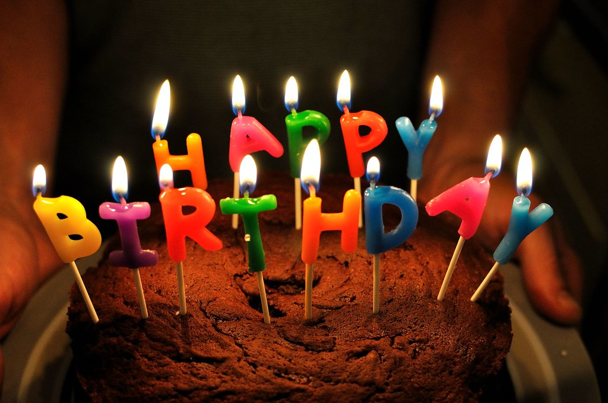
Concept Development: Celebrations
Every culture in the world has its own celebrations. They are called traditions or customs.
A celebration is:
a special occasion
shared by people in the same culture, country, family or other group like a club or sports team
often on the same day each year
usually a time that people gather together in one place
usually a happy time.
Theory

Slide 8
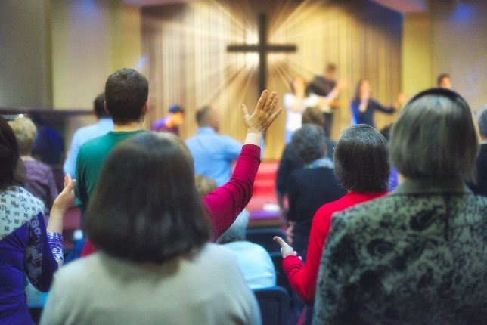
I Do: Special Occasions
A celebration is a special occasion.
One example of a special occasion is Christmas.
It is a special occasion because Christian people commemorate the birth of Christ. Many people who aren’t Christian still celebrate this time of year.
It is a special occasion because it happens once every year.
Music that is played at Christmas includes:
Christmas carols like Jingle Bells
religious music like church hymns.
Theory

Slide 9
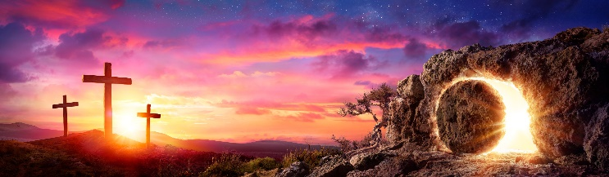
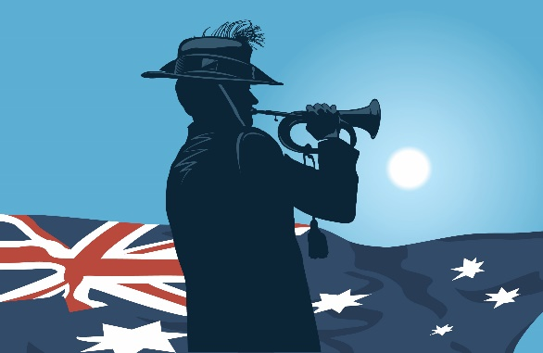
We Do: Special Occasions
Let’s think of some other special occasions.
We will write three more special occasions on the board.
Do they happen once a year?
Do they happen for a reason?
What music goes with them?
Theory

Slide 10

I Do: Sharing a Celebration 1
A celebration is shared by people in the same culture, country, family or other group like a club or sports team.
One example is when Australians celebrate Anzac Day.
Anzac Day happens on the same day every year on 25 April.
On Anzac Day, people in Australia and New Zealand think about the sacrifices made by people who served in the army, air force and navy to protect us and our friends.
Anzac Day is shared by people from Australia and New Zealand.
The music heard on Anzac Day is played by a single trumpet. It is called The Last Post. It was played every morning to wake the soldiers who were fighting in the war. It is played on Anzac Day to remind us of the sound the soldiers heard every day.
Theory

Slide 11
I Do: Sharing a Celebration 2
A celebration is shared by people in the same culture, country, family or other group like a club or sports team.
One example is when Aboriginal Australians celebrate NAIDOC week.
During NAIDOC week, we celebrate all the achievements of our people.
NAIDOC is made up of letters that stand for: National Aboriginal and Islander Day Of Celebration.
Music that is plated during NAIDOC week includes songs by great Aboriginal musicians like the song Treaty by Yothu Yindi.
Theory

Slide 12
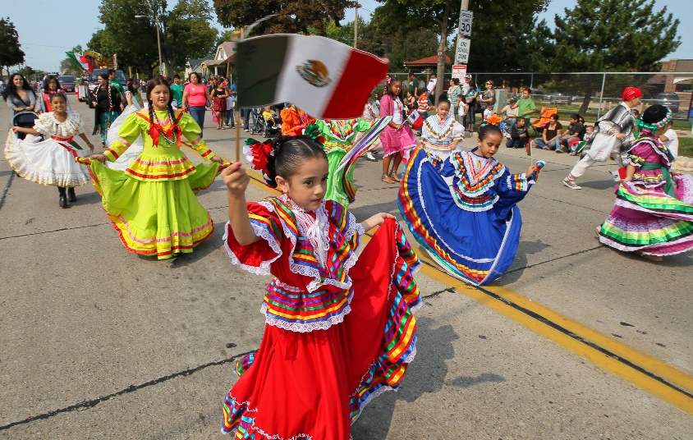
We Do: Sharing a Celebration
Let’s think of some other celebrations we share with people in the same culture, country, family or other group like a club or sports team.
We will write three more celebrations on the board.
Who do we share them with?
Why do we have these celebrations?
What music goes with them?
Theory

Slide 13
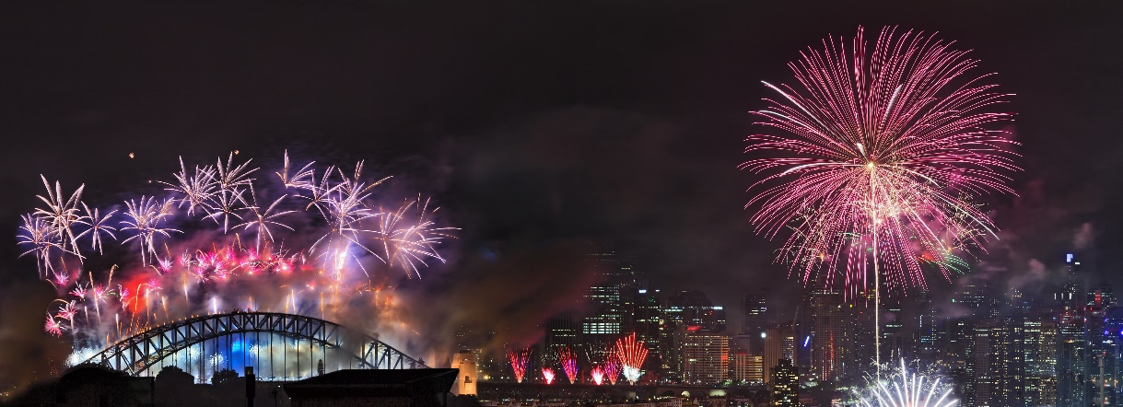
I Do: Once a Year
A celebration often happens on the same day each year.
New Year’s Day happens on the same day each year.
New Year’s Day happens on 1 January every year.
On this day, we celebrate that a new year is beginning, and we think back on all the things we did in the previous year.
In many countries, they sing a song at the start of New Year's Day called Auld Lang Syne. The song is about remembering the days gone by.
Theory

Slide 14

We Do: Once a Year
A celebration often happens on the same day each year.
Let’s think of some celebrations that happen once a year. It is okay if we think about the same ones as earlier.
We will write three celebrations on the board.
What date does the celebration happen?
Why is it on this date?
What music is sung or played on this day?
Theory

Slide 15
I Do: Gather Together
A celebration is usually a time when people gather together in one place.
We gather together to celebrate somebody’s birthday.
We come together in one place to celebrate the day that our friend or family member was born. We celebrate them because we love them.
Usually there is a birthday cake to share. There may be candles on the cake. The person whose birthday it is blows out the candles.
At a birthday, people sing the song, Happy Birthday.
Theory

Slide 16
We Do: Gather Together
A celebration is usually a time when people gather together in one place.
Let’s think of some celebrations that bring us together in one place. It is okay if we think about the same ones as earlier.
We will write three celebrations on the board.
Who comes to this celebration?
Where do they gather?
Is it the same day every year?
What music or songs are used?
Theory

Slide 17
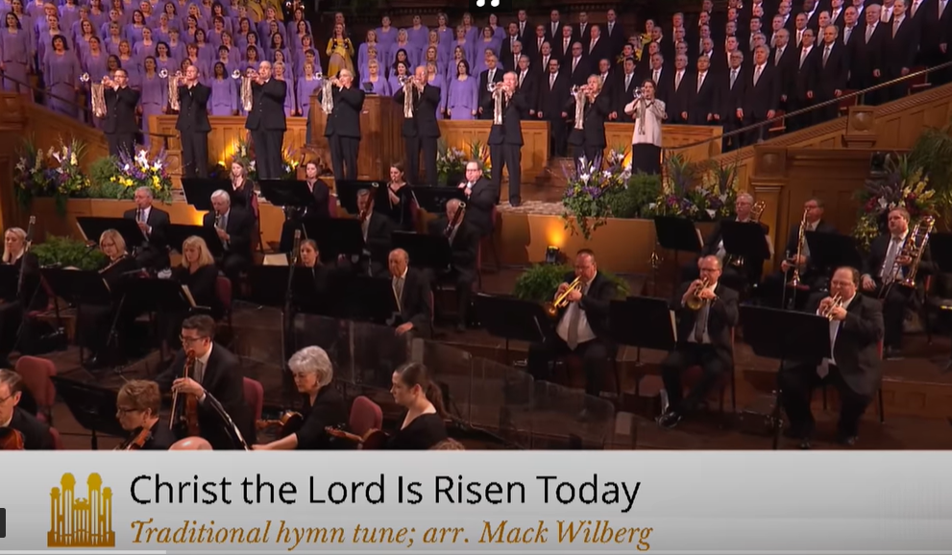
I Do: Customs
A celebration usually has its own traditions or rules. They are called customs. Easter has its own customs.
During Easter in many places around the world, children search for chocolate eggs that have been hidden by the Easter bunny. This is called an Easter egg hunt.
In some parts of the world, Easter is celebrated with a hat parade. People compete to make and wear the fanciest hat.
Some people go to church at Easter and listen to Easter hymns like Christ the Lord is Risen Today.
Theory

Slide 18
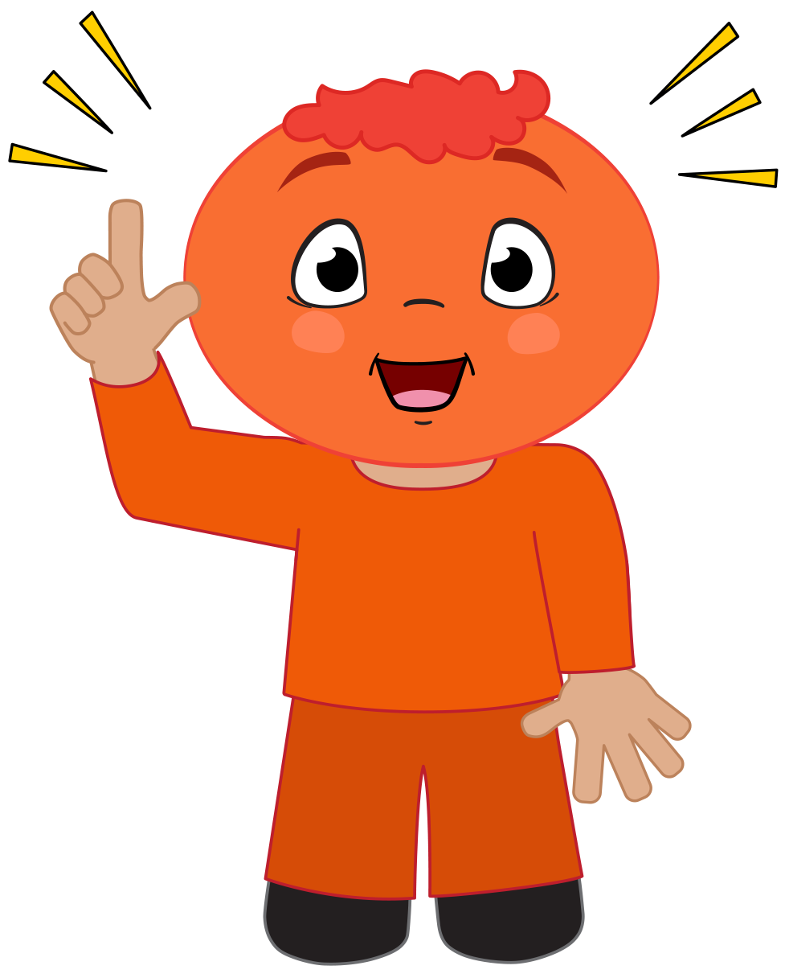
We Do: Customs
A celebration usually has its own traditions or rules. They are called customs.
Let’s think of some celebrations that have their own customs. It is okay if we think about the same ones as earlier.
We will write three celebrations on the board.
What are the customs?
Is there more than one custom?
Is a song part of the custom? If so, what song?
Theory

Slide 19
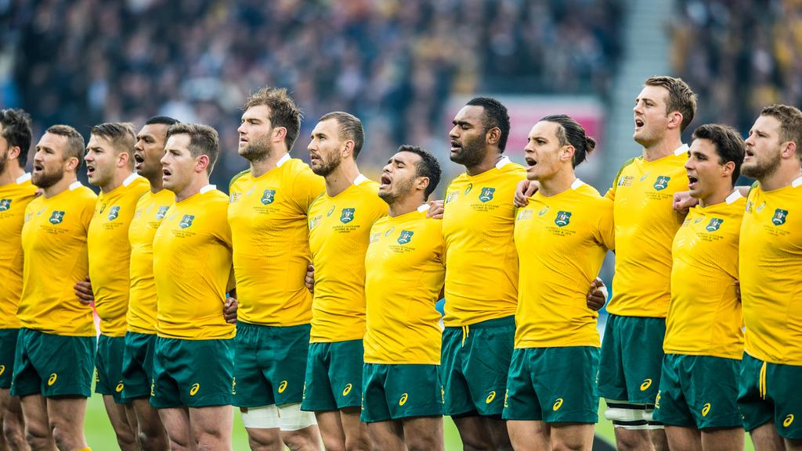
I Do: Happy Times 1
A celebration is usually a happy time.
Some celebrations are sad. At funerals, we celebrate the life of a person who has died, but we are sad because they have passed.
Other celebrations are happy. When a sporting team wins a game or a championship, they celebrate the victory.
Usually the members of a team, or the fans, sing a song. Sometimes the players pour water or sports drinks all over each other.
Theory

Slide 20
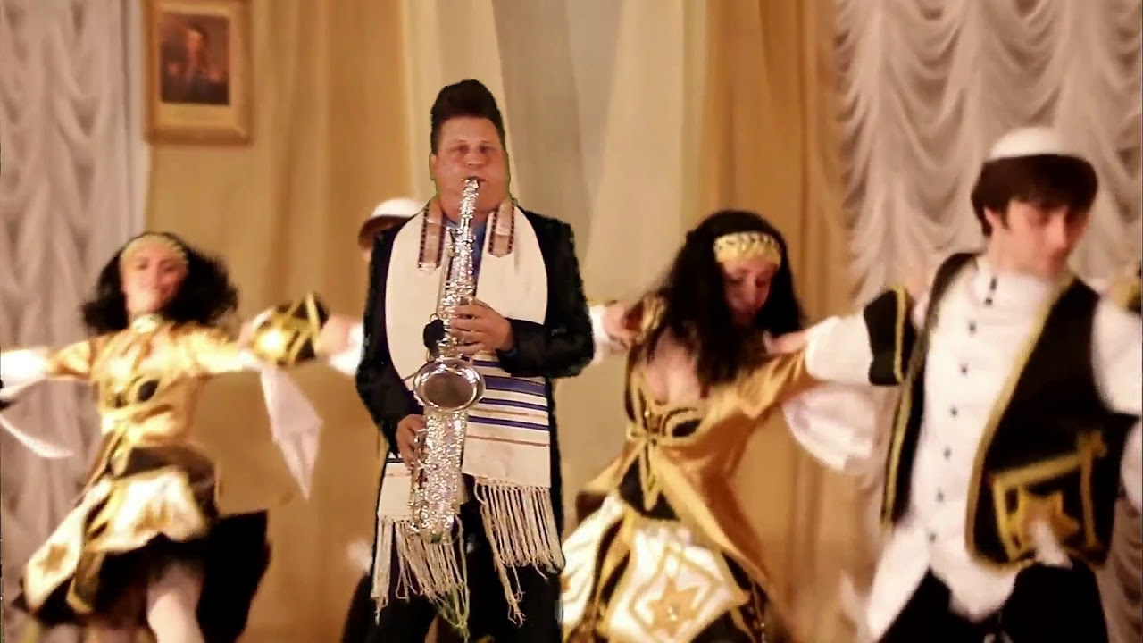
I Do: Happy Times 2
A celebration is usually a happy time.
A wedding is a happy celebration.
A wedding is different from some celebrations because it happens only once. A wedding is when two people choose to marry each other in front of their family and friends.
The Wedding March is often played on an organ while the bride walks down the aisle. At the wedding party, a band or DJ plays music so everyone can dance.
Theory

Slide 21
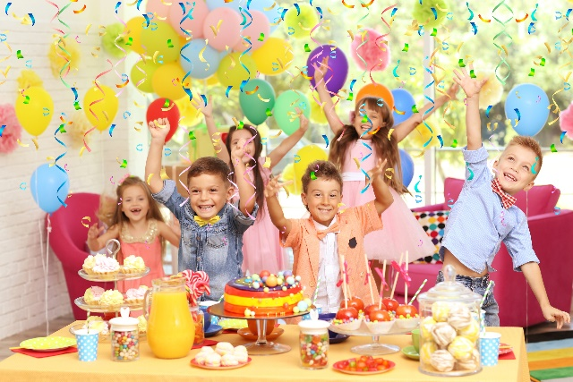
We Do: Happy Times
A celebration is usually a happy time.
Let’s think of some celebrations that are happy times. It is okay if we think about the same ones as earlier.
We will write three celebrations on the board.
Why are people happy at this celebration?
Is there more than one custom?
Is there music? Does the music sound happy? Why?
Theory

Slide 22
Respond: Student Work Sheet
Let’s write a list of some celebrations we have learnt about in today’s lesson and the music that goes with it.
Celebration | Music
1. | 1.
2. | 2.
3. | 3.
4. | 4.
5. | 5.
Theory

Slide 23
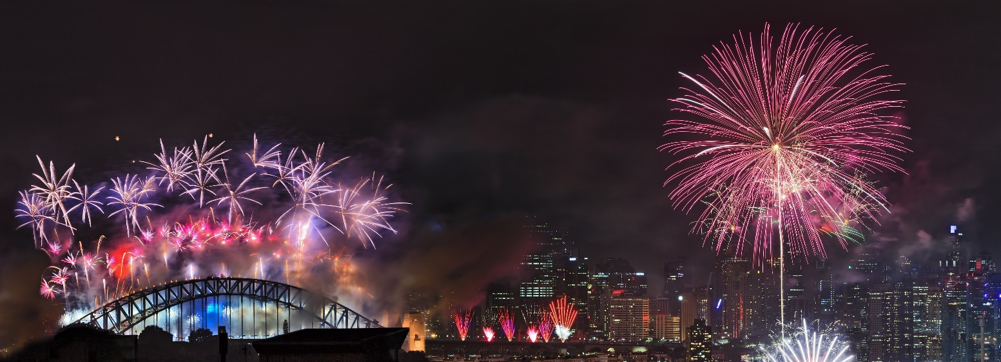
Summary
In this lesson, we learnt what it means to celebrate.
We learnt about celebrations from our own culture and the music we listen to when we celebrate our customs.
Theory

Slide 24
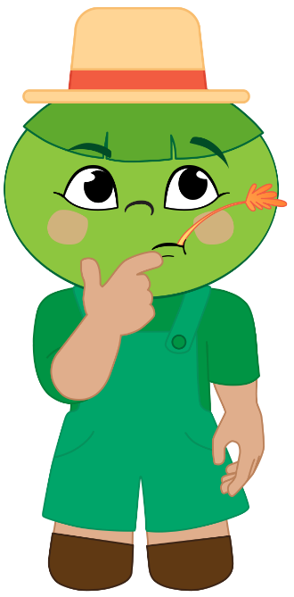
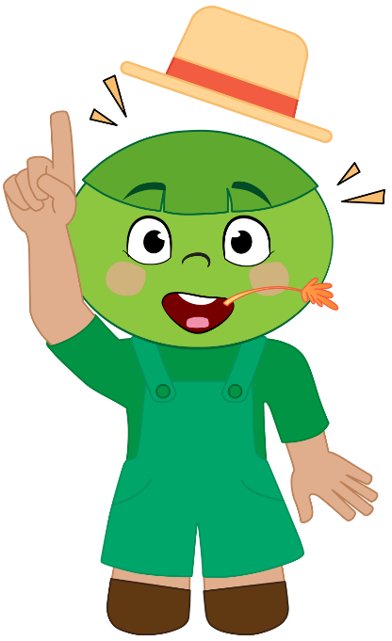
Reflect and Connect
How well are you able to:
explain what a celebration is?
name some celebrations from your culture?
give examples of music used in different celebrations?
Theory

Slide 25
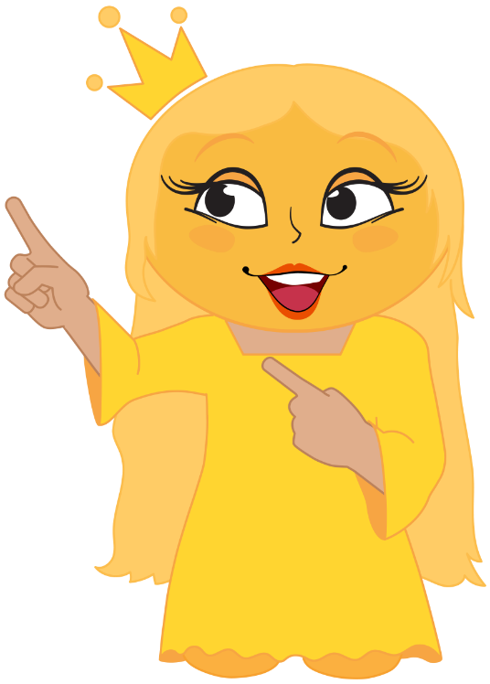
Reflect and Connect
In the next lesson, we will learn more about how the Do Re Mi family helps us to read, sing and play celebration music from around the world
Theory

Slide 26
Goodbye Song
Goodbye everybody.
Goodbye everybody.
Goodbye.
Goodbye.
Goodbye.
Theory

