Slide 1
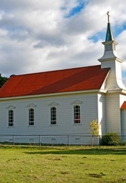
The Arts
Week 1: Lesson 2
Unit 3:
Music in the World -
Music for Celebration
Version 1

Slide 2

Song of Faith/Home Over There 1

Slide 3
Good Listening Behaviours
Practical

Slide 4
Learning Objective
In this lesson, you will learn:
to sing a new hello song
to sing a new song called ‘O Think of the Home Over There’
keeping the beat with ‘O Think of the Home Over There’.
Success Criteria
You will be successful when you can:
sing the new hello song with some confidence
sing the start of ‘O Think of the Home Over There’ with some confidence
show body positions for the first part of ‘O Think of the Home Over There’
keep the beat while speaking ‘O Think of the Home Over There’.
Practical

Slide 5

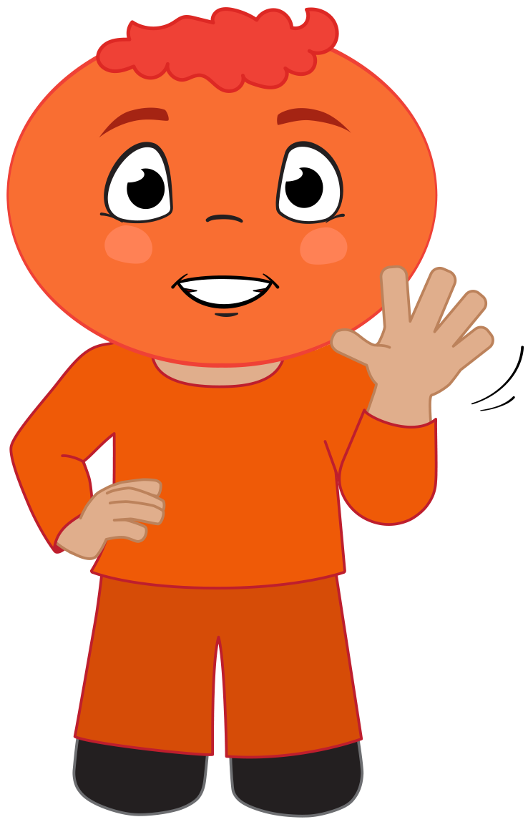
I Sing: Hello Song
Hello, hello, How do you do?
How do you do? How do you?
Hello, hello, How do you do?
How do you do today?
If you're wearing blue, stand up!
If you're wearing blue, stand up!
Pat pat pat your knees
Pat pat pat your knees
Pat pat pat your knees
Pat your knees today
Practical

Slide 6





I Sing: Hello Song Part 1
Hel – lo ; Hel- lo How do you do?
How do you do? How do you do?
Practical

Slide 7
We Sing: Hello Song Part 1
Hel – lo ; Hel- lo How do you do?
How do you do? How do you do?
Practical

Slide 8

I Sing: Hello Song Part 2
Hel – lo ; Hel- lo How do you do?
How do you do? How do you do to- day ?
Practical

Slide 9
We Sing: Hello Song Part 2
Hel – lo ; Hel- lo How do you do?
How do you do? How do you do to- day ?
Practical

Slide 10
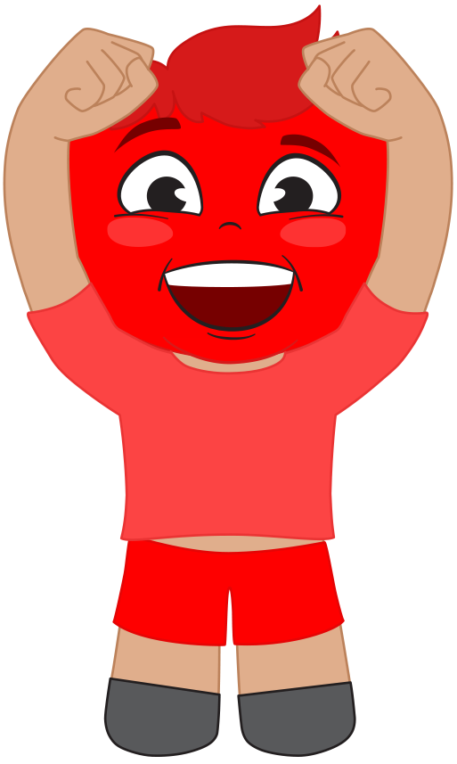
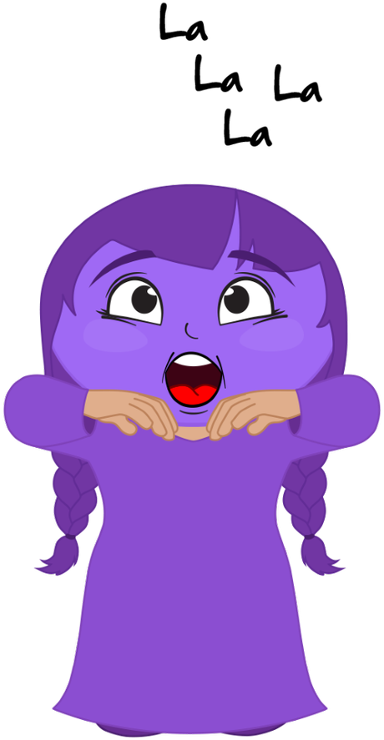
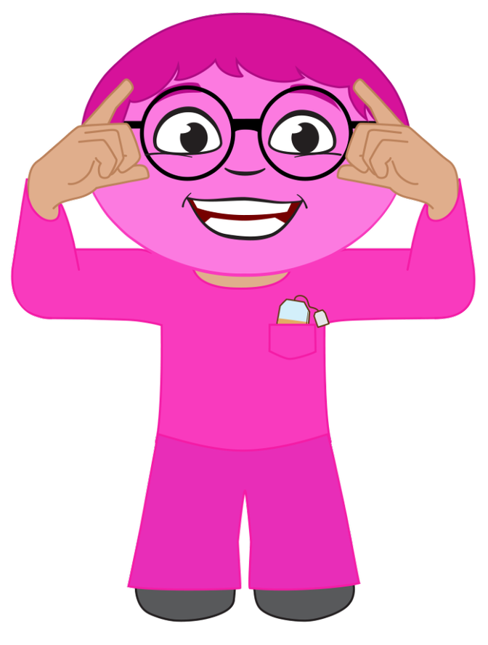

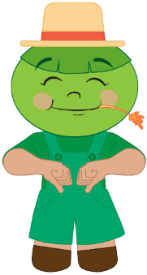


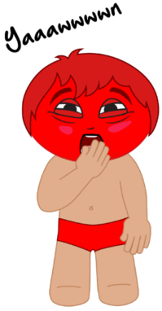
Recite: Do Re Mi Family Song
Mister Do is dozing in his bright red underwear.
Missus Re is radiant with spiky orange hair.
Miss Mi is a meanie in her shiny crown so yellow.
Mister Fa’s a farmer; he’s a jolly green-faced fellow.
Missus So loves sewing with her ball of string so blue.
Missus La sings opera dressed in purple hues.
Mister Ti’s a teacher and he likes to drink pink tea.
Little Do is way up high as red as red can be.
Now we’ve met the members of our music family,
Children join together and sing along with me.
Practical

Slide 11


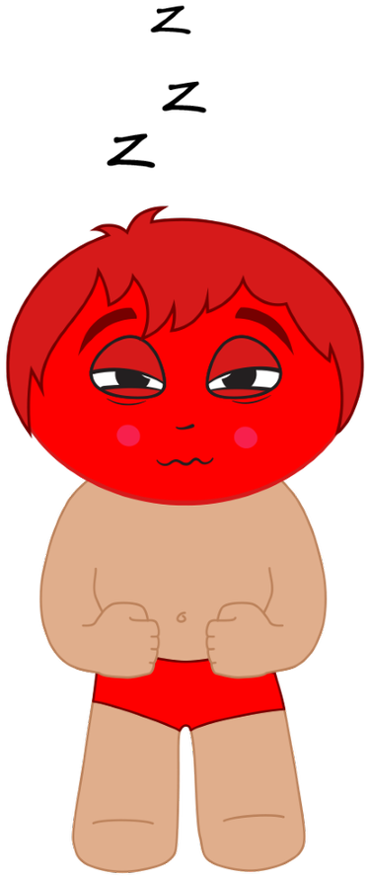
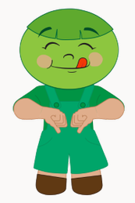
Recall: Hand Signs
Practical

Slide 12
Apply: Mister Do
Practical

Slide 13

Apply: Mister Fa
Practical

Slide 14
Apply: Missus So
Practical

Slide 15
Apply: Missus La
Practical

Slide 16

Concept Development: Songs of Faith
‘O Think of the Home Over There’ is a ‘Song of Faith’. It is sung in churches.
We are learning celebration songs in this unit.
Songs of Faith are celebration songs.
Practical

Slide 17

Listen: O Think of the Home Over There
(Musical instrumental introduction first).
O Think of the Home over there
By the side of the river of light
Where the saints all immortal and fair
Are robed in their garments of white.
Over there, over there.
O think of the home over there
Over there, over there.
O think of the home over there.
Practical

Slide 18
Lyrics: O Think of the Home Over There
(Musical instrumental introduction first).
O Think of the Home over there
By the side of the river of light
Where the saints all immortal and fair
Are robed in their garments of white.
Over there, over there.
O think of the home over there
Over there, over there.
O think of the home over there.
Practical

Slide 19
I Say: O Think of the Home Over There
(Musical instrumental introduction first).
O Think of the Home over there
By the side of the river of light
Where the saints all immortal and fair
Are robed in their garments of white.
Over there, over there.
O think of the home over there
Over there, over there.
O think of the home over there.
Practical

Slide 20
We Say: O Think of the Home Over There
(Musical instrumental introduction first).
O Think of the Home over there
By the side of the river of light
Where the saints all immortal and fair
Are robed in their garments of white.
Over there, over there.
O think of the home over there
Over there, over there.
O think of the home over there.
Practical

Slide 21
I Sing: Home Over There
(Musical instrumental introduction first).
O Think of the Home over there
By the side of the river of light
Where the saints all immortal and fair
Are robed in their garments of white.
Over there, over there.
O think of the home over there
Over there, over there.
O think of the home over there.
Practical

Slide 22
We Sing: Home Over There
(Musical instrumental introduction first).
O Think of the Home over there
By the side of the river of light
Where the saints all immortal and fair
Are robed in their garments of white.
Over there, over there.
O think of the home over there
Over there, over there.
O think of the home over there.
Practical

Slide 23


I Sing: Home Over There 1
O think of the home o- ver there
By the side of the ri- ver of light
Practical

Slide 24
We Sing: Home Over There 1
O think of the home o- ver there
By the side of the ri- ver of light
Practical

Slide 25
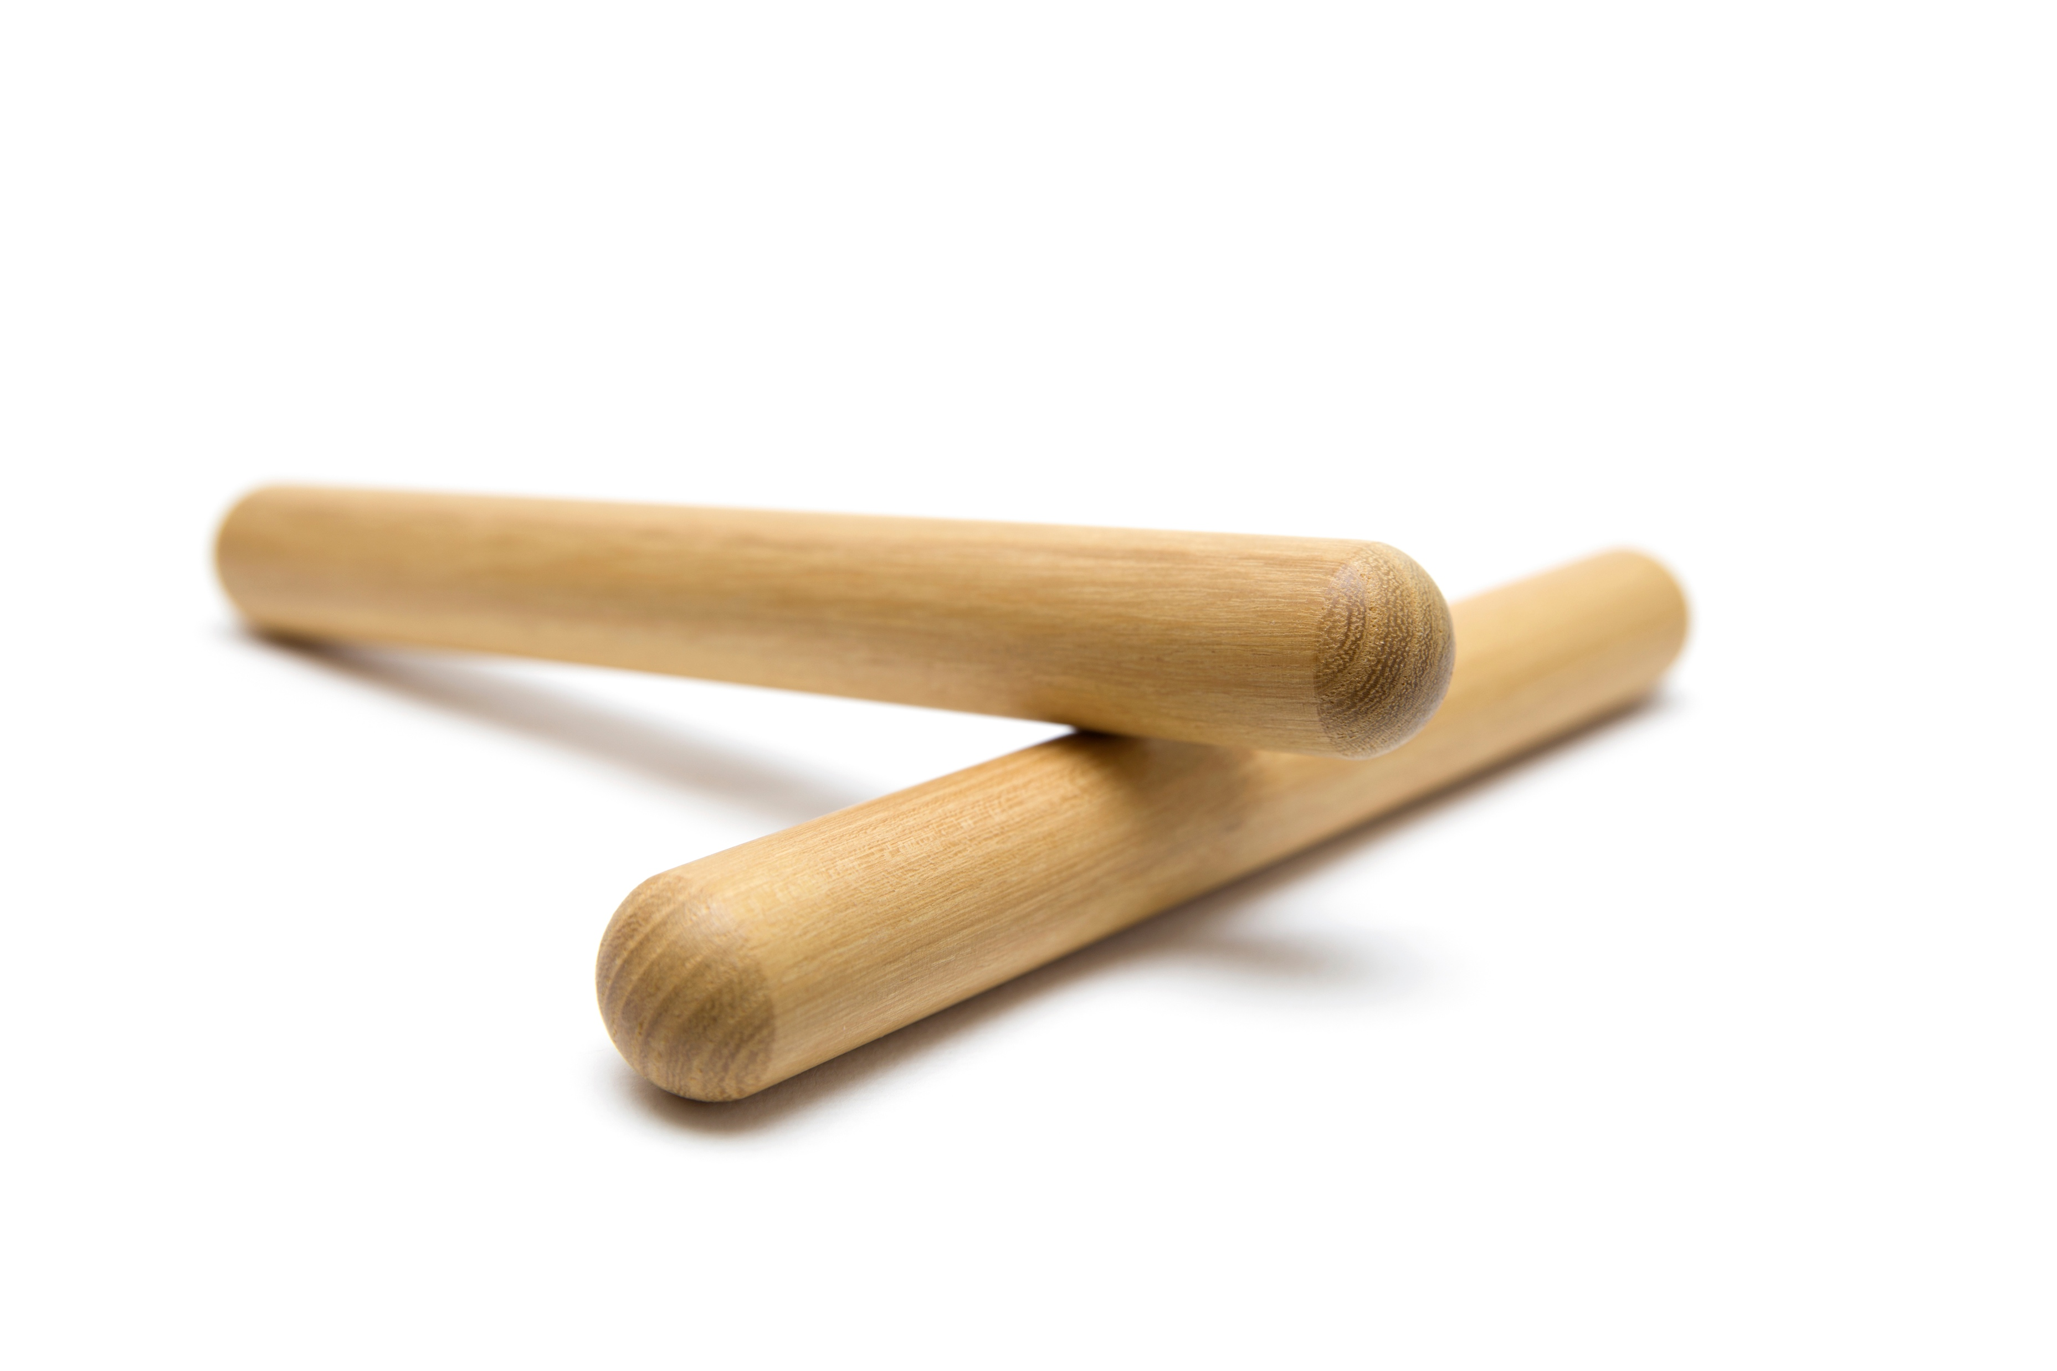
Beat and Sing: Home Over There 1
O think of the home o- ver there
By the side of the ri- ver of light
Practical

Slide 26
I Sing: Home Over There 2
Where the saints all im- mor- tal and fa- ir
Are ____ robed in their garm- mets of white.
Practical

Slide 27
We Sing: Home Over There 2
Where the saints all im- mor- tal and fa- ir
Are robed in their garm- ets of white.
Practical

Slide 28
Beat and Sing: Home Over There 2
Where the saints all im - mortal and fair
Are robed in their gar- ments of white.
Practical

Slide 29
Learn: Hand Signs Home Over There
Practical

Slide 30
Learn: Mister Do
O think of the home o- ver there
Practical

Slide 31
Learn: Mister Fa
O think of the home o- ver there
Practical

Slide 32
Learn: Missus La
O think of the home o- ver there
Practical

Slide 33
Learn: Missus So
O think of the home o- ver there
Practical

Slide 34
I Sing: Hand Signs
O think of the home o- ver there
Practical

Slide 35
We Sing: Hand Signs
O think of the home o- ver there
Practical

Slide 36
Reflect and Connect
In this lesson, we practised:
singing ‘O Think of the Home Over There’
doing the hand signs for ‘O Think of the Home Over There’
playing clap sticks while singing ‘O Think of the Home Over There’.
How well are you able to:
Sing the right notes for ‘O Think of the Home Over There’?
Do the right hand signs while singing ‘O Think of the Home Over There’?
Play clap sticks in time with singing?
Practical

Slide 37
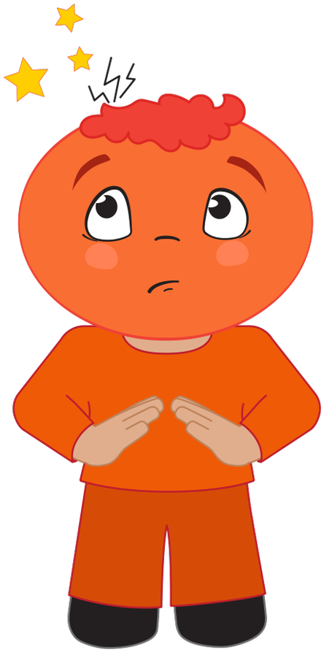

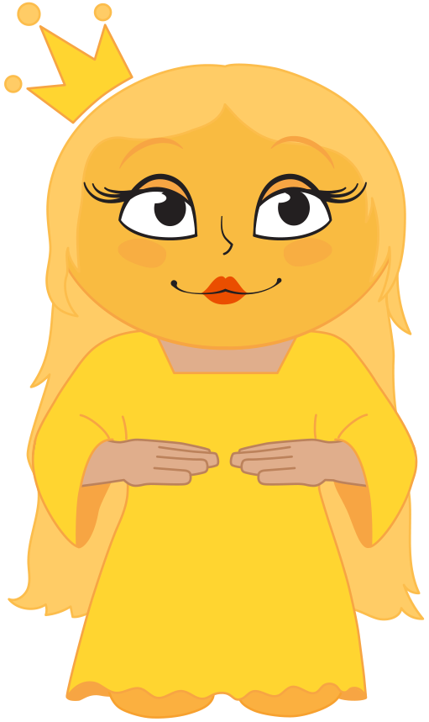
Reflect and Connect
In the next lesson, we will learn continue learning ‘O Think of the Home Over There’.
Practical

Slide 38
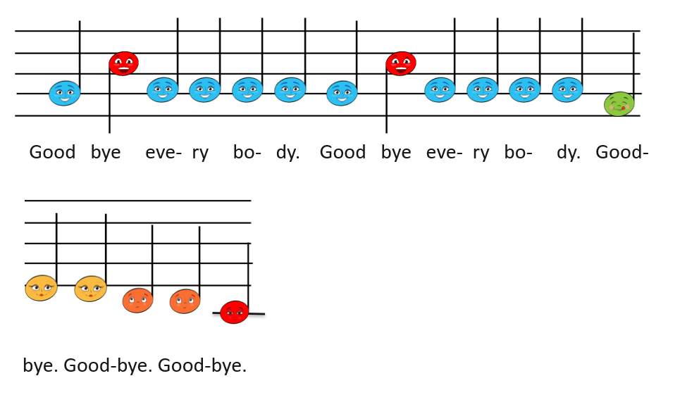

Goodbye Song
Goodbye song piano
Goodbye song vocal
Practical

