Slide 1
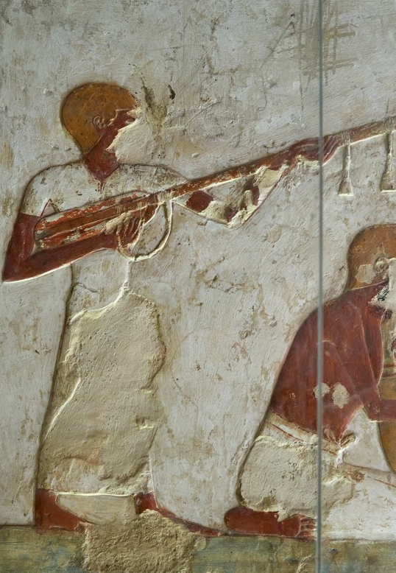
The Arts
Music for Learning
Lesson 1: Week 1
Unit 3: Music in the World - Instruments of the World
Version 1

Slide 2
Introduction to a World of Music

Slide 3
Learning Objective
In this lesson, we will learn:
that every culture in the world has its own music tradition
that every musical tradition has its own instruments, styles and dances
how the elements of music are used differently around the world.
Success Criteria
You will be successful when you can:
use the elements of music to describe the music from different cultures.
Theory
Theory

Slide 4
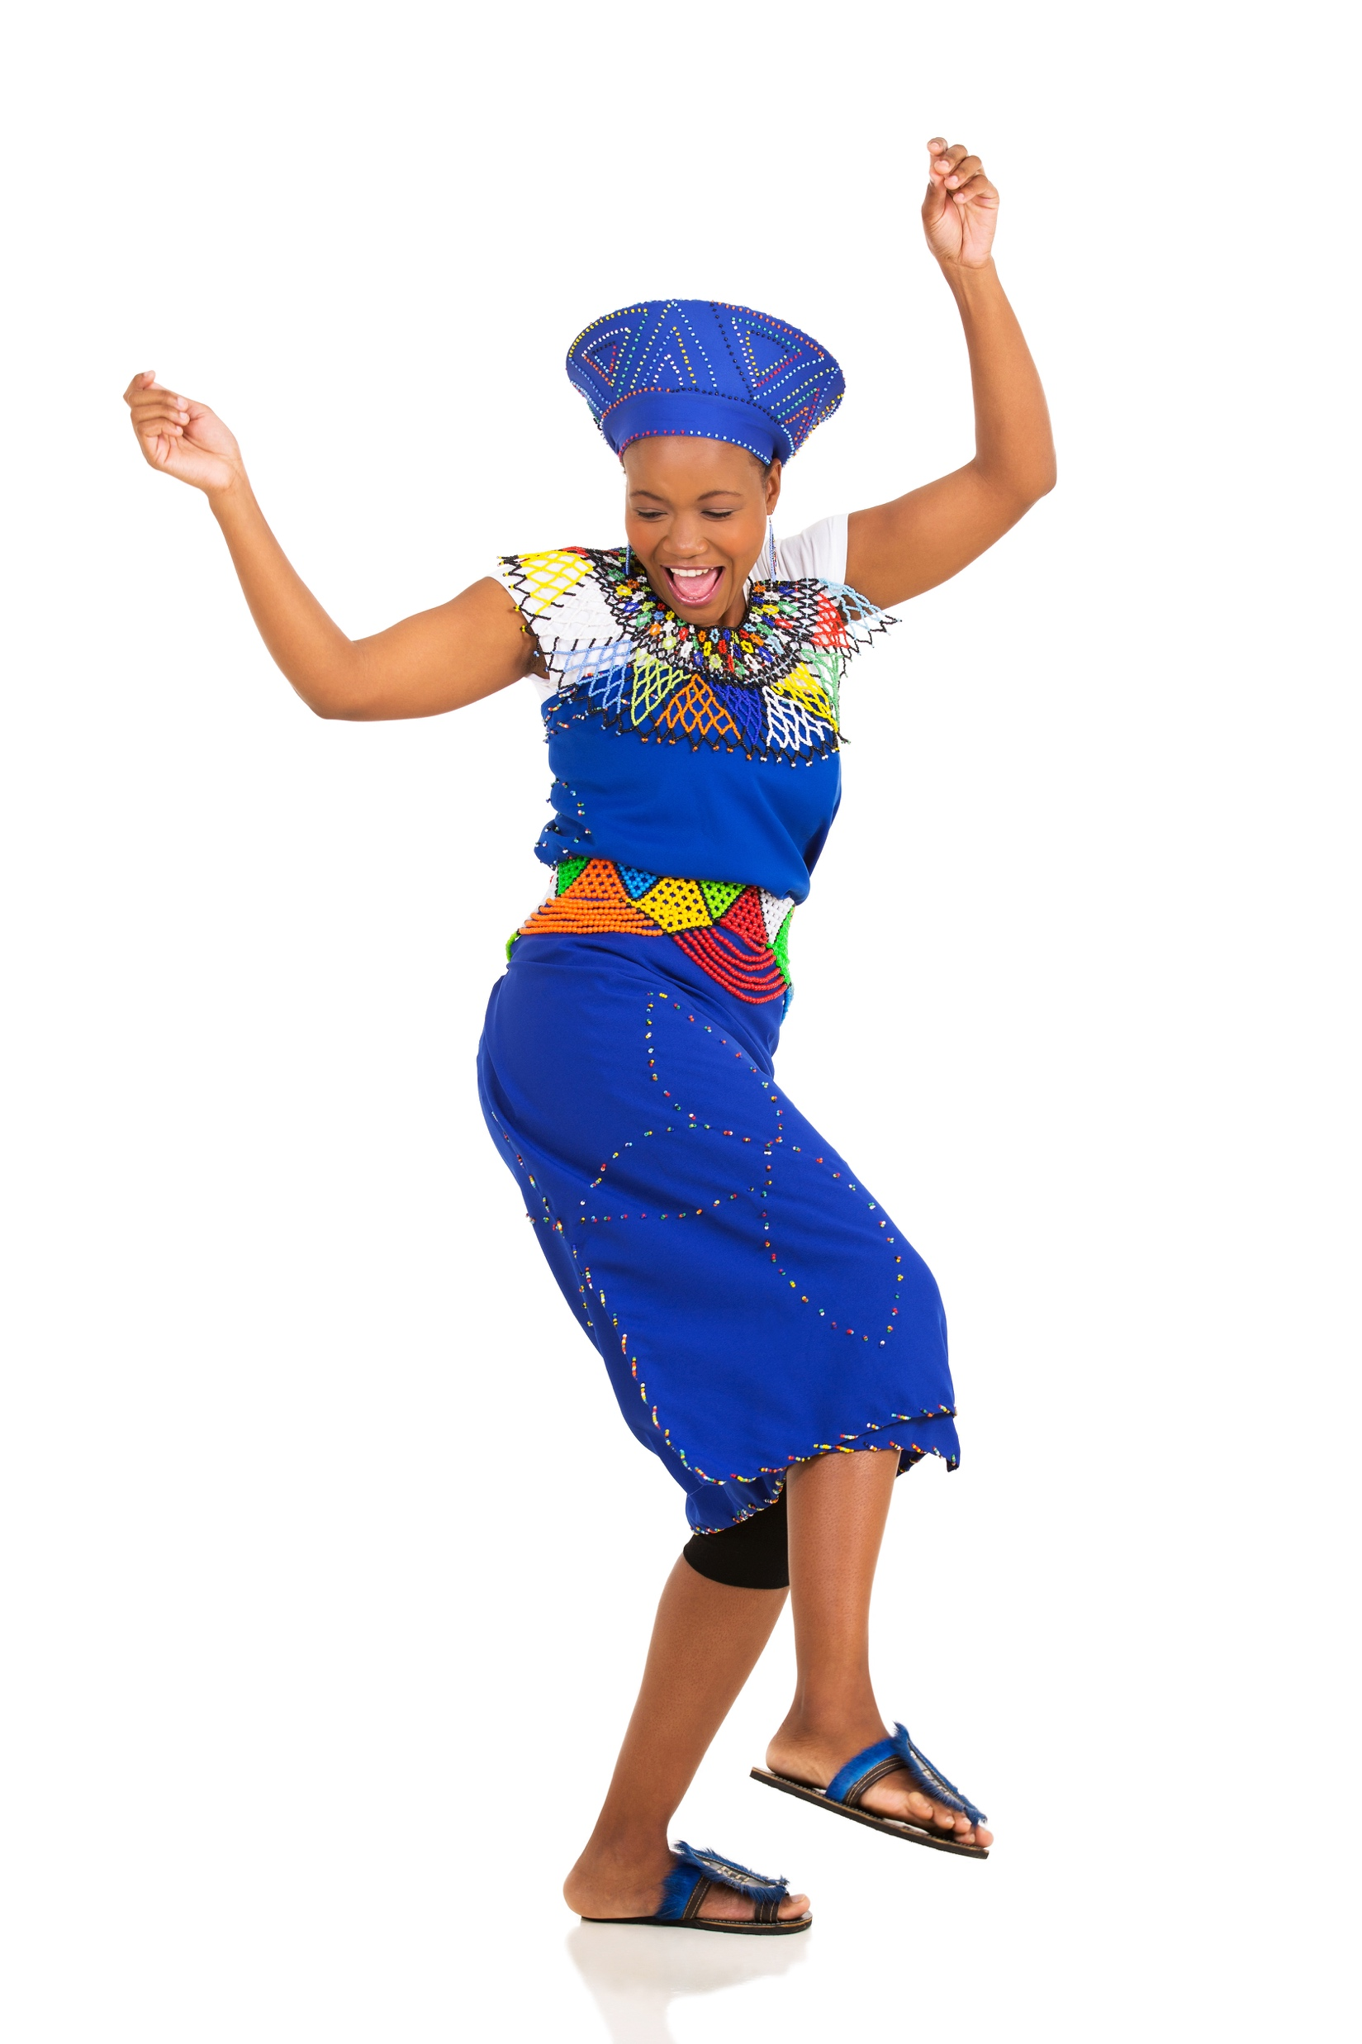
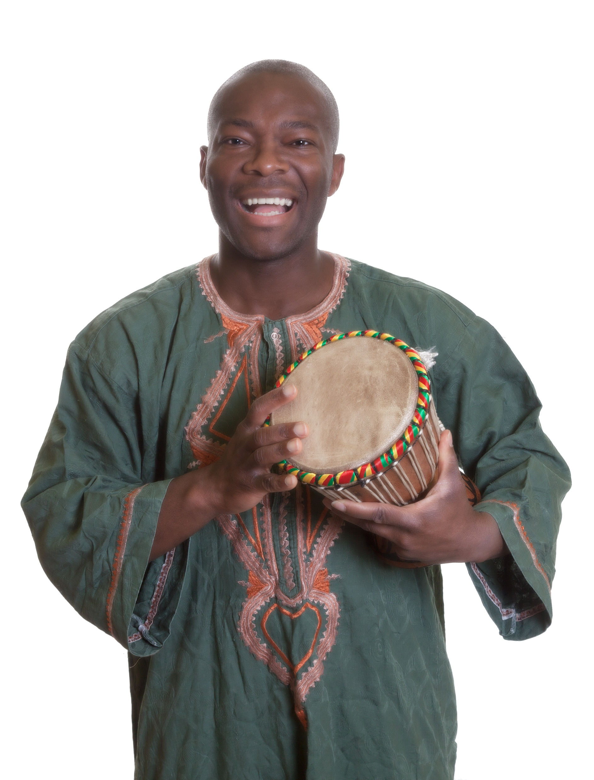
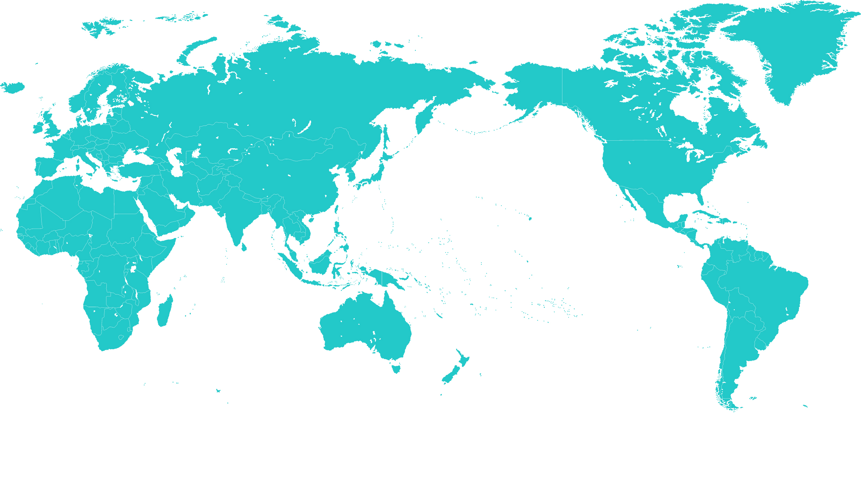

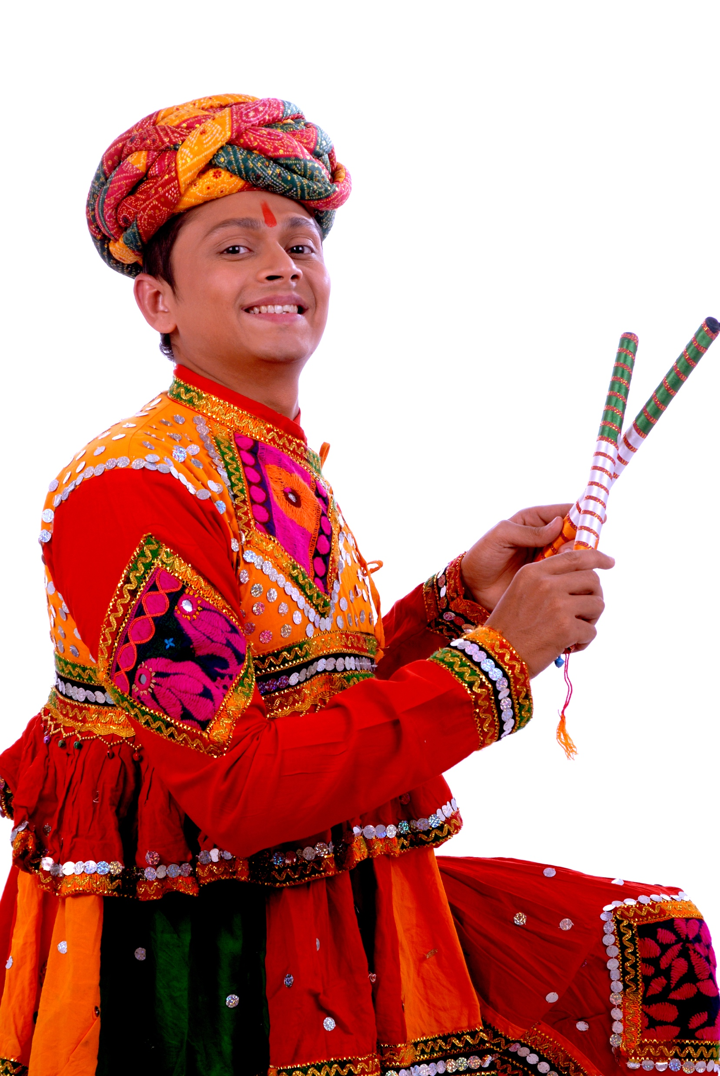
Concept Development: Music Traditions
There are thousands of different types of music played by people around the world.
Every culture has its own music.
We call these music ‘traditions’.
These traditions may have gradually evolved over hundreds and even thousands of years.
Theory

Slide 5

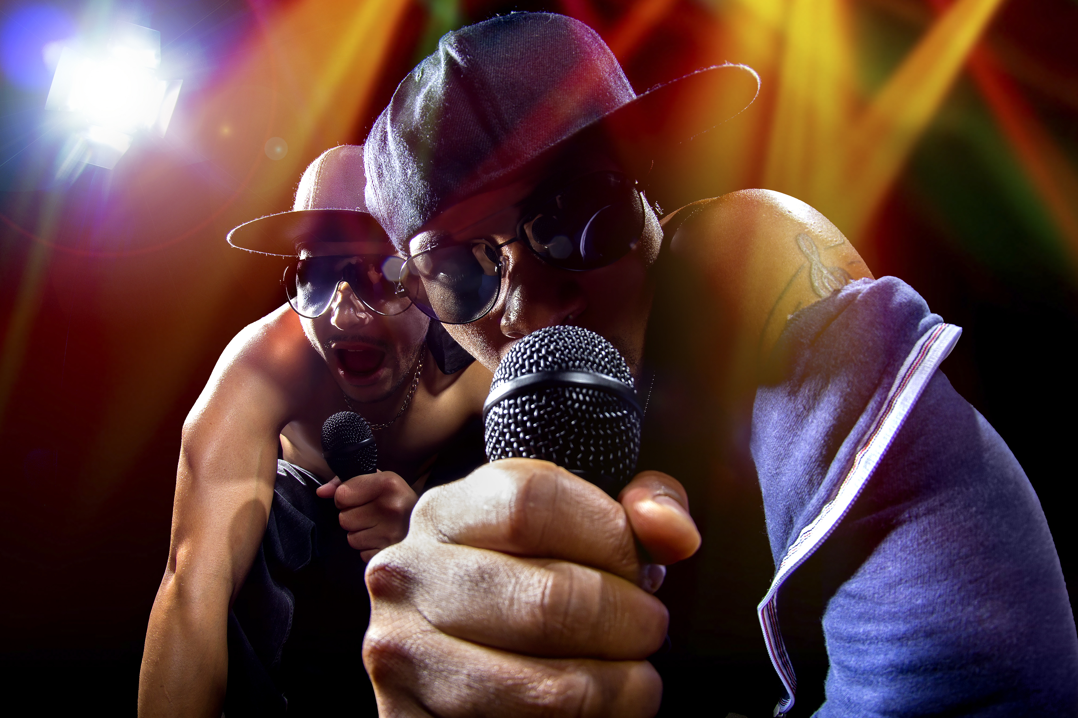
Concept Development: Music Cultures
There is evidence of music stretching back as far as 42,000 years. Archaeologists found flutes made of bones from extinct woolly mammoths in Germany.
Written music has been found written in clay from more than 4000 years ago.
Some music is much newer – for example, hip hop started in New York in the USA and has only been around for 50 years.
Theory

Slide 6
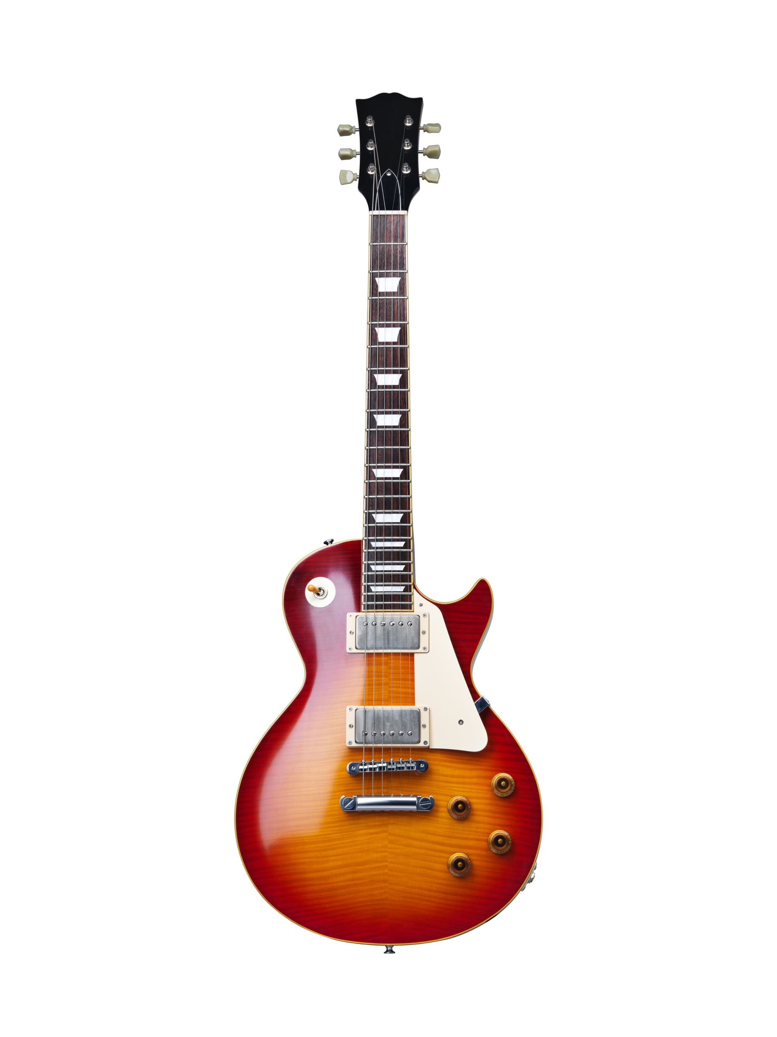
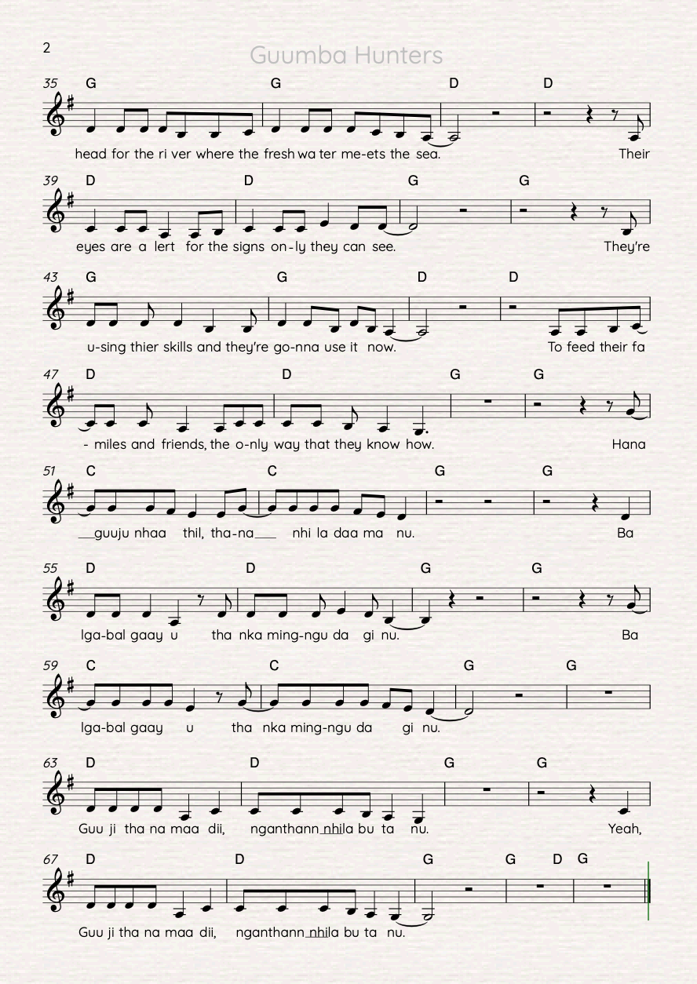
Concept Development: Music Cultures
Each musical tradition has its own special mix of:
musical instruments
notes and rhythms
costumes or clothing
dance.
Theory

Slide 7
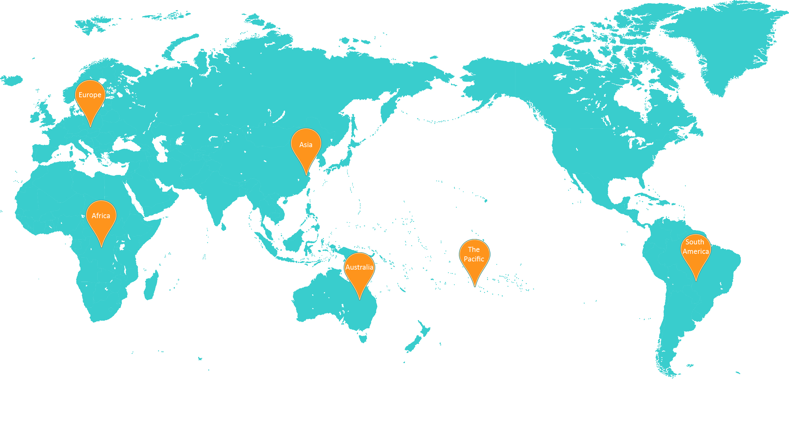
Concept Development: Music Traditions
Some regions that we will be learning about are:
The Pacific; Australia, Africa; Asia – China, Japan, Indonesia; Europe; and South America .
Theory

Slide 8
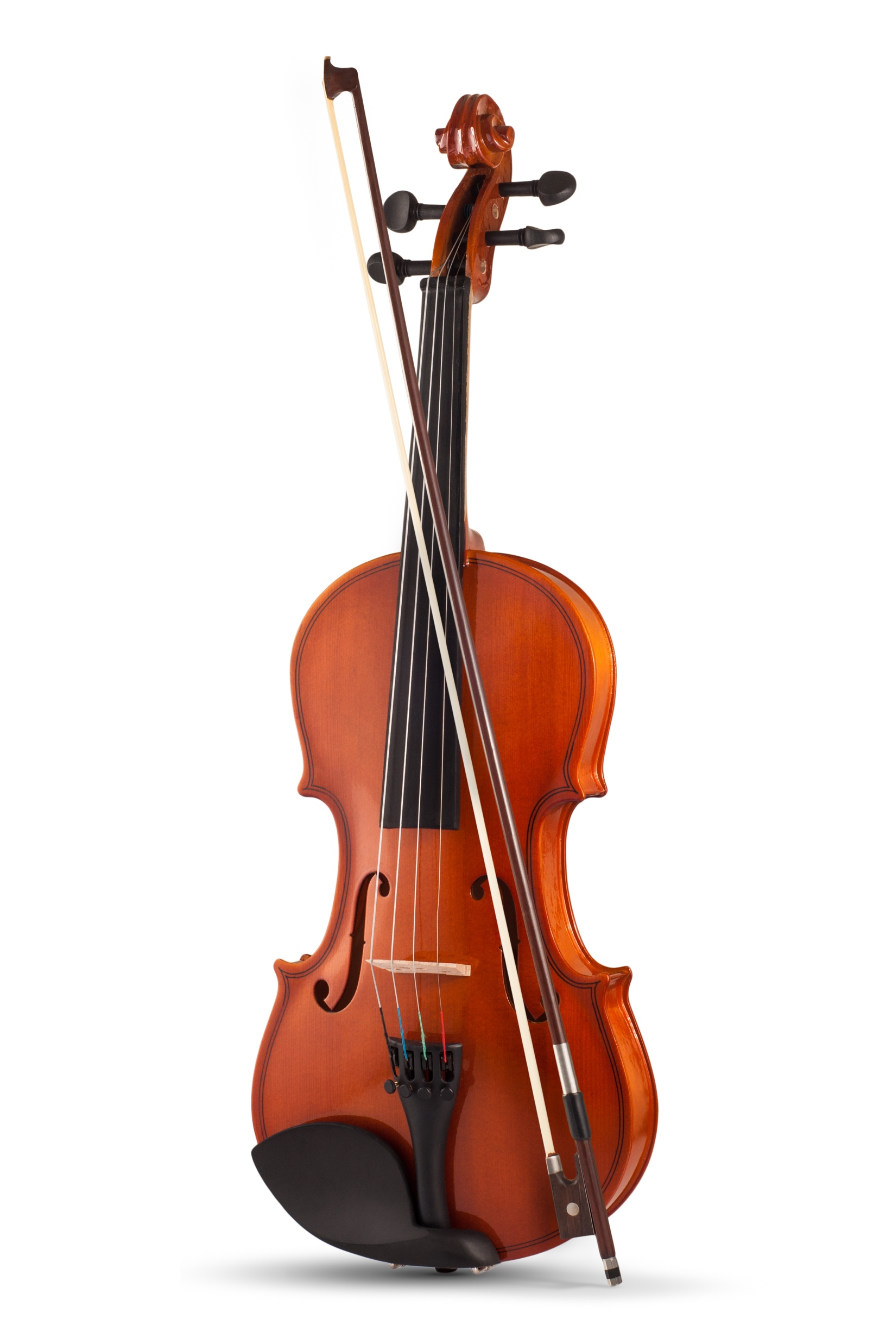
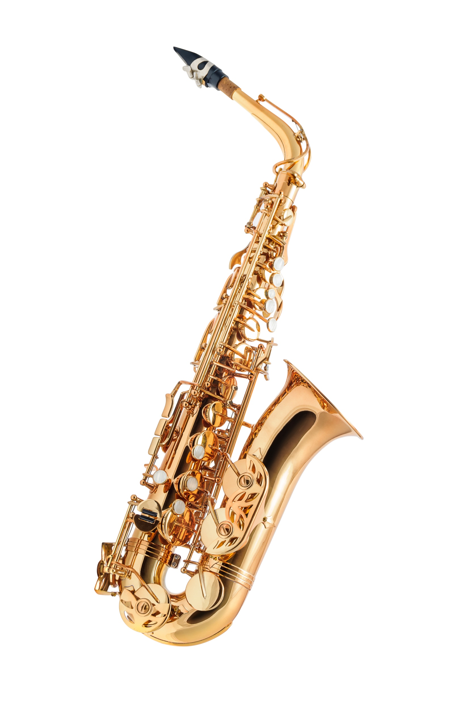
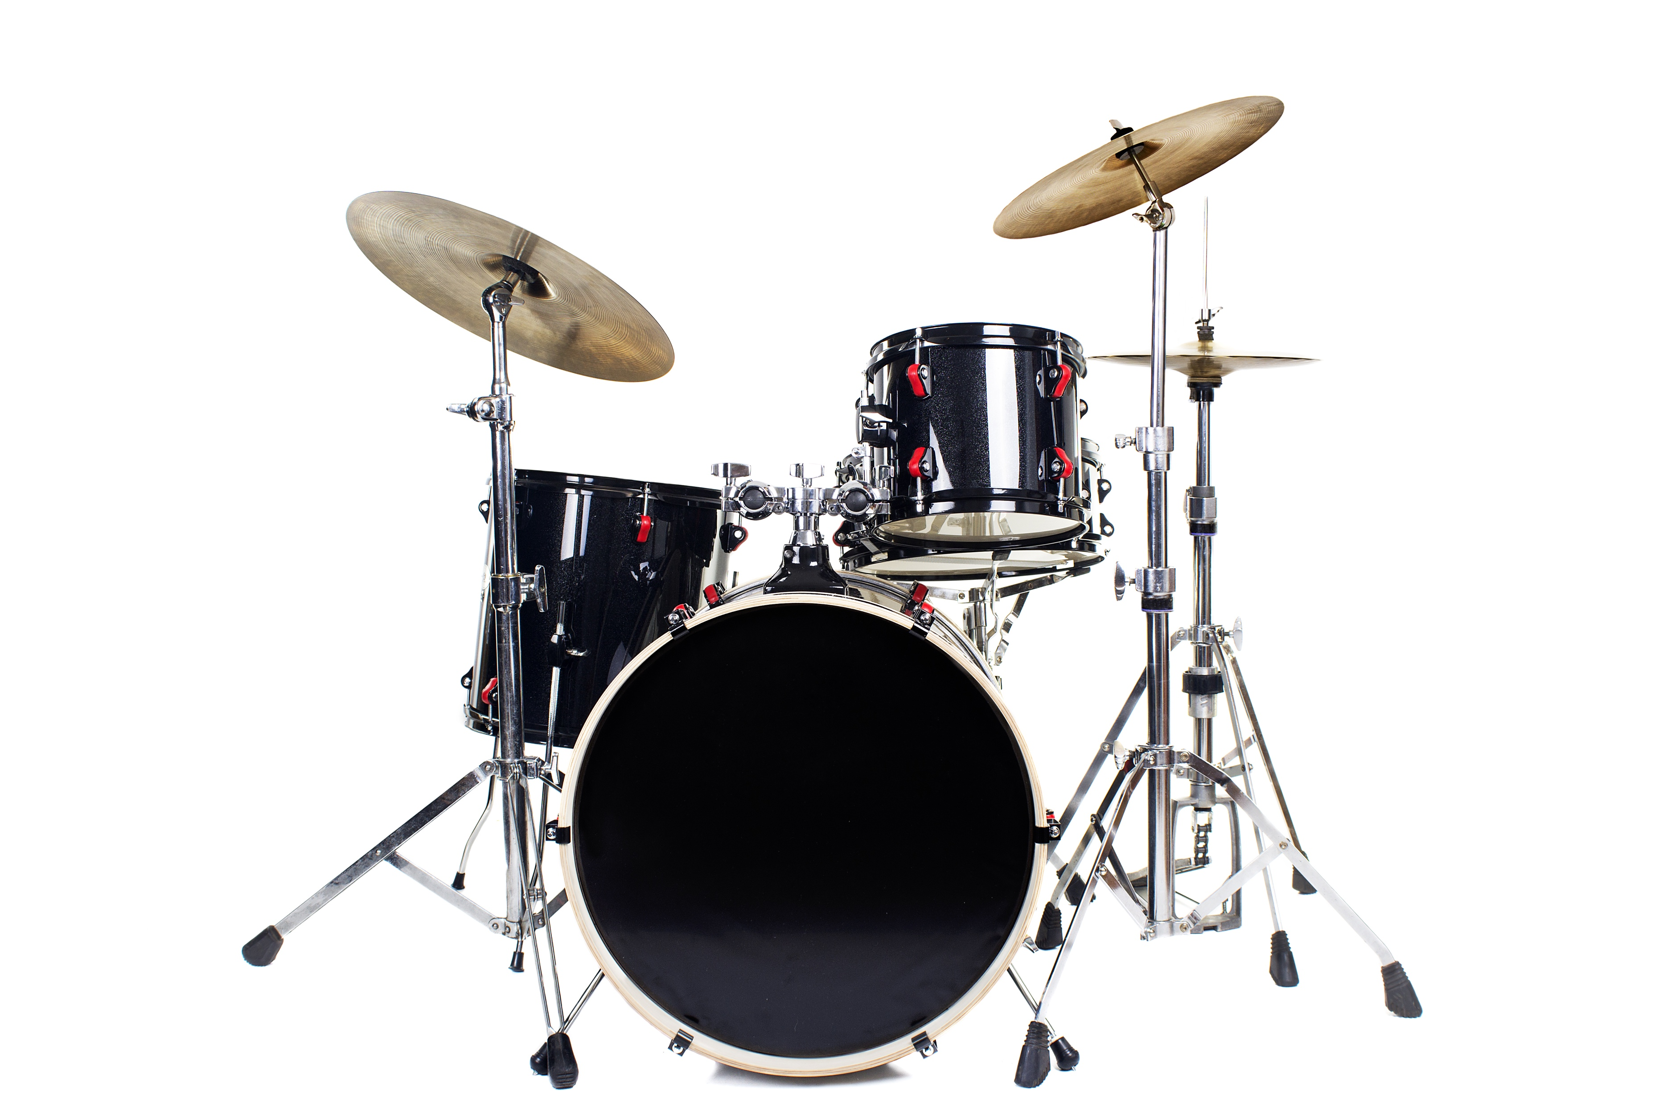
Activating Prior Knowledge: Instrument Families
Instruments are put into different groups called families.
An instrument’s family is based how its sound is produced.
String
Wind
Percussion
Theory

Slide 9
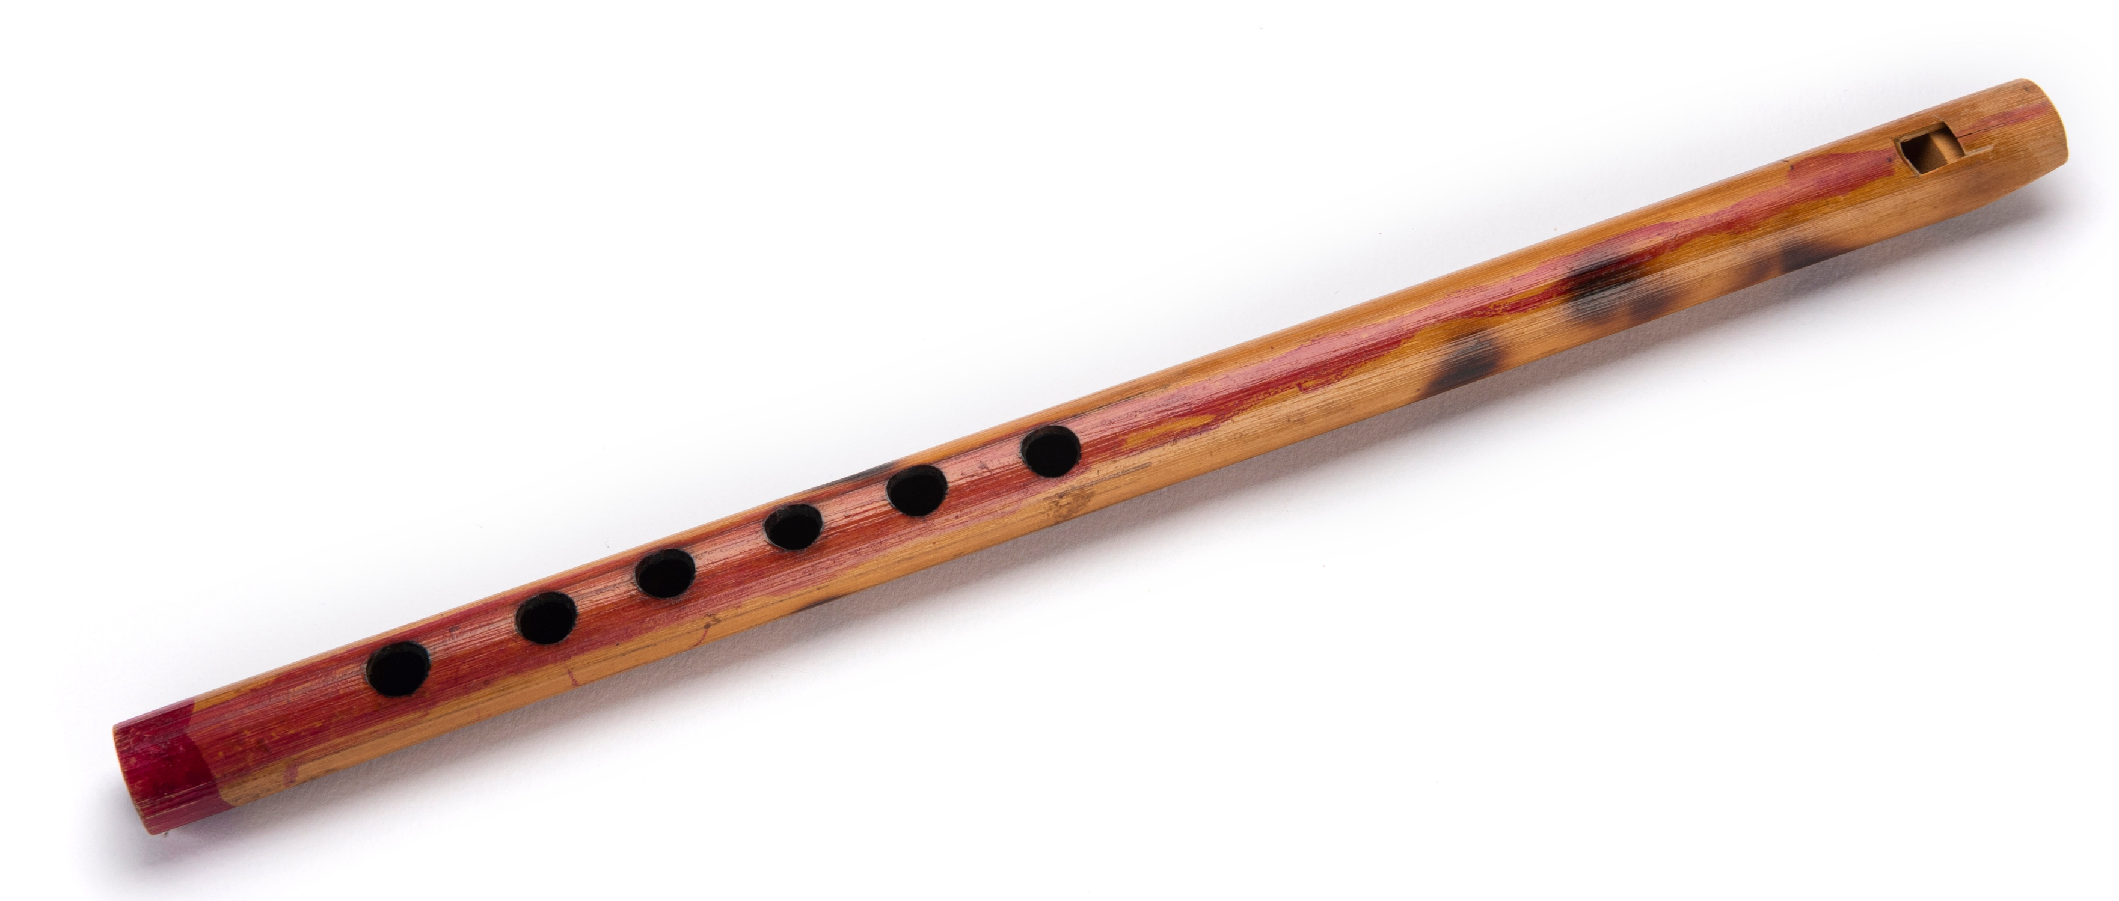
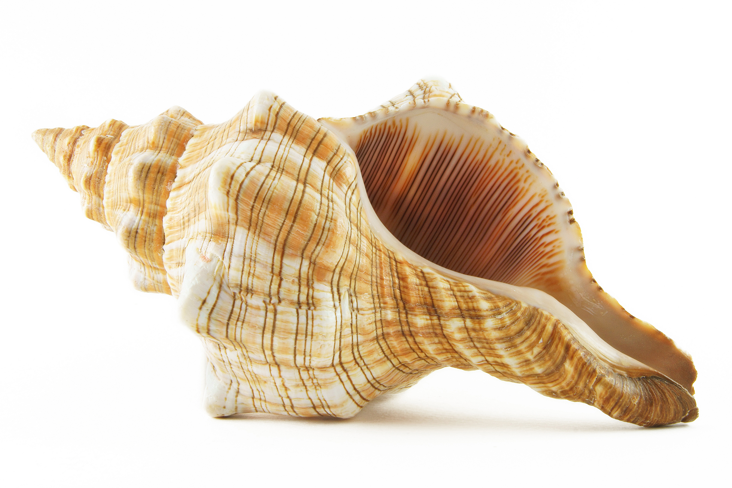
Concept Development: Wind Family
Wind instruments make a sound when they are blown into.
They are usually made of wood or metals such as brass. Some are made of plastic, bones or shells.
Here are some instruments that belong to the wind family.
They are each from a different musical tradition.
Theory

Slide 10
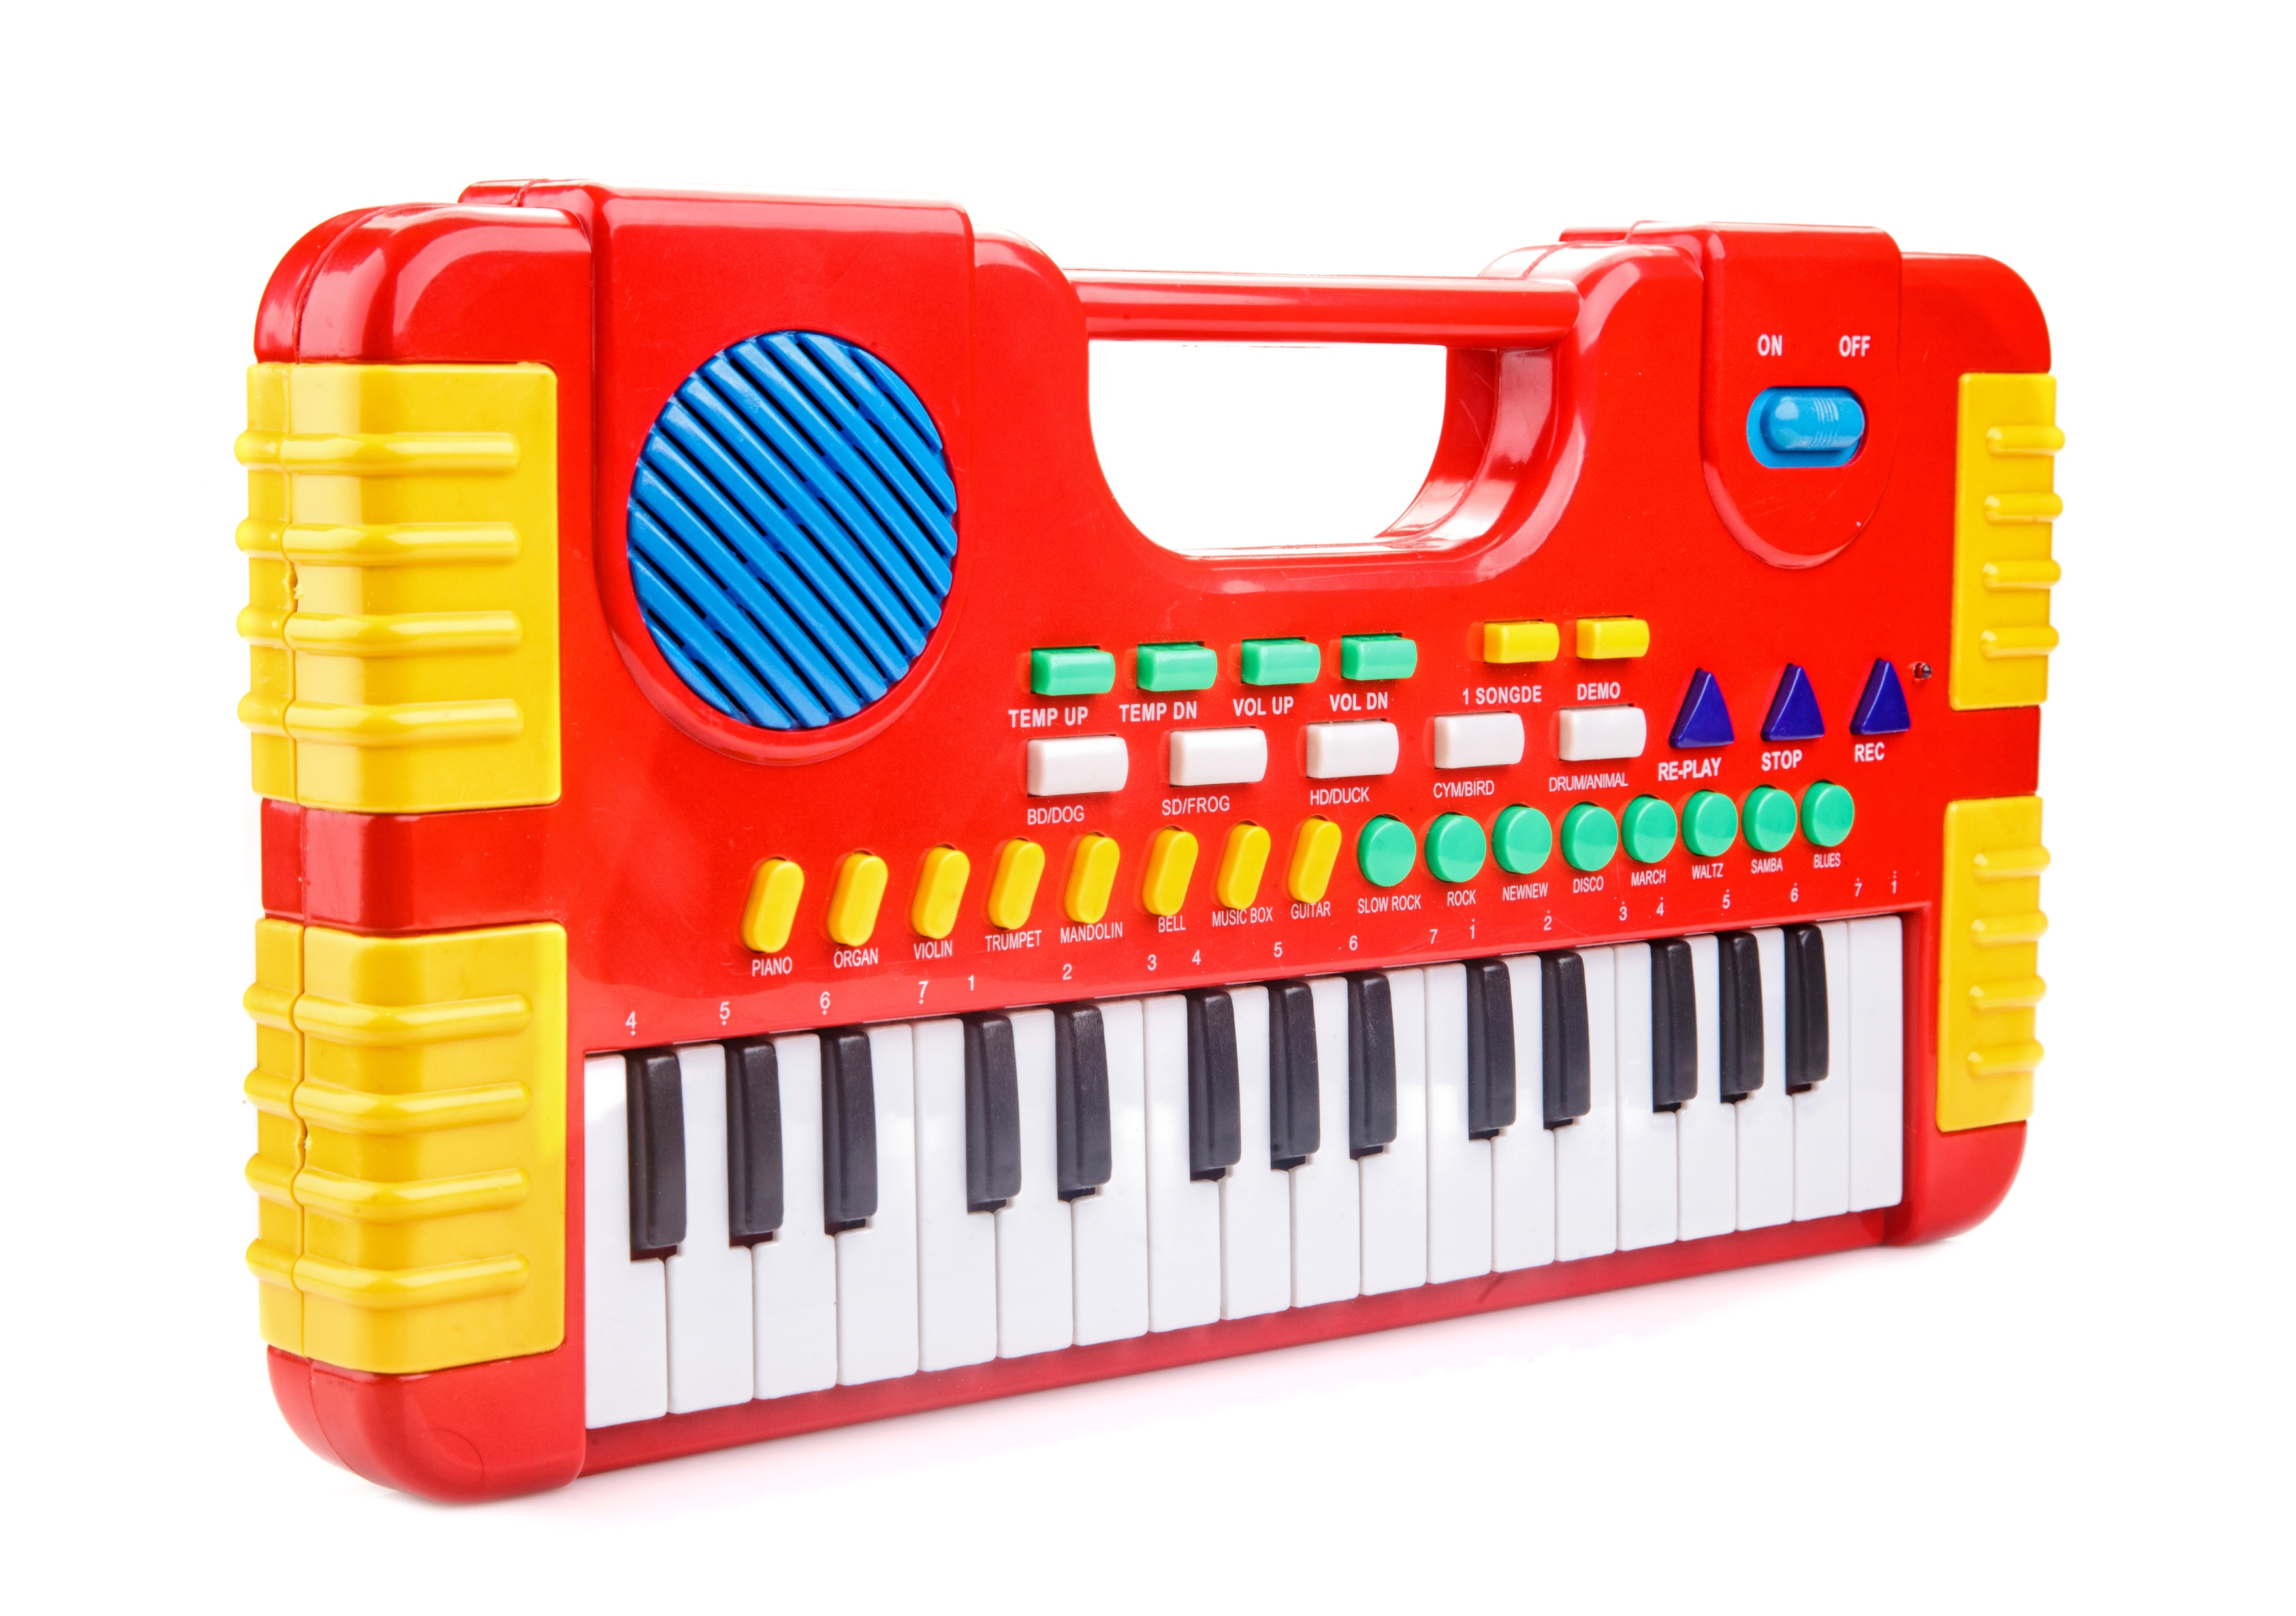
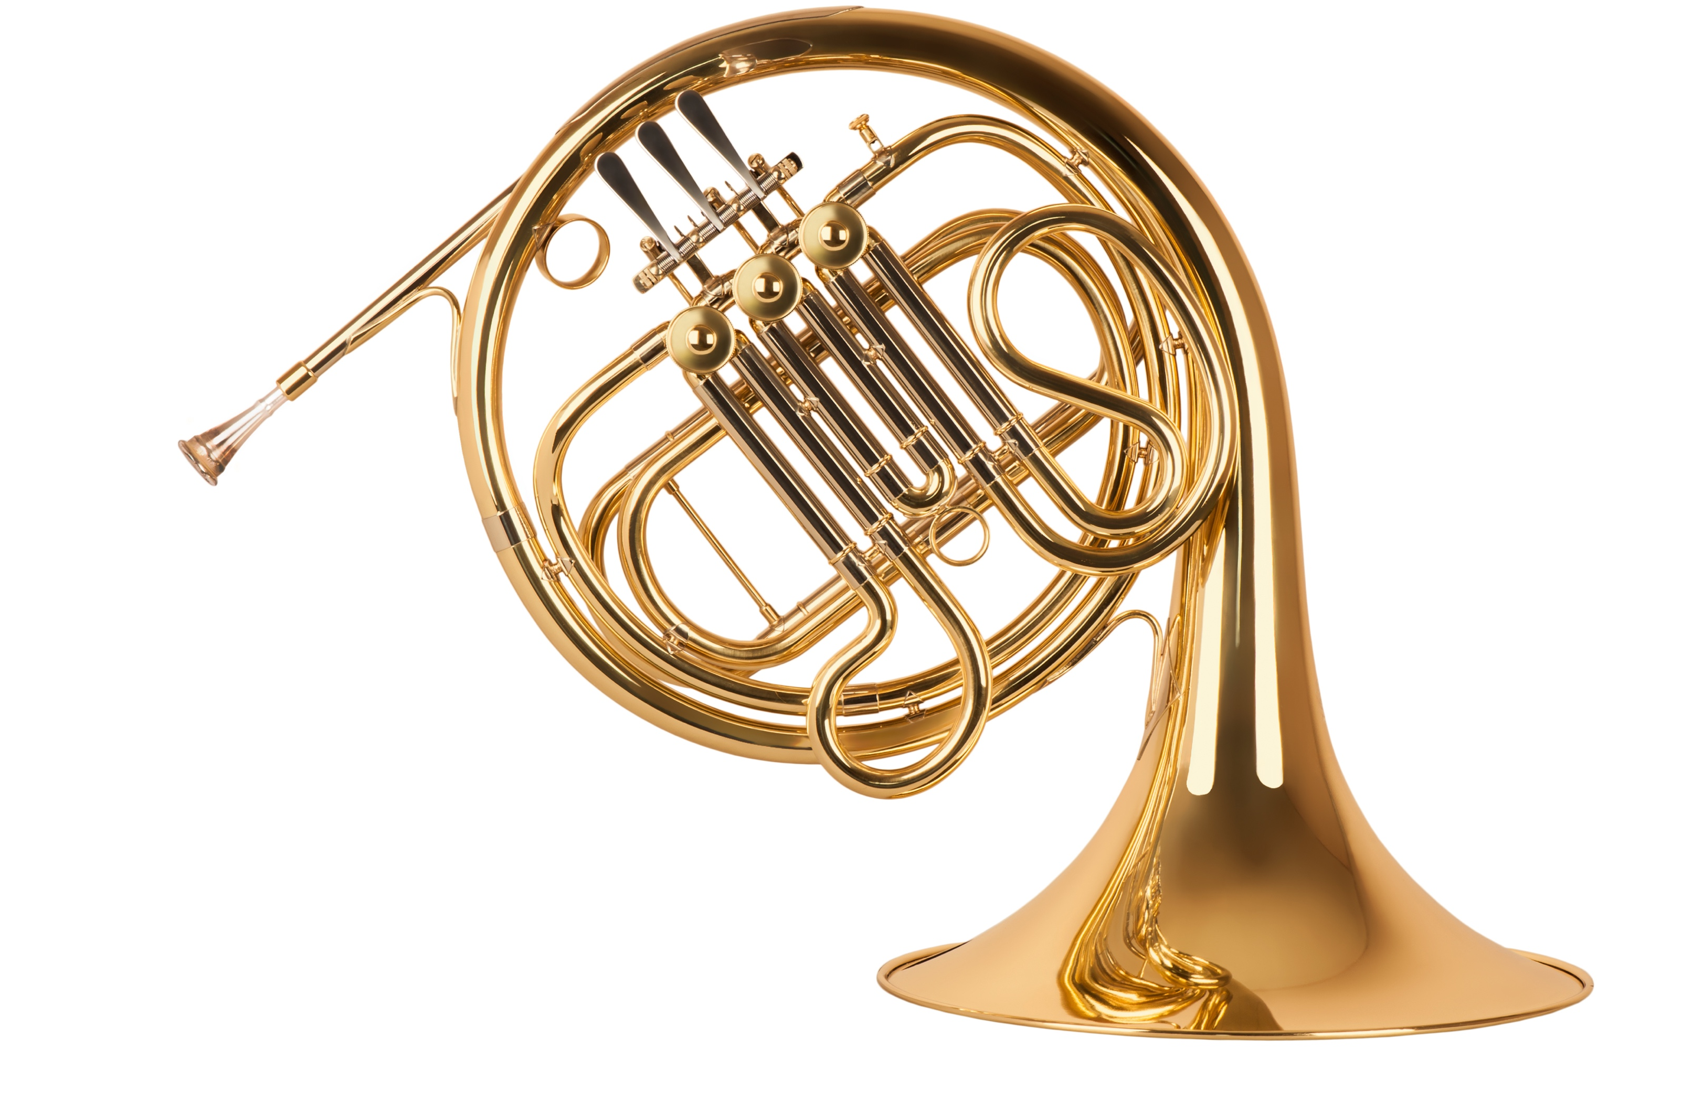
Guided Practice: Wind Family
Let’s look at these pictures of instruments that are all part of the wind family. They are each from a different musical tradition.
We will match the instrument to the name of the material it is made from.
Shell
Metal (brass)
Wood
Plastic
Theory

Slide 11
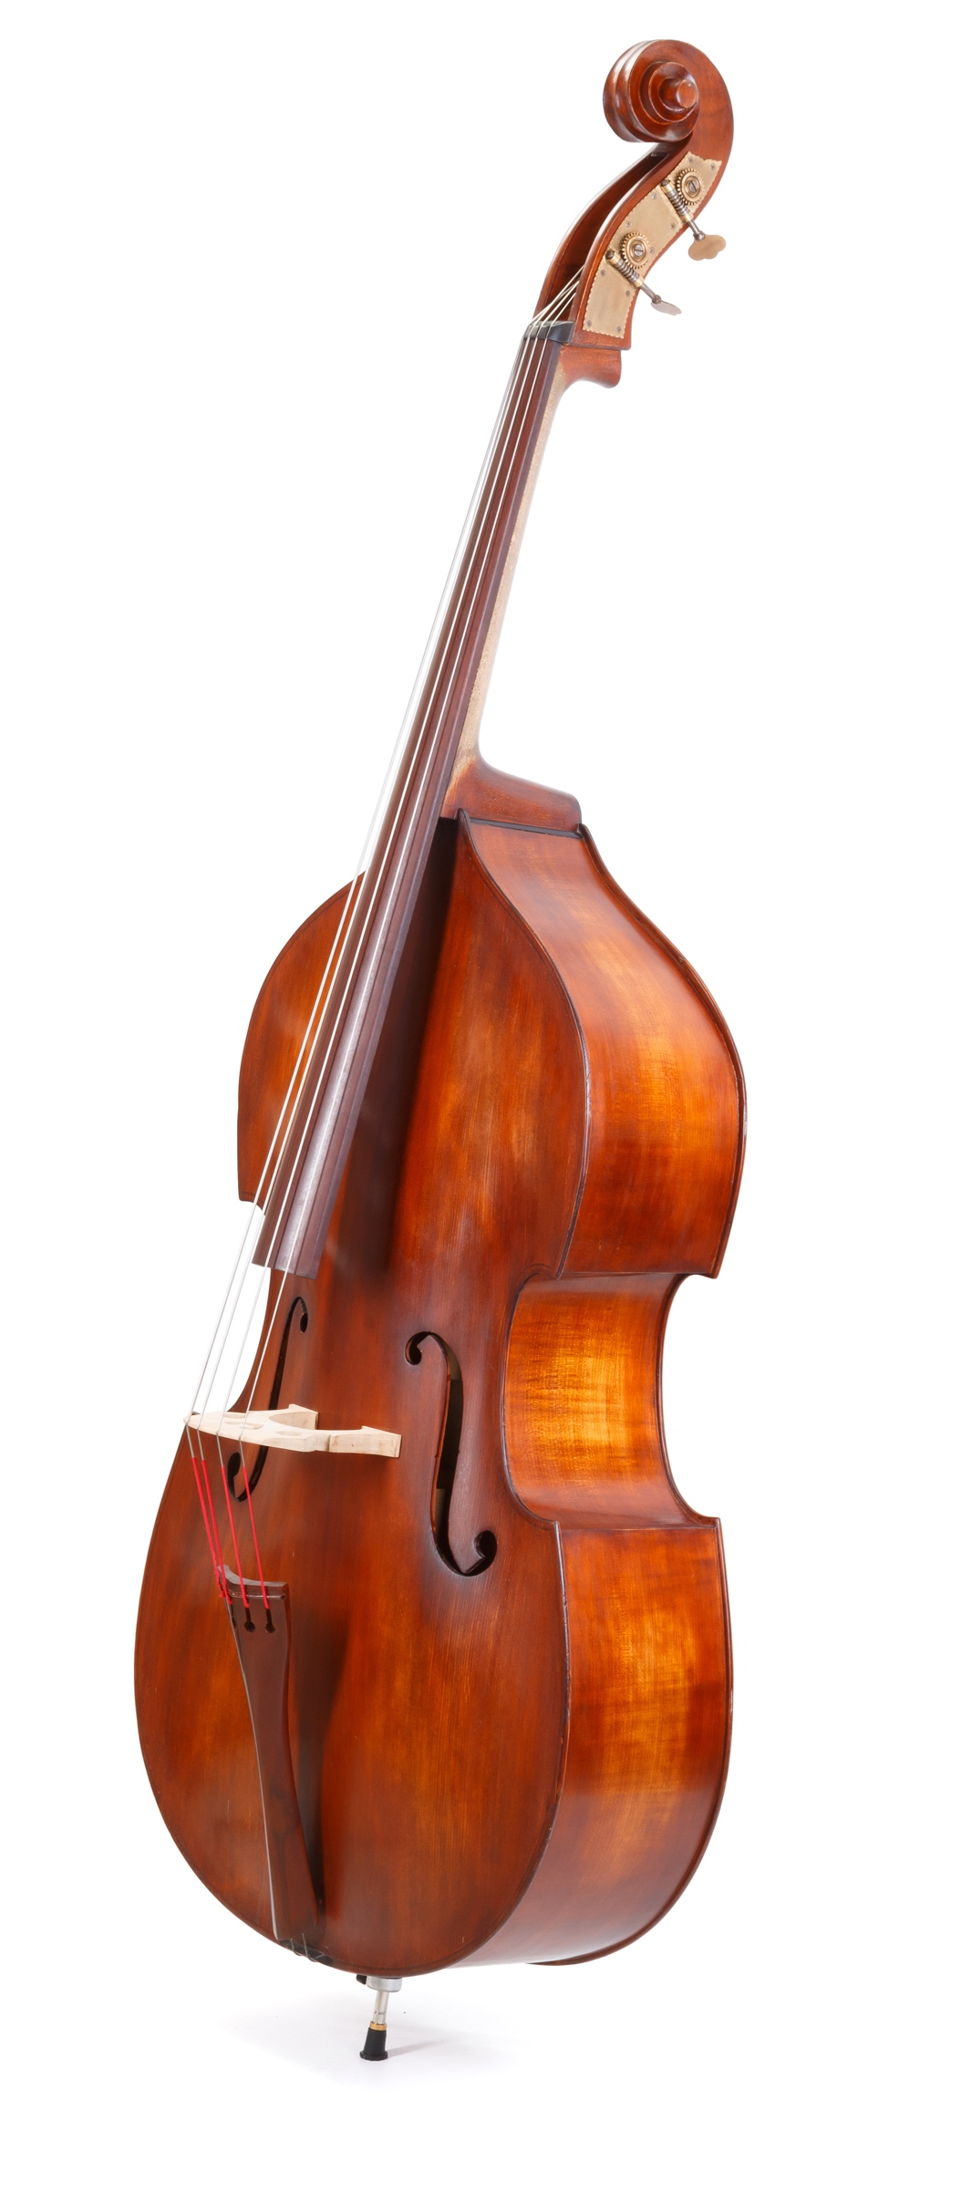
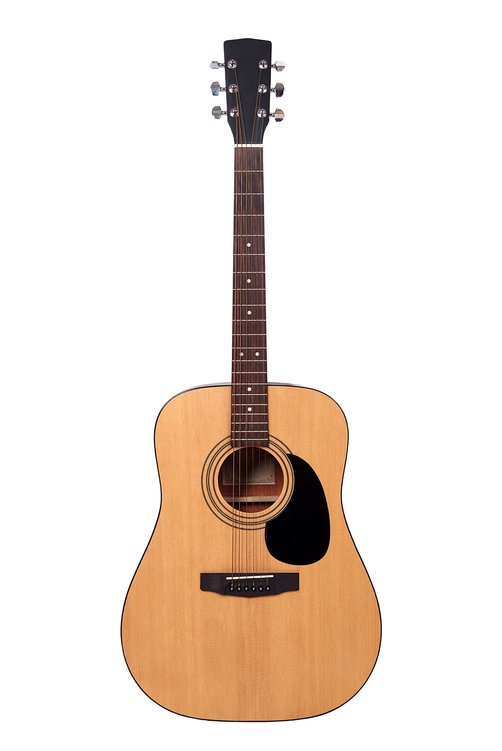
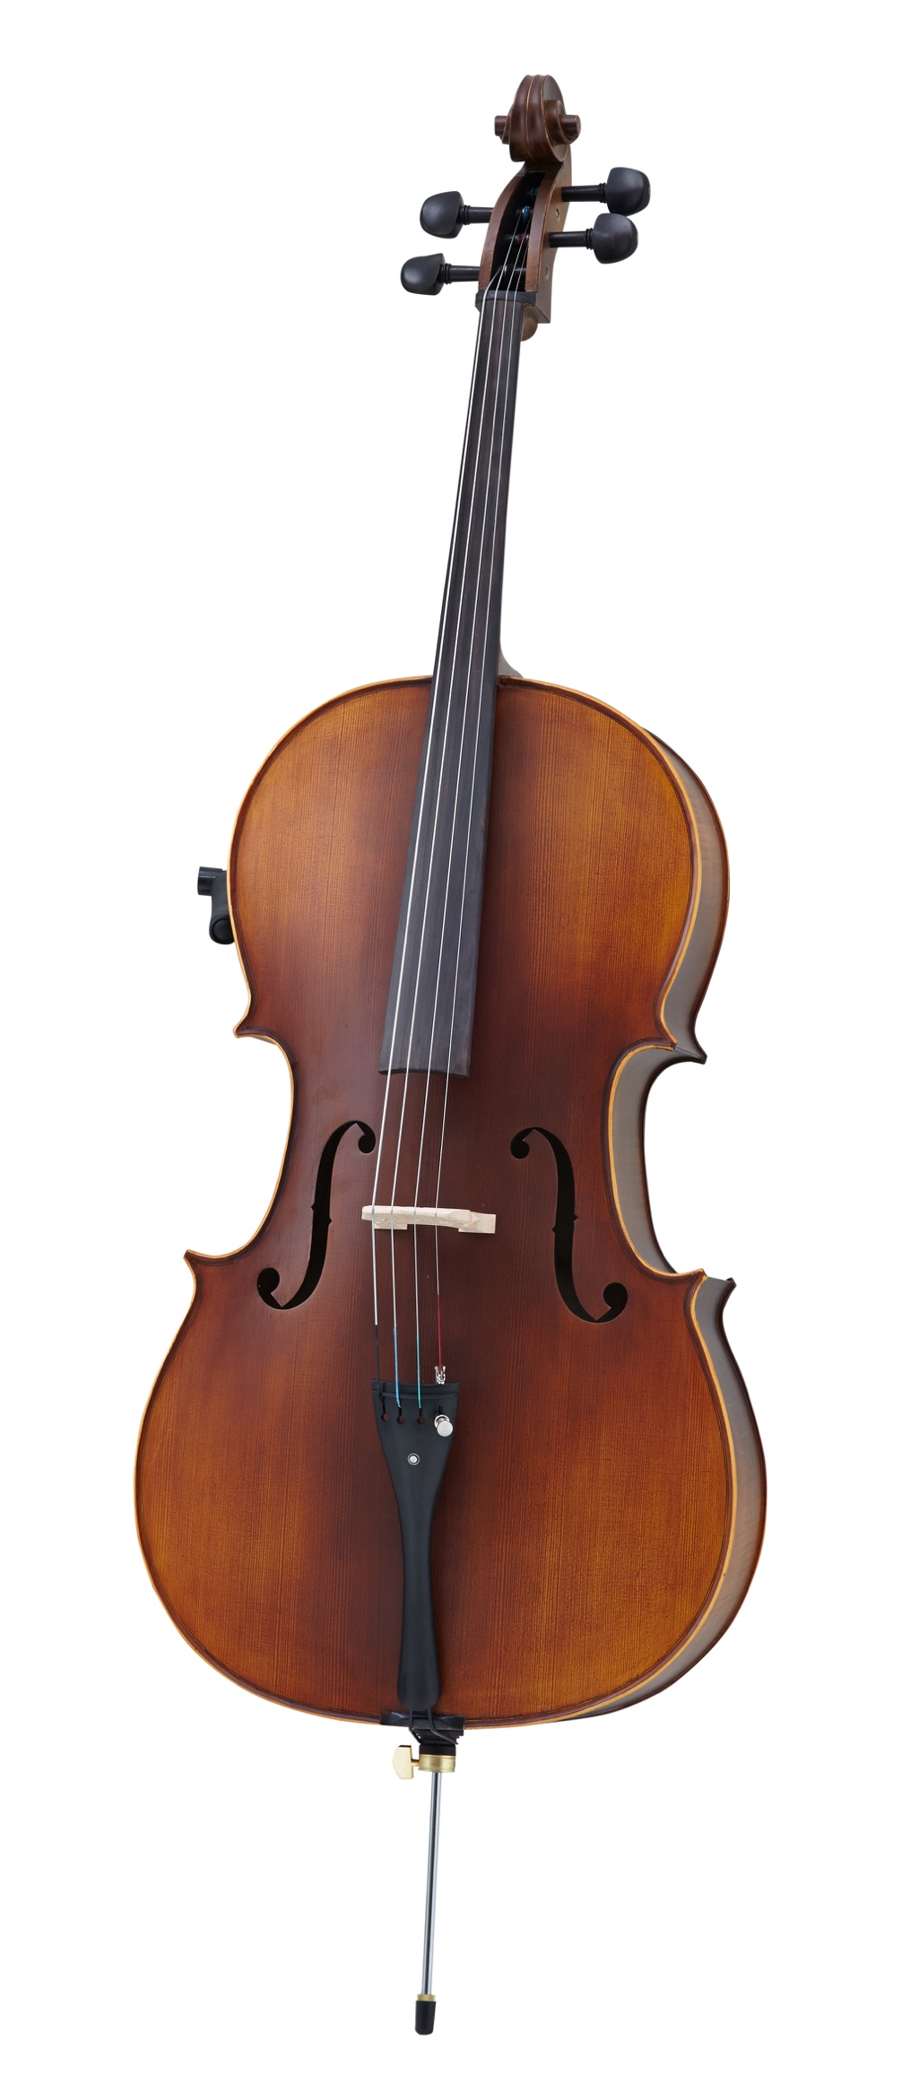
Concept Development: String Family
String instruments make a sound when their strings are plucked, strummed or bowed. The vibrations of the strings on the instrument make the sound.
Here are some instruments that belong to the string family.
Violin Double Bass Cello Acoustic Guitar
Theory

Slide 12
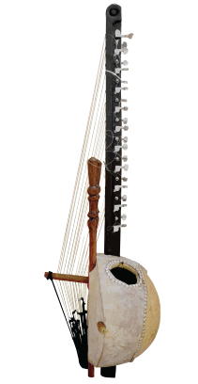
Guided Practice: String Family
Have a look at these instruments.
Let’s work out which belong to the string family.
Insert instrument picture - GUITAR
Theory

Slide 13
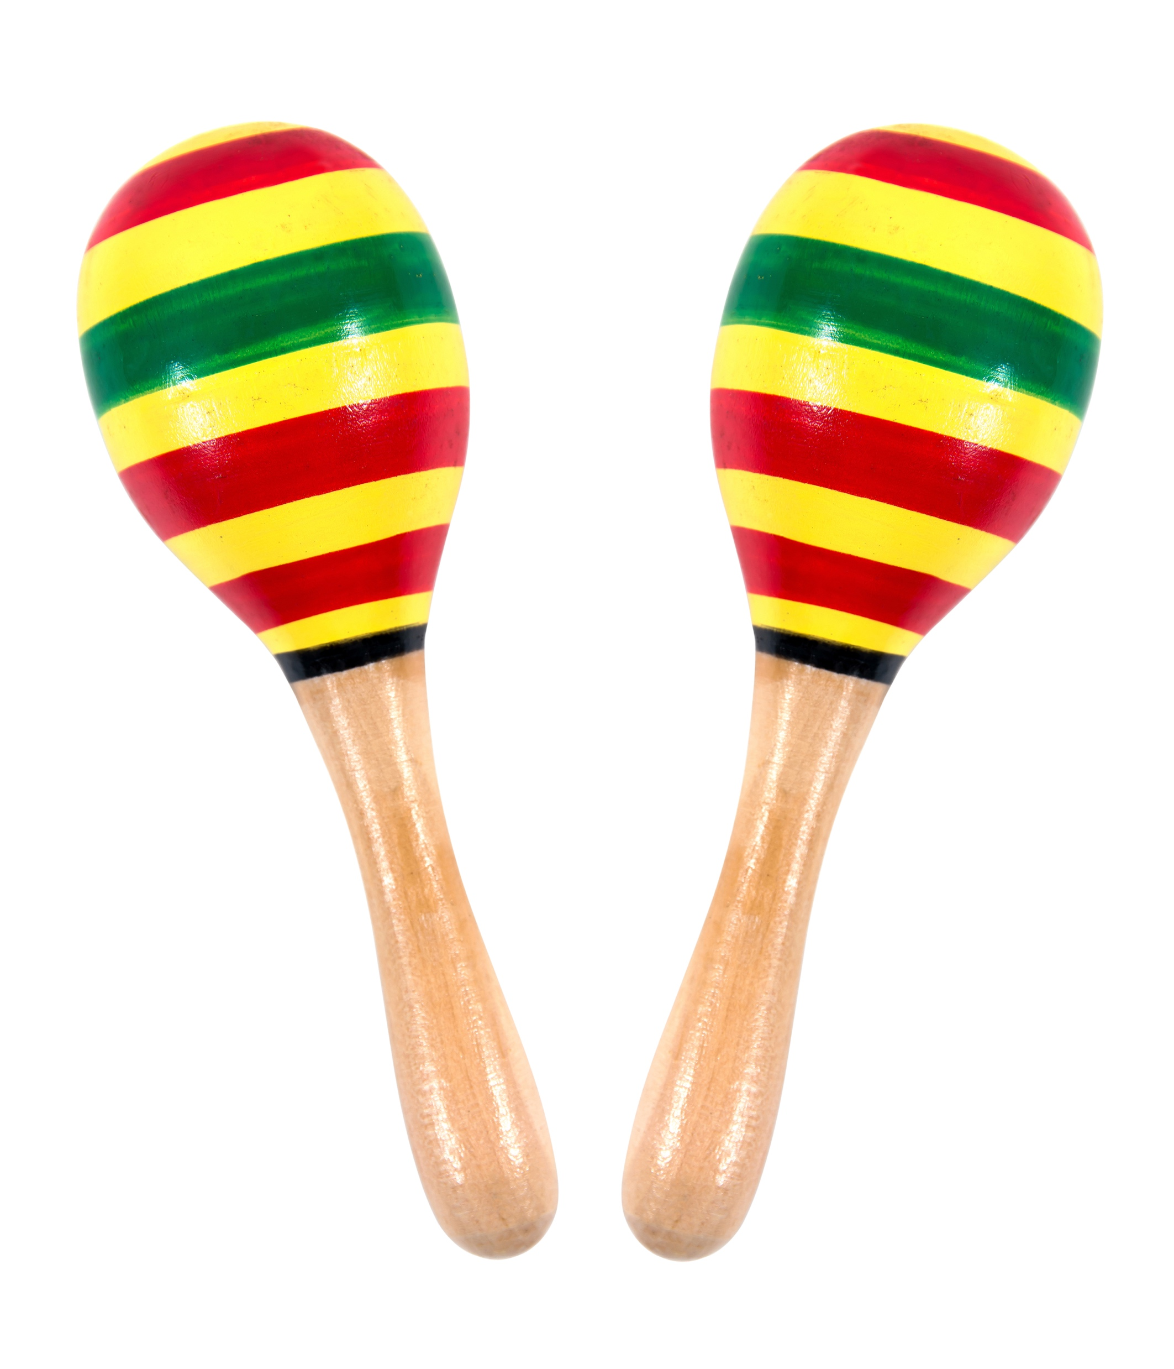
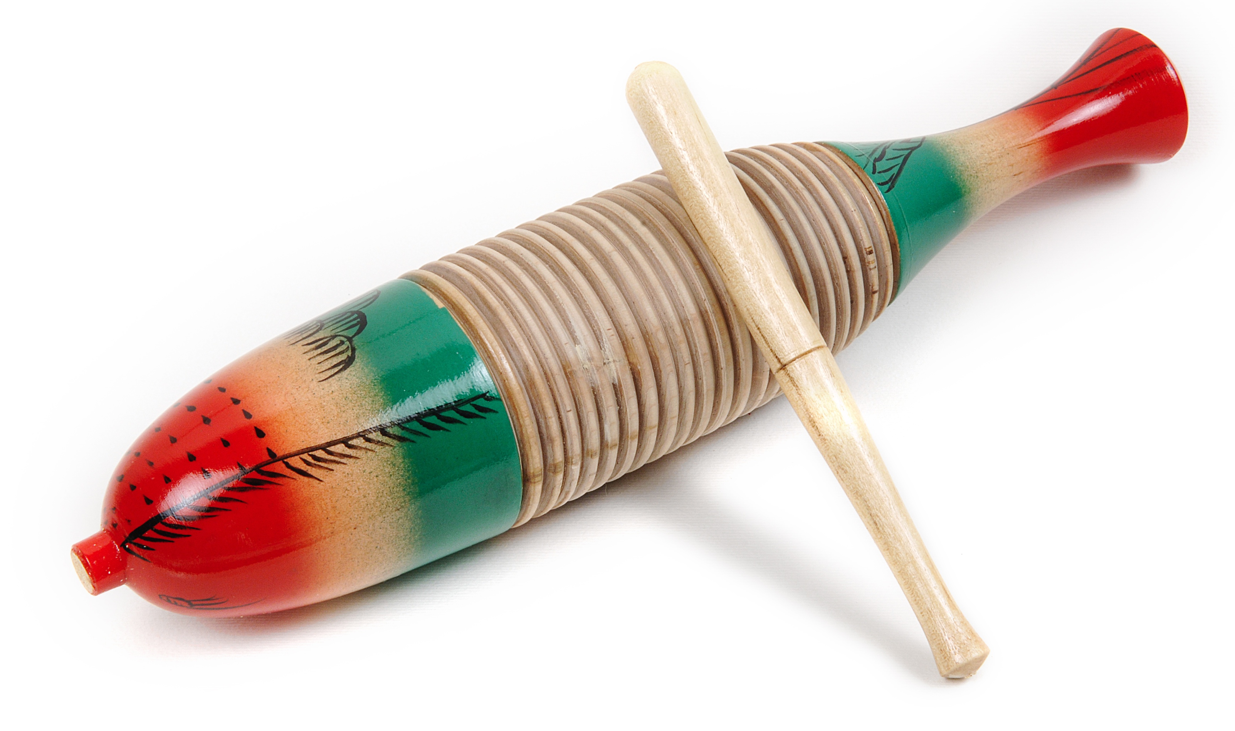
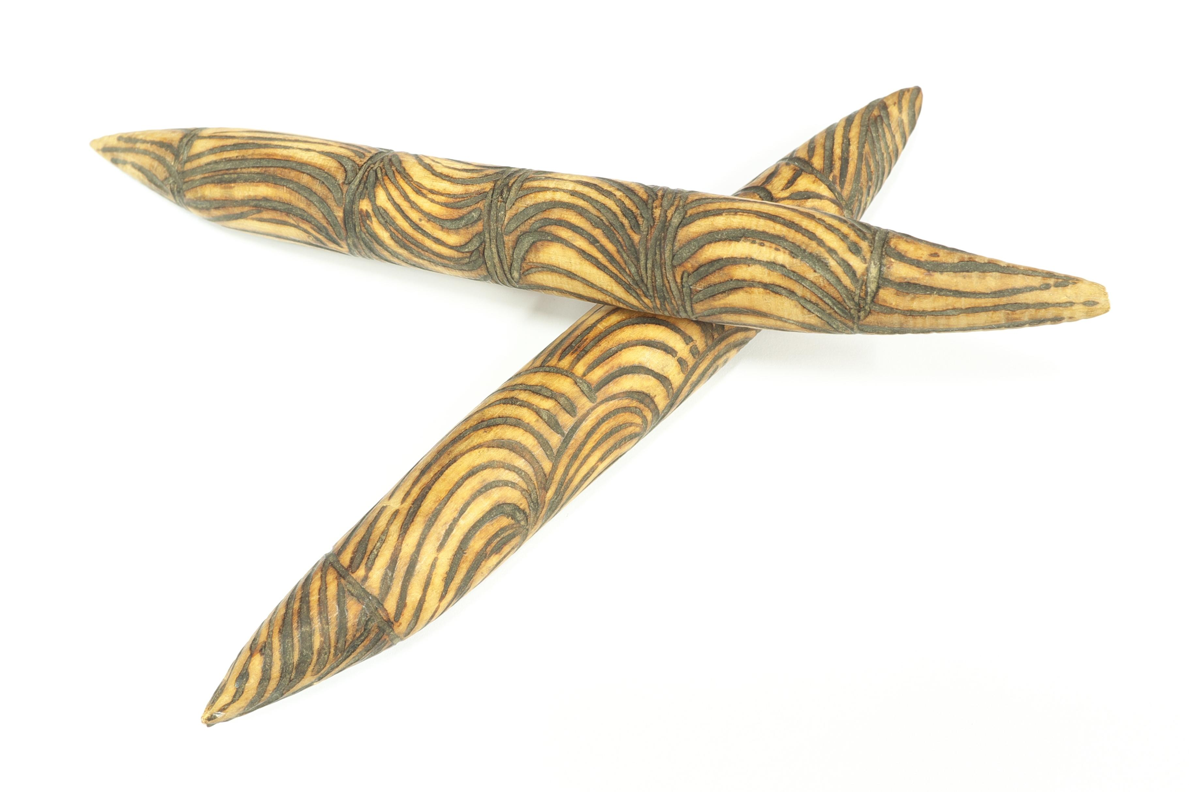
Concept Development: Percussion Family
Percussion instruments make a sound when they are hit, shaken, scratched or rubbed.
Here are some instruments that belong to the percussion family.
They are each from different musical traditions.
Theory

Slide 14
Guided Practice: Percussion Family
Percussion instruments make a sound when they are hit, shaken, scratched or rubbed.
Let’s look at these pictures and work out how the sound might be made – we will match up the words with the pictures
Scratched
Hit with sticks
Hit together
Shaken
Theory

Slide 15
Concept Development: Elements of Music
The elements of music are what we use to create music and describe music.
Three of the main elements of music are:
Dynamics
Tempo
Timbre
Theory

Slide 16
Concept Development: Dynamics
Dynamics describe the volume of music.
We use dynamics to describe how soft or loud music is.
Here are some words we use to describe dynamics in music:
Soft
Loud
Getting softer
Getting louder
Piano
Forte
Fortissimo
Pianissimo
Theory

Slide 17
Checking for Understanding: Dynamics
Listen to the song clips.
Choose one of the words in the box to describe the sound of each piece of music and write your answer on your whiteboard.
Soft
Loud
Getting softer
Getting louder
Piano
Forte
Fortissimo
Pianissimo
Question 1
Question 2
Question 3
Theory

Slide 18
Concept Development: Timbre
Timbre is the tone or sound quality that is made by different instruments.
Using words about timbre lets us describe a song and how it sounds.
Tone
Wind
Voices
Instrumental
Strings
Percussion
Instruments
Bright
Dark
Theory

Slide 19
Checking for Understanding: Timbre
Listen to the song clips.
What is the timbre of each?
Choose one of the words in the box to describe the sound of each piece of music and write your answer on your whiteboard.
Tone
Wind
Voices
Instrumental
Strings
Percussion
Instruments
Bright
Dark
Question 1
Question 2
Question 3
Theory

Slide 20
Concept Development: Tempo
Tempo is how fast or slow music is. It is the speed of the music.
Speed
Quick
Fast
Faster
Getting slower
Slow
Slower
Tempo
Getting slower
Theory

Slide 21
Checking for Understanding: Tempo
Listen to the song clips.
What is the tempo of each?
Choose A or B and write your answer on your whiteboard.
Question 1
Question 2
Question 3
A B
slow fast
A B
slow fast
A B
slow fast
Theory

Slide 22
Student Worksheet
Complete your worksheet about music musical instruments and the elements of music.

Slide 23
Reflect and Connect
In this lesson, we learnt:
every culture in the world has its own music tradition
every musical tradition has its own instruments, styles and dances
that different musical traditions use the elements of music differently.
Theory
Notes:
Insert your name.

Slide 24
Reflect and Connect
In the next lesson, we will learn about music from the Pacific region.
Theory

