Slide 1
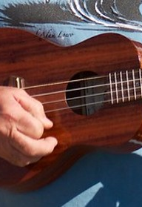
The Arts
Music for Learning
Lesson 2: Week 1
Unit 3: Music in the World - Instruments of the World
Version 1

Slide 2
Performance

Slide 3

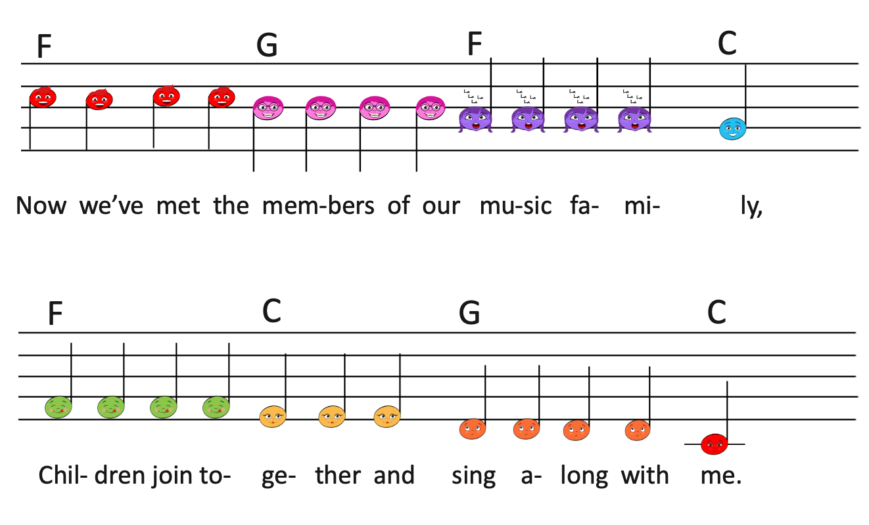
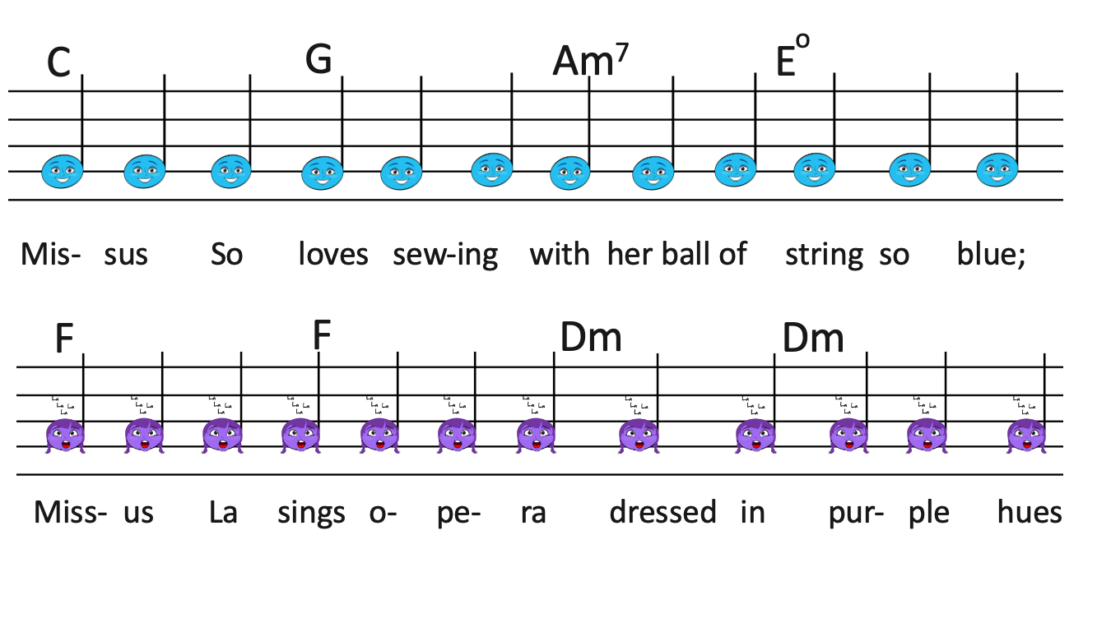
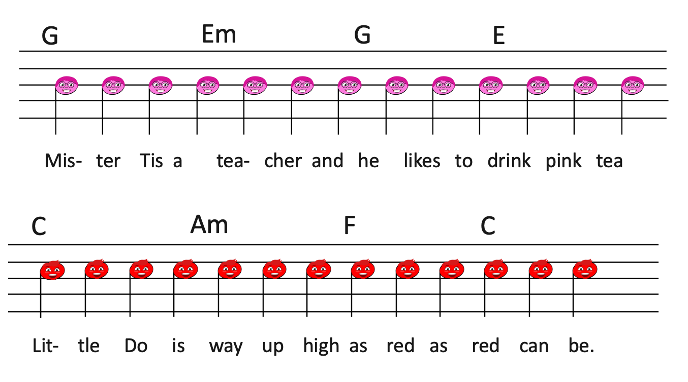
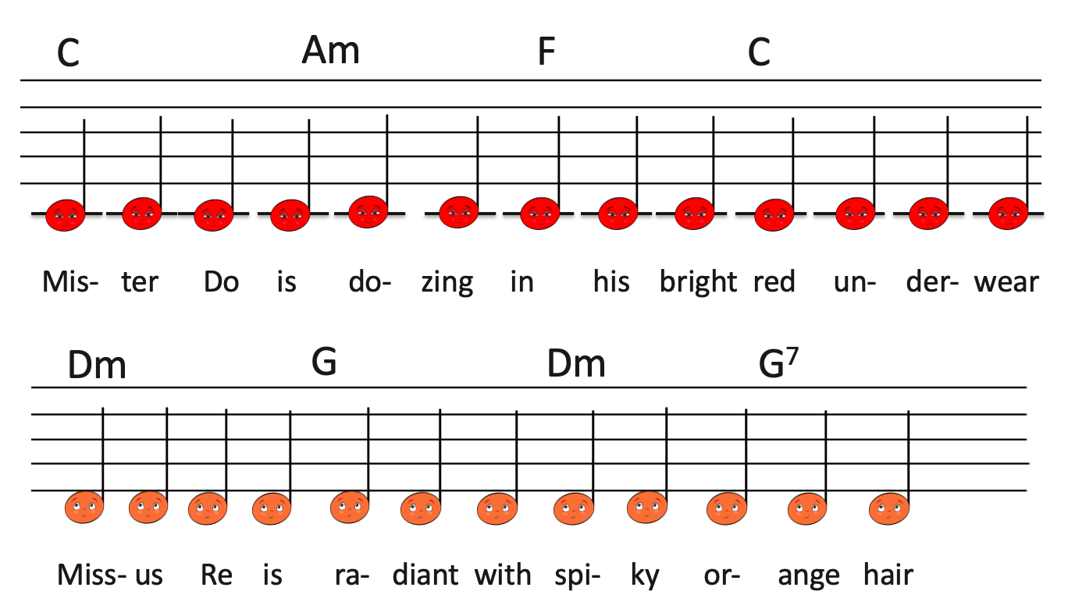
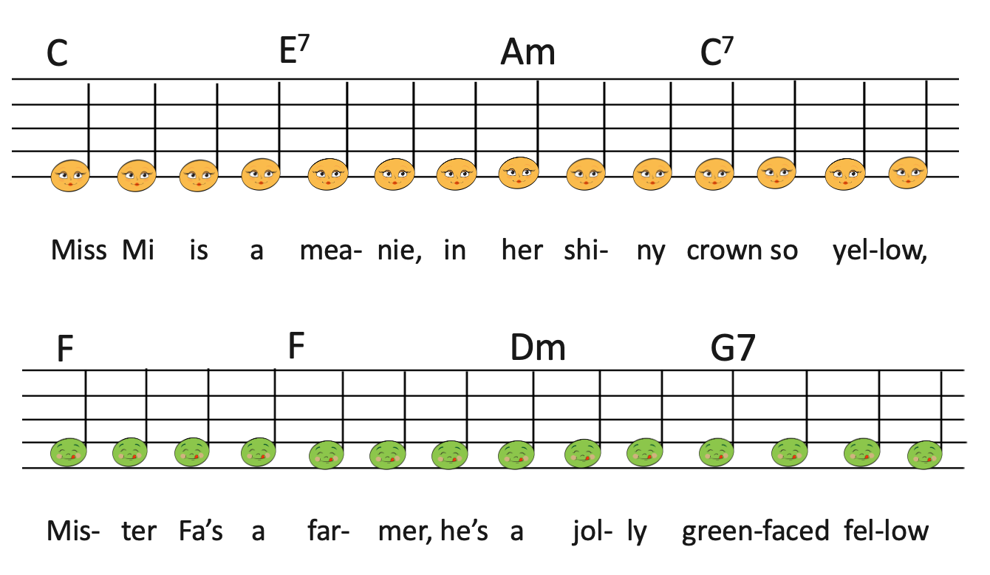
We Sing: Warm-Up Song
Practical

Slide 4
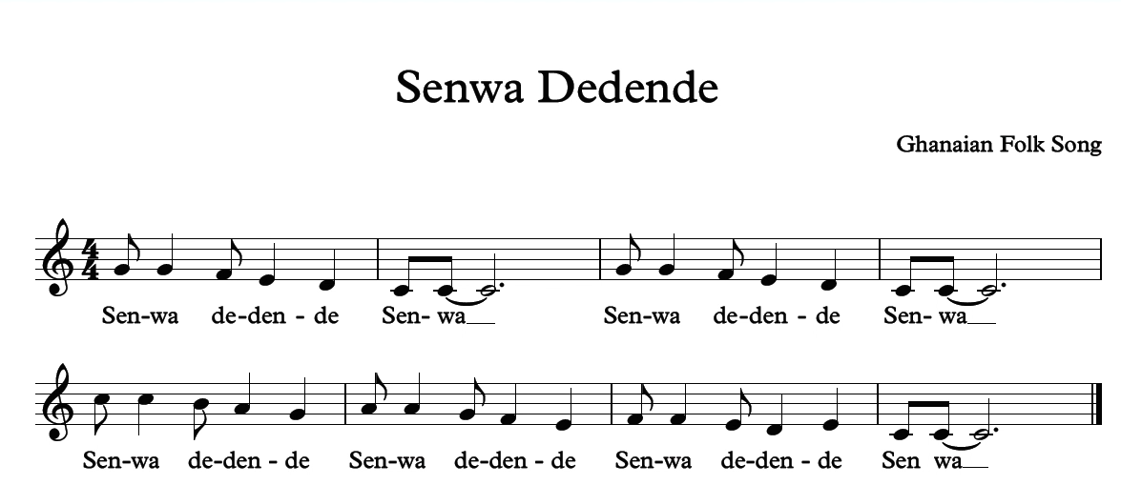
Concept Development: Senwa Dedende
‘Senwa Dedende’ is a children’s song from Ghana, in Africa.
The song is about a mother calling her child home for dinner.
Practical

Slide 5
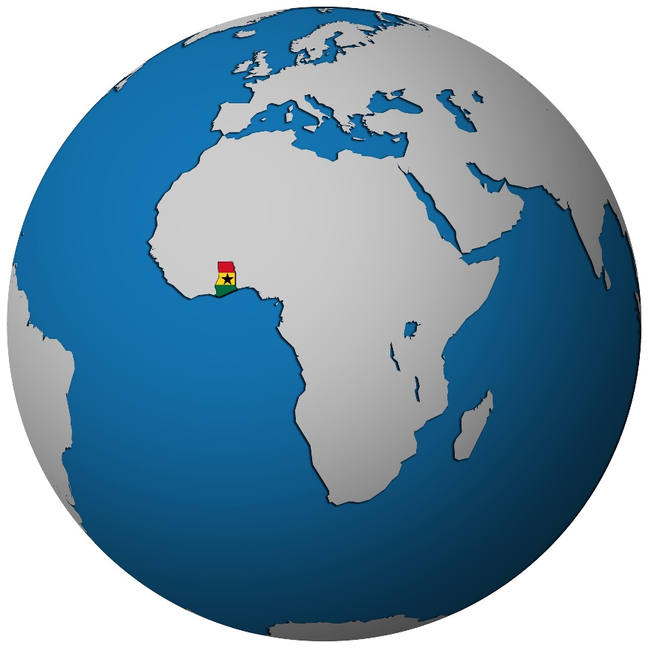
Concept Development: Ghana, Africa
Senwa Dedende is from Ghana. Ghana is a country in West Africa.
Practical

Slide 6


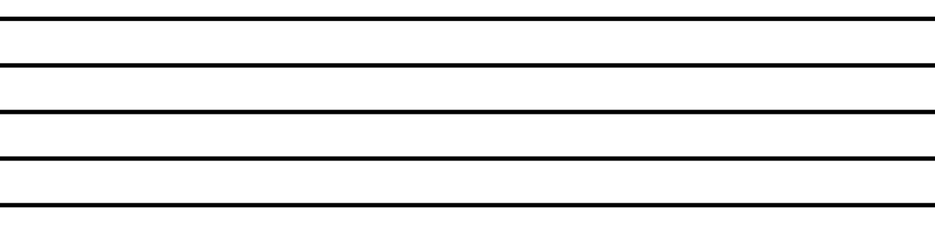
We Sing: First Note So
Practical

Slide 7







I Sing: Senwa Dedende Senwa
Sen- wa de- den- de sen- wa.
Practical

Slide 8
We Sing: Senwa Dedende Senwa
Sen- wa de- den- de sen- wa.
Practical

Slide 9
I Sing: First Two Lines
Sen- wa de- den- de sen- wa.
Sen- wa de- den- de sen- wa.
Practical

Slide 10
We Sing: First Two Lines
Sen- wa de- den- de sen- wa.
Sen- wa de- den- de sen- wa.
Practical

Slide 11


We Sing: First Note Little Do
Practical

Slide 12



I Sing: Senwa Dedende
Sen- wa de- den- de.
Practical

Slide 13
We Sing: Senwa Dedende
Sen- wa de- den- de
Practical

Slide 14
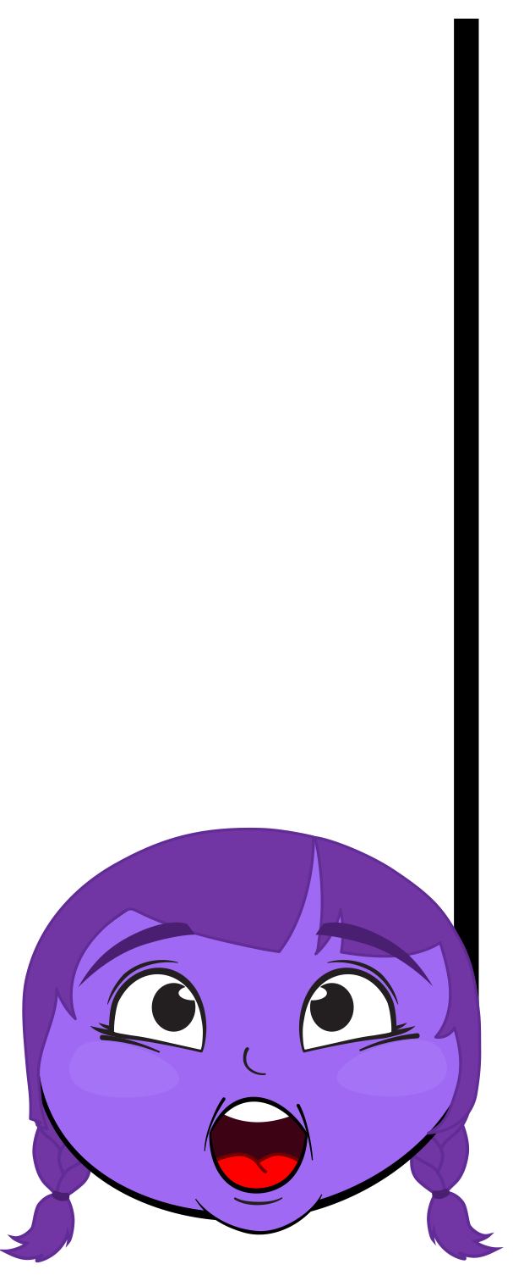
We Sing: First Note La
Practical

Slide 15
I Sing: Senwa Dedende
Sen- wa de- den- de
Practical

Slide 16
We Sing: Senwa Dedende
Sen- wa de- den- de
Practical

Slide 17

We Sing: First Note Fa
Practical

Slide 18
I Sing: Senwa Dedende Senwa
Sen- wa de- den- de sen- wa
Practical

Slide 19
We Sing: Whole Song
Sen- wa de- den- de sen- wa
Practical

Slide 20
We Sing: Whole Song
Sen- wa de- den- de sen- wa
Sen- wa de- den- de sen- wa
Practical

Slide 21
We Sing: Whole Song
Sen- wa de- den- de
Sen- wa de- den- de
Practical

Slide 22
We Sing: Whole Song
Sen- wa de- den- de
Sen- wa de- den- de
Practical

Slide 23
We Sing: Whole Song
Sen- wa de- den- de sen- wa
Practical

Slide 24
Concept Development: The Ukulele
The ukulele looks like a small guitar. It is made up of a body, a short neck, four strings, a fretboard, a sound hole, a bridge and four tuning keys. The body of the ukulele is usually made of wood. Ukuleles made from different types of wood sound different.
There are three different types of ukuleles: the baritone ukulele, the tenor ukulele and the soprano ukulele.
The baritone is the biggest ukulele, it has the deepest sound.
The soprano is the smallest ukulele, it has the highest sound.
The tenor ukulele is in between the baritone and soprano in its size and pitch.
Practical

Slide 25
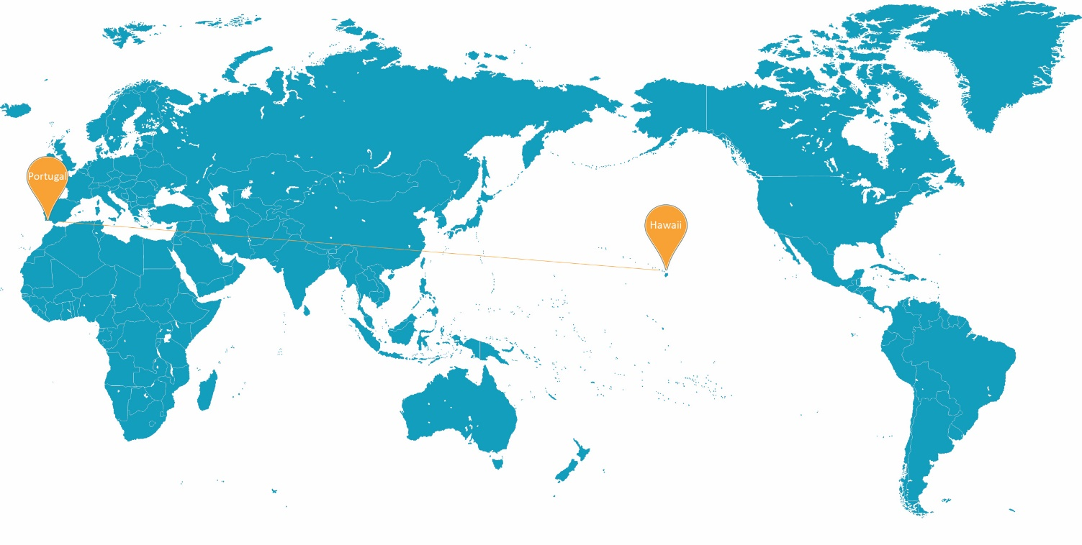
Concept Development: The Ukulele Origins
The ukulele originated in the country of Portugal in Europe, where it was called a ‘machete’.
It became famous around the world after it was taken by the Portuguese to the Polynesian island of Hawai’i.
The word ‘ukulele’ means ‘jumping flea’ in the local language. Perhaps because when you play it your fingers jump around like fleas.
Practical

Slide 26
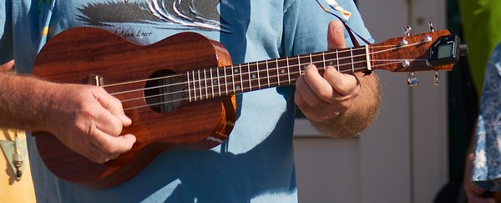
Concept Development: The Ukulele Parts
Neck
Sound hole
Nut
Headstock
Bridge
Body
Strings (4)
Frets
Tuners (4)
Practical

Slide 27
Concept Development: Ukulele Chords
The ukulele is a very popular instrument because it has only four strings and is easy to carry around.
Most people play chords on the ukulele – meaning they strum the strings together at the same time, to create harmonies to sing over.
There are many chords, but you can play lots of songs if you know three or four.
Practical

Slide 28
Concept Development: Playing Chords
You play ukulele chords by pressing the fingers on your left hand above the ridges, called ‘frets’, and strumming the strings over the sound hole with your right hand.
When you put your fingers on different frets, you make different chords.
We are going to learn 3 chords today – C Major, F Major and G Major.
Practical

Slide 29
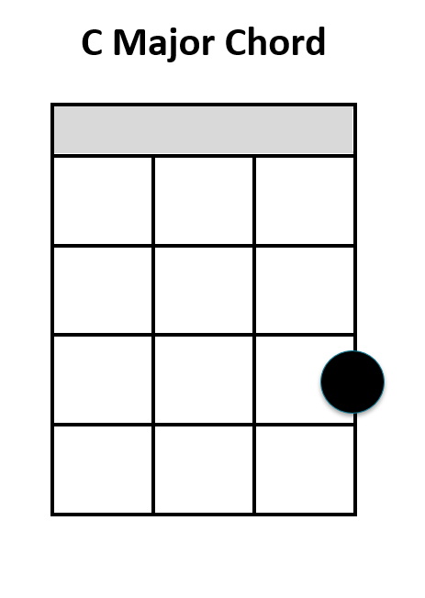
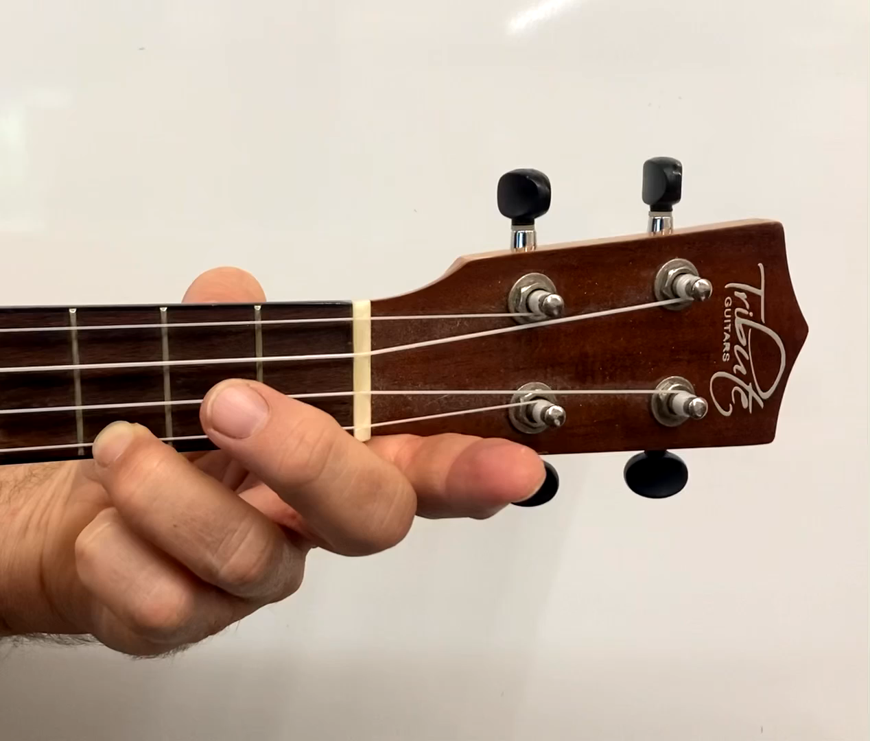
I Play: Ukulele C Chord
To play C Major, put your ring finger on the third fret of the top string.
I will do this first.
Top string
Ring finger
Third fret
Practical

Slide 30
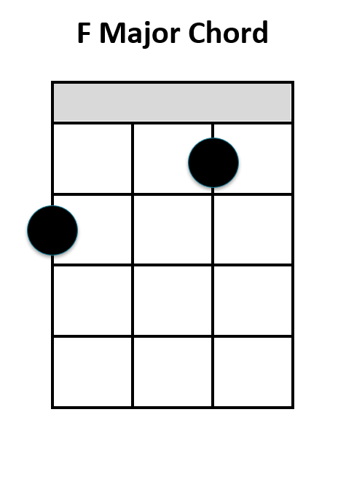
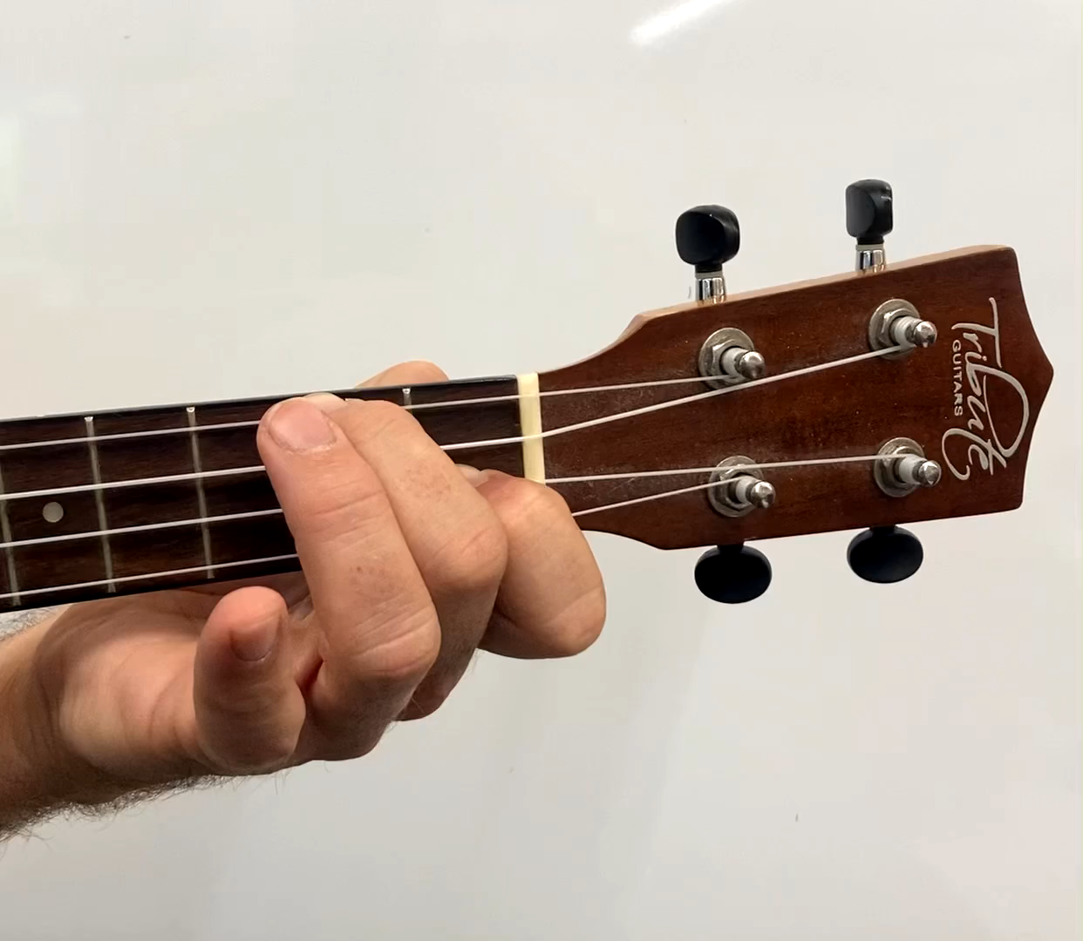
I Play: Ukulele F Chord
To play F Major, you put your middle finger on the second fret of the bottom string and your pointer finger on the first fret of the third string.
I will do this first.
Practical

Slide 31
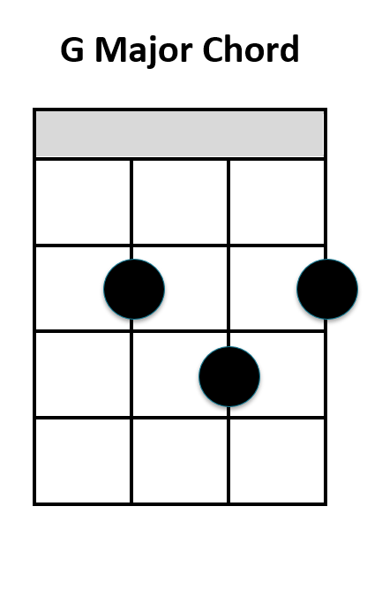
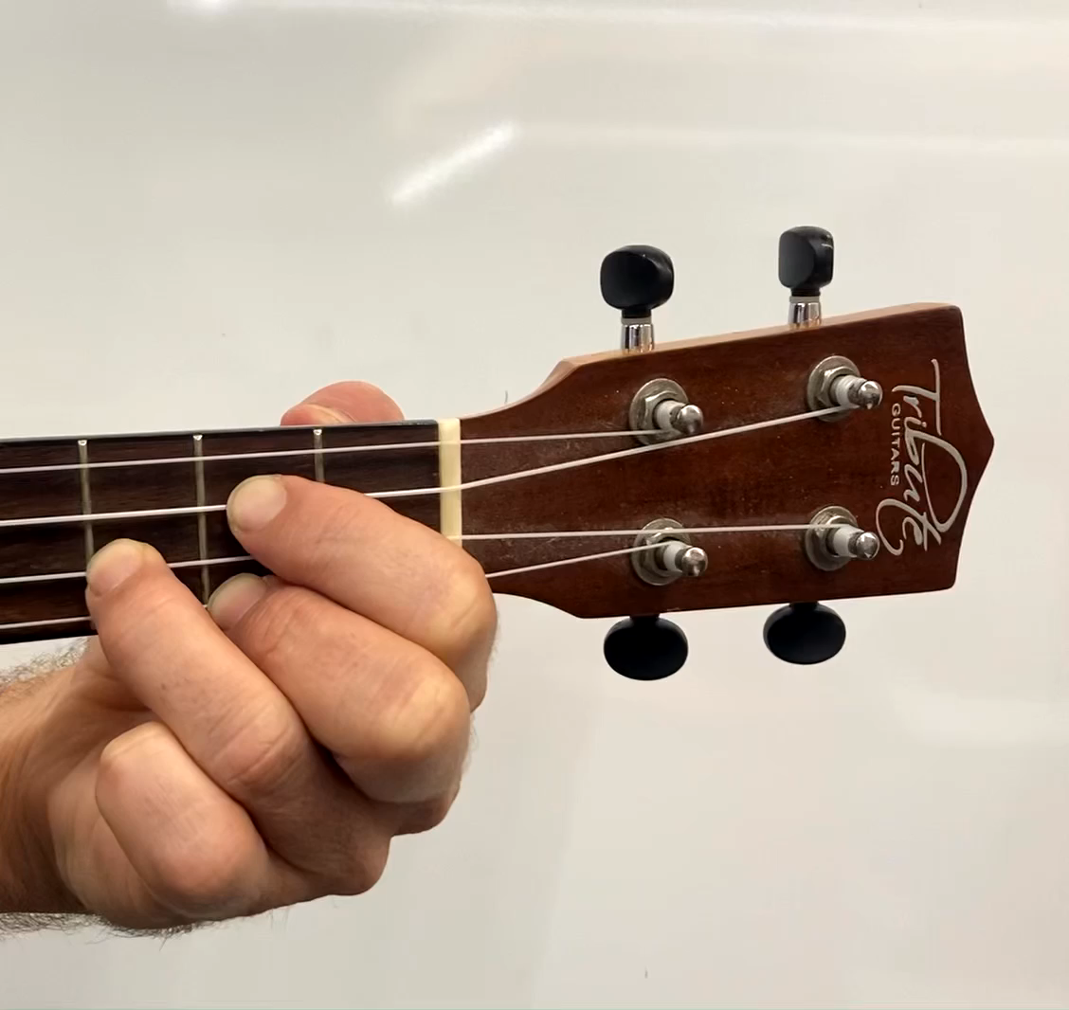
I Play: Ukulele G Chord
To play G Major, you put your pointer finger on the second fret of the second string, your middle finger on the third fret of the third string and your ring finger on the second fret of the top string.
I will do this first.
Practical

Slide 32
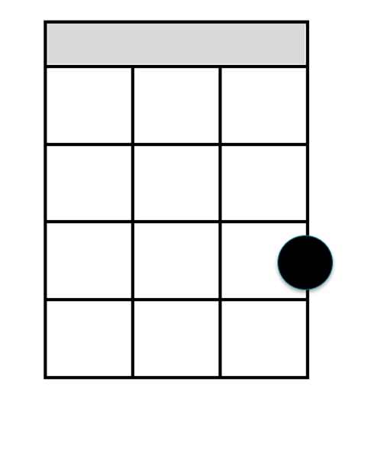

Checking for Understanding: Chords
Watch the video of each chord being played. Match the video and the names with the diagrams.
C
G
F
Practical

Slide 33
Reflect and Connect
In this lesson, we:
learnt the song ‘Senwa Dedende’
practiced our singing of ‘Senwa Dedende’
learnt about the ukulele
learnt how to play three chords on the ukulele.
How well are you able to:
sing the right notes
identify each different ukulele chord.
Practical
Notes:
Insert your name.

Slide 34
Reflect and Connect
In the next lesson, we will:
get better at singing ‘Senwa Dedende’
learn how to play two ukulele chords – one after the other
Practical

