Slide 1
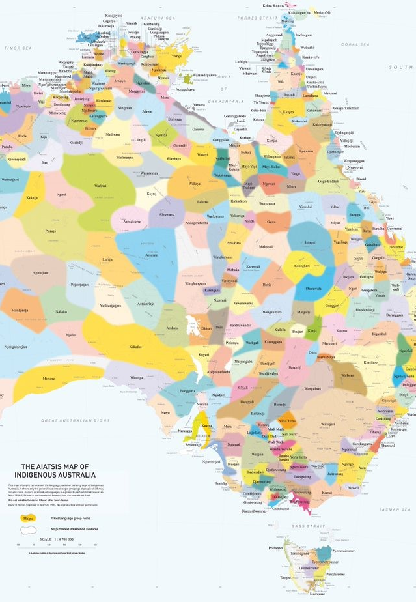
The Arts
Lesson 1: Week 1
Unit 3: Music in the World - Indigenous Australian Musicians
Version 2

Slide 2
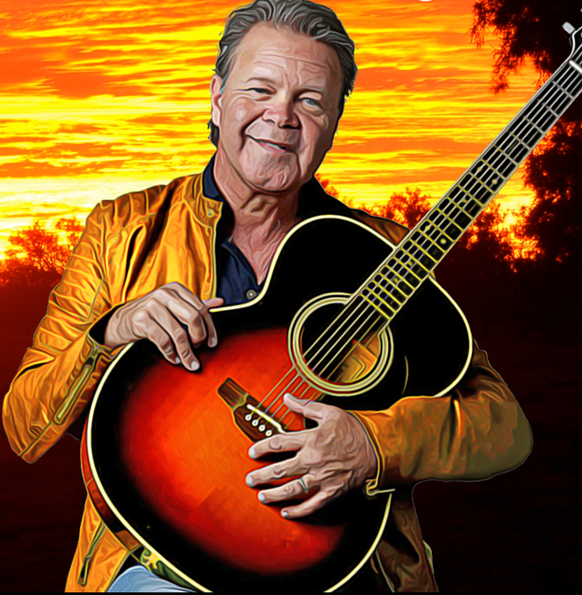
Contemporary Indigenous Music and Artists

Slide 3
Learning Objective
In this lesson, we will learn about contemporary Indigenous music and Indigenous music artists.
Success Criteria
You will be successful when you can place some Indigenous music artists on a timeline.
Theory

Slide 4
Concept Development: Indigenous Music
Contemporary Indigenous music has a diverse range of musical styles and genres.
A number of Indigenous Australians have achieved mainstream success in the music industry, such as Jimmy Little, Yothu Yindi, Troy Cassar-Daley, Christine Anu, Jessica Mauboy, and the Warumpi Band.
The genres and styles of these musicians range through pop, rock, country, R&B and alternative music.
Theory

Slide 5
Concept Development: Archie Roach
Archie Roach was born on 8 January 1956.
He is a singer, songwriter, guitarist and a campaigner for the rights of Indigenous Australians.
Archie became well known for his song ‘Took the Children Away’ from his solo album Charcoal Lane in 1990.
Archie still provides vocals for soundtracks for artists, albums, bands and films.
Theory

Slide 6

Concept Development: Archie Roach
Australia/Gunditjmara/Bundjalung
Gunditjmara
Bundjalung
Theory

Slide 7
Concept Development: Yothu Yindi
Yothu Yindi is an Australian music group with Aboriginal and non-Aboriginal band members.
Yothu Yindi collaborated with Paul Kelly and Peter Garrett on the song ‘Treaty’.
Yothu Yindi varies between two musical styles: traditional and commercial.
Yothu Yindi music combines aspects of Aboriginal Australian music with pop rock.
The band often blend typical instruments associated with pop/rock bands, such as guitars and drums, with the traditional instruments yidaki (didgeridoo) and bilma (clapping sticks).
Theory

Slide 8
Concept Development: Yothu Yindi
Australia/Yolngu
Theory

Slide 9
Concept Development: Troy Cassar-Daley
Troy Cassar-Daley was born on 18 May 1969.
Troy Cassar-Daley is key figure in Australian country music.
He is the winner of forty Golden Guitar Awards, as well as five ARIA awards and nine Deadly awards.
Cassar-Daley plays the guitar and harmonica and sings.
Well known for songs such as ‘Little Things’.
Has also performed duets with iconic performers such as Slim Dusty and Jimmy Barnes.
Theory

Slide 10
Concept Development: Troy Cassar-Daley
Australia/Gumbaynggirr/Bundjalung
Gumbaynggirr
Bundjalung
Theory

Slide 11
Concept Development: Jessica Mauboy
Jessica Mauboy was born on 4 August 1989.
Her music style is mostly a mix of pop, R&B and dance.
Mauboy also incorporates hip-hop, soul and funk into her music style.
Jessica Mauboy’s first studio album was released in 2007 and she was the second highest selling Australian artist of that year.
Mauboy has collaborated with international artists such as Flo Rida, Pitbull, Jay Sean and Snoop Dogg.
Theory

Slide 12
Concept Development: Jessica Mauboy
Australia/Kuku Yalanji
Theory

Slide 13
Concept Development: Christine Anu
Christine Anu was born on 15 March 1970.
Anu’s music style is pop and often draws on her Aboriginal culture in her music’s beat. For example, she incorporates traditional Indigenous rhythms with modern dance beats.
Christine became a popular figure in music after releasing a cover of Warumpi Band’s ‘My Island Home’.
Theory

Slide 14
Concept Development: Christine Anu
Australia/Torres Strait Islands
Theory

Slide 15
Concept Development: Warumpi Band
Warumpi Band was an Australian country, blues rock and Aboriginal rock band.
The band formed in the outback settlement Papunya in 1980 in the Northern Territory.
Warumpi wrote their songs in English, Luritja and Gumatj language.
Theory

Slide 16
Concept Development: Warumpi Band
Australia/Luritja/Yolngu
Yolngu
Luritja
Theory

Slide 17
Concept Development: Baker Boy
Baker boy was born on 10 October 1996.
Baker Boy is an Indigenous Australian rapper, dancer, artist and actor.
His music style is Australian hip-hop and R&B soul.
Baker Boy plays the yidaki and sings.
He is known for performing (singing and rapping) his songs in both English and Yolngu Matha.
Baker Boy was nominated for ARIA awards in 2020 and 2019.
He was named Young Australian of the Year in 2019.
Theory

Slide 18
Concept Development: Baker Boy
Australia/Yolngu
Theory

Slide 19
Concept Development: Jimmy Little
Jimmy Little lived from 1 March 1937 to 2 April 2012.
Jimmy’s music was influenced by US singerNat King Cole and US country music artist Jim Reeves.
Jimmy had a smooth style and voice that earned him the nickname ‘The Honey Voice’.
Jimmy is well known for his rendition of the song ‘Danny Boy’.
Theory

Slide 20
Concept Development: Jimmy Little
Australia/Yorta Yorta
Theory

Slide 21
Concept Development: Gurrumul
Gurrumul lived from 22 January 1971 to 25 July 2017.
Gurrumul played drums, piano keyboard, guitar (a right-hand-strung guitar played left-handed) and didgeridoo, and sang in his music. He is most famous for his singing.
Gurrumul sang stories of his land in languages such as Gaalpu, Gumatj and Djambarrpuynu, as well as in English.
Gurrumul was born blind and began to teach himself to play instruments from the age of 4.
Theory

Slide 22
Concept Development: Gurrumul
Australia/Yolngu
Theory

Slide 23
Timeline
Let’s place the artists on the timeline. Start with the oldest.
Gurrumul
1971–2017
Warumpi Band
1980–2000
Yothu Yindi
1985–present
Jimmy Little
1937–2012
Christine Anu
Born 1970
Jessica Mauboy
Born 1989
Baker Boy
Born 1996
Archie Roach
Born 1956
Oldest
Newest
Theory

Slide 24
Student Worksheet
Complete your worksheet about contemporary Indigenous music and Indigenous music artists.

Slide 25
Reflect and Connect
In this lesson, we learnt about contemporary Indigenous music and Indigenous music artists.
Theory
Notes:
Insert your name.

Slide 26
Reflect and Connect
In the next lesson, we will learn about Indigenous and non-Indigenous musical instruments.
Theory

