Slide 1

The Arts
Week 1: Lesson 2
Unit 3:
Music in the World - Indigenous Australian Musicians
Version 1

Slide 2
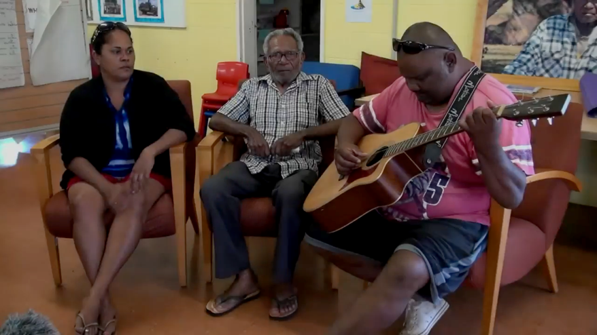
Practical –
Evac by Tami Gibson

Slide 3

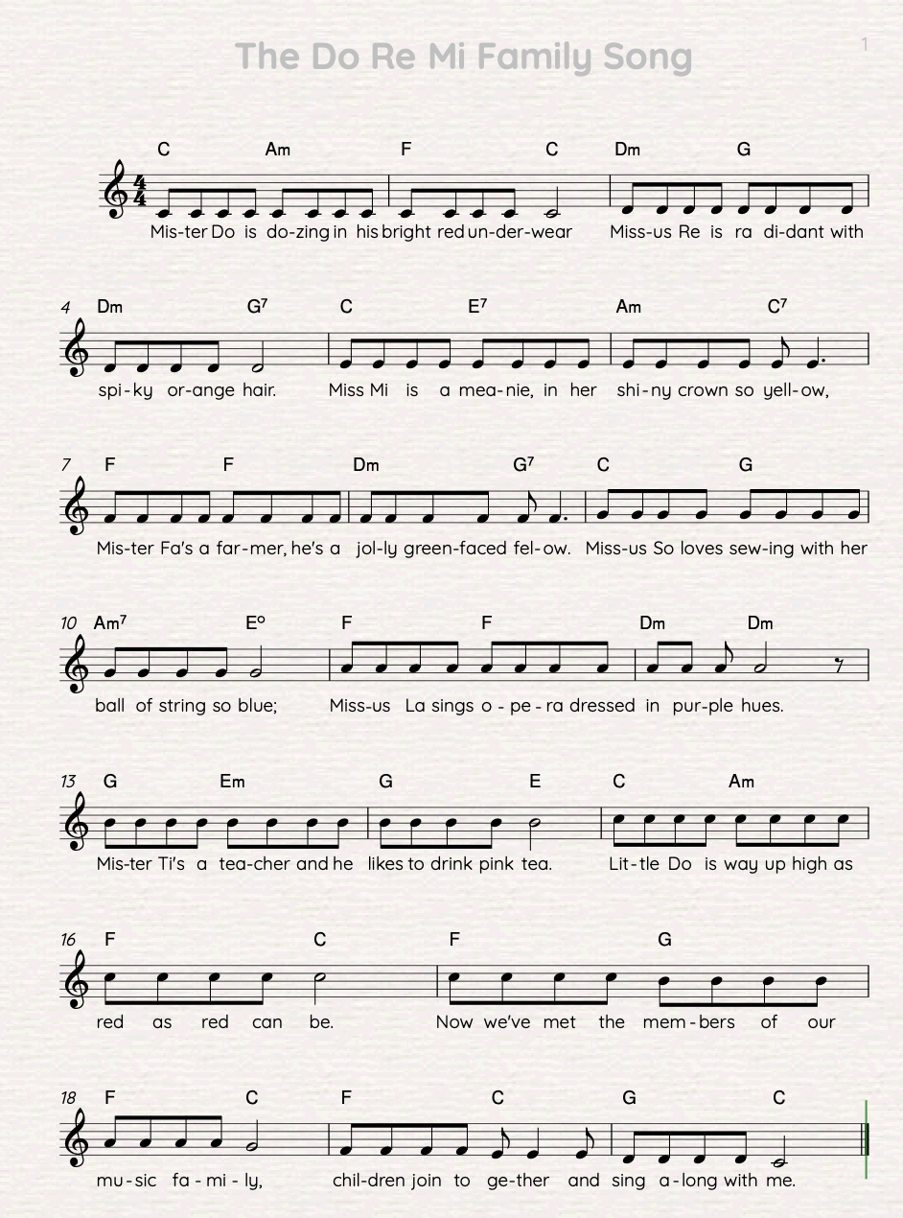
We Sing: Warm-Up Song
Practical

Slide 4
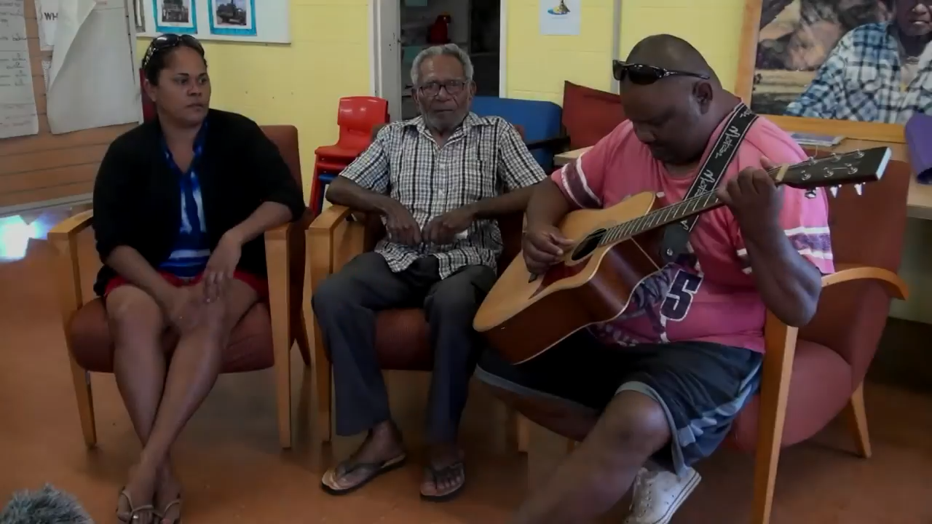
Listen: Evac
Watch and listen to the song ‘Evac’, by Tammy Gibson.
Practical

Slide 5
Concept Development: Evac – Verse 1
Do you recall the day
When they took our people away?
From Jepsens to Sandy Bay
By army trucks that came.
At Townsville those people were chained
But the train still sped on its way.
Cattle carts rolled along
To the sound of the unknown
Practical

Slide 6
We Say: Evac – Verse 1, Part 1
Do you recall the day
When they took our people away?
From Jepsens to Sandy Bay
By army trucks that came.
Practical

Slide 7
You Say: Evac – Verse 1, Part 1
Do you recall the day
When they took our people away?
From Jepsens to Sandy Bay
By army trucks that came.
Practical

Slide 8
We Say: Evac – Verse 1, Part 2
At Townsville those people were chained
But the train still sped on its way.
Cattle carts rolled along
To the sound of the unknown.
Practical

Slide 9
You Say: Evac – Verse 1, Part 2
At Townsville those people were chained
But the train still sped on its way.
Cattle carts rolled along
To the sound of the unknown.
Practical

Slide 10
We Say: Evac – Verse 1, Parts 1 and 2
Do you recall the day
When they took our people away?
From Jepsens to Sandy Bay
By army trucks that came.
At Townsville those people were chained
But the train still sped on its way.
Cattle carts rolled along
To the sound of the unknown.
Practical

Slide 11
You Say: Evac – Verse 1, Parts 1 and 2
Do you recall the day
When they took our people away?
From Jepsens to Sandy Bay
By army trucks that came.
At Townsville those people were chained
But the train still sped on its way
Cattle carts rolled along
To the sound of the unknown.
Practical

Slide 12
Listen: Evac
Watch and listen to the song ‘Evac’, by Tammy Gibson.
Practical

Slide 13



I Play: Xylophone Accompaniment 1
A E C A
Practical

Slide 14
We Play: Xylophone Accompaniment 1
A E C A
Practical

Slide 15
You Play: Xylophone Accompaniment 1
A E C A
Practical

Slide 16
I Play: Xylophone Accompaniment 2
B G D B
Practical

Slide 17
We Play: Xylophone Accompaniment 2
B G D B
Practical

Slide 18
You Play: Xylophone Accompaniment 2
B G D B
Practical

Slide 19
I Play: Xylophone Accompaniment 3
C G E G C
Practical

Slide 20
We Play: Xylophone Accompaniment 3
C G E G C
Practical

Slide 21
You Play: Xylophone Accompaniment 3
C G E G C
Practical

Slide 22
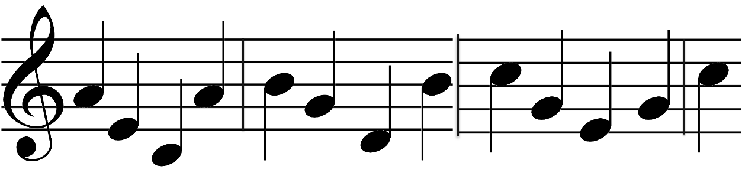
I Play: Xylophone Accompaniment
A E C A B G D B C G E G C
Practical

Slide 23
We Play: Xylophone Accompaniment
A E C A B G D B C G E G C
Practical

Slide 24
You Play: Xylophone Accompaniment
A E C A B G D B C G E G C
Practical

Slide 25
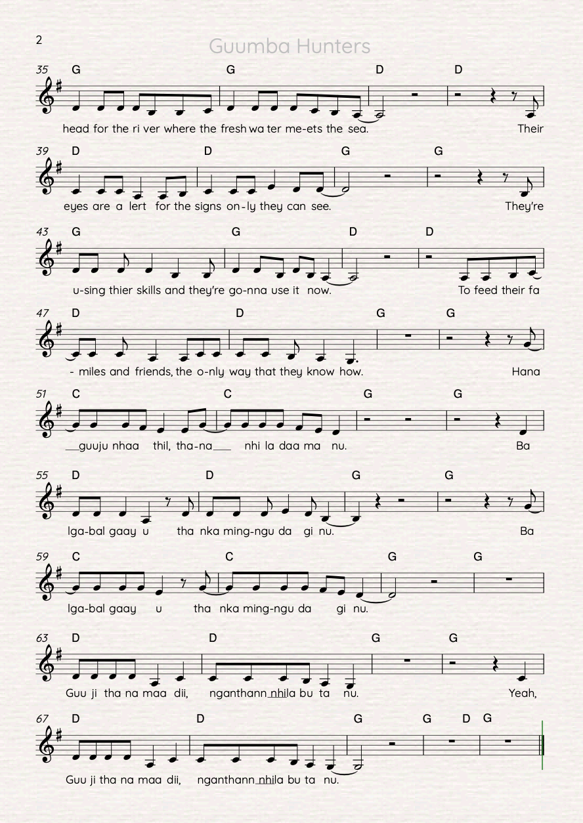
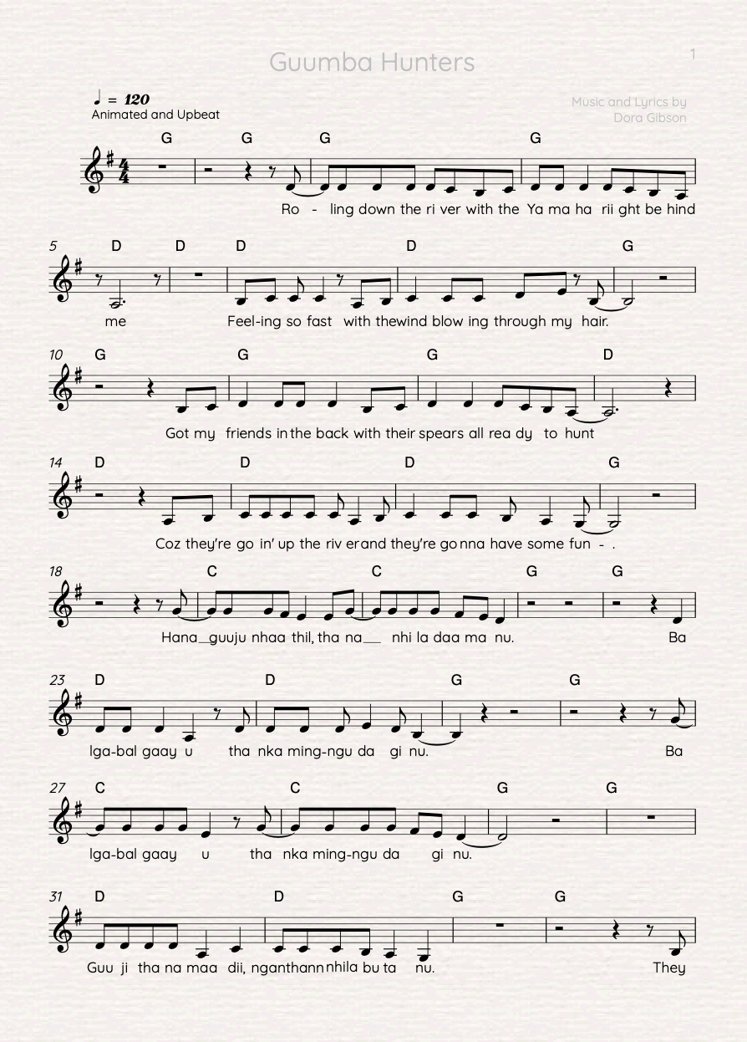
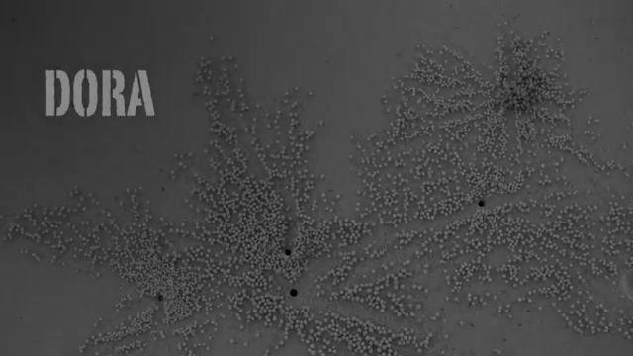
You Sing: Guumba Hunters
Practical

Slide 26
Reflect and Connect
In this lesson we:
learnt the words to a new song called ‘Evac’
learnt a xylophone accompaniment part for the song ‘Evac’.
How well are you able to:
Say the words to ‘Evac’
play the xylophone part.
Practical

Slide 27
Reflect and Connect
In the next lesson, we will learn:
how to sing more of the song ‘Evac’
how to play more of the xylophone part to ‘Evac’.
Practical

