Slide 1
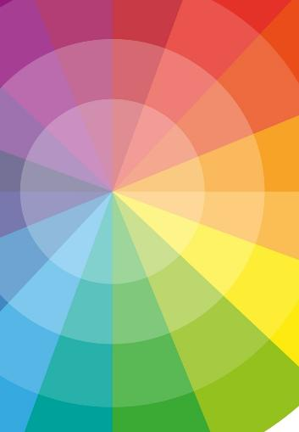
Unit 1B
Art and Identity
Lesson 1
Colour Mixing
Unit 1B Version 2

Slide 2
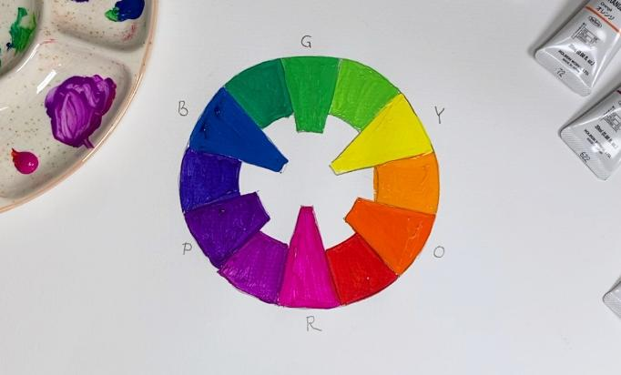
In this lesson, we will make a colour wheel that shows complementary and analogous colours.

Slide 3

You will be successful when you can:
create a colour wheel
point out analogous and complementary colours.

Slide 4


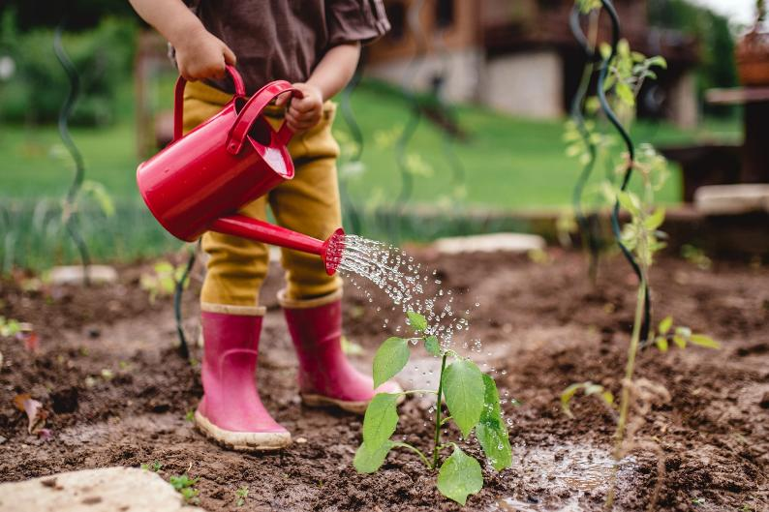

Slide 5

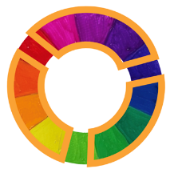
hue
Another word for colour.
analogous colours
Colours that are next to each other on the colour wheel.

Slide 6
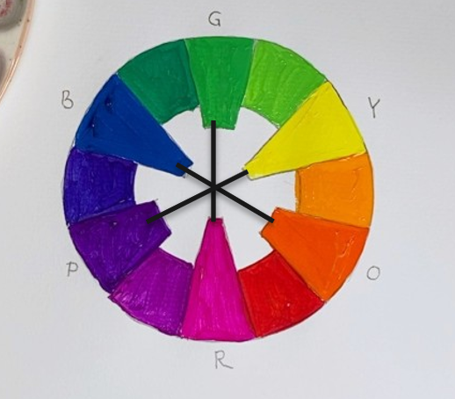

complementary colours
Colours that are across from each other in the colour wheel.
neutral colour
A colour without much intensity, appearing dull or not bright.

Slide 7


The Colour Wheel

Slide 8
Analogous Colours

Slide 9

On a colour wheel, analogous colours are…
the brightest colours
the colours beside each other that are harmonious
the darkest colours

Slide 10
Analogous Colours

Slide 11
Complementary Colours

Slide 12
Complementary Colours

Slide 13
An example of complementary colours is:

Slide 14

Mixing Colours

Slide 15
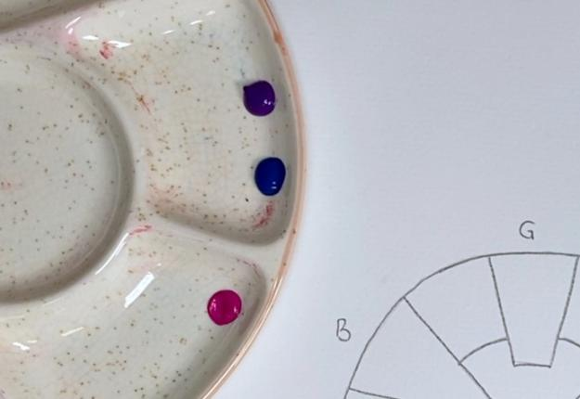
Put a small dollop of purple, magenta and blue on your palette.

Slide 16
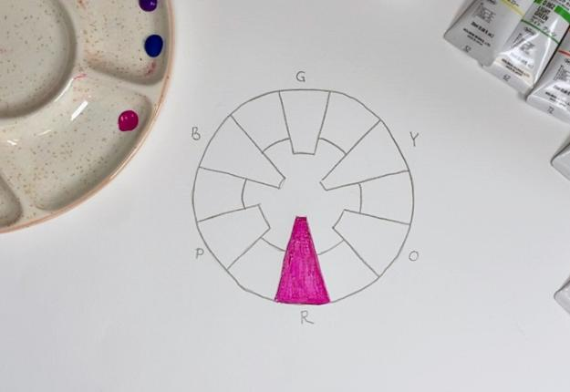
Paint in the section for red (magenta). Clean your brush well.

Slide 17
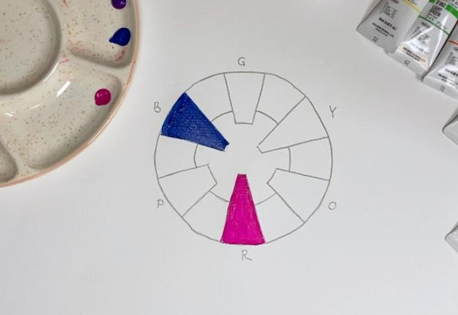
Neatly paint in the section for blue. Clean your brush well.

Slide 18
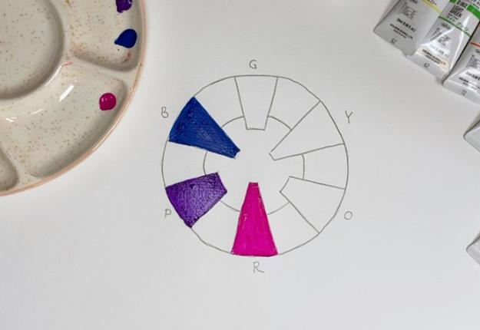
Neatly paint in the section for purple. Clean your brush well.

Slide 19
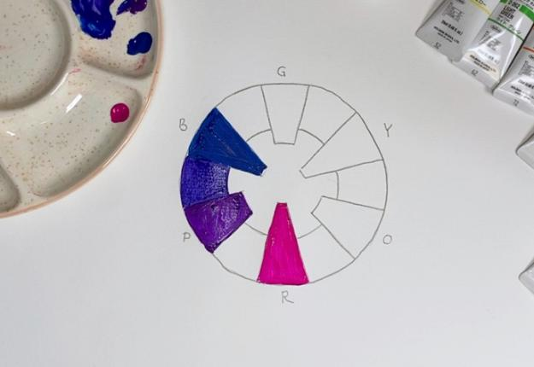
Mix small amounts of blue and purple to create blue-purple. When finished, clean your brush well.

Slide 20
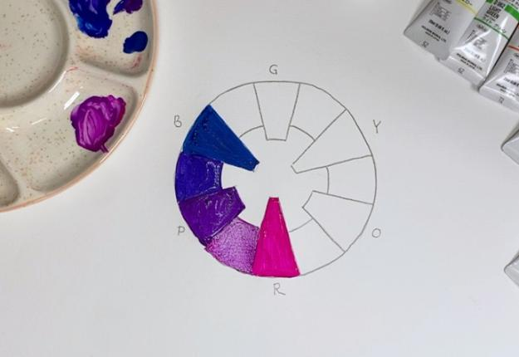
Mix small amounts of purple and magenta to create purple-magenta. When finished, clean your brush well.

Slide 21
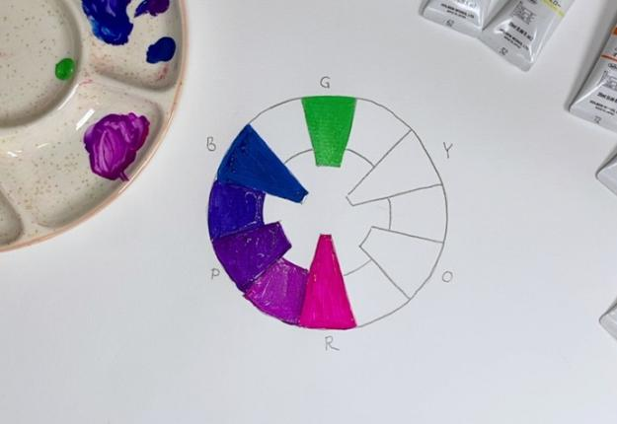
Paint in the section for green. When finished, clean your brush well.

Slide 22
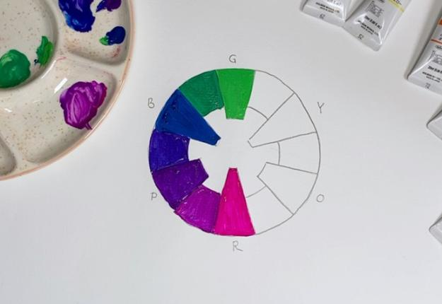
Mix small amounts of blue and green to create blue-green. When finished, clean your brush well.

Slide 23
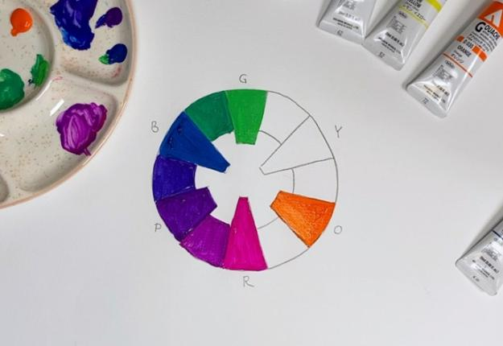
Paint in the section for orange. When finished, clean your brush well.

Slide 24
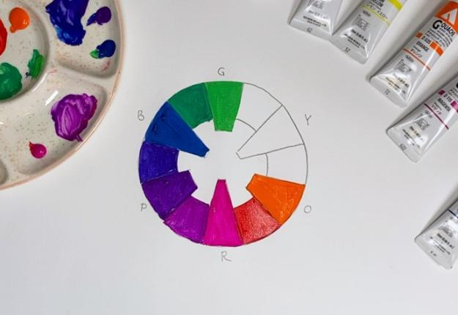
Mix small amounts of magenta and orange to create magenta-orange. When finished, clean your brush well.

Slide 25
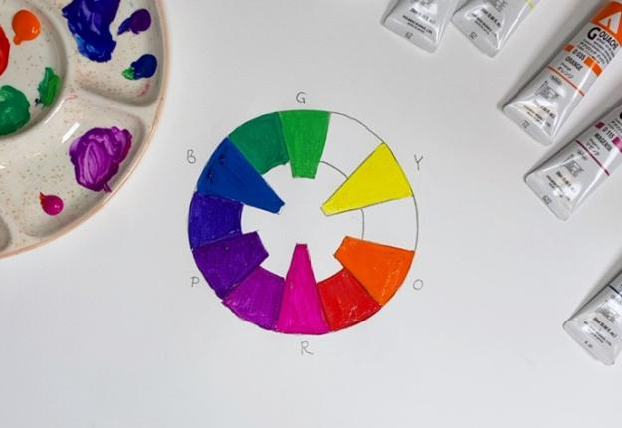
Paint in the section for yellow. When finished, clean your brush well.

Slide 26
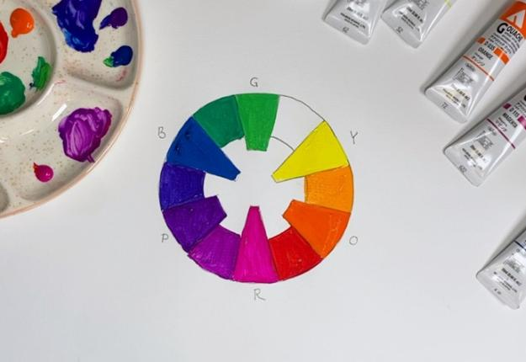
Mix small amounts of yellow and orange to create yellow-orange. When finished, clean your brush well.

Slide 27
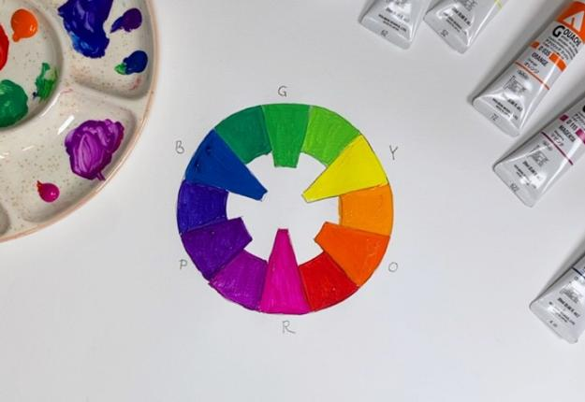
Mix small amounts of yellow and green to create yellow-green. When finished, clean your brush well.

Slide 28
Draw a line connecting each of the complementary colours.

Slide 29
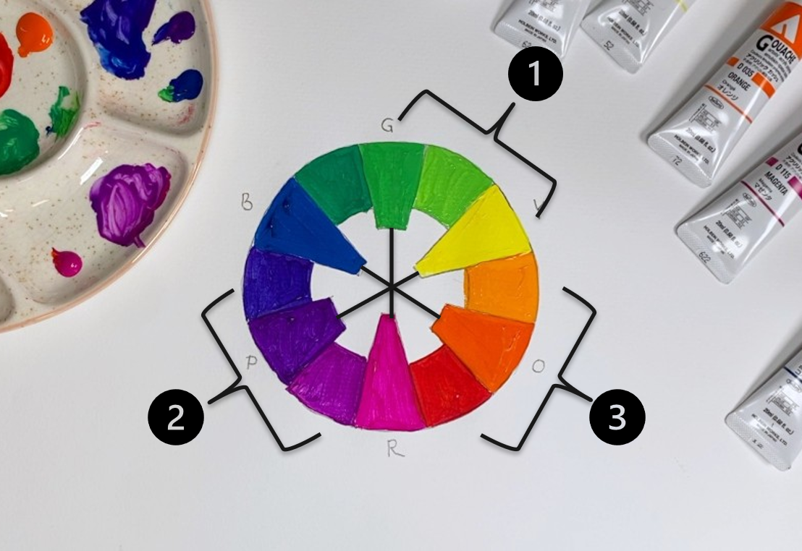
Draw a line connecting three sets of analogous colours that you like.

Slide 30
When creating a colour wheel, it is important to clean your brush well between colours to:
make the brush last longer
keep colours from mixing into each other
keep the water container clean

Slide 31

Colour Mixing

Slide 32
Hue: another word for colour.
Analogous colour: colours next to each other on the colour wheel.
Complementary colour: colours opposite each other on the colour wheel.
Neutral colour: colours without intensity, that look dull or not bright.

Slide 33



Reflect

Slide 34

This area of my colour mixing was hard. I had to pay special attention here because…
if I mixed in too much of one colour, the result was unbalanced looking.

Slide 35
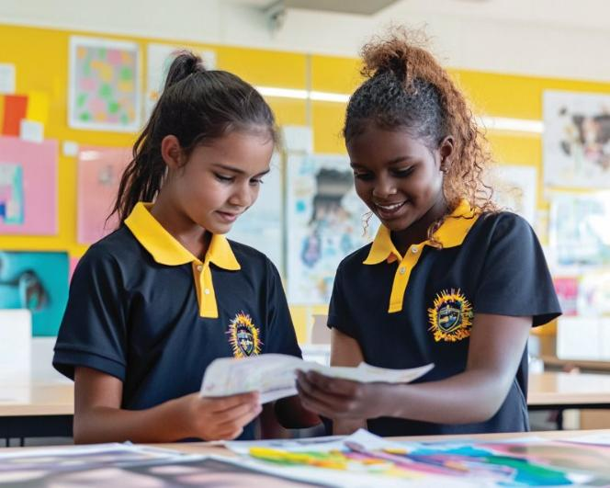

Slide 36


Slide 37
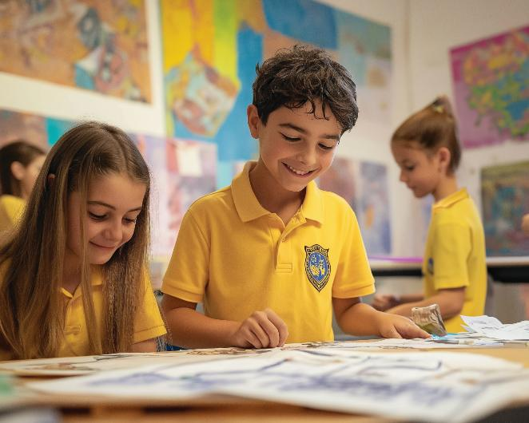

Slide 38

Analogous colours are beside each other on the colour wheel.
Complementary colours are across from each other on the colour wheel. They are harmonious; they go well together.

Slide 39
In what part of your work today did you discover something new about yourself or your skills?

Slide 40
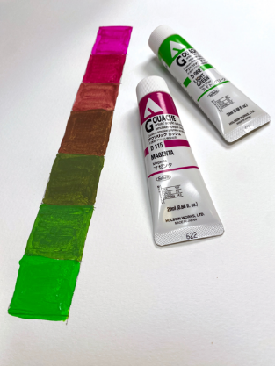
In the next lesson, we will practise painting complementary value scales.

