Slide 1
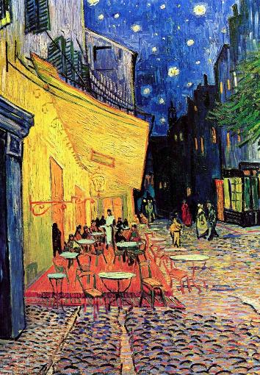
Unit 1B
Art and Identity
Lesson 2
Neutral Colours
Unit 1B Version 2

Slide 2
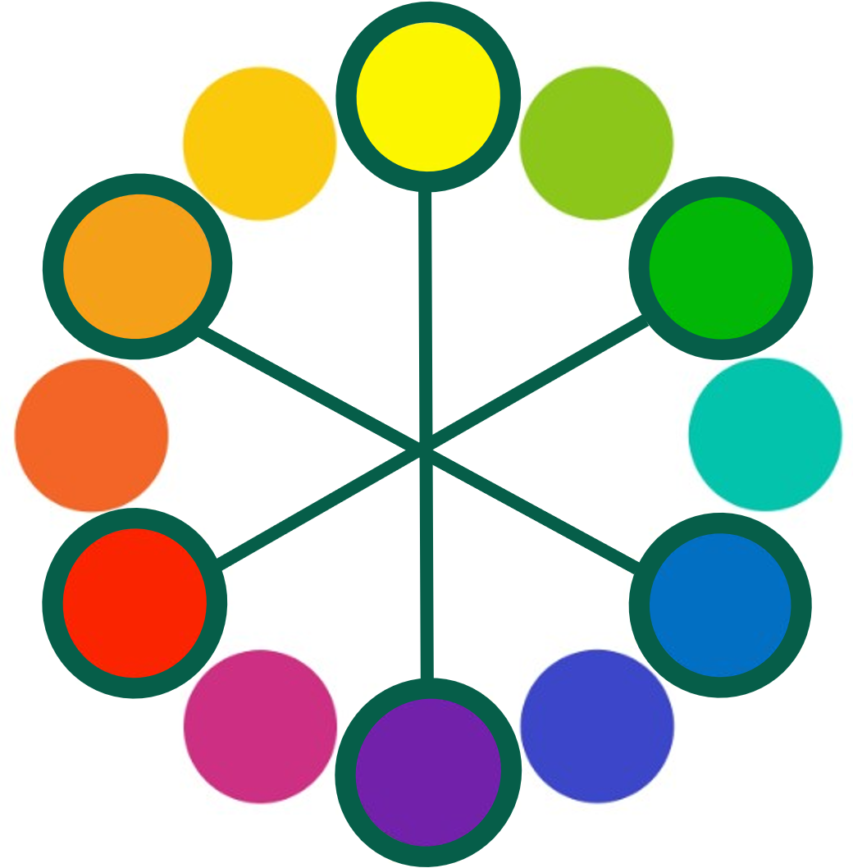
Analogous colours are next to each other in the colour wheel.

Slide 3
Complementary colours are across from each other in the colour wheel.

Slide 4

On a colour wheel, analogous colours are…
the brightest colours
the colours beside each other that are harmonious
the darkest colours

Slide 5
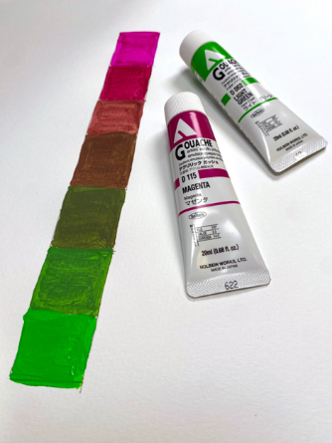
In this lesson, we will practise painting complementary value scales.

Slide 6
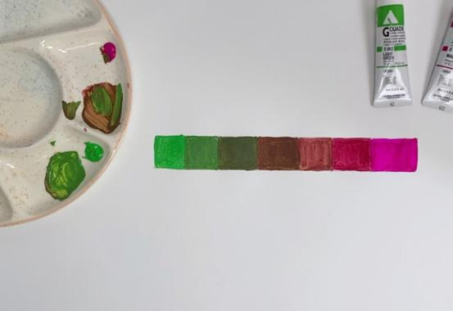
You will be successful when you can:
mix complementary colours with control
create a value scale using complementary colours.

Slide 7

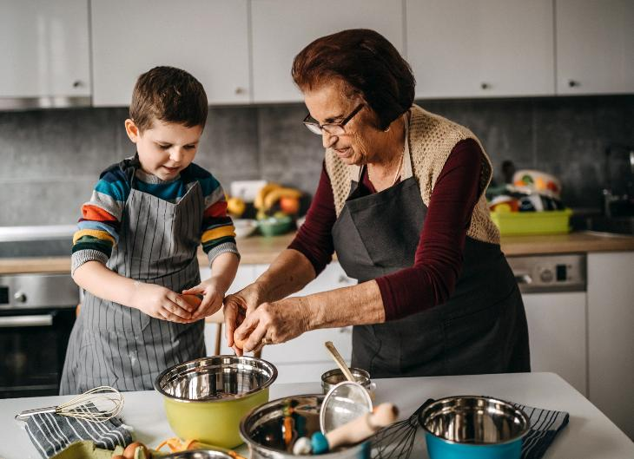


Slide 8


tint
A colour mixed with white.
tone
A colour mixed with black or grey.

Slide 9




value
How light or dark a colour is.
value scale
A range of the same colour from light to dark.

Slide 10
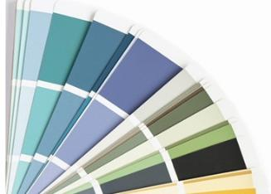
neutral colour
A colour without much brightness, appearing dull or not bright.

Slide 11


Value Scales

Slide 12
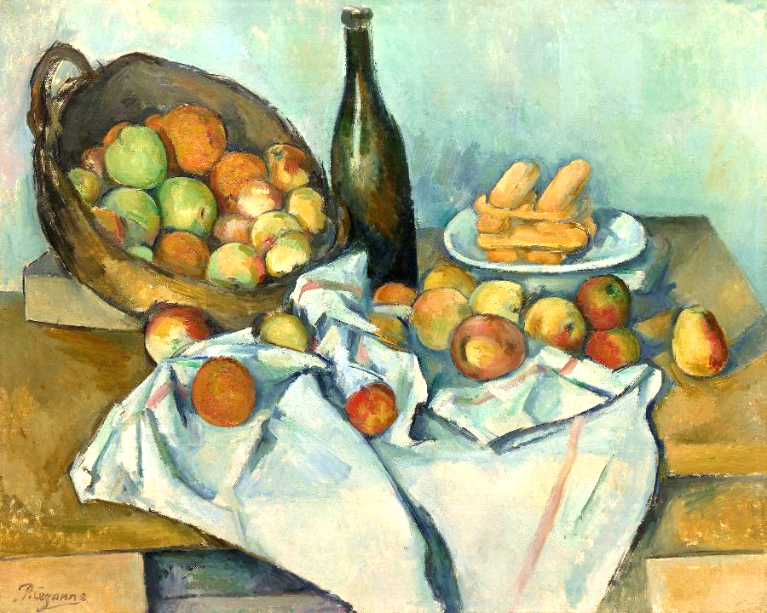
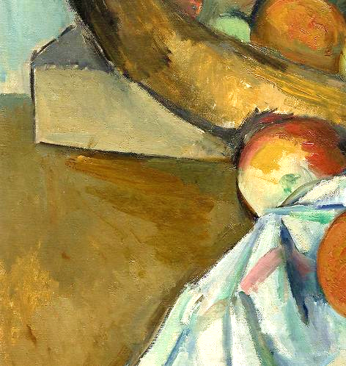
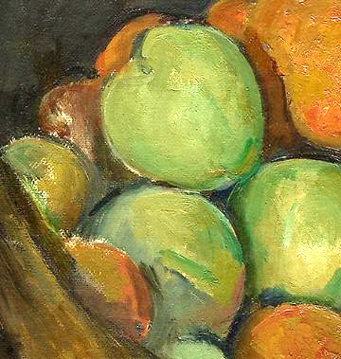
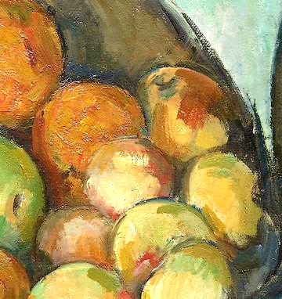
Mixing Complementary Colours

Slide 13
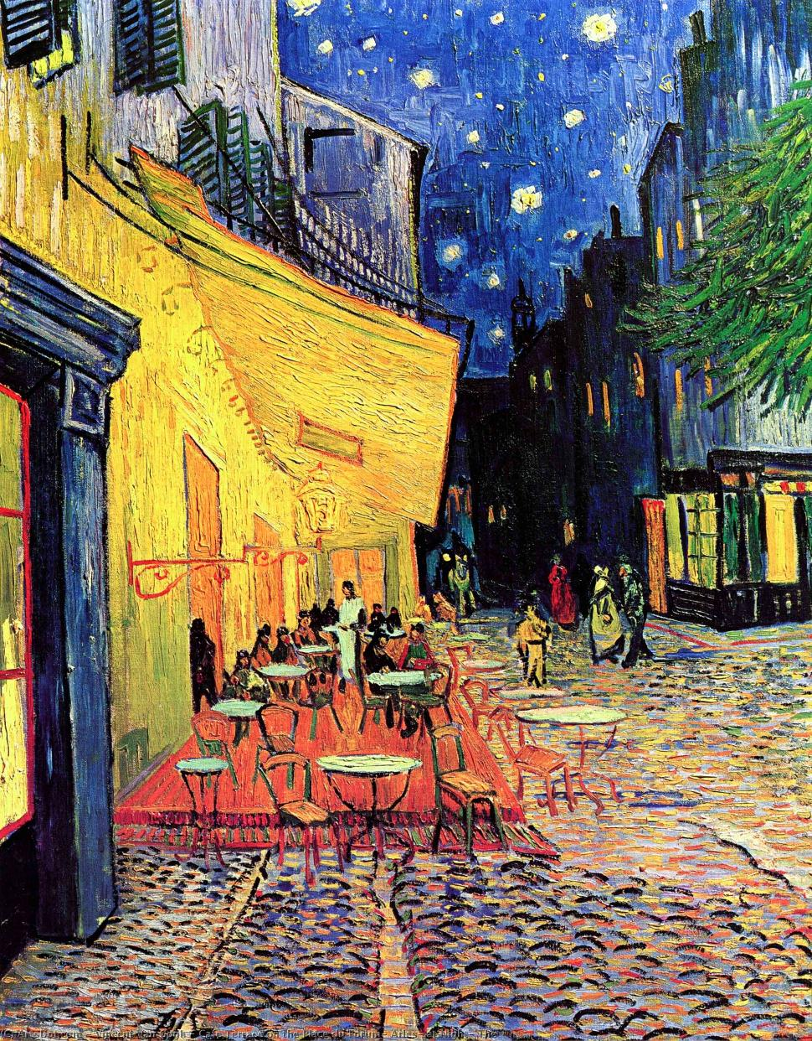
Mixing Complementary Colours

Slide 14

Mixing Complementary Colours

Slide 15

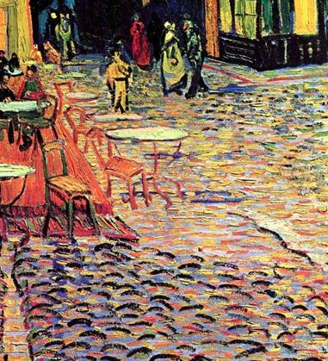
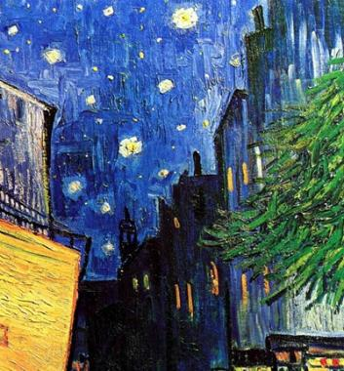
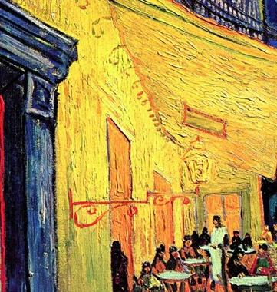
Mixing Complementary Colours

Slide 16
When we mix two complementary colours, they make:
brighter colours
neutral colours like greys and browns
more complementary colours

Slide 17

Value Scales

Slide 18
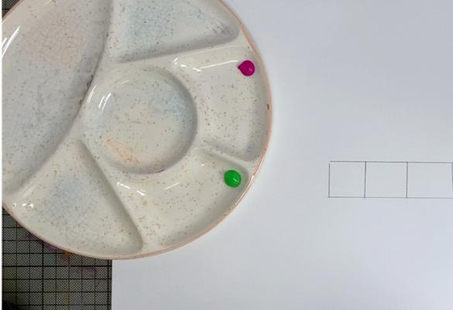
Put a small dollop of two complementary colours of your choice on your palette.

Slide 19
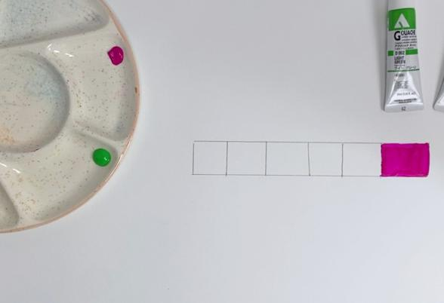
Start with the lighter colour. Paint in the first section with the pure hue.

Slide 20
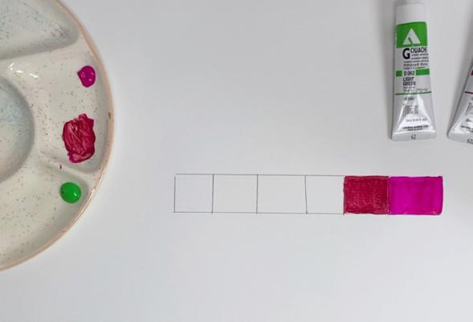
Mix in a very tiny amount of the complementary colour until you achieve a slightly darker value and paint in the next section.

Slide 21
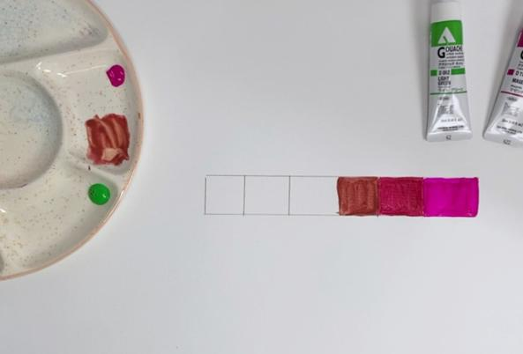
Again, mix in more of a very tiny amount of the complementary colour until you achieve a slightly darker value and paint in the next section.

Slide 22
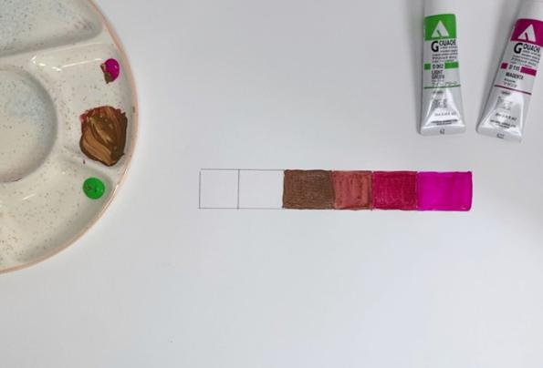
Mix in more of a very tiny amount of the complementary colour until you achieve a slightly darker value and paint in the next section.

Slide 23
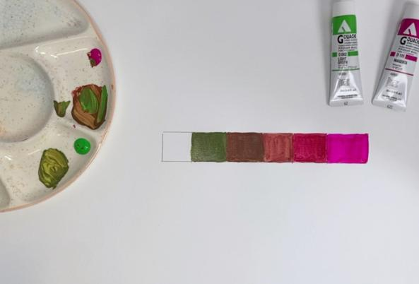
Clean your brush well. Switch to the other colour (green) and mix in a very tiny amount of the dark value on your palette. Paint in the next section.

Slide 24
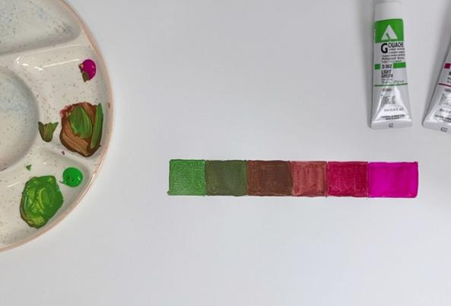
Mix in more of a very tiny amount of the complementary colour until you achieve a slightly darker value and paint in the next section.

Slide 25

Finally, paint in the last section with the pure hue (green).

Slide 26
When mixing complementary colours, we start mixing with the:
lightest
colour
darkest
colour
mid-value
colour

Slide 27

Value Scales

Slide 28
Tint: a colour mixed with white.
Tone: a colour mixed with grey or black.

Slide 29
Value: how light or dark a colour is.
Value scale: a range of the same colour from light to dark .
Neutral colour: a colour without much intensity, appearing dull or not bright.

Slide 30



Reflect

Slide 31

This area of my value scale was challenging:
Mixing the mid-tones was challenging because I had to have just the right amount of each colour.

Slide 32


Slide 33


Slide 34
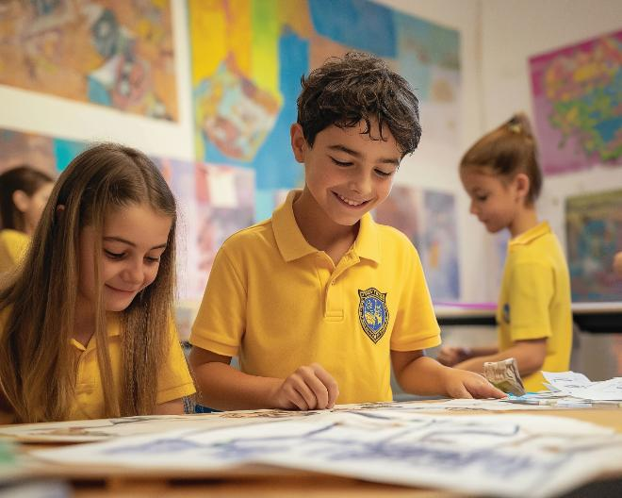

Slide 35

Artists can make neutral colours by mixing complementary colours. They practise doing this by painting a value scale using two complementary colours.

Slide 36
In what part of your work today did you discover something new about yourself or your skills?

Slide 37
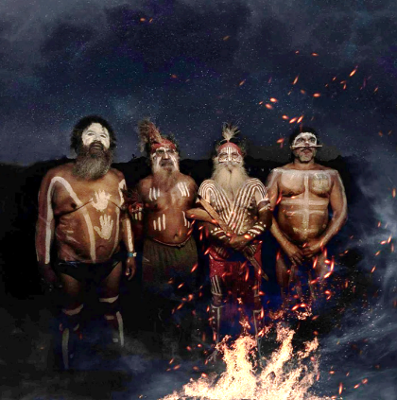
In the next lesson, we will identify the ideas and practices found in an artwork.

Slide 38
Slide 12: Cézanne, P. (c. 1895) The Basket of Apples, oil on canvas, 65 × 80 cm, Art Institute of Chicago. Available at: Wikimedia Commons, “File:Paul Cézanne, The Basket of Apples.jpg” (Accessed: 2 October 2025).
Slide 1, 13-15: van Gogh, V. (1888) Café Terrace at Night. Oil on canvas. Kröller-Müller Museum, Otterlo, Netherlands. Available at: Wikimedia Commons, “File:Vincent-van-gogh-cafe-terrace-on-the-place-du-forum-arles-at-night-the.jpg” (Accessed: 2 October 2025).
Slide 38: Raven, C. (2018) Elders at Dupang Festival [Facebook post]. Available at: https://www.facebook.com/100050384414438/posts/elders-at-dupang-festival-0-/2073059196057318/ (Accessed: 2 October 2025).

