Slide 1
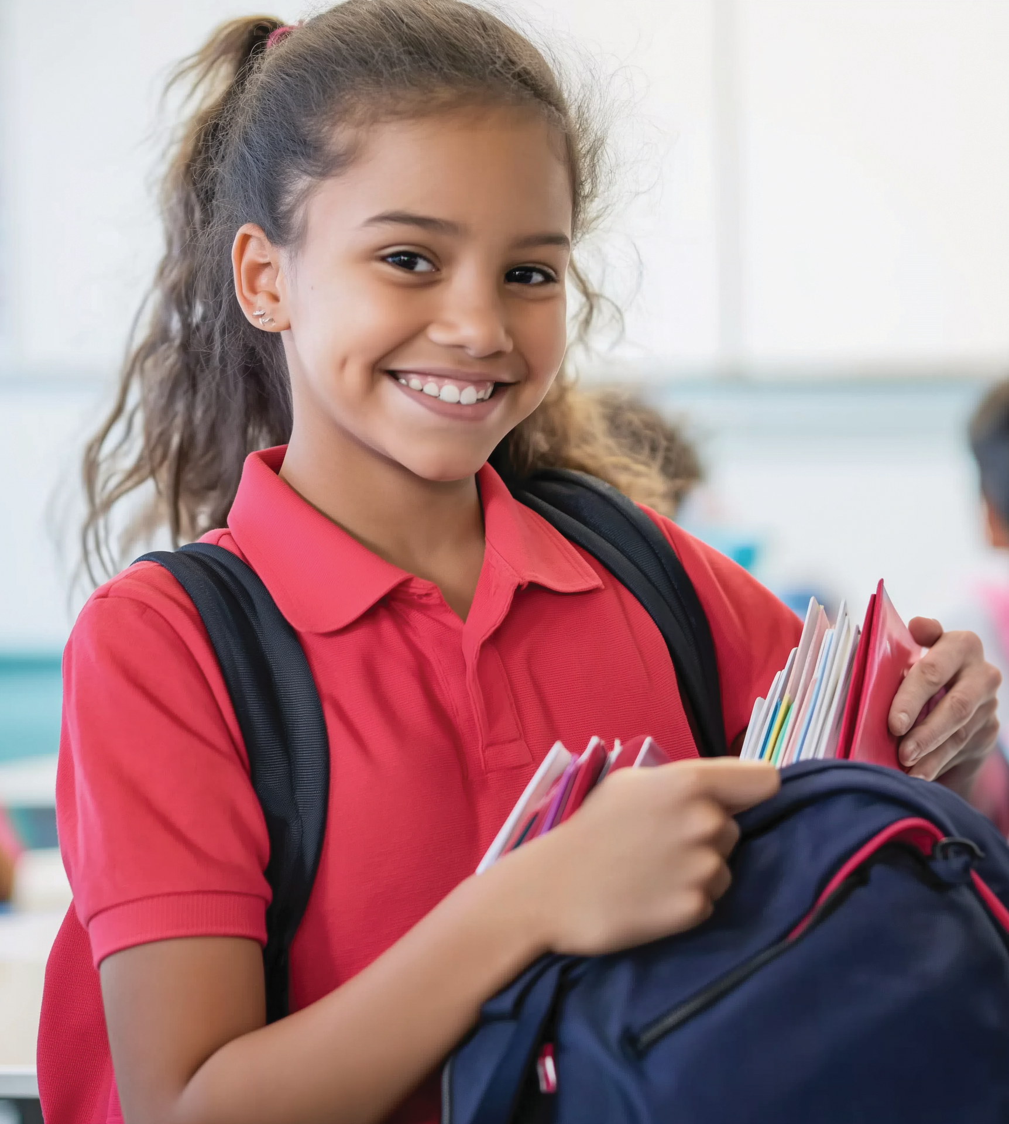
Classroom Rules
Get Ready for School

Slide 2
In this lesson, you will learn the classroom rules, ‘Get Ready for School’.

Slide 3
You will be successful when you can demonstrate the classroom rules, ‘Get Ready for School’.

Slide 4
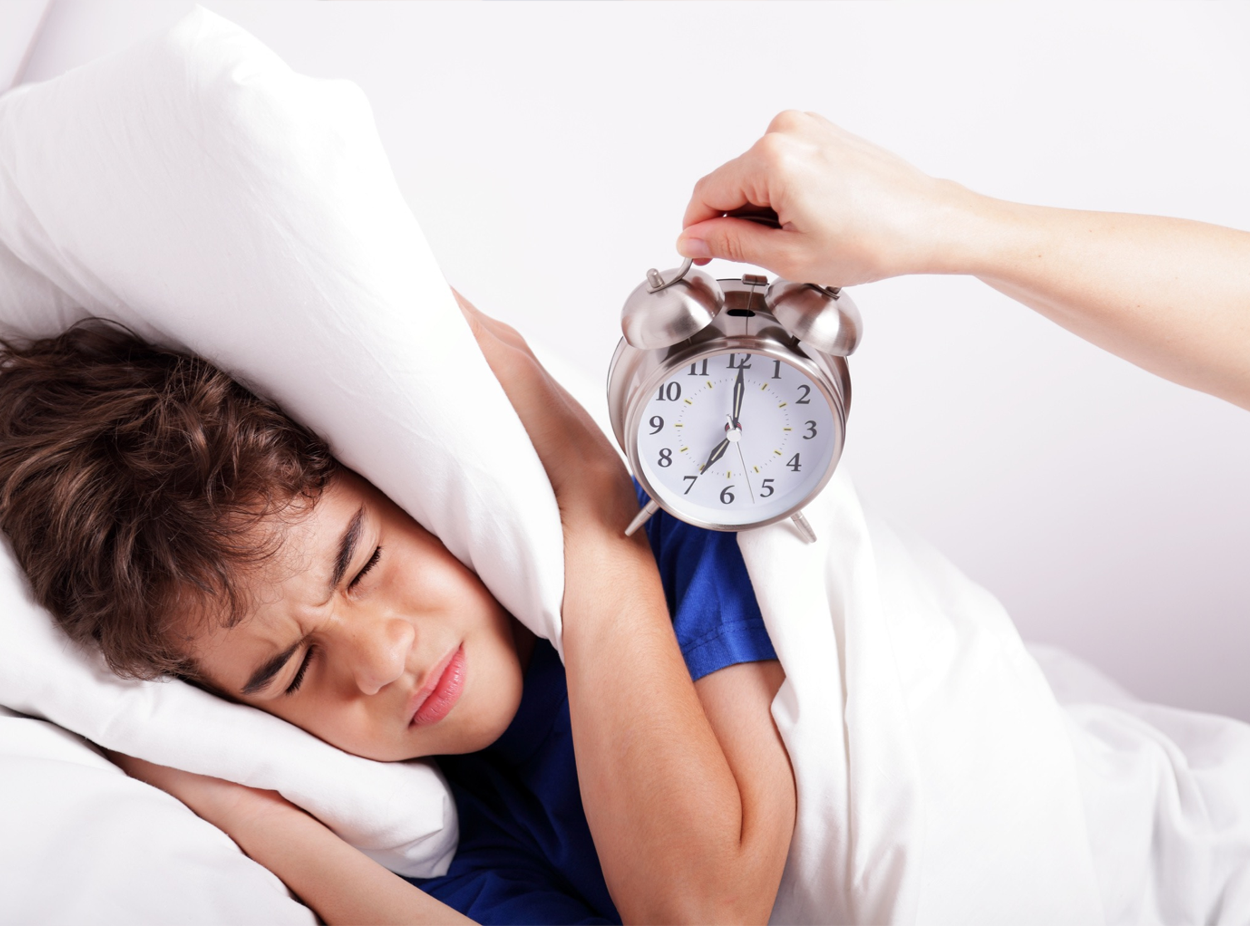
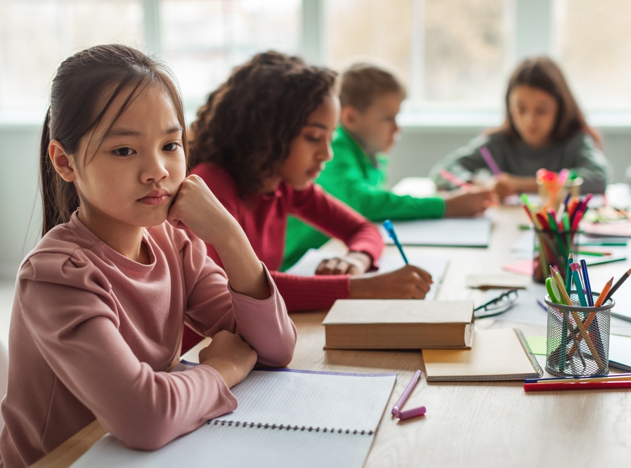
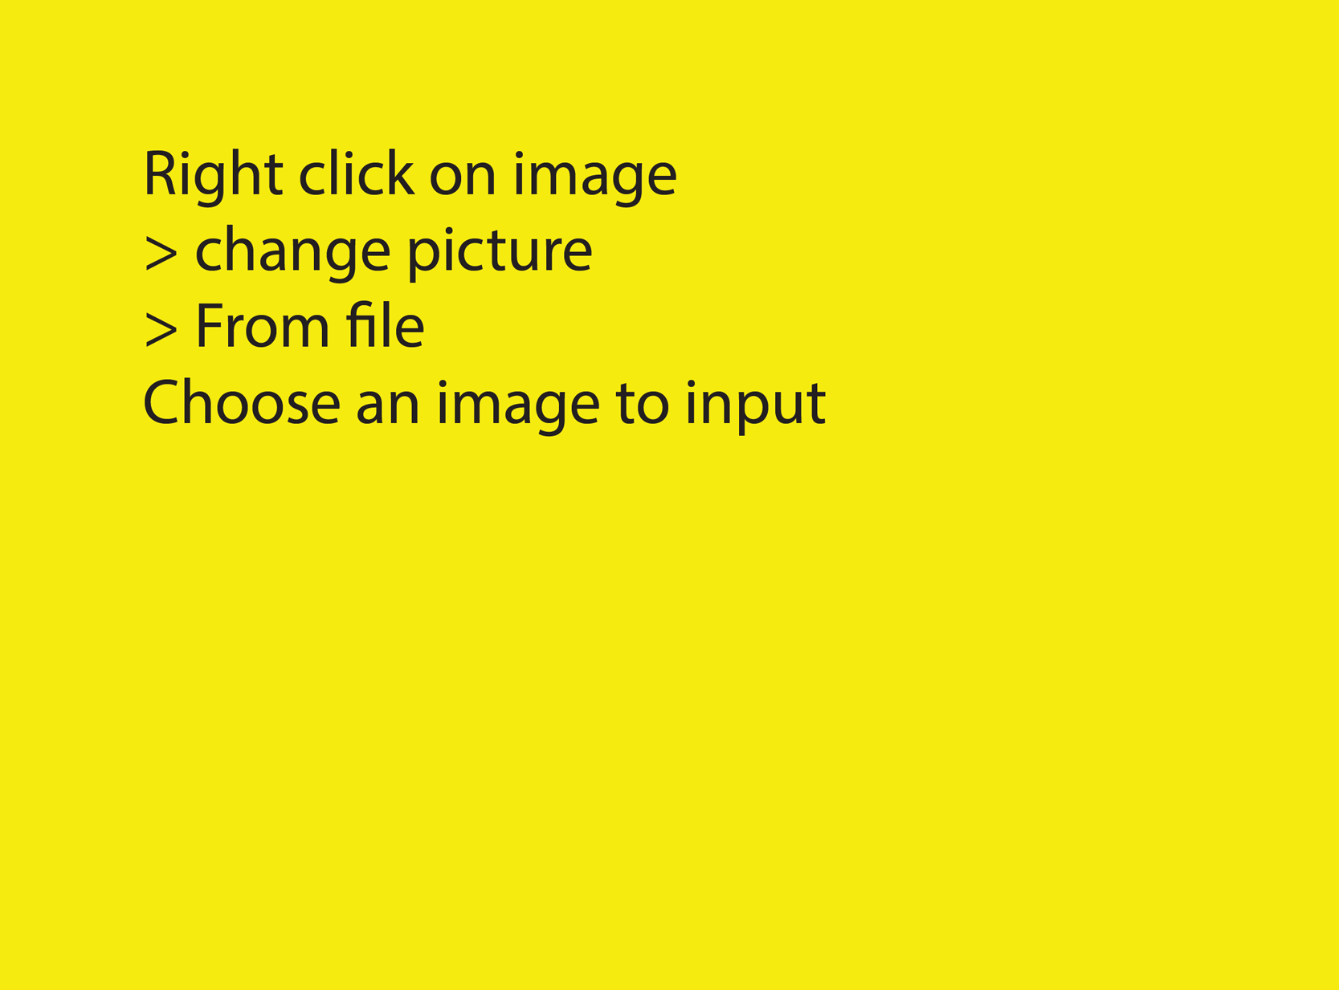

Slide 5
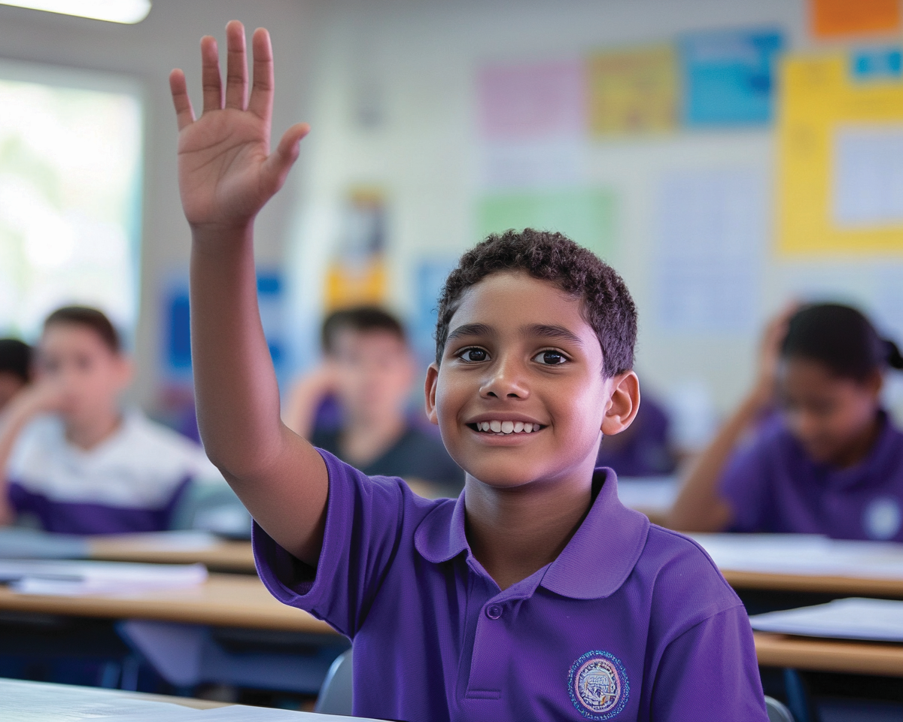
What Are Rules?
Rules tell us what we need to do.

Slide 6


Thumbs Up or Thumbs Down
Rules help us work well with others, be respectful, share and solve problems together.
yes
no

Slide 7
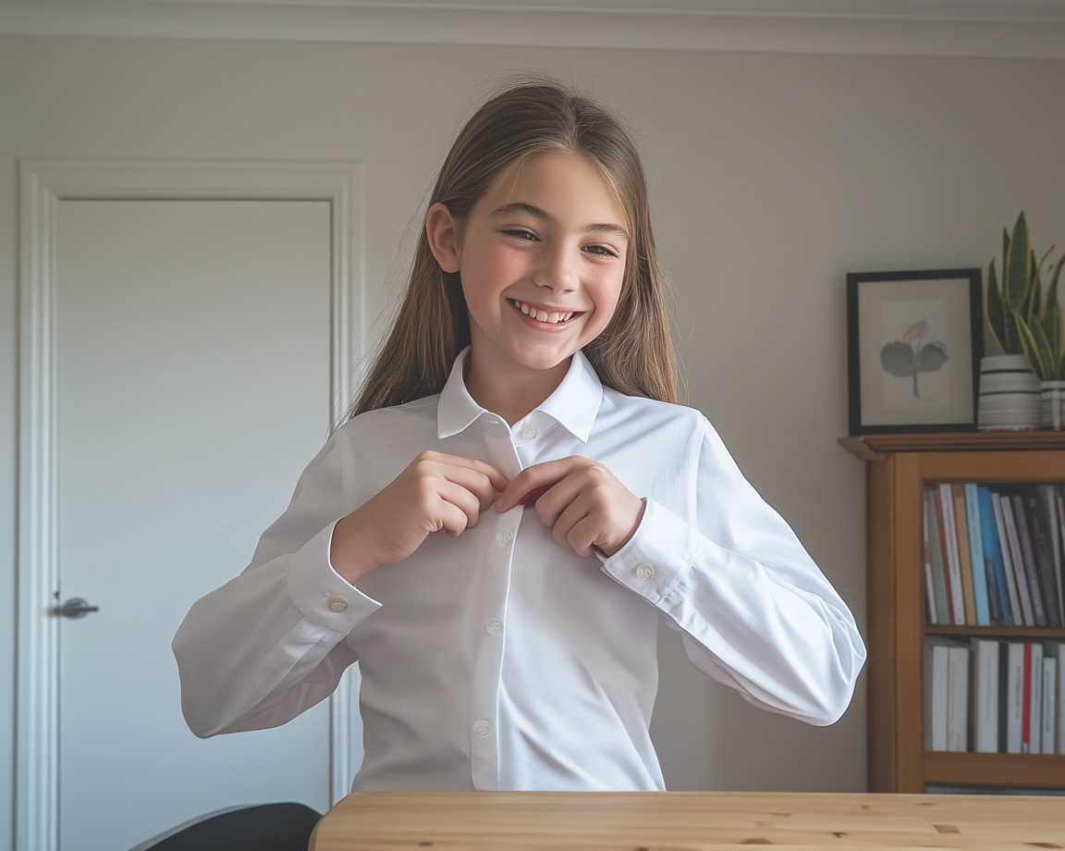
Get Ready for School
Our ‘Get Ready for School’ rules make sure we're prepared and ready to learn every day.

Slide 8
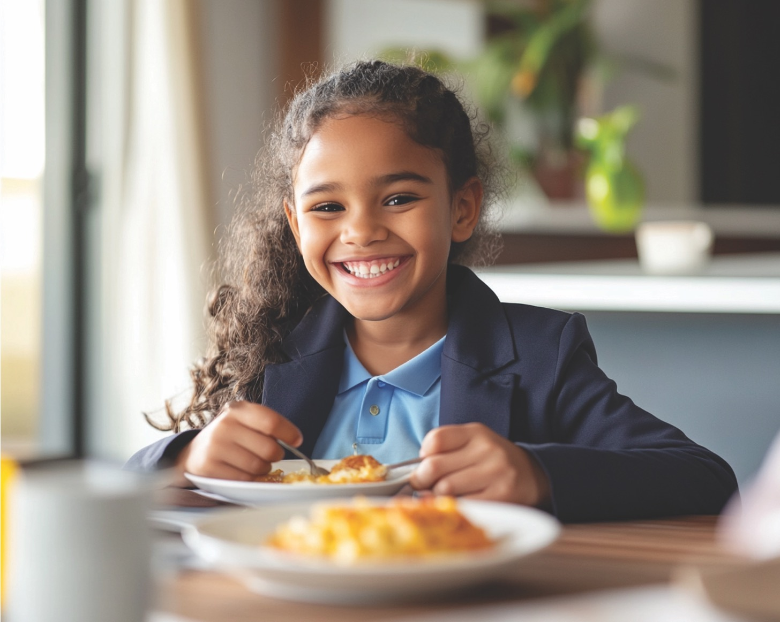
Eat Breakfast
A good breakfast helps your brain work well.

Slide 9
Wear a Uniform
Wearing our uniform makes us feel like we belong to our school.

Slide 10
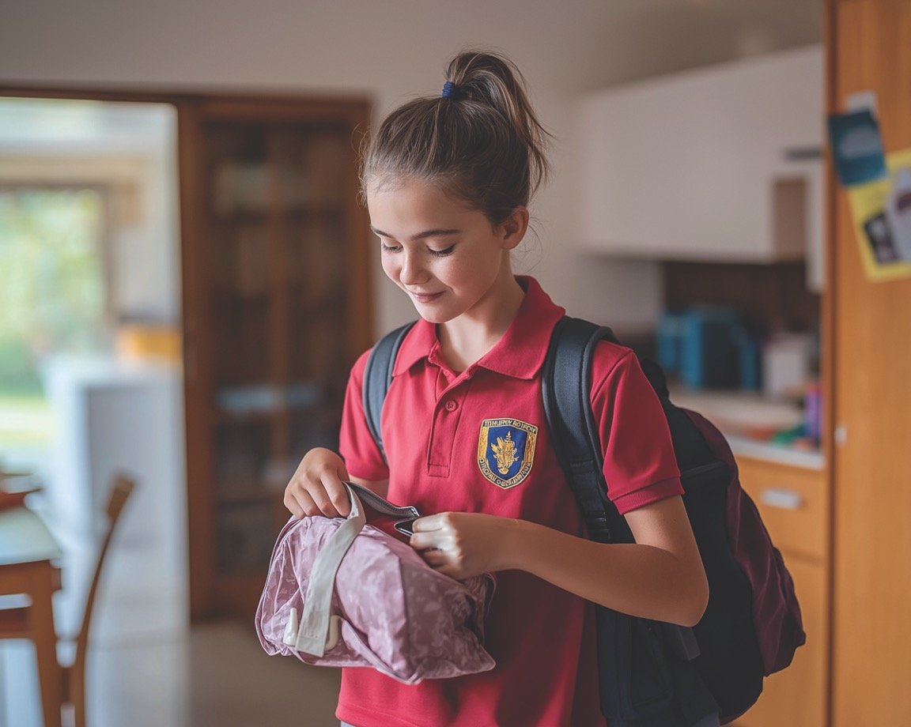
Pack Your School Bag
Pack everything you need for school.

Slide 11
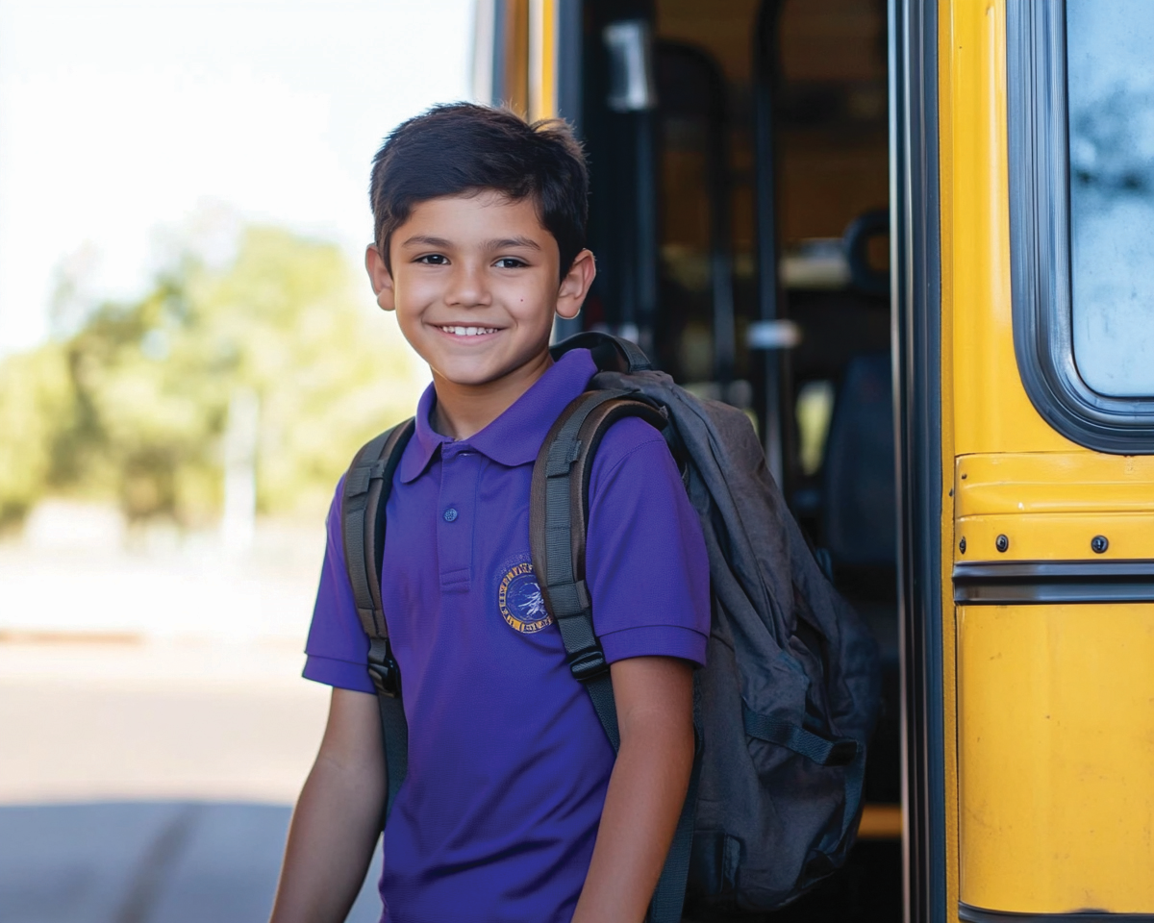
Be at School Before the Bell
Arriving at school before the bell helps us feel relaxed and ready.

Slide 12
Come to School Every School Day
Coming to school show you care about your education and are responsible.

Slide 13
Thumbs Up or Thumbs Down
Eating breakfast before school gives your brain the nutrients it needs to work well.
yes
no

Slide 14
Wear Your Uniform

Slide 15
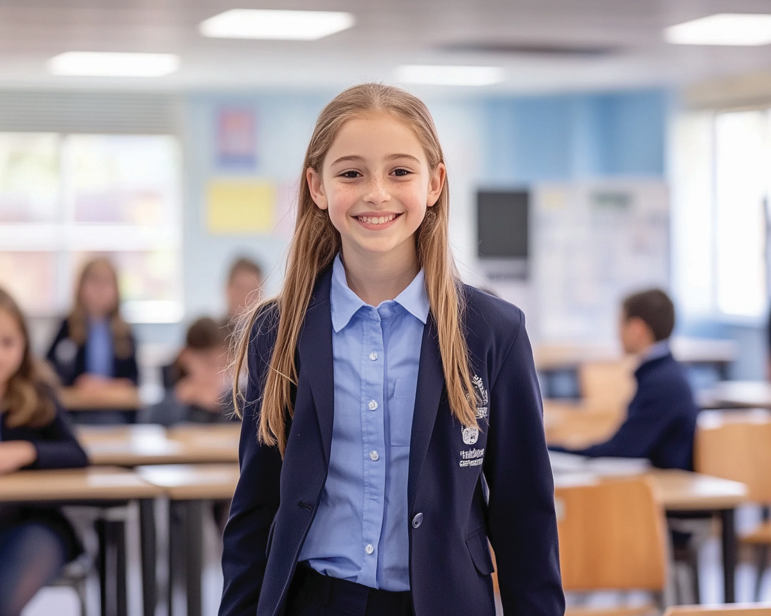
Wear Your Uniform

Slide 16
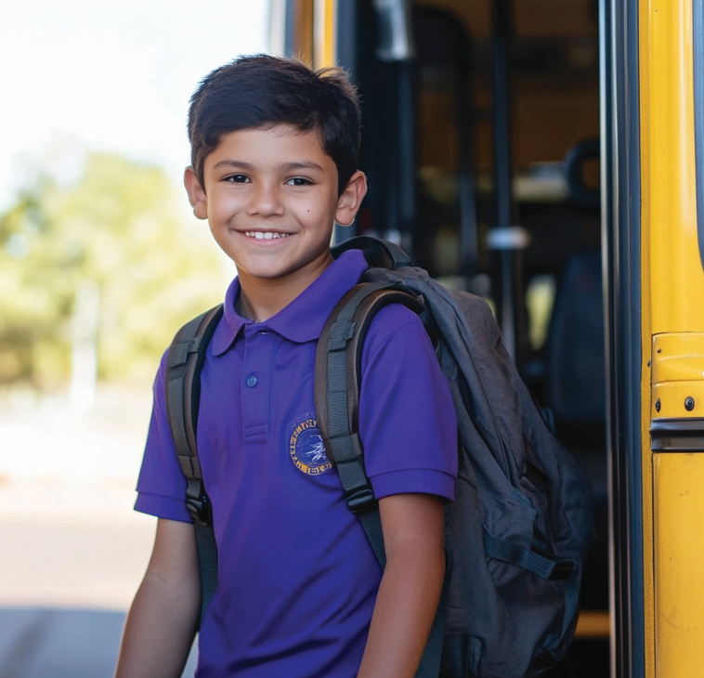
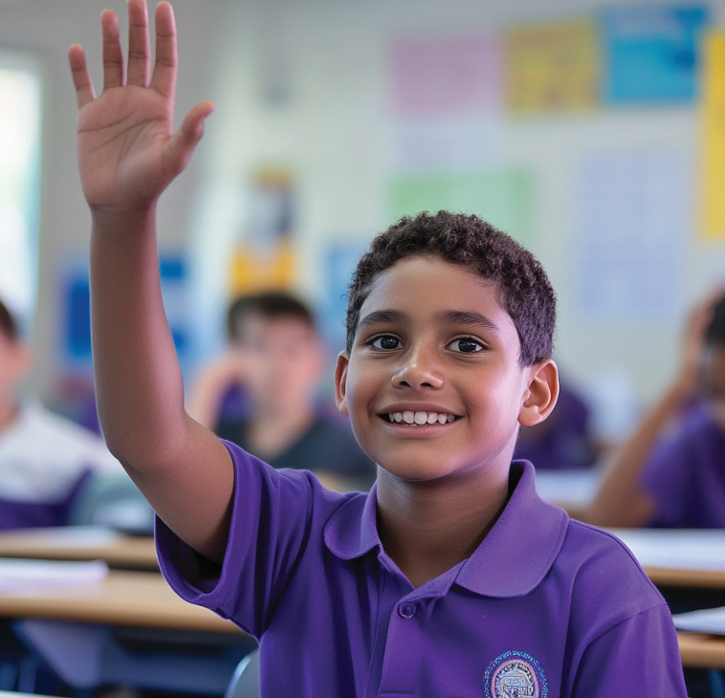
Get Ready for School

Slide 17
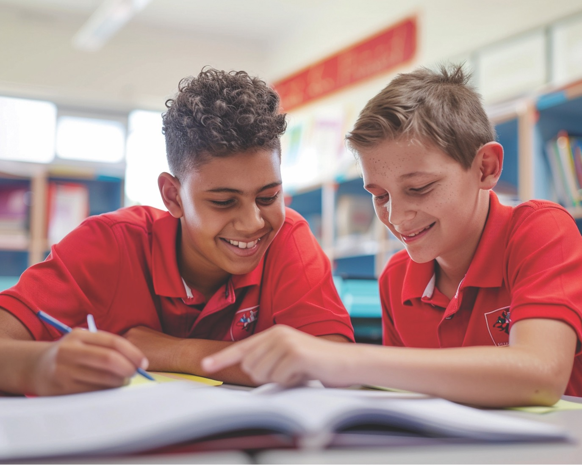

Slide 18
Our ‘Get Ready for School’ rules make sure we're prepared and ready to learn every day.

Slide 19

How well did you:
demonstrate the classroom rules, ‘Get Ready for School?’

