Slide 1

School Motto
Get Ready. Work Hard.
Be Good.

Slide 2
In this lesson, you will learn what our school motto is, and why it’s important.

Slide 3
You will be successful when you can recognise the school motto and abide by its values.

Slide 4

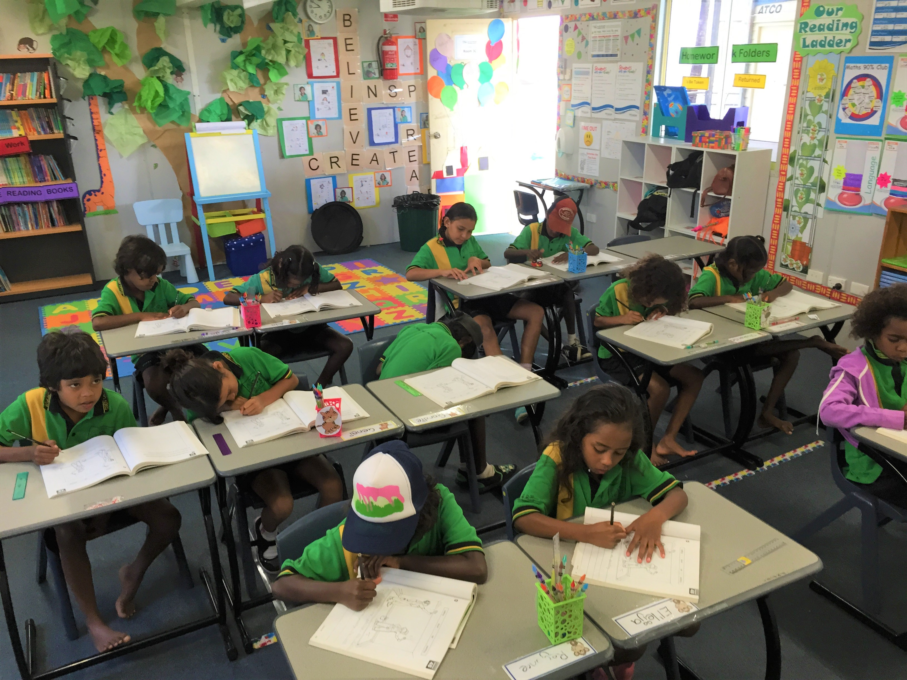


Slide 5
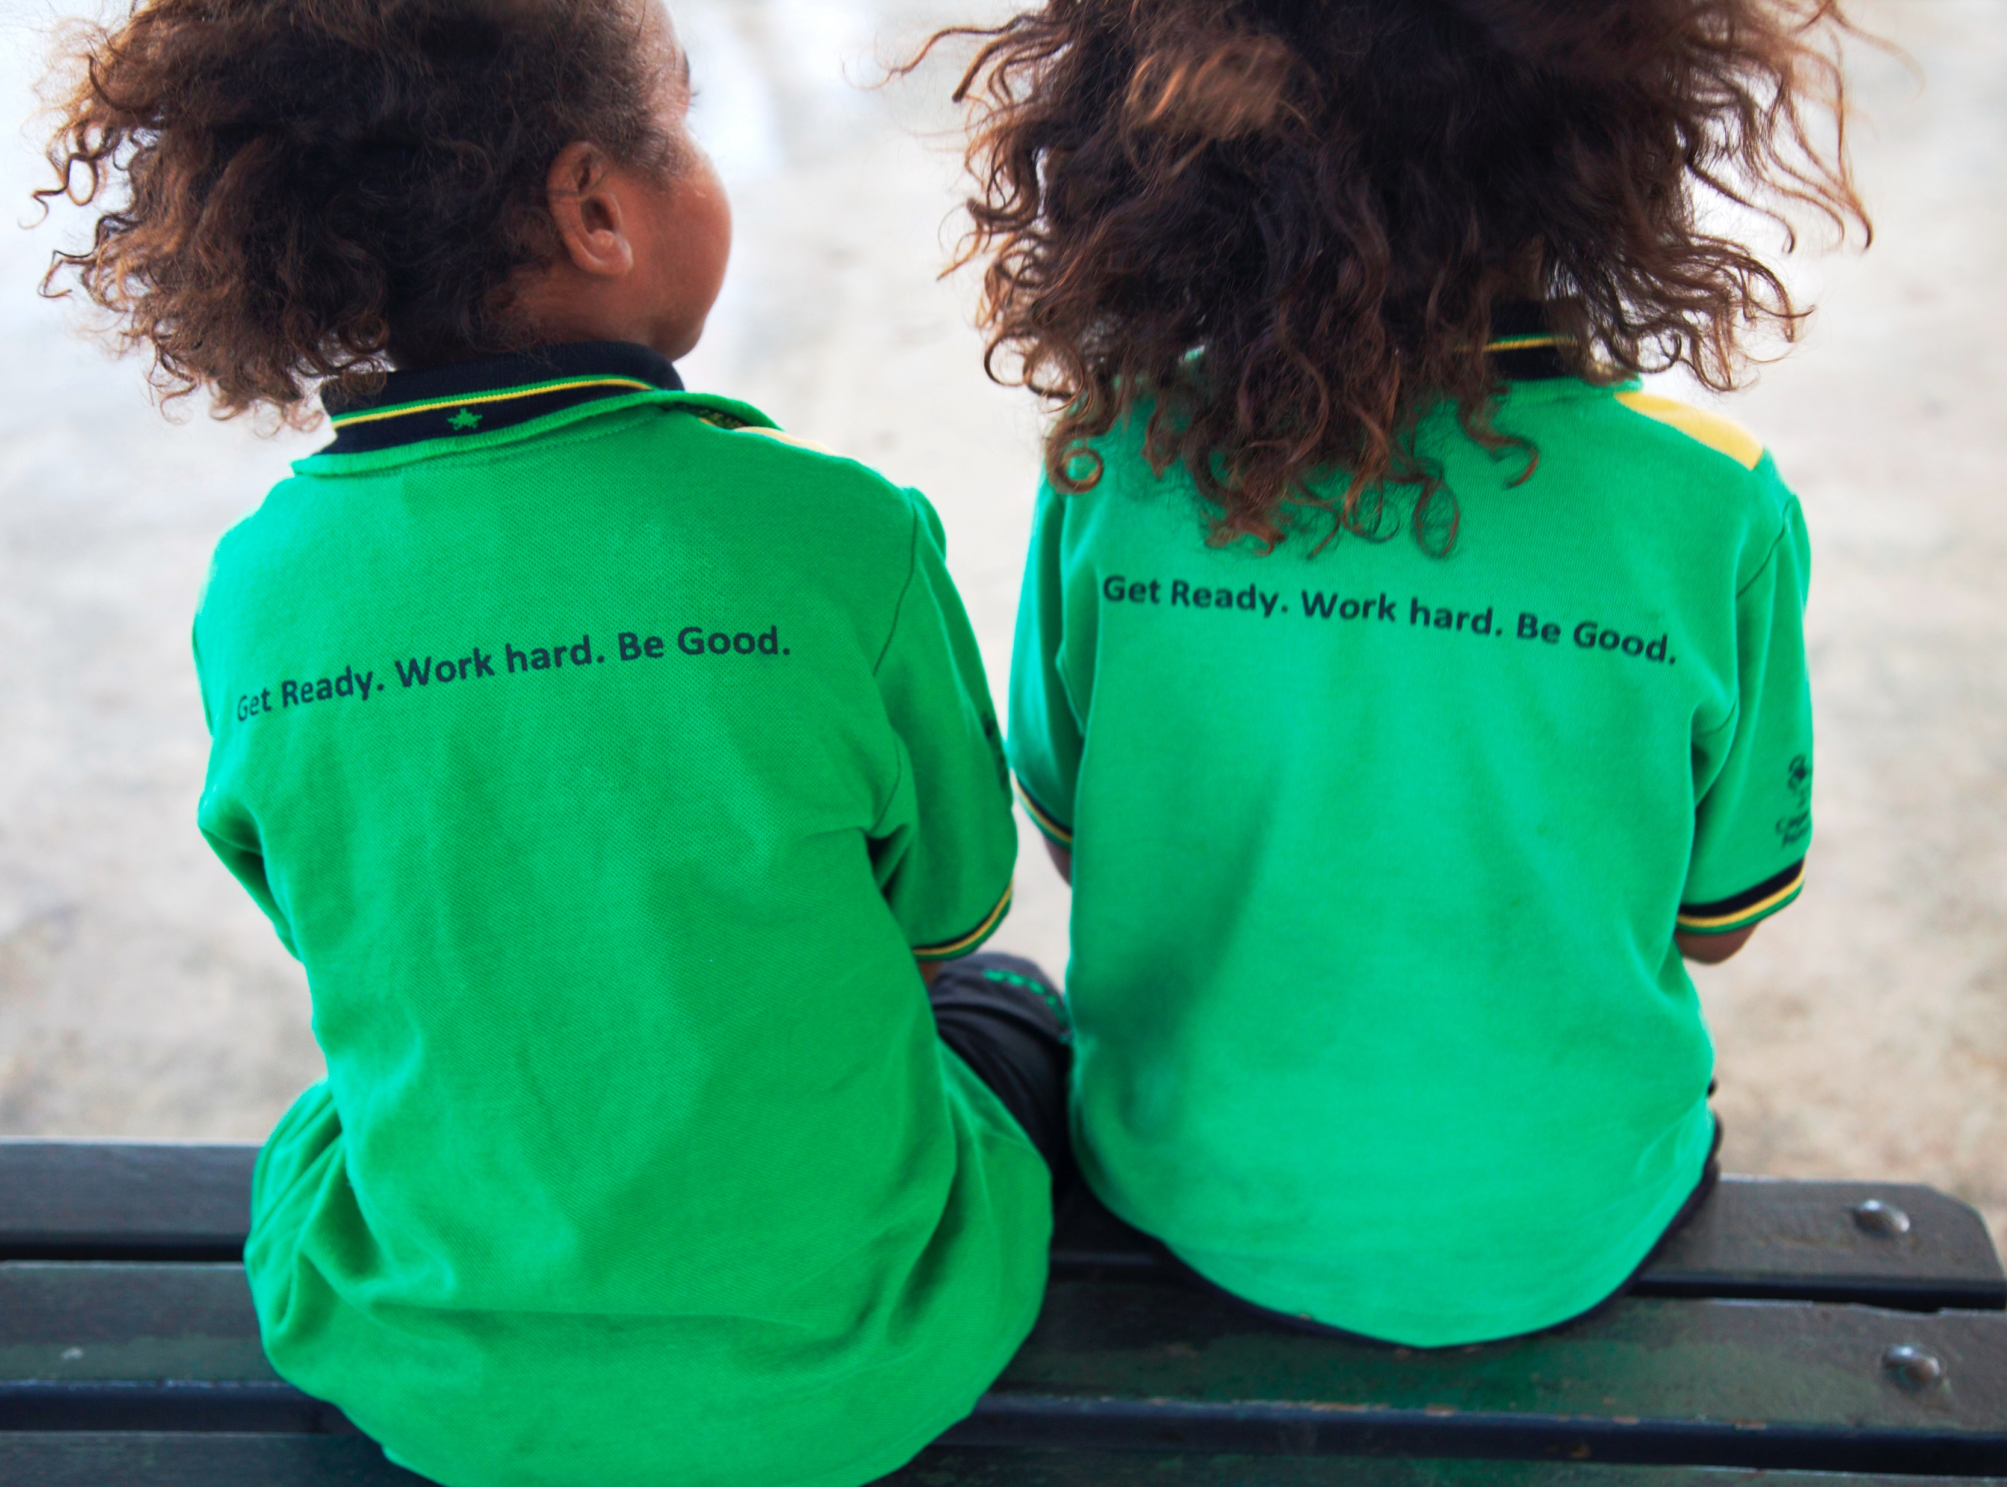
What Is Our School Motto?
A motto is a special message that tells us how to behave.
Get Ready.
Work Hard.
Be Good.

Slide 6


Thumbs Up or Thumbs Down
Our school motto is 'Get Ready. Work Hard. Be Good.’ It helps us know how to act and treat others at school.
yes
no

Slide 7

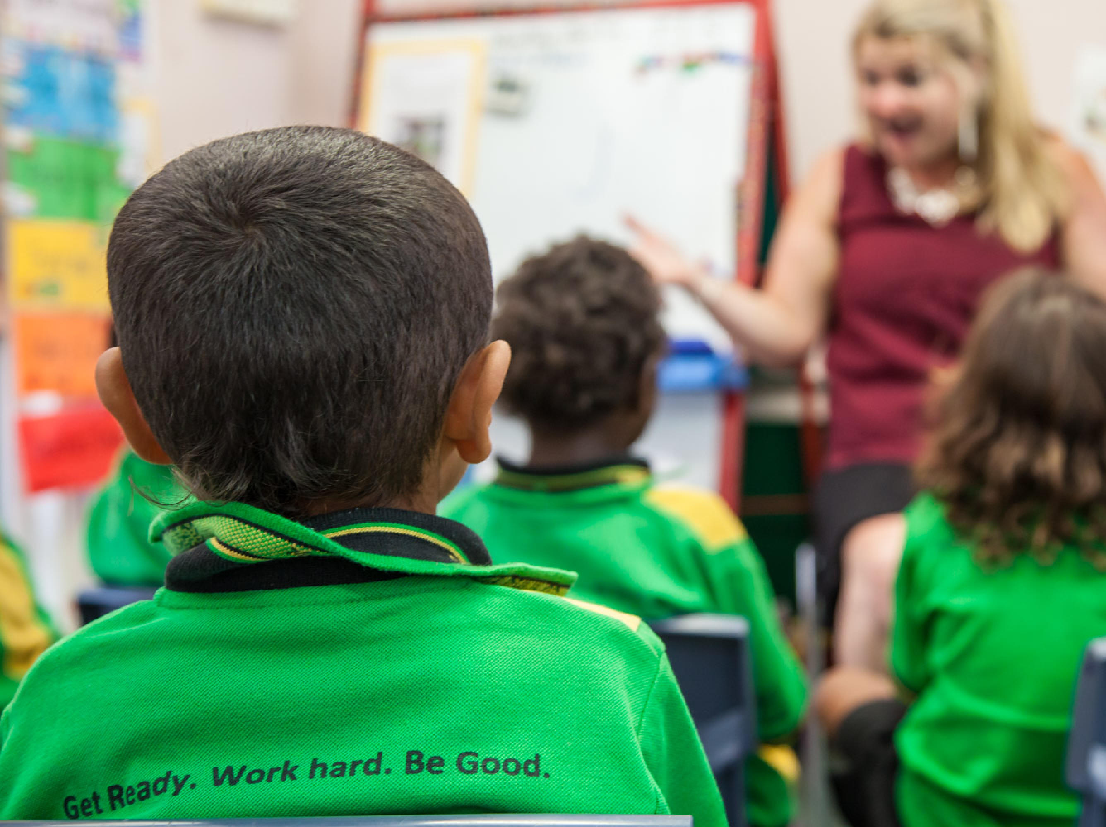

Get Ready
Be ready to learn by having everything you need and pay attention to do your best.

Slide 8
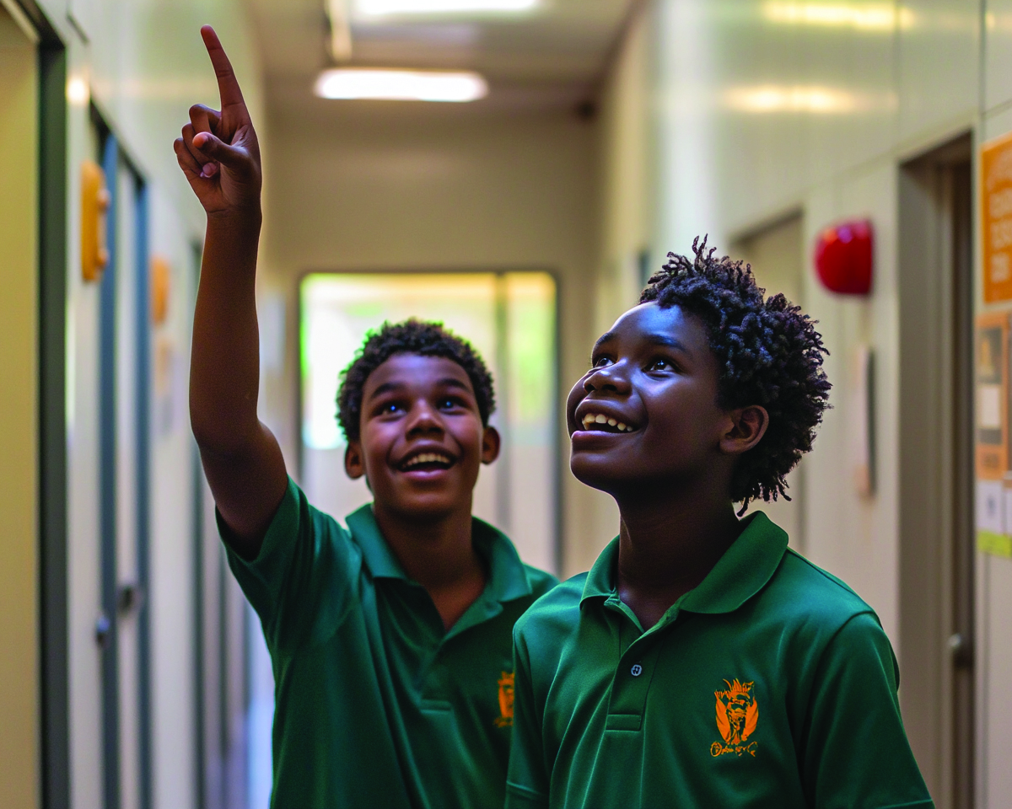



Work Hard
Try your best, keep going and don’t give up.

Slide 9


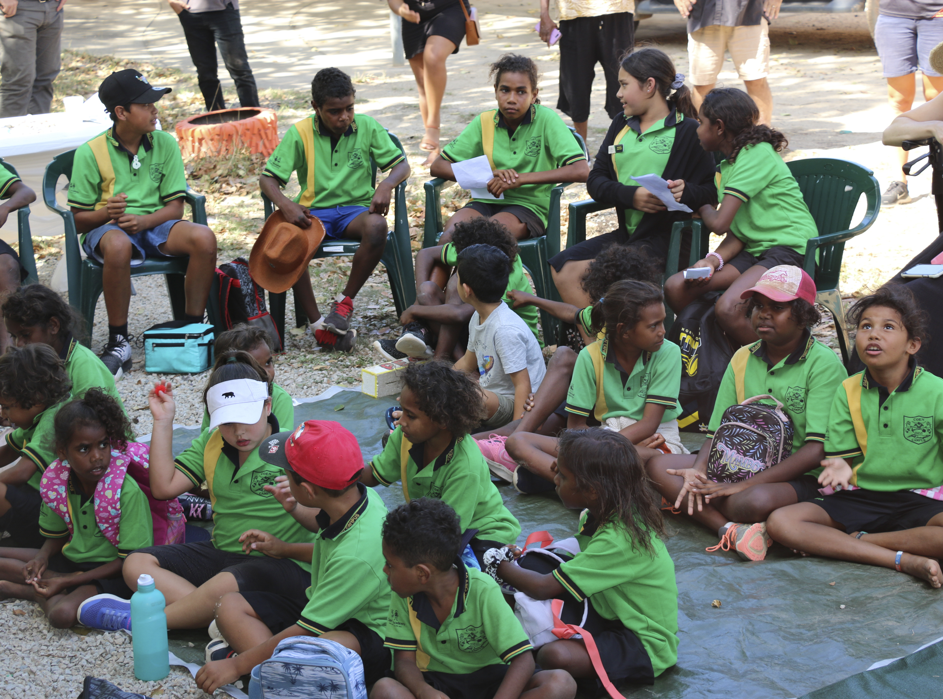
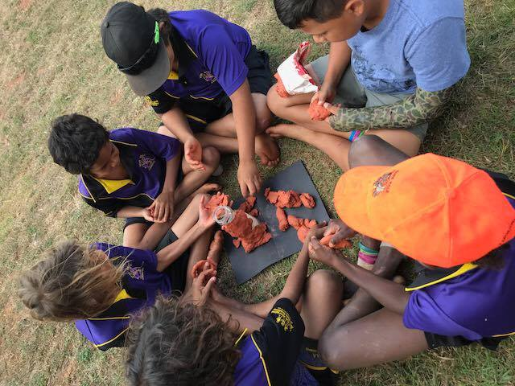
Be Good
Behave in a way that is kind, respectful and thoughtful towards others.

Slide 10
Thumbs Up or Thumbs Down
Working hard will help you learn new things and get better at them.
yes
no

Slide 11
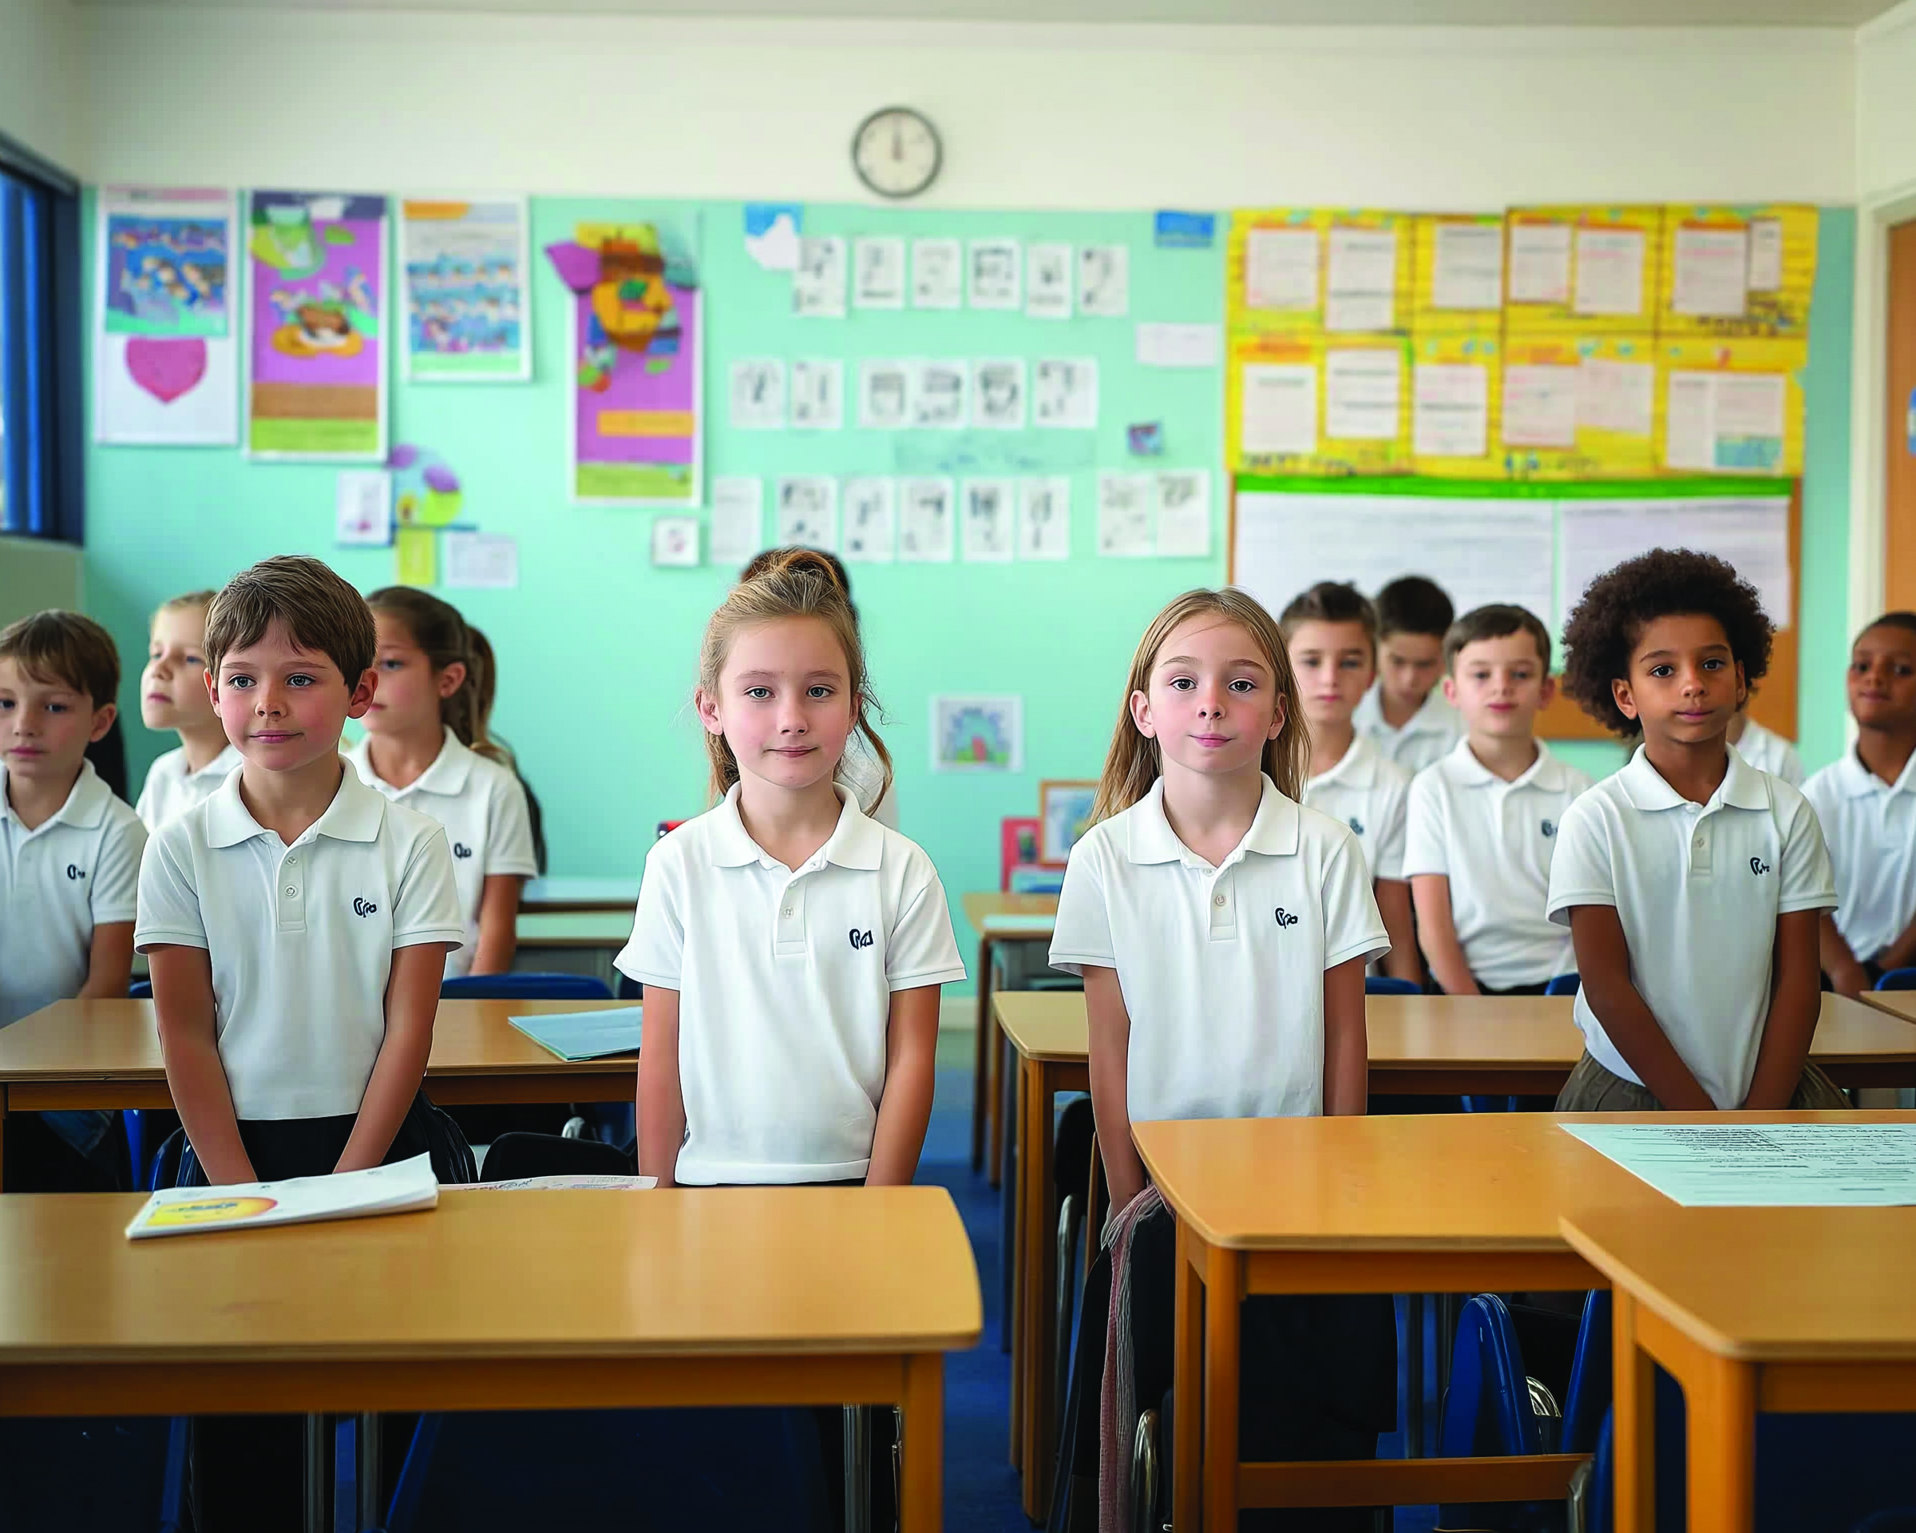
Get Ready

Slide 12
Get Ready

Slide 13
Work Hard

Slide 14
Work Hard

Slide 15

Be Good

Slide 16
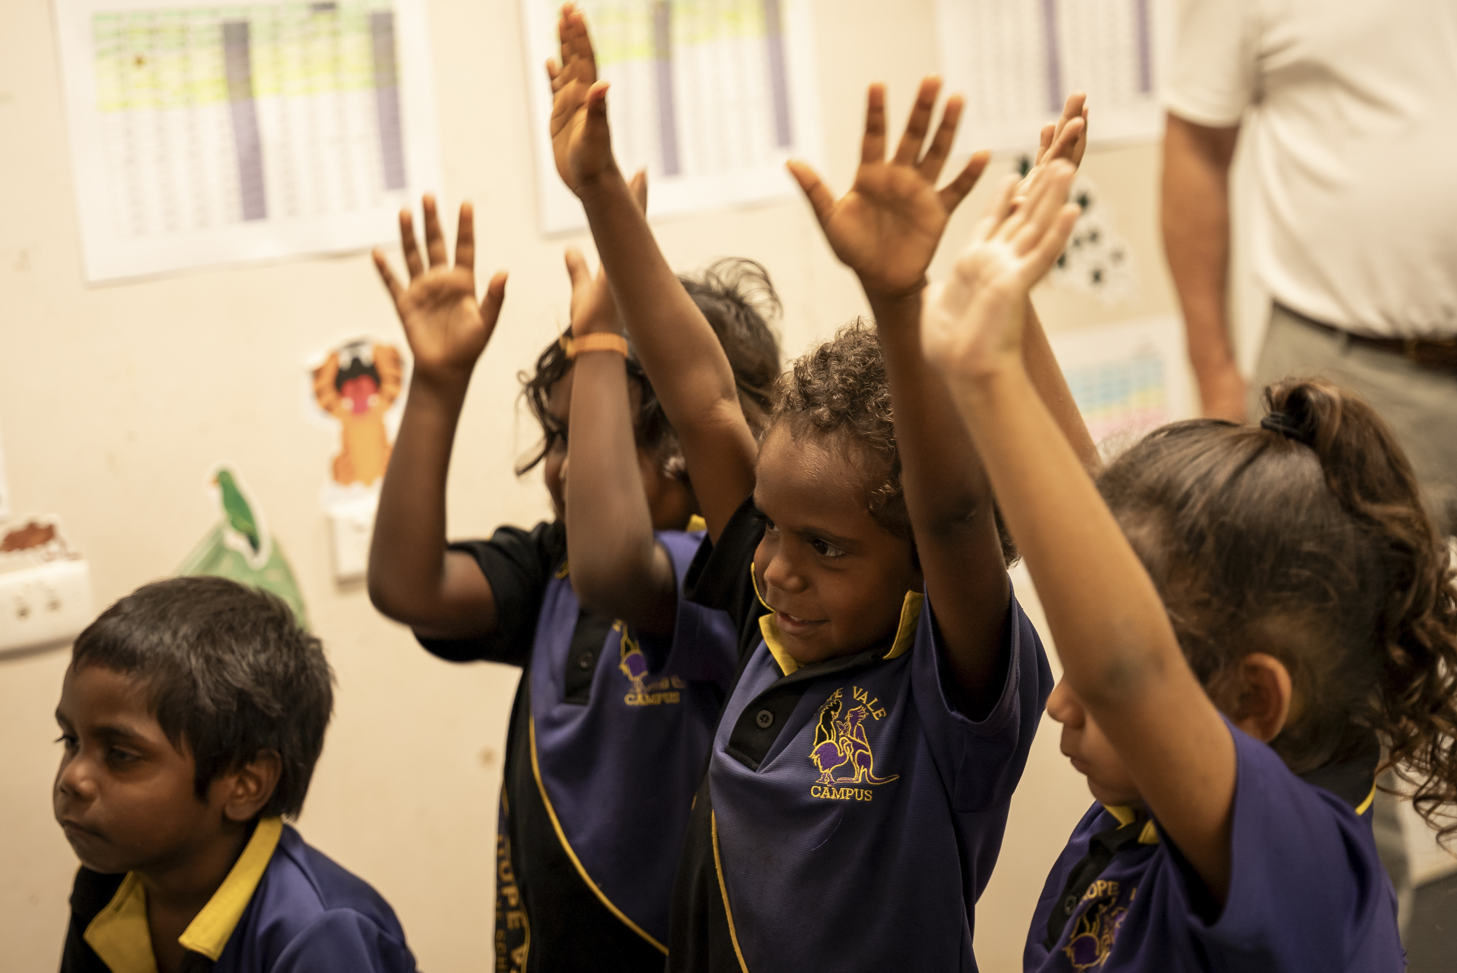
Be Good

Slide 17

School Motto

Slide 18


Slide 19
Get Ready.
Work Hard.
Be Good.

Slide 20

How well did you:
recognise the school motto and abide by its values?

