Slide 1

Classroom Rules
Unit 1, Week 1
Learn Well

Slide 2
In this lesson, you will learn the classroom rule, ‘Learn Well’.

Slide 3
You will be successful when you can learn the classroom rule, ‘Learn Well’.

Slide 4
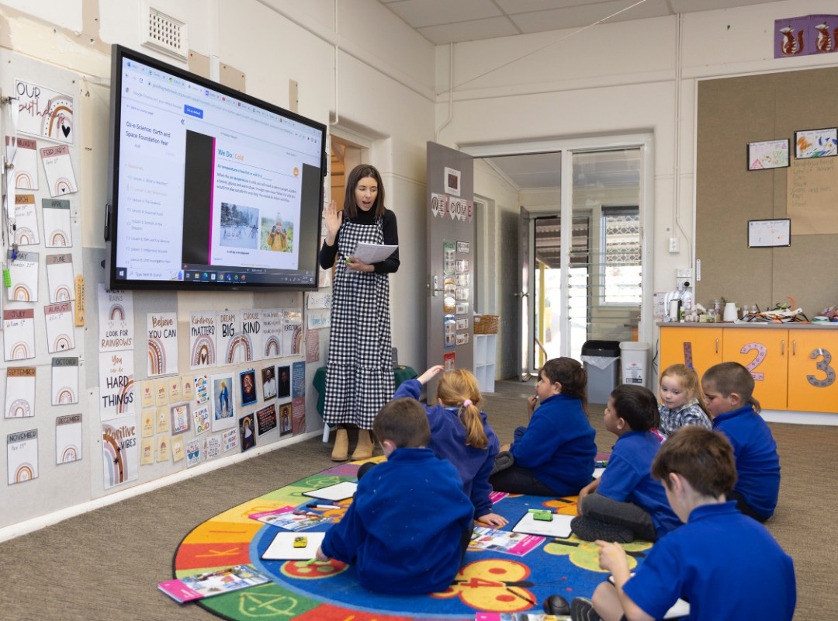

Slide 5
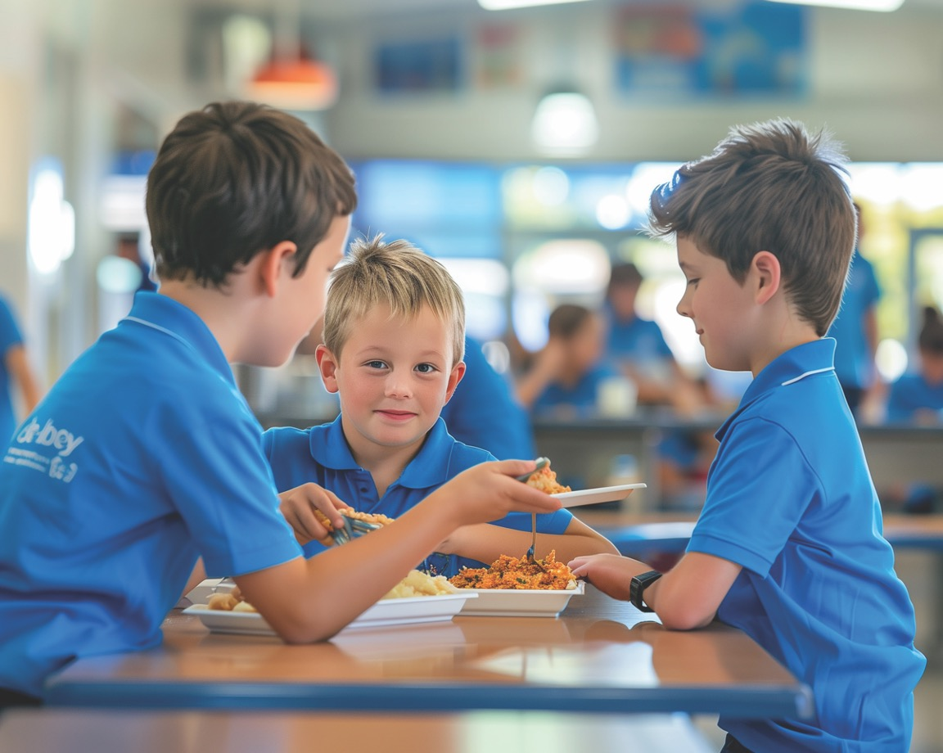
What Are Rules?
Rules tell us what we need to do.

Slide 6


Thumbs Up or Thumbs Down
Following rules helps me learn at school.
yes
no

Slide 7

Learn Well
Our ‘Learn Well’ rules help us learn a lot and feel like we are keeping up.

Slide 8
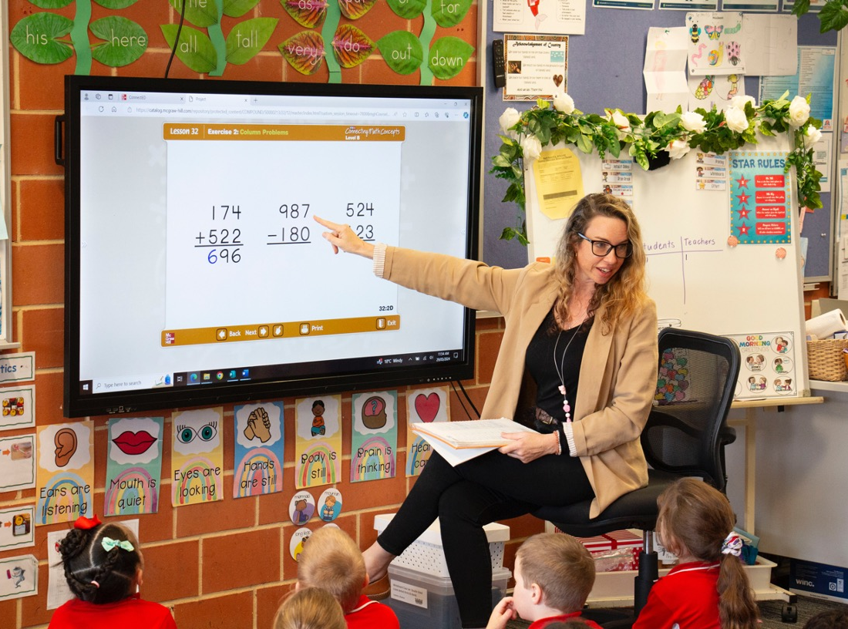
Track the Teacher
Keep your eyes on the teacher.

Slide 9

Listen
Listening helps us learn.

Slide 10

Respond on Signal
We all act together at the same time.

Slide 11

Use Your Speaking Voice
Speak clearly so everyone can hear.

Slide 12

Complete Independent Work
Complete tasks on your own.

Slide 13
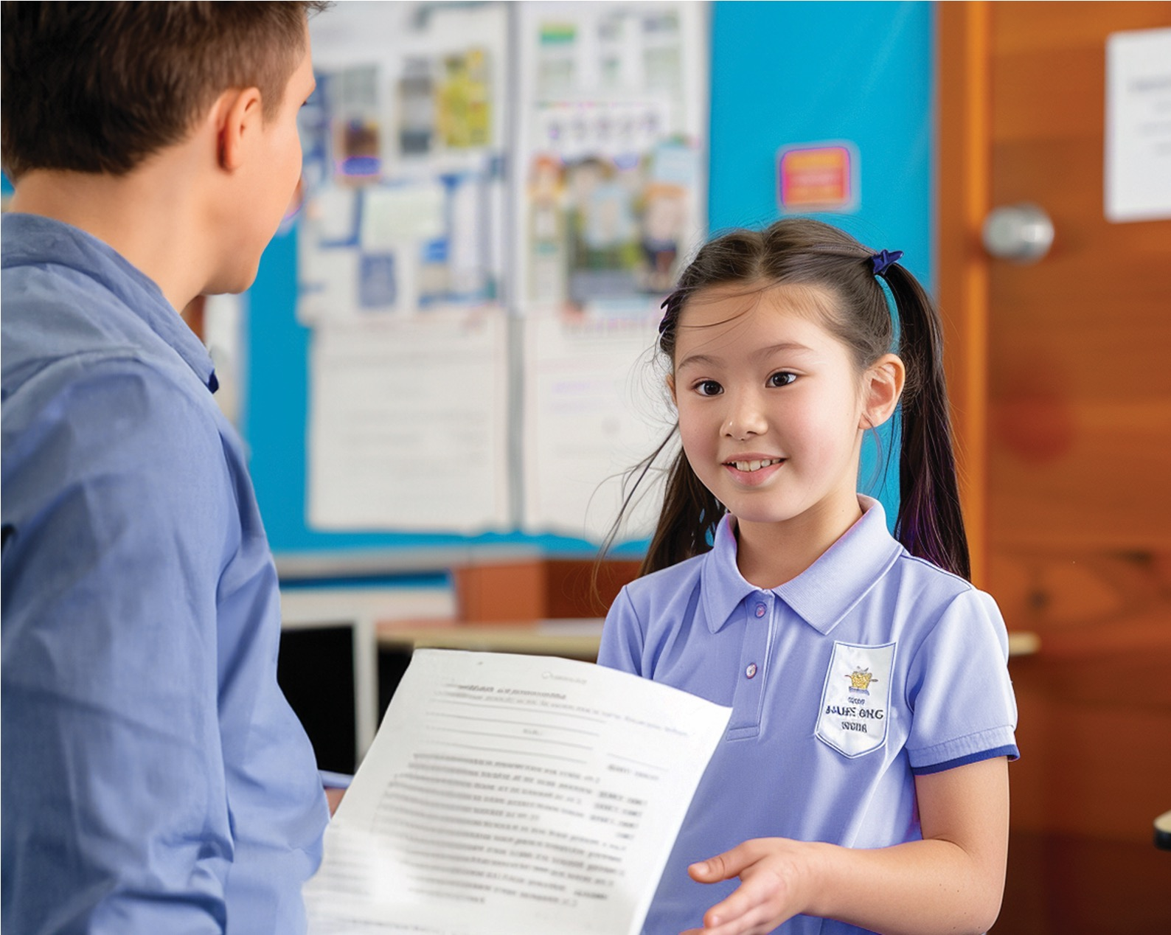
Hand in Completed Work
Give your finished assignments to the teacher.

Slide 14
Thumbs Up or Thumbs Down
Doing independent work means working on a task by yourself without distractions.
yes
no

Slide 15
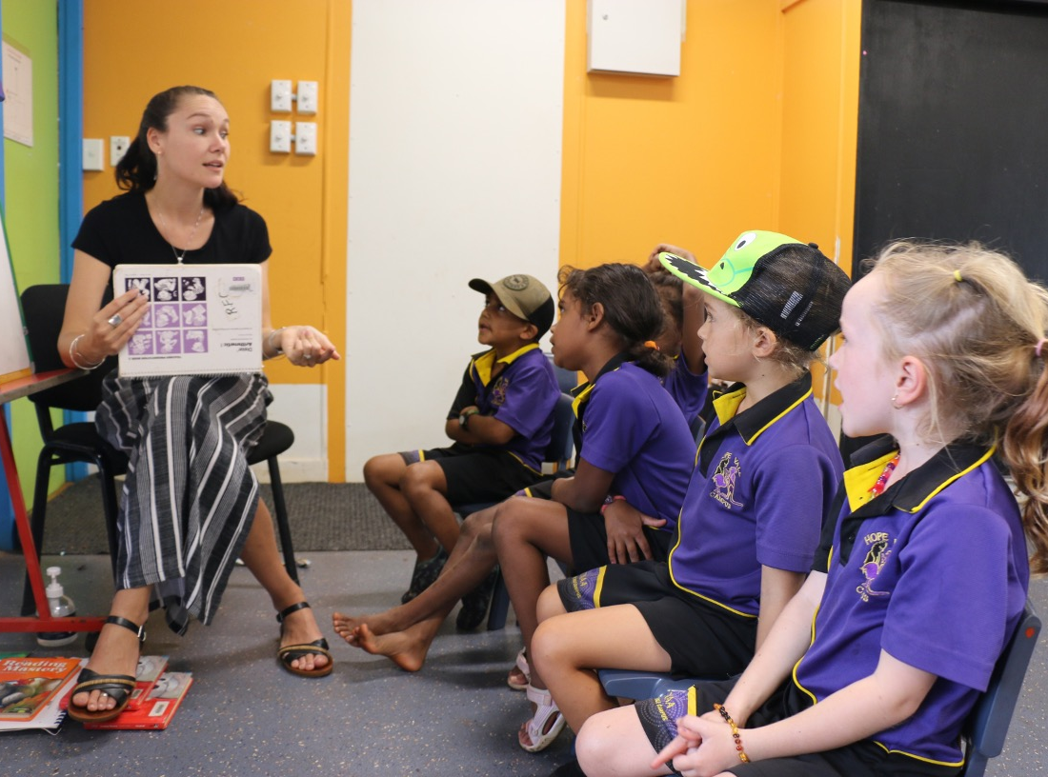
Track the Teacher

Slide 16

Track the Teacher

Slide 17
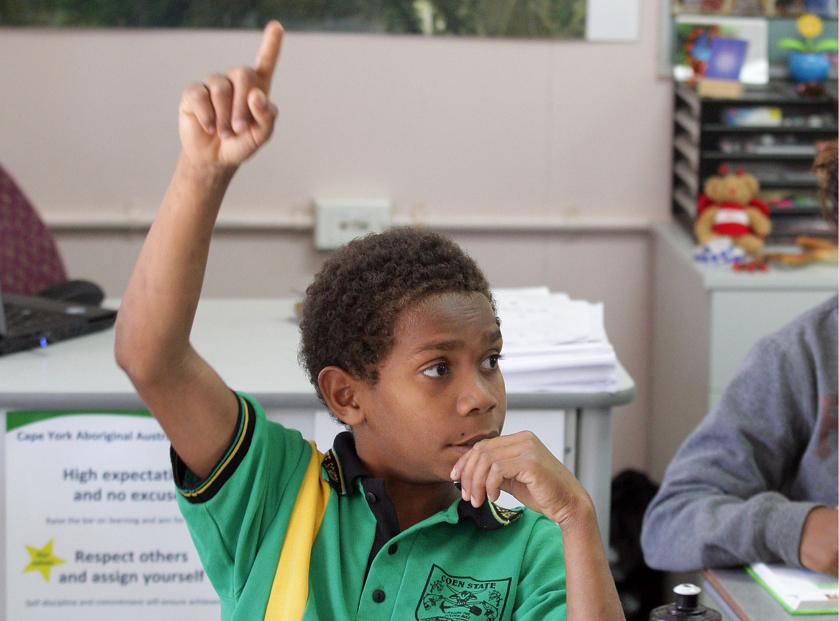
Respond on Signal

Slide 18

Respond on Signal

Slide 19
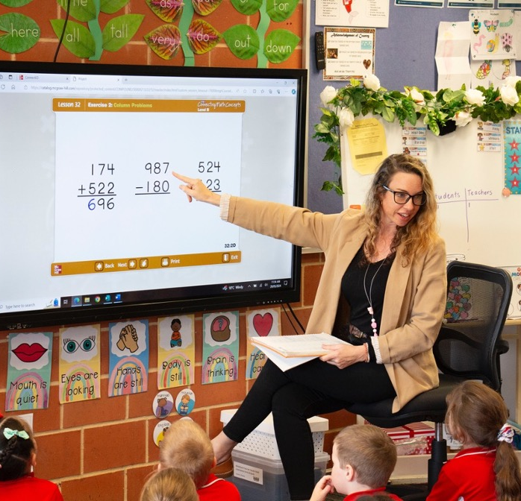




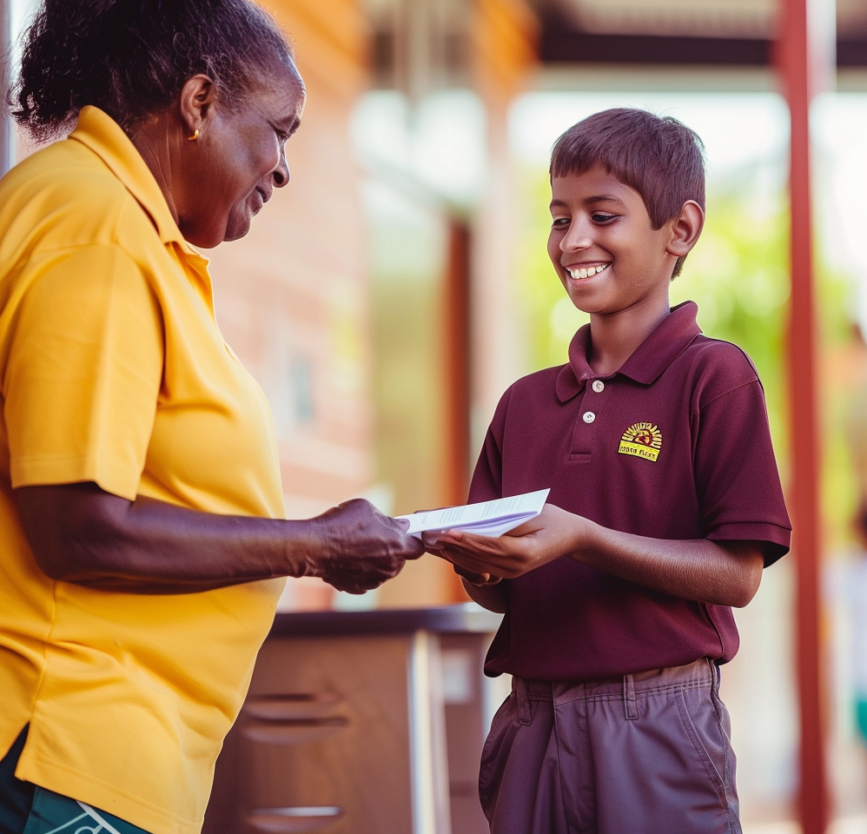
Learn Well

Slide 20


Slide 21
Our ‘Learn Well’ rules help us learn a lot and feel like we are keeping up.

Slide 22

How well did you:
follow the classroom rules, ‘Learn Well’?

