Slide 1

Classroom Rules
Unit 1, Week 2
Apologise When Wrong

Slide 2
In this lesson, you will learn the classroom rule, ‘Apologise When Wrong’.

Slide 3
You will be successful when you can demonstrate the classroom rule, ‘Apologise When Wrong’.

Slide 4
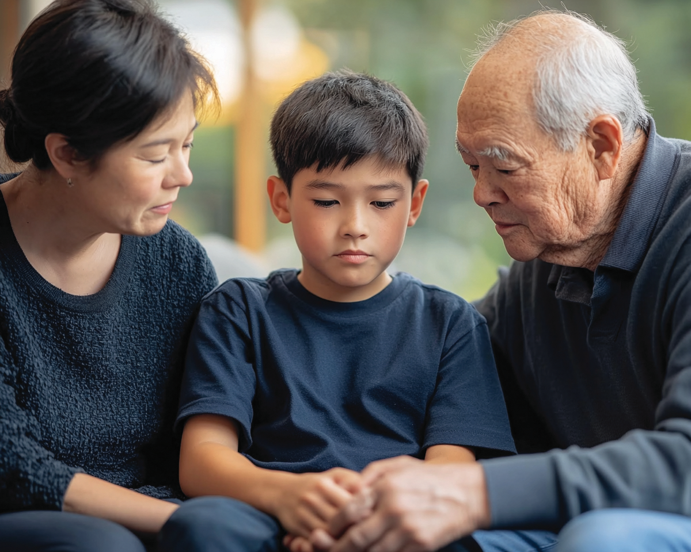
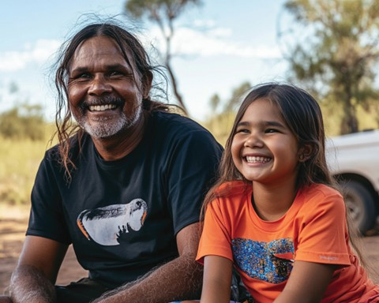

Slide 5

What Are Rules?
Rules tell us what we need to do.

Slide 6


Thumbs Up or Thumbs Down
When we demonstrate rules, school is a positive and supportive place for everyone.
yes
no

Slide 7
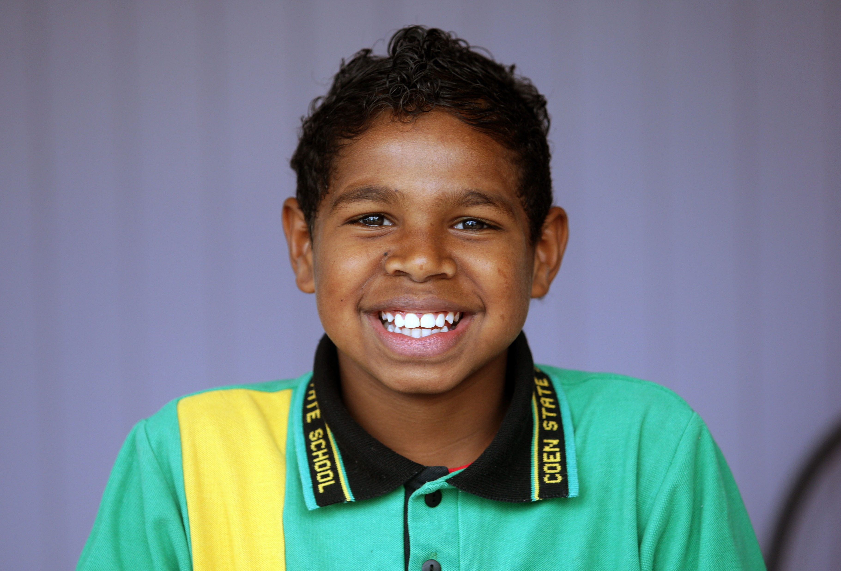
Apologise When Wrong
Our ‘Apologise When Wrong’ rules help us reflect on our actions, take responsibility, and repair any harm caused.

Slide 8
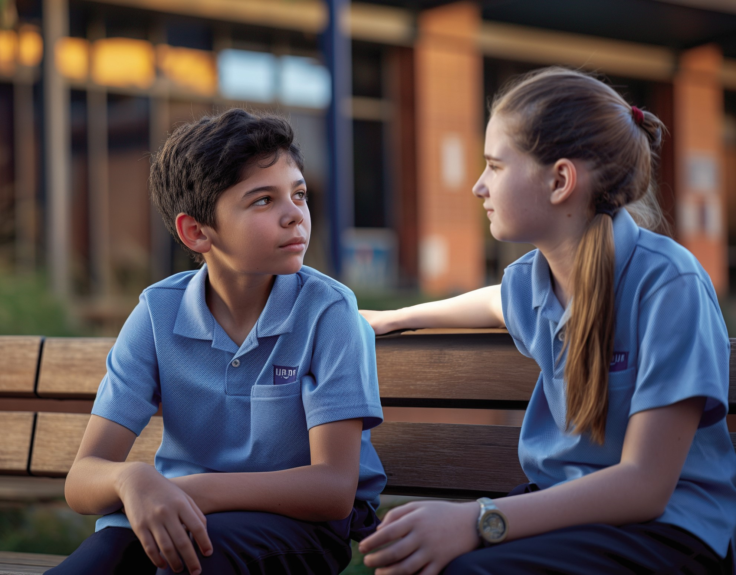
Identify Emotions
Knowing what we feel helps us understand ourselves better.

Slide 9
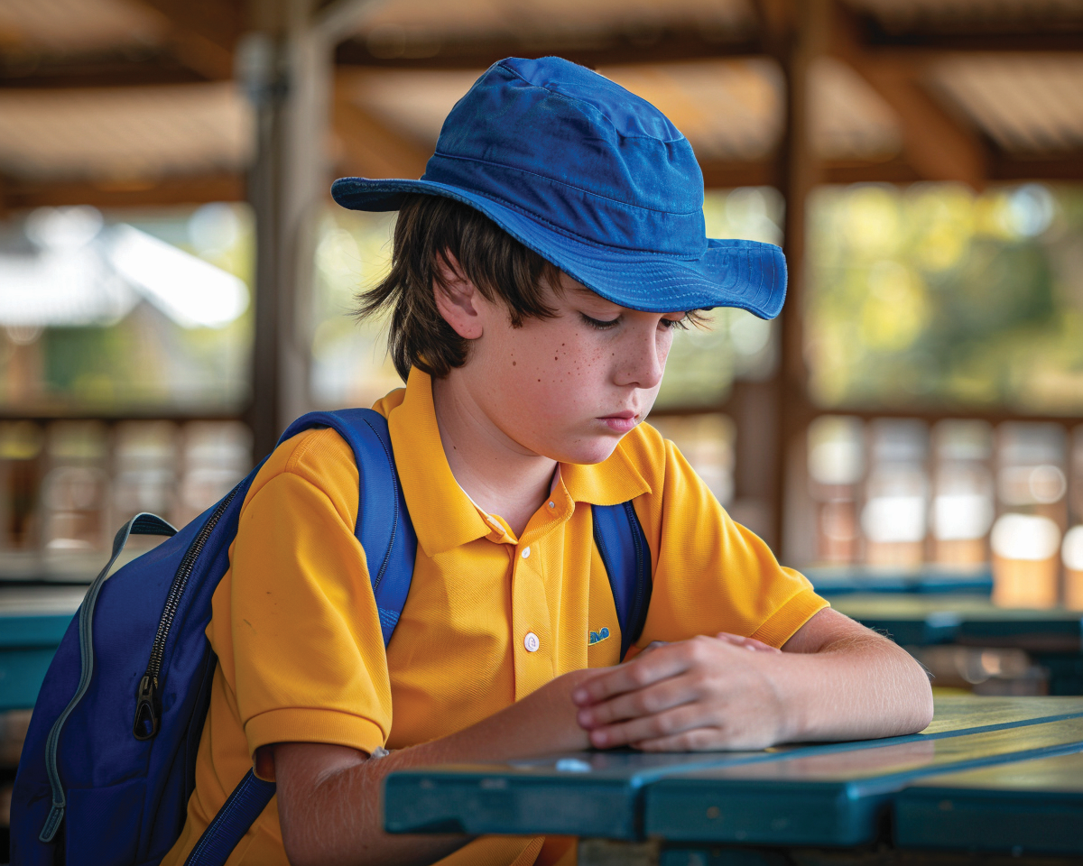
Reflect on Behaviour
Reflecting on our behaviour helps us see our mistakes and find ways to improve next time.

Slide 10

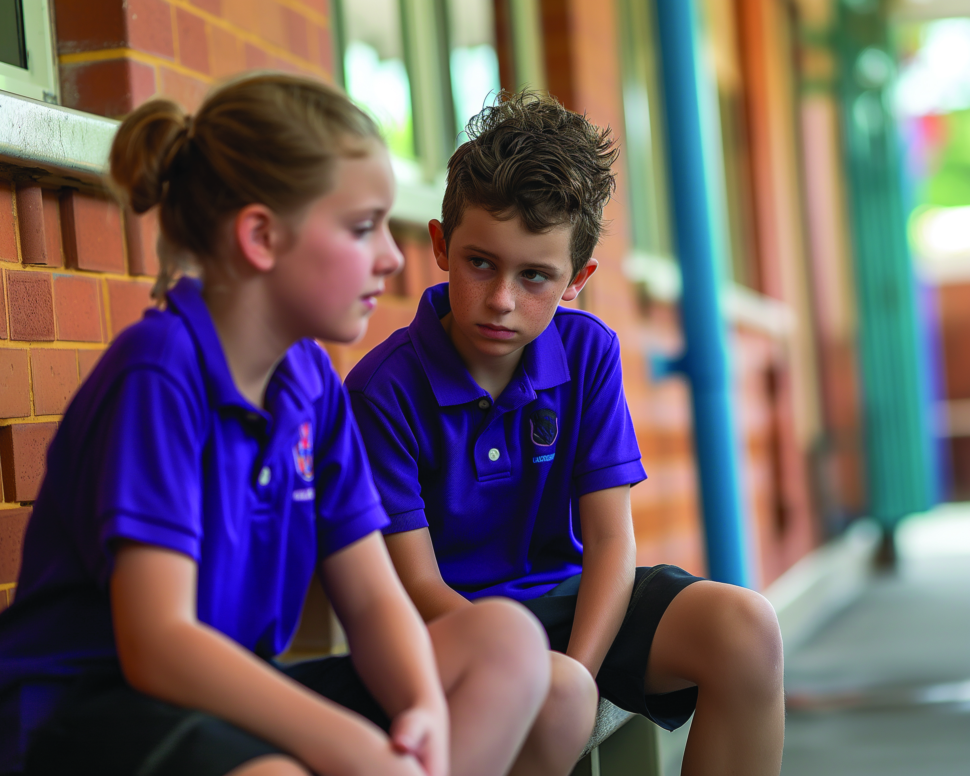
Understand the Consequences
Understanding consequences helps us think before we speak or act.

Slide 11
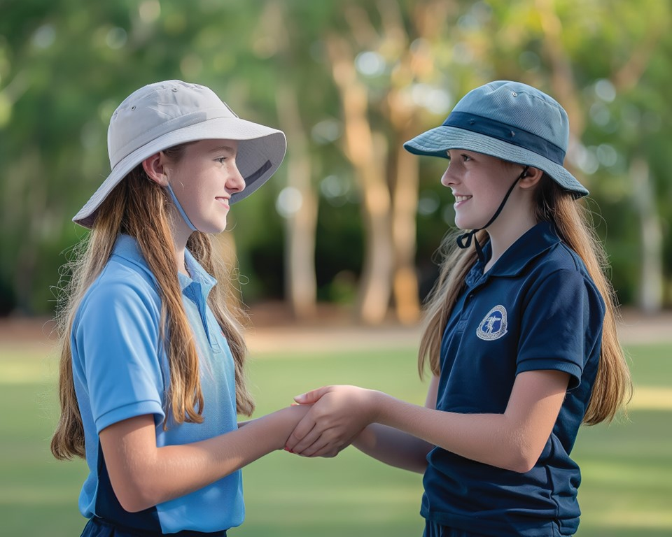
Make Reparations
Making reparations means taking action to fix a wrong you’ve done.

Slide 12
Thumbs Up or Thumbs Down
Reflecting on our behaviour shows we care about being a better person and want to be the best version of ourselves.
yes
no

Slide 13
Understand the Consequences

Slide 14

Understand the Consequences

Slide 15
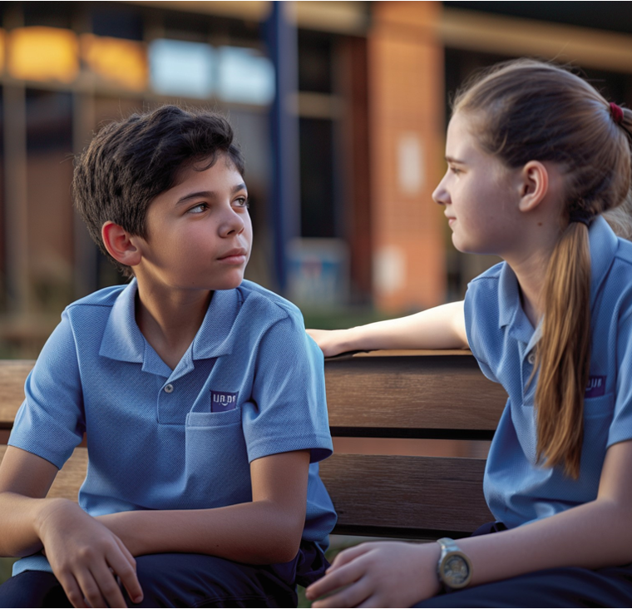
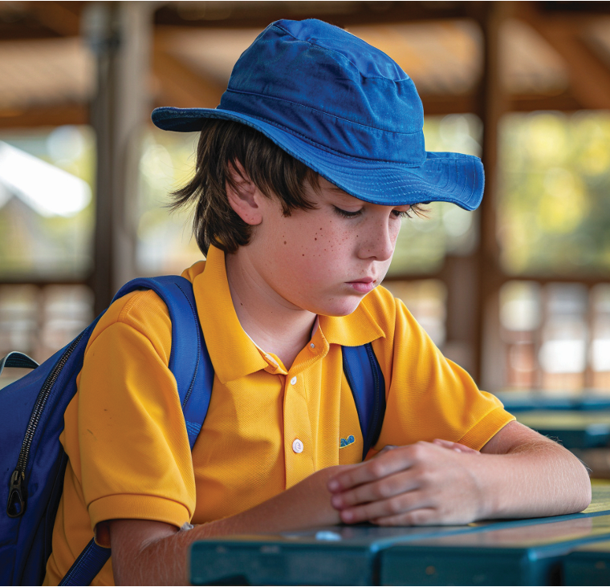
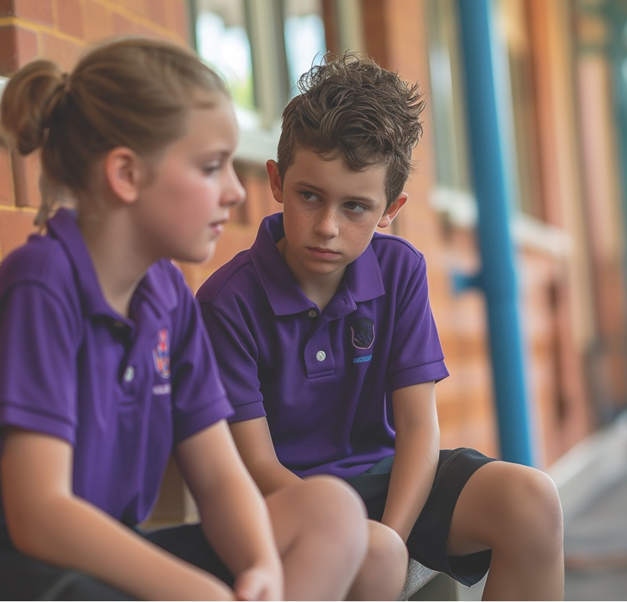
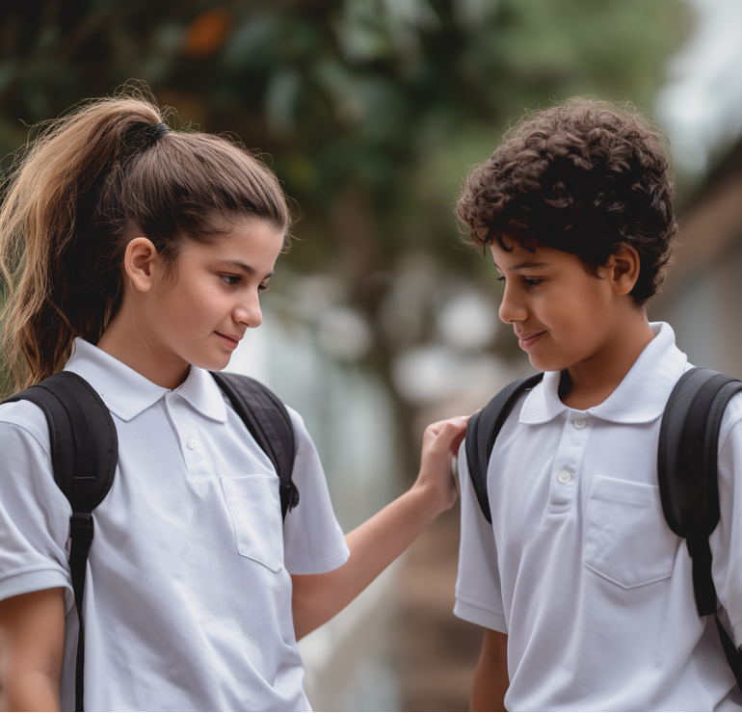
Apologise When Wrong

Slide 16
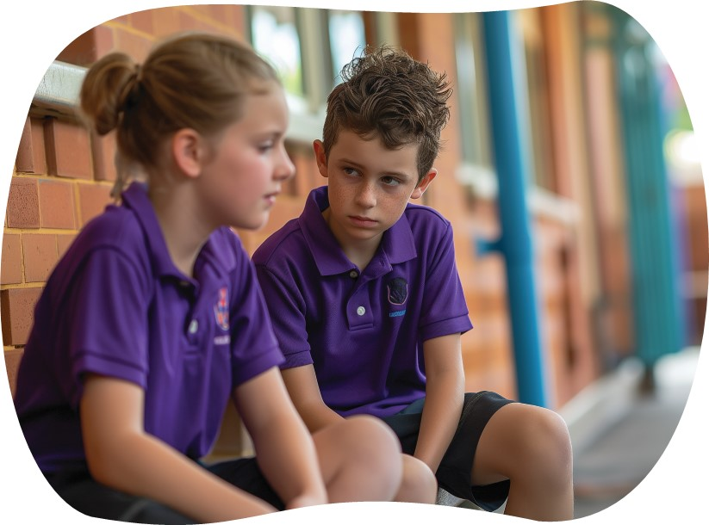

Slide 17

Our ‘Apologise When Wrong’ rules help us reflect on our actions, take responsibility, and repair any harm caused.

Slide 18

How well did you:
demonstrate the classroom rule, ‘Apologise When Wrong’?

