Slide 1

Classroom Rules
Unit 1, Week 2 Apologise When Wrong

Slide 2
In this lesson, you will learn the classroom rule, ‘Apologise When Wrong’.

Slide 3
You will be successful when you can follow the classroom rule, ‘Apologise When Wrong’.

Slide 4
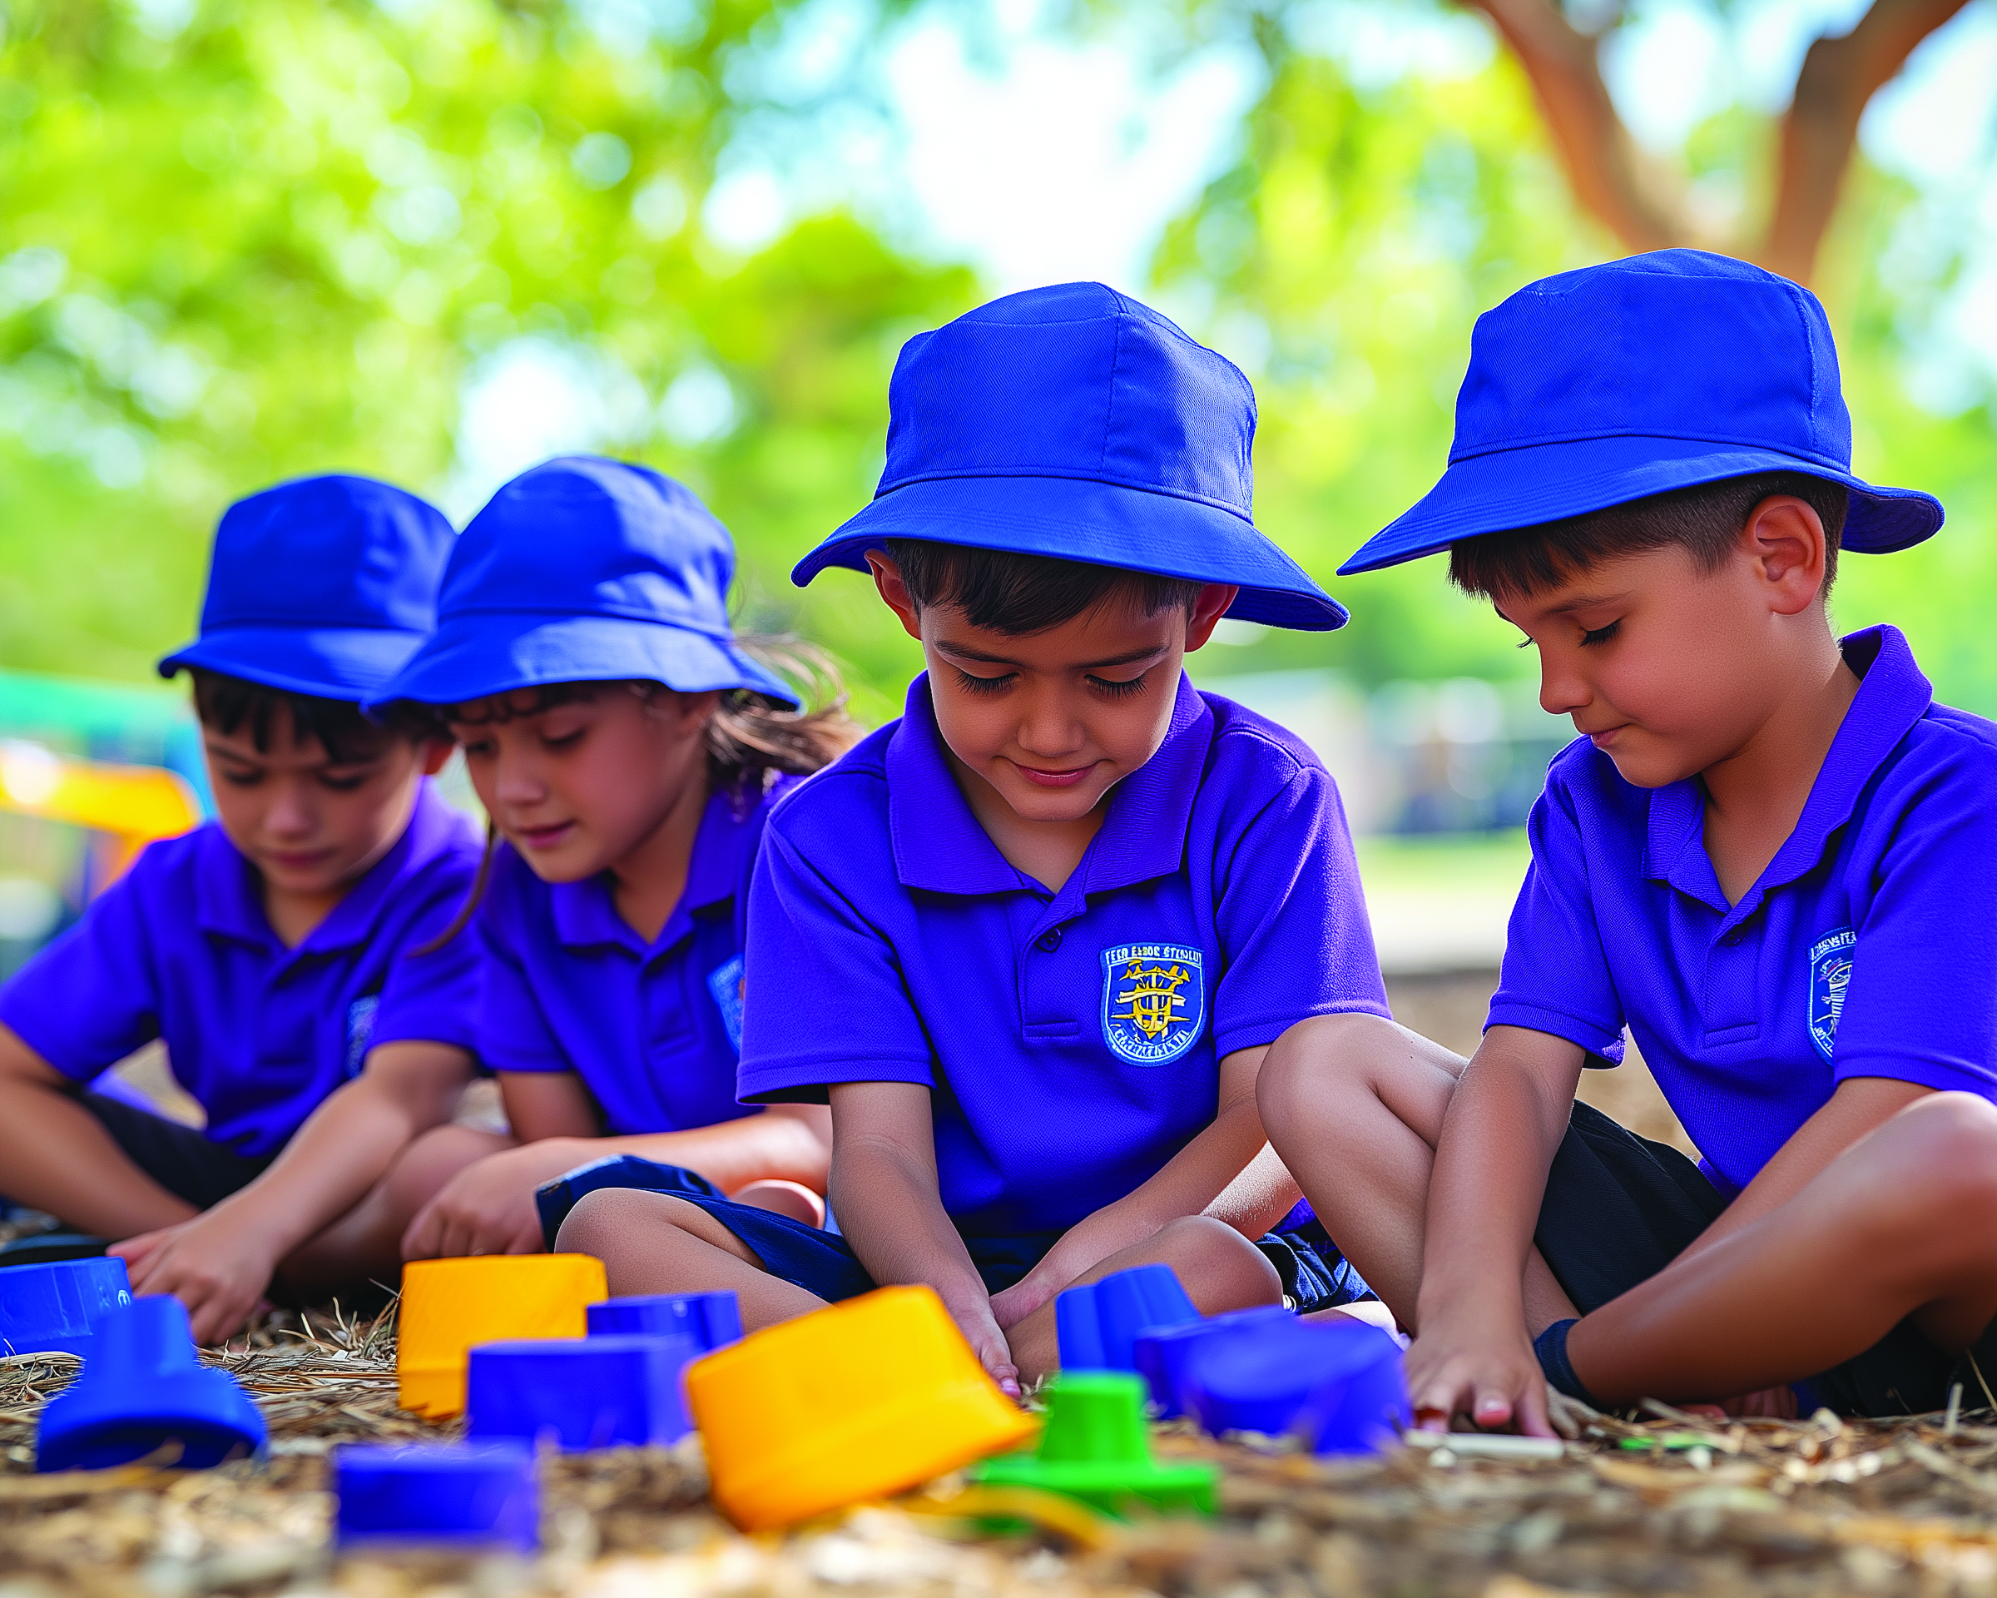
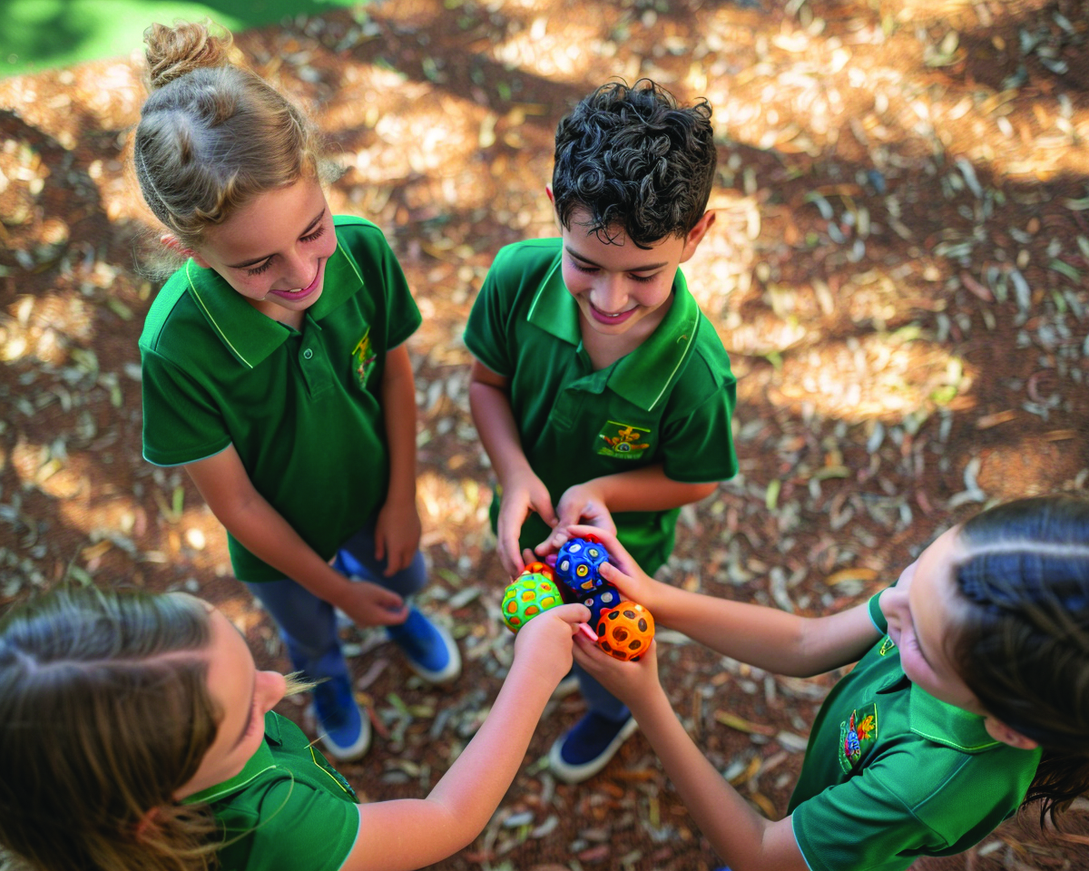
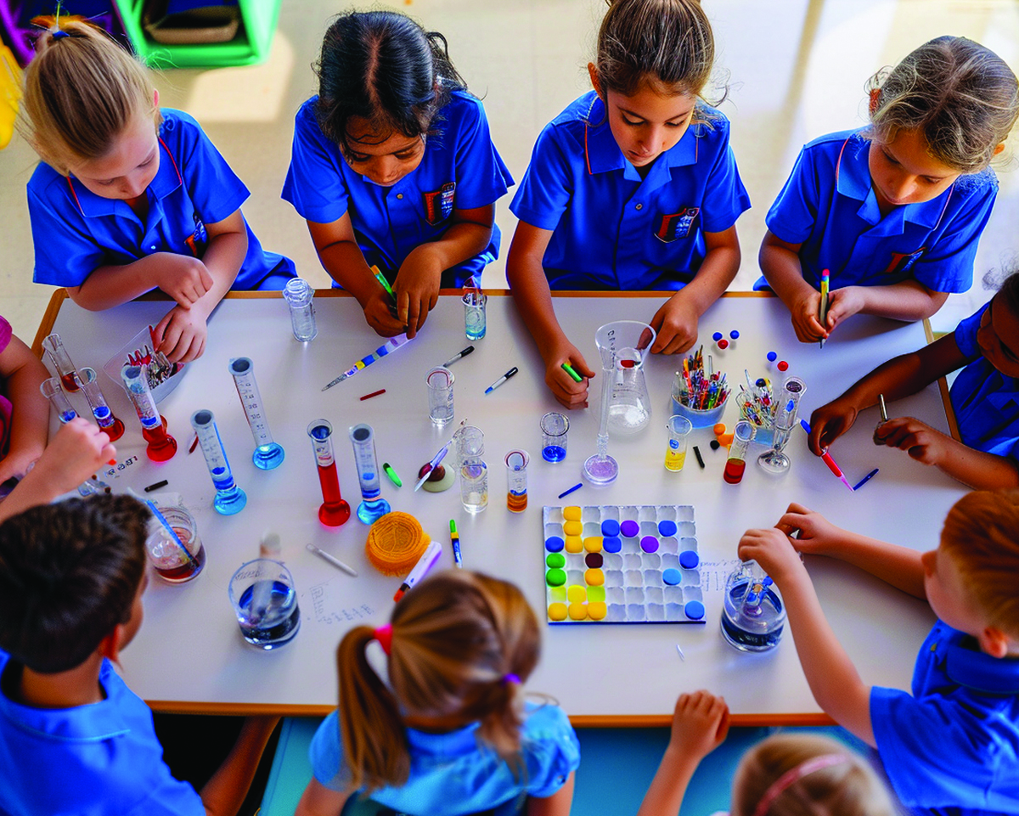

Slide 5

What Are Rules?
Rules tell us what we need to do.

Slide 6


Thumbs Up or Thumbs Down
When we follow the rules, school is a happy place for everyone.
yes
no

Slide 7
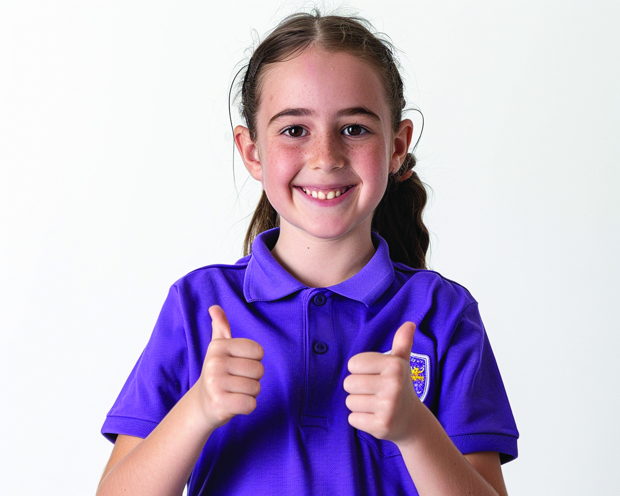
Apologise When Wrong
Our ‘Apologise When Wrong’ rules help us understand our feelings, fix our mistakes and make everyone feel better.

Slide 8

Identify Emotions
Take time to notice how we feel inside.

Slide 9

Reflect on Behaviour
Think about our actions.

Slide 10
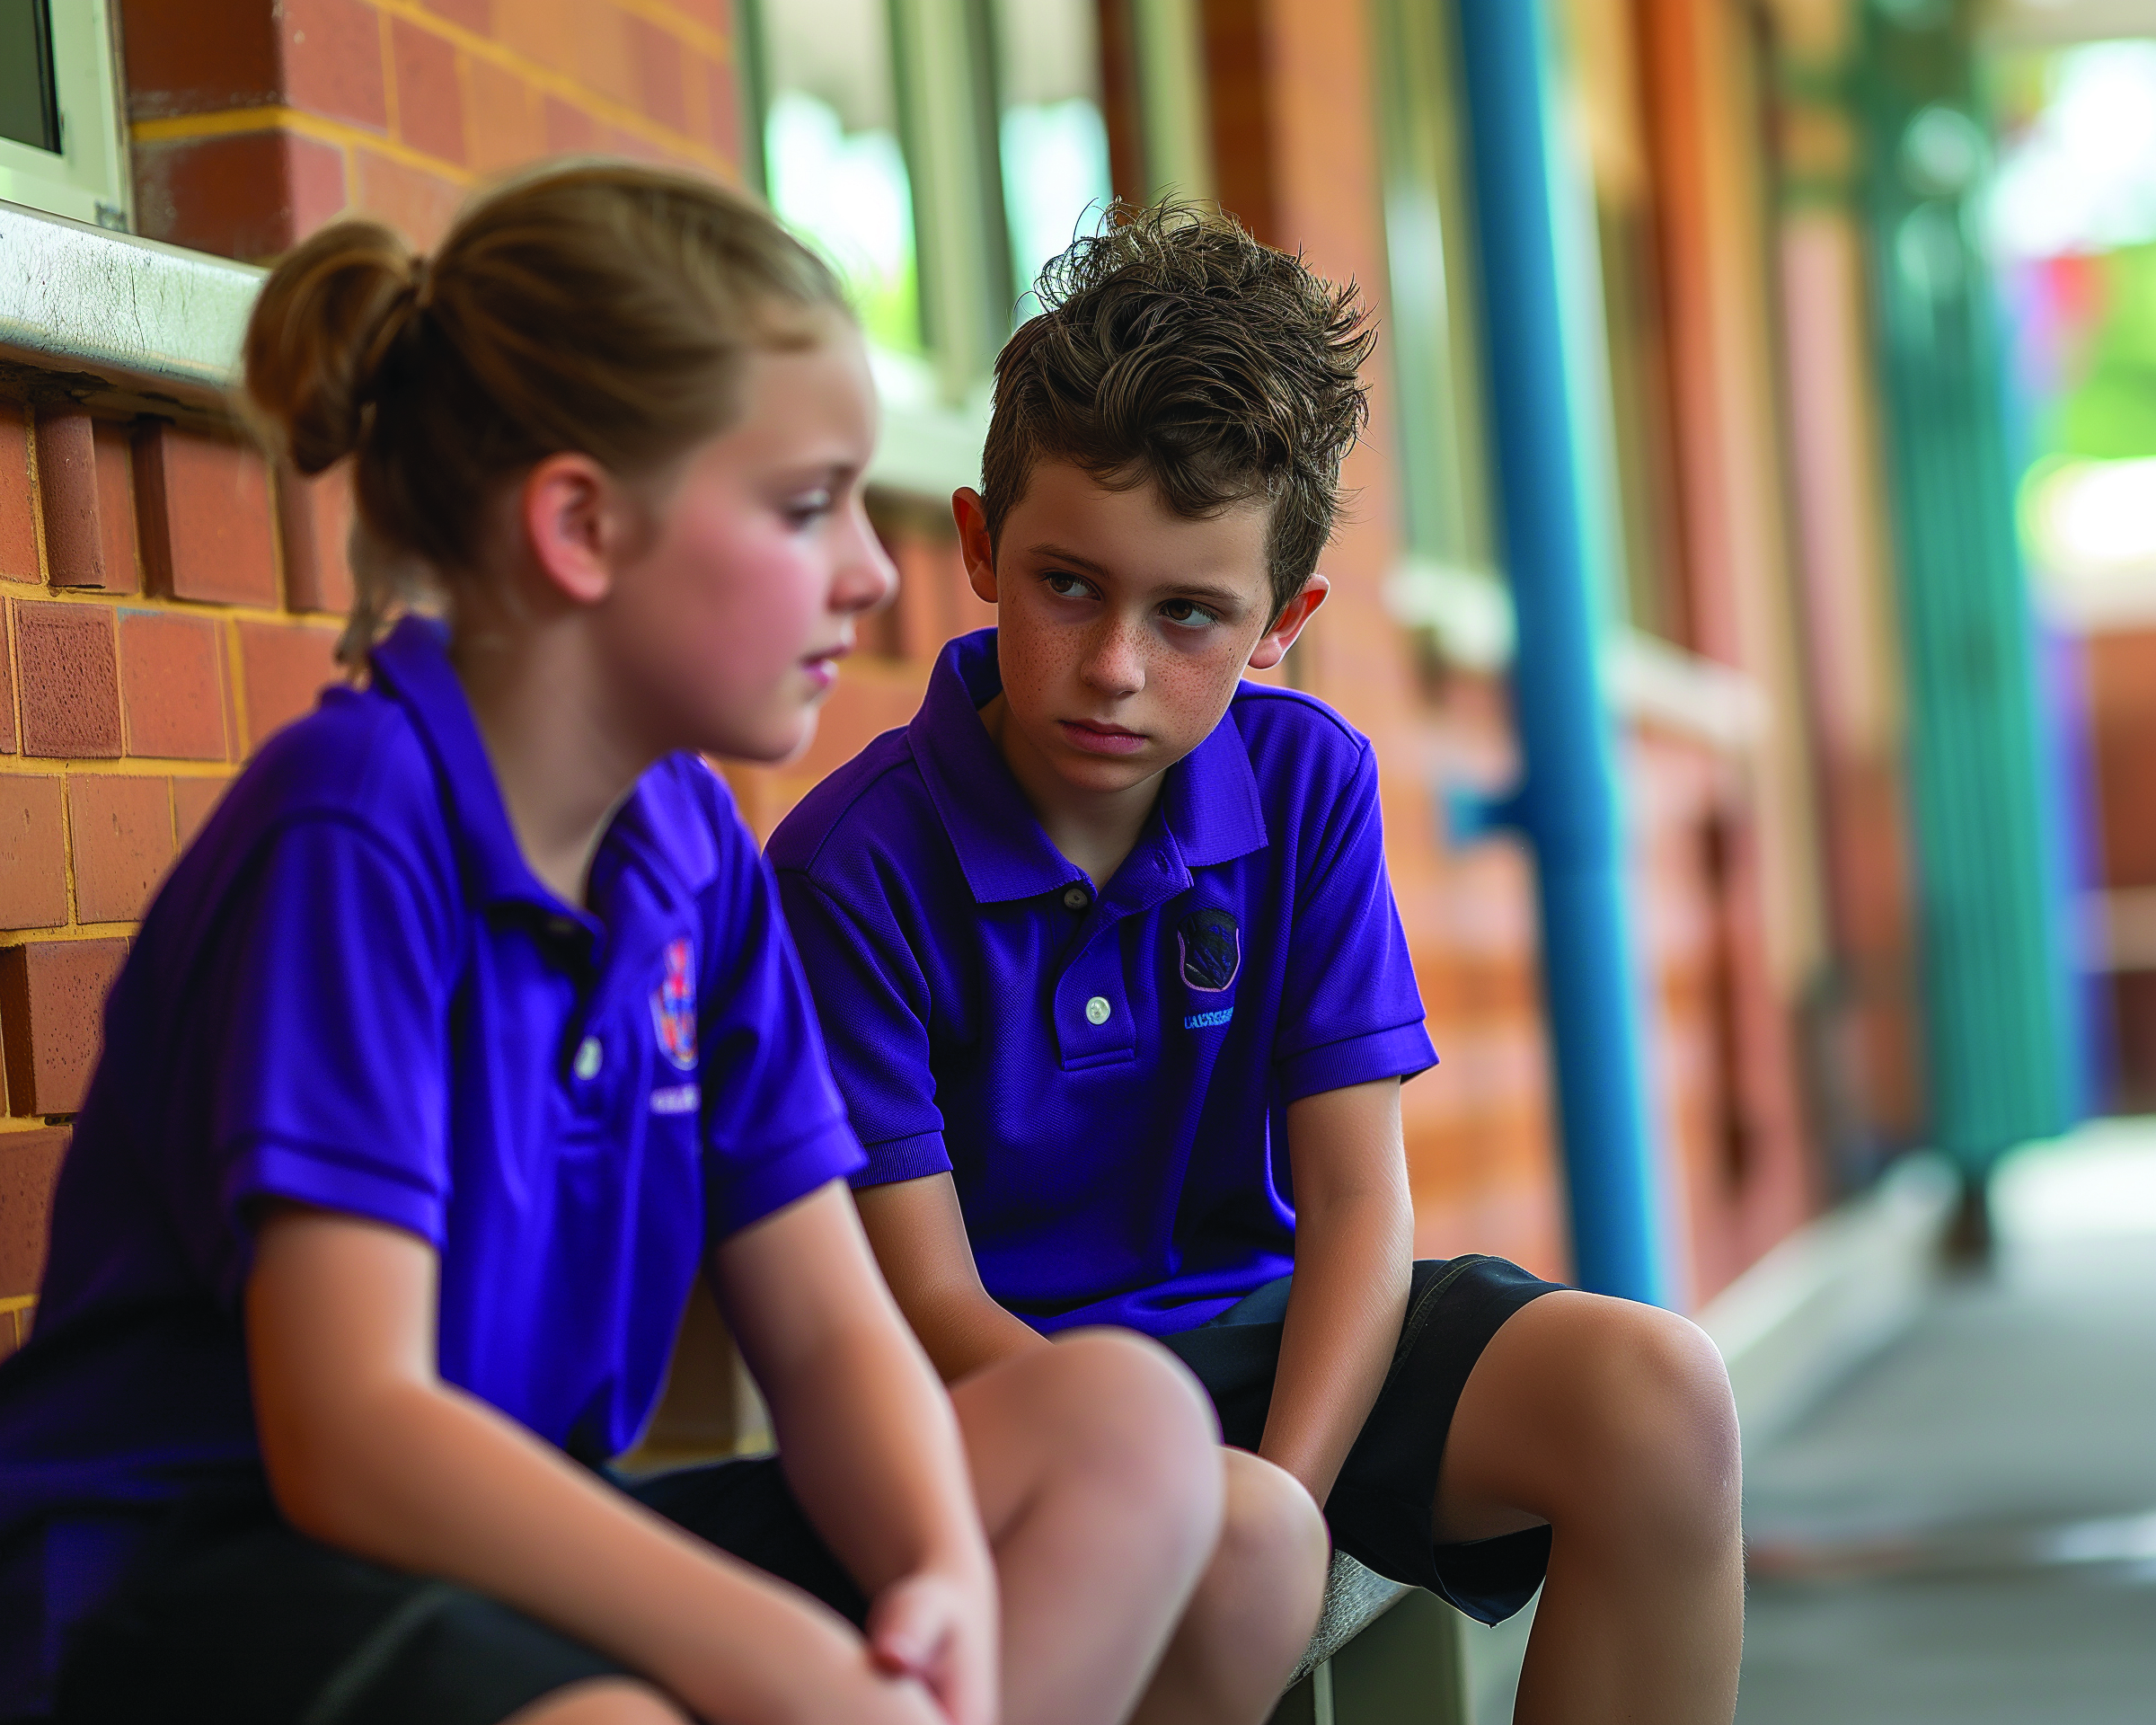
Understand the Consequences
Think about how our choices affect ourselves and others.

Slide 11
Make Reparations
Take action to fix a problem we caused.

Slide 12
Thumbs Up or Thumbs Down
When we make reparations, it means we do something to fix the problem we caused.
yes
no

Slide 13
Understand the Consequences

Slide 14

Understand the Consequences

Slide 15
Apologise When Wrong

Slide 16


Slide 17
Our ‘Apologise When Wrong’ rules help us understand our feelings, fix our mistakes and make everyone feel better.

Slide 18

How well did you:
follow the classroom rule, ‘Apologise When Wrong’?

