Slide 1

School Rules
Unit 2, Week 1
Before School Starts

Slide 2
In this lesson, you will learn the school rule, ‘Before School Starts’.

Slide 3
You will be successful when you can demonstrate the classroom rule, ‘Before School Starts’.

Slide 4



Slide 5
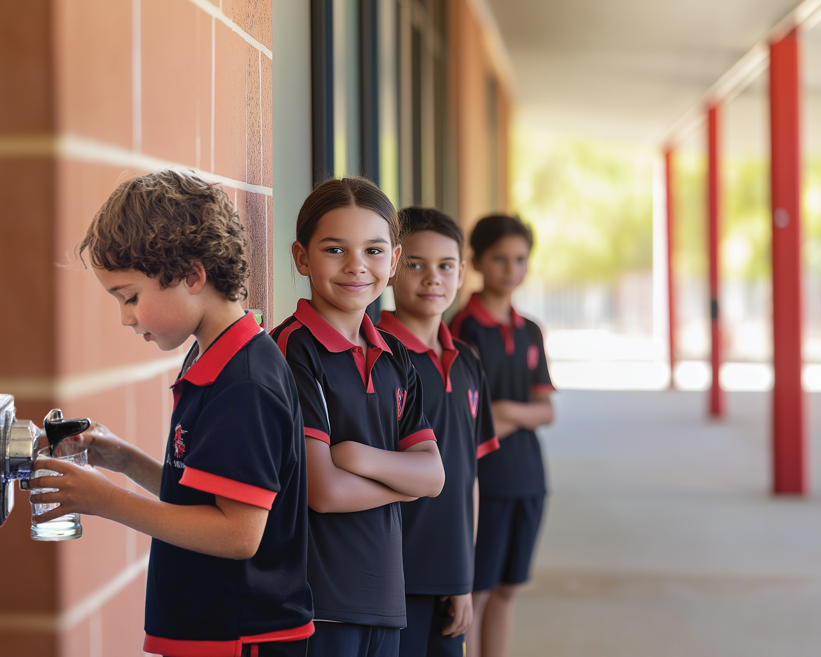
What Are Rules?
Rules tell us what we need to do.

Slide 6


Thumbs Up or Thumbs Down
When we demonstrate rules, school is a positive and supportive place for everyone.
yes
no

Slide 7

Before School Starts
Our ‘Before School Starts’ rules help us prepare for the day so we can focus on learning.

Slide 8
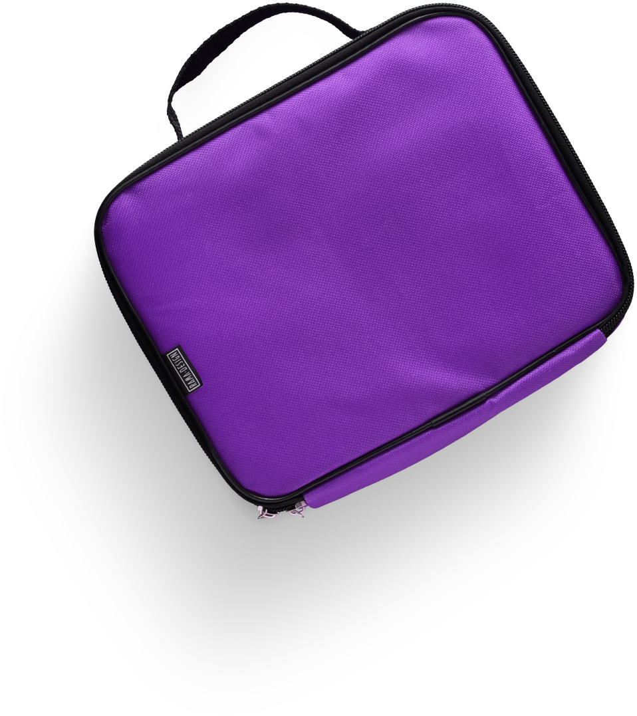
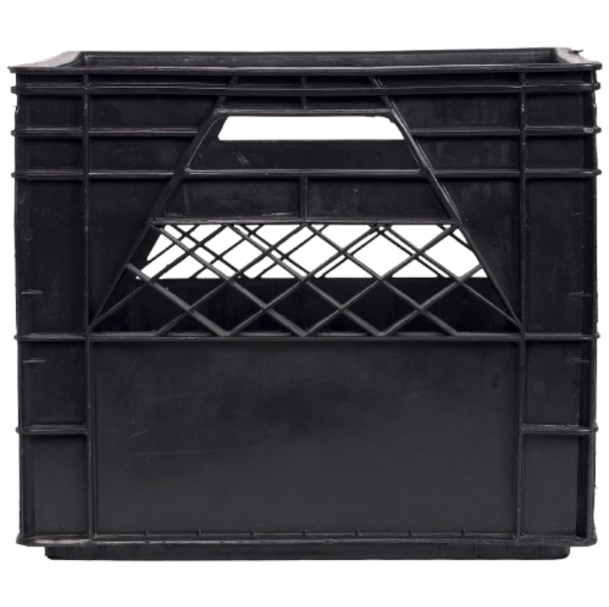
Store Your Lunch
Put your lunch or lunch orders in their set places.

Slide 9

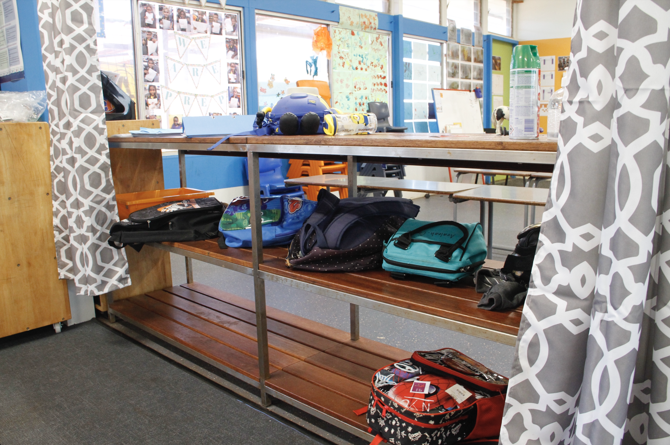
Put Your Bag in its Spot
Putting your bag in its spot keeps the classroom organised and safe.

Slide 10
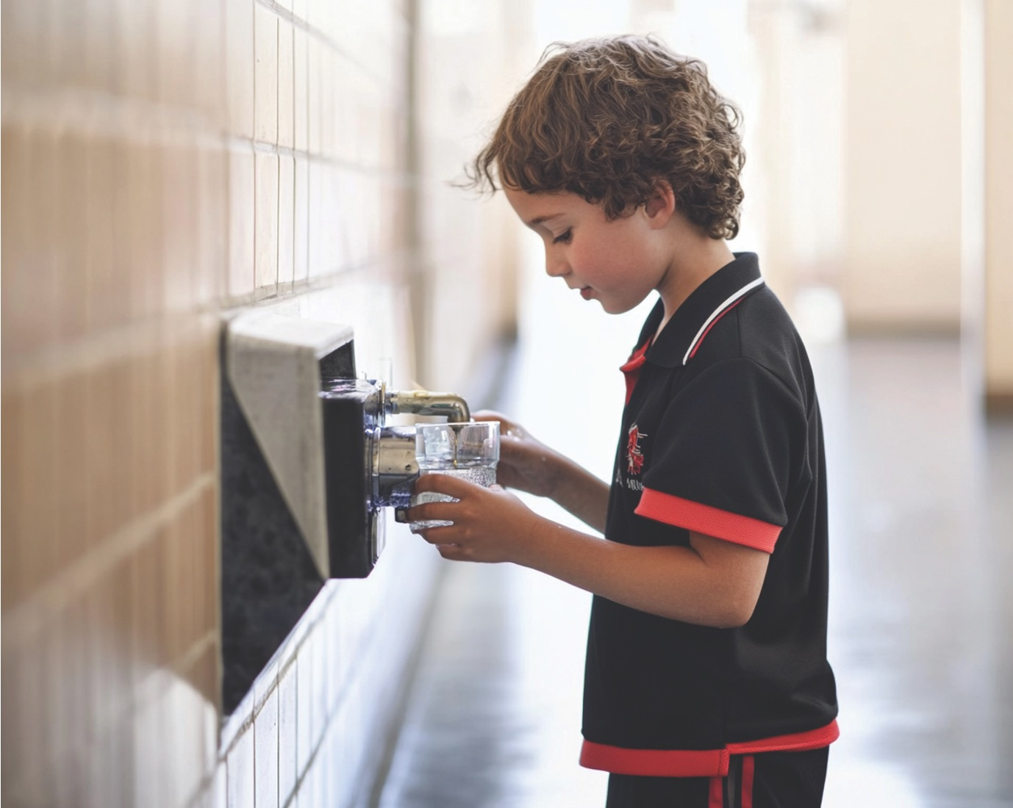
Fill Your Water Bottle
Keeping your water bottle filled is key to staying energised and focused in everything you do.

Slide 11
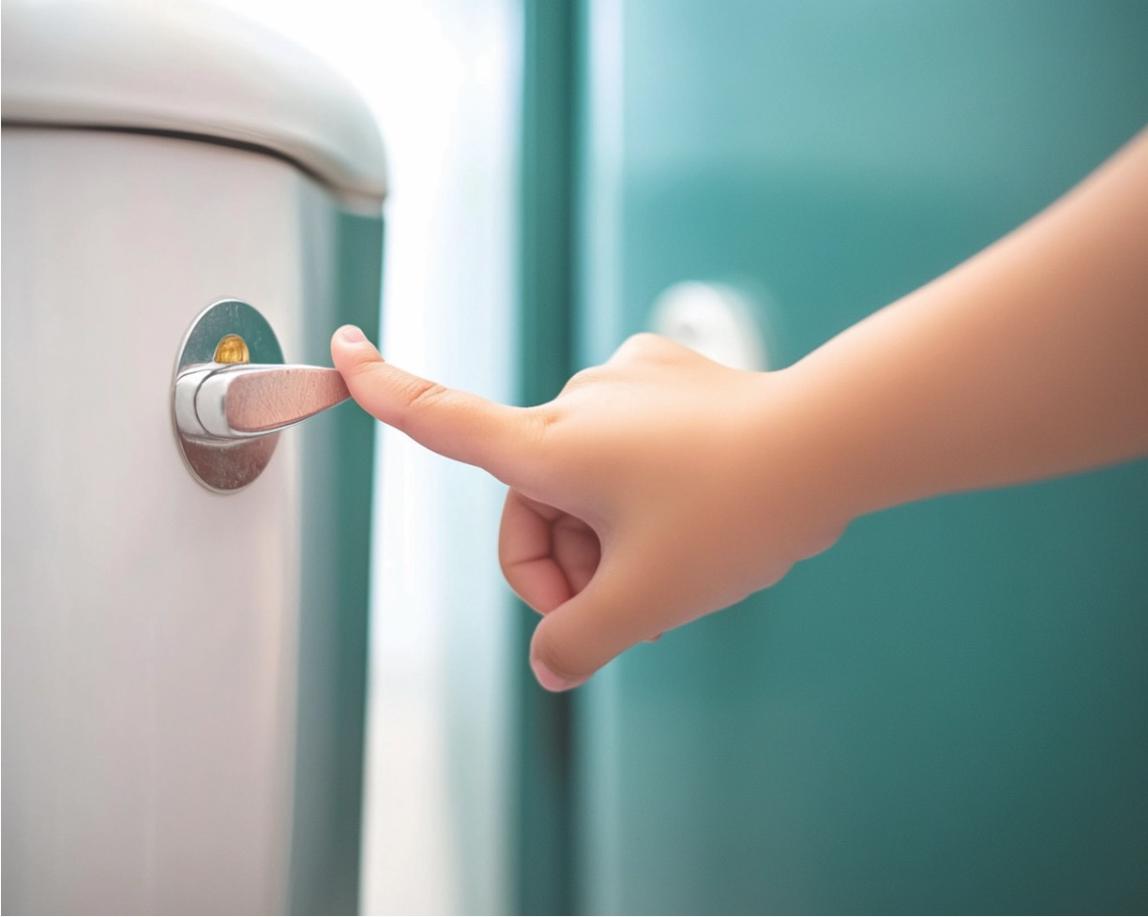
Use the Toilet
Use the toilet before class starts to stay focused and ready to learn.

Slide 12

Play Quietly
Using quiet voices helps everyone settle in and prepare for the day.

Slide 13
Thumbs Up or Thumbs Down
Filling your water bottle up before lessons start helps your brain work better, so you can concentrate and learn more easily.
yes
no

Slide 14
Put Your Bag in its Spot

Slide 15
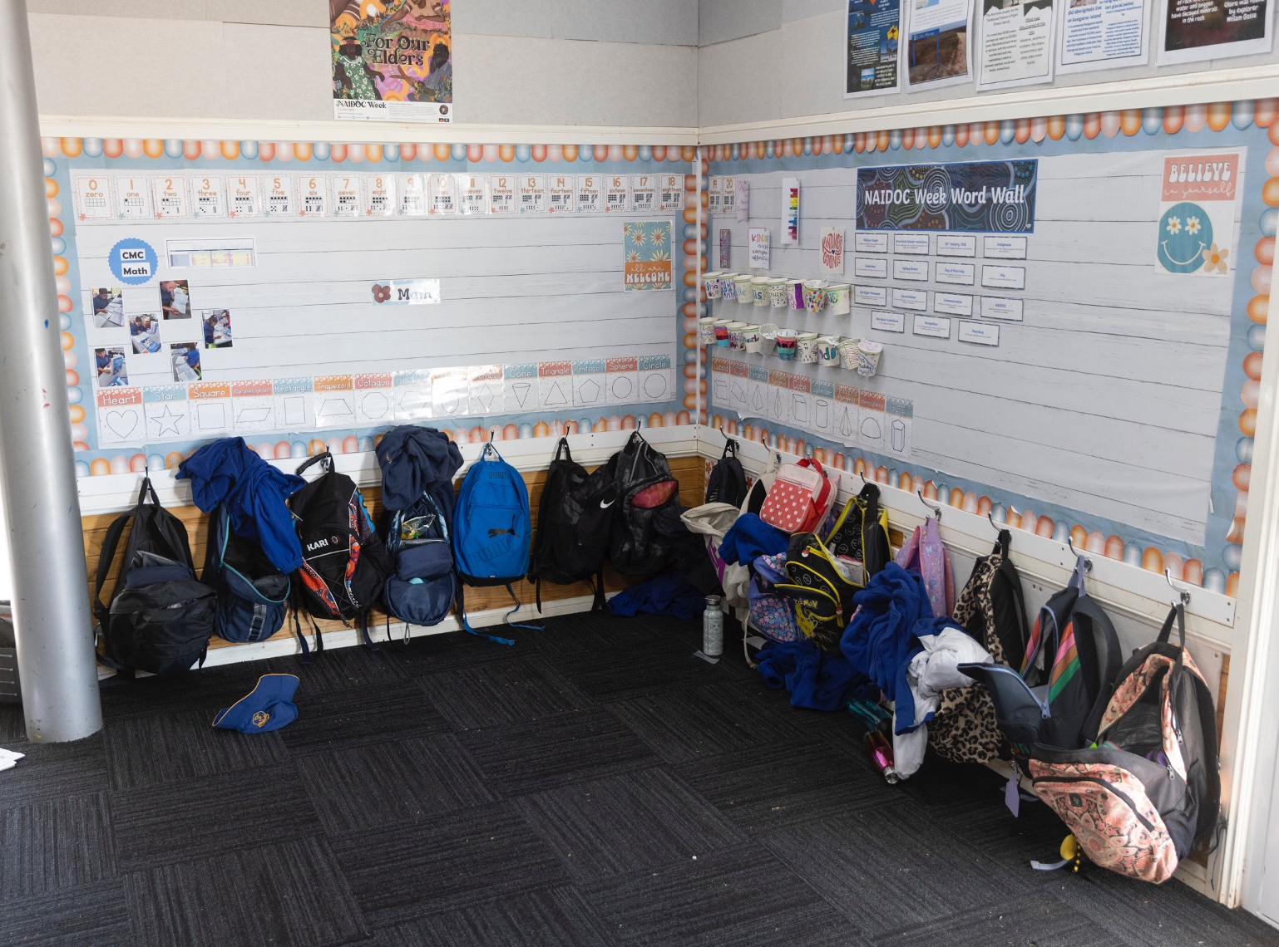
Put Your Bag in its Spot

Slide 16
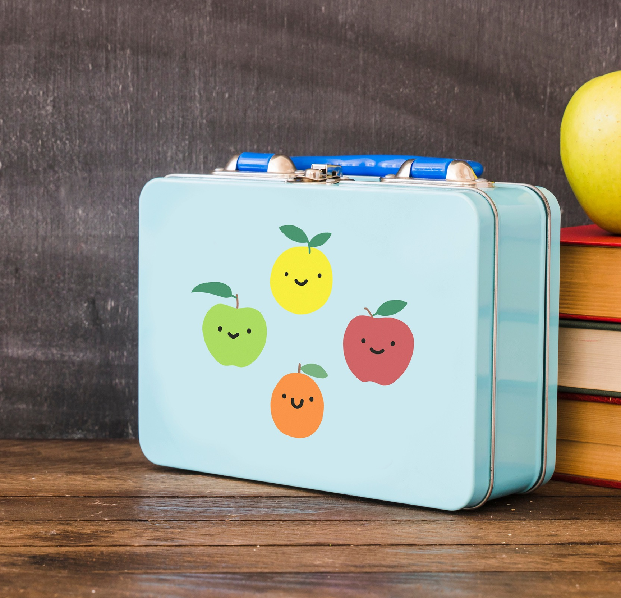
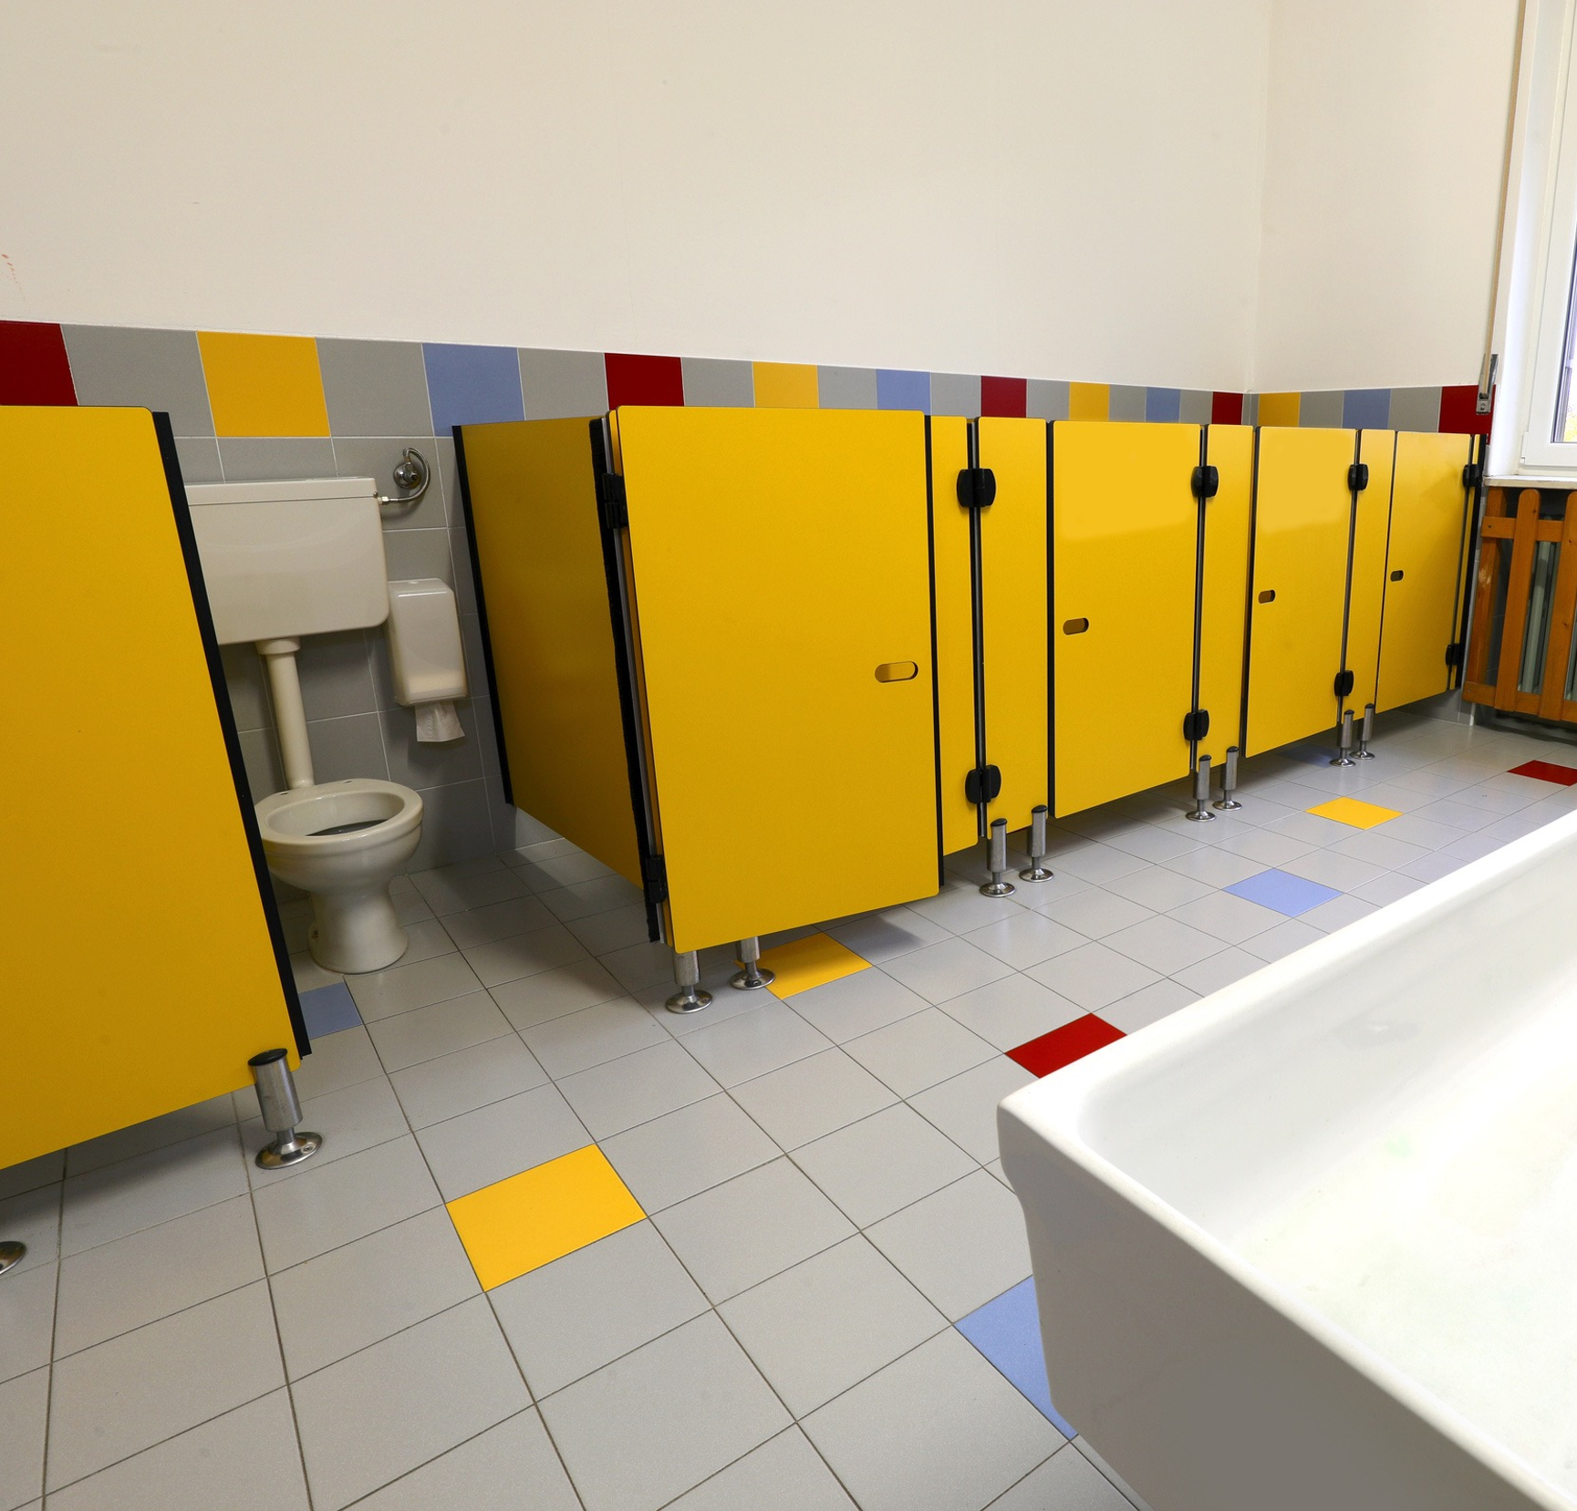
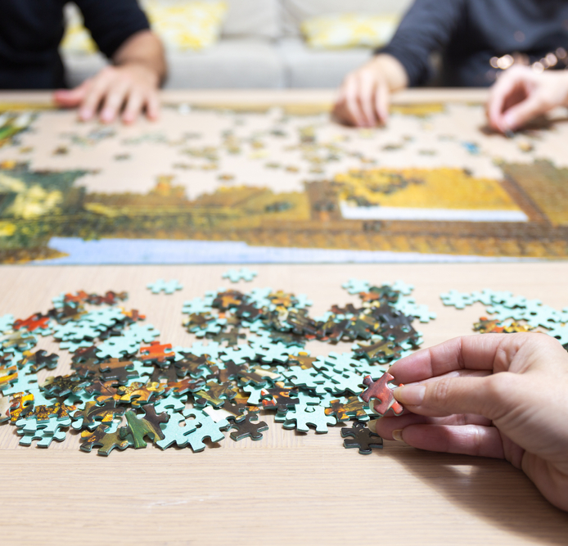
Before School Starts

Slide 17
Our ‘Before School Starts’ rules help us prepare for the day so we can focus on learning.

Slide 18

How well did you:
demonstrate the classroom rules, ‘Before School Starts?’

