Slide 1

School Rules
Unit 2, Week 1
Before School Starts

Slide 2
In this lesson, you will learn the school rule, ‘Before School Starts’.

Slide 3
You will be successful when you can follow the school rule ‘Before School Starts’.

Slide 4



Slide 5

What Are Rules?
Rules tell us what we need to do.

Slide 6


Thumbs Up or Thumbs Down
Rules help us to work together in school.
yes
no

Slide 7
Before School Starts
Our ‘Before School Starts’ rules make sure we have what we need throughout the day.

Slide 8
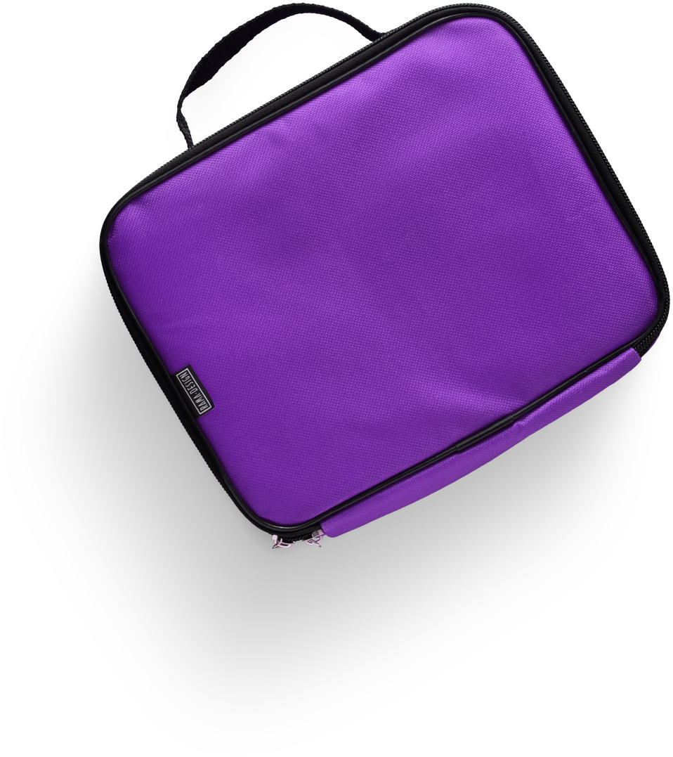
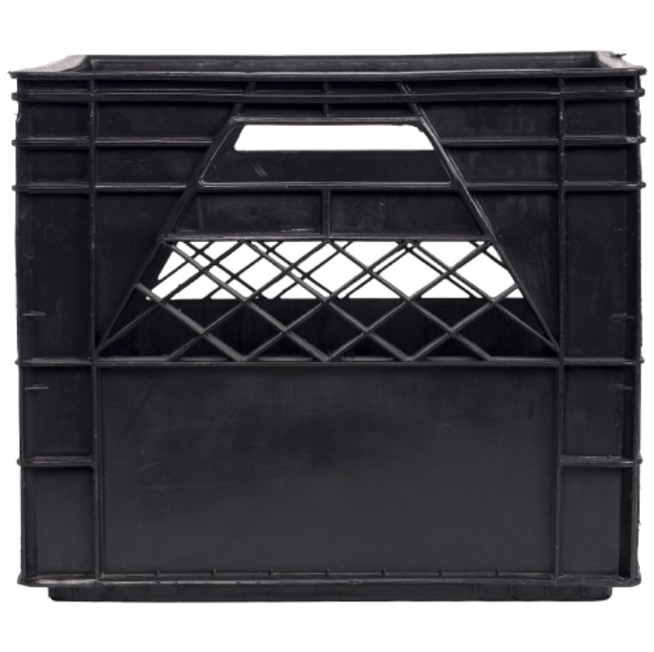
Store Your Lunch
Put your lunch in the crate.

Slide 9
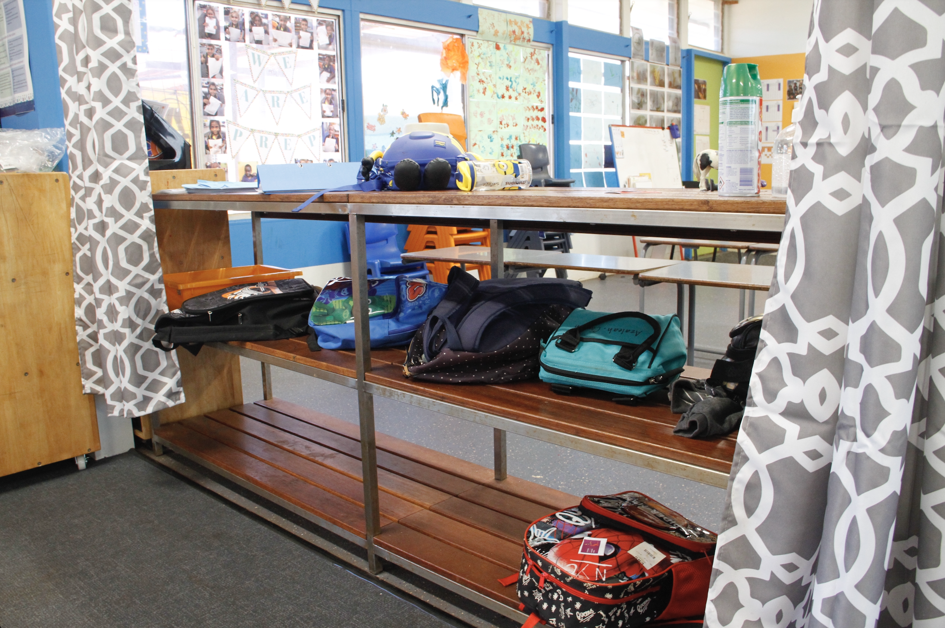
Put Your Bag in its Spot
Put your bag where it belongs.

Slide 10
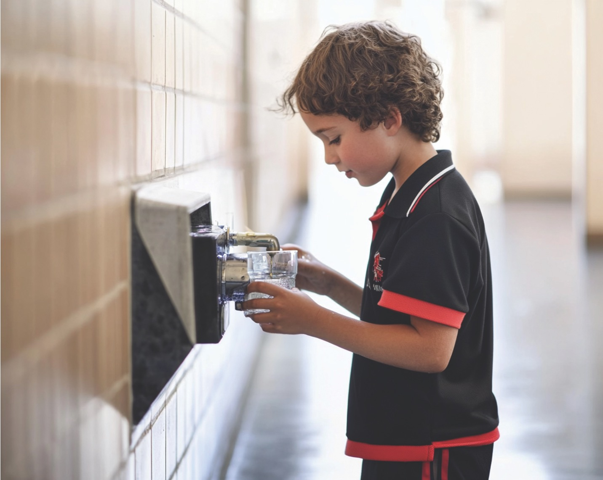
Fill Your Water Bottle
Fill your water bottle.

Slide 11
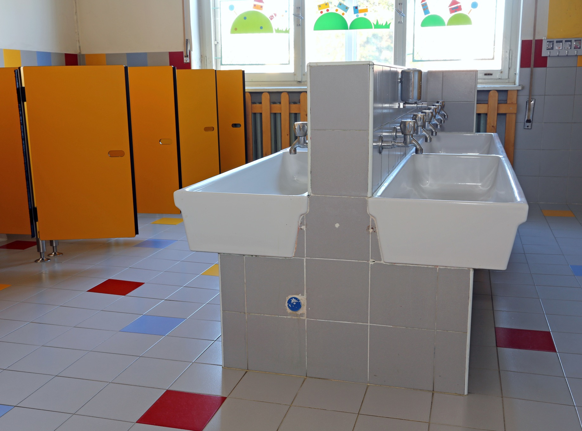
Use the Toilet
Use the toilet before class.

Slide 12

Play Quietly
Play quietly to help create a safe and happy classroom.

Slide 13
Thumbs Up or Thumbs Down
Playing quietly before class is a rule we must follow.
yes
no

Slide 14
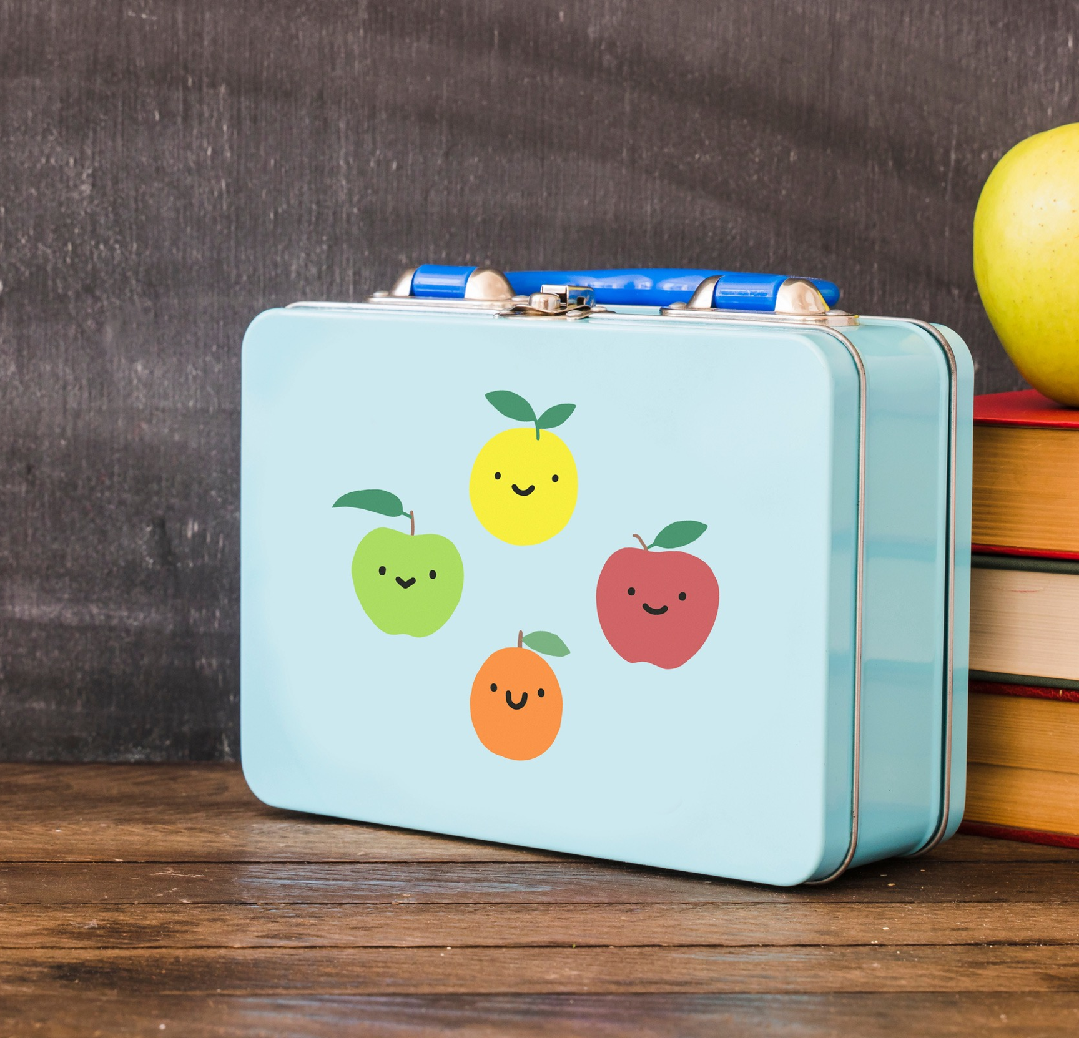
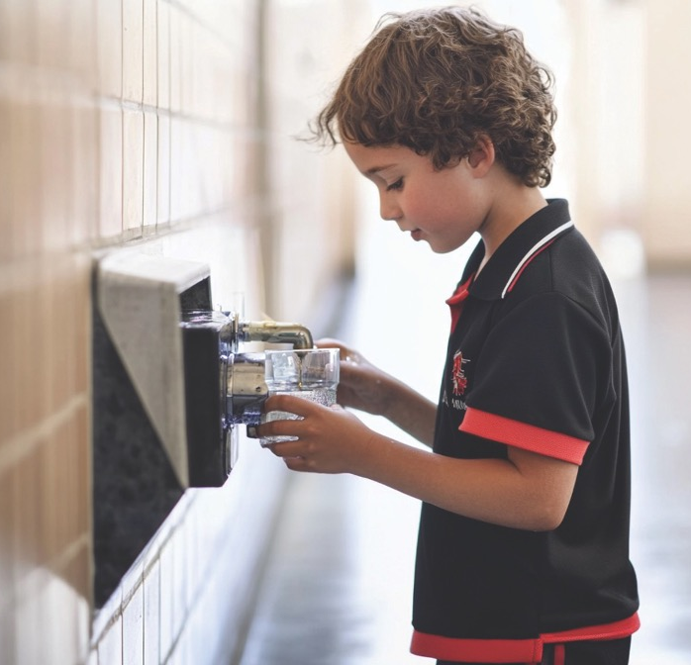
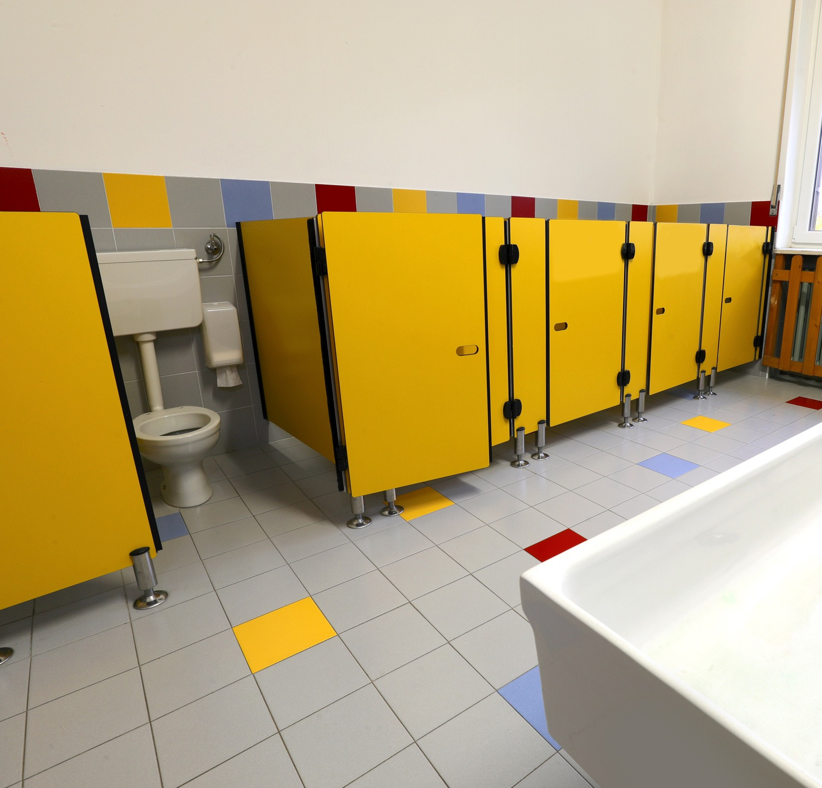
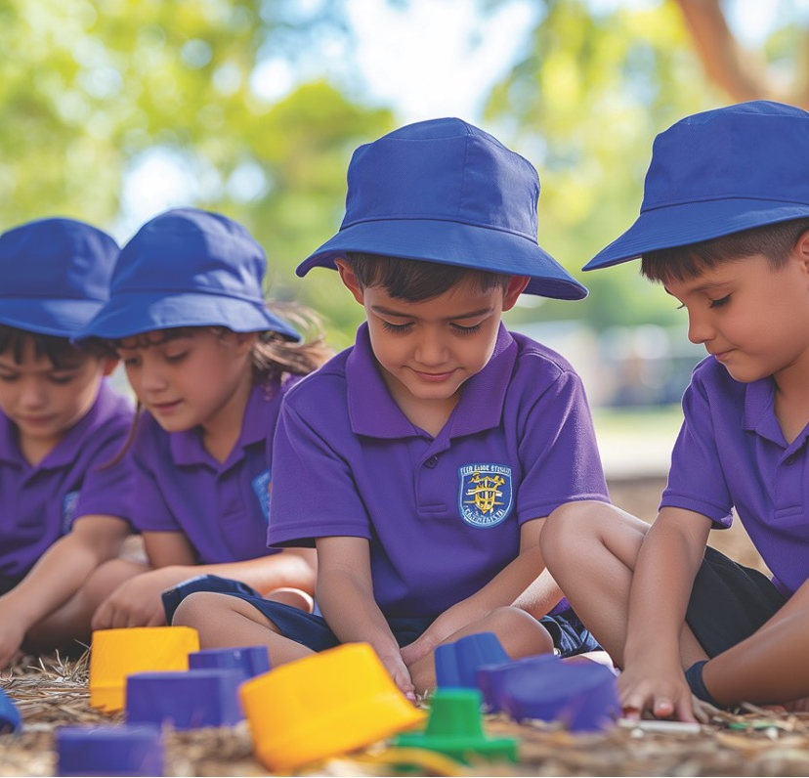
Before School Starts

Slide 15
Our ‘Before School Starts’ rules make sure we have what we need throughout the day.

Slide 16

How well did you:
learn the classroom rules, ‘Before School Starts?’

