Slide 1
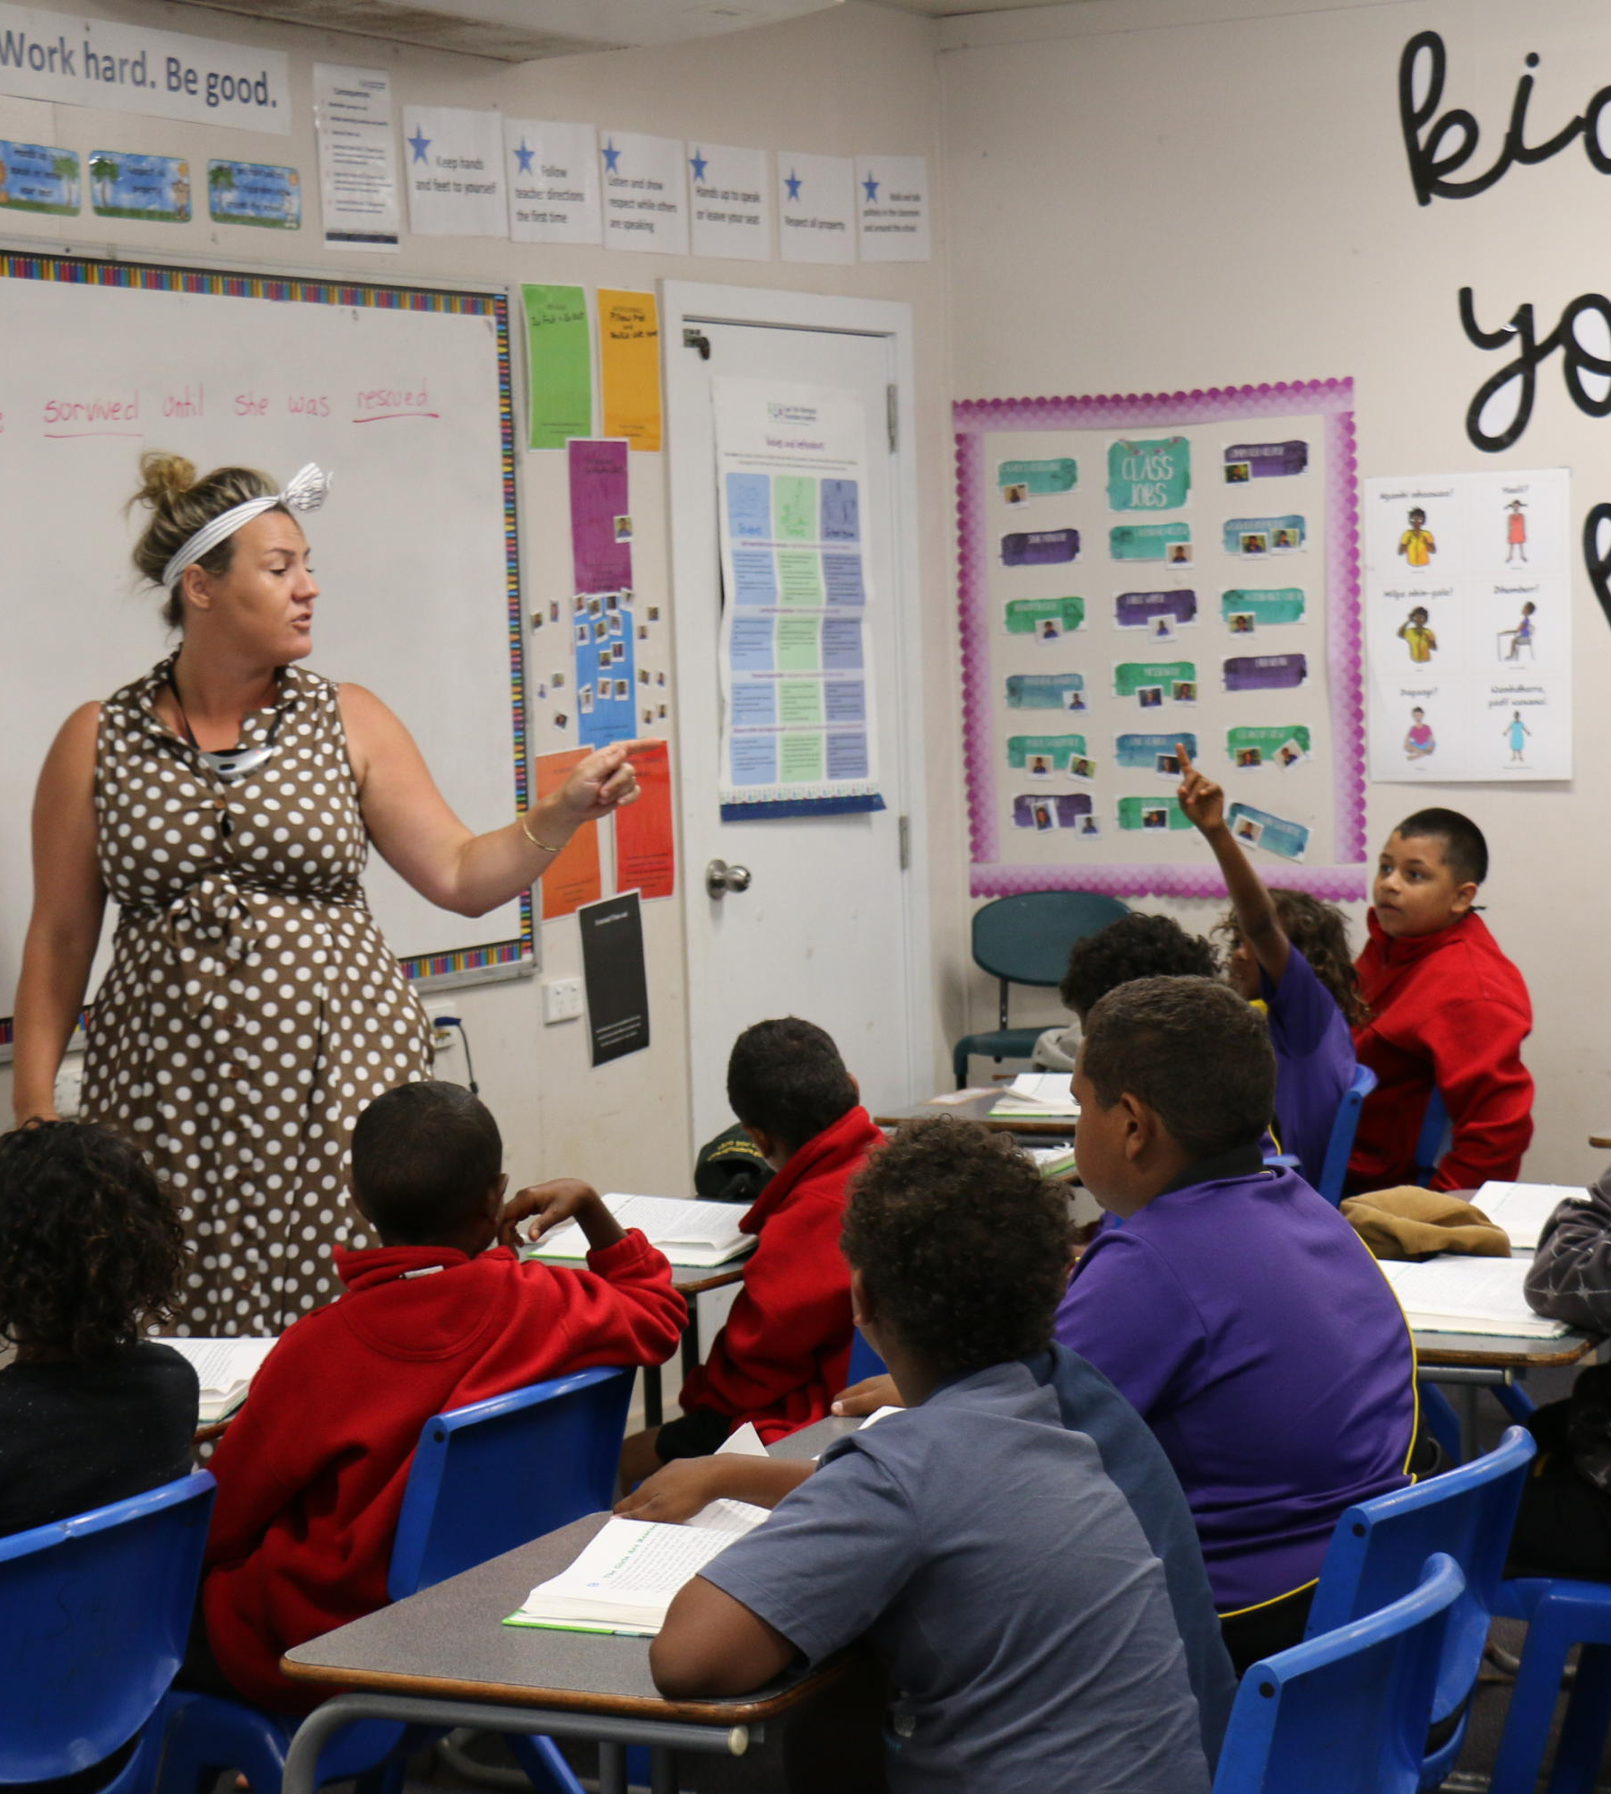
School Rules
Unit 2, Week 1
Homeroom Check In

Slide 2
In this lesson, you will learn the school rule, ‘Homeroom Check-In.’

Slide 3
You will be successful when you can follow the school rule, ‘Homeroom Check-In.’

Slide 4
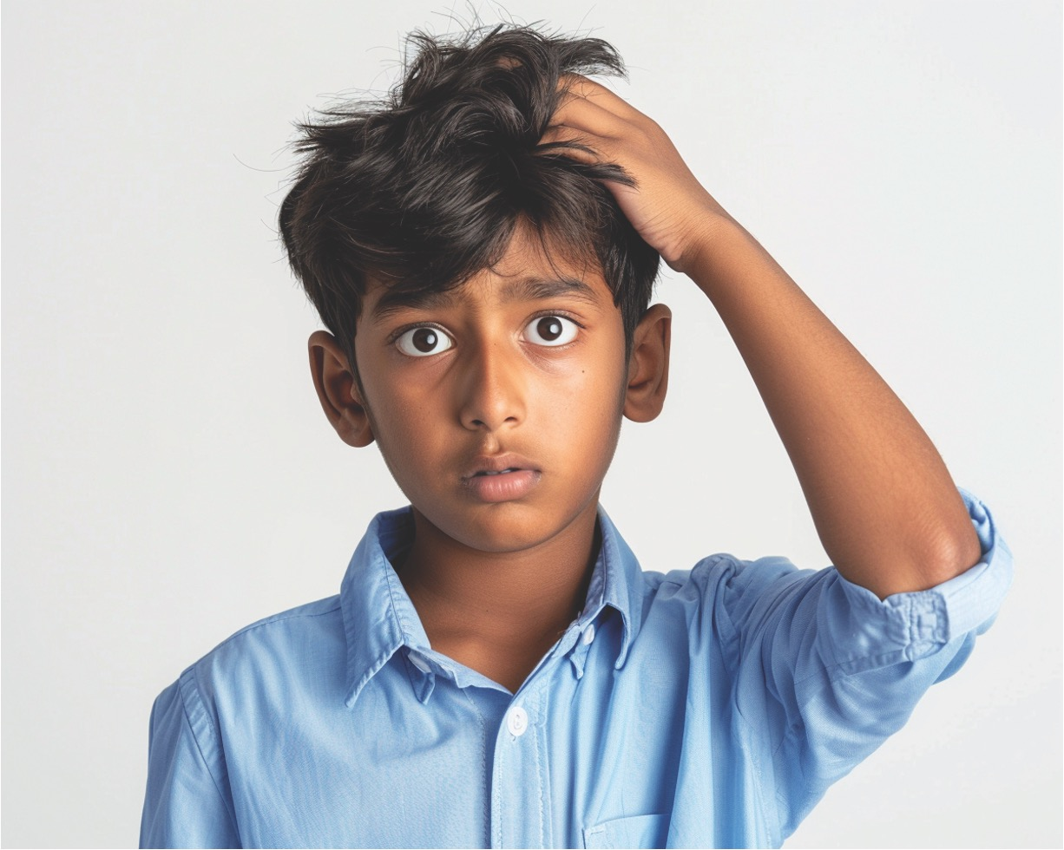



Slide 5
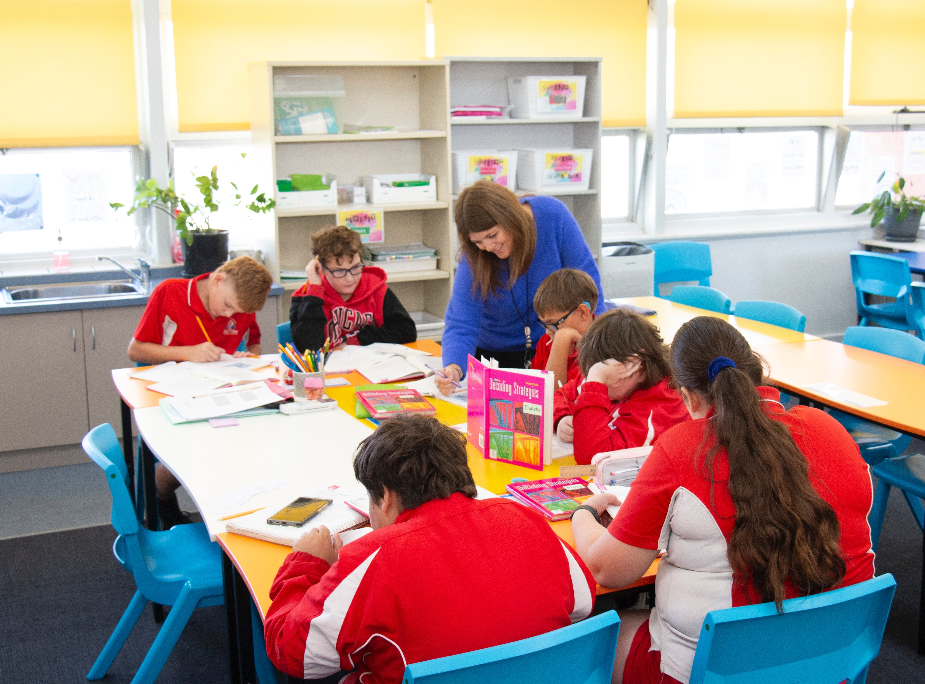
What Are Rules?
Rules tell us what we need to do.

Slide 6


Thumbs Up or Thumbs Down
Rules can show us how to share.
yes
no

Slide 7

Homeroom Check-In
The ‘Homeroom Check-In’ rules help us to be ready for everything we are going to do that day.

Slide 8
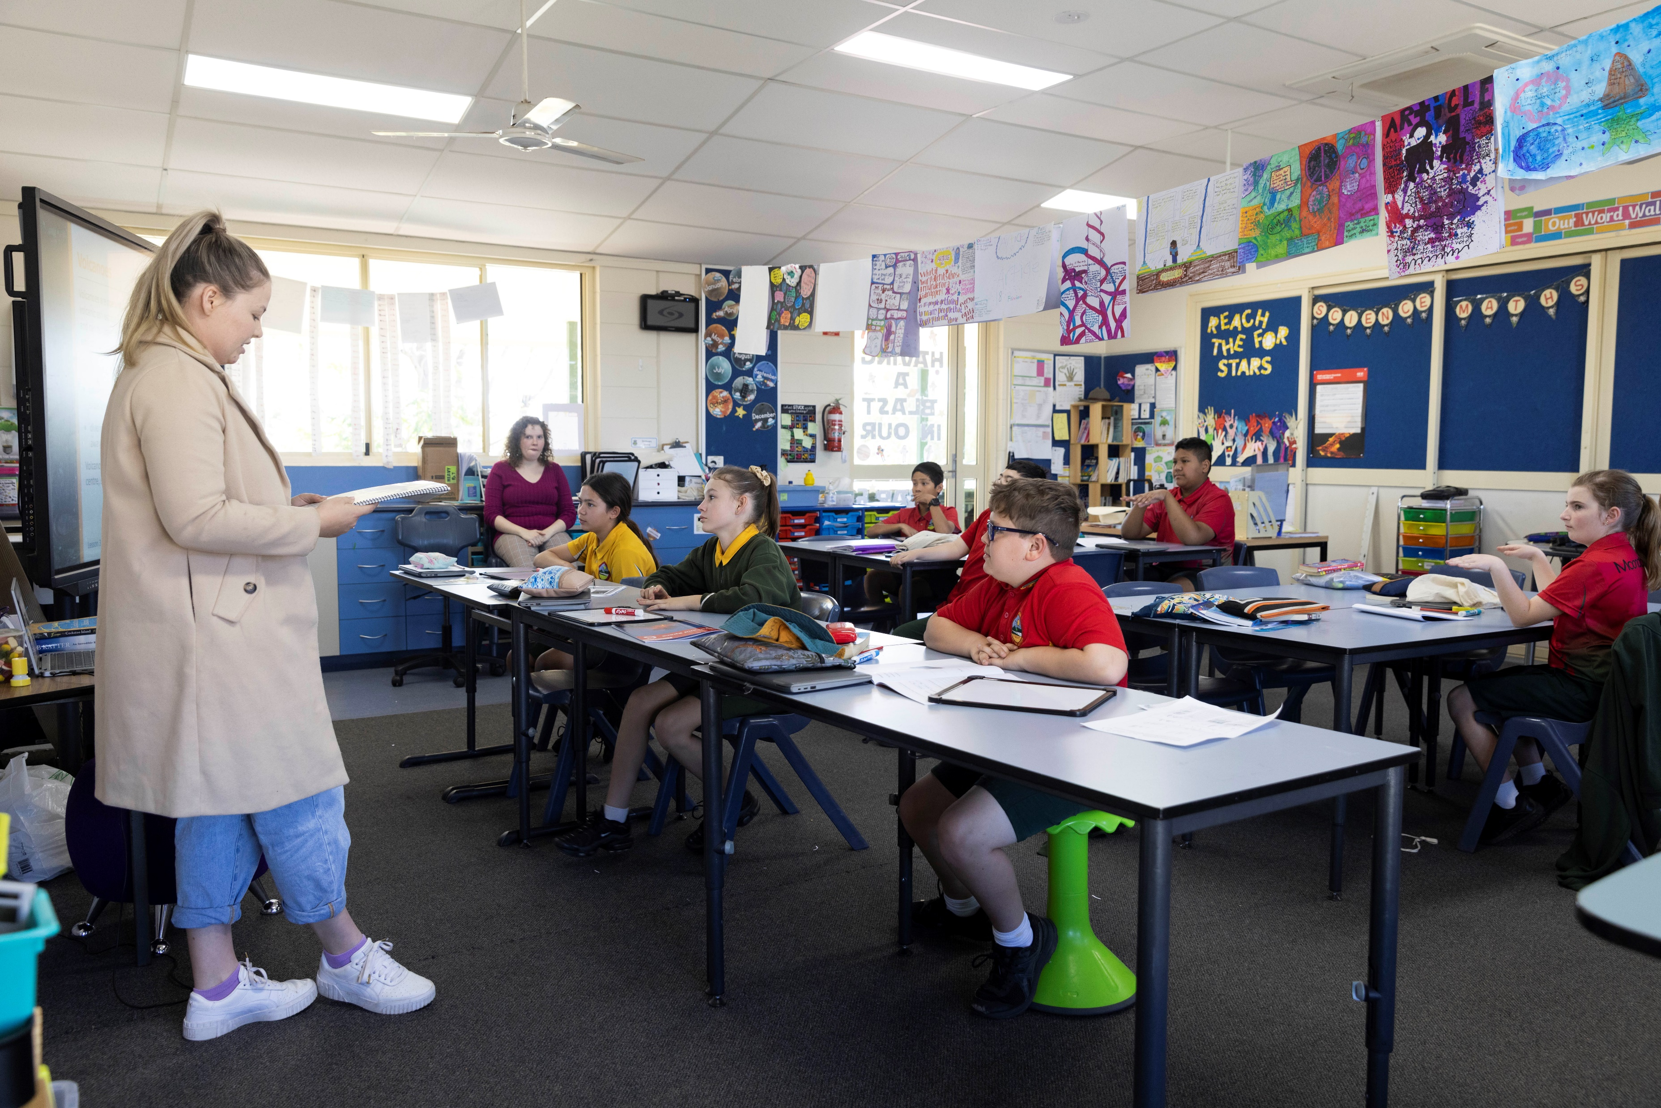
Mark the Roll
Sit still and quietly. When your name is called, respond with ‘Here.’

Slide 9

Read the Daily Announcements
Reading daily announcements keeps everyone informed.

Slide 10

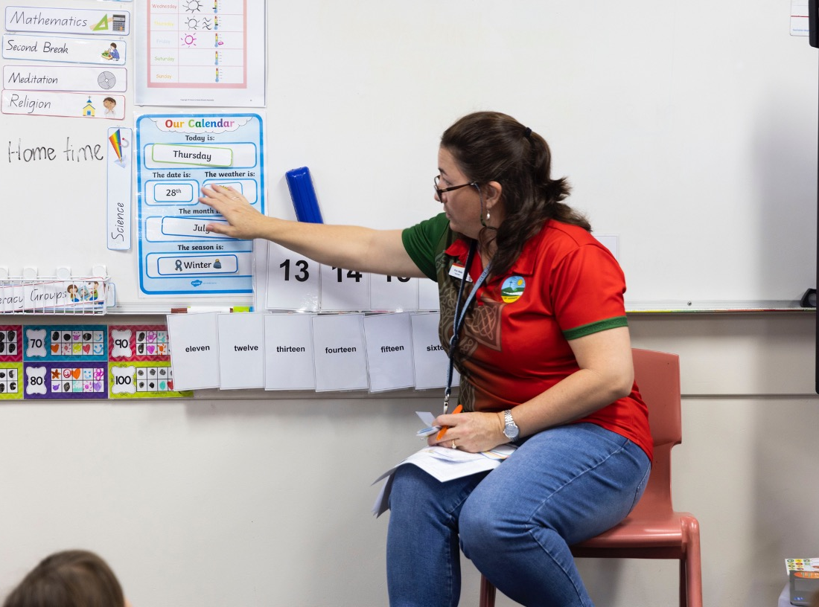
Review the Daily Calendar
Review the daily calendar.

Slide 11
Thumbs Up or Thumbs Down
Reading the daily announcements is important to keep everyone connected within our school community.
yes
no

Slide 12
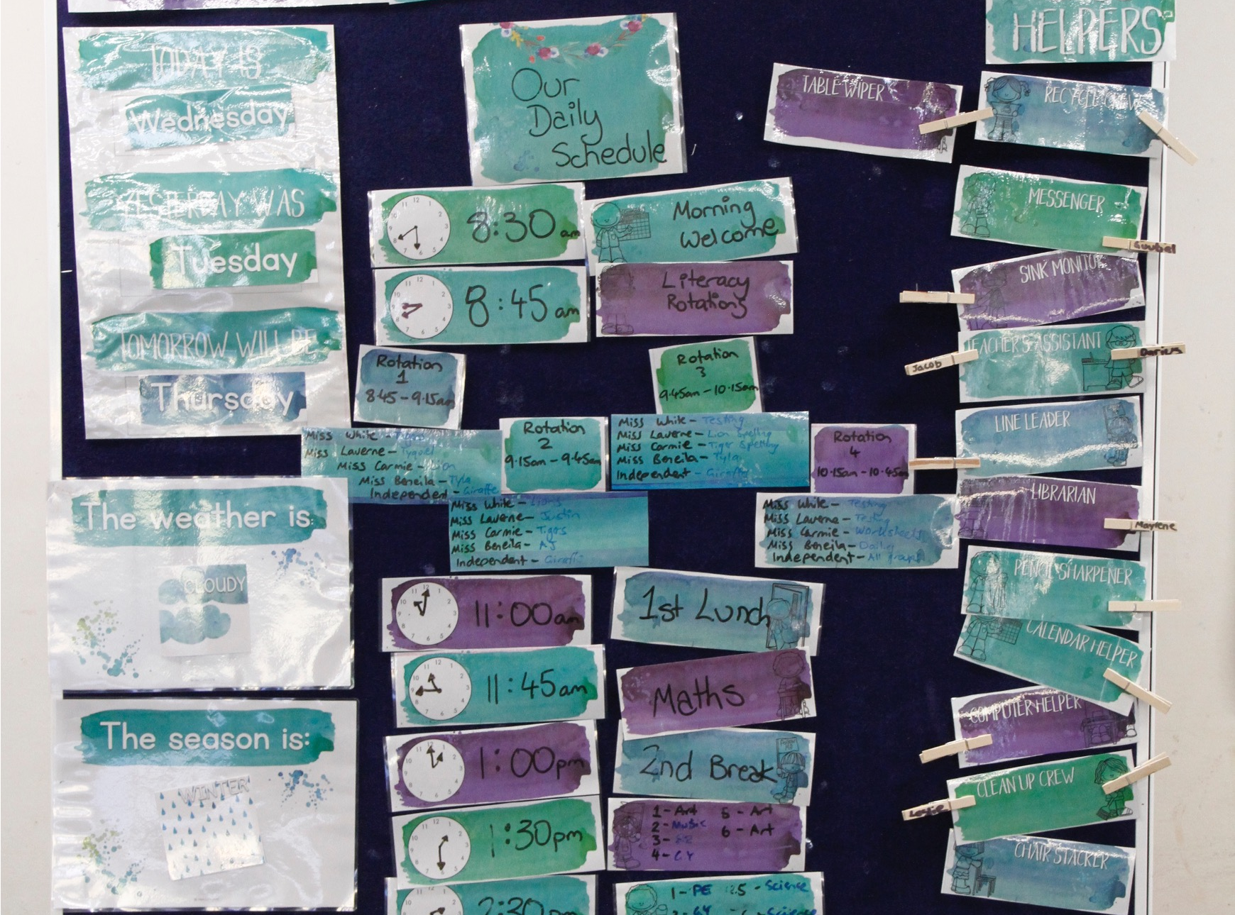
Review the Daily Calendar

Slide 13

Review the Daily Calendar

Slide 14
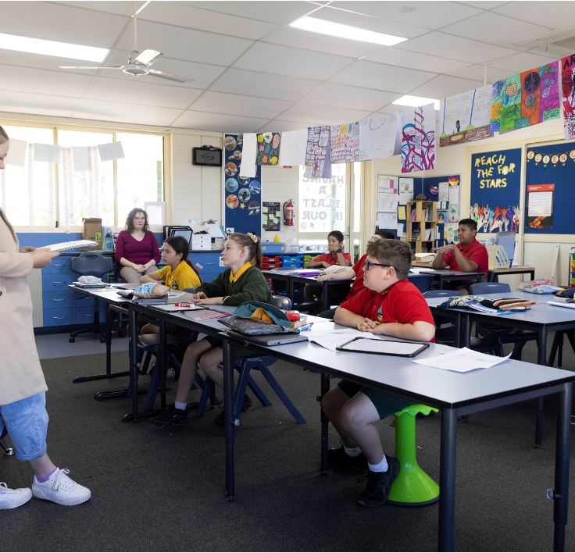

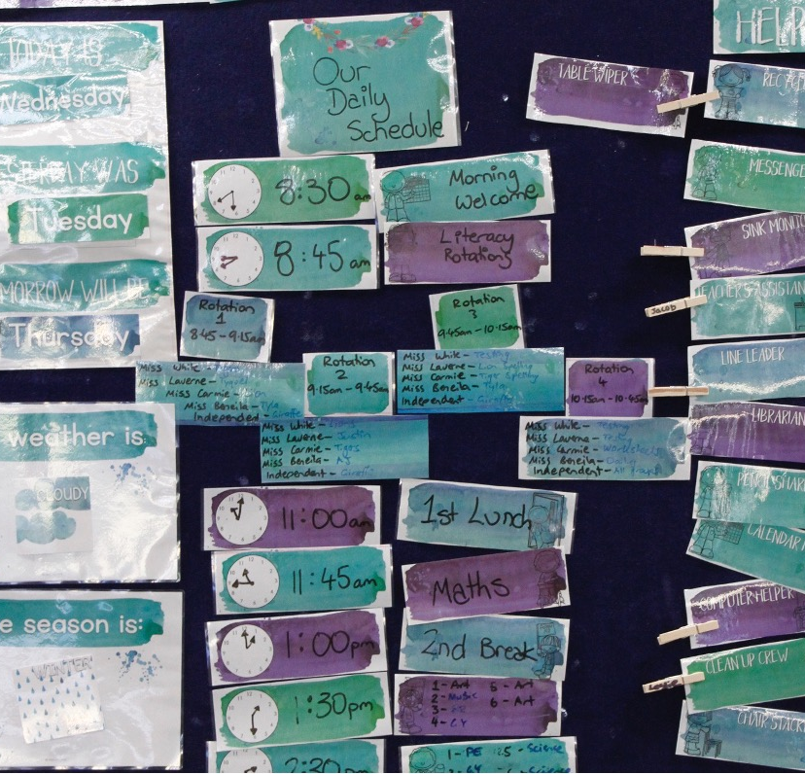
Homeroom Check-In

Slide 15
The ‘Homeroom Check-In’ rules help us to be ready for everything we are going to do that day.

Slide 16

How well did you:
follow the school rules for ‘Homeroom Check-In’?

