Slide 1
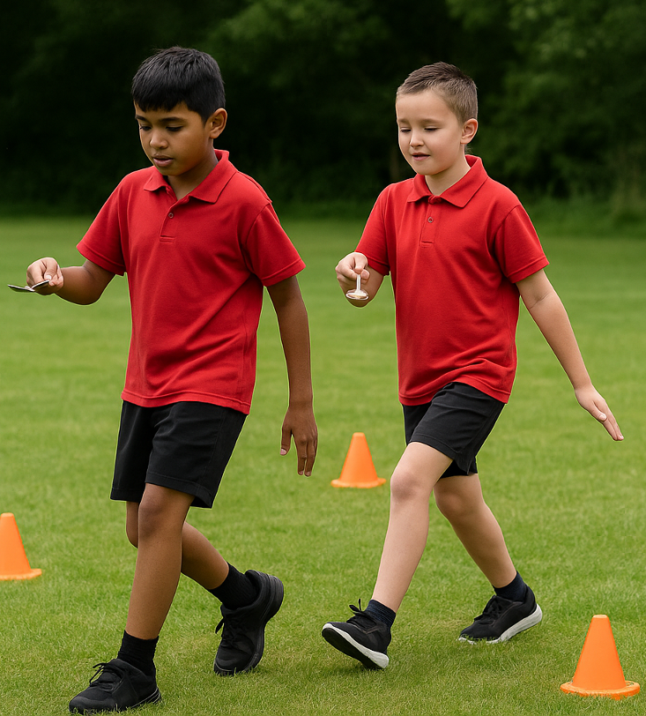
Water Relay
Unit 1: Knowing Me, Knowing You
Lesson 1
Lesson 6 (Extension)

Slide 2
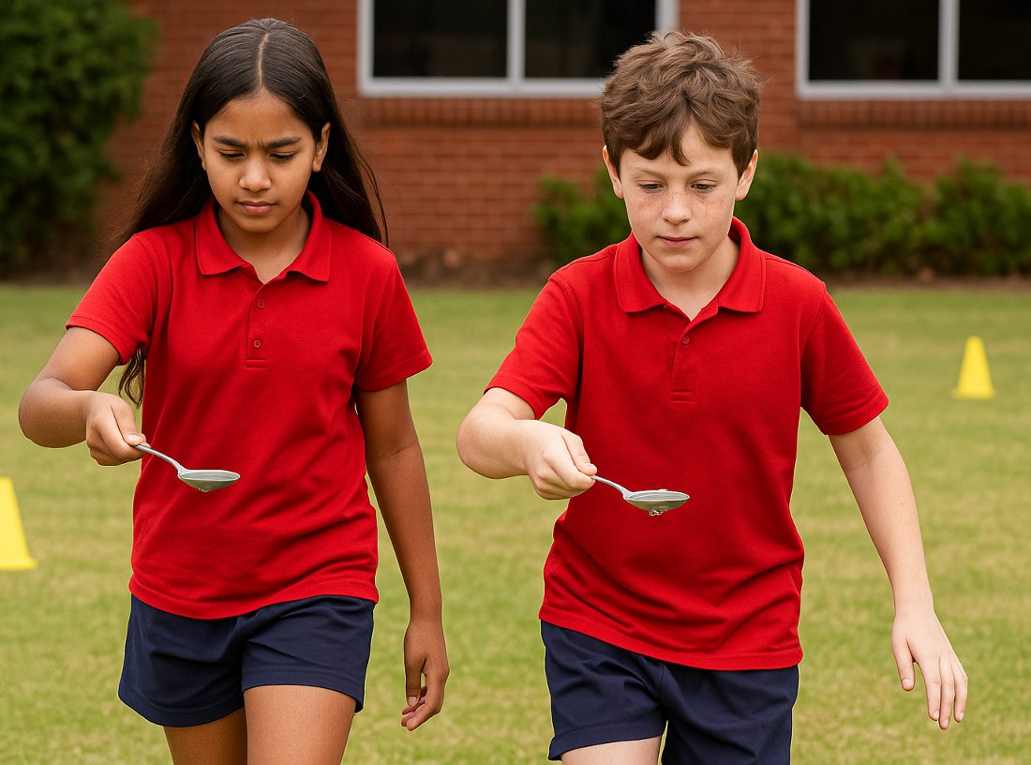
Lesson 1

Slide 3
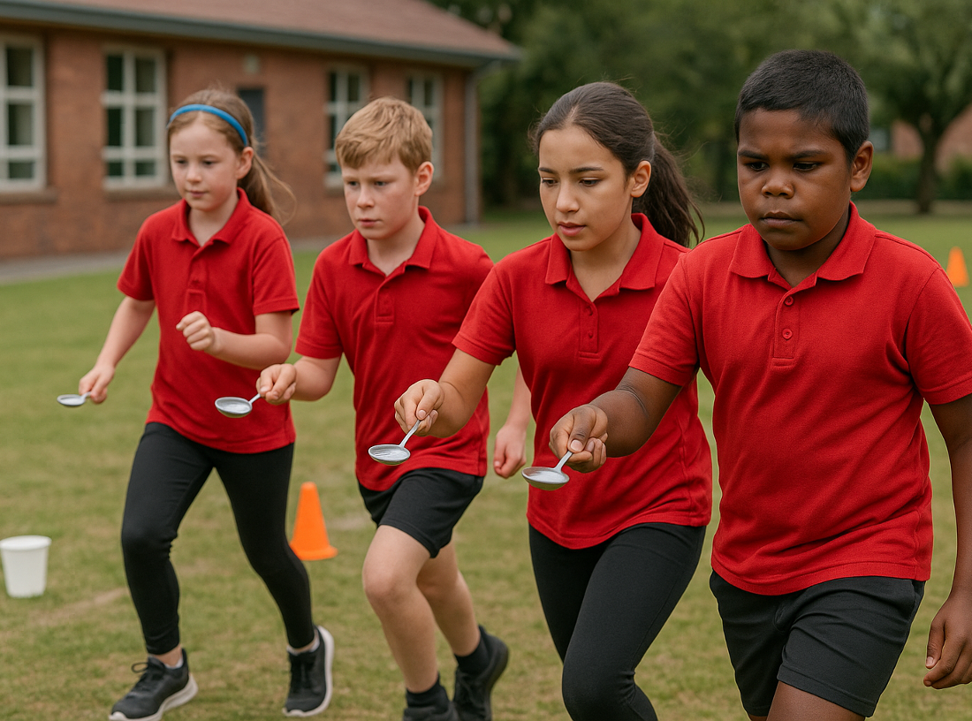
You will practise regulating your emotions, so they do not negatively affect your behaviour.

Slide 4

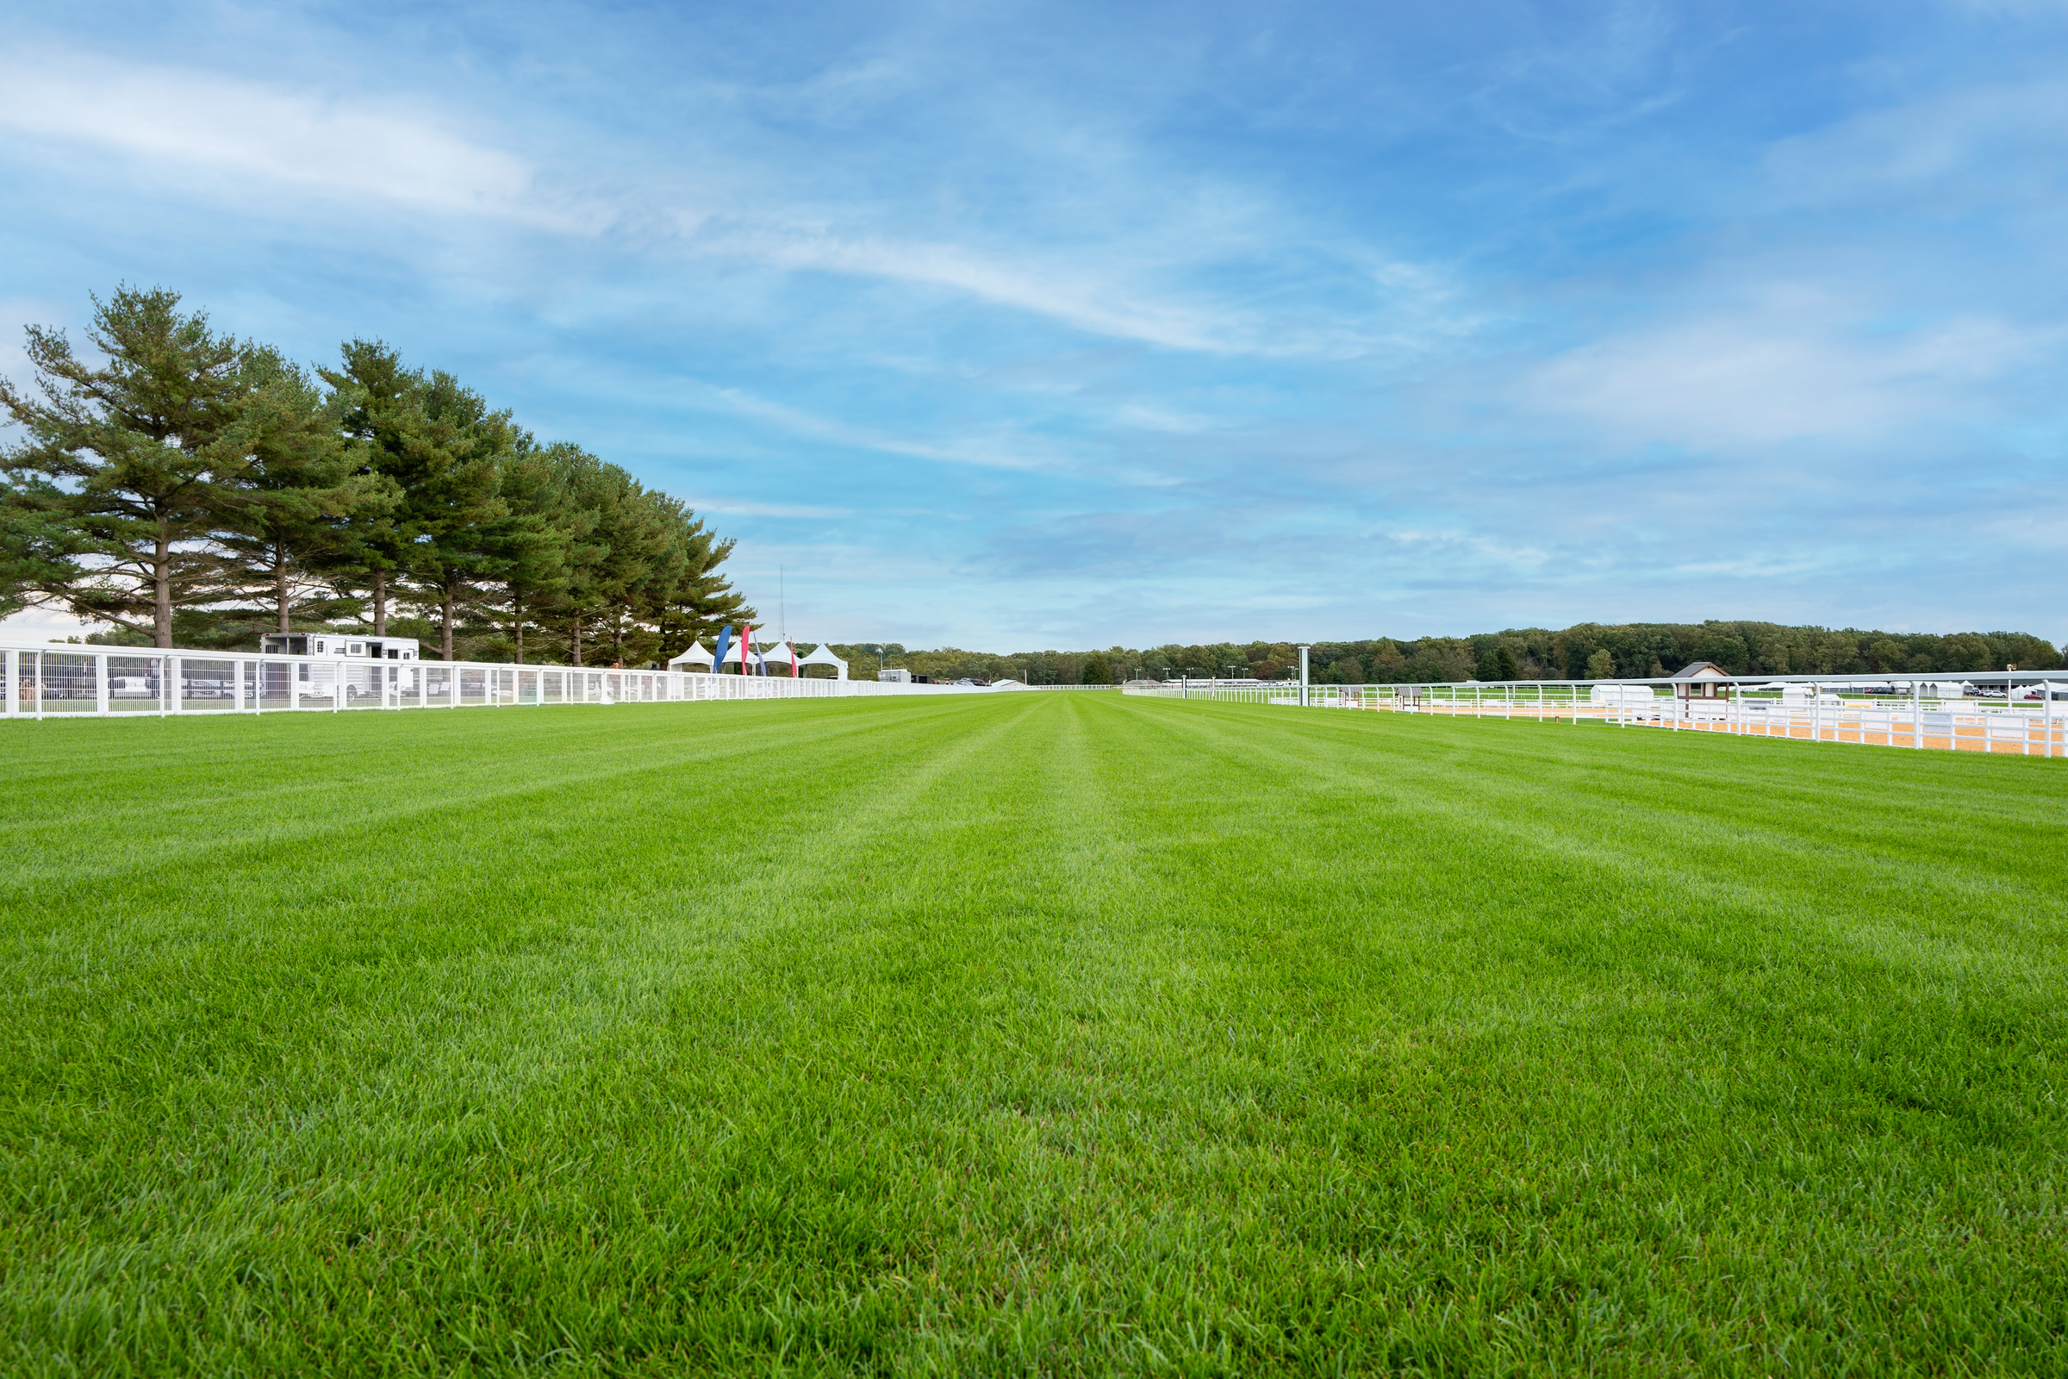




Slide 7
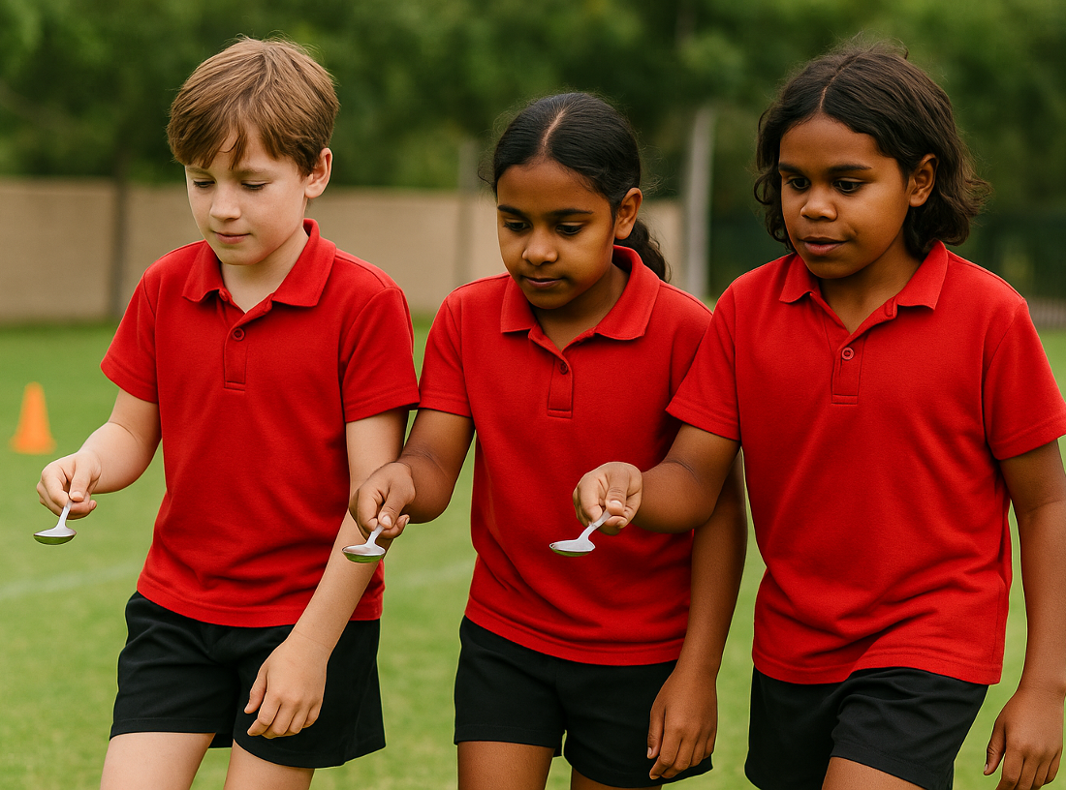
Lesson 6 (Extension)

Slide 8
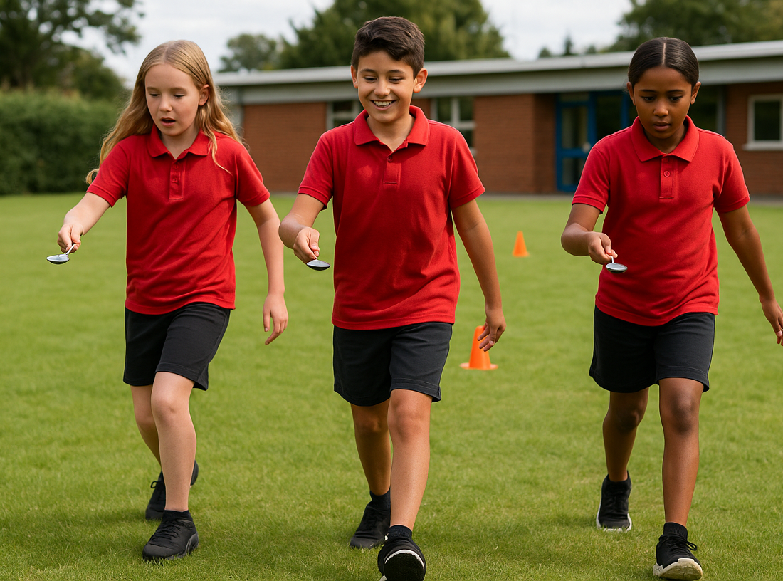
You will learn to recognise cues your body gives when feeling overwhelmed and practise strategies to remain calm under pressure.

Slide 10
`

